Slide 1
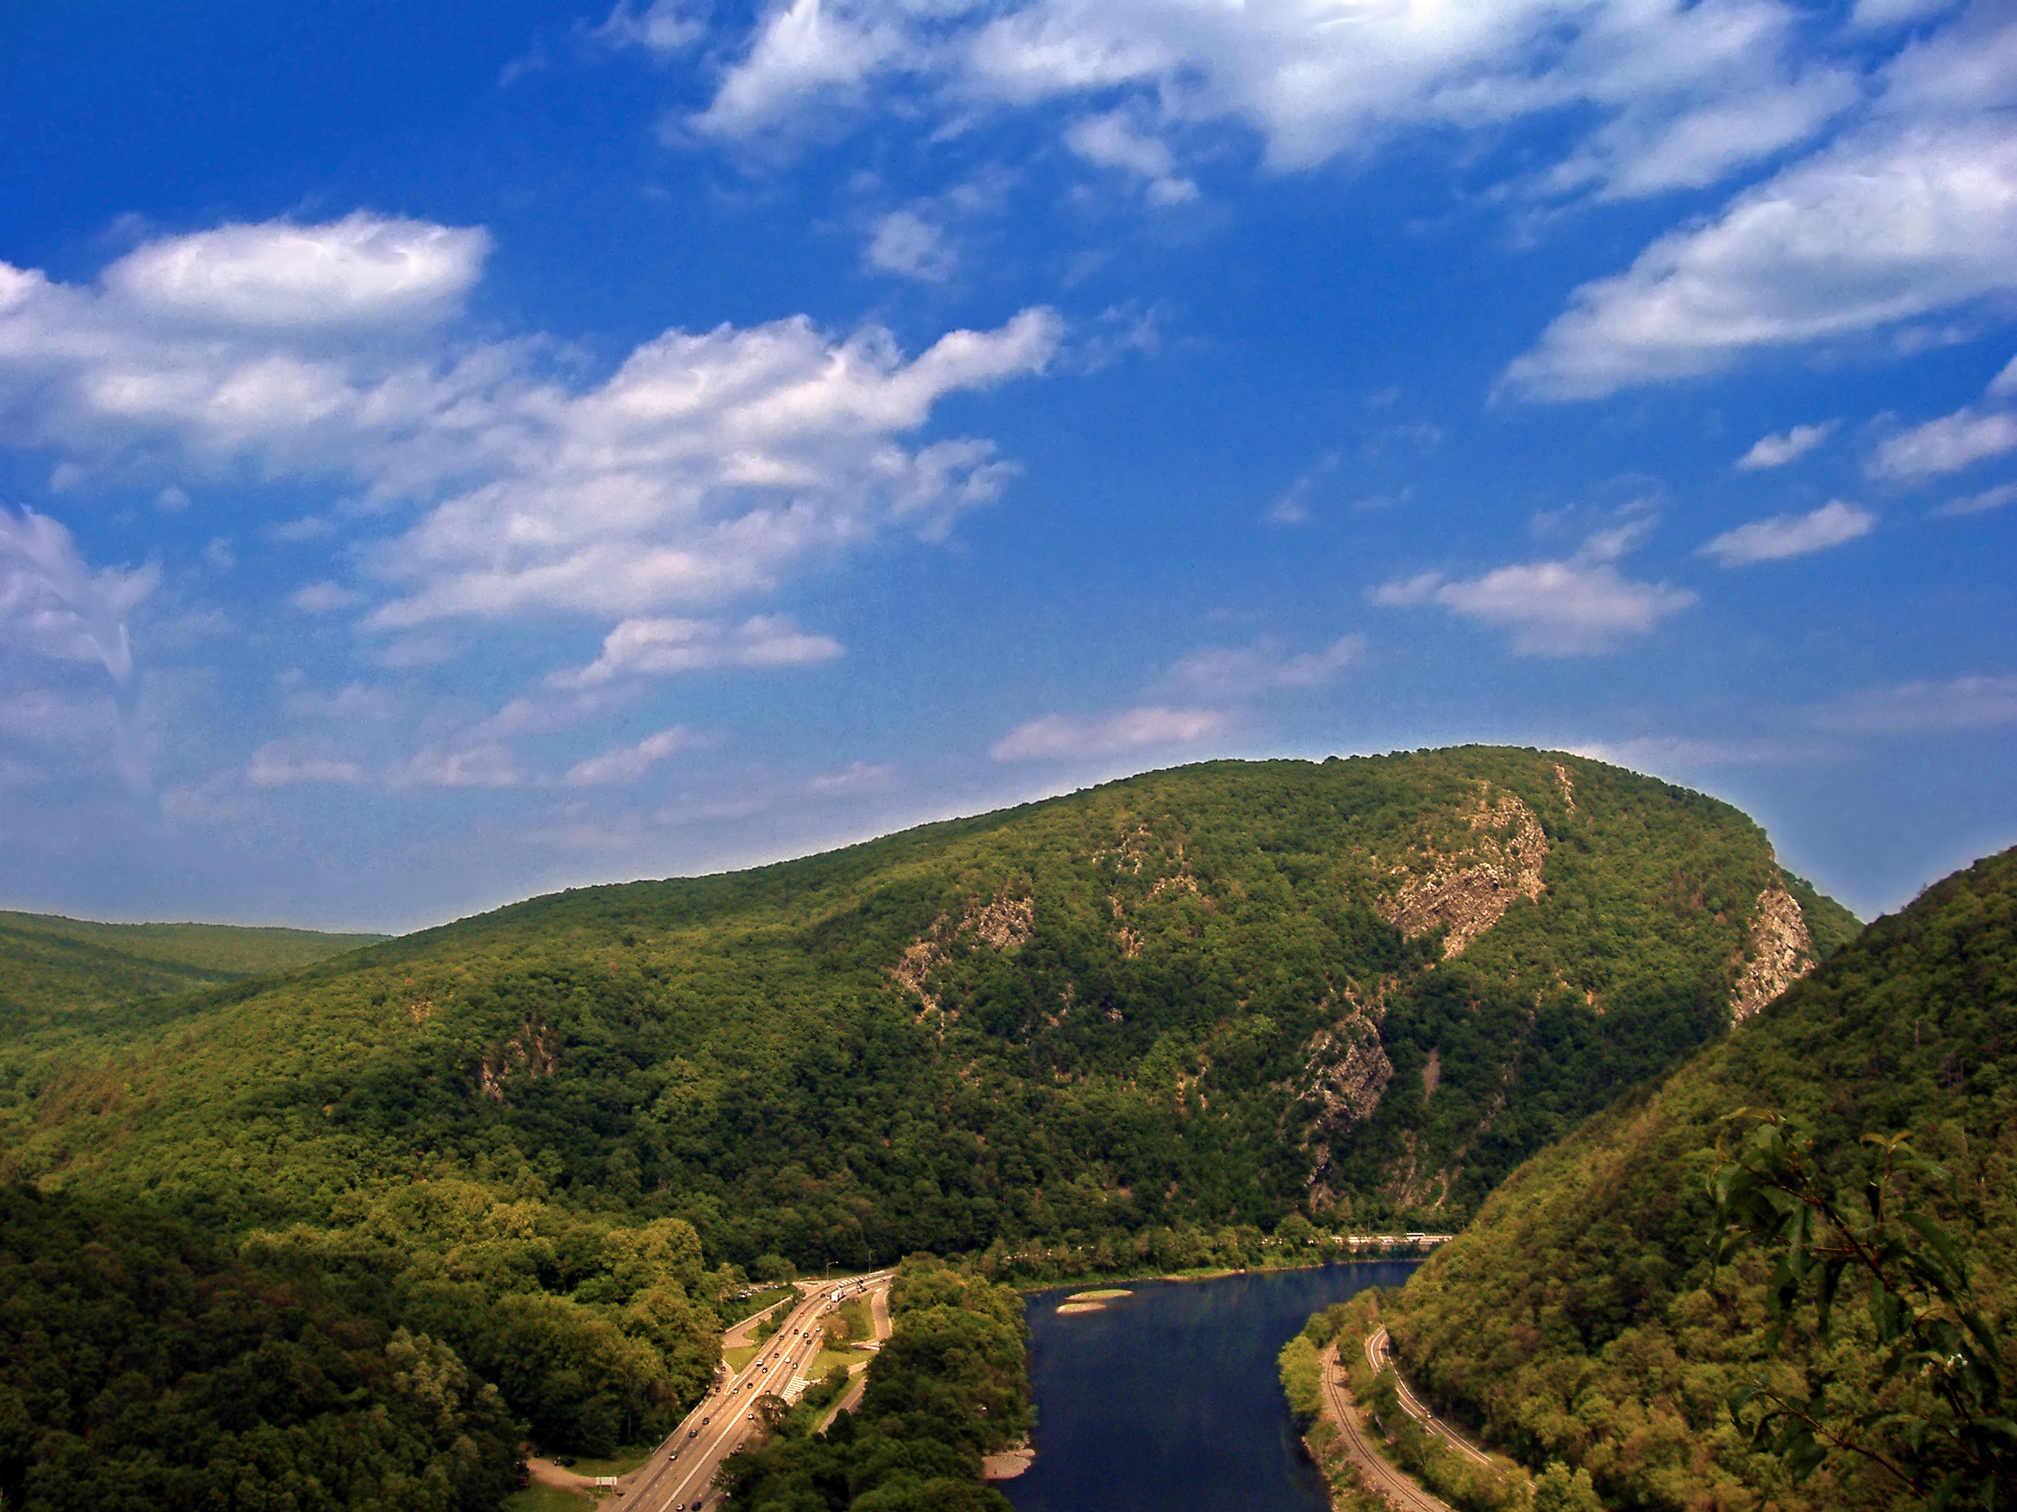
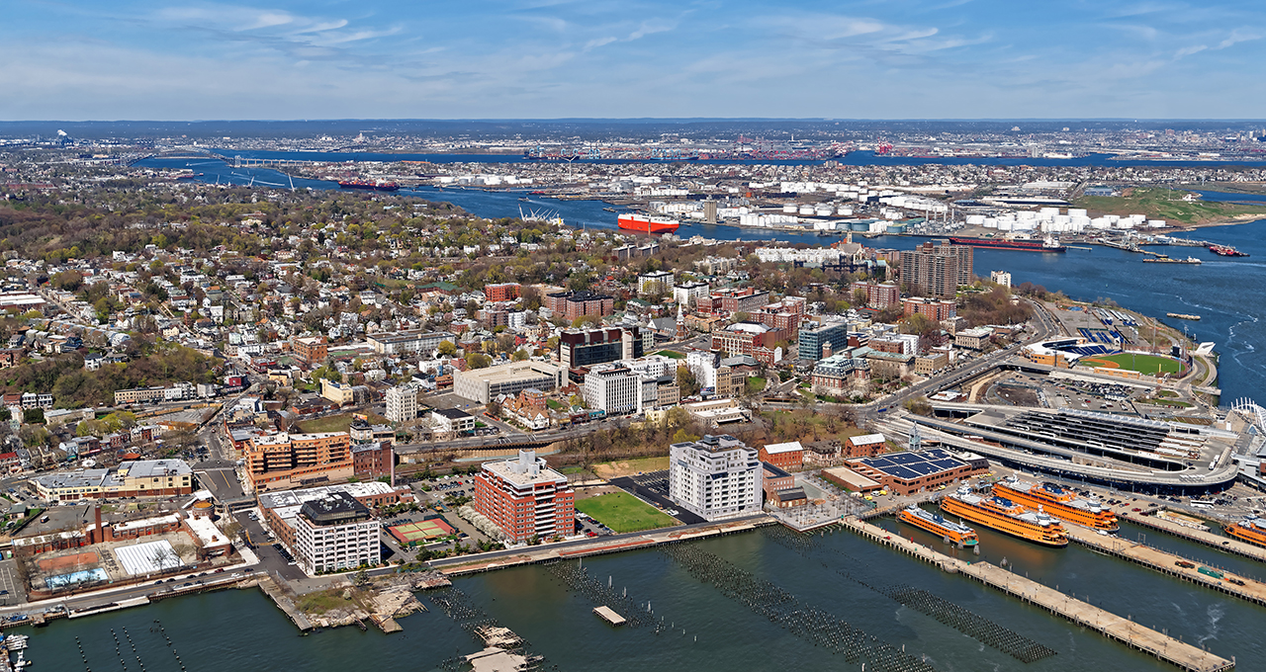
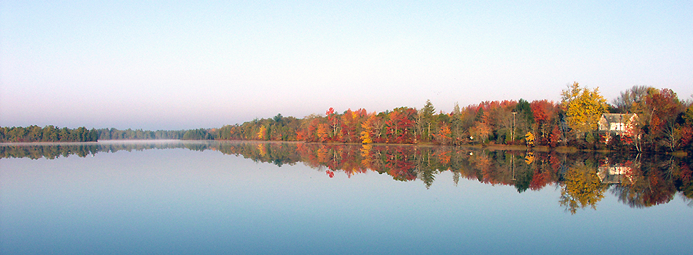
How many of you incorporate your region into your lessons?
Notes:
Vicky

Slide 2
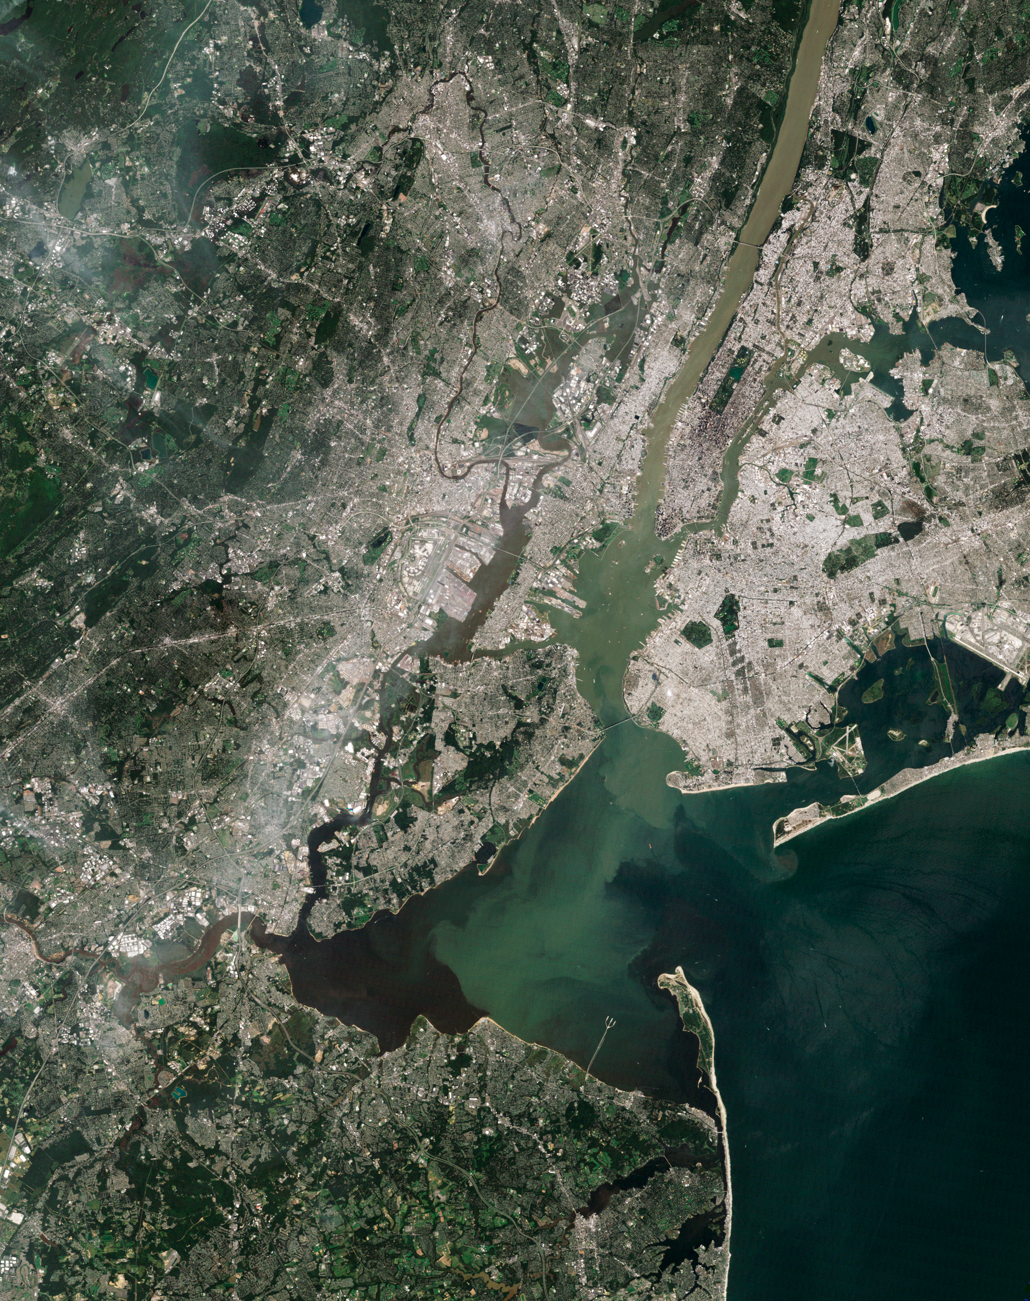
How many of you teach about your region from this perspective?

Slide 3
Teachers?
Grades?
How many of you teach about satellites and satellite images during the school year?
How would you rate your knowledge of satellites, spatial resolution, and image analysis?
Notes:
Vicky

Slide 4
How a Satellite Sees!
Vicky Gorman
GOES-R Teachers Workshop
Kennedy Space Center, Florida
18 November 2016

Slide 5
Satellites 102 “How do satellites see?” aka, Paint by Numbers for Grown-Ups

Slide 6
How do satellites see?

Slide 7
What happens to the numbers sent from the satellite to Earth?

Slide 8
Pixels
Satellite pictures are received as composites of tiny blocks.
These blocks are of varying energy intensities.
The blocks are often shown in shades of gray
Colors can be assigned to each block.
The area each block covers determines how detailed the image can be.
The smaller the block, the greater the detail in a satellite image.

Slide 9
1 | 1 | 1 | 1 | 2 | 2 | 2 | 3
1 | 1 | 5 | 2 | 2 | 2 | 3 | 4
1 | 5 | 2 | 2 | 2 | 3 | 4 | 4
5 | 5 | 5 | 2 | 2 | 2 | 3 | 3
2 | 2 | 2 | 2 | 2 | 2 | 2 | 2

Slide 10
The instruments on a satellite sent information from space to a computer on Earth. What does the computer need to do before a scientist can use the information?
1 | 1 | 1 | 1 | 2 | 2 | 2 | 3
1 | 1 | 5 | 2 | 2 | 2 | 3 | 4
1 | 5 | 2 | 2 | 2 | 3 | 4 | 4
5 | 5 | 5 | 2 | 2 | 2 | 3 | 3
2 | 2 | 2 | 2 | 2 | 2 | 2 | 2

Slide 12
Color Key
1
2
3
4
5
Green
Blue
Brown
Black
Tan

Slide 13
1 | 1 | 1 | 1 | 2 | 2 | 2 | 3
1 | 1 | 5 | 2 | 2 | 2 | 3 | 4
1 | 5 | 2 | 2 | 2 | 3 | 4 | 4
5 | 5 | 5 | 2 | 2 | 2 | 3 | 3
2 | 2 | 2 | 2 | 2 | 2 | 2 | 2

Slide 15
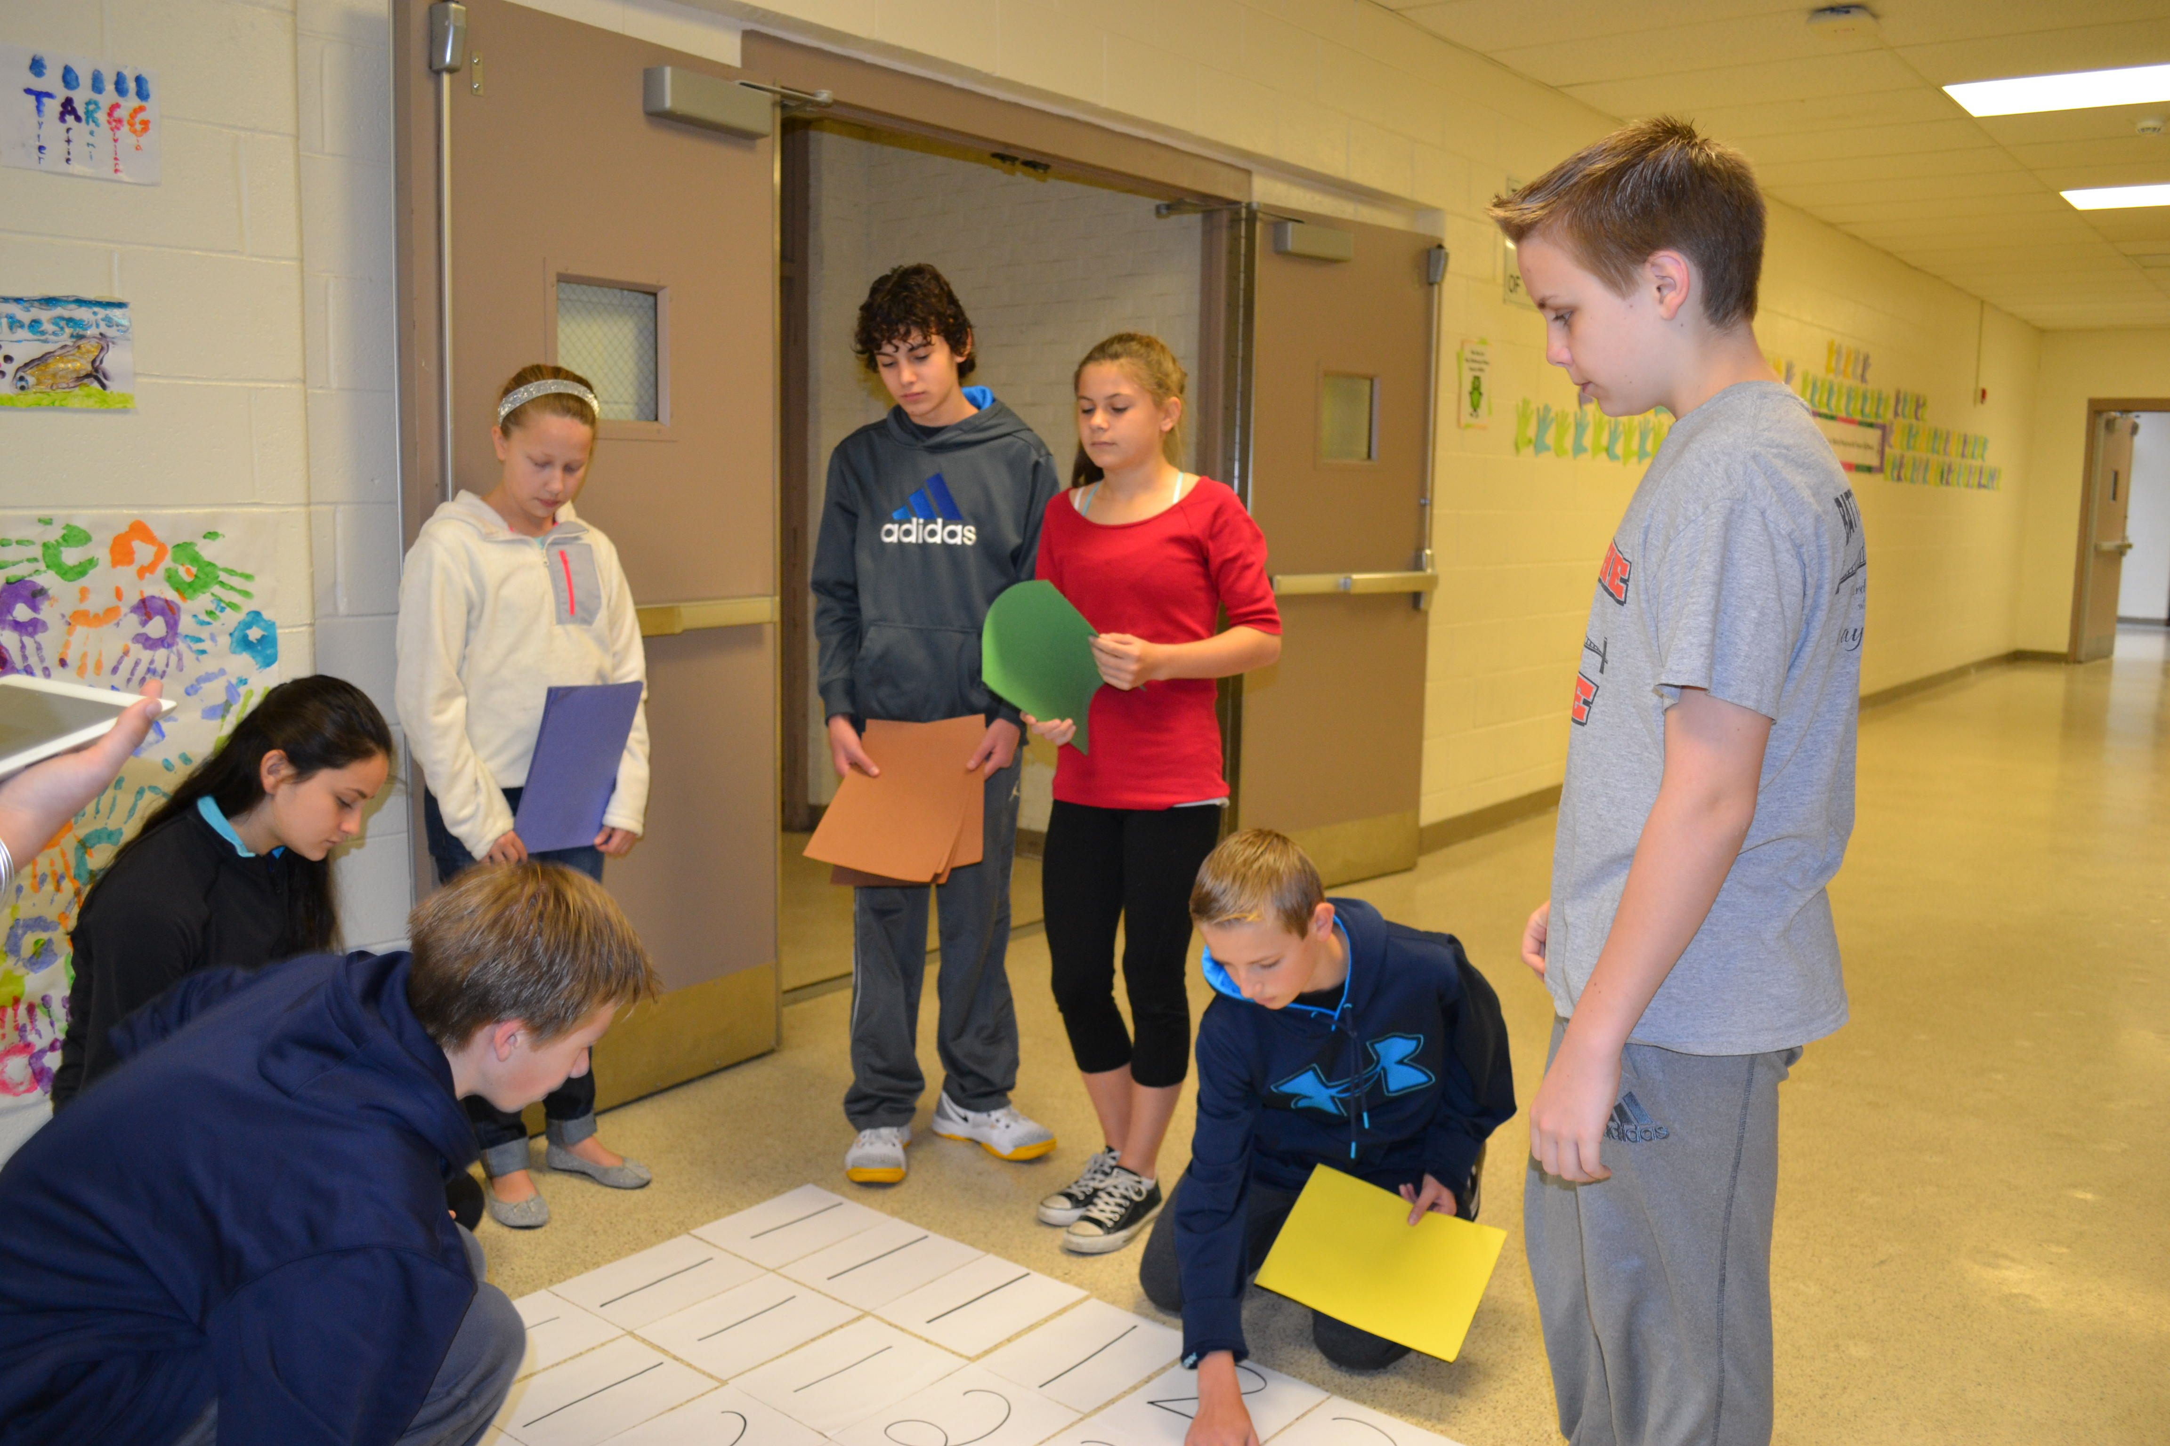

Slide 16
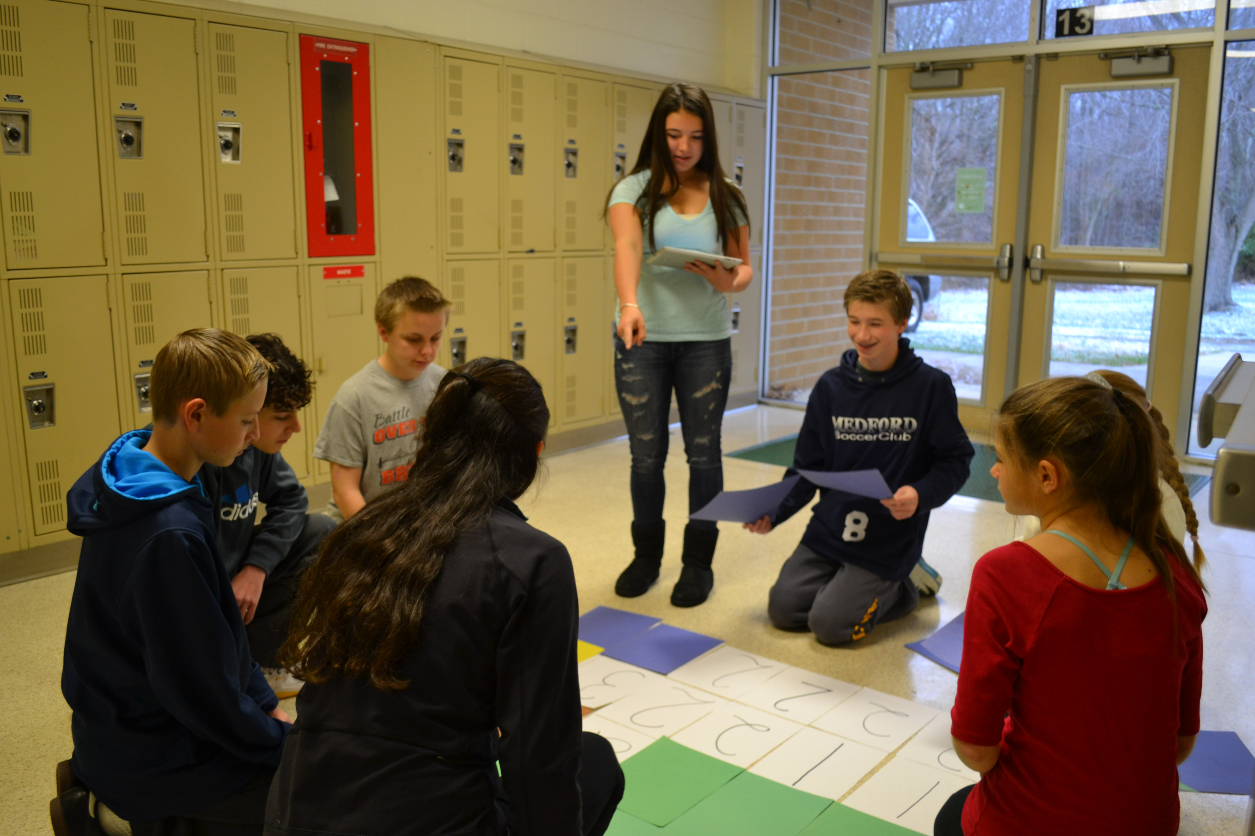

Slide 17
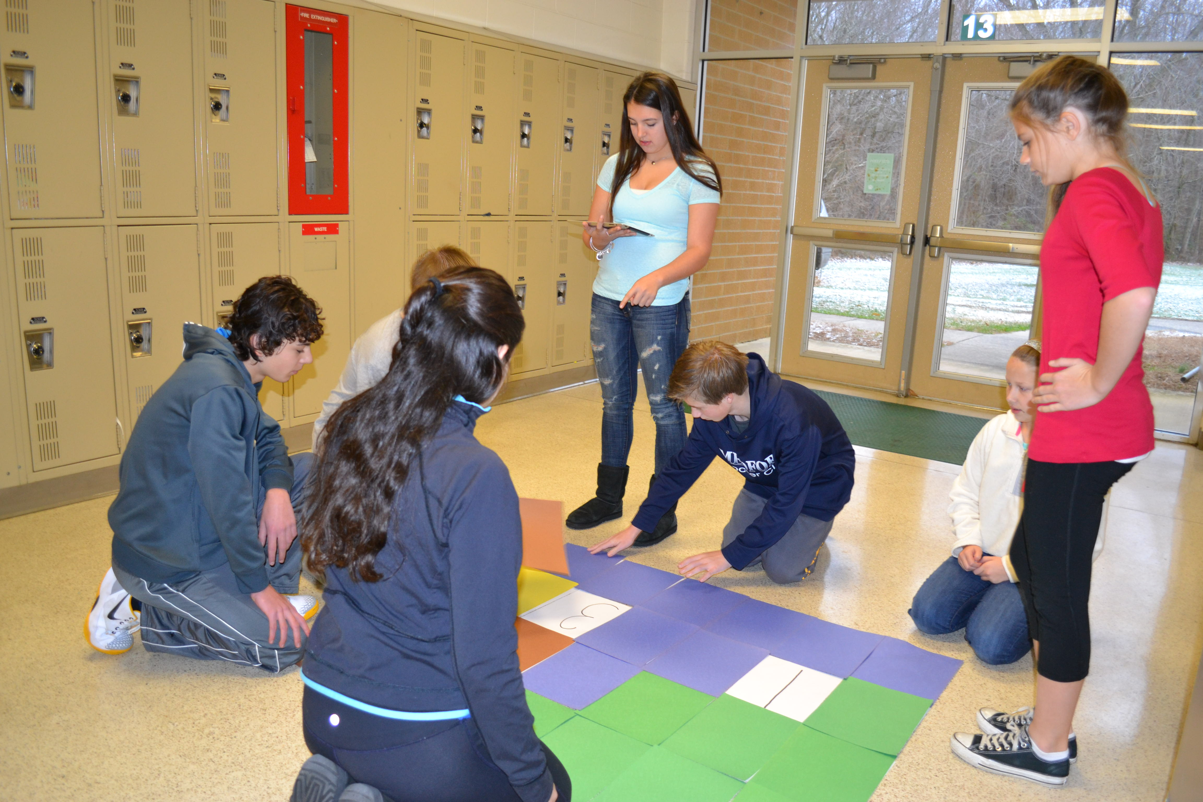

Slide 18
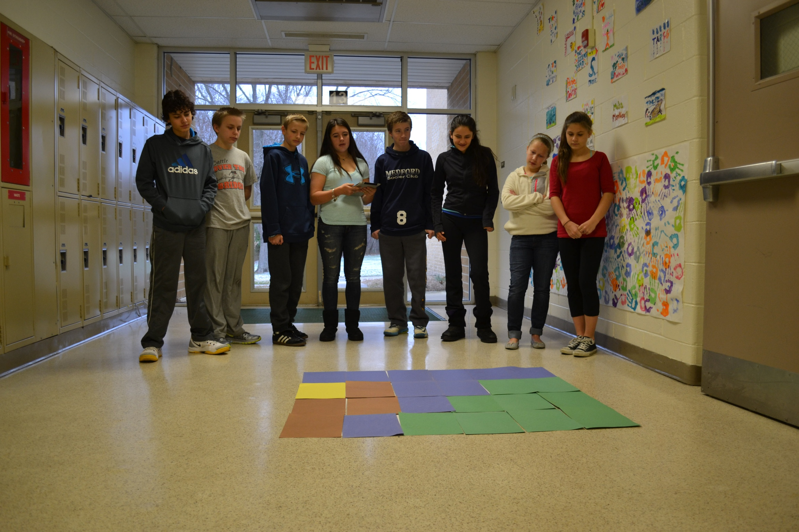

Slide 19
1 | 1 | 1 | 1 | 1 | 1 | 1 | 1
1 | 1 | 2 | 2 | 2 | 2 | 1 | 1
1 | 2 | 2 | 4 | 4 | 2 | 2 | 1
1 | 1 | 2 | 2 | 2 | 2 | 1 | 1
1 | 1 | 1 | 1 | 1 | 1 | 1 | 1

Slide 20
1 | 1 | 1 | 1 | 1 | 1 | 1 | 1
1 | 1 | 2 | 2 | 2 | 2 | 1 | 1
1 | 2 | 2 | 4 | 4 | 2 | 2 | 1
1 | 1 | 2 | 2 | 2 | 2 | 1 | 1
1 | 1 | 1 | 1 | 1 | 1 | 1 | 1

Slide 21
2 | 4 | 4 | 4 | 4 | 4 | 4 | 4
2 | 2 | 2 | 2 | 2 | 4 | 4 | 4
2 | 2 | 2 | 5 | 5 | 5 | 5 | 2
2 | 1 | 2 | 5 | 5 | 5 | 5 | 5
2 | 1 | 2 | 1 | 5 | 5 | 5 | 5

Slide 22
2 | 4 | 4 | 4 | 4 | 4 | 4 | 4
2 | 2 | 2 | 2 | 2 | 4 | 4 | 4
2 | 2 | 2 | 5 | 5 | 5 | 5 | 2
2 | 1 | 2 | 5 | 5 | 5 | 5 | 5
2 | 1 | 2 | 1 | 5 | 5 | 5 | 5

Slide 24
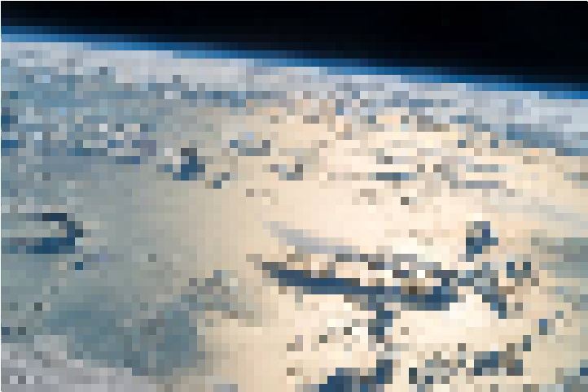

Slide 25
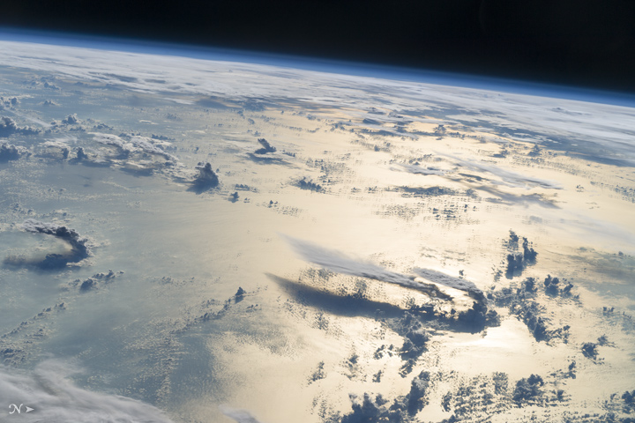
Notes:
Flying over the Philippine Sea, an astronaut looked toward the horizon from the International Space Station and shot this photograph of three-dimensional clouds, the thin blue envelope of the atmosphere, and the blackness of space. The late afternoon sunlight brightens a broad swath of the sea surface on the right side of the image. In the distance, a wide layer of clouds mostly obscures the northern Philippine islands (top right).
Looking toward the Sun to capture an image is a special technique used by astronauts to accentuate the three dimensions of landscapes and cloudscapes through the use of shadows. Two large thunderclouds rise next to one another (lower right). These clouds have long tails, also known as anvils, that stretch nearly 100 kilometers to the south. Anvils form when thunderstorm clouds rise high into the atmosphere and reach a “capping layer” thousands of meters (tens of thousands of feet) above sea level. Capping layers stop the upward growth of a cloud, deflecting air currents horizontally to form anvils

Slide 26
1 | 5 | 5 | 5 | 3 | 1 | 3 | 1
1 | 5 | 3 | 5 | 1 | 1 | 1 | 1
1 | 1 | 5 | 5 | 3 | 1 | 3 | 1
3 | 1 | 5 | 5 | 5 | 1 | 1 | 1
5 | 1 | 5 | 5 | 5 | 5 | 1 | 1

Slide 27
1 | 5 | 5 | 5 | 3 | 1 | 3 | 1
1 | 5 | 3 | 5 | 1 | 1 | 1 | 1
1 | 1 | 5 | 5 | 3 | 1 | 3 | 1
3 | 1 | 5 | 5 | 5 | 1 | 1 | 1
5 | 1 | 5 | 5 | 5 | 5 | 1 | 1
Notes:
Wildfires in the southeastern United States are usually small and do not produce much smoke compared to the big blazes in the western United States, Canada, or Russia. But a cluster of fires in Georgia, North Carolina, Tennessee, and Kentucky in November 2016 defied that trend.
On November 7, 2016, the Moderate Resolution Imaging Spectroradiometer (MODIS) instrument on NASA’s Terra satellite observed thick plumes of smoke streaming from forests in the southern Appalachians. Extreme drought fueled the outbreak of fires, and strong winds spread smoke broadly across the Southeast.
The ongoing—and in some areas record-breaking—drought began in May 2016 and intensified throughout the summer. By November, data from the U.S. Drought Monitor showed exceptional drought—the highest level on the scale—across parts of Mississippi, Alabama, Georgia, Tennessee, and North Carolina. All of the American Southeast, except for coastal areas, faced at least moderate drought.

Slide 30
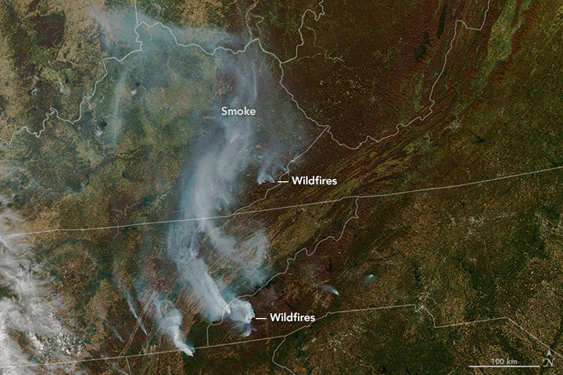

Slide 31
Color Key
1
2
3
4
5
Green
Blue
Brown
Black
Tan

Slide 32
Color Key
1
2
3
4
5
Green
Blue
Brown
Black
Tan
6
7
8
9
10
Gray-white
Blue-green
Dark blue
Red
Yellow

Slide 33
6 | 6 | 6 | 6 | 6 | 6 | 6 | 6
6 | 6 | 6 | 6 | 6 | 6 | 6 | 6
7 | 7 | 7 | 6 | 6 | 6 | 6 | 6
8 | 8 | 8 | 7 | 7 | 6 | 6 | 6
8 | 8 | 8 | 8 | 8 | 7 | 7 | 6

Slide 34
6 | 6 | 6 | 6 | 6 | 6 | 6 | 6
6 | 6 | 6 | 6 | 6 | 6 | 6 | 6
7 | 7 | 7 | 6 | 6 | 6 | 6 | 6
8 | 8 | 8 | 7 | 7 | 6 | 6 | 6
8 | 8 | 8 | 8 | 8 | 7 | 7 | 6

Slide 35
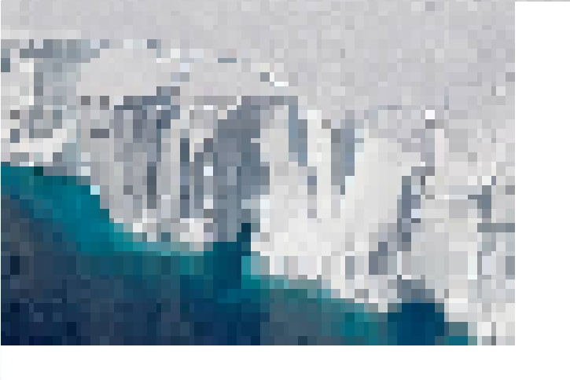

Slide 36
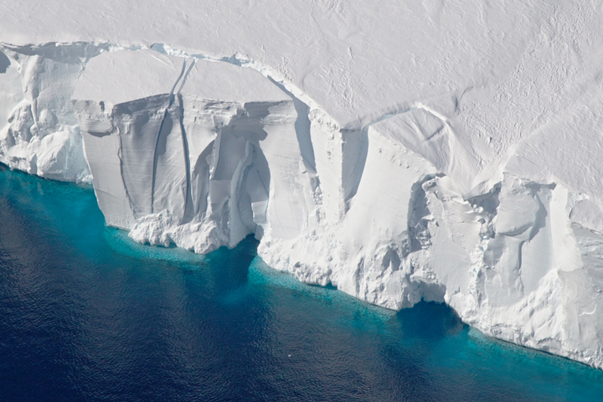
Notes:
As scientists and crew with NASA’s Operation IceBridge mission prepared for a research flight on November 5, 2016, the weather in Punta Arenas, Chile, was cold, wet, and windy. But when they reached their survey site in West Antarctica, skies were clear and winds were calm—a perfect day for scientists to collect data over the Getz Ice Shelf.
IceBridge, now in its eighth year, continues to build a record of how ice is responding to changes in the polar environment. The Getz Ice Shelf in West Antarctica is one area that scientists try to examine each year. “Getz is an ice shelf that has been experiencing some of the highest basal melt rates of the Antarctic ice shelves,” said Nathan Kurtz, IceBridge project scientist and a sea ice researcher at NASA’s Goddard Space Flight Center.
The images above show two views of Getz as photographed on November 5 from a NASA research airplane by Jeremy Harbeck, a sea ice scientist at NASA Goddard. The top image shows ice in the process of calving from the front of the shelf, soon to become an iceberg. The second image shows an area farther upstream, near the grounding line—the boundary where the ice sheet loses contact with bedrock and begins to float on the ocean. Here, a web of deep cracks, or crevasses, spans the icescape.
Kurtz notes that the team has flown over the Getz Ice Shelf many times before. Flight paths are often exact repeats of those flown in previous years, which helps scientists understand how the height of the ice surface changes over time. This year, new flights over Getz were added to the existing observations. Scientists mapped the bathymetry (shape and depth of the seafloor) below the ice shelf, and they mapped the ice surface and bedrock upstream of the grounding line.
The flight over Getz is just one of a number of key areas flown during the IceBridge campaign. Each flight plan is prioritized in order of importance: baseline (the highest priority), high, medium, and low. The flight on November 5 over Getz, for example, was categorized as “high” priority. Since the start of 2016 science flights on October 14, the team has flown six out of eight baseline missions, eight out of 15 high priority lines, and one medium and low priority mission each. Research flights for the season continue through November 18.
“We are in pretty good shape so far, having flown so many missions due to a combination of favorable weather, no major airplane issues, and all instruments operating well,” Kurtz said. “We’re about four weeks into the campaign, and it’s possible we could tie the record of most flights flown with Operation IceBridge if things continue to go well.”

Slide 37
10 | 10 | 10 | 10 | 10 | 10 | 10 | 10
10 | 10 | 9 | 9 | 9 | 10 | 9 | 9
10 | 9 | 9 | 9 | 9 | 9 | 9 | 10
10 | 9 | 9 | 9 | 9 | 9 | 10 | 10
10 | 10 | 9 | 9 | 9 | 10 | 10 | 10

Slide 38
10 | 10 | 10 | 10 | 10 | 10 | 10 | 10
10 | 10 | 9 | 9 | 9 | 10 | 9 | 9
10 | 9 | 9 | 9 | 9 | 9 | 9 | 10
10 | 9 | 9 | 9 | 9 | 9 | 10 | 10
10 | 10 | 9 | 9 | 9 | 10 | 10 | 10

Slide 39
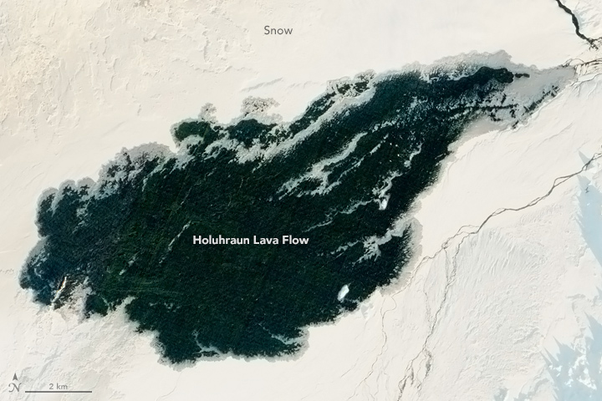
Notes:
More than a year after the latest eruption at Iceland’s Holuhraun lava field, the newly-formed lava may still be toasty underneath. Although the basaltic rock formed a hard crust, according to volcanologists, the flow is probably still hot enough to prevent snow from building up atop it.
“You’re not going to freeze the lava flow,” said Erik Klemetti, a volcanologist at Denison University and author of the Eruptions blog at Wired magazine. “You need to wait for the soil to freeze to get snow to accumulate in temperate latitudes.”
The 2014–15 eruption was a big one—Iceland’s largest basaltic lava flow since the Laki eruption of 1783–84, which killed more than 20 percent of the population. In February 2015, Icelandic scientists declared the recent eruption over; lava had spread across 84 square kilometers (32 square miles), an area slightly larger than the island of Manhattan. Using surveillance flight data, scientists from the University of Iceland’s Institute of Earth Sciences estimated the lava’s thickness at an average of 10 meters to 14 meters (33 to 46 feet).
The sheer mass of lava could mean the flow still retains heat at a depth of a couple of meters, Klemetti said. “There’s some amount of steam—little bits of vapor that can come off, keep [the flow] ambiently warmer,” he said. Additionally, the lava flow is jagged—far rougher than the surrounding rock, and not a surface that encourages snow buildup. Plus, the rock is black and unvegetated, Klemetti noted, which means it absorbs more heat from the Sun than the area around it.
Holuhraun’s 2015 flow appears dark against the Icelandic snowscape. This image was captured by the Advanced Land Imager on NASA’s Earth Observing-1 satellite at 10:00 a.m. local time. The photo has been edited to correct for the low angle of the Sun, which caused the white snow to appear reddish. Snow does appear to build up along the edges of the lava flow, where the lava is thinner.

Slide 40
So…what do you think?

Slide 45
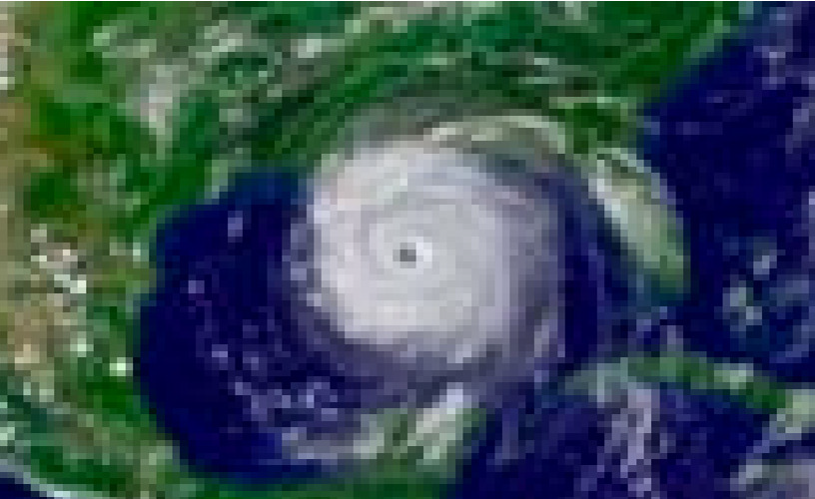

Slide 46
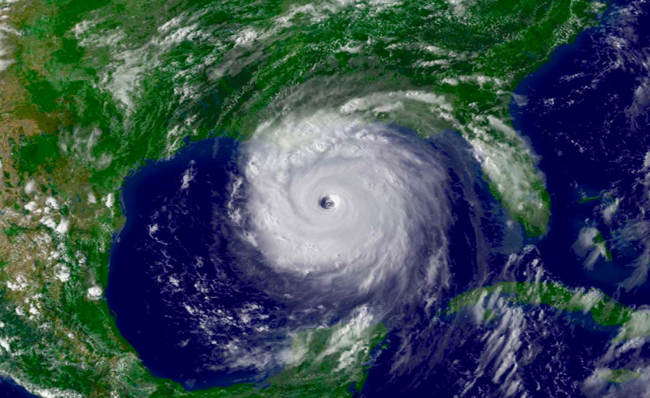

Slide 47
Vicky Gorman
vgorman@medford.k12.nj.us

