Slide 1
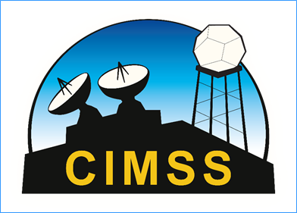
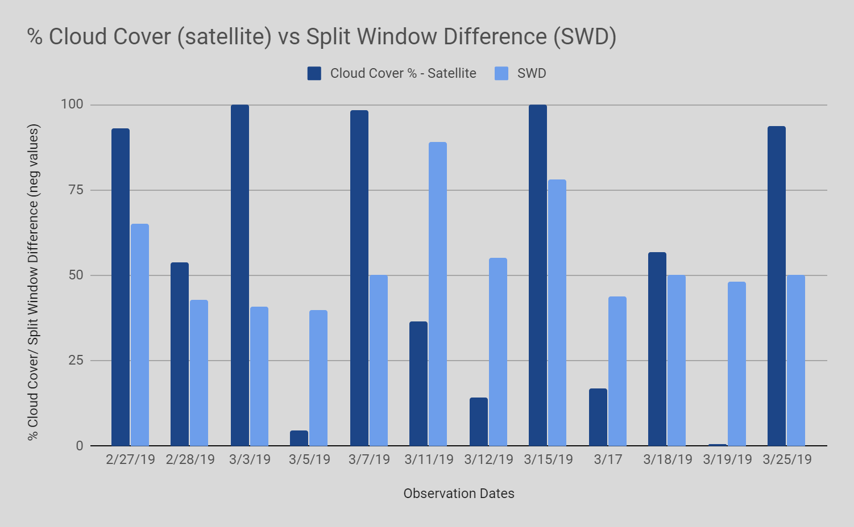
Split Window Difference Values Show No Correlation
to Percent Cloud Cover
“What is the correlation between cloud cover percentage and the GOES split window difference in Medford, NJ USA?”
Samantha Barrile, Royce Jacobs, Sophia Tenebruso
Citizen Science Education Program, Memorial Middle School, Medford, NJ, USA
ABSTRACT
GOES-16 also known as GOES-East, is a geostationary satellite launched in late 2016. It records weather observations from multiple different types of instruments. One of these instruments is the Advanced Baseline Imager (ABI). The ABI represents a major advancement over previous GOES. There is three times more spectral information, four times greater spatial resolution, and five times greater temporal resolution. The ABI uses specific bands of the Electromagnetic Spectrum to identify factors in the environment. One of these factors is water vapor. Split Window Difference, or SWD for short, is related to water vapor in the air. Since clouds form from condensed water vapor, the research team decided to see if there was a correlation between SWD and percent cloud cover. During four consecutive weeks, ground cloud observations were recorded using the GLOBE cloud protocol, cloud data sheets, and the GLOBE observer app. SWD was determined by looking at a product from GOES scientists. An image was analyzed and using a color key and estimated latitude and longitude of Medford, NJ, SWD data was collected. The SWD was compared to percent cloud cover. Based on the results, no correlation was found. This could be due to the time of year the data was taken, as well as the fact that percentage cloud cover using the GLOBE protocol does not yield exact numbers. In addition, it was learned through further research that SWD is normally not used in isolation. It is usually used with several other ABI bands’ data to produce good analysis. If a future scientist were to research similar topics to this, it would be recommended to record data in summer months, learn and study clouds before taking observations, and check another GOES product against a measurement that can be observed from the ground using a GLOBE protocol.
RESEARCH METHODS
DISCUSSION AND CONCLUSION
The research team followed GLOBE protocols to collect data on clouds. The GLOBE Observer app was also used. Every day, for four weeks, between 2/26/19 and 3/26/19, cloud data was taken at Medford Memorial Middle School, Medford, NJ. Within one hour of solar noon, the research team went outside and collected data on cloud type, sky visibility and color, cloud cover, and surface conditions. All of this information was recorded on paper printouts of the GLOBE cloud protocol data sheets and later transferred to the GLOBE Observer app. Some of the cloud observations happened the same time as satellite overflights. When this happened, NASA Langley would send emails with satellite matches. This allowed for the team to compare ground data with satellite data. This helped provide a more accurate picture. As data was collected, it was put into a table. This table was used to help the research team determine if there was a correlation between SWD and percent cloud cover. When it came time to produce a graph, a problem occurred. Percent cloud cover is determined by the GLOBE cloud protocol data sheets in ranges. For example, <10%, 10%-25%, 25%-50%, 50%-90%, and >90%. These ranges were not very useful when comparing against a specific SWD. Although this was an issue, the research team was able to use the satellite match data. And, as it turned out, all but one satellite match was from GOES-16. After analyzing the graph, no clear correlation or pattern was found.
After analysis of the data and graph, no clear correlation or pattern was found between percentage cloud cover and SWD. Because clouds form from condensed water vapor, a better approach might have been to get SWD data and then several hours later check on cloud coverage. Or, perhaps, limit data taking to the afternoon when clouds usually form because of the heating by the Sun. Much was learned when working with the data about how to be a scientist and just how difficult it is to use one satellite product and be able to conclude just one thing. After the research was finished, the team went back to the internet to learn more about how scientists use SWD. Here is some of the information found. This information can be used by students wanting to use GOES SWD in their research in the future.
• In a clear sky, a larger positive value sometimes means more total water vapor in the atmosphere.
• The amount of water vapor in the air also depends on how the temperature changes with altitude. If there's a cold air mass on the surface and a temperature inversion exists, the correlation between SWD and water vapor might be messed up.
• Measuring split window difference works best during the summer and in the afternoon. Since the research in this poster was conducted during February and March, weather conditions made it difficult to interpret the data correctly and accurately.
• It would be interesting to check SWD and see what values can predict possible convective activity, such as thunderstorms and tornadoes. This might be good for a research team in Tornado Alley.
• When the moisture is close to the surface and warm, the SWD will be smaller. If the water vapor is well distributed vertically through the atmosphere, the SWD will be larger.
• SWD indicates moisture in the atmosphere, but it can also indicate dust. If a team wanted to conduct SWD research again, maybe the dust and water vapor comparison could be checked.
It is possible that maybe with a deeper understanding of the data, a correlation could be found between percentage cloud cover and SWD. As said before, simple correlations are not always possible with data from a complex instrument like the ABI. SWD is not a product that was meant to be used by itself. Other information must be considered and included in analysis before a useful conclusion can be reached.
RESULTS
Date | Observation Number | Cloud Cover % - Ground | Cloud Cover % - Satellite | SWD | Observation Cloud Type
2/26/19 | 1 | 25-50 |  | -45 | Cirrocumulus
2/27/19 | 2 | 50-90 | 93.18 | -65 | Cirrocumulus
2/28/19 | 3 | 25-50 | 53.84 | -43 | Cirrocumulus
3/1/19 | 4 | 90-100 |  | -46 | Nimbostratus
3/2/19 | 5 | 90-100 |  | -67 | Nimbostratus
3/3/19 | 6 | 90-100 | 100 | -41 | Stratocumulus
3/4/19 | 7 | 90-100 |  | -47 | Altostratus
3/5/19 | 8 | 0 | 4.55 | -40 | None
3/6/19 | 9 | 25-50 |  | -46 | Cirrostratus, Cumulus
3/7/19 | 10 | 50-90 | 98.51 | -50 | Cumulus
3/8/19 | 11 | 90-100 |  | -49
3/9/19 | 12 | 10-25 |  | -46
3/10/19 | 13 | 90-100 |  |  | Stratus
3/11/19 | 14 | 10-25 | 36.67 | -89 | Cirrocumulus
3/12/19 | 15 | 10-25 | 14.18 | -55 | Altocumulus
3/13/19 | 16 | 10-25 |  | -84 | Cirrus
3/15/19 | 17 | 50-90 | 100 | -78 | Cumulus
3/16/19 | 18 | <10 |  | -46 | Cirrostratus, Altostratus
3/17/19 | 19 | 10-25 | 17.05 | -44 | Cirrus, Altostratus
3/18/19 | 20 | 90-100 | 56.93 | -50 | Altostratus
3/19/19 | 21 | 0 | 0.75 | -48 | None
3/20/19 | 22 | 50-90 |  | -70 | Altostratus, Altocumulus, Stratus
3/24/19 | 23 | 25-50 |  | -62 | Cirrostratus & Cirrocumulus
3/25/19 | 24 | 90-100 | 93.6 | -50 | Cirrostratus
3/26/19 | 25 | 0 |  | -42 | None
HYPOTHESIS
It was decided there would be a correlation between amount and distribution of water vapor and percentage cloud cover, but exactly what that correlation would be, was unknown. Later on in the research period, contact was made with Dr. Dan Lindsey, NOAA. He suggested to see if there was a more negative split window difference on cloudy days and a less negative split window difference on clear days.
FUTURE RESEARCH
What would probably be best, for future research teams, would be to choose another GOES product and find correlations between it and a measurement that can be taken from the ground. GLOBE has many protocols for soil moisture, precipitation, aerosols, humidity, etc. And, GOES has many different products like rainfall rate, cirrus cloud detection, smoke detection, snow cover and land-surface temperature.In addition, future research teams should learn and study clouds before taking observations. This would reduce the possibility of human error. It’s also recommended to take split window difference during warm months.
Figure 1:
Data table showing observation dates, the observation number, percent cloud cover from ground-cloud observations, percent cloud cover from the satellite matches, split window difference, and the cloud types from the ground-cloud observations.
STEM OPPORTUNITIES
Meteorologist, Satellite Engineer, Climatologist
REFERENCES
ABI Bands Quick Information Guides. (n.d.). Retrieved from https://www.goes-r.gov/education/ABI-bands-quick-info.html
Instruments: ABI Improvements. (n.d.). Retrieved from https://www.goes-r.gov/spacesegment/abi-improvements.html
RAMMB/CIRA SLIDER: GOES-16. (n.d.). Retrieved January 28, 2019, from http://rammb-slider.cira.colostate.edu/?sat=goes-16&z=0&im=12&ts=1&st=0&et=0&speed=130&motion=loop&map=1&lat=0&opacity[0]=1&opacity[1]=0.5&hidden[0]=0&hidden[1]=0&pause=0&slider=3760&hide_controls=0&mouse_draw=0&follow_feature=0&follow_hide=0&s=rammb-slider&sec=conus&p[0]=band_13&p[1]=split_window_difference_10_3-12_3&x=5000&y=5000
Staff, S. X. (2017, January 24). GOES-16 satellite sends first images of Earth. Retrieved from https://phys.org/news/2017-01-goes-satellite-images-earth.html
Figure 2:
Graph showing percent cloud cover from the satellite matches against split window difference.
GLOBE IVSS BADGES AWARDED FOR THIS PROJECT
Notes:
1

