Slide 1
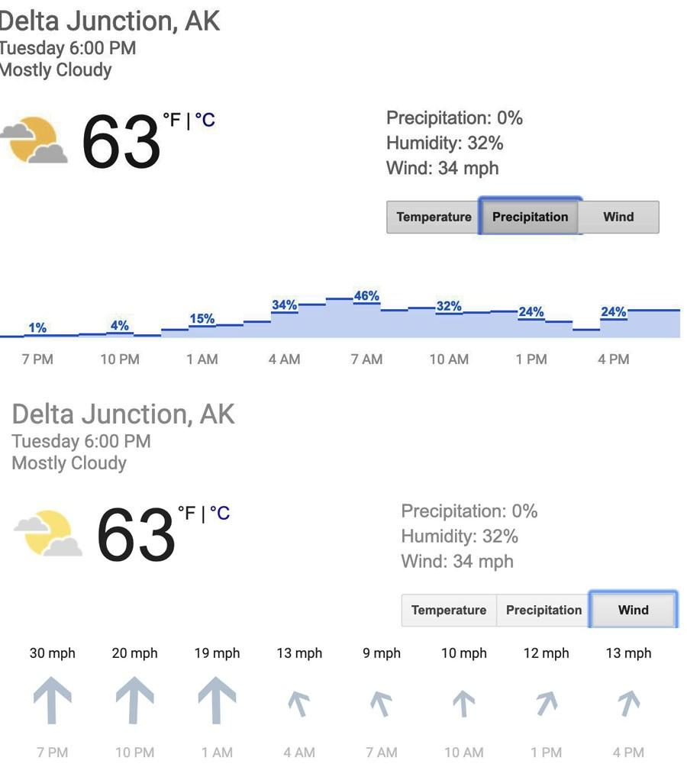
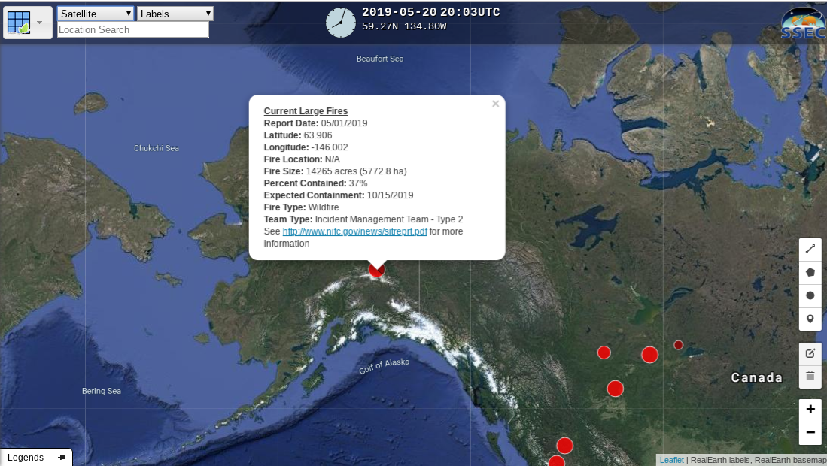
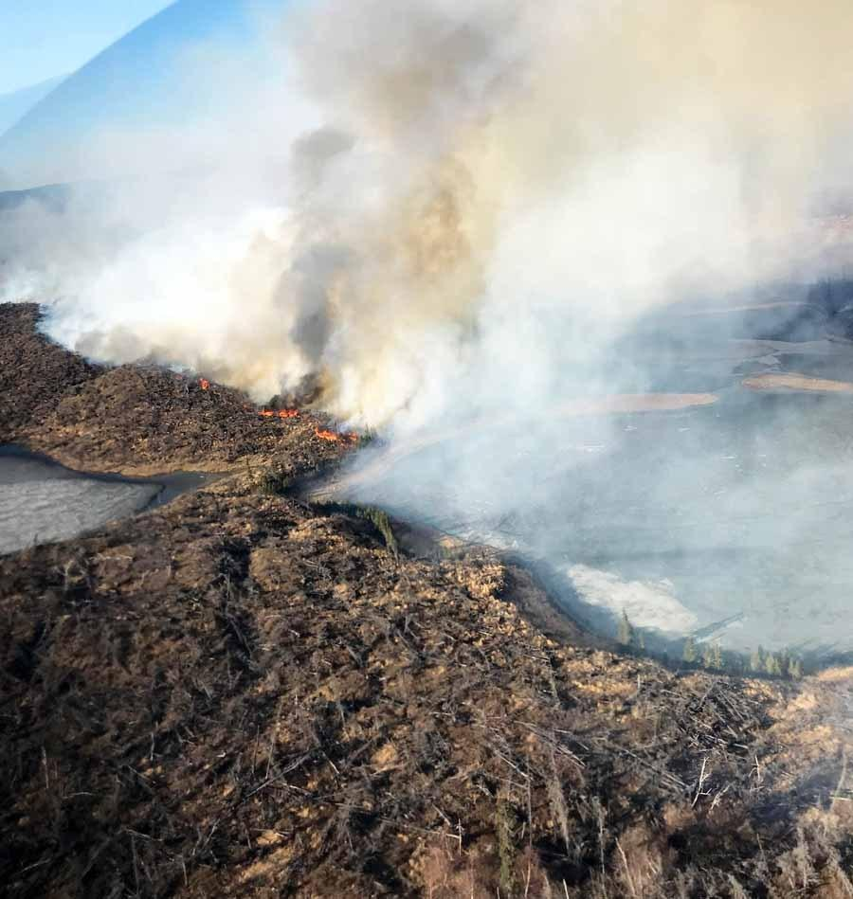
Effects of WildFires
By Erik Garay, Valio Marconi, Rhys Chappell, Brandon Ngo, Bryan Ngo
The environment and the local areas around it affect the spread of a wildfire by producing different types of weather and having not enough ambience to sustain the spread. A wildfire spreading rate can be increased by the combustible plants, which are usually plants that carry dead fuel and is flammable. Not only that, Alaska has been having unexpecting windy and increasing warm weather causing dry fuel for the wildfire. The fire has spreaded south and is continuing to be area restrictedly and keeping all civilians off-limits due to unexploded ordnance on the ground. With all this occurring, the spreading rate will spread in an uncontrollable situation.
The Oregon Lakes Wildfire, located in Alaska, is an excellent example of a spreading wildfire due the environmental factors around it that will be used as evidence in this passage. “The fire was reported April 30 and so far has been burning in an area that is off-limits to firefighters and low-flying fire suppression aircraft due to the likelihood of unexploded ordnance on the ground,” Gabbert stated. “Due to the unseasonable dry fuels and forecasted windy and warmer weather…” As one can see here, explosions and combusions are constantly being monitored by the Alaskan Fire Department. Explosions aren’t the only factors that help spreads this horrendous fire, but also wind factor. According to Google Weather, on May 8th 2019, the delta junction “shows 30 mph south winds tapering off Tuesday night and a 46 percent chance of precipitation early Wednesday morning. “ As one can see, wind plays a massive role in spreading the enormous wildfire and continues to add the fuel as of today. “Due to the predicted weather, the fire is expected to continue to grow to the north and possibly threaten State of Alaska timber values along the Delta River and Delta Creek. According to the National Weather Service, a weak south flow will develop over the Alaska Range this afternoon and continue into Monday, causing a slight warming and drying trend” Not also that, temperatures in Delta Junction could reach from high 60s and could potentially reach up to low 70s depending on how bad the heat is. Keep in mind that Delta Junction average temperature in may the previous years were in low 30s, according to weather-us.com. That concludes the temperature was shown to double since this years climate change.
A wildfire starts off from some sort of origin. Sometimes, in fact, the cause is unknown due to the fact that it spread so quickly the evidence was already destroyed. But what causes a wildfire might not be exactly what a lot of people may think. Simply just throwing a glass bottle on the side of a street being striked directly on sunlight can cause a fire to spark up. Other methods includes matches or cigarettes that inadvertently catch on fire, a campfire that isn’t properly extinguished, sparks from a vehicle or train, an uncontrolled burn, fireworks, and so much more. Furthermore, the spread of the fire can blossom tremendously with the assistance of wind. With the high speed winds, and going in the unfortunate direction, many more acres are burned down and can reach places close to civilization where many people live. However, the start of the fire is where many investigators or civilians seem to startle with disbelief. Such a small cigarette or fuse can start and burn thousands of acres because of how quick flames can spread. Think of wildfires like the spread of water -- it will flow throughout the acres or land it has access to and can spread. Going on a little tangent, water will spread if there is a opening on the floor of where the water is. This is how rivers and lakes are created. Similarly, fire can spread whenever no conflicted solution is present. Anything flammable can start the dangerous combustion. Even children and pets can start fires. The situation being unchecked, many evacuations are necessary and possibly even be a threat to thousands of people.
https://wildfiretoday.com/tag/oregon-lakes-fire/
https://www.livescience.com/63458-wildfires.html

