Slide 1
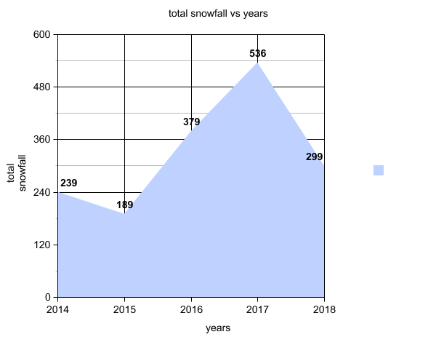
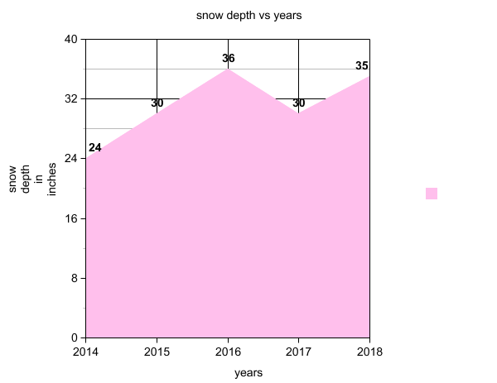
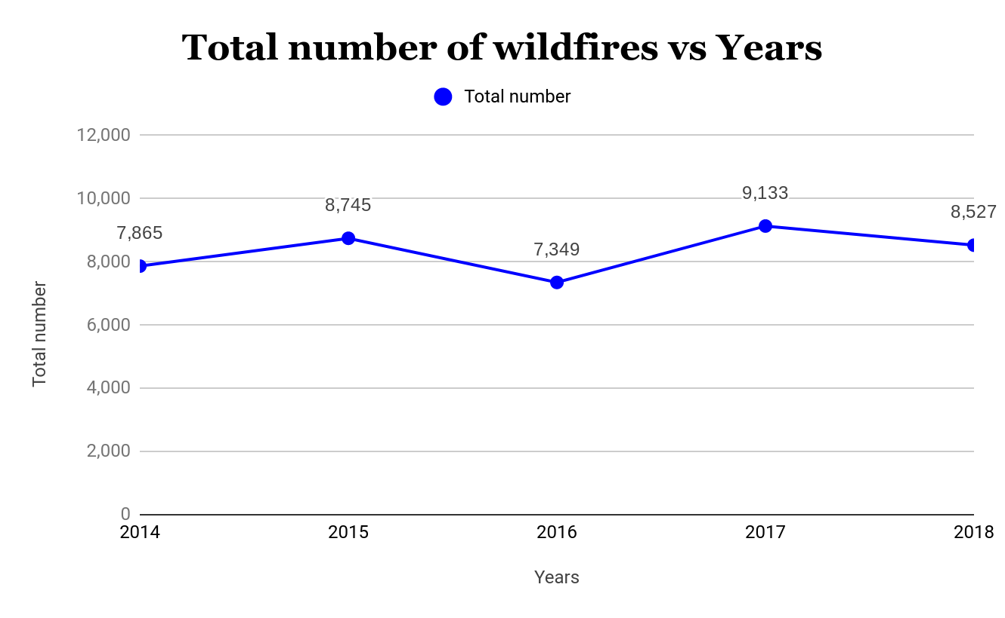
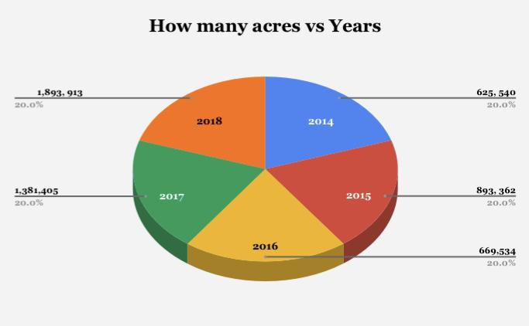
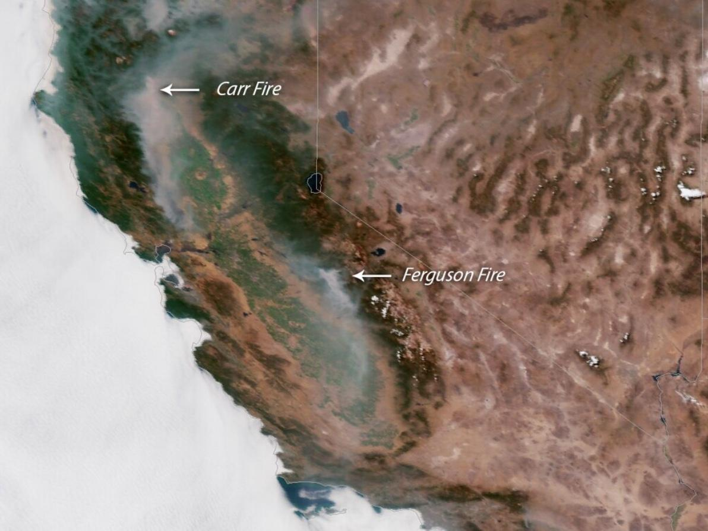
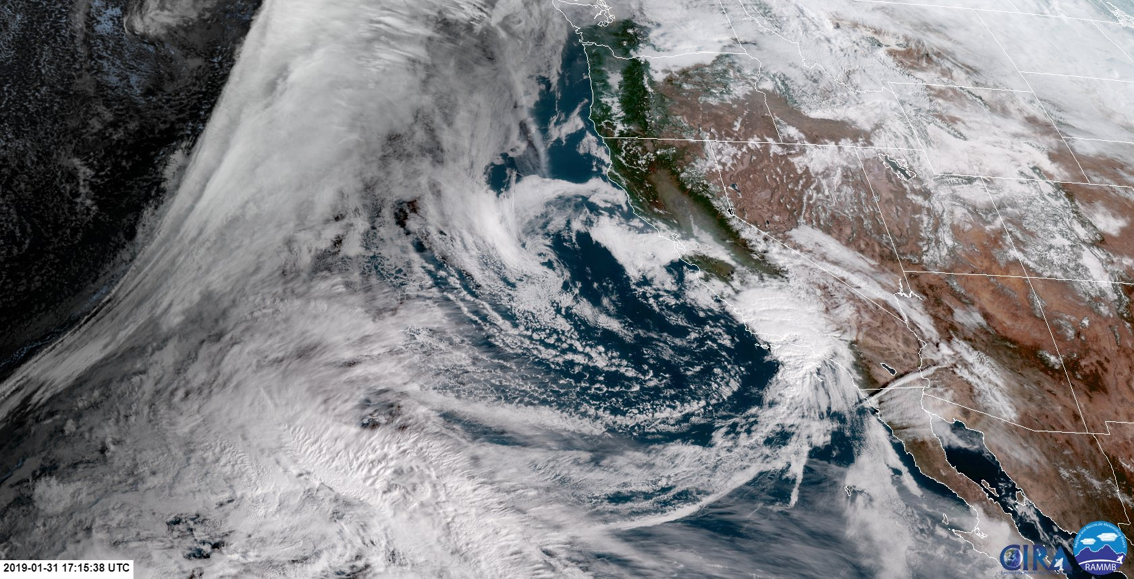
Abstract:
The snowpacks in the California Alps vary from year to year and so do the amount of California wildfires. We wondered whether the amount of wildfires affected the amount of snowpack. This made us hypothesize that if there was an increase of smoke from wildfires, landing on mountain tops that it would increase the speed of snow melting and reduce the snowpack amount. Ultimately we found no direct correlation.
Impact of Local Fires On Snowpack
By: Katrina Simon, Katie Hulse & Ella Stannard
Wildfires
Throughout the last five years, California has been experiencing one of the deadliest wildfire seasons ever recorded. This unexpected environmental crisis was caused by dry conditions and powerful windstorms in Southern California, in 2014. Some examples of these tragedies include wildfires such as the Hunter’s fire located in Hunter’s Valley, and many more in the San Diego area. However, the fires continued though 2015. During which, a majority of them occurred in the river valley regions, one of the most devastating, torched 151,000 acres of California. This year was one of the most damaging years to our environment. In 2016, the water in the Pacific Ocean began to warm, causing a lack of precipitation. Throughout the months of May through August there was another large increase of wildfires. This lead to a disastrous number of 669, 534 acres burned. According to Calfire.com, California has had the most wildfires during 2017, with a total of 9,133 fires. These fires are in the Los Angeles, San Bernardino, and San Diego areas which have extremely dry conditions compared to other areas. These took place during the hot summer, and lasted throughout October. Finally, 2018 was the most destructive wildfire season ever recorded, with a whopping total of 8527 fires and 1,893, 913 acres burned. This damage was off the charts and left California in shock.
Snowpack and Snow Depth
While there have been many serious wildfires in California, the snowpack has varied greatly throughout the last five years. The question is whether or not the amount of fires affected the amount o f sustainable snowpack. For example in 2014, California was in the midst of one of the largest droughts in history. It was the driest it has been in the Sierra Nevada’s in 500 years and the the snowfall rate was 95% below the average. The low snowpack carried on through the following year as well. In 2015, California was extremely hot and dry. For instance, the snow depth was several meters lower than it was in the drought of 1977 which was off the charts. The department of water concludes that it was the first time in recorded history that there was zero snow fall on April 1st. The snow season usually carries through that time of the year, sometimes even through May. This caused major hardship for Ski resorts and other snow organizations. This was not only due to little snow fall, but extreme temperatures that were already causing the drought to worsen.
Introduction:
California’s Wildfires
How many fires occur
The severity of the overall fires throughout that year
How many acres they cover
2015-2018
California’s Snowpack
How long the snow season lasts
How many feet of snow fall throughout the year
2015-2018
Questions
Does el nino effect the amount of snowfall or fire?
Does the amount of fires in California affect the snowfall later in the year?
“What happened in 2015 in that very low precipitation co-occurred with record high temperatures. And that’s what made the snowpack low, so extremely low.” This dangerous combination caused the snowpack to melt faster than ever before. People related the sound of the rushing water to the music of the mountains. Ski resorts shut down early, people didn’t ski or snowboard, animals were at risk, and California had the lowest snowpack in 3100 years. Thankfully in the years 2016-2017, things were looking up. The drought was finally coming to an end and in the process one of the largest snowpack California has ever had was created. This kept rivers flowing sustainably for months to come. Water was plentiful for the first time in ages. Snow continuously increased by percent throughout the months to the point of the snow fall being 175% above average. In fact the snowpack grew over 500 inches. Although this resulted in rushing rivers as the spring faded into summer, it temporarily ended the California drought. The key word is temporary because this did not last through the year. By 2018 the drought had returned and there was less snowfall and snowpack.
Hypothesis:
The amount of wildfires in a given year will affect the amount of snowpack in California. (As the wildfires increase, the snowpack decreases.)
Conclusion
We had originally hypothesized that the amount and extremity of wildfires throughout a year would negatively impact the amount of snowpack in the California mountain ranges. After in-depth research, we have concluded that there is no correlation between wildfires and snowpack. It is in fact possible for there to be wildfires all year, in the highest severity and have a plentiful snowpack remaining. For example, on the graph titled “Total Number of Wildfires Vs Years” the year that experienced the largest amount of wildfires was 2017, while shown on graph “Total Snowfall Vs Years” the year 2017 had the most snowpack. Thus, further demonstrated that there is no direct correlation between the two.
References
https://www.onthesnow.com/california/mammoth-mountain-ski-area/historical-snowfall.html
https://www.nesdis.noaa.gov/GOES-R-Series-Satellites
https://www.usatoday.com/story/news/nation/2018/11/13/california-fires-how-do-wildfires-start-they-getting-worse/1987691002/
Acknowledgments
We would like to thank our Biology teacher, Mrs. Kozick who gave us this opportunity to do this project.
Job opportunities
With the information that we have researched, there can be many job opportunities. Such as, a wildlife biologist, a weather forecaster, water conservation jobs and wildfire protection systems.
Notes:
Stem job opportunities - what you can do with this information in a career path

