Slide 1
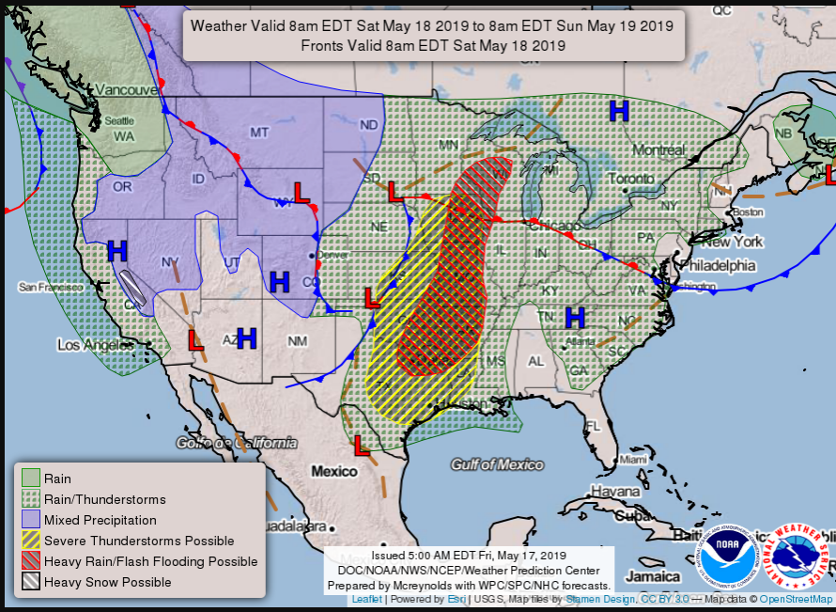
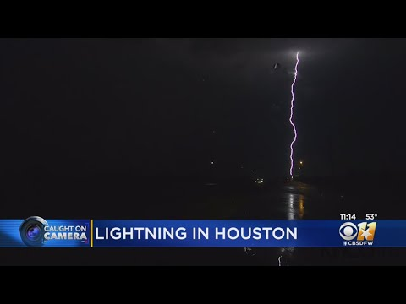
The Effect of Humidity on the Number of Lightning Storms in Texas
(By: Danica Bjornestad, Alison Alves, Bekah Konecky, and Theodore Thai)
Abstract
Our topic we chose is lightning storms in Texas. We chose this topic because we wanted to analyze the relationship between humidity to the number of lightning storms. We researched the causes of these storms. Lightning storms are caused by positive and negative charges and humidity contributes to the frequency of these storms. Based on this background research, we formed a hypothesis of: If Texas has many lightning storms because of the humidity and temperature of the Gulf of Mexico, then California is likely to have few because it is near the cold, less humid Pacific Ocean. From our research, we found that as you get closer to the gulf, the humidity rises, resulting in more thunderstorms. The average humidity is about 89% near the gulf. To contrast, California’s average humidity near the Pacific Ocean is 70%, thus having less lightning storms. Furthermore, we found that temperature has an effect on the number of storms. As a result, our hypothesis was supported because Texas does have more lightning storms than California because it is near the humid, Gulf of Mexico.
2. Research Questions
Why are lightning storms important to the atmosphere?
Lightning makes more oxidants which help clean up the atmosphere.
What are the long term impacts of the storms?
The explosive shock wave created by lightning can cause concussions and auditory injury at extremely close range. Other physical injuries can be caused by objects damaged or thrown by a lightning strike.
Why are lightning storms increasing in Texas?
Texas is by the Gulf of Mexico. The Gulf of Mexico has warm temperatures, which increases the chance of lightning storms.
The hotter air makes more water vapor which increases lightning activity
What causes lightning storms?
Positive charges go up to the negative charges, building up above the clouds until a giant spark is formed and the lightning strikes.
Lightning is an explosion of electricity
How are the lightning storms currently impacting the life in Texas?
The storms are causing an increase in rainfall which has caused flash warnings to be issued. The large amount of lightning also puts tall structures at risk of being struck.
3. Hypothesis and Essential Question
Hypothesis: If Texas has many lightning storms because of the humidity and temperature of the Gulf of Mexico, then California is likely to have few because it is near the cold, less humid Pacific Ocean.
Essential Question:. Does humidity and temperature have an effect of the number of lightning storms?
4. Methods/Procedure
The effect of humidity in different places on lightning storms
Has a high effect on lightning storms
California is not that humid; fairly dry; not many lightning storms; humidity rate is about 70%
Texas is fairly humid; gets more humid as you go towards the Gulf; many lightning storms; humidity rate is about 89%
Michigan is fairly humid; Has a lot of lightning storms; Humidity rate is about 73.5%
New York has a humid subtropical climate; hot, moist summers and dry winters; moderate occurrence with lightning; humidity rate is about 69%
Florida is very humid; has many lightning storms; humidity rate is about 93%
The effect of temperature in different places on lightning storms
Has a high effect
California has a Mediterranean climate with warmer, drier weather in the summer and colder, wetter weather in the winter; average temperature for California’s coast is about 57.17℉
Texas has a humid subtropical climate where it is arid in the west and humid in the east. The average temperature is 48.3℉ in the winter and 85.3℉ in the summer.
Michigan is very cold in the winter (January is the coldest at 17.8ºF) and get hot in the summer (July is the hottest at 83.4ºF)
New York has a wide range in temperature; very low in the winter to hot in the summer; low temperatures average at 38℉ and high temperatures at 84℉
Florida rather mild winters and can get very hot in the summer depending on city; the average temperature in the winter is 58℉ and 81℉ in the summer
Other things that affect the lightning storms
Moisture: The Atlantic and Pacific oceans, as well as the Gulf of Mexico are typical sources for moisture because their large bodies of water. Water temperature is also important on how much moisture there is in the atmosphere. Evaporation is higher in warm ocean currents and therefore they put more moisture into the atmosphere than cold ocean currents at the same latitude.
Instability: Air is considered unstable if it continues to rise when given a push upward or continues to sink if given a push downward. Unstable air is characterized by warm moist air near the surface and cold dry air up high. In these situations, if a parcel of air is forced upward it will continue to rise on its own. As this parcel rises it cools down and some of the water vapor will condense forming the giant cumulonimbus cloud that is the thunderstorm.
A Lifting Mechanism: For thunderstorms to develop, there needs to be some mechanism that creates the upward motion, something that will push the air upward. The push upward is a direct result of air density. Some of the sun's heat that warms the earth's surface is transferred to the air which creates different air densities. The inclination for air to rise increases while the density decreases. The difference in air density is the main source for lift and is accomplished by several methods: differential heating, terrain, fronts, dry lines and outflow boundaries.
This is a picture of Satellite Image of the United States showing Texas’ Weather for May 18th. This shows how severe and frequent thunderstorms are around the southern part of Texas.
5. Results
In states with high humidities and temperatures have more lightning storms than states with low humidities and temperatures. For example, Florida is very humid and warm and therefore has lot of lightning storms. However, California has fewer lightning storms because of its low humidity and hot weather.
6. Future Research
If California becomes warmer, what does that mean for us? Do the mountains and altitudes help buffer the storms?
Climate change, specifically global warming, is causing the number of lightning strikes to increase a lot. According to studies from UC Berkeley, for every temperature increase of 1º C, the number of lightning strikes will increase by 12%. By the end of the century, for every one lightning strike there was at the beginning of the century, there will be three strikes by the end of the century. This would mean a 50% increase in lightning strikes nationwide.
Mountains and higher altitude do not help buffer lightning storms. In fact, lightning storms occur more frequently in higher elevation because of the drier air and can be much more dangerous in the mountains due to their closer proximity to the clouds. However, mountain ranges can prevent storms on one side from coming to the other side. This often makes one side of the mountain very lush and green from rainfall and snow. The other side becomes dry and barren, becoming a desert, but this does not stop lightning which occurs within the clouds.
7. Conclusion
To conclude, the lightning storms in Texas were caused by the very high humidity near the Gulf of Mexico. In California, there are much fewer lightning storms because of the low humidity near the Pacific Ocean. Because of this, it can be concluded that temperature and humidity do play an important role in how many lightning storms occur in a location. According to data from various different states, as the the level of humidity increases, so does the number of lightning storms experienced there. The same is also true about temperature. Locations that have moderate to warm temperatures experience more lightning storms and locations with colder temperatures have less lightning storms.
8. References
https://www.theguardian.com/environment/2014/nov/13/lightning-strikes-will-increase-due-to-climate-change
https://www.usclimatedata.com/climate/united-states/us
https://www.weatherwizkids.com/weather-lightning.htm
9. Related STEM Job Opportunities
STEM jobs such as meteorologists can use our research to look more into the thunderstorms of Texas.

