Slide 1
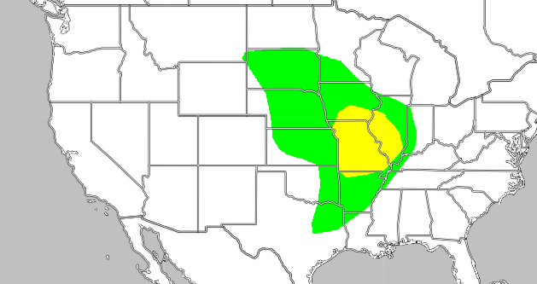
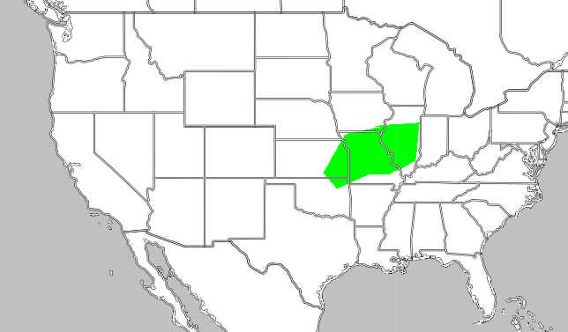
By: Zachary margala and Patrick Wisniewiski
Extreme and excessive rain patterns in the mid to east U.S.A.
Background
Data collection
References
The weather scenario currently being investigated is the excessive rainfall within the southern regions of the united states. As seen from Real Earth's current world display, heavy rainfall and flooding has been prevalent in the Eastern side of Texas and in all of Louisiana. Giving from data over the course of three days and due to strong winds based around the current area, it is hypothesized that the storm will head up North towards Maine, New York, Delaware, ect. And will also split south into Florida, Louisiana, and Mississippi. This particular storm has been noted to cause heavy flooding in Houston, therefore making it’s center most active.
Our data was collected using real earth. We found a filter called wind patterns and excessive brain activity. We looked first at the rain activity. It was concentrated in houston texas and the days before had the storm more toward the gulf of mexico. Wwe look at the wind patterns to try to estimate where the storm will go. No other websites were used to find data used in this poster
Real earth
https://realearth.ssec.wisc.edu/
Results
After the storm died down the rain threat all but disappeared. However after may 10th the storm stopped.but as of may 21st the rain threat is regrowing in the middle east. This might create a new storm moving east again. Most likely form winds fmoving in the same patterns.
May 21st May 10th
Summary
Hypothesis
After we waited for the storm to end and we looked at the data we discovered some major things, first What ended up happening was that after the storm moved through louisiana and florida it curved upward at angle. This moved the storm toward the ocean making it more powerful. However the storm also moved too far into the ocean and was blown even fathar out where it disappeared outside the range of our data. And second we were a little off with our hypothesis and the wind was stronger then expected.
We hypothesized that the storm will head up North towards Maine, New York, Delaware, ect. And will also split south into Florida, Louisiana, and Mississippi. This particular storm has been noted to cause heavy flooding in Houston, therefore making it’s center most active.

