Slide 1
Potential Rainy Convective Cloud Detection using HYDRA based on MODIS Infrared Bands
Cesar Manuel Salazar Aquino
Joan Manuel Castro Sánchez
Advisor: Dr. Nazario Ramirez
April 29, 2016

Slide 2
Objectives and Goals
Find Potential Convective Clouds using MODIS Infrared Bands for Cold Clouds.
Discriminate difference types of cold clouds. Ex: Cumulonimbus vs Cirrus.
Determine if convective cells detect based on MODIS Bands and rainfall detection obtain by NEXRAD shows similar characteristics.

Slide 3
Methodology
Apply a transector cut for potential cold clouds raining zones.
Compare Brightness Temperature (BT) for different MODIS infrared bands.
Classify cold clouds cells and determining where are potential convective zones.
Compare and validate potential convective cells with MODIS Visible Bands and NEXRAD Reflectivity at same time.
DATA SETS are obtained from:
MODIS Visible and Infrared Bands (26, 31, 34, 35 and 36)
TJUA NEXRAD Reflectivity at Level 2 for lower angles (0.5 and 3.4 degrees)

Slide 4
Rainy Events
August 28, 2015: Hurricane Ericka passed southern coast of Puerto Rico
April 27, 2016: A strong trough affects Caribbean Basin since last weekend.

Slide 5
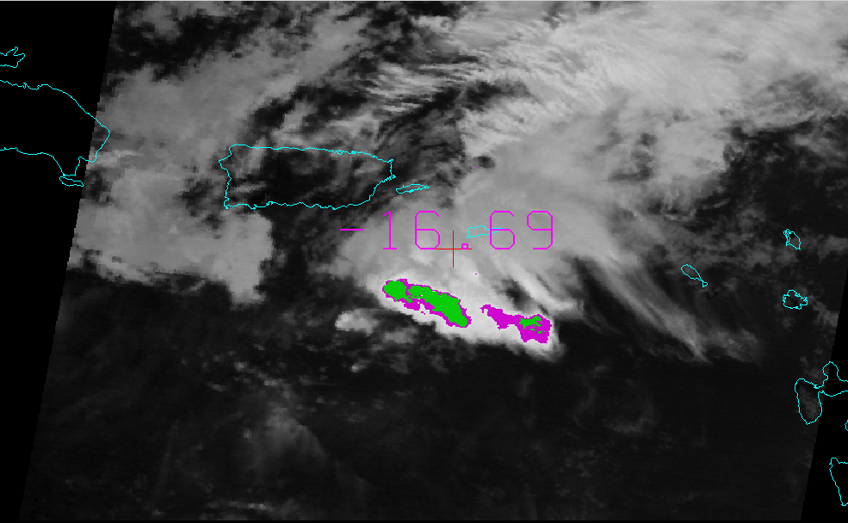
MODIS Brightness Temperature (BT)
BT Band 31 at 11 um (K)
MODIS (BT) Difference
BT Band 36 at 14.2 um and BT Band 31 at 11um
Dispersion Analysis:
BT Band 31 vs Difference BT Band 36 – BT Band 31
Cold Clouds Zone
BT < 210 K
No Clouds Zone
BT > 290 K

Slide 6
Cold Clouds Zone
BT < 210 K
No Clouds Zone
BT > 290 K
Cumulonimbus are cold clouds with strong rainfall activity. High temperature changes across vertical profile shows unstable conditions in troposphere that affected rainfall potential activity.
Cirrus are cold clouds but don’t generate rainfall. Low Temperature changes across vertical profile. Stable conditions in troposphere affected rainfall potential activity.

Slide 7
Results: Case 1 MODIS AQUA and NEXRAD Images August 28, 2015 at 1505 UTC
Convective Cloud Detection based on MODIS Infrared Bands (11 and 14.2 um)
Convective Cloud Detection based on MODIS Visible and Near Infrared Bands (Band 26 at 1.37 um)

Slide 8
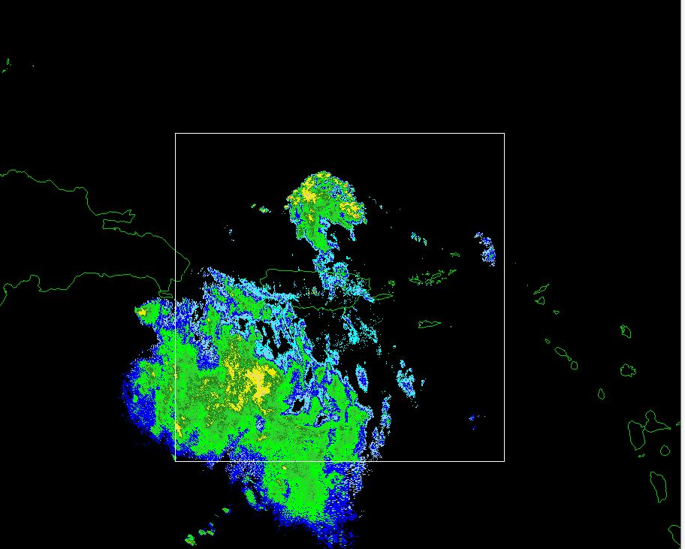
Results: Case 1 MODIS AQUA and NEXRAD Images August 28, 2015 at 1505 UTC
Convective Cloud Detection based on MODIS Infrared Bands (11 and 14.2 um)
Convective Cloud Detection based on NEXRAD Reflectivity Level 2 at 0.5 degrees.

Slide 9
Results: Case 2 MODIS AQUA and NEXRAD Images April 27, 2016 at 1430 UTC
Convective Cloud Detection based on MODIS Infrared Bands (11 and 14.2 um)
Convective Cloud Detection based on NEXRAD Reflectivity Level 2 at 2.4 degrees.

Slide 10
Preliminary Results
MODIS infrared channels help on the identification of potential convective cells. Even when two cases have been studied the results look promising, especially with cumulonimbus.
Ratio between MODIS infrared bands will be an alternative to identify clouds even during the nighttime.
Cloud identified with MODIS infrared channel have been corroborated using NEXRAD obtaining similar patterns.
Channels 31 and 36 from MODIS appear to be important.

Slide 11
Future Work
Use other case studies to corroborate the results obtained.
Apply statistical test to study the significance and validity of the conclusions.
Include another products as optical thickness, optical depth, precipitable water path as well as others.

