Slide 1
Observing Some of The Characteristics of Tropical Storm Bertha, 2014 With the Use of Hydra Software
Lawrence Pologne
Caribbean Institute for Meteorology and Hydrology
April 29, 2016
UPRM

Slide 2
Introduction
Bertha was formed in the tropical Atlantic on early August 01, 2014 just east of Barbados under marginally favourable conditions (strong westerly shear and dry air entrainment) and thus struggled to maintain its surface circulation.
Uncertainty in positioning can lead to large errors in forecast tracks, putting lives and property at stake
This presentation aims to demonstrate that high resolution polar orbiting satellite imagery can be utilized to gain insight into disorganized weather systems such as Bertha. And ultimately, provide warnings to aviation users.

Slide 3
Data and Methodology
10 km Modis data from the NASA EOS satellite DB system valid August 02, 2014; 0240z and 1455z.
Sounding data from Wyoming university website for 00z, 12z Aug 02, 2014.
Use of Hydra software to process the DB data.

Slide 4
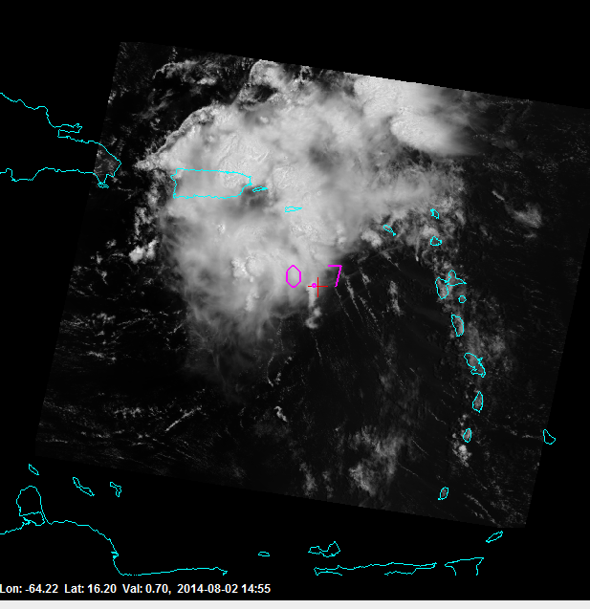
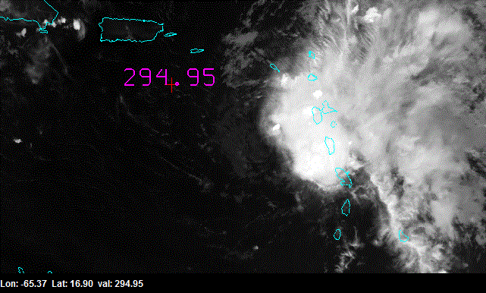
Bertha’s disorganized structure
made it difficult for hurricane
forecasters
Nhc 15z centre
MODIS B1 Vis centre
MODIS B31 11 micron
0240z
Exposed centre
Indicates shear
+ weakening system

Slide 5
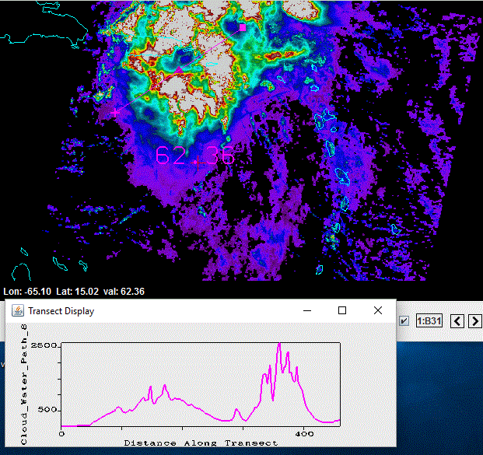
Cloud Water Path: A measure of total amount of liquid water between points in a column. Used to indicate dry air entrainment.
Huge disparities in moisture
content across storm

Slide 6
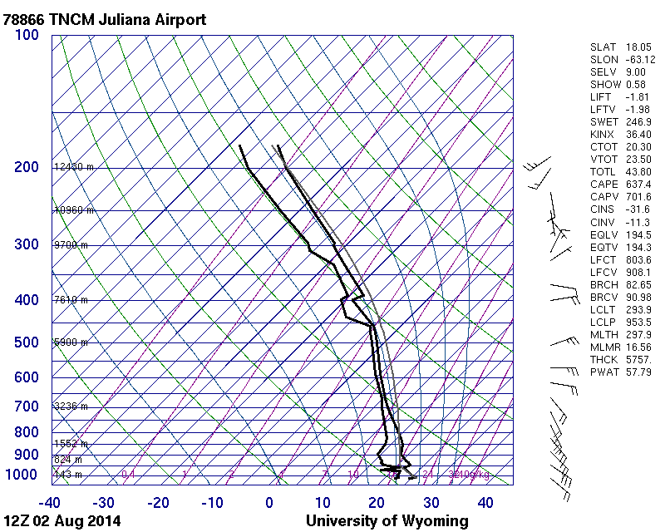
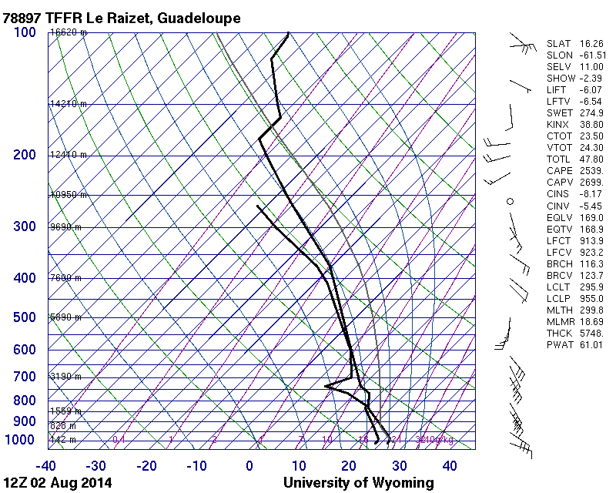
It may not be “all clear” when the “all clear” is given. A tropical cyclone can still pose hazards to aviation in its wake. The threat of Icing is seen well behind the centre position;
Implications for Aviation Users
saturated water above freezing level.

Slide 7
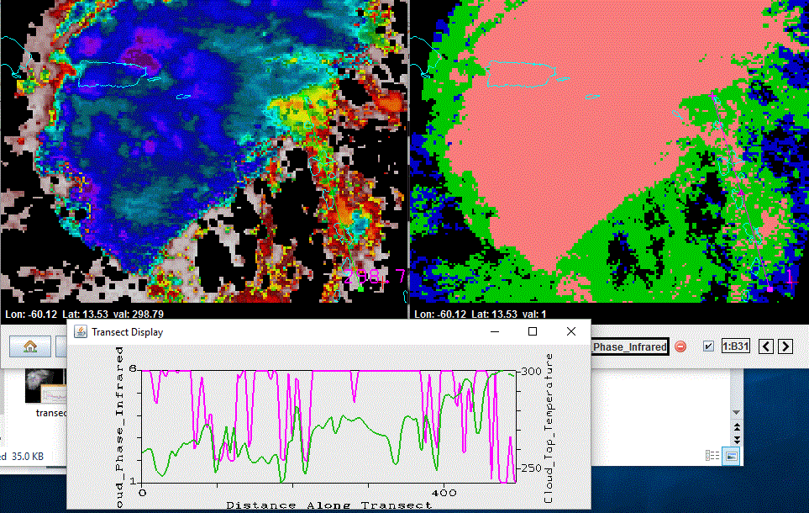
Cloud phase versus
Cloud top temp
Cloud phase (green curve); top temp (red)
Look for icing where cloud phase(values ~ 1)
coincide with below zero temperatures.

Slide 8
Conclusion
Hydra software can be utilized to investigate the structure of tropical cyclones;
The use of high resolution data from DB satellites can depict hazards pertinent to aviation users.

Slide 9
Acknowledgements
Many thanks to organizers: U. Wisconsin, NOAA, CIRA
Fcilitators: Kathy, Liam, Jessica for their patience and willingness to help
Host: Raphael for the good lunch
Co-attendants: for their cooperation and helpfulness
Looking forward for continued collaboration and I will be imparting what I acquired out of workshop onto my research work and teaching at the Caribbean Institute for Meteorology, Barbados.
Thank You
???

