Slide 1
NDVI during wet and dry periods in Puerto Rico
Eric Harmsen
Course: Satellite Direct Broadcast in Support of
Real-Time Environmental Applications
26-29 April 2016

Slide 2
Overview
The Normalized Difference Vegetation Index (NDVI) is and indicator of the presence of green vegetation.
Importance: to assess vegetation health
My project: Comparison of the NDVI over Puerto Rico during during wet (Dec 8, 2014) and dry (May 8, 2015). Severe drought occurred during the dry period.
I found that the NDVI was a relatively good measure of drought conditions, however, other indicators (e.g., the soil moisture saturation and crop stress coefficient) may be better indicators.

Slide 3
Methods
A clear sky image (Dec 8, 2014) and MODIS data files were provided by the instructor.
A second data set was obtained exhibiting drought conditions.
Identify appropriate image using NASA Worldview website.
Download archived MODIS data from Level 1 and Atmosphere Archive and Distribution Service (LAADS).
Evaluate NDVI for the two dates using the following equation
NDVI = (NIR-VIS)/(NIR+VIS)
4. Compare NDVI for both dates
5. Compare drought NDVI image with soil moisture saturation and crop stress coefficient.

Slide 4
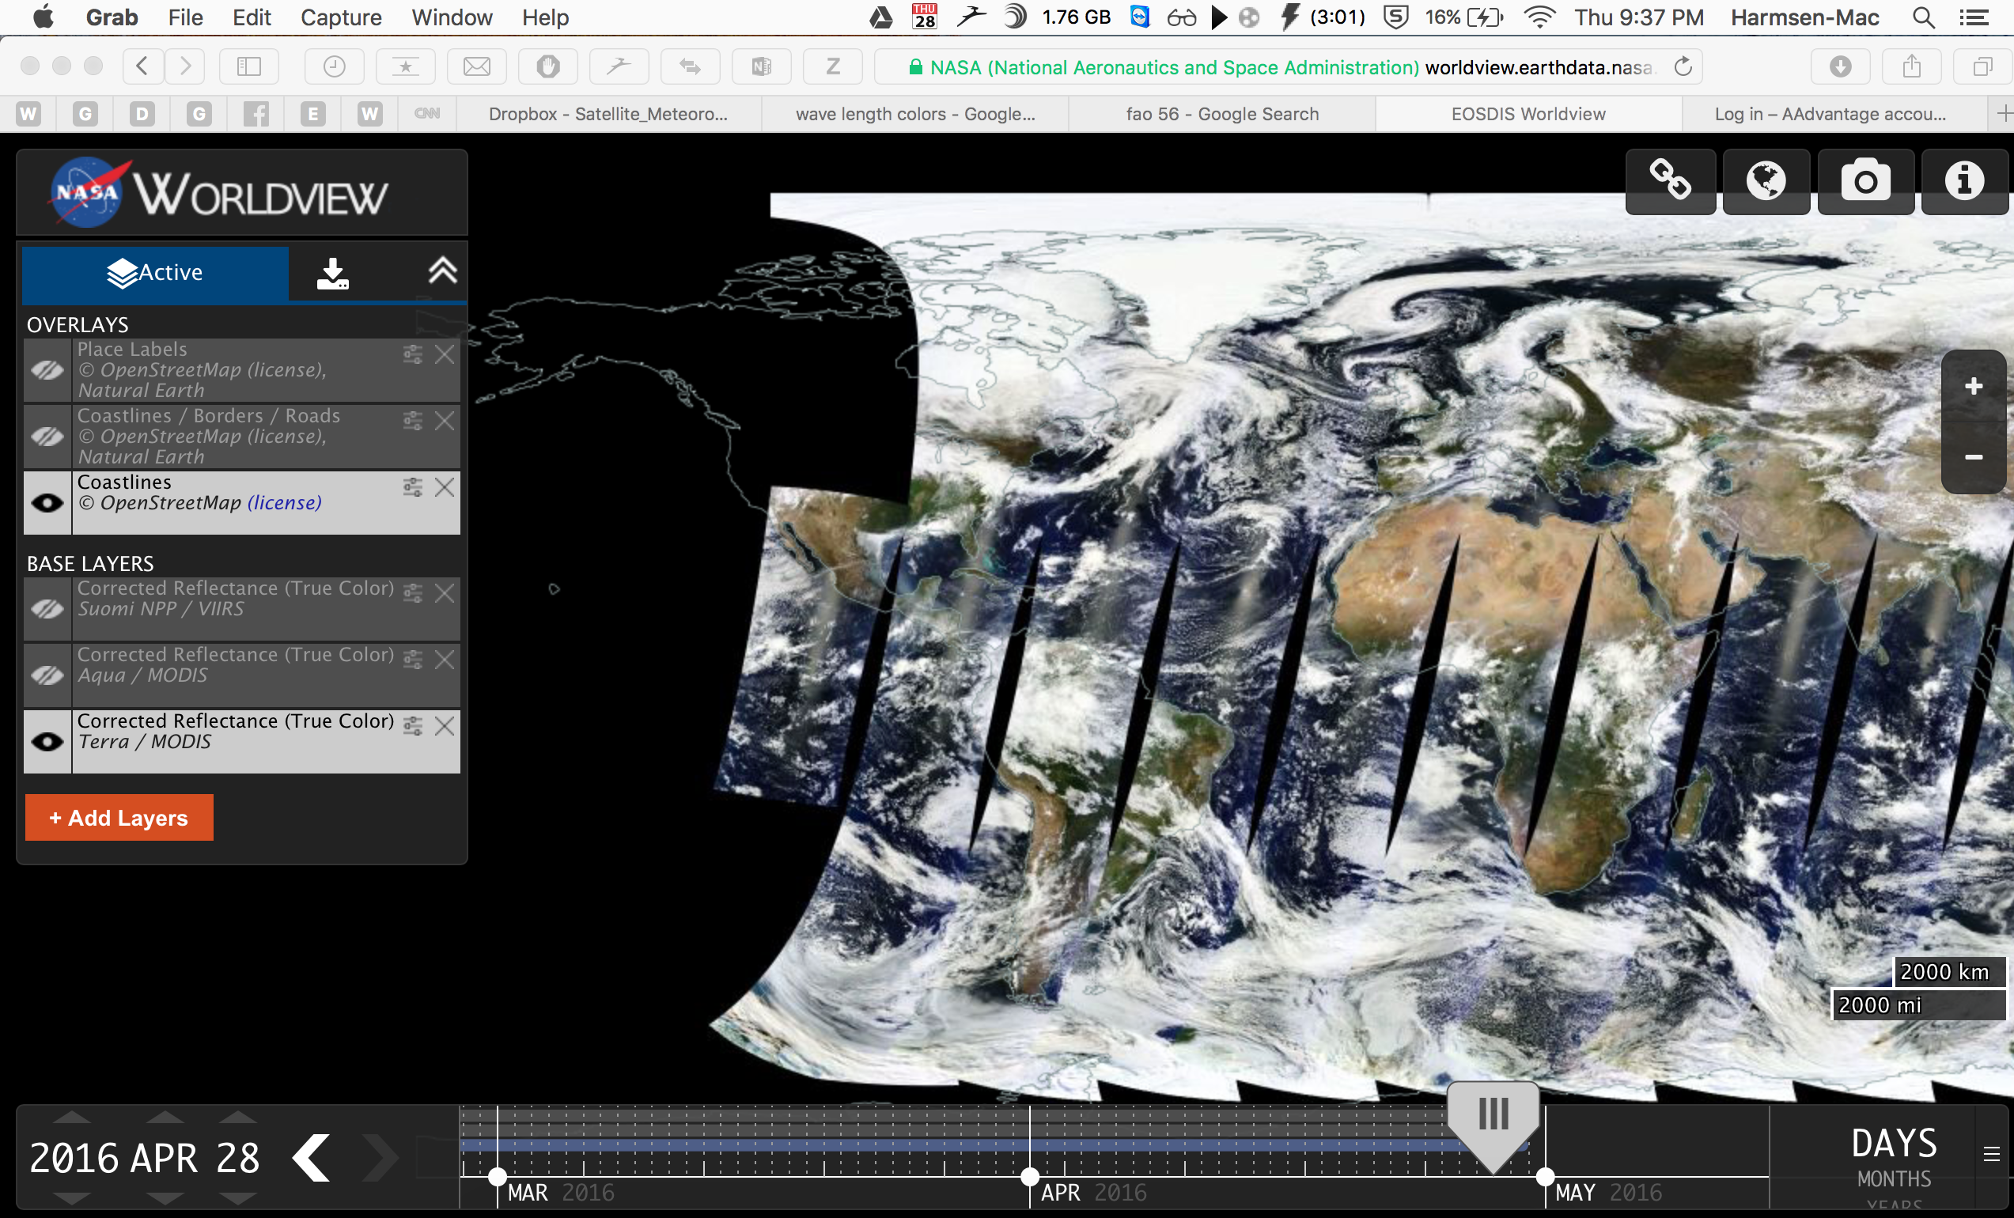

Slide 5
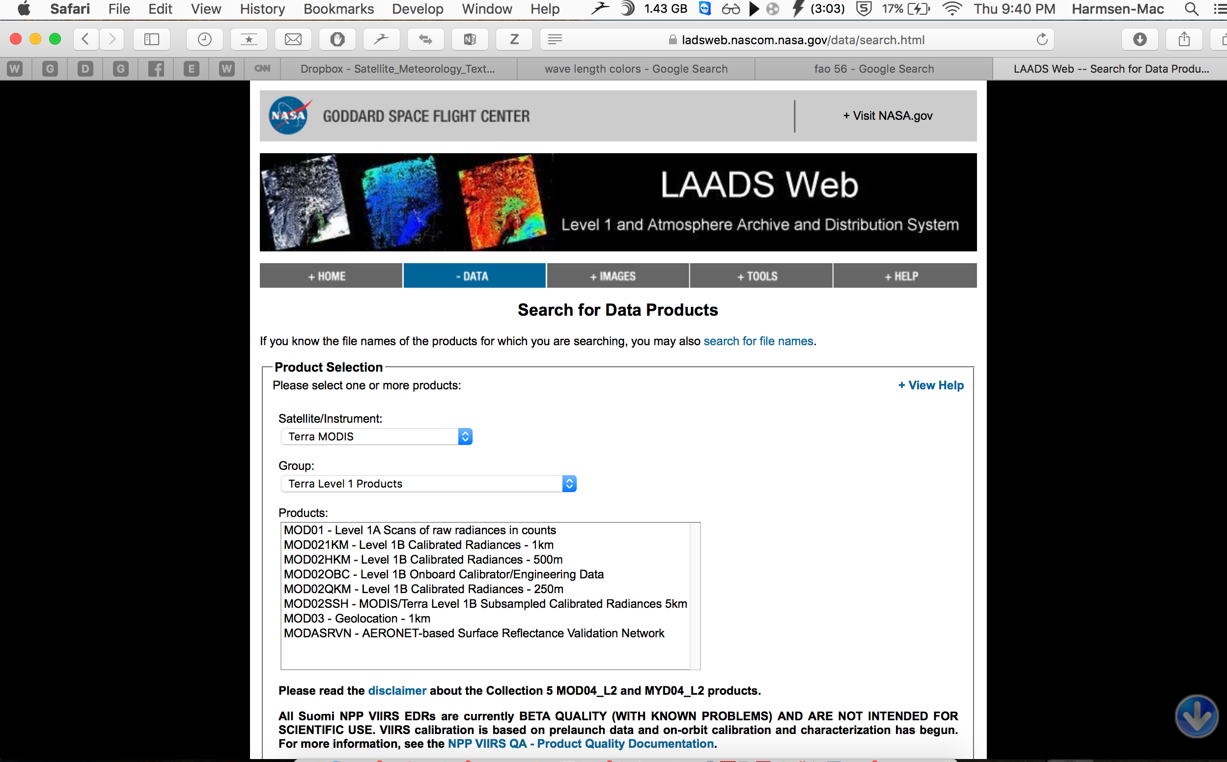

Slide 6
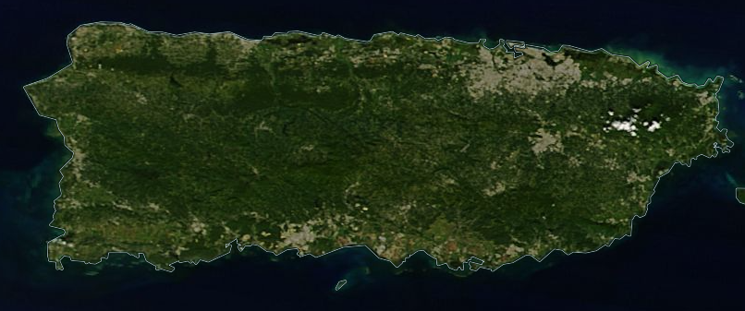
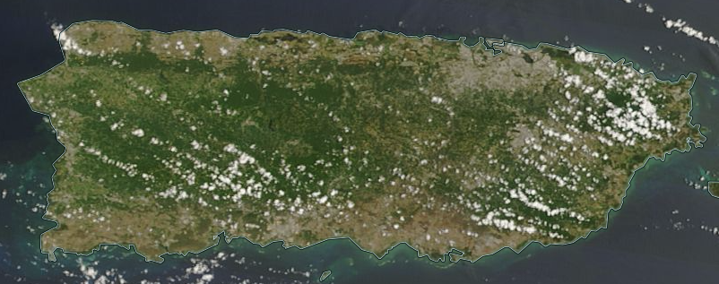
Dec 8, 2014
May 8, 2014

Slide 7
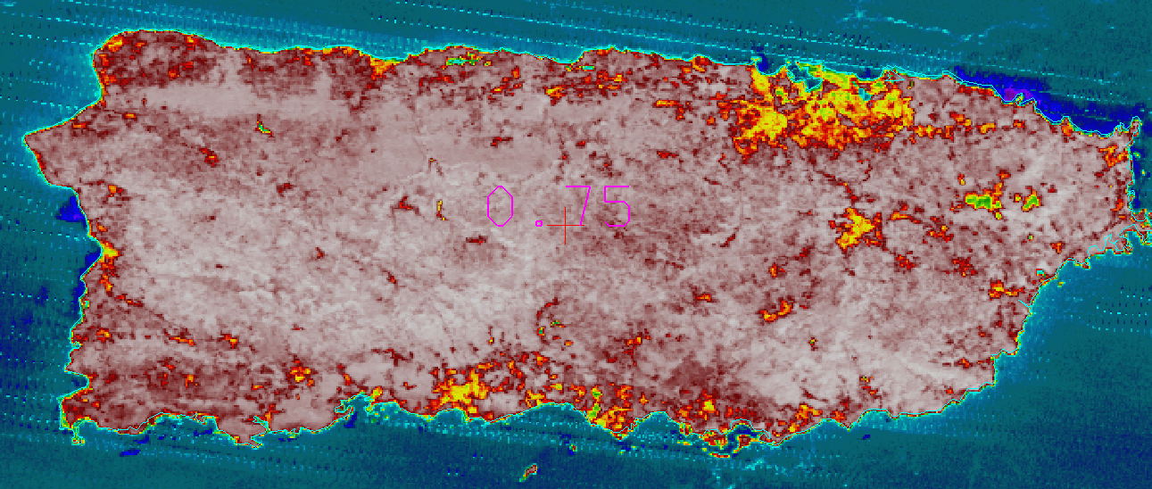
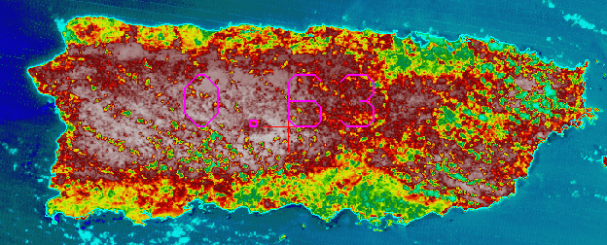

Slide 8
NDVI December 8, 2014
0.08
0.09
0.81
Clouds

Slide 9
NDVI May 8, 2015
0.11
0.23
0.74
0.28

Slide 10
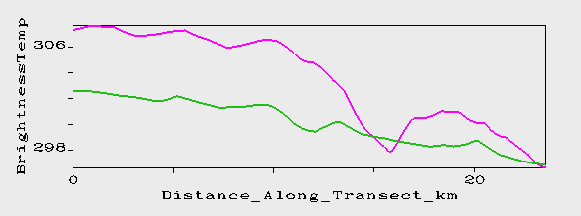
Brightness temperature transect between San Juan
and El Yunque, Puerto Rico

Slide 11
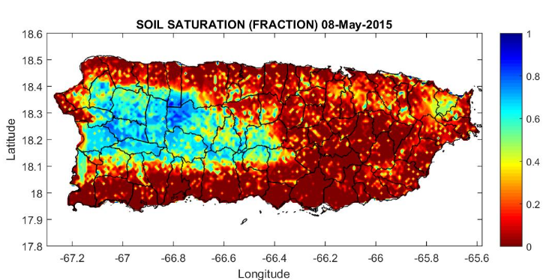
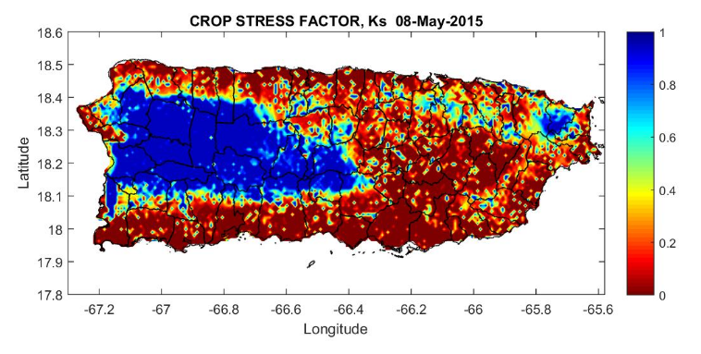

Slide 12
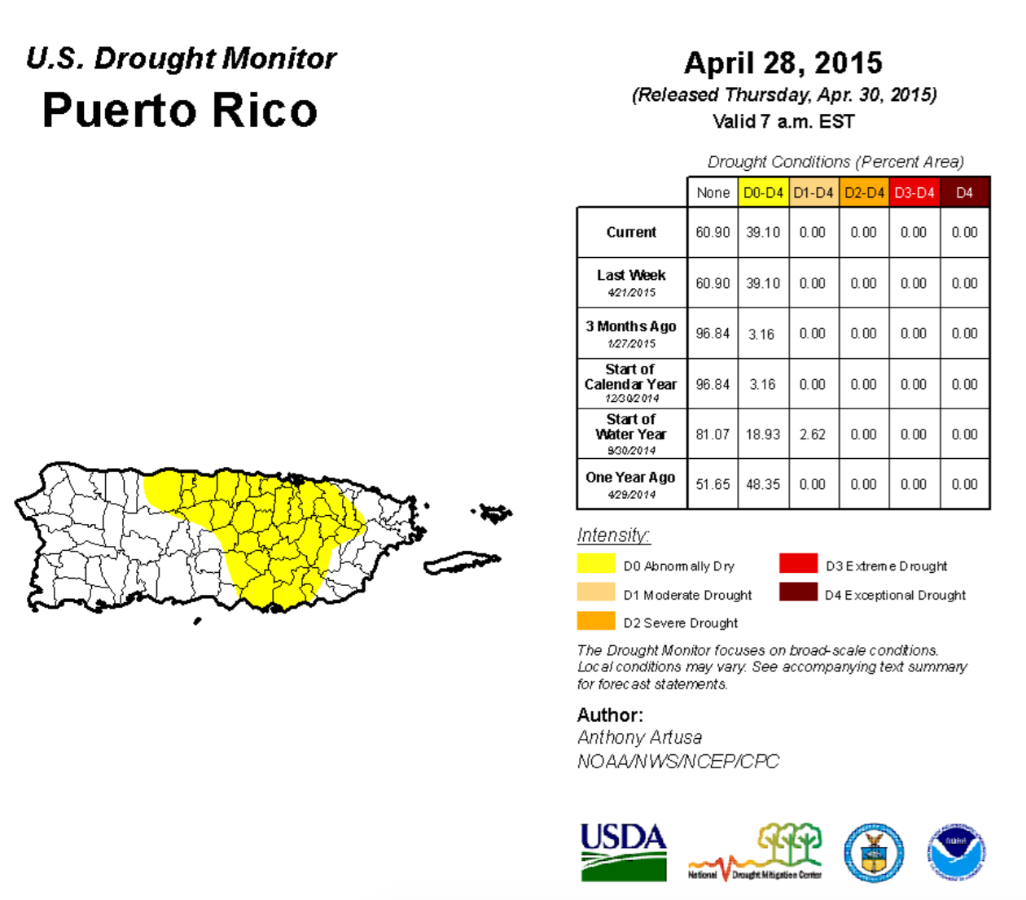

Slide 13
Conclusions
NDVI is a relatively good indicator of Vegetation health
Significant differences were observed between the wet and dry conditions.
Cloud cover can result in erroneous values of the NDVI
Comparison of the NDVI for the drought conditions with soil moisture saturation and crop stress coefficient show that NDVI is less sensitive the potential adverse conditions on the ground.

