Slide 1
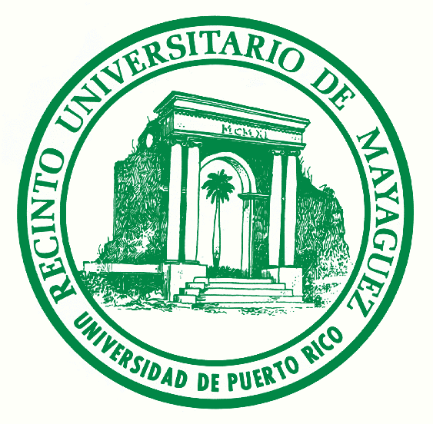
Coastal Upwelling at the Yucatan Peninsula
Fernando Gilbes-Santaella
UPRM-Department of Geology
PR Polar Orbiter Workshop
26-29 April 2016
fernando.gilbes@upr.edu

Slide 2
Overview
The main objective of this project was to detect the coastal upwelling at the Yucatan Peninsula using the Chl and SST products from VIIRS.
The monitoring of related coastal upwelling processes in near-real time is important to evaluate the water quality and biogeochemical processes, which help to develop better coastal management strategies.
This project included the download of SEADAS products files from the UPRM DBPS, examine the files in HYDRA, and compare the products using the available tools.
A very strong upwelling event was detected during April 26, 2016 and described using Chl, SST, and Rrs671.

Slide 3
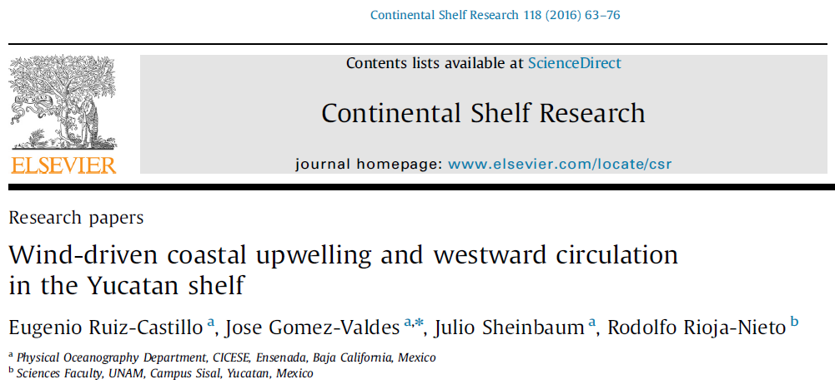
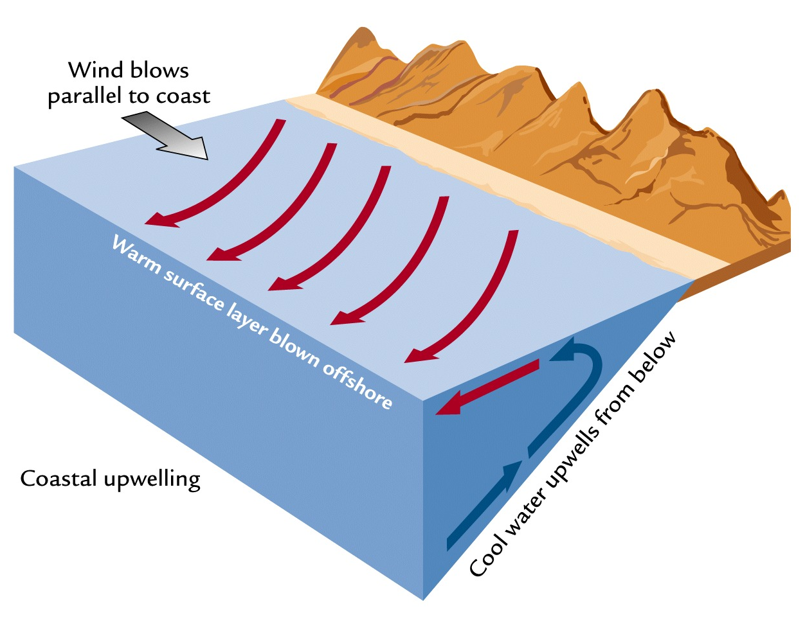
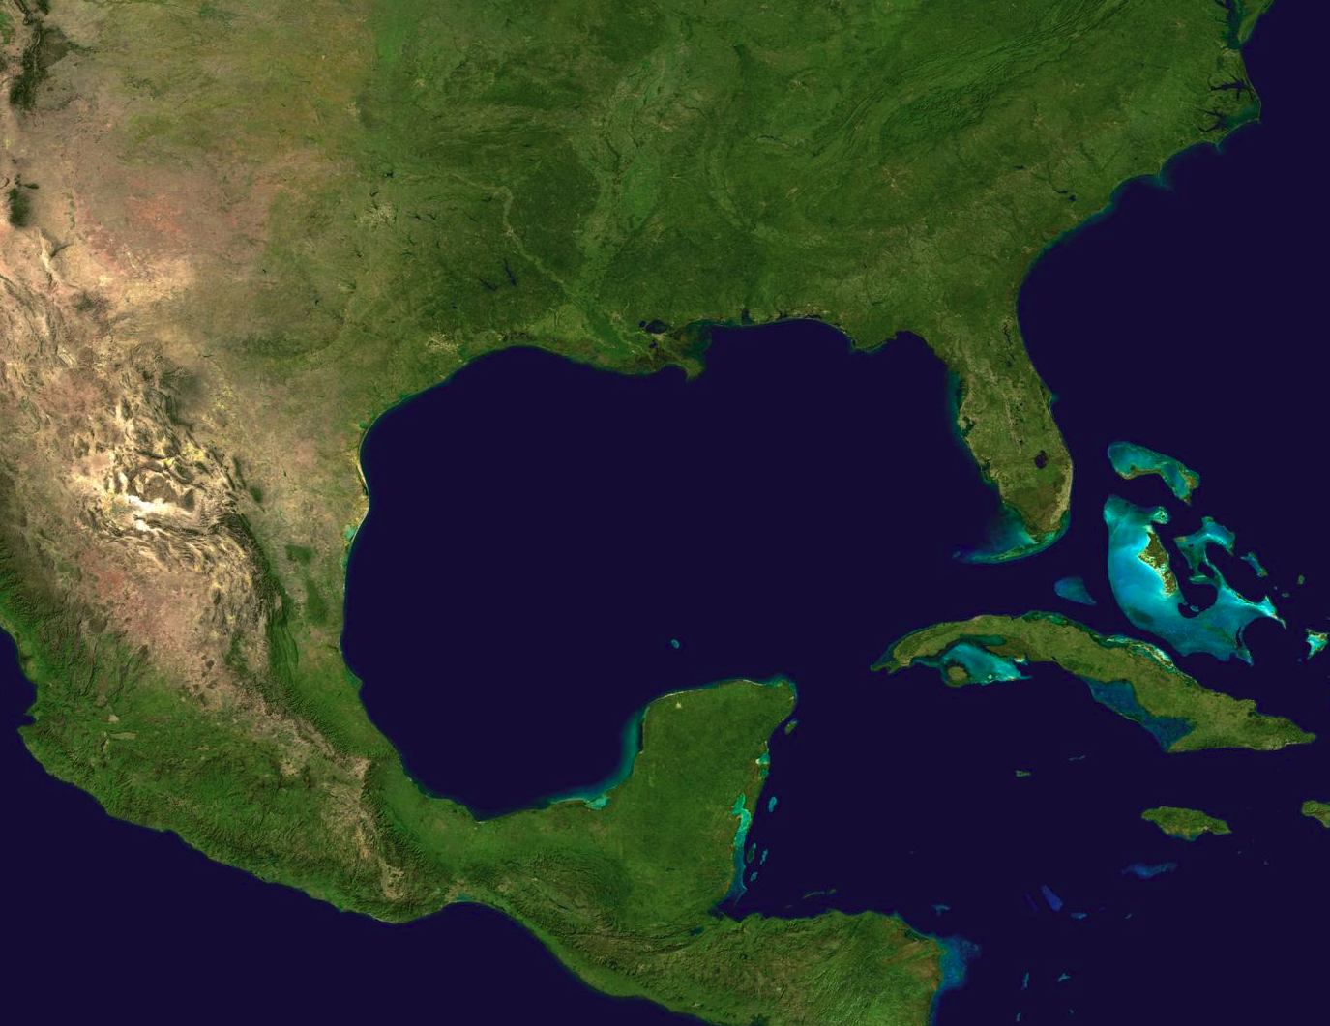
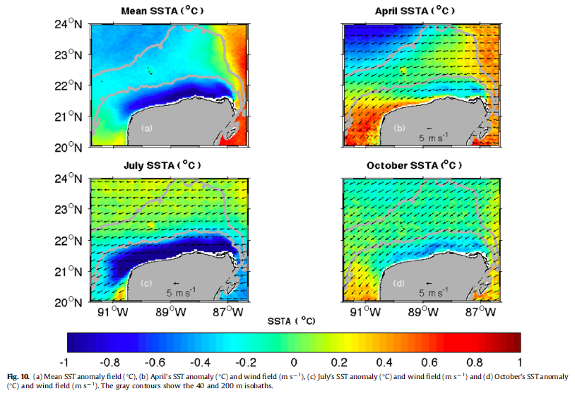
Coastal upwelling
Cold and nutrient rich waters move up

Slide 4
Data and methods
Reviewed the jpegs available at the UPRM DBPS in order to determine which images/days were covering the study area (Yucatan Peninsula) and can be used.
Downloaded the SEADAS products file for April 26 and 23, 2016.
For example: SEADAS_npp_d20160426_t1905177_e1919291.hdf
Files were open in HYDRA and the Chl, SST, and Rrs671 products were display and compared. It was found that the current UPRM DBPS is not generating the SST product. Therefore, an additional processing was required from Liam Gumley for that product.

Slide 5
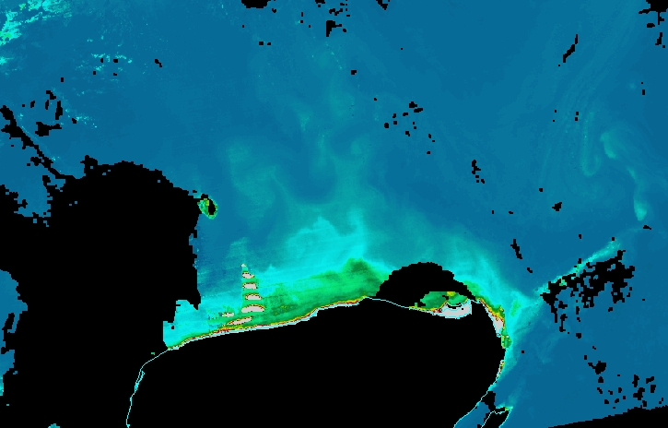
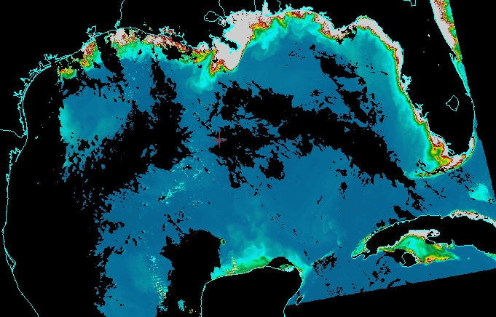
Chl for April 26, 2016

Slide 6
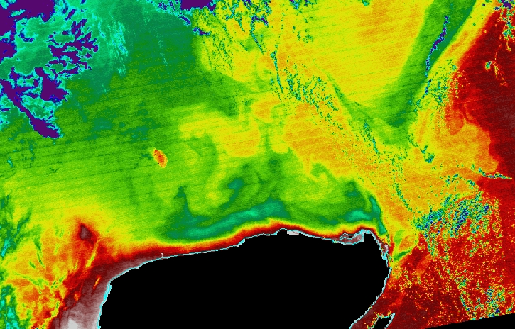
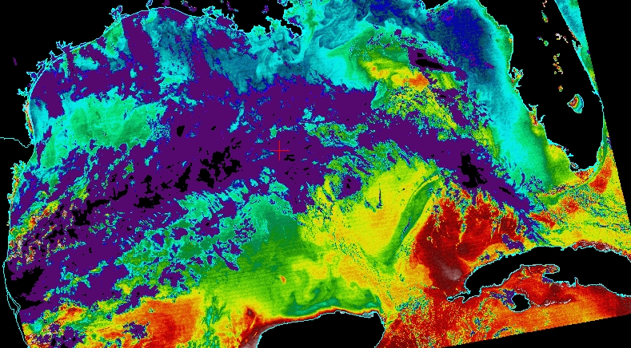
SST for April 26, 2016

Slide 7
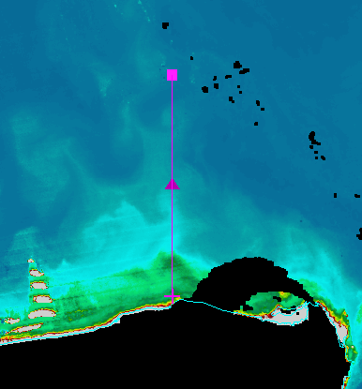
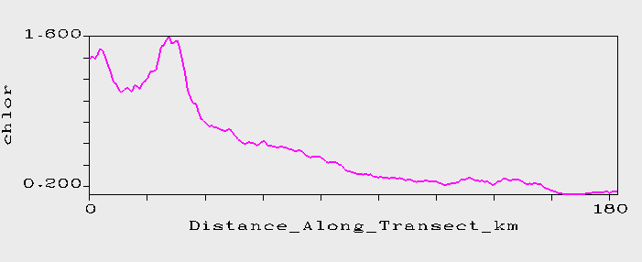
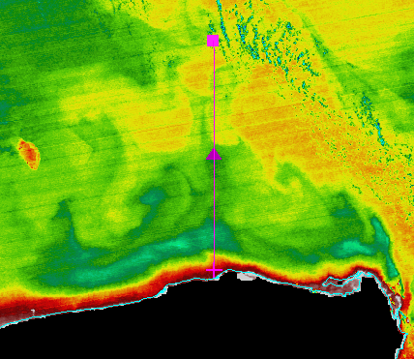
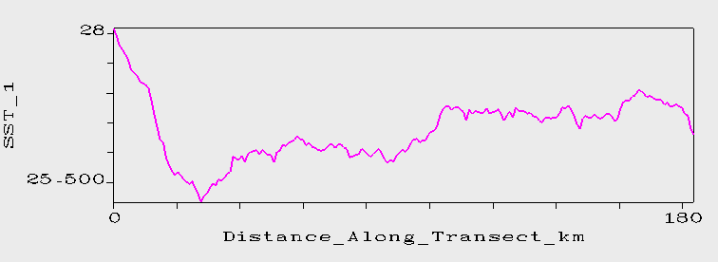
April 26, 2016
Chl
SST

Slide 8
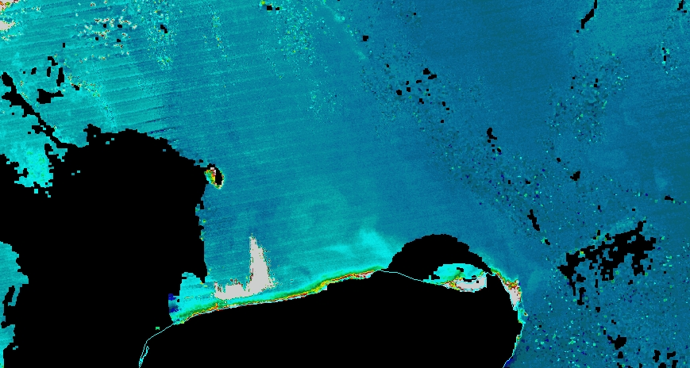
Detection of Inorganic Suspended Particles
April 26, 2016
Chl
Rrs671

Slide 9
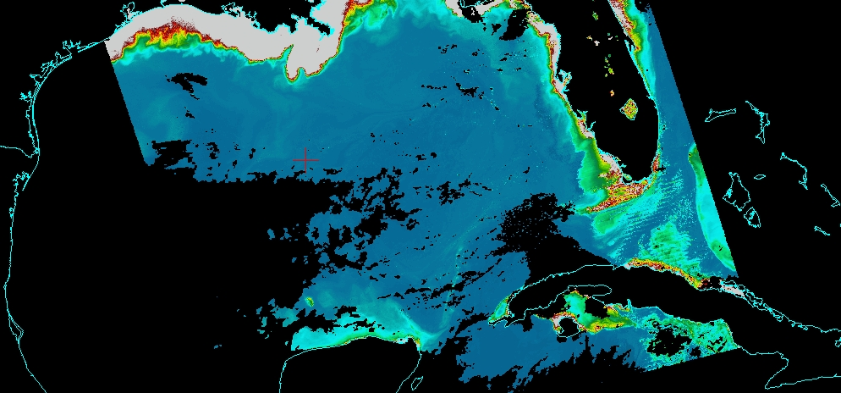
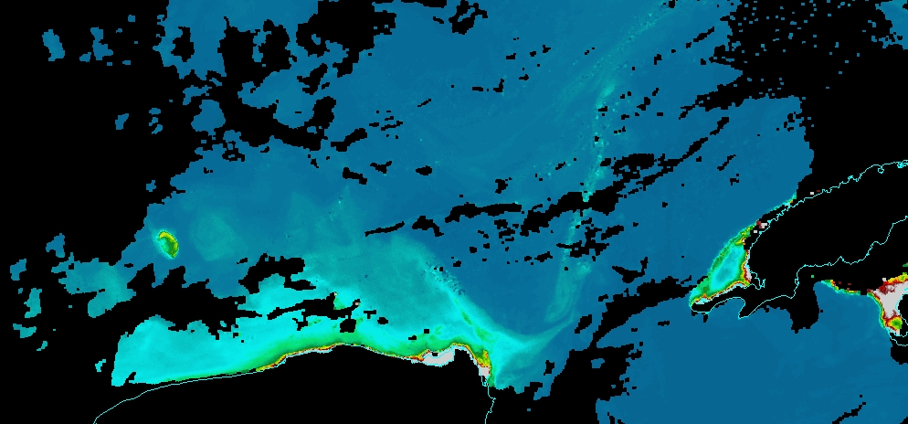
Detection of coastal upwelling during
April 23, 2016

Slide 10
Conclusions
Coastal upwelling at the Yucatan Peninsula was detected with VIIRS ocean products during April 2016.
Chl values were up to 4 times higher in the nutrient-rich upwelling waters that in the offshore waters.
SST was ~2 ºC lower in the upwelling waters than in the offshore warm waters.
UPRM DBPS is not generating the SST product and will be good to add it to the processing routine.
VIIRS capabilities represent a new alternative to study oceanographic processes in our region using ocean color.
New projects will be developed in the Caribbean region using UPRM DBPS products.
Efforts will be made to integrate in our courses the use of the collected images at UPRM.

Slide 11
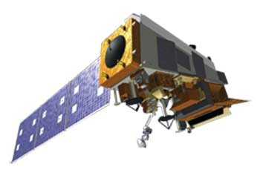
!Muchas gracias! Thank you…
Fernando Gilbes-Santaella
UPRM-Department of Geology
PR Polar Orbiter Workshop
26-29 April 2016
fernando.gilbes@upr.edu

