Slide 1
Superstorm Sandy: Geophysical and Human Activities Impacts
Theo Kioussis & Patrick Fullerton
Hampton Direct Broadcast Workshop
09 June, 2017

Slide 2
Background
What became known as “Superstorm Sandy” formed in the Caribbean on October 22, 2012 as a tropical depression
Struck Eastern Cuba on October 25, 2012 as a Category 3 Hurricane
Struck the Eastern U.S on October 29, 2012 near Atlantic City, New Jersey
Wreaked havoc on much of the U.S’s east coast as well as Caribbean Islands

Slide 3
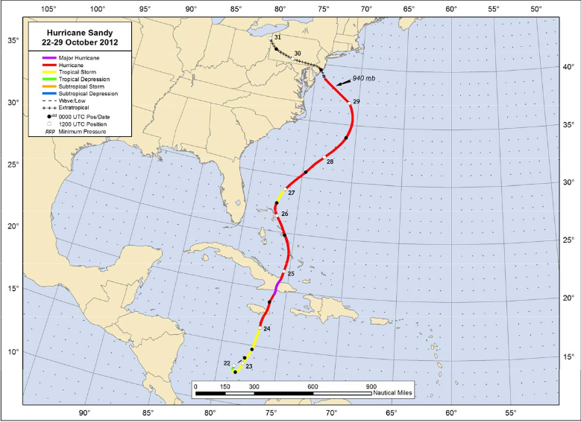

Slide 4
Preliminary Hypotheses:
We will be able to identify a difference in land features before and after the storm as a result of land scarring and flooding wrought by the storm
We will identify effects on human structures/activities
Such things as power outages, instances of boating

Slide 5
Methods:
The VIIRS DNB is useful for assessing the storm’s impact on human activities
MODIS bands 1 & 2 were most useful for viewing surface and land features in assessing for land scarring/flooding

Slide 6
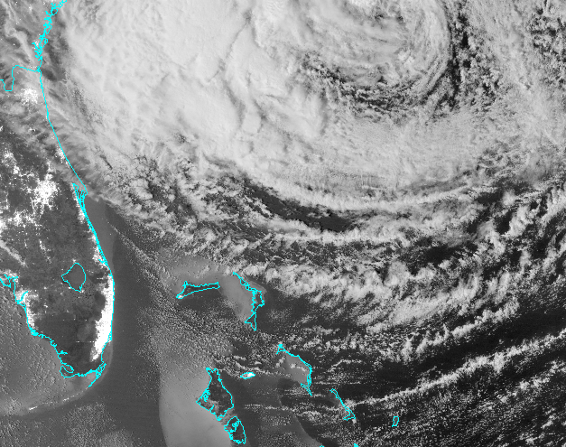
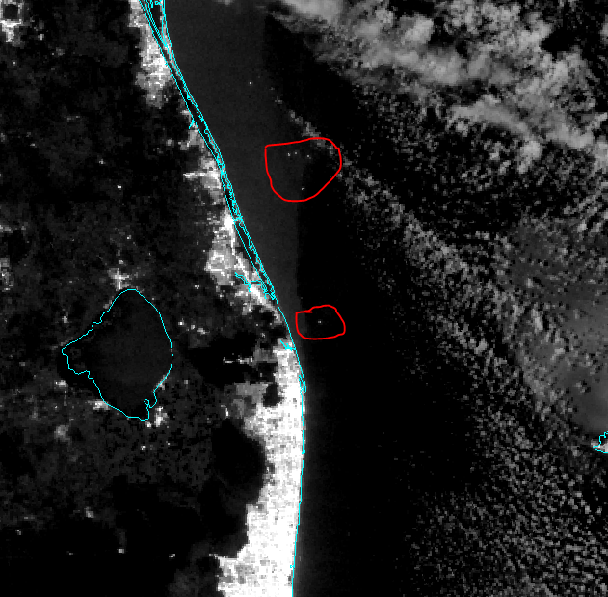
Boats: VIIRS DNB 10/28/12

Slide 7
VIIRS DNB 10/28/12

Slide 8
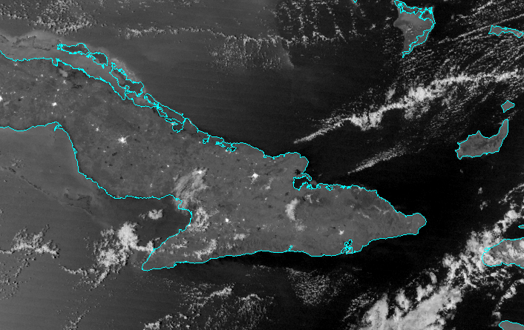
VIIRS DNB image of Cuba 10/28/12

Slide 9
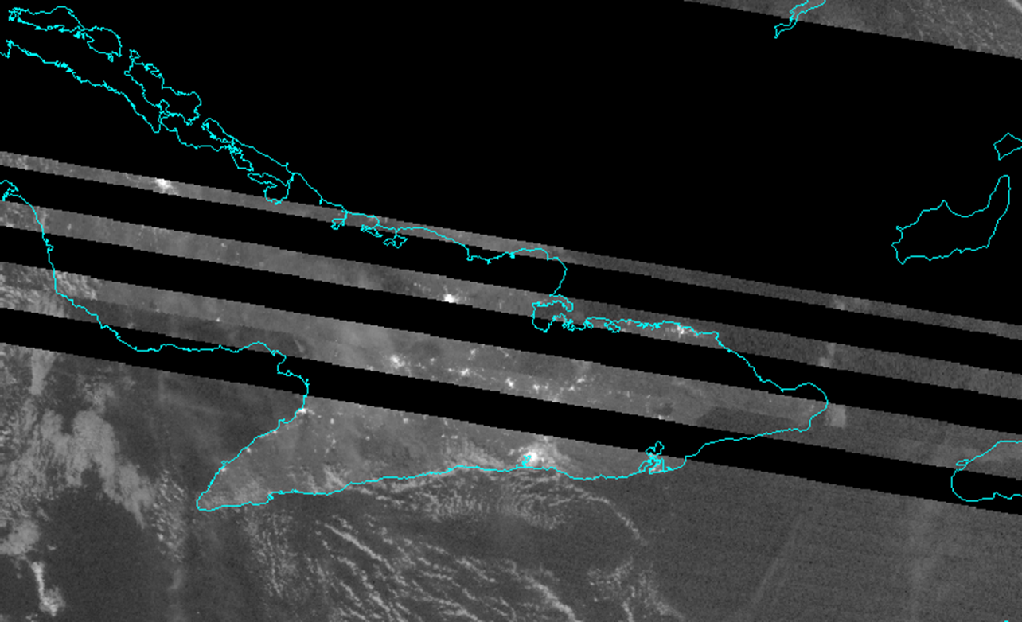
VIIRS DNB Image of Cuba Last Night

Slide 10
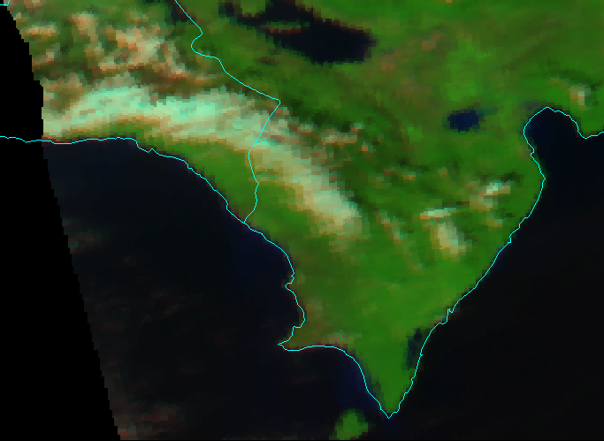
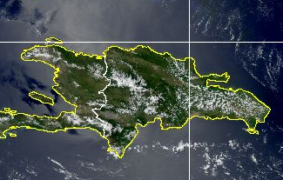
Sandy Aftermath in Haiti/Dominican Republic
Haiti/D.R Yesterday
“This is a disaster of major proportions,” Haitian Prime Minister Laurent Lamothe told the Associated Press. “The whole south is under water.” (Ferreira)

Slide 11
Conclusions:
One cannot always access the data that one wants to
The data that is available isn’t always perfect
We were, however, able to identify some of the features that we sought, demonstrating that the available data is quite useful

Slide 12
Where to go from Here:
Cross-referencing data
Archived data: something more than we have access to?
We would prefer a before and after approach, as was the initial intention

Slide 13
Consulted Works:
https://www.livescience.com/40774-hurricane-sandy-s-impact-infographic.html
https://www.weather.gov/images/okx/Sandy/Track_NHCreport.png
https://www.livescience.com/24380-hurricane-sandy-status-data.html
http://world.time.com/2012/10/29/in-haiti-hurricane-sandy-leaves-behind-death-and-devastation/

