Slide 1



Guam NWS Polar Orbiter Direct Broadcast Applications Workshop
Introduction
Kathleen Strabala
University of Wisconsin-Madison
Cooperative Institute for Meteorological Satellites Studies (CIMSS)
Space Science and Engineering Center (SSEC)
16 and 19 April 2018

Slide 2
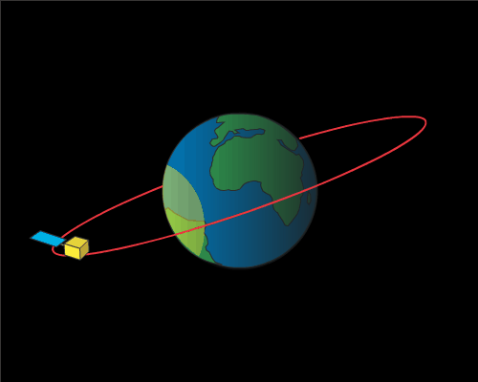

Geostationary Satellite Orbit

Slide 3
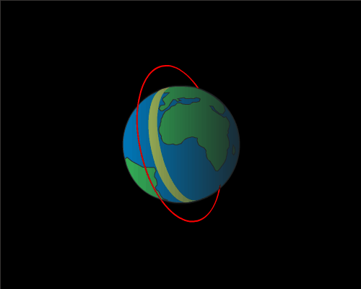

Polar Satellite Orbit - Low Earth Orbit (LEO)

Slide 4
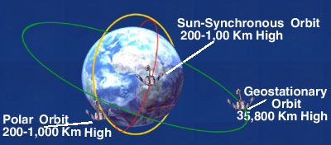
Polar Versus Geostationary Orbit
A Sun-synchronous orbit is one where the satellite passes over any given point of the planet's surface at the same local solar time.

Slide 5
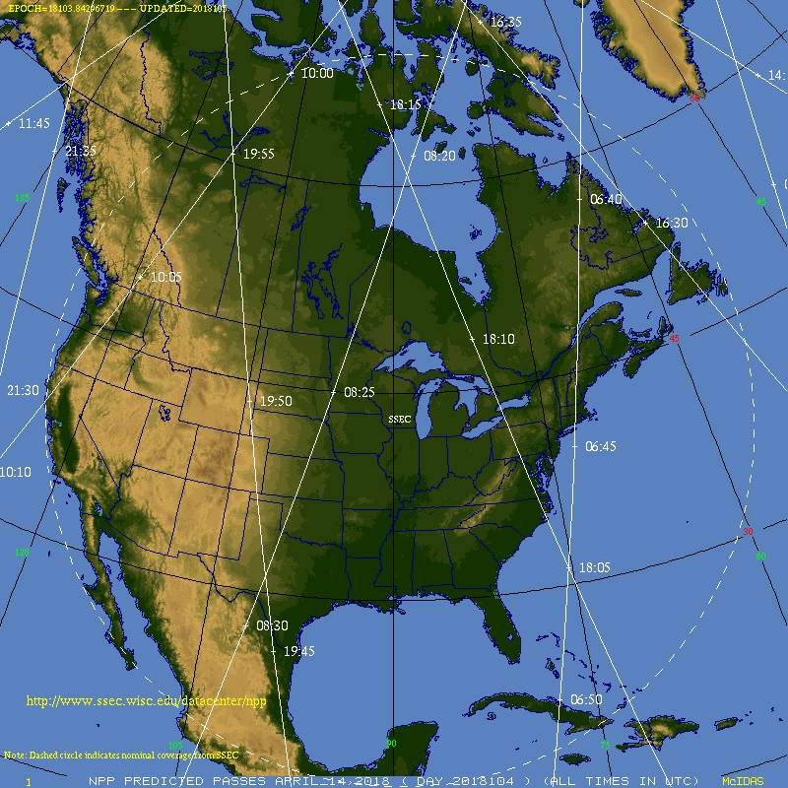

Slide 6
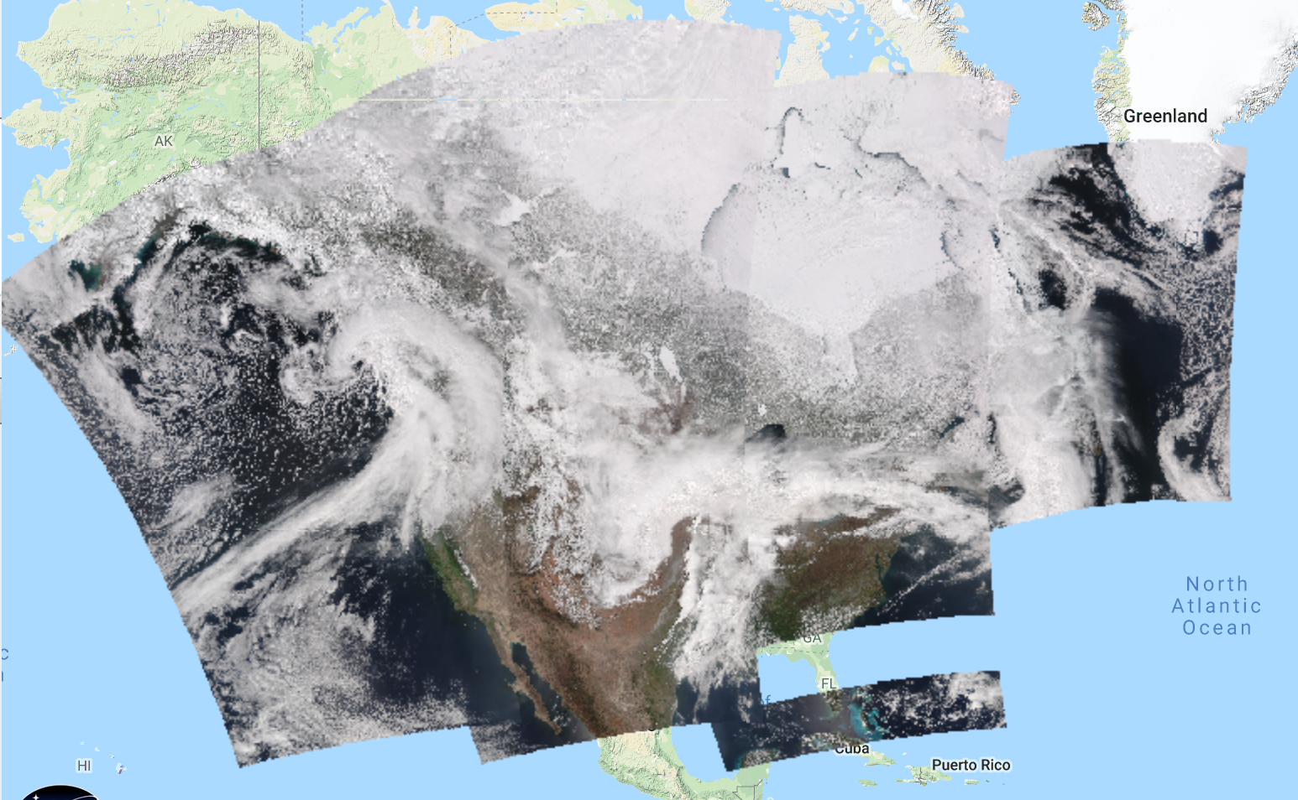
Daytime Passes Observed at UW-Madison Antenna Facility on 14 April 2018

Slide 7
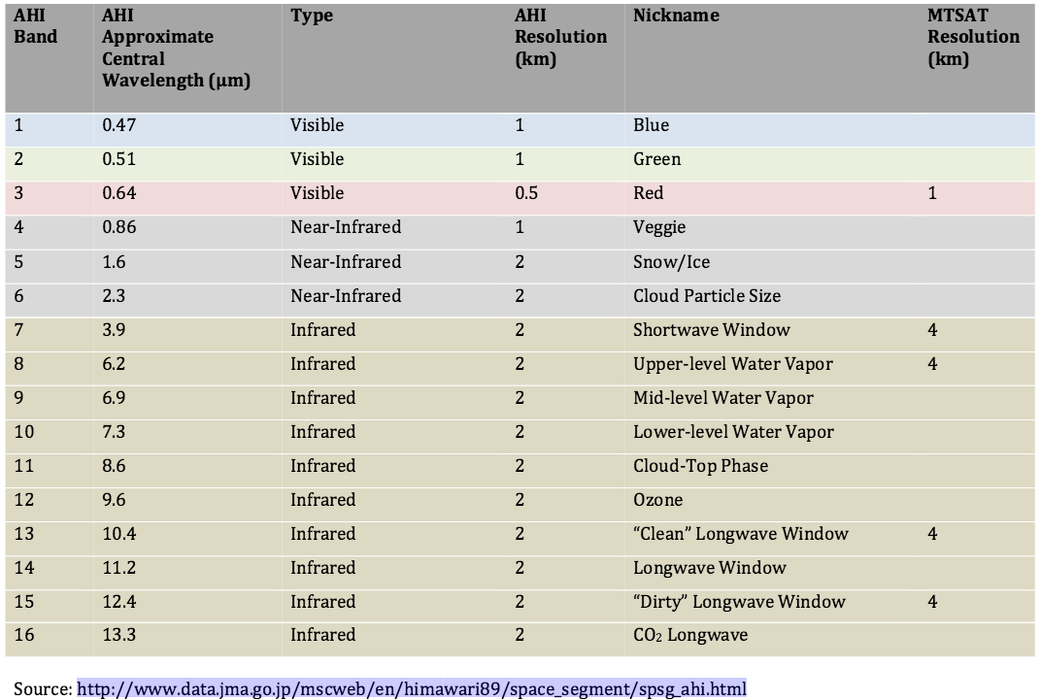
Advanced Himawari Imager Spectral Bands

Slide 8
LEO verses GEO Satellite Instruments
GEO
LEO
High Spatial Resolution
Moderate Spectral Resolution
Well Calibrated
High Temporal Coverage
Hemispheric Observations
No Microwave
Most no IR sounders
Higher Spatial Resolution
Moderate Spectral Resolution with Some Unique Bands
Very Well Calibrated
Low Temporal Coverage
Global Observations
Microwave Sounders
Hyperspectral IR Sounders

Slide 9
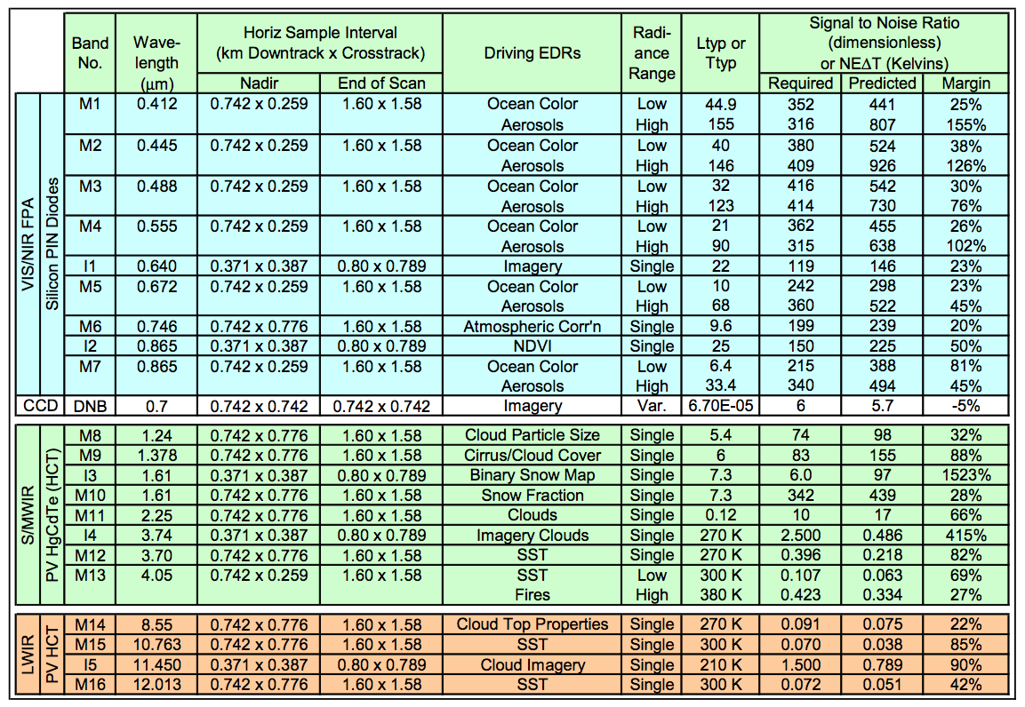
VIIRS Instrument Characteristics

Slide 10
MODIS Instrument Characteristics

Slide 11
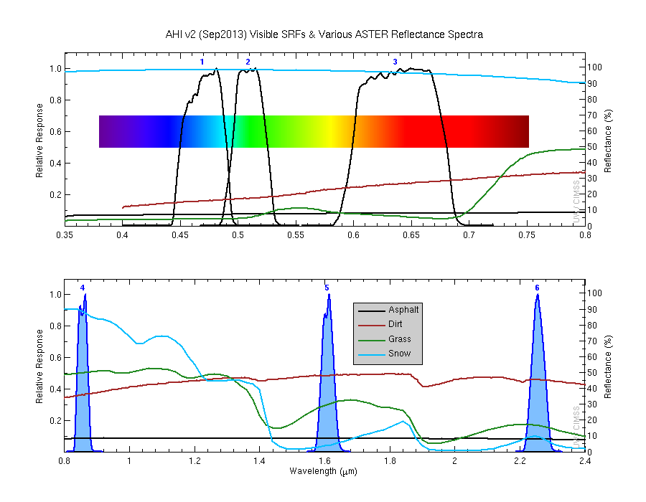
Visible and Near-IR bands on the AHI ….

Slide 12
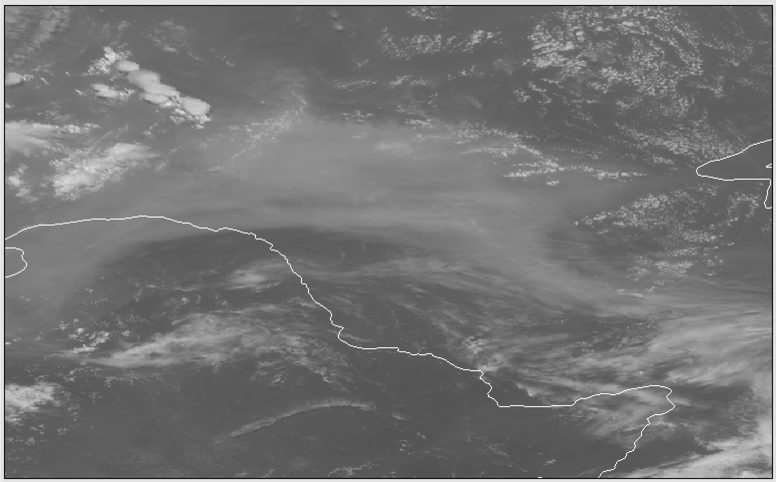
ABI/AHI Band 1 (0.47 μm)
Example from the Advanced Himawari Imager
Kuchinoerabu-jima
Smoke over Siberia

Slide 13
Visible and Near-IR bands on the AHI ….

Slide 14
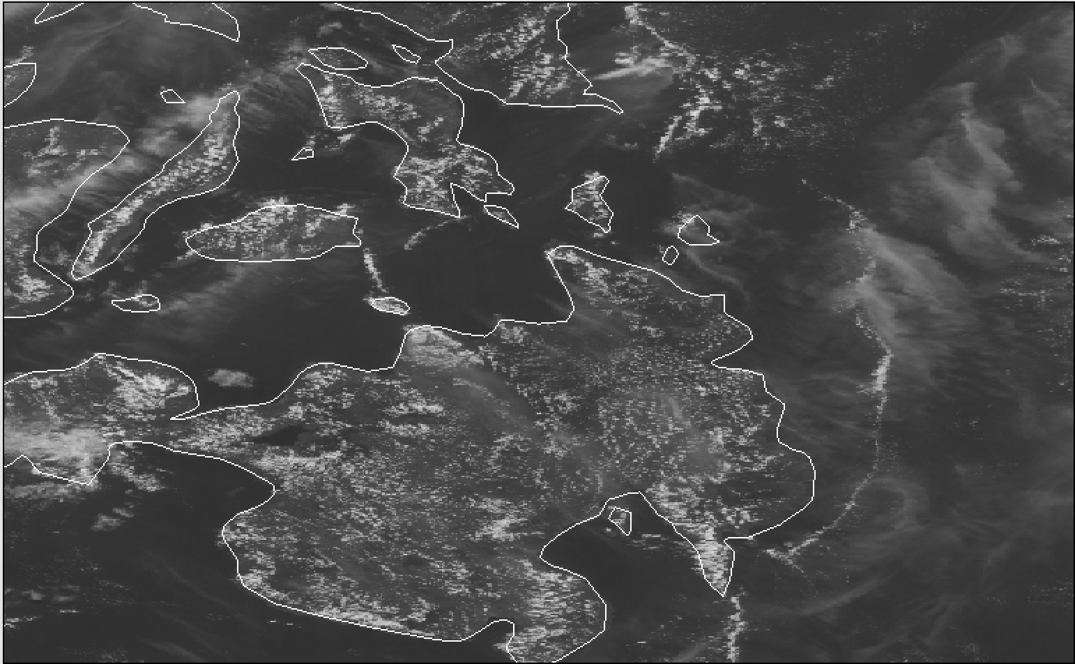
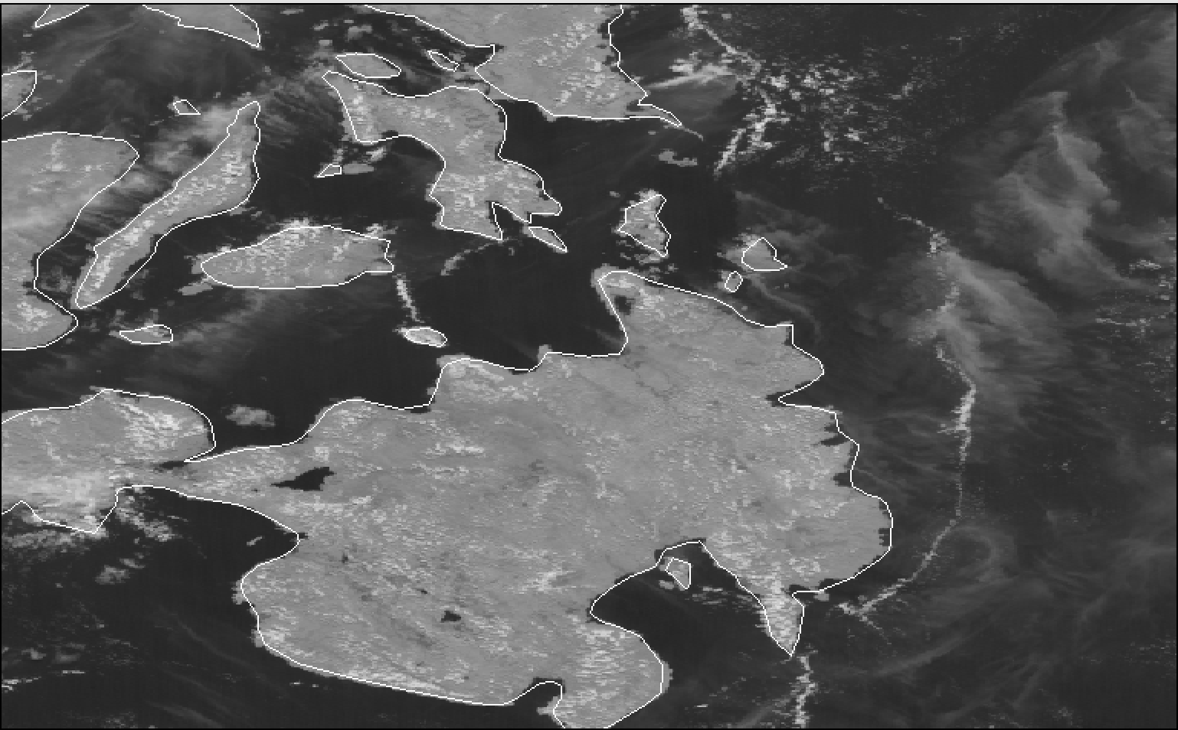
AHI Band 3 Versus Band 4
AHI Band 3 (.64 μm)
AHI Band 4 (.86 μm)
Philippine Island of Mindanao

Slide 15
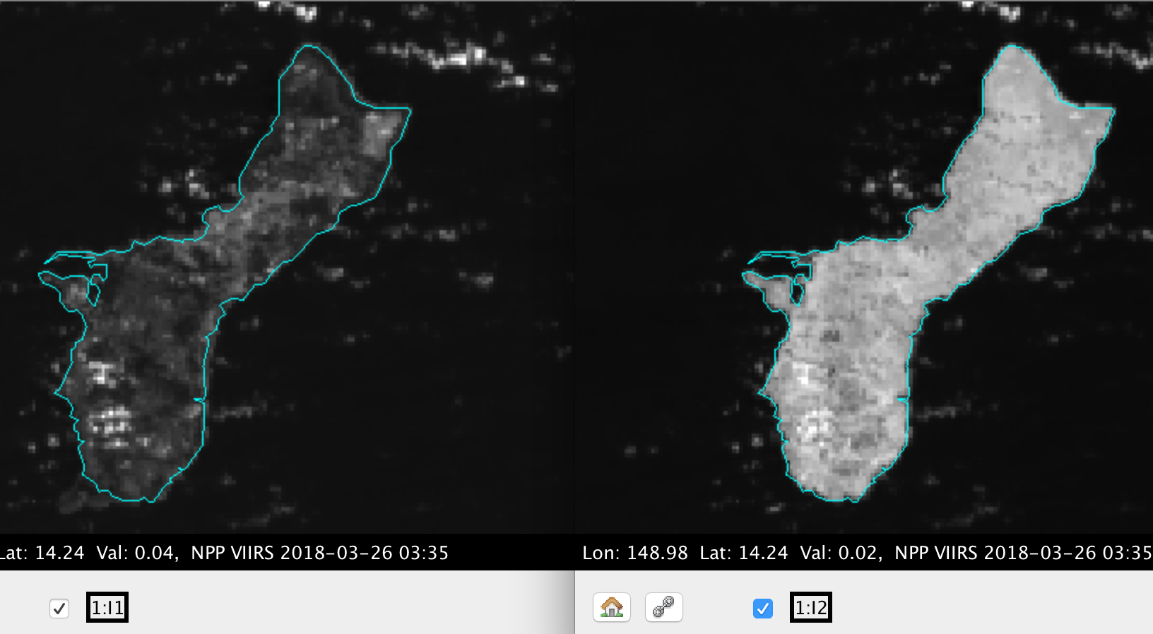
VIIRS I-Band 1 versus 2
VIIRS I-Band 1 (.64 μm)
VIIRS I-Band 2 (.86 μm)

Slide 16
Visible and Near-IR bands on the AHI ….

Slide 17
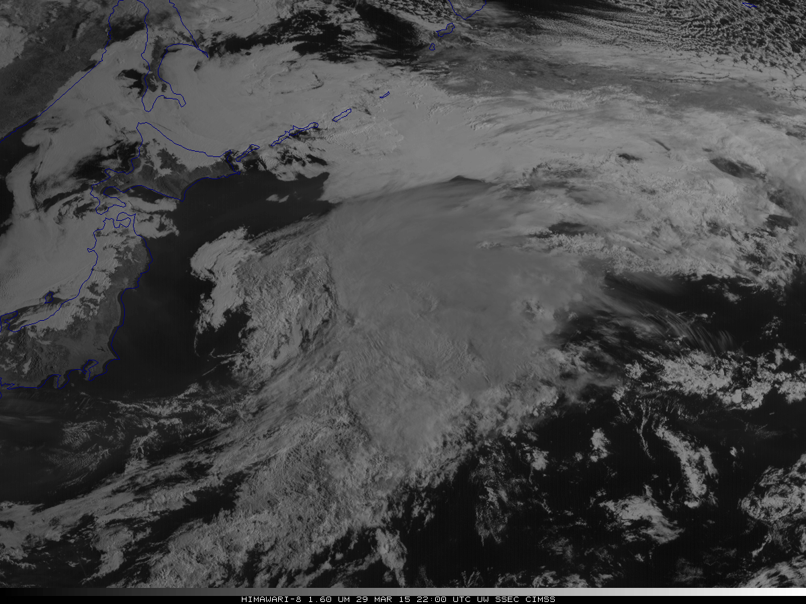
ABI/AHI Band 5 (1.6 μm)
Example from the Advanced Himawari Imager
Water clouds
Ice clouds

Slide 18
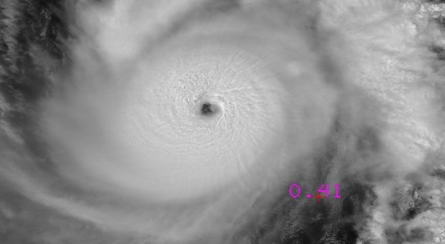
Super Typhoon Jelawat
VIIRS I-Band 1 (.64 μm) 375m
Reflectances
30 March 2018 – 0401 UTC

Slide 19
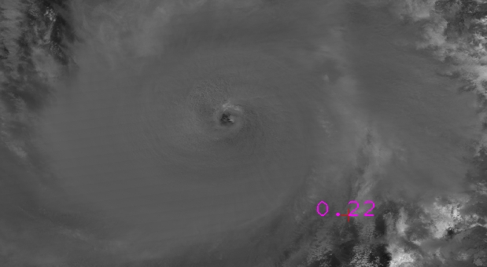
Super Typhoon Jelawat
VIIRS I-Band 3 (1.6 μm) 375m
Reflectances
30 March 2018 – 0401 UTC

Slide 20
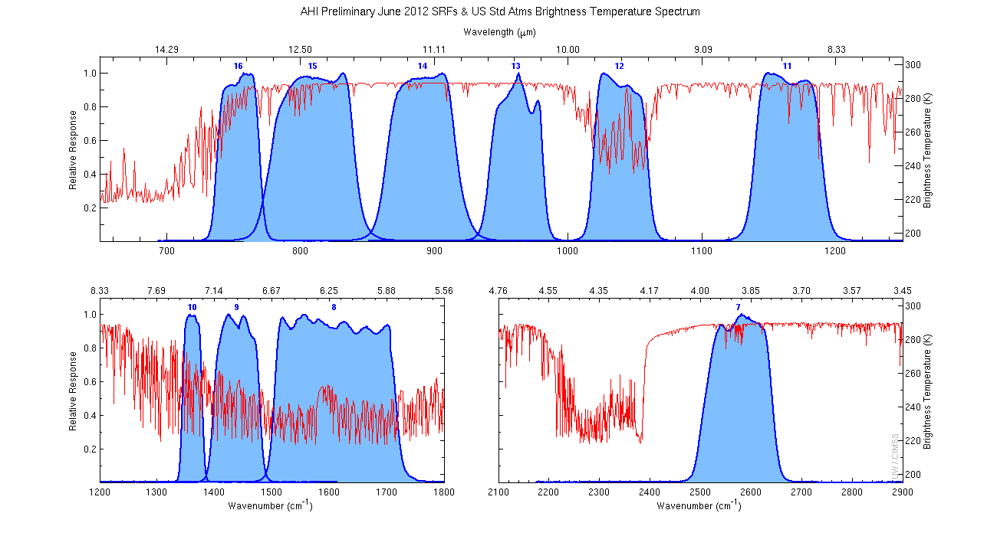
The IR channels on the AHI
Clouds, Stability Indices
Cloud Phase, SO2, dust
Fires, Radiances
Ozone, Downward Radiation
Rainfall, Aerosol
Hurricane, Imagery
Sample use only, many other uses
SO2, Radiances
Winds, WV profiling
TPW, Rainfall rate
Fires, Fog
AHI has many more bands than the MTSAT imagers.
Notes:
Schmit, T. J., M. M. Gunshor, W. P. Menzel, J. J. Gurka, J. Li, and A. S. Bachmeier, 2005: Introducing the next-generation Advanced Baseline Imager on GOES-R. Bull. Amer. Meteor. Soc., 86, 1079-1096.

Slide 21
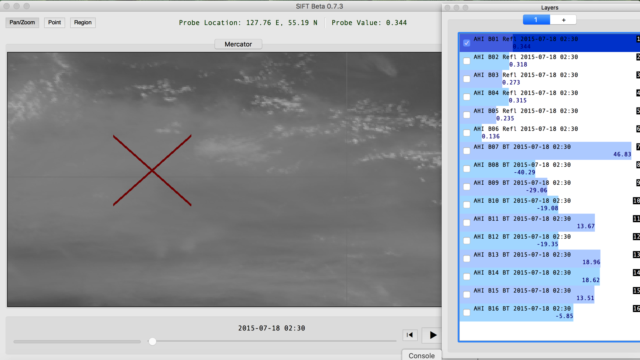
AHI Band 1 (.47 micron)

Slide 22
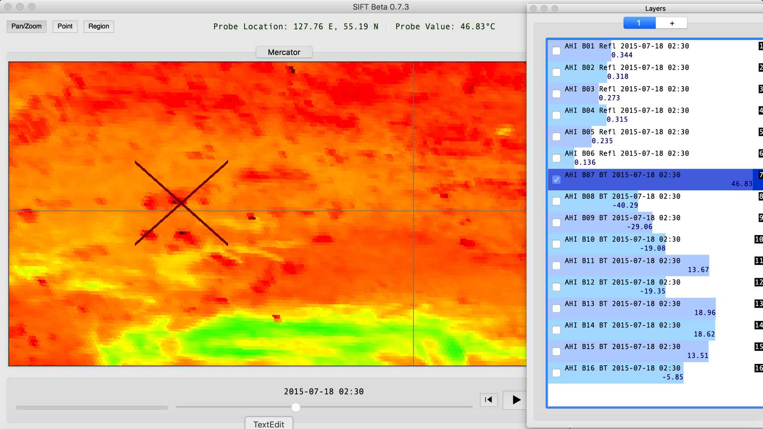
AHI Band 7 (3.9 micron)

Slide 23
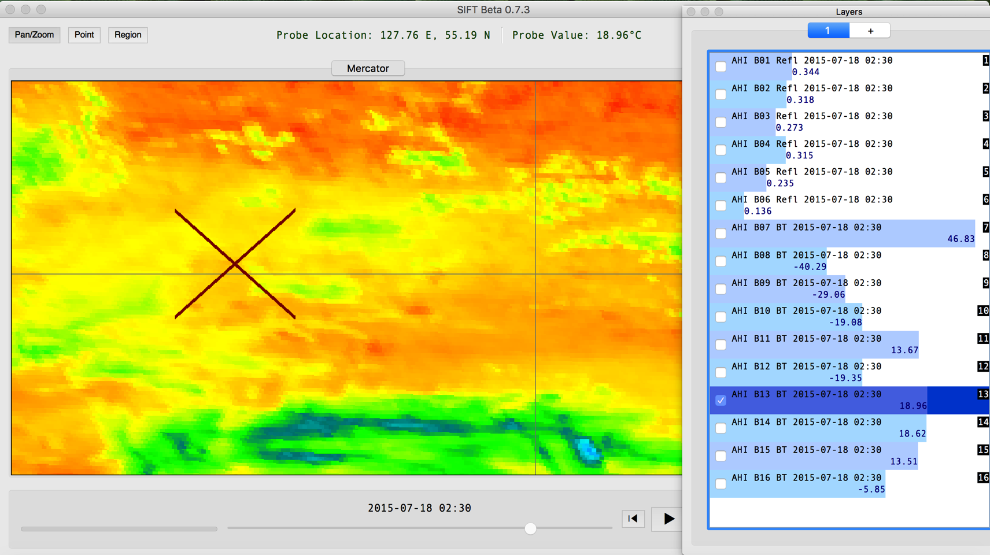
AHI Band 13 (10.4 micron)

Slide 24
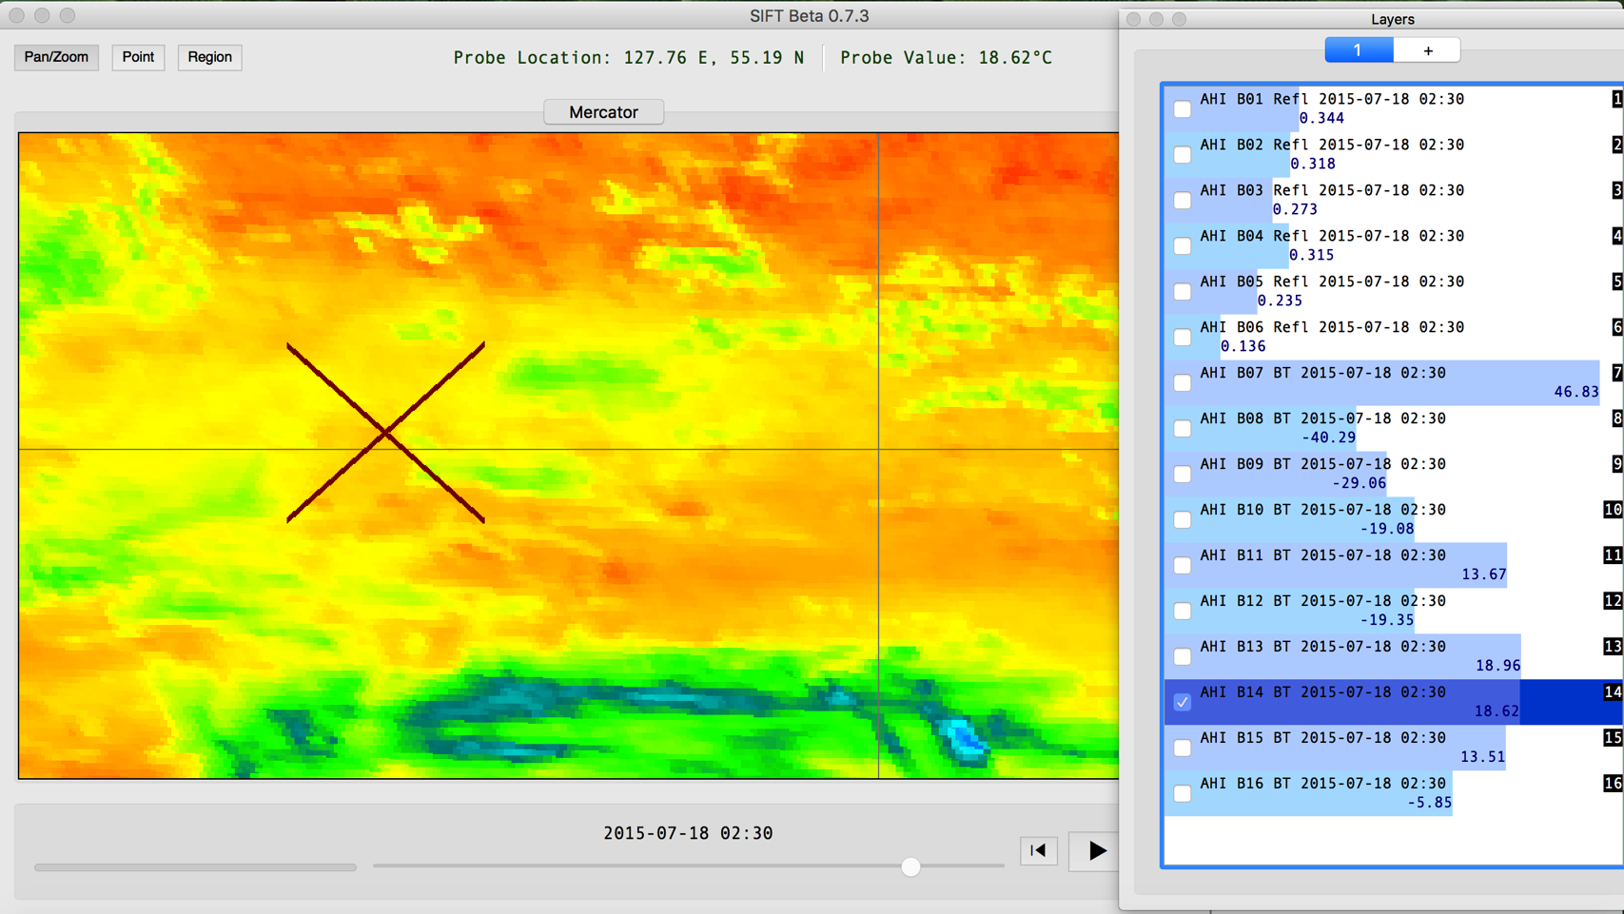
AHI Band 14 (11.2 micron)

Slide 25
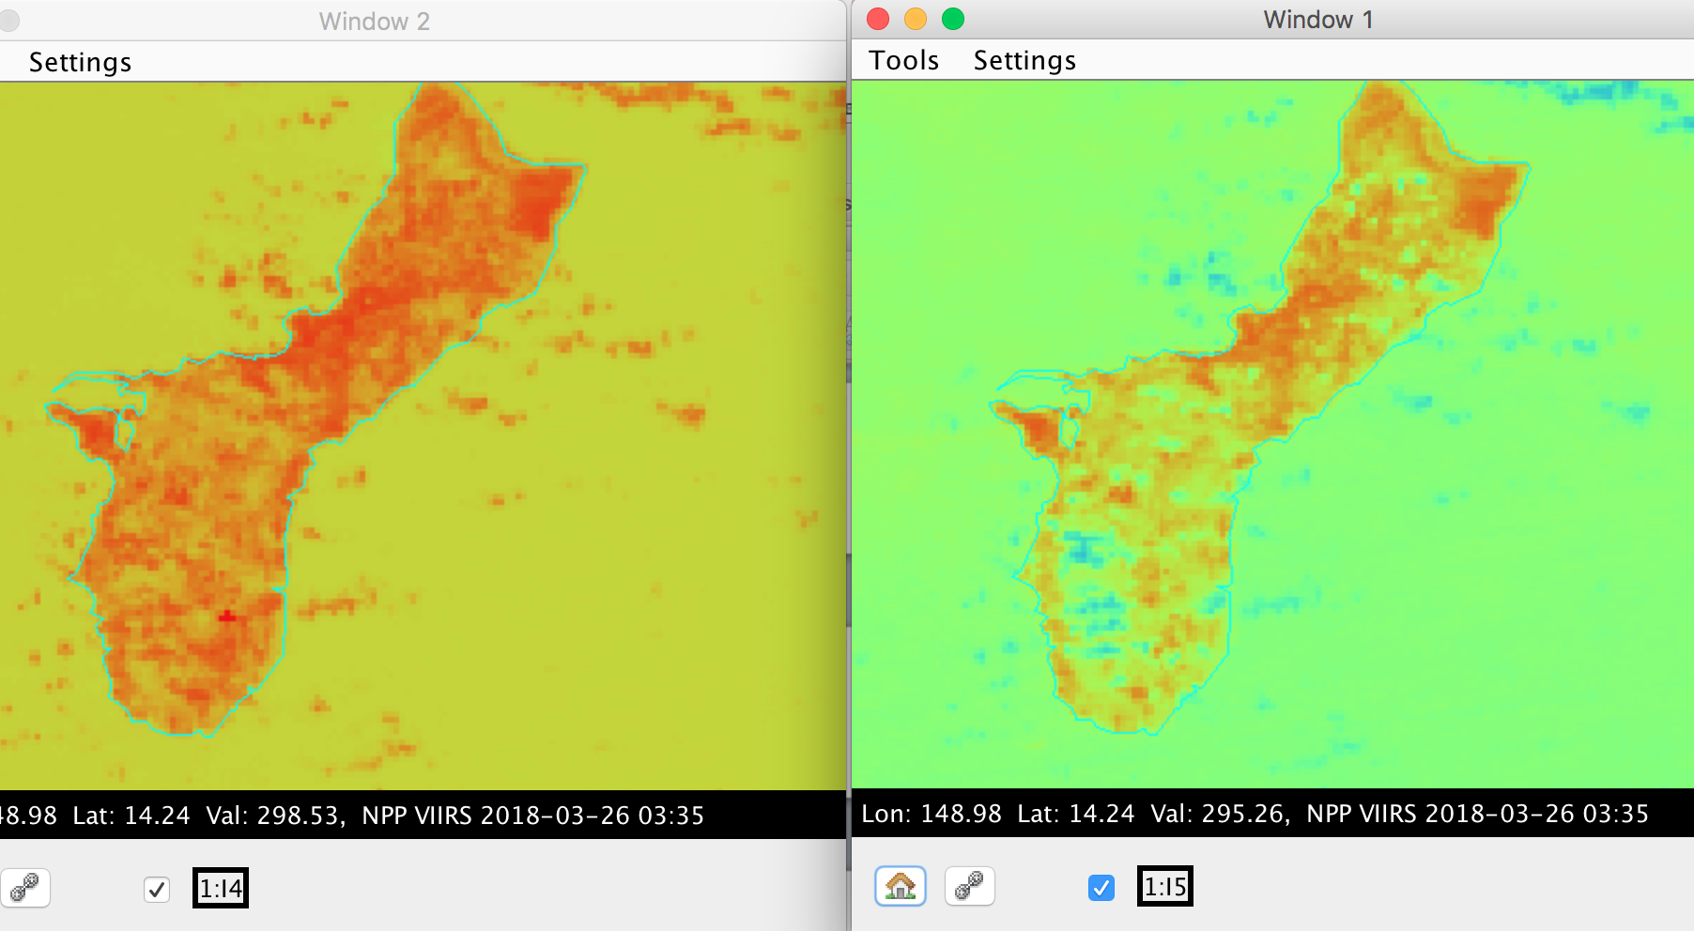
VIIRS I-Band 4 versus 5 (375m)
VIIRS I-Band 4 (3.74 μm)
VIIRS I-Band 5 (11.45 μm)

Slide 26
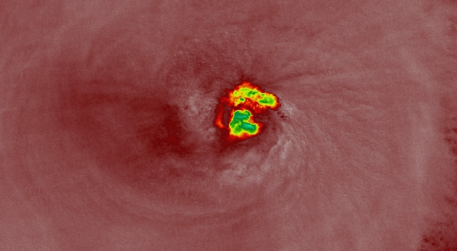
Super Typhoon Jelawat
VIIRS I-Band 4 (3.74 μm) 375m
Brightness Temperatures
30 March 2018 – 0401 UTC

Slide 27
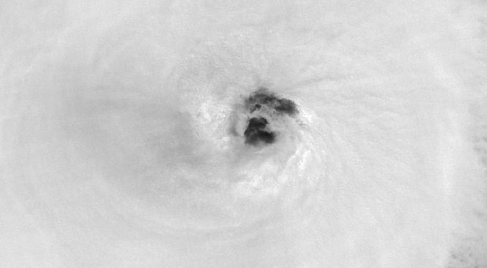
Super Typhoon Jelawat
VIIRS I-Band 4 (3.74 μm) 375m
Brightness Temperatures
30 March 2018 – 0401 UTC

Slide 28
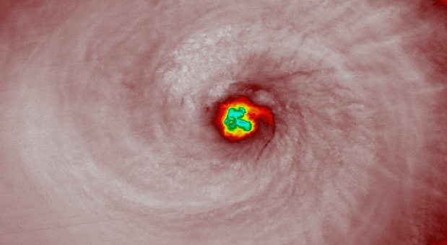
Super Typhoon Jelawat
VIIRS I-Band 5 (11.4 μm) 375m
Brightness Temperatures
30 March 2018 – 0401 UTC

Slide 29
VIIRS
Day/Night Band
Visible wavelength available at night!
  735 m spatial resolution centered at about .7 microns
What can now be seen at night?
  Cities
  Smoke, Dust, Ash
  Low Clouds/Fog
  Fires, Volcanoes (Lava)
  Auroras
  Lightning
How much can be seen depends heavily on lunar illumination – Phase of moon, and rising setting times

Slide 30
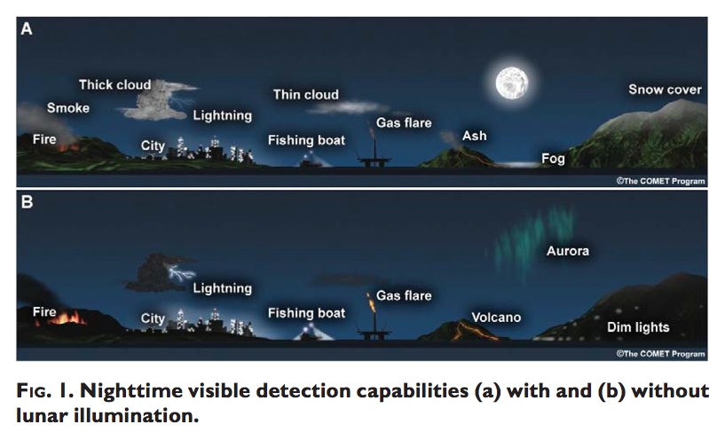
VIIRS Day/Night Band
Taken from: T., Miller, S. D., Turk, F. J., Schueler, C., Jullian, R., Deyo, S., Dills, P., and Wang, S., 2006: The NPOESS VIIRS Day/Night Visible Sensor, Bulletin Am. Met. Society, DOI:10.1175/BAMS-87-2-191, p. 191-199.

Slide 31
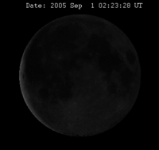
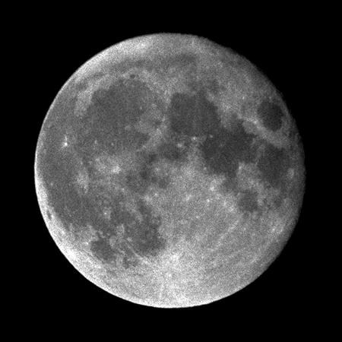
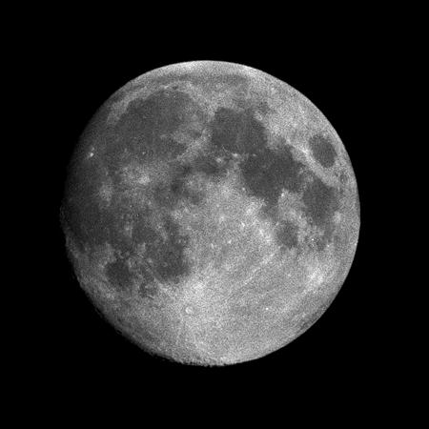
Lunar Reflectance Model
9 Aug 1987 1900 UTC
2 Feb 1988 1600 UTC
Perigee: 357,643 km
Apogee: 406,395 km
Mean Distance = 384,401 km
Notes:
Information from: http://www.fourmilab.ch/earthview/moon_ap_per.html
Moon Radius = 1738 km
Earth Radius 6378.14 km
The Moon's orbit is inclined 5.145396° with regard to the ecliptic (the plane in which the Earth's orbit around the Sun lies or, more precisely, the plane in which the centre of gravity of the Earth-Moon system [its barycentre] orbits the Sun), so as seen from the centre of the Earth the Moon drifts up and down slightly more than five degrees in the course of each orbit.
The Moon's orbital inclination, combined with the inclination of the Earth's axis of rotation, causes the Moon's declination, as observed from the Earth, to vary between ±28.5° when the Moon's inclination adds to that of the Earth, and ±18° when the two inclinations oppose one another; the maxima and minima of declination repeat every 18.6 years, the period in which the ascending node of the Moon's orbit precesses through a full circle. (Recall Earth’s own declination is about 23.5 degrees)
The combination of the eccentricity and inclination of the Moon's orbit causes the Moon, as seen from the Earth, to nod up and down and left and right. These apparent motions, the lunar librations, allow us to observe, over a period of time, more than 59% of the Moon's surface from the Earth, albeit with the terrain in the libration zones near the edge of the visible disc, only very obliquely.
The intensity of light varies as the inverse square of the distance between a light source and the observer, so taking the ratio between the perigee and apogee distances in the photographs above as typical, the distance at apogee was 1.1363 times the perigee distance, and hence the Moon's intensity at perigee was the square of this quantity, 1.2912 times brighter—about 30%.

Slide 32
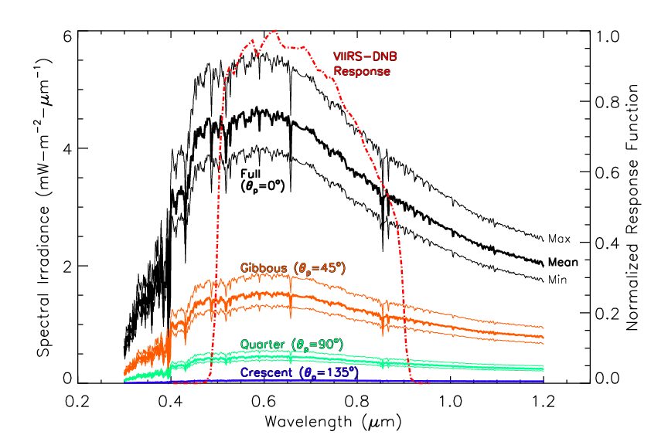
Lunar Reflectance Model
9 Aug 1987 1900 UTC
2 Feb 1988 1600 UTC
Perigee: 357,643 km
Apogee: 406,395 km
Mean Distance = 384,401 km
Notes:
Information from: http://www.fourmilab.ch/earthview/moon_ap_per.html
Moon Radius = 1738 km
Earth Radius 6378.14 km
The Moon's orbit is inclined 5.145396° with regard to the ecliptic (the plane in which the Earth's orbit around the Sun lies or, more precisely, the plane in which the centre of gravity of the Earth-Moon system [its barycentre] orbits the Sun), so as seen from the centre of the Earth the Moon drifts up and down slightly more than five degrees in the course of each orbit.
The Moon's orbital inclination, combined with the inclination of the Earth's axis of rotation, causes the Moon's declination, as observed from the Earth, to vary between ±28.5° when the Moon's inclination adds to that of the Earth, and ±18° when the two inclinations oppose one another; the maxima and minima of declination repeat every 18.6 years, the period in which the ascending node of the Moon's orbit precesses through a full circle. (Recall Earth’s own declination is about 23.5 degrees)
The combination of the eccentricity and inclination of the Moon's orbit causes the Moon, as seen from the Earth, to nod up and down and left and right. These apparent motions, the lunar librations, allow us to observe, over a period of time, more than 59% of the Moon's surface from the Earth, albeit with the terrain in the libration zones near the edge of the visible disc, only very obliquely.
The intensity of light varies as the inverse square of the distance between a light source and the observer, so taking the ratio between the perigee and apogee distances in the photographs above as typical, the distance at apogee was 1.1363 times the perigee distance, and hence the Moon's intensity at perigee was the square of this quantity, 1.2912 times brighter—about 30%.

Slide 33
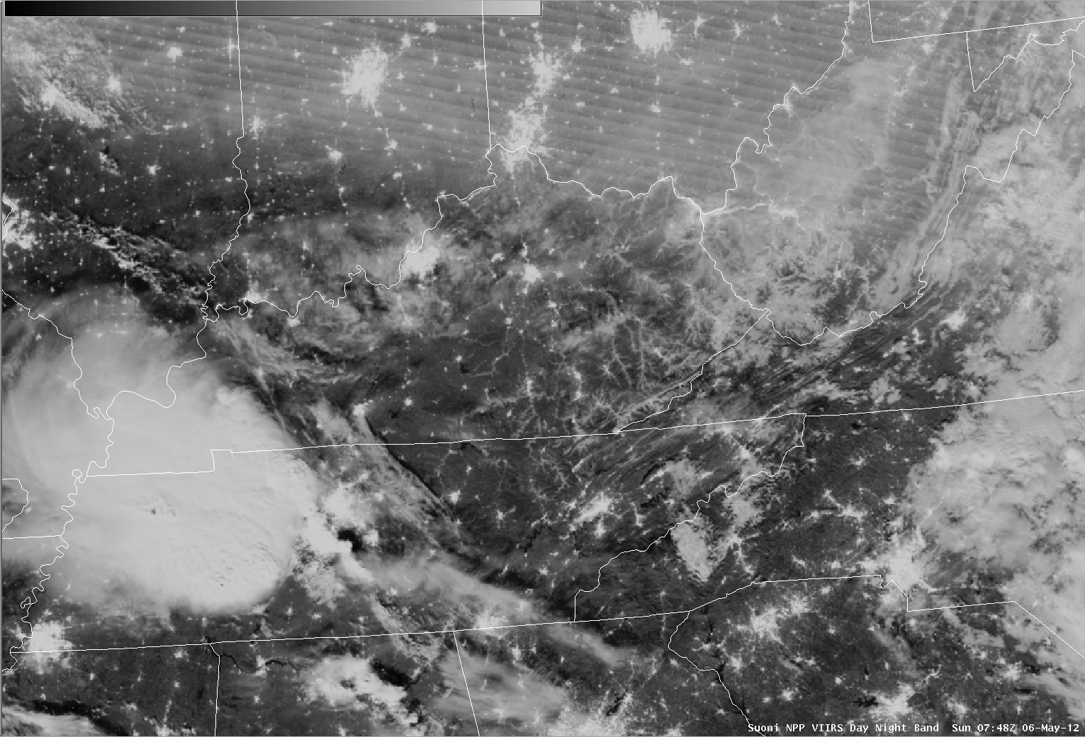
VIIRS Fog Detection Capability
Day/Night Band 6 May 2012

Slide 34
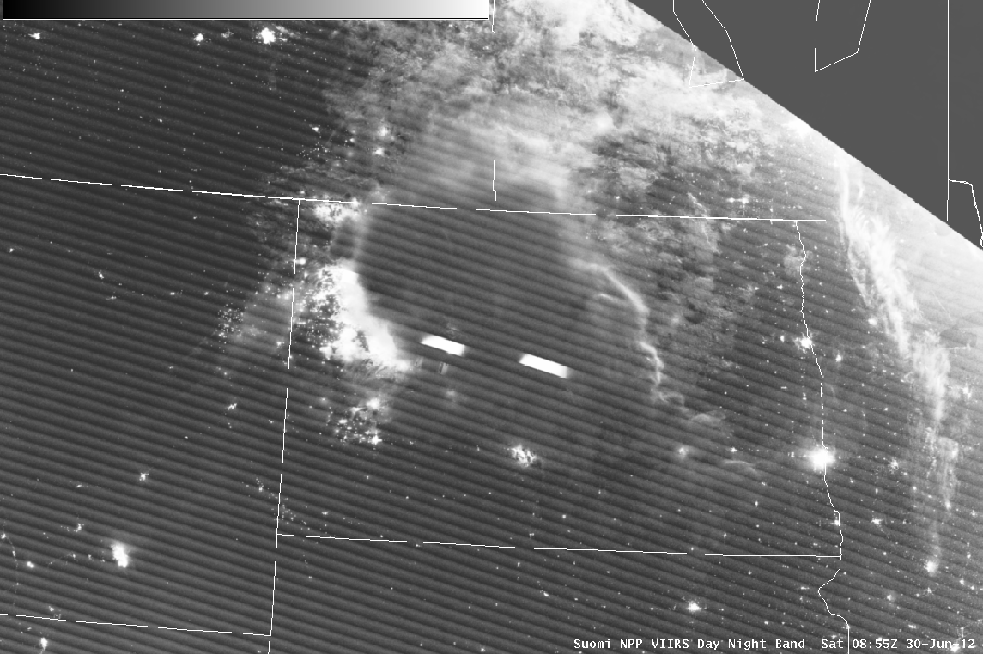
VIIRS in AWIPS Day/Night Band
Lightning Detection 30 June 2012
Side lighting from Sun
Illumination from oil fields
Lightning

Slide 35
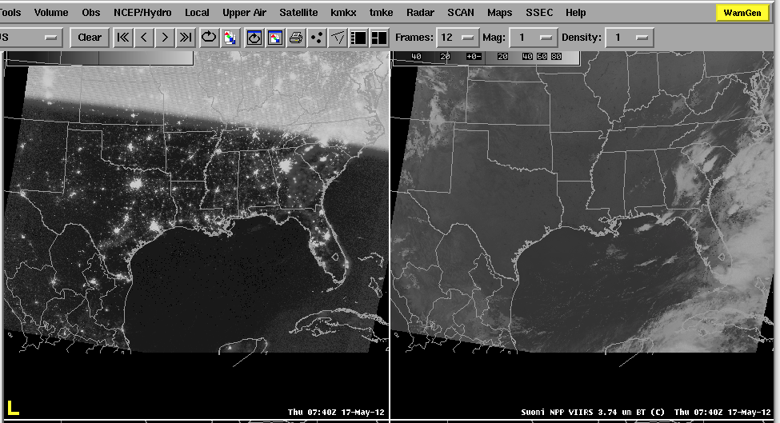
Moon Phase Affects
How Much Can be Seen
Stray light region
Thick Cloud
Thick Cloud
Crescent moon means less illumination making it difficult to identify clouds

Slide 36
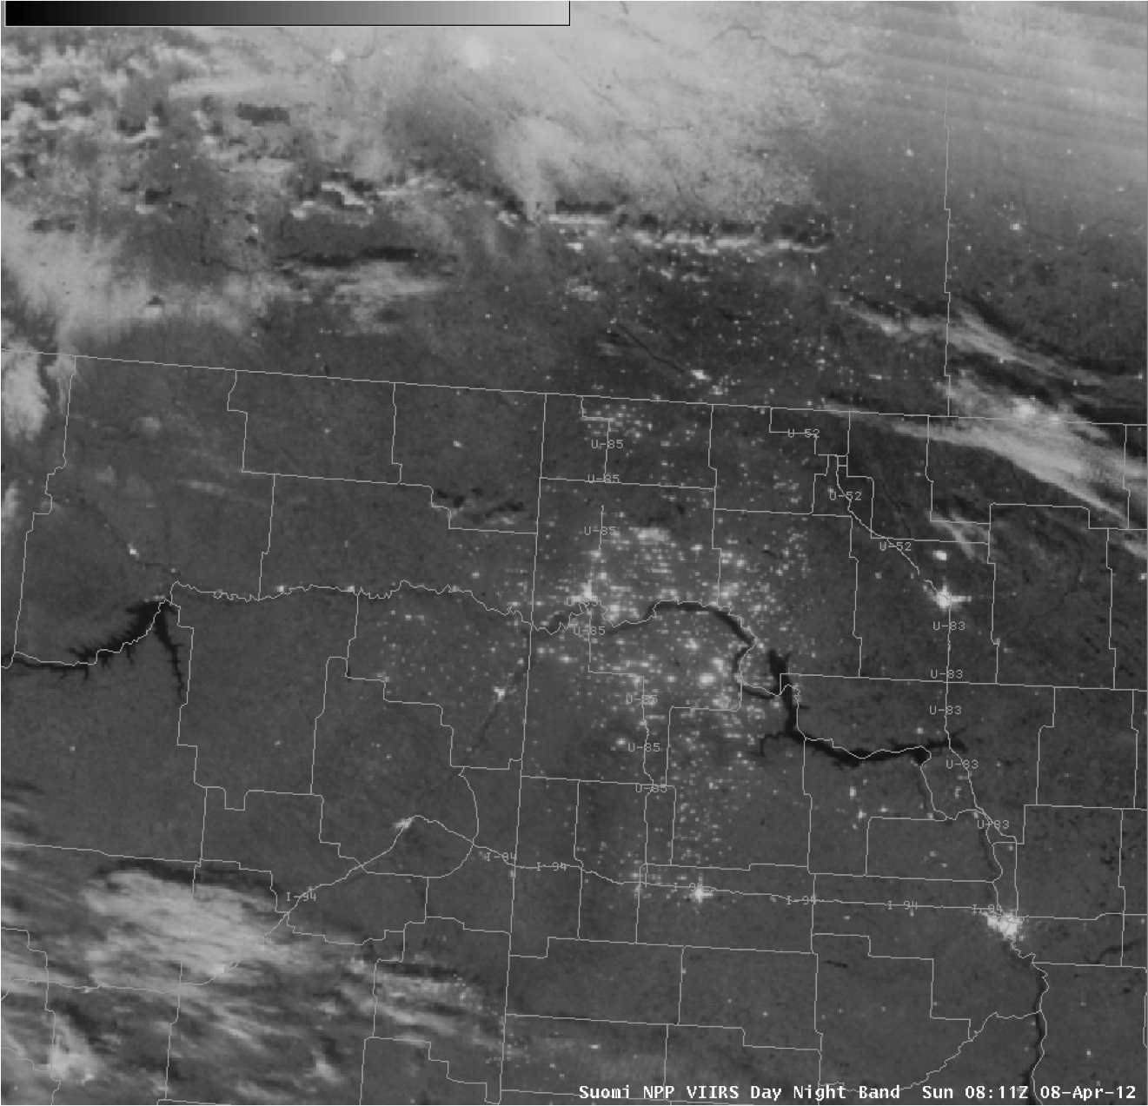
VIIRS in AWIPS Day/Night Band
Mining Operations 8 April 2012
Another example of a Day/Night Band image from 08 April 2012 revealed a large number of natural gas flares and illuminated “man camps” associated with extensive drilling operations in the Bakken Shale Oil Field area of eastern Montana and western North Dakota.

Slide 37
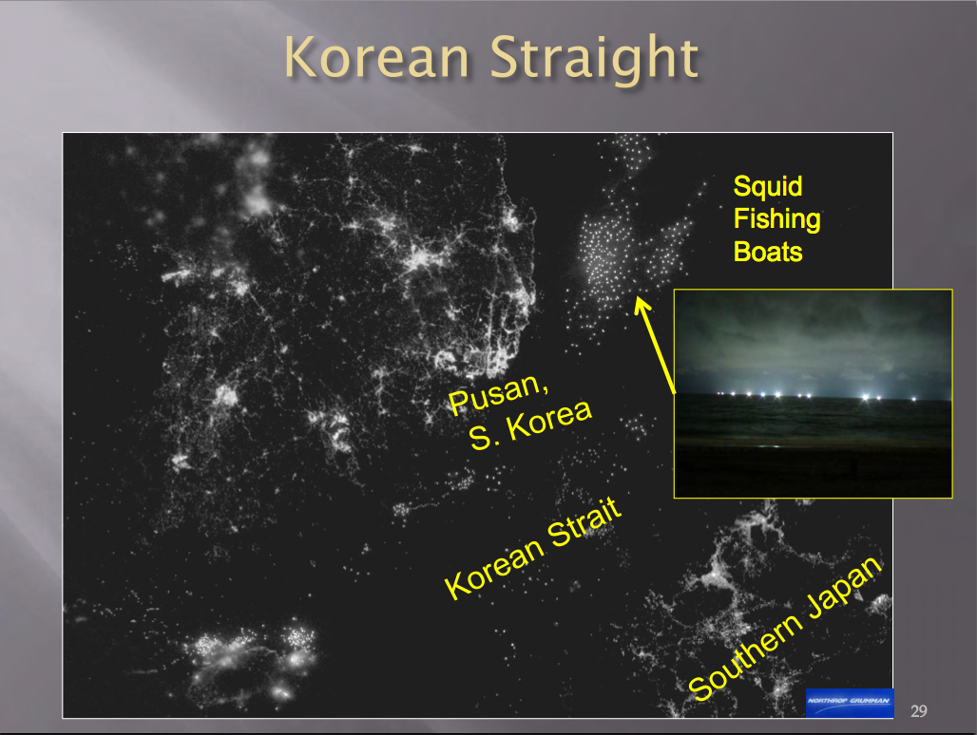

Slide 38
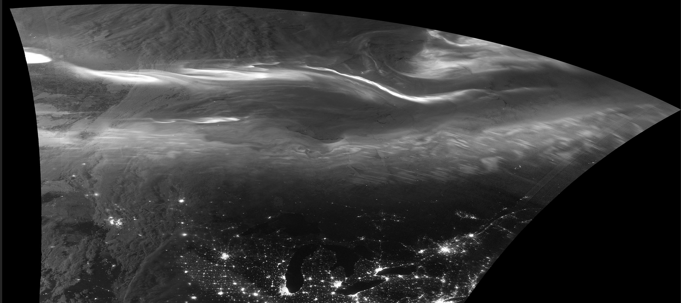
Aurora Borealis
S-NPP VIIRS 25 March 2018

Slide 39
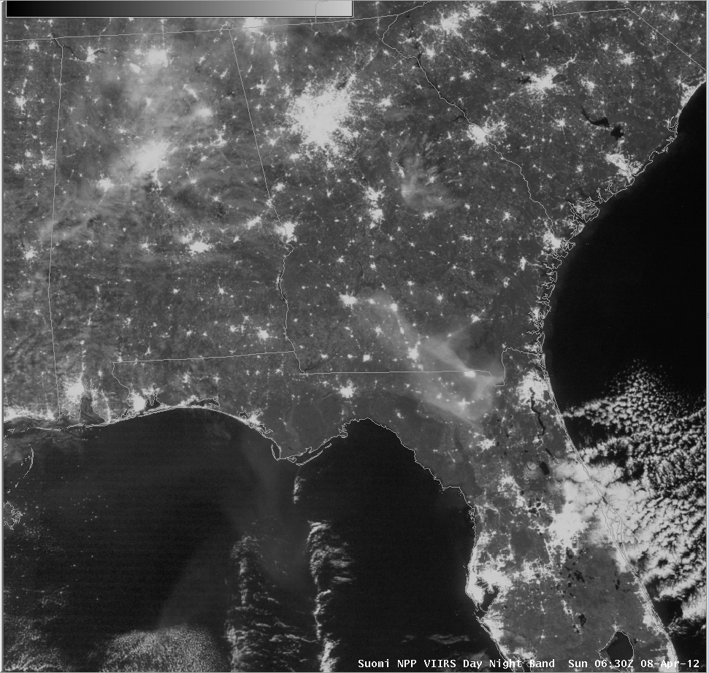
VIIRS in AWIPS Day/Night Band
Smoke Detection 8 April 2012
Smoke from County Line Fire in northern Florida
SSEC/CIMSS

Slide 40
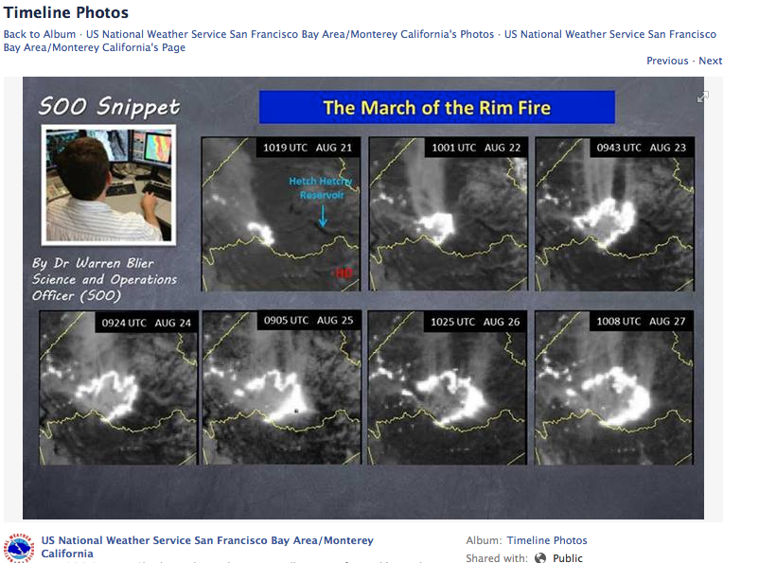

Slide 41
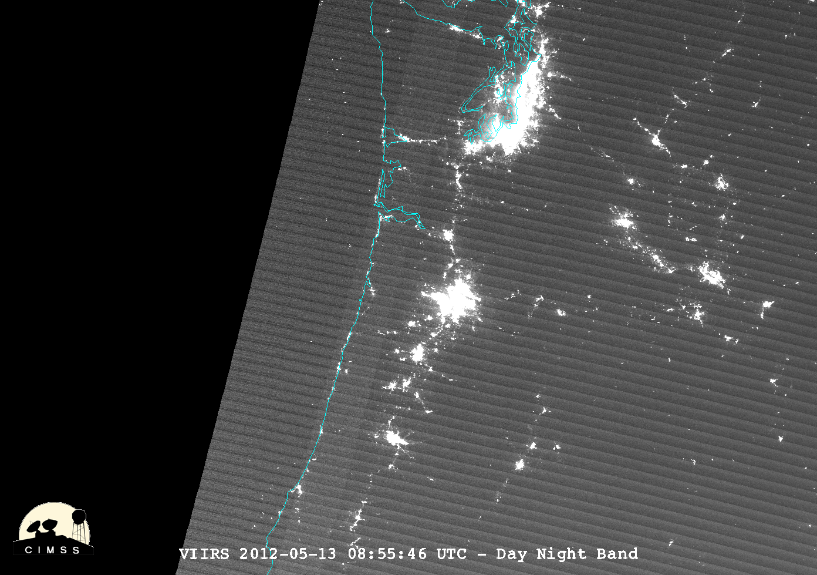
Examples Ships
Seattle
Ships

Slide 42
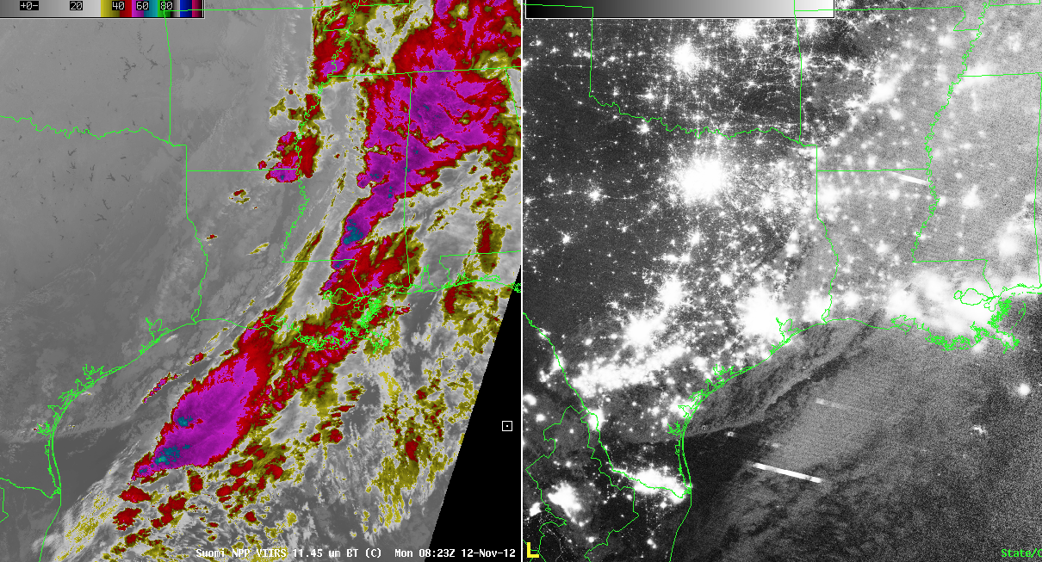
VIIRS Day/Night Band
New Moon

Slide 43
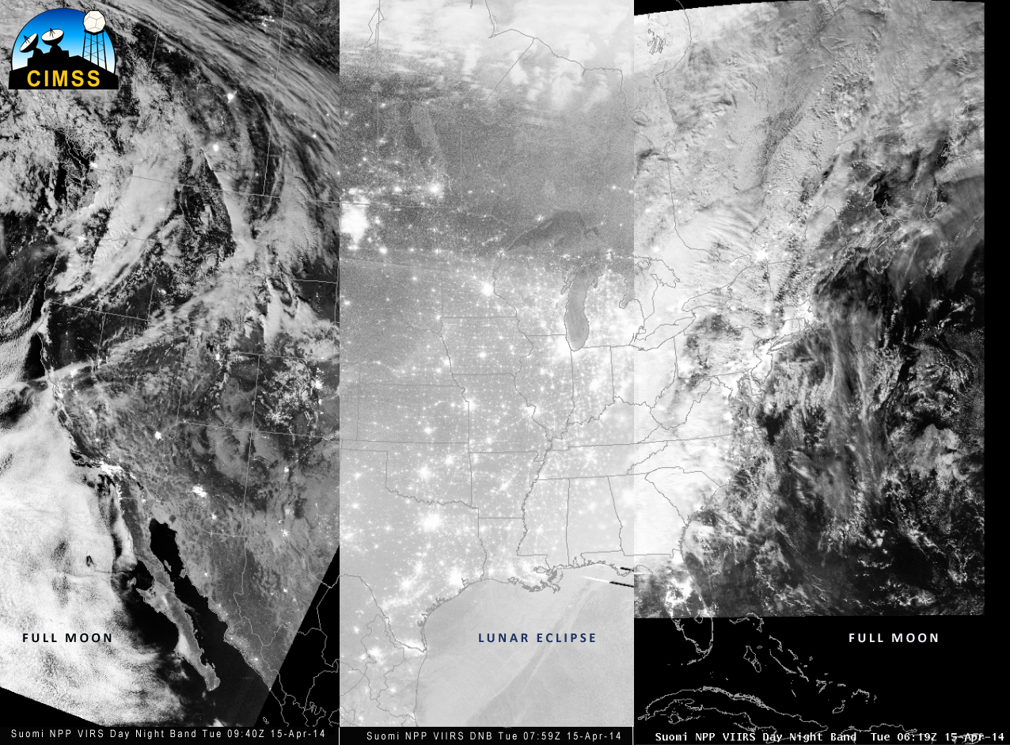
Reminder: It’s Moonlight that is illuminating things!
(This shows three successive orbits on 15 April 2014)

Slide 44
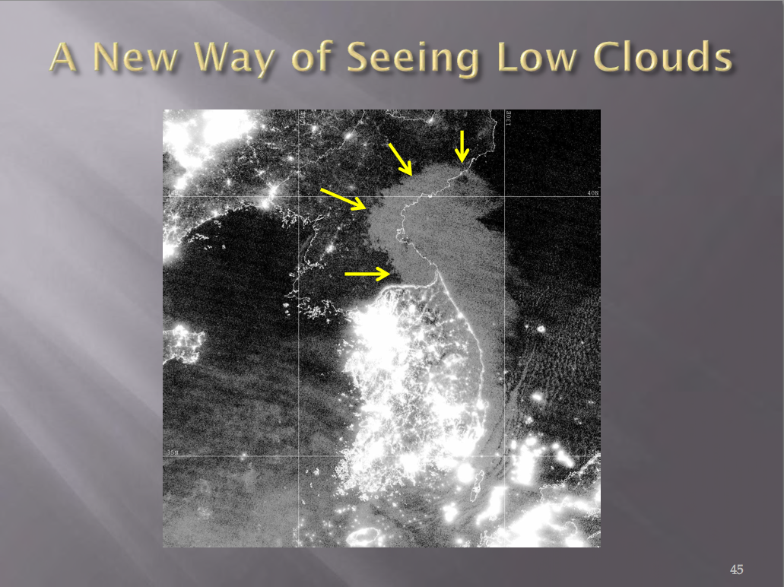

Slide 45
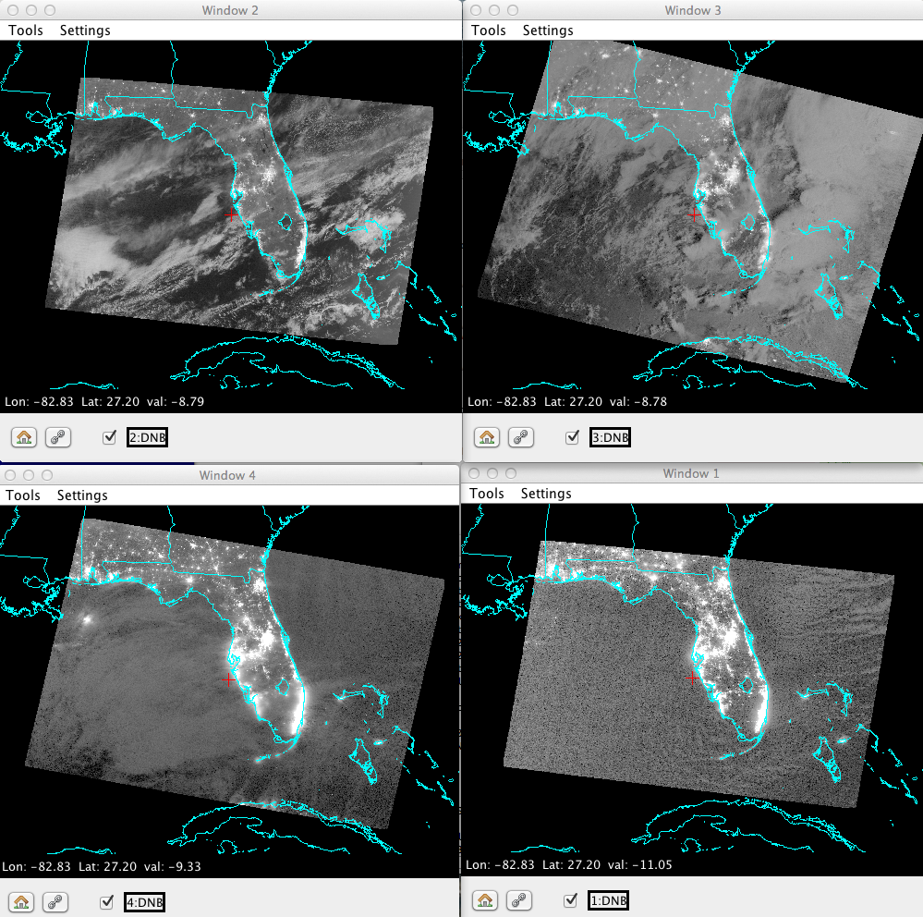




Four Lunar Illumination Regimes

Slide 46
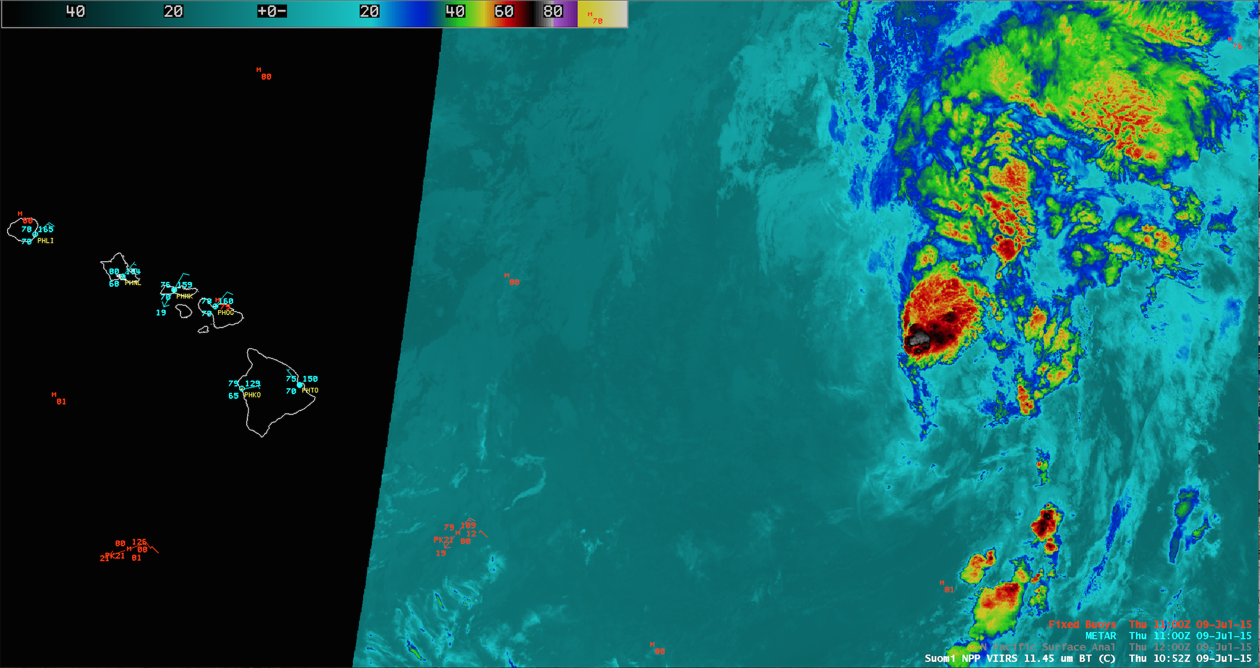
Tropical Storm Ela in the Pacific
Low Level Circulation Center (LLCC) Located to the Southwest of the Deep Convection associated with the system as seen by the VIIRS Day/Night Band
VIIRS Infrared 11 micron Imagery in AWIPS-II 11:00 UTC 9 July 2015

Slide 47
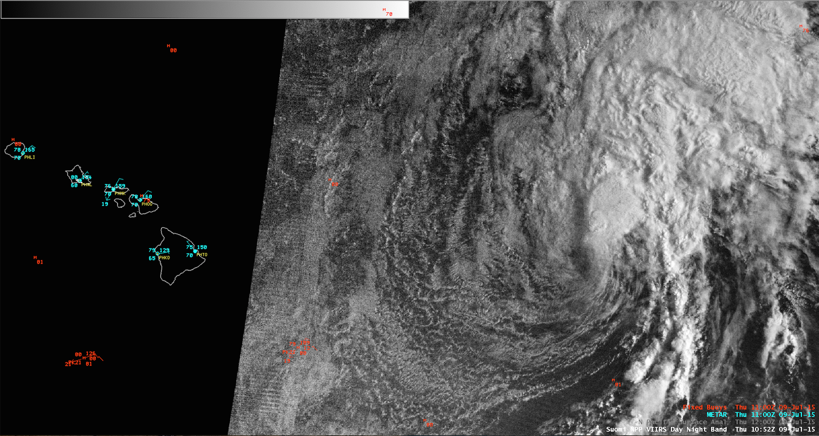
Tropical Storm Ela in the Pacific
Low Level Circulation Center (LLCC) Located to the Southwest of the Deep Convection associated with the system as seen by the VIIRS Day/Night Band
VIIRS Infrared 11 micron Imagery in AWIPS-II 11:00 UTC 9 July 2015

Slide 48
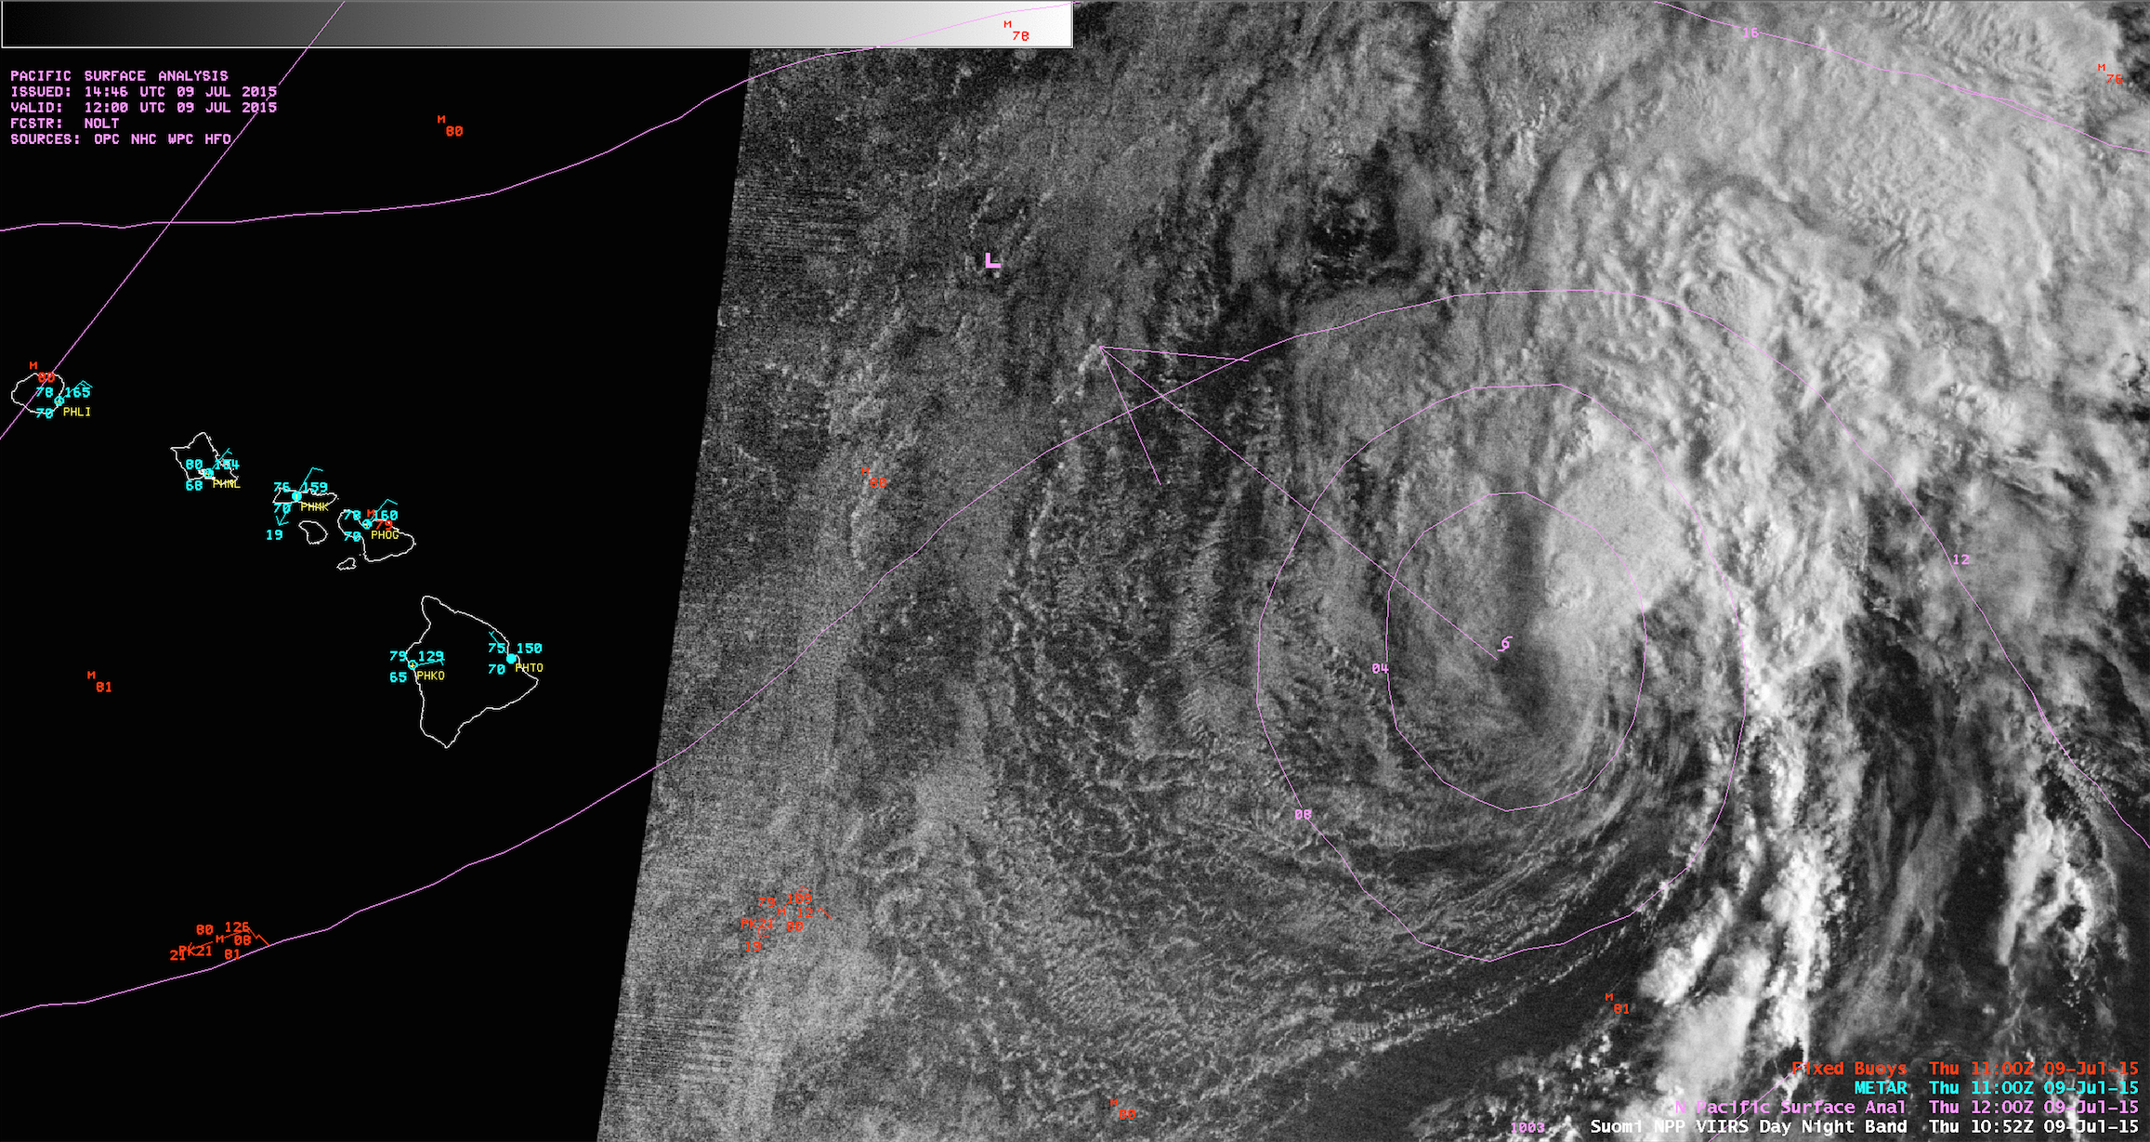
TROPICAL STORM ELA DISCUSSION NUMBER 7
NWS CENTRAL PACIFIC HURRICANE CENTER HONOLULU HI EP042015
500 AM HST THU JUL 09 2015
A 1052Z VIIRS DAY/NIGHT BAND IMAGE WAS INSTRUMENTAL IN HELPING TO LOCATE THE PARTIALLY EXPOSED CENTER OF ELA THIS MORNING.
VIIRS Infrared 11 micron Imagery in AWIPS-II Overlaid with 12:00 UTC N Pacific Surface Analysis

Slide 49
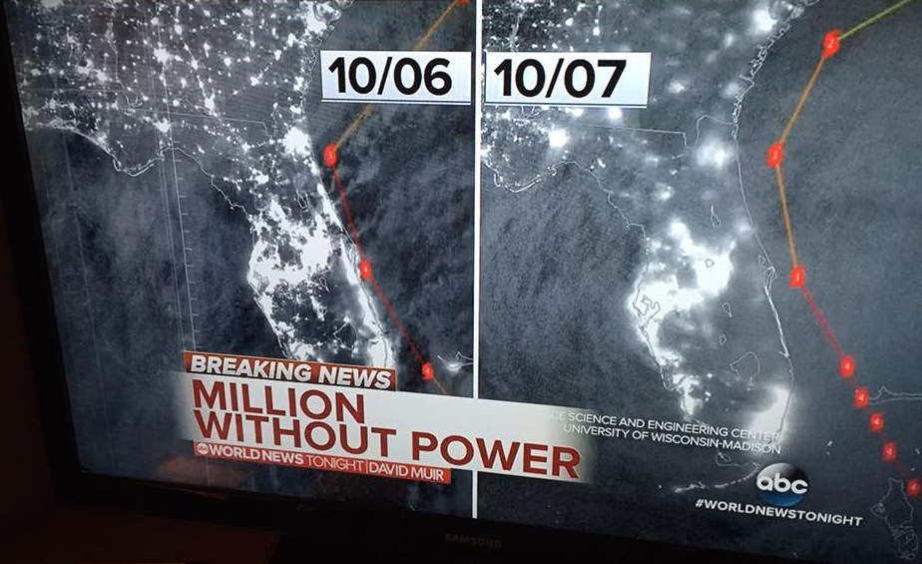
The Effects of Hurricane Matthew as seen in the VIIRS DNB (October 2016)
VIIRS Day/Night Band imagery - overnight 6 October (left) and 7 October (right) 2016
Image created in near real-time using CIMSS/SSEC DB data in Real-Earth

Slide 50
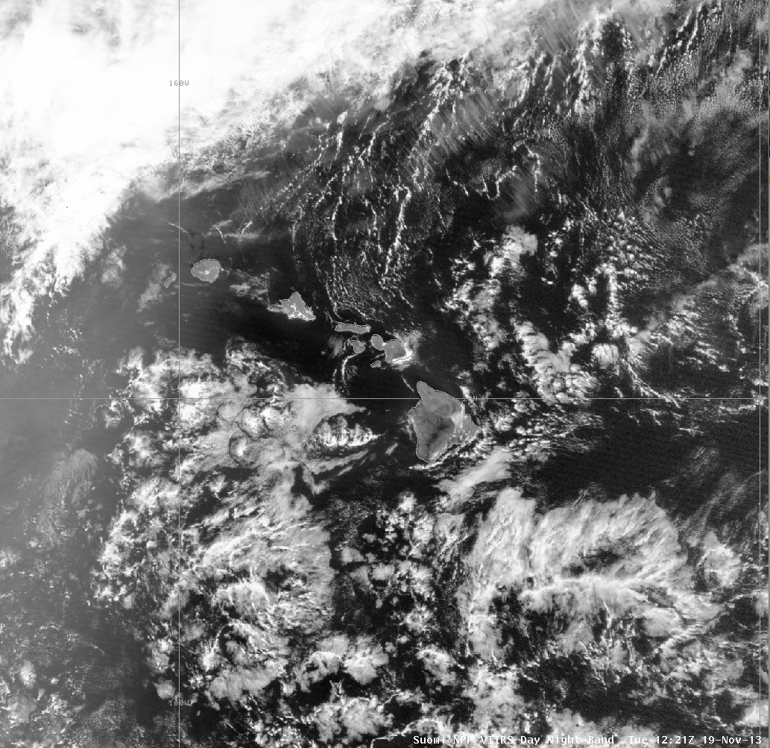
AREA FORECAST DISCUSSION
NATIONAL WEATHER SERVICE HONOLULU HI
330 AM HST TUE NOV 19 2013
.DISCUSSION...
CURRENTLY...SKIES OVER THE ISLANDS ARE MOSTLY CLEAR
...AND DRY CONDITIONS PREVAIL IN MOST AREAS...EXCEPT FOR PERSISTENT SHOWERS THAT HAVE BEEN ANCHORED ALONG THE LOWER SLOPES OF WINDWARD HALEAKALA FOR THE PAST SEVERAL HOURS. LOW CLOUDS ARE INCREASING IN COVERAGE
OVER WATERS S OF THE ISLANDS FROM KAUAI TO MOLOKAI...BUT RADAR IS THUS FAR NOT DETECTING ANY SHOWERS FALLING FROM THESE STABLE CLOUDS. A RECENTLY RECEIVED VIIRS NIGHTTIME VISIBLE IMAGE CONFIRMS THAT THESE ARE STABLE STRATOCUMULUS. LOOKS LIKE A SUNNY START TO THE DAY
NEARLY STATEWIDE...WITH INCREASING CLOUDS OVER INTERIOR AND LEEWARD
AREAS THIS AFTERNOON.

Slide 51
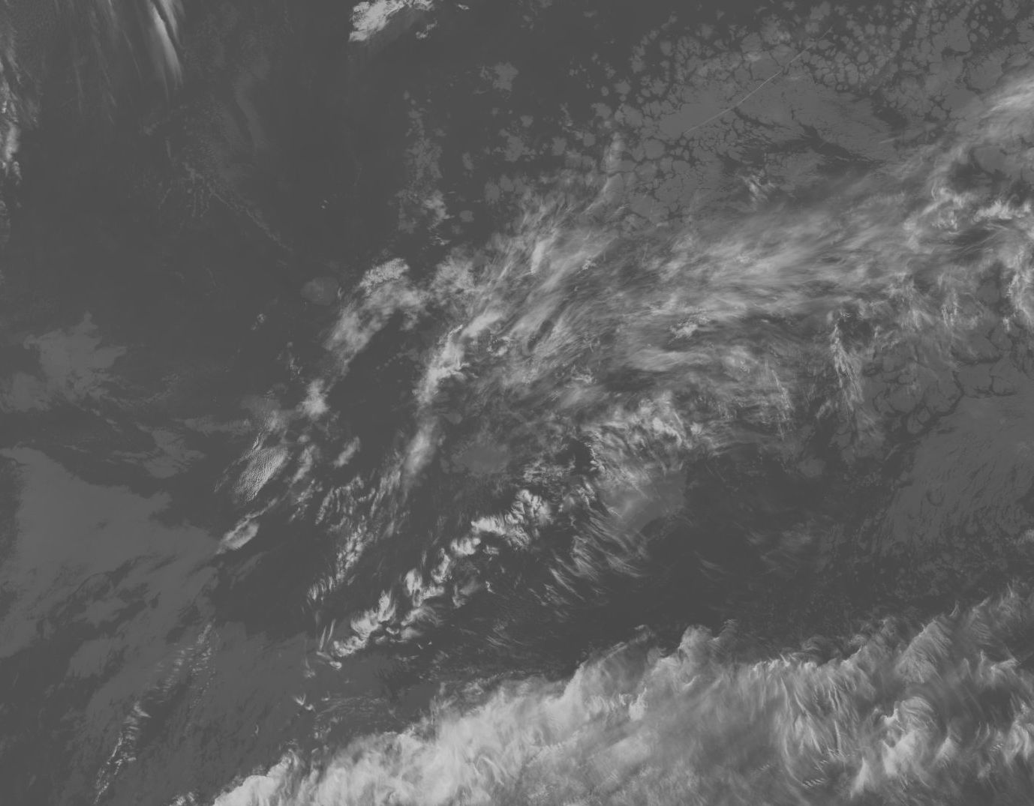
SNPP VIIRS IR Window Band (11 micron) 11:36 UTC (1:36 AM) 11 January 2016

Slide 52
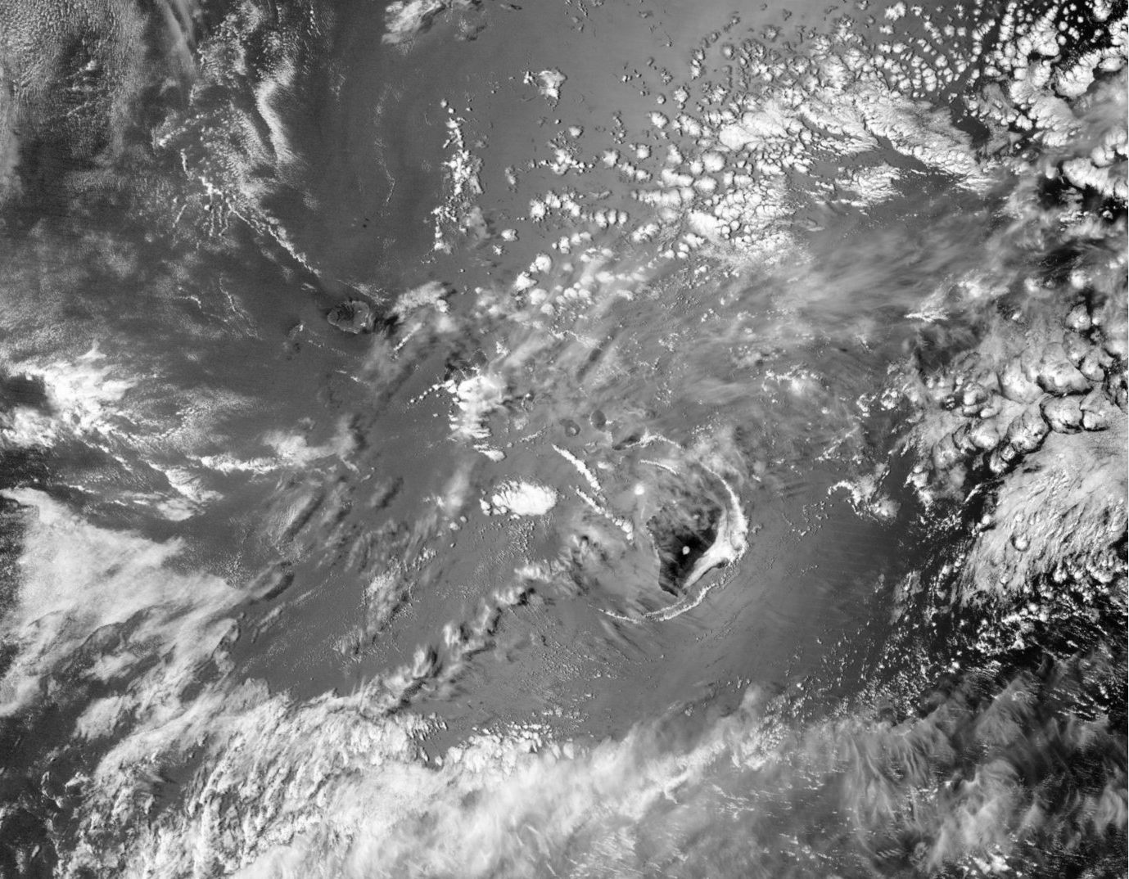
SNPP VIIRS Day/Night Band 11:36 UTC (1:36 AM) 11 January 2016

Slide 53
