Slide 1
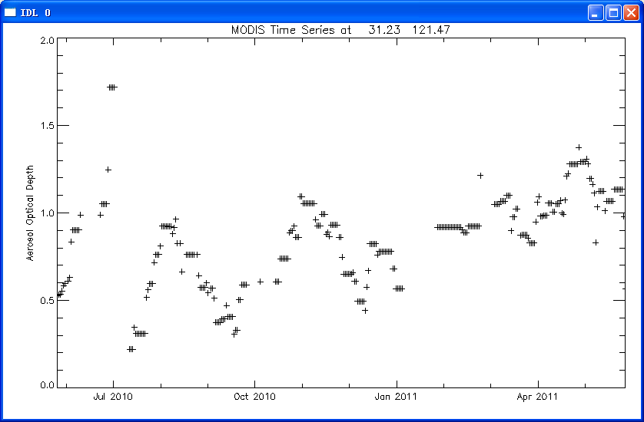
Time Series of Aqua MODIS
Aerosol Optical Depth for Shanghai, China

Slide 2
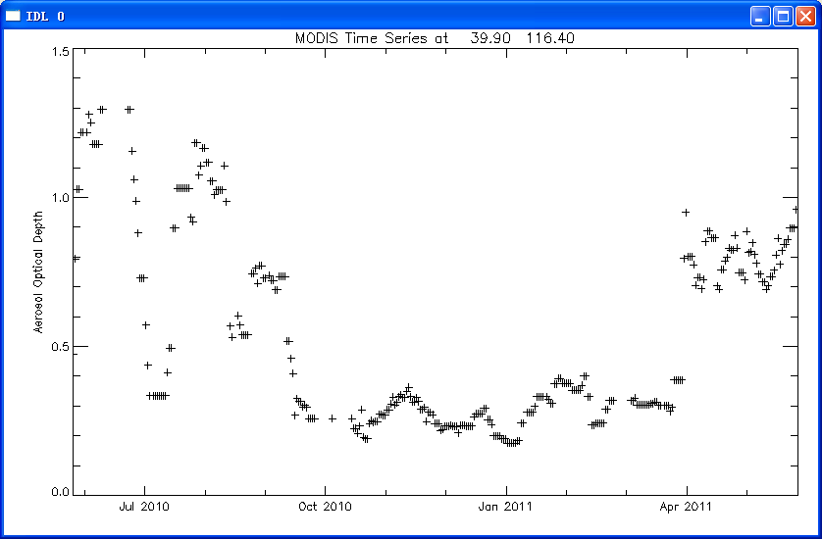
Time Series of Aqua MODIS
Aerosol Optical Depth for Beijing, China

Slide 3
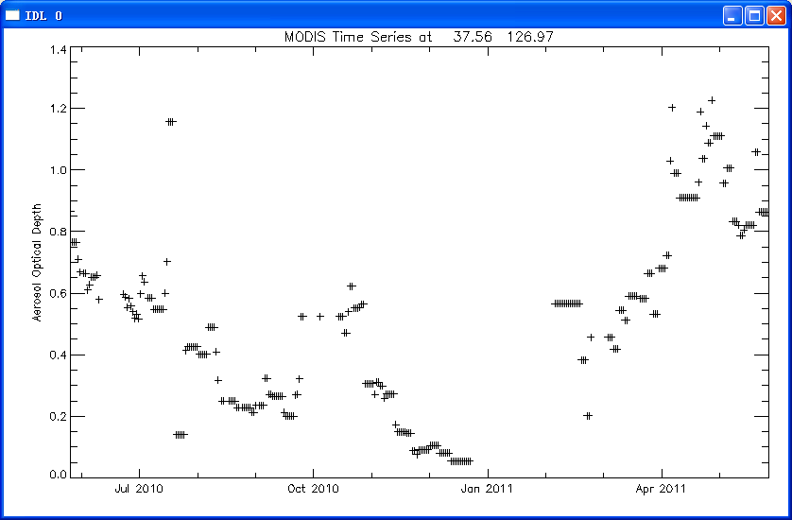
Time Series of Aqua MODIS
Aerosol Optical Depth for Seoul, Korea

