Slide 1
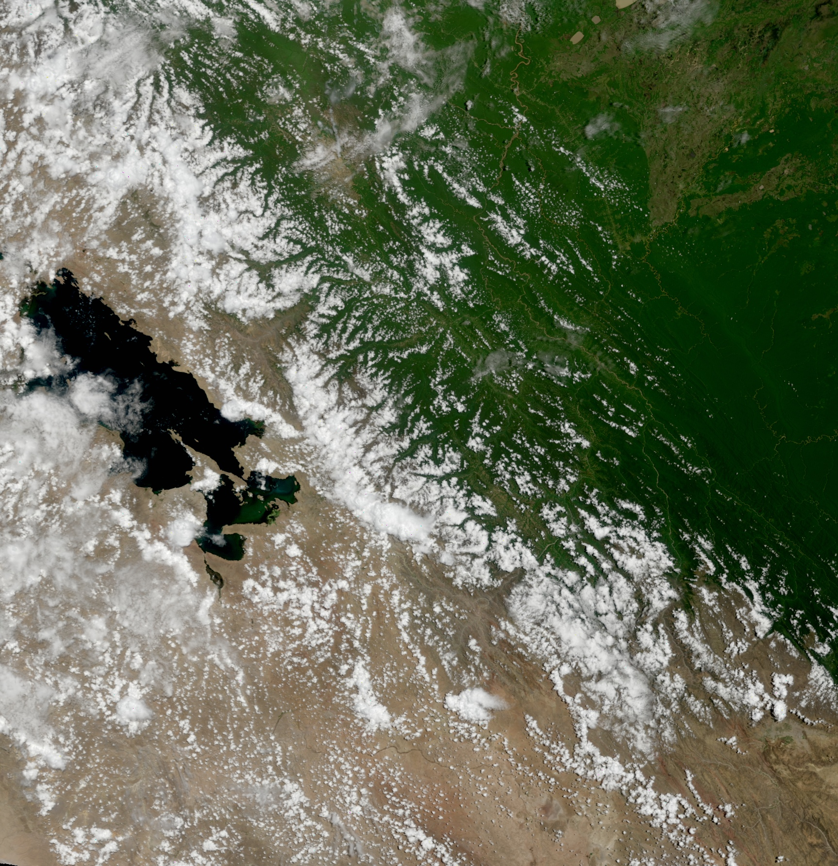
DB Product Applications
2011 IMAPP Training Workshop: Satellite Direct Broadcast for Real-Time Environmental Applications
ECNU, China
4 June 2011
Part 2
Kathleen Strabala
Cooperative Institute for Meteorological Satellite Studies
Space Science and Engineering Center
University of Wisconsin-Madison
Notes:
Title slide

Slide 2
Aviation Applications Continued
Clouds
Composition
Cloud Top Properties
Cloud Phase

Slide 3
Clouds
MOD06 Cloud Product contains
Cloud Top Properties at 5km
Cloud Top Pressure, Cloud Top Temperature, Cloud Fraction, Cloud Emissivity
Cloud Phase at 5 km
Cloud Optical Properties at 1 km (Daytime only)
Cloud Effective Radius
Cloud Optical Thickness

Slide 4
Cloud Top Property Algorithm
Cloud Top Pressure, Temperature, Emissivity derived using CO₂ “slicing”
MODIS product utilizes 4 spectral channels in the 13 – 14 μm region.
5x5 1 km pixel retrievals where at least 5 of the 1 km pixels are cloudy as determined by the cloud mask
Cloud properties retrieved both day and night

Slide 5
Notes:
The brightness temperatures of the outgoing radiance observed by an airborne interferometer are shown along with the MODIS infrared spectral bands. The brightness temperatures generally decrease as the center of an absorption band is approached. This decrease is associated with the decrease of tropospheric temperature with altitude. Near about 690 cm⁻¹, the temperature shows a minimum which is related to the colder tropopause. On the basis of the sounding principle already discussed, the MODIS team selected a set of sounding wave numbers such that a temperature layers in the troposphere can be described. The arrows indicate the selection. The associated weighting functions are also shown revealing that the radiation is coming from broad overlapping layers, helping to confound the inversion problem from multispectral radiance measurements to temperature profile.

Slide 6
Cloud Phase
IR Brightness Temperature Difference Product
Band 29 (8.6 μm) – Band 31 (11 μm)
Takes advantage of difference in water/ice cloud absorption in this spectral region
Near Infrared Bands (1.6 and 2.1 μm)
Short Wave Infrared Bands (4 μm region)

Slide 7
MODIS – Snow/Ice and Ice Clouds

Slide 8
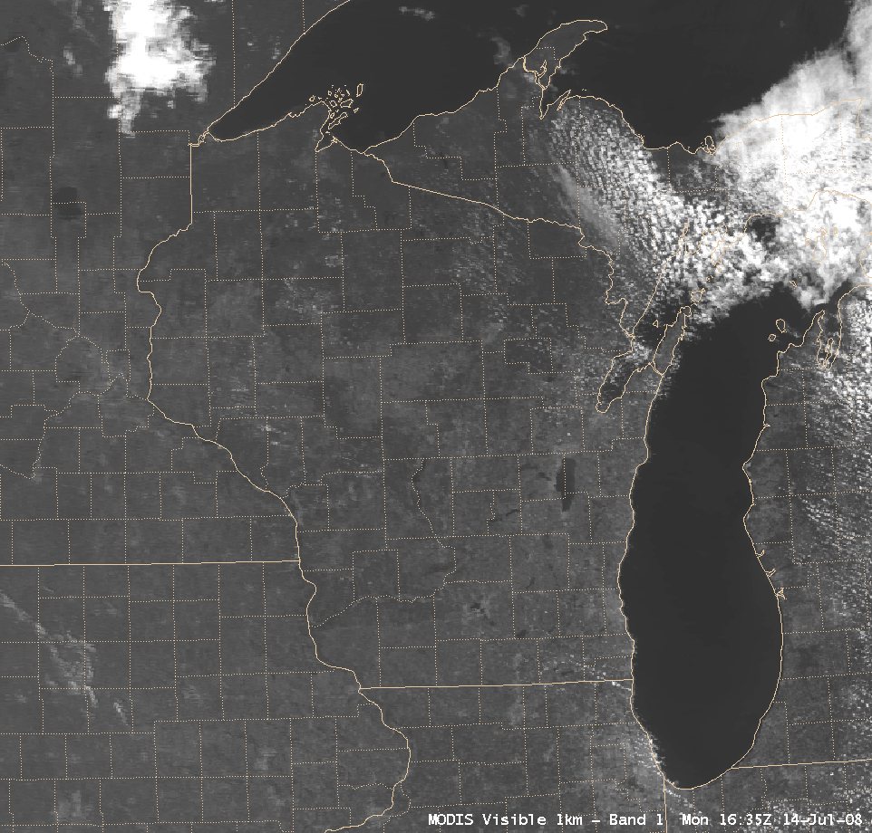
MODIS Products in AWIPS
Visible (0.65 µm): 1-km resolution

Slide 9
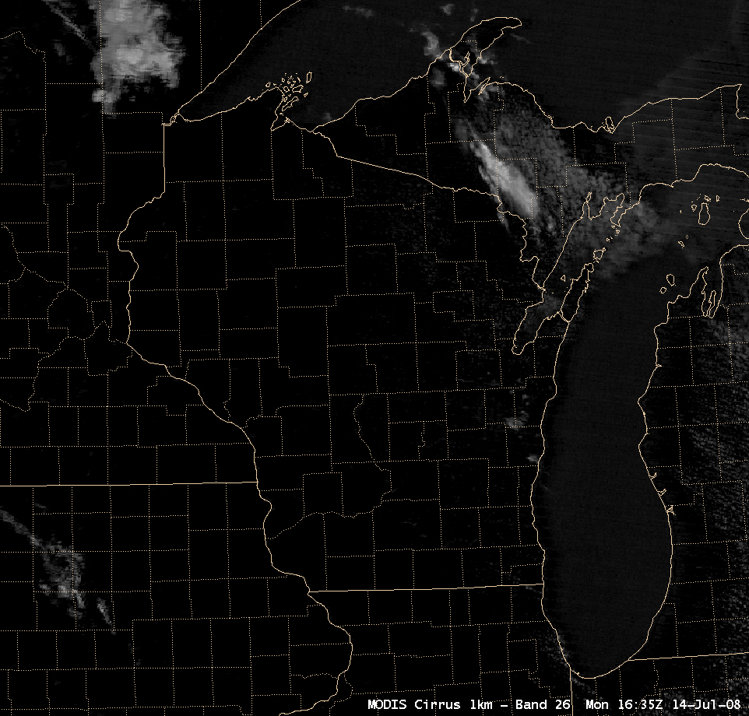
Cirrus detection (1.3 µm): 1-km resolution

Slide 10
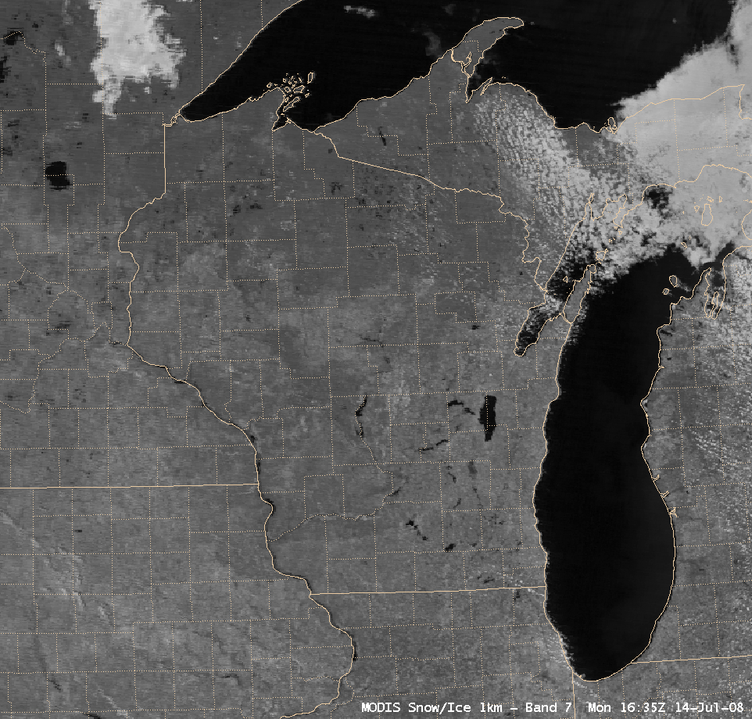
Snow/ice discrimination (2.1 µm): 1-km resolution

Slide 11
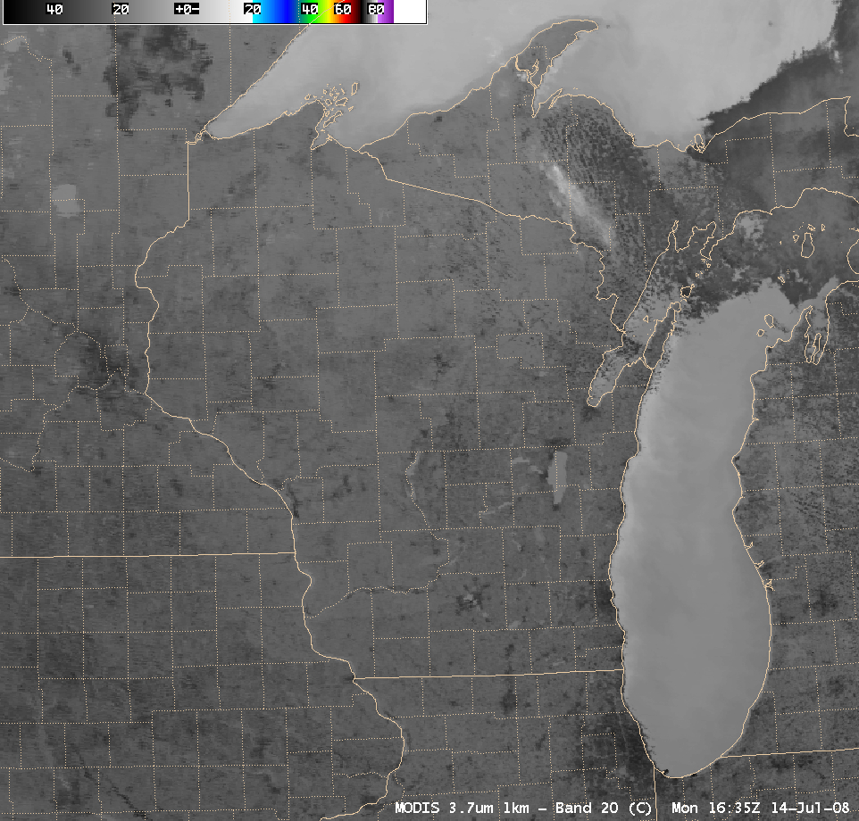
Shortwave IR (3.7 µm): 1-km resolution

Slide 12
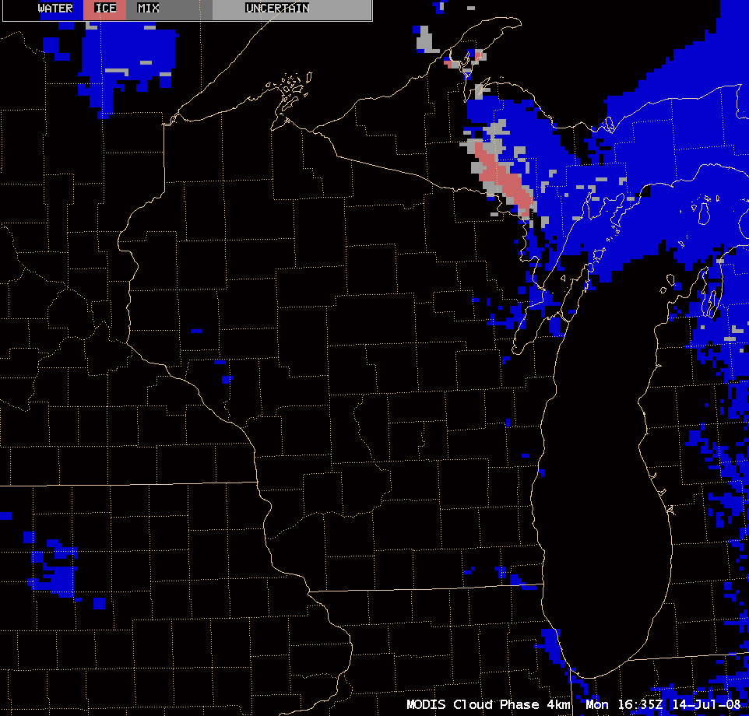
Cloud Phase: 4-km resolution

Slide 13
Using Satellite Imagery to Help Diagnose Areas of Aircraft Icing Potential
GOES IR window animation 17 October 2008

Slide 14
Icing
Freezing Level
Altitude at which the temperature is 0 degrees C
Above this level the temperature is < 0 C
Water Can Exist at Temperatures Well Below Freezing
Supercooled Water
An airplane whose temperature is < freezing in this environment can accrue ice

Slide 15
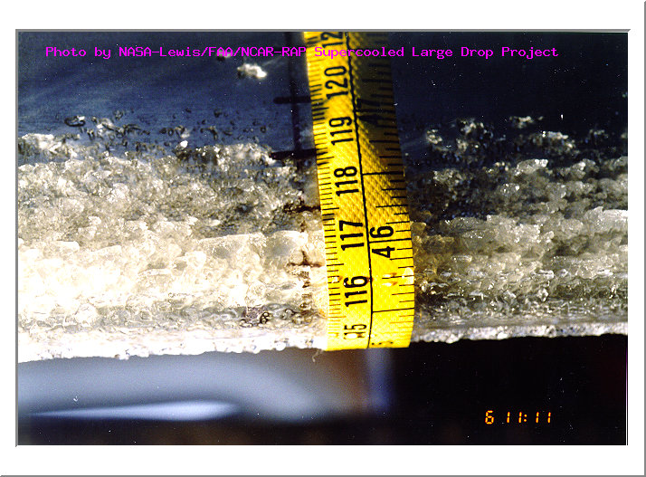
Why is This Important?
We worry about icing because it can adversely affect the flight characteristics of an aircraft. Icing can increase drag, decrease lift, and cause control problems. The added weight of the accreted ice is generally only a factor in light aircraft.
Ice Accumulation On
The Wing of a Small Aircraft
NASA

Slide 17
Freezing Rain Sounding

Slide 18
A closer view using AWIPS images of the MODIS visible channel, 11.0 µm “IR window” channel, Cloud Top Temperature (CTT) product, and Cloud Phase product at 17:29 UTC (below) indicated that much of the cloud shield along the trailing (western) edge of the shortwave over Minnesota and Iowa exhibited cloud top temperatures that were below freezing (generally in the -5 to -12º C range), but the MODIS Cloud Phase product designated those trailing edge clouds as “Water droplet” clouds (blue enhancement). Within this area of supercooled water droplet clouds were several pilot reports of icing at the 8000-foot altitude across southern Minnesota and western/central Iowa.

Slide 20
Other Cloud Applications Too
Identification of mature T-storms
Must glaciate, meaning tops of cell must be ice
Accurate height of “thin” high clouds
Energy transmitted from below the cloud in the IR window. Can’t get accurate level from window BT.
Important for pilots. Clouds mean more moisture, dry entrainment and potential for turbulence.

Slide 21
Ash Detection

Slide 22
Why is this important?
Grimsvotn

Slide 24
Ash Detection Why is this important?
Ash particles can clog airline engines
One such event caused a commercial airliner to make an emergency landing

Slide 25
Okmok Volcano

Slide 26
Okmok Volcano Eruption 13 July 2008

Slide 27
Okmok Eruption 12 July 2008

Slide 28
NOAA Aerosol Trajectory Model

Slide 29
GOES Visible Image Loop 17 July 2008

Slide 30
Terra MODIS Band Comparison 17 July 2008

Slide 31
MODIS 1.38 μm Reflectances 17 July 2008

Slide 32
MODIS 1.38 μm Reflectances
18 July 2008

Slide 33
Pilot Reports 18-19 July 2008
Pilot reports (PIREPS) from aircraft encountering the Okmok volcanic plume over the northwestern and
northcentral continental US on 18-19 July 2008:
DLN UA /OV DLN 270080/TM 1900/FL320/TP MD80/RM ORANGE CLOUD ASSOCIATED WITH VOLCANIC ACTIVITY. NO SMELL, CLR ABV/BLW FL320/ZLC
RDM UUA /OV DSD280030/TM 1909/FL310/TP B737/RM LGT ASH CLOUD FL320 -ZSE
PDX UUA /OV BTG180060/TM 1912/FL330/TP B738/RM FL330-310 ASH CLOUD CLR AT FL300 -ZSE
SLE UA /OV BTG180060/TM 1921/FL300/TP B733/RM BAND OF SULFER DIOXIDE WEST TO EAST FL300-340 AWC-WEBSWA
PDT UA /OV PDT/TM 1937/FL380/TP NUMEROUS/SK ORANGE HAZE/RM VOG 320-380 SMELLS THROAT IRRATATION -ZSE
PDX UUA /OV KPDX/TM 2018/FL320/TP B739/RM VERY THIN PROB ASH CLOUD VISIBLE E-W OVER PDX AND MT HOOD AT APPROX FL320 AWC-WEBASA
LWS UUA /OV MQG130050/TM 2051/FL350/TP B737/RM VOLCANIC ASH CLOUD 320-380 –ZSE
LWS UUA /OV MQG 135060/TM 2053/FL320/TP SVRL ACFT/RM VOLCANIC ASH CLOUD 320-386 CLIMBING/DESCENDING TO AVOID ZLC
MSO UA /OV MLP143070/TM 2053/FLUNKN/TP B737/RM BAND OF CLOUDS W/ ORANGE TINT FL300-FL350 AWC-WEBSWA
PDT UA /OV PDT200020/TM 2100/FL290/TP B737/WV 275039KT/TB SMOOTH/RM ASH CLOUD APPEARS TO BE DISPERSED IN SEVERAL AREAS.MAIN CLOUD LOCATED FURTHER NORTH RUNS W-E AWC-WEBSWA
MSO UUA /OV MSO 120030/TM 2115/FL320/TP CL60/RM ASH CLOUD FL320-395 ZLC

Slide 34
SIGMET eventually extended 18 July 2008

Slide 35
Numerical Weather Prediction
Good Grief, what is this doing here?

Slide 36
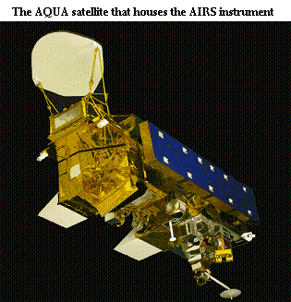
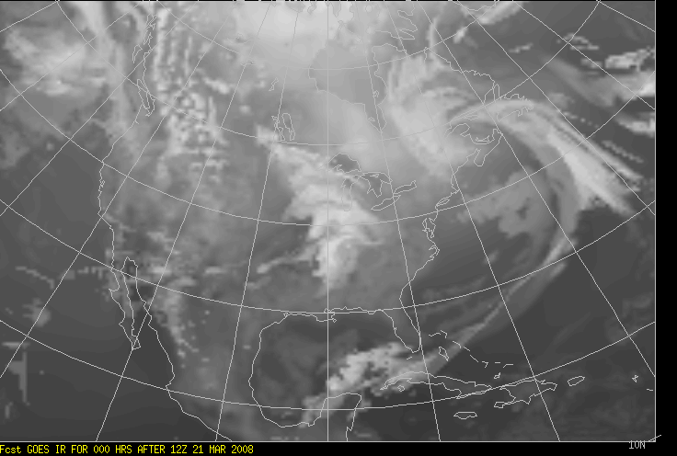
The Cooperative Institute for Meteorological Satellite Studies
University of Wisconsin, Madison
The Direct Broadcast Version of the CIMSS Regional Assimilation System for Global Users
Bob Aune
Advanced Satellite Products Branch, Cooperative Research Program Center for Satellite Applications and Research DOC/NOAA/NESDIS
DBCRAS

Slide 37
What is Numerical Weather Prediction?
Describing the Atmosphere mathematically
Equations of motion
Taking the Derivative with respect to time
Delta T is time step
Need good representation of the atmosphere in 3 dimensions to start with
Assimilation
Gathering all surface observations (METARS)
Radiosondes – Balloon launches that provide vertical profiles of the temperature, moisture and winds
Satellite observations

Slide 38
Why should I care about DBCRAS?
Uses MODIS Products to improve the depiction of clouds and moisture in the initial model conditions
MOD07 Total Precipitable Water Vapor
MOD06 Cloud Top Pressure, Cloud Emissivity
Others only assimilate satellite clear radiances
Requires efficient and reliable internet connection
≈ 500MB of ancillary data required per model run

Slide 39
Why should I care about DBCRAS?
Products created at 48 km resolution out to 72 hours
Automatically creates forecast imagery

Slide 40
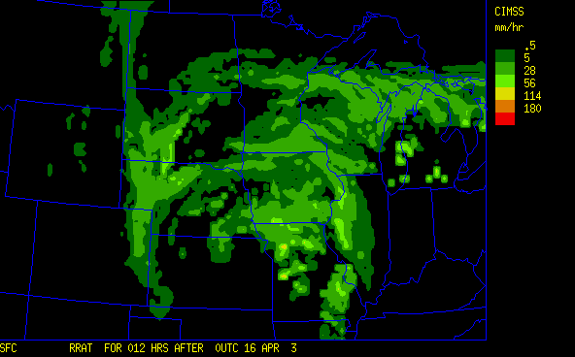
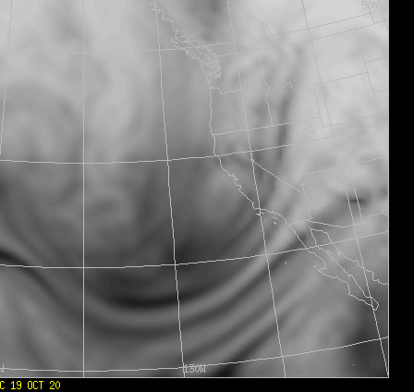
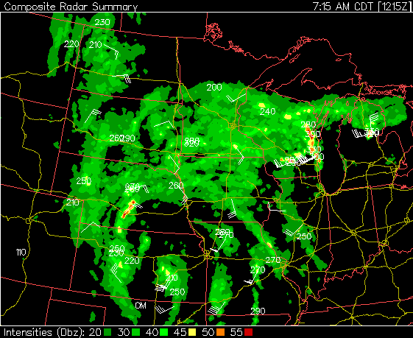
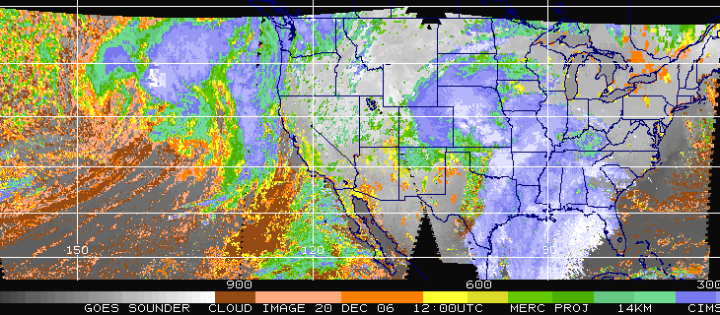
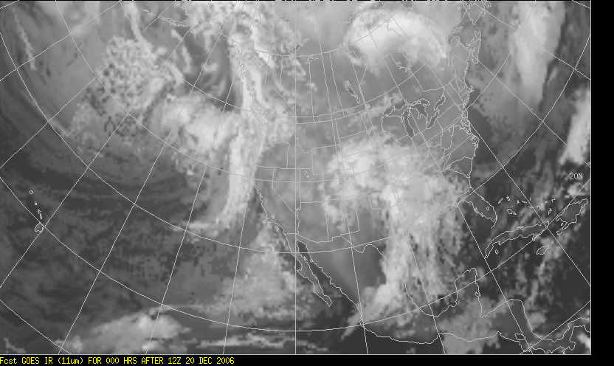
Improvements to CRAS Validated by GOES
48 hr forecasts
Preservation of information:
Mass conservation in advection
Reduced gradient dissipation
40 m/sec
2nd order diffusion
6th order filter
Exact solution
Radar dBz
Simulated 6.7µ image from 33-hour CRAS forecast
Improved physics:
Radiative fluxes
Moist physics
12-hour forecast rain-rate from 20 km CRAS
GOES Sounder cloud-top pressure
Simulated 11µ image from CRAS
Improved Initial Fields:
Water vapor
3D cloud water
Upper-level winds
Temperature fields

Slide 41
Summary of improvements made to the CRAS forecast model that were validated using observations from GOES.
Year Description of Improvement GOES Product
1996 | Initialize water vapor mixing ratio fields | Sounder 3-layer precipitable water
1998 | Initialize 3D cloud fields | Sounder cloud products
1998 | Precipitation parameterization | Sounder cloud products
1998 | Shortwave and longwave radiative flux | Sounder skin temperature
1999 | 6th order filter to preserve gradients | Imager water vapor
1999 | Precipitation drag on vertical motion | Sounder cloud temperatures
2001 | Hydrometeor advection (horizontal) | Sounder cloud products
2002 | Hybrid convective parameterization | Sounder cloud products
2002 | Turbulent mixing to Improve low clouds | Sounder cloud product
2004 | Sub-surface soil model | Sounder skin temperature
2006 | Cloud particle sedimentation | Sounder cloud products

Slide 42
CIMSS Regional Assimilation System - Details
Specifications
Grid: Limited area, re-locatable, Arakawa C grid
Map: Lambert conformal or polar stereographic
Resolution: Horizontal: 127km to 10km
Vertical: ~40 sigma levels, floating top
Platforms: Linux, Intel compiler
Performance: 150 minutes on a single 3.6 GHz Intel Xeon
(72hr fcst, 275x150x38 grid, dx=48 km,
dt=200 sec)
Dynamics: Semi-implicit time scheme, 3rd order
Advective form - Leslie, et.al.,1985
Pseudo-non-hydrostatic, Raymond
and Aune, 1998
3rd order Time filter - Raymond, 1991
6th order tangent - Raymond, 1988
Physics: Radiation – Ackerman and Stephens, 1987
Turbulence – Raymond, 1999
Precip/Clouds – modified Kessler, 1974
and Tiedke, 1993
Precip Fall rate – Kreitzberg and Perkey, 1976
Convection – Raymond and Aune, 2002
Initialization: Vertical normal mode - Bourke
and McGregor, 1983
Analysis: Recursive filter - Control variables
3D variational - heights and winds, Seaman et al.,1977
1D variational - satellite radiances/retrievals
Input grids: Currently using CRAS moisture analysis merged with winds and temperatures from the NCEP GFS
Topography: USGS 2-minute surface elevation,
land-water flag
Climatology: Monthly albedo, deep-soil temperature,
sub-soil moisture, sea ice, roughness, vegetative roughness, leaf-area index,
greenness
Observations:
In situ: RAOBs, surface data, ACARS
GOES: 3-layer precipitable water Cloud-top pressure and effective cloud amount,
4-layer thickness
Cloud-track and water vapor winds
Other: Gridded hourly precip, Stage II, from NCEP SST and sea ice coverage from NESDIS
C R A S
CRAS TEMPESTUS HODIE
Tomorrow’s Weather Today

Slide 43
ECNU DBCRAS Set up
User: imcras
PW: XXXXXX
DBCRAS 48 km software package is installed at:
/home/imcras/dbCRAS
NdbCRAS 16 km software package is installed at:
/home/imcras/NdbCRAS

Slide 44
dbCRAS Archive
Output grib2 file archive directories:
/archive/data/dbcras/<YYYY_MM_DD_ddd>/<HH>UTC/
YYYY is the year
MM is the month
DD is the day of the month
ddd is the day of the year
HH is the dbcras run time, either 00 or 12 UTC
Ex: /archive/data/dbcras/ 2010_05_11_131/12UTC

Slide 45
DBCRAS IR window
DBCRAS 12 hour Pre-forecast 11 μm Brightness Temperatures 00 UTC 10 April 2011

Slide 46
DBCRAS IR Window
DBCRAS 72 hour Forecast 11 μm Brightness Temperatures 12 UTC 10 April 2011

Slide 47
DBCRAS Moisture (TPW)
DBCRAS 12 hour Pre-forecast Total Precipitable Water Vapor 00 UTC 10 April 2011

Slide 48
DBCRAS Moisture (TPW)
DBCRAS 72 hour Forecast Total Precipitable Water Vapor 12 UTC 10 April 2011

Slide 49
DBCRAS Sea Level Pressure, Precipitation
DBCRAS 72 hour Forecast SLP, Precipitation 12 UTC 10 April 2011

Slide 50
Applications
Weather Forecasting
CRAS is used by some US Forecasters in the US
DBCRAS was installed at Taiwan Central Weather Bureau in November 2008
Aerosol transport – Dust storm case study
Fire hazard
Others?

Slide 51
References
Bayler, G., R. M. Aune and W. H. Raymond, 2000: NWP cloud initialization using GOES sounder data and improved modeling of nonprecipitating clouds. Mon. Wea. Rev. 128, 3911-3920.
Raymond, W. H., and R. M. Aune, 1998: Improved precipitation forecasts using parameterized feedbacks in a hydrostatic forecast model. Mon. Wea. Rev., 126, 693-710.
Raymond, W. H., 1999: Non-local turbulent mixing based on convective adjustment concepts (NTAC). Bound-layer Meteor, 92, 263-291.

Slide 52
How accurate is the CRAS model?
AREA FORECAST DISCUSSION
NATIONAL WEATHER SERVICE TWIN CITIES/CHANHASSEN MN
224 PM CDT WED OCT 29 2008
.DISCUSSION...
NEXT COLD FRONT EXPECTED TO COME THROUGH DRY...WITH LIMITED
MOISTURE...LITTLE CLOUD WILL BE ASSOCIATED...AS INDICATED BY
MODEL BUFKIT TIME/HGT OVERVIEWS AND CRAS IR SATELLITE FCST. SOME
CONCERN HOW FAR SOUTH CURRENT STRONG LOOKING SHORT WAVE MOVING
THROUGH MT/ID/WY REGION. MODELS DIVE THIS FEATURE FAR ENOUGH SOUTH
TO LIMIT THREAT OF SIGNIFICANT CLOUDS OVER THE CWA. FRONT SHOULD
EXIT TO THE SOUTHEAST OF THE AREA BY FRIDAY MORNING. SHOULD SEE
SOME MARGINAL COOLING BEHIND THIS FRONT. AGREE WITH MAV GUIDANCE
NUMBERS FOR THE MOST PART.

Slide 53
How accurate is the CRAS model?? Comparison from 5 November 2008
GOES Observations
CRAS 12 Hour forecast
6.7 micron
(CRAS no
Clouds)
11 micron

Slide 54
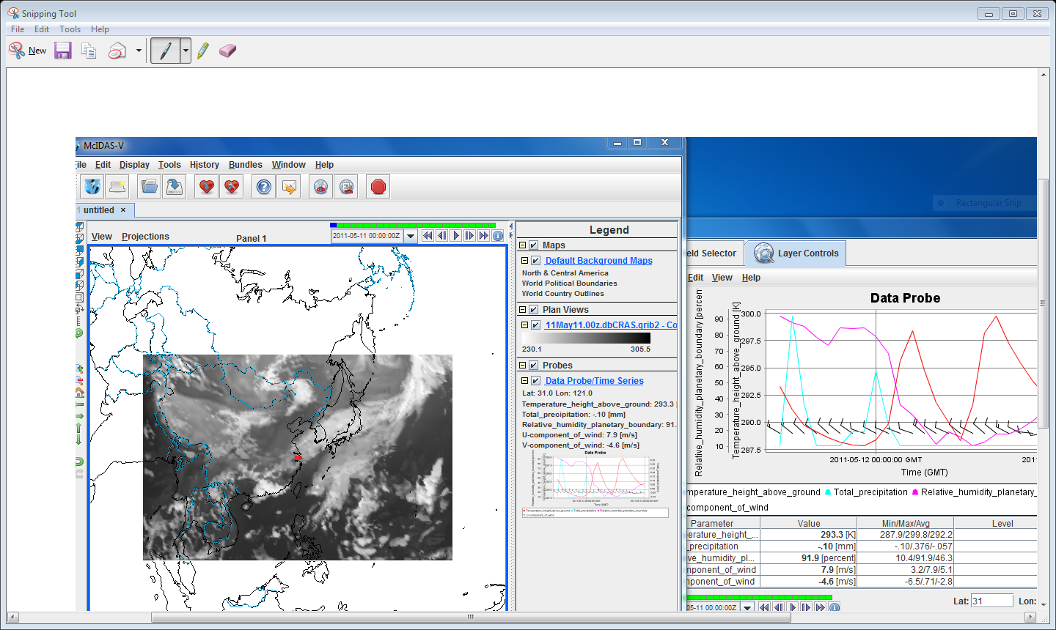
Examining DBCRAS Output

Slide 55
Air Quality Applications
Aerosol Detection

Slide 56
Infusing Satellite Data into Environmental Applications
Used by the US Environmental Protection Agency to Monitor and Forecast Air Quality in the United States
http://www.star.nesdis.noaa.gov/smcd/spb/aq/

Slide 58
Dust Storm Case Study

Slide 59
PM Observations, MODIS AOD and GOES AOD retrieval Time Series

Slide 60
Correlation Between MODIS AOD and PM Observations

Slide 61
Fires

Slide 62
MODIS Fire Detection Applications

Slide 63
MODIS Fire Detection Applications

Slide 64
Forecasting Fire Potential over South Africa sing DBCRAS CSIR Meraka Institute

Slide 65
Global Applications
http://www.wamis.co.za/

Slide 66
Other Applications

Slide 67
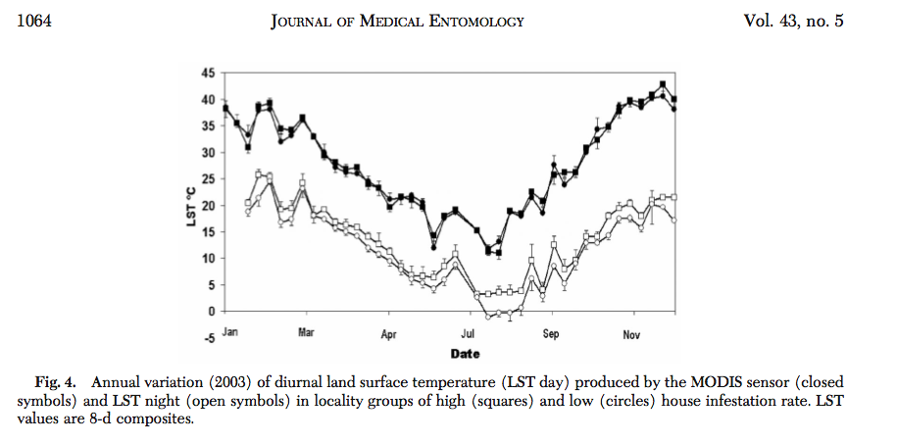
MODIS LST and buggers
Reference: X. Porcasi, , S. S. Catala, H. Hrellac, M. C. Scavuzzo, D. E. Gorla, 2006: Infestation of Rural Houses by Triatoma Infestans
(Hemiptera: Reduviidae) in Southern Area of Gran Chaco in Argentina, J. Med. Entomol. 43(5): 1060-1067.

Slide 68
Using MODIS Sun Glint Patterns
What is sun glint?
Application
Identifying regions of calm waters
Relationship of calm waters and sea surface temperatures

Slide 69
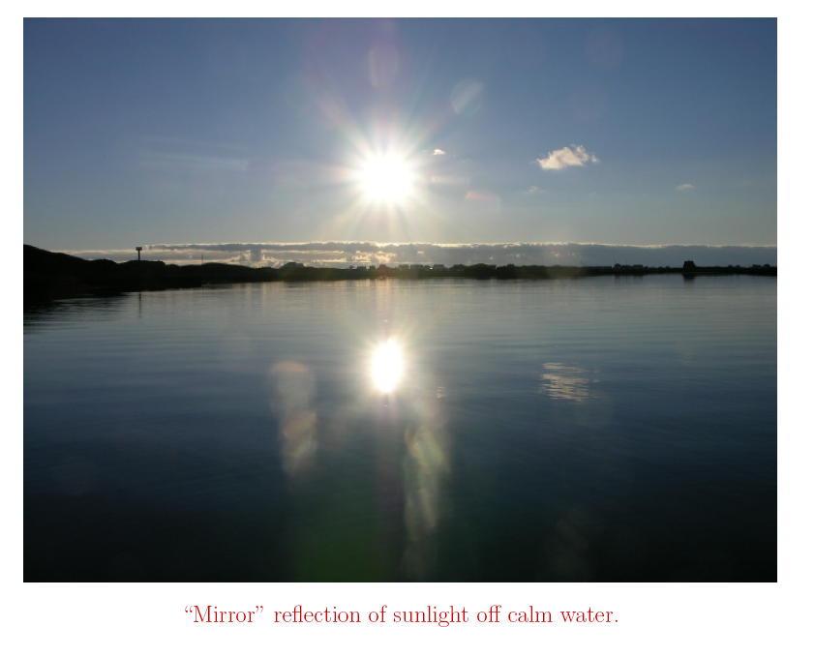
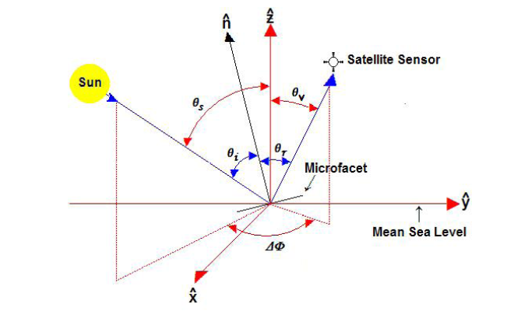
Sun Glint
Simple example where your eye is the sensor
Sun Glint Ellipse Defined by: θ_{r} < 36
cos θ_{r} = sin θ_{v} cos θ_{s} cos ΔΦ + sin θ_{v} cos θ_{s}
Where θ_{v} = Viewing Zenith Angle
θ_{s} = Solar Zenith Angle
ΔΦ = Relative Angle – difference between the Solar and Viewing azimuth angles.

Slide 70
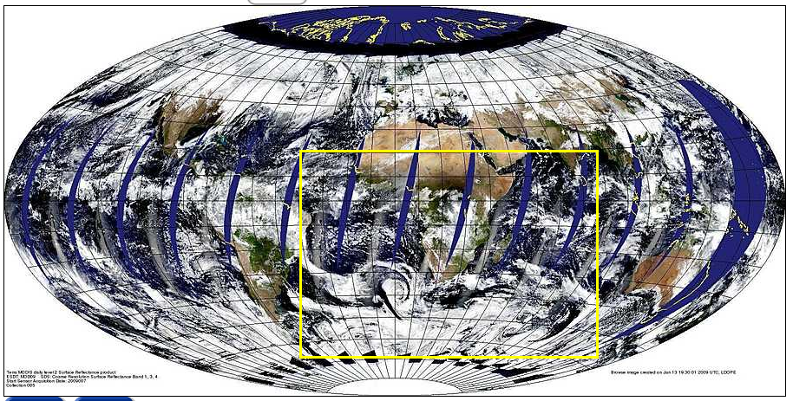
Aqua MODIS Sun Glint Example 7 January 2009

Slide 71
Sun Glint Patterns

Slide 72
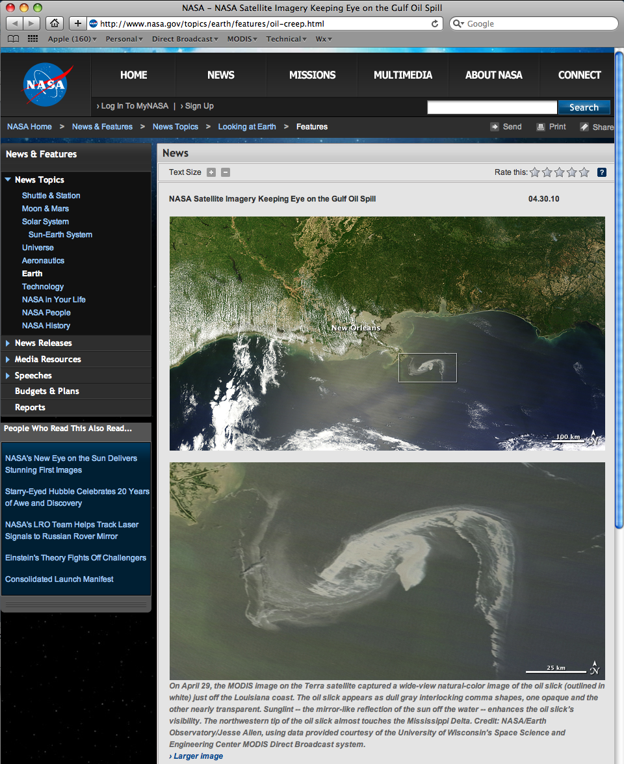
NASA Feature Article 30 April 2010
http://www.nasa.gov/topics/earth/features/oil-creep.html

Slide 73
Example From Lake Michigan 4 June 2009

Slide 74
Numerical Weather Prediction Wind analysis 18 UTC 4 June 2009

Slide 75
MODIS Sea Surface Temperatures 4 June 2009

Slide 76
MODIS 4 μm Brightness Temperatures

Slide 77
MODIS Sunglint Pattern 8 June 2009

Slide 78
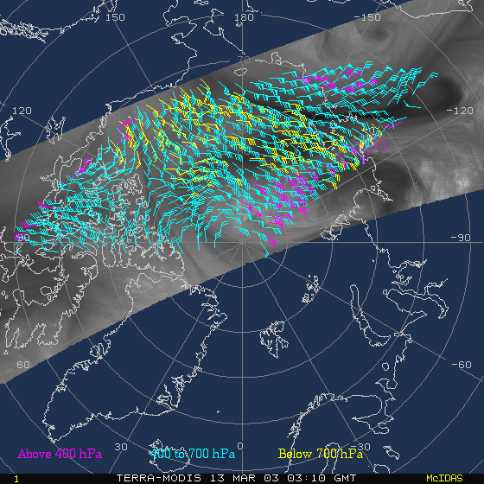
MODIS Polar Wind Vectors can be derived automatically
Jeff Key, Chris Velden, Dave Santek
Wind vectors are generated using automatic feature tracking software developed for GOES.
6.7 µm heights are assigned based on forecast atmospheric profile.
11.0 µm heights are assigned based on window brightness temperature or CO2 cloud height.
Winds are automatically quality controlled.
Terra MODIS 6.7 µm (band 27) 2003/03/13
Notes:
Forecast scores (anomaly correlations) as a function of forecast range for the geopotential at 1000 hPa (left) and 500 hPa (right). Study period is 5-29 March 2001. Forecast scores are the correlation between the forecast geopotential height anomalies, with and without the MODIS winds, and their own analyses. The Arctic (“N. Pole”) is defined as north of 65 degrees latitude.
There is a significant positive impact on forecasts of geopotential from assimilation of MODIS WV winds, particularly for Arctic, but also for whole Northern Hemisphere.

Slide 79
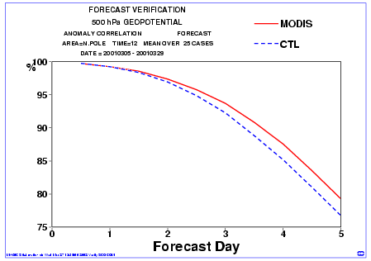
Positive impact on forecast demonstrated by ECMWF
NWP Centers using MODIS Polar Winds Operationally:
ECMWF, GMAO, JMA, CMC, FNMOC, UKMO, DWD, NCEP/EMC
Key, J. R., D. Santek, C. S. Velden, N. Bormann, J.-N. Thépaut, L. P. Riishojgaard, Y. Zhu, and W. P. Menzel, 2003. Cloud-Drift and Water Vapor Winds in the Polar Regions from MODIS. IEEE Transactions on Geoscience and Remote Sensing, 41, 482-492.

