Slide 1
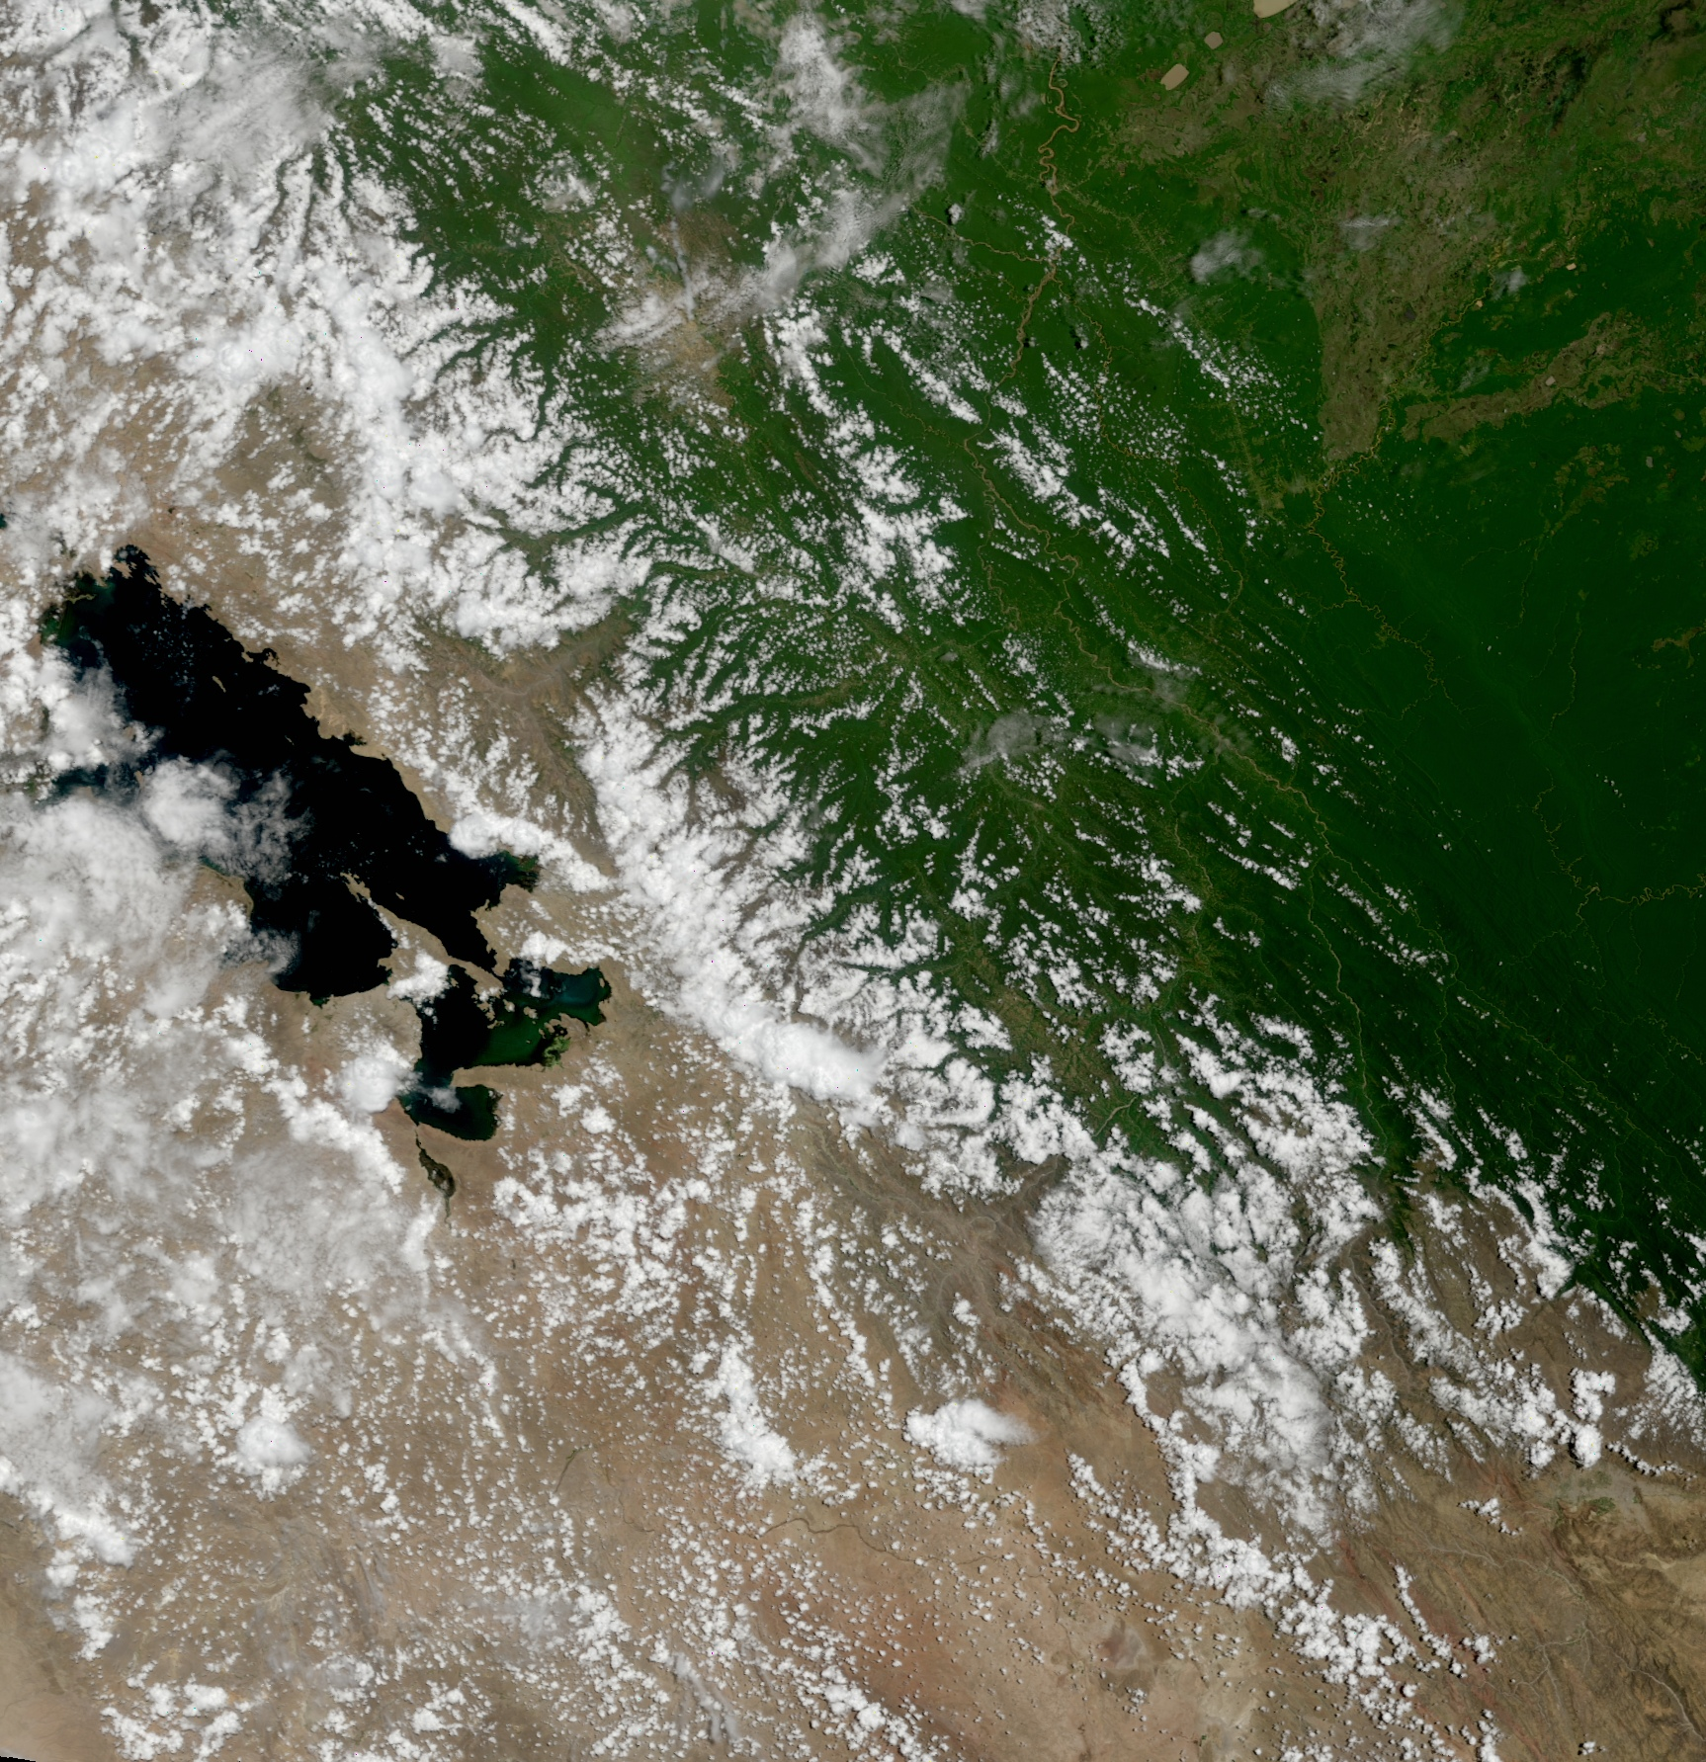
MODIS Products
2011 IMAPP Training Workshop: Satellite Direct Broadcast for Real-Time Environmental Applications
ECNU, China
3 June 2011
Part 3
Kathleen Strabala
Cooperative Institute for Meteorological Satellite Studies
Space Science and Engineering Center
University of Wisconsin-Madison
Notes:
Title slide

Slide 2
MODIS Aerosol Product (MOD04)

Slide 3
Scattering and Absorption of Light by Aerosols
I=Light
Detector (W/m²)
Io=Light Source (W/m²)
L=Path Length
The quantity L is called the density weighted path length. σ_{ext(λ)} L is a measure of the cumulative depletion that the beam of radiation has experienced as a result of its passage through the layer and is often called the optical depth τ_{λ}.

Slide 5
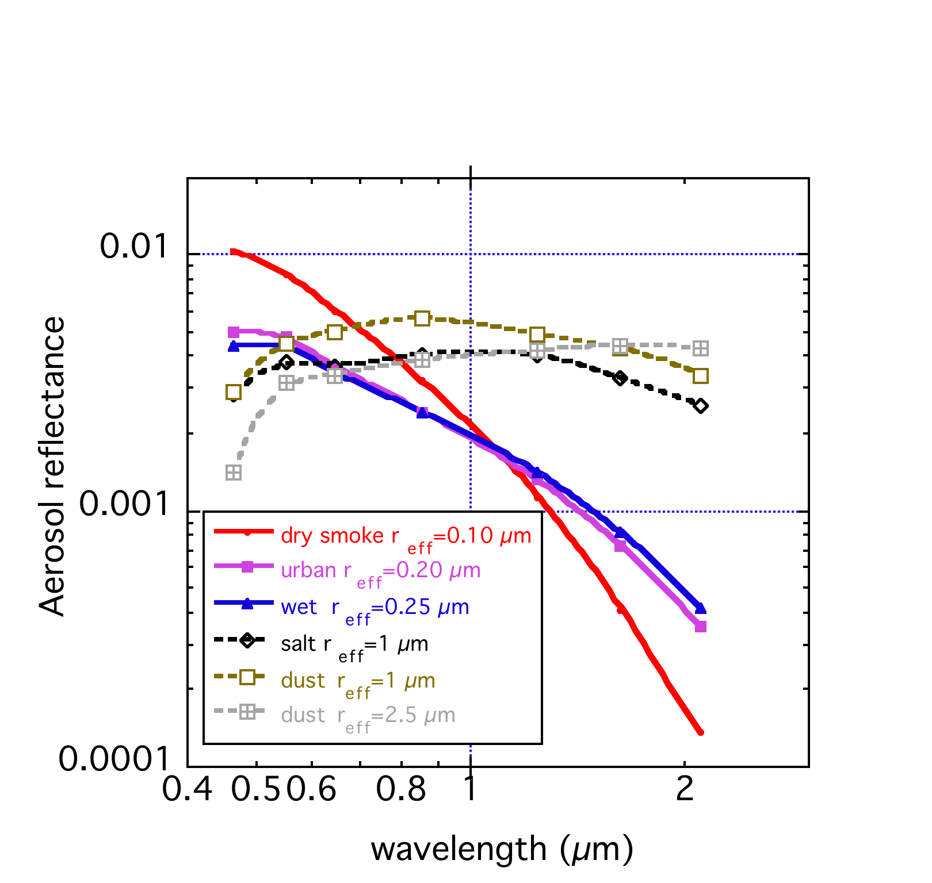
Getting A Best Fit for the Observations Match Theory and Observations

Slide 6
3 non-dust models
plus dust
Set by geography and
season
Models are dynamic f(τ)
Notes:
We have to build a LookUp Table that gives top of atmosphere radiance for a variety of geometries and aerosol amounts. Then we match the observed radiance from MODIS to the calculated radiance in the LUT to get the AOT. But to make the calculation we need to input other information about the aerosol optical properties besides the optical thickness. These assumptions make a big difference in the accuracy of the retireval. Over land we make arbitrary assumptions about the aerosol types depending on season and geography.

Slide 7
The Ocean Algorithm
Choice of 4 fine modes
and 5 coarse modes
And 5 coarse modes
In order to minimize
(ρ_{meas} - ρ_{LUT}) over 6 wavelengths
Notes:
This is the annimation I use to explain the ocean algorithm. Here we don’t worry too much about the ocean surface because it is well-characterized at the wavelengths we use in the retrieval. Because of the constant surface we have more information from the aerosol and can determine both aerosol optical thickness and also aerosol size with good accuracy. The algorithm finds a combination of one fine mode and one coarse mode, and the relative amounts of each that best match the measured reflectances at top of atmosphere in 6 wavelengths. When it makes the match, everybody is happy.

Slide 8
MODIS Over Land Algorithm
20 x 20 pixels at 500 m resolution
(10 km at nadir)
400 total
- 56 water
________
344
- 24 snow
________
320
- 55 cloud
_______
265
-116 “bright”
________
149 “good”
water
snow
cloud
cloud
Discard brightest 50%
and darkest 20% of the
149 good pixels.
10 km
44 pixels
Notes:
Here we show why we retrieve at 10 km resolution even though we use 500 m pixels. We are in the data discarding business! In a 10 km box we have 20 x 20 pixels at 500 m (400 total). In this land scene we eliminate pixels identified as water, snow or cloud and are left with 265 pixels. Then because we are looking for dark vegetated surfaces, we eliminate the pixels determined to be too bright. That brings us down to 149 good pixels. We aren’t done yet! Then we systematically discard the brightest 50% of the pixels to be sure to eliminate residual cloud or bright surfaces, and also the darkest 20% to eliminate cloud shadows. From the original 400 pixels we are left with 44 pixels. We average the measured reflectances of these 44 pixels and do the retrieval from them. All we need in the 10 km box is 12 remaining pixels to do a retrieval.

Slide 9
MOD04 Key Output Parameters 10x10 pixel (1km) resolution
Optical_Depth_Land_And_Ocean –
Aerosol Optical Thickness (AOT) at 0.55 microns for both ocean (best) and land (corrected)
Optical_Depth_Ratio_Small_Land_And_Ocean - Ratio of small mode optical depth to total at 0.55 microns
Corrected_Optical_Depth_Land (3 bands) - Corrected optical thickness at 0.47, 0.55, and 0.66 microns
Effective_Optical_Depth_Average_Ocean (7 bands) - AOT at seven bands for average solution at .47, .55, .66, .86, 1.2, 1.6 and 2.1 microns

Slide 10
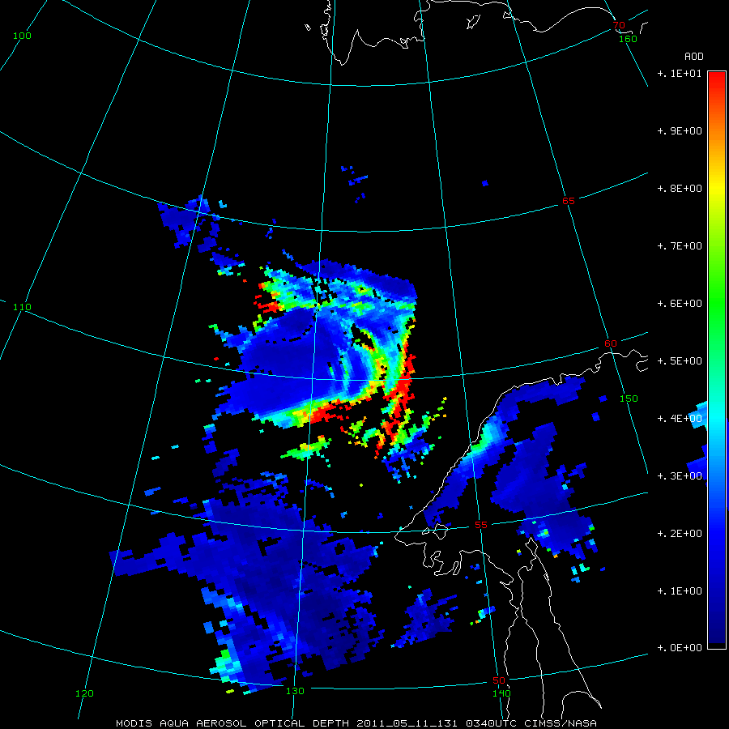

Slide 11
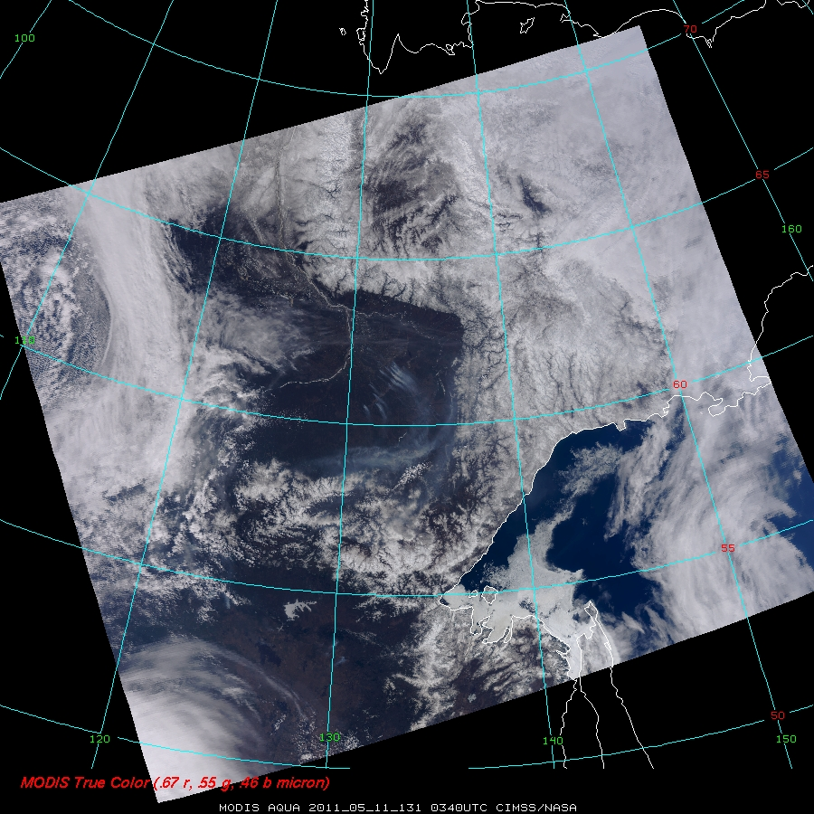

Slide 12
How does the DB product differ from the NASA archived product?
Not HDFEOS (Straight HDF4)
DB version includes 4 arrays only
No Deep Blue algorithm included
Collection 6 (before the end of the year) will include:
One product that includes the best retrieval for the pixel
Ocean/Land or Deep Blue
1 km retrieval

Slide 13
Richard Kleidman

Slide 14
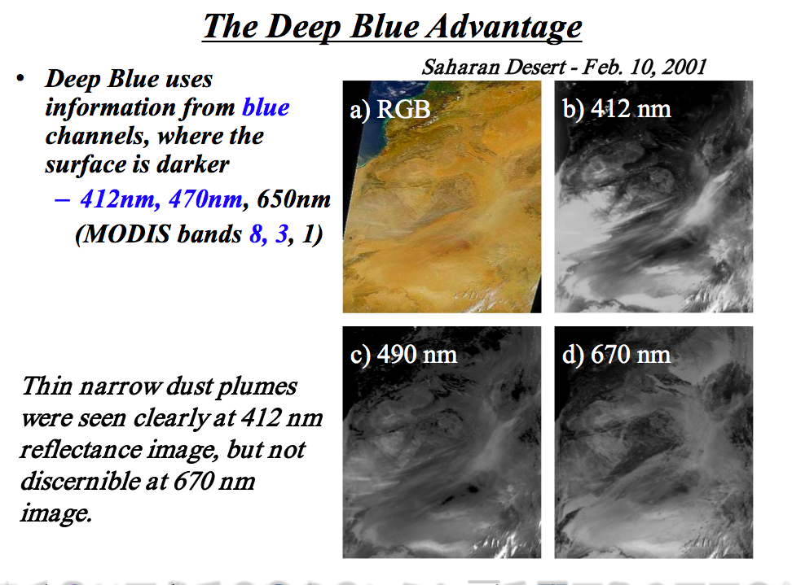
Richard Kleidman

Slide 15
References
Levy, R. C., L. A. Remer, and O. Dubovik, 2007: Global aerosol
optical properties and application to Moderate Resolution
Imaging Spectroradiometer aerosol retrieval over land.
J. Geophys. Res., 112, D13210
Levy, R. C., L. Remer, S. Mattoo, E. Vermote, and Y. J.
Kaufman, 2007: Second-generation algorithm for retrieving
aerosol properties over land from MODIS spectral
reflectance. J. Geophys. Res., 112, D13211, 22 pages.
Remer, L. A., Y. J. Kaufman, D. Tanre, S. Mattoo, D. A. Chu,
J. V. Martins, R-R. Li, C. Ichoku, R. C. Levy, R. G. Kleidman,
T. F. Eck, E. Vermote, & B. N. Holben, 2004: The MODIS
Aerosol Algorithm, Products and Validation. Journal of
Atmospheric Sciences, 64, 4, 947-973.

Slide 16
What is IDEA?

Slide 17
IDEA: NASA-EPA-NOAA partnership to improve air quality assessment, management, and prediction by infusing (NASA) satellite measurements into (EPA, NOAA) analyses for public benefit.
IDEA (Infusing satellite data into environmental air quality applications)
Part of NASA Earth Science Enterprise (ESE) Applications Program strategy to demonstrate practical uses of NASA sponsored observations from remote sensing systems and predictions from scientific research.

Slide 18
Simple IDEA-I Tutorial
Brad Pierce

Slide 19
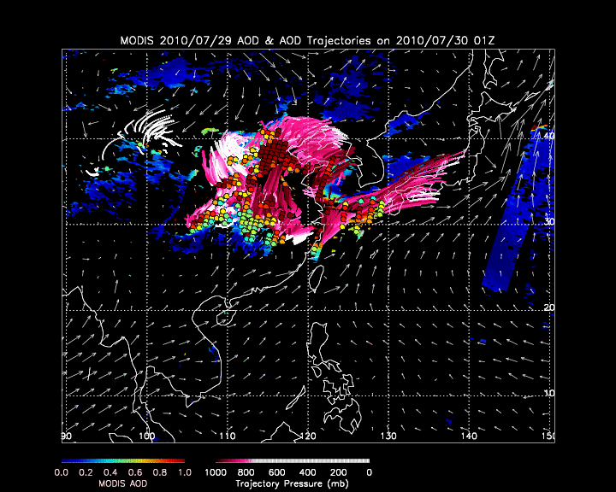
Trajectory Forecast
The trajectory forecast animation displays the most important components of an aerosol forecasts

Slide 20
Trajectory Forecast
The trajectory forecast animation displays the most important components of an aerosol forecasts
MODIS
Aerosol Optical Depth
(AOD)

Slide 21
Trajectory Forecast
The trajectory forecast animation displays the most important components of an aerosol forecasts
High AOD areas

Slide 22
Trajectory Forecast
The trajectory forecast animation displays the most important components of an aerosol forecasts
Air Parcel Trajectories

Slide 23
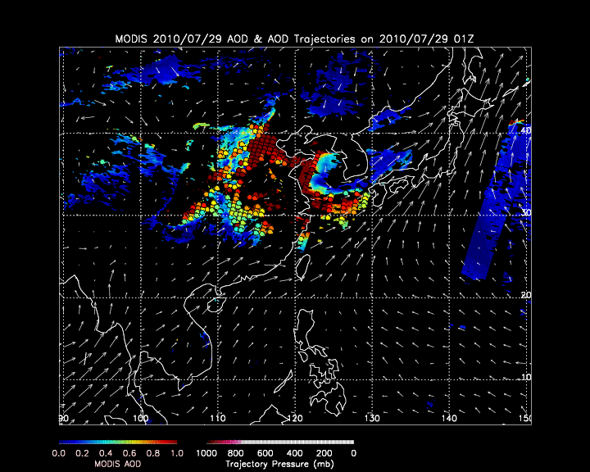
Trajectory Forecast - Initialization
The trajectory forecast begins when the MODIS overpass occurs
High values of AOD (>0.4) are located and used to initialize the trajectories

Slide 24
Trajectory Forecast - Initialization
The high MODIS AOD values are determined by calculating mean AOD values on a 50kmx50km grid, or 5 pixels square

Slide 25
Trajectory Forecast
The trajectories are initialized at the high AOD values at 50mb, 100mb, 150mb, and 200mb above the surface
The air parcel trajectories are run using the 12Z NOAA/NCEP GFS forecast data providing a 48hr forecast via trajectories
The pressure levels of the trajectories are plotted in mb and colored to a magenta-white scale. White indicates that the air parcel no longer affects the surface

Slide 26
Trajectory Forecast
The most recent 12 hours of the 48 hour forward trajectories are plotted at each frame of the animation.
The most recent day of MODIS data remains on the plot.
The 850mb wind field vectors are plotted to show wind direction and speed.

Slide 28
IDEA-I Notes

Slide 29
References
Al-Saadi, J. A. et al., 2005: Improving National Air Quality Forecasts with Satellite Aerosol Observations, BAMS, DOI:10.1175/BAMS-86-9-1249.

Slide 30
References continued
R. Bradley Pierce, et. al, “Impacts of background ozone production on Houston and Dallas, Texas, air quality during the Second Texas Air Quality Study field mission”, JOURNAL OF GEOPHYSICAL RESEARCH, VOL. 114, D00F09, doi:10.1029/2008JD011337, 2009
R. Bradley Pierce and T. Duncan A. Fairlie, 1993 “Chaotic Advection in the Stratosphere- Implications for the Dispersal of Chemically Perturbed Air From the Polar Vortex”, JOURNAL OF GEOPHYSICAL RESEARCH, VOL. 98, NO. D10, PAGES 18,589-18,595.

Slide 31
Trajectory Model and .dat files
Trajectory Model is included in the IDEA-I
GFS_traject_3d_v01.f
Located in the /ideai/IMAPP_IDEA/Traject
Trajectory forecast images are created from the daily trajectory forecast .dat files
Ex: traj_48hr_20110531.dat
Dr. Bradley Pierce gave me information about how to read the .dat files using an IDL program. Ask, and I will give it to you.

Slide 32
Limitations
Terra only retrievals
Limitations of MOD04
Clouds
Bright surfaces
10 km resolution
Aerosols too thick
The time it takes to run the trajectory forecast is proportional to how much aerosols are found (~3 hours)

