Slide 1
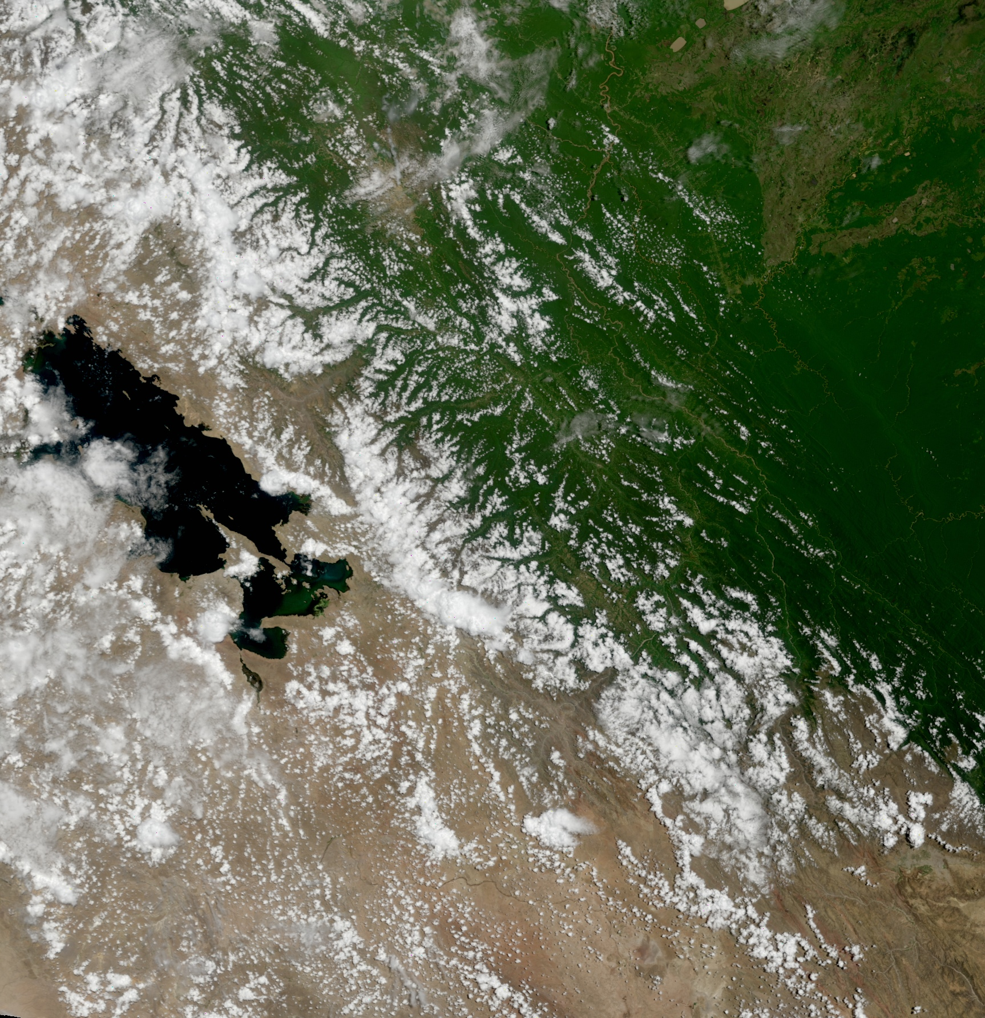
MODIS Products
2011 IMAPP Training Workshop: Satellite Direct Broadcast for Real-Time Environmental Applications
ECNU, China
2 June 2011
Part 2
Kathleen Strabala
Cooperative Institute for Meteorological Satellite Studies
Space Science and Engineering Center
University of Wisconsin-Madison
Notes:
Title slide

Slide 2
MODIS Standard Land Products
Land
MOD 09 - Surface Reflectance
MOD 10 - Snow Cover
MOD 11 - Land Surface Temperature & Emissivity
MOD 12 - Land Cover/Land Cover Change
MOD 13 - Gridded Vegetation Indices (NDVI & EVI)
MOD 14 - Thermal Anomalies (Fires)
MOD 15 - Leaf Area Index & FPAR
MOD 16 - Evapotranspiration
MOD 17 - Net Photosynthesis and Primary Productivity
MOD 29 - Sea Ice Cover
MOD 43 - Bidirectional Reflectance Distribution Function (BRDF)
MOD 44 - Vegetation Cover Conversion

Slide 3
MODIS Vegetation Indices

Slide 4
Photo-Chemistry
Light may be absorbed and participate in (drive) a chemical reaction. Example: Photosynthesis in plants
Only certain wavelengths are absorbed by some participant(s) in the reaction
Some structure must be present to allow the reaction to occur –Chlorophyll
Combination of chemical and structural properties of plants

Slide 5
Primary and secondary absorbers in plants
Primary
Chlorophyll-a
Chlorophyll-b
Secondary
Carotenoids
Phycobilins
Anthocyanins

Slide 6
Absorption of Visible Light by Photo-pigments
Sunlight
Intensity
Chlorophyll b
Phycocyanin
Absorption
B-Carotene
Chlorophyll a
300 400 500 600 700 800
Wavelength [nm]
Lehninger, Nelson and Cox

Slide 8
Theoretical description
VISIBLE radiation is highly absorbed
by vegetation in the red (0.68 micron)
and in the blue (0.47 micron). The
absorption is mainly due to
photosynthetically active pigments
NIR radiation is reflected
and transmitted with very
little absorption by vegetation
Contrast between RED and NIR
responses is correlated to
vegetation amount

Slide 9
Soil and crop reflectance

Slide 10
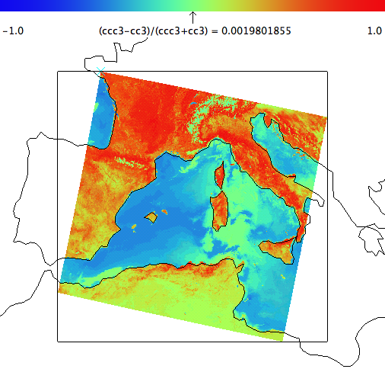
Normalized Difference Vegetation Index (NDVI)
Defined as the ratio (r_{.86} - r_{.68})/(r_{.86} + r_{.68})
Correlated with:
Plant Biomass | Crop Yield
Plant Nitrogen | Plant Dhlorophyll
Water Stress | Plant Diseases
Insect Damage
Applications:
Vegetation Monitoring | Agricultural Activities
Drought studies | Landcover Change
Public Health Issues (mosquitos) | Climate Change Detection
Net Primary Production | Carbon Balance

Slide 11
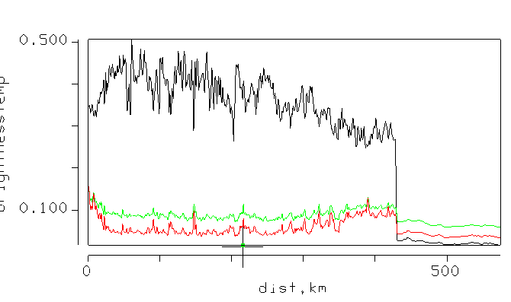
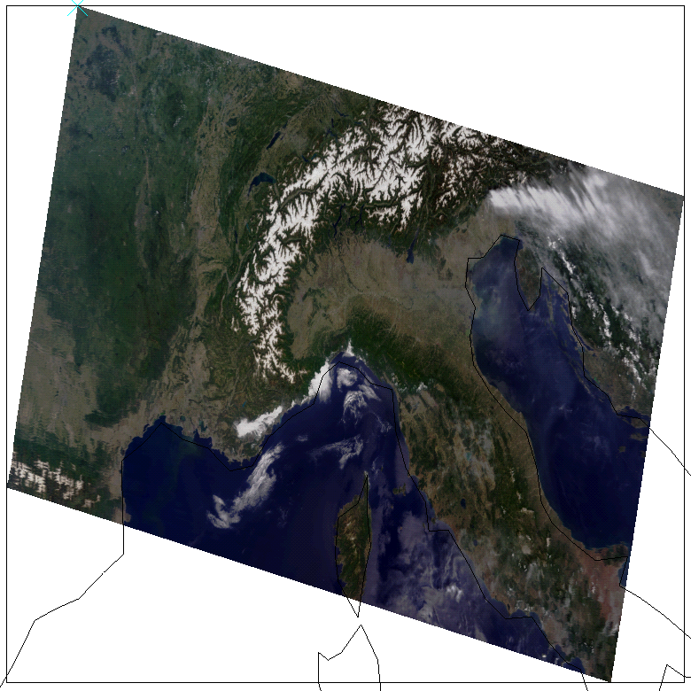
NIR and VIS over Vegetation and Ocean
Vegetation
Ocean
NIR (.86 micron)
Green (.55 micron)
Red (0.68 micron)
RGB
NIR

Slide 12
Enhanced Vegetation Index (EVI)
Where L is a canopy background adjustment term (Set to 1)
C₁ and C₂ are called aerosol resistance terms (Set to 6 and 7.5 respectively) G is the gain factor (Set to 2.5)
Improved sensitivity in high biomass regions
(de-coupling of canopy background signal)
Improved results in areas of high aerosol concentrations (uses blue band to correct for aerosols in red band)
Based on knowledge of wavelength dependency of aerosol effects

Slide 13
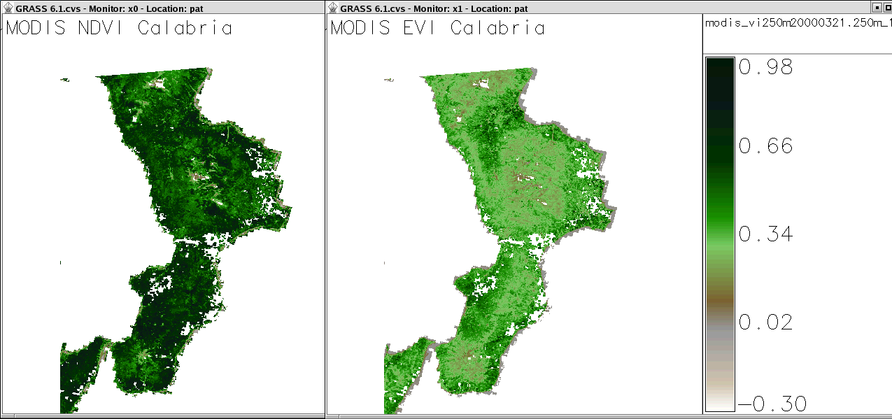
Comparison of NDVI and EVI
Both NDVI and EVI maps are colored with identical color table
(MODIS/Terra scene MOD13, composite of 21 March - 5 April 2000, Calabria, Southern Italy).
EVI is less prone to atmospheric distortion (from http://mpa.itc.it/rs/modis_ndvi_evi/)

Slide 14
How does DB VI version differ from the MOD13 product?
DB VI product uses the corrected reflectance, but not the MODIS surface reflectance MOD09 product
Corrected reflectance product removes the effects of the small particle scattering (Rayleigh scattering), but not the Mie scattering (includes aerosols)
NASA VI product (MOD13) uses the BRDF (Bidirectional Reflectance Distribution Function) product as input

Slide 15
Surface Reflectance (MOD09)
The surface reflectance product is defined as the reflectance that would be measured at the land surface if there were no atmosphere.

Slide 16
Surface Reflectance
ρ_{TOA} is the reflectance observed at the top of the atmosphere,
T_{g} refers to gaseous transmission,
ρ_{R} is the molecular scattering intrinsic reflectance,
ρ_{R+A} is the intrinsic reflectance of the molecules and aerosols,
T _{R +A} is the transmission of the molecules and aerosols and
S_{R+A} is the spherical albedo.

Slide 17
The effects of atmospheric and surface reflection are not uniform across a scan This will affect your retrievals
Example from MODIS Today web site

Slide 18
Importance of aerosol
correction when
Retrieving NDVI over China

Slide 19
Reference
E.F. Vermote, Nazmi Z. El Saleous, Christopher O. Justice, “Atmospheric correction of MODIS data in the visible to middle infrared: first results”. Remote Sensing of the Environment 83. (2002), 97–111.

Slide 20
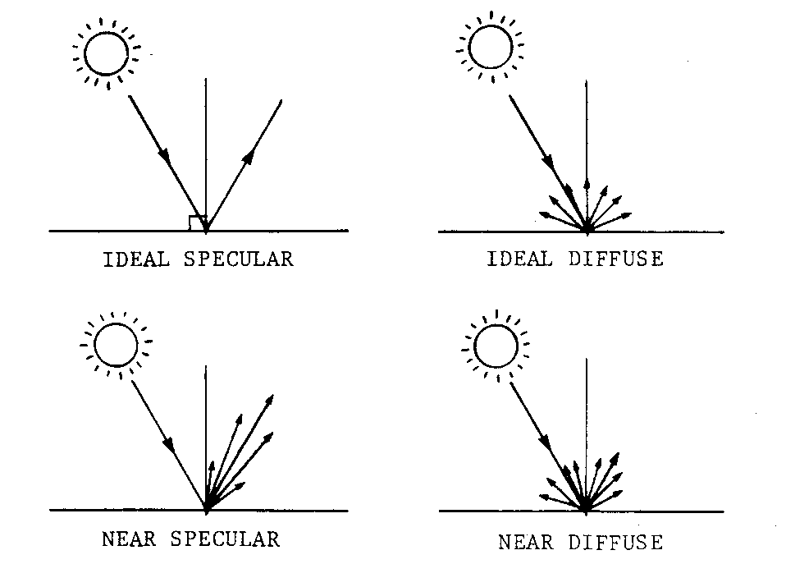
BRDF (Bi-directional Reflectance Distribution Function)
Wolfgang Lück

Slide 21
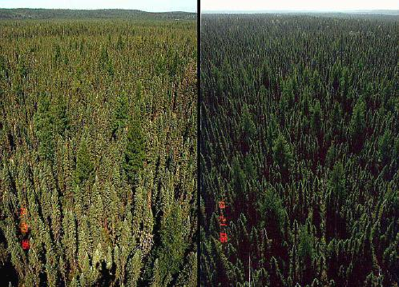
BRDF Example
Black spruce forest in Canada.
Left, sun behind camera
Right, sun opposite

Slide 22
BRDF modeled refectances 16 days of UW MODIS DB data
18 April 2010

Slide 23
Inputs and Processing Chain for MODIS VI Production
Level1B,
Geolocation
Cloud
Masking
Atmospheric
Correction
(Surface
Reflectance)
16 Day modeled
reflectances over
a grid cell (BRDF)
VI
Equation

Slide 24
BRDF References
Shuai,Y., C. B. Schaaf, A. H. Strahler, J. Liu, Z. Jiao, Quality assessment of BRDF/albedo retrievals in MODIS operational system, Geophys. Res. Lett., 35, L05407, doi:10.1029/2007GL032568,2008.
Schaaf, C. B., F. Gao, A. H. Strahler, W. Lucht, X. Li, T. Tsang, N. C. Strugnell, X. Zhang, Y. Jin, J.-P. Muller, P. Lewis, M. Barnsley, P. Hobson, M. Disney, G. Roberts, M. Dunderdale, C. Doll, R. d'Entremont, B. Hu, S. Liang, and J. L. Privette, and D. P. Roy,First Operational BRDF, Albedo and Nadir Reflectance Products from MODIS, Remote Sens. Environ., 83, 135-148, 2002.

Slide 25
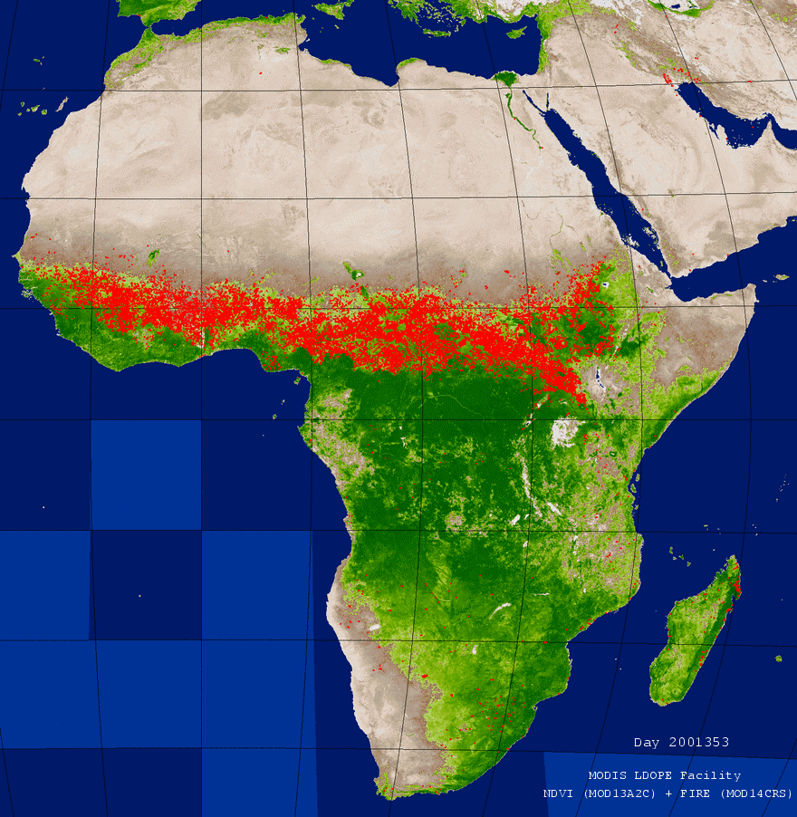
Relevance of NDVI: FIRES
http://landweb.nascom.nasa.gov/animation/area.html

Slide 26
REFERENCES
MOD13 Web Page:
Citation:
Ramachandran, Bhaskar, Justice, Christopher O., Abrams, Michael J., Huete, Alfredo, Didan, Kamel, Leeuwen, Willem, Miura, Tomoaki and Ed Glenn. MODIS Vegetation Indices, Land Remote Sensing and Global Environmental Change, Remote Sensing and Digital Image Processing: 2011. Springer New York, 978-1-4419-6749-7, Physics, 579-602.
Huete, A., K. Didam, T. Miura, E.P. Rodiguez, X. Gao and L.G. Ferreira: 2002. Overview of the radiometric and biophysical performance of the MODIS vegetation indices: 2002. Remote Sensing of the Environment, 83, 195-213.
Algorithm Theoretical Basis Document (ATBD)
http://modis.gsfc.nasa.gov/data/atbd/atbd_mod13.pdf

Slide 27
Applications
Monitoring of seasonal, inter-annual, and long term variations of vegetation structure and biophysical parameters
Climate Studies - Model input
Famine Early Warning - Drought
Epidemiology
Correlated with Net Primary Production
Fire Potential - US National Weather Service Forecasters

Slide 28
MODIS NDVI
Product from ECNU
28 October 2010

Slide 29
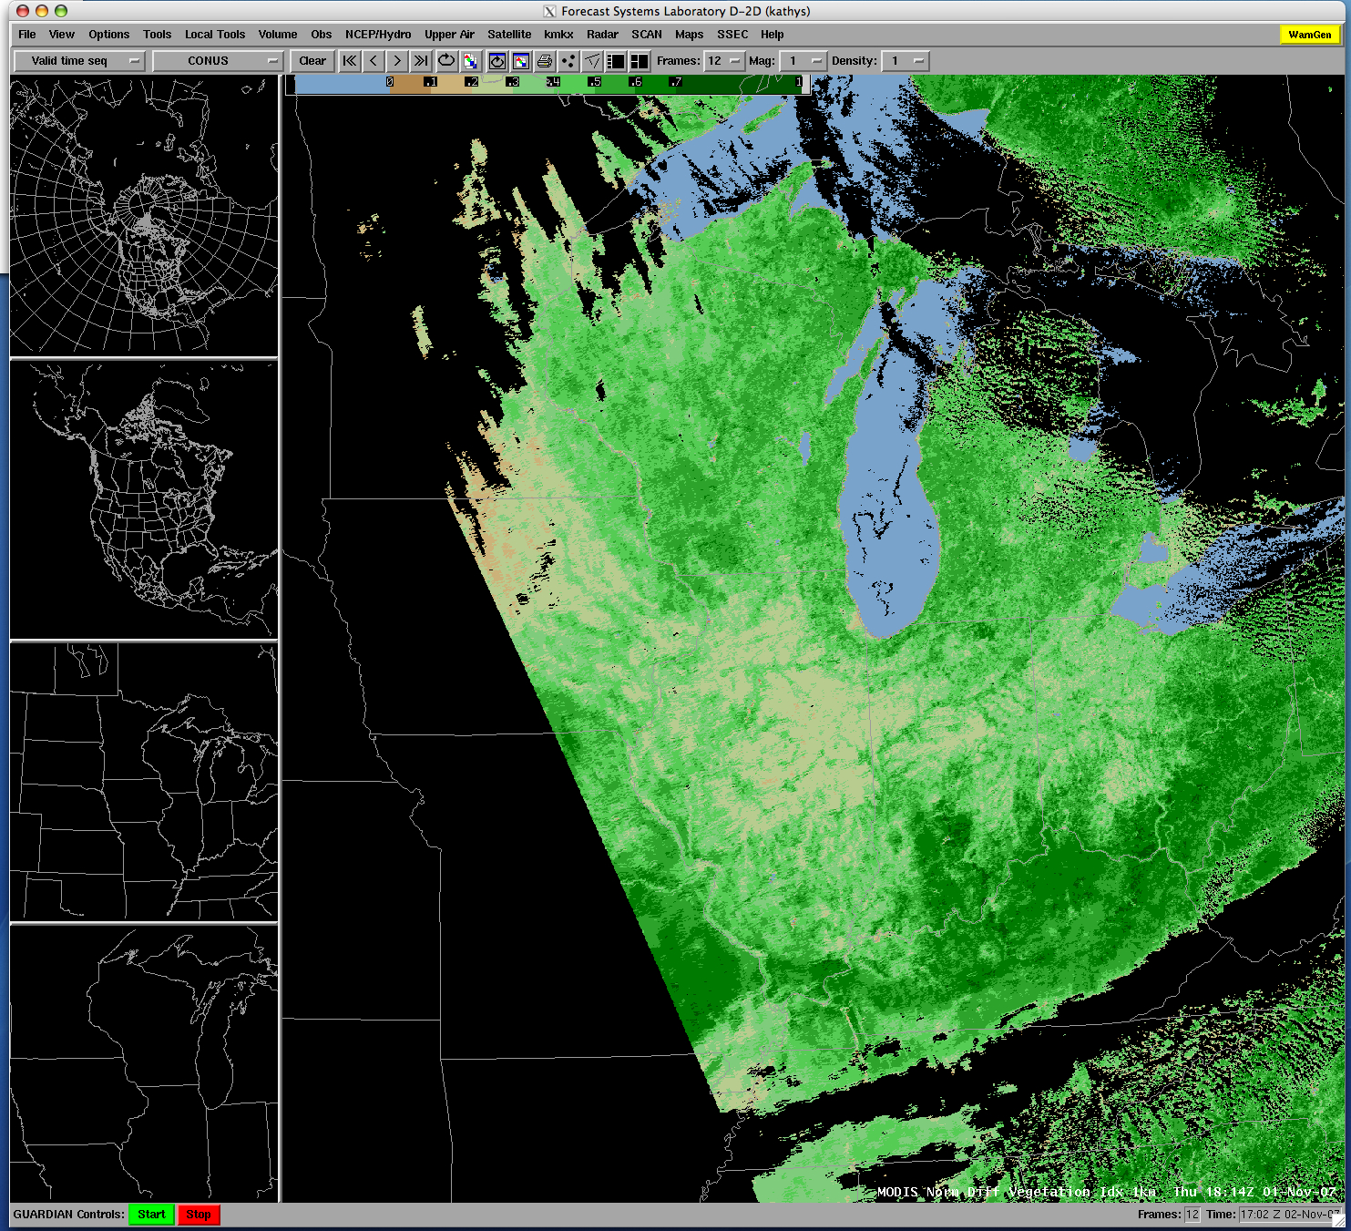
Example of MODIS NDVI product viewed by US Operational Forecasters in AWIPS 1 November 2007

Slide 30
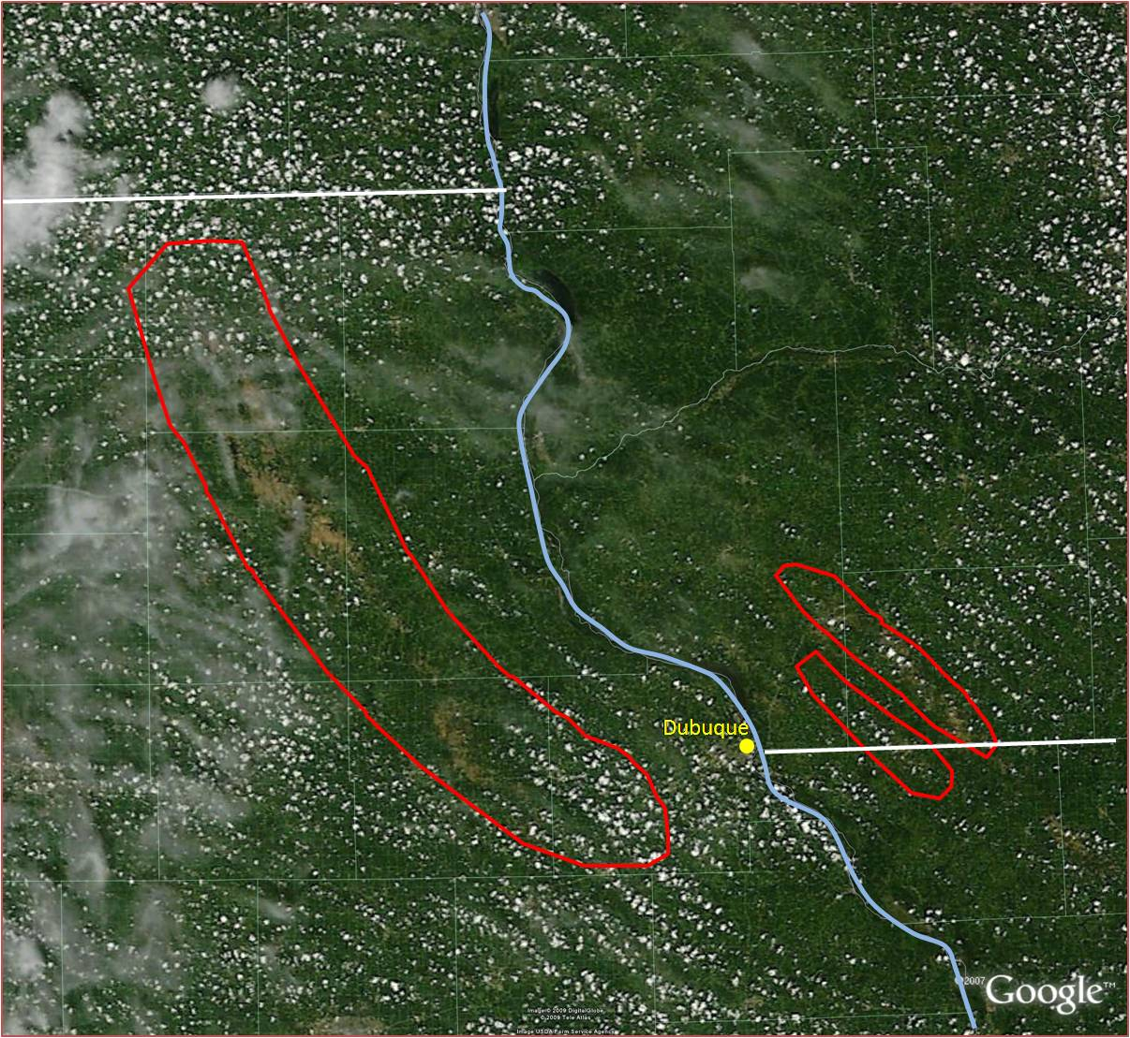
MODIS NDVI product
used to determine
extent of hail damage
July 2008

Slide 31
MODIS Fire Product (MOD14)

Slide 32
MODIS Fire Product Louis Giglio Chris Justice
Based upon the Temperature Sensitivity difference between 4 and 11 microns
Contextual Fire Detection Algorithm
Infrared static Brightness Temperature thresholds
Dynamic thresholds compare pixel to surrounding background
Swath based

Slide 33
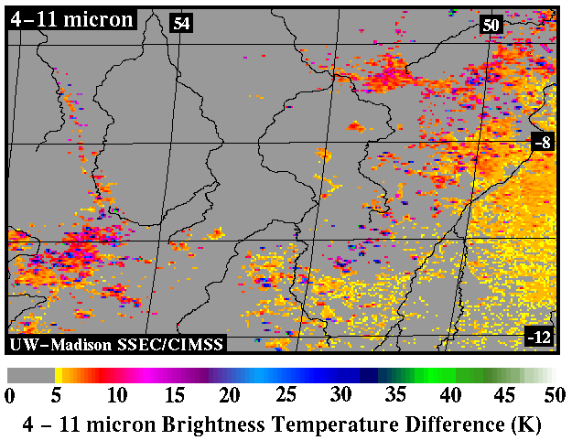
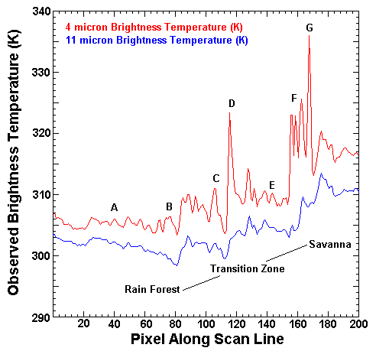
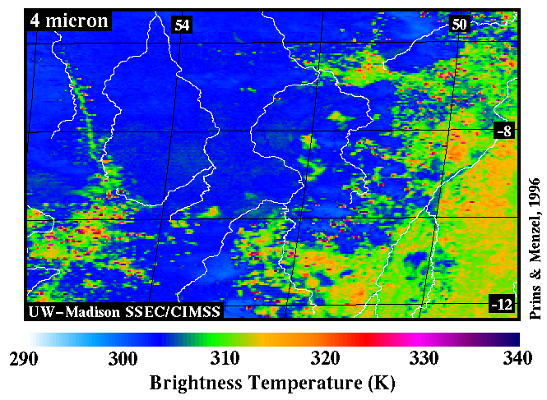
How are Meteorological Satellites Used to Monitor Fires?
Pixel
p
1-p

Slide 34
Temperature Sensitivity
dB/B = α dT/T
α = c₂/λT B is proportional to T^{α}
Wavelength Typical Scene Temperature Temperature Sensitivity
(4.0 μm) 300 11.99
(11 μm) 300 4.32
T(4)**12=P*T_{fire}**12+(1-P)*T**12 ~ P*400**12+(1-P)*300**12
T(11)**4=P*T**4_{fire}+(1-P)*T**4 ~ P*400**4+(1-P)*300**4
Warm part of pixel has more influence for B(4) than B(11)

Slide 35
Temperature Sensitivity of B(λ,T) for typical earth scene temperatures
B (λ, T) / B (λ, 273K)
4μm
2
1
6.7μm
10μm
15μm
microwave
250 300
Temperature (K)

Slide 36
B(10 um,T) / B(10 um,273) ∝ T⁴
B(10 um,273)= 6.1
B(10 um,200)= 0.9 → 0.15
B(10 um,220)= 1.7 → 0.28
B(10 um,240)= 3.0 → 0.49
B(10 um,260)= 4.7 → 0.77
B(10 um,280)= 7.0 → 1.15
B(10 um,300)= 9.9 → 1.62
1
200 300

Slide 37
B(4 um,T) / B(4 um,273) ∝ T¹²
B(4 um,273)= 2.2 x 10⁻¹
B(4 um,200)= 1.8 x 10⁻³ → 0.0
B(4 um,220)= 9.2 x 10⁻³ → 0.0
B(4 um,240)= 3.6 x 10⁻² → 0.2
B(4 um,260)= 1.1 x 10⁻¹ → 0.5
B(4 um,280)= 3.0 x 10⁻¹ → 1.4
B(4 um,300)= 7.2 x 10⁻¹ → 3.3
1
200 300

Slide 38
MOD14 Key Output Parameters 1km resolution
fire_mask 8 bit unsigned integer
0 missing input data
3 water
4 cloud
5 non-fire
6 unknown
7 fire (low confidence)
8 fire (nominal confidence)
9 fire (high confidence)
Line and element of fire pixel
Latitude and longitude of fire pixel
Fire pixel confidence (one value for each fire detected per scene)

Slide 39
Algorithm Description
MODIS bands 21 and 22 (3.99 micron)
Band 22 saturates at 331 K
Band 21 “fire channel” saturates at ~ 500 K
12 bit range broader – less sensitive
The calibration of B21 uses fixed calibration coefficients and not using the scan-by-scan onboard black body (more noise)
So use Band 22 unless it is saturated
MODIS band 31 (11 micron)
Saturates at ~ 400 K for Terra
Saturates at ~ 340 K for Aqua

Slide 40
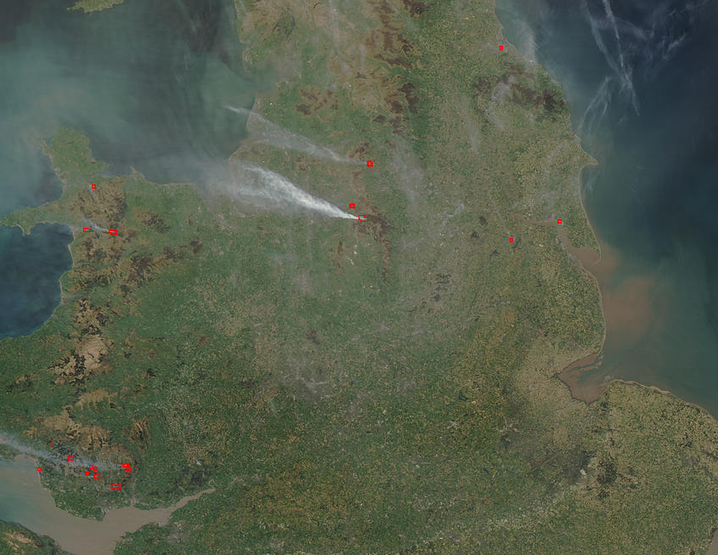
Algorithm Description (cont.)
Aqua MODIS true color image 18 April 2003 12:45 UTC

Slide 41
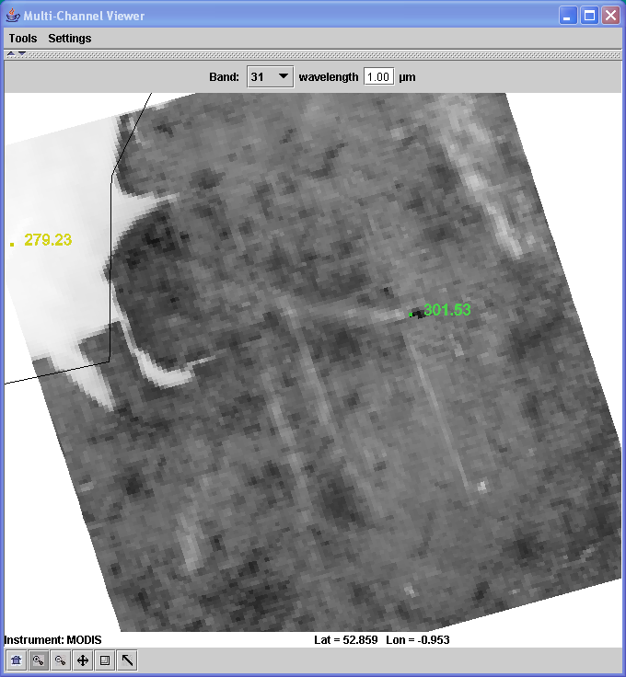
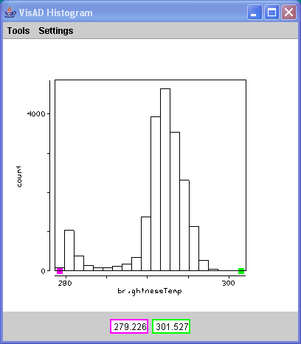
Band 31 Example

Slide 42
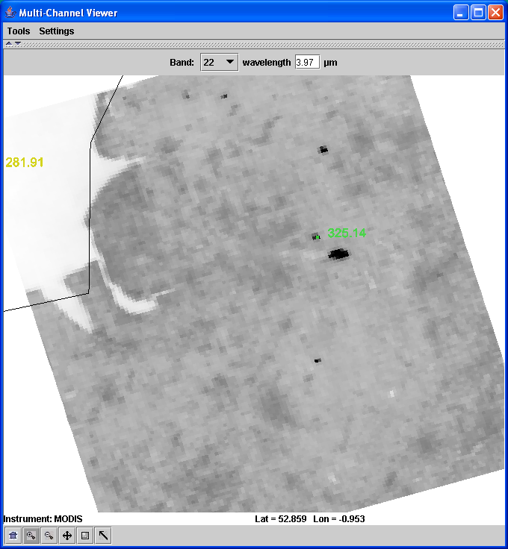
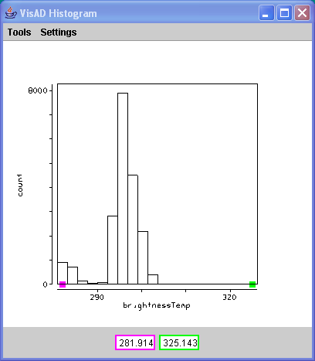
Band 22 Example

Slide 43
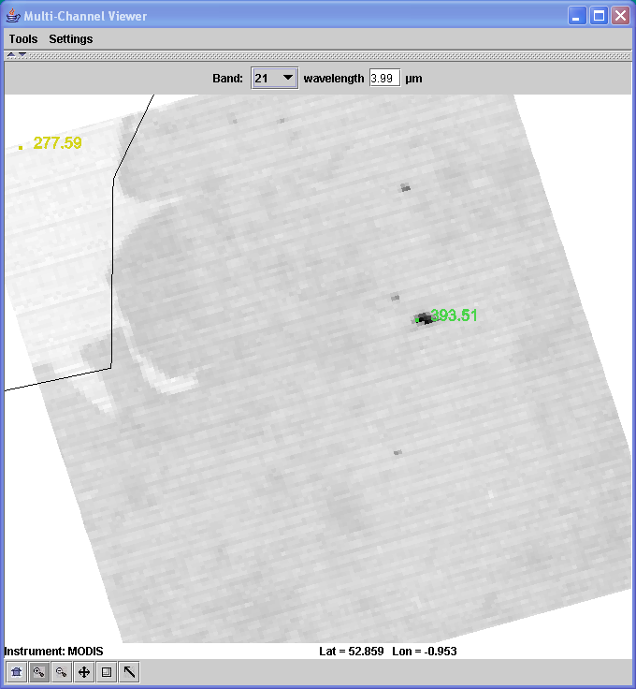
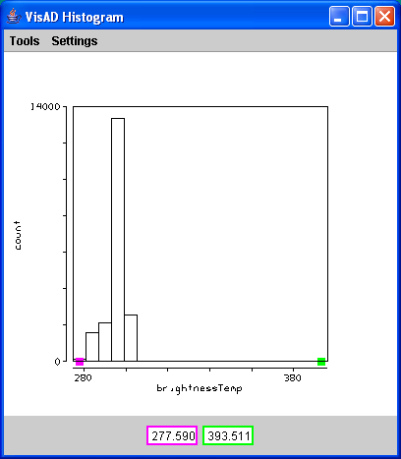
Band 21 Example

Slide 44
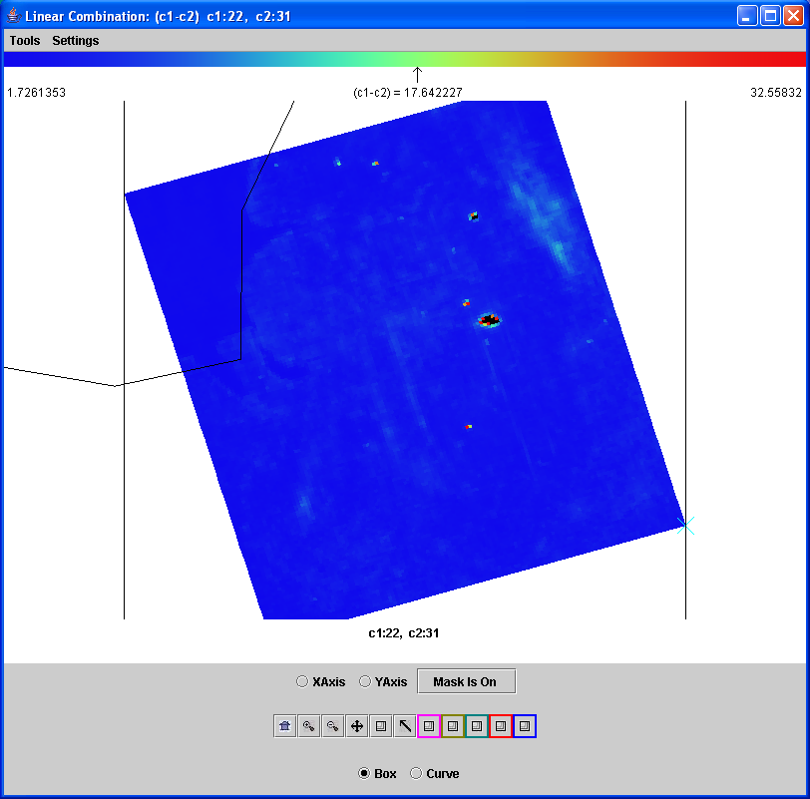
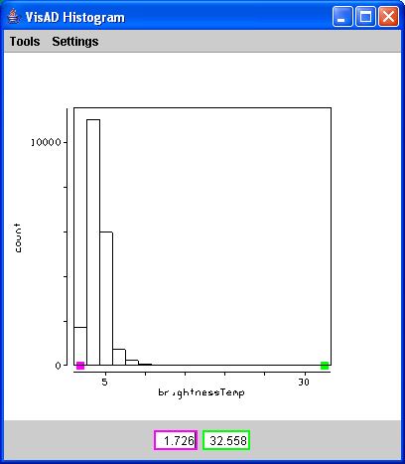
Band 22 – Band 31 Example

Slide 45
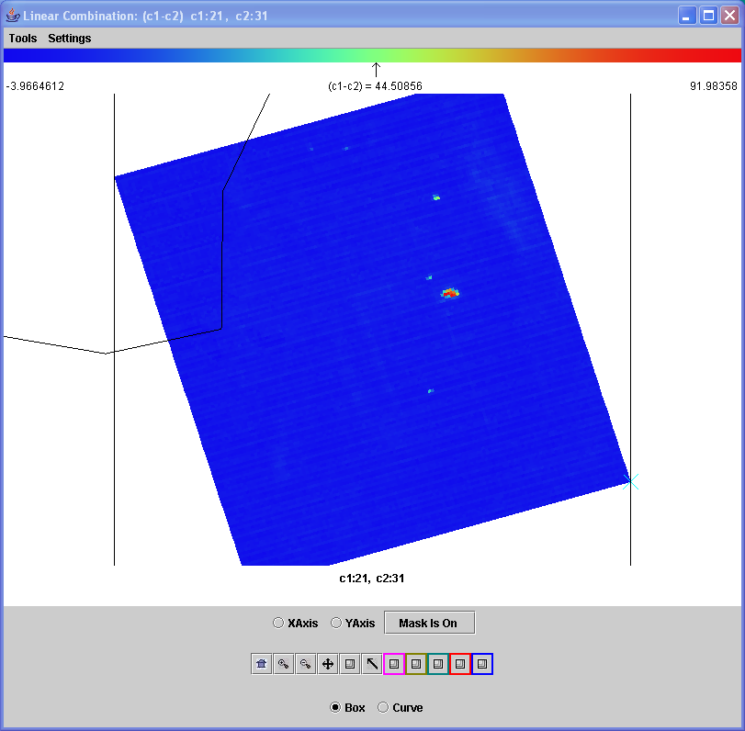
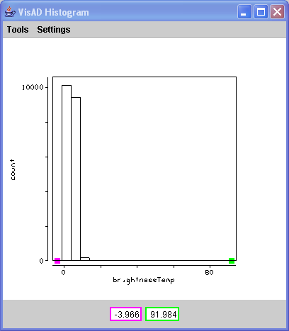
Band 21 – Band 31 Example

Slide 46
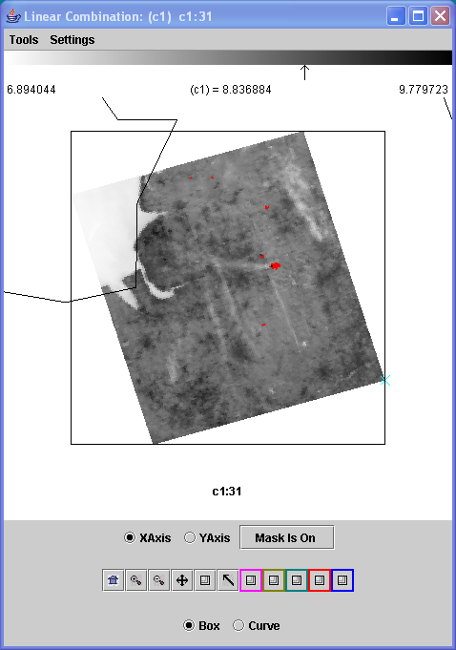
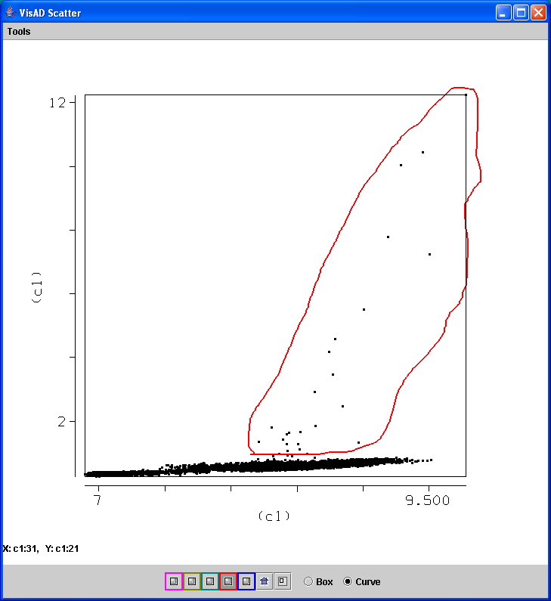
Example of Relationship between Planck Radiance of 4 and 11 microns

Slide 47
Algorithm Description (cont.)
Potential Fire Pixel identified
BT4 > 310 K (~37 C)
BT4-11 > 10 K
.86 micron reflectance < .3
Otherwise flagged as non-fire pixel

Slide 48
Screening Potential Fire Pixels
BT4 > 360 K (~87 C)
Contextual Tests: Performed on as many as 21 x 21 box surrounding potential fire pixel to separate out from background
(2)
(3)
(4)
(5)
(6)
Where δ is the Mean Absolute Difference (MAD):
MAD =

Slide 49
Problem Areas
If there are many fires – hard to get representative background temperature in max 21x21 pixel region
Sunglint – Affects 4 micron band radiance
Transition areas – contextual tests pick up boundaries
Coastal areas – need really good geolocation so no mixed pixels are included
Clouds – BT4-11 large over water and thick ice cloud

Slide 51
Aqua MODIS Aerosol/Fire Case Study 11 May 2011 03:40 UTC

Slide 52
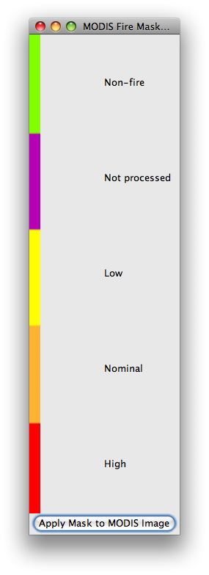
MODIS Fire Product
11 May 2011
03:40 UTC
Aqua MODIS

Slide 53
MODIS Fire Product
11 May 2011
03:40 UTC
Aqua MODIS

Slide 54
- Giglio, L., Csiszar, I., Justice, C.O. 2006. Global distribution and seasonality of active fires as observed with the Terra and Aqua MODIS sensors. Journal of Geophysical Research - Biogeosciences, Vol 111, G02016, doi:10.1029/2005JG000142. - Giglio, L., Descloitres, J., Justice, C. O., and Kaufman, Y., 2003, An enhanced contextual fire detection algorithm for MODIS. Remote Sensing of Environment, 87:273-282. - Justice, C. O, Giglio, L., Korontzi, S., Owens, J., Morisette, J. T., Roy, D., Descloitres, J., Alleaume, S., Petitcolin, F., and Kaufman, Y., 2002, The MODIS fire products. Remote Sensing the of Environment 83:244-262.
REFERENCES

Slide 55
MODIS Ocean Products

Slide 56
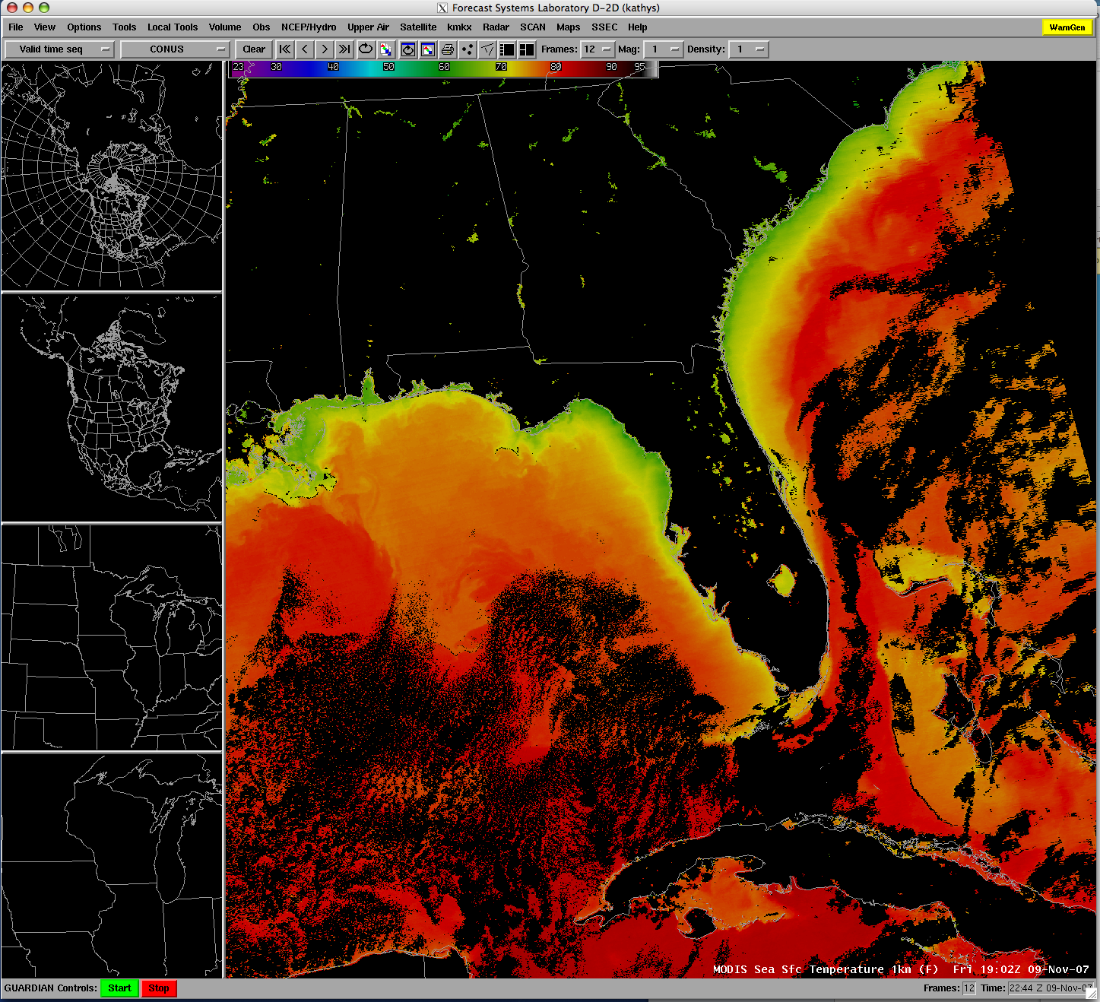
MODIS Sea Surface Temperature viewed in AWIPS

Slide 57
MODIS Sea Surface Temperature used by Forecasters
AREA FORECAST DISCUSSION...UPDATED
NATIONAL WEATHER SERVICE MILWAUKEE/SULLIVAN WI
338 AM CDT TUE MAY 31 2011
UPDATED TO ADD TODAY/TONIGHT AND AVIATION/MARINE SECTIONS
.MARINE...CLEAR MODIS IMAGE FROM MONDAY EARLY AFTN SHOWED SHALLOWER NEAR SHORE WATERS HAD WARMED INTO THE LOWER 50S...WHILE MID LAKE TEMPS REMAINED IN THE MID 40S DUE TO OVERTURNING. TIGHTENING PRESS GRADIENT THIS MORNING AND SUNSHINE WILL RESULT IN STRONG MIXING EARLY THIS MRNG. HENCE WL BUMP UP START OF SMALL CRAFT ADVY SEVERAL HOURS...AND RUN INTO THE EVE. FEW GUSTS NEAR THE SHORE MAY REACH 30-35 KNOTS LATER THIS MRNG/EARLY AFTN.

Slide 58
MODIS Sea Surface Temperature

