Slide 1



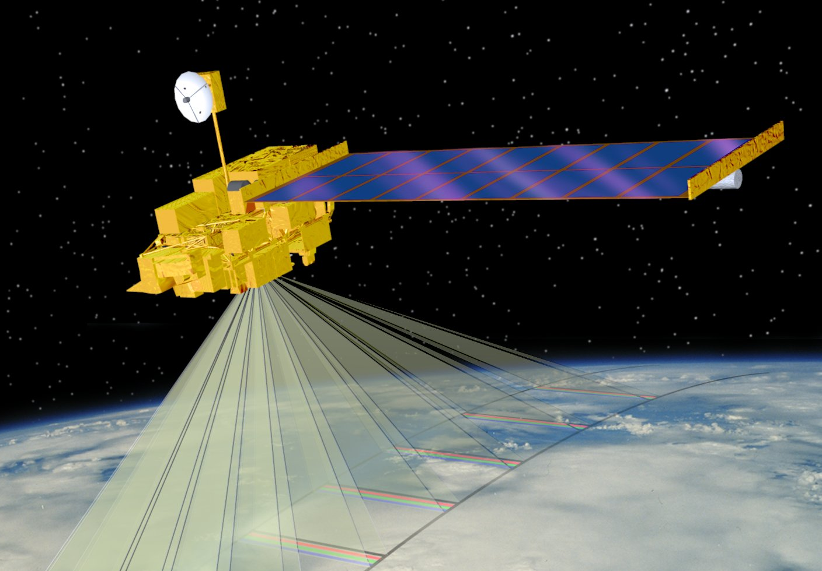
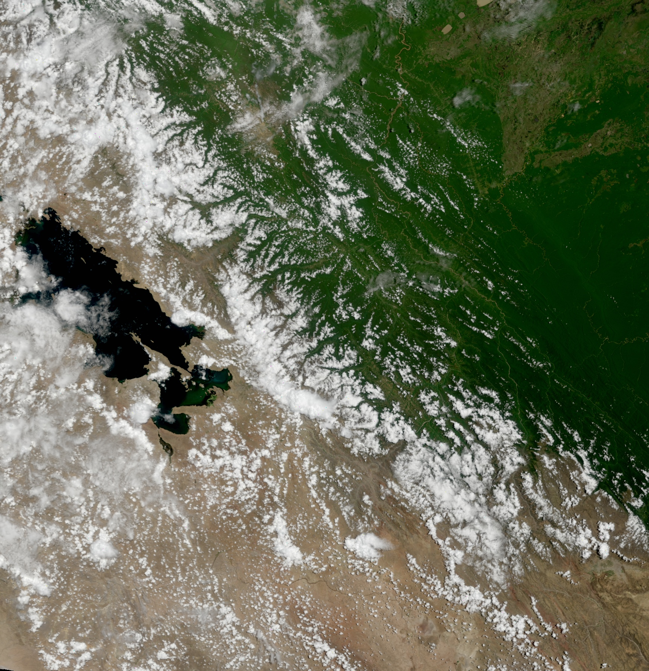
MODIS Products
2011 IMAPP Training Workshop: Satellite Direct Broadcast for Real-Time Environmental Applications
ECNU, China
3 June 2011
Part 1
Kathleen Strabala
Cooperative Institute for Meteorological Satellite Studies
Space Science and Engineering Center
University of Wisconsin-Madison
Notes:
Title slide

Slide 2
Information about MODIS Products
Main MODIS website - http://modis.gsfc.nasa.gov/
  MODIS Land Team Website
  http://modis-land.gsfc.nasa.gov/
  MODIS Atmosphere Website
  http://modis-atmos.gsfc.nasa.gov/
  MODIS Ocean Biology Group
  http://oceancolor.gsfc.nasa.gov/
  MODIS Calibration and Geolocation
  http://mcst.gsfc.nasa.gov/

Slide 3
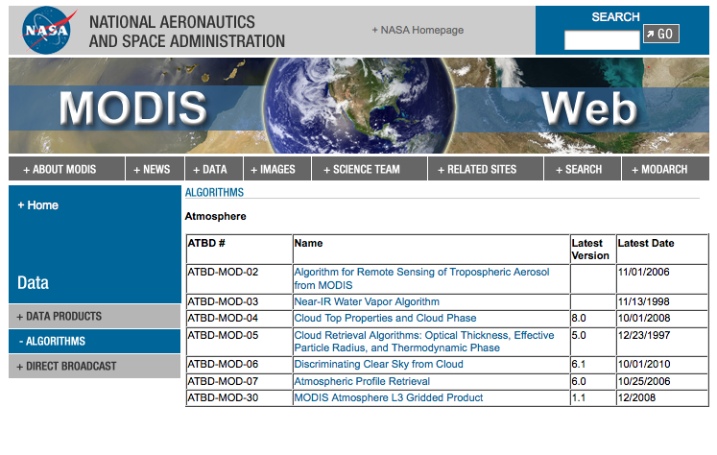
Algorithm Theoretical Basis Documents (ATBDs)
Detailed description of the techniques for each product:
http://modis.gsfc.nasa.gov/data/atbd/index.php

Slide 4
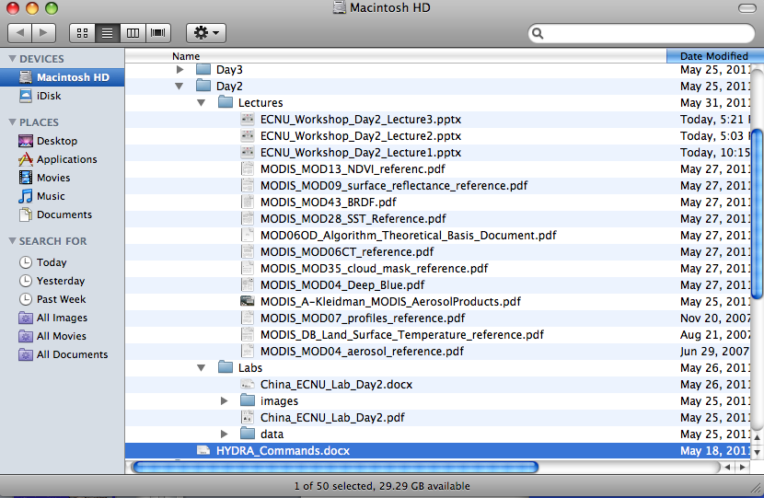
References Provided

Slide 5
MODIS Standard Products (1)
Atmosphere
MOD 04 - Aerosol Product
MOD 05 - Total Precipitable Water (Water Vapor)
MOD 06 - Cloud Product
  Cloud Top Properties (MOD06CT)
  Cloud Phase (part of MOD06CT)
  Cloud Optical Depth (MOD06OD)
MOD 07 - Atmospheric Profiles
MOD 08 - Gridded Atmospheric Product
MOD 35 - Cloud Mask

Slide 6
MODIS Standard Products (2)
Land
MOD 09 - Surface Reflectance
MOD 10 - Snow Cover
MOD 11 - Land Surface Temperature & Emissivity
MOD 12 - Land Cover/Land Cover Change
MOD 13 - Gridded Vegetation Indices (NDVI & EVI)
MOD 14 - Thermal Anomalies (Fires)
MOD 15 - Leaf Area Index & FPAR
MOD 16 - Evapotranspiration
MOD 17 - Net Photosynthesis and Primary Productivity
MOD 29 - Sea Ice Cover
MOD 43 - Bidirectional Reflectance Distribution Function (BRDF)
MOD 44 - Vegetation Cover Conversion

Slide 7
MODIS Standard Products (3)
Ocean
MOD 18 - Normalized Water-leaving Radiance
MOD 19 - Pigment Concentration
MOD 20 - Chlorophyll Fluorescence
MOD 21 - Chlorophyll_a Pigment Concentration
MOD 22 - Photosynthetically Available Radiation (PAR)
MOD 23 - Suspended-Solids Concentration
MOD 24 - Organic Matter Concentration
MOD 25 - Coccolith Concentration
MOD 26 - Ocean Water Attenuation Coefficient
MOD 27 - Ocean Primary Productivity
MOD 28 - Sea Surface Temperature
MOD 36 - Total Absorption Coefficient
MOD 37 - Ocean Aerosol Properties
MOD 39 - Clear Water Epsilon

Slide 8
Lecture Outline
MODIS Level 2 Atmosphere product theory and algorithms
  MODIS Cloud Mask Product (MOD35)
  MODIS Cloud Phase Product (part of MOD06)
  MODIS Cloud Top Properties Product (part of MOD06)
  MODIS Atmospheric Profiles Product (MOD07)
  MODIS Aerosol Optical Depth Product (MOD04)
MODIS Level 2 Land product theory and algorithms
  MODIS Vegetation Indices (MOD13)
  MODIS Surface Reflectance and BRDF Product (MOD09 and MOD43)
  MODIS Fire Product (Thermal Anomalies) (MOD14)
MODIS Level 2 Ocean product theory and algorithms (SeaDAS)
  Ocean Color (MOD20)
  Sea Surface Temperatures (MOD28)

Slide 9
MODIS Atmosphere Products

Slide 10
MODIS Cloud Mask (MOD35)

Slide 11
MODIS Cloud Mask
Ackerman, Frey, Strabala –SSEC http://modis-atmos.gsfc.nasa.gov/MOD35_L2/index.html
1 km nadir spatial resolution day & night, (250 m day)
  19 spectral bands (0.55-13.93 µm, incl. 1.38 µm) 11 individual spectral tests (function of 5 processing paths) combined for initial pixel confidence of clear
  spatial variability test over ocean
  clear sky restoral tests applied at end (sanity checks)
48 bits per pixel including individual test results and processing path
bits 1,2 give combined test results as: confident clear, probably clear, undecided, obstructed/cloudy (clear sky conservative)

Slide 12
Confidence Level of Clear
Example thresholds for the simple IR window cold cloud test.
Notes:
Example of simple IR confidence test. Confidence of 1 meand high confidence clear region.

Slide 13
Quality Flags
Each test returns a confidence (F ) ranging from 0 to 1.
Similar tests are grouped and minimum confidence selected [min (F_{i} ) ]
Quality Flag is
Four values; 0, >.66, >.95 and >.99

Slide 14
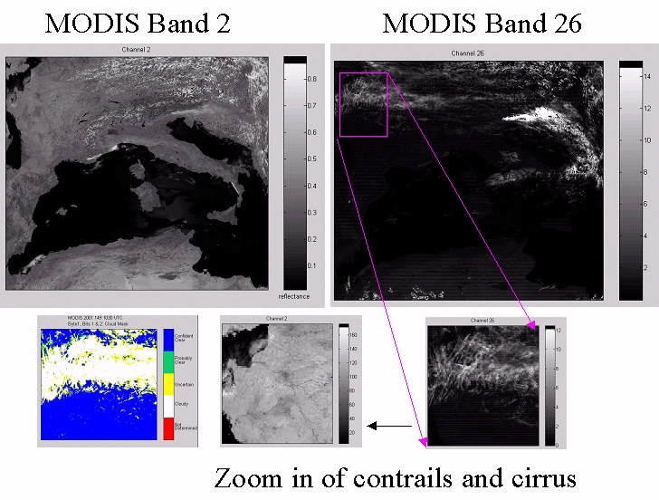
Some tests see cloud, some don’t
Notes:
This is a scene in May 2001. The left is channe 2 (0.87 microns) and the right 1.38 microns. I’ve zoomed into an area with contrails and thin cirrus to show that the channel2 can hardly see these, while the 1.38 is evident. The cloud mask result for this region is shown in the color image.

Slide 15
Thresholds Domains
Day/Night – Solar Zenith > 85 = night
Land/Water – Based upon 1km USGS map
Desert – Based upon USGS 1 km Olson Ecosystem map
Polar Day/Night – Latitude greater than 60
Coast – 2 pixels surrounding water bodies
High Elevation - > 2000 m
Sunglint – Intense point of solar reflection

Slide 16
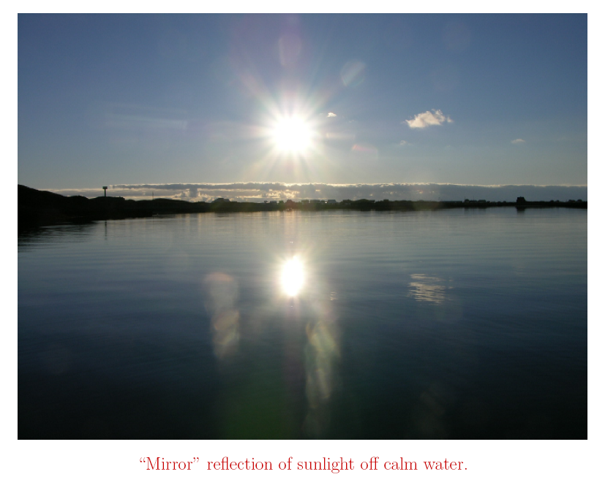
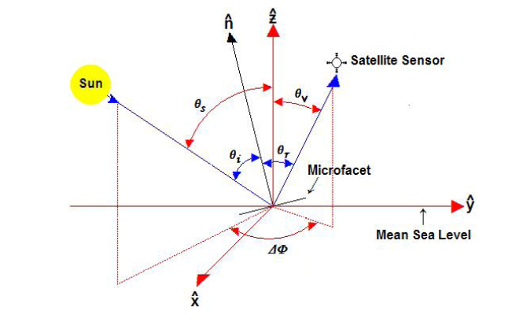
Sun Glint
Simple example where your eye is the sensor
Sun Glint Ellipse Defined by: θ_{r} < 36
cos θ_{r} = sin θ_{v} cos θ_{s} cos ΔΦ + sin θ_{v} cos θ_{s}
Where θ_{v} = Viewing Zenith Angle
θ_{s} = Solar Zenith Angle
ΔΦ = Relative Angle – difference between the Solar and Viewing azimuth angles.

Slide 17
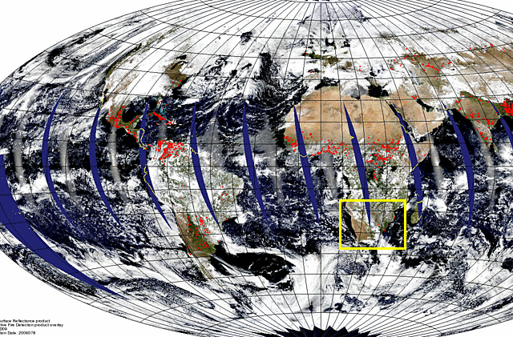
Aqua MODIS Sun Glint Example
19 March 2006

Slide 18
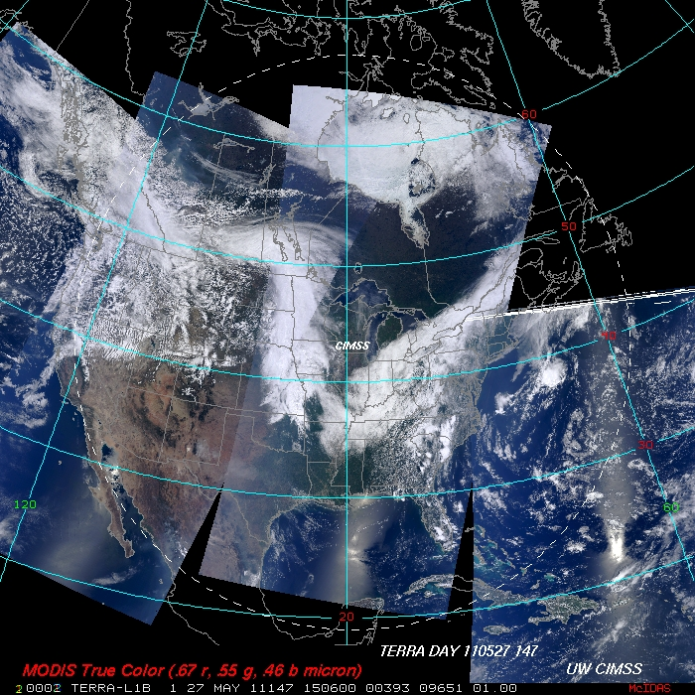

Slide 19
Detecting Clouds (IR) Thresholds vary based upon scene type
IR Brightness Temperature Threshold Tests
BT11 < SST- 6 K ( Reynolds blended SST global 1 degree - oisst.20060215
Land - GDAS sfc temp global 1 degree -gdas1.PGrbF00.060220.18z )
BT6.7 < Threshold mid-level cloud
BT13.9 < Threshold cold high cloud (large viewing zenith angles
cause problems)
IR Brightness Temperature Difference Tests
BT8 - BT11 > Threshold (High thin cloud)
BT11-BT12 > Threshold (High thin cloud)
BT3.9 - BT11 > 12 K indicates daytime low cloud cover
BT11 - BT6.7 large neg diff for clr sky over Antarctic Plateau winter
BT11 – BT7.3 Temperatures close in poles or snow/ice mean cloud

Slide 20
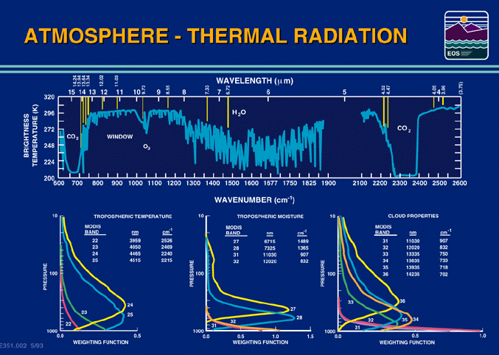
Notes:
The brightness temperatures of the outgoing radiance observed by an airborne interferometer are shown along with the MODIS infrared spectral bands. The brightness temperatures generally decrease as the center of an absorption band is approached. This decrease is associated with the decrease of tropospheric temperature with altitude. Near about 690 cm⁻¹, the temperature shows a minimum which is related to the colder tropopause. On the basis of the sounding principle already discussed, the MODIS team selected a set of sounding wave numbers such that a temperature layers in the troposphere can be described. The arrows indicate the selection. The associated weighting functions are also shown revealing that the radiation is coming from broad overlapping layers, helping to confound the inversion problem from multispectral radiance measurements to temperature profile.

Slide 21
Detecting Clouds (vis)
Reflectance Threshold Test
r.87 > 5.5% over ocean indicates cloud
r.66 > 18% over vegetated land indicates cloud
Near IR Thin Cirrus Test
r1.38 > threshold indicates presence of thin cirrus cloud
ambiguity of high thin versus low thick cloud (resolved with BT13.9)
problems in high terrain
Reflectance Ratio Test
r.87/r.66 between 0.9 and 1.1 for cloudy regions
must be ecosystem specific – snow causes false signal
Snow Test
NDSI = [r.55-r1.6]/ [r.55+r1.6] > 0.4 and r.87 > 0.1 then snow

Slide 22
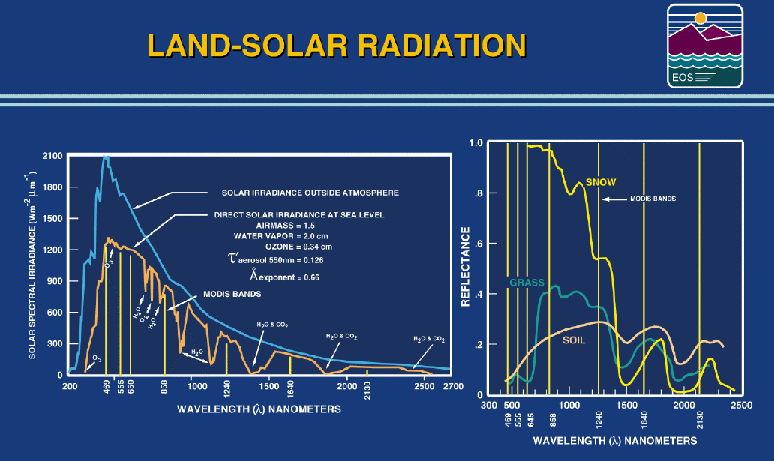
Notes:
Or land applications, MODIS has several spectral bands that are above and below
step function increases or decreases in the reflectivity of vegetation (increases above
0.72 um) or snow/ice (decreases above 1.4 um). The multispectral data will be used
to reveal the extent of vegetation and snow/ice in the various regions of the globe.

Slide 23
Other Tests
BT11 Spatial variability test (3x3 pixels)
  Cloud if > .50 K
Clear Sky Restoral Tests (sanity checks)
  Clear if land night BT11 > 292 K
  Desert clear if BT11 > 300 K

Slide 24
Use of Threshold File
Code section from Fortran Land_Day.f subroutine
Daytime Land Thresholds from thresholds.dat.Aqua file
c ******** START OF GROUP 3 TESTS ****************
c ... visible (channel 1) reflectance threshold test.
if (visusd) then
if (nint(masv66) .ne. nint(bad_data)) then
nmtests = nmtests + 1
call set_qa_bit(qa_bits,20)
if (masv66.le.dlref1(2)) then
call set_bit(testbits,20)
nptests = nptests + 1
end if
call conf_test(masv66,dlref1(1),dlref1(3),dlref1(4),
+ dlref1(2),1,c5)
cmin3 = min(cmin3,c5)
ngtests(3) = ngtests(3) + 1
end if
end if
! Daytime land
dl11_12hi : 3.0
dl11_4lo : -14.0, -12.0, -10.0, 1.0
dlco2 : 222.0, 224.0, 226.0, 1.0
dlh20 : 215.0, 220.0, 225.0, 1.0
dlref1 : 0.22, 0.18, 0.14, 1.0
dlref3 : 0.04, 0.035, 0.03, 1.0
dlvrat : 1.85, 1.90, 1.95, 1.0
dltci : 0.035, 0.0125

Slide 25
Users can fine tune thresholds for a region of interest
Thresholds file included in delivery
  thresholds.dat.Aqua
  thresholds.dat.Terra
  Contain Cloud mask 0, 1 and inflection point thresholds values for each test
  File can be updated and the scene rerun
  Example for daytime land reflectance in band 1:
  dlref1 : 0.22, 0.18, 0.14, 1.0
  if too much cloud found, change to
  dlref1 : 0.24, 0.20, 0.16, 1.0

Slide 26
Non-static Inputs
MODIS L1B (MOD021KM, MOD02QKM) and geolocation file (MOD03)
Daily Near Real-Time SSM/I EASE-Grid Daily Global Ice Concentration and Snow Extent (NISE) (Nighttime) ex: NISE_SSMIF13_20020430.HDFEOS
Daily SSMI sea ice concentration from the National Centers for Environmental Predition (NCEP) (Nighttime) ex: eng.020430
6 hourly Global Data Assimilation System T126 resolution analysis from NCEP (Land Surface Temperature) ex: gdas1.PGrbF00.020430.00z
Weekly Optimum Interpolation (OI) Sea Surface Temperature (SST) Analysis ex: oisst.20050608

Slide 27
Output Product Description
Product Resolution: 1 km and 250 m

Slide 28
bit field Description Key Result
0 Cloud Mask Flag 0 = not determined
1 = determined
1-2 FOV Confidence Flag 00 = cloudy
01 = uncertain 10 = probably clear
11 = confident clear
Processing Path Flags
3 Day / Night Flag 0 = Night / 1 = Day
4 Sun glint Flag 0 = Yes / 1 = No
5 Snow / Ice Background Flag 0 = Yes/ 1 = No
6-7 Land / Water Flag 00 = Water
01 = Coastal
10 = Desert
11 = Land

Slide 29
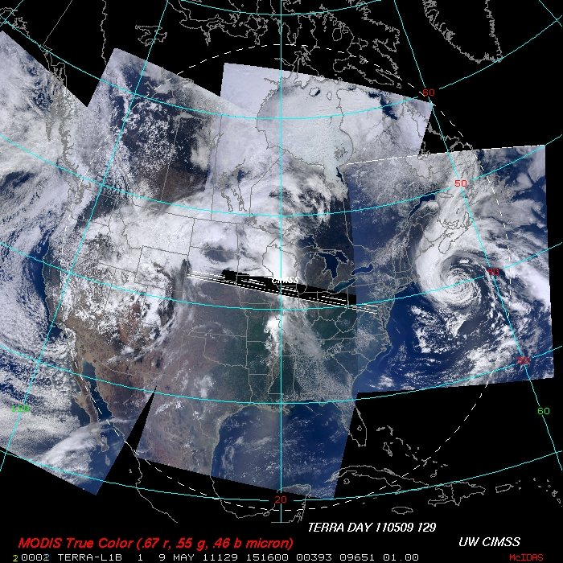

Slide 30
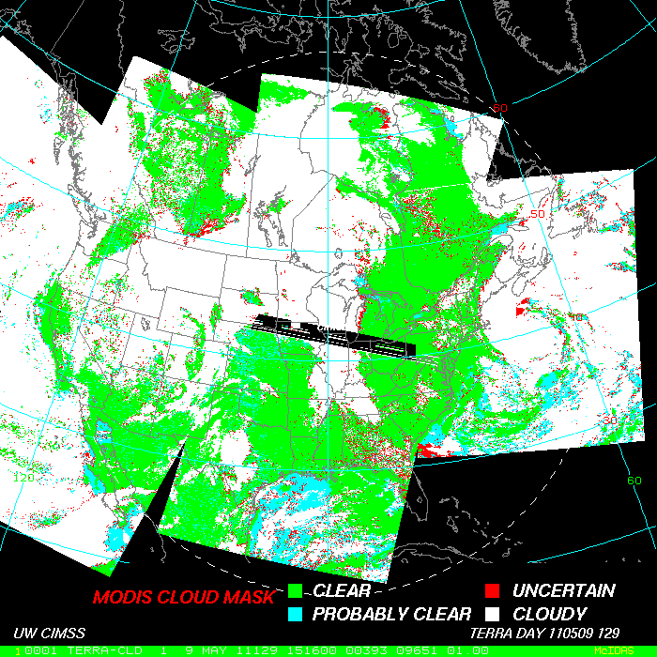

Slide 31
ADDITIONAL INFORMATION
bit field Description Key Result
8 Heavy Aerosol Flag 0 = Yes / 1 = No
9 Thin Cirrus Detected (solar) 0 = Yes / 1 = No
bit field Description Key Result
10 Shadow Found 0 = Yes / 1 = No
11 Thin Cirrus Detected (IR) 0 = Yes / 1 = No
12 Spare

Slide 32
1-km Spectral Test Cloud Flags
bit field Description Key Result
13 Cloud Flag - 11 μm IR Threshold 0 = Yes / 1 = No
14 High Cloud Flag - CO2 Threshold Test 0 = Yes / 1 = No
15 High Cloud Flag - 6.7 μm Test 0 = Yes / 1 = No
16 High Cloud Flag - 1.38 μm Test 0 = Yes / 1 = No
17 High Cloud Flag - 3.7-12 μm Test 0 = Yes / 1 = No
18 Cloud Flag - IR Temperature Difference 0 = Yes / 1 = No
19 Cloud Flag - 3.9-11 μm Test 0 = Yes / 1 = No
20 Cloud Flag - Visible Reflectance Test 0 = Yes / 1 = No
21 Cloud Flag - Visible Ratio Test 0 = Yes / 1 = No
22 Clear-sky Restoral Test 0 = Yes / 1 = No
23 Cloud Flag - 7.3-11 μm Test 0 = Yes / 1 = No

Slide 33
Additional Tests
bit field Description Key Result
24 Cloud Flag - Temporal Consistency 0 = Yes / 1 = No
25 Cloud Flag - Spatial Consistency 0 = Yes / 1 = No
26 Clear-sky Restoral Tests 0 = Yes / 1 = No
27 Cloud Test – Surface Temp. Comparison 0 = Yes / 1 = No
28 Suspended Dust Flag 0 = Yes / 1 = No
Cloud Flag – 8.6-7.3 μm Test 0 = Yes / 1 = No
Cloud Flag – 11 μm Spatial Variability 0 = Yes / 1 = No
Spare
250-m Cloud Flag - Visible Tests
32-47 250 m visible reflectance test 0 = Yes / 1 = No

Slide 34
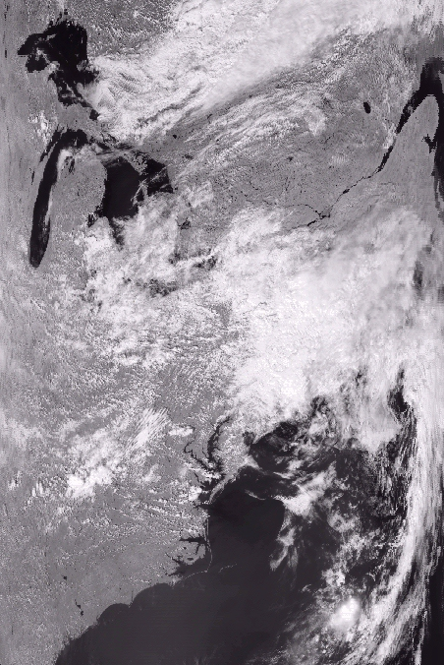
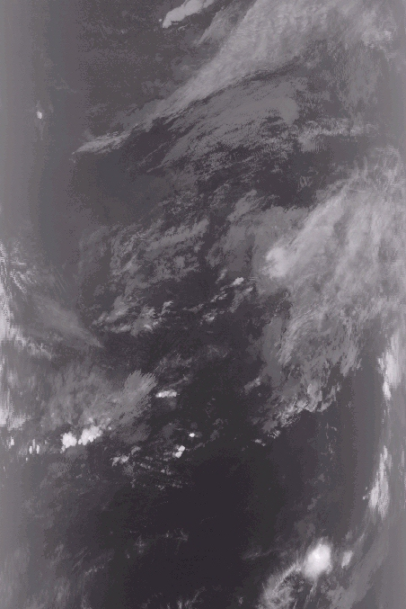
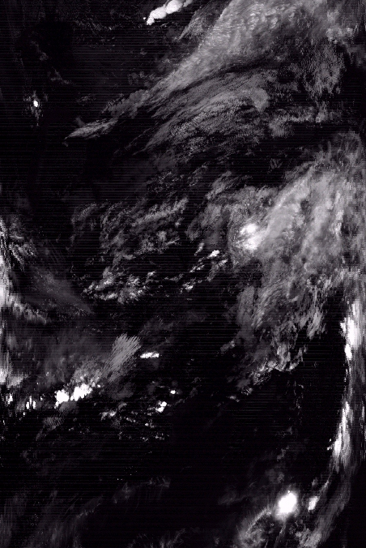
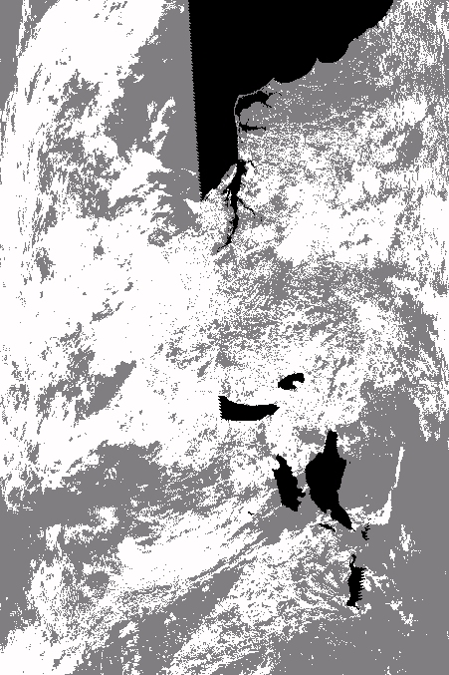
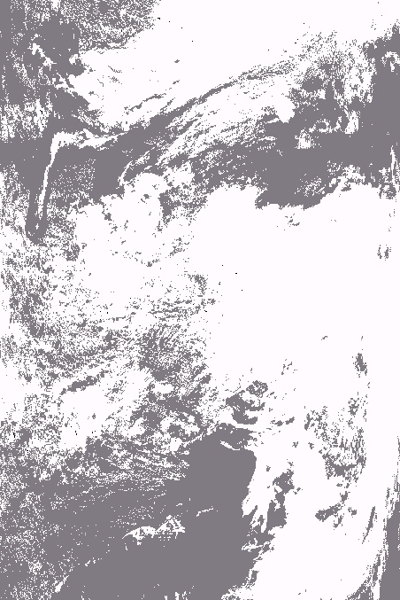

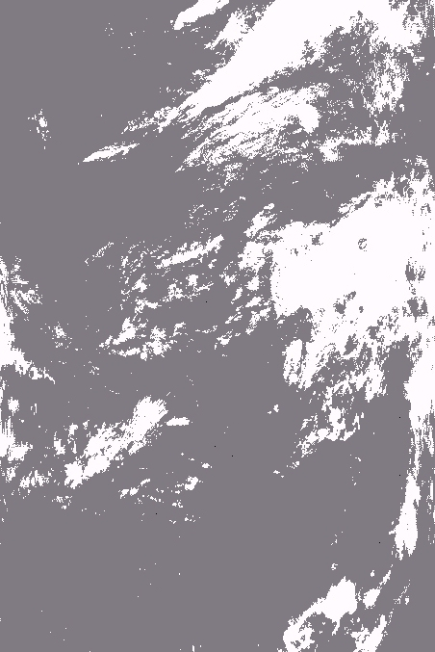
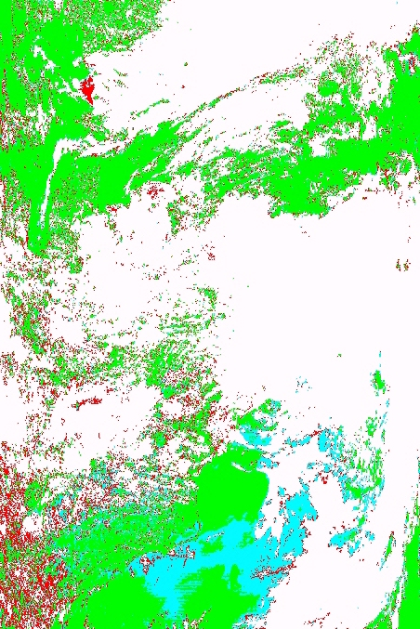
MODIS 0.86 µm
MODIS 13.9 µm
MODIS 1.38 µm
Cloud Mask 3.9-11 µm Test
Cloud Mask Visible Test
Cloud Mask 13.9 µm Test
Cloud Mask 1.38 µm Test
Final Cloud Mask

Slide 35
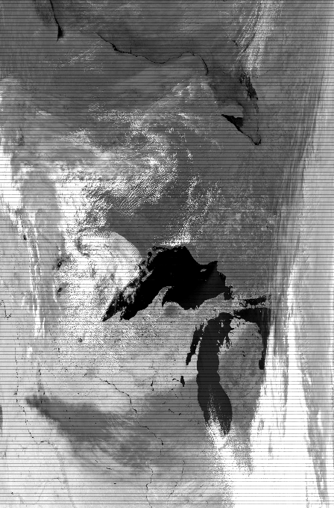
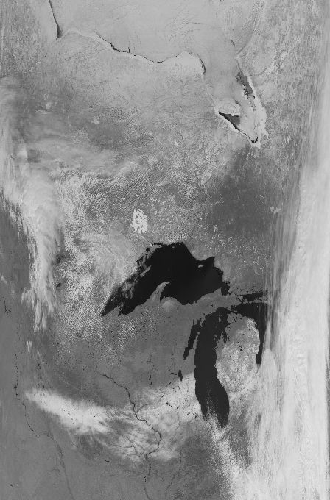
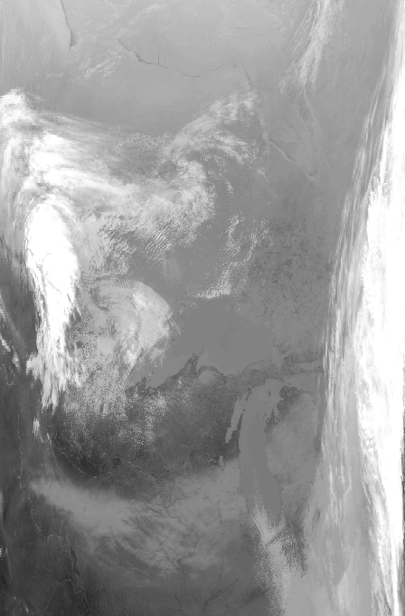
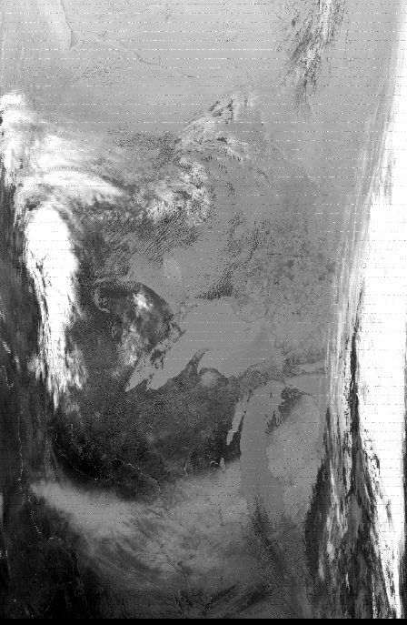
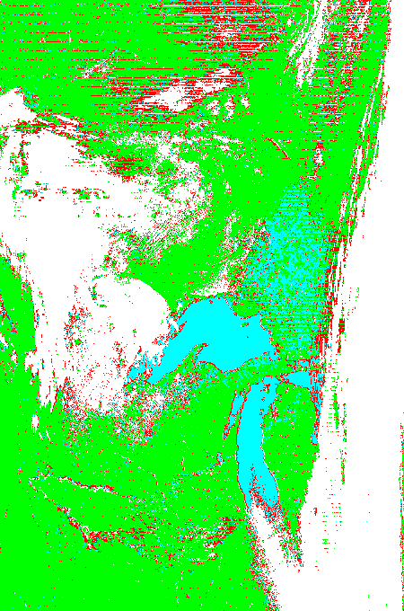
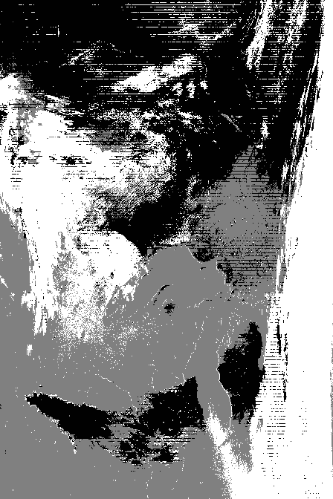
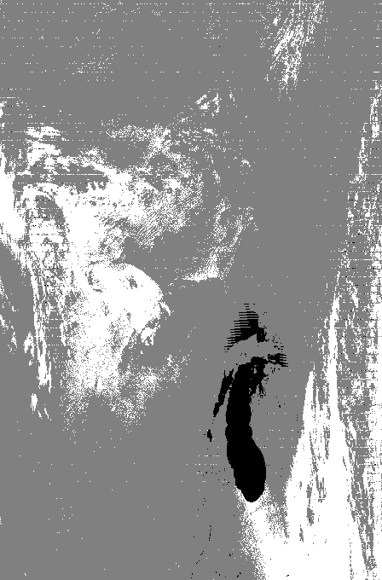
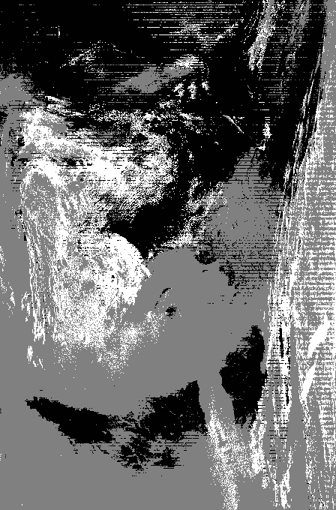

1.6 µm image
0.86 µm image
11 µm image
3.9 µm image
cloud mask
Snow test
(impacts choice of
tests/thresholds)
VIS test
(over non-snow
covered areas)
11 - 12 BT test (primarily for high cloud)
13.9 µm
high cloud test
(sensitive in cold regions)
3.9 - 11 BT test for low clouds
aa
MODIS cloud mask example
(confident clear is green, probably clear is blue, uncertain is red, cloud is white)
Notes:
Mask is consistent with the ARM site and ER-2observations, including correct snow identification.
A useful reference is Ackerman, S. A., K. I. Strabala, W. P. Menzel, R. A. Frey, C. C. Moeller, and
L. I. Gumley, 1998: Discriminating clear-sky from clouds with MODIS. J. Geophys. Res., 103, D24 ,
32141-32158.

Slide 36
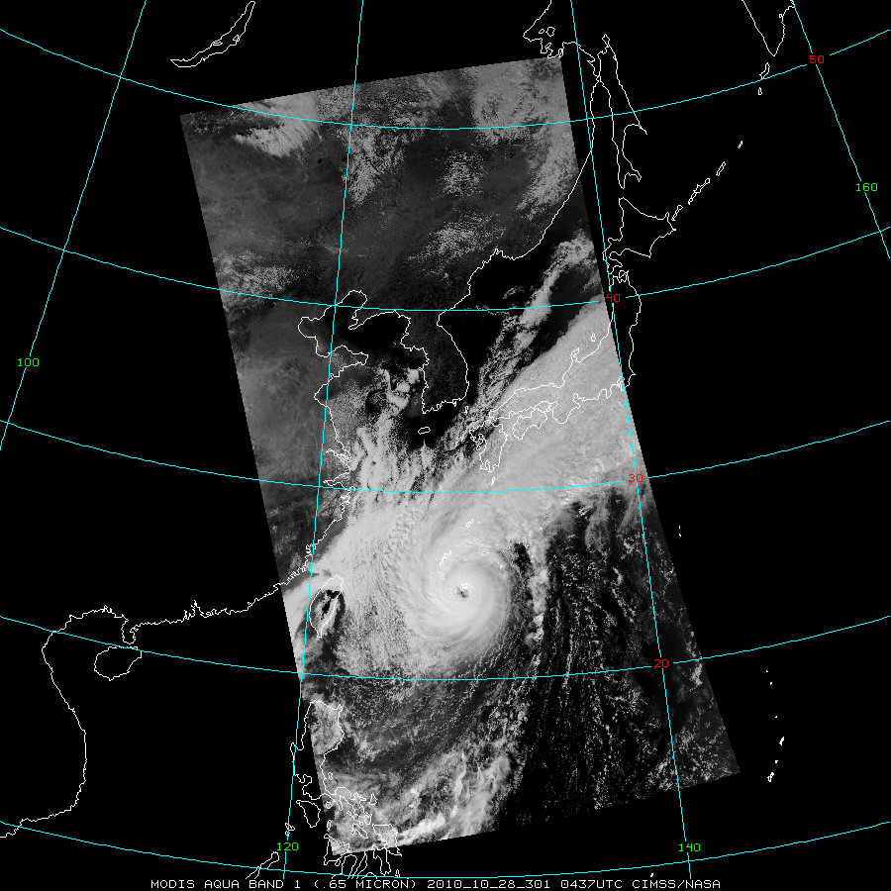

Slide 37
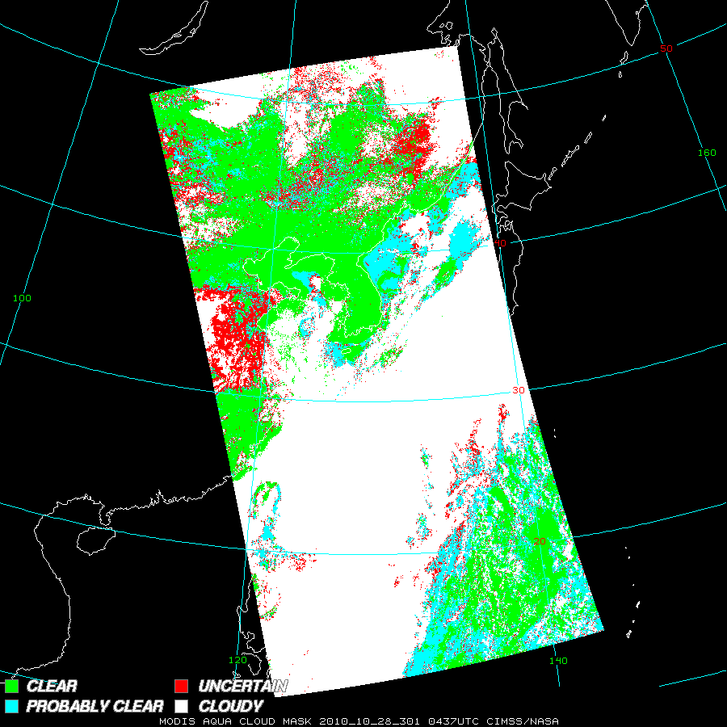

Slide 38
Known Problems
MODIS algorithm is clear sky conservative
  If there is a doubt, it is cloudy
Nighttime algorithm is different –
  16 versus 36 channels available
Transition regions
  terminator, edges of desert regions, edges of snow regions, etc.
Very specific regions
  Certain surfaces, certain times of year, certain sun angles (bare soils over the midwest during the spring)

Slide 39
References
Ackerman, S. A., K. I. Strabala, W. P. Menzel, R. A. Frey, C. C. Moeller, and L. E. Gumley, 1998: Discriminating clear sky from clouds with MODIS. J. Geophys. Res., 103, 32 141– 32 157.
Frey, R., S. A. Ackerman, Y. Liu, K. I. Strabala, H. Zhang, J. Key, and X. Wang (2008), Cloud detection with MODIS: Part I. Improvements in the MODIS Cloud Mask for Collection 5, J. Atmos. Oceanic Technol., 25, 1057 – 1072.
Ackerman, S. A., R. E. Holz, R. Frey, E. W. Eloranta, B. Maddux, and M. J. McGill (2008), Cloud detection with MODIS: Part II. Validation, J. Atmos. Oceanic Technol., 25, 1073 – 1086.

Slide 40
MODIS Cloud Phase (part of MOD06CT)

Slide 41
Cloud Phase
Dr. Bryan Baum SSEC
Based upon the differential absorption of ice and water between 8 and 11 microns
Simple brightness temperature difference (8-11 BTDIF) thresholding technique
Included as part of the MOD06 product

Slide 42
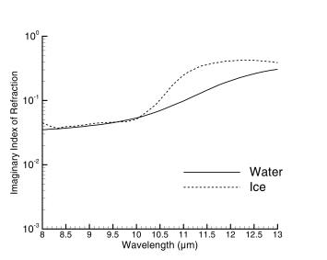
Imaginary Index of Refraction of Ice and Water
8 – 13 microns

Slide 43
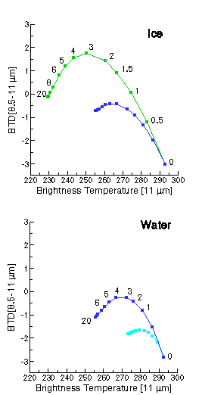
Simulations of Ice and Water Phase Clouds
8.5 - 11 μm BT Differences
τ =
High Ice clouds
BTD[8.5-11] > 0 over a large range of optical thicknesses τ
T_{cld} = 228 K
Midlevel clouds
BTD[8.5-11] values are similar (i.e., negative) for both water and ice clouds
T_{cld} = 253 K
Low-level, warm clouds
BTD[8.5-11] values always negative
T_{cld} = 273 K
τ =
Ice: Cirrus model derived from FIRE-I in-situ data (Nasiri et al, 2002)
Water: r_{e}=10 μm
Angles: θ_{ο} = 45º, θ = 20º, and φ = 40º
Profile: midlatitude summer

Slide 44
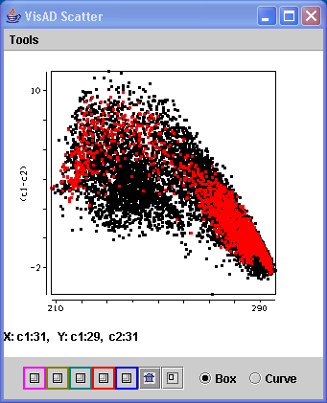
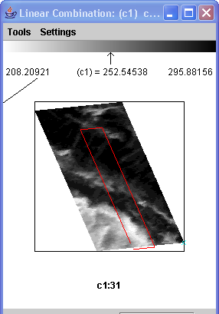
Ice Cloud Example

Slide 45
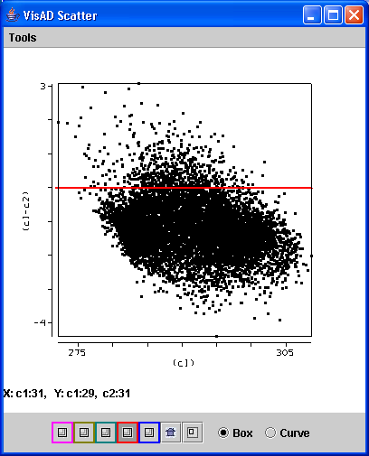
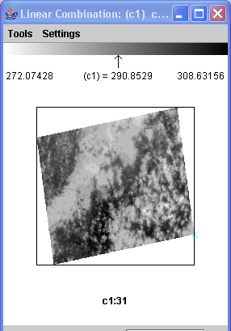
Water Cloud Example

Slide 46
IRPHASE Thresholds
Ice Cloud
  BT11 < 238 K or BTD8-11> 0.5 K
Mixed Phase
  BT11 between 238 and 268 K
  and
  BTD8-11 between –0.25 and –1.0 K
Water Cloud
  BT11 > 238 K and BTD8-11 < -1.5 K
or
  BT11>285 and BTD8-11 < -0.5 K

Slide 47
MOD06 Cloud Phase Key Output Parameters
5x5 pixel (1km) resolution
Surface_Temperature (GDAS input)
Surface_Pressure (GDAS input)
Cloud_Top_Pressure
Cloud_Top_Temperature
Tropopause_Height
Cloud_Fraction
Cloud_Effective_Emissivity
Cloud_Top_Pressure_Infrared
Brightness_Temperature_Difference_B29-B31
Brightness_Temperature_Difference_B31-B32
Cloud_Phase_Infrared
Cloud Optical Depth (daytime – 1 km product)
Cloud Effective Radius (daytime – 1km)

Slide 48
Output Product Description
4 categories
1 – Water Cloud
2 – Ice Cloud
3 – Mixed Phase Cloud
6 – Undecided

Slide 49
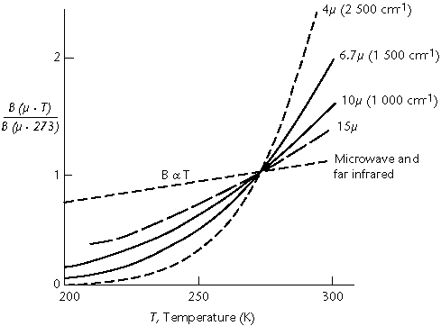
Temperature Sensitivity of B(λ,T) for typical earth scene temperatures
B (λ, T) / B (λ, 273K)
4μm
2
1
6.7μm
10μm
15μm
microwave
250 300
Temperature (K)

Slide 50
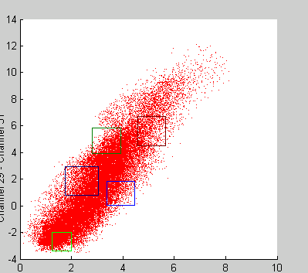
N=0.8
N=1.0
N=0.6
8.6-11
N=0.4
N=0.2
N=0
11-12
Broken clouds appear different in 8.6, 11 and 12 um images;
assume Tclr=300 and Tcld=230
T(11)-T(12)=[(1-N)*B11(Tclr)+N*B11(Tcld)]⁻¹
- [(1-N)*B12(Tclr)+N*B12(Tcld)]⁻¹
T(8.6)-T(11)=[(1-N)*B8.6(Tclr)+N*B8.6(Tcld)]⁻¹
- [(1-N)*B11(Tclr)+N*B11(Tcld)]⁻¹
Warm part of pixel has more influence at shorter wavelengths

Slide 51
Known Problems
Mid-level cloud (BT ~ 250 K)
  Ambiguous solution
Surface Emissivity Effects
  Not always the same over the IR window (granite)
Mixed phase cloud category
  should be considered as undecided

Slide 52
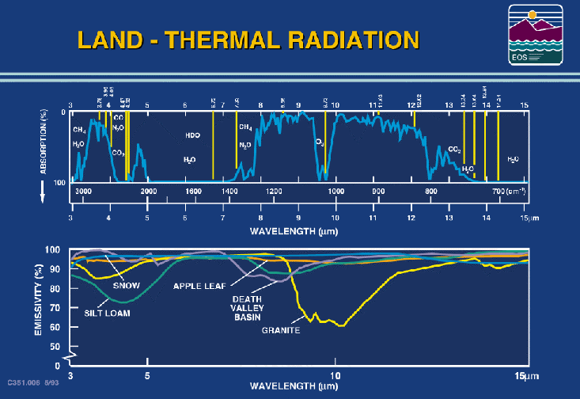
Notes:
It is important to note that the atmospheric windows are not transparent (there is some moisture
absorption of radiation in the 8 to 12 um region) and that the earth surface does not exhibit blackbody
behavior. These characteristics must be accounted for when using remote sensing data over land to
infer temperature and moisture profiles. They are also important for mapping land surface properties.
MODIS is well situated to make multispectral determinations of land cover type and temperature.

Slide 54
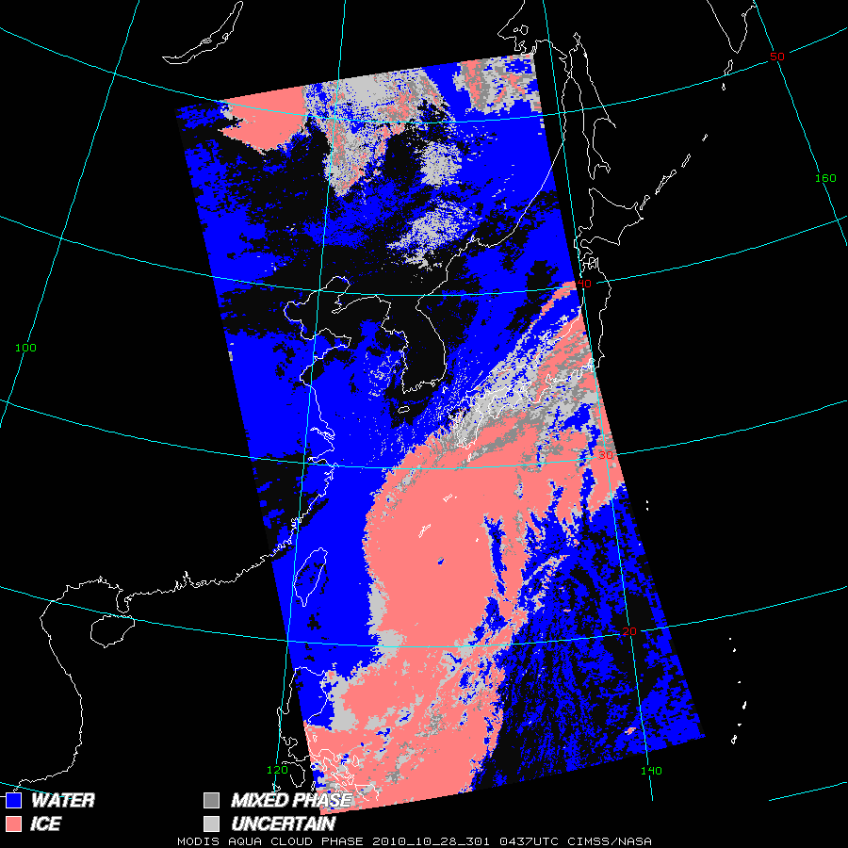

Slide 55
Applications
Meteorological
  Aviation - icing
  Thunderstorm maturity - glaciation
  Freezing rain
  Numerical Weather Prediction Models
2. Climatological
- Global Cloud Modeling - Ice and water clouds absorb and reflect differently at different wavelengths

Slide 56
References
Strabala, K. I., S. A. Ackerman, and W. P. Menzel, 1994: Cloud properties inferred from 8-12 µm data. J. Appl. Meteor., 33, 212-229.

Slide 57
MODIS Cloud Top Properties (MOD06CT)

Slide 58
Cloud Top Properties
Menzel, Frey - SSEC
Cloud Top Pressure, Temperature, Emissivity derived using CO₂ “slicing”
MODIS product utilizes 4 spectral channels in the 13 – 14 μm region.
5x5 1 km pixel retrievals where at least 5 of the 1 km pixels are cloudy as determined by the cloud mask
Cloud properties retrieved both day and night

Slide 59
Inputs
MODIS L1B (MOD021KM) and geolocation file (MOD03)
MODIS Cloud Mask (MOD35)
6 hourly Global Data Assimilation System T126 resolution analysis from NCEP (Vertical Profiles of Temperature and Moisture) ex: gdas1.PGrbF00.020430.00z
Weekly Optimum Interpolation (OI) Sea Surface Temperature (SST) Analysis
ex: oisst.20050608

Slide 60
Notes:
The brightness temperatures of the outgoing radiance observed by an airborne interferometer are shown along with the MODIS infrared spectral bands. The brightness temperatures generally decrease as the center of an absorption band is approached. This decrease is associated with the decrease of tropospheric temperature with altitude. Near about 690 cm⁻¹, the temperature shows a minimum which is related to the colder tropopause. On the basis of the sounding principle already discussed, the MODIS team selected a set of sounding wave numbers such that a temperature layers in the troposphere can be described. The arrows indicate the selection. The associated weighting functions are also shown revealing that the radiation is coming from broad overlapping layers, helping to confound the inversion problem from multispectral radiance measurements to temperature profile.

Slide 61
CO2 channels see to different levels in the atmosphere
14.2 um 13.9 um 13.6 um 13.3 um

Slide 62
Radiative Transfer Equation
The radiance leaving the earth-atmosphere system sensed by a satellite borne radiometer is the sum of radiation emissions from the earth-surface and each atmospheric level that are transmitted to the top of the atmosphere. Considering the earth's surface to be a blackbody emitter (emissivity equal to unity), the upwelling radiance intensity, I_{λ}, for a cloudless atmosphere is given by the expression
I_{λ} = ε_{λ}^{sfc} B_{λ}( T_{sfc}) τ_{λ}(sfc - top) + Σ ε_{λ}^{layer} B_{λ}( T_{layer}) τ_{λ}(layer - top)
layers
where the first term is the surface contribution and the second term is the atmospheric contribution to the radiance to space.

Slide 63
When reflection from the earth surface is also considered, the Radiative Transfer Equation for infrared radiation can be written
o
I_{λ} = ε_{λ}^{sfc} B_{λ}(T_{s}) τ_{λ}(p_{s}) + ∫ B_{λ}(T(p)) [dτ_{λ}(p)/ dp] dp
p_{s}
where
F_{λ}(p) = { 1 + (1 - ε_{λ}) [τ_{λ}(p_{s}) / τ_{λ}(p)]² }
The first term is the spectral radiance emitted by the surface and attenuated by the atmosphere, often called the boundary term and the second term is the spectral radiance emitted to space by the atmosphere directly or by reflection from the earth surface.
The atmospheric contribution is the weighted sum of the Planck radiance contribution from each layer, where the weighting function is [ dτ_{λ}(p) / dp ]. This weighting function is an indication of where in the atmosphere the majority of the radiation for a given spectral band comes from.

Slide 64
Radiative Transfer Equation
I_{λ} = ε_{λ}^{sfc} B_{λ}(T_{s}) τ_{λ}(p_{s}) + ∫ B_{λ}(T(p)) [dτ_{λ}(p)/ dp] dp
RTE in Cloudy Conditions
I_{λ} = η I^{cd} + (1 - η) I^{clr} where cd = cloud, clr = clear, η = cloud fraction
^{λ λ}
o
I^{clr} = B_{λ}(T_{s}) τ_{λ}(p_{s}) + ∫ B_{λ}(T(p)) dτ_{λ} .
^{λ} p_{s}
p_{c}
I^{cd} = (1-ε_{λ}) B_{λ}(T_{s}) τ_{λ}(p_{s}) + (1-ε_{λ}) ∫ B_{λ}(T(p)) dτ_{λ}
^{λ} p_{s}
o
+ ε_{λ} B_{λ}(T(p_{c})) τ_{λ}(p_{c}) + ∫ B_{λ}(T(p)) dτ_{λ}
p_{c}
ε_{λ} is emittance of cloud. First two terms are from below cloud, third term is cloud contribution, and fourth term is from above cloud. After rearranging
p_{c} dB_{λ}
I_{λ}^{cd} - I_{λ}^{clr} = ηε_{λ} ∫ τ(p) dp .
p_{s} dp

Slide 65
Cloud Properties from CO2 Slicing
RTE for cloudy conditions indicates dependence of cloud forcing (observed minus clear sky radiance) on cloud amount (ηε_{λ}) and cloud top pressure (p_{c})
p_{c}
(I_{λ} - I_{λ}^{clr}) = ηε_{λ} ∫ τ_{λ} dB _{λ}(T) .
p_{s}
Higher colder cloud or greater cloud amount produces greater cloud forcing; dense low cloud can be confused for high thin cloud. Two unknowns require two equations.
p_{c} can be inferred from radiance measurements in two spectral bands where cloud emissivity is the same. ηε_{λ} is derived from the infrared window, once p_{c} is known.

Slide 66
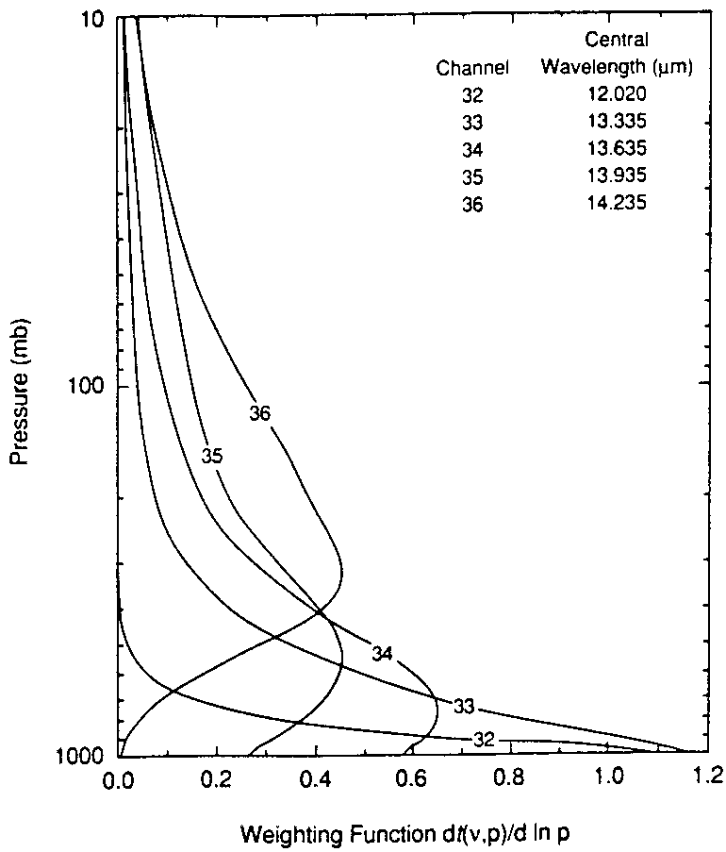
Different ratios
reveal cloud properties
at different levels
hi - 14.2/13.9
mid - 13.9/13.6
low - 13.6/13.3
Meas Calc
p_{c}
(I_{λ1}-I_{λ1}^{clr}) ηε_{λ1} ∫ τ_{λ1} dB_{λ1}
p_{s}
----------- = ----------------
p_{c}
(I_{λ2}-I_{λ2}^{clr}) ηε_{λ2} ∫ τ_{λ2} dB_{λ2}
p_{s}

Slide 68
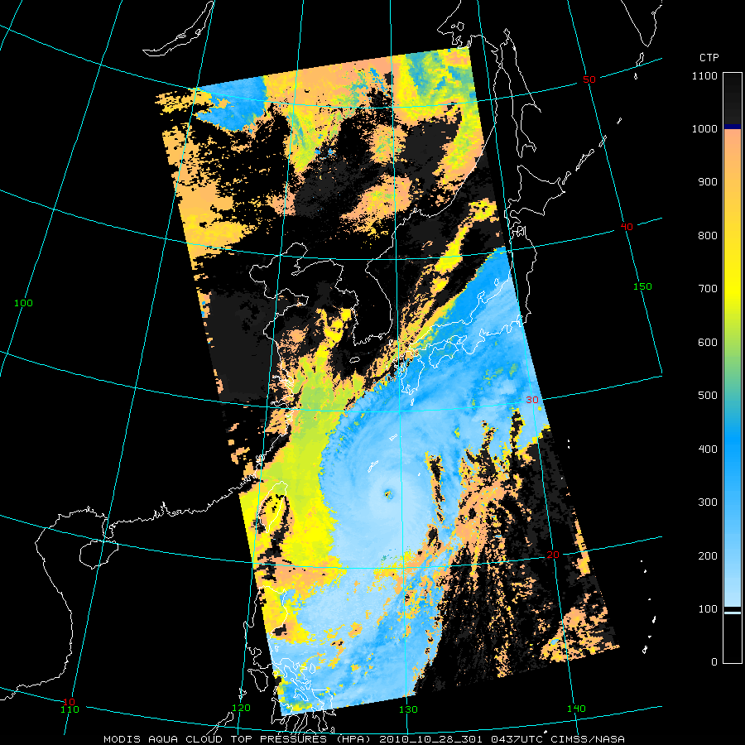

Slide 70
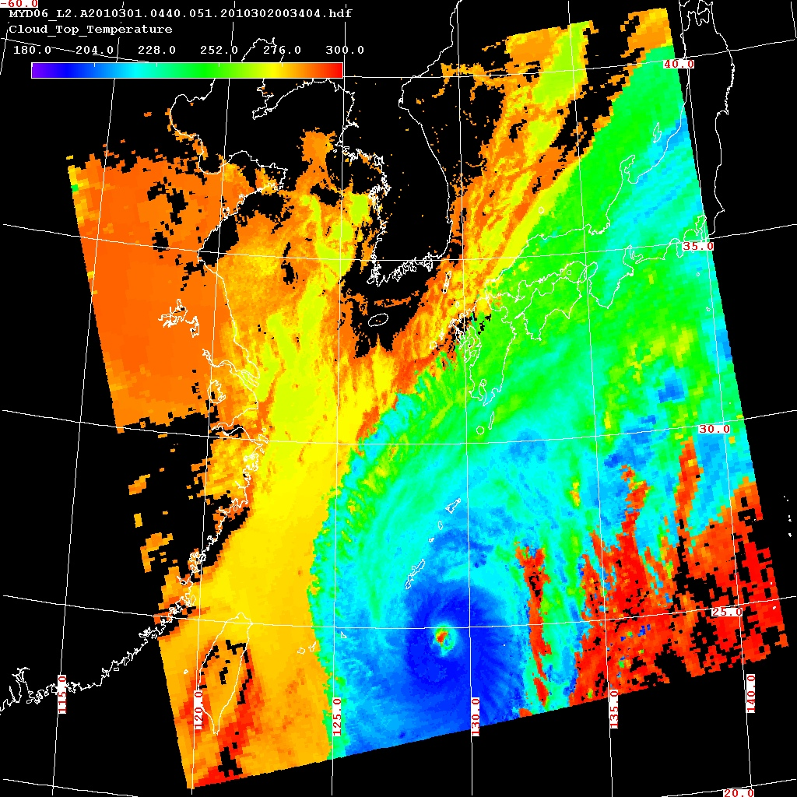

Slide 71
MOD06 Key Output Parameters
5x5 pixel (1km) resolution
Surface_Temperature (GDAS input)
Surface_Pressure (GDAS input)
Cloud_Top_Pressure
Cloud_Top_Temperature
Tropopause_Height
Cloud_Fraction
Cloud_Effective_Emissivity
Cloud_Top_Pressure_Infrared
Brightness_Temperature_Difference_B29-B31
Brightness_Temperature_Difference_B31-B32
Cloud_Phase_Infrared
Cloud Optical Depth (daytime – 1 km product)
Cloud Effective Radius (daytime – 1km)

Slide 72
Known Problems
Low cloud
  Vantage point of satellite means more sensitive to high cloud than low cloud. New algorithm address this
Solution converges on highest pressure level
  Addressed with latest algorithm

Slide 73
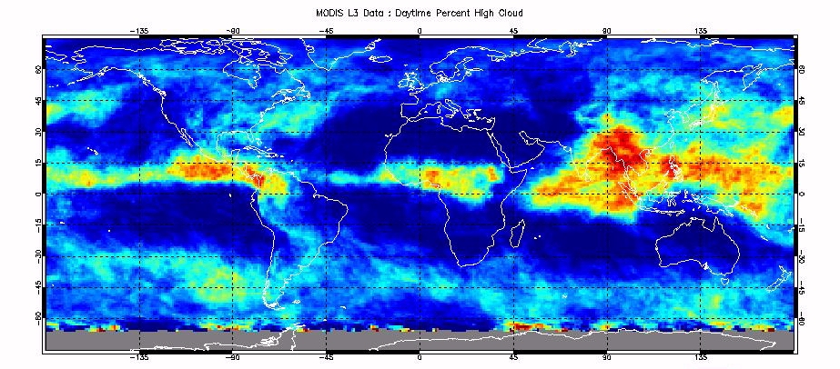
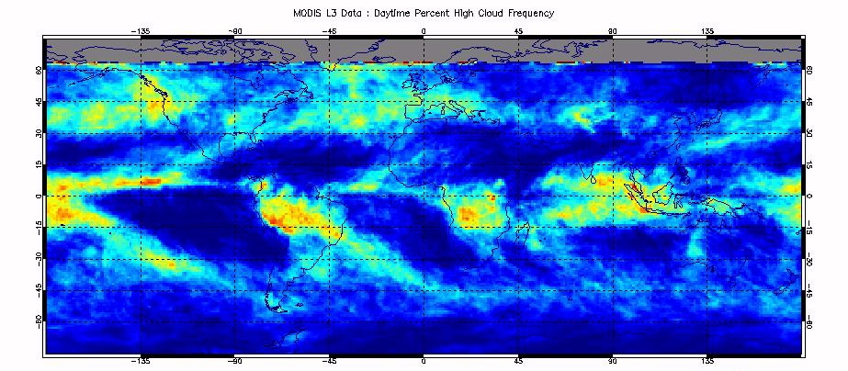

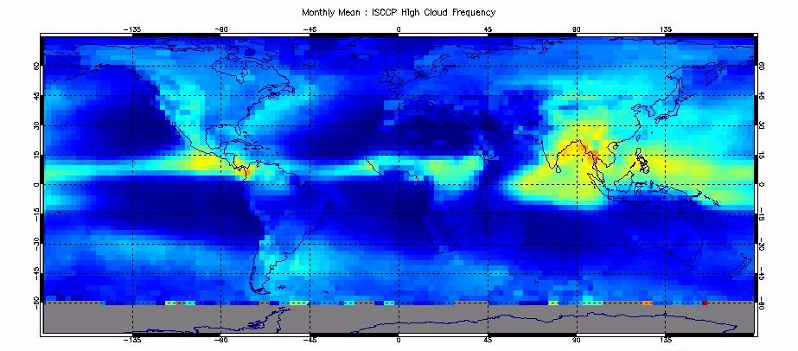
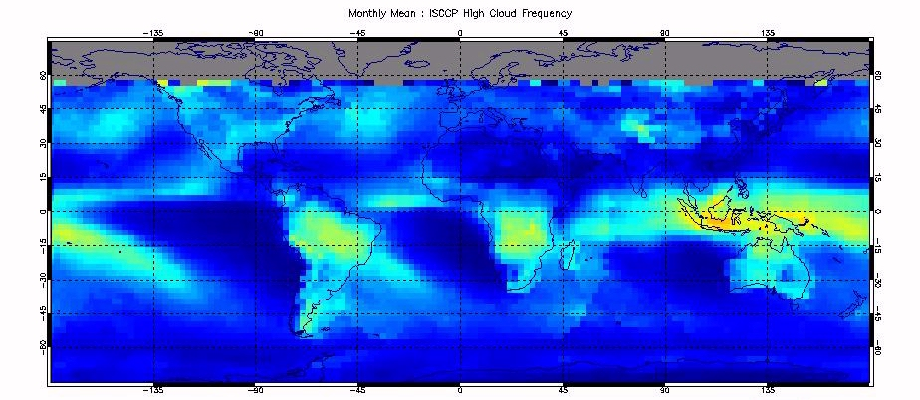
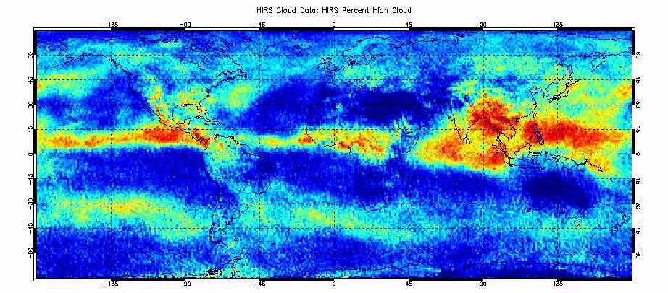
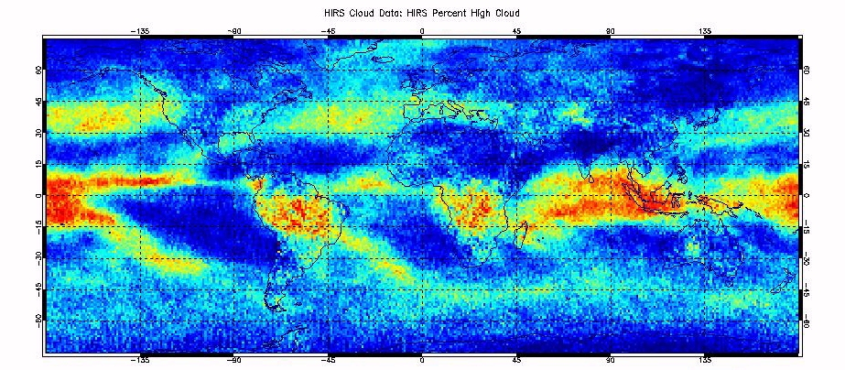
Validation - Comparison of HIRS/ISCCP/MODIS
High Cloud Frequency
July 2002
December 2002

Slide 74
References
Menzel, W. P., F. Richard, H. Zhang, D. P. Wylie, C. Moeller, R. E. Holz, B. Maddux, K. I. Strabala, and L. E. Gumley (2008), MODIS global cloud-top pressure and amount estimation: Algorithm description and results, J. Appl. Meteorol. Climatol., 47, 1175 – 1198, doi:10.1175/2007JAMC1705.1.

Slide 75
MODIS Atmospheric Profiles (MOD07)

Slide 76
MODIS Atmospheric Profiles
Eva Borbas, Suzanne Wetzel-Seemann SSEC
Retrievals are performed in 5x5 FOV (approximately 5km resolution) clear-sky radiances over land and ocean for both day and night.
Algorithm is a statistical regression and has the option for a subsequent nonlinear physical retrieval.
Regression predictors include MODIS infrared radiances from bands 25, 27-36 (4.4 - 14.2mm).
Clear sky determined by MODIS cloud mask (MOD35).

Slide 77
Notes:
The brightness temperatures of the outgoing radiance observed by an airborne interferometer are shown along with the MODIS infrared spectral bands. The brightness temperatures generally decrease as the center of an absorption band is approached. This decrease is associated with the decrease of tropospheric temperature with altitude. Near about 690 cm⁻¹, the temperature shows a minimum which is related to the colder tropopause. On the basis of the sounding principle already discussed, the MODIS team selected a set of sounding wave numbers such that a temperature layers in the troposphere can be described. The arrows indicate the selection. The associated weighting functions are also shown revealing that the radiation is coming from broad overlapping layers, helping to confound the inversion problem from multispectral radiance measurements to temperature profile.

Slide 78
Atmospheric Profile Output
Atmospheric precipitable water
short Water_Vapor
short Water_Vapor_Low
short Water_Vapor_High
Profiles of temperature and moisture (20 levels)
short Retrieved_Moisture_Profile
short Retrieved_Temperature_Profile
Total column ozone
short Total_Ozone
Pressure_Level = 05., 10., 20., 30., 50., 70., 100., 150., 200., 250., 300., 400., 500., 620., 700., 780., 850., 920., 950., 1000. ;

Slide 79
Algorithm Discussion
Clear radiance exiting the atmosphere for a MODIS IR band with
wavelength λ:
p_{sfc}
I_{λ} = ε_{λ}^{sfc} B_{λ}(T_{sfc}) τ_{λ}(p_{sfc}) - ∫ B_{λ}(T(p)) [ dτ_{λ}(p) / dp ] dp .
o
I_{λ} is measured by MODIS for λ = 4.4 - 14.2μm (I₂₅, I₂₇, … I₃₆)
I_{λ} can be considered a nonlinear function of the atmospheric properties including T, q, ozone, surface pressure, skin temperature, and emissivity.
We can infer a statistical regression relationship using calculated radiances from a global set of radiosonde profiles and surface data.
Relationship is inverted to retrieve atmospheric properties from observed MODIS radiances.

Slide 80
Algorithm Discussion
Global radiosondes: data set drawn from NOAA-88, TIGR-3, ozonesondes, ECMWF, desert radiosondes containing 12000+ global radiosonde profiles of temperature, moisture, and ozone used for training data set.
RT model: RT Model used is the CRTM (Community Radiative Transfer Model distributed by the Joint Center for Satellite Data Assimilation (JCSDA)
Radiosonde temperature-moisture-ozone profile / calculated MODIS radiance pairs are used to create the statistical regression relationship.
Notes:
To perform the retrieval, the regression relationship is applied to actual MODIS observations.

Slide 81
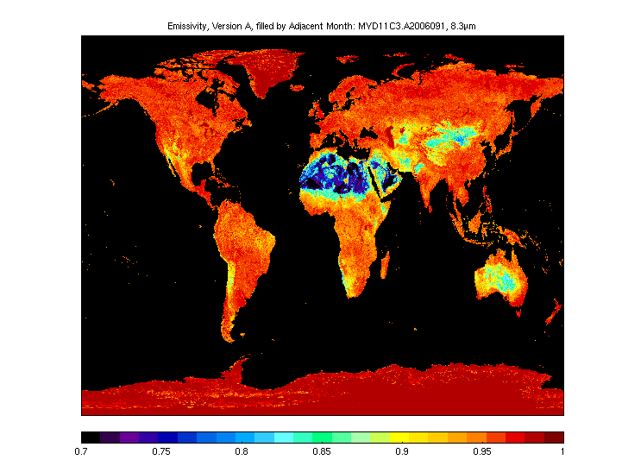
Recent improvements to the algorithm:
Global database of infrared (IR) land surface emissivity
Distributed for use in the retrieval of atmospheric temperature and moisture profiles is introduced.
Emissivity is derived using input from the MODIS operational land surface emissivity product (called MYD11).
MODIS MOD07 retrieval algorithm requires a surface emissivity value corresponding to each of the global training profiles
Improvement is evident over retrievals made with a typical assumption of constant emissivity.
Database available from:
http://cimss.ssec.wisc.edu/iremis/

Slide 82


Typhoon Sinlaku, 7 September 2002
Aqua MODIS
Total Precipitable Water Vapor
Aqua MODIS true color image
TPW = 72.5 mm
Notes:
Maximum TPW = 72.5mm
we do get data from elsewhere and we do look at it….
After tearing through the Okinawan island chain and
Taiwan late last week, Typhoon Sinlaku slammed into
China this weekend, causing as many as 26 deaths
and $100 million in destruction. The typhoon can be
seen making landfall over China in this true-color
image taken on September 7, 2002, by the Moderate
Resolution Imaging Spectroradiometer (MODIS), flying
aboard NASA?s Aqua spacecraft. When the typhoon
hit China, it was packing winds of up to 87 miles (144
kilometers) per hour. The typhoon destroyed over a
quarter of a million acres of cropland, collapsed tens of
thousands of buildings, and forced hundreds of
thousands from their homes. More than 1,500 people
have been killed this year in China as a result of
flooding and severe storms.
Image courtesy Jacques Descloitres, MODIS Land
Rapid Response Team at NASA GSFC

Slide 83


PW High
700-300 hPa
PW (mm):
0 3 6 9 12 15 18
PW Low
920 hPa - sfc
Notes:
Two other products are subsets of TPW: high and low
same scale. See higher PW above 700hPa near convection. See stronger gradients, more small scale features than near surface.
Terra modis june 2, 2001

Slide 84


Slide 86
ARM CART Site Comparison

Slide 87



Global Total Precipitable Water Comparison 22 May 2002
MODIS TPW
TPW (mm):
0 6 12 18 24 30 36 42 48 54 60 66 72
SSM/I f-14 TPW
Ascending and descending
passes were averaged
Notes:
The SSM/I (resolution 12.5 km) retrieves products for clear or cloudy skies over ocean only, and uses the 22 and 37 GHz microwave channels. MODIS and SSM/I show similar patterns of TPW distribution and similar magnitudes, however MODIS retrievals are somewhat less moist over tropical oceans. Some of the differences can be attributed to the fact that MODIS does not retrieve cloudy pixels and, thus, does not capture the moist environment around clouds. This can affect the results even where MODIS retrievals were performed since the retrieval only requires that 5 of the 25 pixels in a 5x5 MODIS field-of-view area be clear. The remaining cloudy pixels are excluded, however the retrieval is still performed using only the clear pixels. Other differences may be attributed to the time differences between the two satellite overpasses.

Slide 88




MODIS profiles agree well with radiosondes and NCEP-GDAS when the atmospheric temperature and moisture is fairly smooth and monotonic:
MODIS
GDAS
Sonde
Pressure (hPa)
Pressure (hPa)
Temperature
Mixing Ratio
Temperature
Mixing Ratio
But not so well with smaller-scale features, such as isolated dry or moist layers:
Pressure (hPa)
Pressure (hPa)
Temperature
Mixing Ratio
Temperature
Mixing Ratio

Slide 89
Applications
Meteorological
  3 dimensional view of atmosphere in clear sky
  Dry Line
  Humidity
  Convection
  Instability
  Severe Weather
  Precipitation Potential
2. Climatological
- Global Circulations Monitoring
- Greenhouse Gas Measure

Slide 90


Slide 91
AREA FORECAST DISCUSSION
NATIONAL WEATHER SERVICE MILWAUKEE/SULLIVAN WI
409 AM CDT FRI JUL 6 2007
.DISCUSSION...FORECAST FOCUS ON POTENTIAL FOR ISOLATED TSTM ACTIVITY TODAY...THEN HOW HIGH WILL THE MERCURY SOAR THIS WEEKEND?
00Z 500/250MB ANALYSIS INDICATED UPPER TROUGHING OVER THE GREAT LAKES/ERN CONUS WITH IMPRESSIVE RIDGING OVER THE WRN CONUS. 500MB HEIGHTS IN THE 596-598DM RANGE FROM AZ NWD INTO WA/ID YIELDING BLISTERING TEMPS WELL INTO THE 100S IN MANY LOCALES ACROSS THE INTERMOUNTAIN WEST. THIS BLOB OF HEAT WILL GRADUALLY ADVECT EWD TOWARD INTO OUR AREA THIS WEEKEND...MORE ON THIS LATER. OTWR NWLY FLOW IN THE LOWER LEVELS OF THE AMS TRYING TO ADVECT SOME DRIER AIR
INTO GREAT LAKES WITH GOES/MODIS TOTAL PRECIP WATER PRODUCTS SHOWING PWS DIPPING AOB 0.75 INCHES...WITH SFC TDS GNRLY IN THE 50S UPSTREAM. IR IMAGERY EARLY THIS MORNING SHOWING CLEAR SKIES OVER ALL OF SRN WI.

Slide 92



SRF Investigation using IASI – MODIS BT Comparison for 2009
by C. Moeller, G. Quinn and D. Tobin
Aqua
Band 27
Aqua Terra
Mean (K): -0.46 0.34
Std (K): 0.29 0.88
Min (K): -2.67 -2.54
Max (K): 2.77 4.1
N: 3323 3781
Terra – Aqua: +0.81 K
Terra
Aqua Terra
Mean (K): 0.18 1.43
Std (K): 0.44 0.88
Min (K): -3.08 -1.22
Max (K): 4.81 5.49
N: 3323 3781
Terra – Aqua: +1.25 K
Aqua Terra
Mean (K): 0.18 1.43
Std (K): 0.44 0.88
Min (K): -3.08 -1.22
Max (K): 4.81 5.49
N: 3323 3781
Terra – Aqua: +1.25 K

Slide 93
References
Seemann, S., J. Li, W. P. Menzel, and L. Gumley, 2003: Operational retrieval of atmospheric temperature, moisture, and ozone from MODIS infrared radiances. Journal of Applied Meteorology and Climatology, 42, 1072-1091.
Aniko Kern, Judit Bartholy, Eva E. Borbas, Zoltan Barcza, Rita Pongracz, Csaba Ferencz, 2008: Estimation of vertically integrated water vapor in Hungary using MODIS imagery. Advances in Space Research, 41, 1933-1945..
S. W. Seemann , E. E. Borbas , R. O. Knuteson , G. R. Stephenson and H.-L. Huang, 2008: Development of a global infrared land surface emissivity database for application to clear sky sounding retrievals from multispectral satellite radiance measurements. Journal of Applied Meteorology, vol. 47, p.108.

