Slide 1
GOES-15 Imager
A Sampling of Imagery Over
Four Yaw Flip Maneuvers
2030UTC 20 Sep 2012 (264),
2030UTC 20 Mar 2013 (079),
2030UTC 23 Sep 2013 (266),
&
2030UTC 20 Mar 2014 (079)
Tony Schreiner, Jim Nelson, Mat Gunshor CIMSS
Tim Schmit NOAA/NESDIS/ASPB
26Mar2014

Slide 2
INTRODUCTION
Does the semi-annual Yaw Flip Maneuver effect the GOES-15 Imager imagery?
If there is an effect, is it systematic?
The following series of images (McIDAS-X) will help to address these concerns.

Slide 3
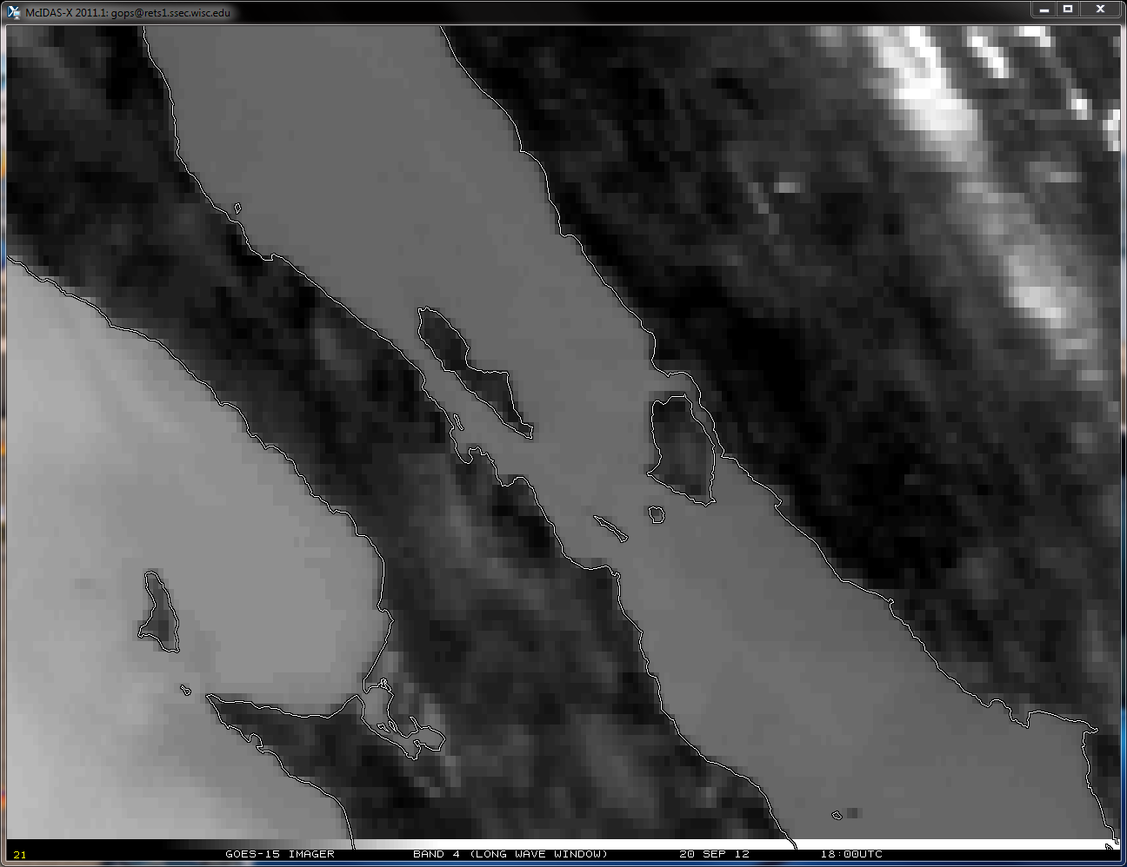
GOES-15 Imager
Band 4 (Long Wave Window)
20 Sep 2012 18:00UTC
Note Shift

Slide 4
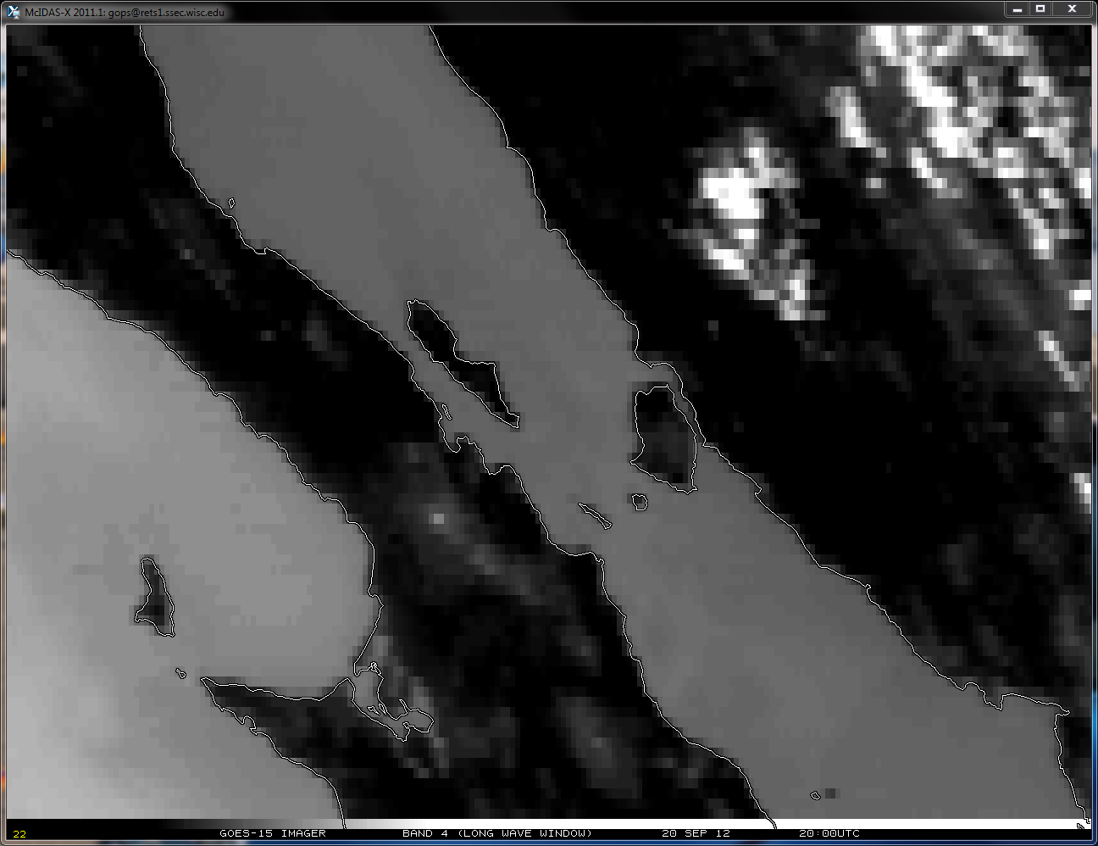
GOES-15 Imager
Band 4 (Long Wave Window)
20 Sep 2012 20:00UTC
Note Shift
The 20 September 2012 Yaw Flip causes the inverted spacecraft to flip to the upright position.
30 minutes prior to the Fall 2012 Yaw Flip Maneuver

Slide 5
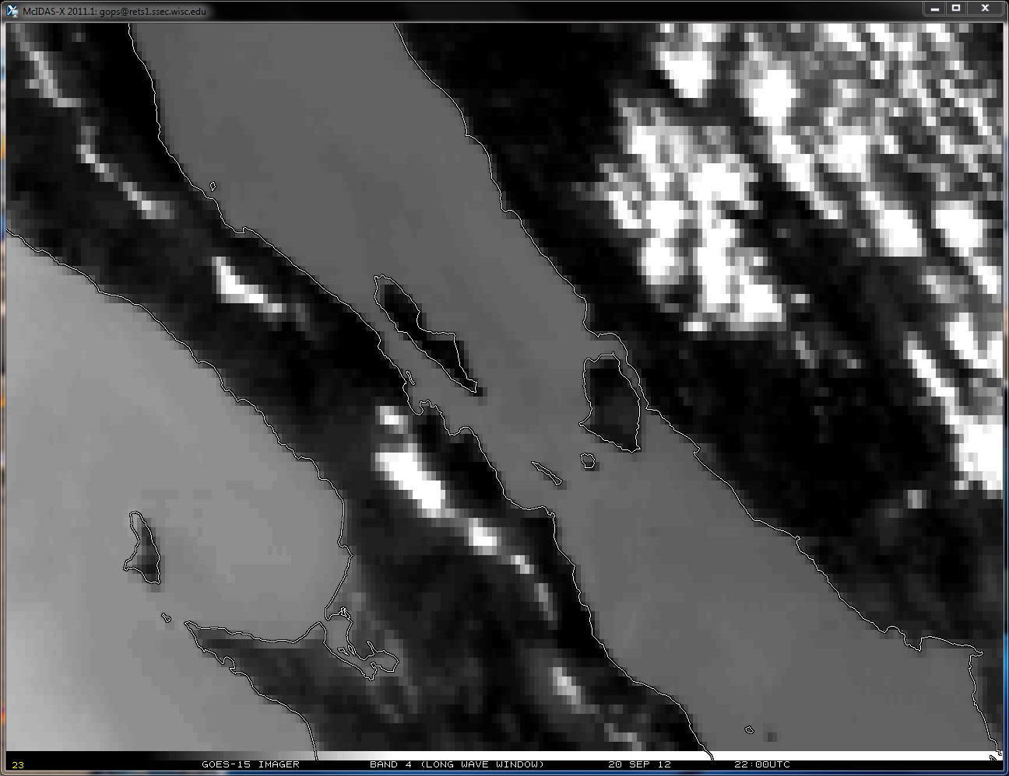
GOES-15 Imager
Band 4 (Long Wave Window)
20 Sep 2012 22:00UTC
Note Shift
The 20 September 2012 Yaw Flip causes the inverted spacecraft to flip to the upright position.
30 minutes after the Fall 2012 Yaw Flip Maneuver
Notes:
YAW FLIP #1 – inverted -> upright September 2012

Slide 6
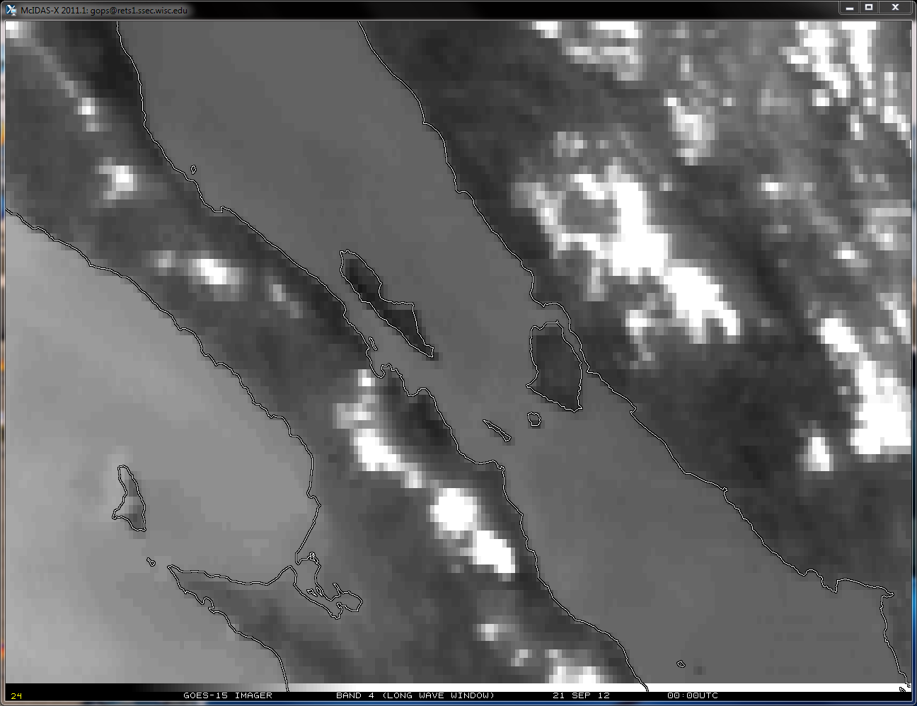
GOES-15 Imager
Band 4 (Long Wave Window)
21 Sep 2012 00:00UTC
Note Shift

Slide 7
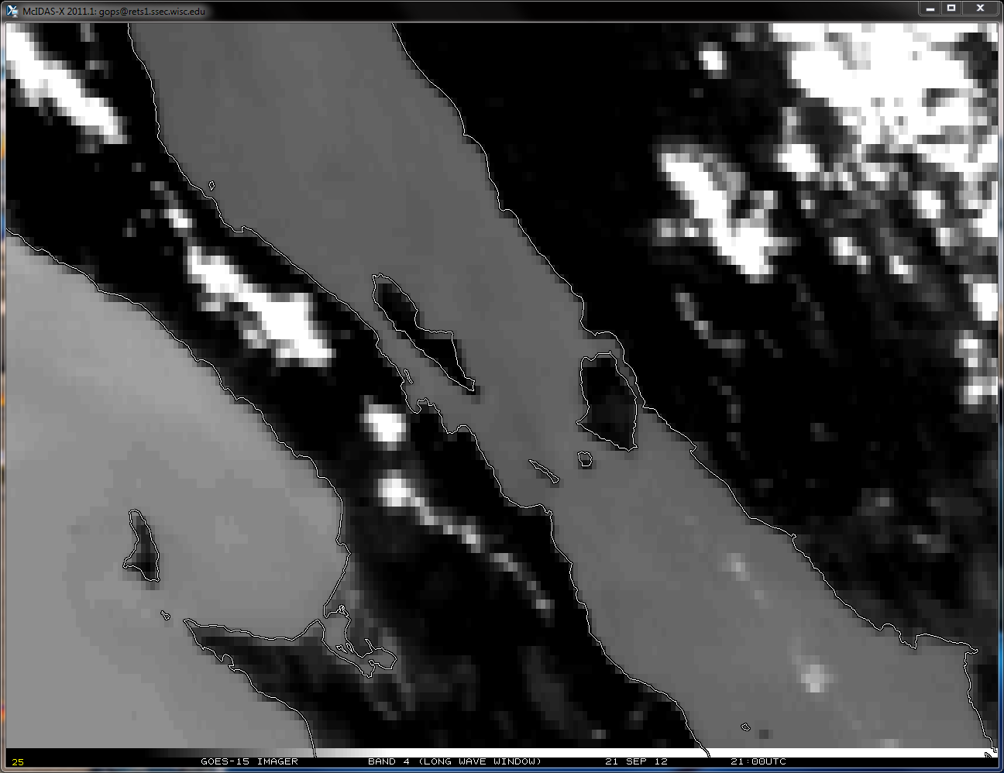
GOES-15 Imager
Band 4 (Long Wave Window)
21 Sep 2012 21:00UTC
Note Shift

Slide 8
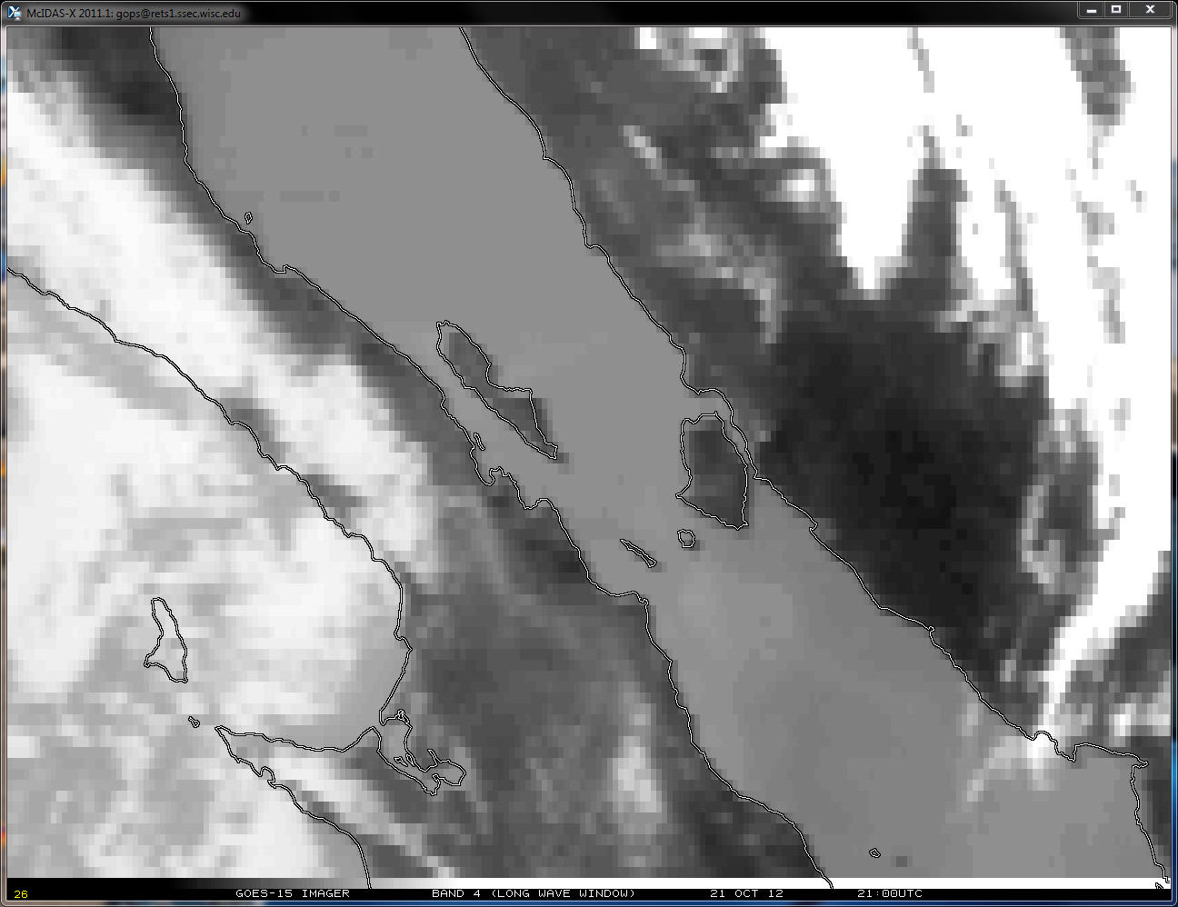
GOES-15 Imager
Band 4 (Long Wave Window)
21 Oct 2012 21:00UTC
Note Shift

Slide 9
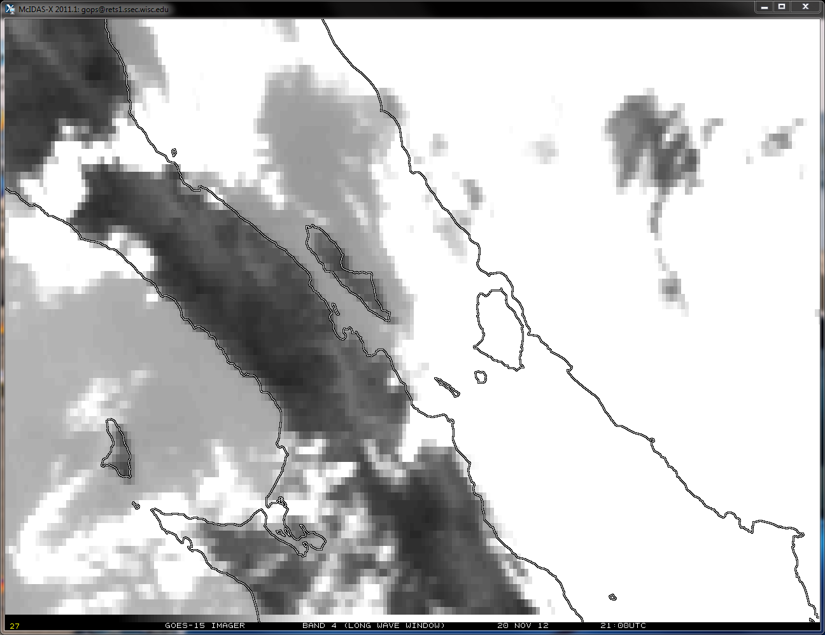
GOES-15 Imager
Band 4 (Long Wave Window)
20 Nov 2012 21:00UTC
Note Shift

Slide 10
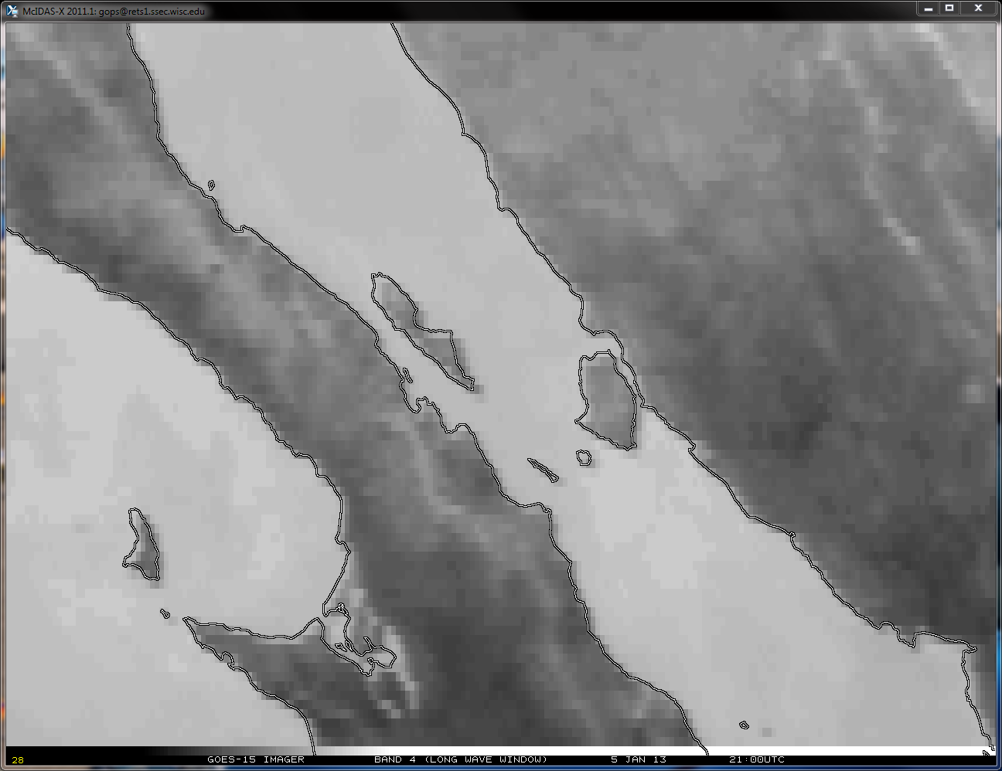
GOES-15 Imager
Band 4 (Long Wave Window)
5 Jan 2013 21:00UTC
Note Shift

Slide 11
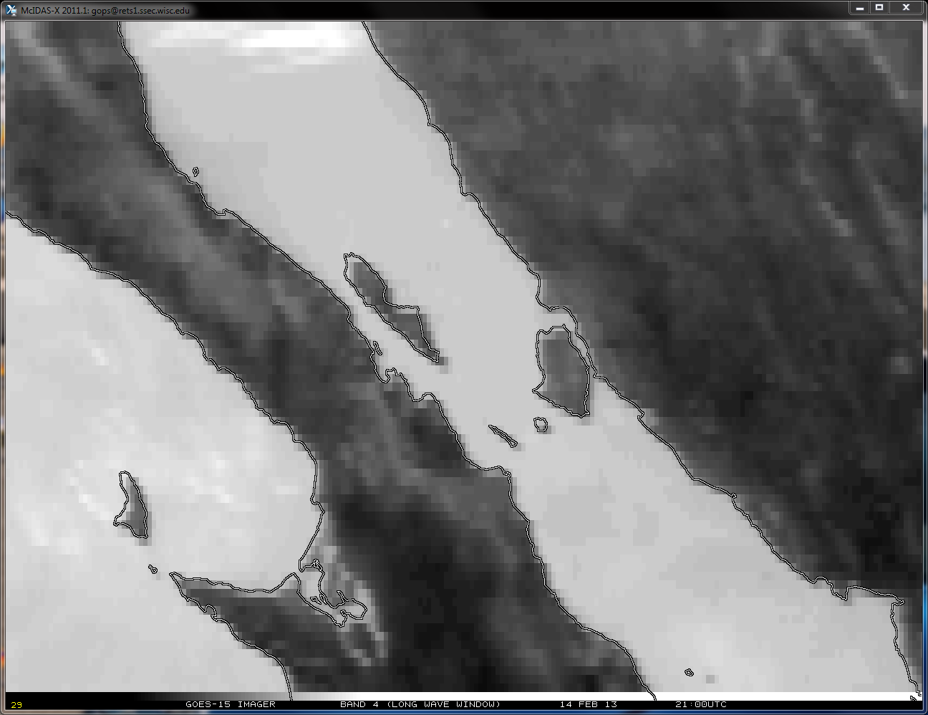
GOES-15 Imager
Band 4 (Long Wave Window)
14 Feb 2013 21:00UTC
Note Shift

Slide 12
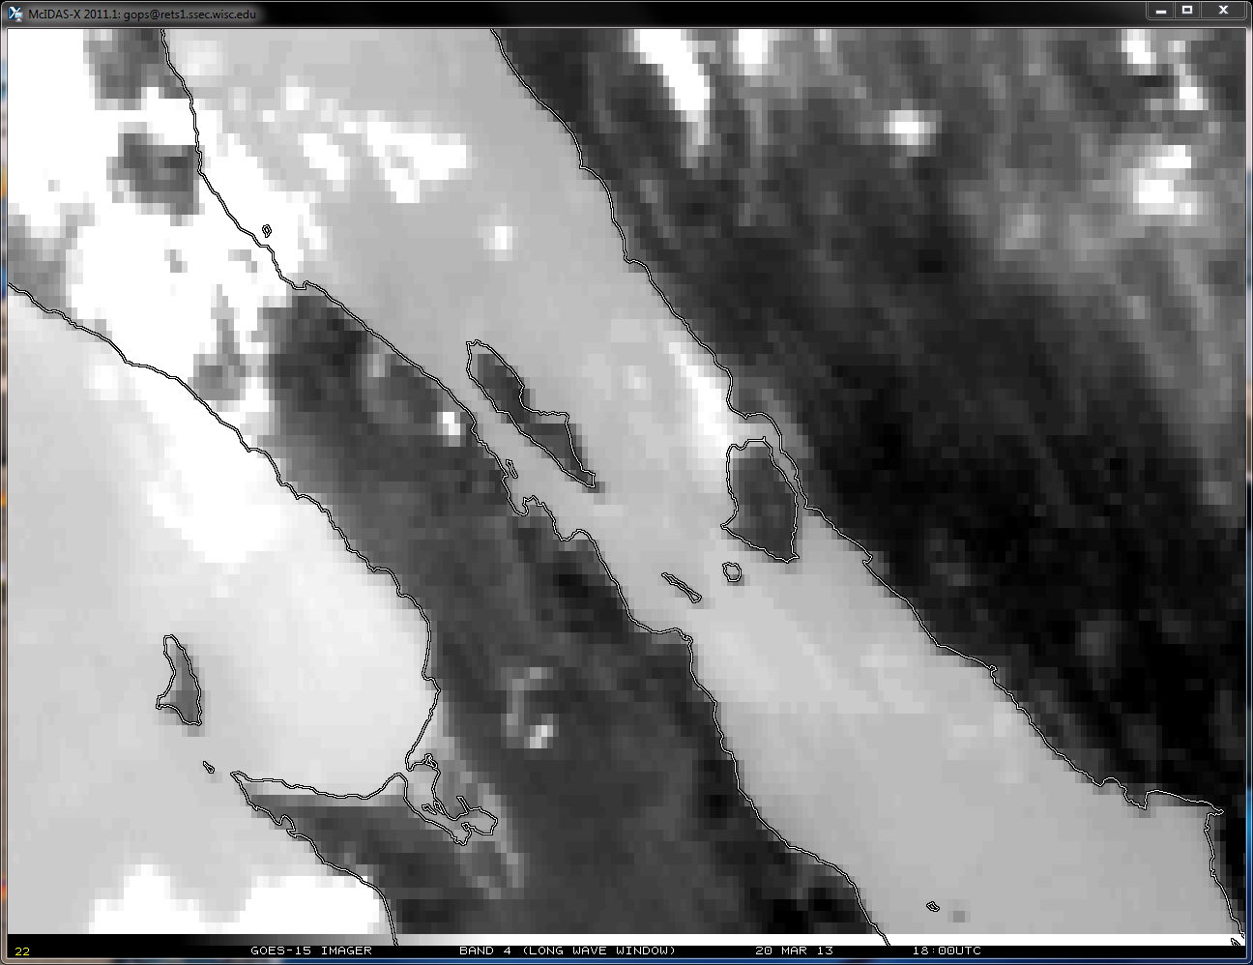
GOES-15 Imager
Band 4 (Long Wave Window)
20 Mar 2013 18:00UTC
Note Shift

Slide 13
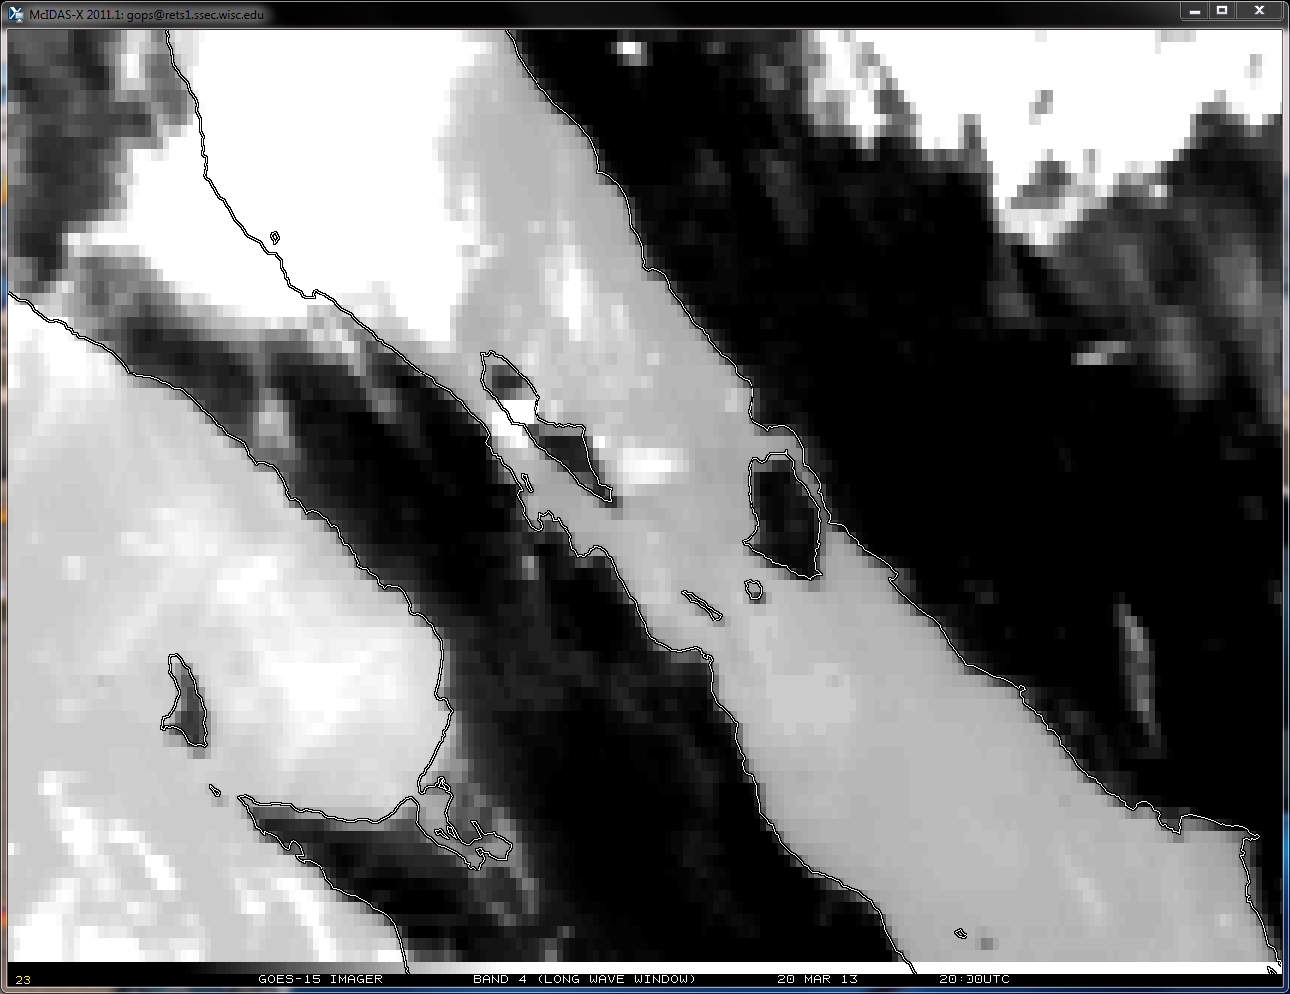
GOES-15 Imager
Band 4 (Long Wave Window)
20 Mar 2013 20:00UTC
Note Shift
The 20 March 2013 Yaw Flip causes the upright spacecraft to flip to the inverted position.
30 minutes prior to the Spring 2013 Yaw Flip Maneuver

Slide 14
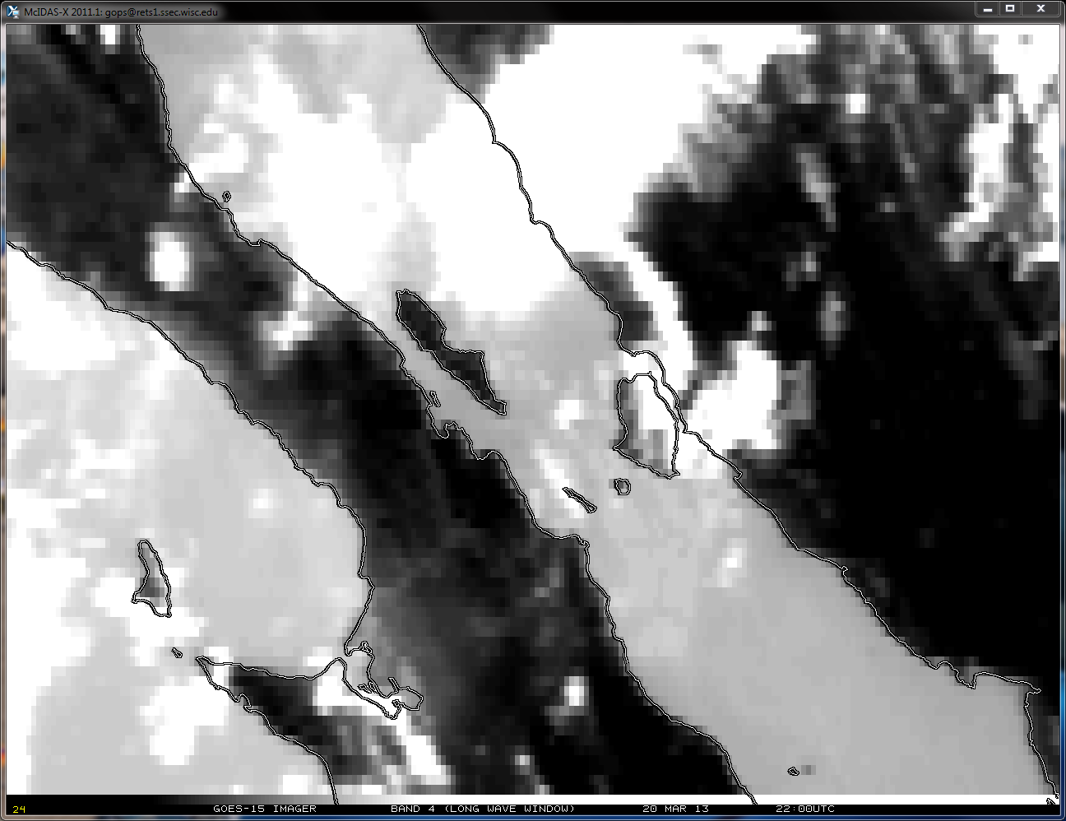
GOES-15 Imager
Band 4 (Long Wave Window)
20 Mar 2013 22:00UTC
Note Shift
The 20 March 2013 Yaw Flip causes the upright spacecraft to flip to the inverted position.
30 minutes after the Spring 2013 Yaw Flip Maneuver
Notes:
YAW FLIP #2 – upright -> inverted March 2013

Slide 15
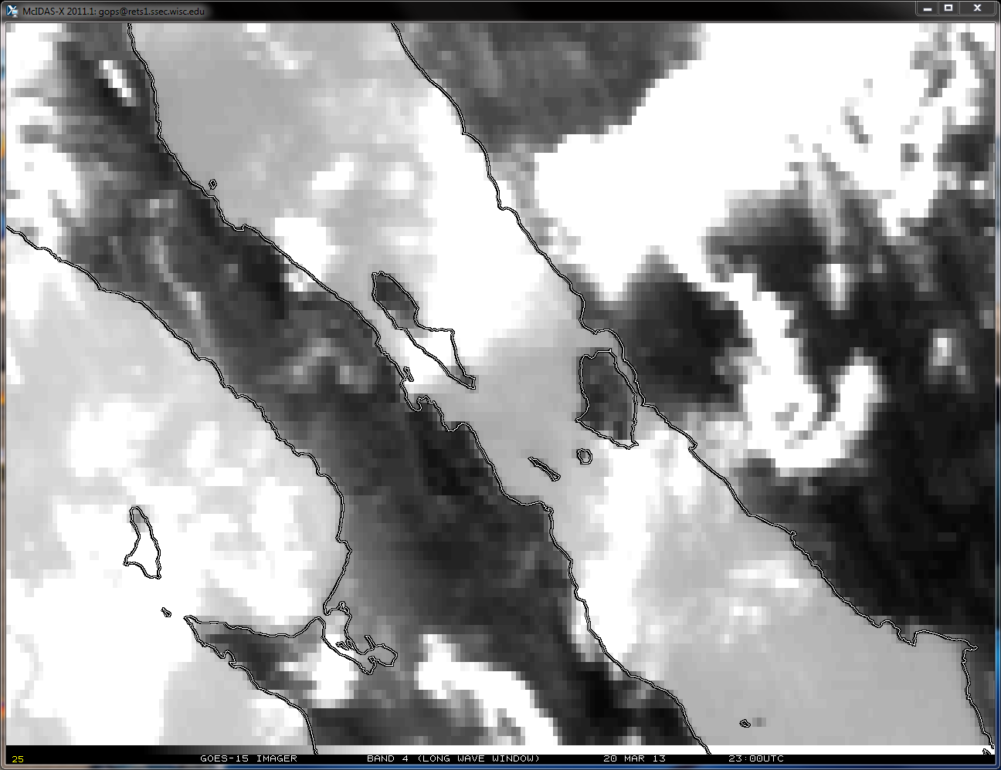
GOES-15 Imager
Band 4 (Long Wave Window)
20 Mar 2013 23:00UTC
Note Shift

Slide 16
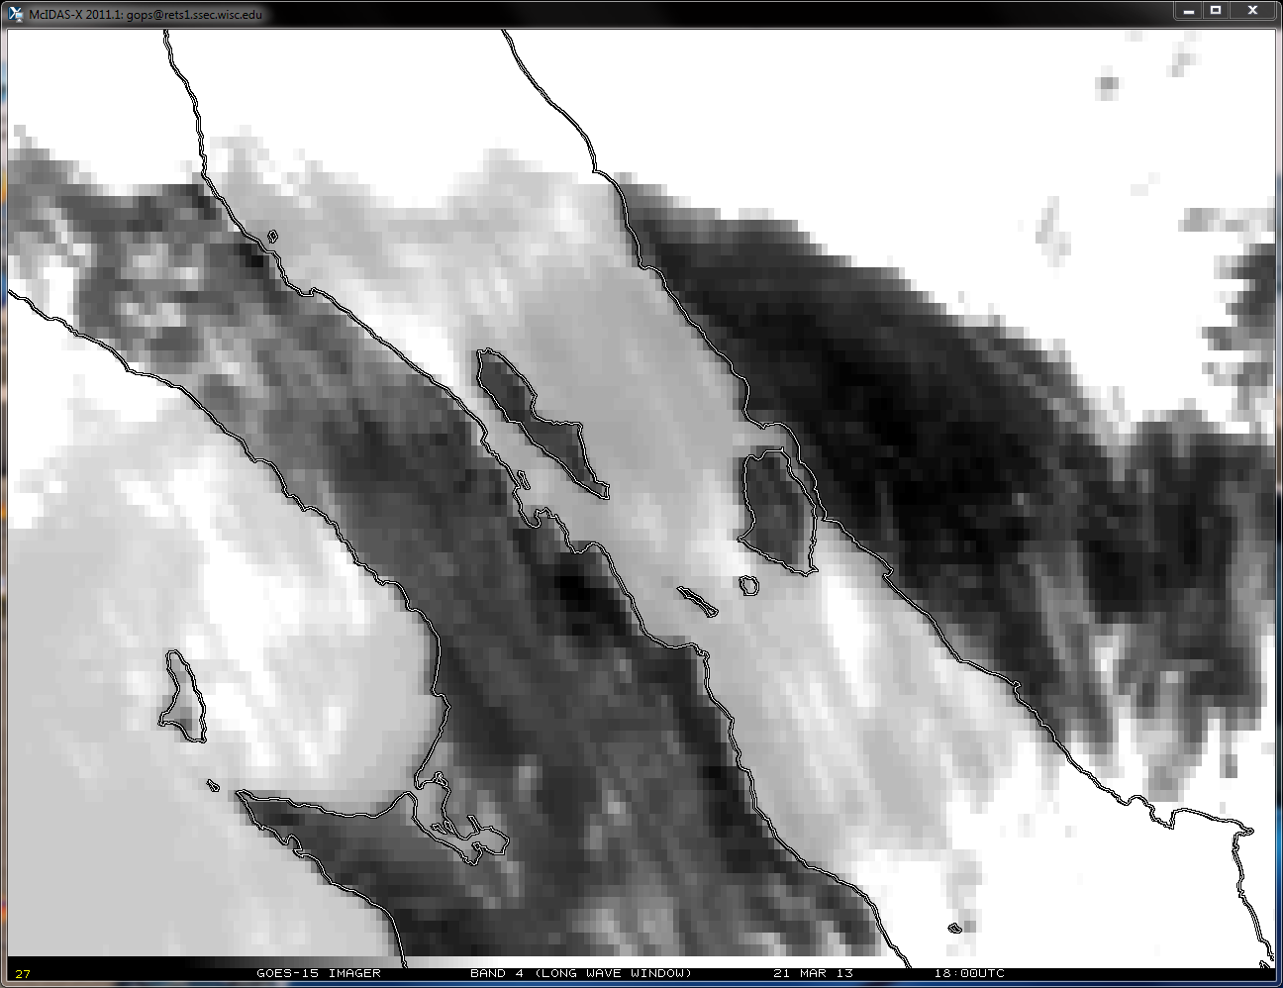
GOES-15 Imager
Band 4 (Long Wave Window)
21 Mar 2013 18:00UTC
Note Shift

Slide 17
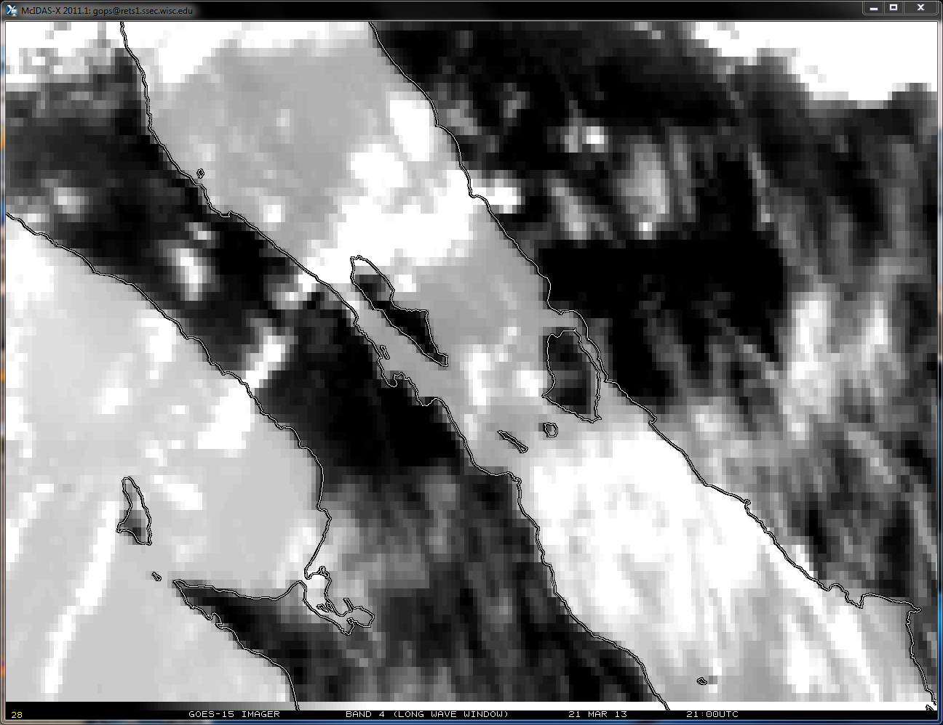
GOES-15 Imager
Band 4 (Long Wave Window)
21 Mar 2013 21:00UTC
Note Shift

Slide 18
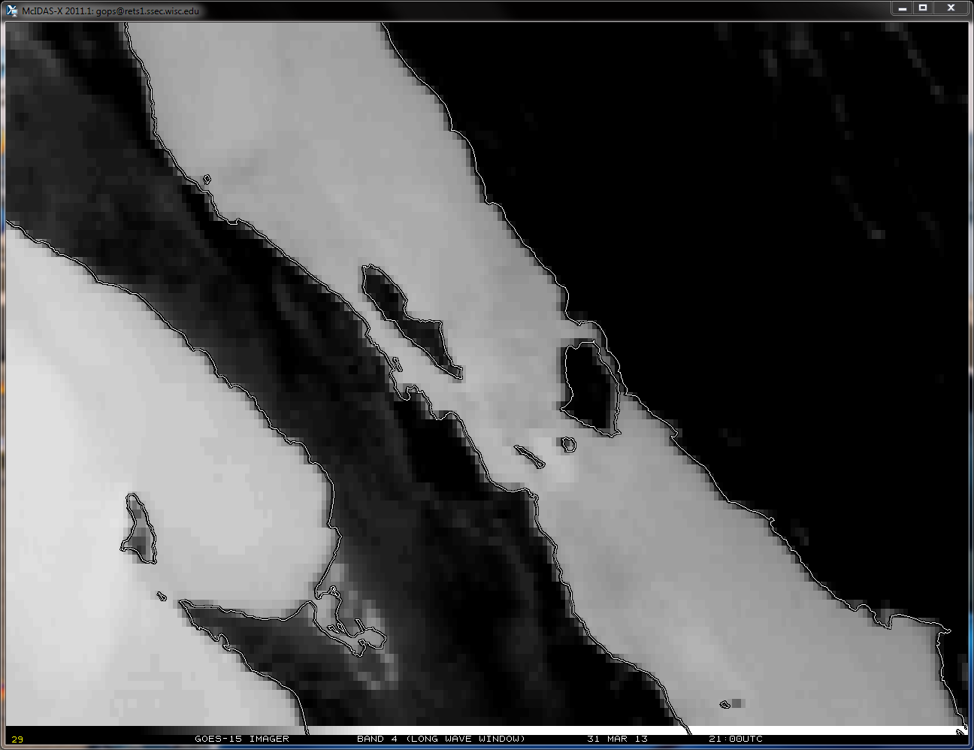
GOES-15 Imager
Band 4 (Long Wave Window)
31 Mar 2013 21:00UTC
Note Shift

Slide 19
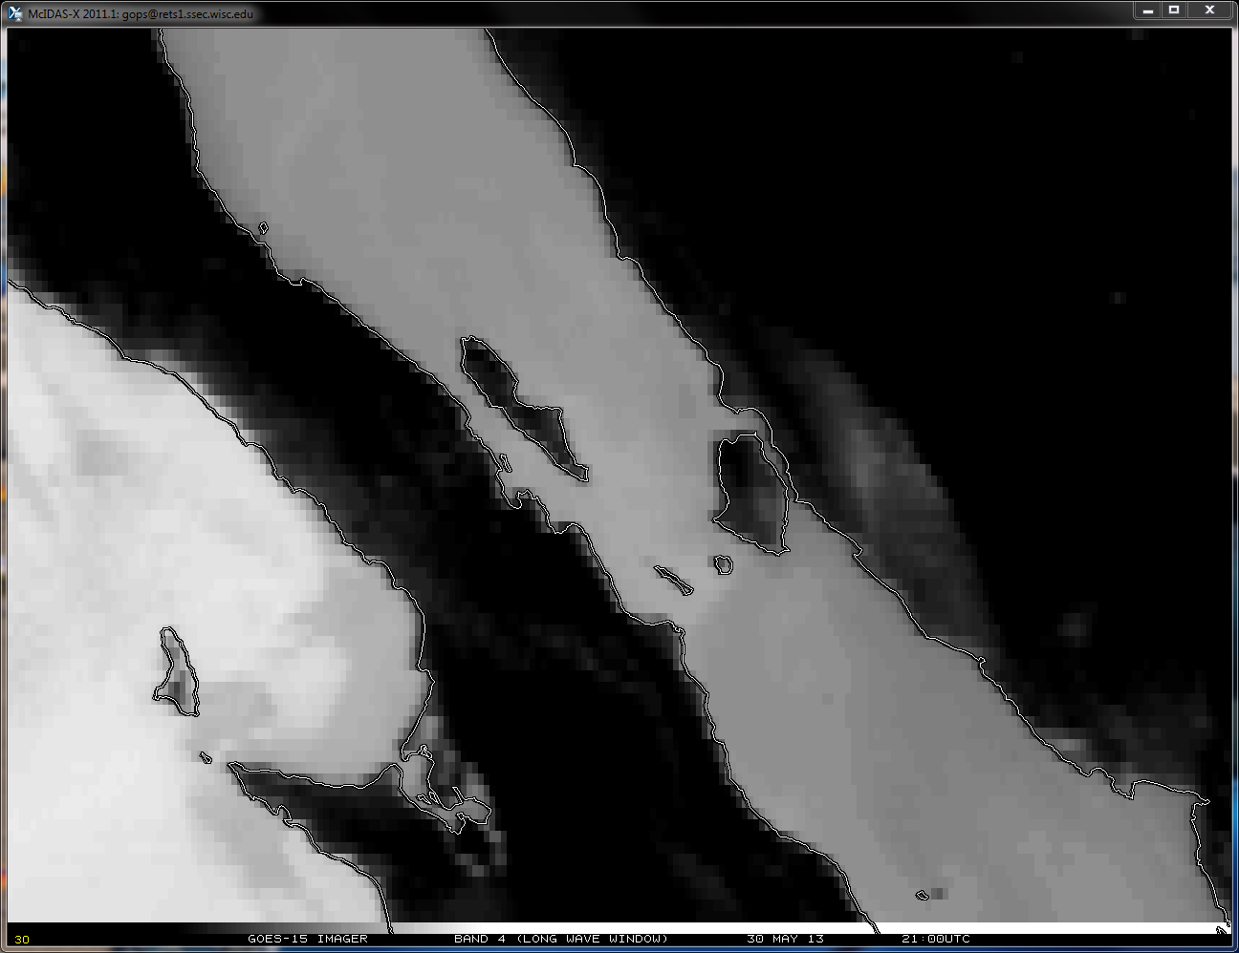
GOES-15 Imager
Band 4 (Long Wave Window)
30 May 2013 21:00UTC
Note Shift

Slide 20
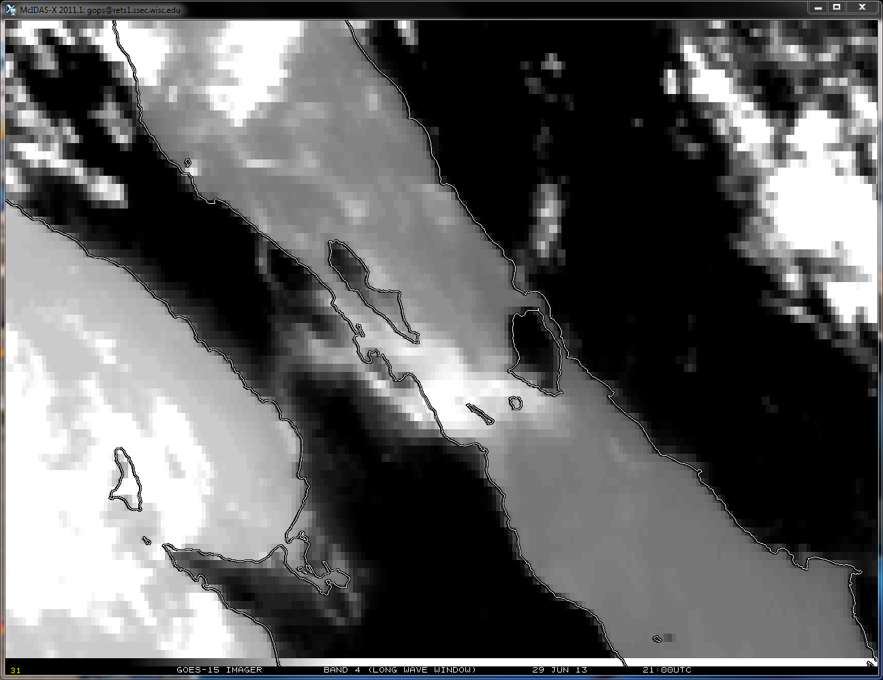
GOES-15 Imager
Band 4 (Long Wave Window)
29 Jun 2013 21:00UTC
Note Shift

Slide 21
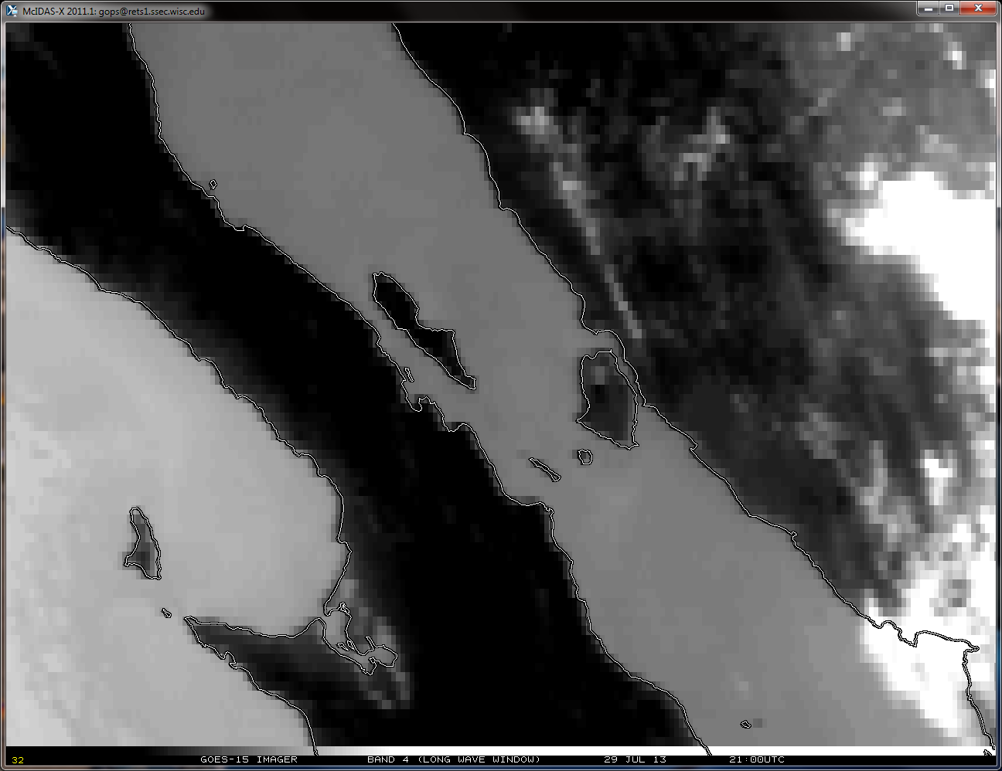
GOES-15 Imager
Band 4 (Long Wave Window)
29 Jul 2013 21:00UTC
Note Shift

Slide 22
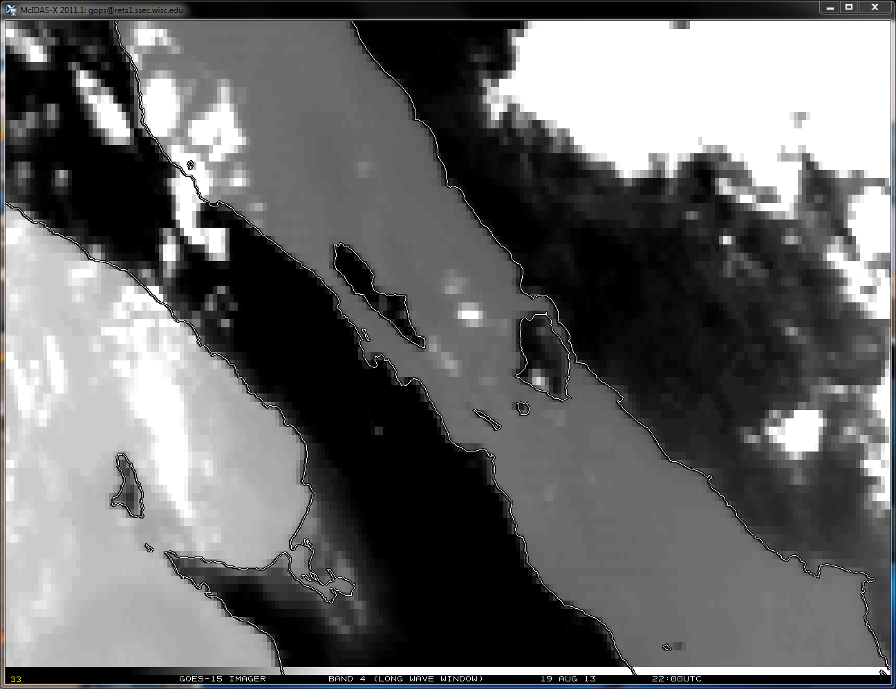
GOES-15 Imager
Band 4 (Long Wave Window)
19 Aug 2013 22:00UTC
Note Shift

Slide 23
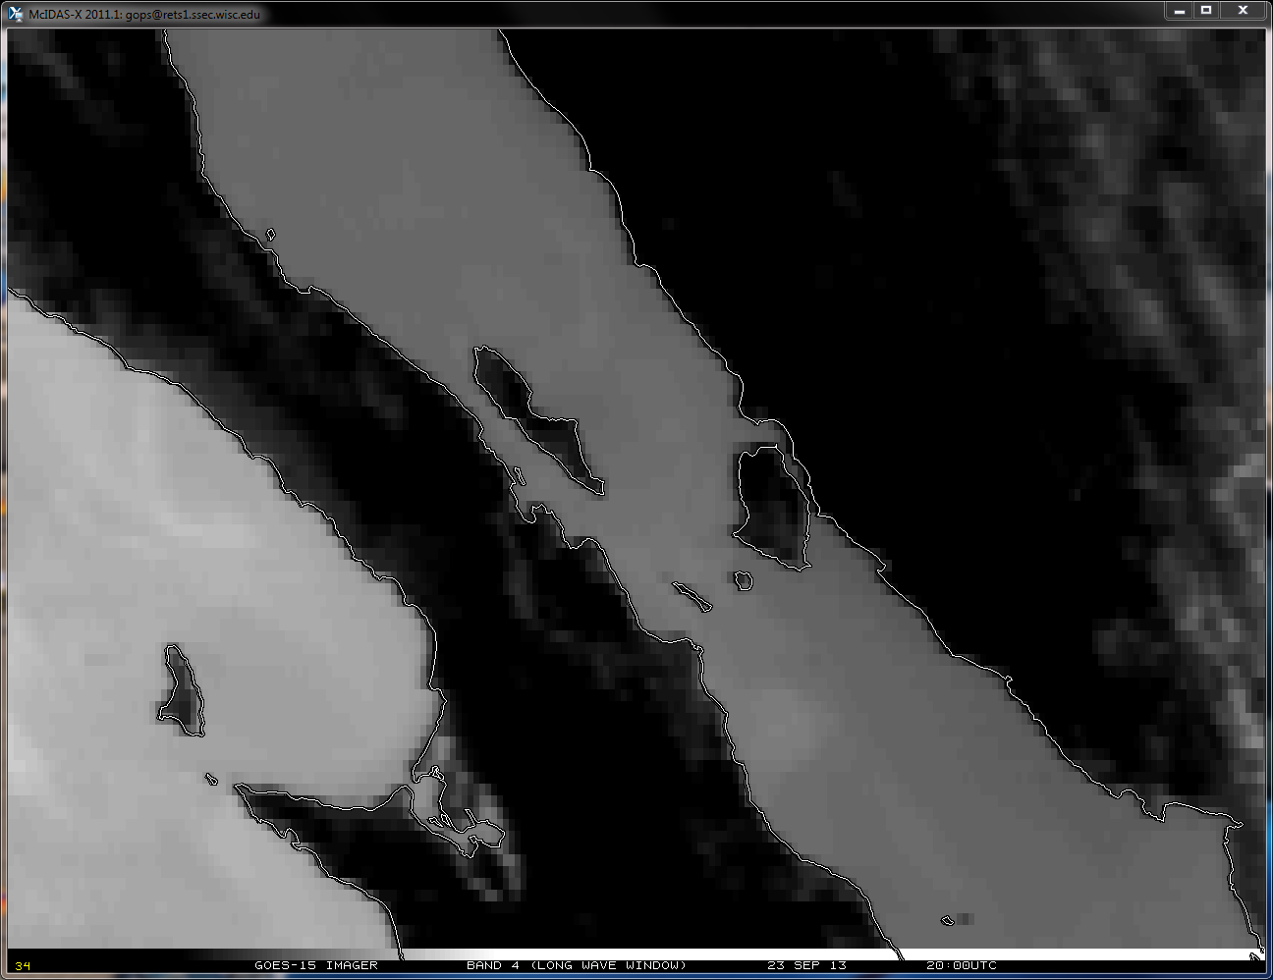
GOES-15 Imager
Band 4 (Long Wave Window)
23 Sep 2013 20:00UTC
Note Shift
The 23 September 2013 Yaw Flip causes the inverted spacecraft to flip to the upright position.
30 minutes prior to the Fall 2013 Yaw Flip Maneuver

Slide 24
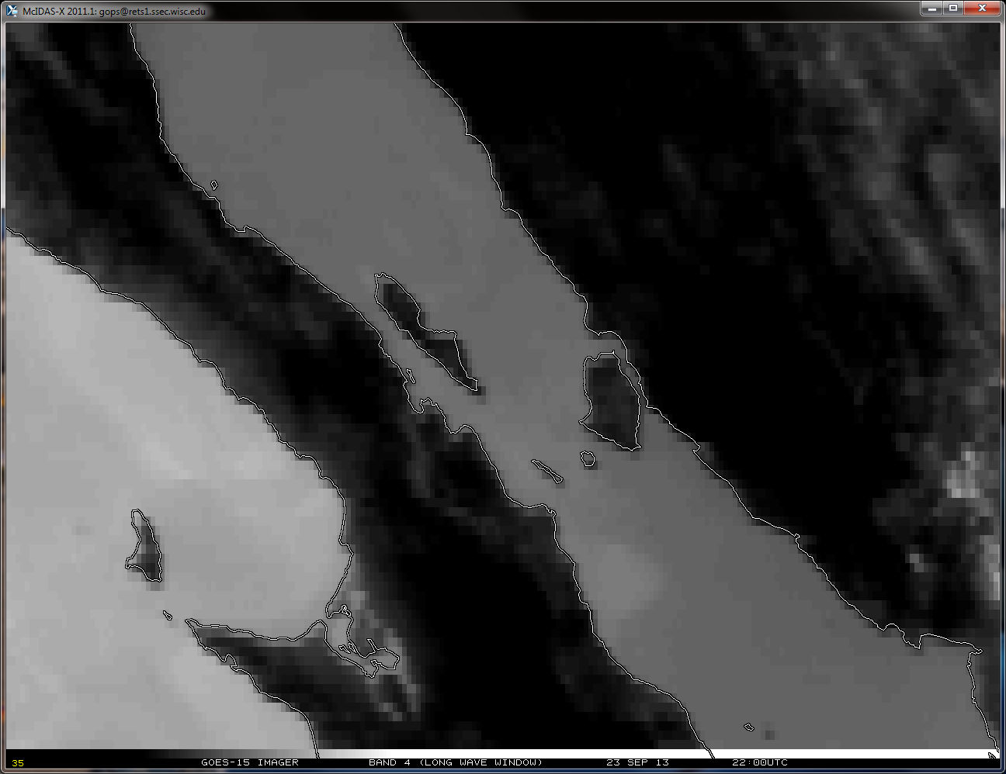
GOES-15 Imager
Band 4 (Long Wave Window)
23 Sep 2013 22:00UTC
Note Shift
The 23 September 2013 Yaw Flip causes the inverted spacecraft to flip to the upright position.
30 minutes after the Fall 2013 Yaw Flip Maneuver
Notes:
YAW FLIP #3 – inverted -> upright September 2013

Slide 25
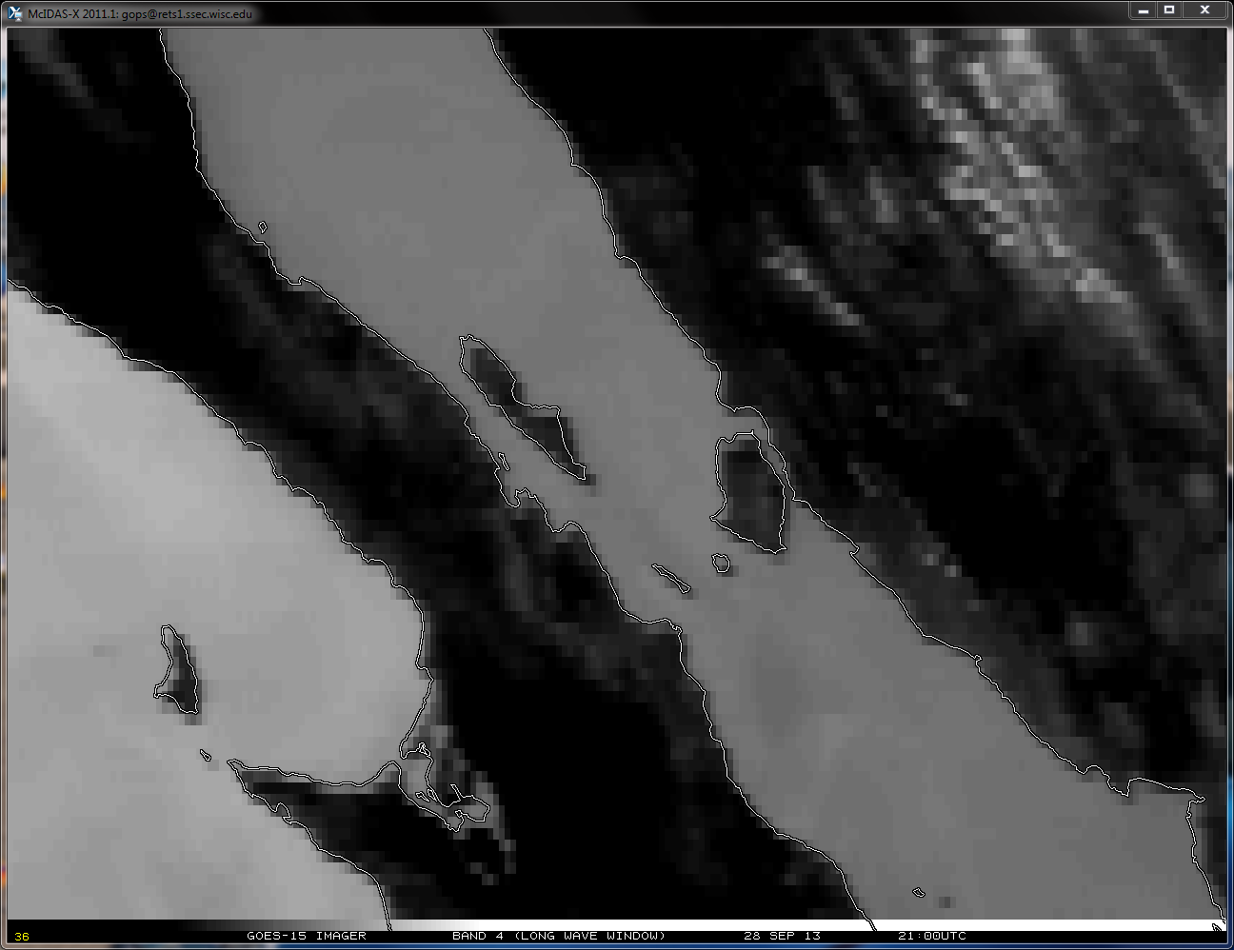
GOES-15 Imager
Band 4 (Long Wave Window)
28 Sep 2013 21:00UTC
Note Shift

Slide 26
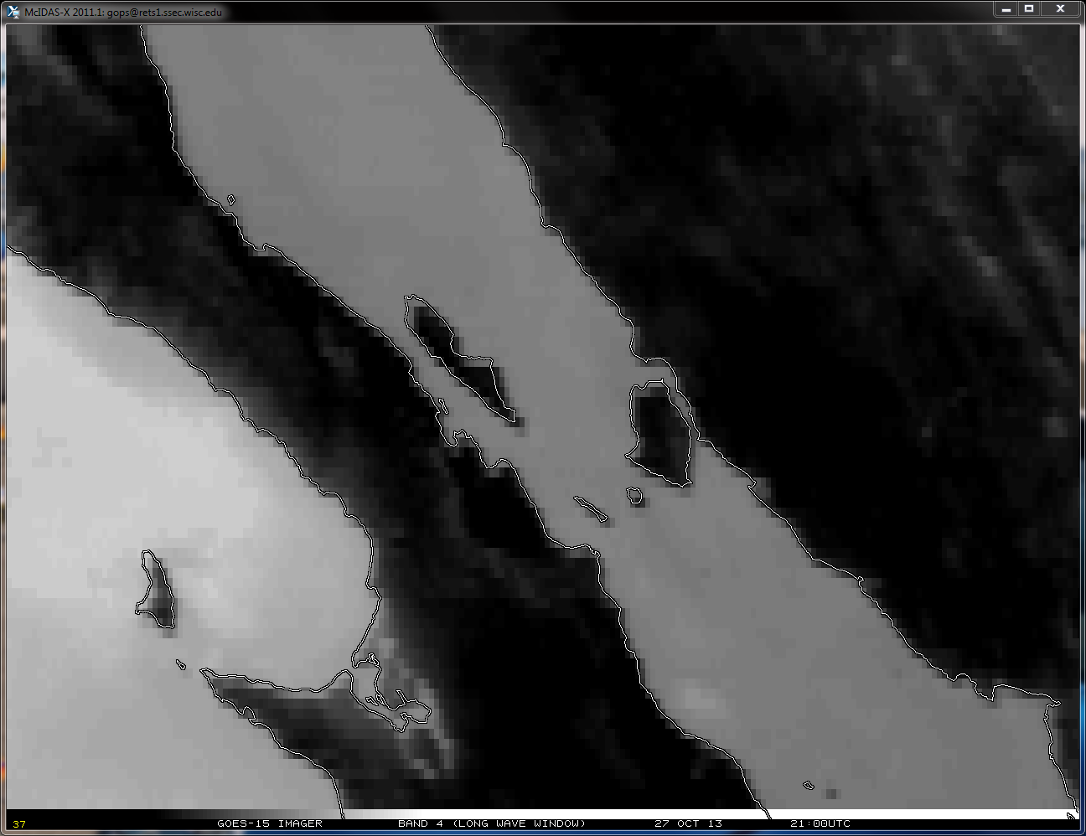
GOES-15 Imager
Band 4 (Long Wave Window)
27 Oct 2013 21:00UTC
Note Shift
34 days after the Fall 2013 Yaw Flip Maneuver

Slide 27
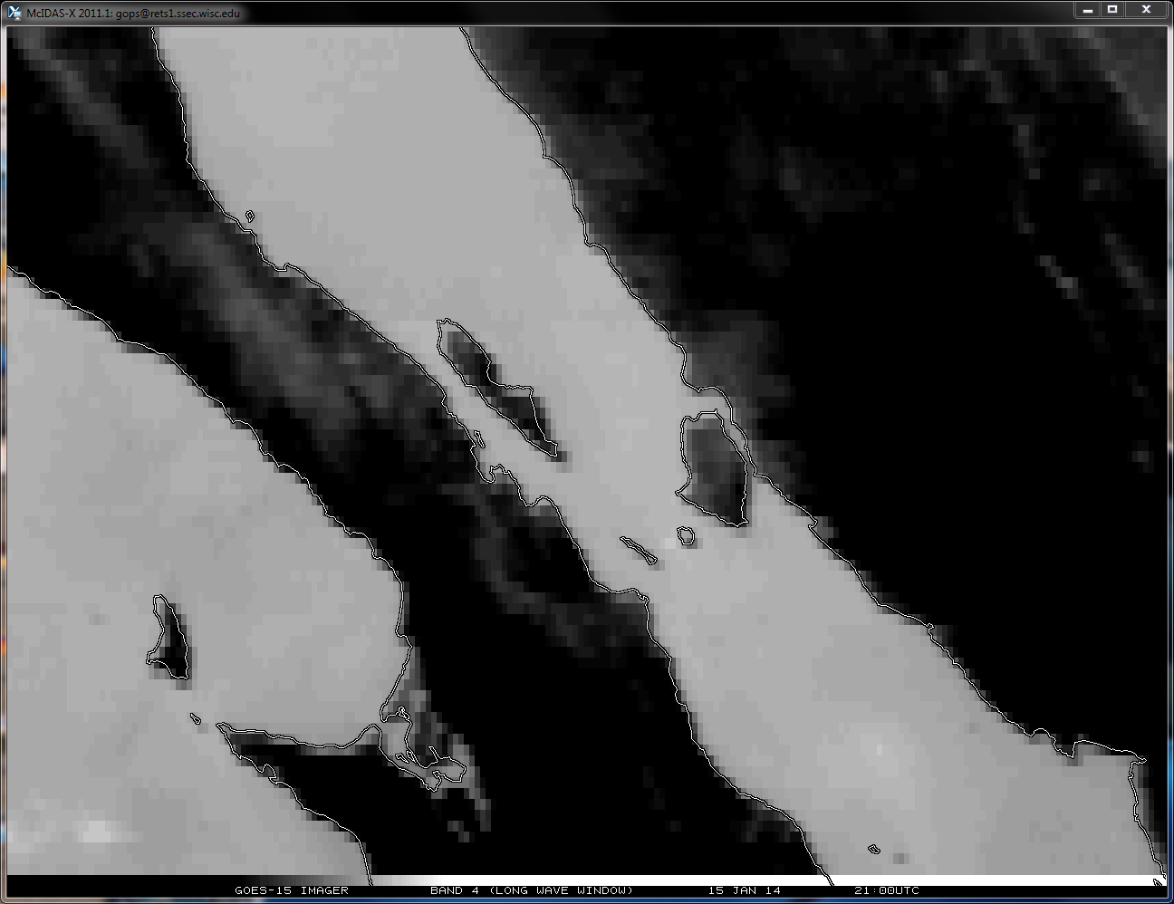
GOES-15 Imager
Band 4 (Long Wave Window)
15 Jan 2014 21:00UTC
Note Shift
64 days prior to the Spring 2014 Yaw Flip Maneuver

Slide 28
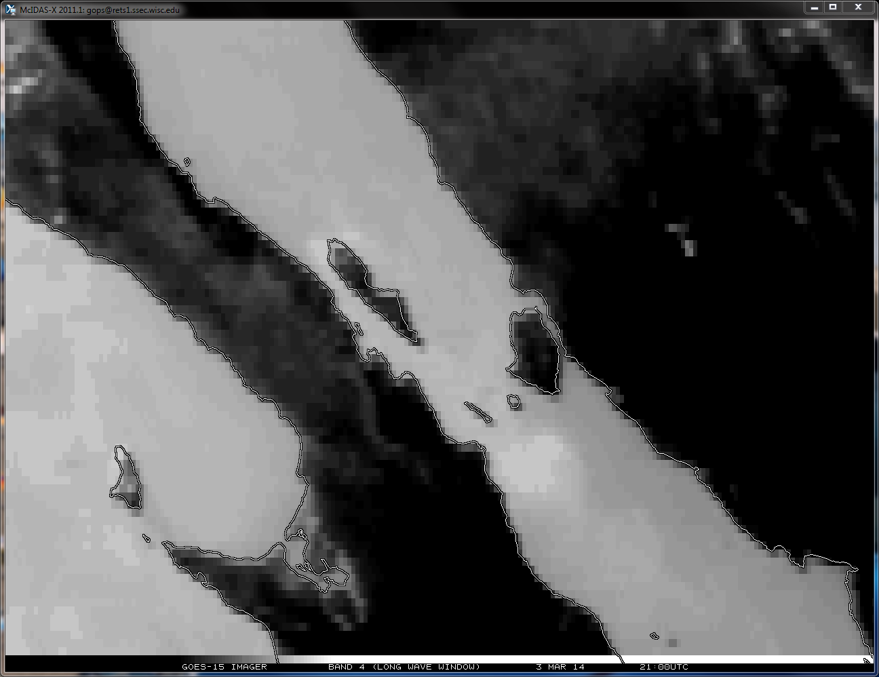
GOES-15 Imager
Band 4 (Long Wave Window)
3 Mar 2014 21:00UTC
Note Shift
17 days prior to the Spring 2014 Yaw Flip Maneuver

Slide 29
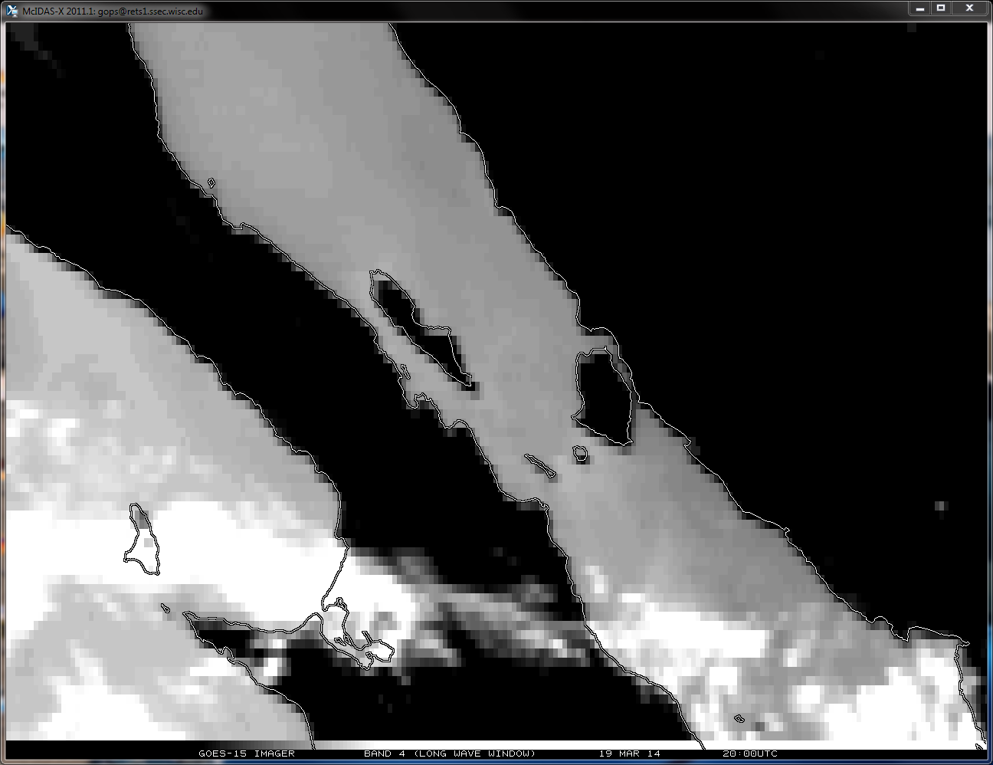
GOES-15 Imager
Band 4 (Long Wave Window)
19 Mar 2014 20:00UTC
Note Shift
The 20 March 2014 Yaw Flip causes the upright spacecraft to flip to the inverted position.
1 day prior to the Spring 2014 Yaw Flip Maneuver

Slide 30
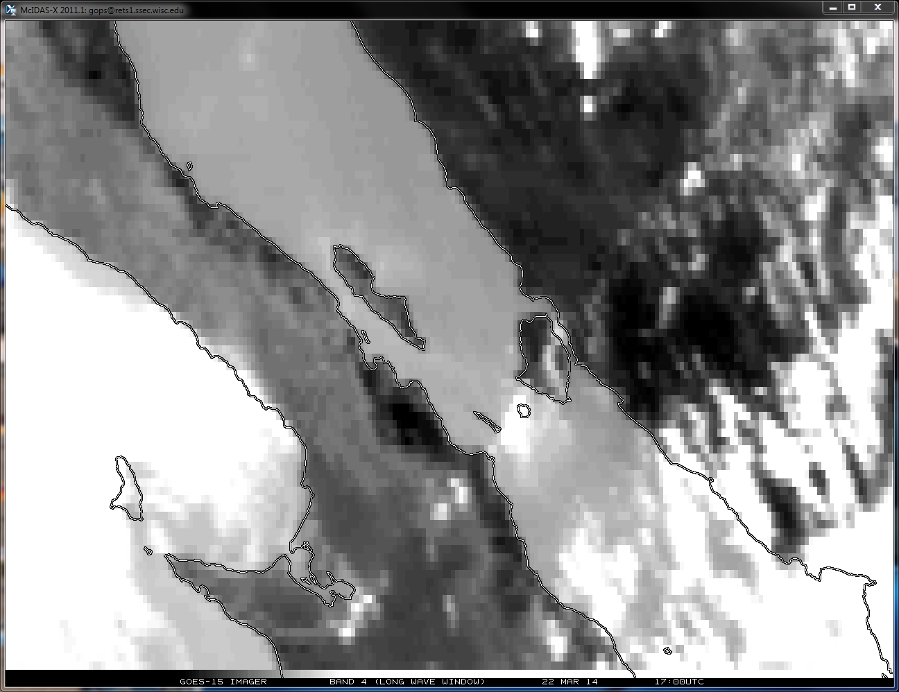
GOES-15 Imager
Band 4 (Long Wave Window)
22 Mar 2014 17:00UTC
Note Shift
The 20 March 2014 Yaw Flip causes the upright spacecraft to flip to the inverted position.
2 days after the Spring 2014 Yaw Flip Maneuver
Notes:
YAW FLIP #4 – upright -> inverted March 2014

Slide 31
GOES-15 Imager
Band 4 (Long Wave Window)
23 Sep 2013 20:00UTC
Note Shift
Note the alignment of the navigation to the previous slide. GOES-15 was again in the inverted orientation.
30 minutes prior to the Fall 2013 Yaw Flip Maneuver

Slide 32
SUMMARY
A systematic shift is observed as a result of the semi-annual Yaw Flip maneuver.
Yaw Flips on Sep. 2012, Mar. 2013, Sep. 2013, and Mar. 2014 were investigated.
When the GOES-15 spacecraft is ‘Yaw Flipped’ from the upright position to the inverted position (Spring/March timeframe) over the Baja Peninsula there is a N/NW displacement.
After the Fall/September timeframe ‘Yaw Flip’ (from inverted to upright position) the GOES-15 Imager imagery exhibits a S/SE displacement over the Baja Peninsula.
The ‘shift’ appears to be constant and complimentary for each Yaw Flip episode in both the N/NW and S/SE direction.
Based on the displayed satellite imagery over the Baja Peninsula, it appears that in the ‘inverted’ mode the navigation is most correct.
But additional investigation would be required over other locations over the GOES-15 domain in order to determine whether this is consistent.

Slide 33
GOES-15 Imager
Band 4 (Long Wave Window)
20 Mar 2013 20:00UTC
Note Shift
Note the alignment of the navigation to previous three slides. GOES-15 again is in the upright orientation.
30 minutes prior to the Spring 2013 Yaw Flip Maneuver
Notes:
This slide shows that *prior* to the Spring 2013 (20 March 2013) Yaw Flip maneuver, when the GOES-15 satellite was in the upright position, the gridded imagery appears to line up perfectly with the gridded imagery immediately after the Fall 2013 (23 September 2013) Yaw Flip maneuver (previous three slides). After this Fall 2013 maneuver the satellite, again, is in the upright position.

Slide 34
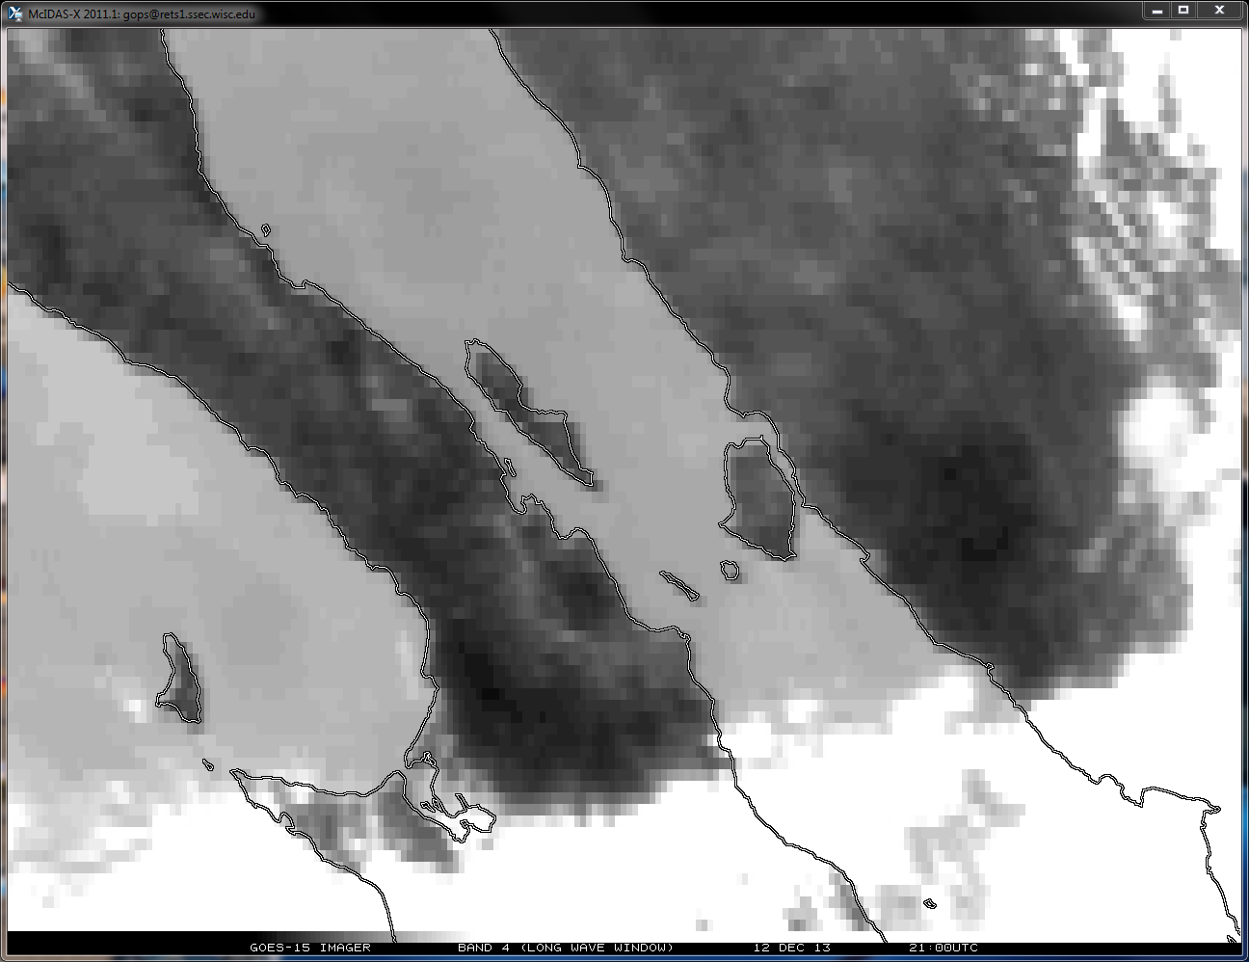

Slide 35
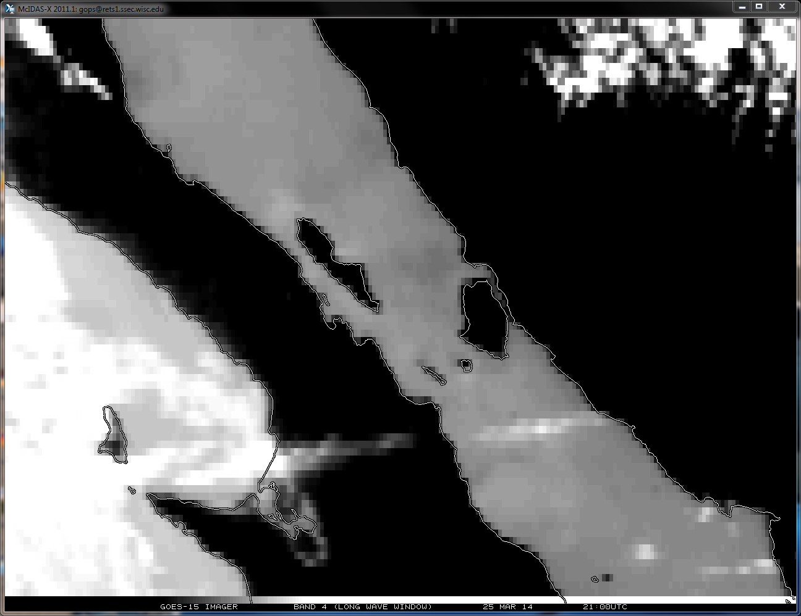
GOES-15 Imager
Band 4 (Long Wave Window)
25 Mar 2014 21:00UTC
Note Shift
5 days after the Spring 2014 Yaw Flip Maneuver

