Slide 1
The NOAA Wildland Fire Program: A New Initiative for Impactful Exploitation of Satellites in Support of Wildland Fire Applications
Mike Pavolonis
NOAA/NESDIS Wildland Fire Program Manager
Mike.Pavolonis@noaa.gov
May 3, 2023
Notes:
Michael J. Pavolonis, Ivan Csiszar, Vanessa Escobar, Mitch Goldberg, Amber Hill, Shobha Kondragunta, Renata Lana, Margaret Laurino, Claire McCaskill, Tom Renkevens, and Ian Zelo

Slide 2
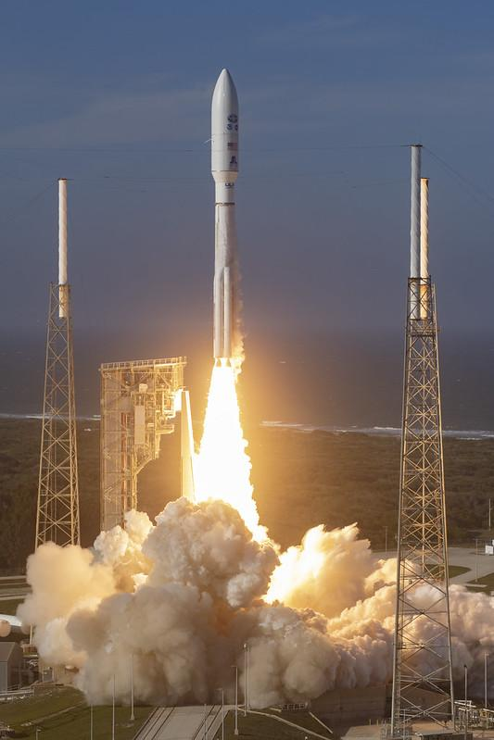
NOAA Satellite Update
GOES-18 has replaced GOES-17 as the operational GOES-West satellite
JPSS-2 (now NOAA-21) was successfully launched on 10 November 2022 and is flying ~50 minutes ahead of NOAA-20 and ~25 minutes ahead of SNPP
Formulation of the next generation of GOES (GeoXO) is underway: fire user needs influenced requirements
GOES-T (now GOES-18) launch on March 1, 2022
Notes:
-2033
-current approaches will extract full value from Geo-XO

Slide 3
New NOAA Wildland Fire Initiatives
NOAA Fire Observation, Research, and Services Team (FOReST)
Enhanced coordination and collaboration across NOAA (NWS/OAR/NESDIS)
FY22 Disaster Relief Supplemental Appropriations (DRSA) and Bipartisan Infrastructure Law (BIL) projects
Projects dedicated to improving wildland fire service delivery, including IMET equipment, major upgrades to satellite products and numerical models, and a Fire Testbed
Co-development of satellite-based fire detection capabilities with USDA and DOI
NOAA/NESDIS Wildland Fire Program
Take full advantage of the opportunity to provide more impactful satellite products and services
Strengthen partnerships
Notes:
-40 new projects
-7 new NESDIS led projects
-Ensure NOAA is a responsive and impactful service delivery provider within the wildland fire enterprise
-Enhanced coordination and collaboration will lead to better tools for IMETs

Slide 4
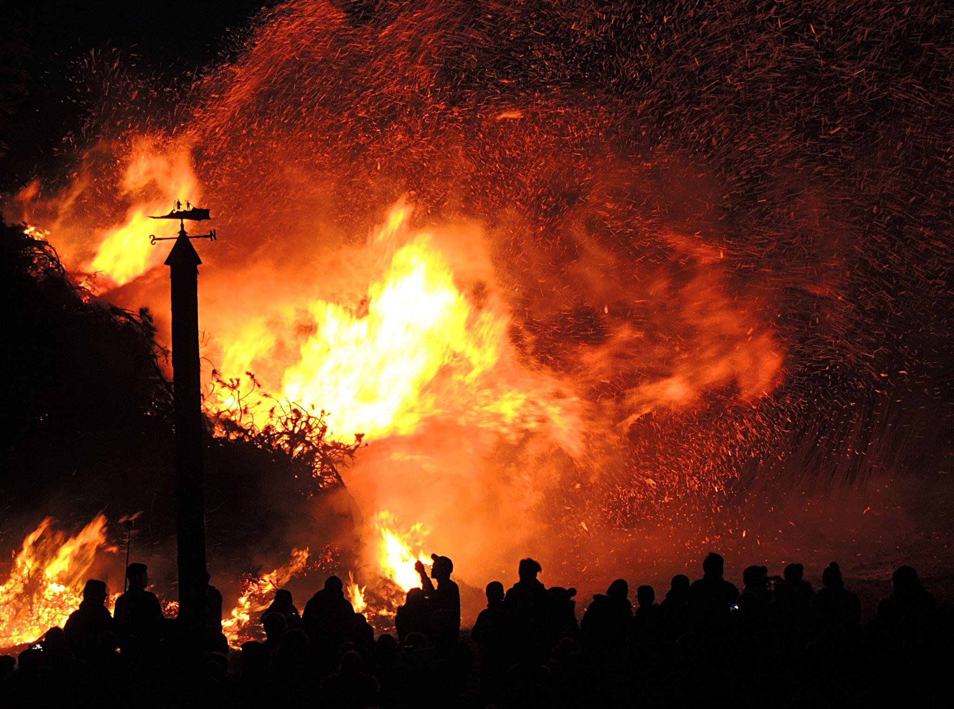
NESDIS Next Generation Fire System (NGFS)
(Supported by the DRSA and BIL)
NESDIS Fire Information System
NESDIS Fire Data and Information Portal
Single or multi-source GEO or LEO satellite data + supplemental data
Fire Software Repository
Notes:
NESDIS has requirements for fire products

Slide 5
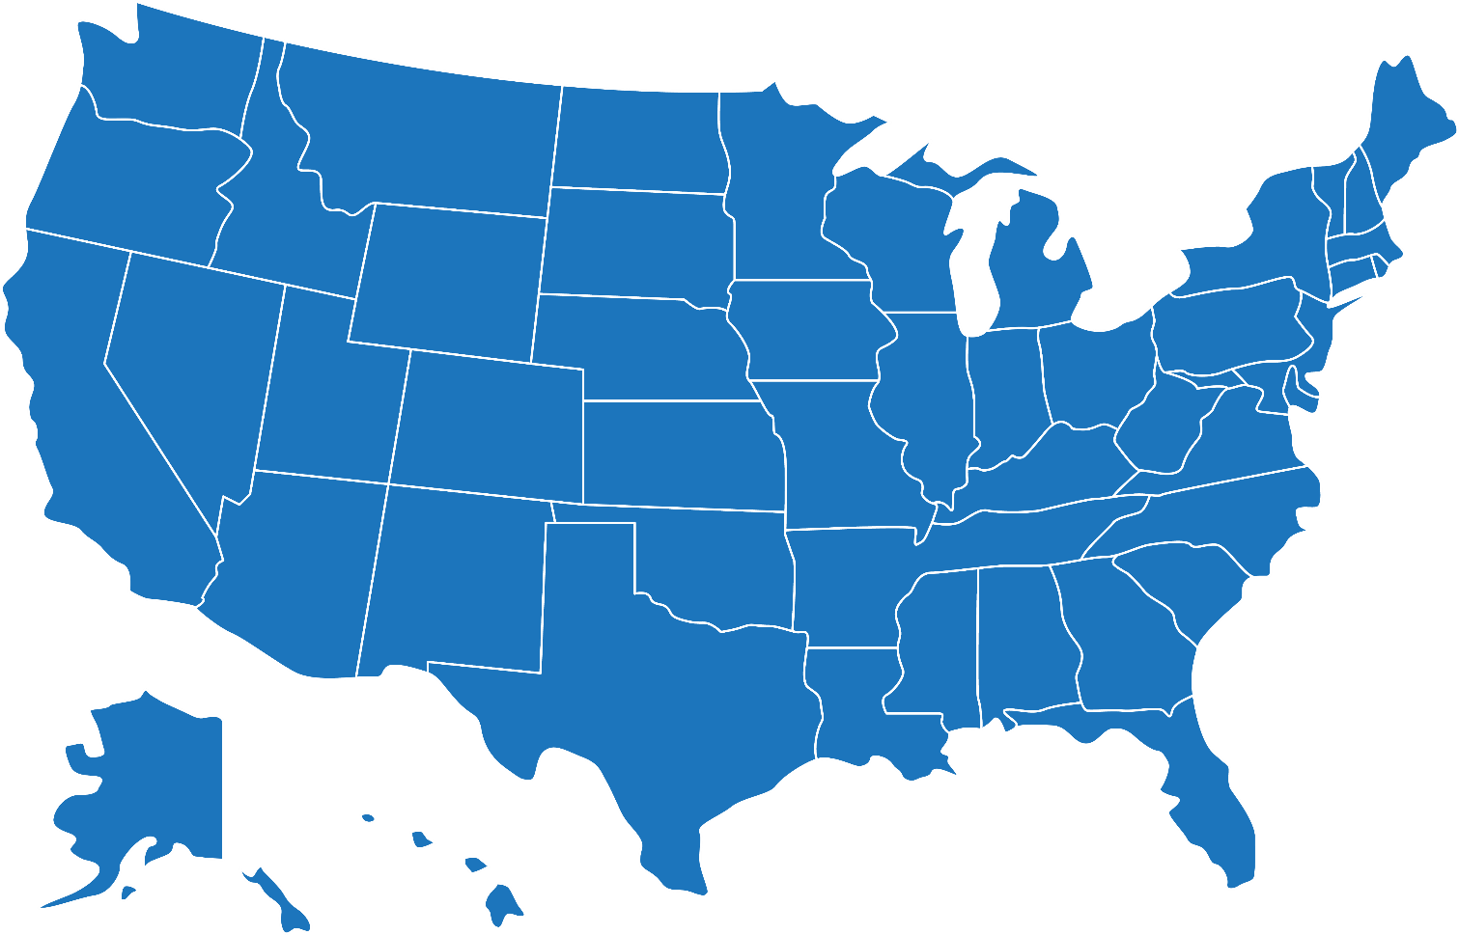
NESDIS NGFS Development Team
CIMSS
University of Wisconsin
NOAA
NESDIS, OAR, NWS
CIRA
Colorado State University
CISESS
University of Maryland
WIFIRE
University of California - San Diego
Also: continuous coordination with external partners and users
GINA
University of Alaska - Fairbanks
GTRI
Notes:
Includes the developers of the current operational fir products, so this is a coordinated effort

Slide 6
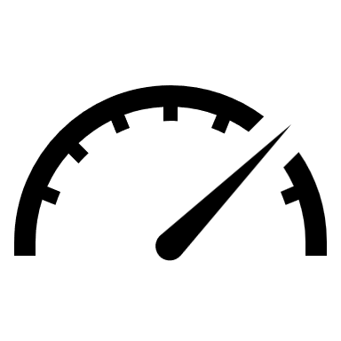
Objectives
Provide satellite-derived information that helps reduce response time to a new fire incident
Enhance weather and fire monitoring in support of incident management
Enable the development of improved smoke and fire behavior/spread forecasting models
Simplify access to fire products and information
Improve understanding of long-term fire trends and patterns

Slide 7
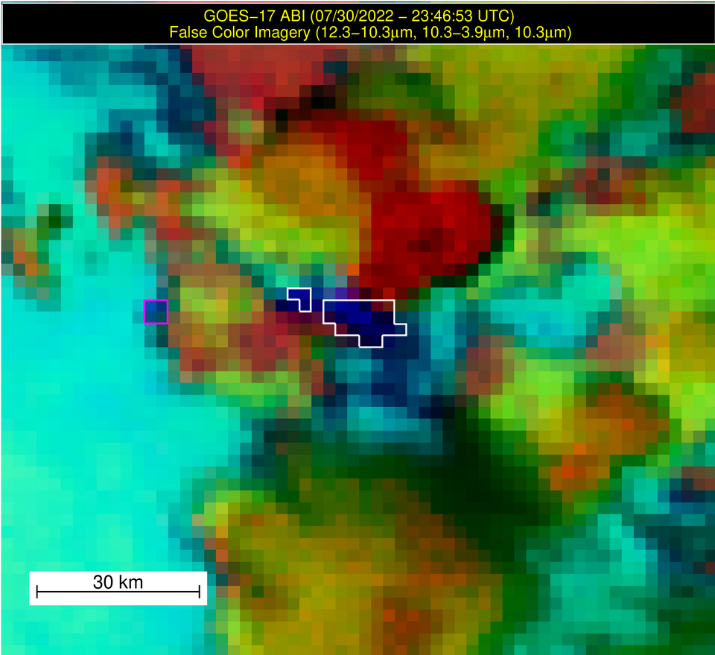
Improved Automated Fire Detection
CAPABILITY | DRIVER(S)
AI: emulate human expert analysis | Early detection and strong performance under cloudy conditions
Event extraction | Align with human perception (convert pixel labels into features)
Event tracking | Near continuous monitoring, advanced metrics, separating newly detected from ongoing events (needed for alerting)
Geospatial layer integration | Context for interpretation, advanced filtering, and data queries
Sensor agnostic and bad data tolerant | Maintainable, scalable, and reliable across a broad range of GEO and LEO sensors
Northern California
Feature 1: Yeti Fire
Feature 2: Mckinney Fire
Notes:
-Rethink satellite product requirements and ensure the requirements support critical use cases. For example, here are the high-level NGFS fire detection requirements.
-The NGFS team has made significant progress on implementing all of these requirements (see example)

Slide 8
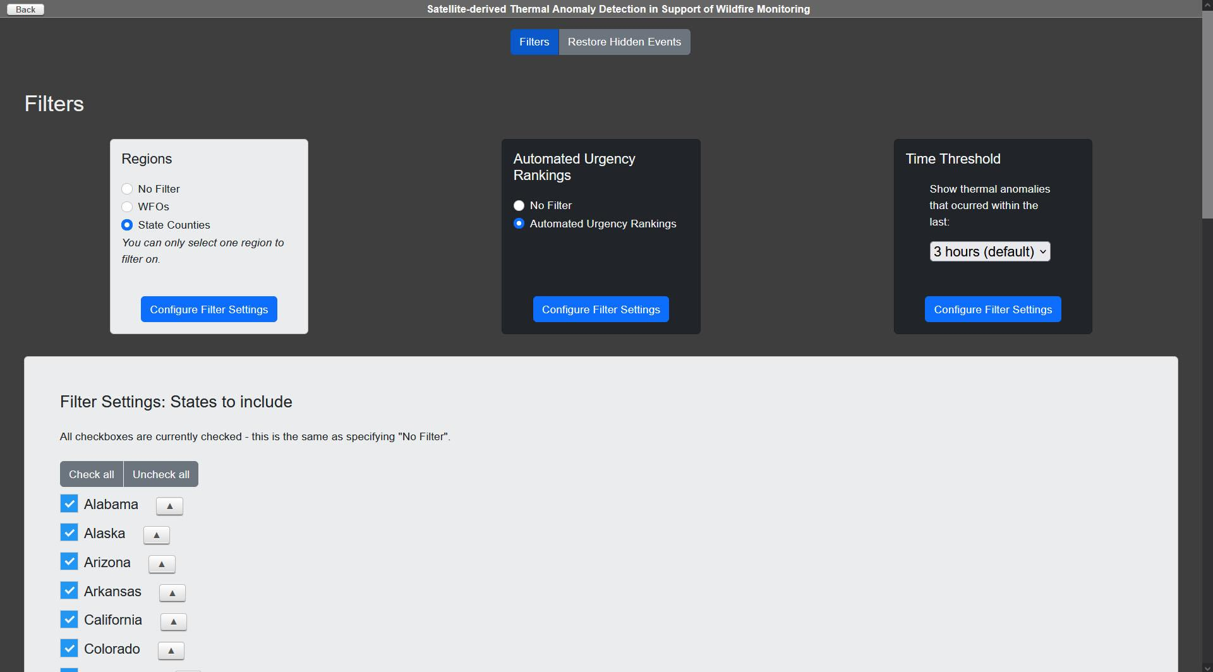
Dashboard interface for new fire detections as a function of fire weather conditions
Users can further filter events by location, fire weather, and age. Also, a WUI filter will be added.
Notes:
Extracting the fire detections that matter most in an initial attack scenario

Slide 9
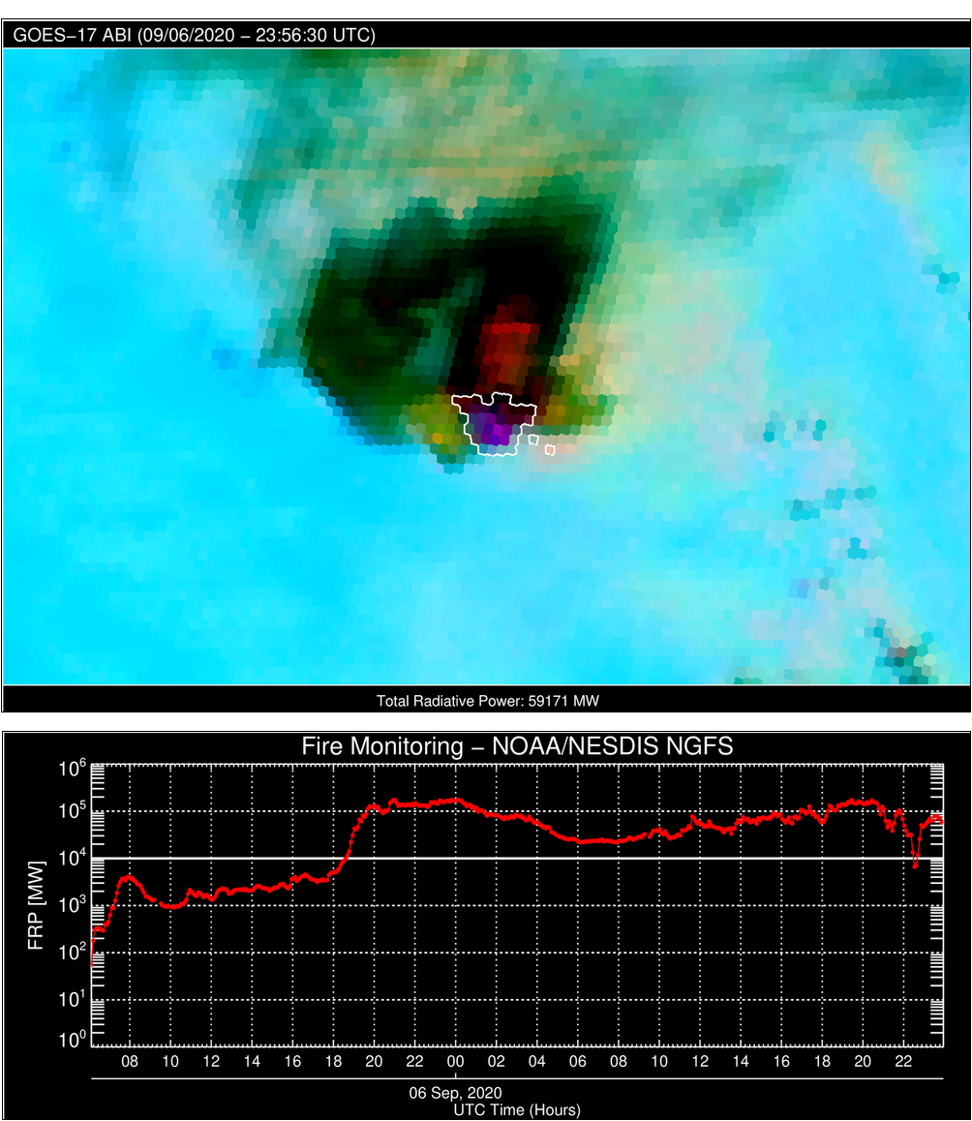
NGFS: Near Continuous Monitoring of Fire Intensity
Automatically corrected for clouds/smoke/moisture
Trends provide early insight into extreme fire behavior
Combination of atmospherically corrected FRP, more consistent hot spot detection, and event-based data model better supports fire and smoke forecasting workflows
Creek Fire: September 5-6, 2020

Slide 10
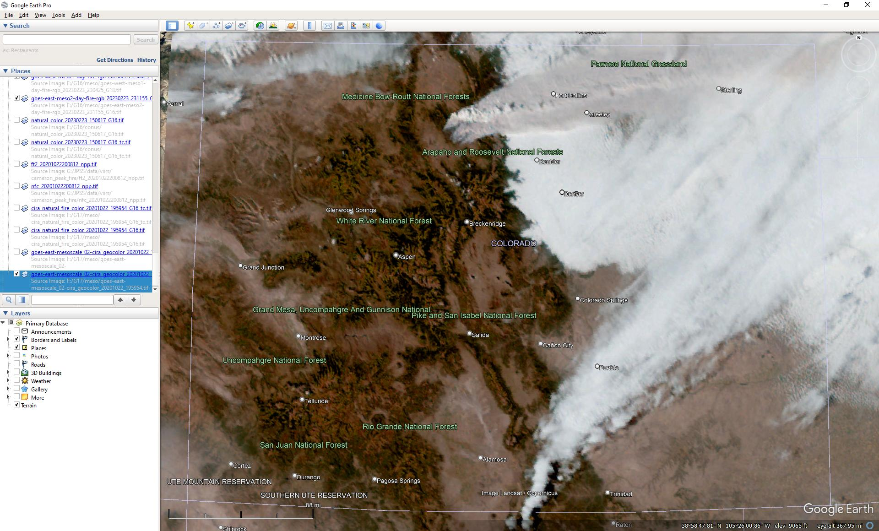
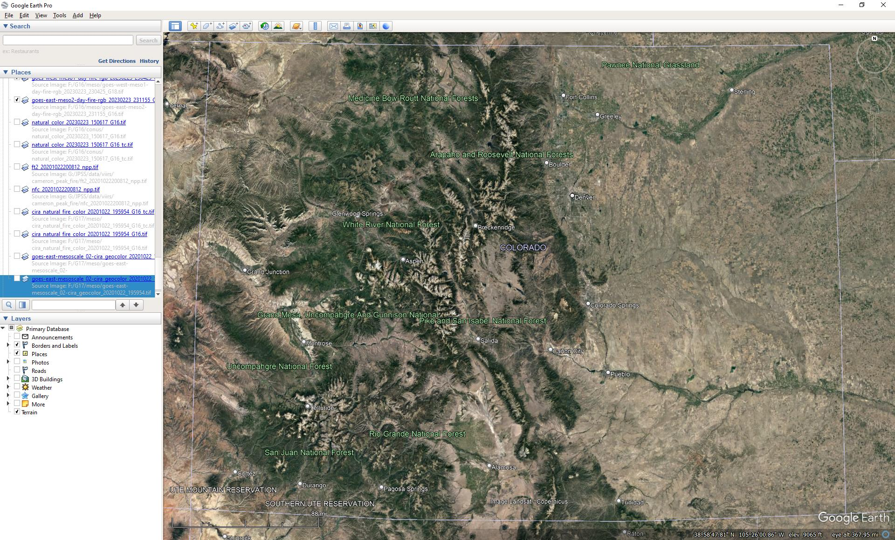
More Accurate GOES-R Geolocation
ABI with Terrain Correction
GOES-16 GeoColor image
uncorrected
Images from Curtis Seaman (CIRA)

Slide 11
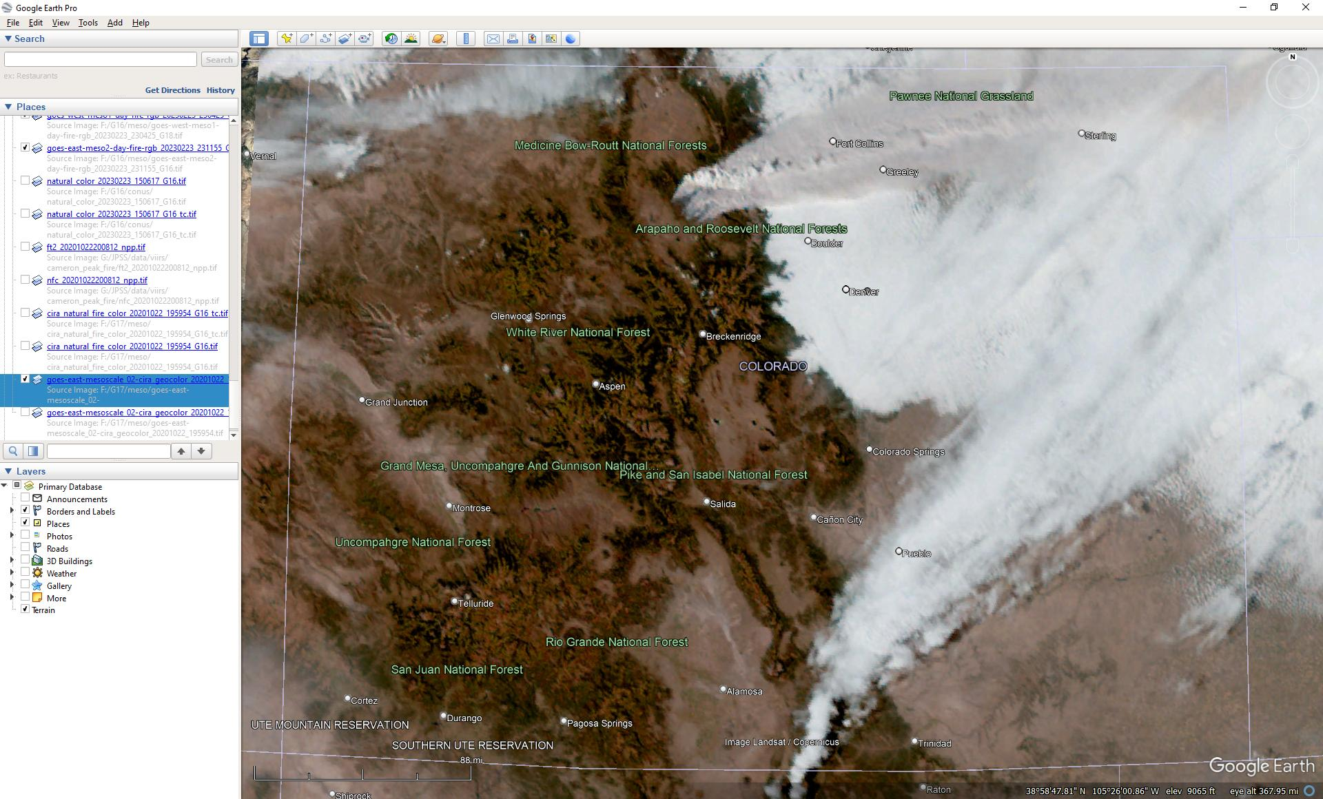
More Accurate GOES-R Geolocation
ABI with Terrain Correction
Terrain corrected geolocation developed by Chris Schmidt (CIMSS)
Images from Curtis Seaman (CIRA)
GOES-16 GeoColor image
Terrain-corrected

Slide 12
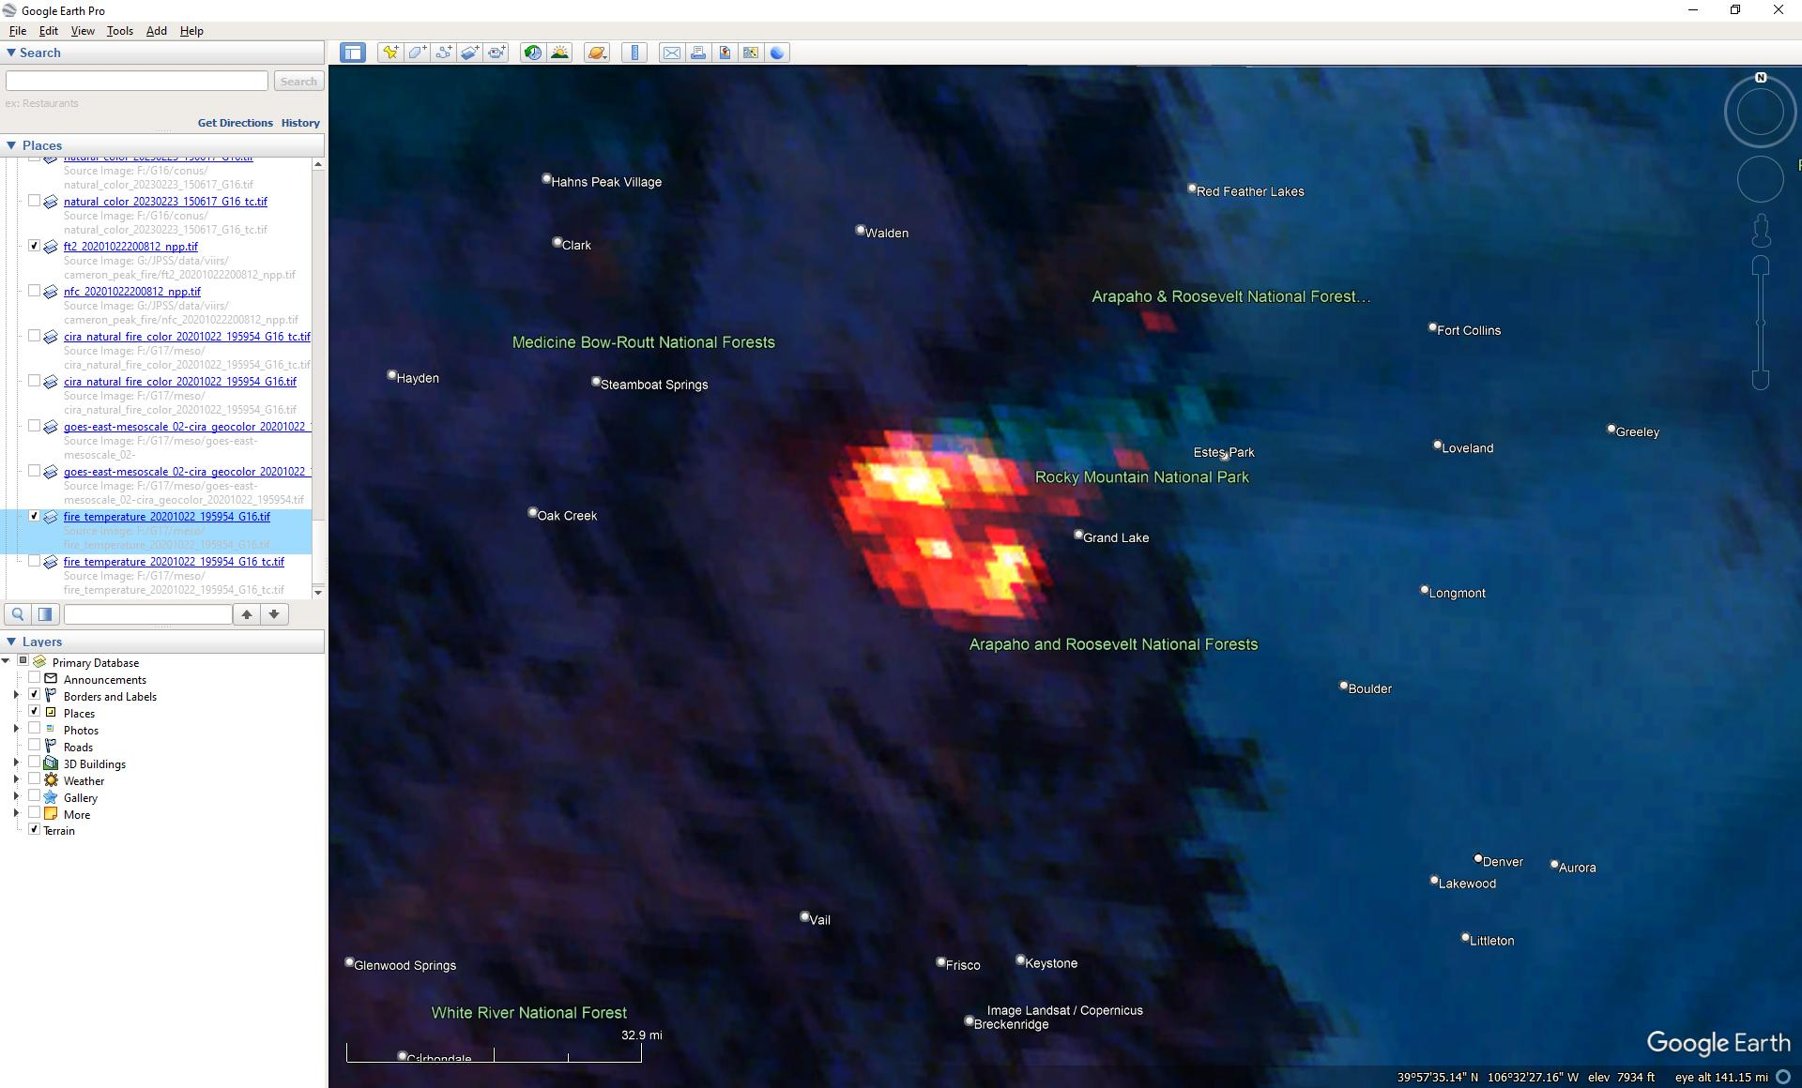
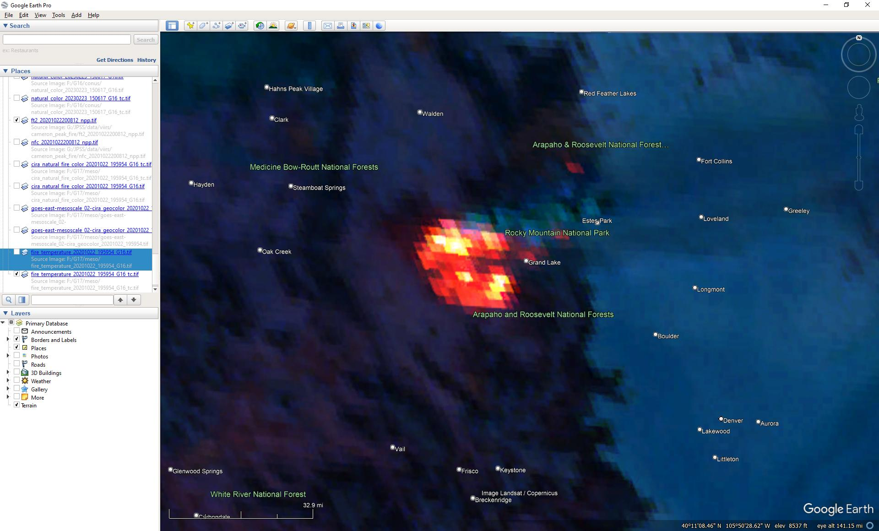
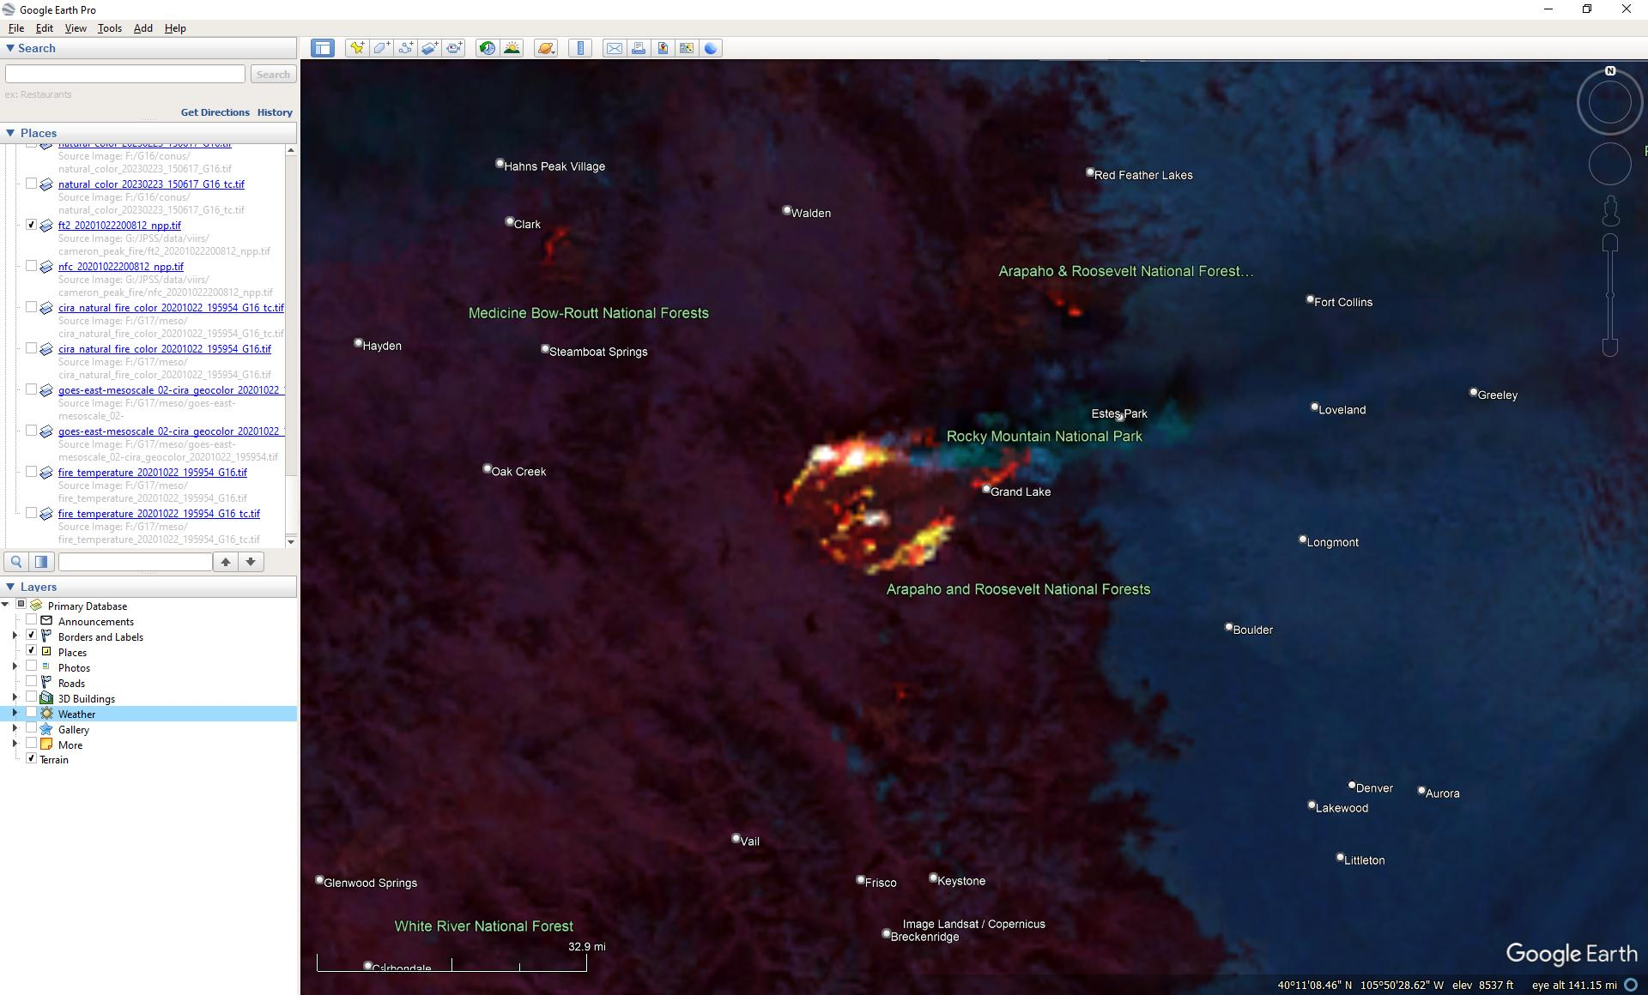
East Troublesome Fire
ABI Fire Temperature RGB
Terrain-corrected
VIIRS Fire Temperature RGB
ABI Fire Temperature RGB
uncorrected
Images from Curtis Seaman (CIRA)
1956 UTC 22 October 2020

Slide 13
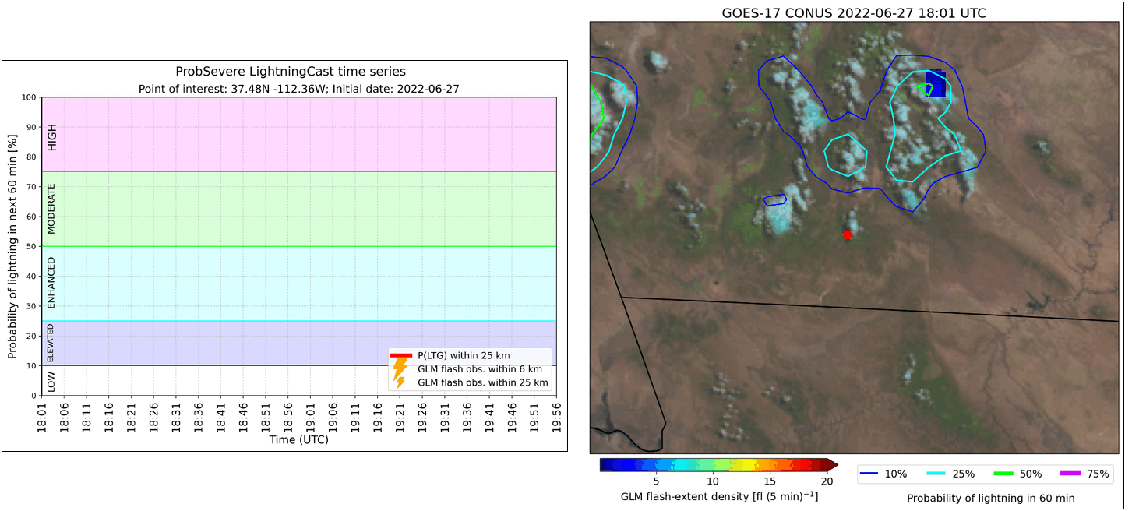
AI/ML-based Lightning Nowcasting in Support of Fire Incident Management
Left Fork fire (Utah)
LightningCast correctly predicted increasing threat prior to lightning being observed
Notes:
Prognostic tools
Also provides a new data set to study convection in the absence of radar

Slide 14
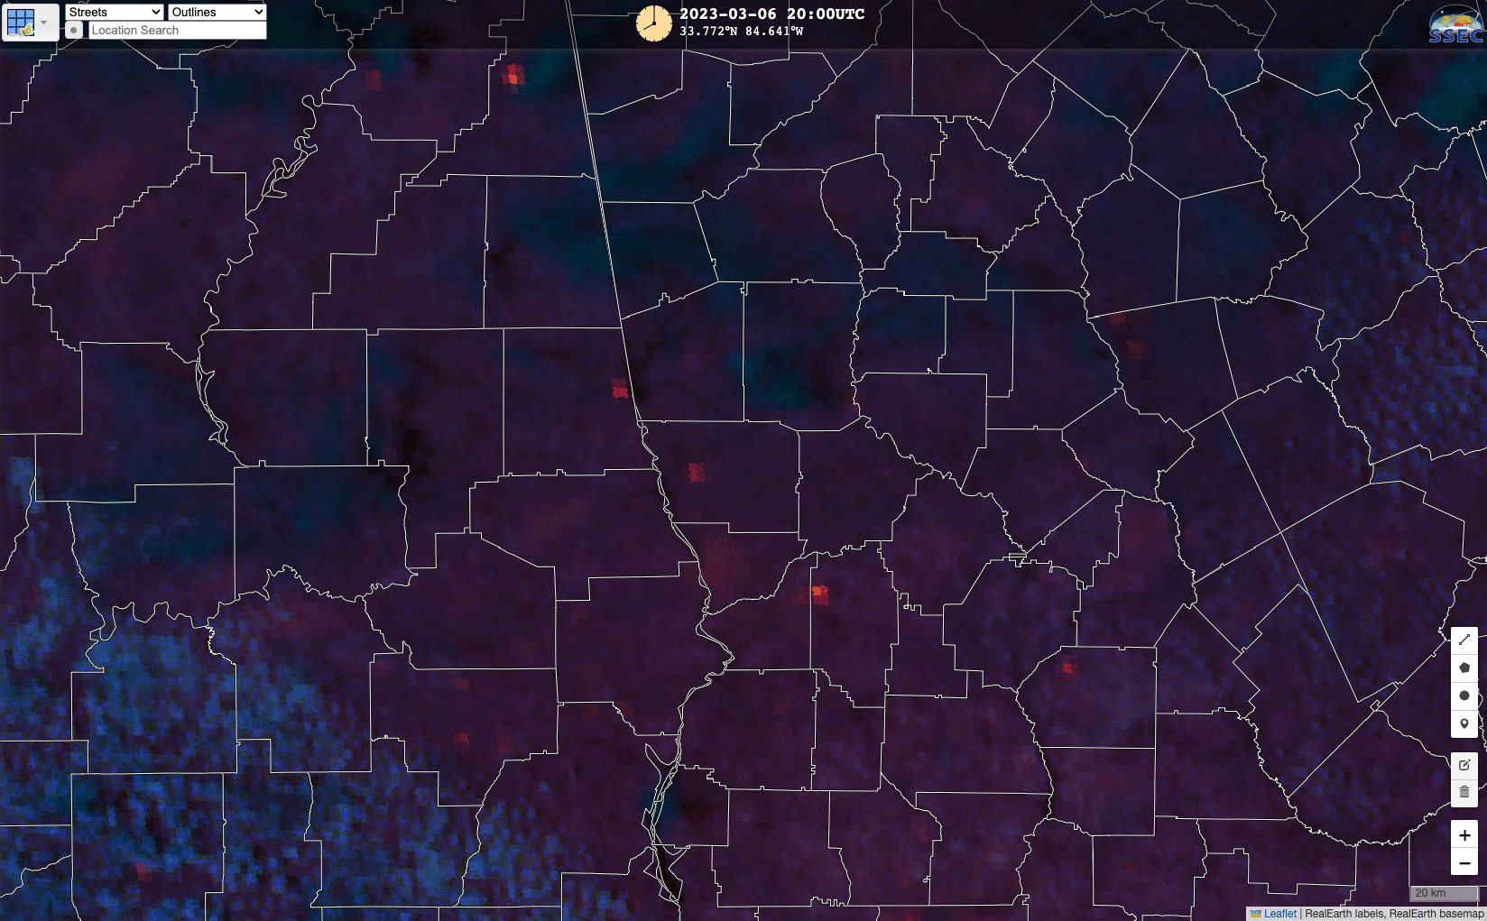
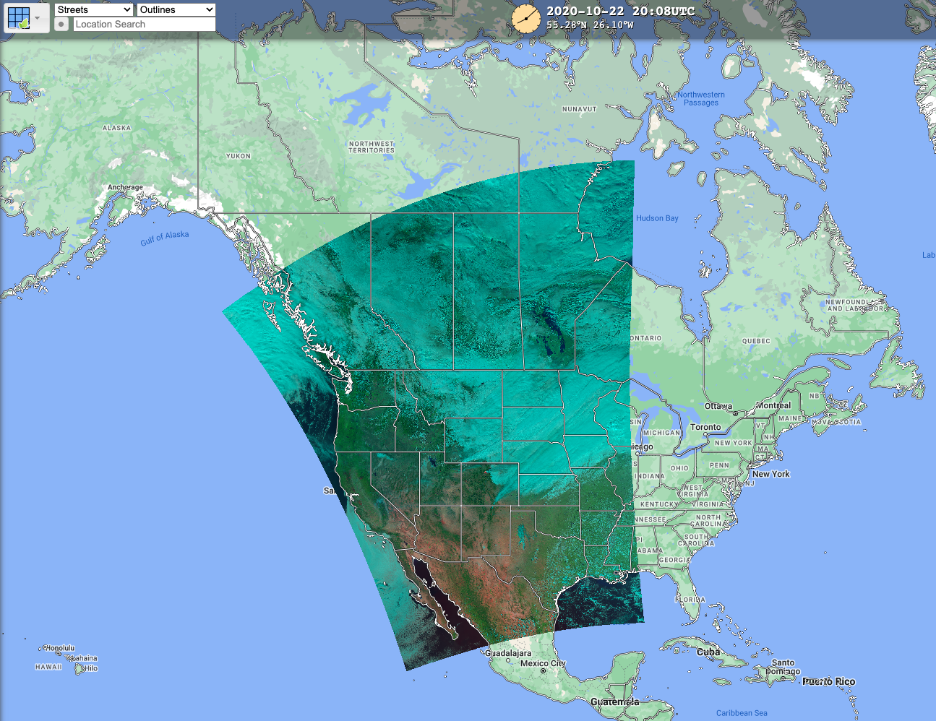
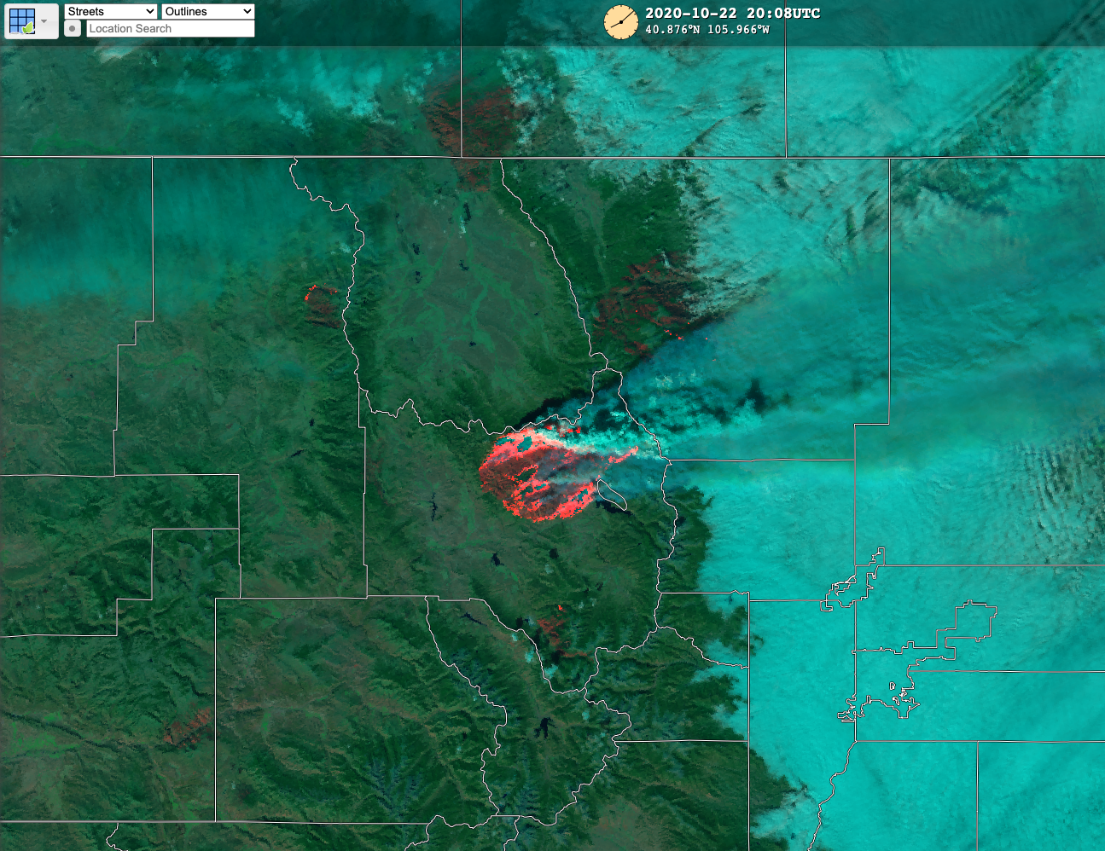
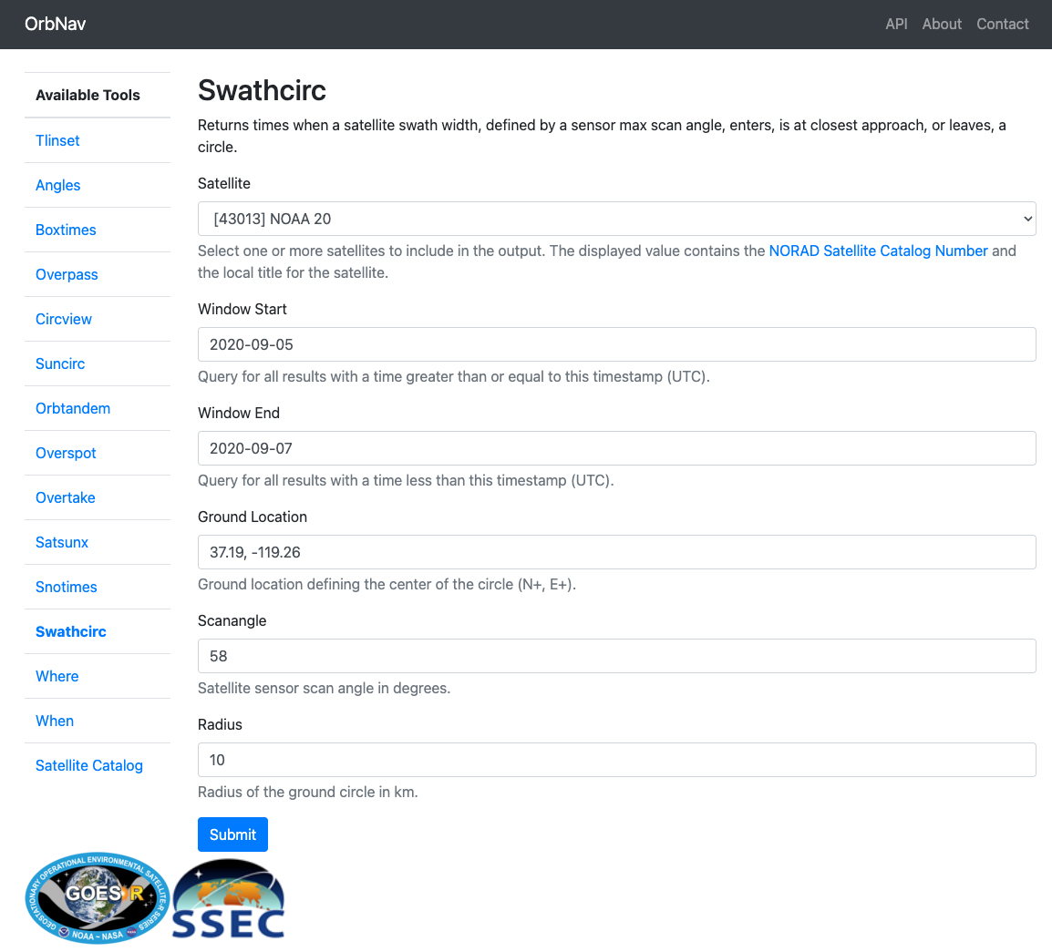
Improved Product Access, Dissemination, and Interoperability
2. Quick visual access: Map viewer
3. Bandwidth friendly: Local/regional scale image tiles and product subsets for active incidents
1. Accessible, interoperable, and trusted: OGC Data Services
4. Improve efficiency and uptake: Automatically track and record past, present, and future LEO overpasses of active incidents and associated GEO coverage
SSEC OrbNav satellite overpass analysis and prediction tool
Notes:
-Machine and human APIs
-Map, services, customized image tiles (local and/or regional scale) and products for incidents
-Tracking detected events across multiple sensors and automated collection of LEO overpass times at each incident to facilitate timely utilization of LEO products and information

Slide 15
Summary
NESDIS Wildland Fire Program:
Maximize the value of NOAA satellite-based products and services for critical wildland fire use cases, including forecast model (fire and smoke) workflows
Improve data access and interoperability
Coordination and partnerships are critical - NOAA satellite derived information is a piece of the puzzle
Upcoming demonstration of new satellite capabilities (NOAA Fire Testbed):
Improved fire detection and monitoring
Terrain corrected GOES-R imagery
Lightning nowcasting
Mike.Pavolonis@noaa.gov
Notes:
-funded WRF SFIRE dev

Slide 16
Backup Slides

Slide 17
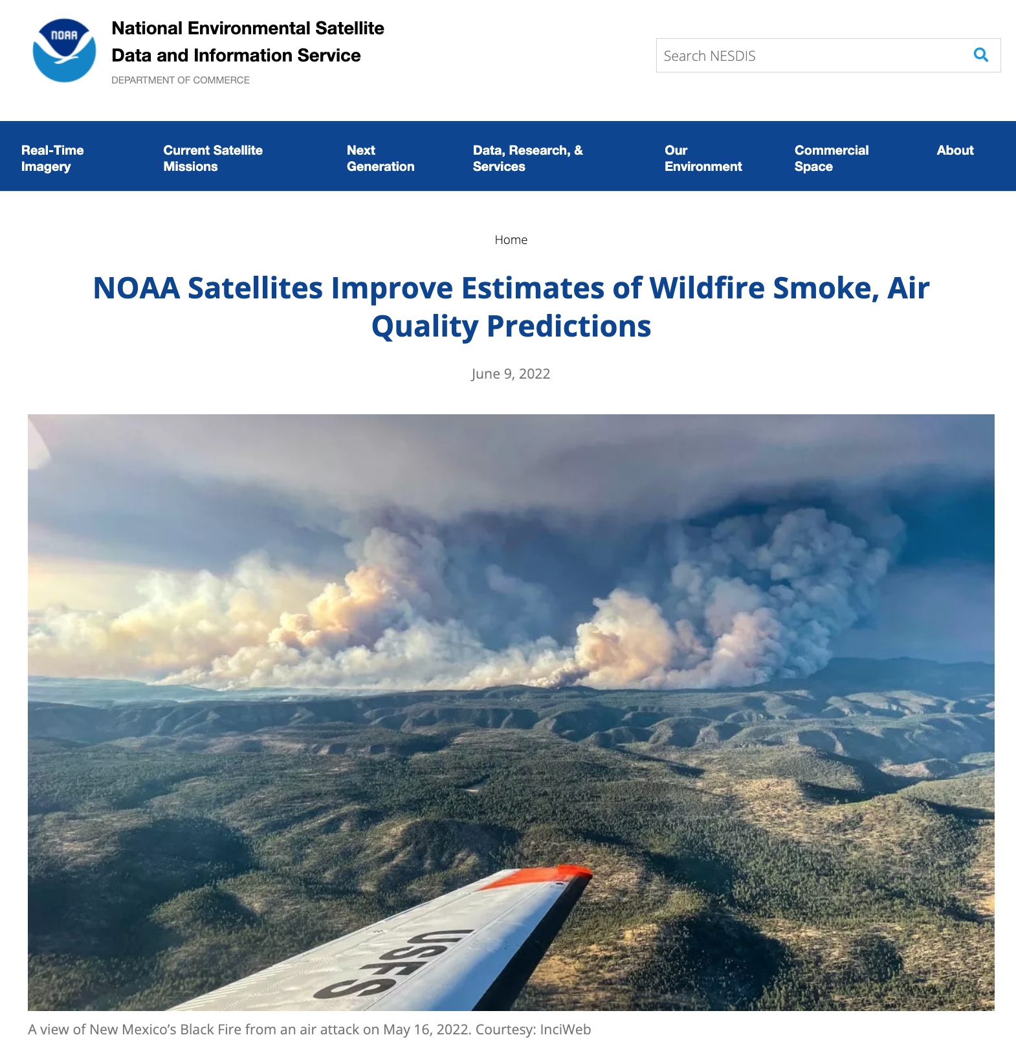
R2O: Satellite-based Monitoring of Fire Emissions and Air Quality
Regional Hourly ABI and VIIRS Emissions (RAVE) for NWS air quality forecasting
RAVE is being integrated into the Community Multiscale Air Quality (CMAQ) modeling system and the Rapid Refresh Forecasting System (RRFS)
NESDIS POC: Shobha Kondragunta
Notes:
Unified forecast system

Slide 18
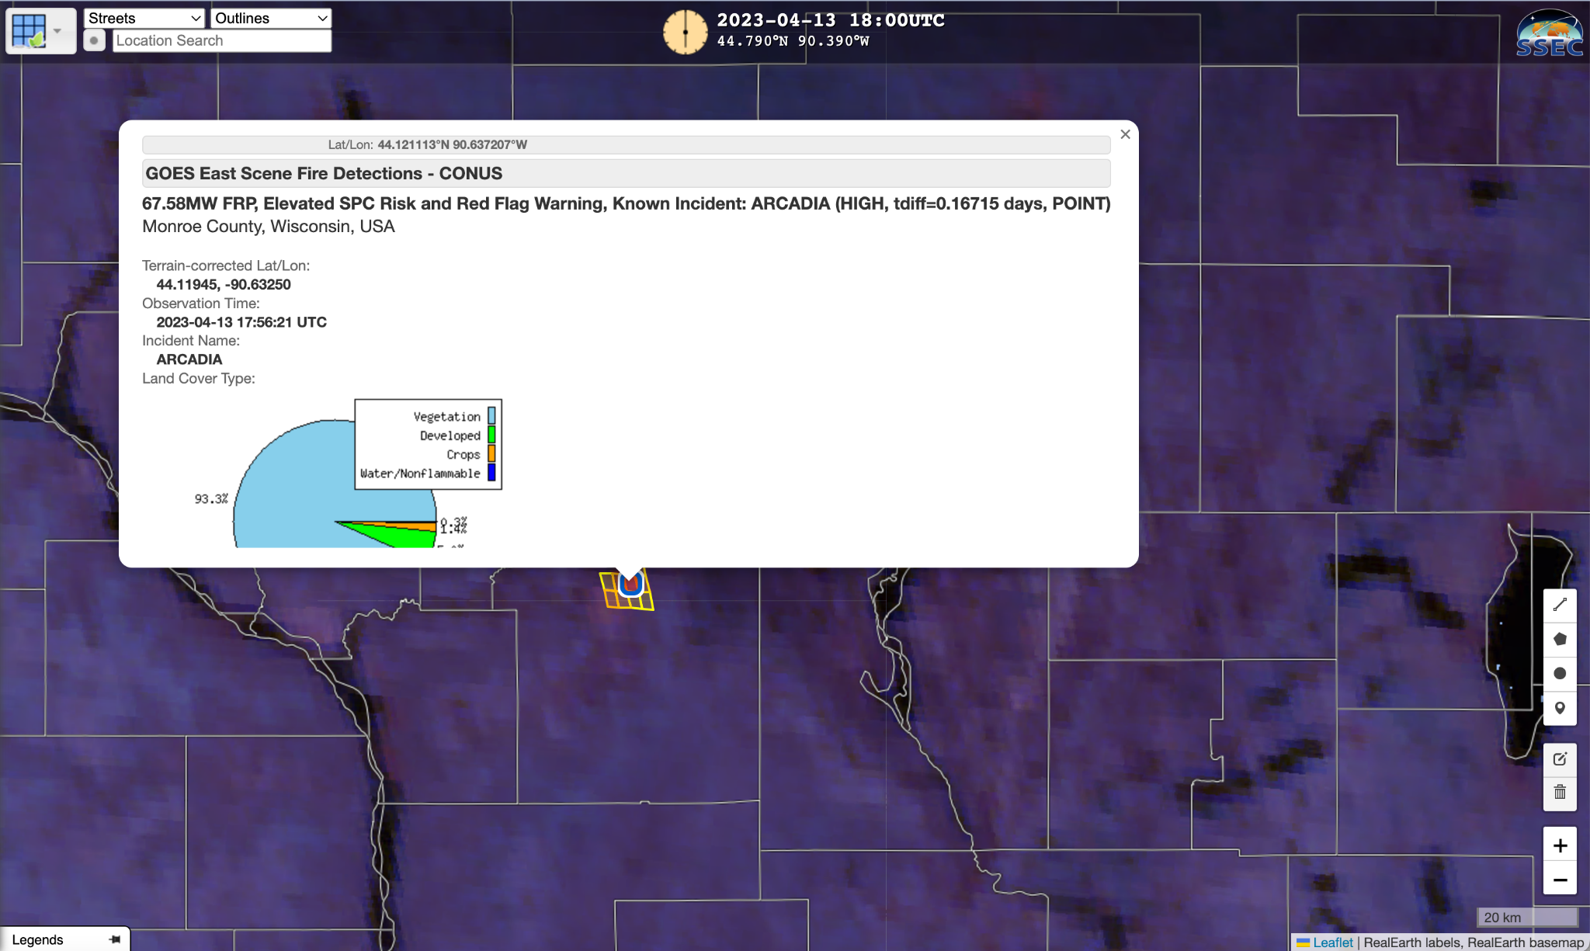
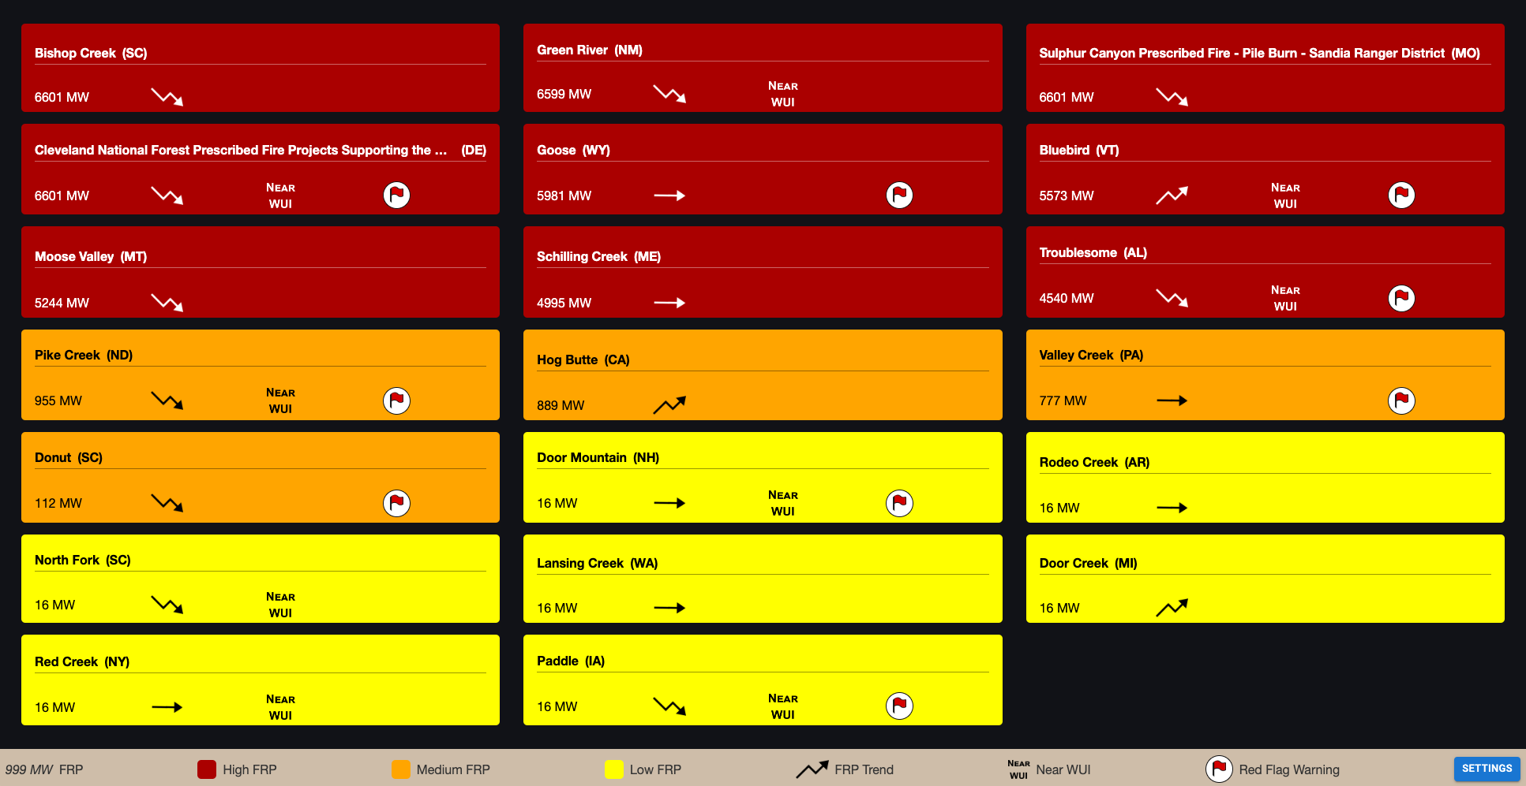
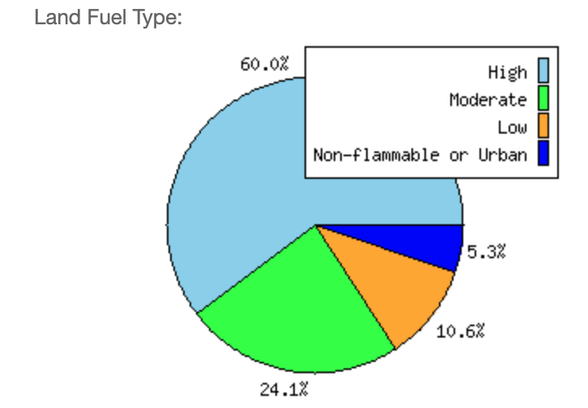
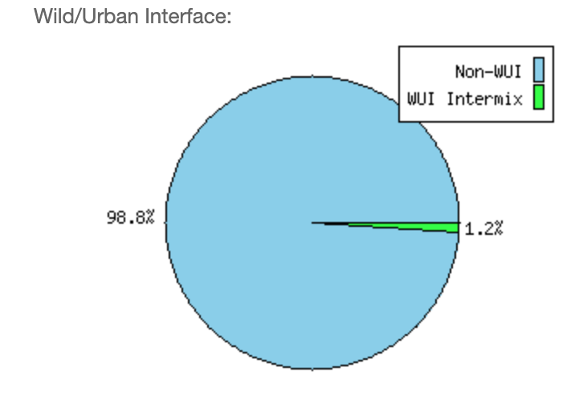
Additional Tools for Incident Management
Illustration of Data Layer Integration
NESDIS NGFS Incident Dashboard Mock-up

Slide 19
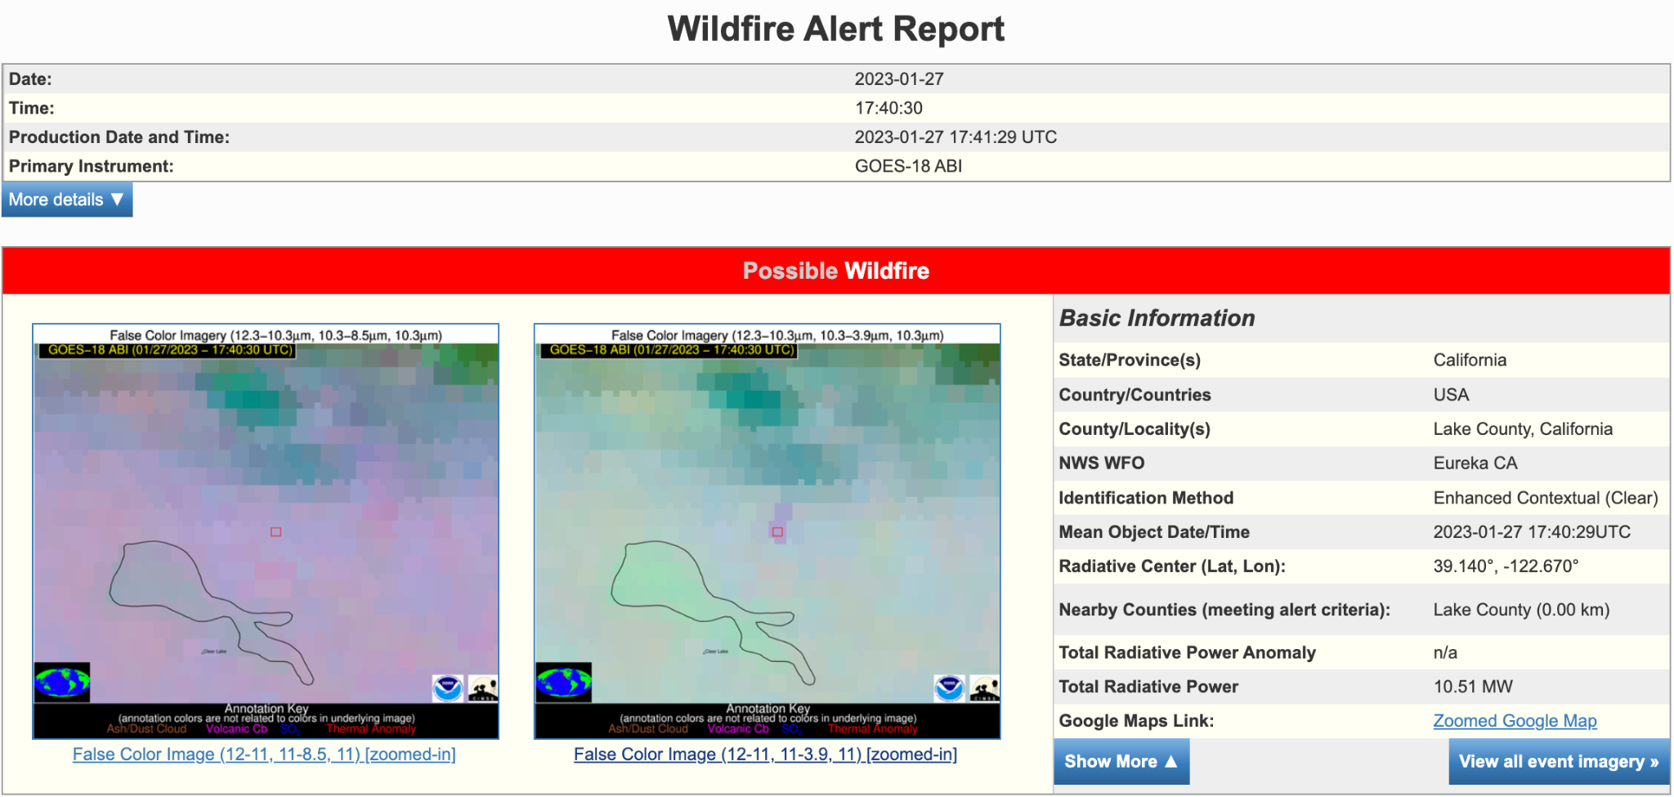
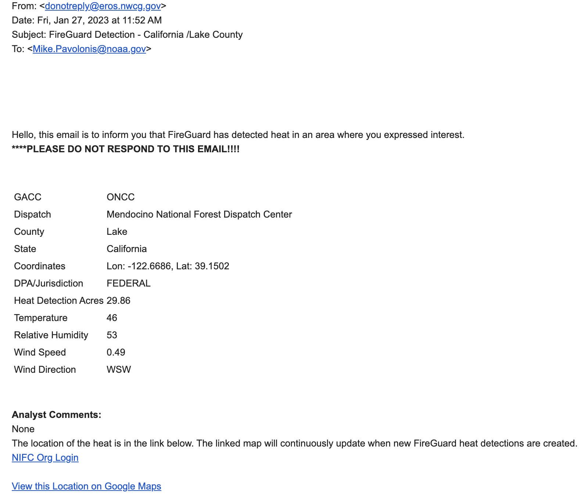
Illustration of Actual GOES NRT Detection Timeliness
NOAA/NESDIS NGFS Initial Detection
FireGuard Alert
17:52 UTC
17:41:29 UTC - 1 minute of latency

Slide 20
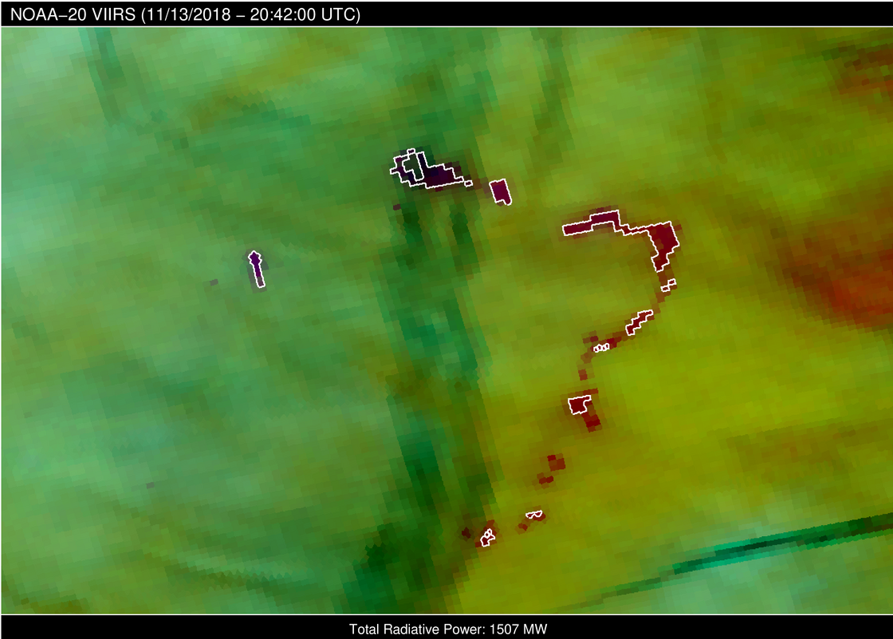
Cloud resilient approach to detection and FRP
Cloud microphysics RGB - Camp Fire
Automated detection under cloudy conditions is needed for near continuous monitoring of intensity and spread (coarse resolution)
White ROI overlay indicates automated NGFS detection

Slide 21
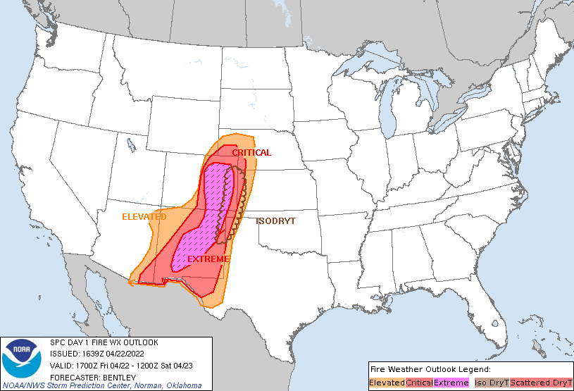
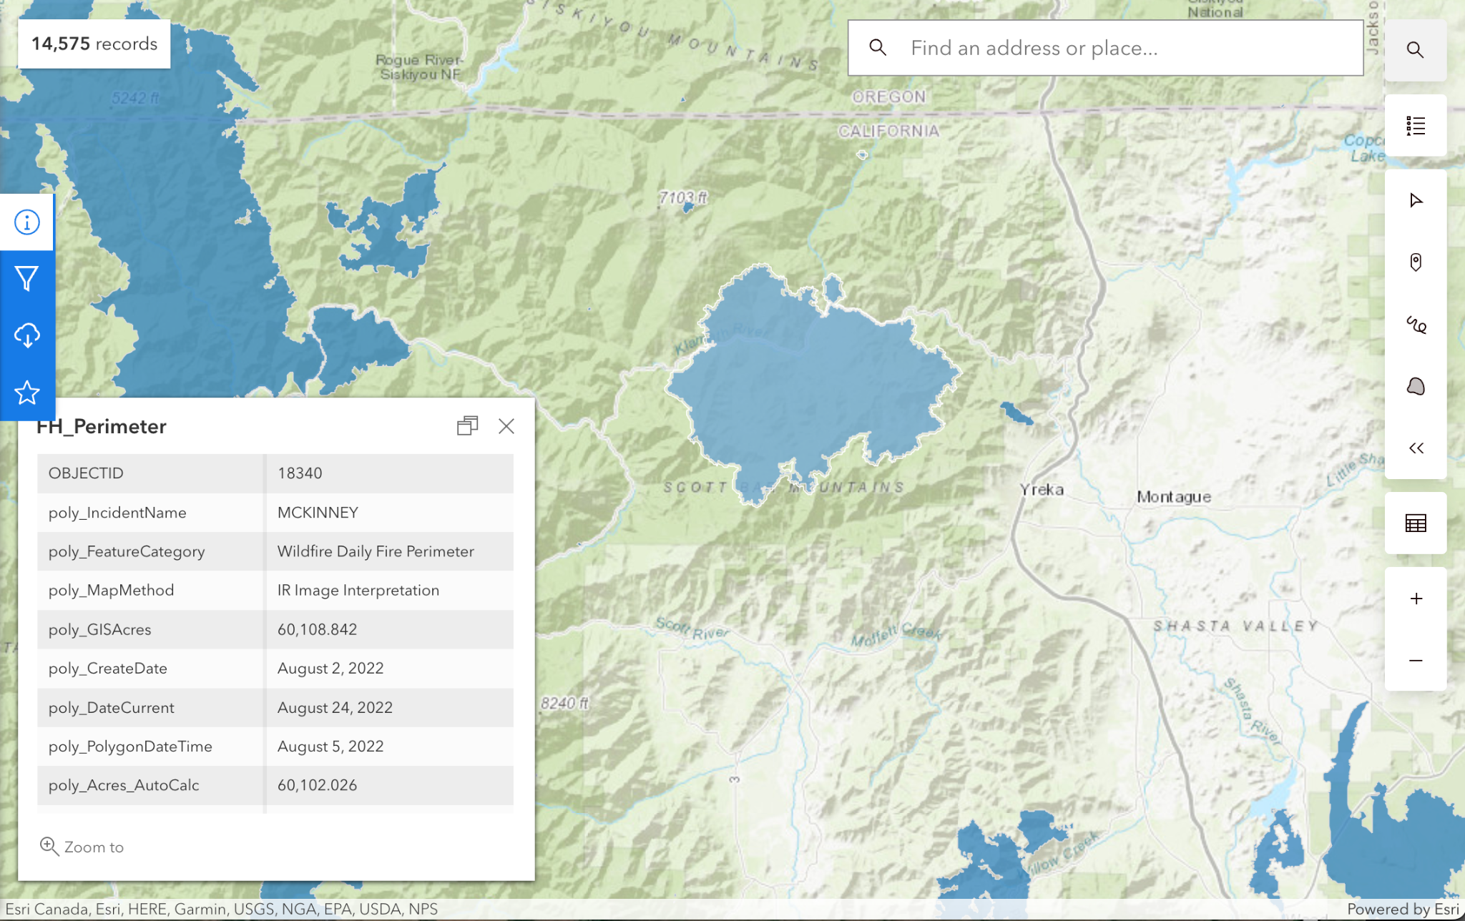
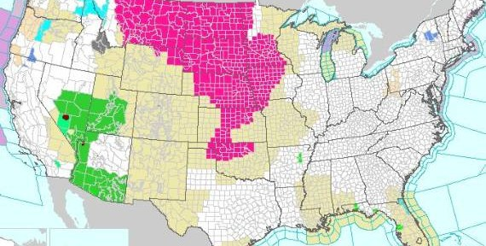
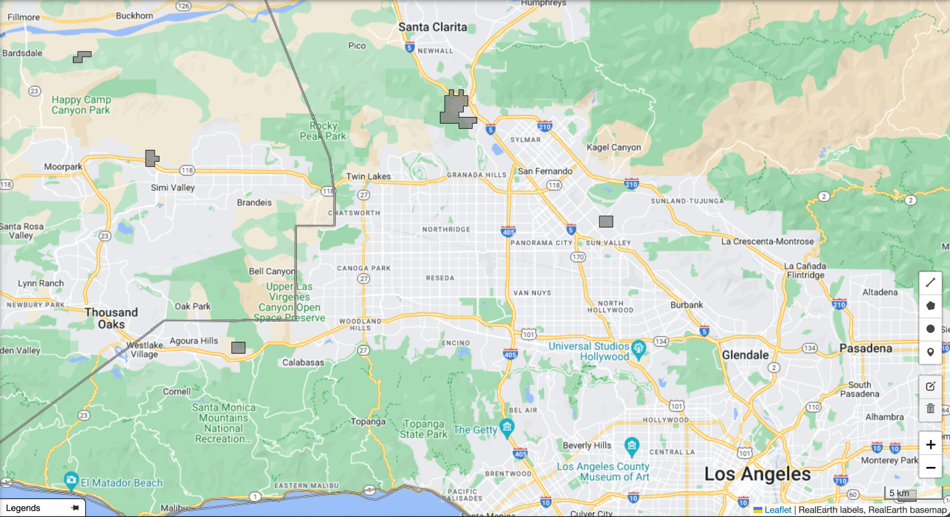
Automated Integration of Geospatial Layers
SPC Fire Weather
Outlooks
NIFC fire data points and perimeters
NWS Red Flag Warnings and Fire Weather Watches
Persistent anomaly database

Slide 22
NGFS Supplemental Active Fire Data Layers
DATA LAYER | SOURCE | STATUS
Country | ESRI | Complete
State | NIST | Complete
County | NIST | Complete
NWS Region | NWS | Complete
WFO | NWS | Complete
GACC | NIFC | Complete
Persistent Sources | NOAA/HMS with updates | Complete
WUI | USGS | In progress
Population Density | LandScan (ORNL) | In progress
Notes:
Alert and event filter; Analysis

Slide 23
NGFS Supplemental Active Fire Data Layers
DATA LAYER | SOURCE | STATUS
Fire Wx Outlooks | NWS/SPC | Complete
Red Flag Warnings/Fire Wx Watches | NWS | Complete
Incident perimeters and points | NIFC | Complete
PyroCb activity | Satellite | In progress
Lightning activity | Satellite and ground-based | In progress
Weather data | Stations and NWP | Not started
Fuel characterization | USGS (LANDFIRE) | In progress
NGFS active fire output description
Notes:
Alert and event filter; Analysis

Slide 24
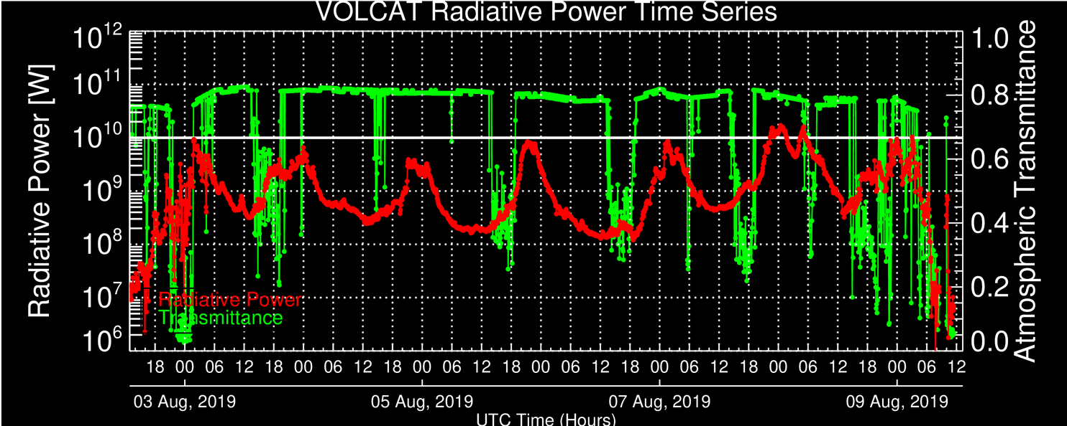
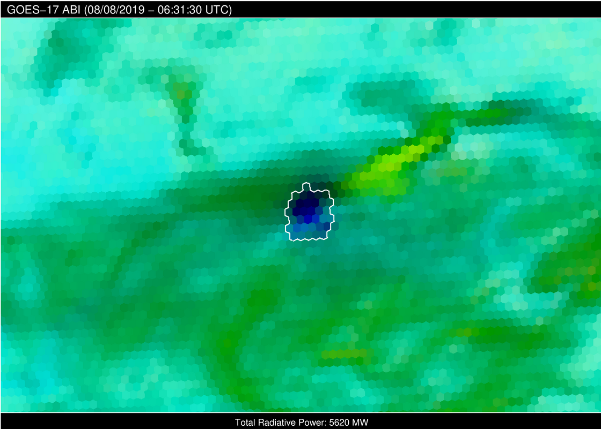
Near Continuous Monitoring of Fire Intensity
Williams Flats Fire
Washington, USA
August 2-9, 2019
Using an all-sky atmospheric correction, fire radiative power (red line) is derived from GOES in a near continuous manner (every 1 or 5 minutes over the U.S.)
See here for full Williams Flats animation
Cloudy sky fire detection and radiative power retrieval

