Slide 1
The NOAA/NESDIS Wildland Fire Program: Recent and Expected Advances in Satellite Product Service Delivery
Mike Pavolonis
NOAA/NESDIS Wildland Fire Program Manager
Mike.Pavolonis@noaa.gov
January 30, 2024
Notes:
7.5 The NOAA/NESDIS Wildland Fire Program: Recent and Expected Advances in Satellite Product Service Delivery

Slide 2
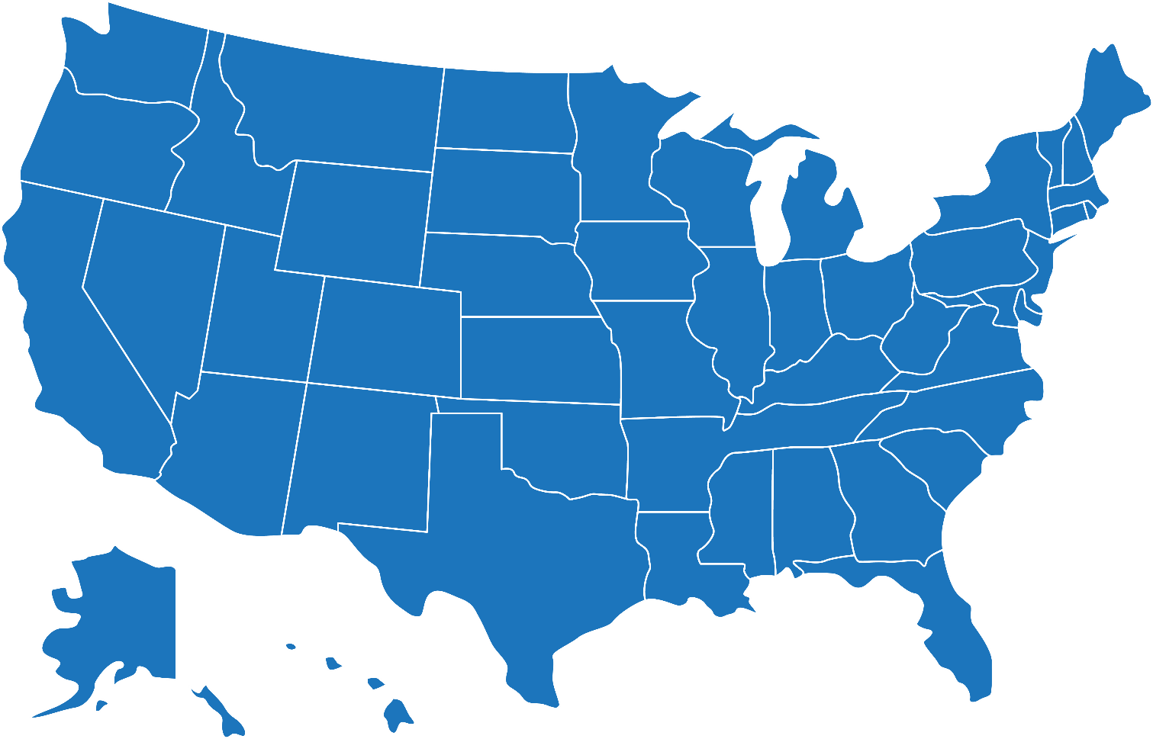
Wildland Fire Products and Services Team
CIMSS
University of Wisconsin
NOAA
NESDIS, OAR, NWS
CIRA
Colorado State University
CISESS
University of Maryland
WIFIRE
University of California - San Diego
Also: continuous coordination with external partners and users
GINA
University of Alaska - Fairbanks
GTRI

Slide 3
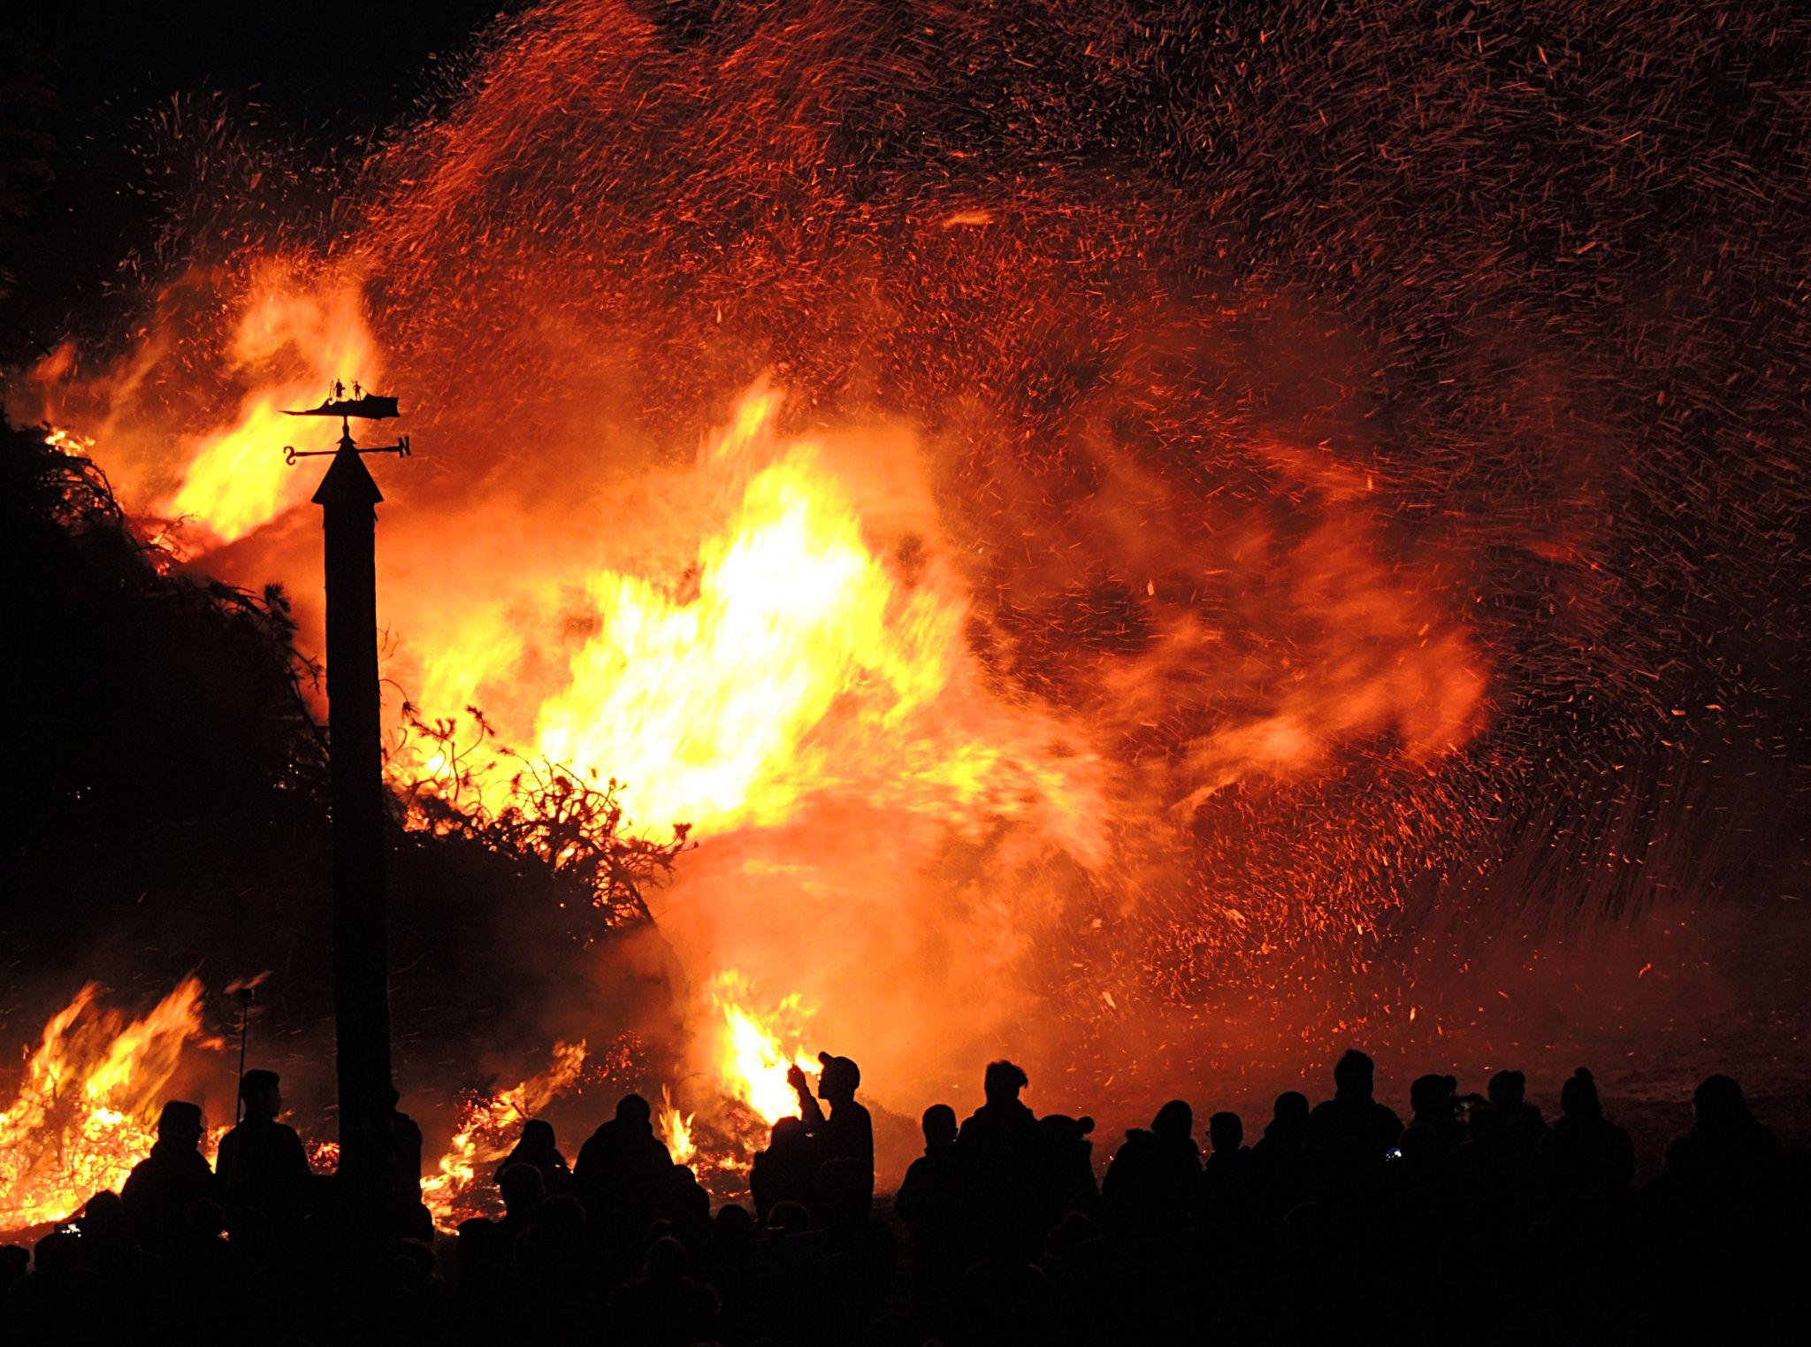
NESDIS Next Generation Fire System (NGFS)
(Supported by the DRSA and BIL)
NESDIS Fire Information System
NESDIS Fire Data and Information Portal
Single or multi-source GEO or LEO satellite data + supplemental data
Fire Software Repository
Notes:
NESDIS has requirements for fire products

Slide 4
Fire environment forecasting
Timely hotspot alerts
Climate monitoring
Critical Applications
Incident awareness and assessment
Smoke analysis and forecasting
Event-based data queries

Slide 5
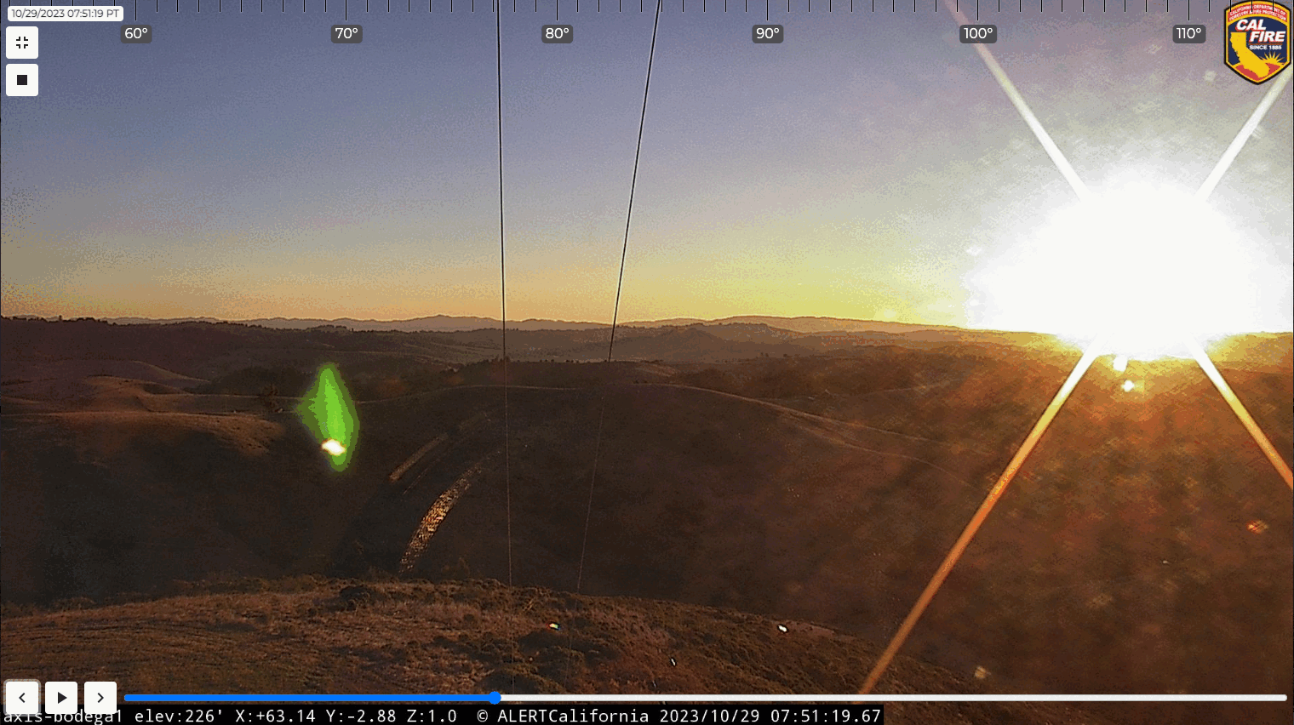
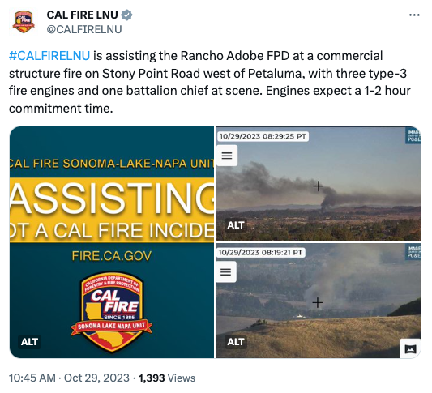
NOAA GOES-R Satellite Fire Detection Capability
Smoke plume
Commercial structure fire - Sonoma Co. (Oct 29, 2023)

Slide 6
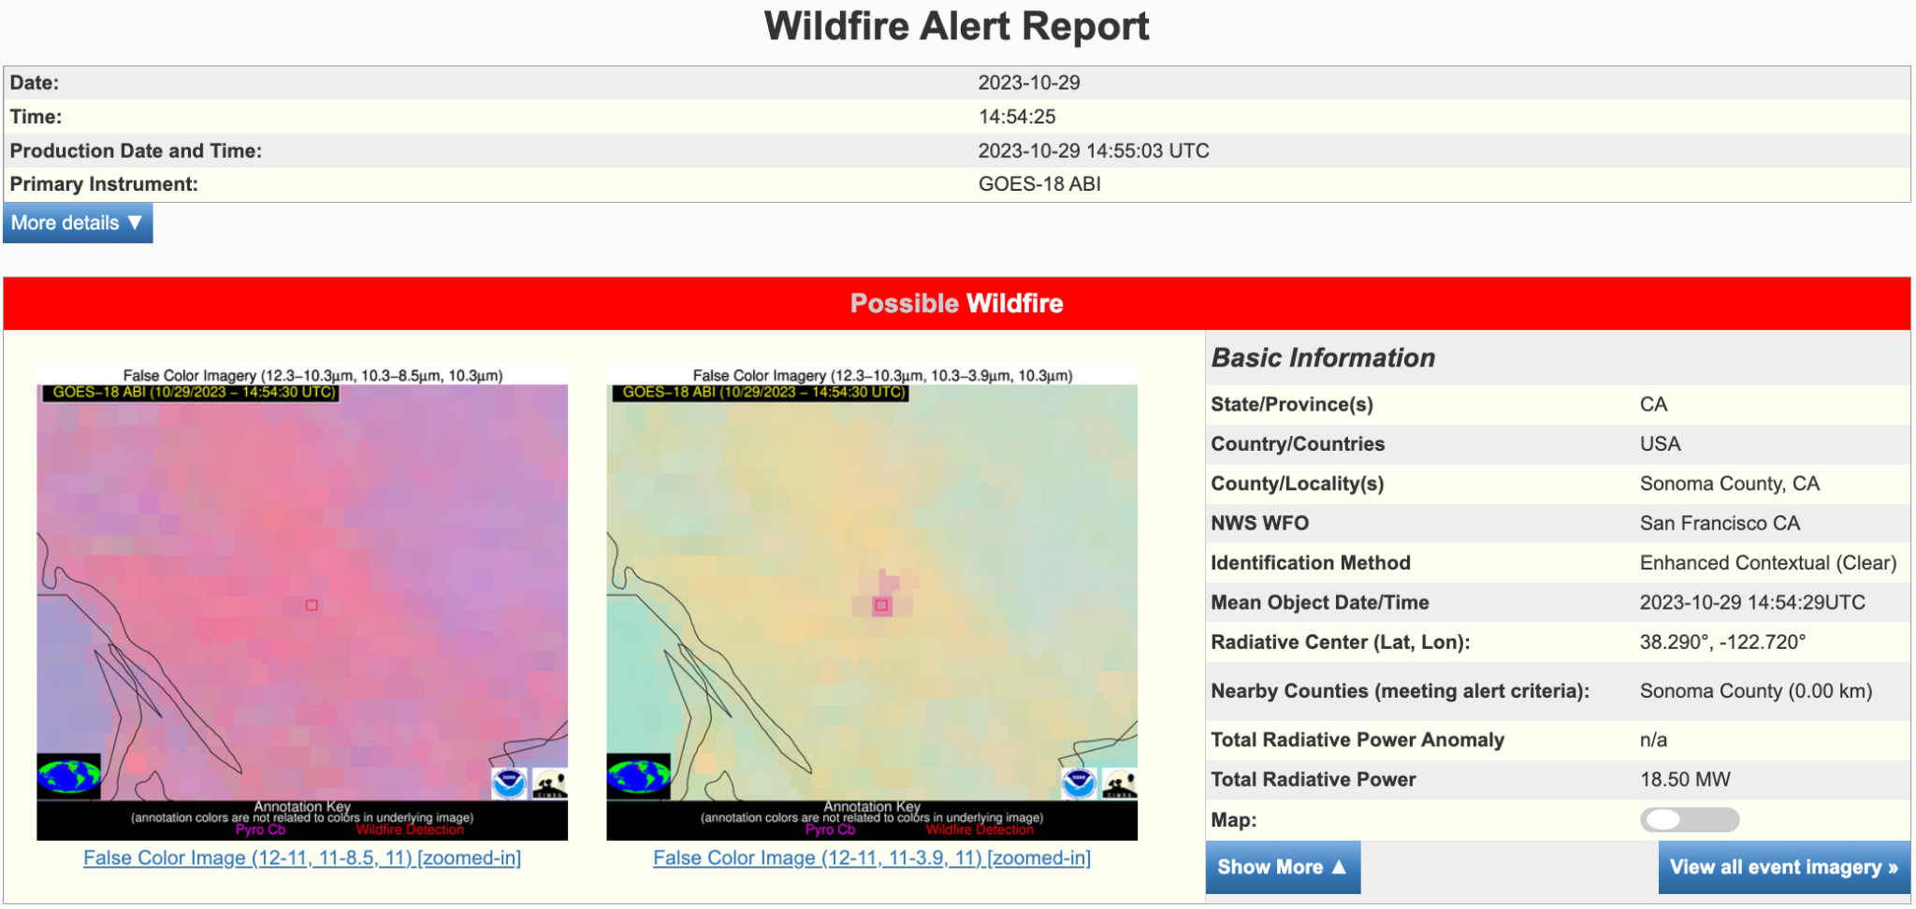
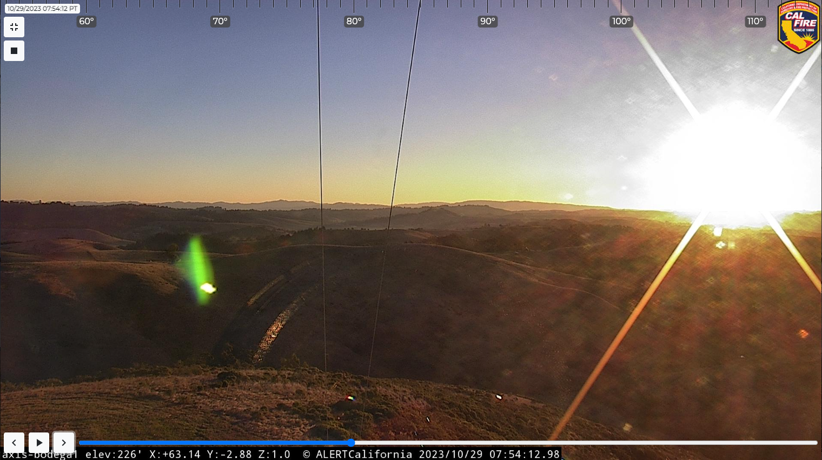
The NOAA NGFS detected the heat from the fire at 7:54:29 AM PDT.
The corresponding alert was generated at 7:55:03 AM PDT
NGFS alert report
07:54:12 AM
07:54:47 AM
Smoke

Slide 7
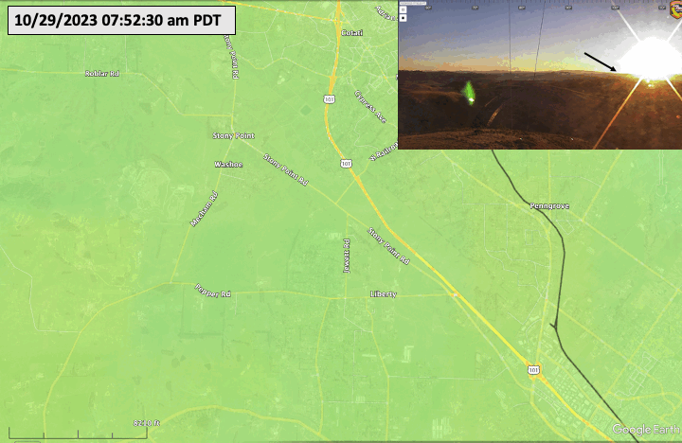
The red box shows the region where the NGFS detected heat.

Slide 8
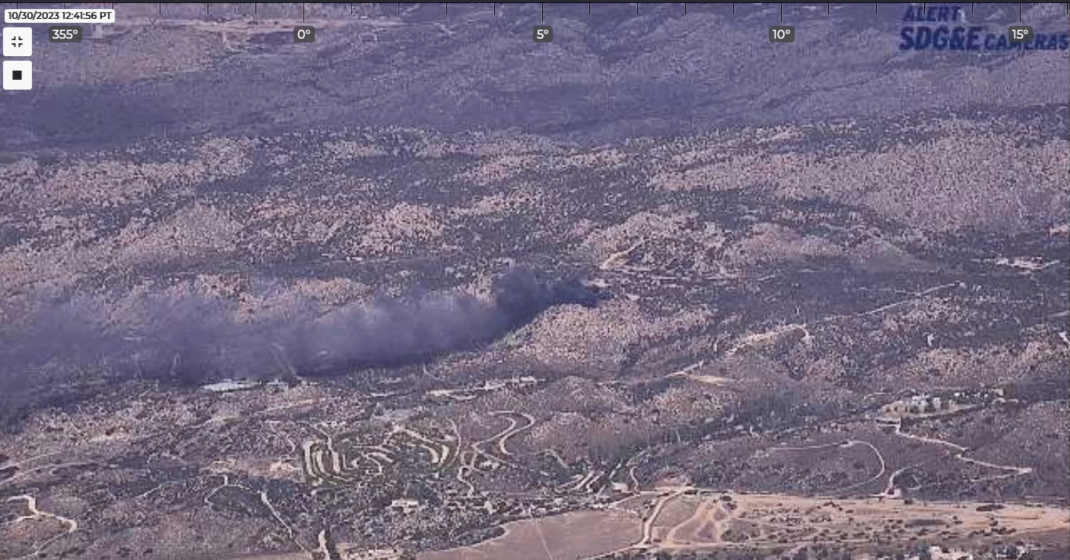
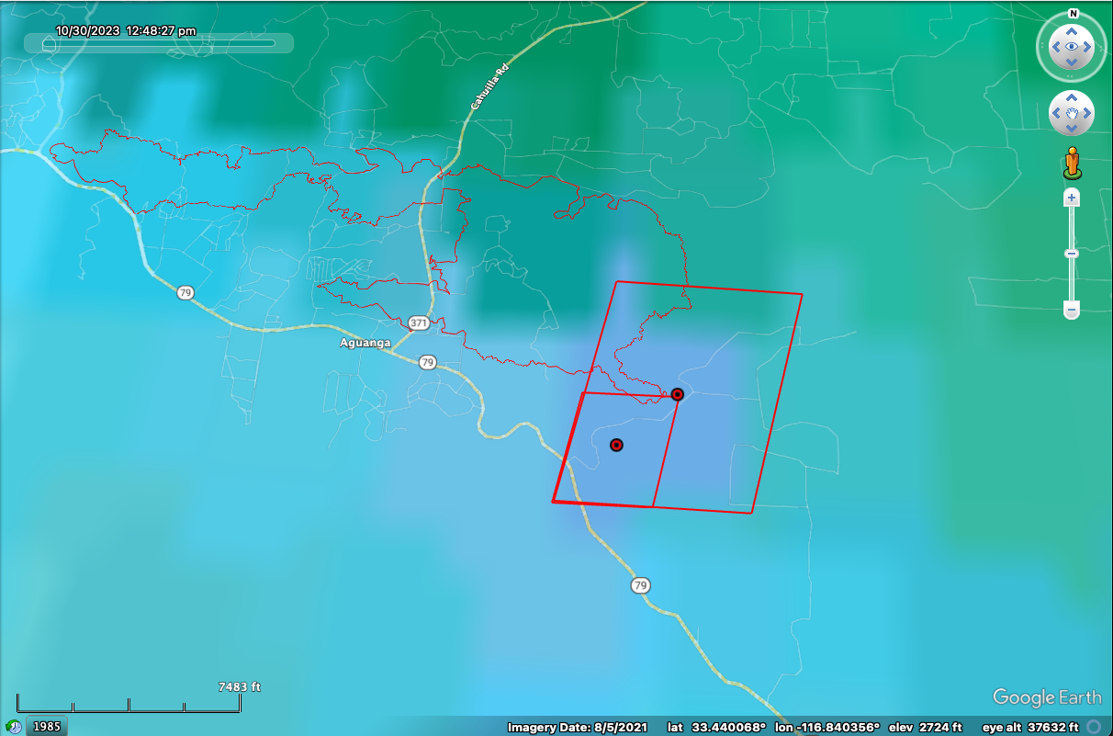
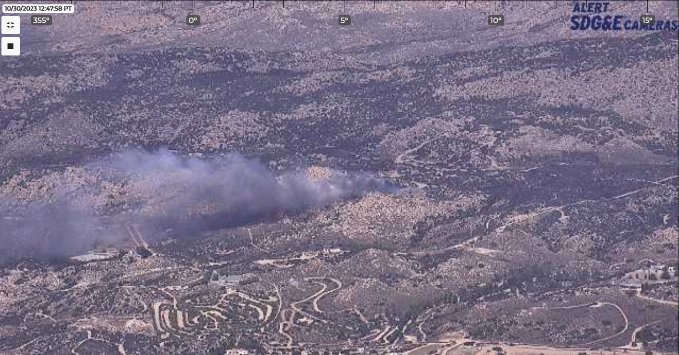
Highland Incident - Riverside County - Oct 30, 2023
12:41:56 pm
GOES-18 Satellite
Nominal 2 km pixel
12:47:58 pm
1 km SWIR pixel
Initial NGFS detection: 12:48:27 pm

Slide 9
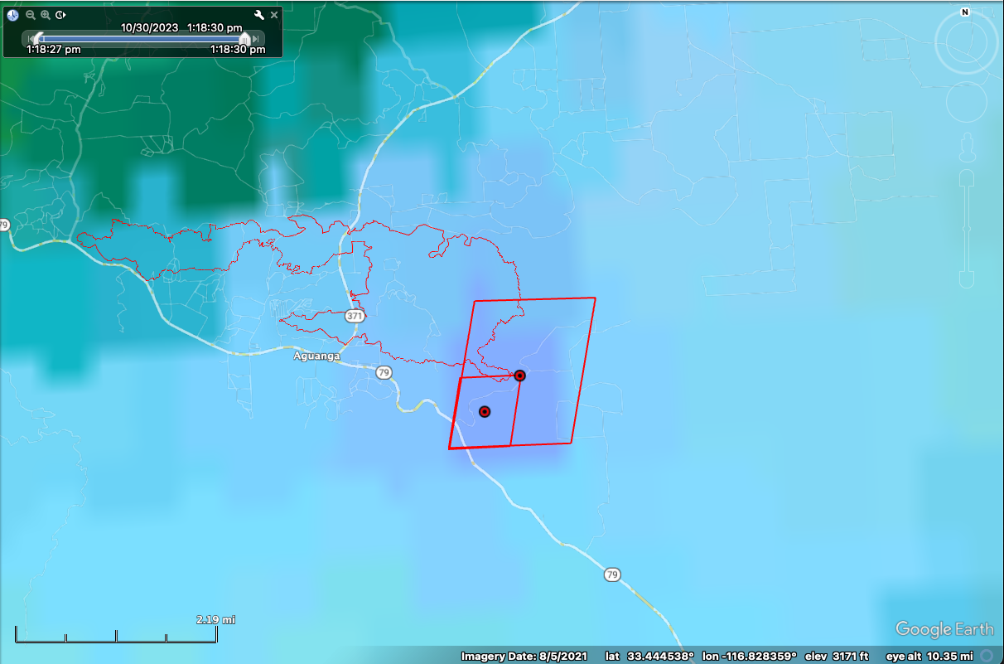
GOES-18
1:18:30 pm

Slide 10
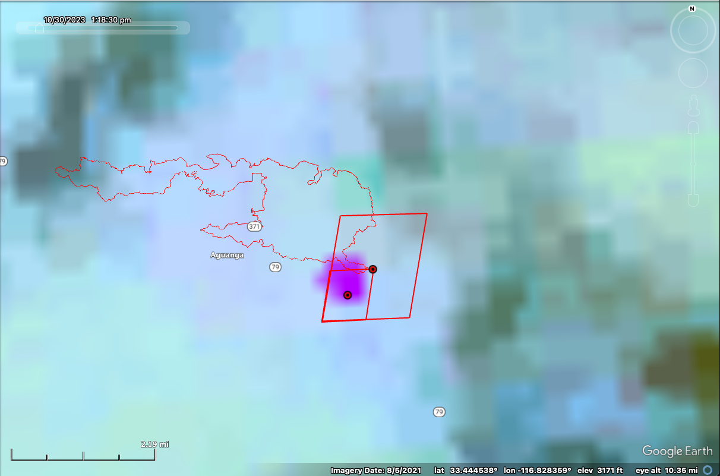
SNPP VIIRS
1:18 pm

Slide 11
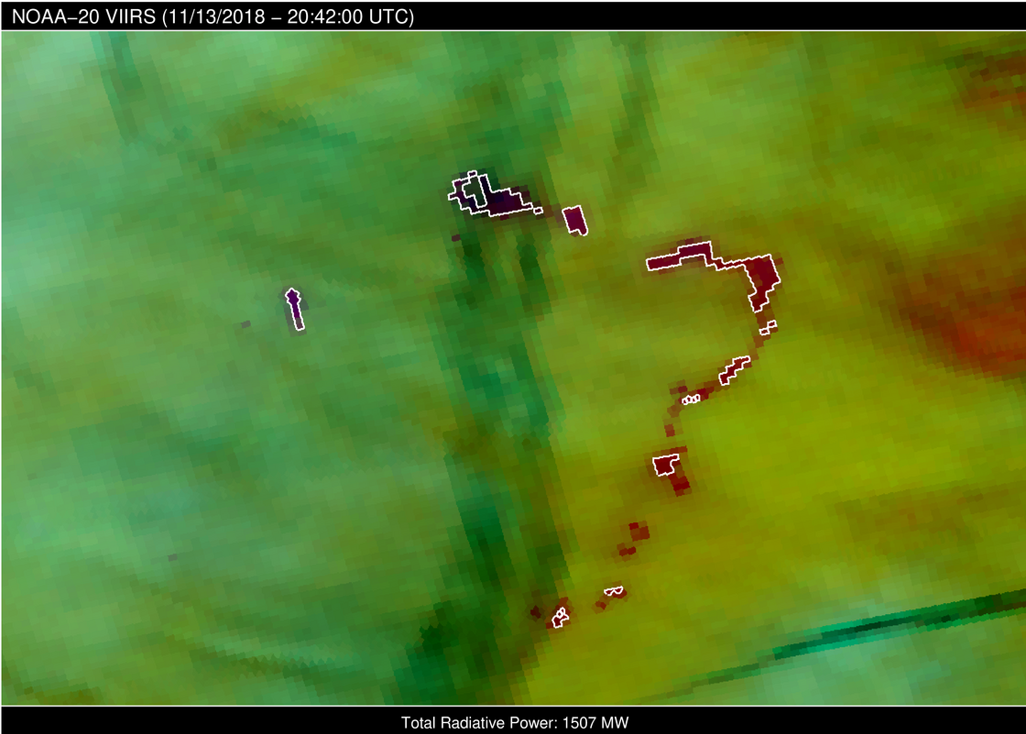
Cloud resilient approach to detection and FRP
Cloud microphysics RGB - Camp Fire
Automated detection under cloudy conditions is needed for near continuous monitoring of intensity and spread (coarse resolution)
White ROI overlay indicates automated NGFS detection

Slide 12
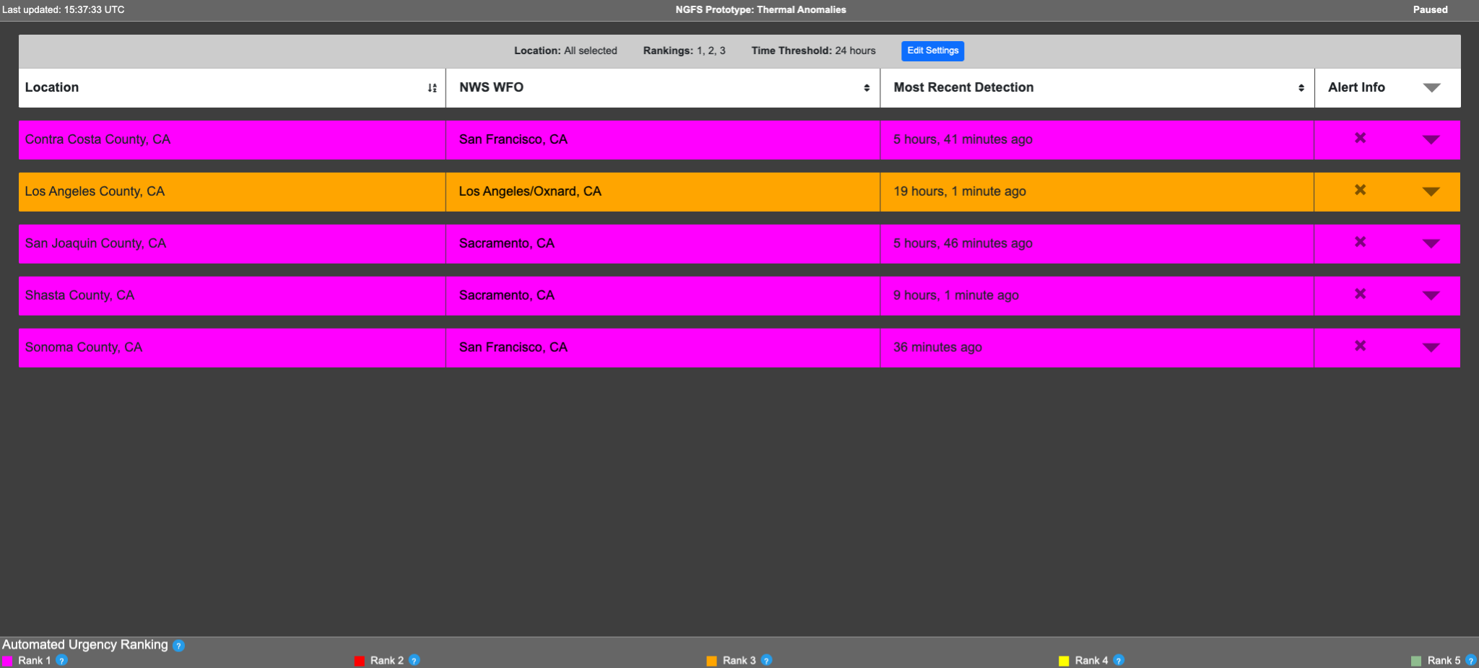
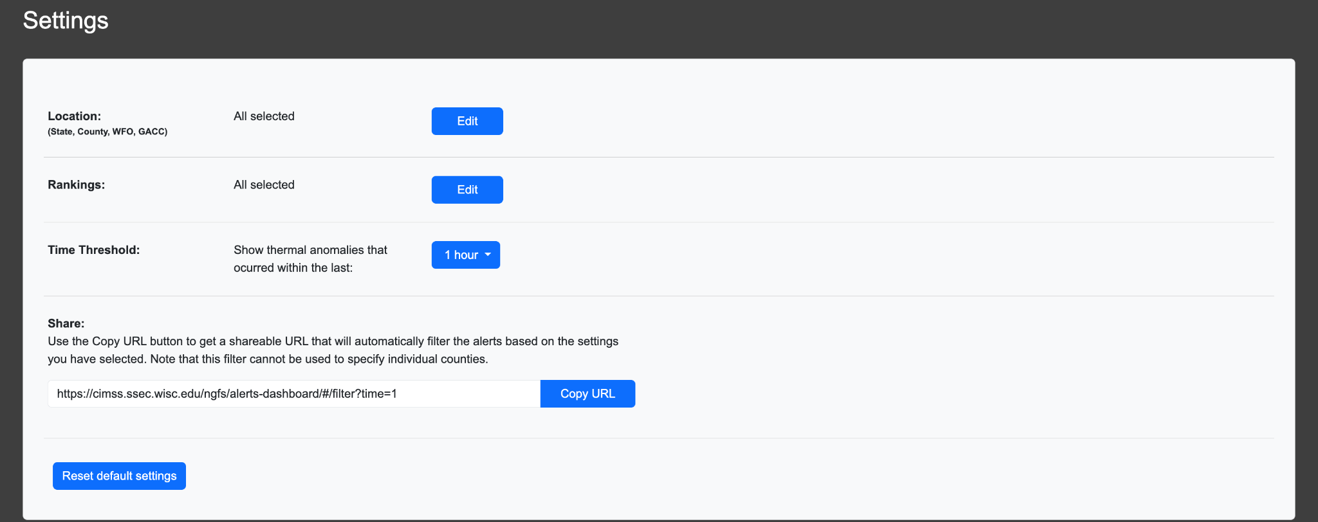
Dashboard interface for new fire detections as a function of fire weather conditions
Users can further filter events by location (GACC, NWS, state, or country), fire weather conditions, and age.

Slide 13
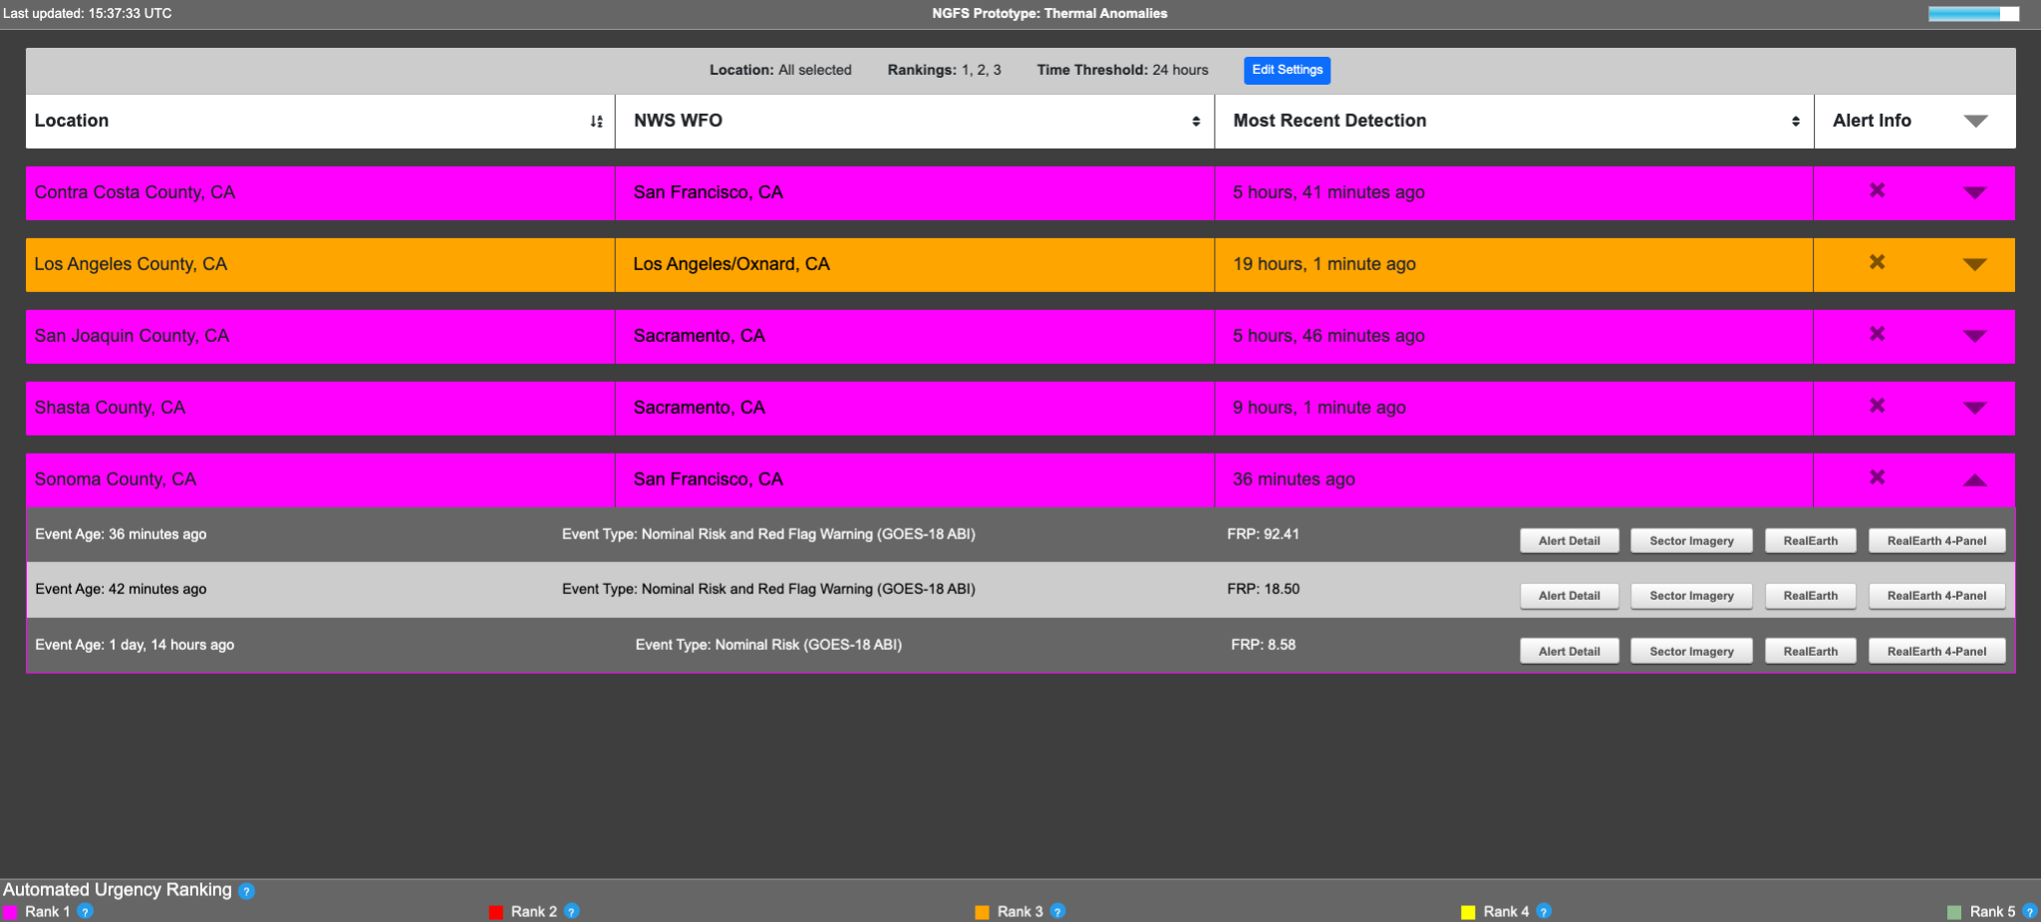

Slide 14
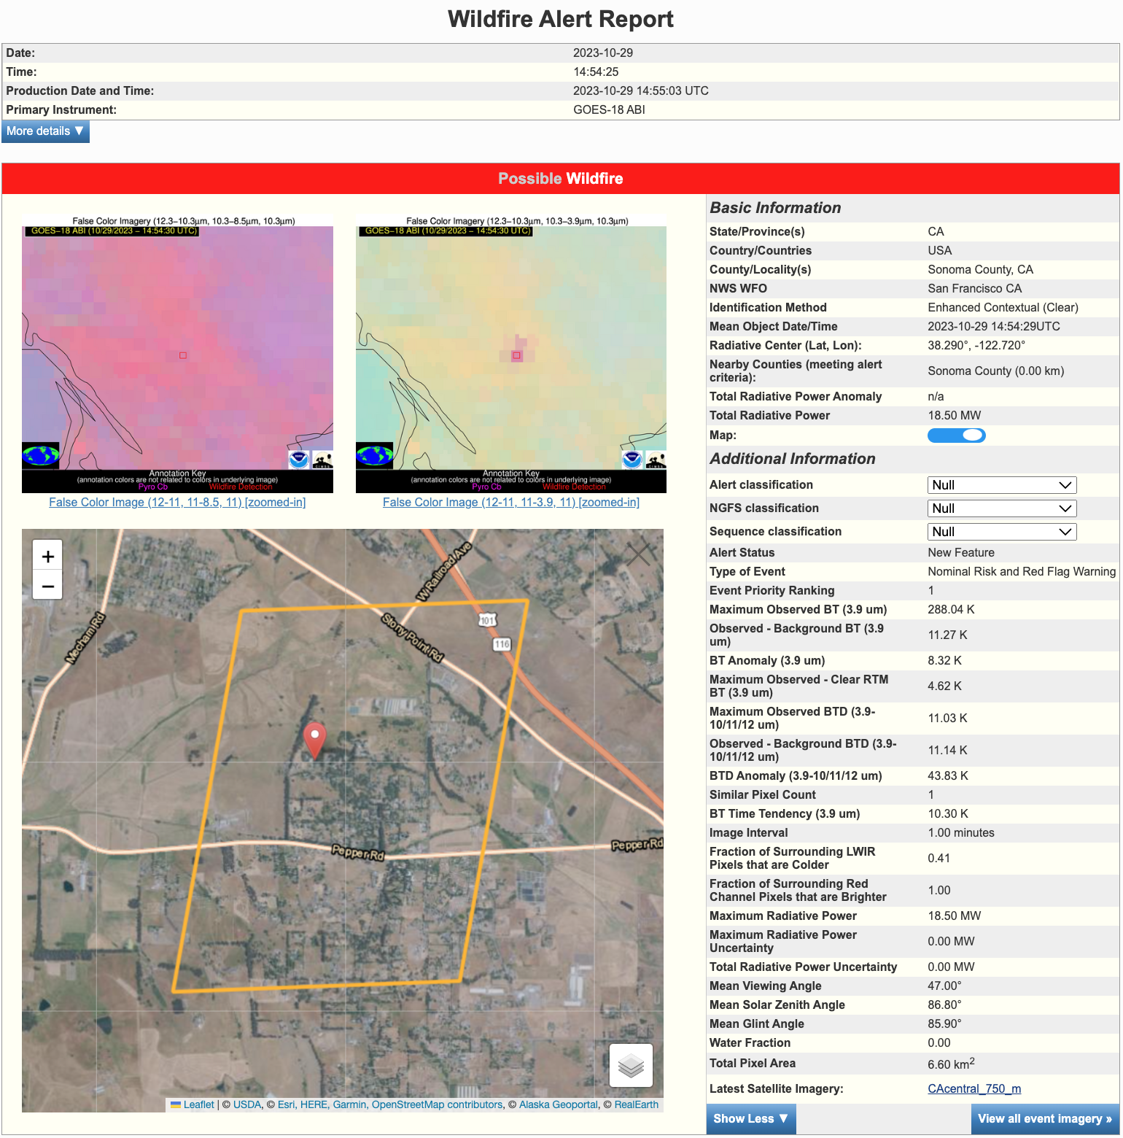
Pre-decisional information:
No automated system is perfect, so a human expert should verify the alert.
The alert report contains detection metrics and imagery needed to evaluate the automated detection.

Slide 16
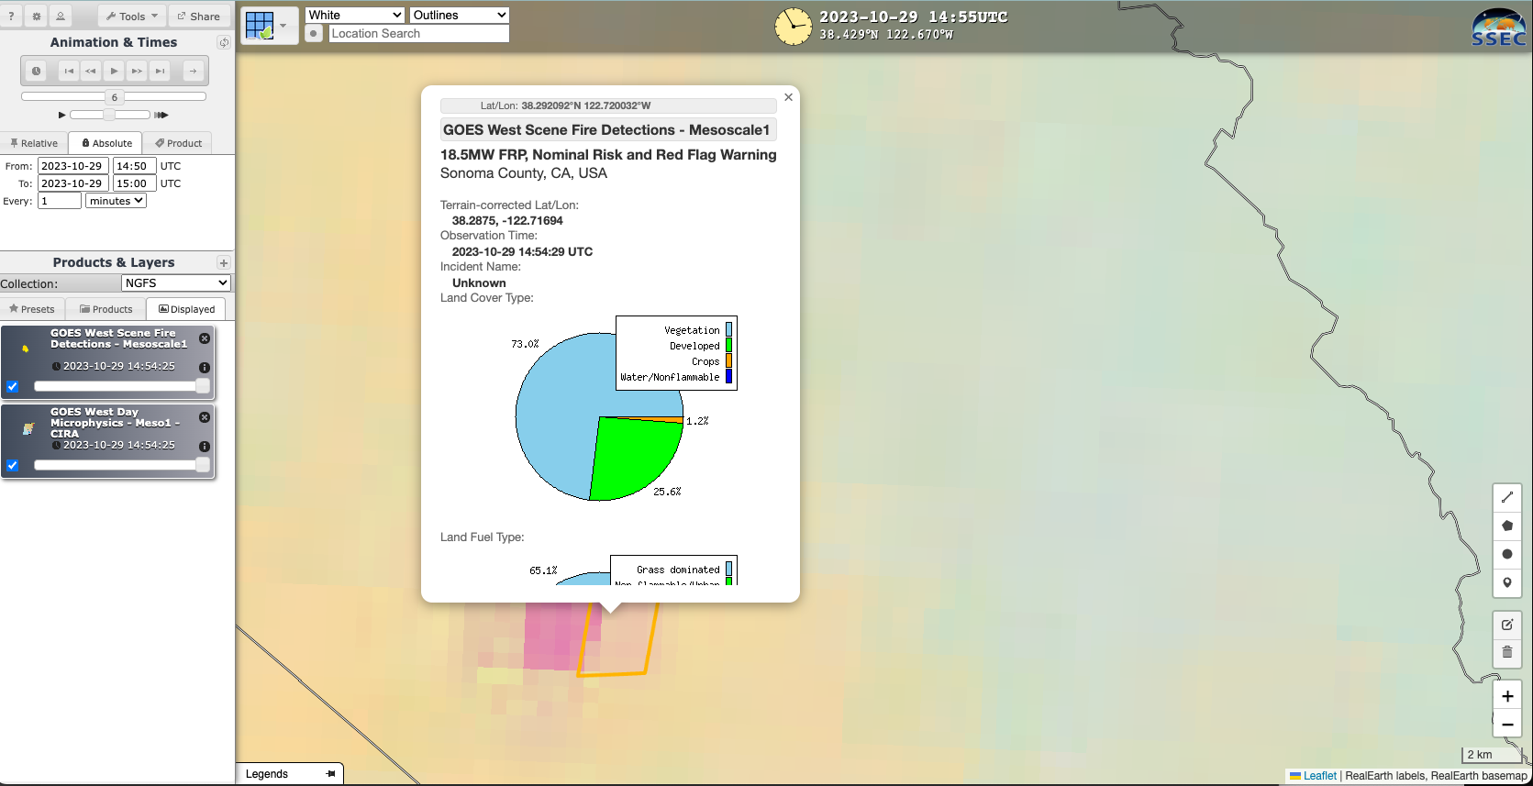
Additional probing is possible via web mapping service
Pie chart of LANDFIRE fuels in each pixel

Slide 17
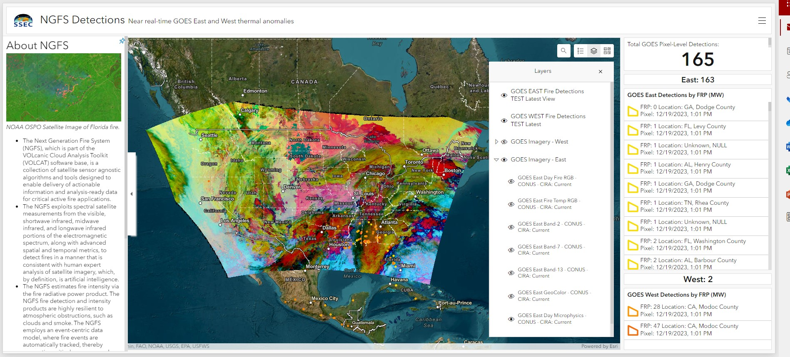
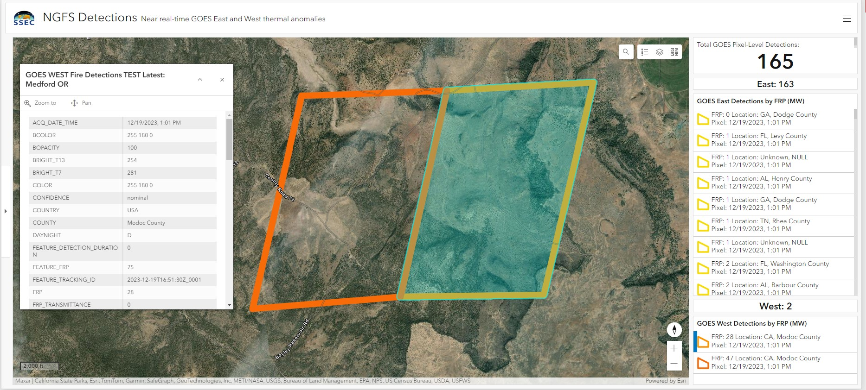
Applications for Incident Awareness and Assessment
ESRI Event Dashboards
Fire radiative power
Notes:
Including FRP nowcasting tools and Pyrocb detection

Slide 18
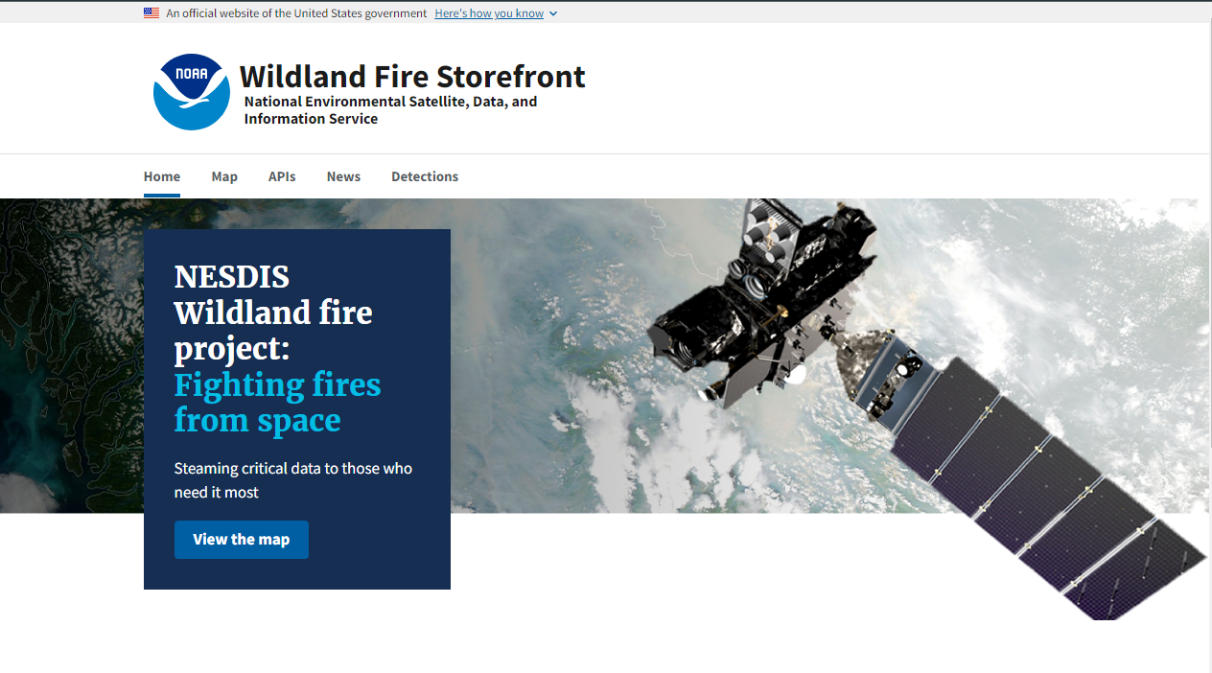
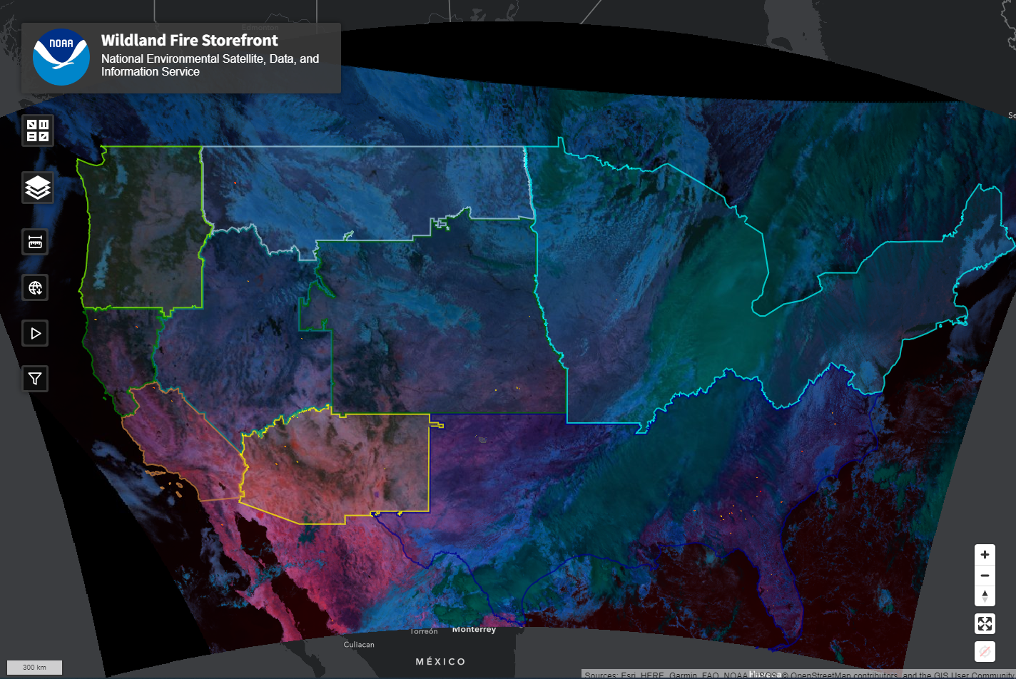
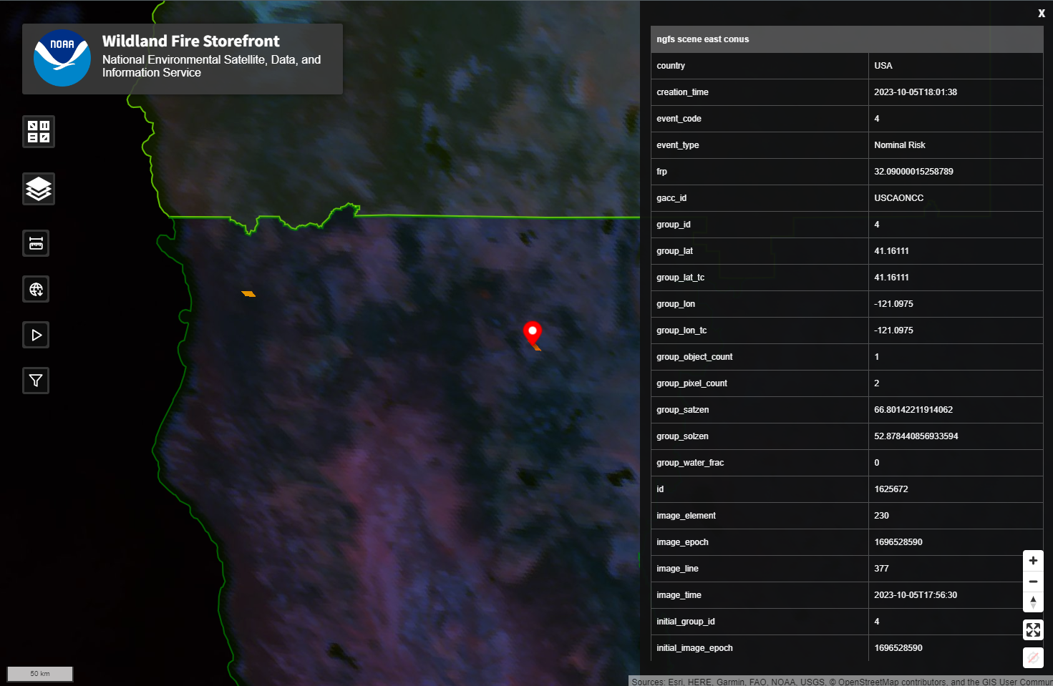
Towards a Dedicated Cloud-based Data Portal for NESDIS Fire Products
A beta version of the data portal will be accessible in February or March
Notes:
cloud-based

Slide 19
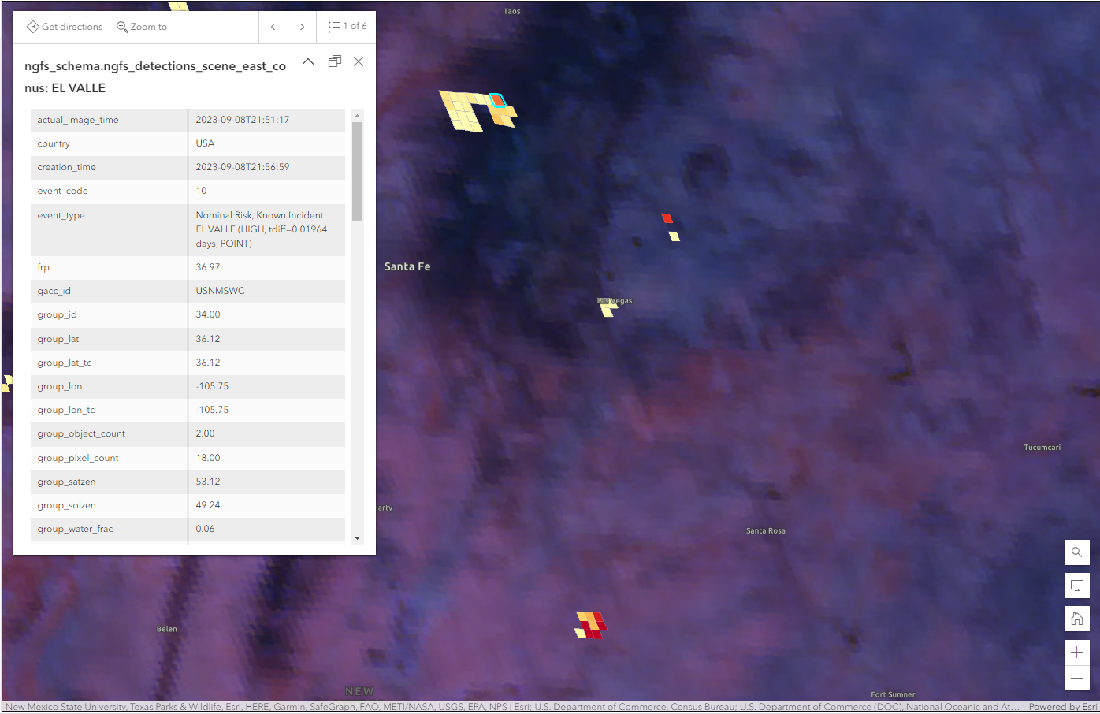
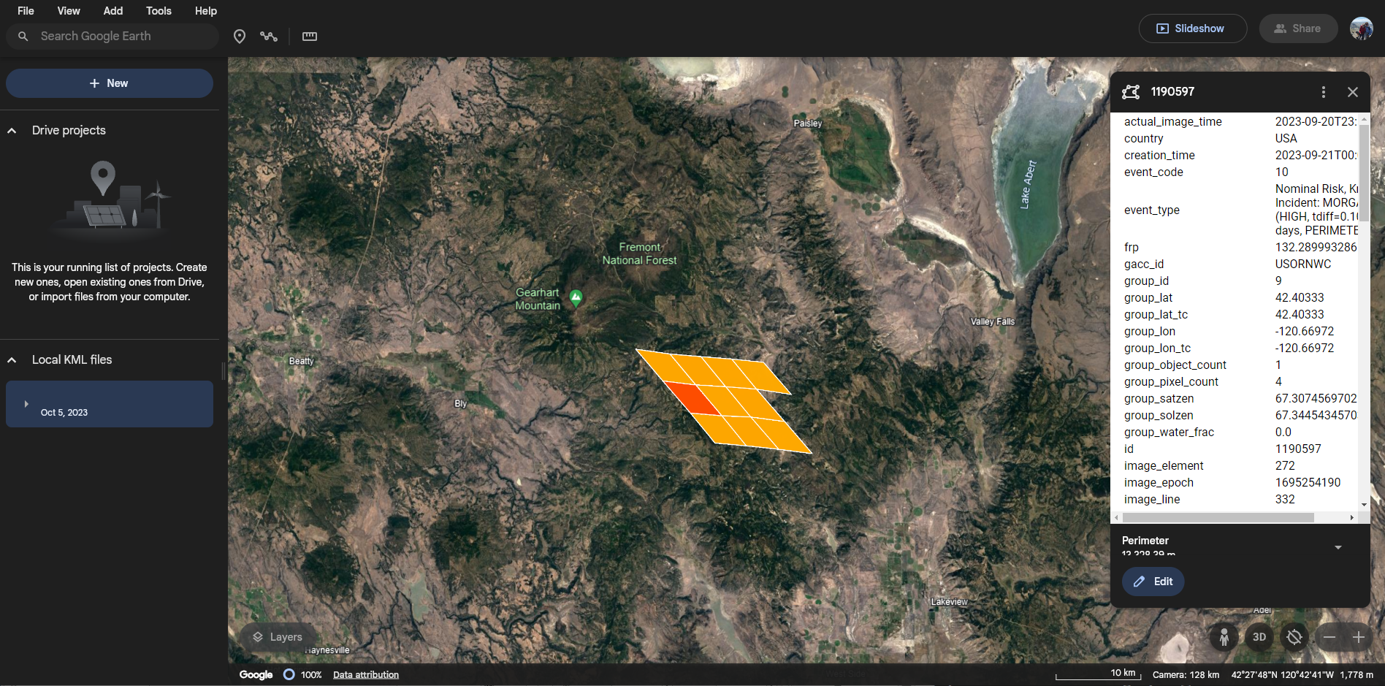
Interoperability through APIs
ArcGIS
OGC Features API
geojson
csv
kml
OGC Tiles APIs
raster
vector
WMTS
raster
Google Earth

Slide 20
Experimental NGFS (v2) alerts are available here. NOAA Fire Testbed and IAA with DOI+USFS will be used to further refine and improve interoperability.
Timely hotspot alerts
Fire Radiative Power (FRP) time series tools are under development. Expect to be demonstration ready later in 2024
Incident awareness and assessment
LightningCast UI for wildland fire operations is available. NGFS products are undergoing testing in WRF-SFIRE workflow.
Fire environment forecasting
Event-based data queries
Once the IT security review is complete, experimental NGFS fire products will be available via OGC data services

Slide 21
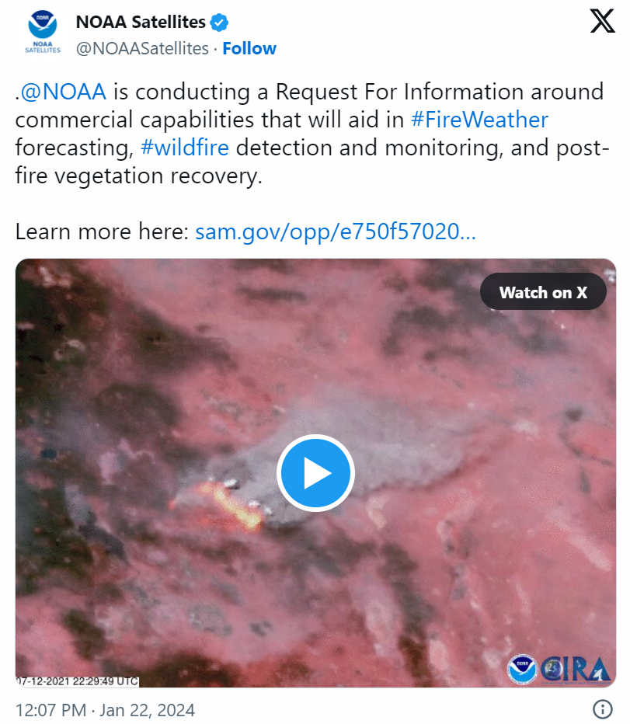
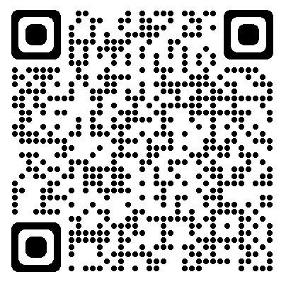
NOAA Fire Weather Request for Information (RFI)
Response Date:
February 16, 2024, 2 P.M. EST

Slide 22
Backup Slides

Slide 23
Links
NOAA Center for Artificial Intelligence
NOAA and Wildland Fire
GOES-R Satellites
JPSS Satellites
NOAA/NESDIS Hazard Mapping System
NOAA LightningCast:
About
Near real-time access

Slide 24
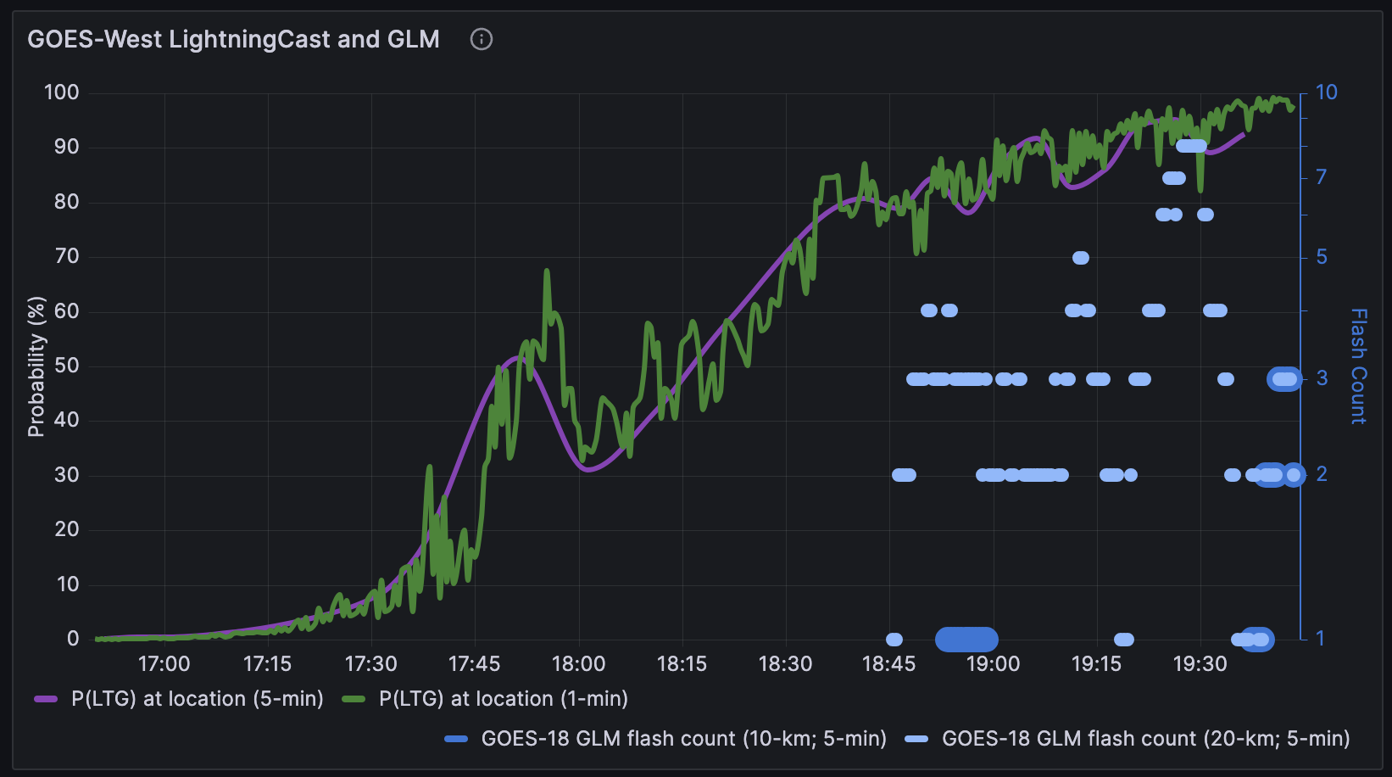
LightningCast: AI Lightning Nowcasting for Incident Safety
GOES-West satellite imagery + LightningCast prediction contours + GOES-West lightning mapper observations
Utah
Pinpoint LightningCast forecast for Table Mountain fire
Significant increase in LightningCast prediction
Table Mountain Fire
~45 minutes of lead-time
First nearby lightning observation
Credit: NOAA/NESDIS and University of Wisconsin CIMSS

Slide 25
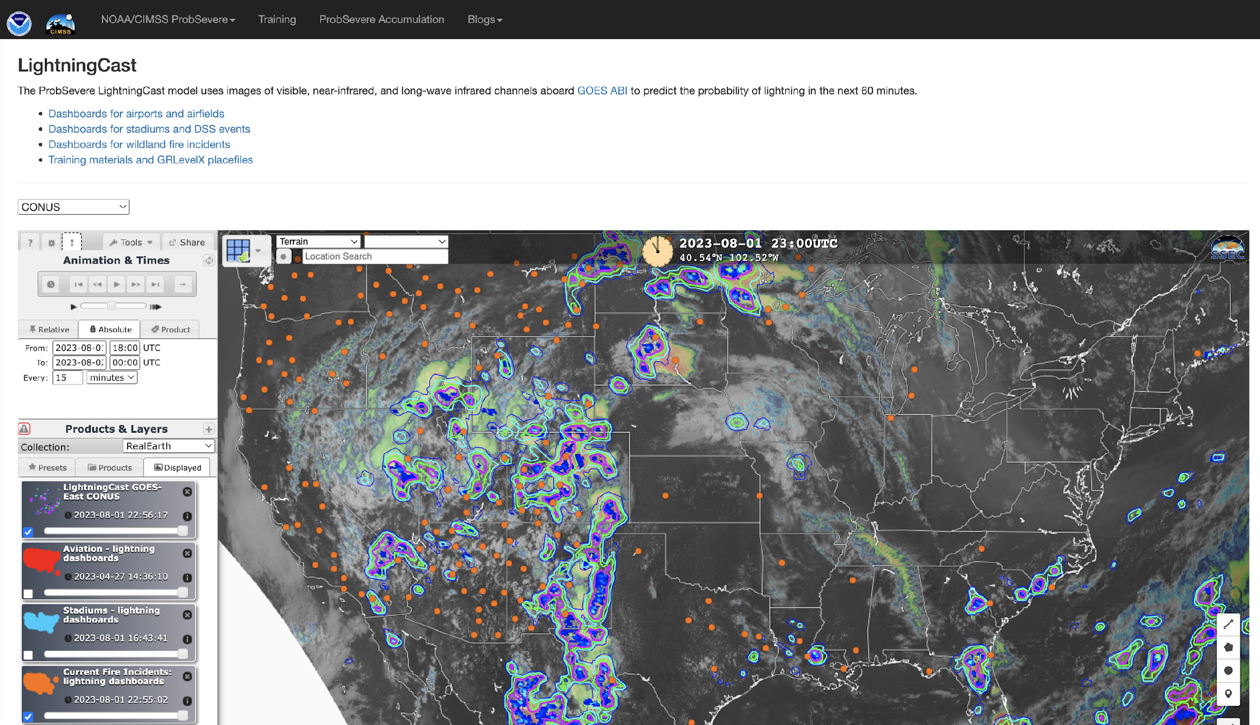
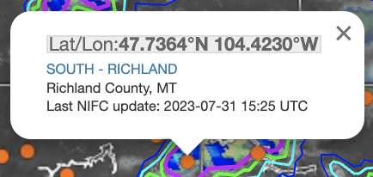
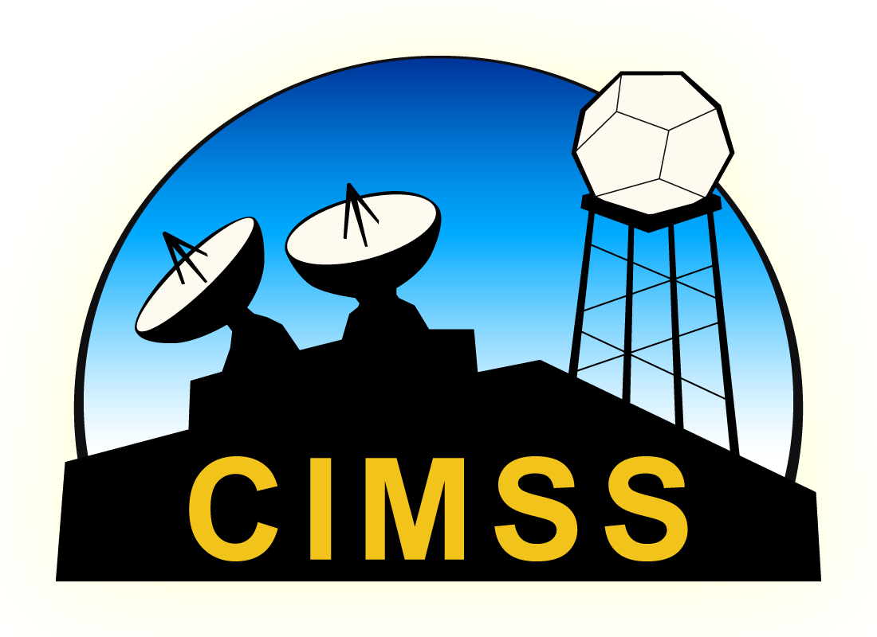
LightningCast web availability
Near real-time output is available: https://cimss.ssec.wisc.edu/severe_conv/pltg.html
Click a location
Toggle on NIFC incident locations
Notes:
Meteograms available at many airports and airfields.

