Slide 1
An evaluation of the impact of improved fire detection and characterization from VIIRS on regional fire radiative power estimations
Ivan Csiszar, Michael Pavolonis (NOAA/NESDIS/STAR)
Chuanyu Xu, Benjamin Marchant, Jason Brunner, Marina Tsidulko, Wei Guo, Yingxin Gu (I.M. Systems, Inc.)
9/13/2023

Slide 2
Background
The baseline VIIRS Active Fire products have been used successfully as input to NOAA’s smoke emission monitoring and forecasting systems
750m VIIRS “M-band” -> 375m VIIRS “I-band” (current operational product)
Heritage algorithm
hybrid thresholding/contextual;
detection based on I-band;
fire radiative power (FRP) from M13 “fire band” partitioned over I-band detections within M-band pixel footprint
explicit internal cloud mask, top-of-atmosphere FRP
see poster no. 295 “An update on the NOAA Operational VIIRS Active Fire product” by I. Csiszar et al.
Necessary improvements have been identified to provide improved fire information as emission sources
Identification of detections not related to biomass burning (non-fire related true hot spots and false detections from spurious signal)
Improved detection and characterization of fires for more complex observing and environmental conditions i.e. clouds and/or heavy smoke
NOAA is developing a Next Generation Fire System (NGFS)
the science algorithm includes all-sky detection and atmospheric correction (based on VOLCAT algorithm)
see poster no. 278 “The NOAA/NESDIS Wildland Fire Program: An Outcome Centric Approach to Satellite Products and Services” by M. Pavolonis et al.

Slide 3
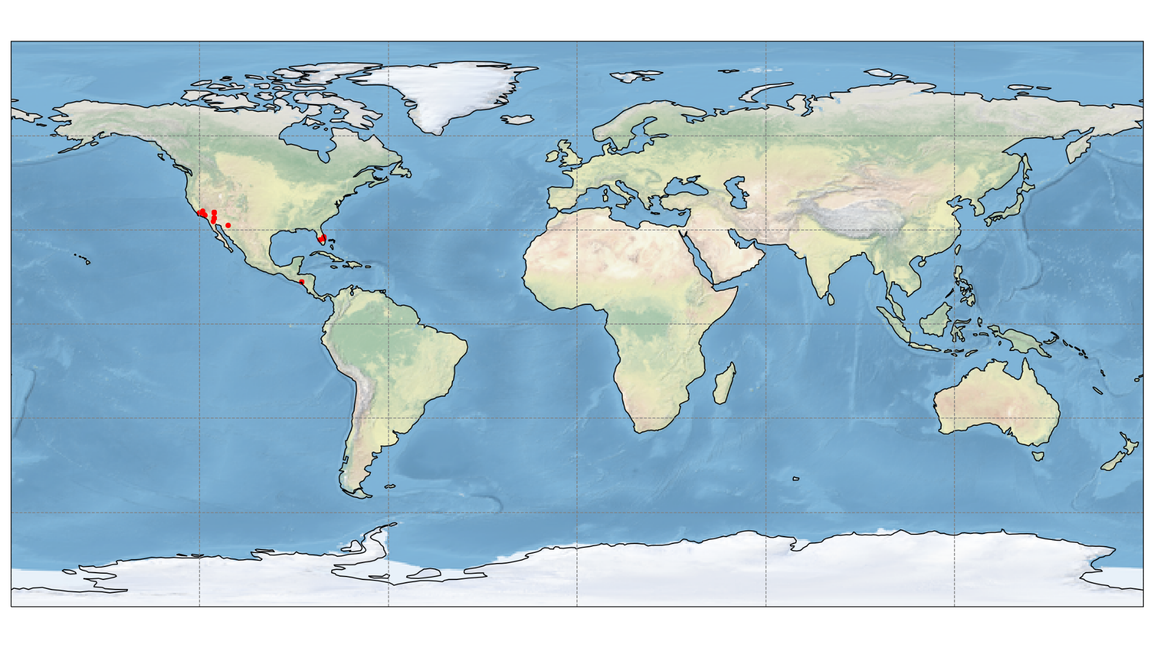
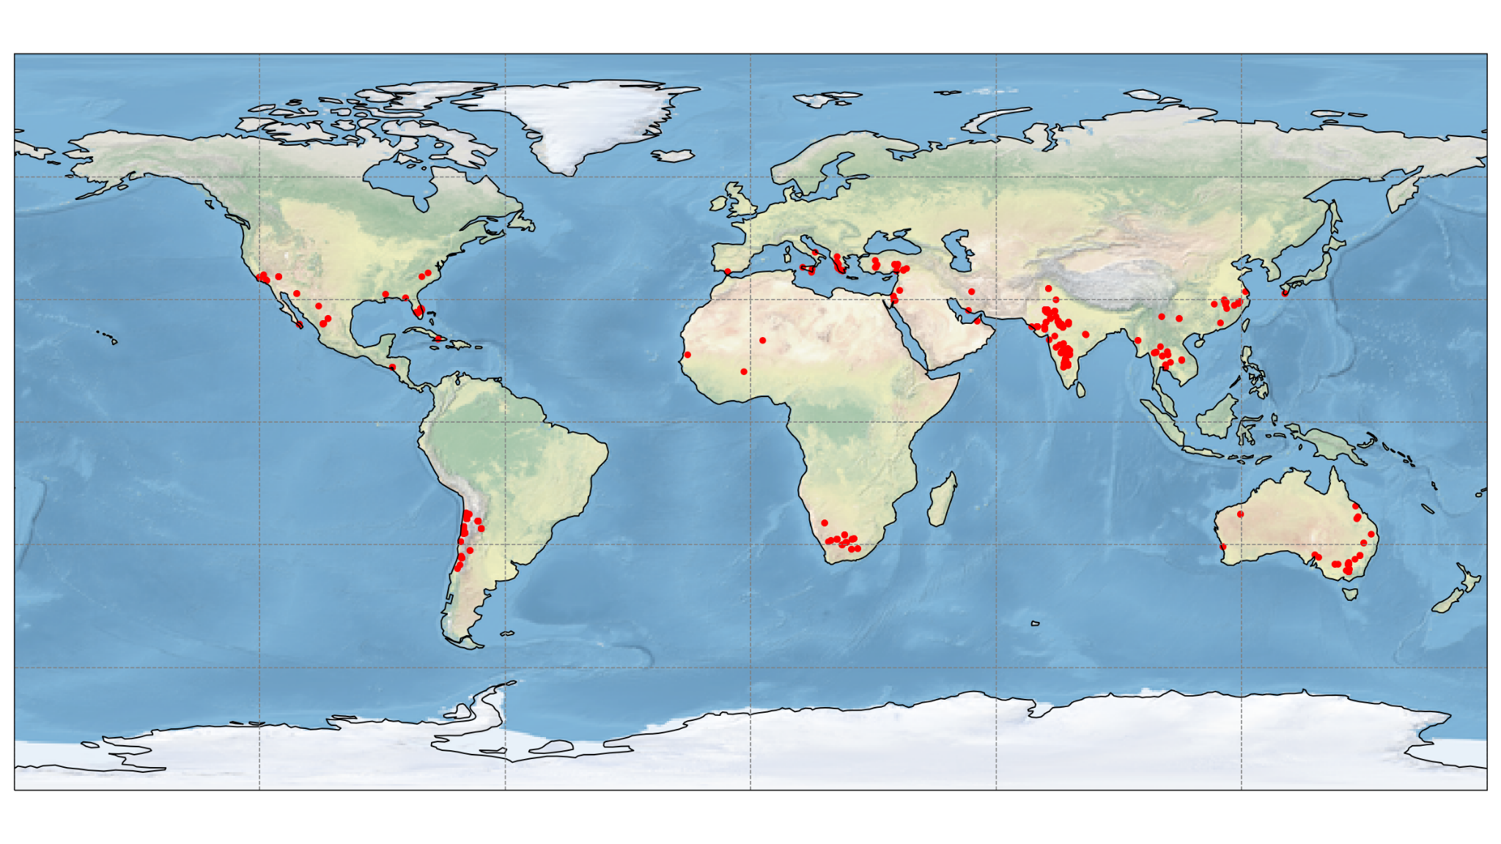
Persistent anomalies: Extending the solar farm database
Solar farms detected in November 2022 by the NOAA Operational VIIRS I-band Active Fire algorithm
Detections using the current operational database
Detections using the extended database
Total count: 294
Total FRP: 2389 MW
Total count: 27075
Total FRP: 250108 MW
NOAA HMS domain
Conterminous US (CONUS) and surrounding areas only (NOAA Hazard Mapping System domain)
Included in the NOAA Operational VIIRS M-band product since December 2019
Included in the NOAA Operational VIIRS I-band product since September 2020
Global
In testing and development
To be included in future NOAA Operational VIIRS I-band products (updated baseline and NGFS)

Slide 4
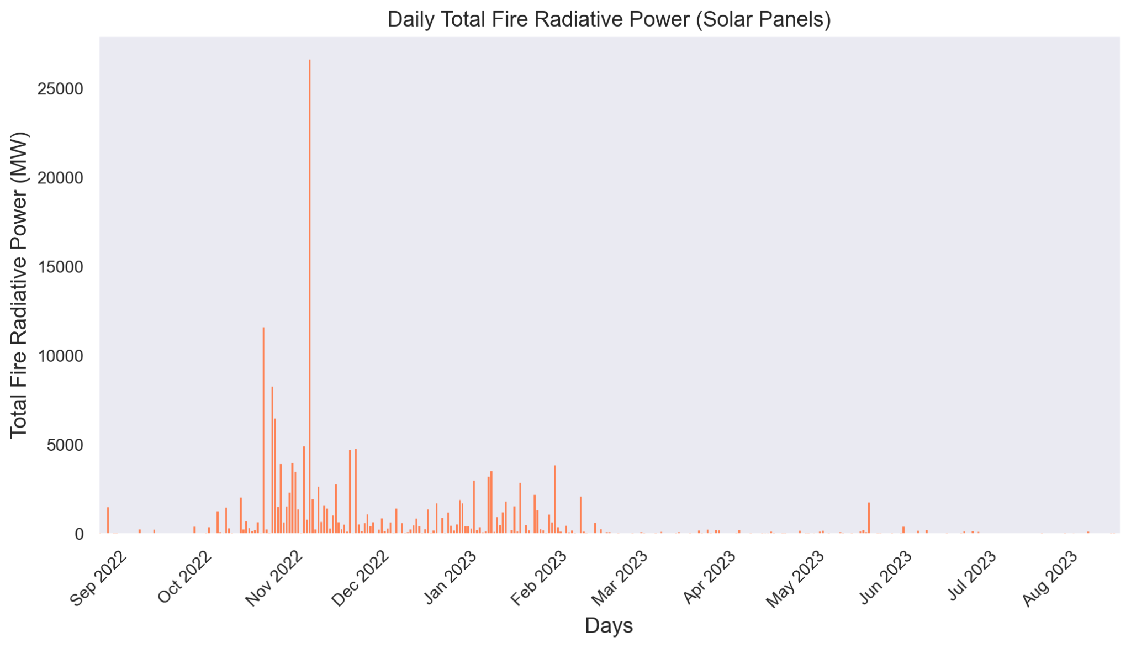
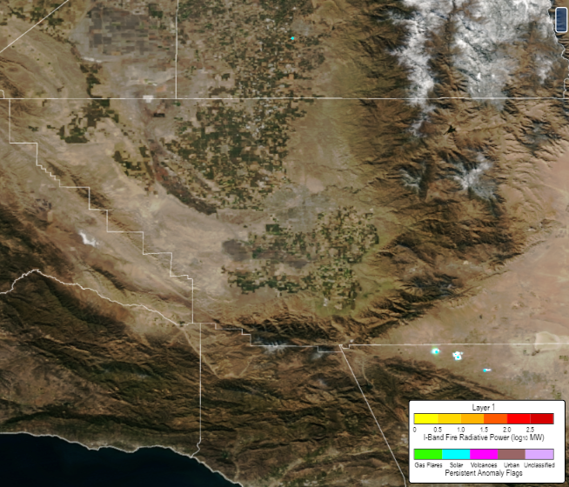
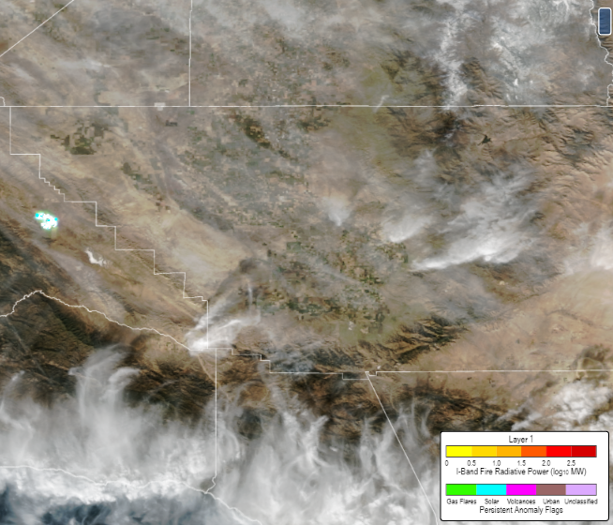
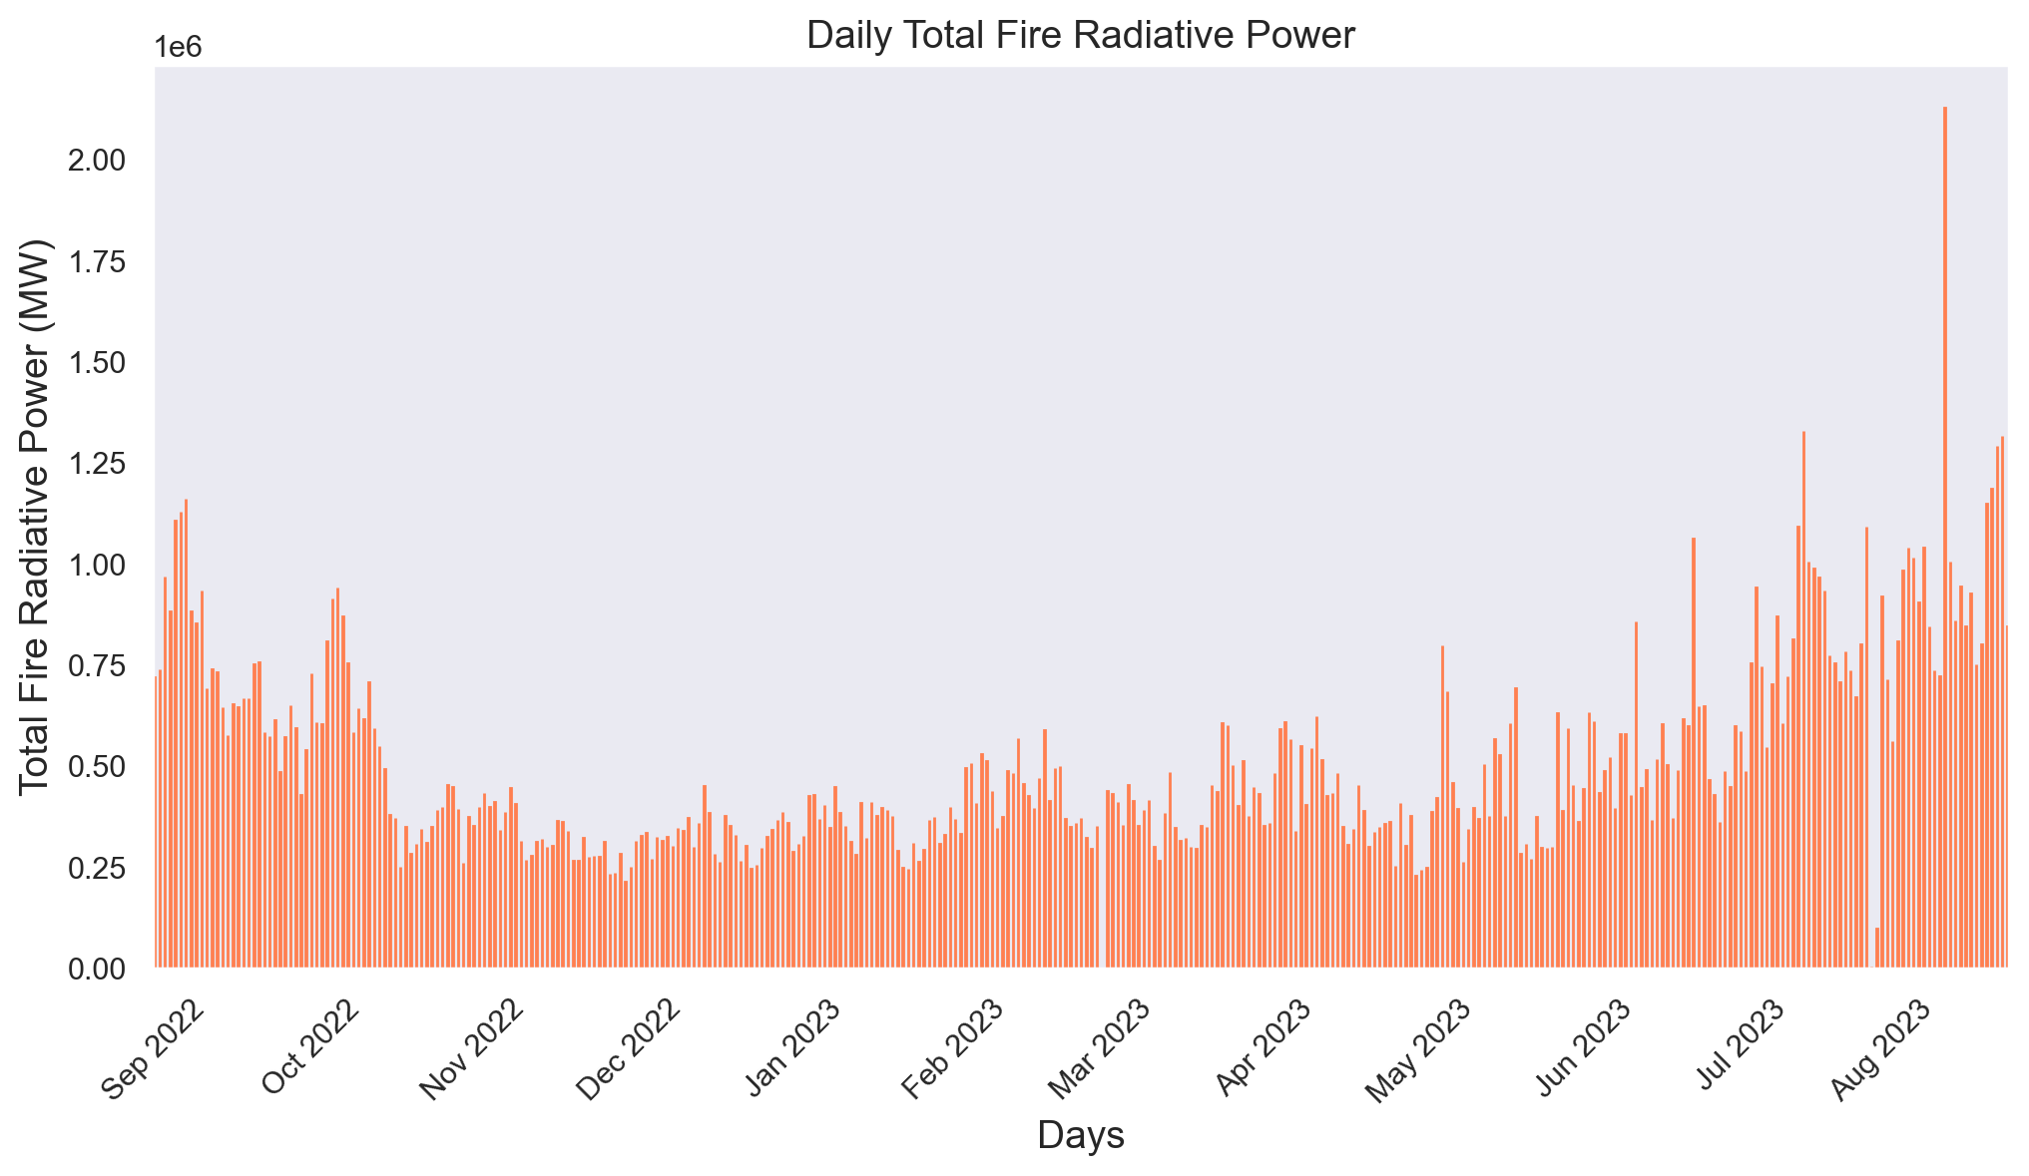
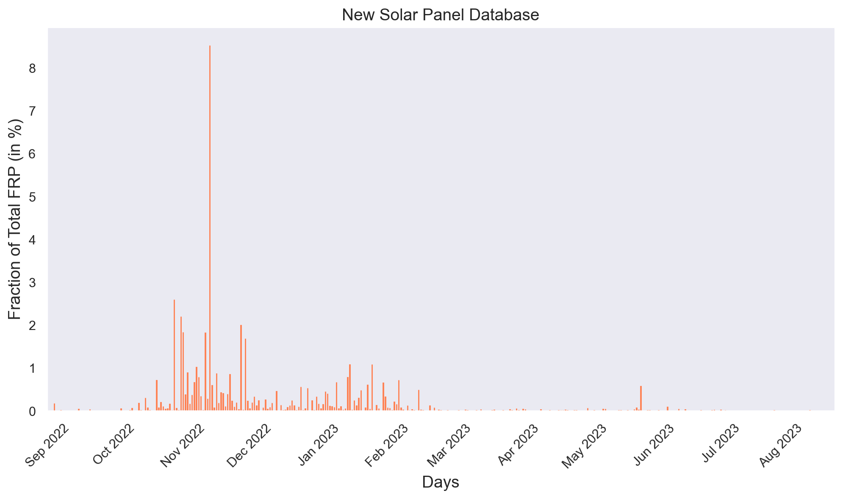
FRP signal from solar farms
Examples from SE CONUS.
Global total, solar farms only
SNPP, 11/16/2022
SNPP, 11/21/2022
Global total, no filter
% of global total, solar farms only

Slide 5
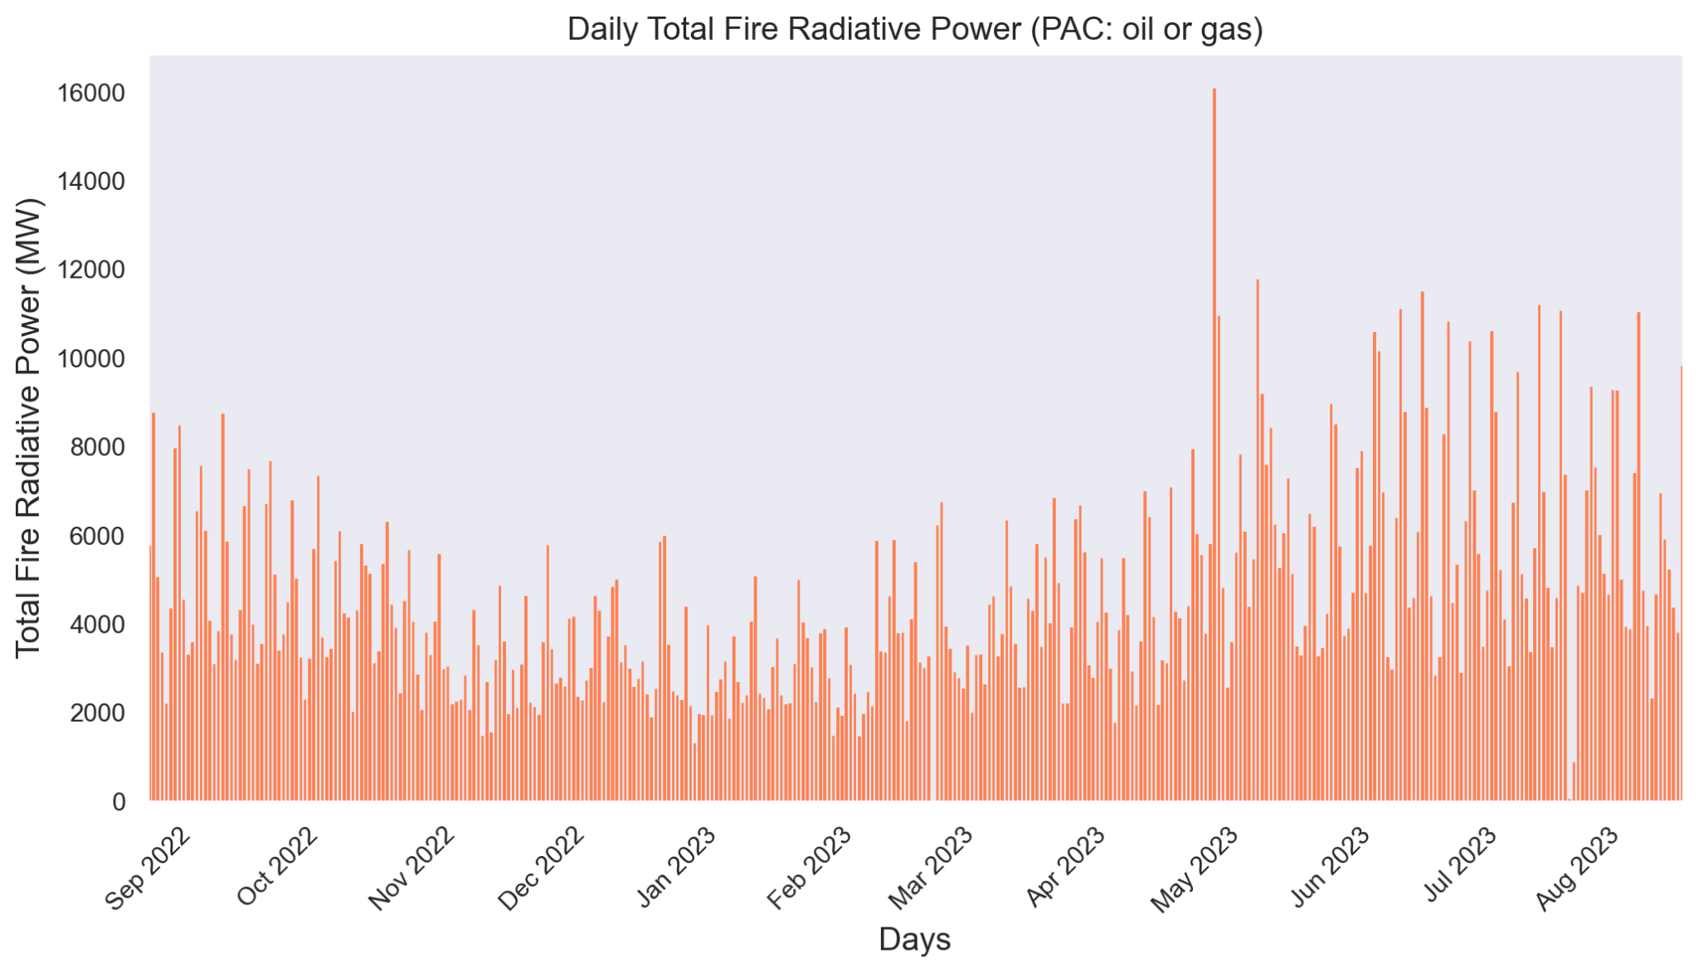
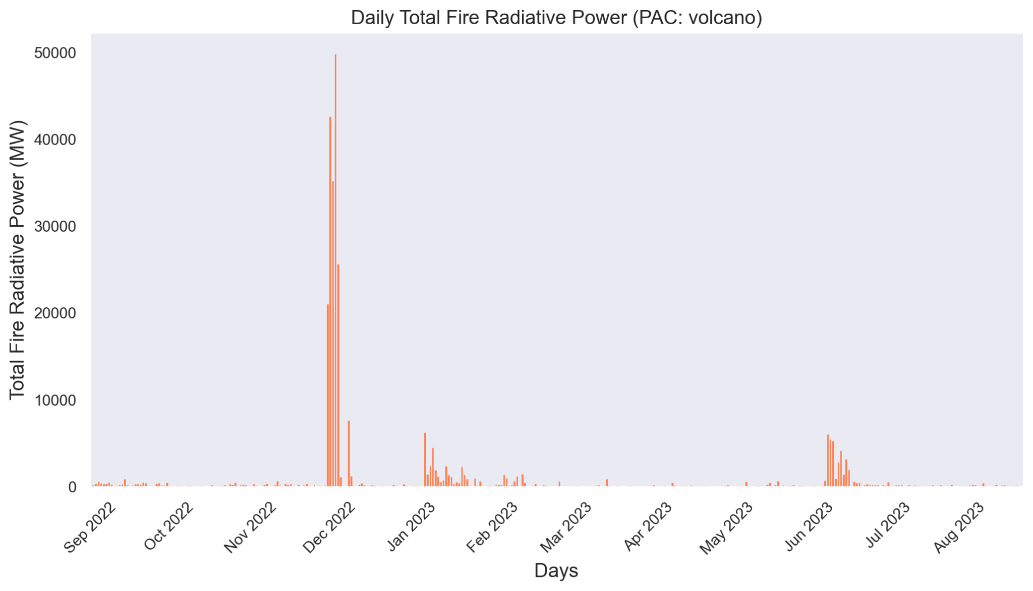
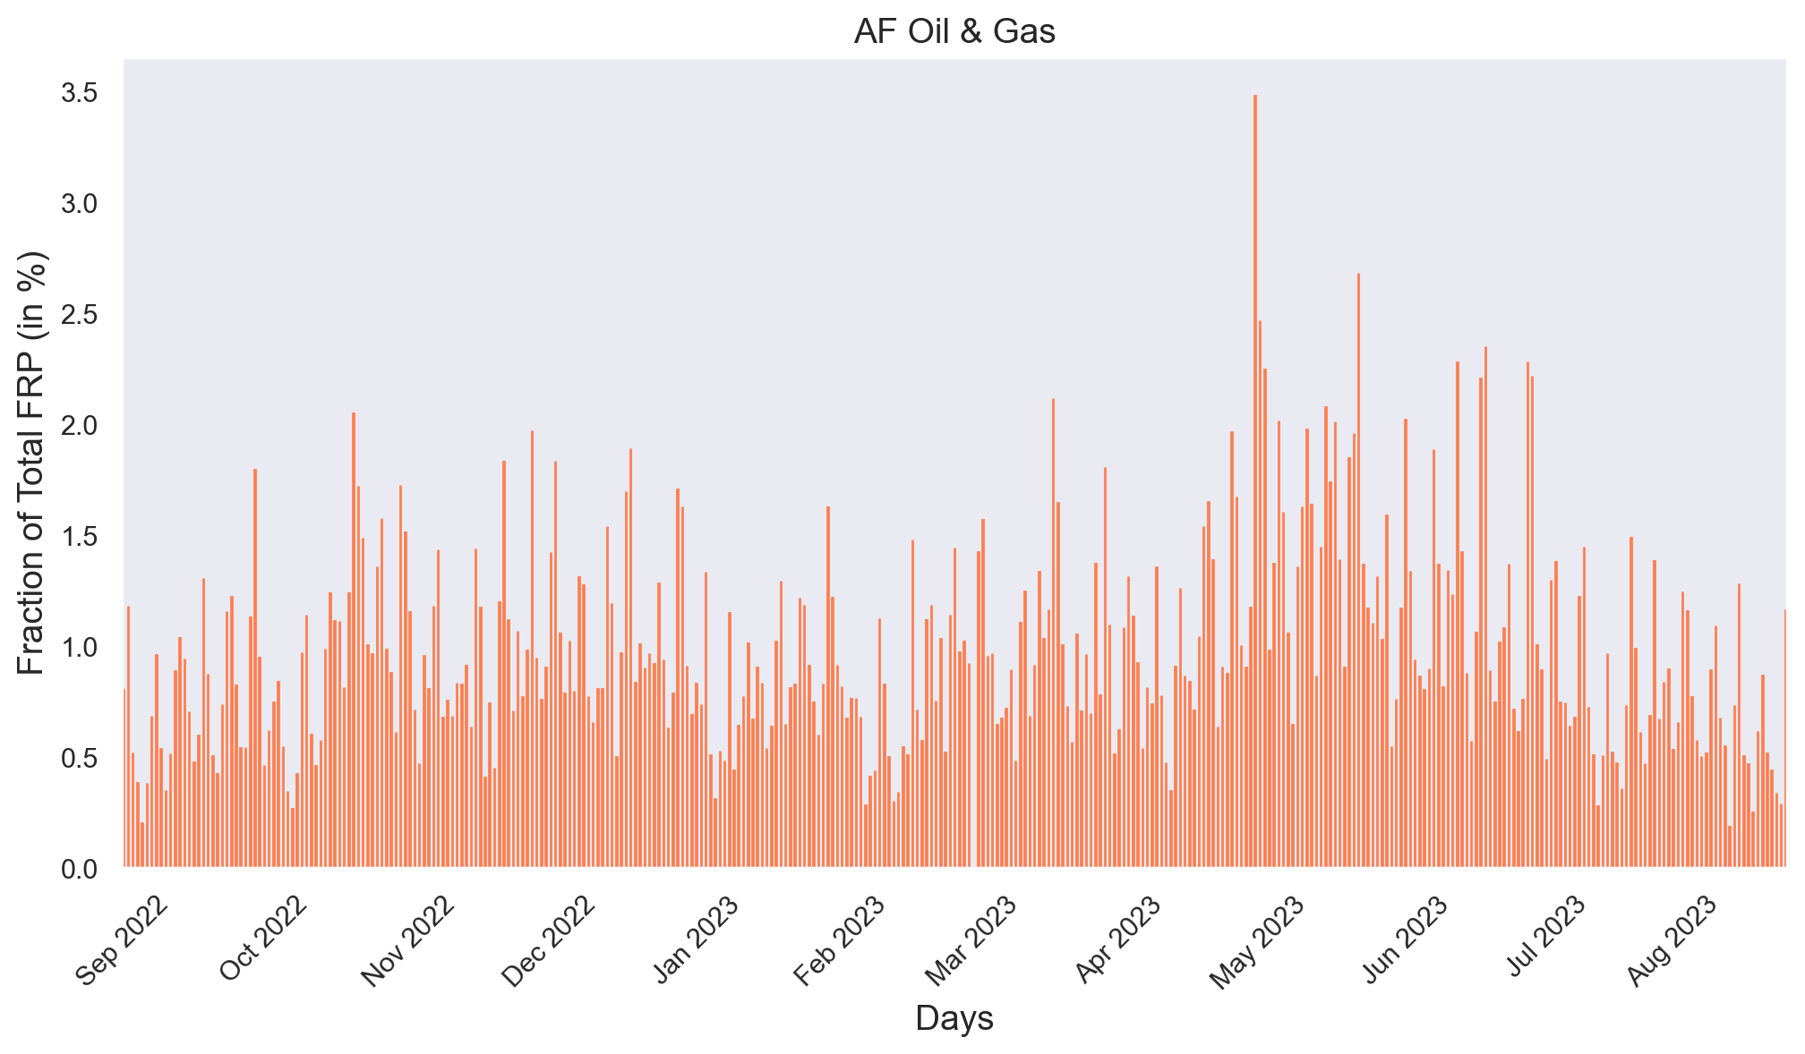
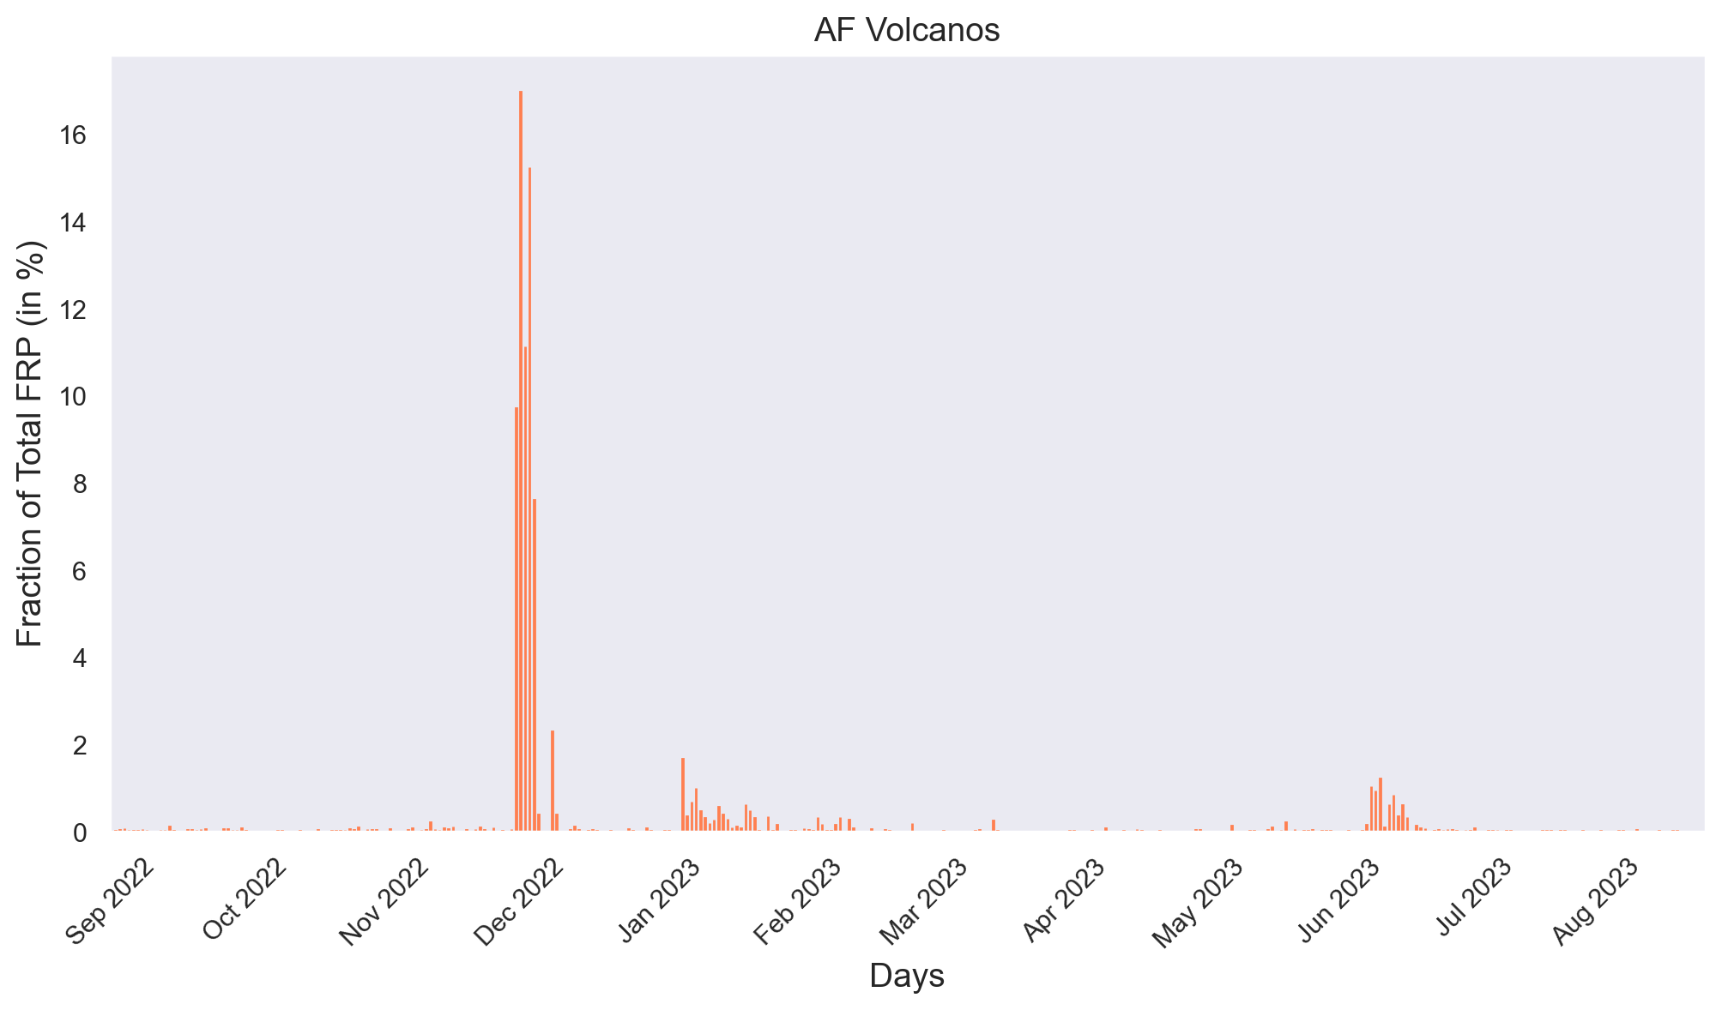
FRP signal from other persistent anomalies
Global total, oil/gas only
Global total, volcanos only
% of global total, oil/gas only
% of global total, volcanos only

Slide 6
Baseline vs. NGFS intercomparison: datasets analyzed
Baseline I-band (375m) VIIRS Active Fire product
operational NDE production system and pre-operational processing
Heritage algorithm
hybrid thresholding/contextual;
explicit internal cloud mask, top-of-atmosphere fire radiative power (FRP)
Sample datasets from the NOAA’s Next Generation Fire System (NGFS)
Algorithm base is VOLCAT modified for fire detection and characterization
No cloud screening upfront, explicit atmospheric correction for all-sky conditions
VIIRS I-band, Suomi NPP and NOAA-20
8-19 November, 2018 over Camp Fire
August 1-31, 2019 for granules that intersect with the [30N -50N] and [125W - 101W] domain
during the FIREX-AQ campaign
MODIS/ASTER Airborne Simulator (MASTER) from the FIREX-AQ (Fire Influence on Regional to Global Environments and Air Quality) campaign in 2019
FRP retrievals at ~20m resolution of observed fires in 2019
A total of 275 scenes between 7/22 – 9/3 2019
Here focus on MASTER scenes over the Western CONUS

Slide 7
Predominantly clear observations
Notes:
42 Granules Total; 23 SNPP, 19 NOAA-20
Mean percent difference: 41.2% (40.5% for SNPP, 42.0% for NOAA-20)
Sum of FRP Total for all granules: 92.3 GW for NGFS, 57.3 GW for Active Fire

Slide 8
Predominantly clear observations
Notes:
22 Granules Total; 11 SNPP, 11 NOAA-20
Mean percent difference: 50.9% (51.1% for SNPP, 50.7% for NOAA-20)
Sum of FRP Total for all granules: 73.3 GW for NGFS, 42.9 GW for Active Fire

Slide 9
Predominantly clear observations
Notes:
20 Granules Total; 12 SNPP, 8 NOAA-20
Mean percent difference: 30.6% (30.9% for SNPP, 30.1% for NOAA-20)
Sum of FRP Total for all granules: 19.0 GW for NGFS, 14.4 GW for Active Fire

Slide 10
WILLIAMS FLATS FIRE CASE VIIRS I-BAND SUMMARY STATS 2-9 AUGUST 2019
 | Mean Percent Difference FRP Total (SNPP/NOAA-20) | NGFS Sum of FRP Total for all Granules (SNPP/NOAA-20) | ACTIVE FIRE Sum of FRP Total for all Granules (SNPP/NOAA-20) | Percent Difference Sum of FRP Total for all Granules (SNPP/NOAA-20) | Total Number of Granules (SNPP/NOAA-20)
DAY+NIGHT | 41.2% (40.5% / 42.0%) | 92.3 GW (48.3 GW / 44.0 GW) | 57.3 GW (29.1 GW / 28.2 GW) | 46.8% (49.7% / 43.8%) | 42 (23/19)
DAY ONLY | 50.9% (51.1% / 50.7%) | 73.3 GW (36.2 GW / 37.1 GW) | 42.9 GW (19.9 GW / 23.0 GW) | 52.2% (57.9% / 46.9%) | 22 (11/11)
NIGHT ONLY | 30.6% (30.9% / 30.1%) | 19.0 GW (12.0 GW / 7.0 GW) | 14.4 GW (9.1 GW / 5.3 GW) | 28.1% (27.9% / 28.4%) | 20 (12/8)

Slide 11
Predominantly clear observations

Slide 15
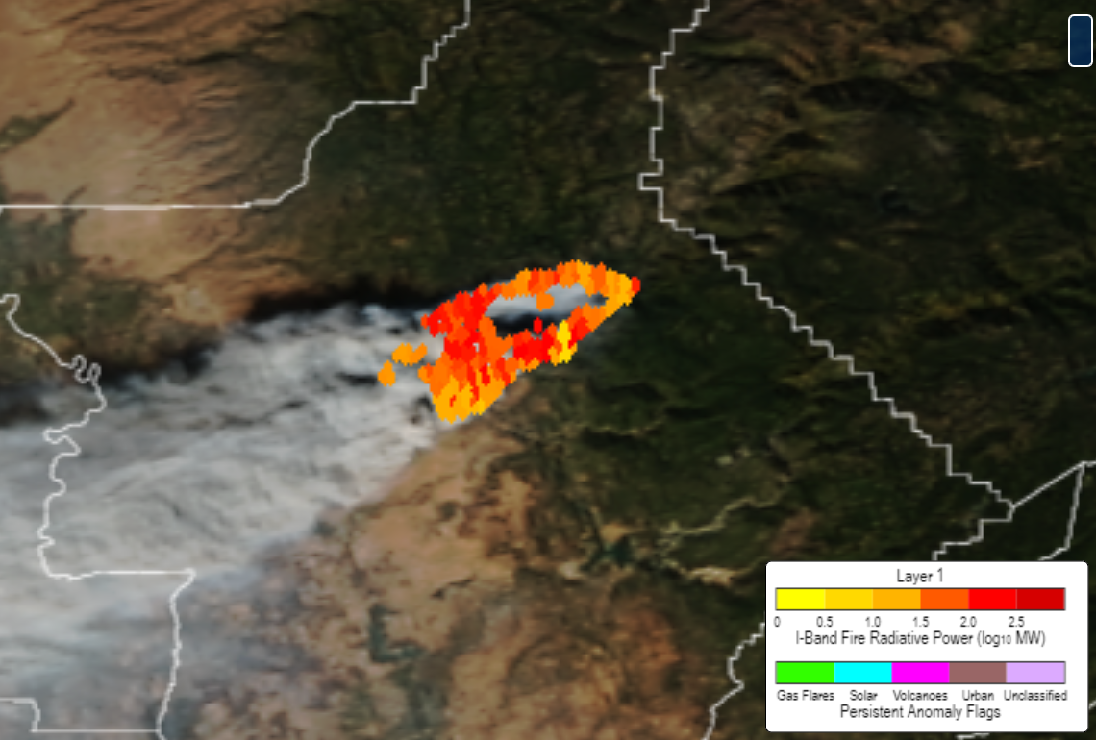
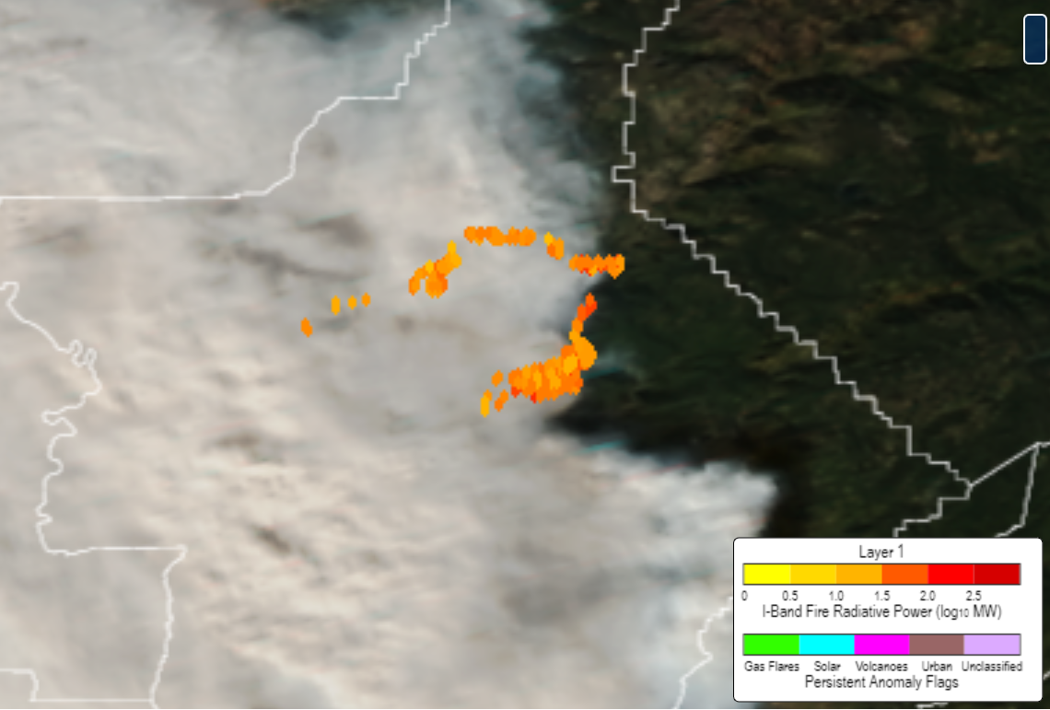
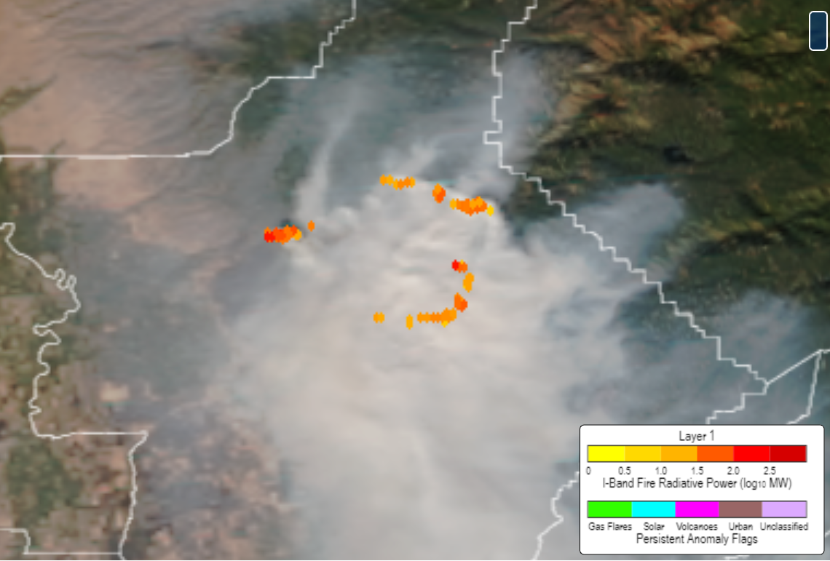
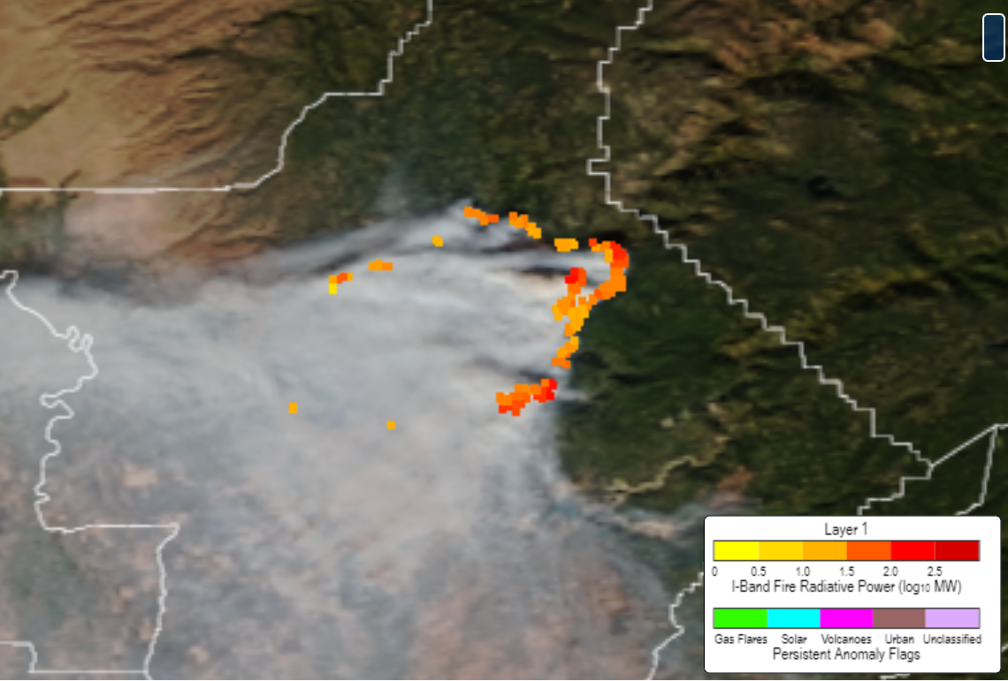
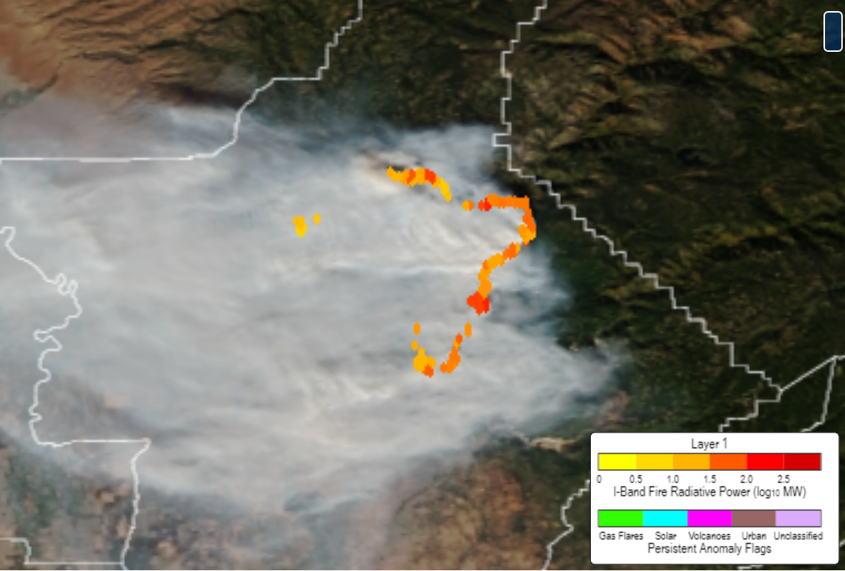
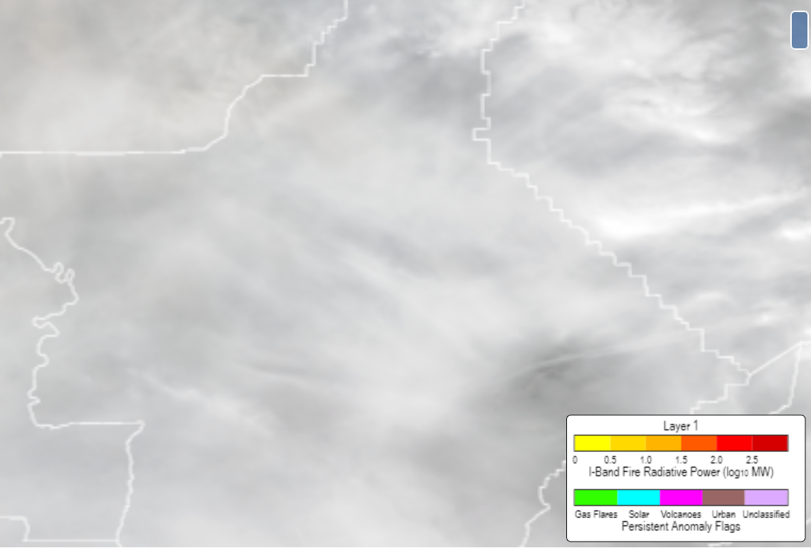
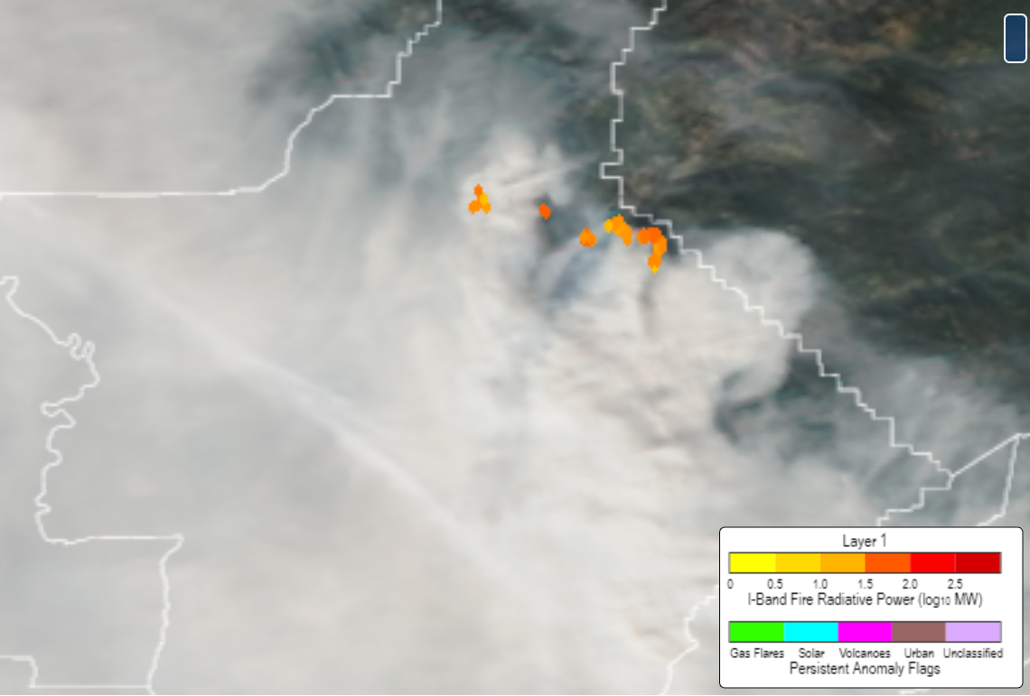
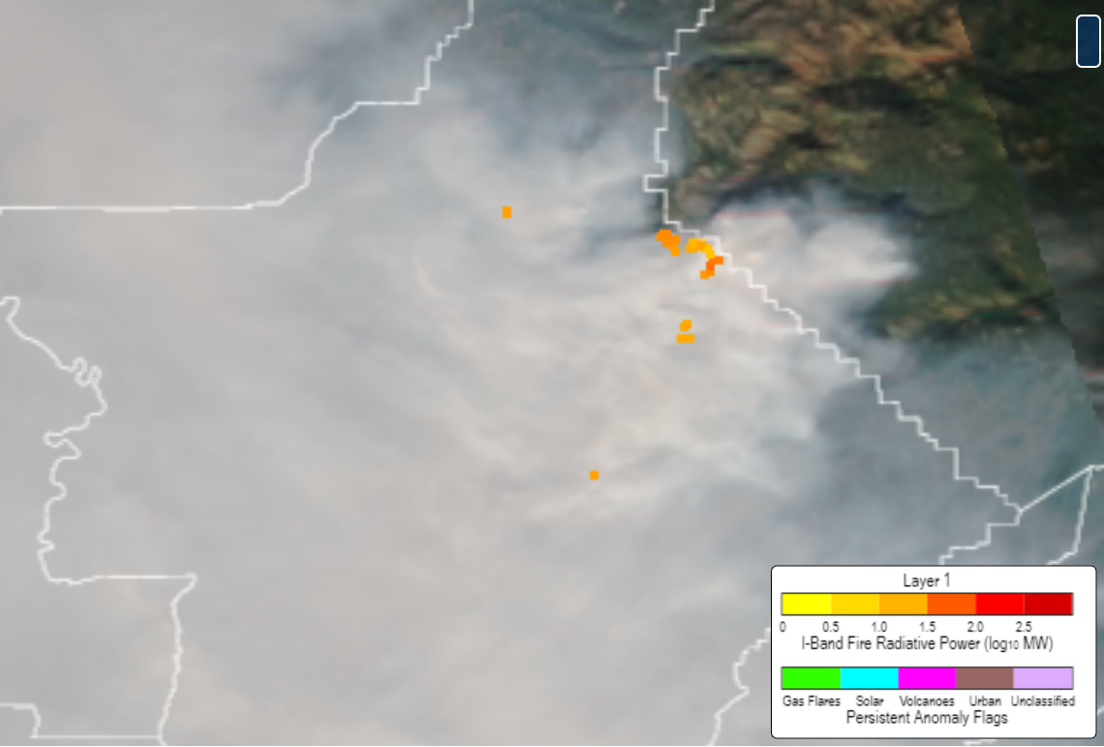
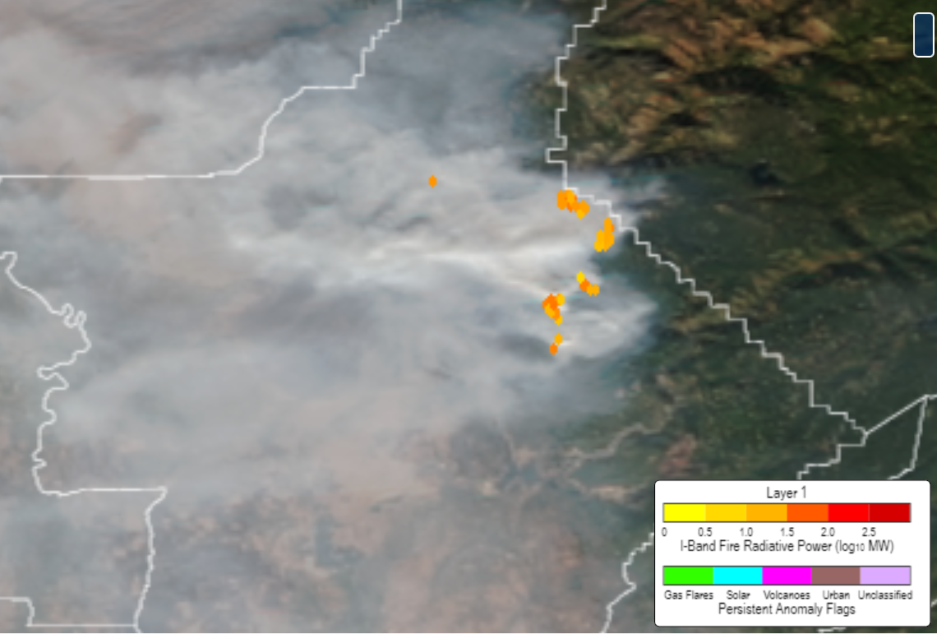
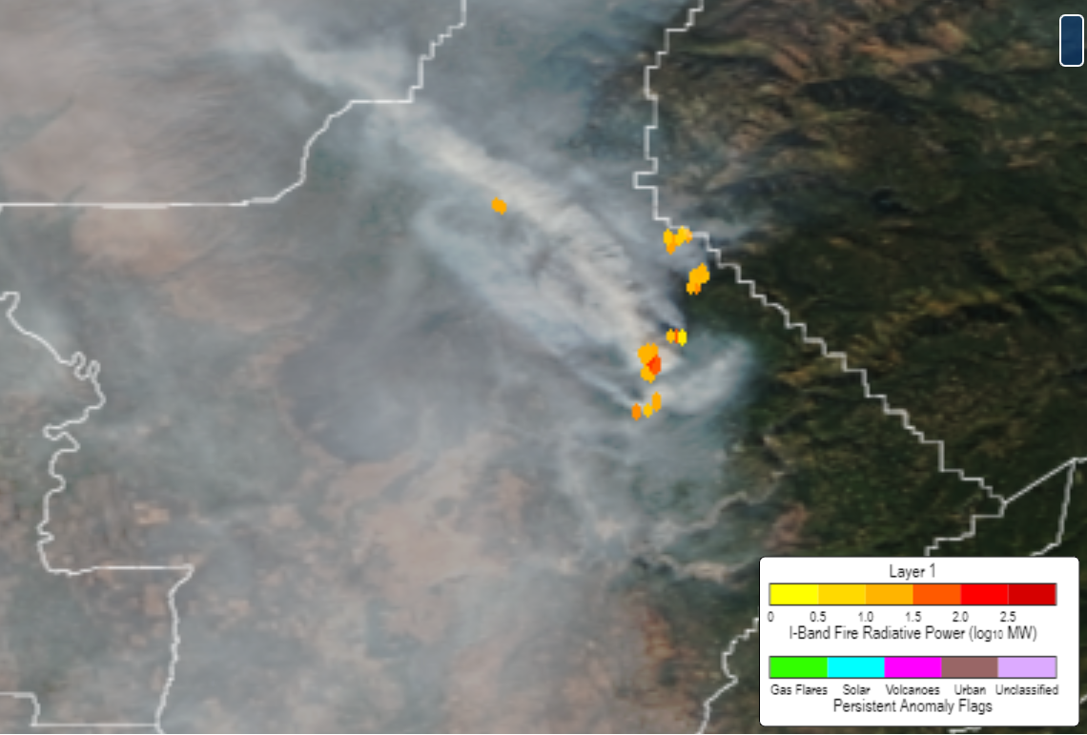
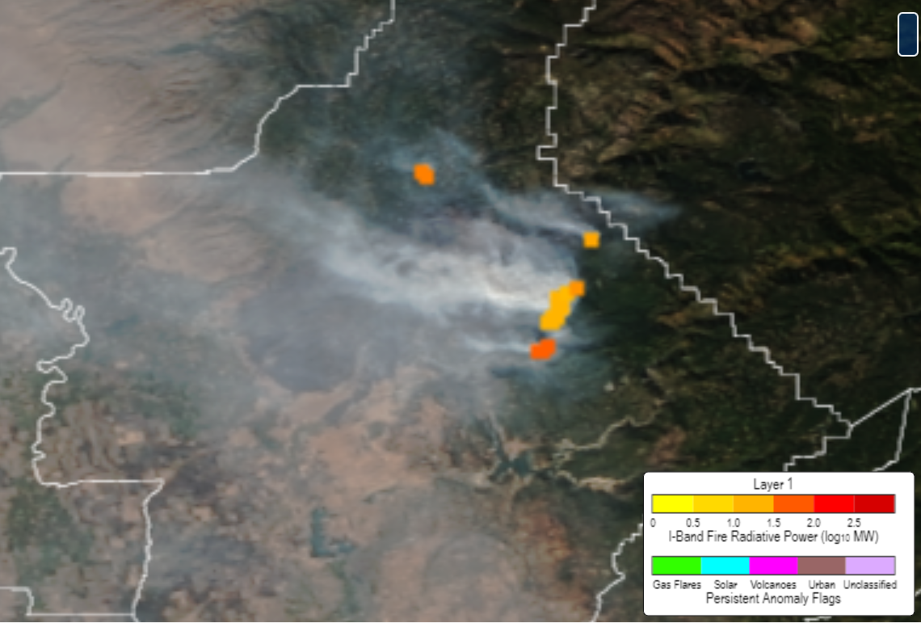
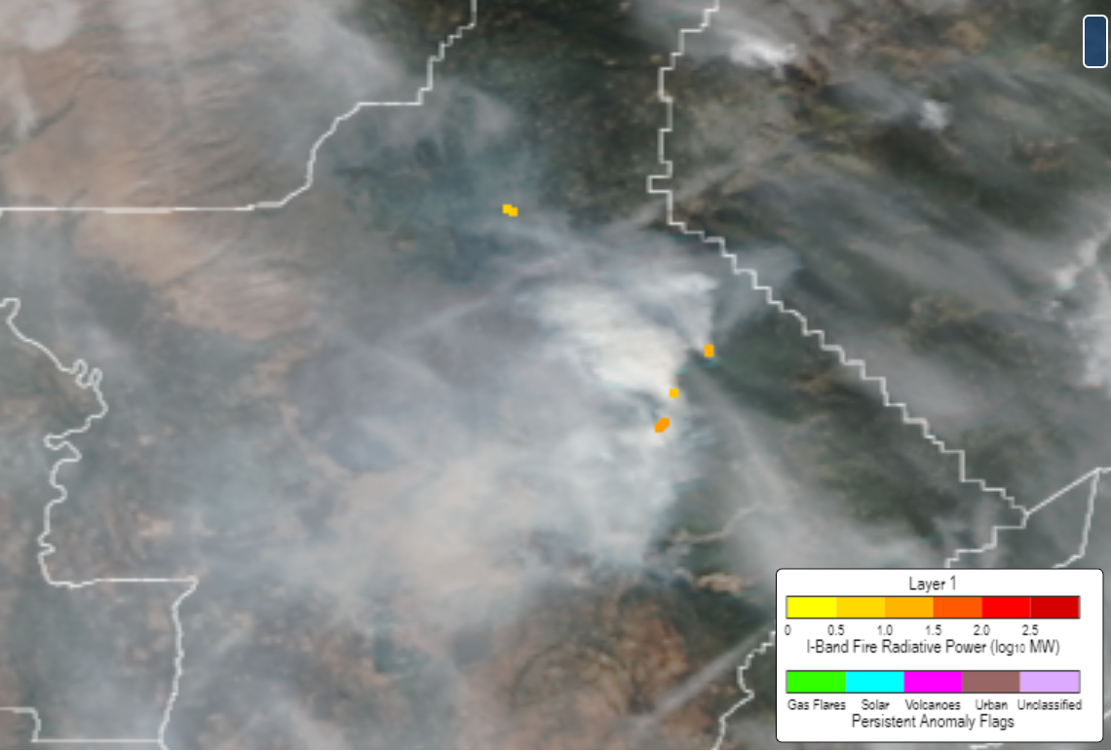
CAMP FIRE CASE VIIRS NOAA-20 I-BAND ACTIVE FIRE DAYTIME
9 NOV 2018
10 NOV 2018
11 NOV 2018
12 NOV 2018
13 NOV 2018
14 NOV 2018
15 NOV 2018
16 NOV 2018
17 NOV 2018
18 NOV 2018
19 NOV 2018
See also: Chow, F. K., and Coauthors, 2022: High-Resolution Smoke Forecasting for the 2018 Camp Fire in California. Bull. Amer. Meteor. Soc., 103, E1531–E1552, https://doi.org/10.1175/BAMS-D-20-0329.1.
https://www.star.nesdis.noaa.gov/jpss/mapper/

Slide 16
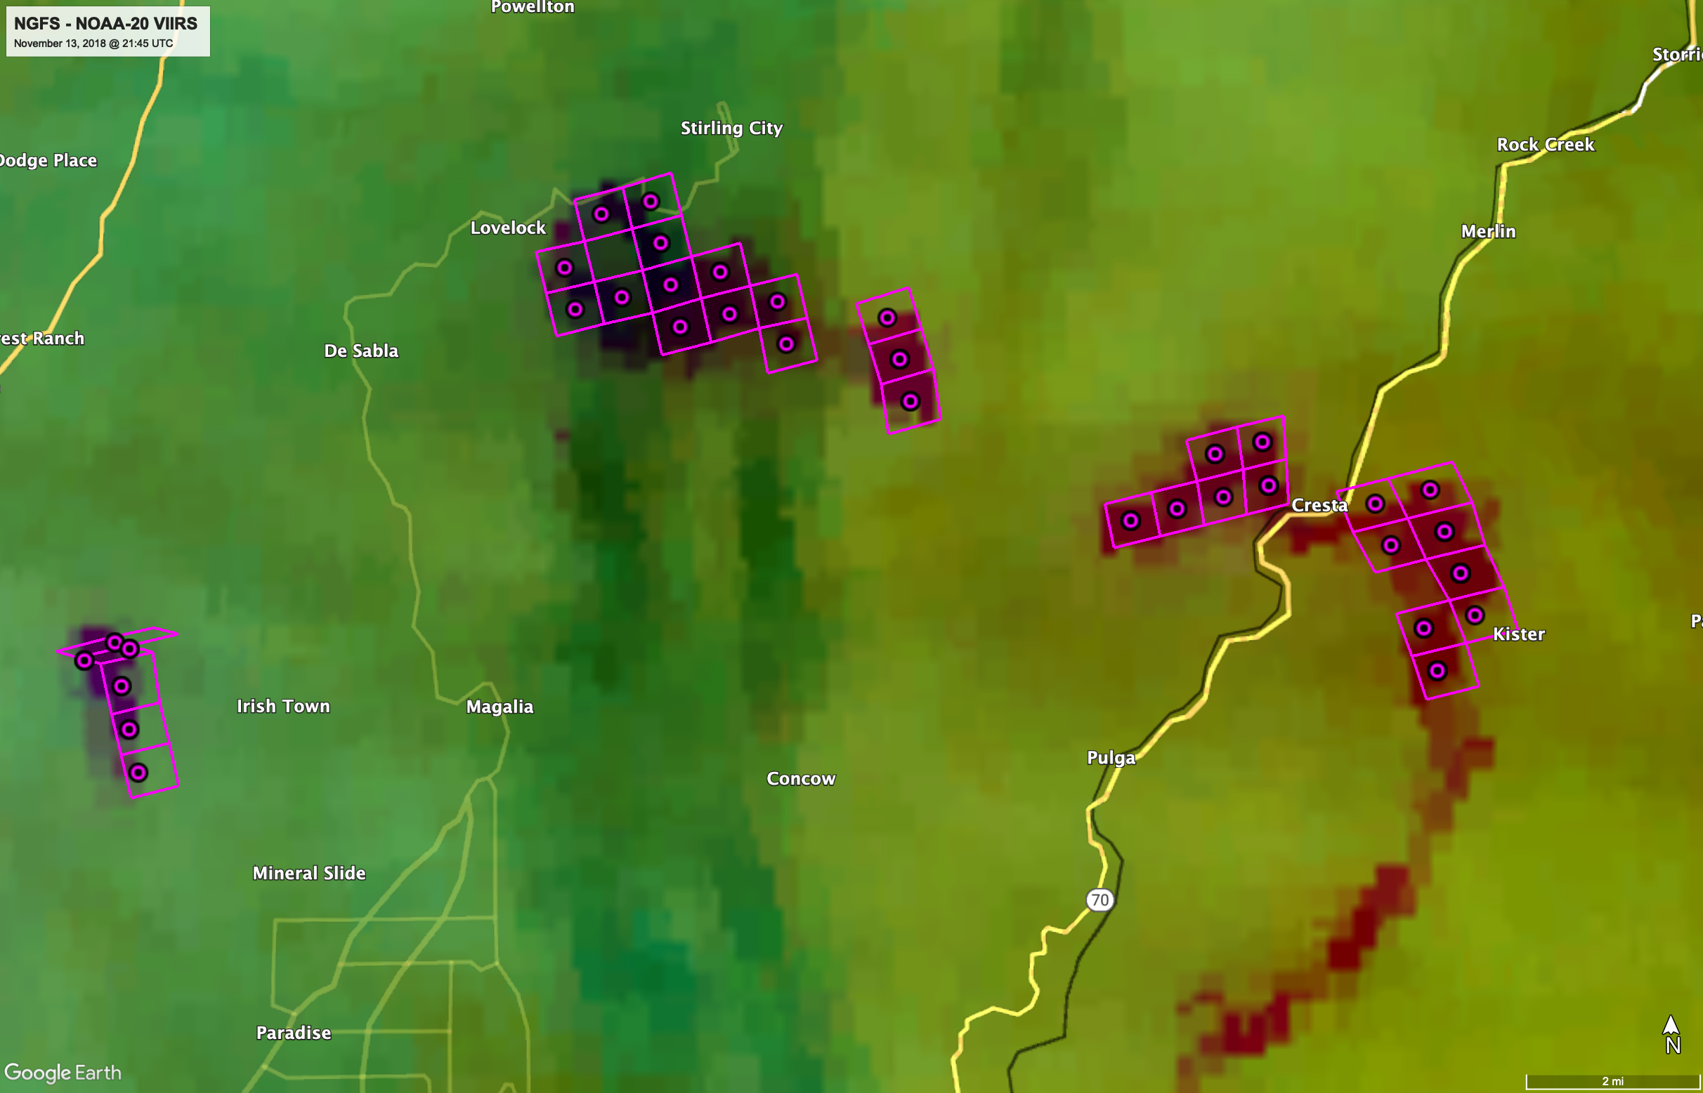
NGFS Fire Detection with Dense Cloud Cover

Slide 17
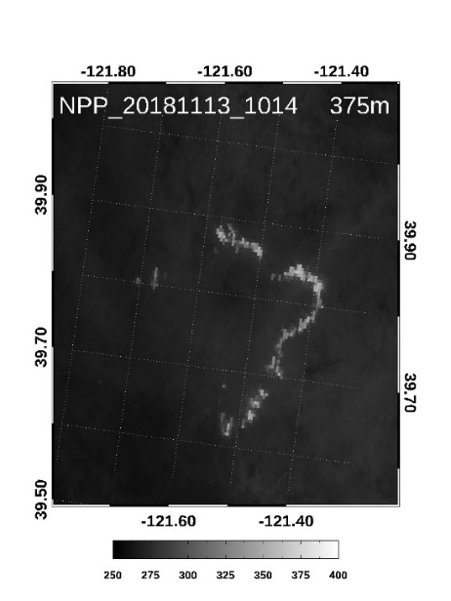
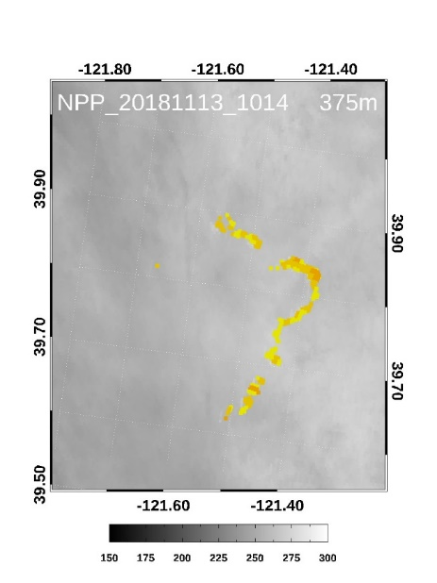
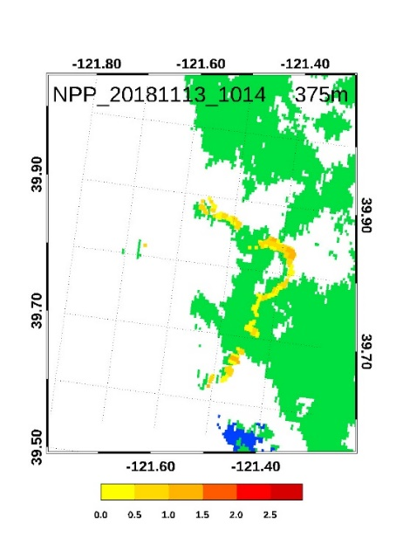
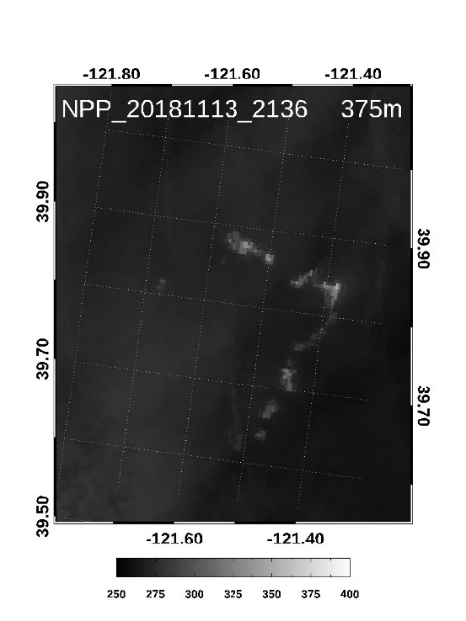
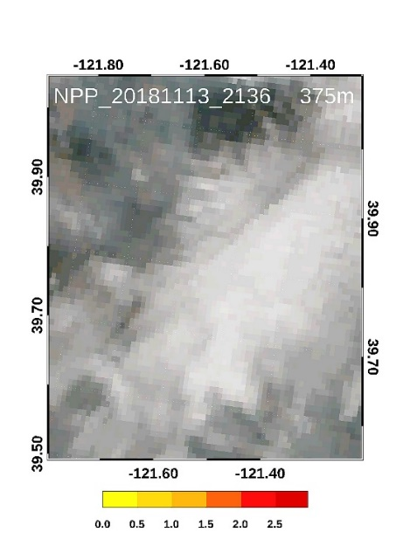
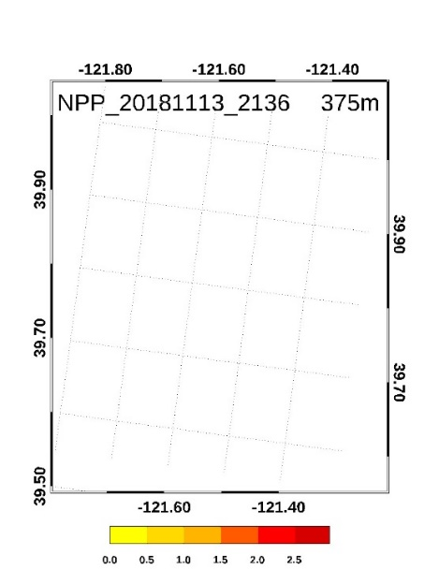
Detection and characterization under clouds and smoke
VIIRS I4 TB
FRP over background image
VIIRS I-band fire mask
cloud
nighttime
land
water
K
K
log₁₀MW
improved
initial screening
daytime
cloud
relaxed internal cloud mask
K
log₁₀MW
log₁₀MW

Slide 18
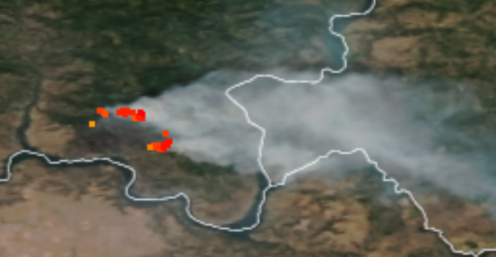
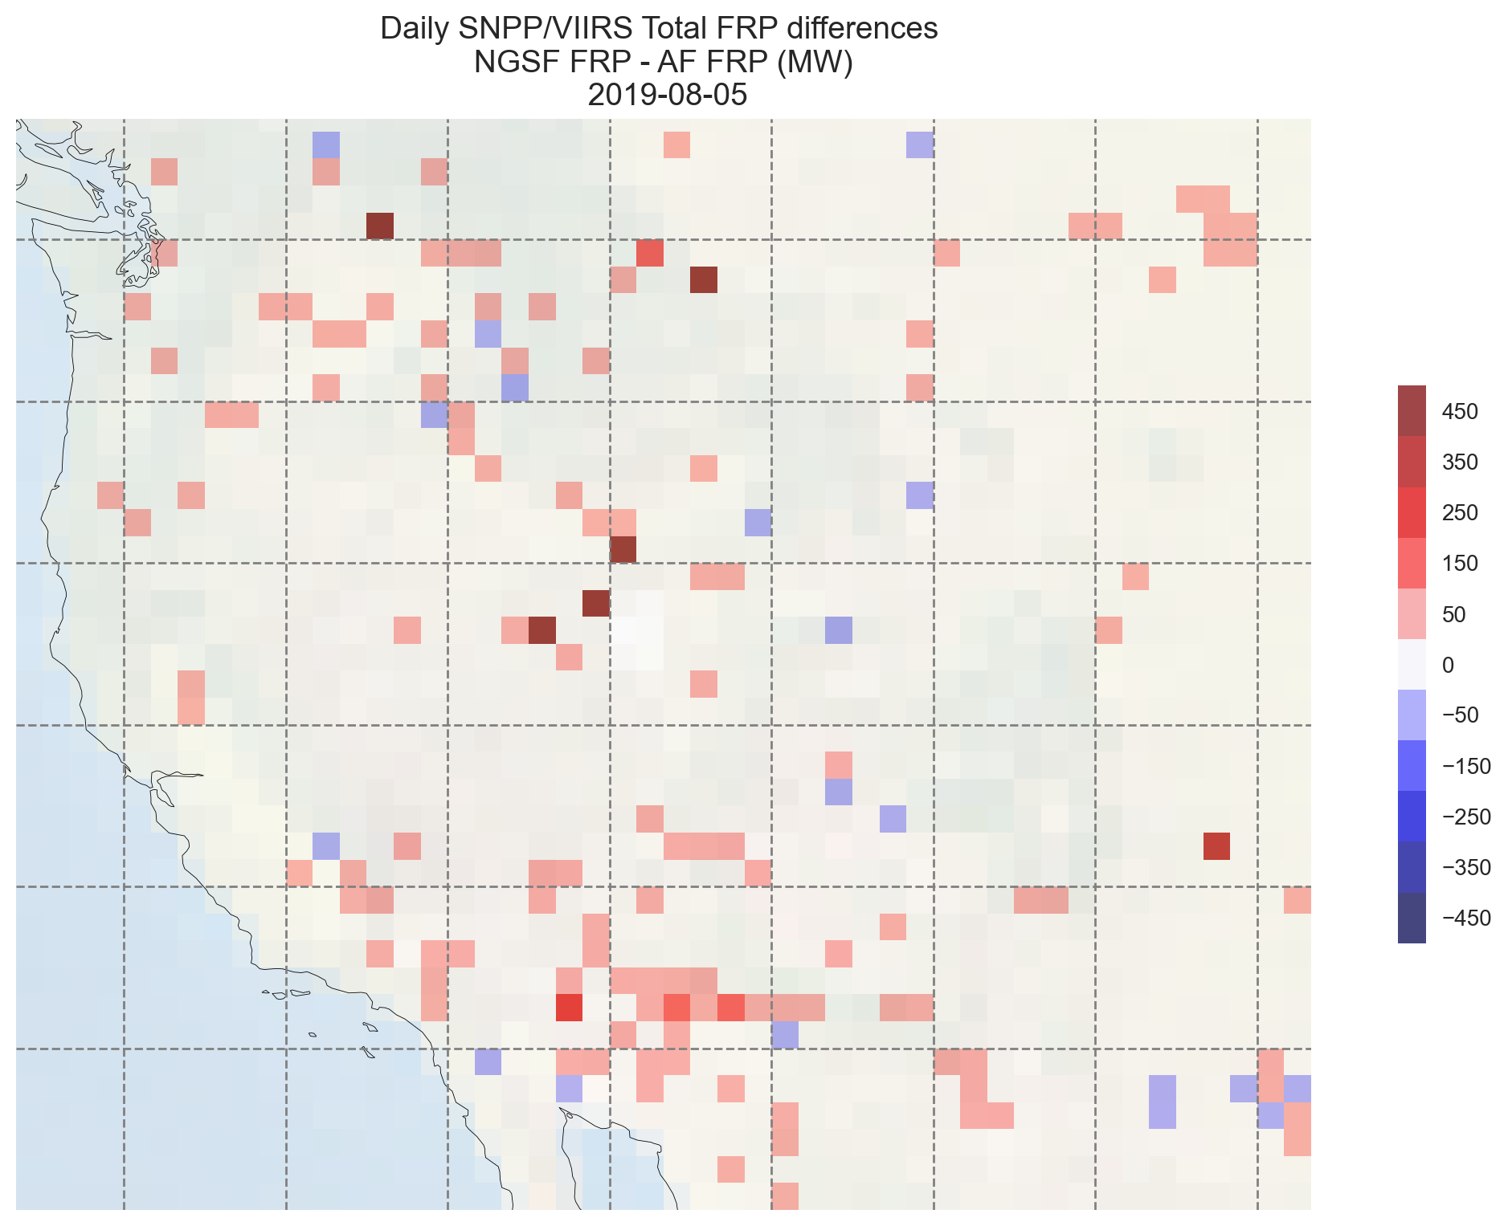
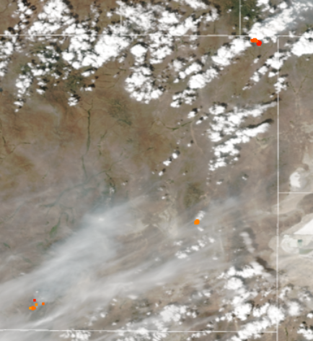
Gridded FRP (daytime only) NGFS - Baseline
https://www.star.nesdis.noaa.gov/jpss/mapper/

Slide 19
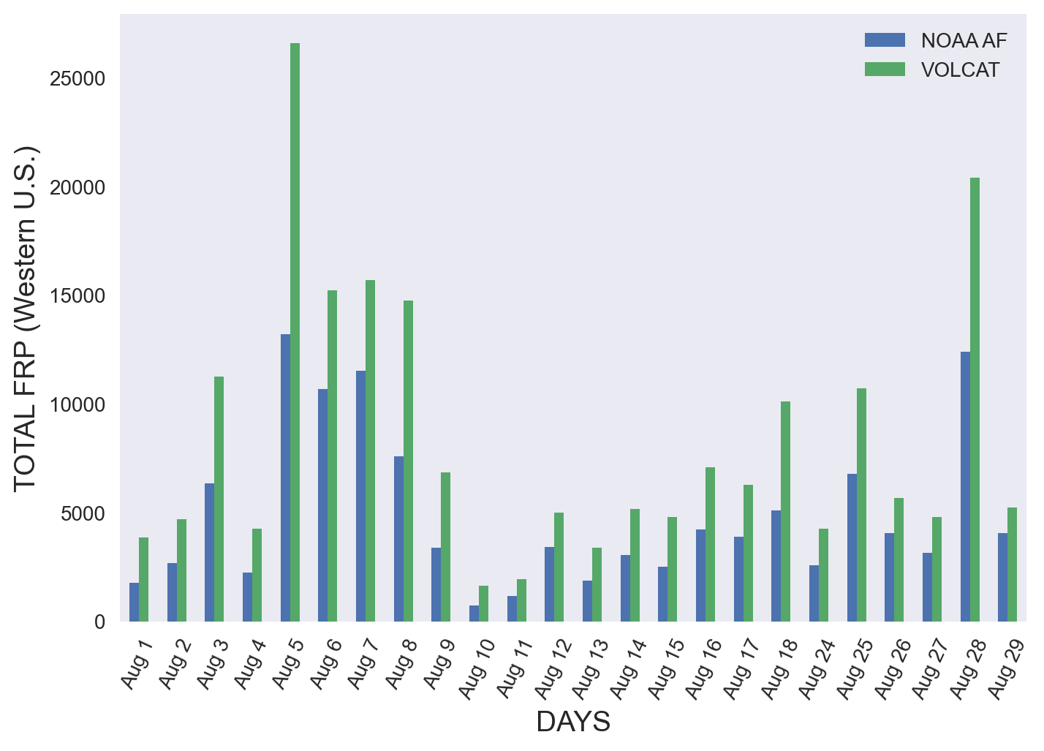
Time series of daytime total FRP from NGFS vs. baseline
Note: August 19,20,21,22,23 and 30 are not included due to incomplete coverage

Slide 20
Summary and path forward
Further improvement of VIIRS fire radiative power is necessary and possible to ensure accurate and complete input to emission models
Persistent anomalies: may have noticeable contribution to FRP signal on select days globally (if unflagged / undetected)
Impact larger over select regions and time periods
e.g. solar farms in SW CONUS in November may produce FRP output similar to large fires
Testing of improved detection and FRP retrieval from NOAA’s Next Generation Fire System (NGFS) is underway
For clear atmosphere, spatial and temporal patterns from baseline and NGFS are consistent
Most impact in expected for complex scenes with cloud and smoke cover
For the select time period and area analyzed, the combined FRP increase from coverage and atmospheric correction in NGFS is ~30-50% and above depending on atmospheric conditions
differences vary spatially and temporally
Work continues towards full evaluation

Slide 21
Fire environment forecasting
Timely hotspot alerts
Climate monitoring
Applications Supported by NGFS
Incident awareness and assessment
Smoke analysis and forecasting
Event-based data queries

Slide 22
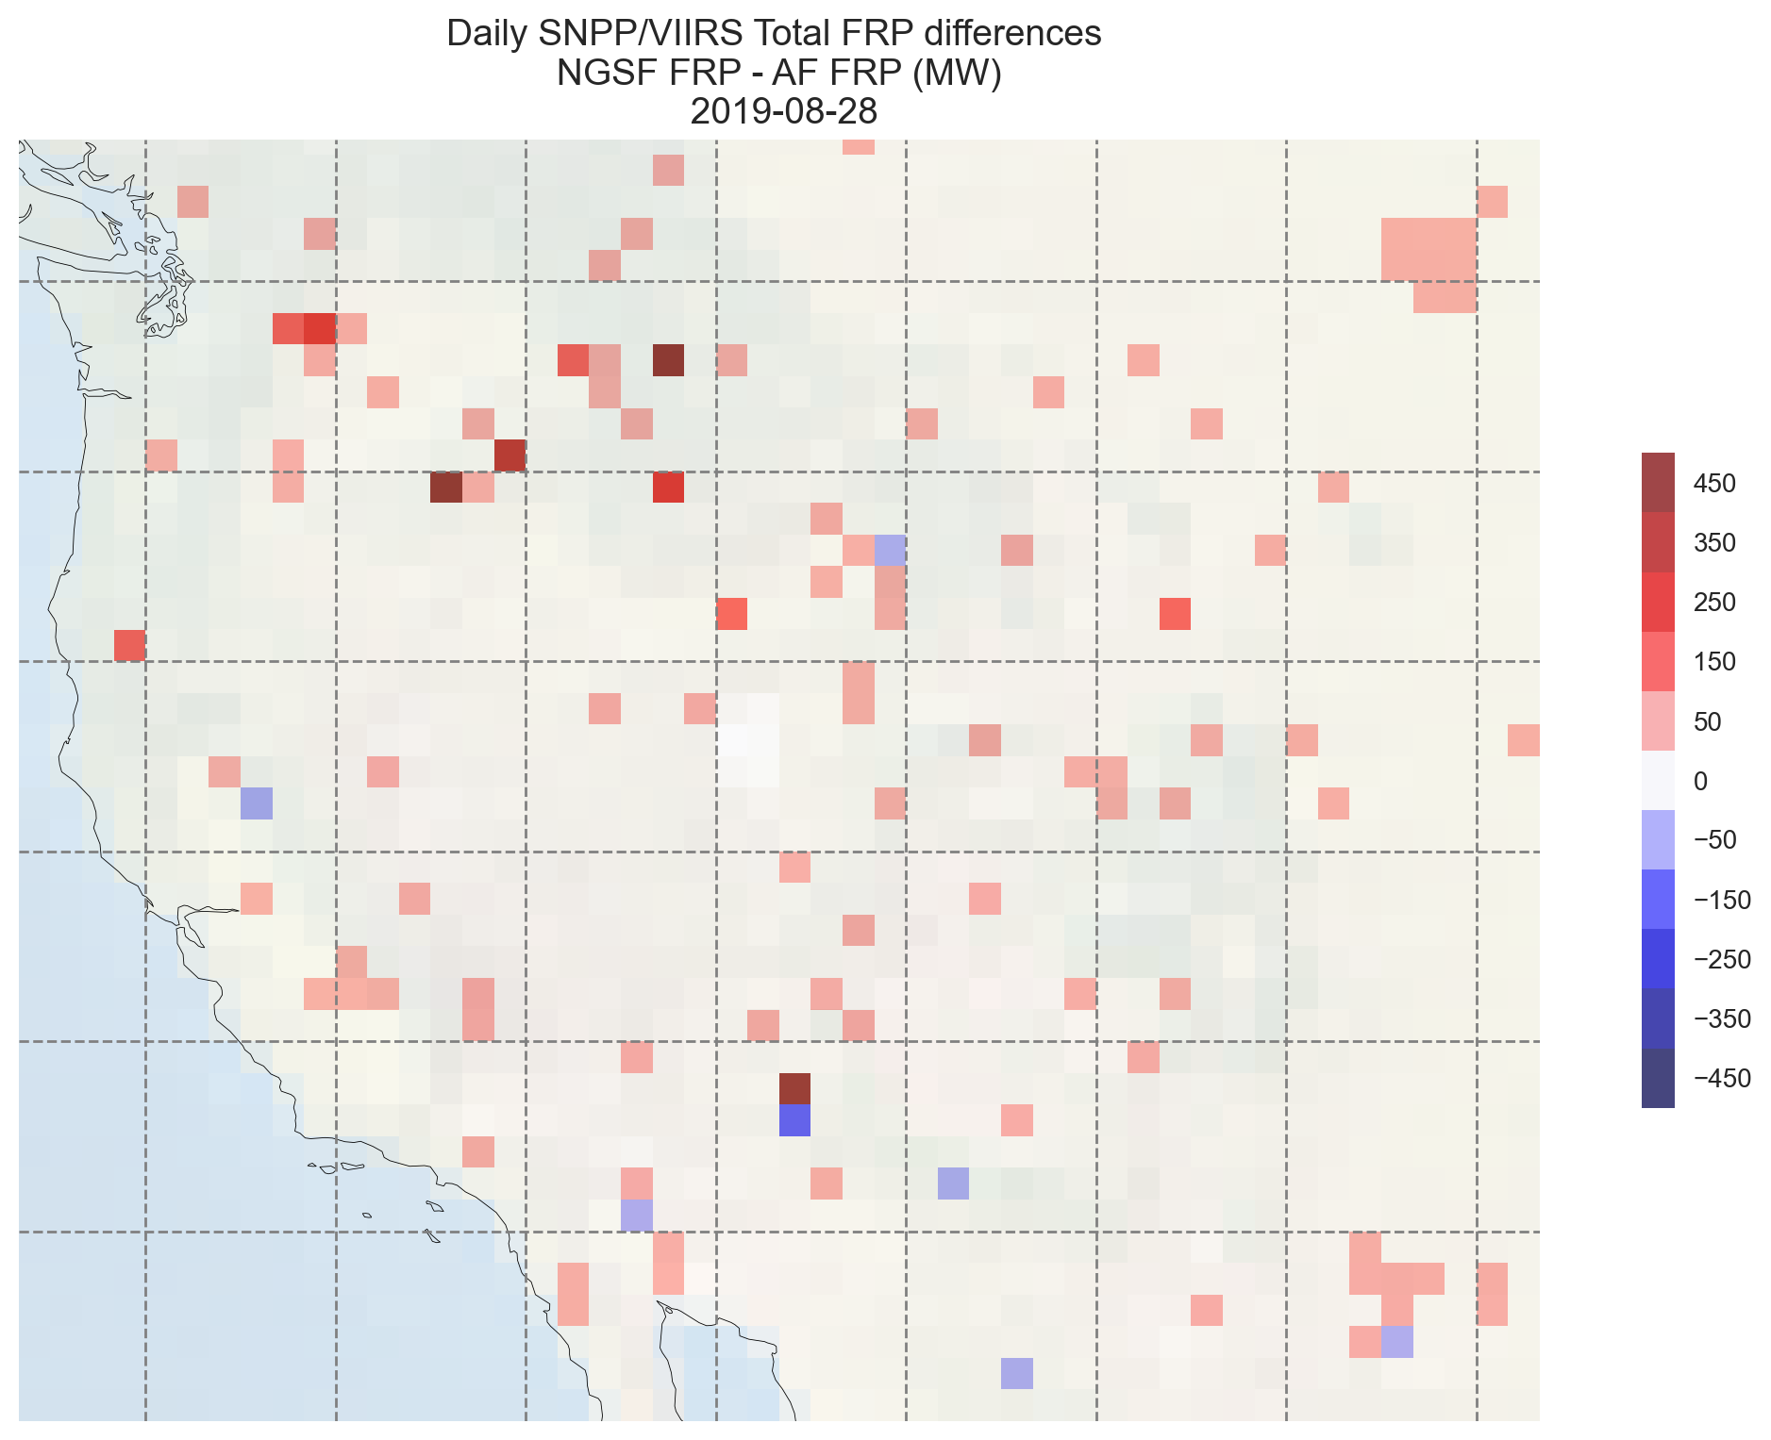
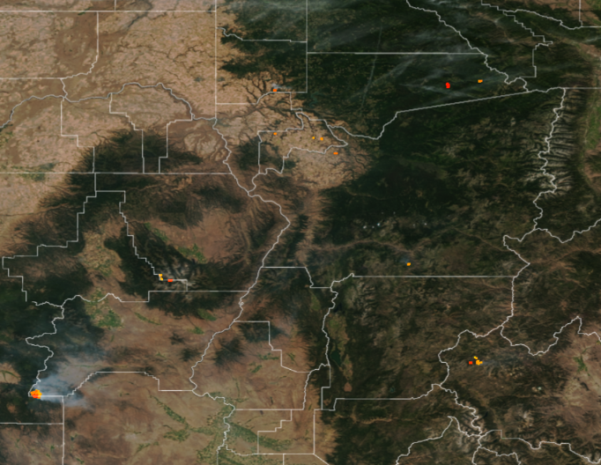
Gridded FRP (daytime only) NGFS - Baseline
https://www.star.nesdis.noaa.gov/jpss/mapper/

Slide 23
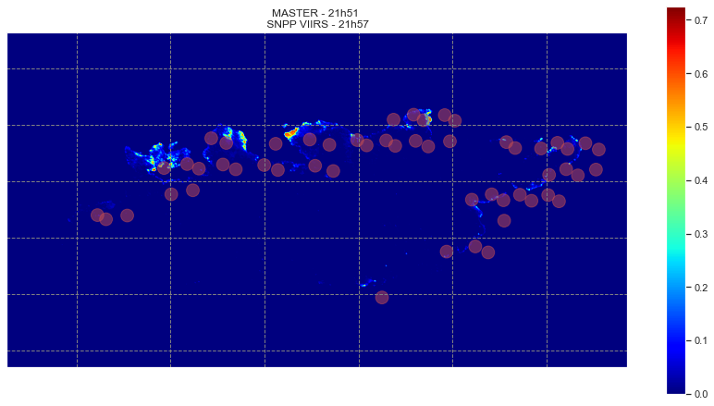
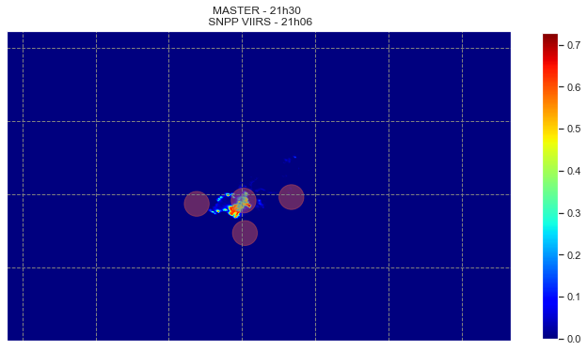
MASTER vs. VIIRS I-band detections and Fire Radiative Power
MASTERFRP_1981718_05_20190803_2151_2159_V01.nc
AF_v2r0_j01_s201908032157305_e201908032158532_c201908032248200.nc
MASTERFRP_1981718_03_20190803_2130_2134_V01.nc
AF_v2r0_npp_s201908032106179_e201908032107421_c201908032214020.nc
MW
MASTER FRP: 2191.2MW; VIIRS FRP: 2183.8MW
MASTER FRP: 188.9MW; VIIRS FRP: 198.3MW
: Suomi NPP VIIRS I-band detections

Slide 24
MASTER VS VIIRS I-BAND ACTIVE FIRE AND NGFS FRP TOTAL SUMMARY STATS 3 AND 6 AUGUST 2019 NORTHWEST USA FIRE CASES
 | Mean Percent Difference FRP Total | Range of Percent Difference FRP Total
MASTER VS VIIRS I-BAND ACTIVE FIRE | 31.7 % | -25.8 % to 66.3 %
MASTER VS VIIRS I-BAND NGFS | 38.0 % | -86.1 % to 26.3 %

Slide 25
CAMP FIRE CASE VIIRS I-BAND SUMMARY STATS 8-19 NOVEMBER 2018
 | Mean Percent Difference FRP Total (SNPP/NOAA-20) | NGFS Sum of FRP Total for all Granules (SNPP/NOAA-20) | ACTIVE FIRE Sum of FRP Total for all Granules (SNPP/NOAA-20) | Percent Difference Sum of FRP Total for all Granules (SNPP/NOAA-20) | Total Number of Granules (SNPP/NOAA-20)
DAY+NIGHT | 50.9% (43.6% / 57.7%) | 309.3 GW (155.5 GW / 153.8 GW) | 218.6 GW (101.2 GW / 117.4 GW) | 34.4% (42.3% / 26.9%) | 64 (31/33)
DAY ONLY | 51.0% (46.5% / 55.3%) | 183.3 GW (94.9 GW / 88.4 GW) | 134.3 GW (60.5 GW / 73.8 GW) | 30.9% (44.3% / 18.0%) | 33 (16/17)
NIGHT ONLY | 50.8% (40.6% / 60.4%) | 126.0 GW (60.6 GW / 65.4 GW) | 84.3 GW (40.7 GW / 43.6 GW) | 39.6% (39.1% / 40.1%) | 31 (15/16)

