Slide 1
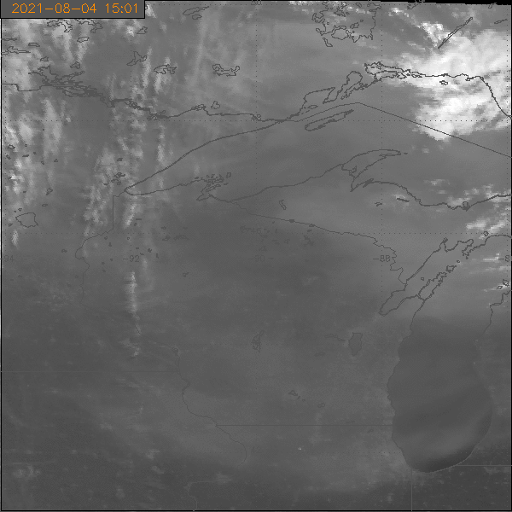
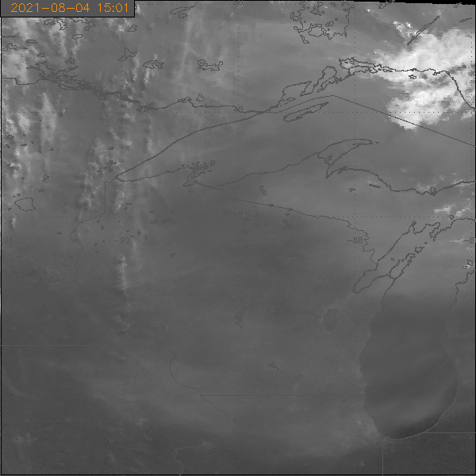
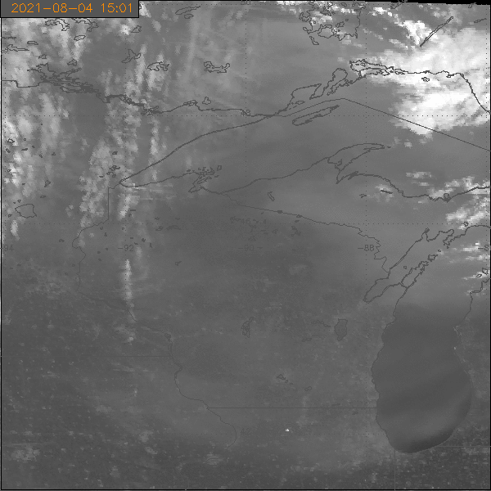
Seeing Smoke Better in Cloudy Regions using ABI 500m Ch2 Data.
Mean 500m Ch2 in 2km Pixels
Darkest 500m Ch2 in 2km Pixels
Brightest 500m Ch2 in 2km Pixels
This is basically a simple low-pass filter using the 500 m ch2 data that leads to better imagery to track smoke in cloudy region. This is August 4, 2021 15 to 19 UTC. Taking the minimum (darkest) ch2 reflectance in each 2 km ABI pixel enhances smoke and removes cloud. The opposite is true when the maximum (brightest) ch2 reflectance is used from each 2km pixel. ABI cloud mask uses 2km pixels and often obscures smoke within broken cloudy scenes.

Slide 2
This is visible imagery with 2-km resolution
Each 2-km value is the mean of the 16 ½-km pixel values
Mean 500m Ch2 in 2km Pixels

Slide 3
This is visible imagery with 2-km resolution
Each 2-km value is the minimum of the 16 ½-km pixel values (darkest)

Slide 4
This is visible imagery with 2-km resolution
Each 2-km value is the maximum of the 16 ½-km pixel values (brightest)

