Slide 1
NOAA/CIMSS ProbSevere version 2 (all hazards)
– Training Module –
Spring 2019
Notes:
This is a short training module for users of the NOAA/CIMSS ProbSevere Model.
ProbSevere version 2 generates probabilities for the 3 severe storm hazards--severe hail, severe straight-line winds, and tornadoes. This training module is designed for users that are already familiar with the legacy NOAA/CIMSS ProbSevere model and provides only information specific to version 2 of ProbSevere.
If you are not familiar with ProbSevere it is recommended you first complete the 2016 ProbSevere training module available at: http://cimss.ssec.wisc.edu/severe_conv/training/training.html

Slide 2
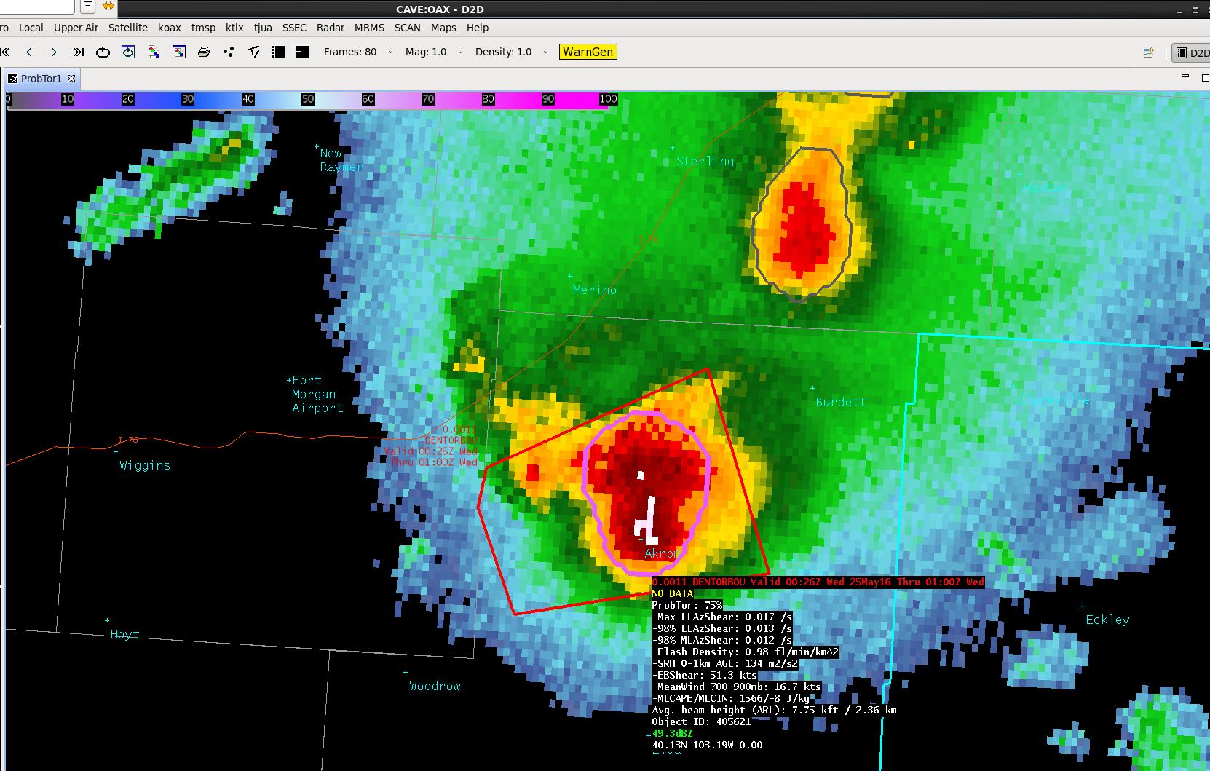
NOAA/CIMSS ProbSevere Model Goals
ProbSevere is a statistical model designed to increase forecaster confidence and/or increase lead-time in severe thunderstorm/tornado warning issuance.
This statistical model predicts the probability that a storm will produce a severe hail, severe wind or a tornado in the near-term (in the next 0-60 min).
ProbSevere can be used as a ‘pre-polygon’ product as well as an aid for warning reissuance.
Notes:
ProbSevere version 2 follows the same radar object-based naïve Bayesian statistical framework as ProbSevere version 1 and also follows the same display concepts. ProbSevere is the probability a storm will produce severe weather in the next 60 minutes. Users have an option of what to display—the maximum of the three hazard predictions—severe hail, severe wind, and tornado or any individual hazard prediction.
ProbSevere is a statistical model designed to increase forecaster confidence and/or increase lead-time in severe thunderstorm/tornado warning issuance.

Slide 3
ProbSevere v2
Probabilities are a function of the dynamic and thermodynamic environment and observations
ProbWind:
a priori: f(MeanWind 1-3 km AGL/ MLCAPE)
VIL Density
Flash Rate vs 3-6 km AzShear
MeanWind 1-3 km AGL vs. 0-2 km AzShear
Satellite Growth Rate
ProbHail:
a priori: 0.03
MESH vs. Wet Bulb 0°C Height
Flash Rate vs. EBS
CAPE in -10°C to -30°C layer vs Precipitable Water
Satellite Growth Rate
ProbTor:
a priori: 0.01
Max 0-2km AzShear
98th %ile 0-2km AzShear vs. 0-1km SRH
98th %ile 3-6km AzShear vs. max flash density
EBS vs. MeanWind 1-3 km AGL
MLCAPE; MLCIN
Notes:
For ProbSevere the most pertinent environmental and observational datasets are utilized for the targeted hazard.
For ProbHail:
a priori: climatology of severe hail producing thunderstorms from database
Maximum Expected Size of Hail (MESH) vs the height of the wet bulb 0C--inclusion of the wet bulb 0C paired with MESH better accounts for lack of melting in low-topped hail storms and increased melting in many southeastern US summertime storms.
Flash Rate (Earth Networks Total Lightning) vs Effective Bulk Shear—measure of updraft strength and potential storm organization
CAPE in -10°C to -30°C layer vs Precipitable Water—Combination of larger CAPE in hail growth zone and lower precipitable water is more favorable for severe hail
Satellite growth rate—Measure of initial updraft intensity
For ProbWind:
a priori: Mean wind (1-3 km AGL)/MLCAPE—measure of environmental momentum to potentially transfer to the surface and potential updraft intensity for mixed-layer parcels (mixed-layer parcels are better for wind, while most unstable parcels are better for hail).
VIL Density—Measure of precipitation core intensity
Flash Rate vs 3-6 km AzShear—measure of updraft intensity and proxy for strength of mid-level storm winds
Mean wind (1-3 km AGL) vs 0-2 km AzShear—measure of environmental momentum to potentially transfer to the surface and proxy for strength of low-level storm winds
Satellite growth rate—Measure of initial updraft intensity
For ProbTor:
a priori: climatology of tornado producing severe thunderstorms in training database
Maximum 0-2km AzShear: Maximum depiction of updraft rotation in lower troposphere
98th percentile 0-2km AzShear vs 0-1 km Storm Relative Helicity: Lower tropospheric updraft rotation intensity vs near surface storm relative helicity
98th percentile 3-6km AzShear vs maximum total lightning flash density: Middle tropospheric updraft rotation vs measure of updraft intensity
Effective Bulk Shear vs Mean Wind 1-3 km above ground level: Storm organization vs momentum present in lower troposphere
MLCAPE and MLCIN: Penalty functions only—too little mixed layer instability or too great mixed layer inhibition reduces likelihood of tornado

Slide 4
AWIPS-II Display

Slide 5
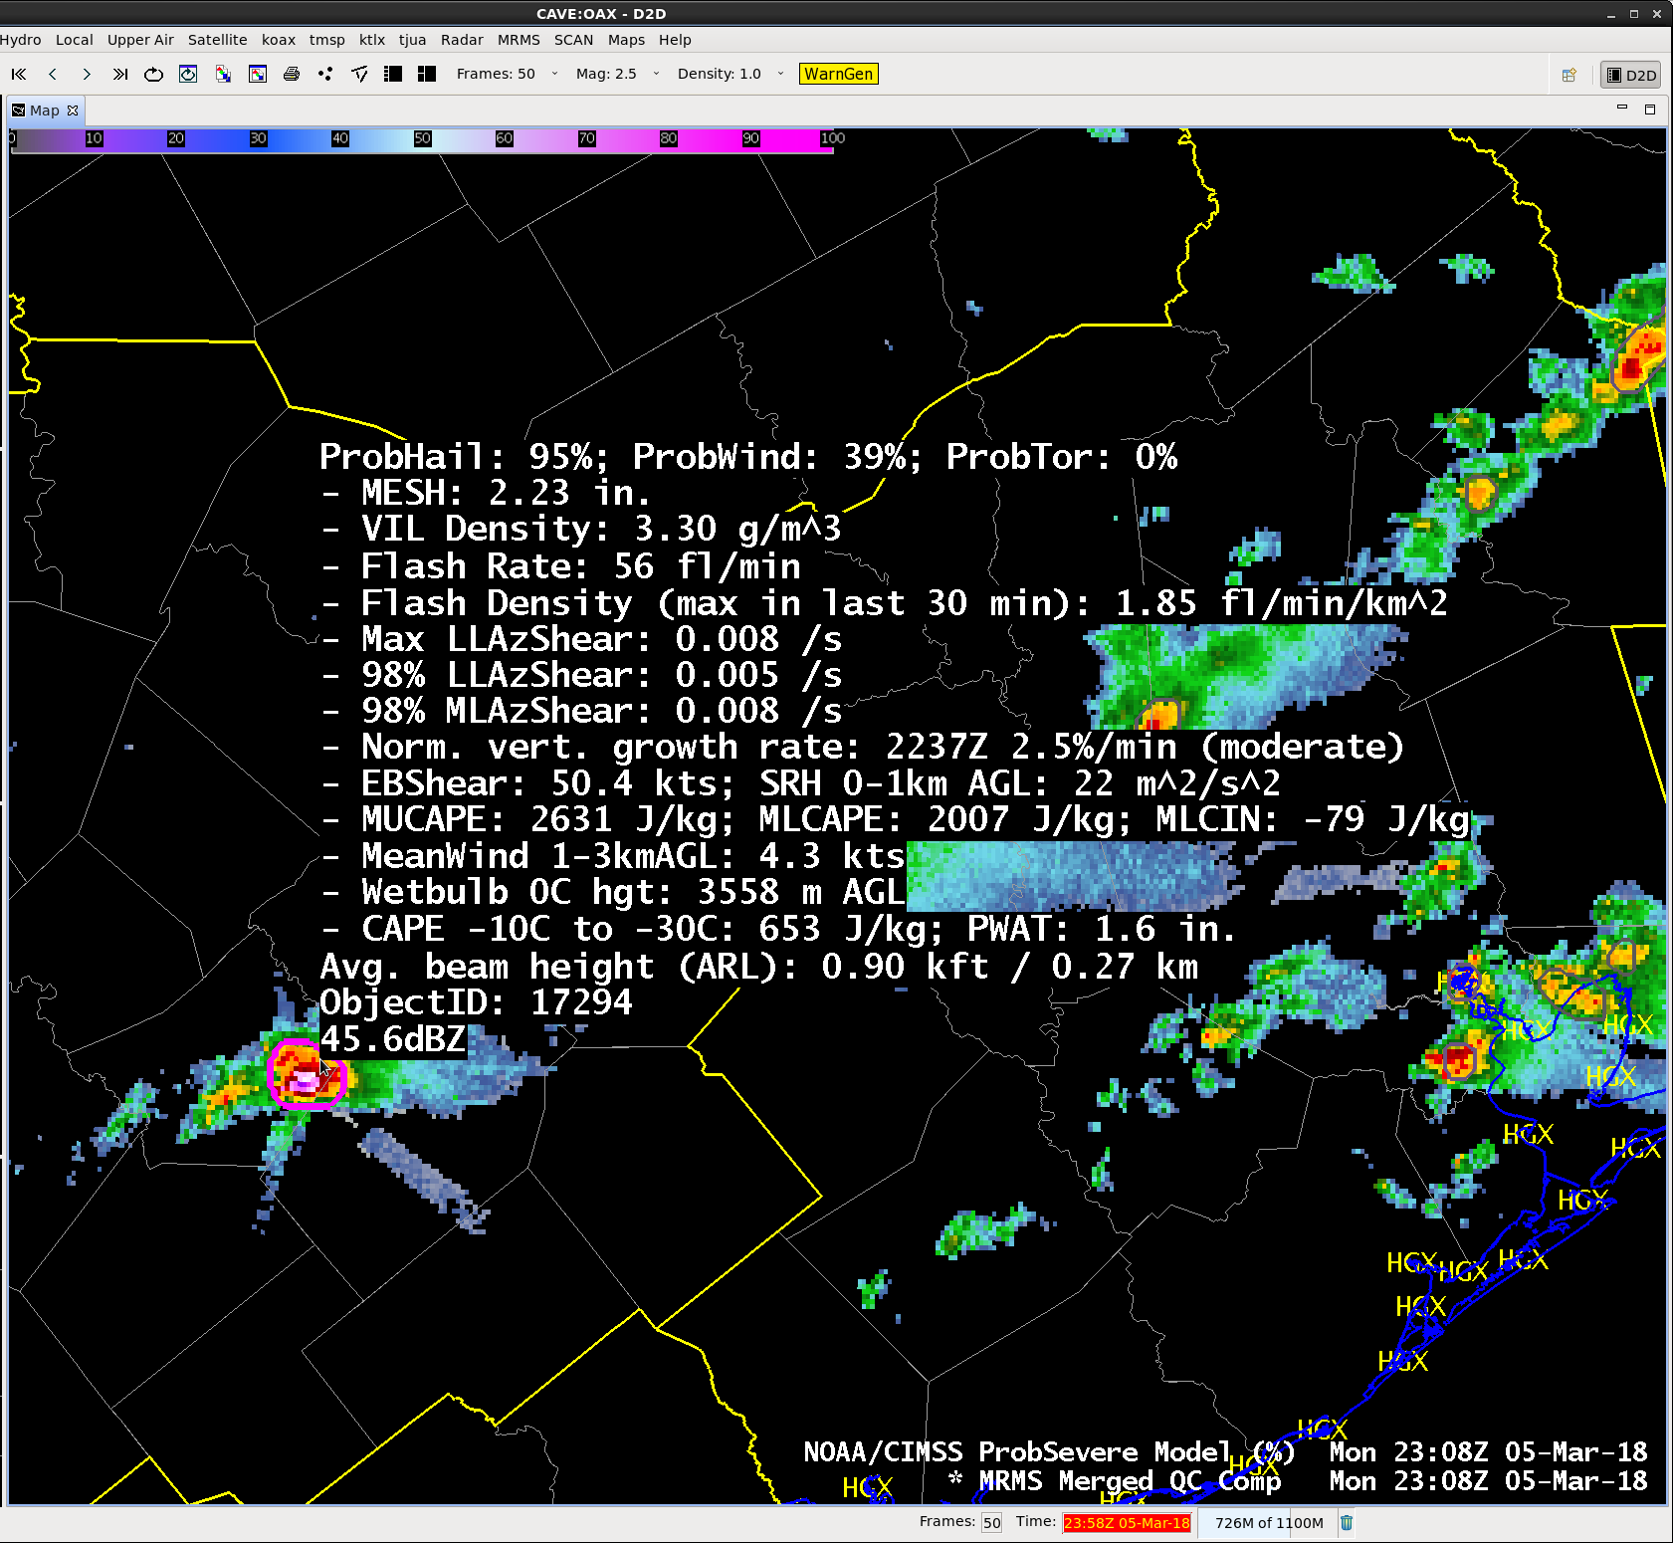
ProbSevere v2 AWIPS-II Display
Model output are shapefiles contoured around radar storm cells.
Enhancement designed for overlay atop radar reflectivity—but can be overlaid on any field (satellite, radar velocity, etc.).
Sampling offers readout of model probability as well as each model predictor.
Notes:
This shows the ProbSevere version 2 visualization. A contour around an identified radar object is color-coded based on the ProbSevere (or individual hazard) value.
Users have options to load the all in one ProbSevere product (displayed here, where the maximum of ProbHail, ProbWind and ProbTor is the colored contour) or any combination of individual hazard models (shown on the following slide and in examples).

Slide 6
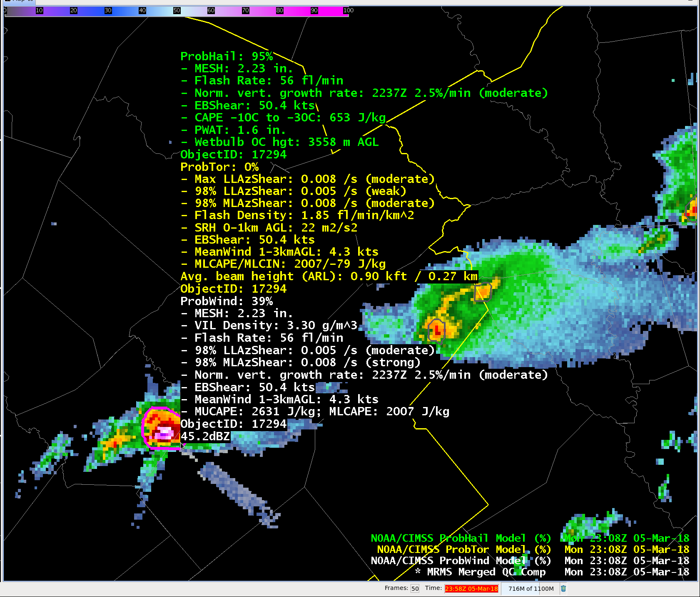
ProbSevere v2 AWIPS-II Display
Notes:
Some users may prefer to load each hazard model individually, here ProbHail (green readout), ProbTor (yellow readout) and ProbWind (white readout) are all loaded. The colored contour is the top product in the AWIPS-2 menu (in this case ProbHail).

Slide 7
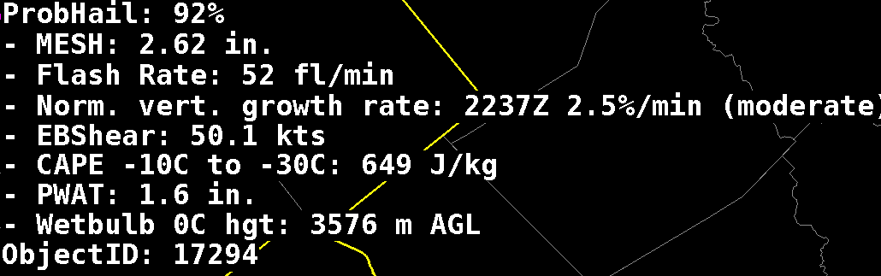
ProbHail Model AWIPS-II Readout
Notes:
Example of AWIPS-2 ProbHail readout. All predictors used by the ProbHail model are included in the read-out, like MESH, CAPE in hail growth region, etc.
See slide 4 for a full description of predictors used.

Slide 8
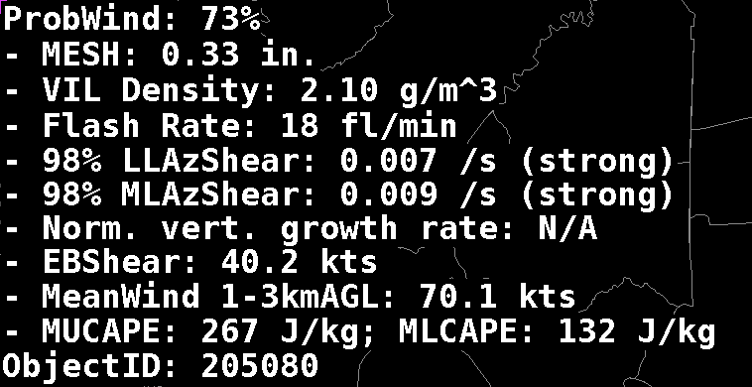
ProbWind Model AWIPS-II Readout
Notes:
Example of AWIPS-2 ProbWind readout. All predictors used by the ProbWind model are included in the read-out, like VIL Density, MRMS AzShear, 1-3km AGL mean wind speed, etc. At request of users, we have added statistically-based descriptors for the MRMS AzShear fields (weak, moderate, and strong).
See slide 4 for a full description of predictors used.

Slide 9
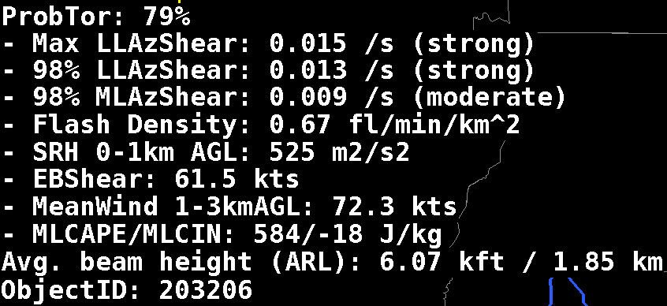
ProbTor Model AWIPS-II Readout
Notes:
Example of AWIPS-2 ProbTor readout. All predictors used by the ProbTor model are included in the read-out, like MRMS AzShear, 0-1km storm relative helicity, etc. At request of users, we have added statistically-based descriptors for the MRMS AzShear fields (weak, moderate, and strong).
See slide 4 for a full description of predictors used.

Slide 10
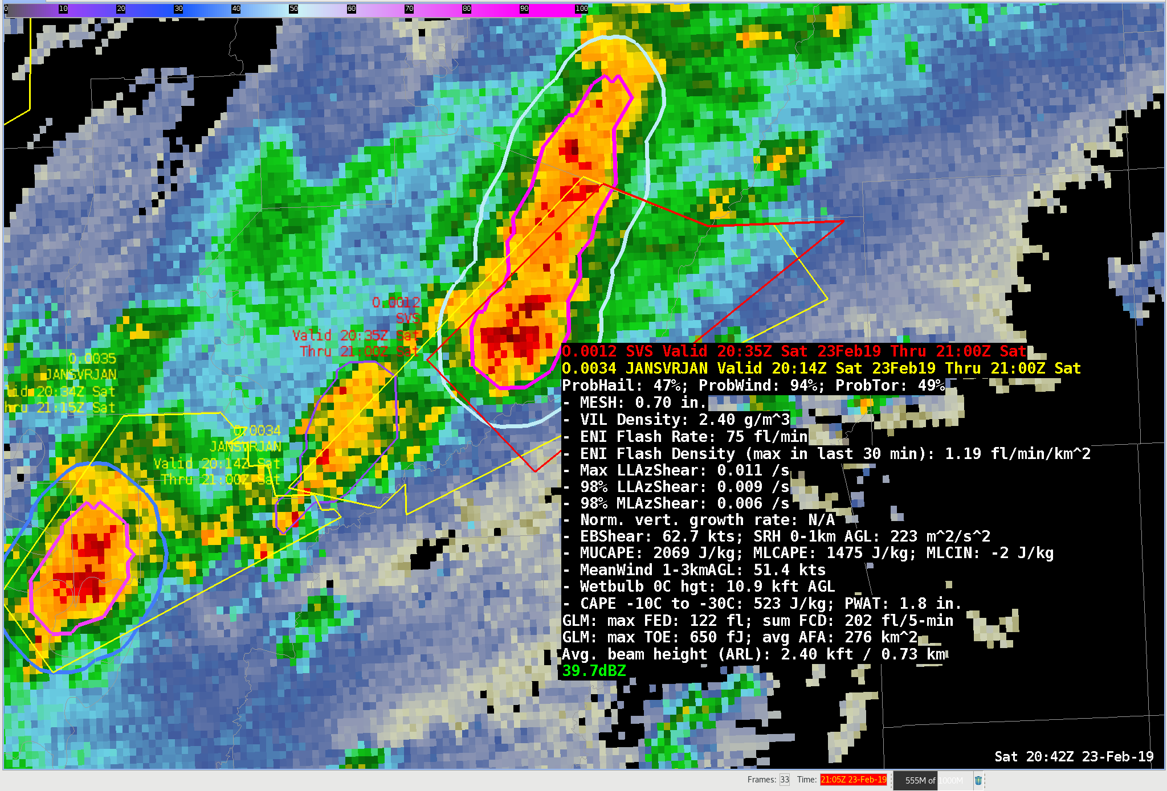
ProbSevere v2 AWIPS-II Display
Supplemental: How to change the ProbTor threshold of the outer contour
Notes:
In previous HWT spring experiments, forecasters have asked to be able to visually see changes in ProbTor as well as changes in the probability of any severe. Our solution is having AWIPSII draw a buffered contour around the original radar object when the probability of tornado meets some threshold. This contour is colored by the ProbTor value and uses the same colormap you have loaded for ProbSevere. The double contour feature is only available when the probability of severe product is loaded (and not ProbHail or ProbWind, for instance). The default threshold is 3%, but you may want to change this based on the expectation of severe weather for the day. For instance, during a moderate or high risk of tornadoes, a threshold such as 10% or even 20% may be more appropriate. This threshold can be changed through your user’s AWIPSII ProbSevere bundle file. If you always want the buffered ProbTor contours visible on every storm, change this value to 0. If you never want to see the ProbTor contours, change this value to 101 or greater. Please click on the supplemental link for step-by-step instructions on how to modify this threshold.

Slide 11
ProbSevere v2 AWIPS-II Display
Supplemental: How to change the ProbTor threshold of the outer contour
Notes:
New for 2019, some fields from the Geostationary Lightning Mapper, or GLM, are shown in the readout. We are still working towards incorporating GLM data quantitatively into ProbSevere, but wanted to show forecasters what GLM was observing in each storm.
Max FED is the maximum flash extent density. This is the number of flashes traversing the same 2-km pixel in the previous 5 minutes.
Sum FCD is the sum of flash centroid density. This is essentially a GLM flash rate over the previous 5 minutes, using the centroid points for each flash.
Max TOE is the maximum total optical energy in a 2-km pixel summed over 5 minutes, with units of femtojoules. This basically measures how bright the brightest pixel is viewed by the GLM.
Avg AFA is the average of the average flash area in the storm. It is the average size of a flash in the previous 5 minutes.

Slide 12
Examples

Slide 13
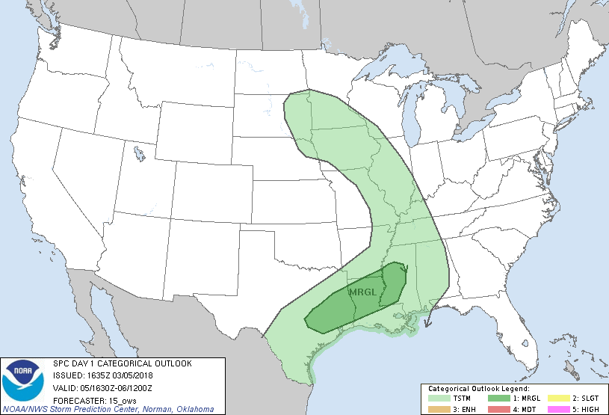
ProbHail Example - 05 March 2018
Notes:
This is the first of 3 quick examples, this example focuses on ProbHail.
This example focuses on south-central Texas during the afternoon hours of March 5, 2018.

Slide 14
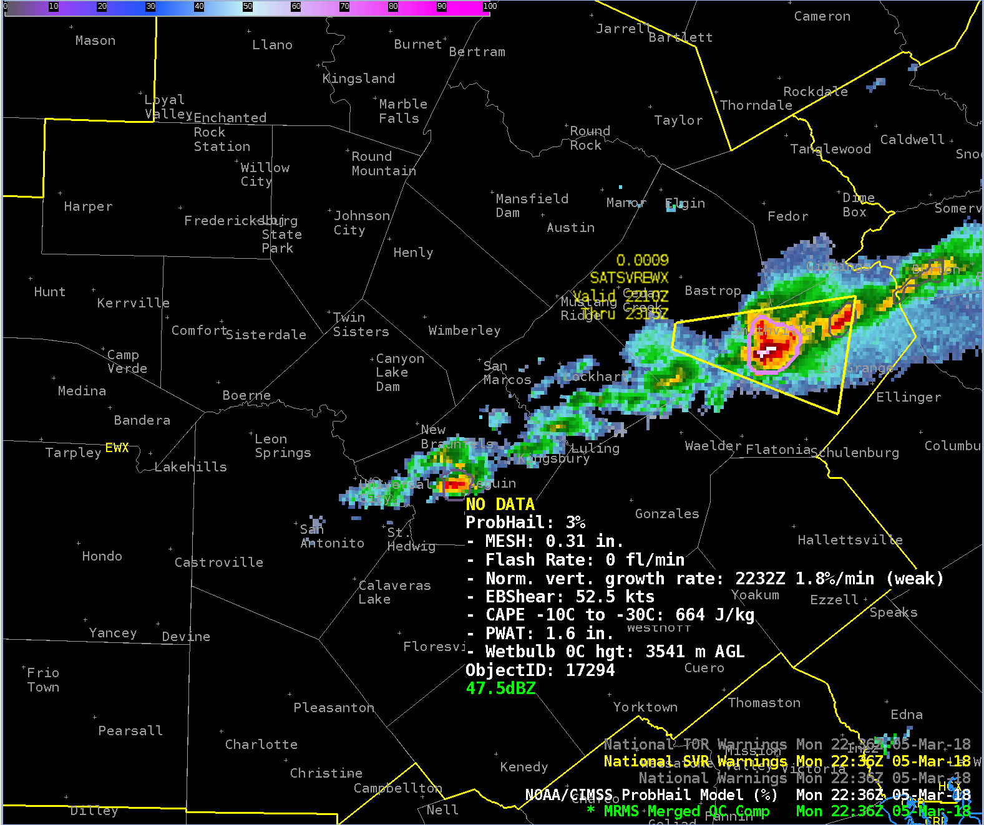
ProbHail Example – 05 March 2018 2236 UTC
ProbHail = 3%
Developing storm near New Braunfels, Texas
Excellent shear and large CAPE in the -10°C to -30°C layer.
Notes:
A storm begins to develop at 2236 UTC near New Braunfels, Texas. The environment is favorable for organized storms and hail growth.

Slide 15
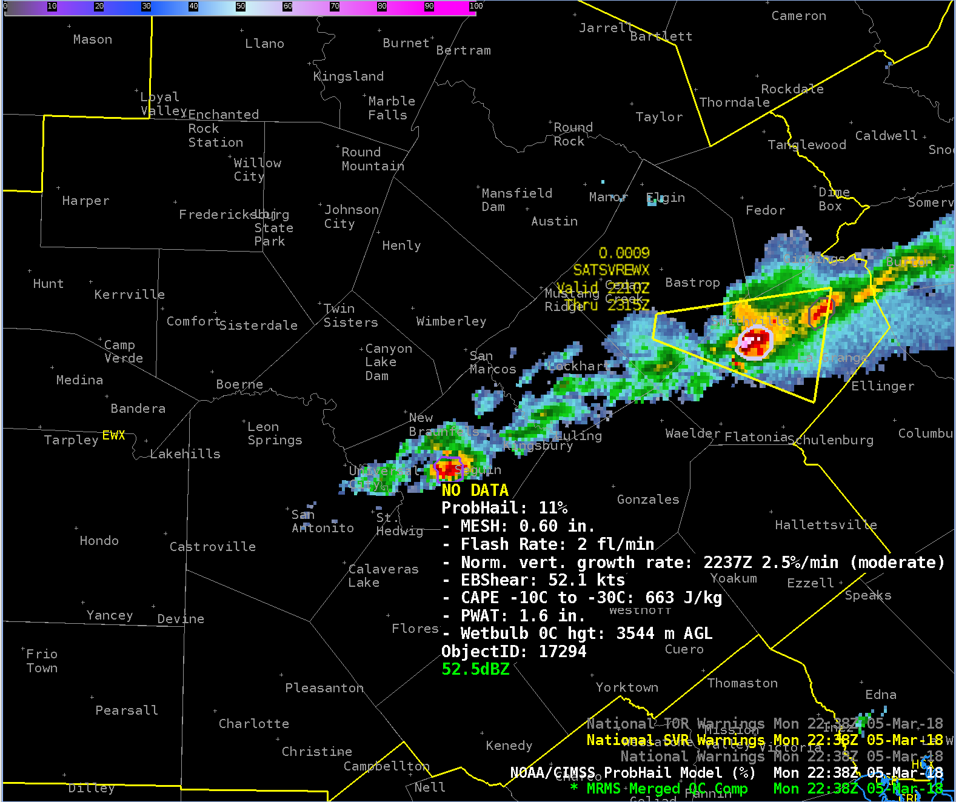
ProbHail Example – 05 March 2018 2238 UTC
ProbHail = 11%
GOES-16 normalized vertical growth rate increases into the moderate category.
MESH increases.
Notes:
.At 2238 UTC the GOES-16 growth rate information became available—this storm was exhibiting moderately strong vertical growth.

Slide 16
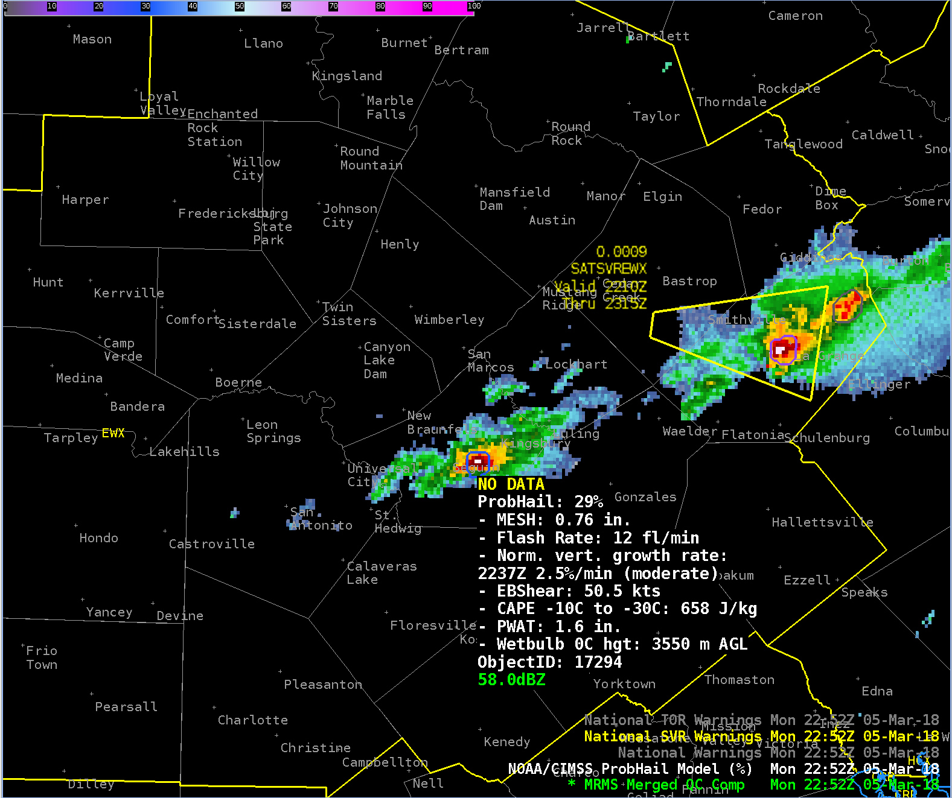
ProbHail Example – 05 March 2018 2252 UTC
ProbHail = 29%
MESH and total lightning are slowly increasing.
Notes:
.Over the past 14 minutes the storm slowly has intensified and ProbHail has slowly increased.

Slide 17
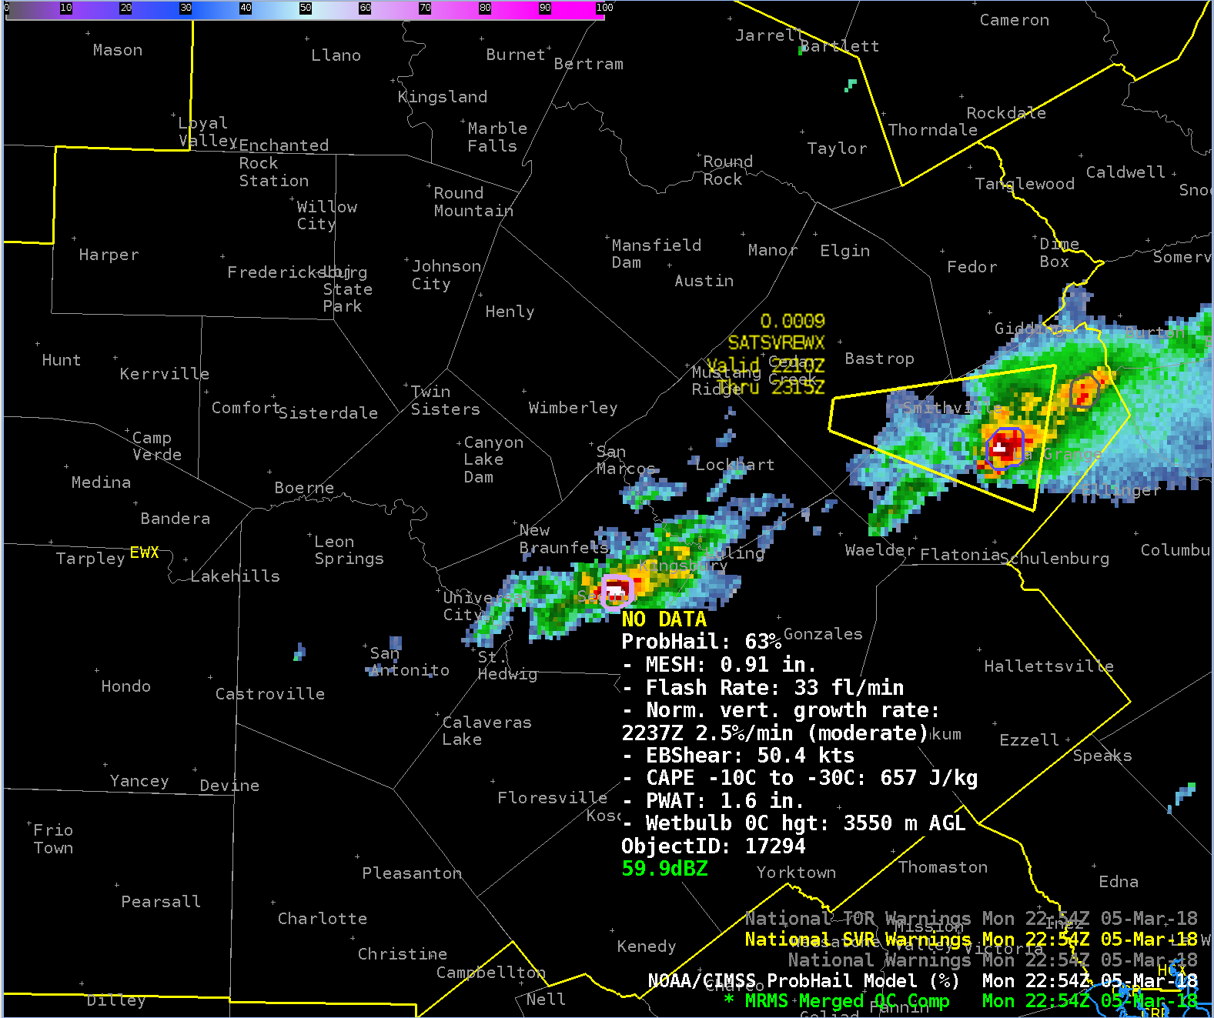
ProbHail Example – 05 March 2018 2254 UTC
ProbHail = 63%
MESH and total lightning begin to rapidly increase.
Notes:
.In just 2 minutes, ProbHail increased from 29% to 63% as MESH and total lightning flash rate rapidly increase.

Slide 18
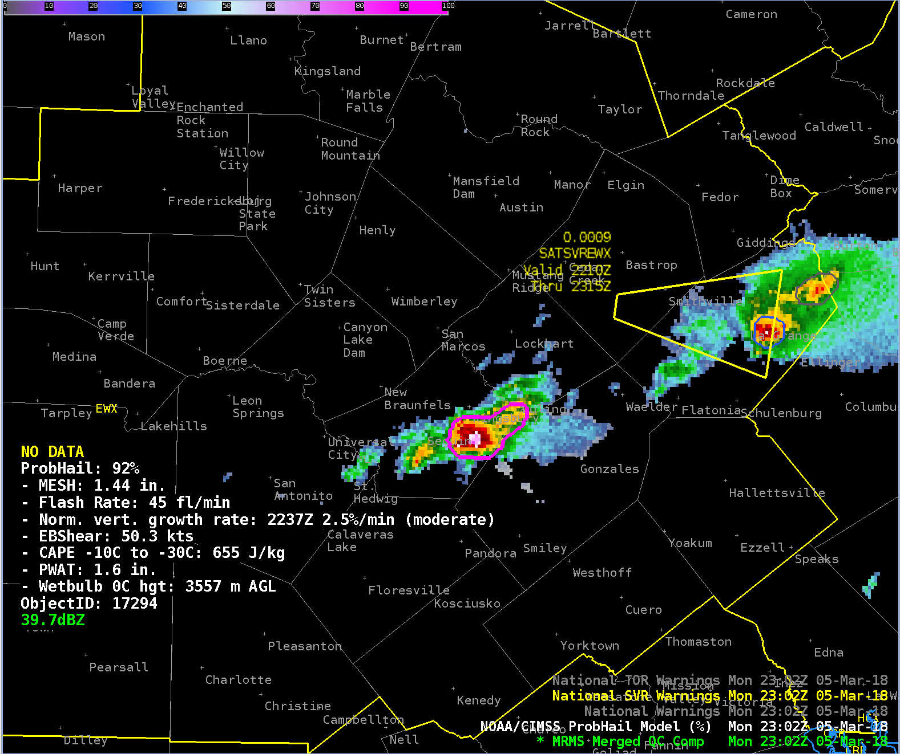
ProbHail Example – 05 March 2018 2302 UTC
ProbHail = 92%
ProbHail is very high due to large MESH (1.44”) and considerable lightning.
Notes:
At 2302 UTC ProbHail for this storm has exceeded 90%.

Slide 19
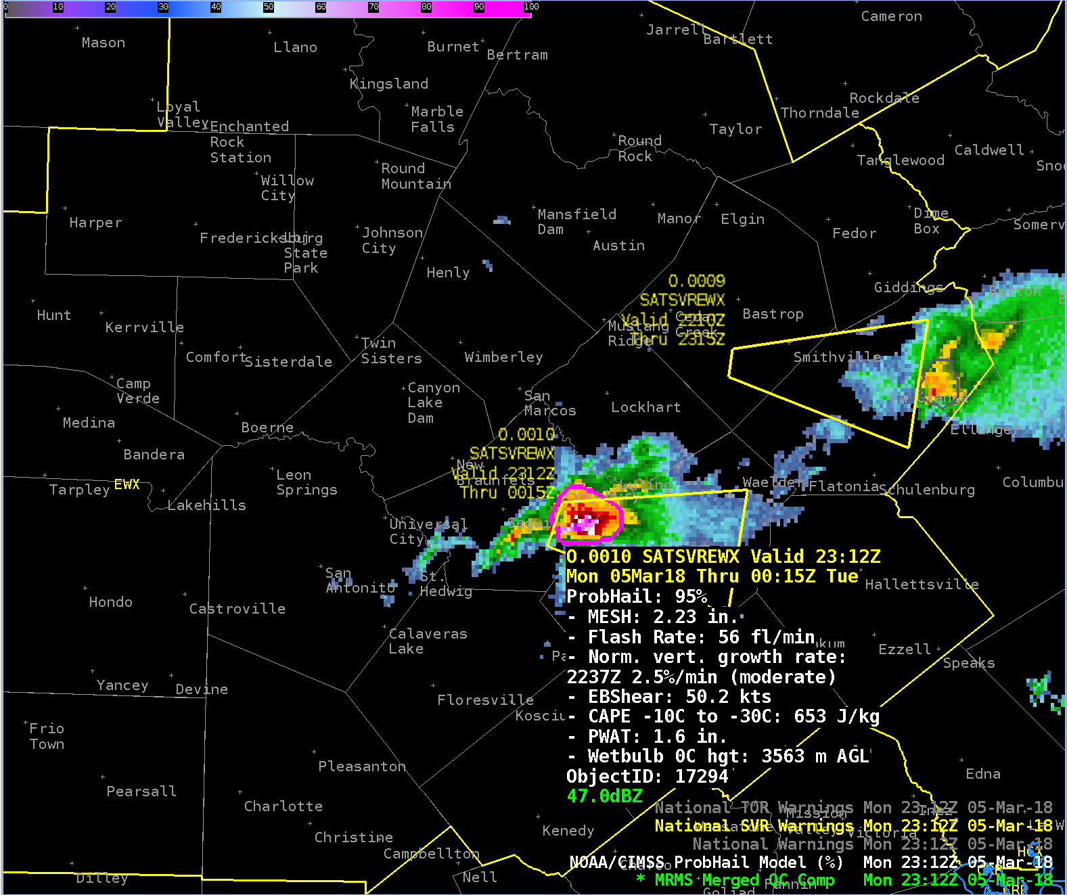
ProbHail Example – 05 March 2018 2312 UTC
ProbHail = 95%
A severe thunderstorm warning is issued at 2312 UTC.
The first severe hail report (1.75”) is received at 2320 UTC.
Notes:
This example illustrates the usage of ProbHail can increase both confidence and lead-time in severe thunderstorm warning issuance.
ProbHail exceeded 60% 26 minutes before the first hail report and 18 minutes before the first severe thunderstorm warning.
ProbHail exceeded 90% 18 minutes before the first hail report and 10 minutes before the first severe thunderstorm warning.

Slide 20
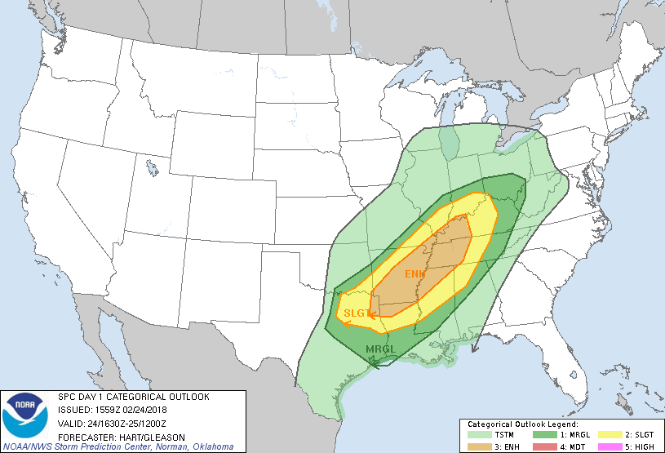
ProbWind Example – 24/25 Feb 2018
Notes:
This is the second of 3 quick examples, focusing on ProbWind.
This example is near Louisville, Kentucky during the late evening hours of February 24, 2018.

Slide 21
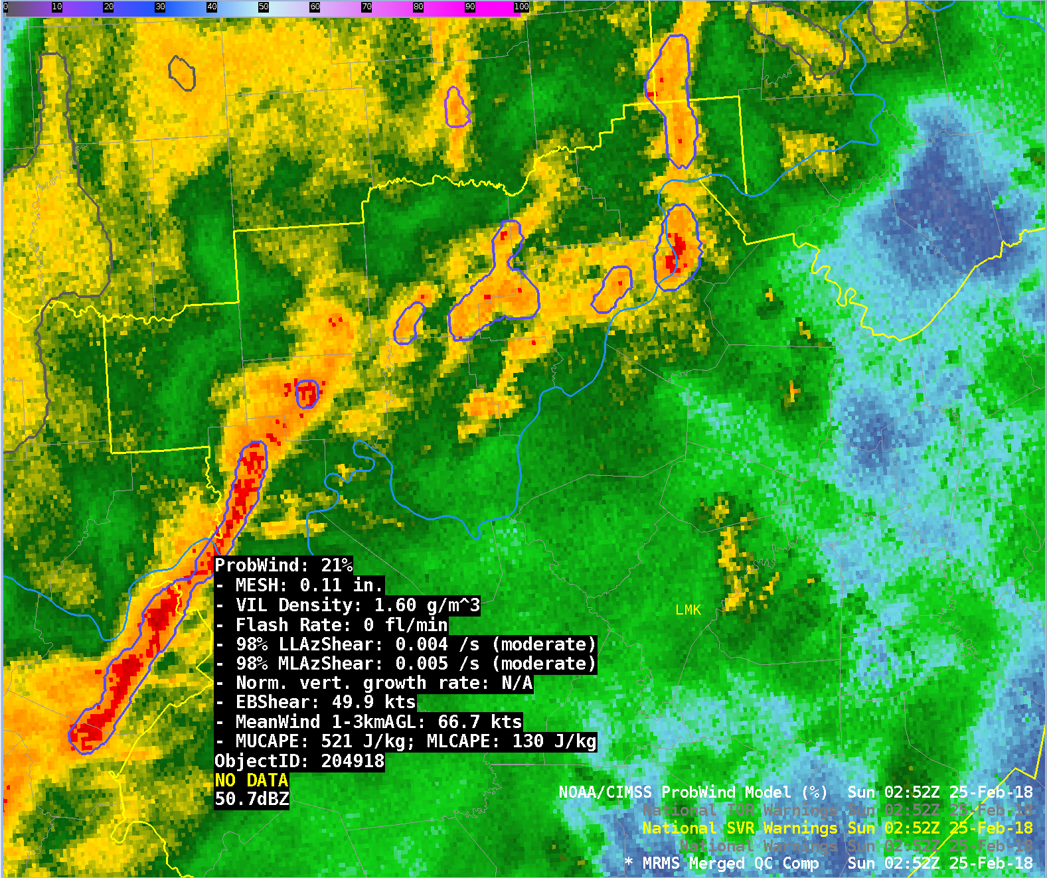
ProbWind Example – 25 Feb 2018 0252 UTC
ProbWind = 21%
A line of strong storms was pushing into the Louisville WFO.
Strong shear and strong synoptic low-level winds are favorable for damaging winds.
Indiana
Kentucky
Notes:
A line of strong storms was pushing toward Louisville, KY at 0252 UTC on 25 Feb 2018. The environment was favorable for damaging winds, ProbWind was 21% at this time.

Slide 22
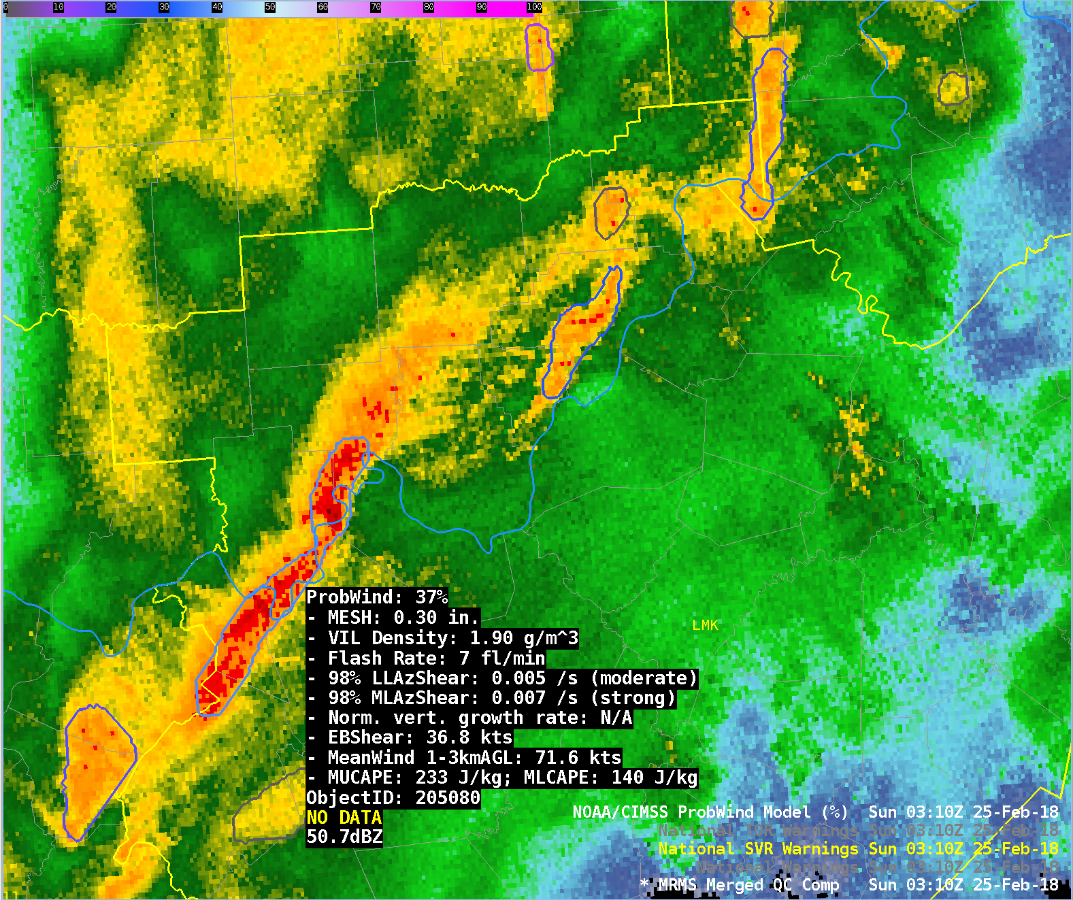
ProbWind Example – 25 Feb 2018 0310 UTC
ProbWind = 37%
AzShear and reflectivity observations intensified causing increase of ProbWind.
Indiana
Kentucky
Notes:
From 0252 UTC to 0308 UTC ProbWind remained in the 20-25% range, then at 0310 UTC AzShear and reflectivity based predictors intensified, causing ProbWind to increase to 37%.

Slide 23
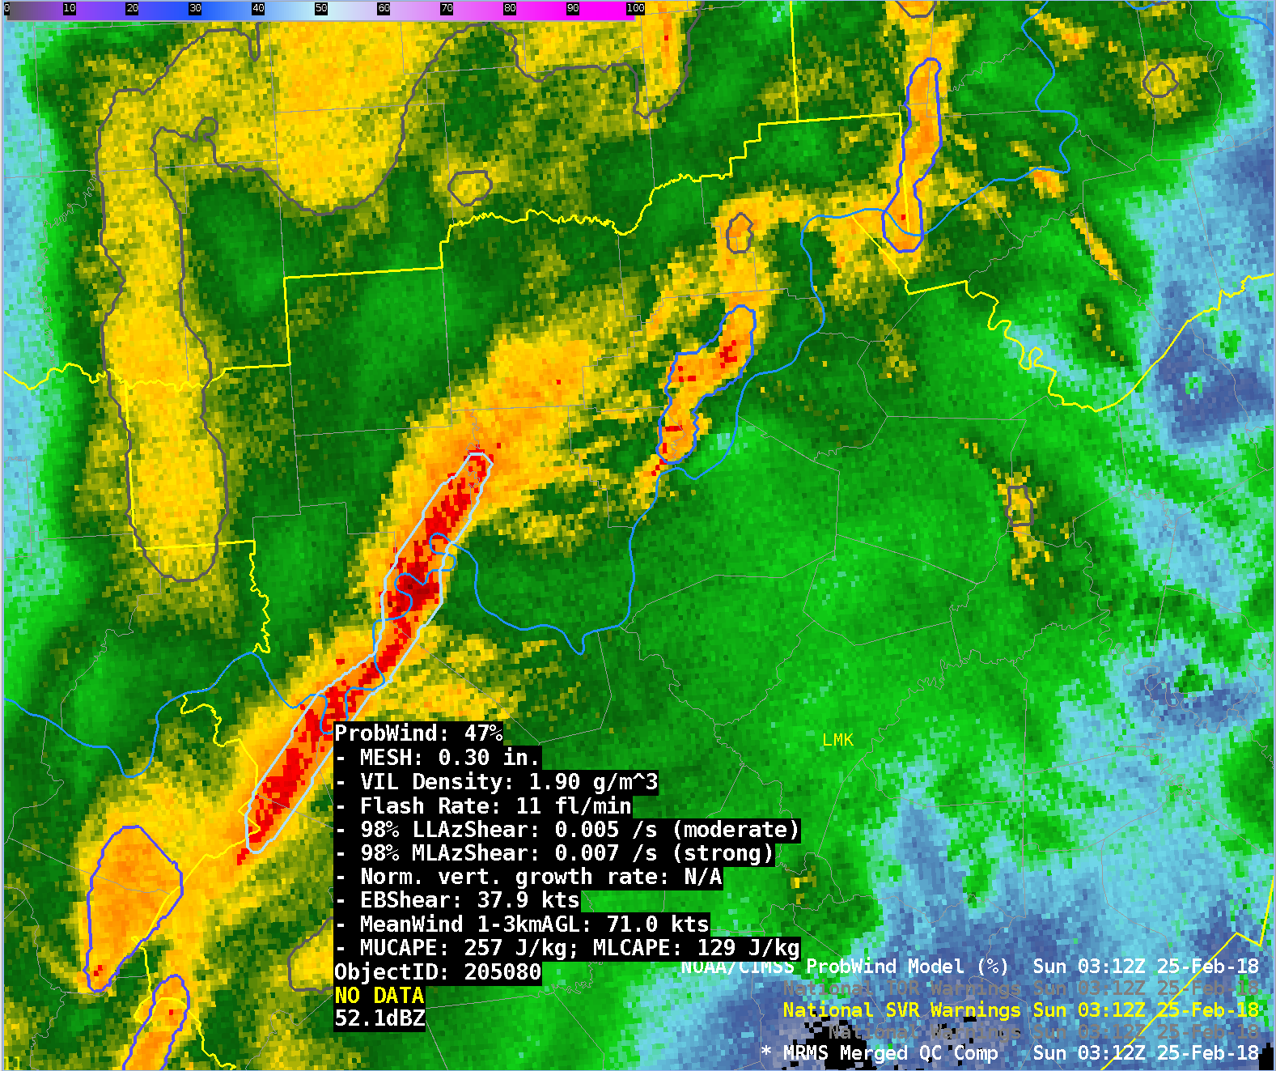
ProbWind Example – 25 Feb 2018 0312 UTC
ProbWind = 47%
ProbWind increase due to increase in total lightning activity.
Indiana
Kentucky
Notes:
ProbWind jumps 10% to 47% in the past 2 minutes as a result of an increase in total lightning.

Slide 24
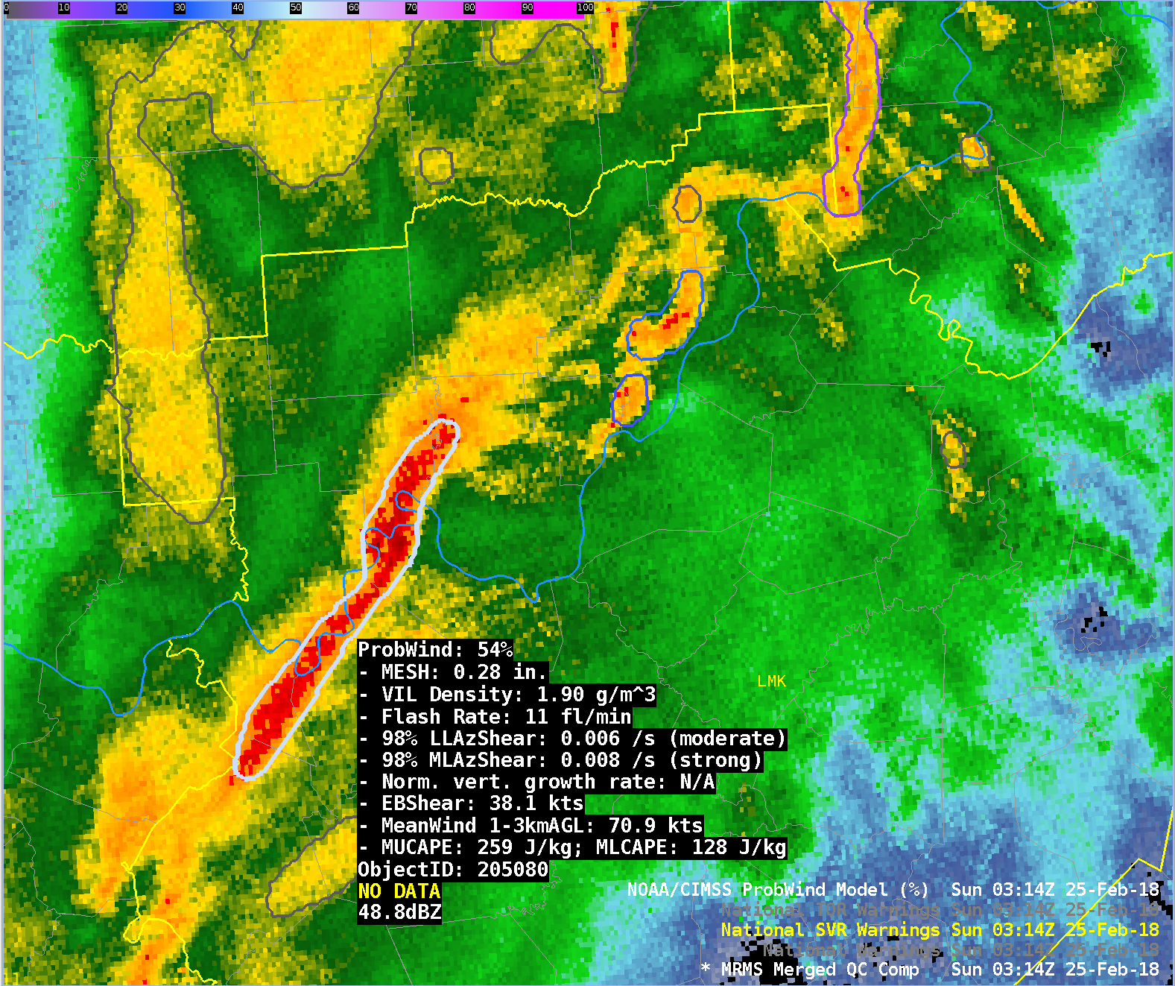
ProbWind Example – 25 Feb 2018 0314 UTC
ProbWind = 54%
ProbWind increase due to increased MRMS AzShear.
Indiana
Kentucky
Notes:
ProbWind increases to 54% as the AzShear predictors strengthen.

Slide 25
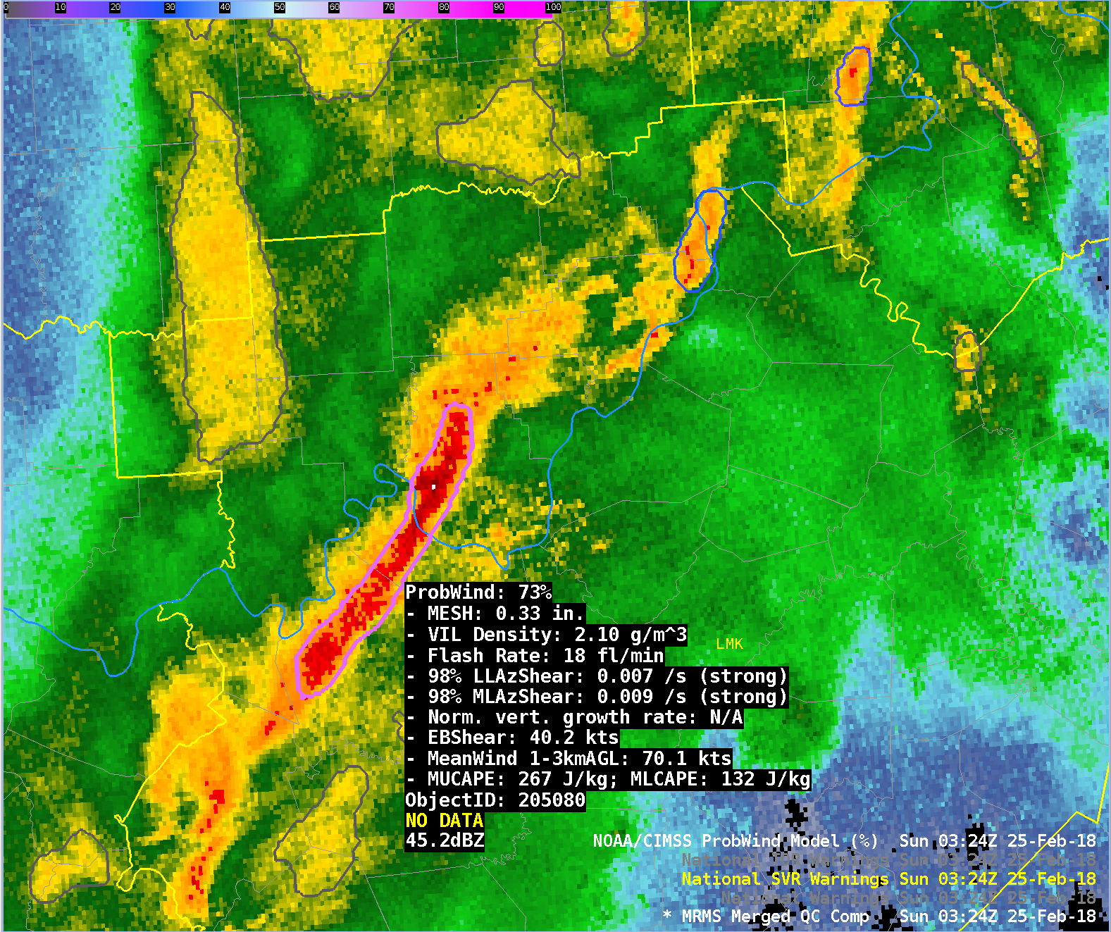
ProbWind Example – 25 Feb 2018 0324 UTC
ProbWind = 73%
ProbWind increase due to increases in MRMS AzShear, reflectivity, and total lightning.
Indiana
Kentucky
Notes:
ProbWind increases to 73% as the AzShear predictors again intensified, MESH, VIL density, and total lightning also increased.

Slide 26
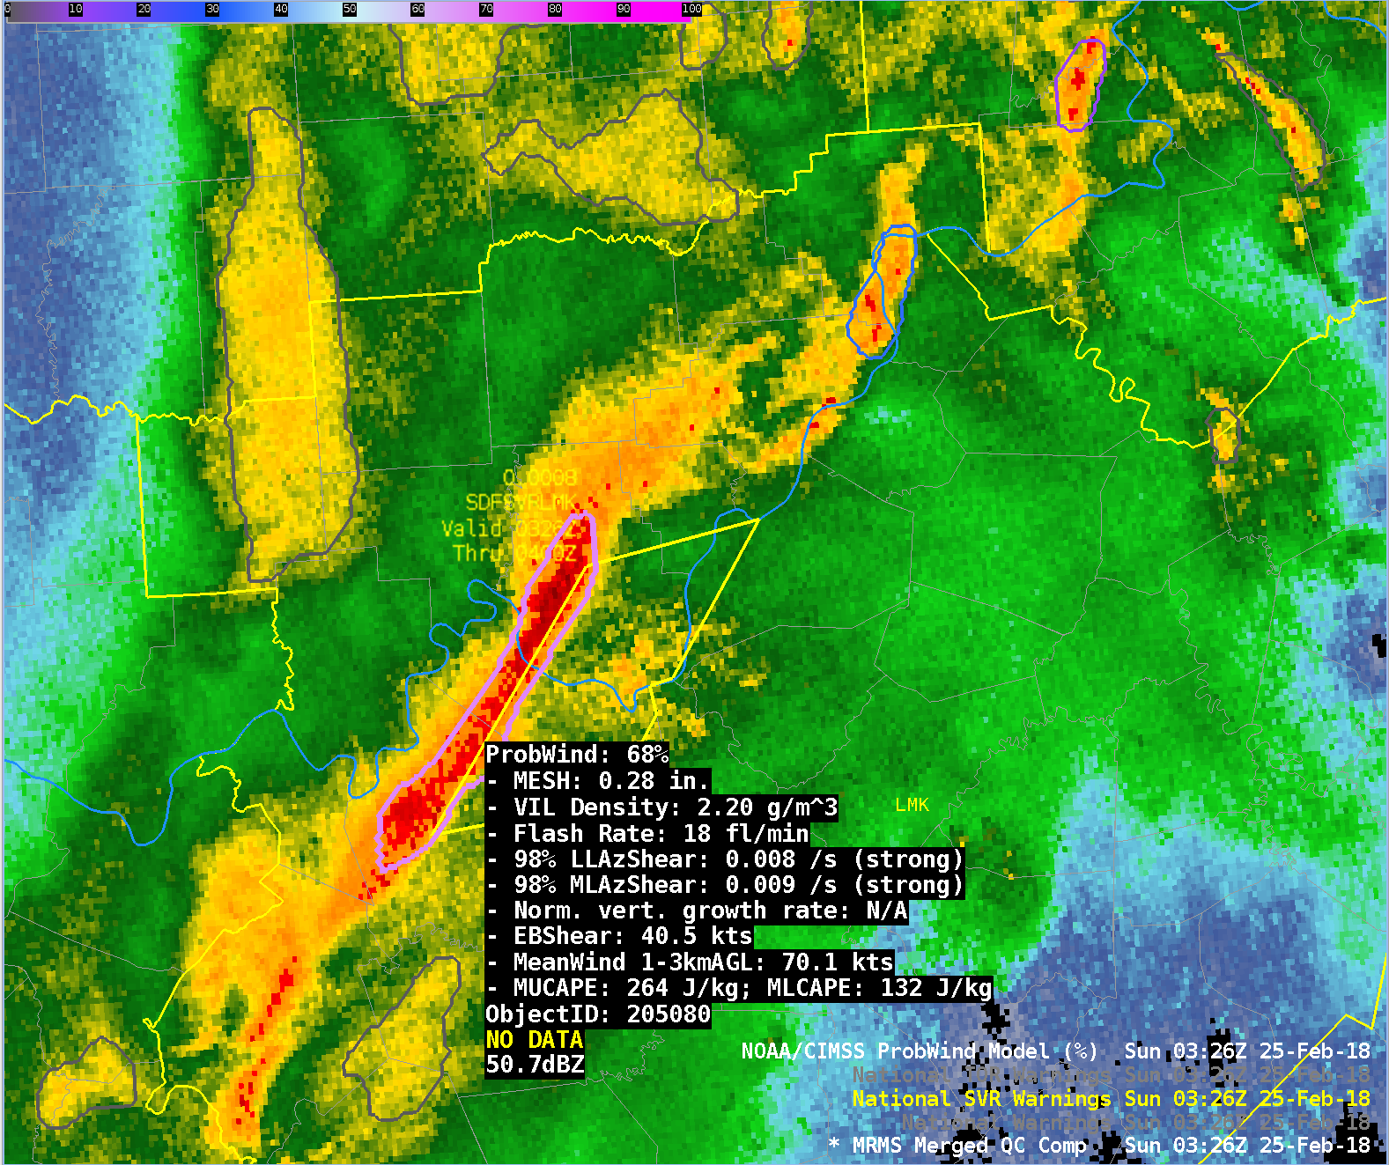
ProbWind Example – 25 Feb 2018 0326 UTC
ProbWind = 68%
A severe thunderstorm warning is issued at 0326 UTC.
Wind damage reports are received at 0356 UTC.
Indiana
Kentucky
Notes:
This example illustrates the usage of ProbWind can increase both confidence and lead-time in severe thunderstorm warning issuance.
ProbWind exceeded 50% 42 minutes before the first wind report and 12 minutes before the first severe thunderstorm warning.
Additionally, note this line segment was the only storm with elevated ProbWind probabilities and was the only line segment that resulted in wind damage reports in this region.

Slide 27
ProbTor Example – 24 Feb 2018
Notes:
The last of the quick examples focuses on ProbTor.
This example is over far northeastern Arkansas during the late afternoon of February 24, 2018.

Slide 28
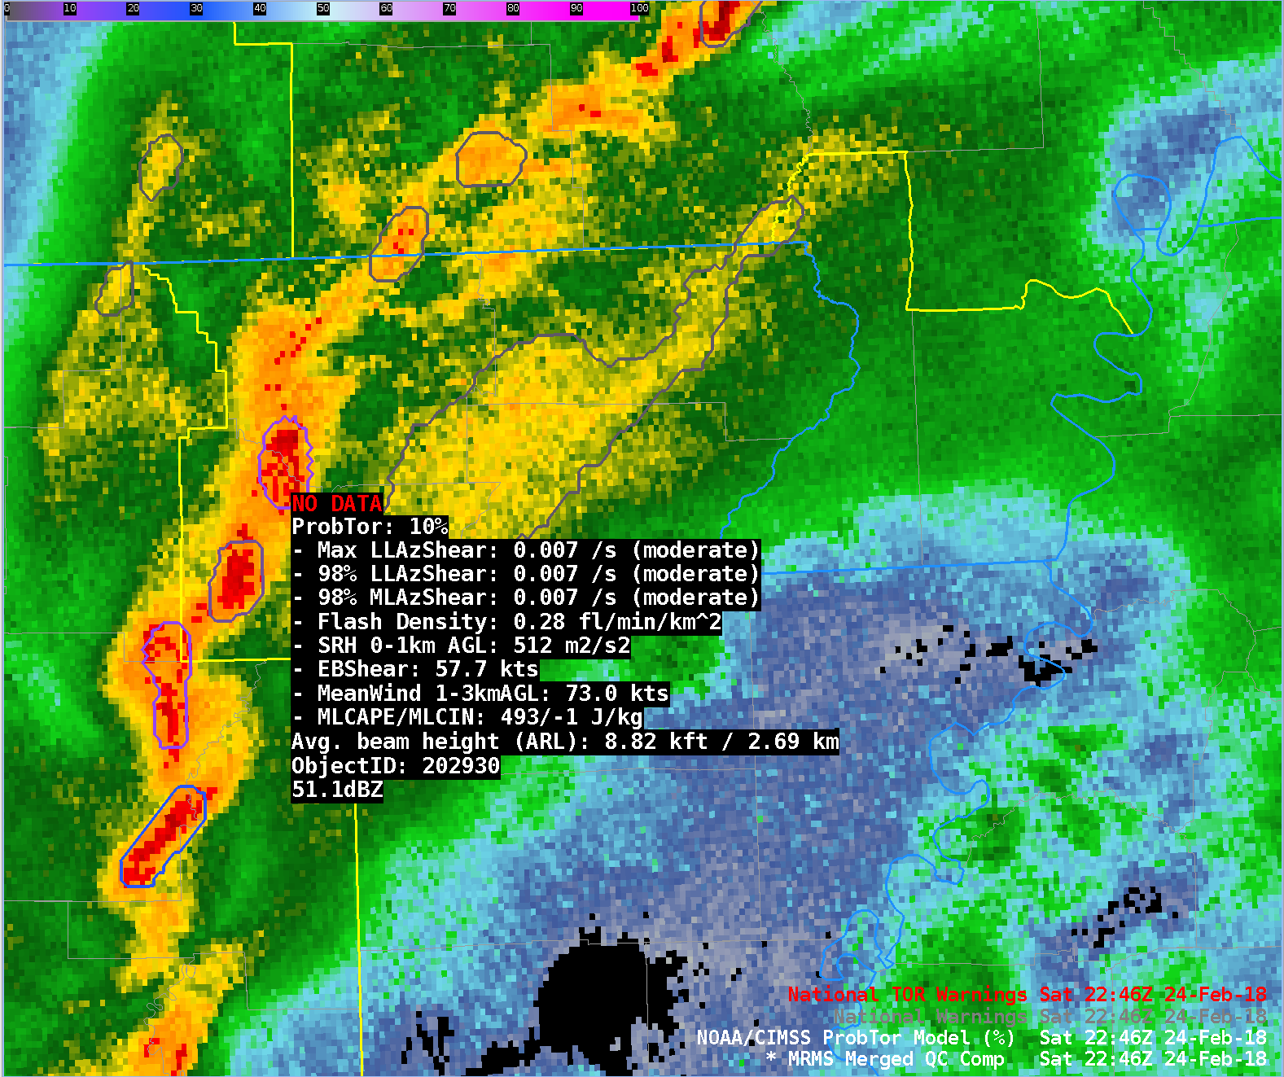
ProbTor Example – 24 Feb 2018 2246 UTC
ProbTor = 10%
A broken line of storms was traversing across NE Arkansas.
The kinematics were very favorable for tornadoes—extreme values of 0-1km storm relative helicity and large effective shear.
Missouri
Arkansas
Notes:
A line of storms was rapidly pushing east across northern Arkansas at 2246 UTC. The storm of interest has a low (given the kinematic environment) ProbTor value of 10% at 2246 UTC.

Slide 29
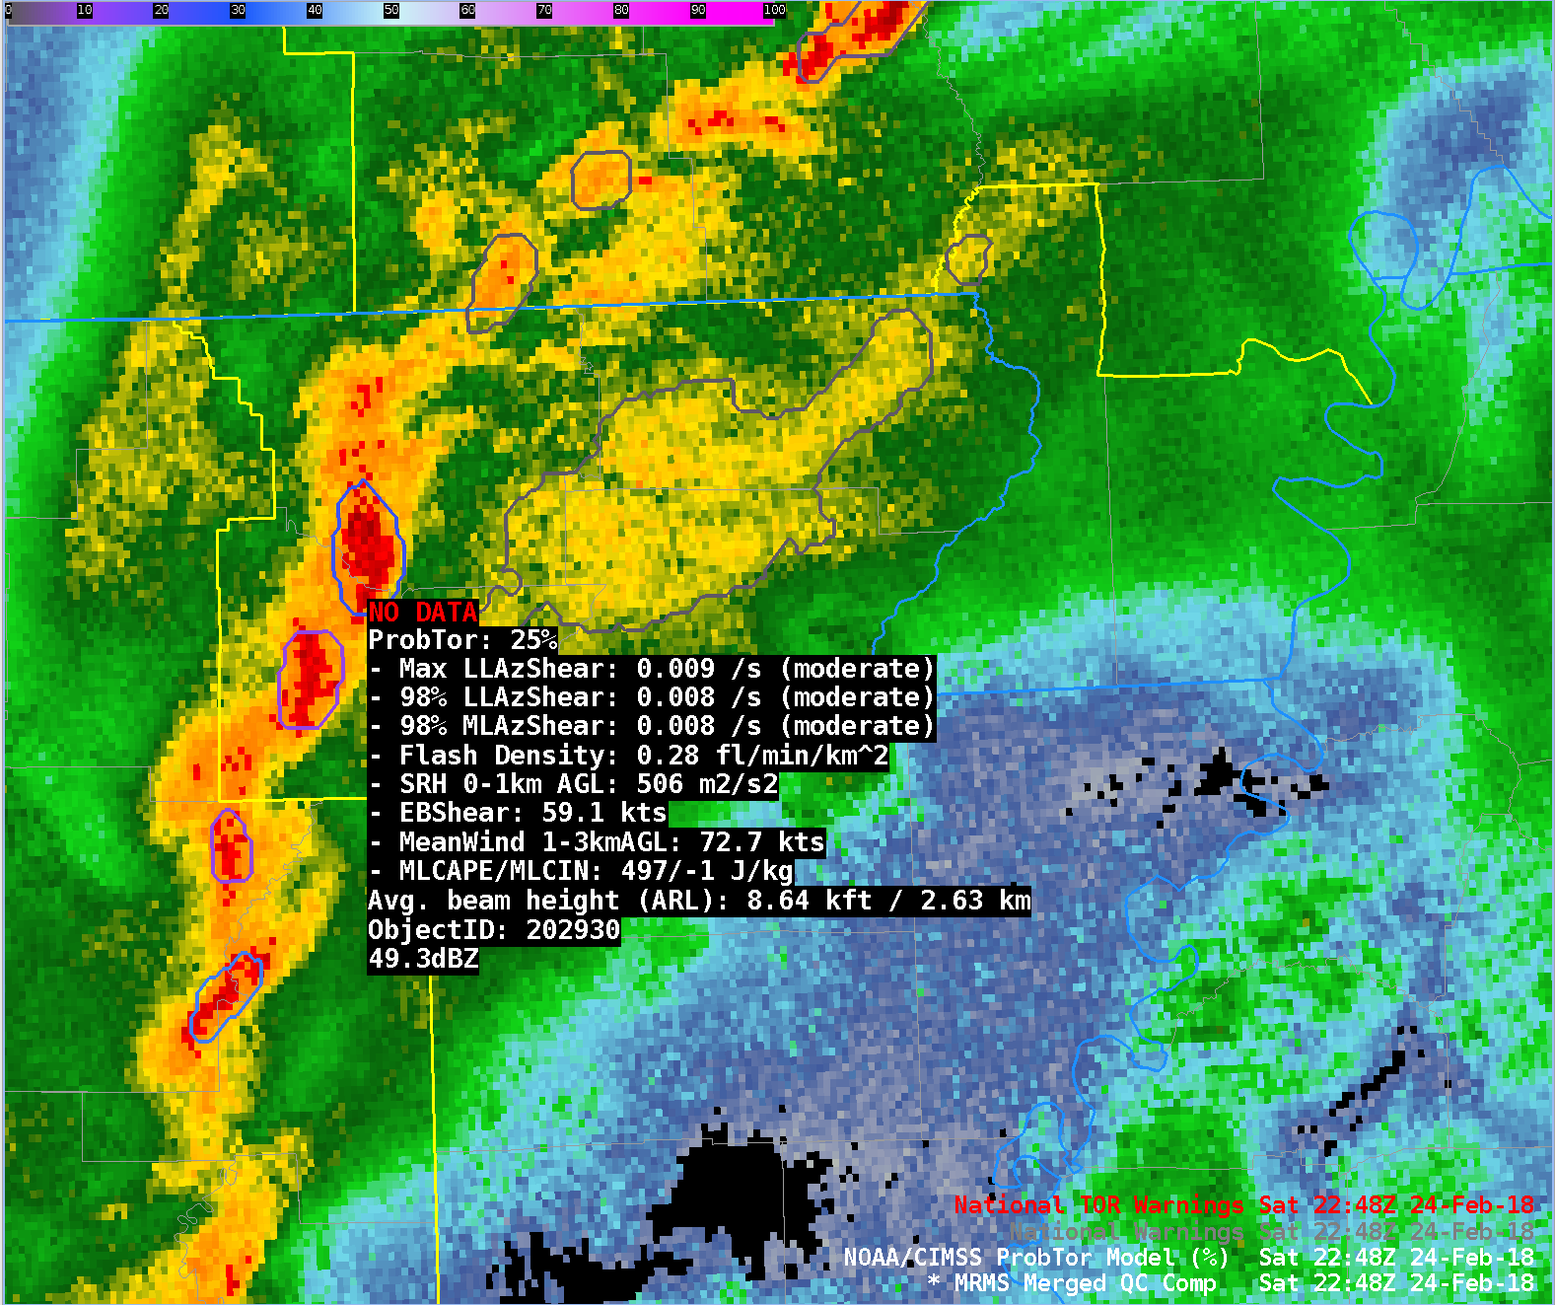
ProbTor Example – 24 Feb 2018 2248 UTC
ProbTor = 25%
ProbTor increases as MRMS low and mid level AzShear strengthens.
Missouri
Arkansas
Notes:
2 minutes later, ProbTor increases to 25% as low and mid level rotation (as indicated by MRMS AzShear) strengthens.

Slide 30
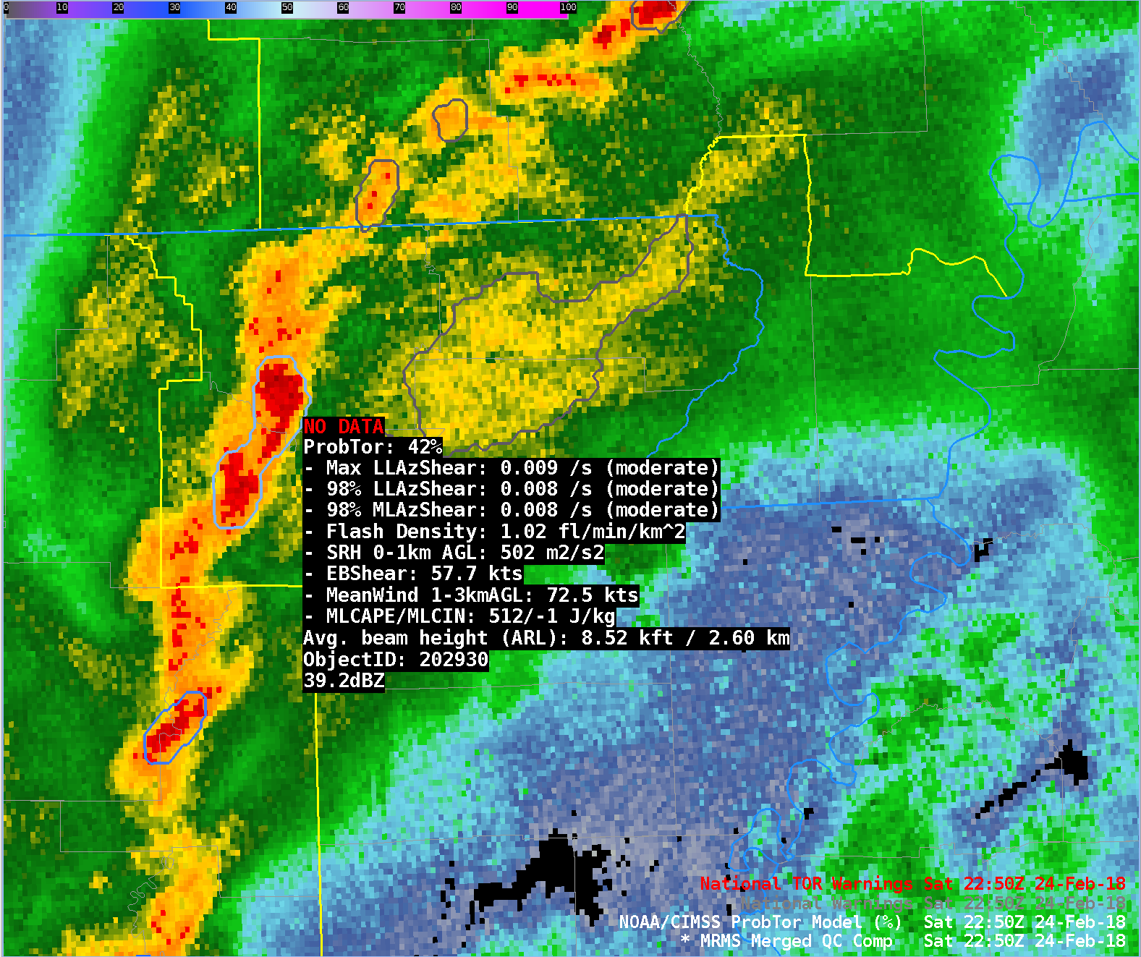
ProbTor Example – 24 Feb 2018 2250 UTC
ProbTor = 42%
ProbTor increases again, this time due to an increase in the storm’s maximum flash density.
Missouri
Arkansas
Notes:
ProbTor increases rapidly at 2250 UTC due to a significant increase in the storm’s maximum flash density. The maximum flash density of a storm was found to be a skillful predictor for tornado.

Slide 31
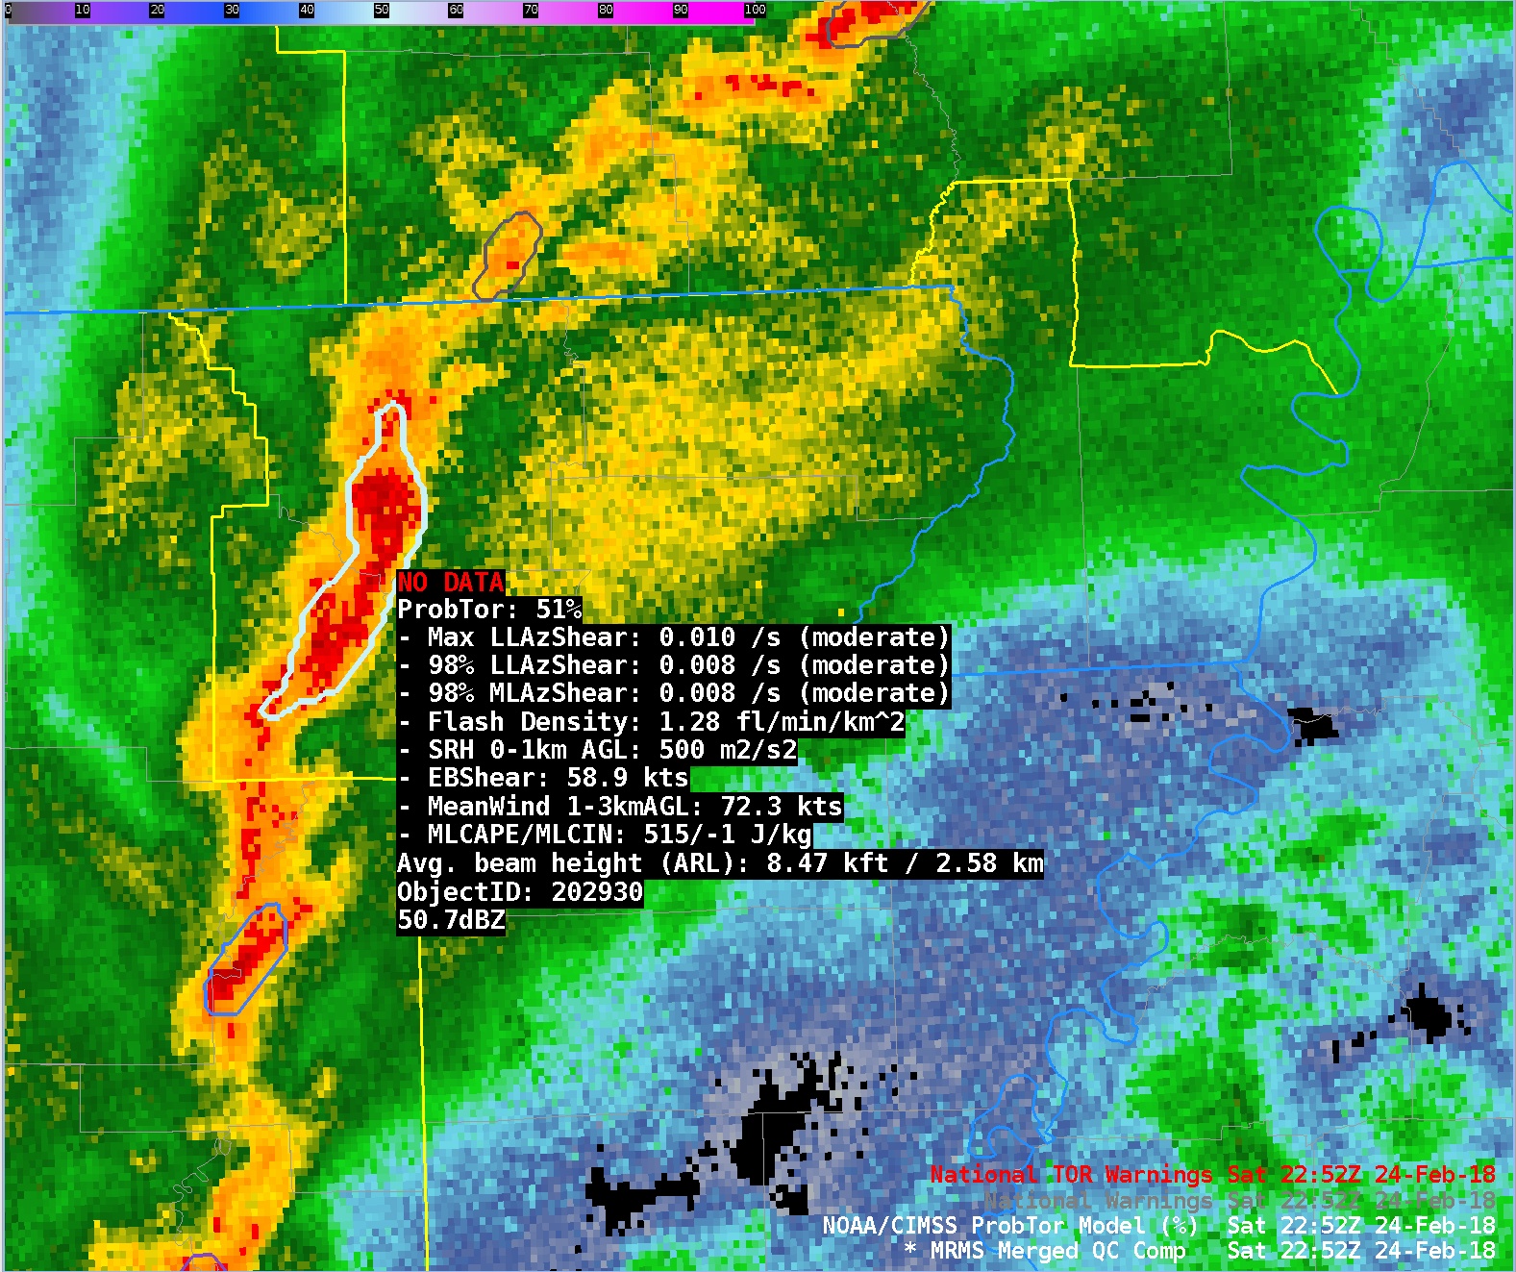
ProbTor Example – 24 Feb 2018 2252 UTC
ProbTor = 51%
ProbTor continues to increase as the low level storm rotation continues to strengthen.
Missouri
Arkansas
Notes:
ProbTor increases again, now to 51% as low level storm rotation strengthens.

Slide 32
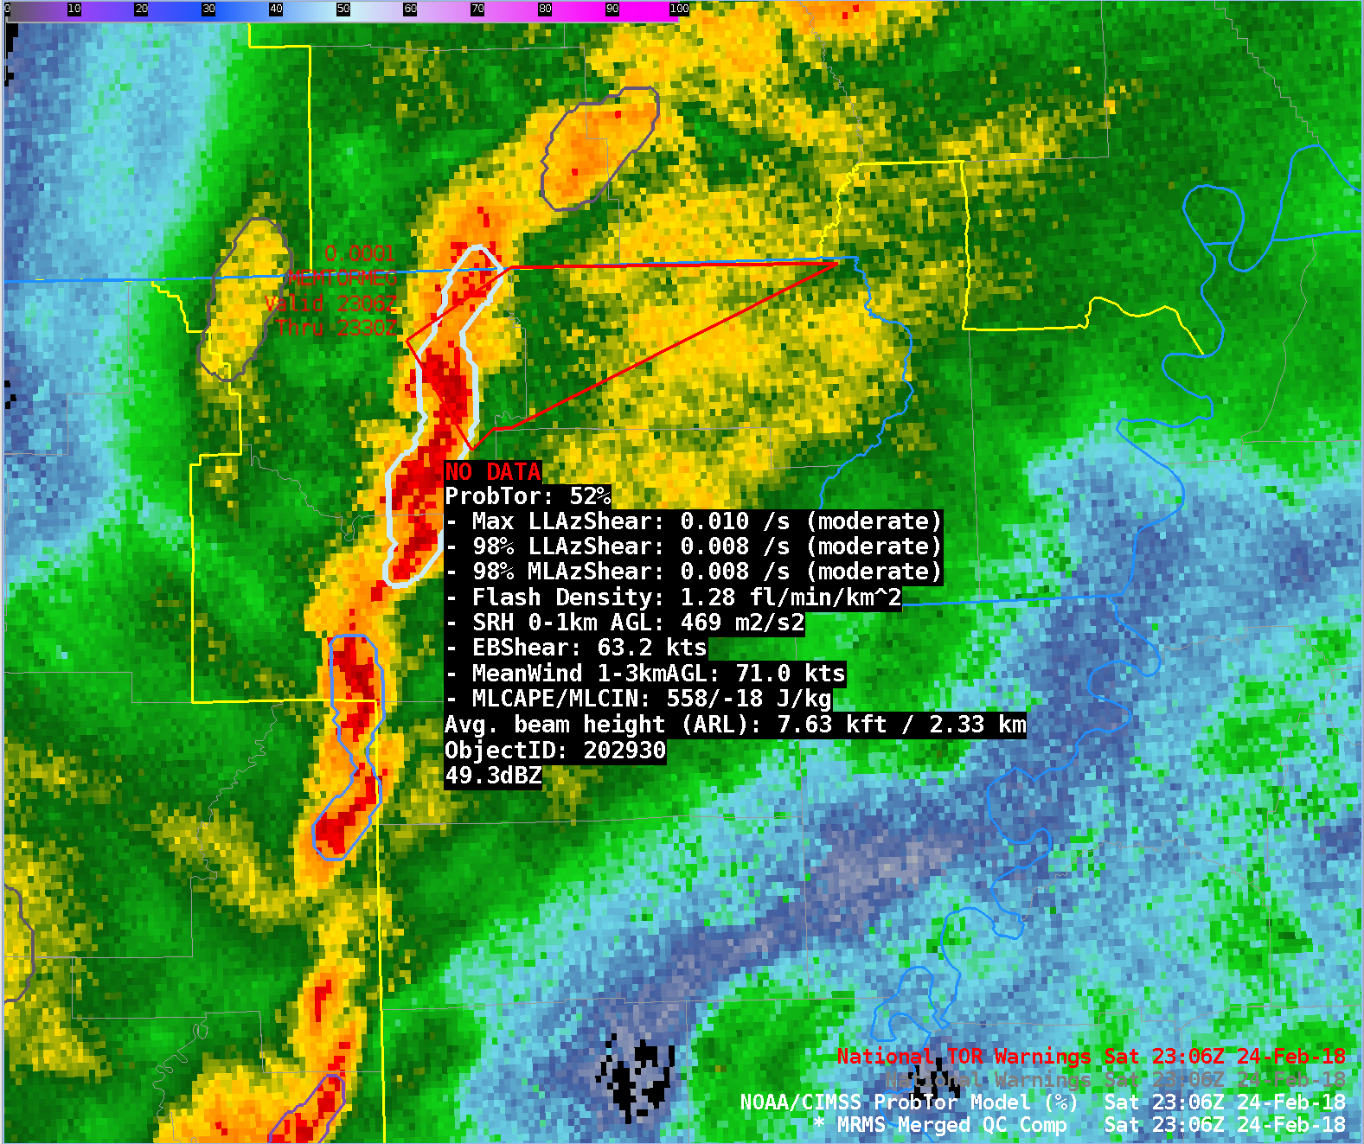
ProbTor Example – 24 Feb 2018 2306 UTC
ProbTor = 52%
A tornado warning is issued at 2307 UTC.
Missouri
Arkansas
Notes:
At 2307 UTC the first tornado warning was issued for this storm (a second tornado warning was issued at 2315 UTC).
This example illustrates the usage of ProbTor can increase both confidence and lead-time in tornado warning issuance.
ProbTor exceeded 50% 38 minutes before the first tornado report and 15 minutes before the first tornado warning.

Slide 33
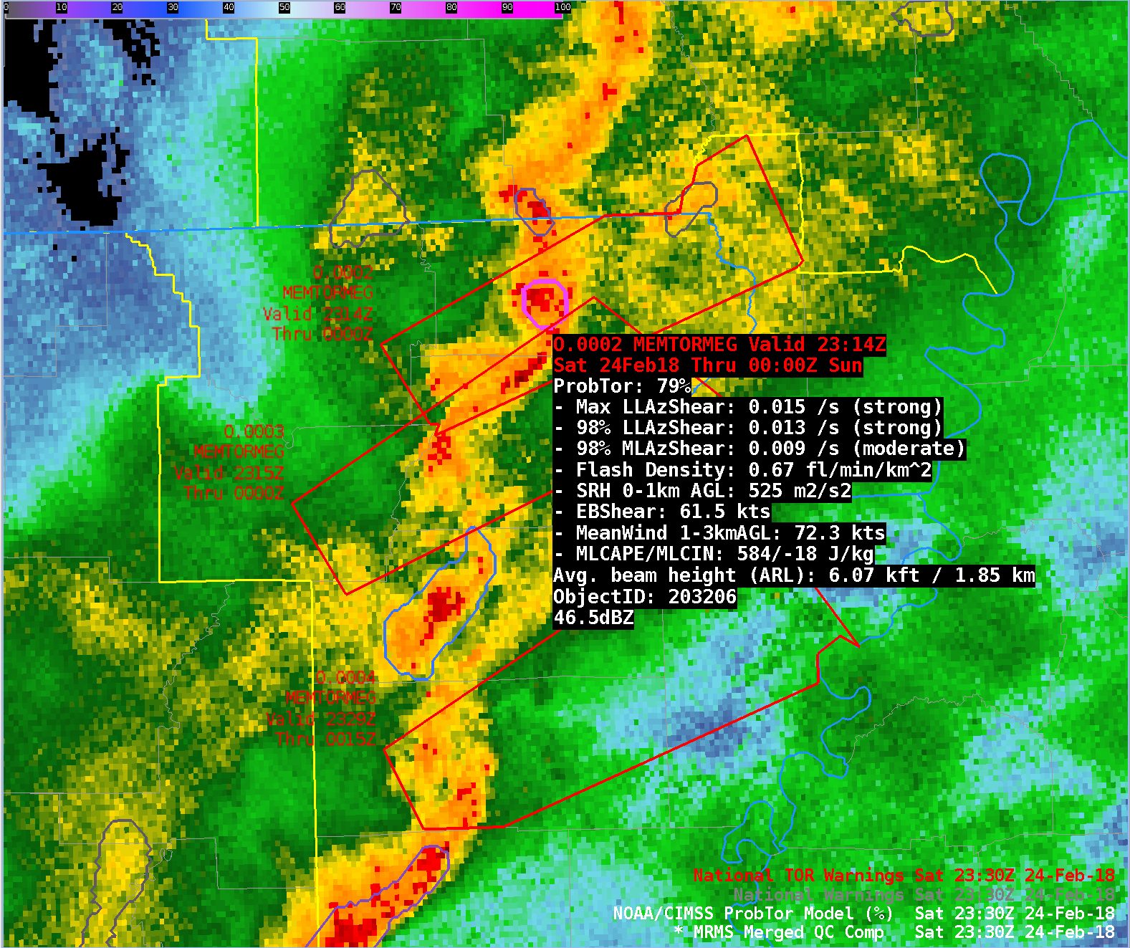
ProbTor Example – 24 Feb 2018 2330 UTC
ProbTor = 79%
A tornado was reported at 2330 UTC. At this time the low level rotation is strong.
Missouri
Arkansas
Notes:
The storm of interest at 2330 UTC exhibits a ProbTor value of 79%--owing to the very favorable kinematics and strong low level storm rotation as indicated by the MRMS AzShear information. Notice the storm of interest exhibits much higher ProbTor values than neighboring storms in a similar kinematic environment. ProbTor can highlight the storm of the highest threat due to the storm-specific observational information used in ProbTor.

Slide 34
Validation

Slide 35
ProbSevere Model Performance
Under forecast
Over forecast
POD/FAR/CSI
Reliability
ProbSevere v2 validation uses the maximum probability from ProbHail, ProbWind, and ProbTor.
Skill plots show ProbSevere is less skillful than experienced forecasters (as expected) , but is comparable and offers increased lead-time.
Reliability diagram shows slight over forecast bias for most probability thresholds, but ProbSevere v2 is well calibrated overall
Notes:
The ProbSevere version 2 verification shown on this slide includes 2,250 severe storms and 42,000 non-severe storms during 2016. ProbSevere verification uses the maximum probability from ProbHail, ProbWind and ProbTor predictions.
ProbSevere is fairly well calibrated and users should expect verification at the approximate rate as the probability (e.g., a storm achieving a 40% probability will produce severe weather 4 in 10 times, a storm achieving a 80% probability will produce severe weather about 8 in 10 times, and so on).
The skill and lead-time analysis demonstrates that ProbSevere is not as skilled experienced NWS forecasters, yet is comparable. The increased lead-time and well-calibrated probabilities can offer the forecaster 1) increased confidence in their decision making and 2) increased lead-time in making warning decisions.

Slide 36
ProbSevere – Hail Improvement
ProbHail Max CSI: 0.43 vs ProbSevere v1 Max CSI (for hail): 0.40
Notes:
The ProbHail verification for hail events shown on this slide includes 800 severe hail producing storms and 42,000 non-severe storms during 2016.
ProbSevere—ProbHail incorporates more physically relevant NWP information than the original version of ProbSevere. As such this figure shows the ProbSevere--ProbHail (red) has higher CSI for most probability thresholds than ProbSevere version 1 (orange) when scoring for hail events.

Slide 37
ProbHail Reliability
Under forecast
Over forecast
Reliability analysis shows ProbHail is well calibrated, with a small over forecast bias for probabilities ≥ 40% and is significantly more reliable than ProbSevere v1.
Notes:
The reliability diagram for ProbHail (red) vs ProbSevere version 1 (orange) for severe hail reports. The reliability diagram is for the same validation sample on the previous slide (800 severe hail producing storms and 42,000 non-severe storms during 2016).
ProbHail users should utilize the good reliability of the probabilities, for example a storm with 60% ProbHail will produce severe hail a bit less than 6 in 10 times; a storm with 80% ProbHail will produce severe hail a bit less than 8 in 10 times.
For severe hail producing storms, ProbHail exhibits much better reliability than ProbSevere v1. As such, users may note, compared to legacy ProbSevere, fewer severe hail producing storms will reach the ProbHail 80% and 90% thresholds.

Slide 38
ProbSevere – Wind Improvement
ProbWind Max CSI: 0.31 vs ProbSevere v1 Max CSI (for wind): 0.26
Notes:
The ProbWind verification for wind events shown on this slide includes 1,650 severe wind producing storms and 42,000 non-severe storms during 2016.
ProbSevere—ProbWind incorporates more physically relevant NWP predictors and more direct measurements of thunderstorm wind velocity than the original version of ProbSevere. As such this figure shows the ProbSevere--ProbWind (red) has higher CSI for most probability thresholds than ProbSevere version 1 (orange) when scoring for wind events.

Slide 39
ProbWind Reliability
Under forecast
Over forecast
Reliability analysis shows ProbWind is well calibrated, with a small over forecast bias for probabilities ≥ 40% and is significantly more reliable than ProbSevere v1.
Notes:
The reliability diagram for ProbWind (red) vs ProbSevere legacy (orange) for severe wind reports.
ProbWind users should utilize the good reliability of the probabilities, for example a storm with 40% ProbWind will produce severe wind a bit less than 4 in 10 times; a storm with 80% ProbWind will produce severe wind a bit less than 3 in 4 times.
For severe wind producing storms, ProbWind exhibits much better reliability than ProbSevere version 1—both a result of a lower false alarm rate and increase in probability of detection for many linear severe wind events.

Slide 40
ProbTor Model Performance
Under forecast
Over forecast
POD/FAR/CSI
Reliability
Verification against LSR’s shows that ProbTor is less skillful than experienced forecasters (as expected), but offers increased lead-time
Reliability analysis shows ProbTor tends to slightly under forecast when probability is ≤ 60% and slightly over forecast when the probability is ≥ 70%
Overall, ProbTor is well-calibrated
Notes:
POD/FAR/CSI/reliability statistics are for ALL tornadoes in validation database. (60 days in 2016; 325 tornadic storms; 45,586 non-tornadic storms)
The lead-time statistics are measured to the FIRST tornado report associated with tornadic storms.
ProbTor skill (as expected) is poorer than experienced NWS forecasters, yet still comparable (CSI: ProbTor: 0.18 vs NWS: 0.23). However, ProbTor, in the median, provides 10-minutes greater lead-time than traditional techniques (ProbTor: 35 min vs NWS: 25 min)**.
ProbTor users should utilize the good reliability of the probabilities, for example a storm with 33% ProbTor will produce a tornado a bit more than 1 in 3 times; a storm with 50% ProbTor will produce a tornado a bit more than 1 in 2 times.
**Note the NWS lead-time values are larger than published statistics. This is due to the validation methodology, since ProbTor can count as a hit up to 90 minutes in the future, we do not penalize the NWS for the first TOR report occurring AFTER (spatially ‘down wind’ of) the initial warning, which acts to inflate total lead-time. The difference between the two lead-times is what is significant.

Slide 41
ProbTor: Kinematic Environment Matters!
3%
10%
Vs.
30%
60%
0%
6%
Marginal Kinematics (e.g.)
0-1 km SRH: 100 m² s⁻²
Eff. Bulk Shear: 30 kts
1-3 km AGL MW: 20 kts
Favorable Kinematics (e.g.)
0-1 km SRH: 200 m² s⁻²
Eff. Bulk Shear: 50 kts
1-3 km AGL MW: 40 kts
Do not expect the same ProbTor probability value to give the same results from event to event—the kinematic fields impact ProbTor!
It is best to use ProbTor in a relative fashion—like in the example above.
Notes:
It is best to use ProbTor in a relative sense—how does a storm’s ProbTor value compare to its neighbors opposed to using a fixed ProbTor threshold.
ProbTor is well-calibrated and responds to storm observations (total lightning and MRMS AzShear), but the kinematic environment also plays a significant role in formulating the probabilities. A day with more marginal kinematics will in general have lower probabilities than a day with more favorable kinematics—however the storms that pose the highest threat will still stand-out relative to its neighbors. Therefore forecasters are encouraged not to use a fixed ProbTor threshold, but must also consider the kinematic environment and temporal trends.

Slide 42
ProbSevere: Known Caveats
ProbSevere will not provide lead time to every storm
ProbSevere requires an identifiable object in radar reflectivity
  Most often in linear modes, object identification can become more difficult—the absence of an object (and hence ProbSevere value) does not mean there is no severe weather threat
ProbSevere is impacted by radar beam blockage and increasing beam height away from radar just as reflectivity and base/SRM velocity interrogation
For storms within ~10 miles of NEXRAD sites, use ProbSevere with caution as AzShear values may be artificially high due t0 non-meteorological targets (AzShear is used within ProbWind and ProbTor)
For storms with strong winds located outside the reflectivity core (i.e., ProbWind object) the ProbWind probabilities will be under forecast
Lead-time will be greatest when the satellite can observe the development of the storm from immature cumulus to cumulonimbus

Slide 43
ProbTor: Known Caveats
ProbTor requires an identifiable object in radar reflectivity
  Most often in linear modes, object identification can become more difficult—the absence of an object (and hence ProbTor value) does not mean there is no tornadic threat
ProbTor interpretation can be more difficult in long convective lines
  Pinpointing the portion of a long convective line posing the highest tornadic threats can become difficult since the entire line is identified as single object (we are working toward improving this)
  ProbTor can over forecast in strong convective lines in favorable kinematic environments
ProbTor is impacted by radar beam blockage and increasing beam height away from radar just as base/SRM velocity interrogation
ProbTor will typically have very low probabilities with ‘land spout’ tornadoes
For storms within ~10 miles of NEXRAD sites use ProbTor with caution as AzShear values may be artificially high due t0 non-meteorological targets
ProbTor will under forecast tornado probabilities when input RAP 0-1km SRH values are too low (compared to truth)

Slide 44
ProbSevere: Summary
ProbSevere is a statistical model that incorporates NWP fields, radar observations, and total lightning observations to predict the probability a storm will produce a severe weather (or a specific hazard if using the hazard models) in the next 0-60 minutes.
All ProbSevere v2 models should be used in combination with existing radar interrogation techniques and is designed to increase forecaster confidence and increase lead-time
ProbTor is best used in a relative sense—how a storm’s values compare to neighbors since the kinematic environment will impact probabilities in addition to observations (the ‘best’ probability threshold will change based on the environment).
ProbTor is fairly well-calibrated; so a storm with a 33% probability will produce a tornado about 1 in 3 times and so on.
ProbTor values will fluctuate in response to changes in strength of storm rotation and storm updraft.
GOES-R GLM is not yet incorporated in ProbSevere—but work continues toward including GLM

Slide 45
Contact and References
Mike Pavolonis (michael.pavolonis@noaa.gov)
John Cintineo (john.cintineo@ssec.wisc.edu)
Justin Sieglaff (justin.sieglaff@ssec.wisc.edu)
Dan Lindsey (dan.lindsey@noaa.gov)
To access this training online and access supplement training please see:
http://cimss.ssec.wisc.edu/severe_conv/training/training.html
ProbSevere All Hazards is also available on the web in real-time:
http://cimss.ssec.wisc.edu/severe_conv/probsevtest.html
ProbTor is also available on the web in real-time:
http://cimss.ssec.wisc.edu/severe_conv/probtor.html
Key References:
https://journals.ametsoc.org/doi/full/10.1175/WAF-D-17-0099.1
https://journals.ametsoc.org/doi/full/10.1175/WAF-D-13-00113.1
Notes:
Please contact the statistical model researchers with questions, suggestions, etc. at the email addresses provided.

