Slide 1
ProbSevere LightningCast
Mike Pavolonis (NOAA/NESDIS/STAR)
John Cintineo (UW-CIMSS)
23 September 2021
With support from GOES-R Science

Slide 2
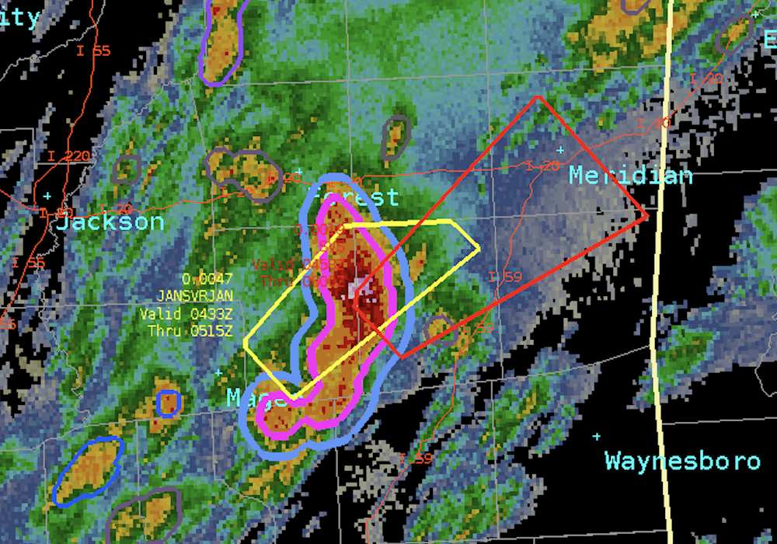
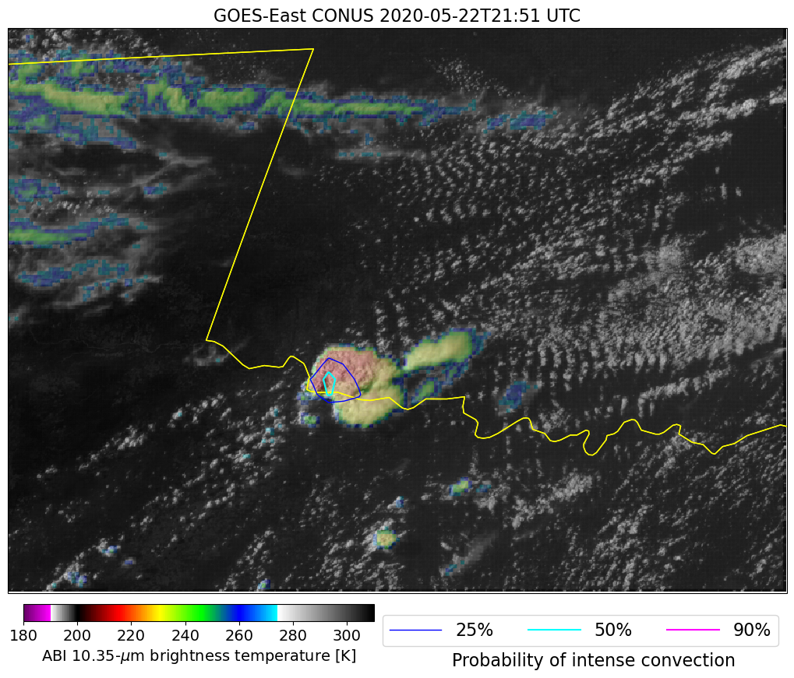
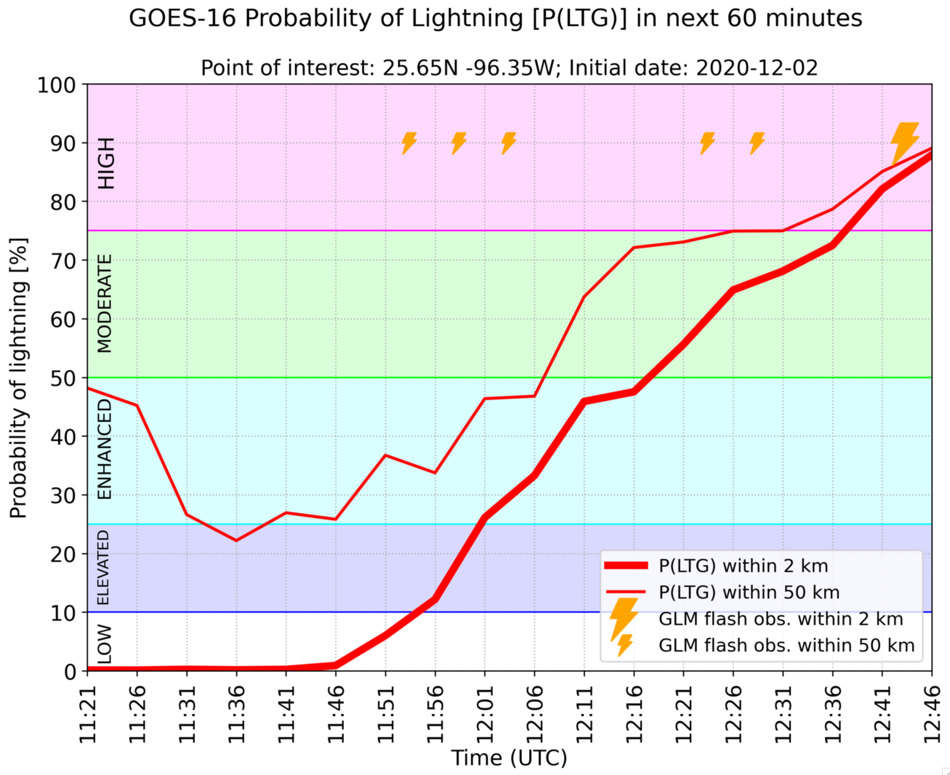
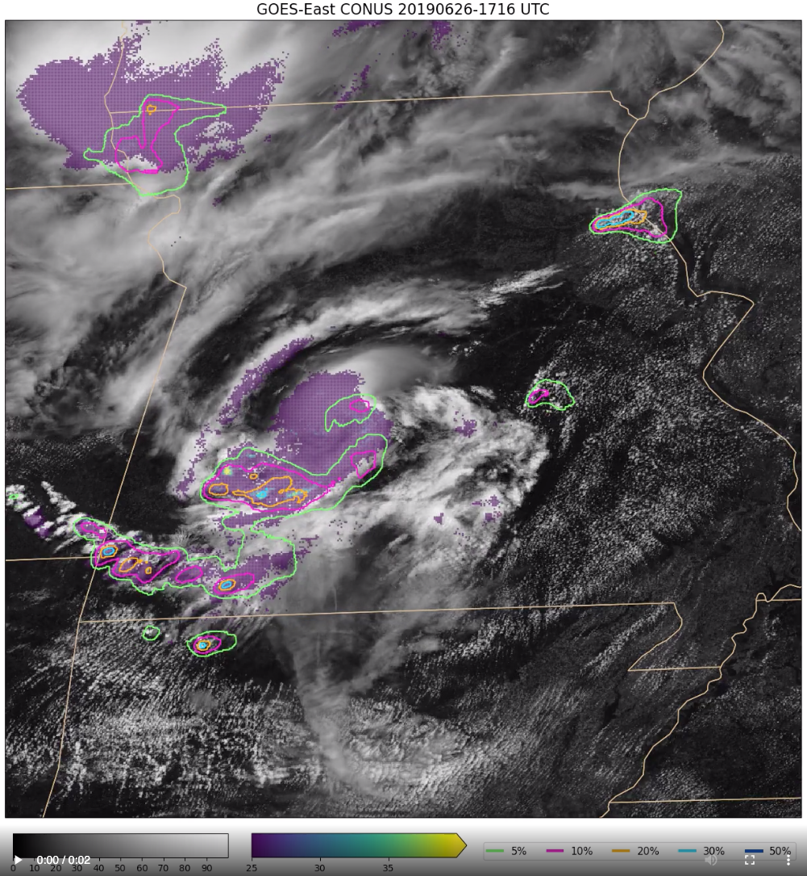
Current ProbSevere Portfolio
1. ProbSevere v2
2. Intense Convection Nowcasting
3. ProbSevere v3
v3
4. Lightning Nowcasting
5. Convective Initiation Nowcasting
Subject of this presentation
v2
Notes:
-Convective nowcasting toolkit
-All components are independent, except PSv3 utilization of ICP
In order from most mature to least mature:
ProbSevere v2: data fusion through classical ML; early R2O success of current AI/ML boom; published (operational) – many lessons learned
ICP: computer vision, ABI + GLM based CNN that identifies storms with visual indicators (OTs, AAPs, thermal couplets, lightning patterns, etc.) consistent with intense/severe storms; published (NRT)
ProbSevere v3: more sophisticated machine learning (gradient boosting machine) with additional predictors including output from the ICP model; will be demonstrated at the 2021 HWT (NRT)
Lightning nowcasting: image segmentation based CNN to generate location specific lightning nowcasts; ABI based; labels were derived from GLM
Convective initiation nowcasting: grad student is developing this model; operational implications, but also hope to use it, in tandem with other models to analyze convective activity and improve understanding of physical processes
Important points: NRT deployment is a critical part of the development and testing process, you can never do enough offline testing to emulate continuous unsupervised testing

Slide 3
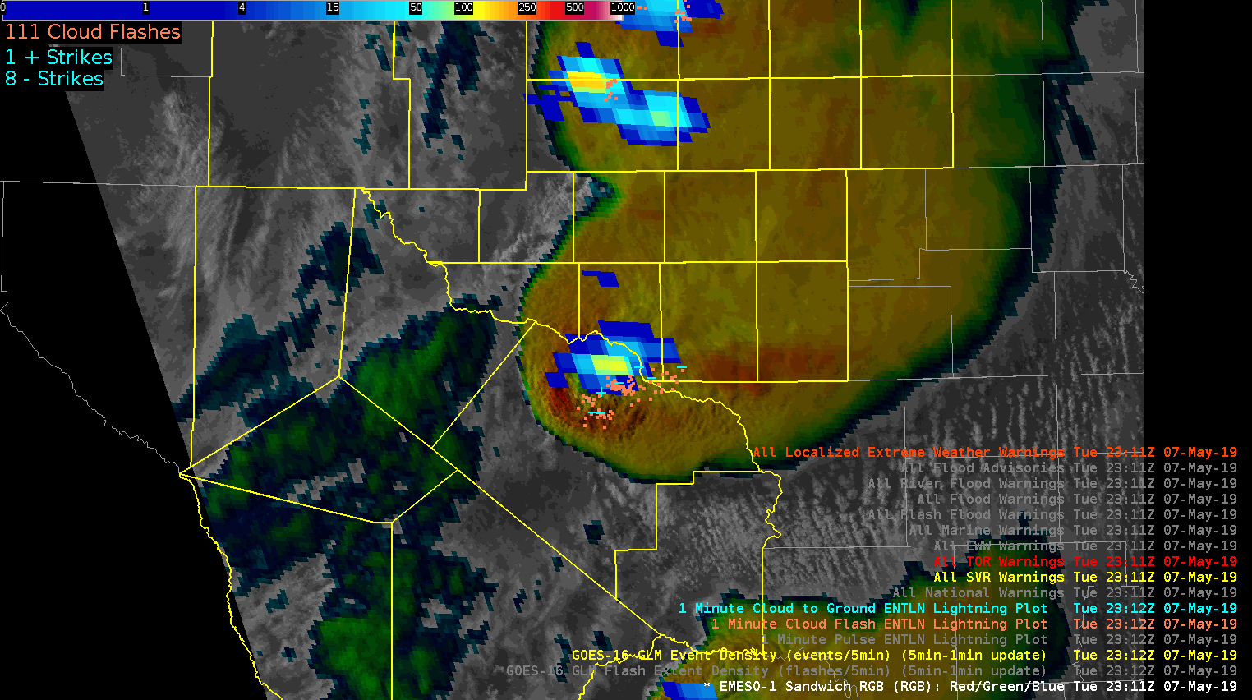
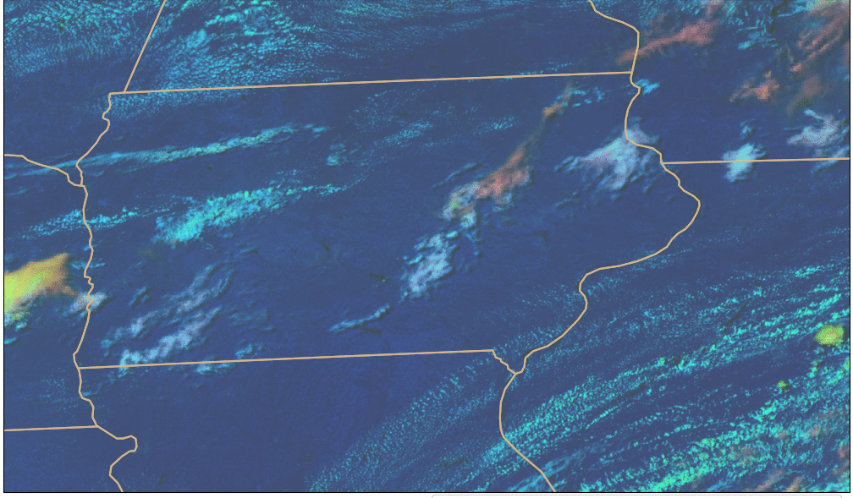
What is ProbSevere LightningCast?
GLM: where lightning is currently present
ABI: multi-spectral images of convective clouds
e.g. Elsenheimer and Gravelle 2019
ProbSevere LightningCast is an ABI-based machine learning model that predicts where the (gridded) GLM will observe lightning up to 60 minutes in the future
Notes:
-GLM observes lightning
-Human interpretation of ABI imagery has been shown to be important for nowcasting lightning, especially lightning initiation
-In short, we used a portion of the historical ABI and GLM data record (2019) to train a machine learning algorithm to analyze multispectral ABI imagery with the goal of nowcasting lightning as observed by GLM

Slide 4
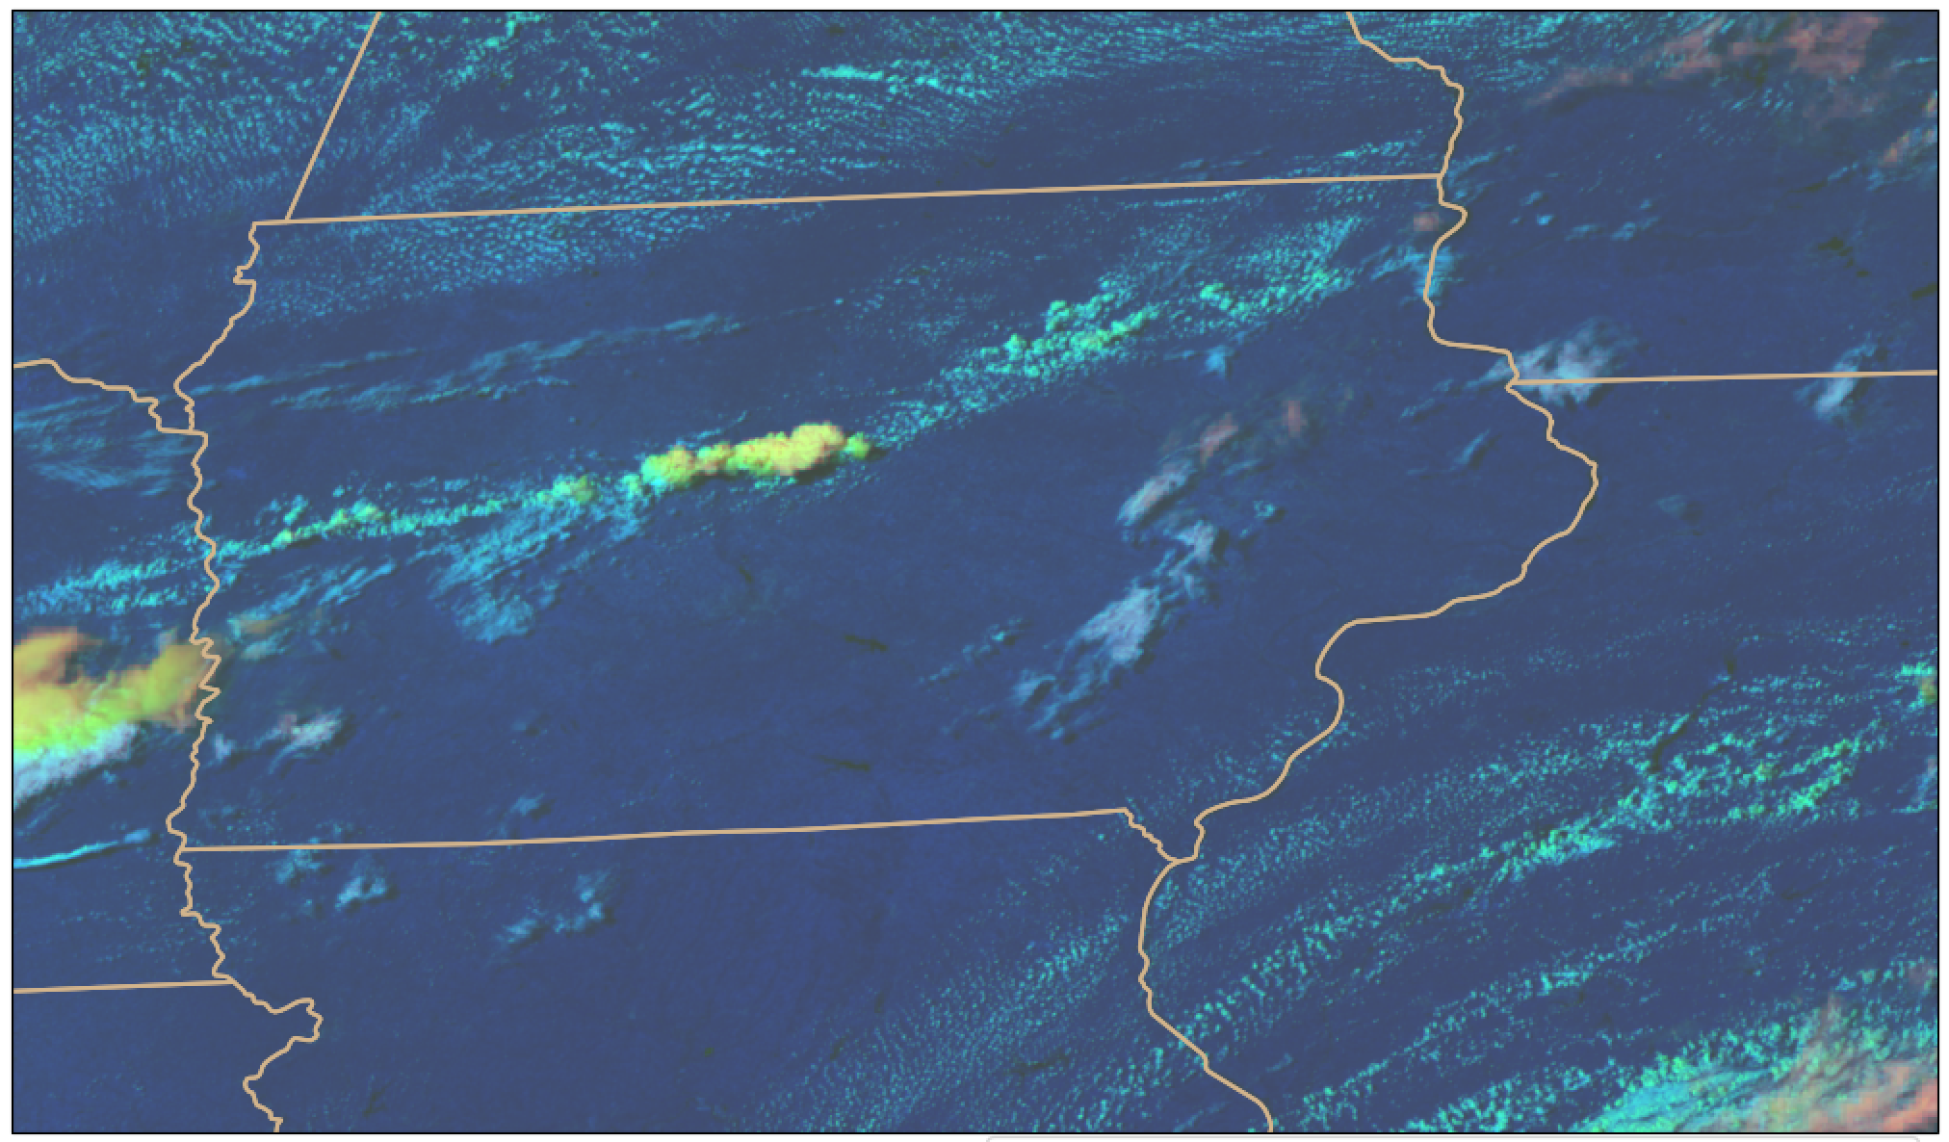
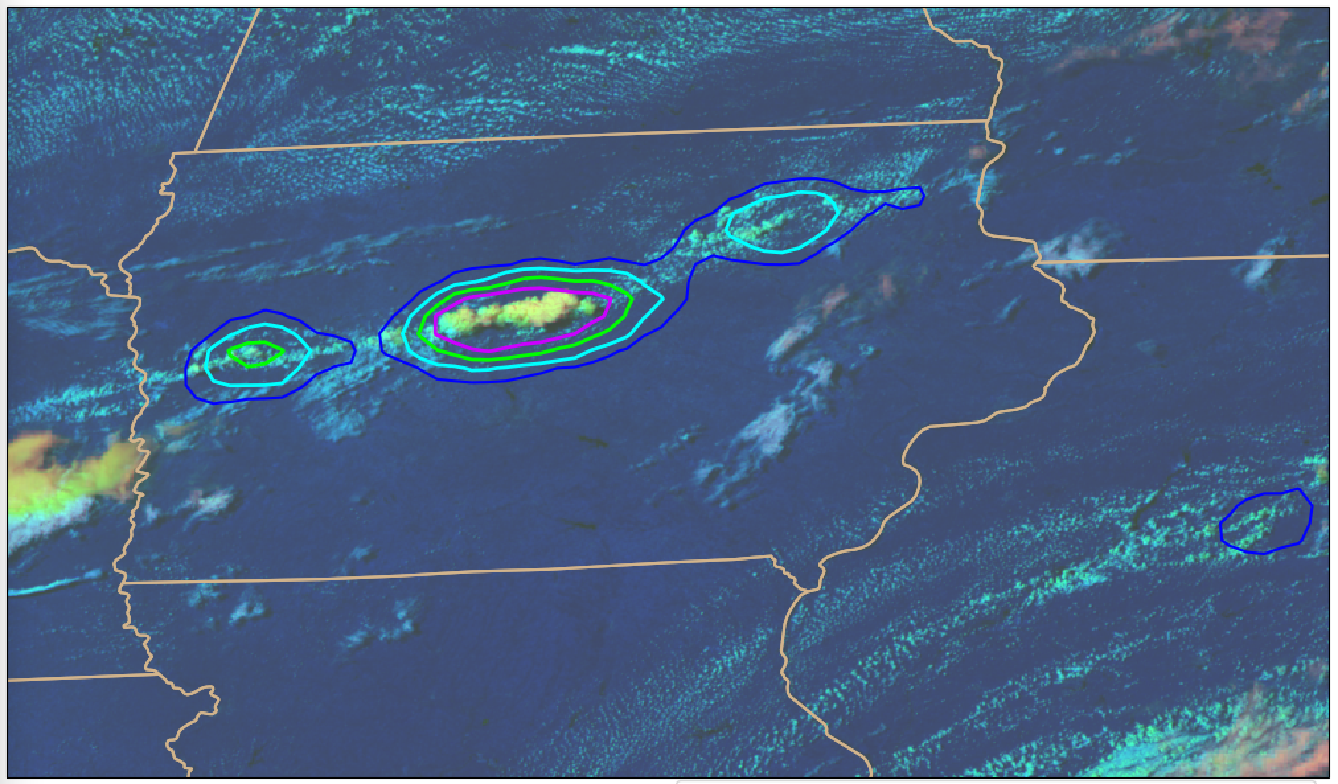
How does ProbSevere LightningCast work?
Input:
-0.64 µm reflectance (band 2)
-1.6 µm reflectance (band 5)
-10.3 µm brightness temperature (band 13)
-12.3 µm brightness temperature (band 15)
Output:
-probability that GLM will observe lightning in the next 60 minutes on the 0.5 km ABI grid
Works day and night; Applicable to any scan domain (meso, CONUS, or FD); Applicable to GOES-East (GOES-16) and GOES-West (GOES-17)
Notes:
-Same family of computer vision machine learning that is used in self driving cars
-Learns the relationship between ABI image patterns (spatial and spectral) and the location of where GLM observed any lightning in the 60 minutes that follow the ABI image time – millions of ABI images with GLM derived labels were used
-Unlike with PSv2 and PSv3, there is no feature detection or tracking; it is a pure computer vision approach (mimics how a human interprets imagery)
-Input: All channel input is at 0.5 km via oversampling
-The contribution from the reflective bands gracefully ramps down to zero at night, with no noticeable discontinuity
-Output: A 0.5 km map of probabilities is the result. The probability map is subsequently subsampled and converted into probability contours.

Slide 5
Why did we develop ProbSevere LightningCast?
The LightningCast activity was initiated in response to an OPC need
Through additional user engagement it became clear that other application areas were also underserved
Impact-based Decision Support Services (IDSS) for outdoor events
Airport and air traffic operations
Wildfire incident response
Personal decision making
The 0-60 minute GLM nowcast is the baseline LightningCast capability. Many other lightning models are possible (different time intervals, different lightning frequency thresholds, ground-based sensors, etc.).
Does the initial LightningCast model work as intended?
Notes:
-Years ago OPC asked for a convective nowcasting tool for the offshore region – akin to PSv2, without a reliance on radar
-Given the limited number of severe wx reports over the ocean, we decided to nowcast lightning, which is a reasonable proxy for convective vigor
-While working the offshore problem it became clear that lightning nowcasting was important for many other applications and there were capability gaps
-The pre-lightning initiation threat is not always obvious and determining when it is safe after storm passage is challenging

Slide 6
5 (75%) – 25 (25%) minutes of lead-time prior to first GLM flash
15 (75%) – 25 (25%) minutes of lead-time prior to first GLM flash
15 (75%) – 30 (25%) minutes of lead-time prior to first GLM flash
30 (75%) – 70 (25%) minutes of lead-time prior to first GLM flash
Notes:
-Clean example with variable lead-time in the midwest
-The lead-time is a function of how rapidly the storm develops

Slide 7
Notes:
-Missouri

Slide 8
Comparison to NEXRAD radar
N. Indiana
Visible/infrared “sandwich” + LightningCast contours
Visible/infrared “sandwich” + composite radar
Spatially coherent LightningCast signals often precede early radar indicators of convective and lightning initiation
Notes:
-Storms in N. Indiana with composite reflectivity
-Not an extreme example

Slide 9
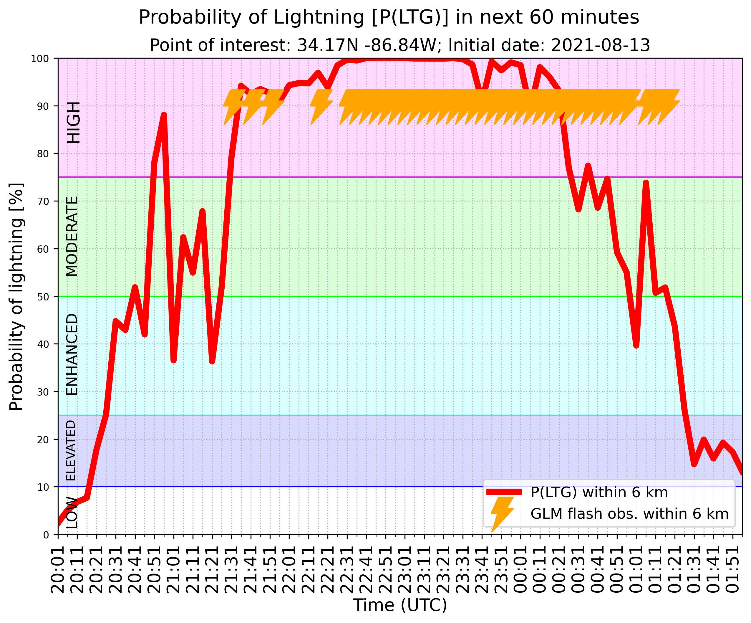
IDSS Example – “Rock the South,” Cullman, AL
Notes:
-Good example of day/night transition and how the model handles lightning potential near the end of a convective event
-Note the SW elongation of the higher probabilities that captures the last gasp of stratiform lightning
-Giving the “all clear” is equally important and challenging

Slide 10
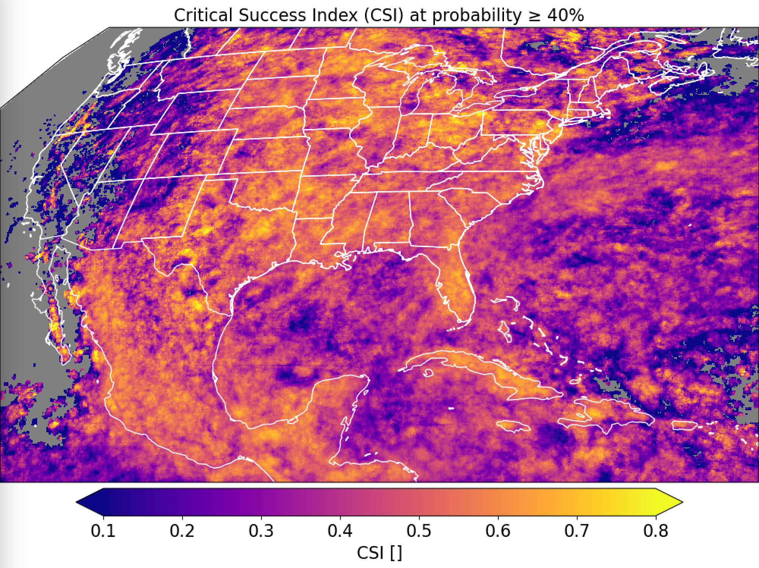
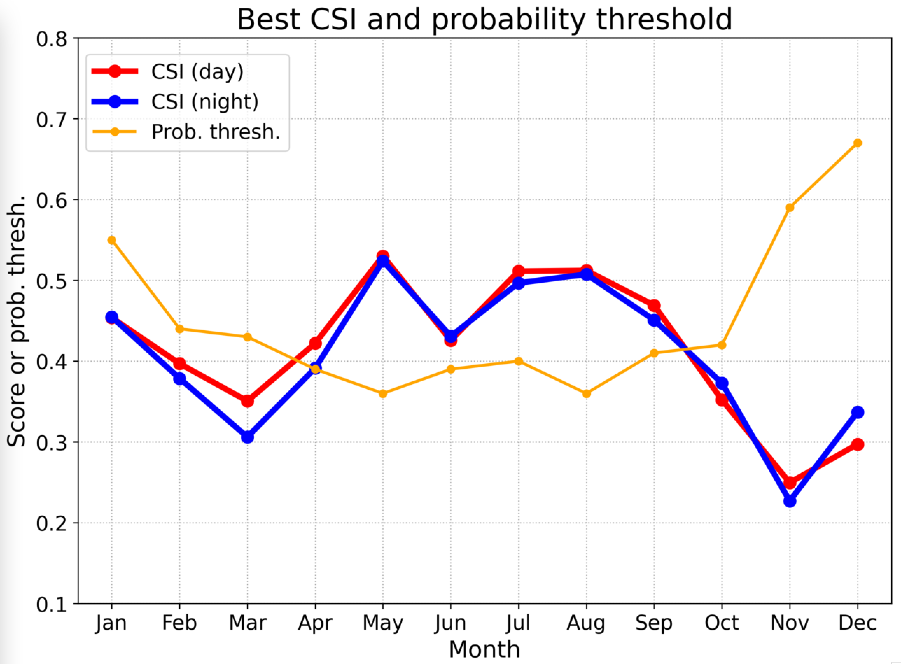
Verification - GOES-16
Seasonal performance
Critical success index for probability > 40%
Notes:
-2020 – completely independent
-Lower scores are most often associated with regions where GLM observed very little lightning, some of which is due to detection efficiency issues
-So yes, the model is working as intended

Slide 11
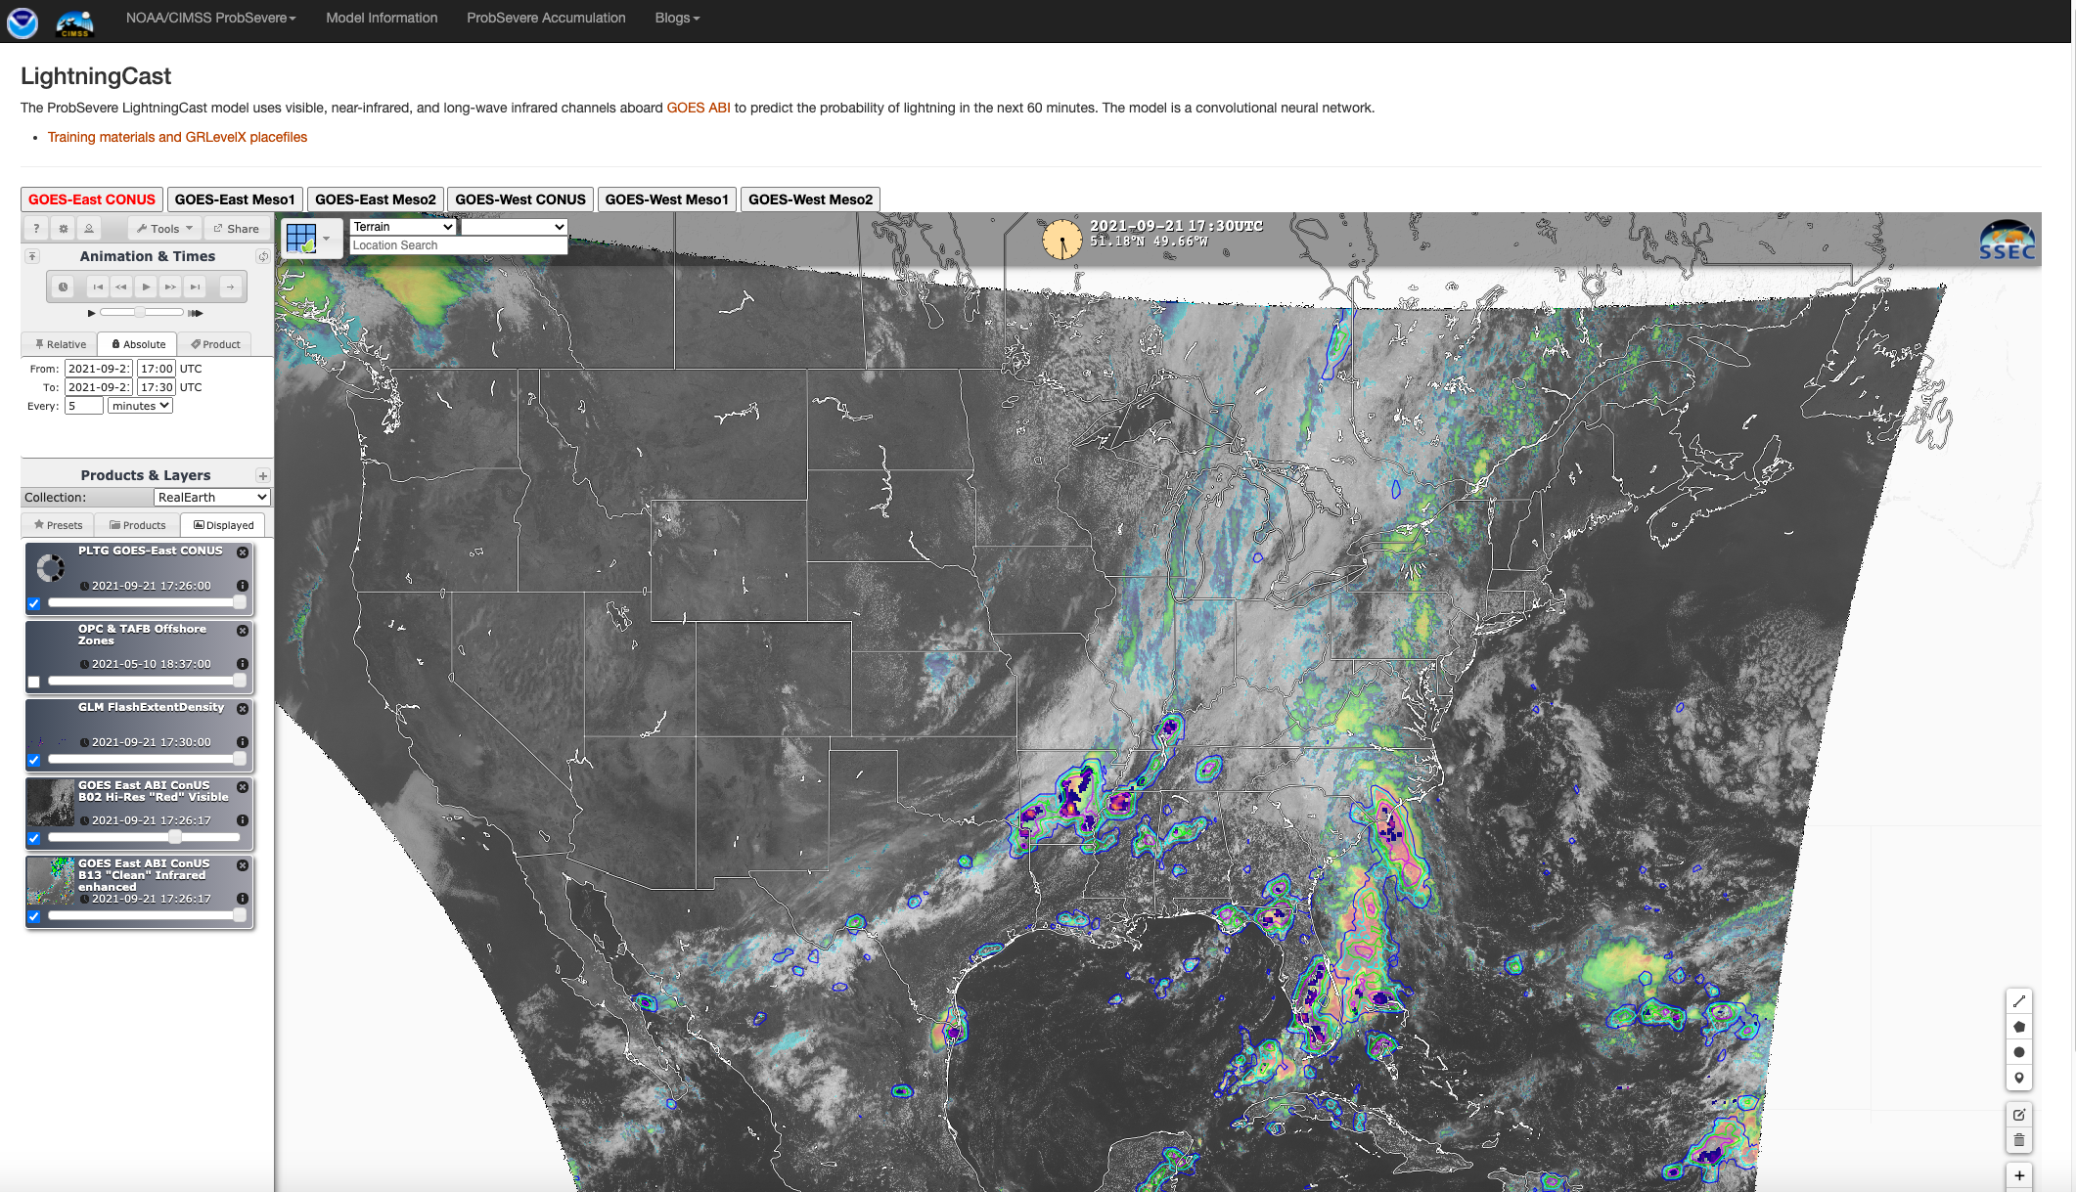
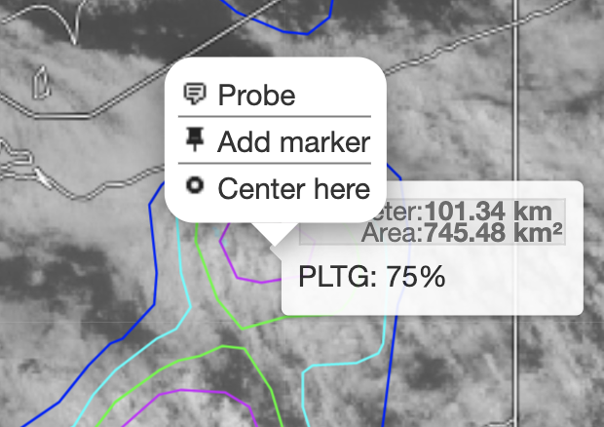
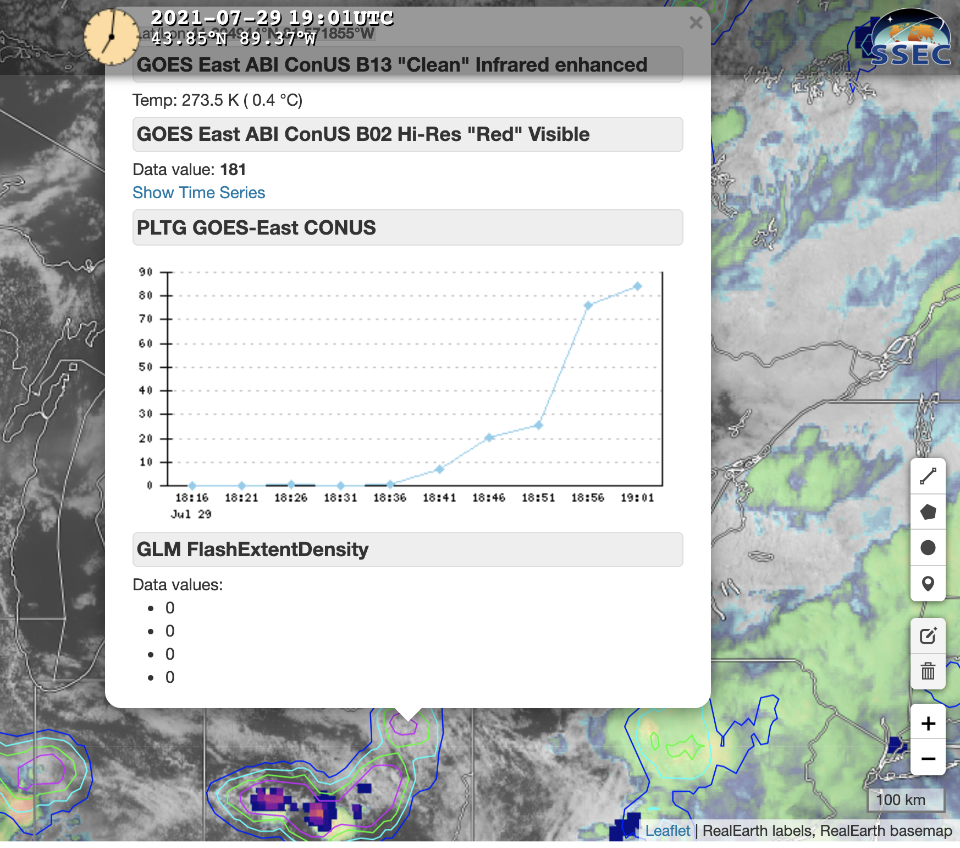
ProbSevere LightningCast Availability
Near real-time output is available via this link
CONUS: ~30s after end of scanning
MESO: ~3s after end of scanning
Link to additional info and GRLevelX Placefiles (parallax corrected contours for radar overlay)
Right click on map
Notes:
-RealEarth is a web mapping service so you can zoom as needed

Slide 12
ProbSevere LightningCast: Summary/Next Steps
Unique quantitative exploitation of GOES-R data: ~30 minutes of lead-time relative to first occurrence of GLM detected lightning
AI tools are not a replacement for human expert analysis, but they enable consistent, efficient, and timely decision-making
User evaluations (OPC/TAFB/WFOs/CWSUs/AWC) will dictate further development of model, user interfaces, and dissemination mechanisms
The existing ProbSevere v2 AWIPS plug-in can be used to display LightningCast contours, but only if v2 ingest is disabled (seeking resolution/alternatives for AWIPS display)
Possible ConOps: deploy LightningCast software on AWIPS boxes
Notes:
-Unique exploitation of GOES-R that provides 10-50 minutes of lead-time ahead of the first occurrence of lightning (~30 minutes is a typical lead-time); systematic and objective
-Does not replace human expert analysis for IDSS, but it may improve efficiency, lead-time, and enable a great focus on hazard communication (uniquely human)
-Now that a sufficiently mature and proven model has been deployed, user feedback will dictate further development of the model, user interfaces, and dissemination mechanisms
-Evaluation plans – OPC/TAFB, WFOs, CWSUs, maybe AWC
-Plan for AWIPS
-Possible ConOps – deploy the software on AWIPS boxes so no additional bandwidth is used

Slide 13
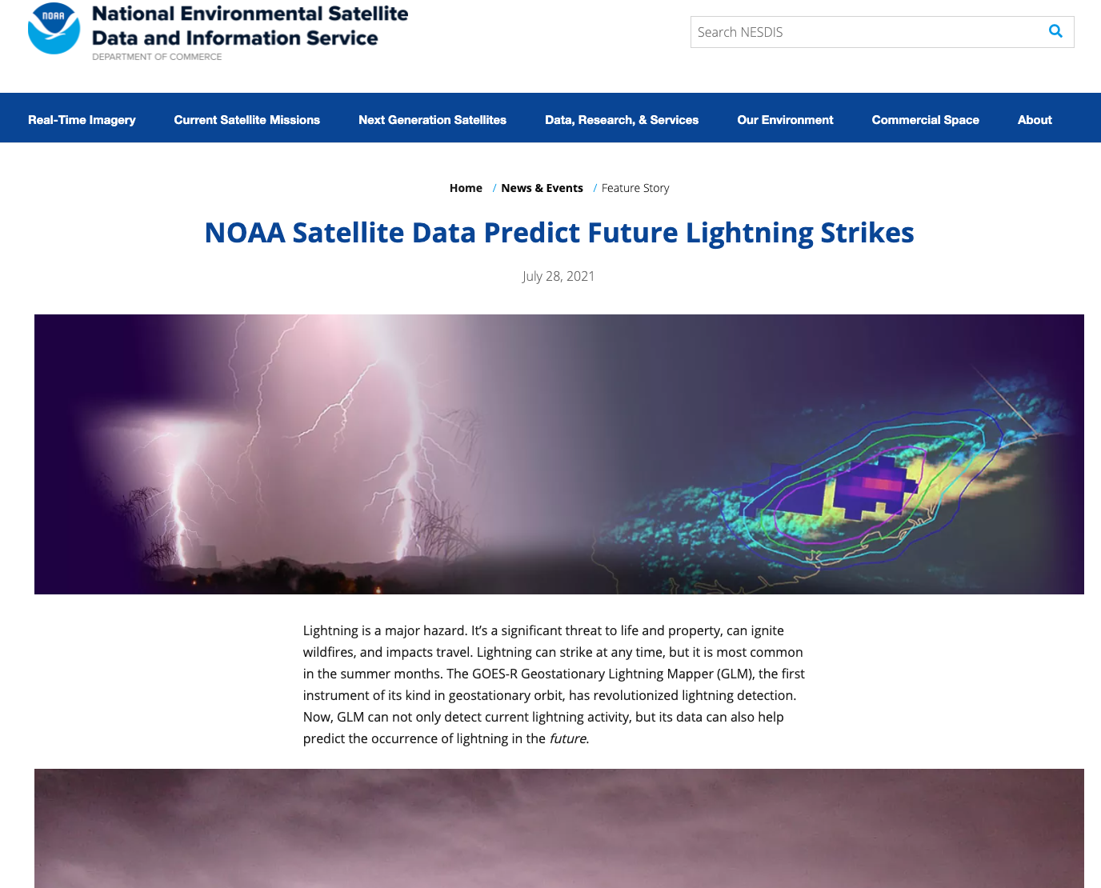
For additional information on ProbSevere LightningCast see this NESDIS news story

Slide 14
Backup Slides

Slide 15
ProbSevere Information
ProbSevere v2.x via Web Mapping Service:
https://cimss.ssec.wisc.edu/severe_conv/probsev.html
ProbSevere v2.x Description:
https://journals.ametsoc.org/view/journals/wefo/35/4/wafD190242.xml
https://cimss.ssec.wisc.edu/severe_conv/training/recorded/ProbSevere2019/presentation_html5.html
ProbSevere Case studies:
http://goesrhwt.blogspot.com/
ABI + GLM Deep Learning Model for Severe Weather Nowcasting:
https://journals.ametsoc.org/view/journals/wefo/35/6/waf-d-20-0028.1.xml
https://cimss.ssec.wisc.edu/satellite-blog/archives/tag/icp
ABI Deep Learning Model for Lightning Nowcasting:
https://cimss.ssec.wisc.edu/satellite-blog/archives/38136
Additional Resources (including addition references):
https://cimss.ssec.wisc.edu/severe_conv/training/training.html

Slide 16
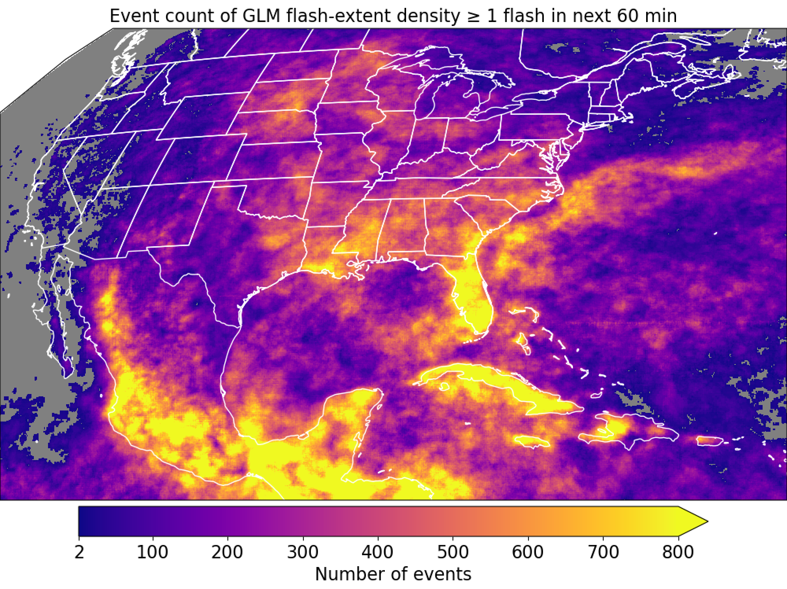
GOES-16

Slide 17
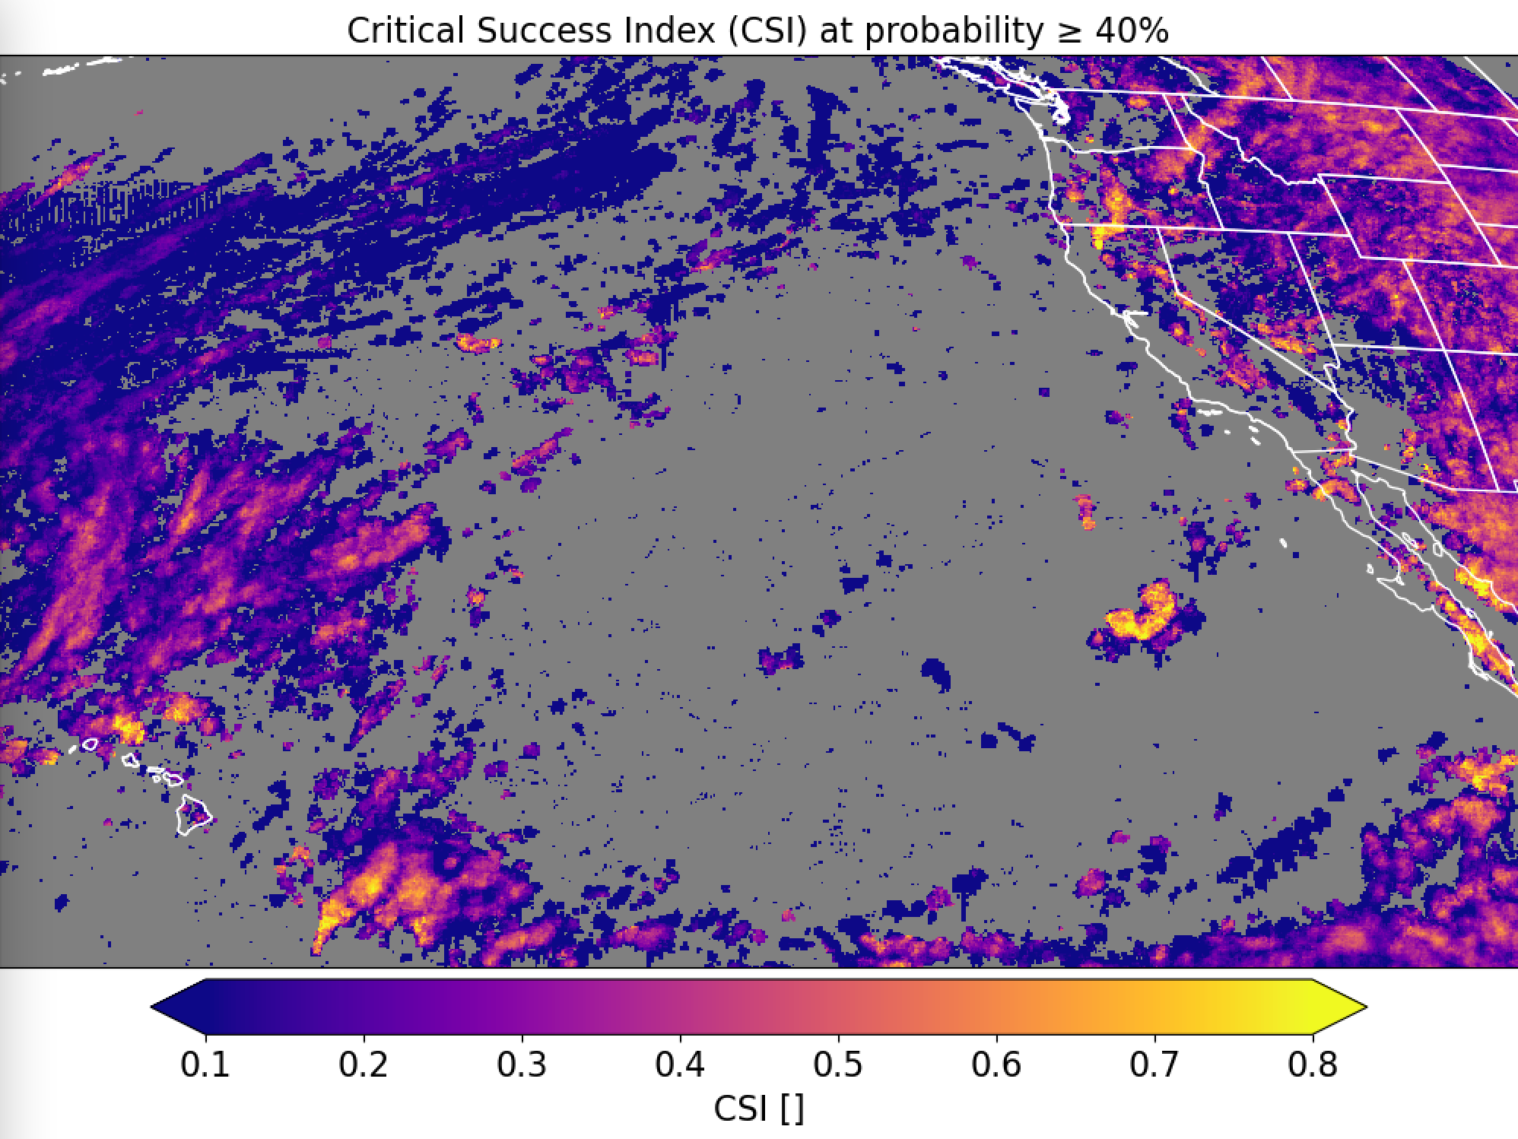
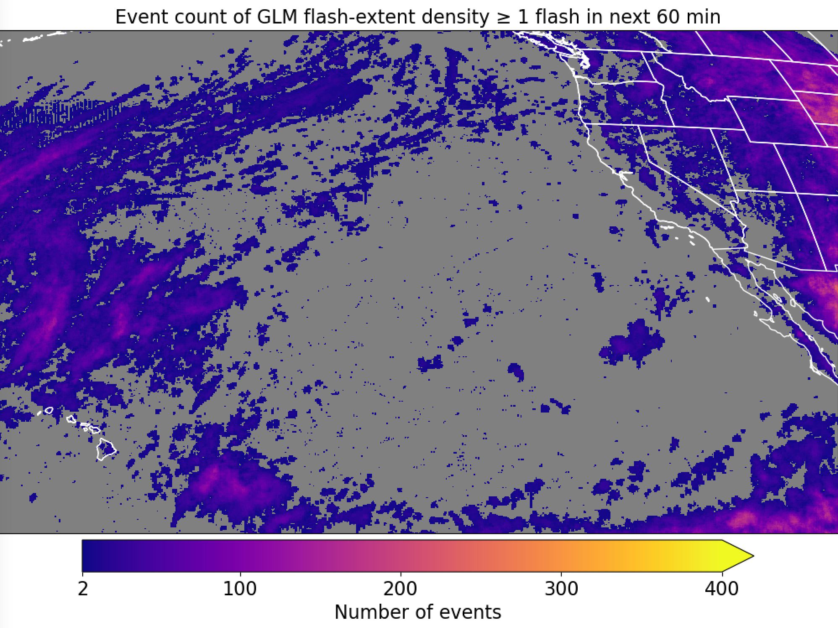
GOES-17
Trained on GOES-16 (CH02 + CH05 + CH13); evaluated on GOES-17

Slide 18
Notes:
Rock the South outdoor music festival - Huntsville

Slide 19
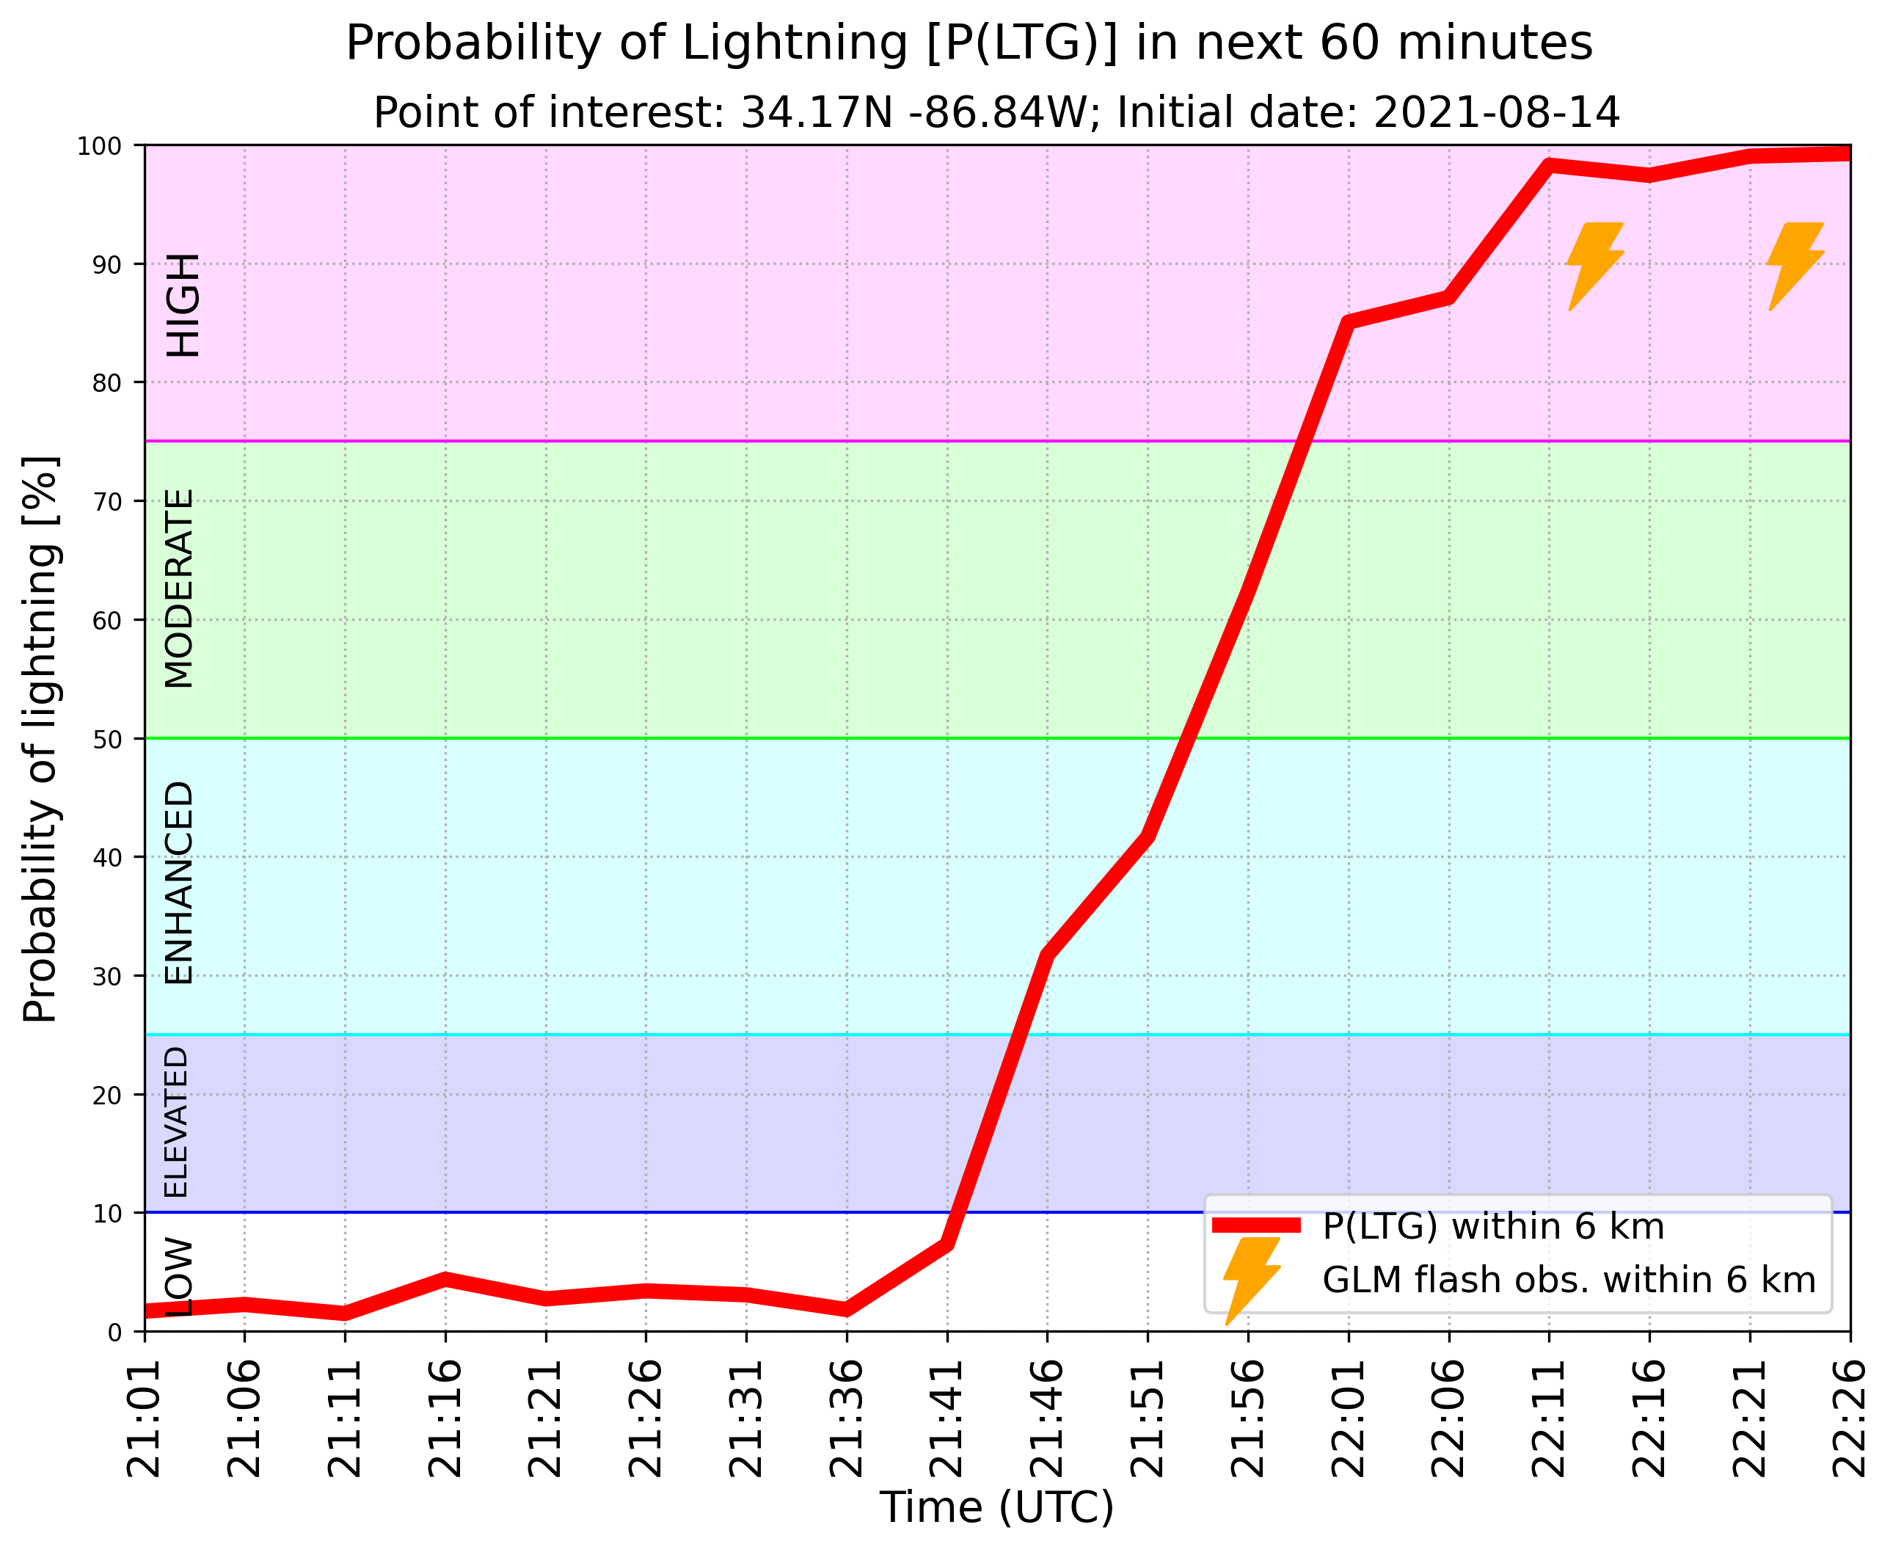
Convective rain evident on radar

Slide 20
Notes:
Nothing specific to point out here. Different regime and sat viewing angle.

Slide 21
Notes:
Early morning example with thick cloud cover

Slide 22
Notes:
Sea-breeze example

Slide 23
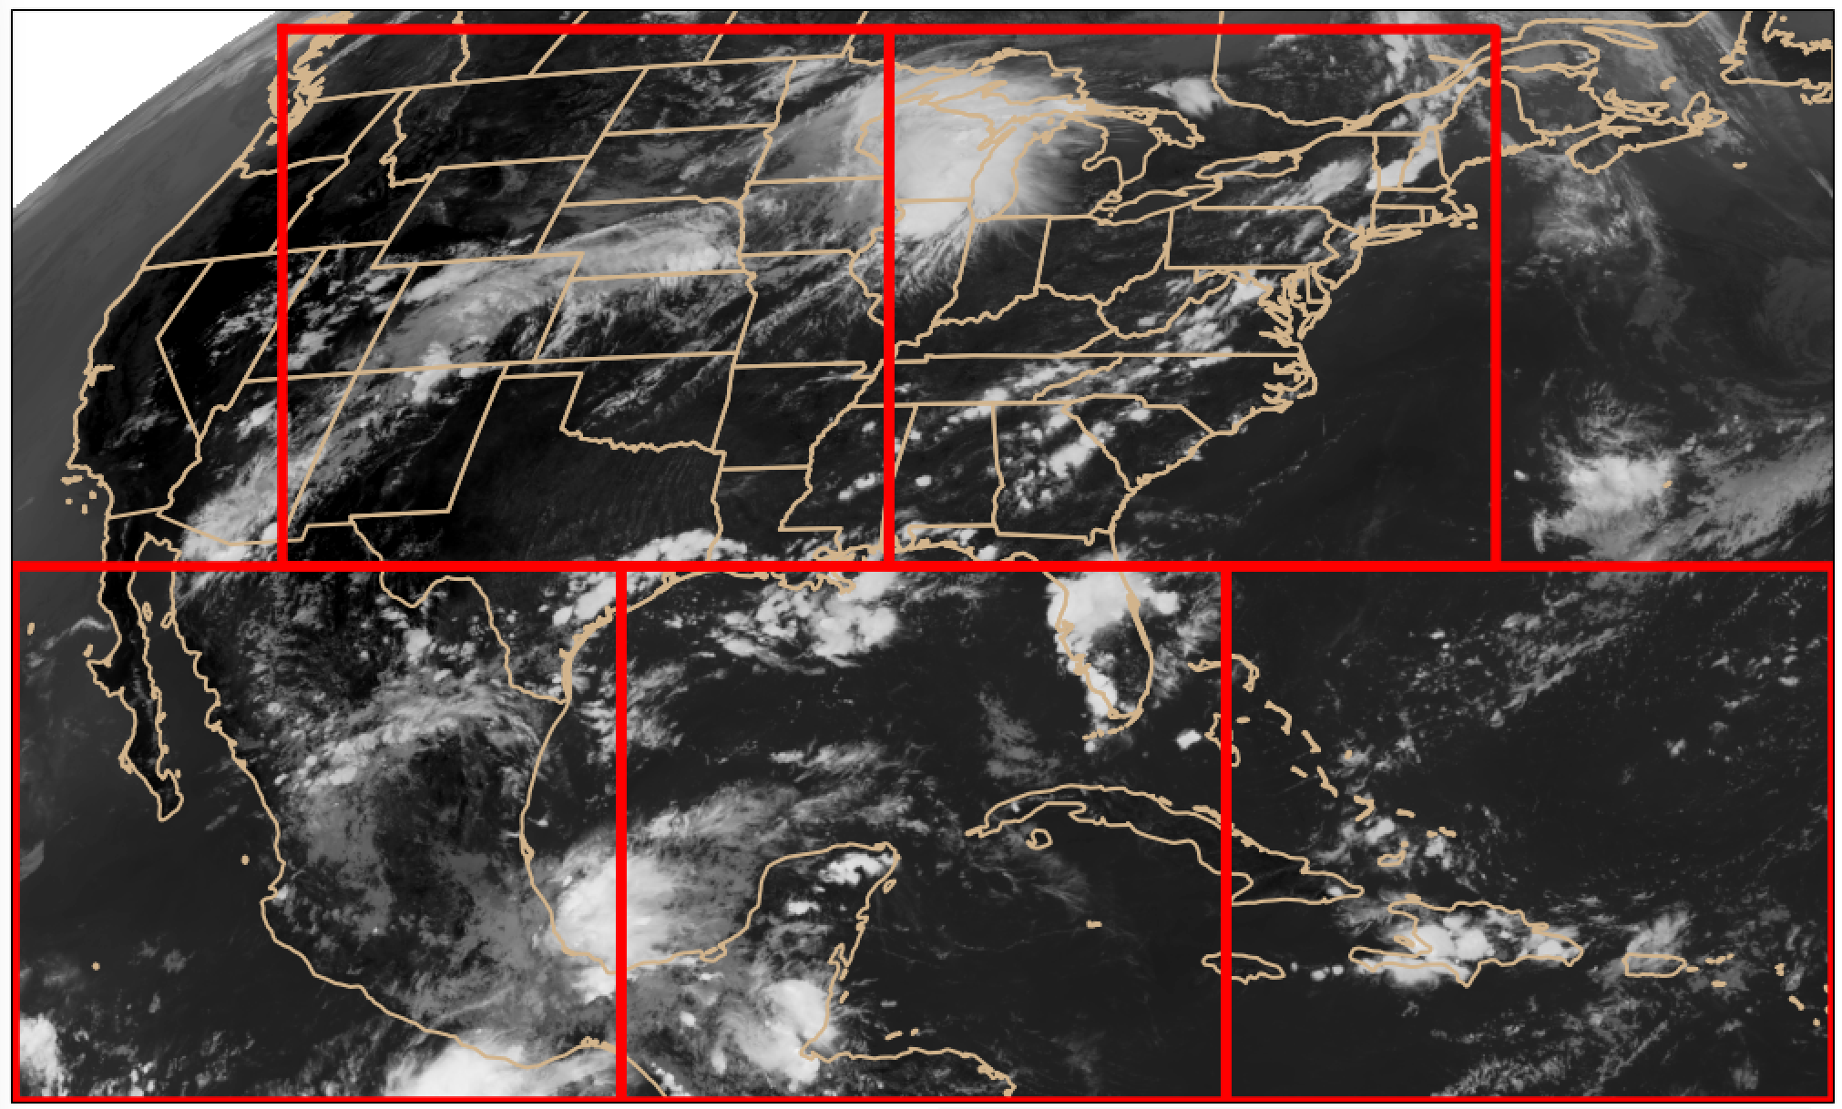
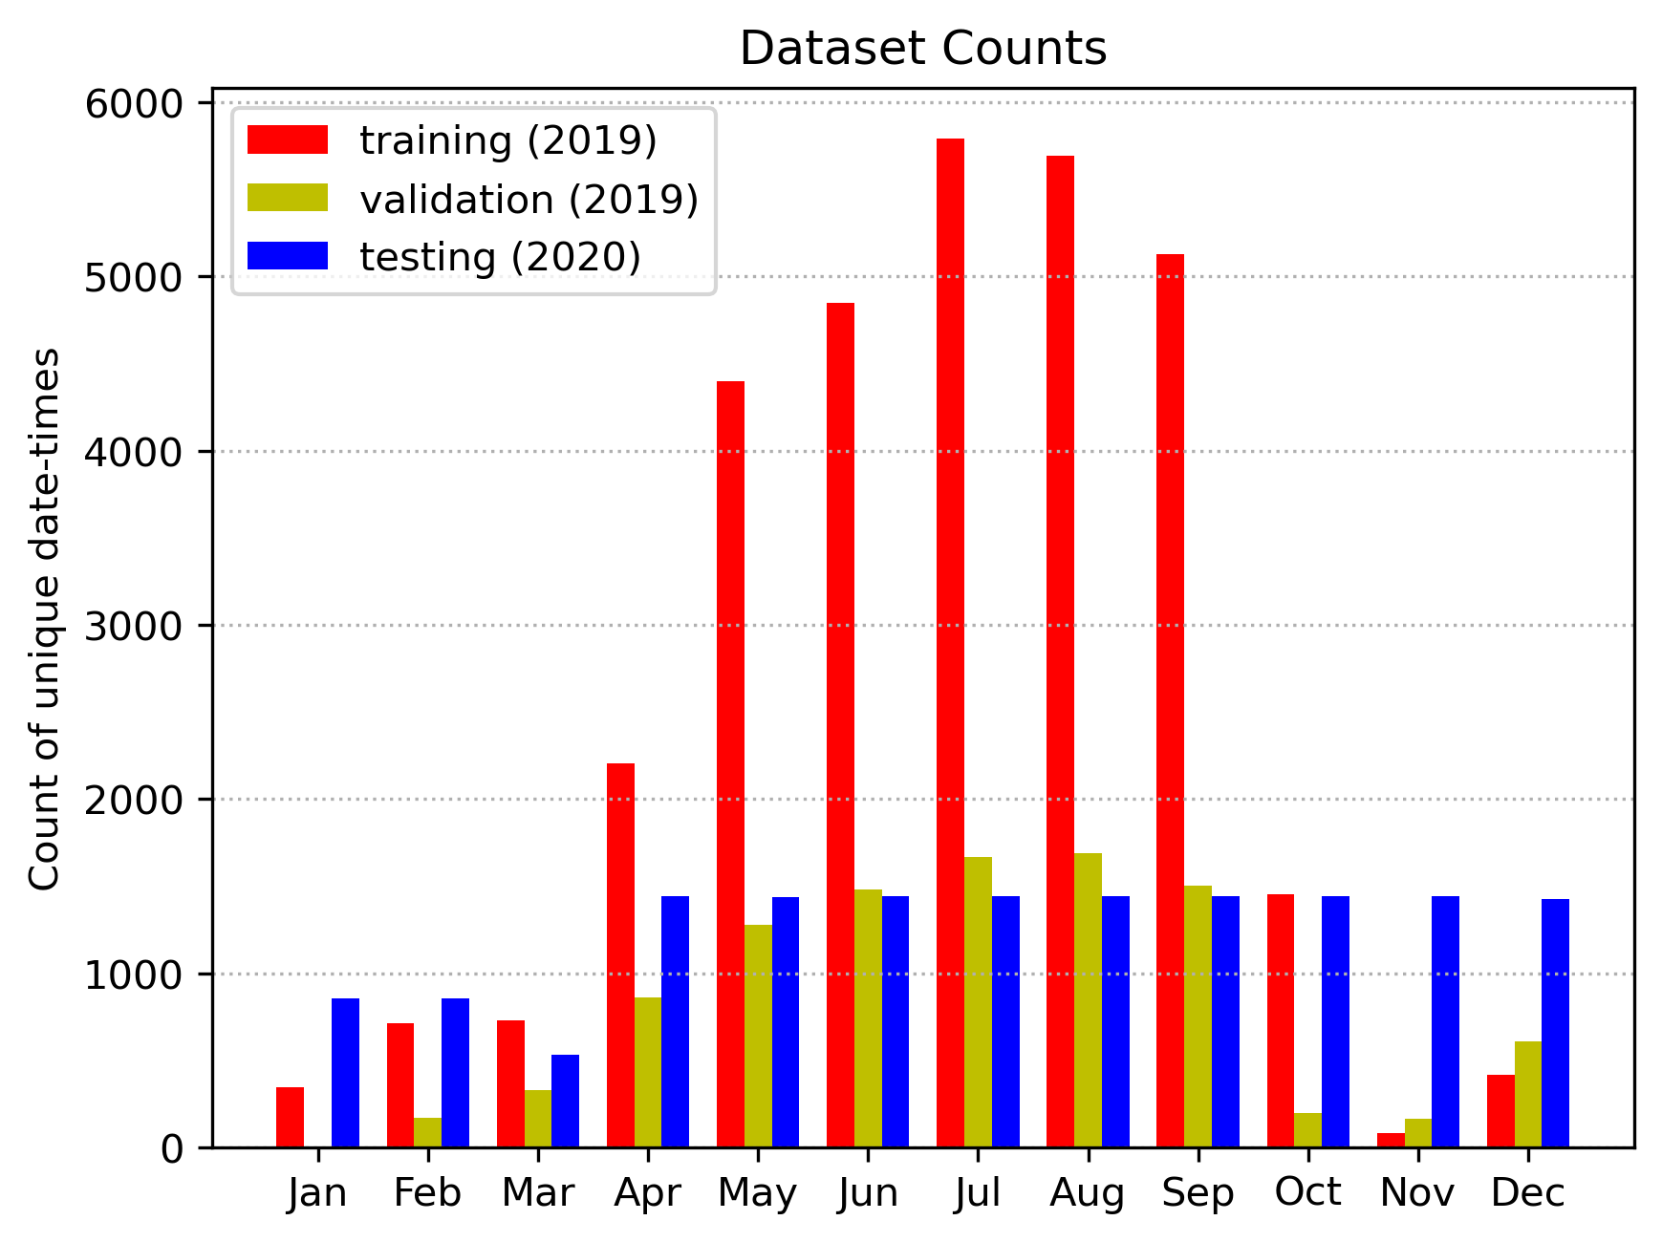
Training and validation data
Training/validation domain: 5 patches from GOES-16 ABI CONUS sector
76,031 training samples
22,539 validation samples

Slide 24
Model: Semantic segmentation, or “U-Net” (Ronneberger et al. 2015)
values indicate layer depth
256
128
128
64
64
32
32
4
16
Input
Conv 3x3 + ReLU
Max-pooling
Upsampling
Concatenation
Conv 1x1 + Sigmoid
16
1

Slide 25
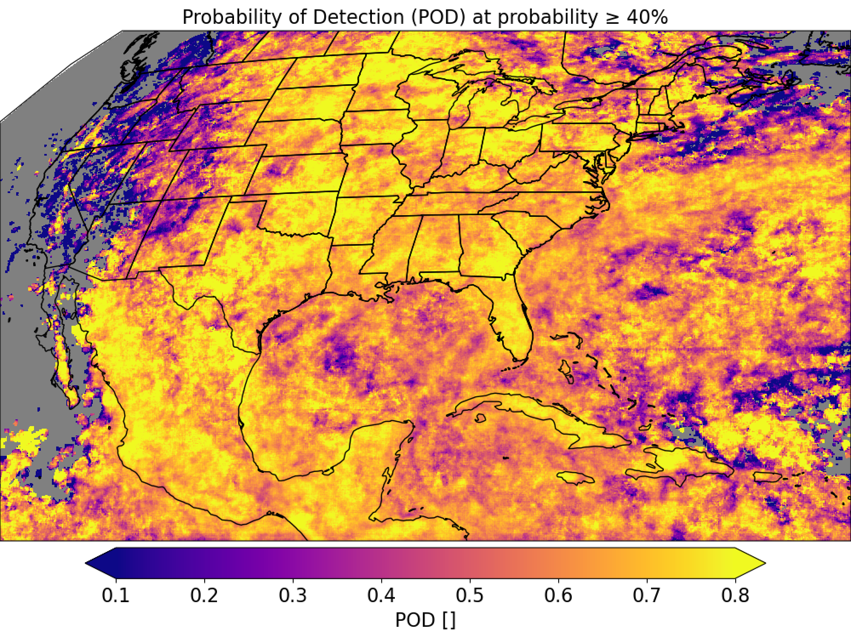
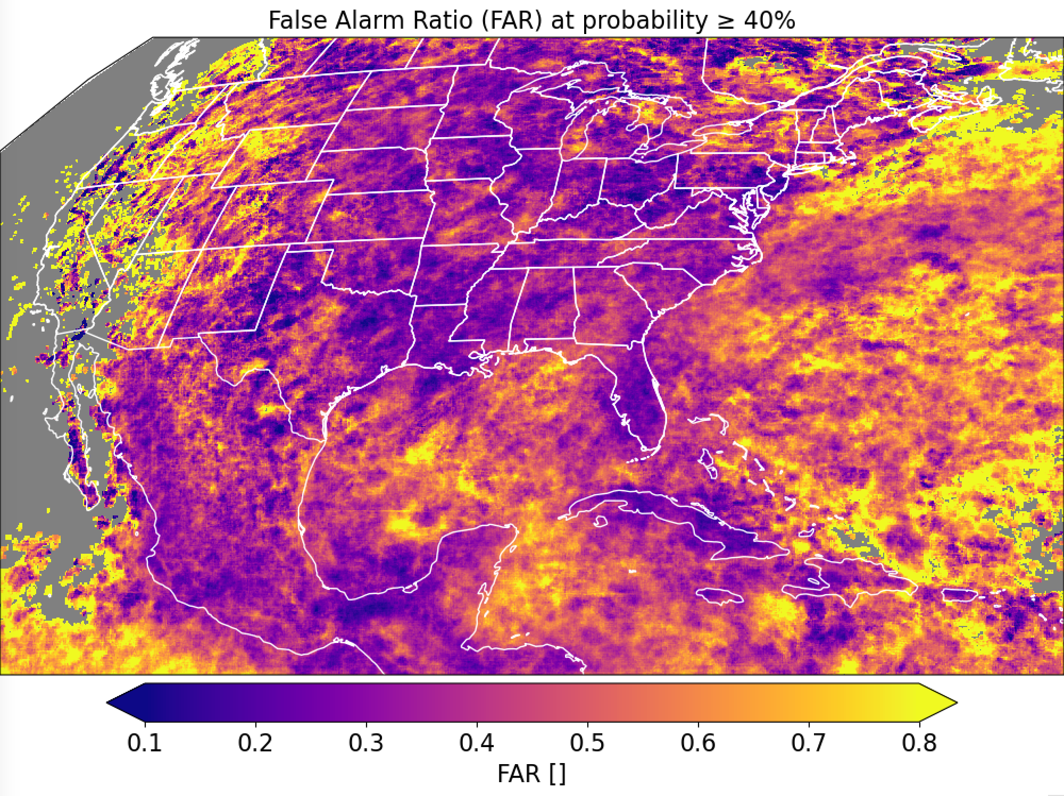
GOES-16

Slide 26
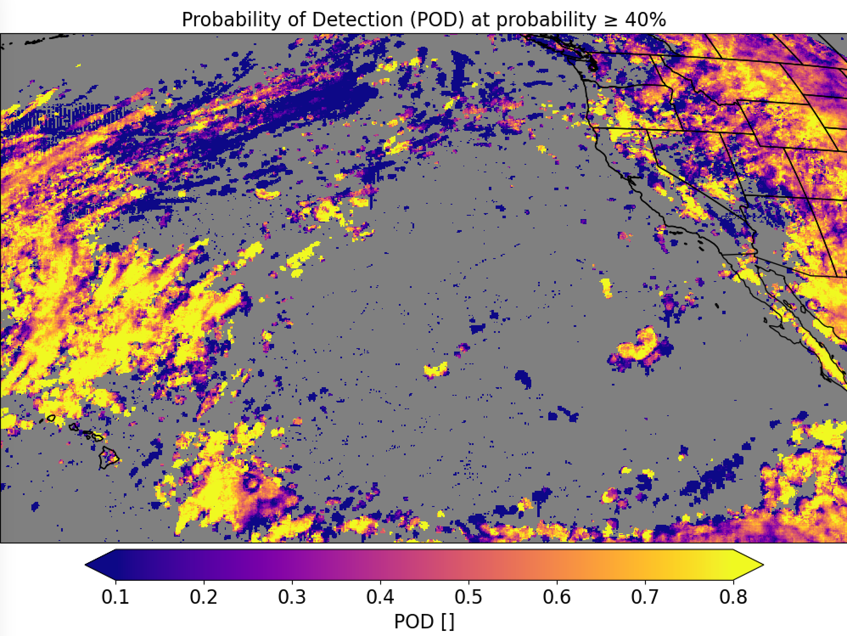
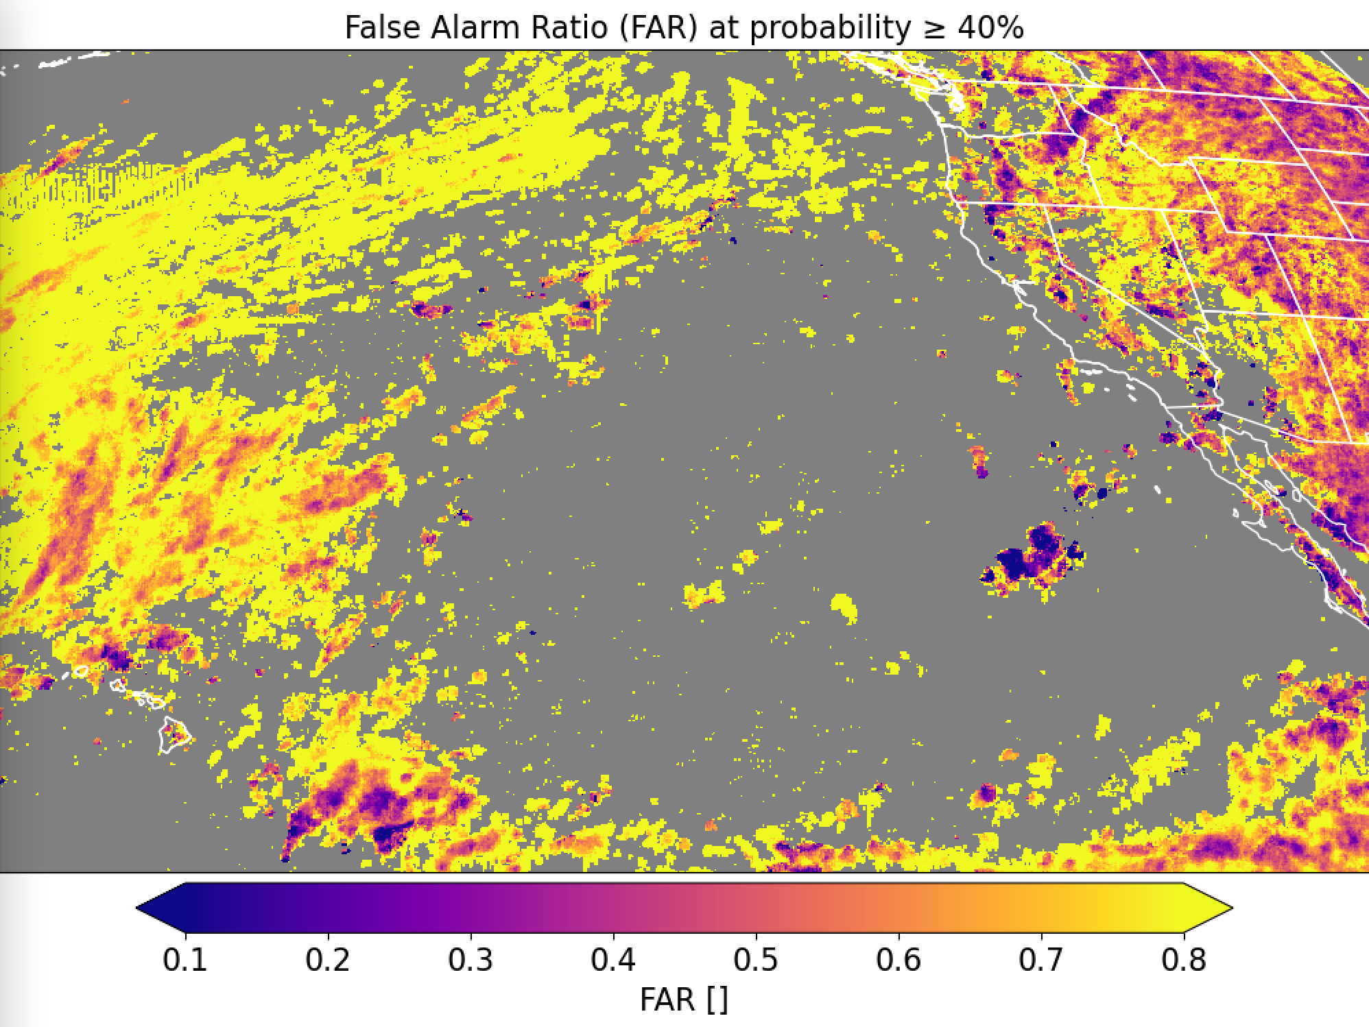
GOES-17
Trained on GOES-16 (CH02 + CH05 + CH13); evaluated on GOES-17

Slide 27
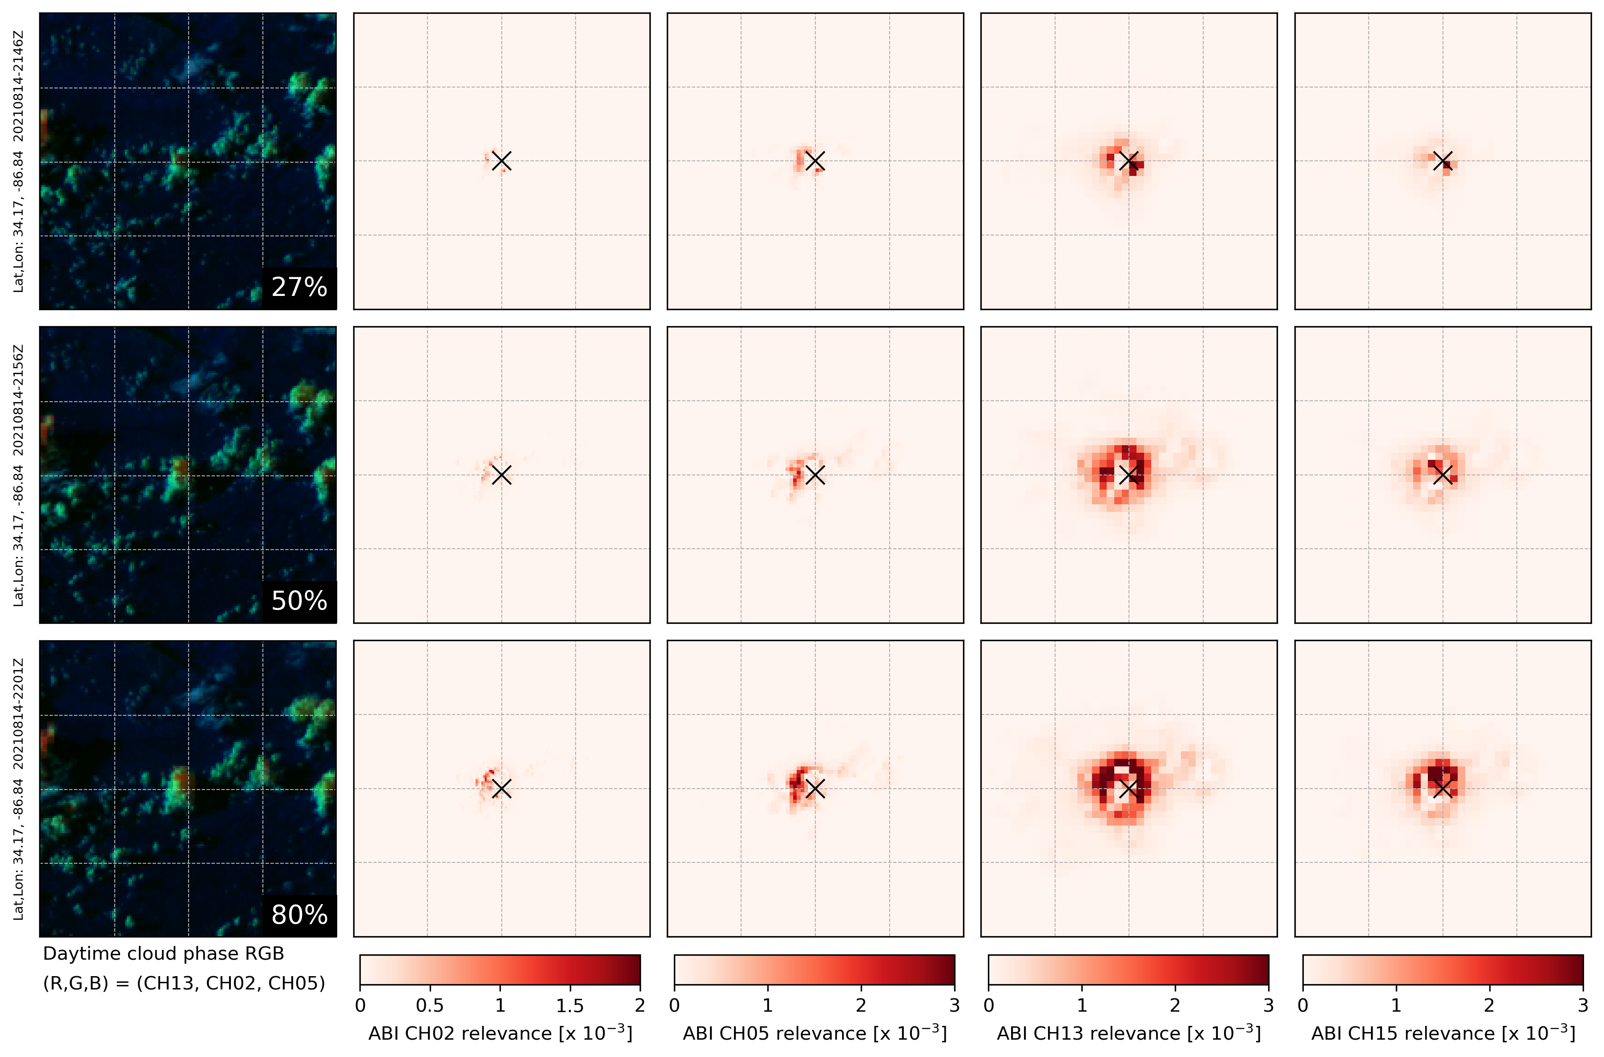
21:46Z
21:56Z
22:01Z

