Slide 1
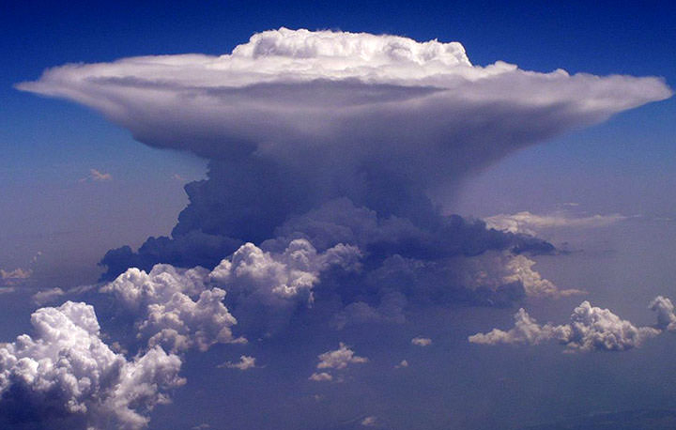
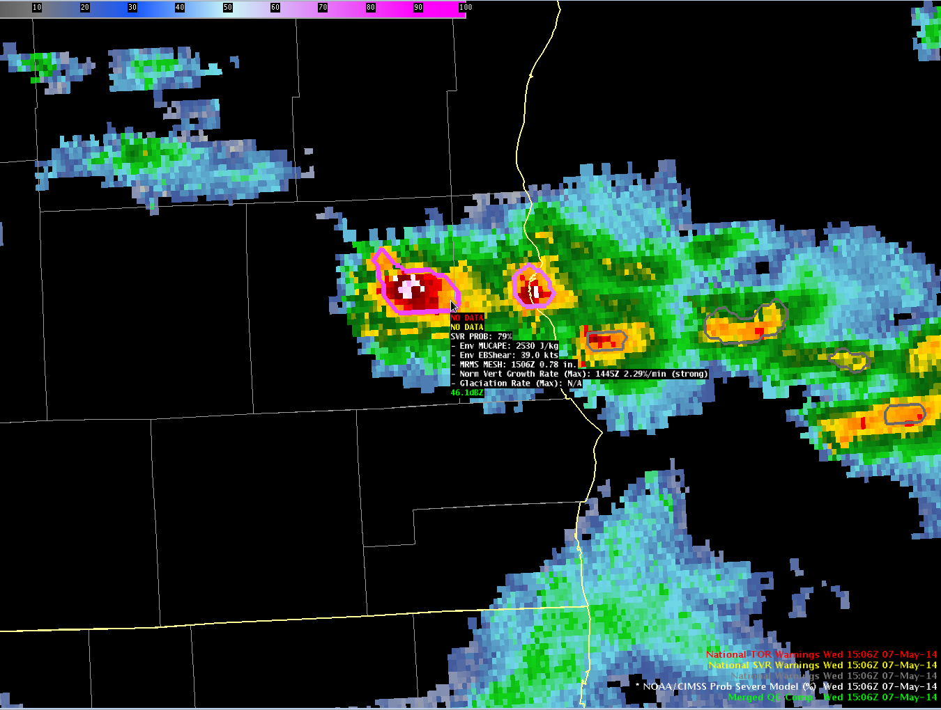
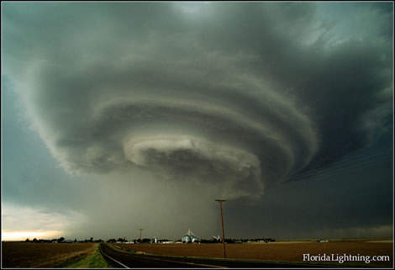
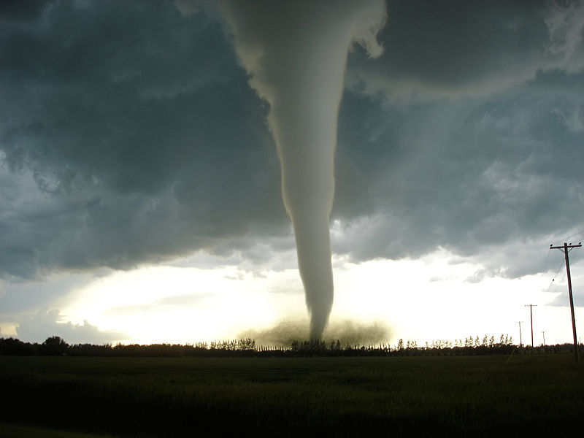


From “Big Data” to Actionable Information:
NOAA/CIMSS ProbSevere model
Michael J. Pavolonis
Physical Scientist
National Environmental Satellite, Data, and Information Service
Center for Satellite Applications and Research
10 June 2015

Slide 2

Collaborative Research
Dan Lindsey (NOAA/NESDIS/STAR)
John Cintineo (UW-CIMSS)
Justin Sieglaff (UW-CIMSS)
Jordan Gerth (UW-CIMSS)
Lee Cronce (UW-CIMSS)
Eric Loken (UW-AOS)

Slide 3
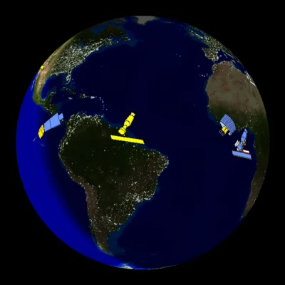
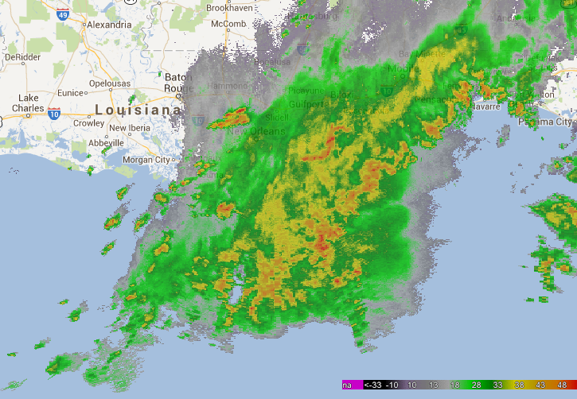
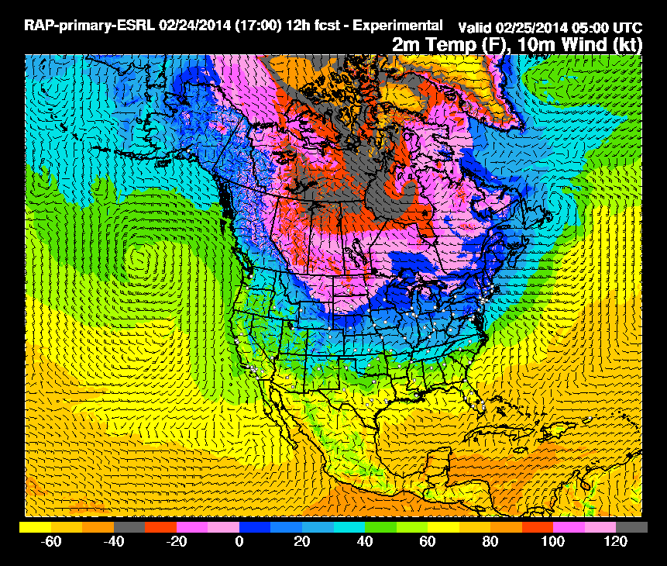
Collecting large volumes of data alone does not directly address any natural hazard problem, the data must be converted into actionable information using science and computers.
Satellite
Radar
High-res Numerical Models
Notes:
We’re in an era of ‘big data’. Our observation systems are becoming more numerous, with larger domains, greater spatiotemporal resolution, and more capabilities. <paraphrase box>. We have to distill the mountains of data into useful information.

Slide 4
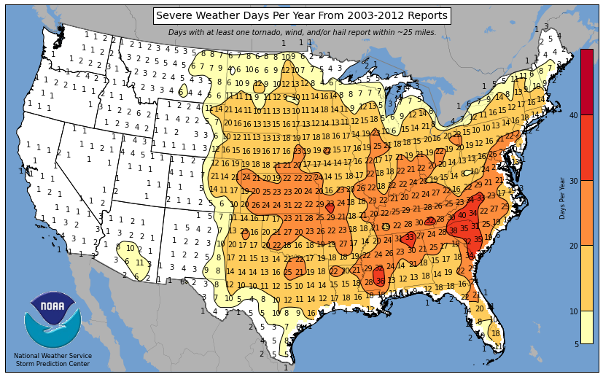
Notes:
Severe weather is common in the U.S.

Slide 5
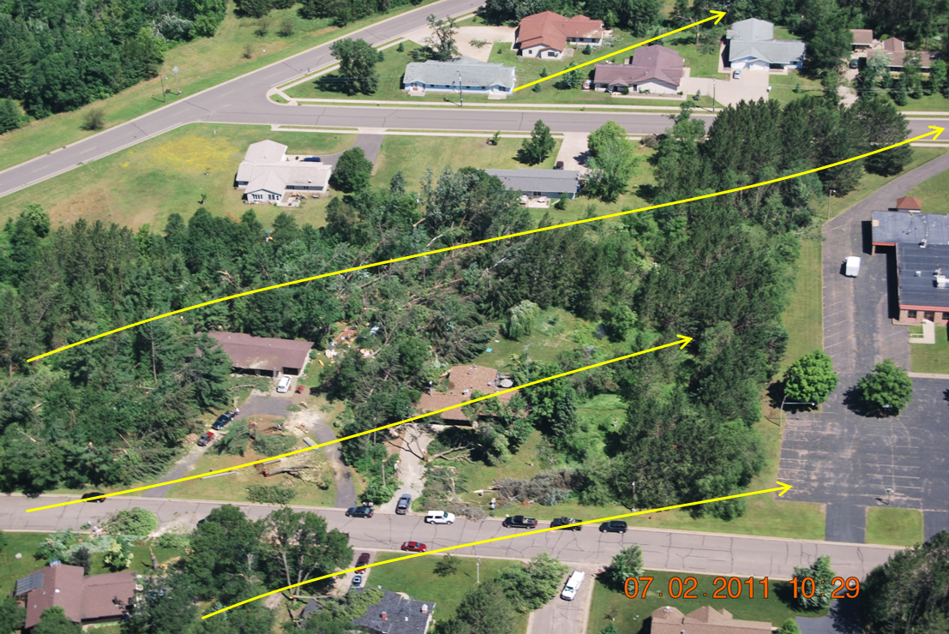
Wind gusts of 58 mph or greater or structural wind damage
NWS Duluth, MN

Slide 6
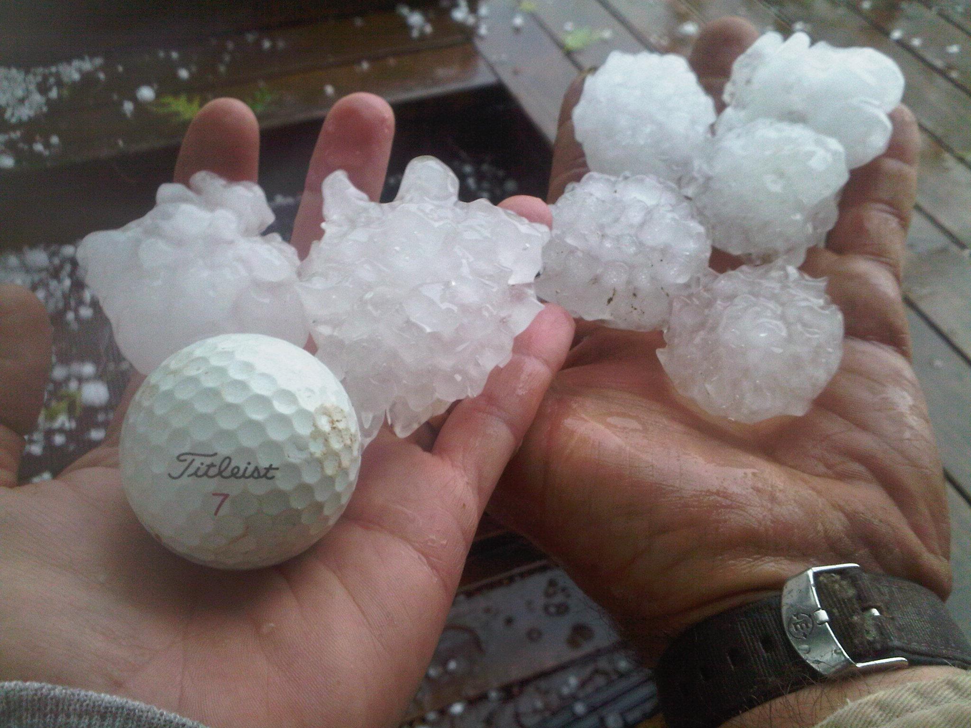
Hail 1 inch in diameter or greater
KY3

Slide 7
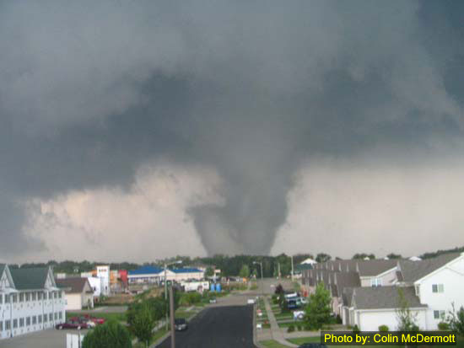
Tornadoes

Slide 8
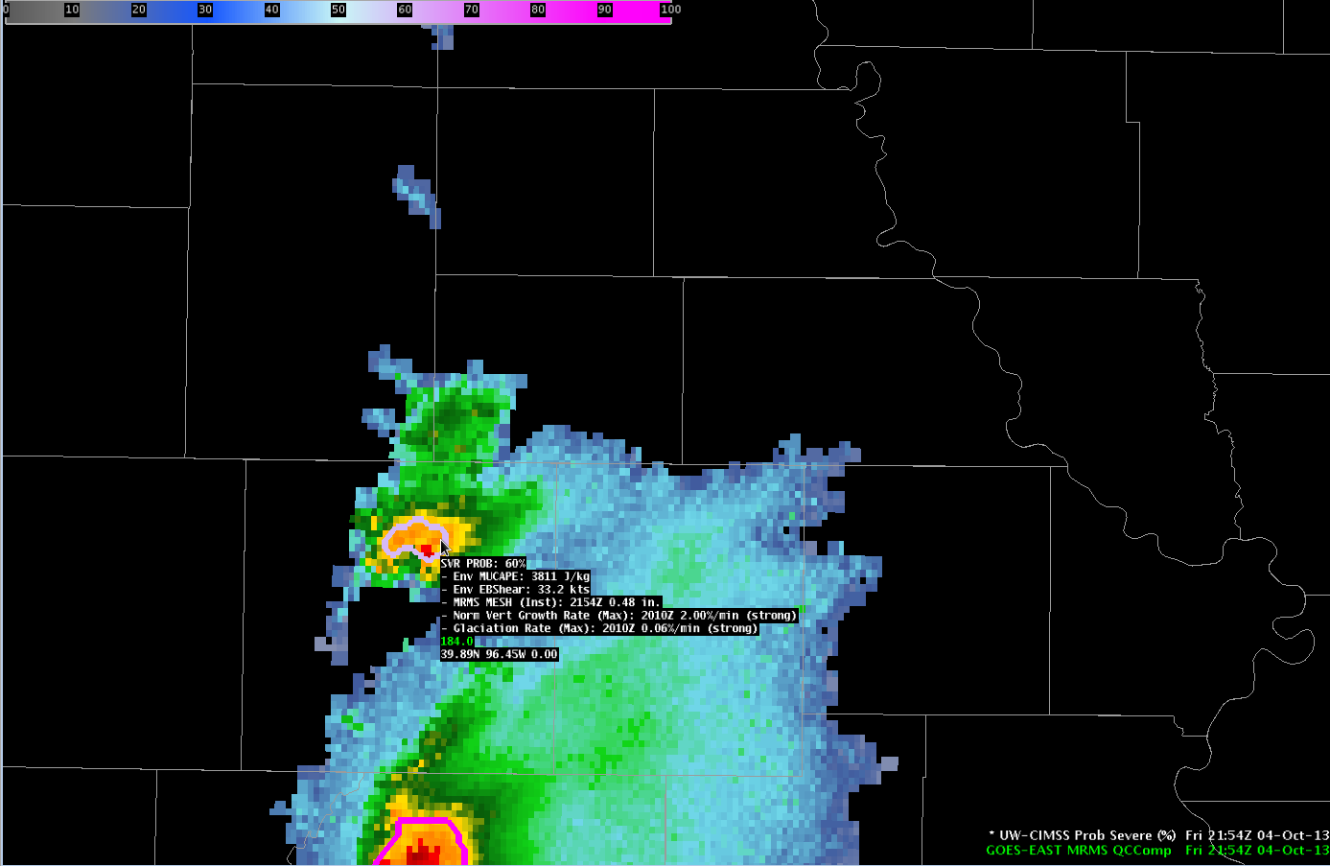
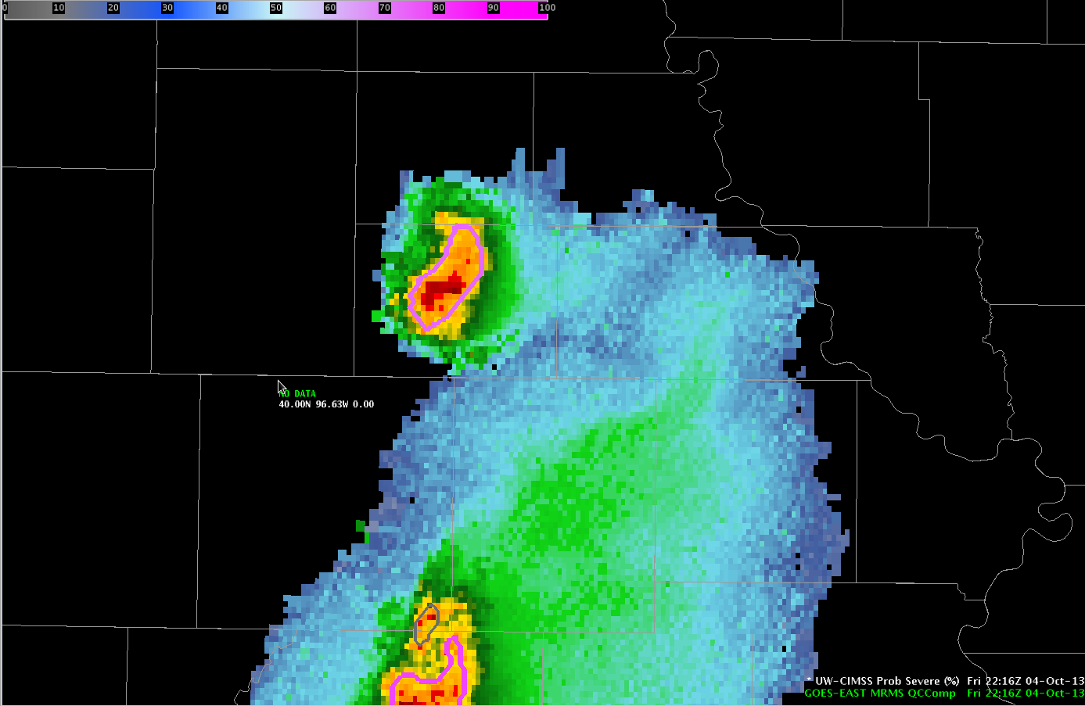
NOAA/CIMSS ProbSevere Model goals
This statistical model predicts the probability that a storm will first produce severe weather in the near-term (in the next 60 min).
The statistical model does not predict if a storm will continue to pose a severe threat or if the storm will decay.
A “pre-polygon” product.

Slide 9
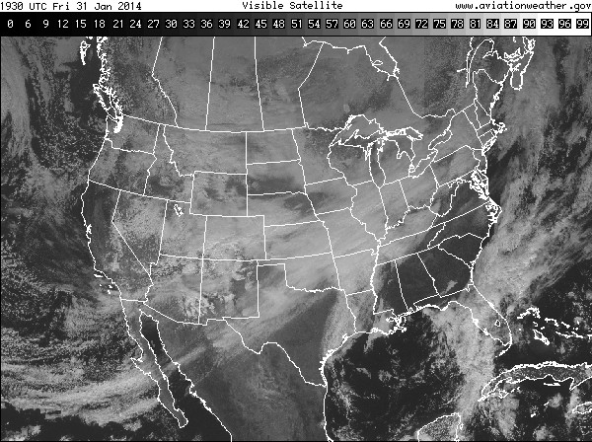
Problem: Converting “Big Data” to Information
High-res Numerical Models
Satellite
Radar
1). Storm Environment
(Energetics of atmosphere)
3). Radar Intensity
2). Development of clouds in time captured by GOES
Probability a developing thunderstorm will produce severe weather in the future (up to 60 minutes)

Slide 10
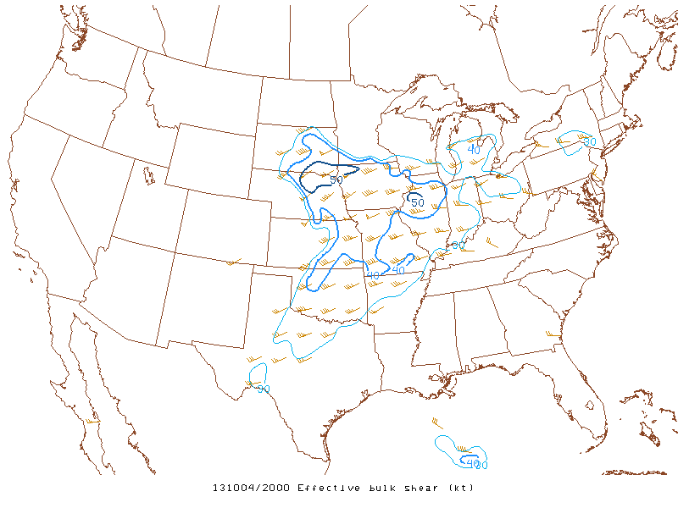
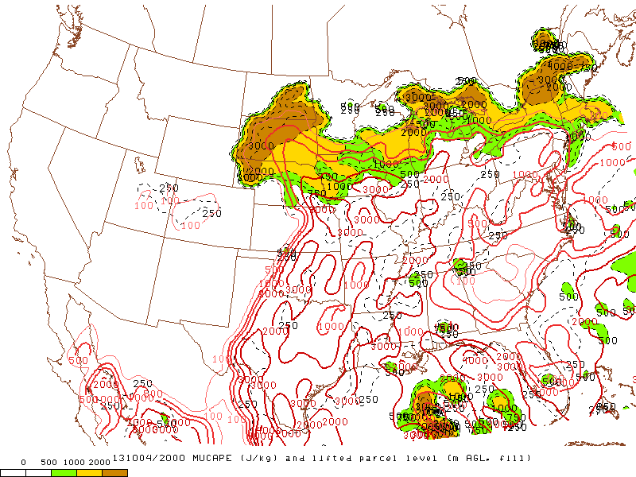
Data sources – Rapid Refresh (RAP)
Effective bulk shear (EBS):
  Discriminates well between supercell and non-supercell convection
  Normalizes shear between storms with deep and shallow inflow layers
Most-unstable CAPE (MUCAPE):
  Rough estimate of maximum updraft potential, even for elevated convection.
Notes:
The storm environment information currently comes from the Rapid Refresh model. We use model information to make a first order approximation of the storm environment—we do this using instability and shear parameters.
The environmental shear parameter used is the effective bulk shear. The EBS normalizes shear between storms with deep and shallow inflow layers and is more accurate when considering elevated convection.
The environmental instability parameter used is the most unstable CAPE. The MUCAPE provides a generous estimate of instability.
One important note about the NWP data used within the model is we do not use a single forecast or single analysis. We create a temporal composite and spatially smooth that temporal composite. The temporal compositing and spatial smoothing acts to mitigate NWP phase and placement errors in convective development. The last outcome we want is a poor NWP solution to squash model probabilities incorrectly—surely if strong convection is developing observed on satellite and radar, there must be sufficient CAPE.

Slide 11
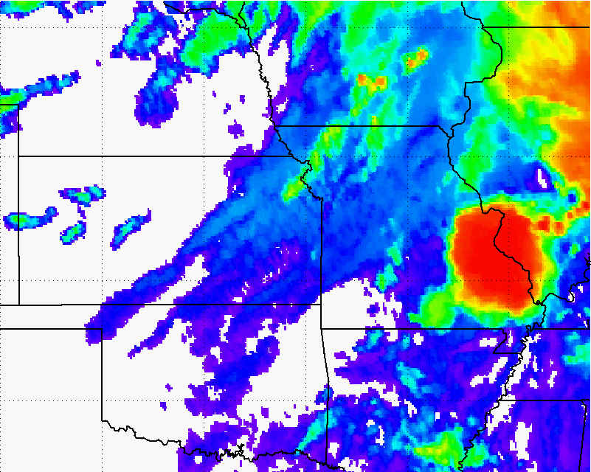
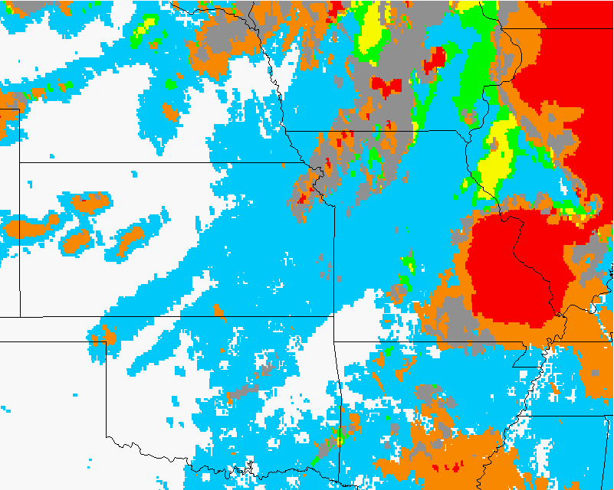
Data sources – GOES-derived Cloud Properties
How much does a developing storm-top cool over a period of time?
  Infers vertical growth of convective clouds (and updraft strength)
Rate-of-change in ice-cloud fraction:
  At cloud-top
  Infers vertical growth and glaciation rate (i.e., how fast is the cloud-top changing from mostly liquid water to ice).
How quickly a developing storm transitions from water cloud (blue) to ice (orange, red, and gray) is automatically quantified.
How quickly a developing storm cools is automatically quantified.
Notes:
The two satellite cloud growth predictors used in the statistical model are a normalized vertical cloud growth rate and a glaciation rate.
How quickly a developing storm cools in infrared brightness temperatures is an indicator of severe potential. In the example over eastern Kansas, we can see rapid cooling in the imagery and the computer quantifies this cooling rate, which is used as input into the statistical model. The cooling rate we use is normalized—such that seasonal and latitudinal differences in the cooling rates are automatically accounted for.
The other satellite predictor used is the glaciation rate or how quickly the cloud-top is transitioning from liquid water cloud droplets (blue in the imagery) to ice crystals (orange, red, and gray in the imagery). Like the normalized vertical growth rates, the computer quantifies this information and how quickly a developing storm-top transitions from water tops to ice tops is an indicator of severe potential.

Slide 12
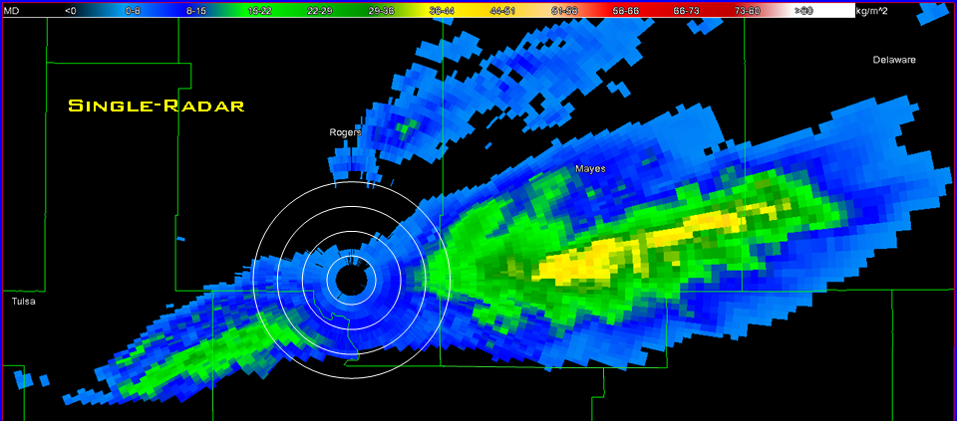
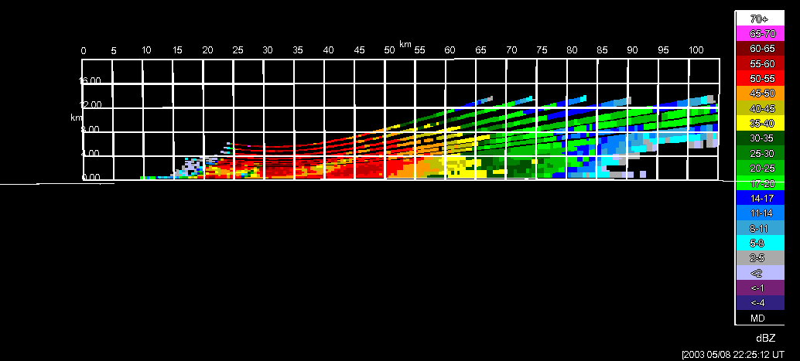
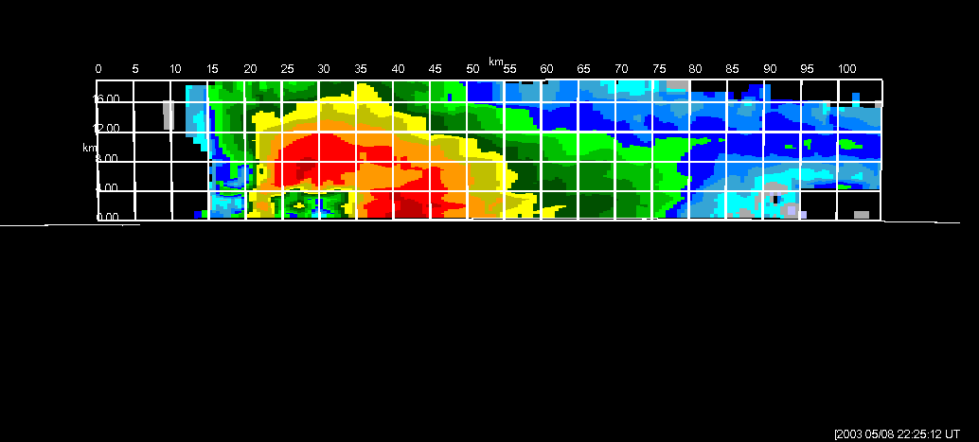
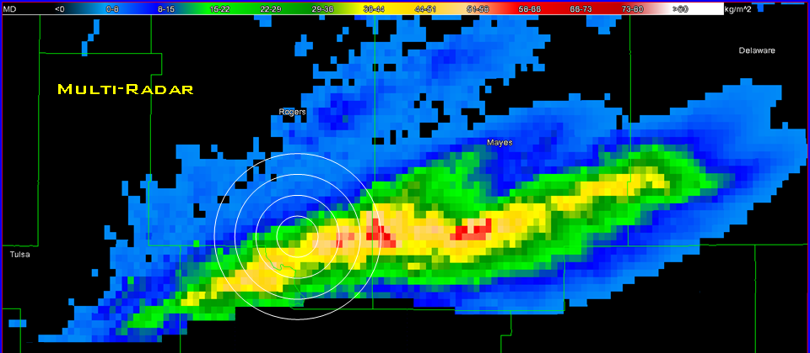
Data sources – Multi-Radar Multi-Sensor products
Developed at OU-CIMMS/NOAA-NSSL
Provide better estimates of radar-derived products
  Overlapping coverage
  Fill gaps caused be cone of silence and terrain blockage
  Increased sampling frequency
Vertical Cross-Section
VIL Tracks
(Figures from OU-CIMMS)
Notes:
The radar dataset we use is the Multi-Radar Multi-Sensor radar products from NCEP’s central operations, developed at NSSL. The MRMS radar fields are a CONUS-wide composite of all individual NEXRAD radars. The MRMS data fill gaps in single site coverage, including cone of silence and offers increased sampling frequency when a storm is sampled by more than one radar. So it updates about every 2 minutes, with at least some new information on most storms.

Slide 13
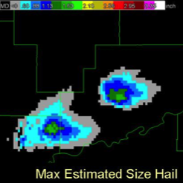
Data sources – MRMS products
Maximum Expected Size of Hail (MESH):
  Empirically derived from the Severe Hail Index (SHI)
  SHI is a thermally-weighted vertical integration of reflectivity above the melting level
MESH
(Figure from OU-CIMMS)
Notes:
The radar storm cell tracking utilizes the MRMS composite reflectivity. The radar data used as a predictor in the statistical model is the MRMS maximum expected size of hail or MESH. The MESH is derived from the Severe Hail Index, which is essentially a thermally weighted vertical integration of reflectivity above the melting level. So it’s really trying to capture the ice content in the storm.

Slide 14
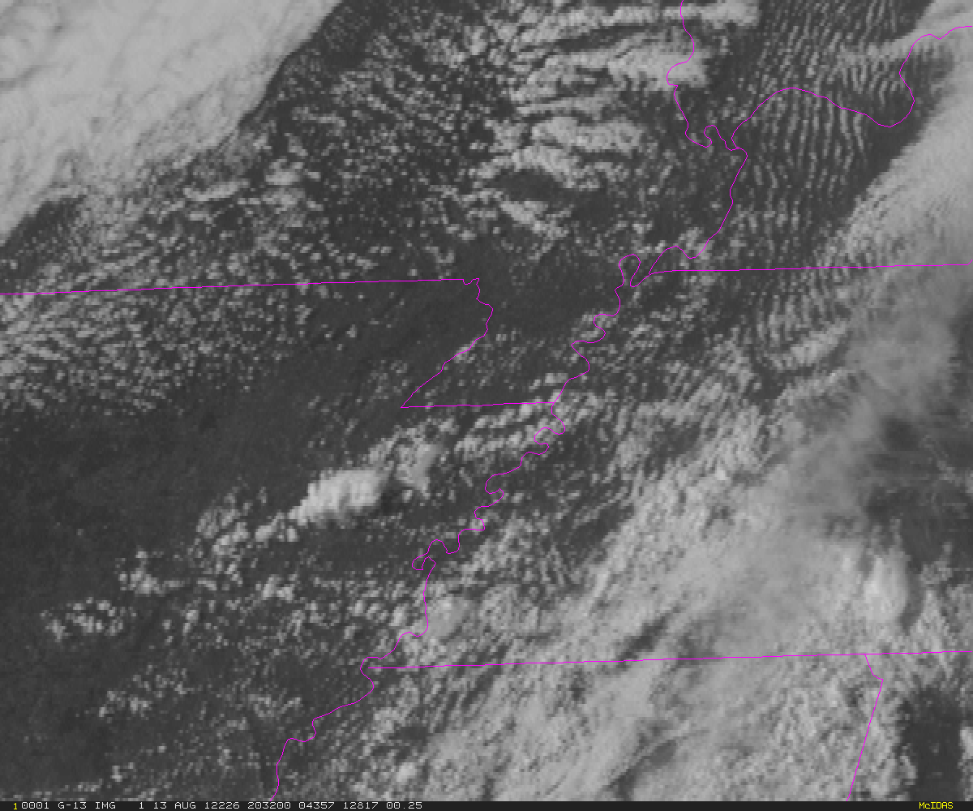
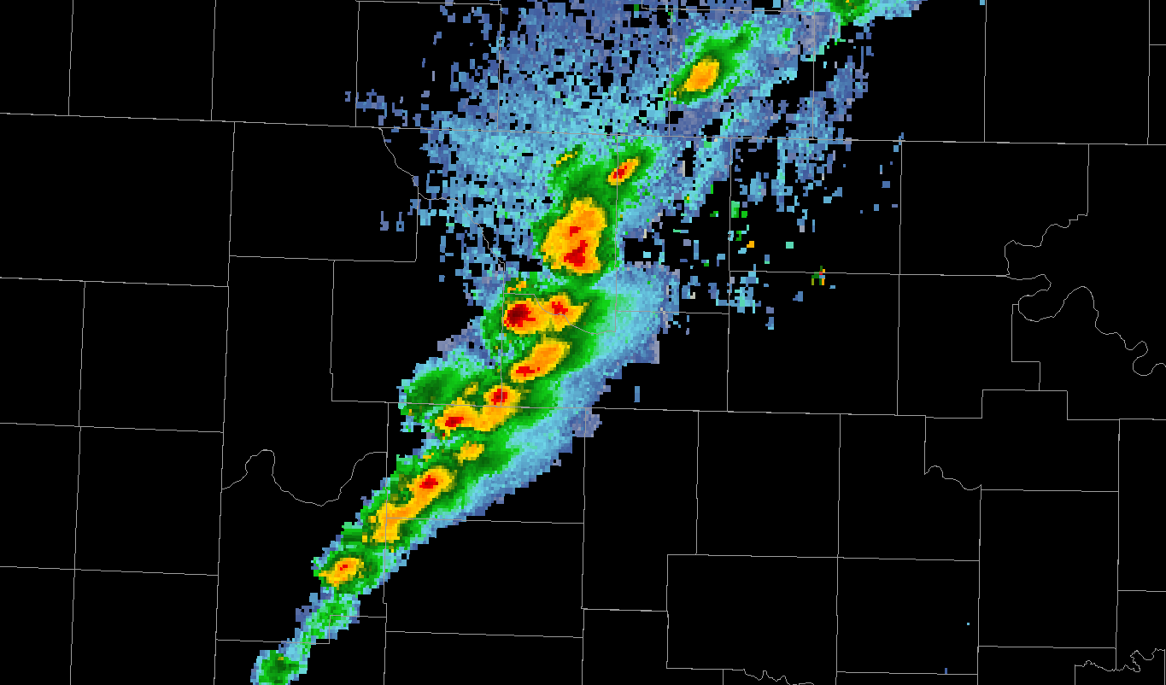
Automated integration of information
A meteorologist sees developing storms and cloud clusters—not satellite pixels or radiances.
The same concepts apply to radar data.
Meteorologists view cells or storms—so the computer needs to identify and track radar cells and their evolution over time.
Notes:
<read slides first> We’re automatically identifying, tracking, and parallax-correcting these storms observed by radar and satellite all at once. We then automatically extract information from gridded fields within the spatial bounds of these identified objects, and compute metrics used in the probabilistic model.

Slide 15

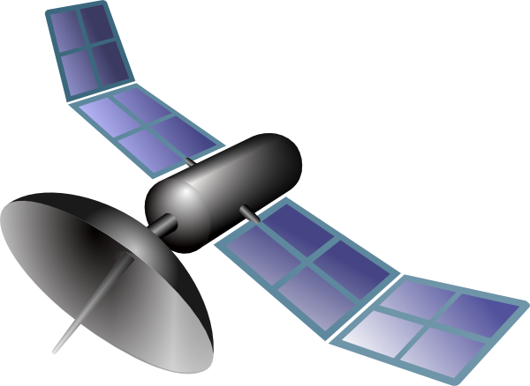
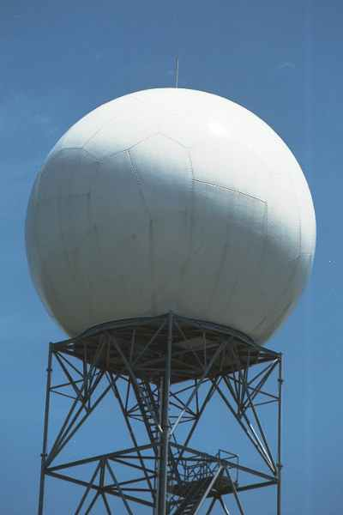
NCEP
What 30 min of processing looks like…
12
ProbSevere
9
3
6
OUTPUT
Input: 0 MB
Input:138 MB
Input:142 MB
Input:145 MB
Input: 230 MB
Input: 234 MB
Input: 237 MB
Input: 322 MB
Input: 325 MB
Input: 328 MB
Input: 414 MB
Input: 417 MB
Input: 421 MB
Input: 506 MB
Input: 510 MB
Input: 513 MB
Input: 598 MB
Adding GOES-R: Input: 4450 MB
Adding GOES-R + HRRR: Input: 5754 MB
File size: 0.2 MB
Notes:
MRMS fields every 2 min
GOES scans about every 7.5 min in RSO
We use 4 new RAP grids each hour
You can see the Input data counter ticking up, but note that the output file size at each time stays about the same, -- usually around 200 kB. This is the file that AWIPS2 uses to render and display the ProbSevere data.

Slide 16
NCEP
What 1 hour of processing looks like…
4 RAP grids
9 CONUS satellite scans
ProbSevere
Input: 1200 MB
OUTPUT
Adding GOES-R: Input: 8900 MB
Adding GOES-R + HRRR: Input: 11,500 MB
30 CONUS radar scans
File size: 0.2 MB
30 output files
Notes:
Here is what an hour of processing looks like. By adding GOES-R, we have a 7-fold increase in input data. Tacking on HRRR data, it’s about an order of magnitude increase in input, yet we still have a consistent output file size of about 200kB.
These estimates are basically just assuming the data we are using now, scaled up for higher spatial and temporal resolution. This doesn’t take into account new data we plan to use including more spectral bands, more NWP-derived fields, dual-pol variables, and total lightning data.
So you can see you how ProbSevere is trying to find a coherent, pertinent signal in an increasingly large ocean of useful data.

Slide 17
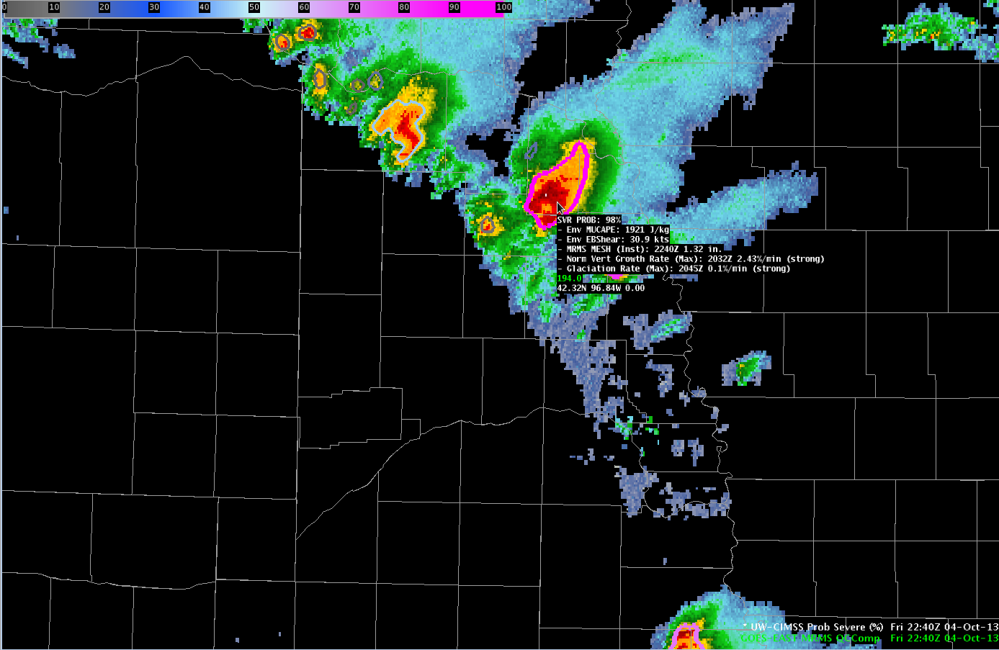
Customized Display for AWIPS II
Norm Vert Growth Rate (Max): Maximum storm cell satellite vertical growth rate.
Time occurred, normalized vertical cloud growth rate per minute.
Classified as weak, moderate, or strong.
Model output are shapefiles contoured around radar storm cells.
Enhancement designed for overlay atop radar reflectivity—but can be overlaid on any field (satellite, radar velocity, etc.).
Sampling offers readout of model probability as well as each model predictor.
SVR PROB: Probability from statistical model 0-100%.
Env MUCAPE: RAP composite MUCAPE for storm environment.
Env EBShear: RAP composite effective bulk shear for storm environment.
Glaciation rate (Max): Maximum storm cell satellite glaciation rate.
Time occurred, percentage of conversion from water to ice cloud-tops per minute. Classified as weak, moderate, or strong.
MESH: Instantenous maximum expected size of hail from MRMS radar data. Time (current) and size (inches).
Notes:
One thing I learned at HWT the last couple of years is that forecasters prize their AWIPS2 screen space. Their screen real-estate is even more precious during warning operations, as radar is the predominant tool used.
So that is why the ProbSevere display for AWIPS2 is meant to complement and enhance forecasters’ current warning operations.
The model output, by default, is displayed in two ways. One is a probability contour with a color enhancement designed for overlay on top of typical radar reflectivity color tables. The shapefile nature of the output makes the display very flexible—the contours can be overlaid on any field within AWIPS-II (for example satellite imagery or radial velocity imagery). Additionally, the model probability and each model predictor is displayed as text when sampling is turned on. The following bullets briefly describe the text read-out.
This field is the statistical model probability and ranges between 0 and 100% for a given storm cell.
This field is the most unstable CAPE from our RAP composite for the storm cell.
This field is the effective bulk shear from our RAP composite for the storm cell.
This field is the instantaneous MRMS MESH value—the time and value are provided. Note the MRMS may not match a single site MESH algorithm—both time and value.
This field is the normalized vertical growth rate of the storm. It is the maximum value attained during the growth stage of the storm and the time that maximum value occurred. The units are percentage of the troposphere depth the cloud grew per minute. So a value of 3%/min would mean the cloud grew 3% of the tropospheric depth every minute—or 45% of the tropospheric depth over the course of 15 minutes. The exact values are not terribly important—we append a statistical measure of intensity with the terms “weak”, “moderate”, or “strong”.
This field is the glaciation rate or the rate at which the storm-top transitioned from liquid water droplets to ice crystals. It is the maximum value attained during the growth stage of the storm and the time that maximum value occurred. The units are percentage of water to ice conversion per minute. So a value of 0.05/min would mean the cloud transitioned 5% of the water droplets to ice crystals every minute—or 75% of the liquid droplets converted to ice crystals over the course of 15 minutes. Again, the exact values are not terribly important—we append a statistical measure of intensity with the terms “weak”, “moderate”, or “strong”.
One thing to note is that ProbSevere links together previous storm growth, observed by satellite, with current storm development, observed by radar. We’ve found that a history of a storm’s satellite growth can help indicate future storm severity, along with the radar signal and the environment the storm resides in.
While each model predictor is provided in the text read-out, it is important to emphasize—the sum of the information--the probability--is more valuable than any individual piece of information.

Slide 18
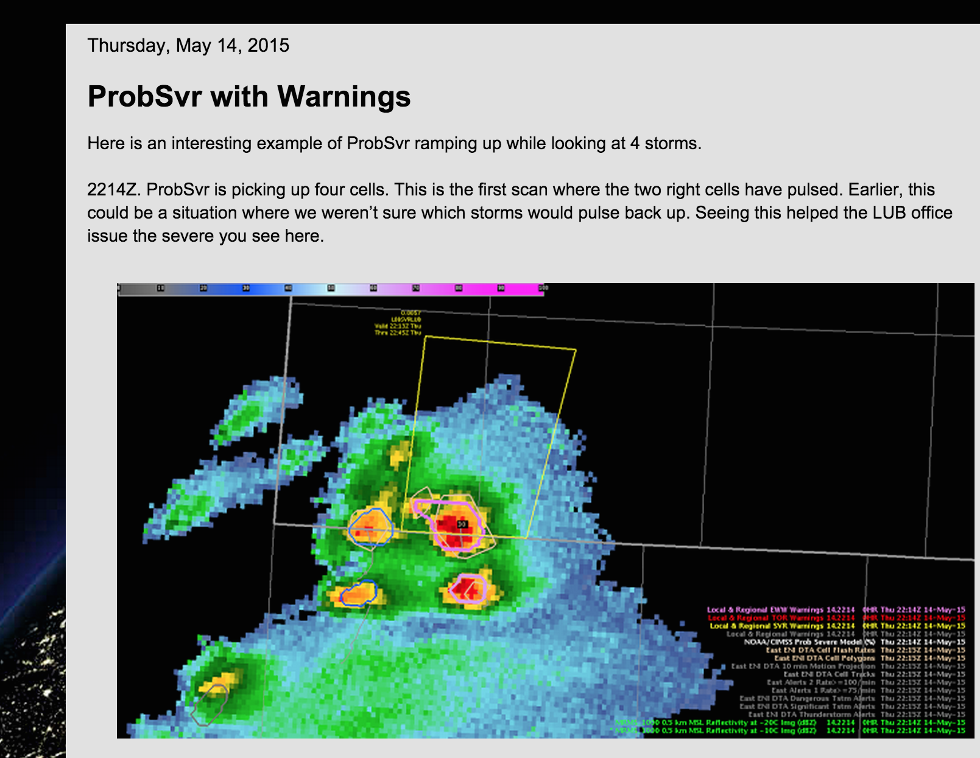
Hazardous Weather Testbed
http://goesrhwt.blogspot.com
http://goesrhwt.blogspot.com/2015/05/probsvr-with-warnings.html

Slide 19
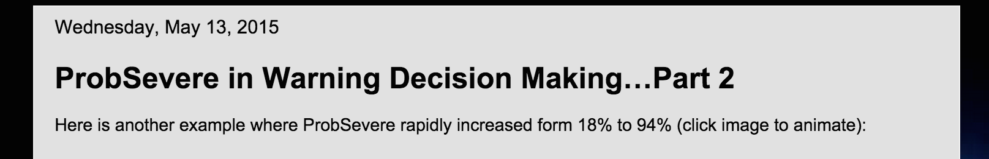
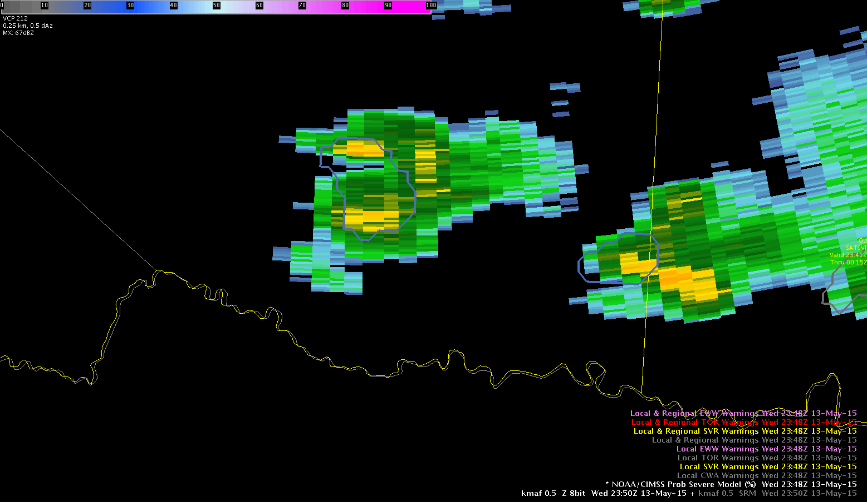
http://goesrhwt.blogspot.com
“The normalized vertical growth rate and the glaciation rate were both strong. In this case, I was confident enough to use the ProbSevere by itself to issue a severe thunderstorm warning. I started drawing the warning polygon prior to the highest percentage coming from ProbSevere. In the end, my polygon was issued nearly coincident with the highest probabilities.”
http://goesrhwt.blogspot.com/2015/05/probsevere-in-warning-decision.html

Slide 20
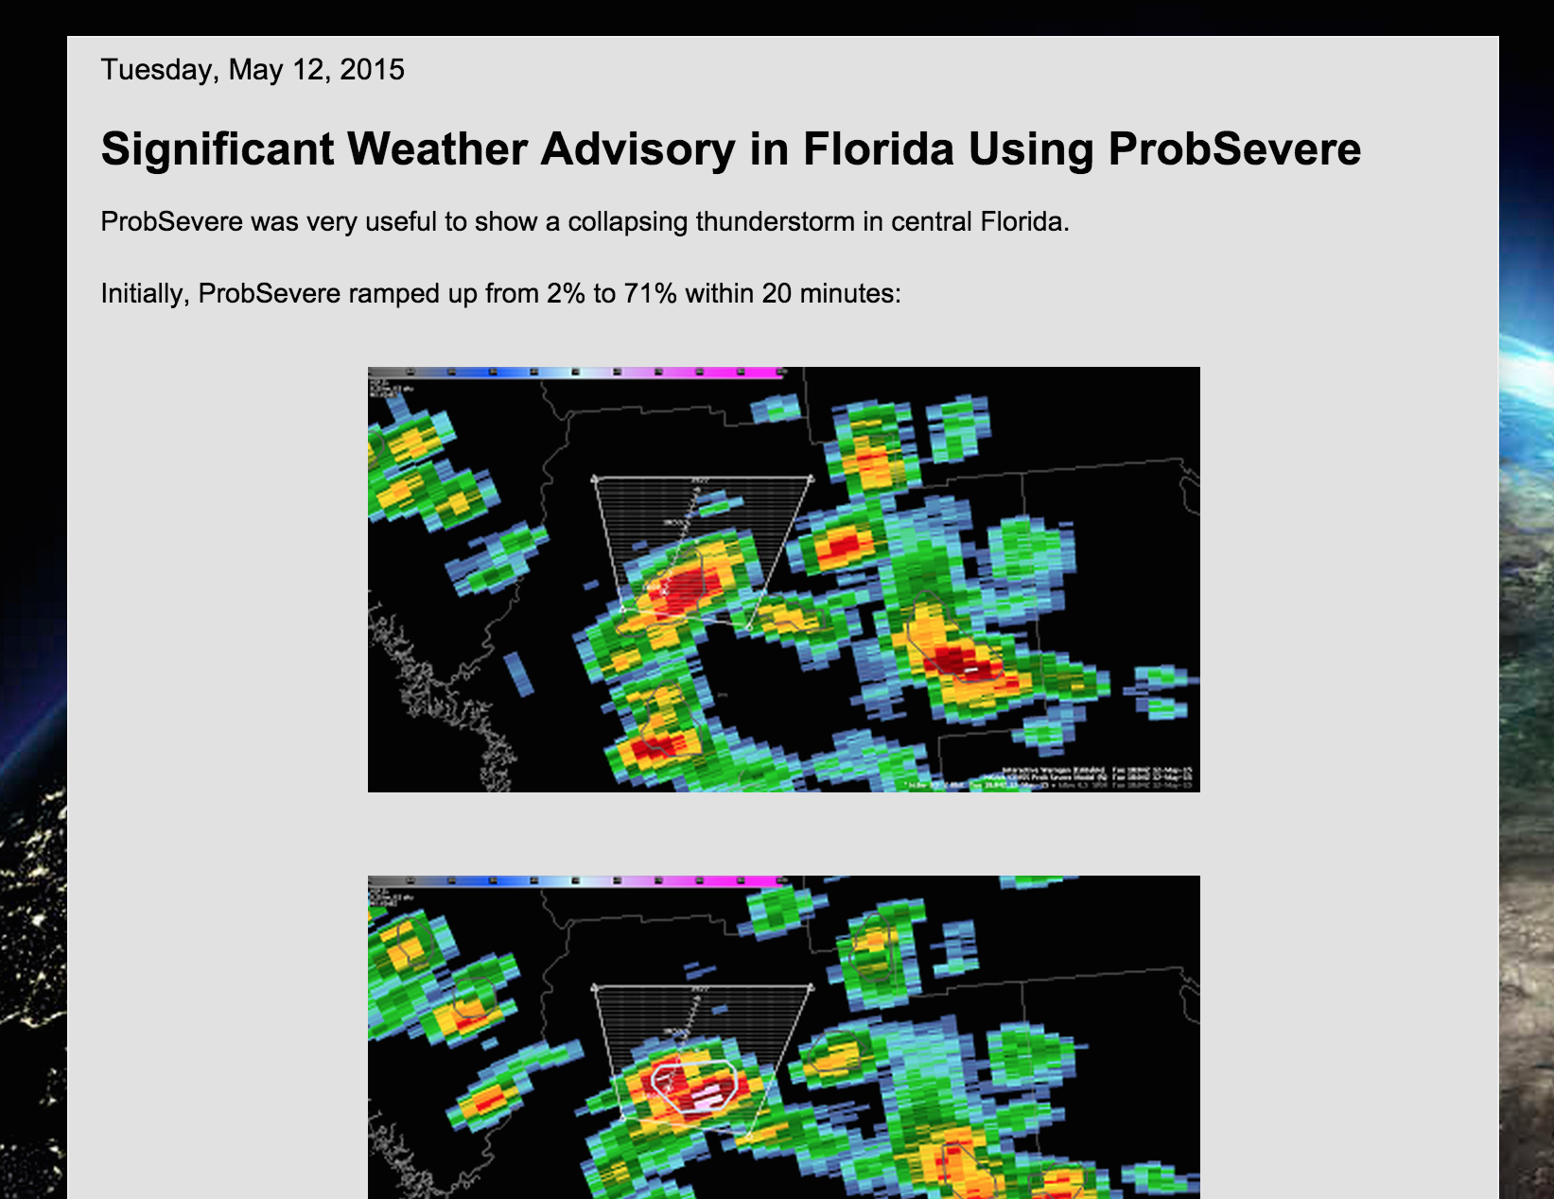
http://goesrhwt.blogspot.com
“This demonstrates that ProbSevere might be useful not only for growing thunderstorms, but collapsing thunderstorms (and their associated risk of strong winds) as well.”
http://goesrhwt.blogspot.com/2015/05/significant-weather-advisory-in-florida.html

Slide 21
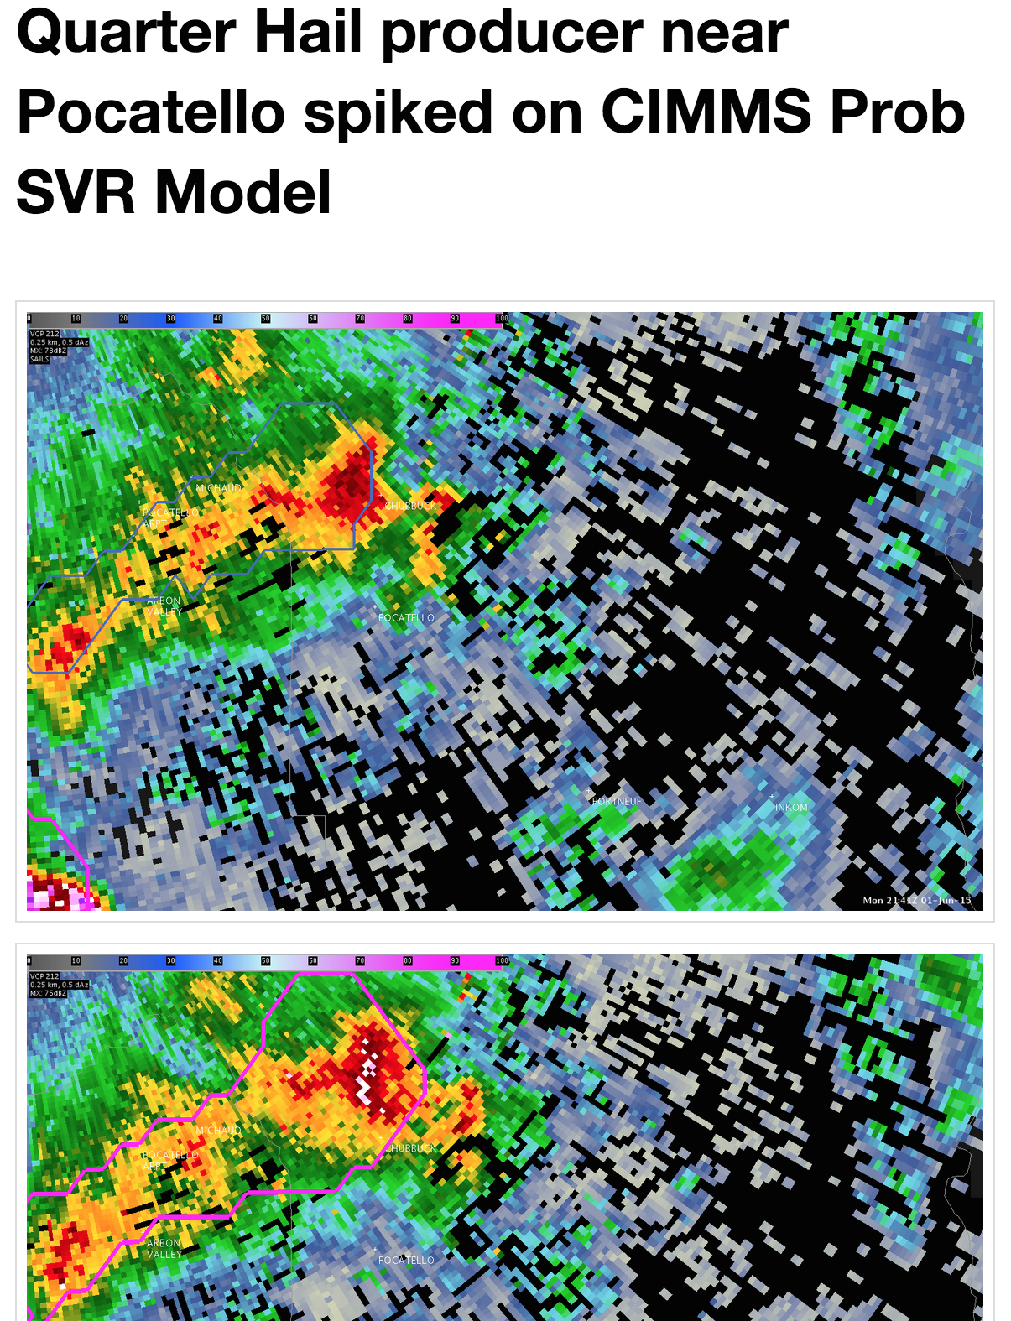
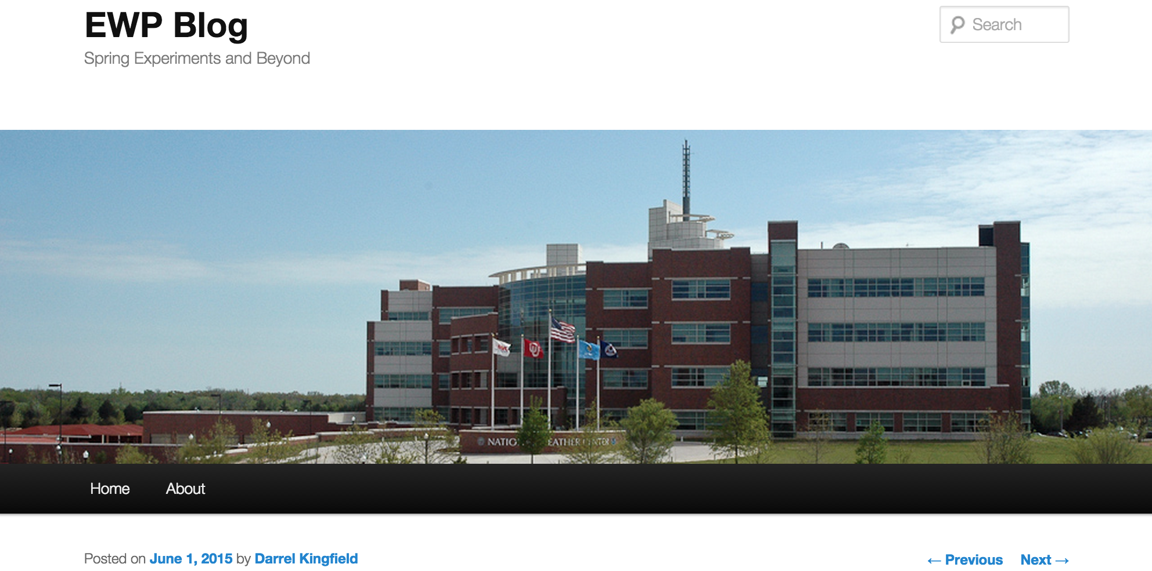
HWT EWP Blog
http://hwt.nssl.noaa.gov/ewp/internal/blog/
CIMSS
“In about a 5 minute span the cell highlighted in blue showed a severe potential of only 20 percent but increased to 89 percent and produced reported one inch hail…”

Slide 22
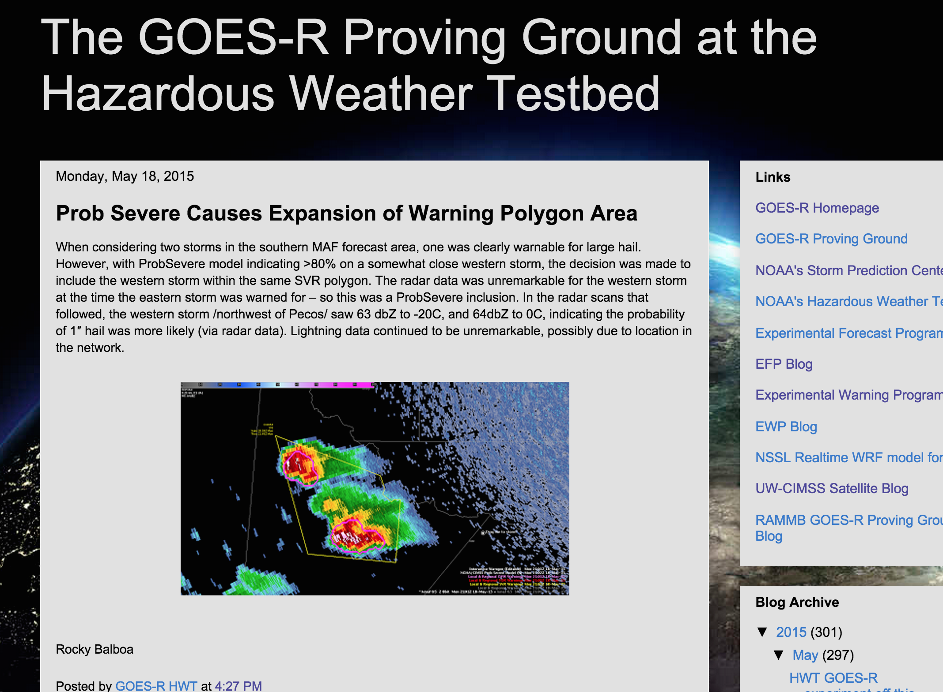
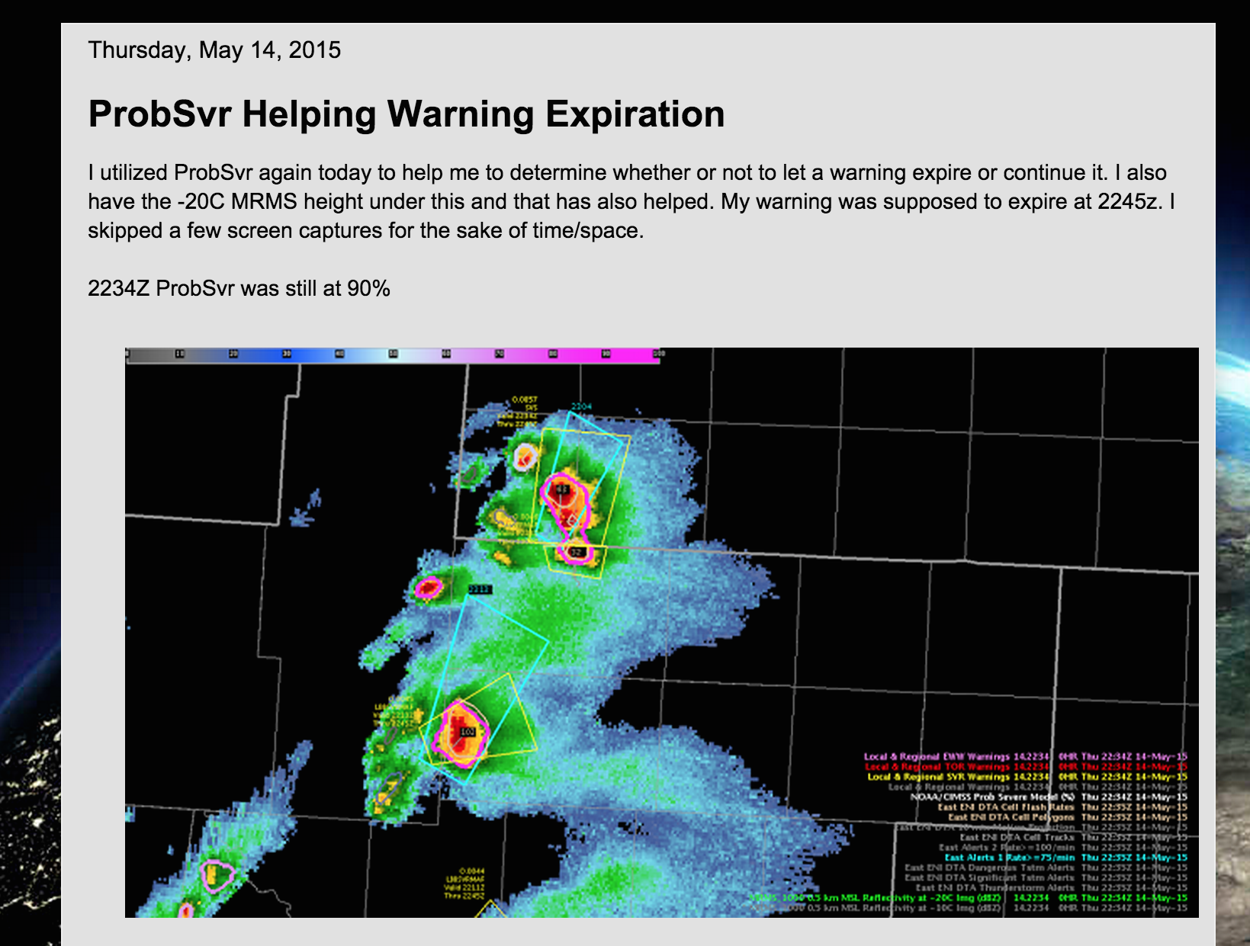
http://goesrhwt.blogspot.com
Expansion of warning polygons
Expiration of warning polygons

Slide 23
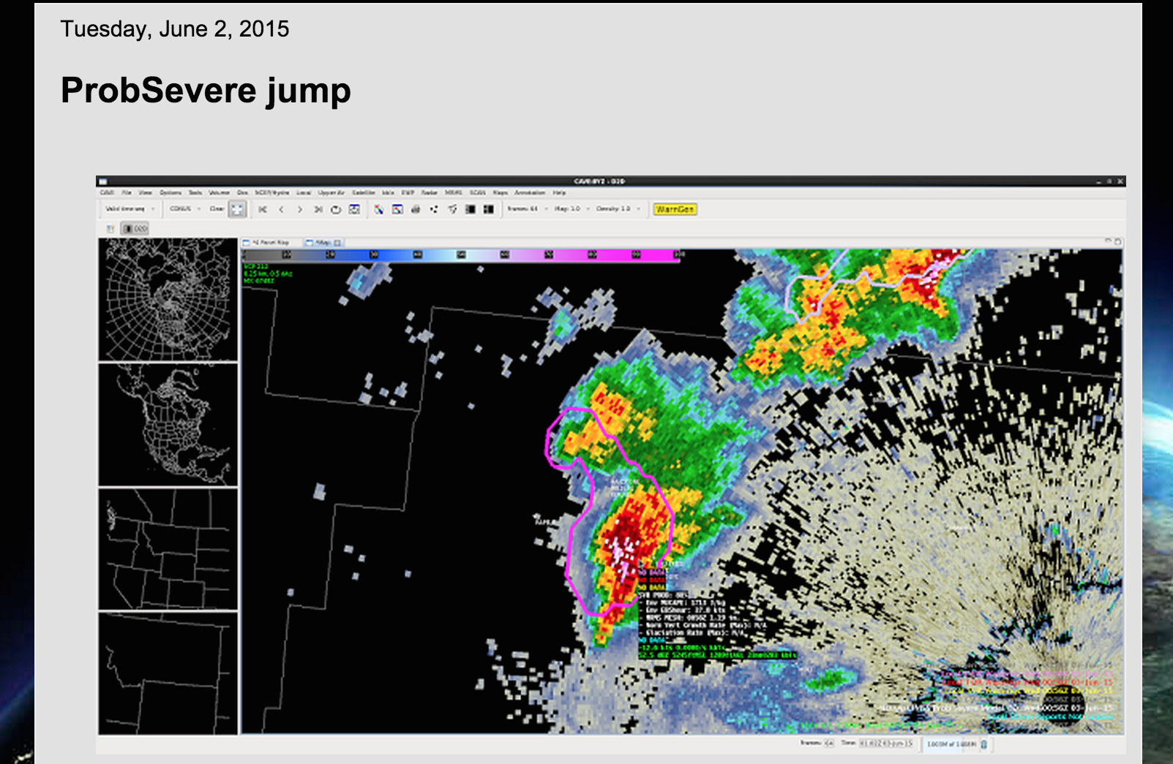
http://goesrhwt.blogspot.com
“The ProbSevere algorithm jumped from 36% to 88% between 0052z and 0056z. At 0102z, a large TBSS appeared, so there was certainly lead time on that feature showing up.”
http://goesrhwt.blogspot.com/2015/06/probsevere-jump.html

Slide 24
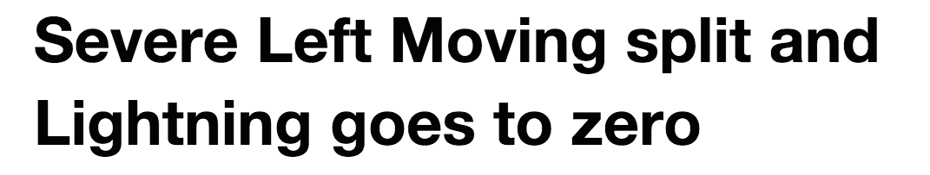

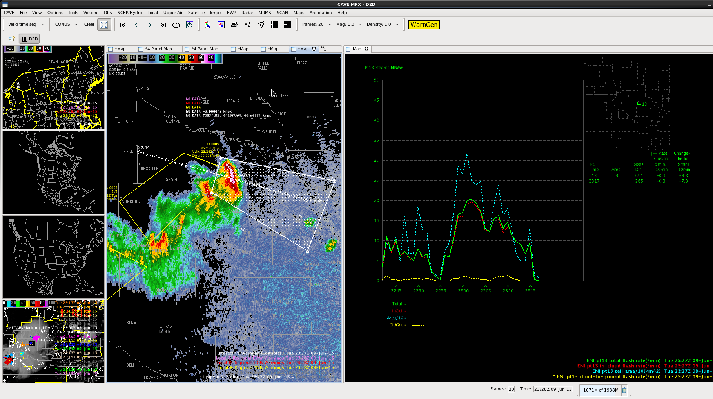
“The initial warning was based on a 90% prob severe according to the NOAA/CIMSS model. This was extremely useful since we had little situational awareness since we just started but had enough trust in it and a quick glance at the radar confirmed it was probably on to something. Helped give us a nearly 20 minute lead time.”

Slide 25
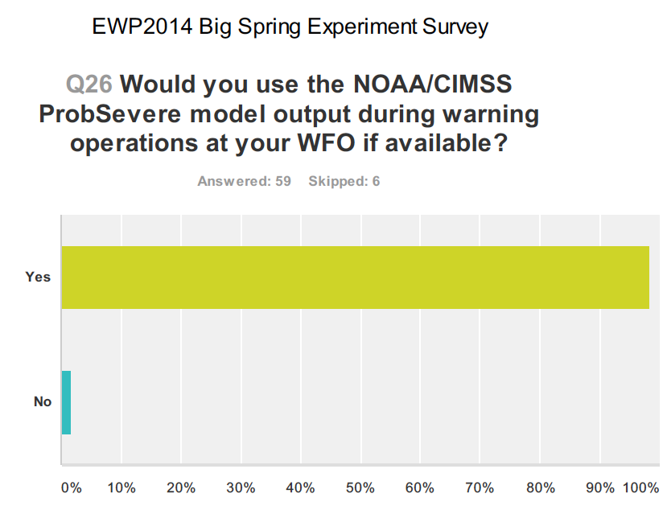
http://goesrhwt.blogspot.com
Notes:
2014 Survey results:
Nearly 75% of forecasters said it increased confidence in issuing warnings
Nearly 50% said it increased lead time to severe hazards.

Slide 26

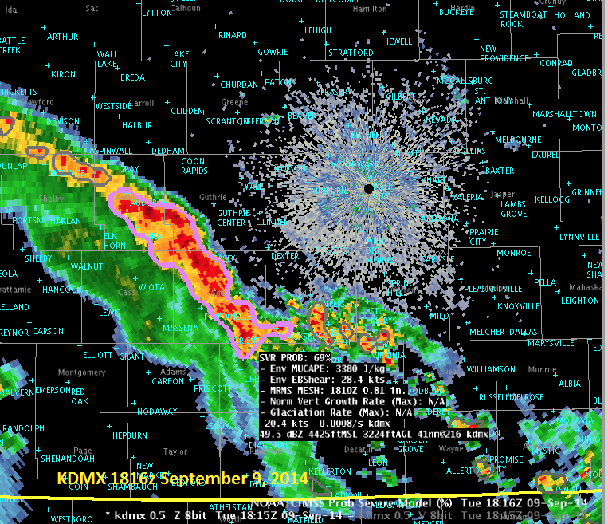
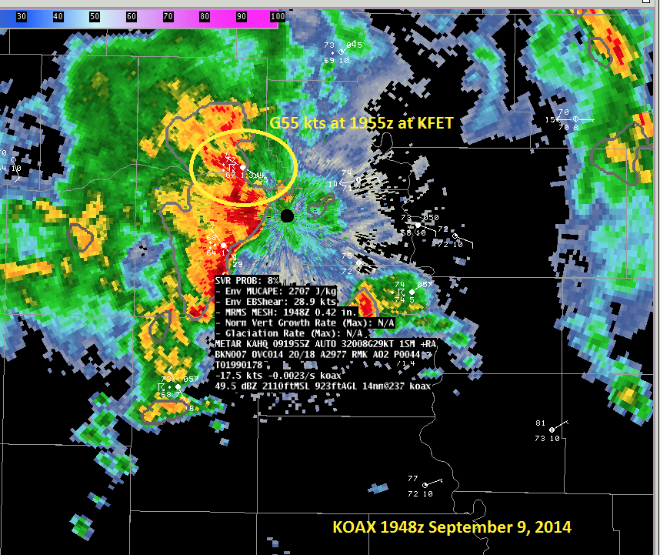
“The above two examples illustrate how the CIMSS Prob Severe product is geared more toward forecasting a large hail threat using available instability parameters, especially when satellite information is not available.”
http://goesrhwt.blogspot.com/2014/09/noaacimss-prob-severe-examples-from.html

Slide 27
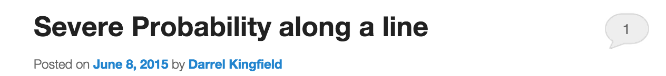
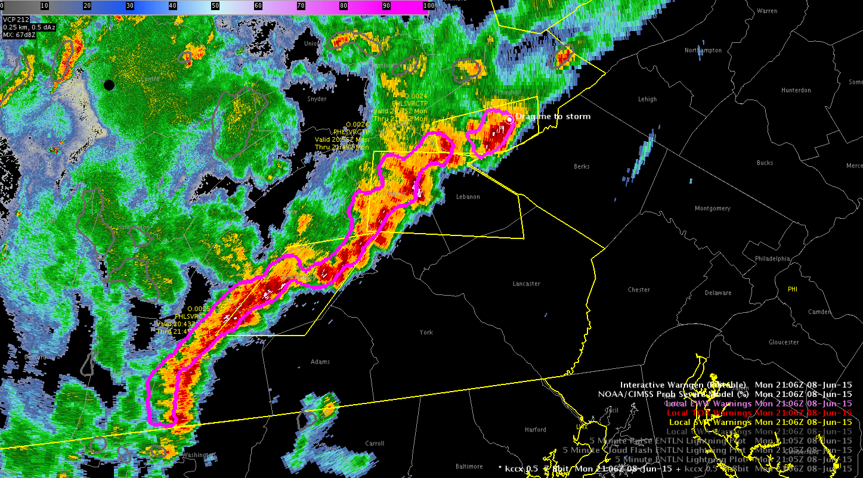
HWT EWP Blog
http://hwt.nssl.noaa.gov/ewp/internal/blog/
“I would like the [ProbSevere] product to follow the stronger cells embedded in the line, thus breaking up the [predictor values] some.”
Notes:
We are working on ways of doing better discrimination of storm cells in lines, while maintaining low product latency.

Slide 28
Model Evaluation (2014)
Notes:
9000 storms (860 severe) for 2014 validation
Decent reliability, a bit of overforecasting/overconfident.
1 ct per bin per storm (if prob in that bin). NOT every forecast.

Slide 29
Model Evaluation (2014)
NWS:19 minutes
ProbSevere: 29 minutes
NWS:0.44
ProbSevere: 0.32
Notes:
9000 storms (860 severe) for 2014 validation
80% threshold for skill/lead-time plot (CSI: 32% model, 44% NWS)—CSI was 27% with median LT of 37 min @ 40% threshold.
May, June and July (1 August day)

Slide 30
Model Evaluation (2014)
We fully expect that the impact of the satellite component will be even greater with GOES-R (more frequent images, factor 4 improvement in spatial resolution, more spectral bands for inferring cloud properties, lightning mapping)
NWS:19 minutes
ProbSevere: 29 minutes
NWS:0.44
ProbSevere: 0.32
Notes:
9000 storms (860 severe) for 2014 validation
80% threshold for skill/lead-time plot (CSI: 32% model, 44% NWS)—CSI was 27% with median LT of 37 min @ 40% threshold.
May, June and July (1 August day)

Slide 31
HWT and GOES-R PG feedback (2014 + 2015)
Strengths
Highlights storms to watch/interrogate with all-tilts radar
Helps prioritize threats
Good performance for discrete storms, especially for hail
Has good utility after initial threats
Forecasters like watching the trend in probability value
Can add lead-time on some storms
Good intuitive display
Liked the scroll-over with predictor information
Weaknesses
Sometimes struggles with linear wind events
Low probs on low-topped convection
No tornadogenesis predictors
Forecasters want more read-out values (e.g., SRH, melting level)
Forecasters want individual hazard prediction
Forecasters want better storm discrimination in squall lines
Notes:
We think that ProbSevere is a useful tool for forecasters as is, but one thing I want to stress is that there is going to be a lot of development and improvements made in the coming years. The current model is just one small step in providing integrated warning guidance to forecasters.

Slide 32
Where do we go from here?
Notes:
We think that ProbSevere is a useful tool for forecasters as is, but one thing I want to stress is that there is going to be a lot of development and improvements made in the coming years. The current model is just one small step in providing integrated warning guidance to forecasters.

Slide 33
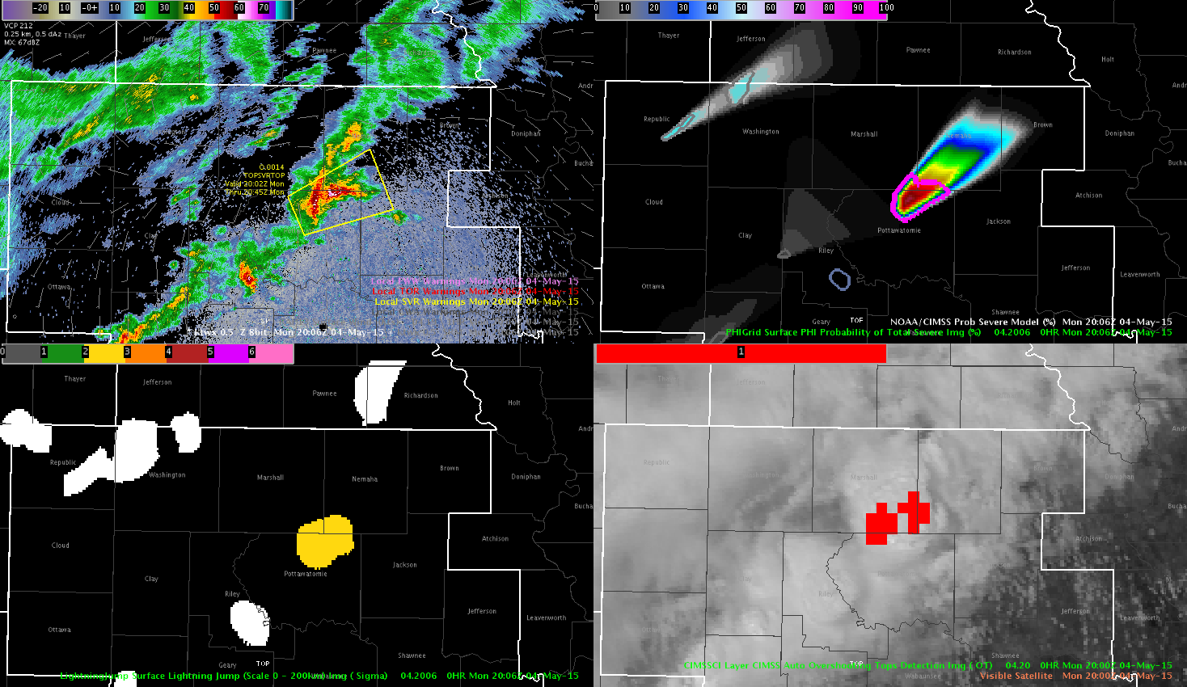
Forecasters at the HWT were using all-tilts radar, ProbSevere, overshooting top detection, and lightning jump algorithm in conjunction for warning decision.
ProbSevere and PHI
Lightning jump algorithm
OT Detection
http://goesrhwt.blogspot.com/2015/05/first-severe-top.html
Notes:
So in part, we want to do what forecasters are already doing! <read box>. Forecasters use all sorts of useful information in a subjective manner to make warning decisions. ProbSevere is just trying to put an objective probability on what the data tell the forecaster. Different tools and observations are useful for different situations, so we want to make ProbSevere adaptable to the observations coming in. Total lightning information, additional NWP and radar fields, ot detection, and other storm-top information from satellite may help increase the utility of ProbSevere in different situations.

Slide 34
ProbSevere being tested as automated probabilistic warning guidance in PHI (Probabilistic Hazards Information), a key component in FACETS.
ProbSevere contours and PHI gridded threat swaths
Notes:
We’re not doing this development in a vacuum. We’re using feedback from HWT forecasters, local PG experiments, leveraging research out of Boulder and Huntsville, AL, and we have a funded collaboration with some folks at NSSL in Norman. <read box, describe figure>. Forecasters at HWT were able to view these very experimental gridded threat swaths. So this is where warning operations is potentially headed.

Slide 35
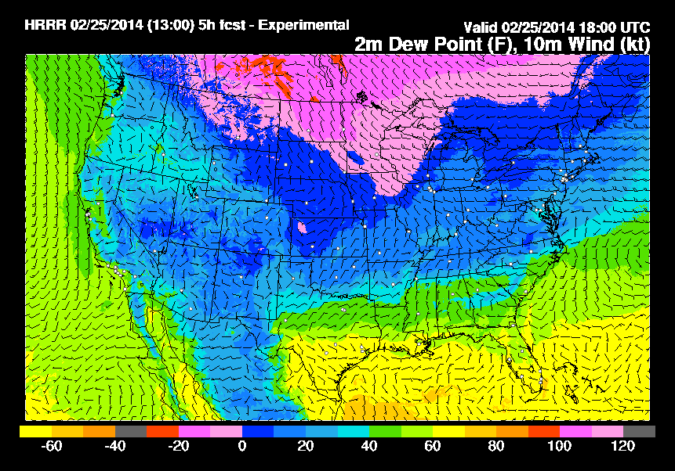
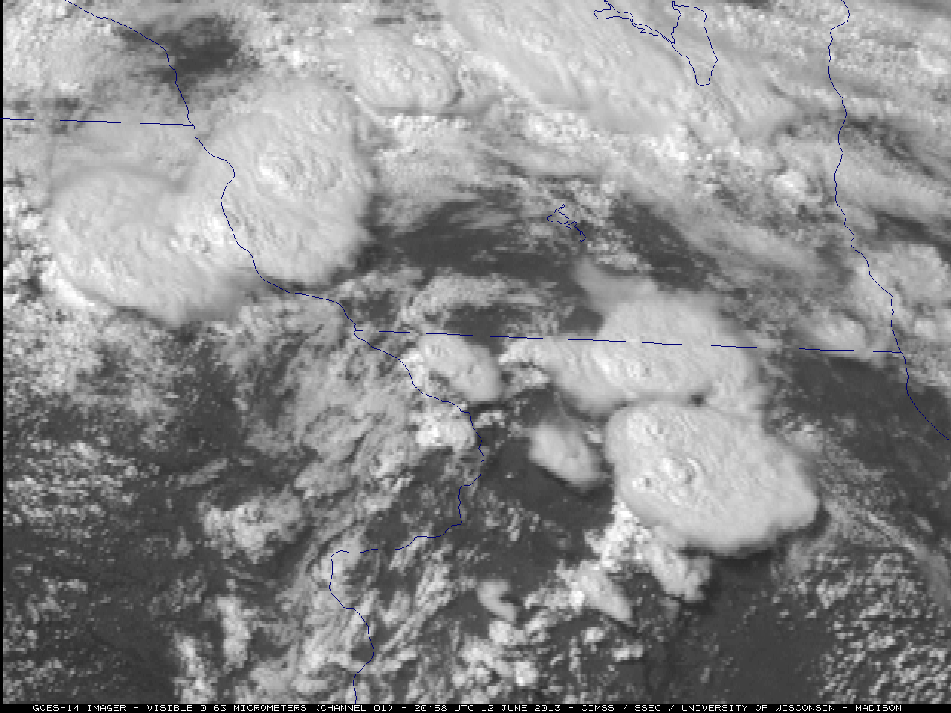
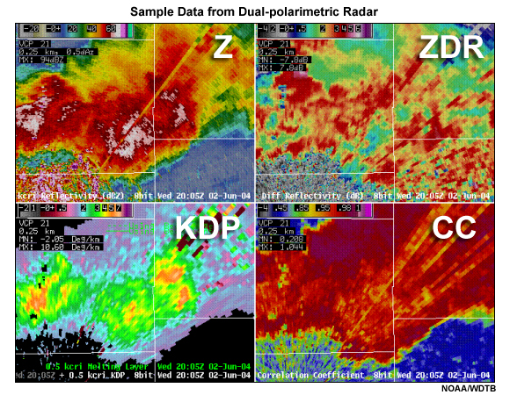
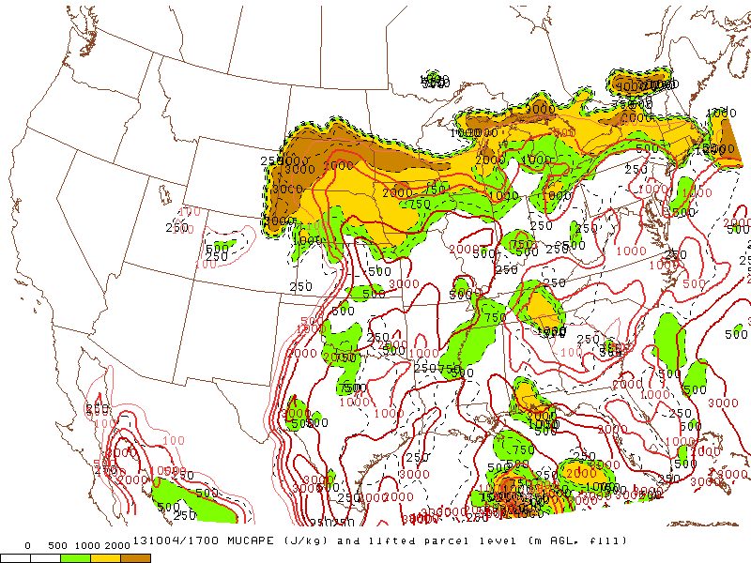
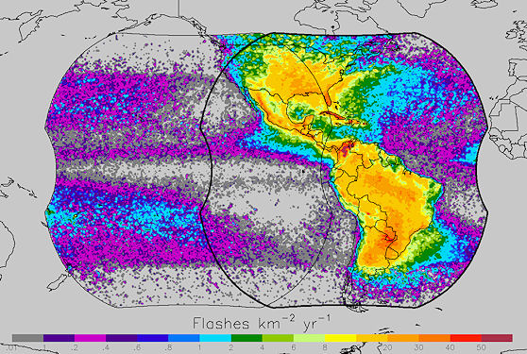




Future Data Integration
NWP / near-storm env.
GOES-R
NEXRAD
HRRR
Super-rapid scan
Dual-pol products
MRMS products
SPC-OA
GLM
Create more refined and specific forecasts of severe weather (tornado, hail, wind)
SREF
OT detection
Images are from NOAA, NASA, UW-CIMSS, and OU-CIMMS
Notes:
There are all sorts of new promising data sets that will have a positive impact on severe weather warning operations. Linking together the pertinent aspects of these data will hopefully only improve the performance of the statistical model, and give forecasters even more confidence, situational awareness, and lead-time to severe hazards. <boxes> But all of this takes time and careful research…we can’t just stick in any and every dataset. A statistical model is only as good as it’s training, so we have to be diligent. Many forecasters have voiced a desire to see probabilistic forecasts tailored to each hazard.

Slide 36



ProbSevere summary
Can increase lead time and confidence of warnings to initial severe weather hazards
A good ‘quick-look’ product that condenses information and focuses forecasters’ attention to potentially severe storms
Displays easily over radar, with scroll-over readout
Skillful as is, but performance should increase with more development

Slide 37

cimss.ssec.wisc.edu/severe_conv/probsev.html
- Available in AWIPS-2 v. 14.4
- Flowing through CR HQ
~ 4-5 min latency
-email:
john.cintineo@ssec.wisc.edu
michael.pavolonis@noaa.gov
justin.sieglaff@ssec.wisc.edu
dan.lindsey@noaa.gov
Notes:
ProbSevere plug-in is baselined in AWIPS-2 v. 14.4
Until your offices upgrade, you can visit our a webpage, which has a google maps interface, and scroll over capability much like what you would see in AWIPS2.
The website also links to blogposts about ProbSevere from the GOES-R HWT blog and the CIMSS satellite blog.
At the bottom there are links to a couple published papers and some training materials given to forecasters at HWT.
Please don’t hesitate to send us emails with general questions or comments or from specific cases you observe. We love hearing from the operational community!
Questions?

