Slide 1
ProbSevere LightningCast
Mike Pavolonis (NOAA/NESDIS/STAR)
John Cintineo (UW-CIMSS)
Justin Sieglaff (UW-CIMSS)
Scott Lindstrom (CIMSS, training)
With support from GOES-R Science

Slide 2
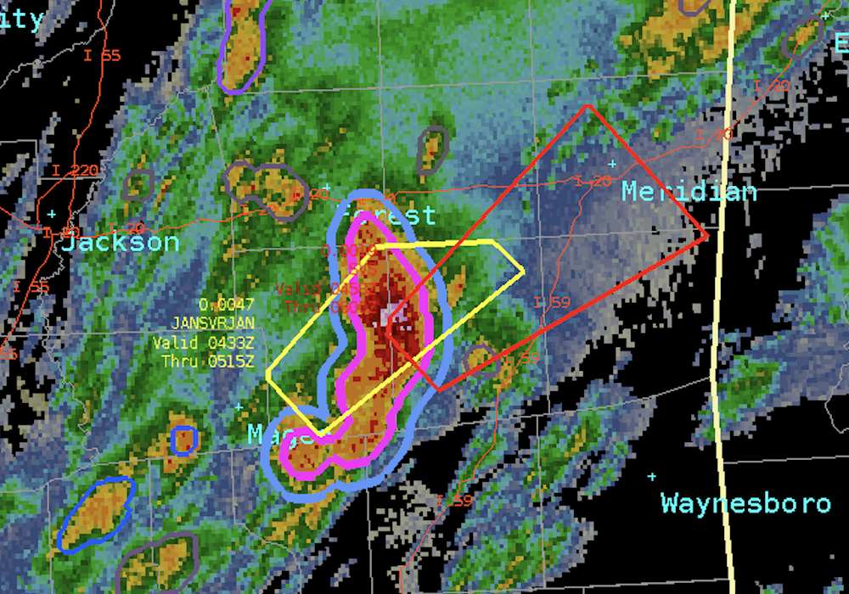
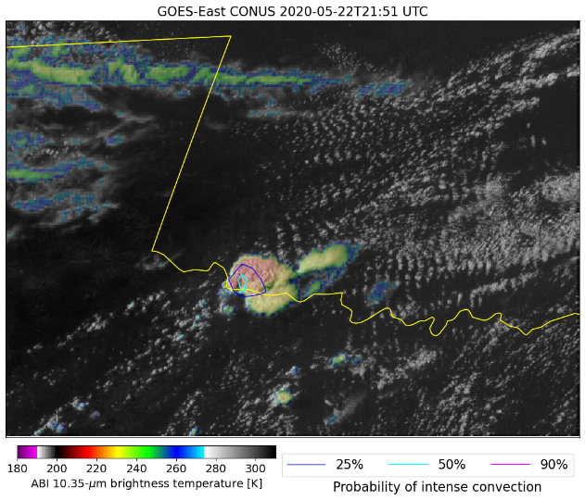
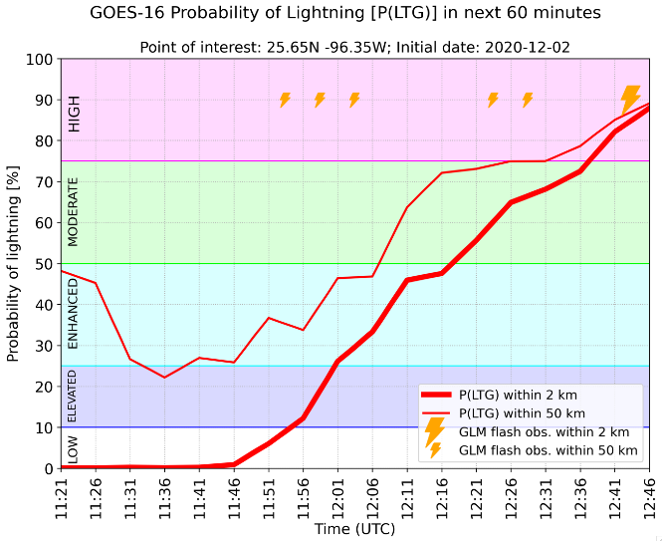
LightningCast is part of ProbSevere Portfolio
1. ProbSevere v2 (operational)
2. IntenseStormNet
3. ProbSevere v3
Given current observations, what is the likelihood of lightning occurring in the future? Train an algorithm with past data.
v3
4. Lightning Nowcasting
Subject of this training
v2
Notes:
-Convective nowcasting toolkit
-All components are independent, except PSv3 utilization of ICP
In order from most mature to least mature:
ProbSevere v2: data fusion through classical ML; early R2O success of current AI/ML boom; published (operational) – many lessons learned
ICP: computer vision, ABI + GLM based CNN that identifies storms with visual indicators (OTs, AAPs, thermal couplets, lightning patterns, etc.) consistent with intense/severe storms; published (NRT)
ProbSevere v3: more sophisticated machine learning (gradient boosting machine) with additional predictors including output from the ICP model; will be demonstrated at the 2021 HWT (NRT)
Lightning nowcasting: image segmentation based CNN to generate location specific lightning nowcasts; ABI based; labels were derived from GLM
Convective initiation nowcasting: grad student is developing this model; operational implications, but also hope to use it, in tandem with other models to analyze convective activity and improve understanding of physical processes
Important points: NRT deployment is a critical part of the development and testing process, you can never do enough offline testing to emulate continuous unsupervised testing

Slide 3
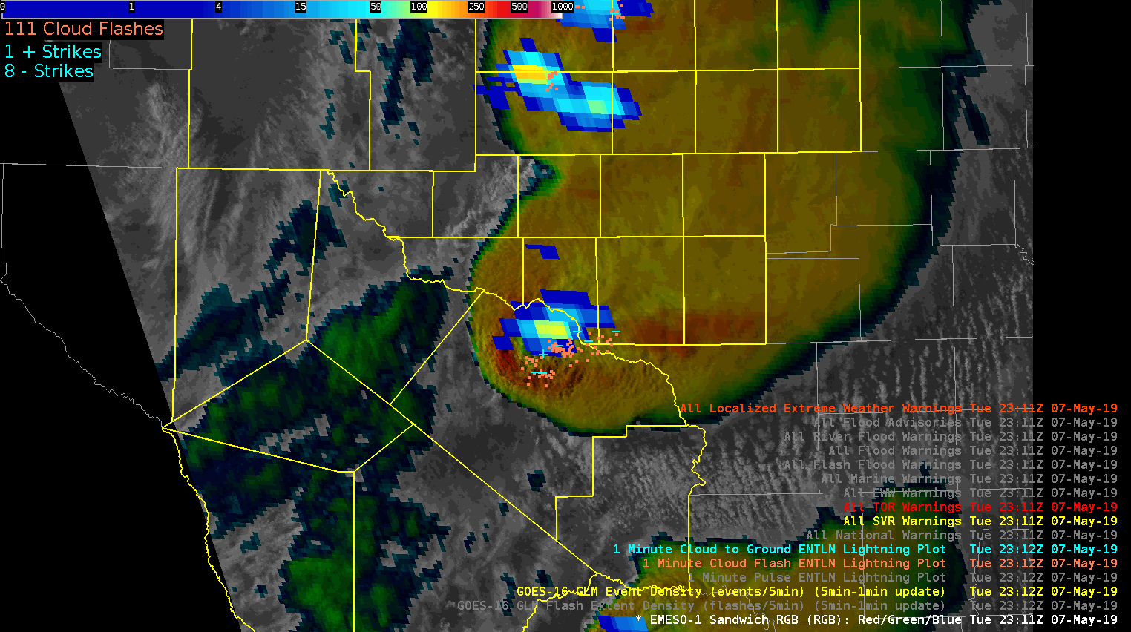
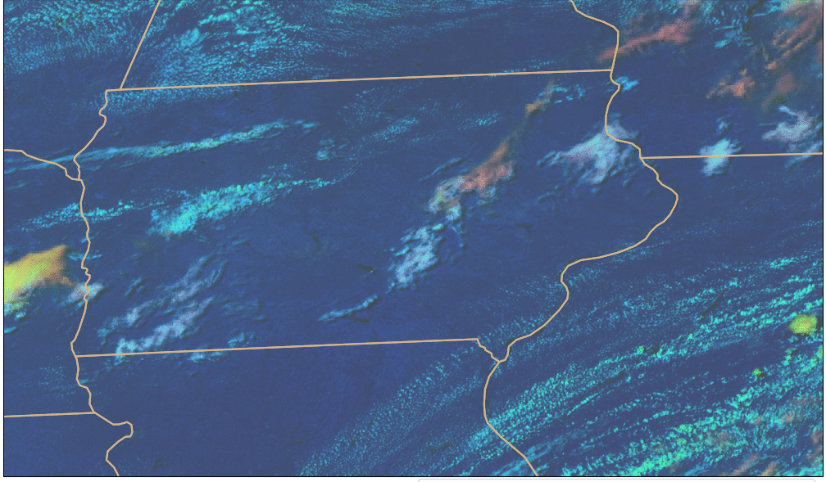
What is ProbSevere LightningCast?
GLM: where lightning is currently present
ABI: multi-spectral images of convective clouds
Day Cloud Phase Distinction is discussed in depth in Elsenheimer and Gravelle 2019
ProbSevere LightningCast is an ABI-based machine learning model that predicts where the (gridded) GLM will observe lightning up to 60 minutes in the future – based on the evolution of ABI cloud imagery. Human eyes/brains already do this – the training mimics this capability.
Notes:
-GLM observes lightning
-Human interpretation of ABI imagery has been shown to be important for nowcasting lightning, especially lightning initiation
-In short, we used a portion of the historical ABI and GLM data record (2019) to train a machine learning algorithm to analyze multispectral ABI imagery with the goal of nowcasting lightning as observed by GLM

Slide 4
Lightning Probability: How?
Take observations of the ABI Bands, including those used operationally in Convective situations (Day Cloud Phase Distinction, for example, during daytime)
Take observations of lightning from GLM
Use both of these to train a model based on ABI data on when lightning will occur
A request for this product came from OPC/WPC – for predictive information over the ocean

Slide 5
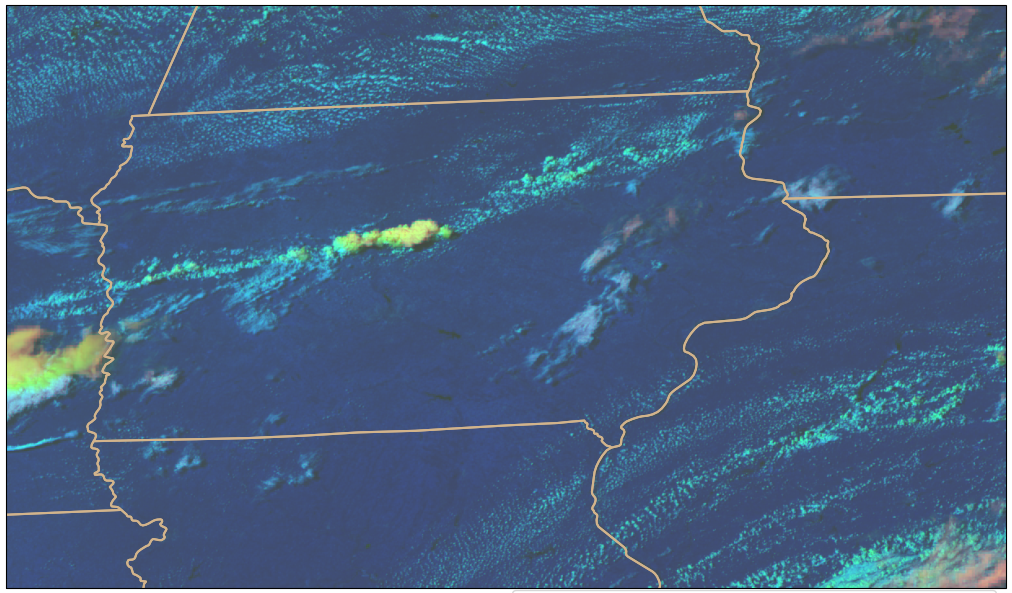
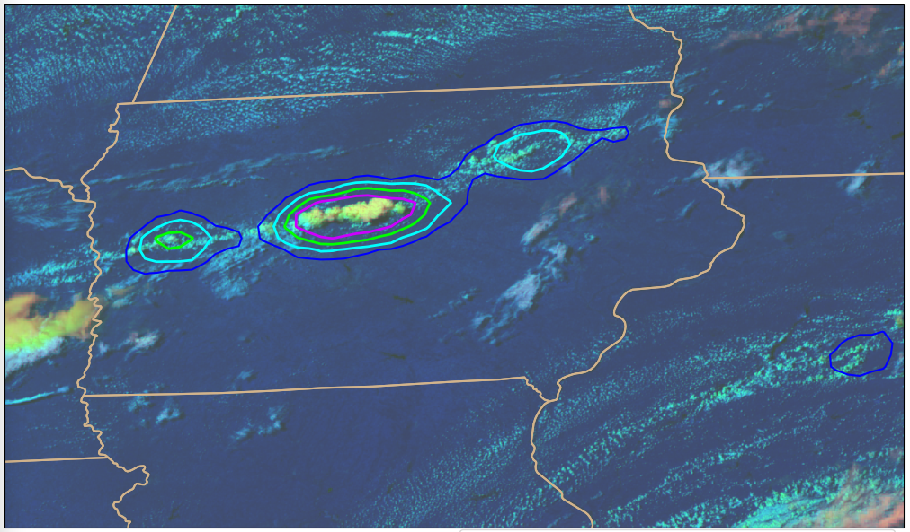
How does ProbSevere LightningCast work?
Input:
0.64 µm reflectance (band 2)
1.6 µm reflectance (band 5)
10.3 µm brightness temperature (band 13)
12.3 µm brightness temperature (band 15)
Output:
probability that GLM will observe lightning in the next 60 minutes
Natively 2-km res. on the ABI grid
Remapped to ~10-km res. on equal lat-lon grid
Works day and night; Applicable to any scan domain (meso, CONUS, or FD); Applicable to GOES-East (GOES-16) and GOES-West (GOES-18)
Notes:
-Same family of computer vision machine learning that is used in self driving cars
-Learns the relationship between ABI image patterns (spatial and spectral) and the location of where GLM observed any lightning in the 60 minutes that follow the ABI image time – millions of ABI images with GLM derived labels were used
-Unlike with PSv2 and PSv3, there is no feature detection or tracking; it is a pure computer vision approach (mimics how a human interprets imagery)
-Input: All channel input is at 0.5 km via oversampling
-The contribution from the reflective bands gracefully ramps down to zero at night, with no noticeable discontinuity
-Output: A 0.5 km map of probabilities is the result. The probability map is subsequently subsampled and converted into probability contours.

Slide 6
Why is LightningCast needed?
The LightningCast activity was initiated in response to an OPC need
Obvious other uses:
Impact-based Decision Support Services (IDSS) for outdoor events
Airport and air traffic operations
Wildfire incident response
Personal decision making
The 0-60 minute GLM nowcast is the baseline LightningCast capability. Many other lightning models are possible (different time intervals, different lightning frequency thresholds, ground-based sensors, etc.).
Notes:
-Years ago OPC asked for a convective nowcasting tool for the offshore region – akin to PSv2, without a reliance on radar
-Given the limited number of severe wx reports over the ocean, we decided to nowcast lightning, which is a reasonable proxy for convective vigor
-While working the offshore problem it became clear that lightning nowcasting was important for many other applications and there were capability gaps
-The pre-lightning initiation threat is not always obvious and determining when it is safe after storm passage is challenging

Slide 7
5 (75%) – 25 (25%) minutes of lead-time prior to first GLM flash
15 (75%) – 25 (25%) minutes of lead-time prior to first GLM flash
15 (75%) – 30 (25%) minutes of lead-time prior to first GLM flash
30 (75%) – 70 (25%) minutes of lead-time prior to first GLM flash
Notes:
-Clean example with variable lead-time in the midwest
-The lead-time is a function of how rapidly the storm develops

Slide 8
Note : LightningCast is frequently shown on animations; however, time tendency (how ABI Band information is changing) is not used in the algorithm.

Slide 9
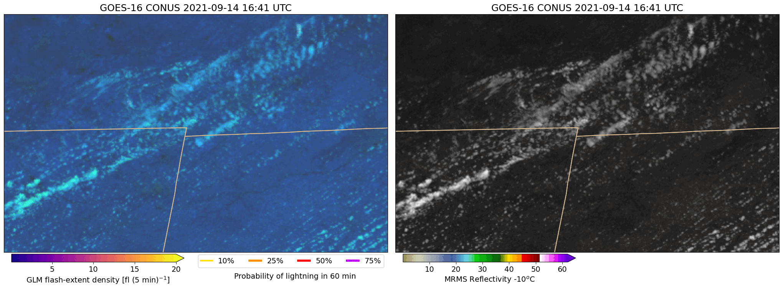
Comparison to NEXRAD radar
Michigan
Michigan
Ohio
Ohio
Day-cloud-phase distinction RGB + LightningCast contours
Visible imagery + Refl. @ -10ºC
Spatially coherent LightningCast signals often precede early radar indicators of convective and lightning initiation
Notes:
-Storms in N. Indiana with composite reflectivity
-Not an extreme example

Slide 10
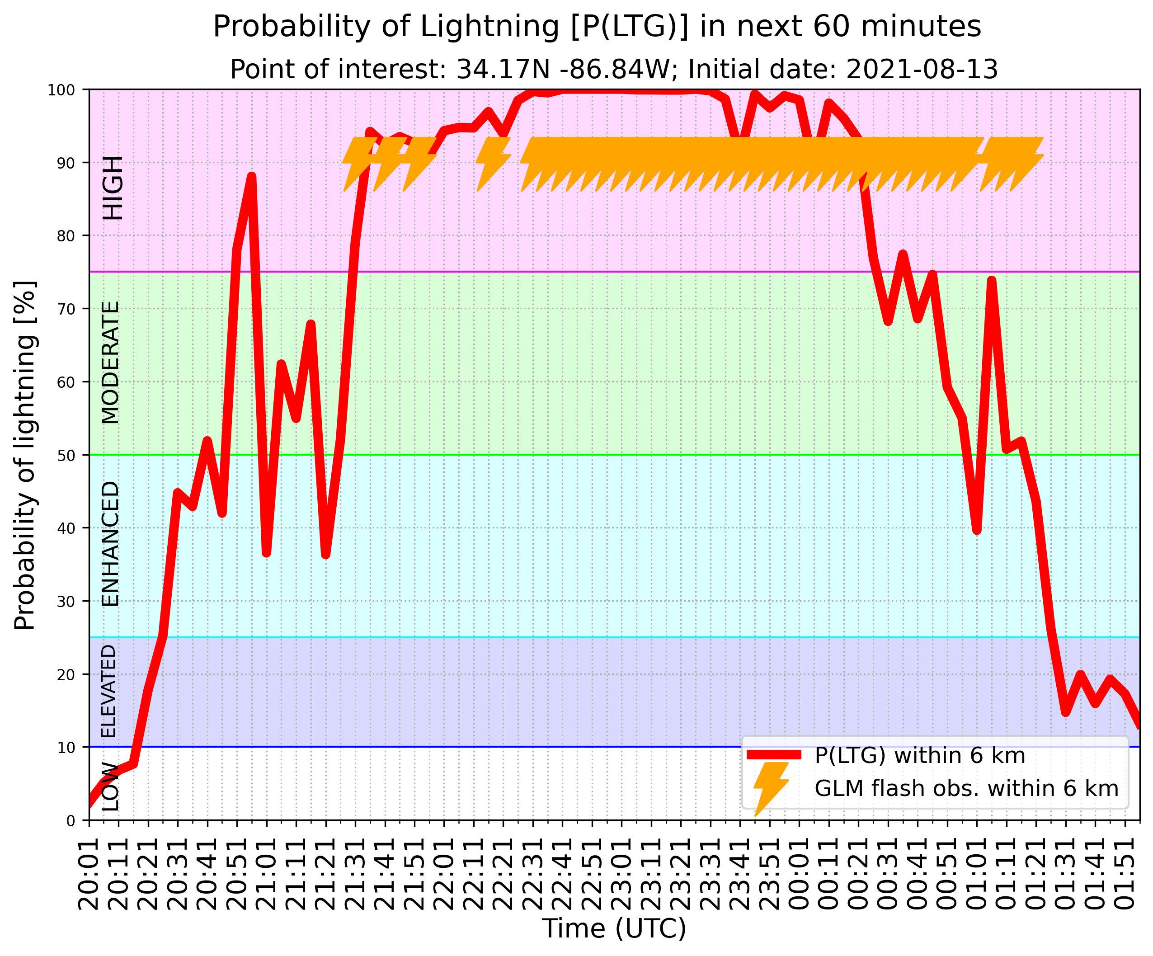
IDSS Example – “Rock the South,” Cullman, AL
Notes:
-Good example of day/night transition and how the model handles lightning potential near the end of a convective event
-Note the SW elongation of the higher probabilities that captures the last gasp of stratiform lightning
-Giving the “all clear” is equally important and challenging

Slide 11
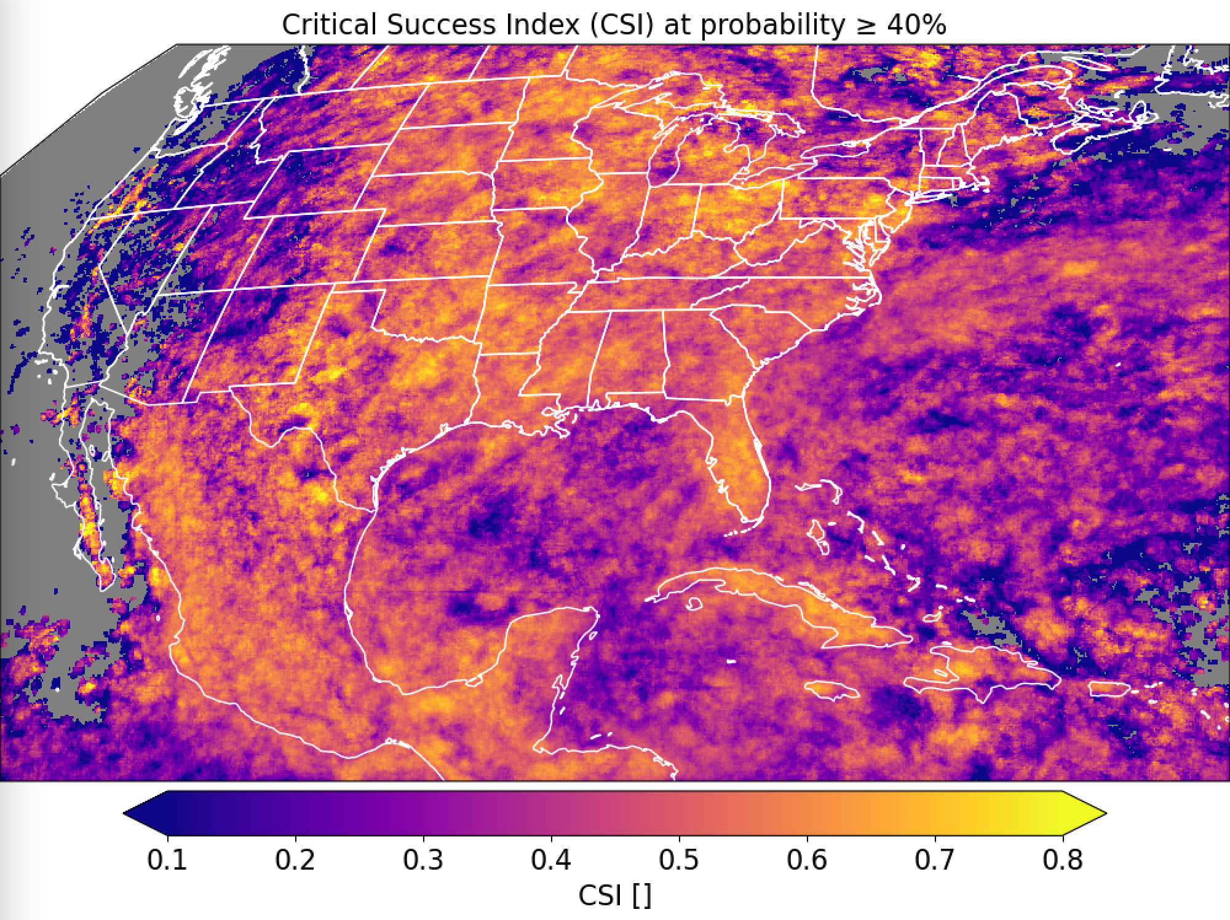
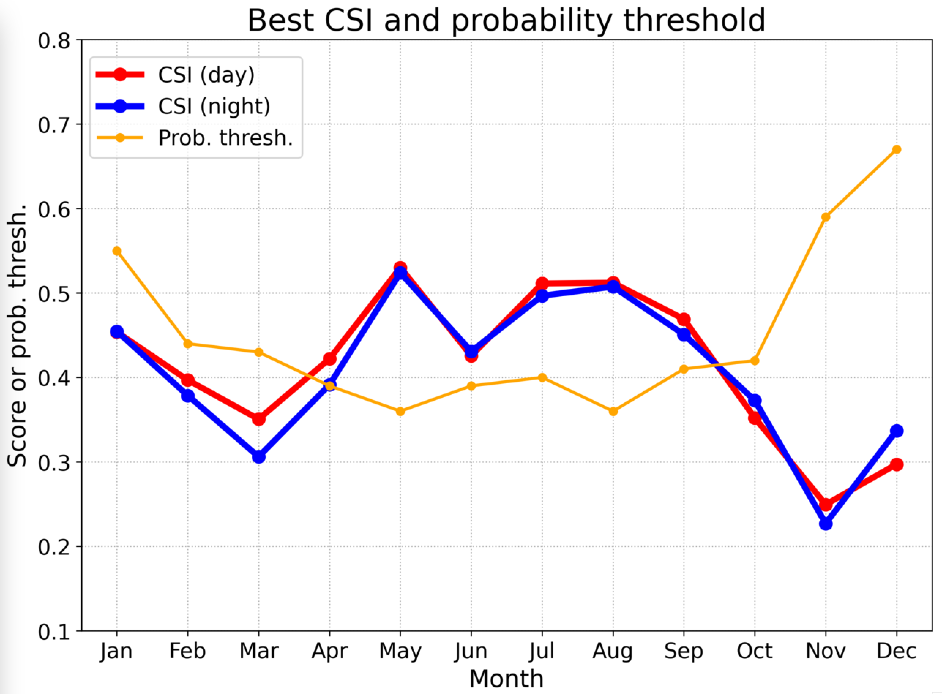
Verification - GOES-16
Seasonal performance
Critical success index for probability > 40%
Notes:
-2020 – completely independent
-Lower scores are most often associated with regions where GLM observed very little lightning, some of which is due to detection efficiency issues
-So yes, the model is working as intended

Slide 12
Verification - GOES-16
What do you see in this CSI map?
Better statistics over land
Better statistics closer to satellite nadir
Bear this in mind as you interpret output
Seasonal performance
Critical success index for probability > 40%
Notes:
-2020 – completely independent
-Lower scores are most often associated with regions where GLM observed very little lightning, some of which is due to detection efficiency issues
-So yes, the model is working as intended

Slide 13
This paper by Solomon and Baker lists reasons why Lightning Production is different over oceanic (v. continental) storms. This example shows continuous high probabilities where lightning is occurring. You can also see regions where lightning probability decreases after lightning occurs. Not all 75% contours show lightning however.

Slide 14
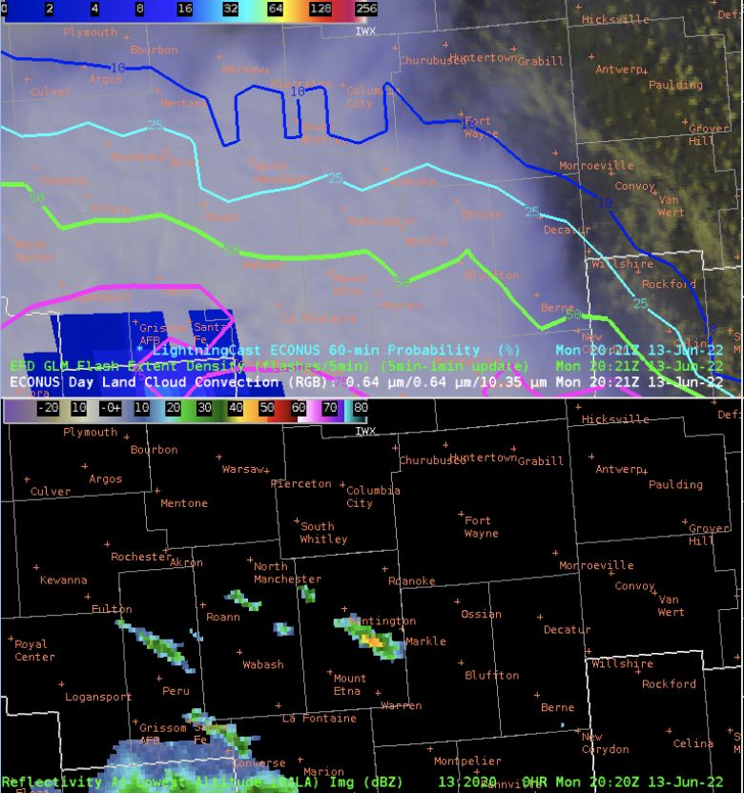
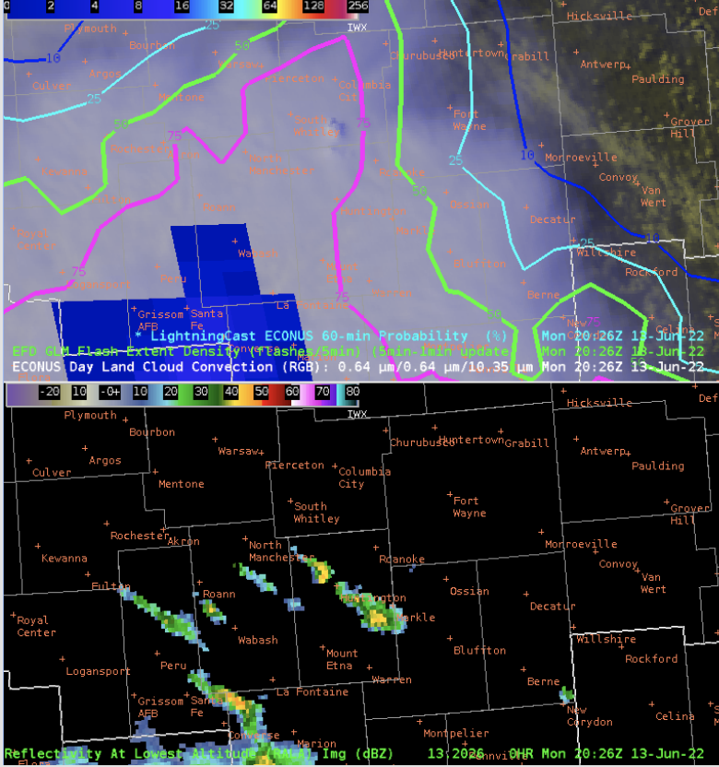
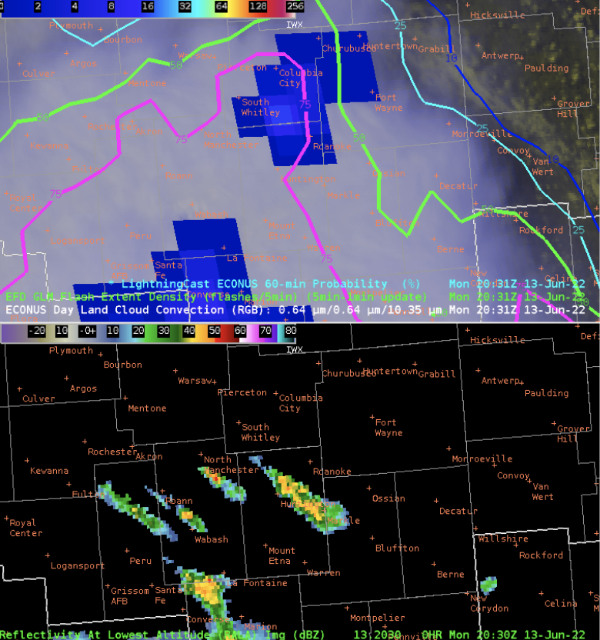
LightningCast and developing convection under thick cirrus
https://goesrhwt.blogspot.com/2022/06/where-is-new-convection-going-up.html
20:21 UTC
20:26 UTC
20:31 UTC
Notes:
This message is here is that thick cirrus can obscure growing convection. LightningCast picks up on the convection late, once it emerges from cirrus deck at 20:26Z.

Slide 15
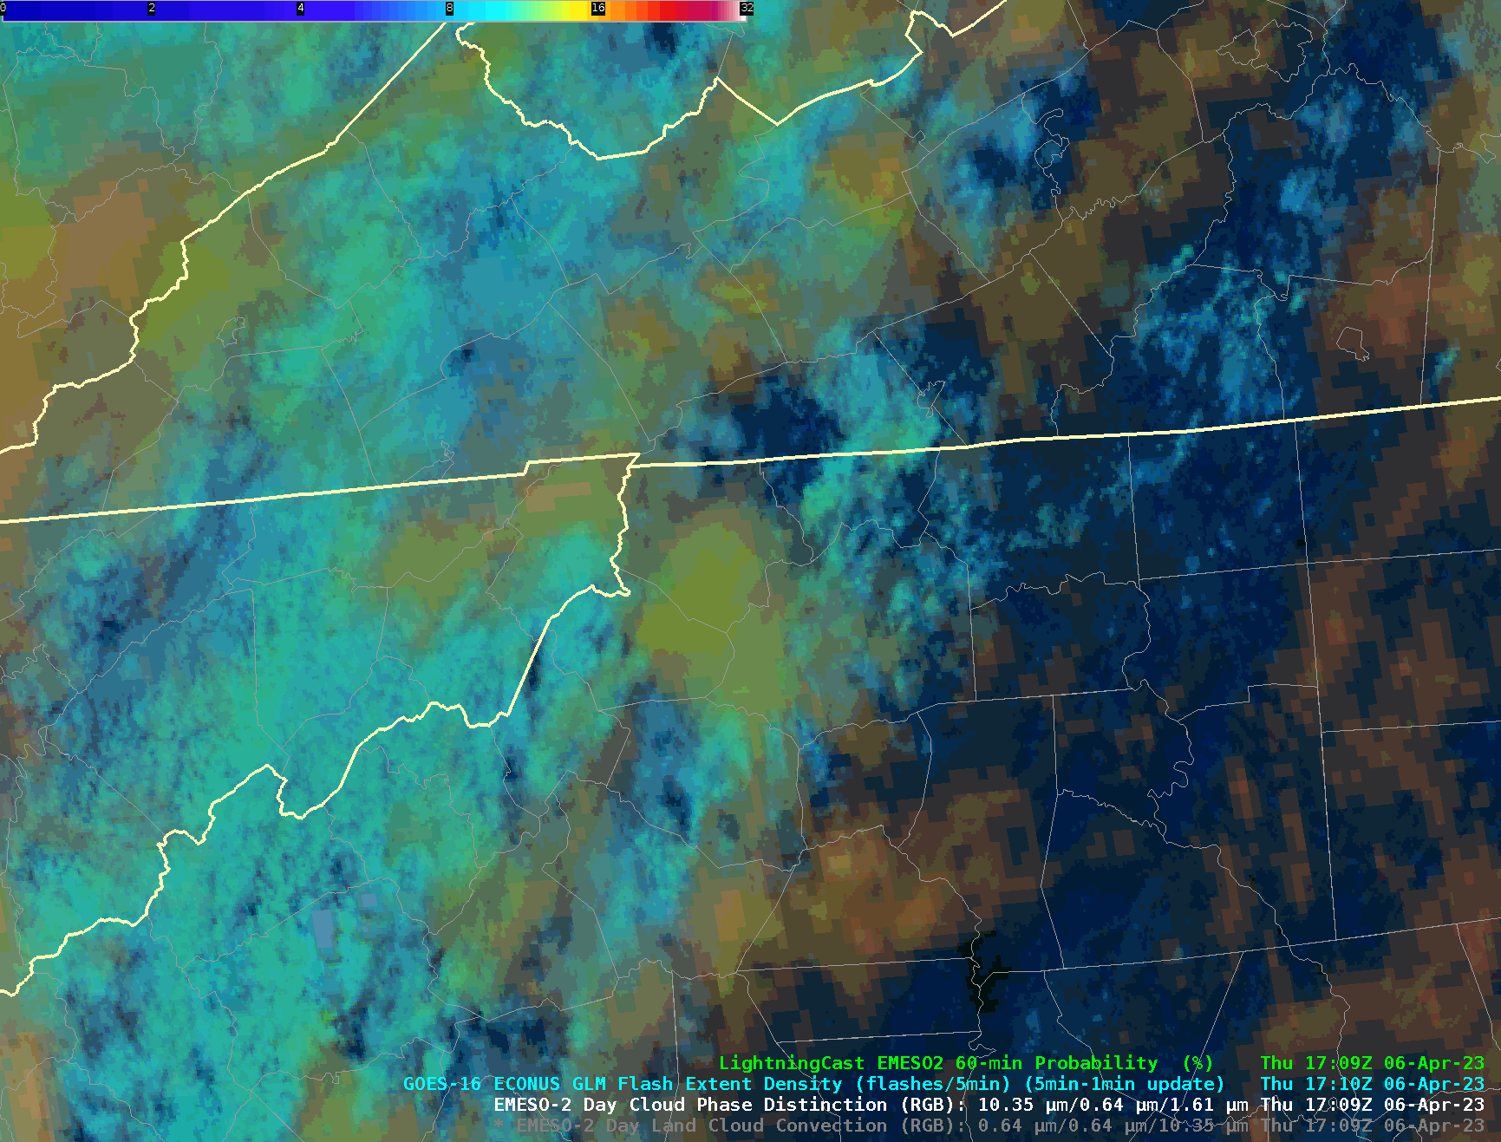
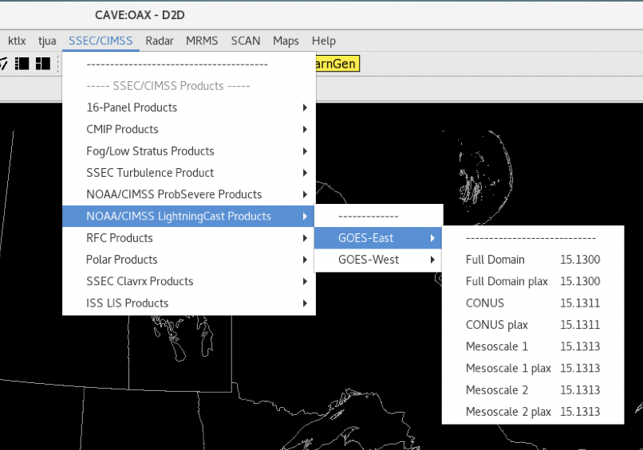
LightningCast in AWIPS
Contours can be customized via LightningCastContourStyleRules.xml
Requires CAVE restart
More info: https://tinyurl.com/lightningcast-in-awips
Ask your ITO to request ProbSevere
LightningCast from your regional HQ
“plax” means “parallax-corrected” (using constant-cloud-height assumption).
To enable sampling, LightningCast must be loaded via the menu and not the product browser.
“NOAA/CIMSS LightningCast Products” may be under a different header at your office.
Notes:
Highlight that GOES-East and –West are available; the 5-min CONUS/PACUS and both 1-min mesos; parallax-corrected and uncorrected contours.

Slide 16
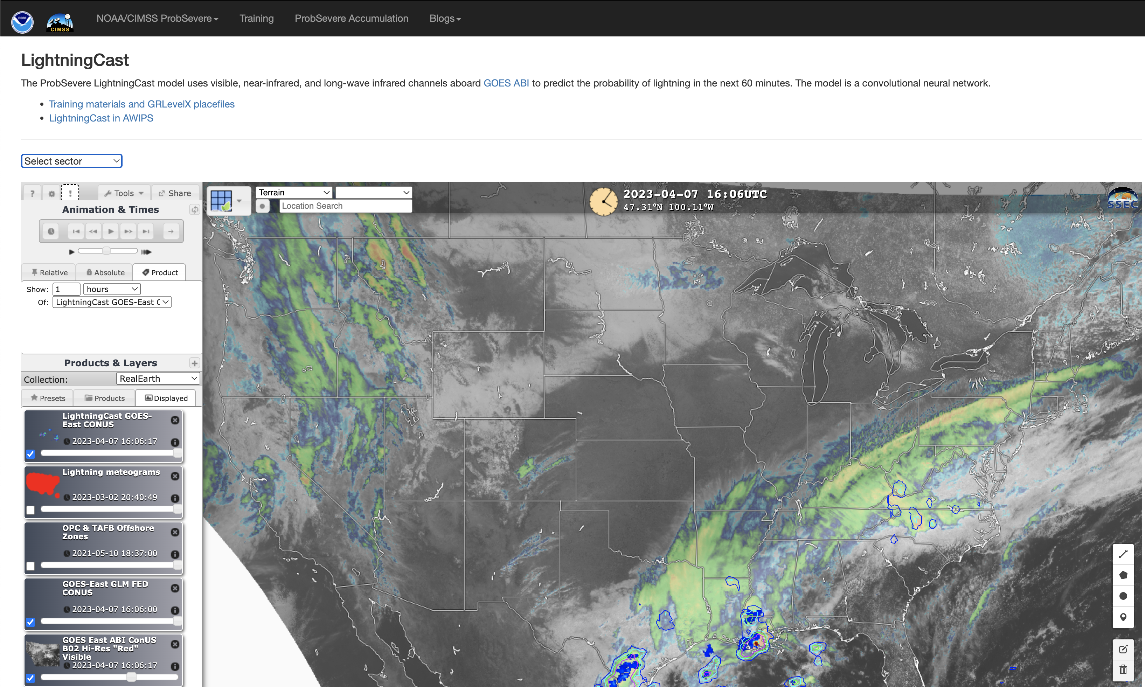
ProbSevere LightningCast web availability
Near real-time output is available: https://cimss.ssec.wisc.edu/severe_conv/pltg.html
Change sector here CONUS: ~25s after end of scanning
MESO: ~3s after end of scanning
Link to additional info and GRLevelX Placefiles (parallax corrected contours for radar overlay)
Notes:
-RealEarth is a web mapping service so you can zoom as needed

Slide 17
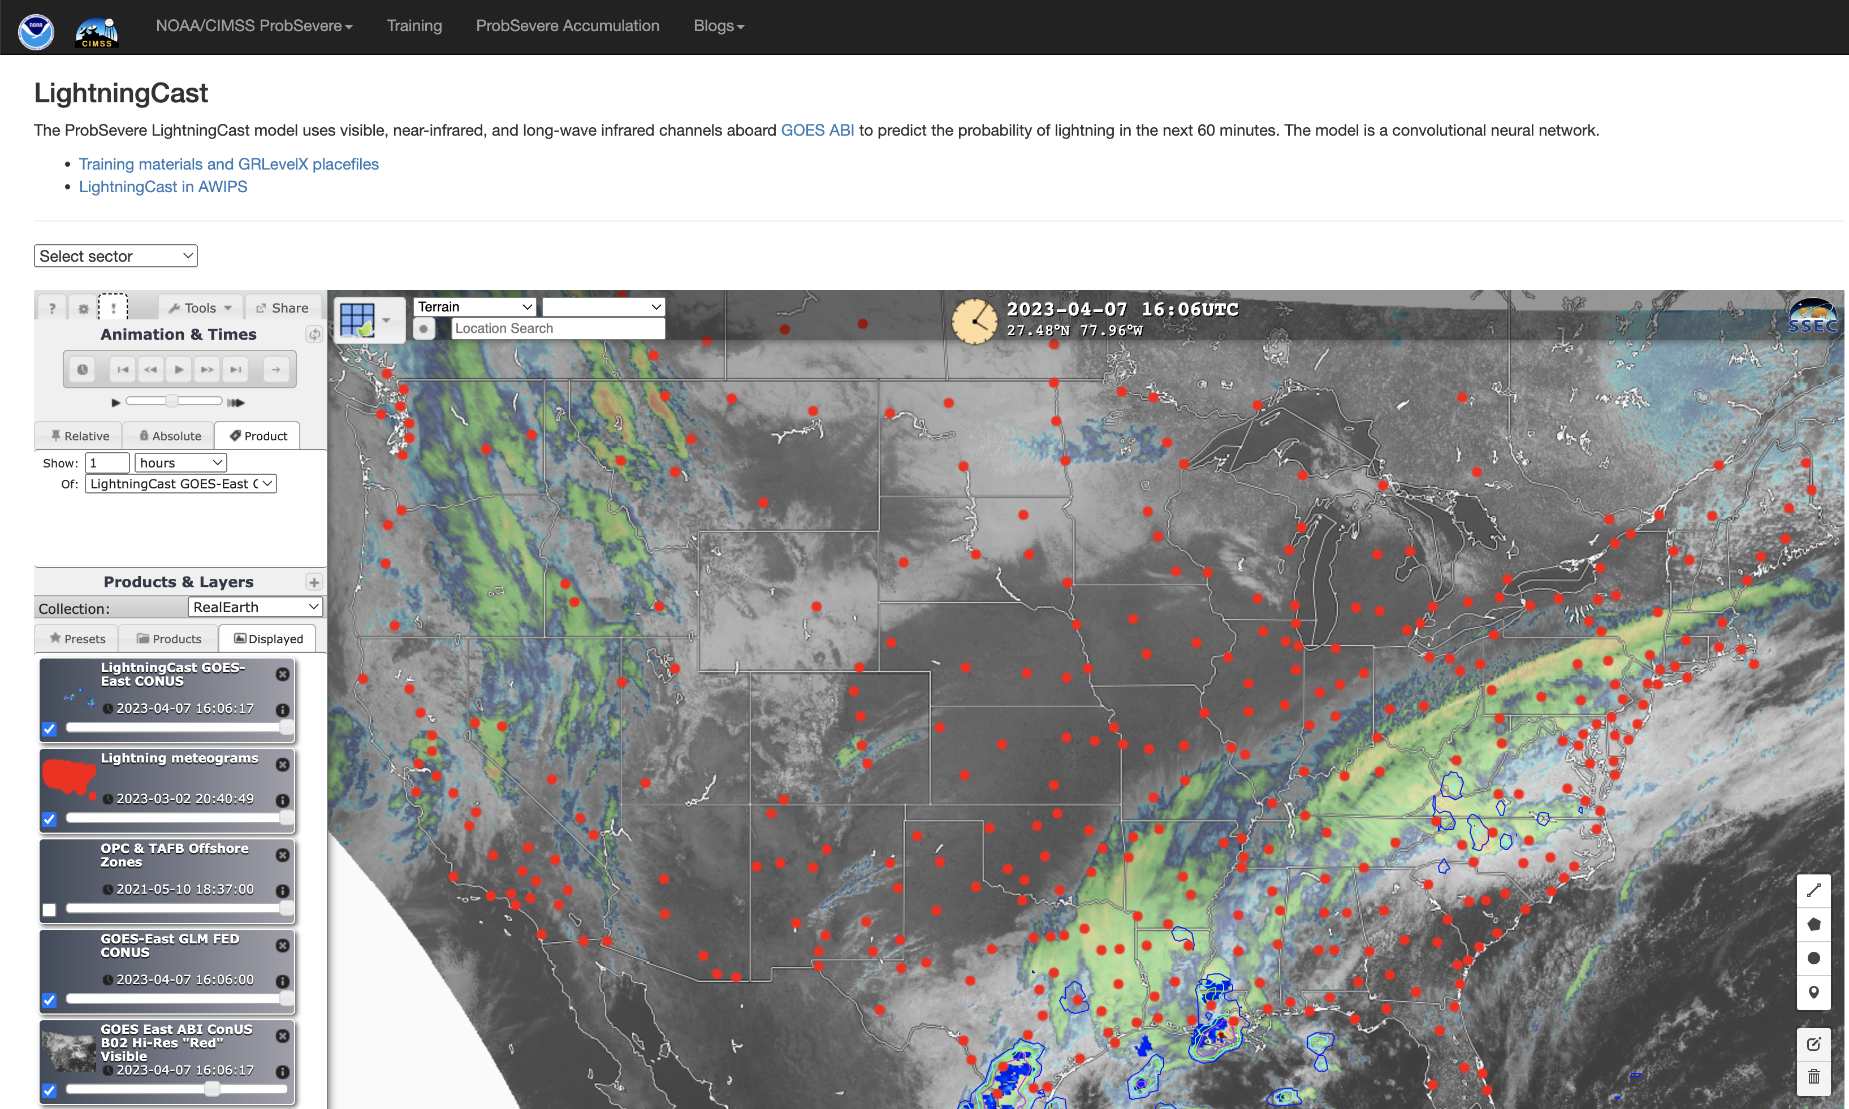
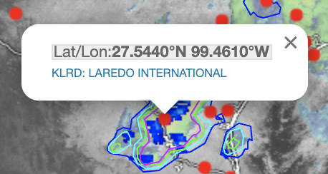
ProbSevere LightningCast web availability
Toggle on meteograms
Click link
Click a location
Notes:
Meteograms available at many airports and airfields.

Slide 18
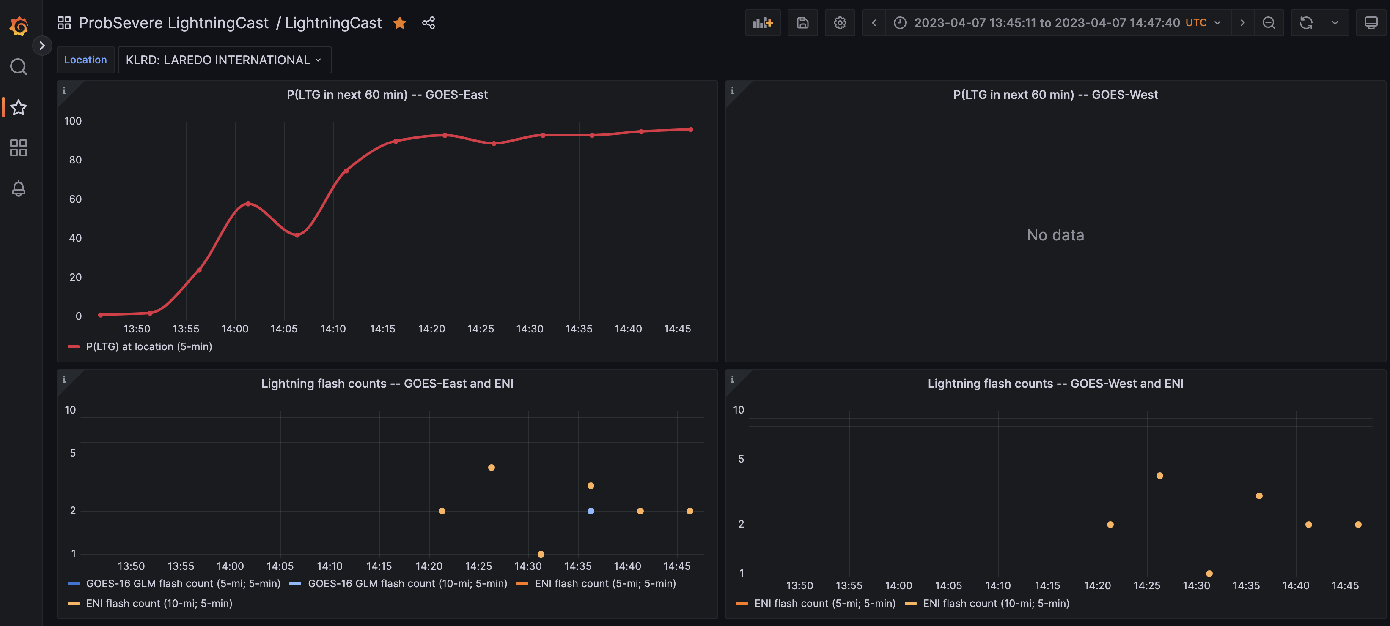
ProbSevere LightningCast web availability
Change location
Change time
Toggle on/off time series
Notes:
Grafana. Time series of LightningCast probabilities for GOES-East and GOES-West, as well as observed flash rates from GLM and ENI.

Slide 19
ProbSevere LightningCast: Summary/Next Steps
Unique quantitative exploitation of GOES-R data: ~20-30 minutes of lead-time relative to first occurrence of GLM-detected lightning.
AI tools are not a replacement for human expert analysis, but they enable consistent, efficient, and timely decision-making.
LightningCast has been selected for transition-to-operations in NESDIS, hopefully by late 2024.
We want to hear ideas from the field regarding how to prioritize R+D and improve LightningCast products.
Notes:
-Unique exploitation of GOES-R that provides 10-50 minutes of lead-time ahead of the first occurrence of lightning (~20-30 minutes is a typical lead-time); systematic and objective
-Does not replace human expert analysis for IDSS, but it may improve efficiency, lead-time, and enable a great focus on hazard communication (uniquely human)
-Now that a sufficiently mature and proven model has been deployed, user feedback will dictate further development of the model, user interfaces, and dissemination mechanisms

Slide 20
General ProbSevere Information
ProbSevere v2.x via Web Mapping Service:
https://cimss.ssec.wisc.edu/severe_conv/probsev.html
ProbSevere v2.x Description:
https://journals.ametsoc.org/view/journals/wefo/35/4/wafD190242.xml
https://cimss.ssec.wisc.edu/severe_conv/training/recorded/ProbSevere2019/presentation_html5.html
ProbSevere Case studies:
http://goesrhwt.blogspot.com/
ProbSevere IntenseStormNet:
https://journals.ametsoc.org/view/journals/wefo/35/6/waf-d-20-0028.1.xml
https://cimss.ssec.wisc.edu/satellite-blog/archives/tag/icp
ProbSevere LightningCast model:
https://cimss.ssec.wisc.edu/satellite-blog/archives/38136
Additional Resources (including addition references):
https://cimss.ssec.wisc.edu/severe_conv/training/training.html

Slide 21
Questions?
michael.pavolonis@noaa.gov
john.cintineo@ssec.wisc.edu
justin.sieglaff@ssec.wisc.edu
scott.lindstrom@noaa.gov

