Slide 1
An OSSE Investigating a Constellation of 4- 5(.8) μm Infrared Sounders-----(Selections for IWW14)
Will McCarty1,2
1Global Modeling and Assimilation Office
2NASA Goddard Space Flight Center
J. Blaisdell3, M. Cordero-Fuentes1,4, D. Carvalho1,5, M. Chattopadhyay1,4, R. Errico1,5, R. Gelaro1,2,
L. Kouvaris3, I. Moradi1,6, S. Pawson1,2, N. Prive1,5, M. E. Sienkiewicz1,4, and J. Susskind2
3Science Applications International Corporation
4Science Systems and Applications, Inc.
5Goddard Earth Sciences Technology and Research
6Earth System Science Interdisciplinary Center

Slide 2
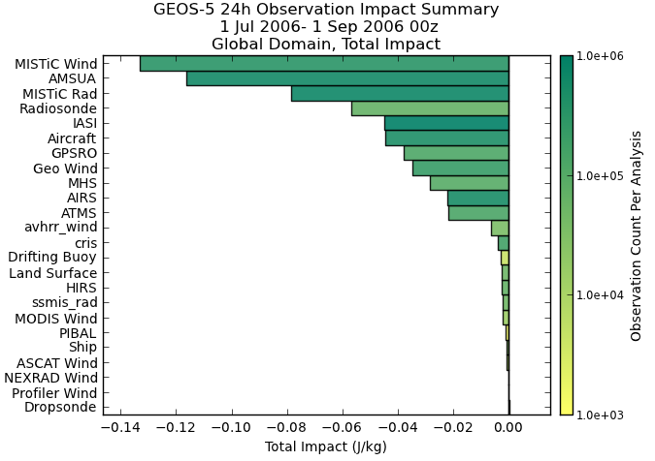
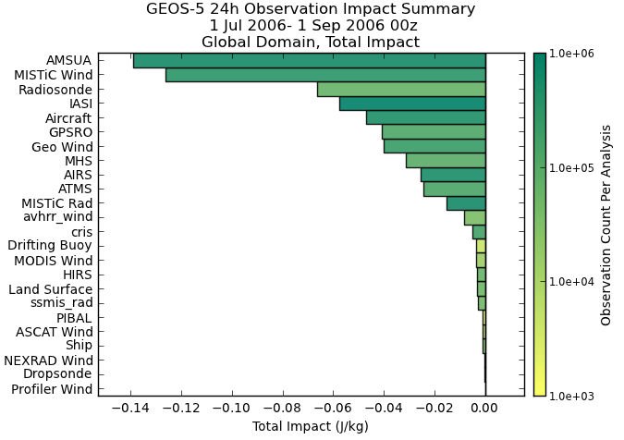
Forecast Impact (FSOI Metric)
Perfect MISTiC Obs 4 Orbit Configuration
Imperfect MISTiC Obs 4 Orbit Configuration
MISTiC Winds observations have a substantial impact on the skill of 24-hour forecasts, traced using an adjoint-based impact tool. Adding observation errors, MISTiC Winds wind data maintain high impact, while the impact of the radiances drops substantially in the “mix”
(Radiance impact drop due to RT shortcomings in ‘imperfect’ observations, recoverable w/ development)

Slide 3
Impact of MISTiC Wind AMVs
No of Obs used
(millions)
Impact per Obs
(negative is good!)
Cloud and WV AMVs combined
The MISTiC Winds sampling strategy results in a consistent distribution of observations through troposphere
The OSSE demonstrates that the highest impact of MISTiC Winds measurements comes from middle troposphere
It is the winds derived from water-sensitive radiances that are the most impactful
Notes:
The main note here is that the mid-troposphere would be a data void, and the sounding AMV procedure fills in that region. The impact per observation shows that those observations have the highest impact-per-observation.
This makes sense as the observations in the upper- and lower-troposphere are to some degree sampled by the GEO imagers.

Slide 4
FSOI Metric for the MISTiC Winds Spectral Radiances
Spectrum (on its side)
Per channel impact on one-day forecast skill (negative is error reduction)
“temp” channels
Big benefit
moisturechannels
Moisture channels: beneficial impacts persist from “perfect” to “imperfect” case
Temperature channels: large beneficial impact in “perfect” observation scenario turns around when errors are introduced – main uncertainty here is in radiation transfer model – this is not a limitation of the observation concept and will be addressed

Slide 5
Summary of Main Results
This GEOS OSSE study has demonstrated the beneficial impacts of the MISTiC Winds concept on global weather prediction
A four-plane constellation has more impact than a single plane
The most beneficial impact is from the mid-tropospheric winds derived from radiance channels that are not available from other platforms
It is important to perform a detailed analysis of errors and their impacts
Development of (used) radiation-transfer code in the short-wave IR is likely to lead to more beneficial impacts – this is also applicable to existing hyperspectral data
The GMAO’s GEOS OSSE suite is suited to other studies, including active wind sensing techniques
Notes:
Summary points from Pawson – FYI

