Slide 1
3D Winds derivation from infrared sounders
From the model concept to the product
Olivier Hautecoeur (Exostaff)
Regis Borde (Eumetsat)
Patrick Heas (INRIA)

Slide 2
The AMV challenges
Current AMVs limitations:
AMVs give an information at a single level of the troposphere.
Height assignment is known to be an important problem.
Only few vectors at mid-level.
Recurrent AMV problems in tropics area (fast speed biases) where important mesoscale phenomena impact the medium range forecast.
The challenges:
Ensure the production
Better error characterisation
Better information in Tropics
Wind profiles

Slide 3
Which strategy adopted at Eumetsat?
Known difficulties with IR sounders data
Cross correlation tracking methods not very efficient considering smooth temperature/humidity fields. Not enough contrast/entropy for good matching.
Really difficult to deal with convection.
Each layer is considered separately.
3D optical flow technique developped
Collaboration with P. Héas (INRIA)
Derive winds from IR sounders Level 2 products
Derivation of all pressure levels in one pass
  Vertical motion is also considered
  u, v, ω retrieved at each level on each grid pixel
Operational model
  Can run in real-time with reasonable computing resources
Based on modern mathematics

Slide 4
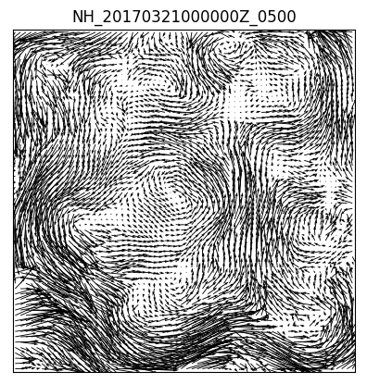
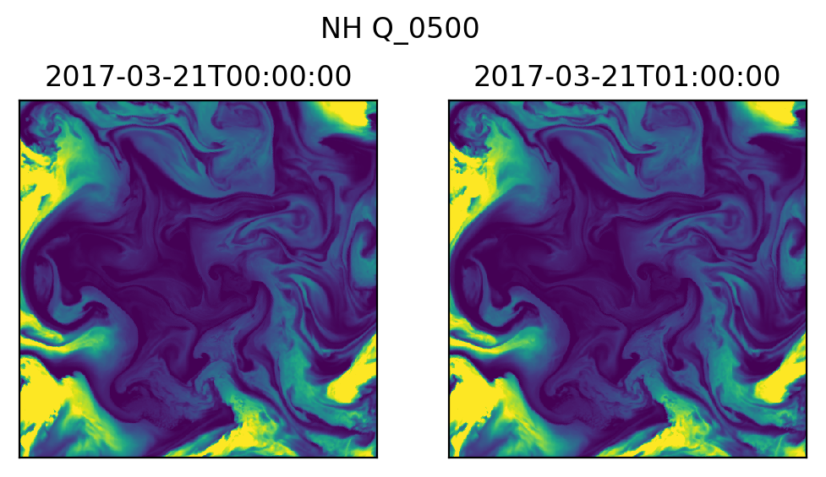
The concept
Grid
  Polar stereographic projection
  Dimension: 512 × 512
  Resolution = 20 km

Slide 5
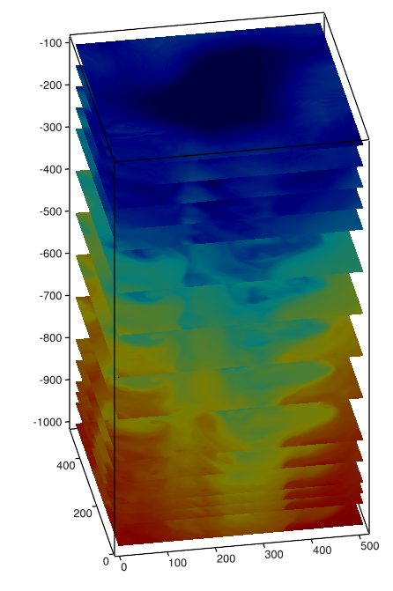
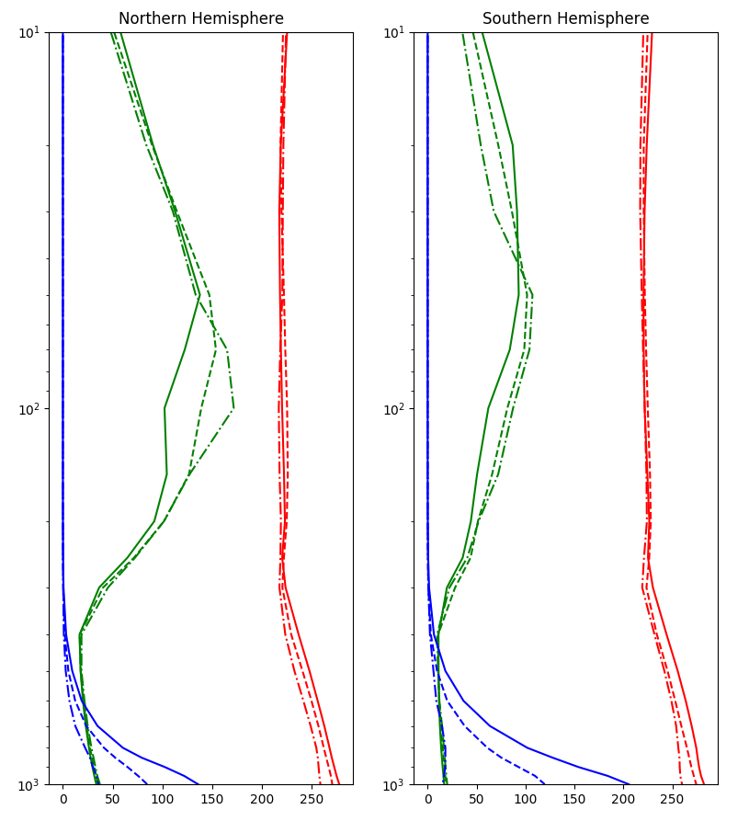
The concept
Joint inversion of
all vertical levels
3 geophysical variables considered

Slide 6




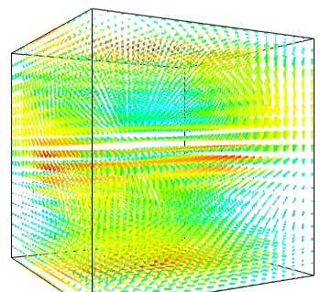
The model
At Time t
Model Settings
Water vapour
Ozone
Temperature
3D Winds Model
At Time t + Δt
Water vapour
3D wind field
U,V,W fields derived from observations
Ozone
Basic Conservation Law
Minimization algorithm
Regularization
Temperature

Slide 7
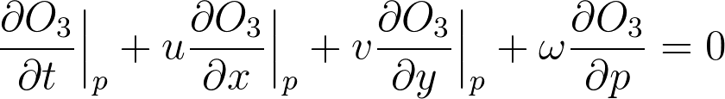
The model
Atmospheric dynamics equations
  For one variable at a pressure level:
… and that’s all!
  no Navier-Stokes
  no Coriolis
  no friction law
  no …
… plus a pinch of mathematics
  to resolve the ill-posed problem

Slide 8
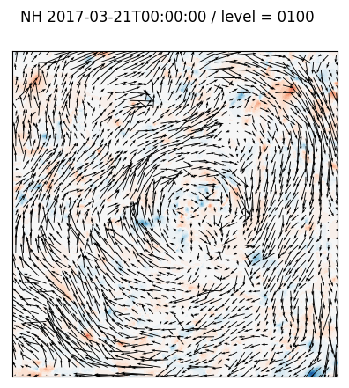
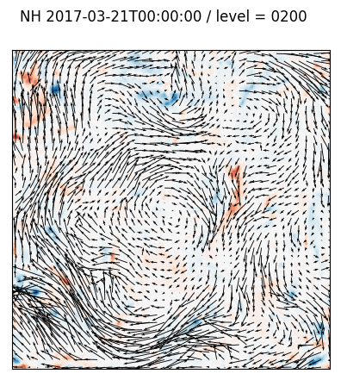
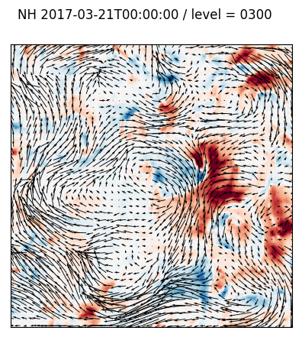
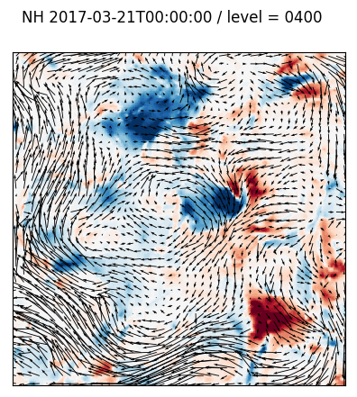
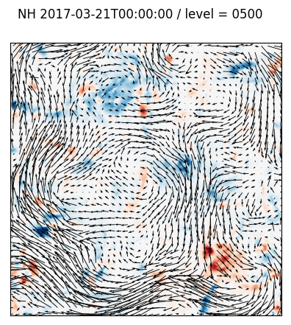
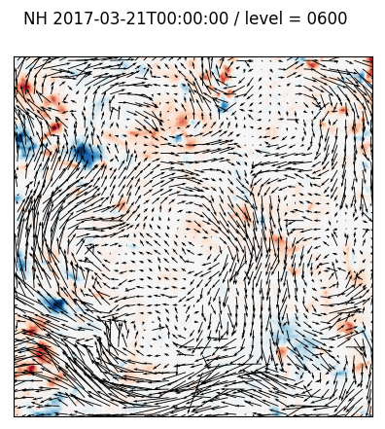
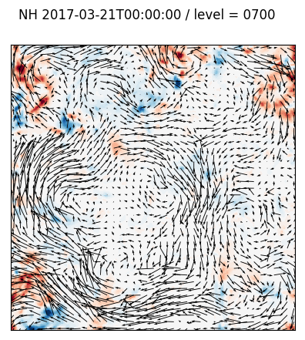
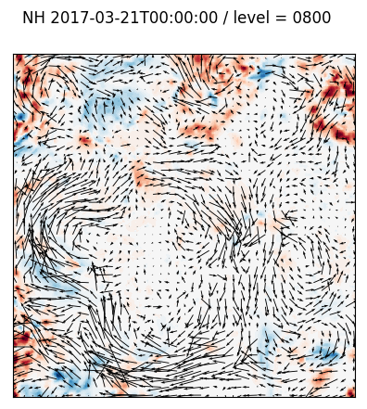
Full 3D winds retrieval

Slide 9
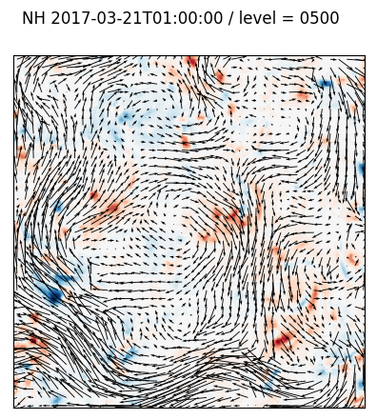
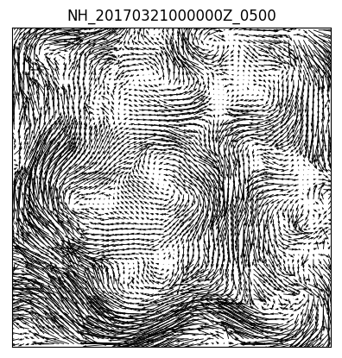
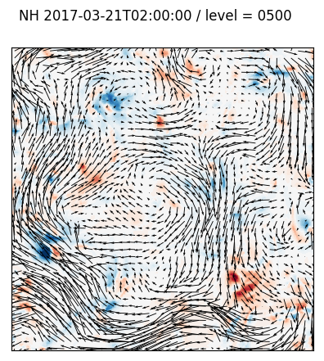
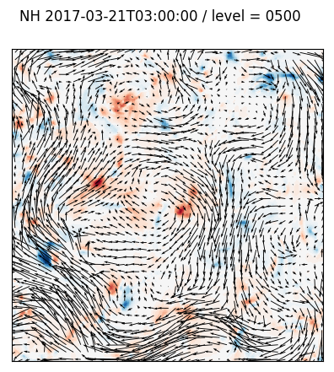
3D + Time dimension
4Dwinds!

Slide 10
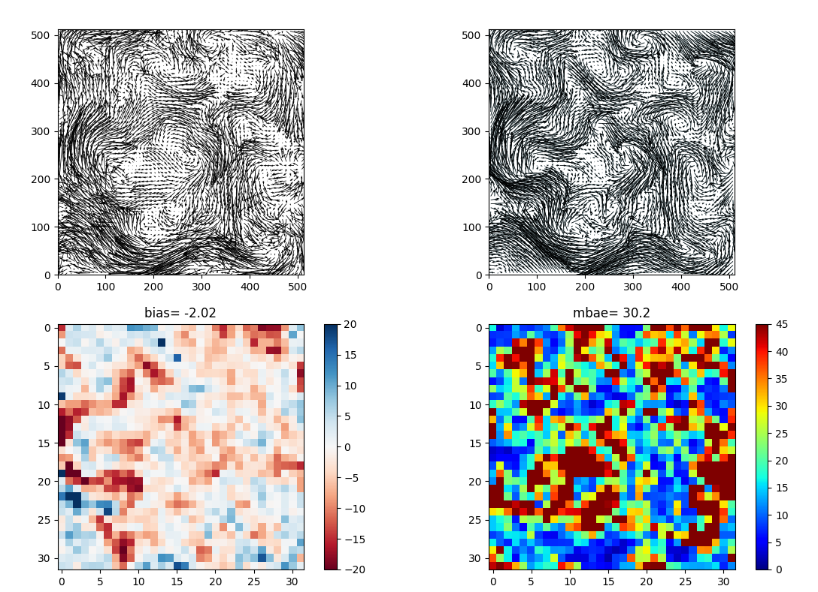
Comparison against forecast (All vectors)
Derived
Forecast winds

Slide 11
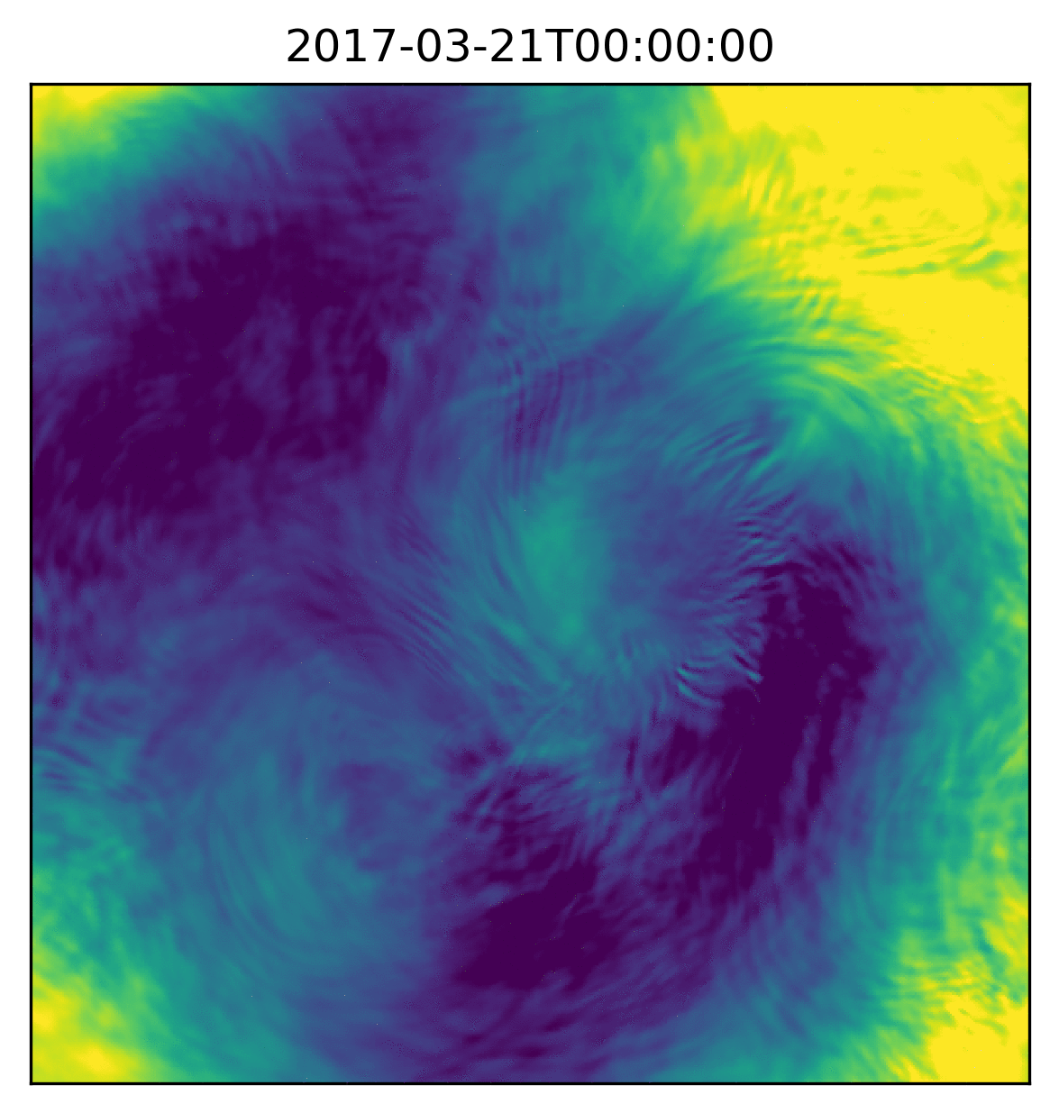
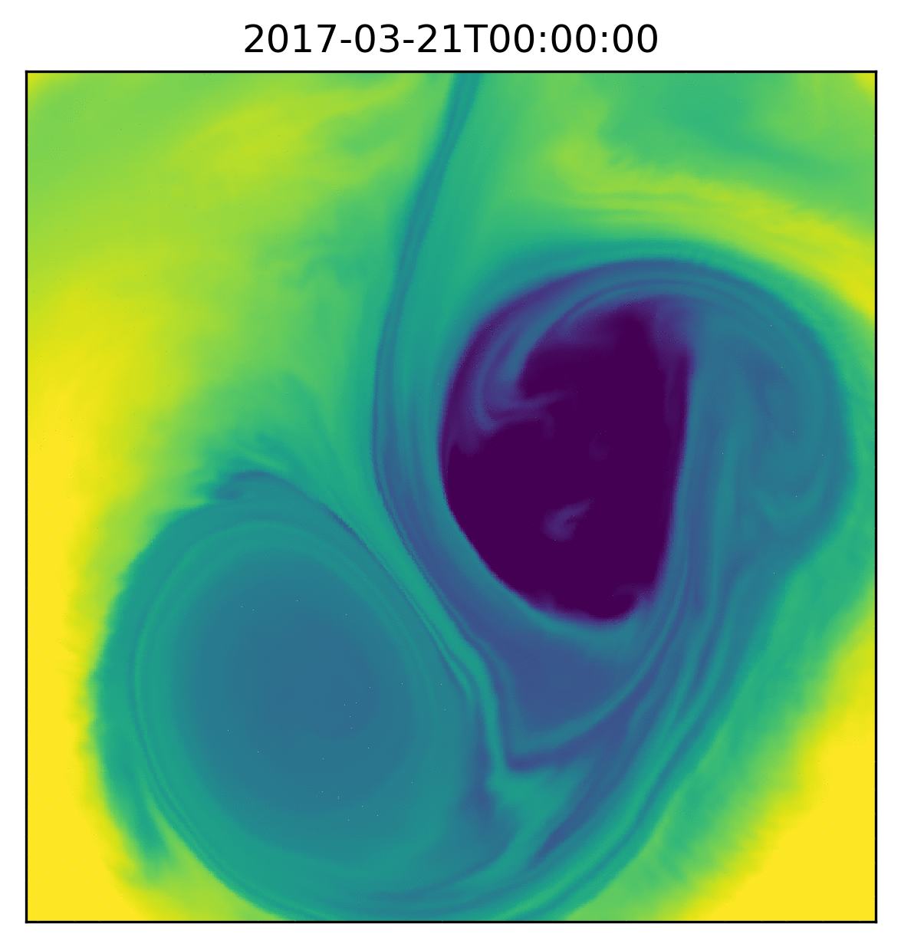
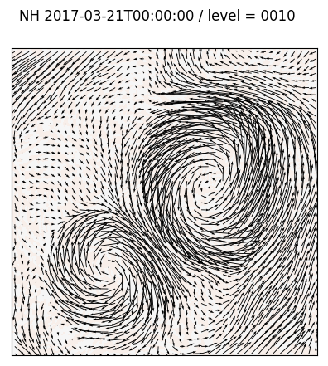
Back to the challenge: the limitations

Slide 12
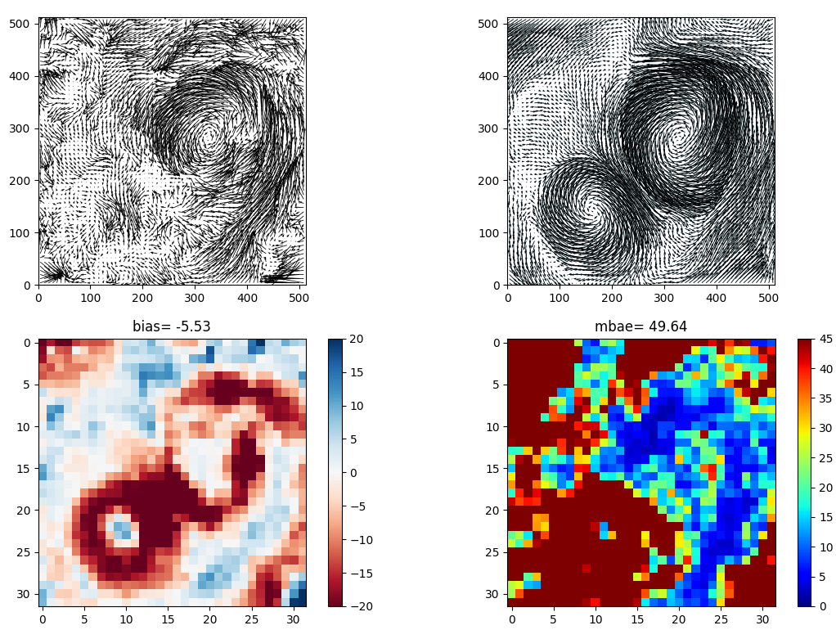
Back to the challenge: the limitations
Large displacements are not a problem, but uniform fields are.

Slide 13
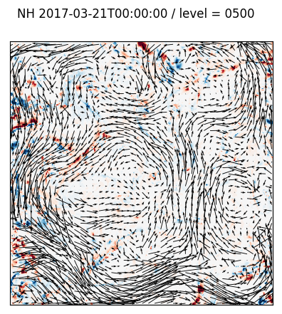
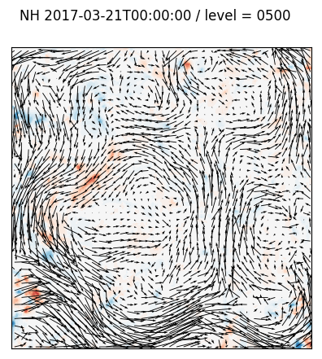
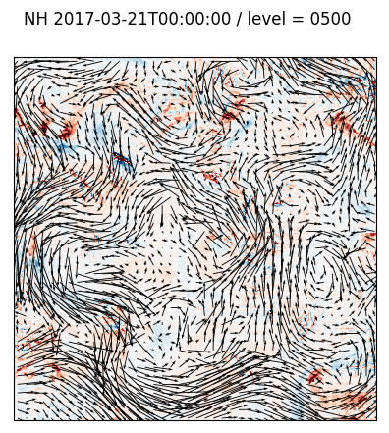
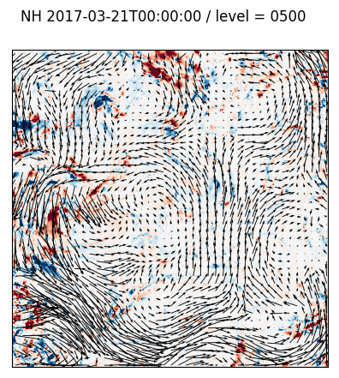
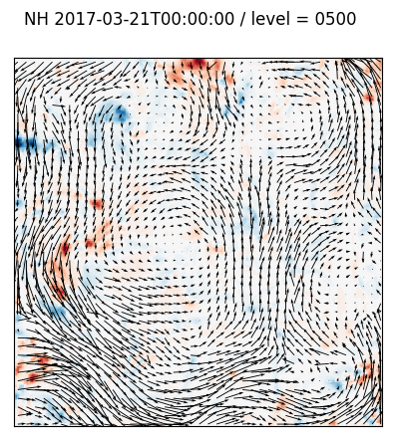
Back to the challenge: hyper-parameters tuning
3D winds derivation tests
Forecast winds field

Slide 14
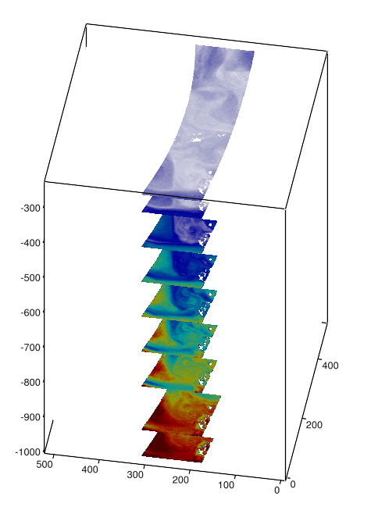
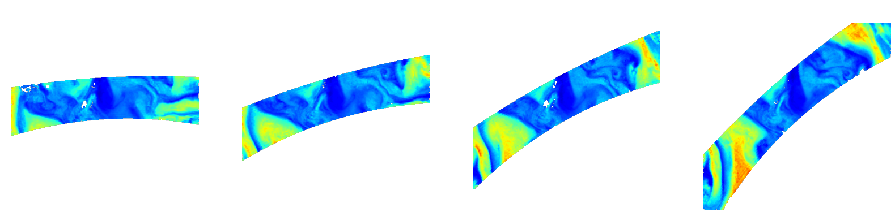
Application to IASI data
Source:
  PW3 dataset in IASI_SND_02 or EARS products (operational production at Eumetsat)
Platform:
  Metop-A and Metop-B to maximize the overlap between the images
Ozone, Water Vapour and Temperature fields
  Interpolated on standard pressure levels
  Re-gridded on Polar stereographic grid
Humidity at 500 hPa for successive overpasses
M01
M02
M01
M02

Slide 15
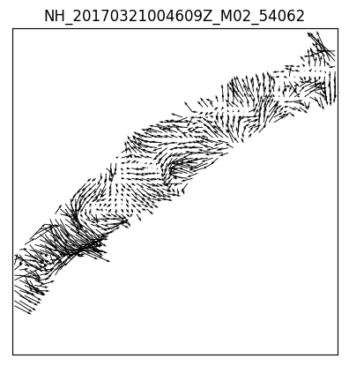
One day of IASI 3D winds
Northern high-latitudes area
  ~ 45N polewards
21 Mars 2017
Winds retrieved at 500 hPa using only two orbit passes
M01 and M02 products used

Slide 16
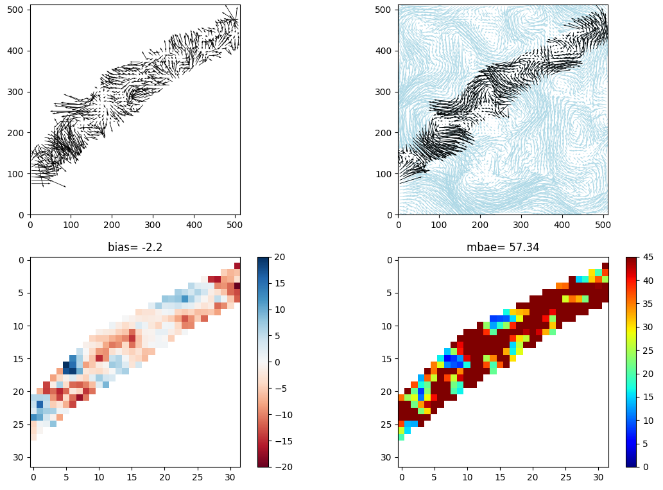
IASI 3D winds
IASI 3D winds
500 hPa
All vectors considered in statistics

Slide 17
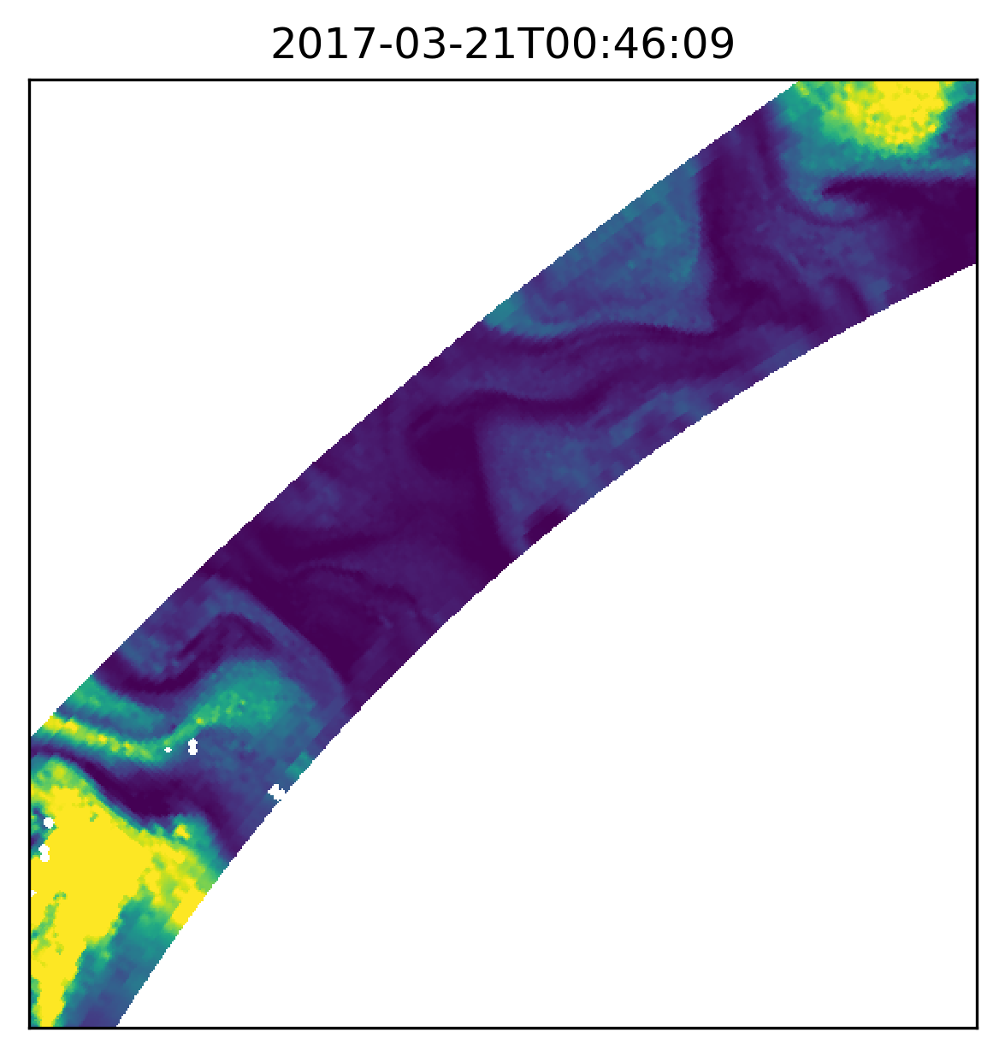
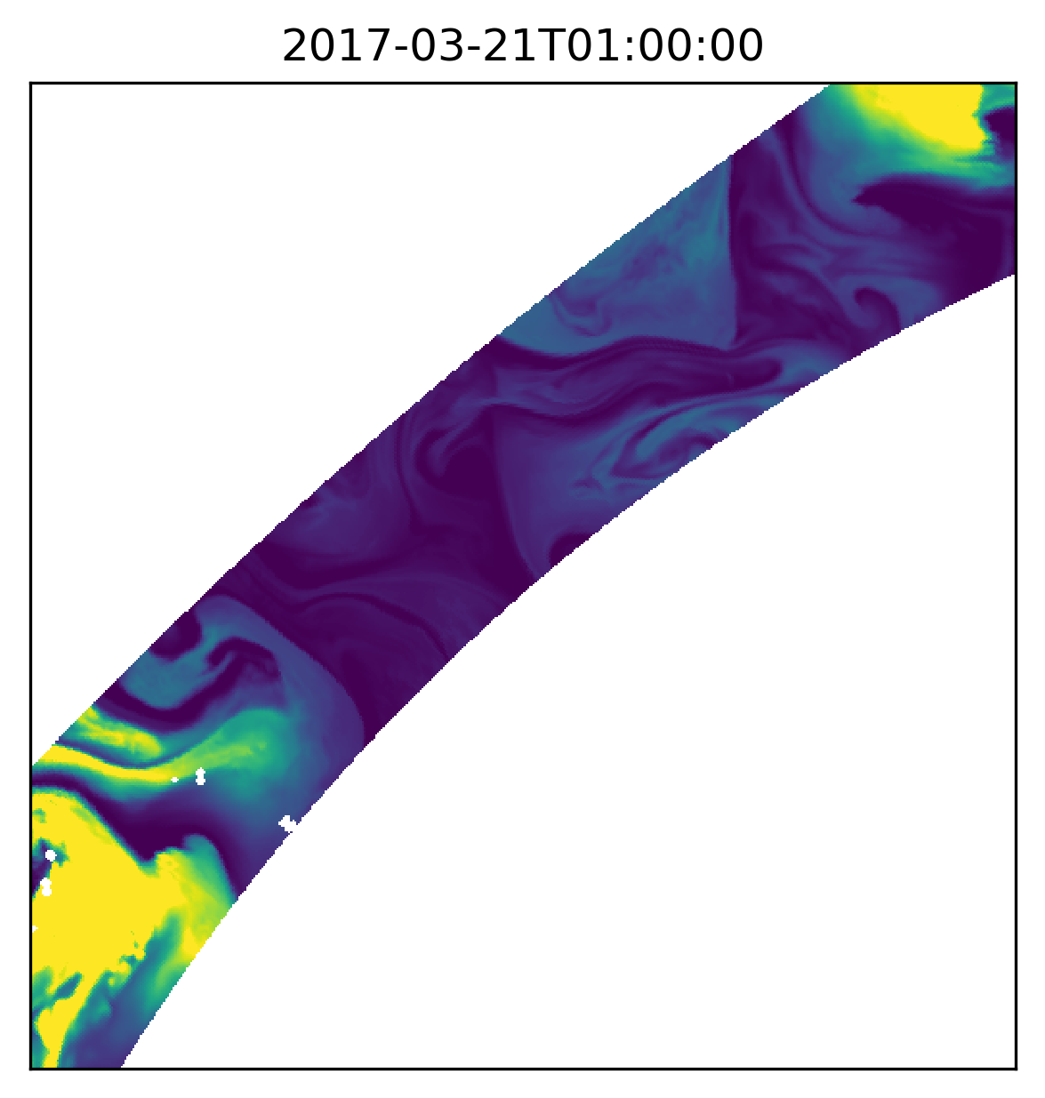
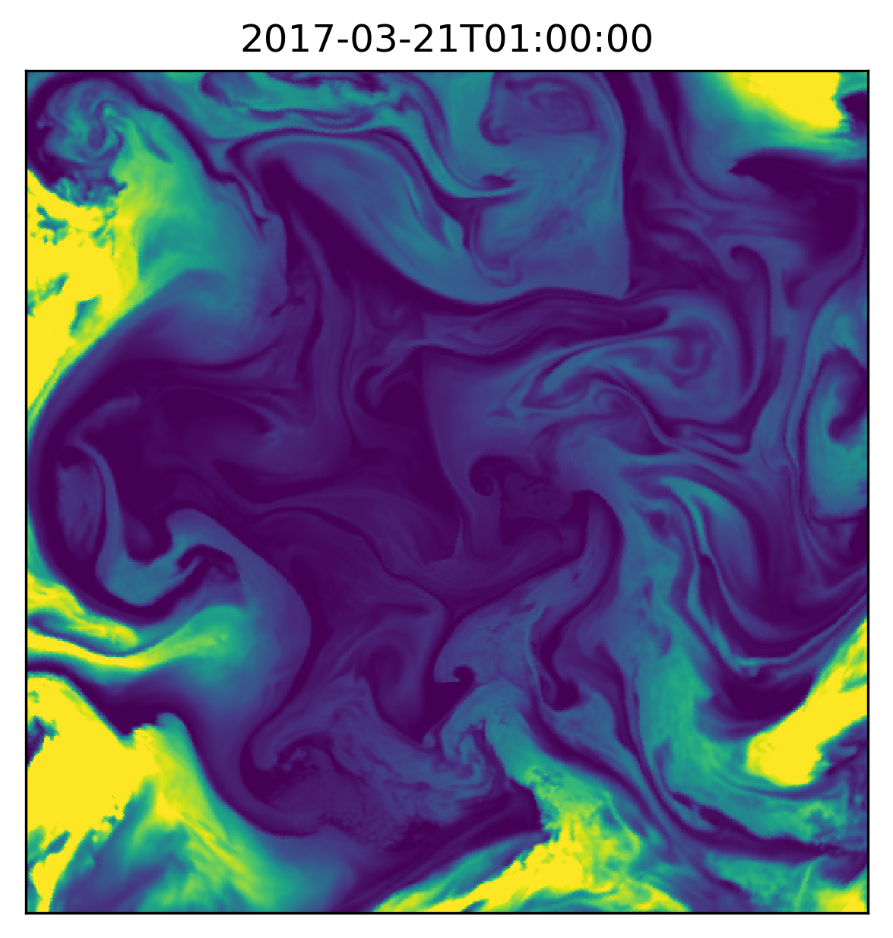
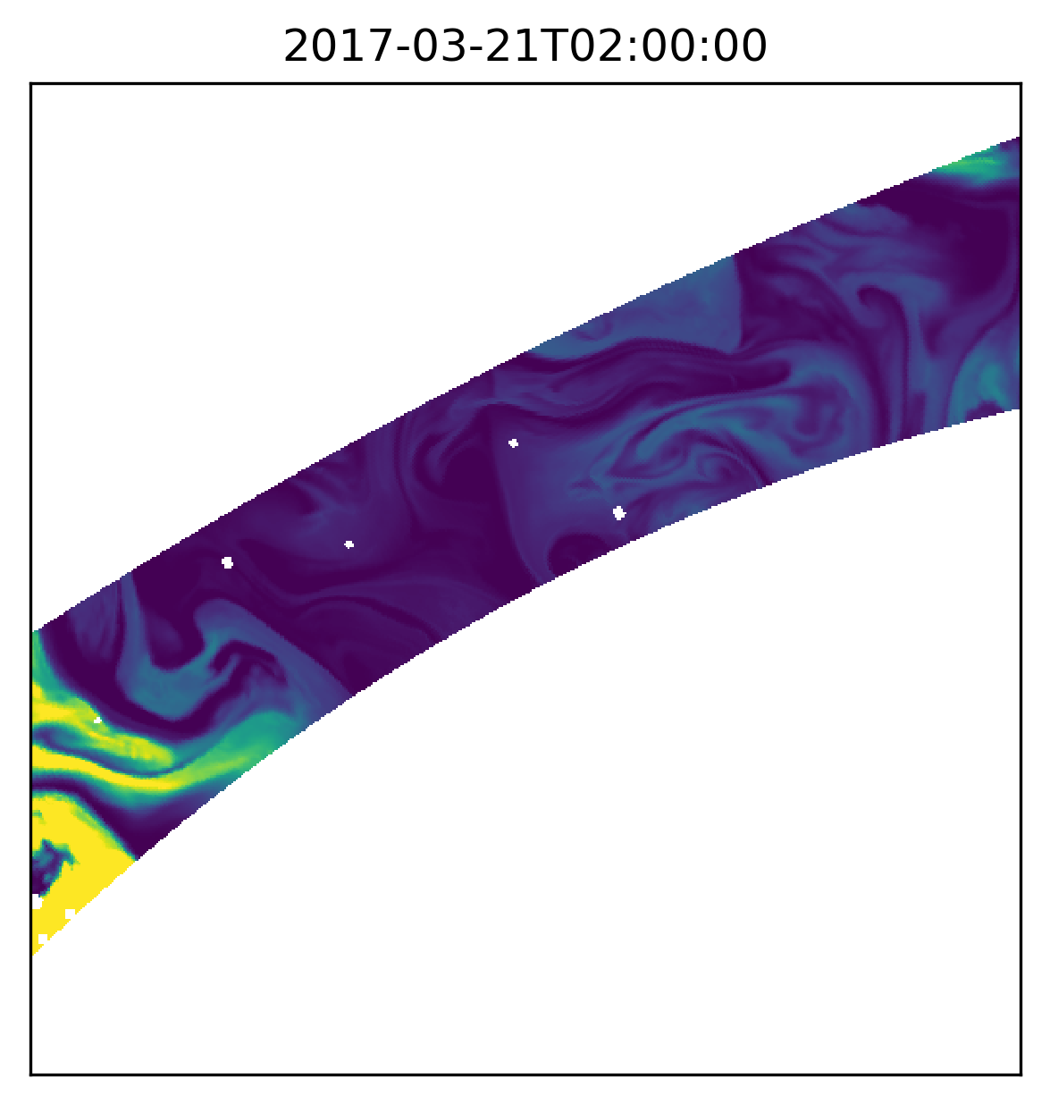
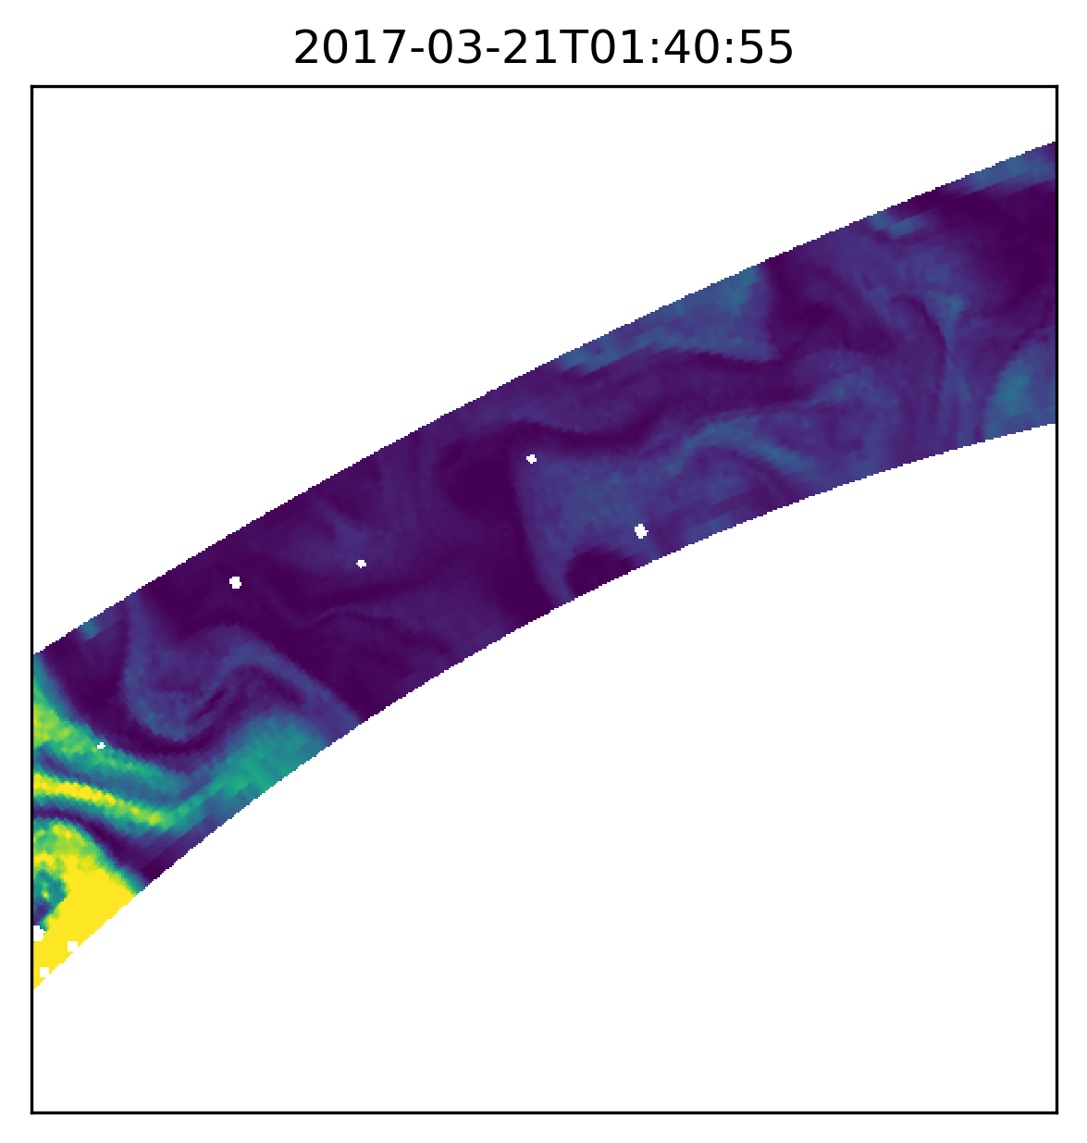
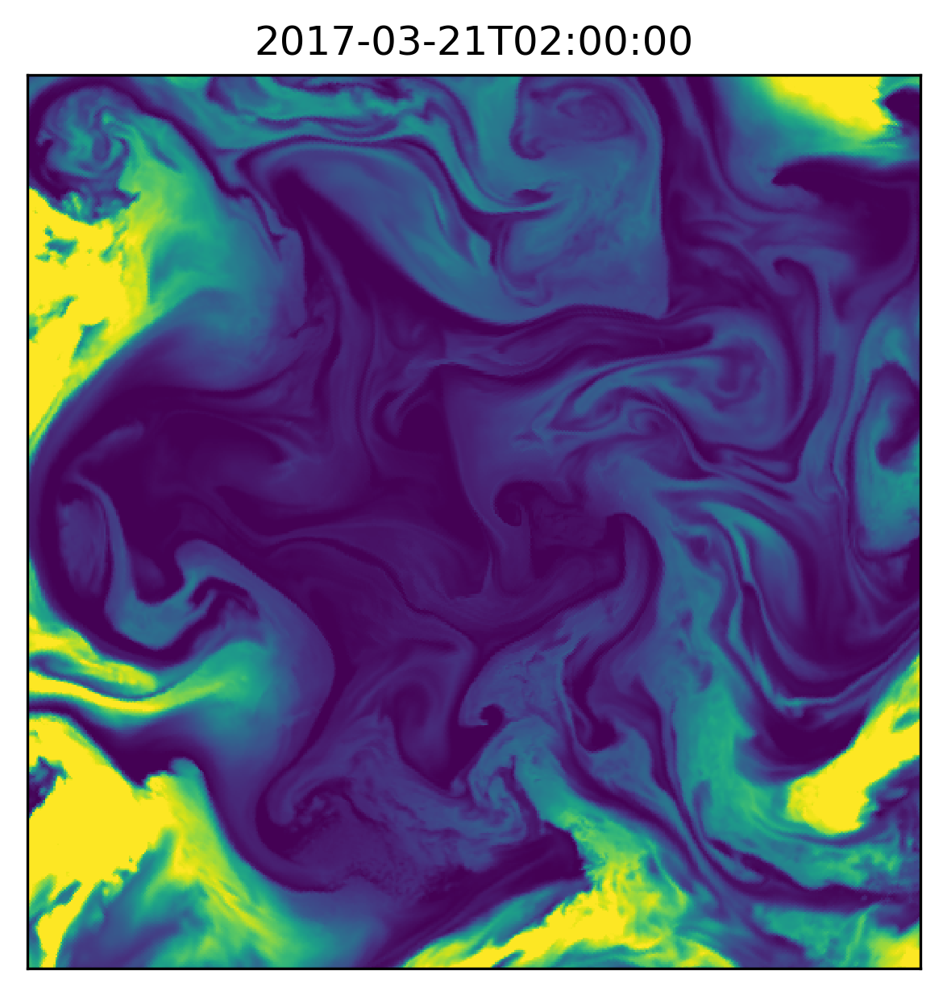
Back to the challenge: effect of orbits swath

Slide 18
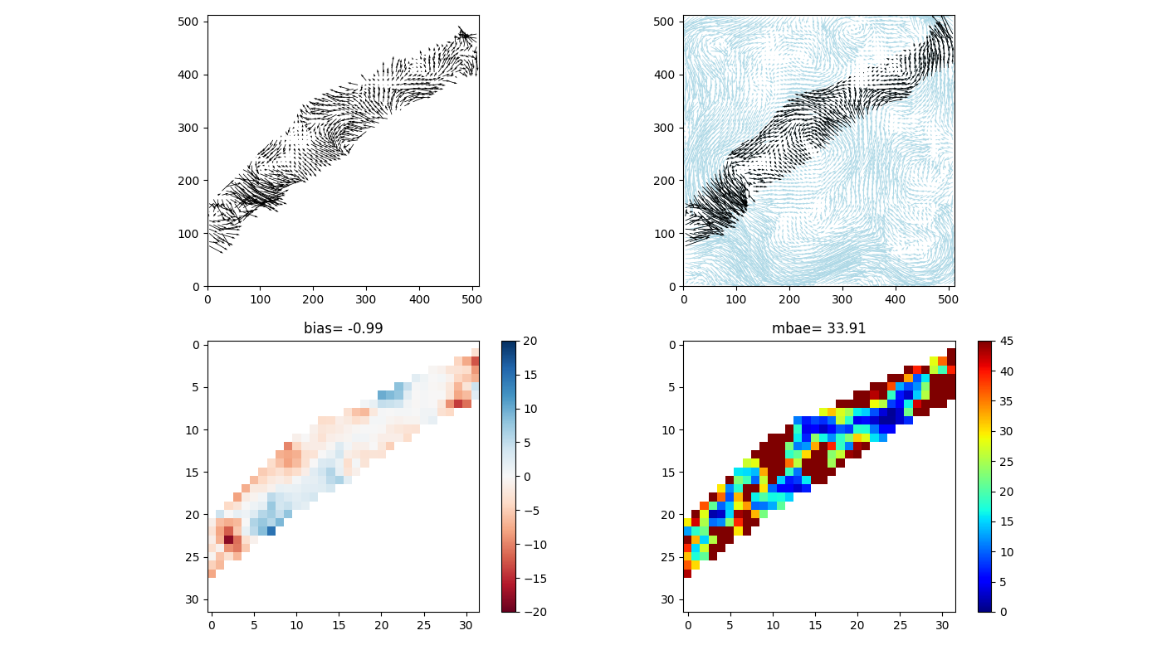
Back to the challenge: effect of orbits swath
500 hPa

Slide 19
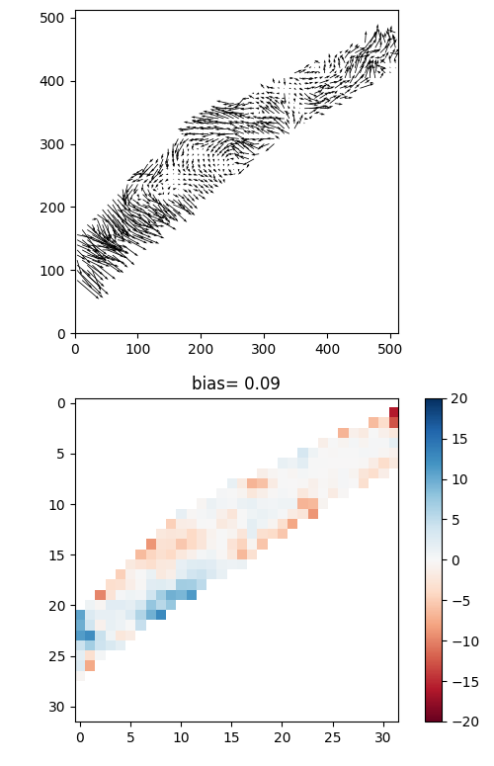
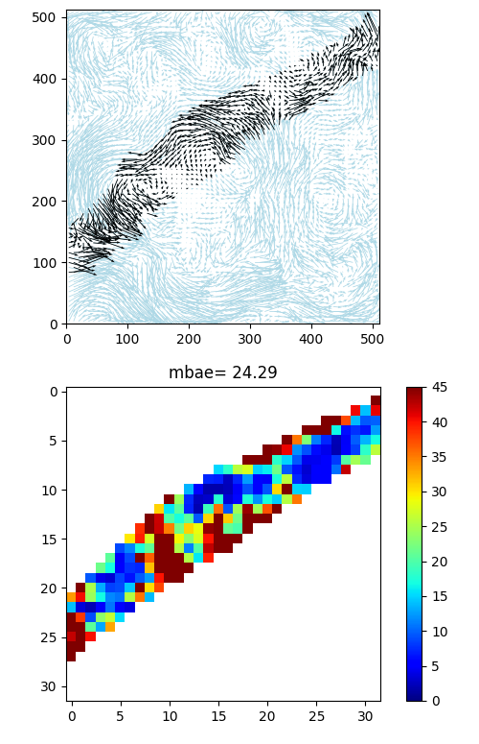
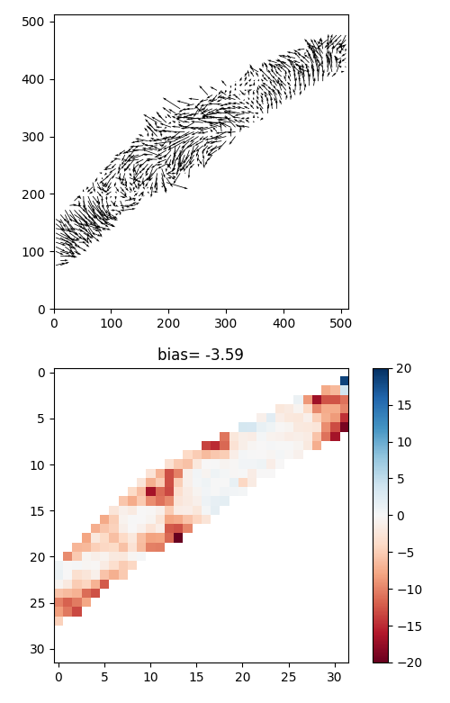
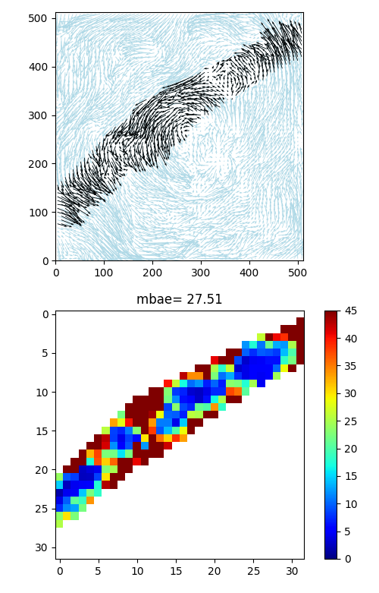
Back to the challenge: effect of orbits swath
Effect varies upon the scale of phenomenon observed
700 hPa
100 hPa

Slide 20
3D winds IASI products development timeline
3Dwinds IASI test data
Operational product 3Dwinds Tristar IASI
Q1
Q3
Q1
2018
Q3
Q1
2019
Q3
Q1
2020
Q3
Q1
2021
Q3
Today
Dec 2018
Launch Metop-C
Jan 2017
Prototype development
Mar 2018
Jan 2018
First validation
Sep 2018
Jan 2018
Operational processor devel.
Jun 2019
Validation and Impact of Tristar products
Jul 2019
Dec 2019
Apr 2019
Continuous Development and Operation Phase

Slide 21

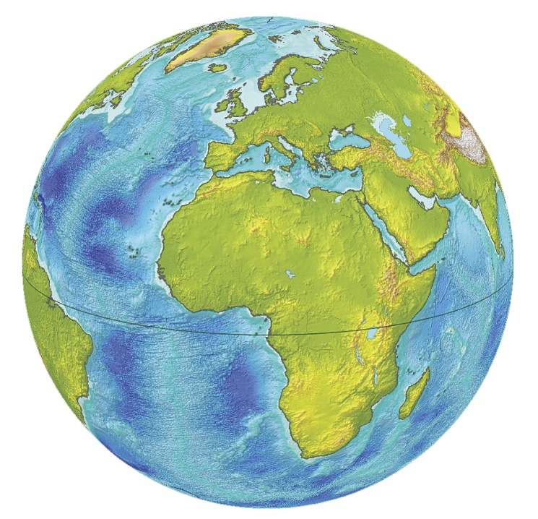
3D winds IASI product characteristics (Tristar)
Metop-B
Tristar configuration on 9:30 orbit
  Production in 2019 after Metop-C
  commissioning phase
  ~30-35 minutes of separation between
  successive views
  Quality will benefit from the reduced time gap
Coverage
  Production on Northern and Southern
  Hemispheres (poleward of 45°)
  Polar Stereographic grid 512x512 pixels,
  resolution = ~20 km
  ~3-4 successive observations around 9:00-10:00 (local solar time)
  Same around 21:00-22:00 (ascending part) for latitude 60°.
  Time consistency will benefit from successive observations capability
Profile
  20 levels from 10 to 1000 hPa, covering Low Stratosphere to Surface
  Vertical resolution: ~0.5 km for LT, ~1.5 km for HT, ~2km for LS
Timeliness (expected)
  For SH products: ~1h - 1h30 after South Pole overpass
  For NH products: ~1h - 2h30 after North Pole overpass (depending on possible secondary dump on McMurdo station)
Fulfill the Global NWP application requirements, at threshold for High Res NWP.
Metop-A
Metop-C

Slide 22
Summary
Algorithm is working
  Wind fields derived and consistent
  No guess needed
  And it’s fast (~2-3 minutes for single-threaded version,
  grid 512×512, 19 levels)
  Hyper-parameters settings
      First set of parameters set
      May be tune during the validation phase
IASI 3D winds product in development
  Mask processing to handle missing data introduced
  Use the same set of hyper-parameters
  Test data can be generated but they will be analysed previous distribution

Slide 23
Future works planned (or potentiential)
Quality index
  Based on the actual model contribution of the data sample
  Should mask uniform region and noisy pixel
IASI (better) input data characterisation
  To tune the data filtering
Reduce the effect of orbit swath borders
  In the pre-processing
  Or / and change the scheme of the data use in the model (in v2)
Validation and inter-comparison study
  Scientific validation against lidar network, RadObs, Forecast, Aeolus
  Comparison with CIMSS AIRS winds, AVHRR winds, …
  Test on Ensemble Nature Runs (Synthetic data high resolution)
Adaptation to other input datasets

Slide 24

To be continued…
Thank You!

Slide 25
User Requirements
Requirements extracted from WMO Oscar database
  For High Troposphere Level (~700 – 200 hPa)
 | Application | Uncertainty | Horizontal resolution | Vertical resolution | Observation cycle | Timeliness
Wind (horizontal) | Global NWP | 1 m.s⁻¹ 3 m.s⁻¹ 8 m.s⁻¹ | 15 km 100 km 500 km | 0.5 km 1 km 3 km | 60 min 6 h 12 h | 6 min 30 min 6 h
 | High Res NWP | 1 m.s⁻¹ 3 m.s⁻¹ 8 m.s⁻¹ | 2 km 10 km 20 km | 0.5 km 0.7 km 1 km | 15 min 60 min 12 h | 15 min 30 min 2 h
Wind (vertical) | Global NWP | 1 cm.s⁻¹ 5 cm.s⁻¹ 5 cm.s⁻¹ | 15 km 200 km 500 km | 0.5 km 2 km 3 km | 60 min 6 h 12 h | 6 min 30 min 6 h
 | High Res NWP | 1 cm.s⁻¹ 2 cm.s⁻¹ 5 cm.s⁻¹ | 5 km 10 km 20 km | 0.5 km 0.65 km 1 km | 15 min 60 min 12 h | 15 min 30 min 2 h
Colors refers to the goal ; breakthrough ;; threshold orange

Slide 26
3D winds MTG-IRS product characteristics
Coverage
  4 LAC (Local Area Coverage) defined
  LAC4 covers Europe, Mediterranean Basin and North Atlantic. It is acquired every 30 minutes.
  Pixel sampling = 4 km at SSP
  Spatial resolution enhanced will allow the use in High Res NWP application
Profile
  20 levels from 10 to 1000 hPa, covering Low Stratosphere to Surface
Frequency
  Number of products per day depends on acquisition scheme.
  Current baseline:
    48 products for LAC4
    16 products for LAC3
    12 products for LAC2
    8 products for LAC1
Timeliness (expected)
  ~45 minutes after LAC acquisition
Fulfill the Global NWP and High Res NWP application requirements

Slide 27
MTG-IRS User requirements (EURD Version 2, 2008)
MTG-IRS products
Temperature and Humidity Profile Product (THPP):
The Temperature and Humidity Profile Product will provide information on the vertical distribution of temperature and humidity. It will include surface temperature and emissivity. It will be derived from IRS observations for clear sky fields of view and for atmospheric layers above selected cloud types. The product will be available with the associated error estimation.
Clear Sky Wind Profile (CSWP):
The clear sky wind profile product, will be derived from the Humidity Profile Product and will provide information on the vertical distribution of atmospheric motion in clear sky and for atmospheric layers above selected cloud types.
Atmospheric Composition:
The atmospheric composition product will be derived from IRS observations for clear sky fields of view and will contain information on ozone and co in broad atmospheric layers.
IRS-Cloud Product (IRS-CP):
The IRS-Cloud Product will contain micro and macro physical information of clouds within the field of view, like cloud fraction, cloud top height, cloud effective radius. It will be derived from the IRS instrument for all <pixels>, and will include an error estimation of the various parameters.
MTG-IRS wind products are not committed for day 1, but as ‘aspirational’.
From: EUMETSAT HQ Level 2 Products Generation and Dissemination baseline for MTG (EUM/MTG/DOC/09/0026, 2013)

Slide 28
State of the art extracting winds from IR sounders
BACKGROUND
EUMETSAT fellow at Met Office, L. Stewart, study done using simulated spectra generated by Met Office UKV 1.5km model.
External study done by DLR for EUMETSAT in 2006. Humidity fields mimicked from Lokall-Modell LM from DWD.
Product recently developed at CIMSS with AIRS (Santek et al., 2016). Presently in demonstration, showed some potential in assimilation experiment in GEOS-5 model (NOAA/NCEP)

Slide 29
State of the art winds extraction from IR sounders
Upcoming products:
  IR sounder 3D winds from EPS-IASI at EUMETSAT
  IR sounder winds from CRiS, IASI at CIMSS
Potential mid-term products:
  IR sounder 3D winds from MTG-IRS
  IR sounder 3D winds from EPS⁻SG - IASI-NG
  New spatial missions with 3D winds as primary product
Thomas Pagano, NASA/JPL: Status of NASA's Atmospheric Infrared Sounder (AIRS) and CubeSat Infrared Atmospheric Sounder (CIRAS) Projects, EUMETSAT Satellite conference, 2017
Kevin Maschhoff, BAE systems: MISTiC Winds, a micro-satellite constellation approach to high resolution observations of the atmosphere using infrared sounding and 3D wind measurements, IWW13, 2016
…etc

Slide 30
International interest and support
CGMS-45: Jeju Island, Republic of Korea, 11-16 June 2017
A45:03: IWWG to liaise with the NOAA representative on PSTG (Jeff Key, jeff.key@noaa.gov) regarding the potential use of 3D winds from AIRS for Year of Polar Prediction studies.
Sixth WMO Workshop on the Impact of Various Observing Systems on Numerical Weather Prediction, Shanghai, China, 10-13 May 2016:
Recommendation 4: Additional data impact studies for new AMV products (e.g. LEO-GEO winds, IR sounder winds, MISR winds) are strongly encouraged.
IWW13: Monterey, USA, 27 June-1 July 2016
Recommendation to space agencies: to implement satellite missions that allow the provision of wind profile information with global coverage (e.g., DWL, hyperspectral IR with high temporal frequency and spatial resolution).

