Slide 1
ATMOPHERIC MOTION VECTORS CLIMATE DATA RECORD PRODUCED AT EUMETSAT
M. Doutriaux-Boucher, A. Lattanzio,
J. Schulz, O. Hautecoeur, R. Borde,
M. Carranza, O. Sus, L. Medici,
and K. Petraityte

Slide 2
AMV reprocessing for climate: why ?
At EUMETSAT we produce in real time meteorological products from polar and geostatinary satellites. Those data are mainly used for weather forecasting application.
Because we have several decade of satellite data. We have a long enough time series to use it to try to understand climate and climate change.
We reprocess AMV from our satellite
products with 2 objectives in mind:
1- a better accuracies, (e.g. better algorithm);
2- a longer homogeneous time series for
monitoring (filling gaps).
Long, stable time series
Understand
short
scale
phenomena
Understand
change
Accuracy
Detect
change
The GEO reprocessing is done using new recalibrated (sensor equivalent) level1.5 images

Slide 3
AMV reprocessing for climate: to which usage ?
Reanalyses using Earth system models
State of Earth system
“assimilation”
Climate data records (Observations)
« Real Earth system »
Earth system modeling without observations
time
Climate change impact: investigate changes in large scale circulation such as northward shift in the storm tracks or widening of the tropics.

Slide 4
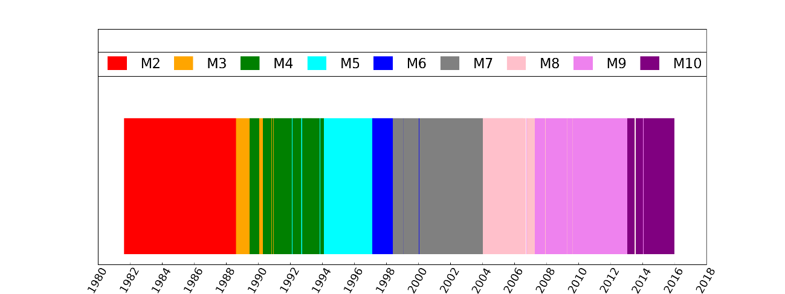
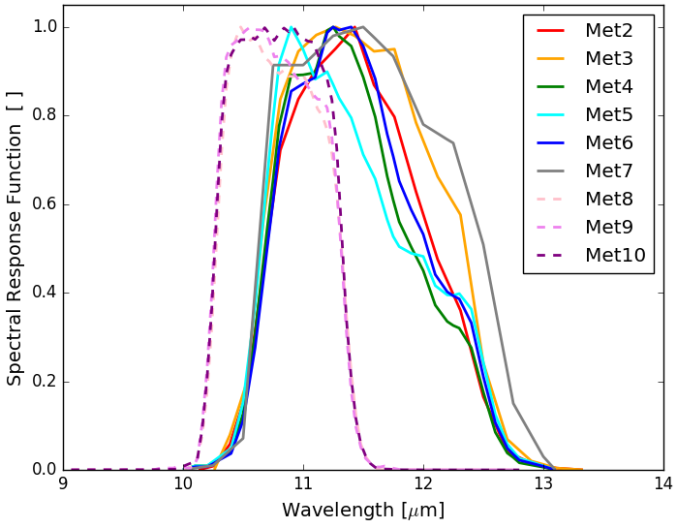
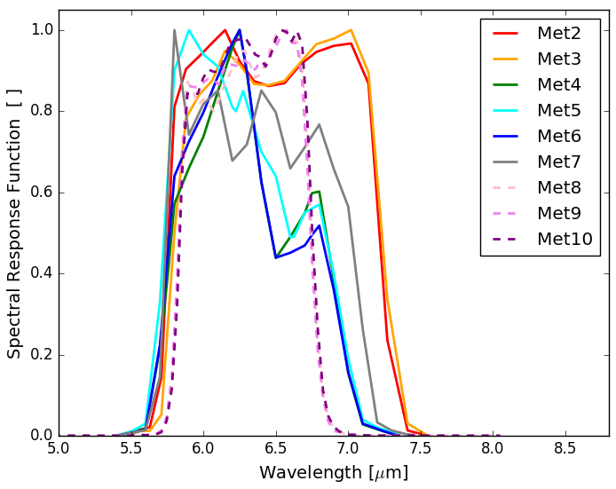
Geostationary AMVs from MVIRI and SEVIRI instruments
MVIRI:
3 channels
30 minutes
IFOV: 5.0 km
SEVIRI:
12 channels
15 minutes
IFOV: 3 km
MVIRI MFG
SEVIRI MSG
Water vapour 6.2 µm
Infrared 10.8 µm

Slide 5
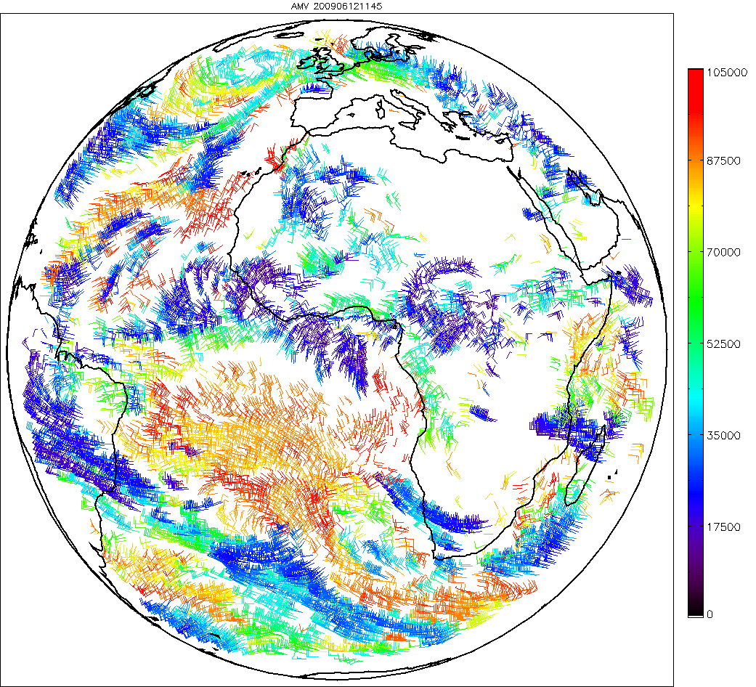
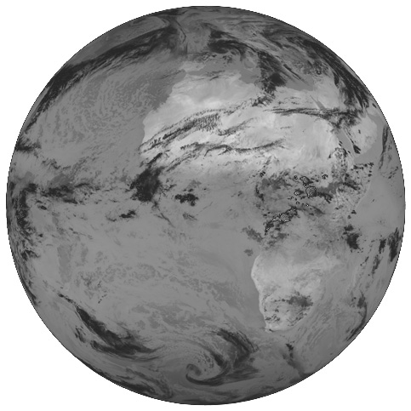
AMV from imager onboard geostationary satellite
About 10000 winds are detected.
SEVIRI 00:00
MVIRI 00:00
00:15
00:30
00:30
01:00
00:45
01:30
Vector height
Intermediate products
v₁
v₂
v₃
?
v_{f}
Final product
Notes:
The atmospheric winds are retrieved operationally every hours. Wind derivation is based on a very basic principle: a feature is spotted in the first image,it is then tracked in the second image. A displacement is computed, knowing that two the 2 images are 15 minutes apart, a speed is derived. The second and more difficult step is the height assignment of the wind vector. The final hourly wind product is an average of 3 vectors derived from each image pair.
So the final product looks like ‘this’ example in the IR channel. About 10000 winds are derived every hours.
The wind is the most used of the EUMETSAT MSG products by the forecasting centers, mainly for data assimilation.

Slide 6
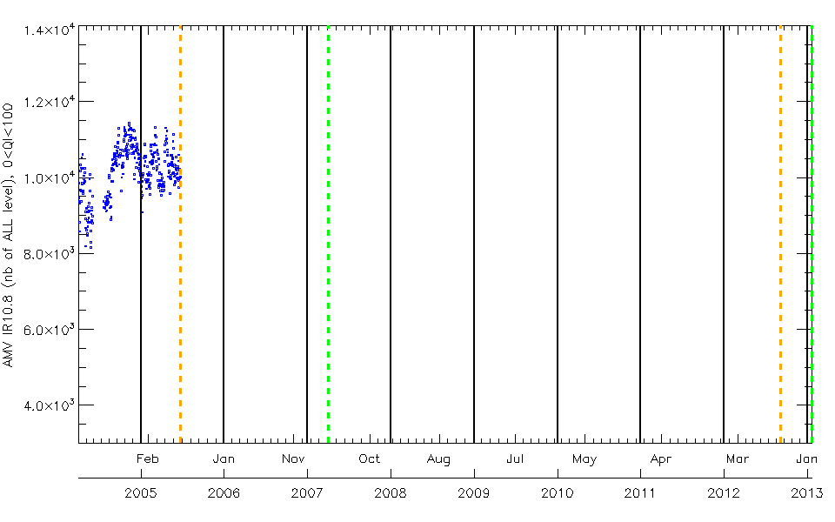
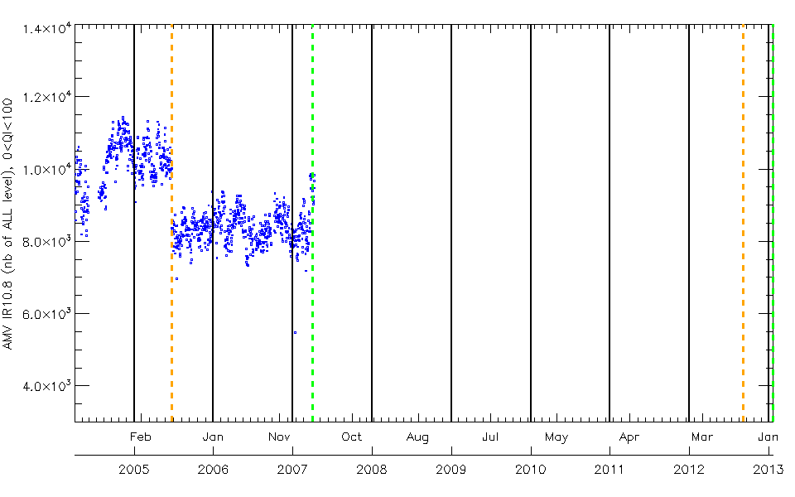
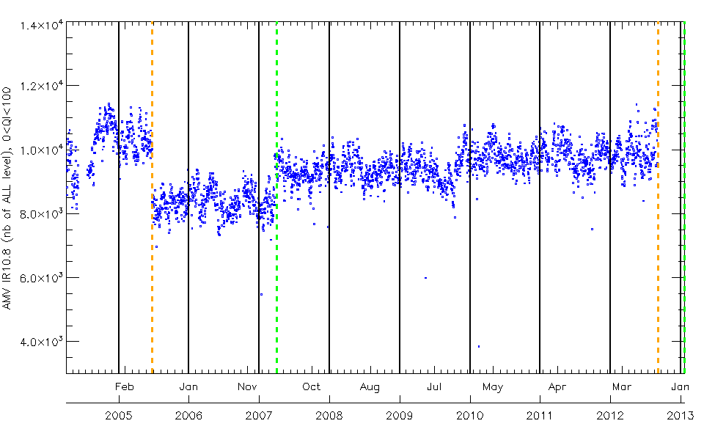
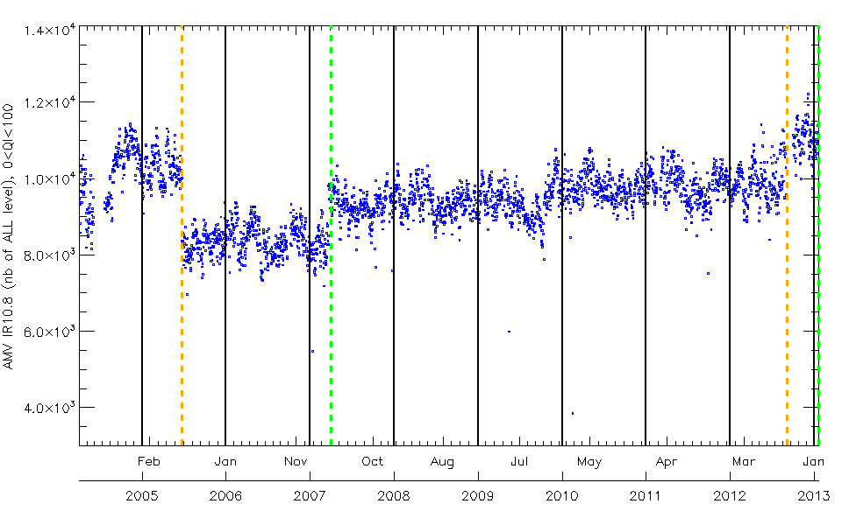
Example of the importance of the usage of a unique algorithm throughout the entire reprocessing period
- Operational statistics
MET9 became operational
Change in height assignment CCC
Change in height assignment and quality control
Note: this is done using a previous reprocessing release -
Notes:
The winds are monitored operationally at EUM in real time. One of the monitored parameter is the numbers of wind per channel per hour.
Because of its importance, the scientific development on the winds is constently ongoing. The algorithm evolved through the time as well as the sensors.
Mid 2005, a change in height assignment and quality control has been introduced leading to a change in the number of produced AMVs. Similarly when MET9 became operational, in april 2007, the number of AMVs increased probably due to the extension of the reprocessing area. Then throughout the period, the number of AMVs varies with some algorithms changes. The last big change in height assignment in Sep 2012 leads to a drastic increase of AMVs.

Slide 7
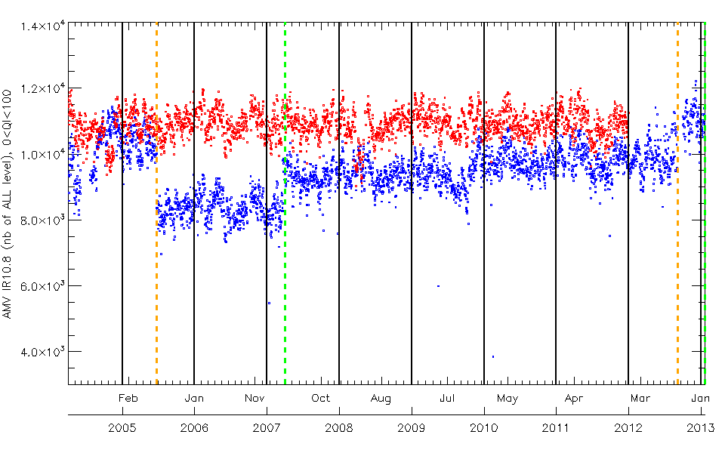
Example of the importance of the usage of a unique algorithm throughout the entire reprocessing period
- Number of operational AMVs
- Number of operational AMVs
- Number of reprocessed AMVs
Note: this is done using a previous reprocessing release -
Notes:
In those condition an assessment of a climate change/trend using this operational product is clearly not possible.
That is were the benefit of the reprocessing become clear.
The red curve shows the number of AMV throughout the period. One can see that the series is quite homogeneous and stable.

Slide 8
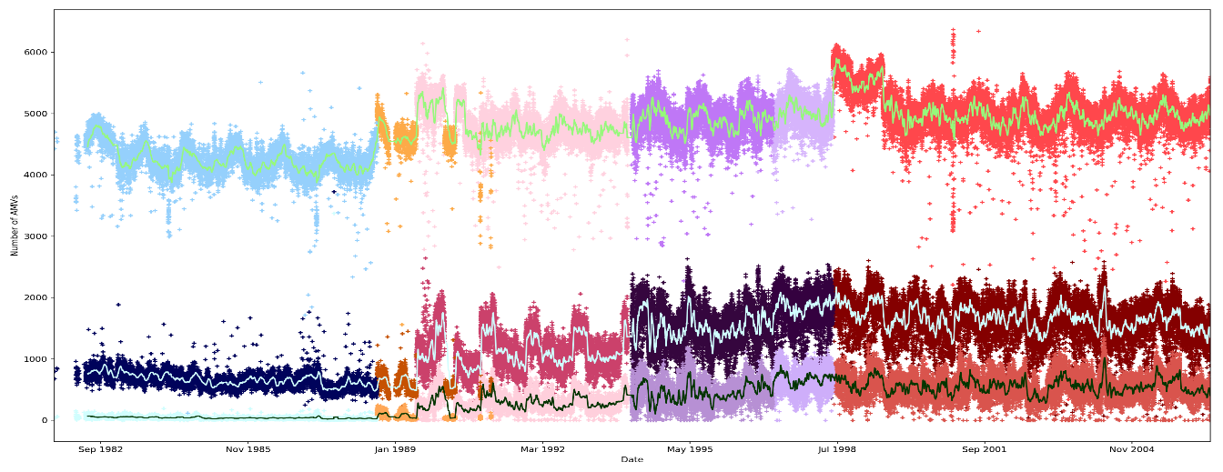
Number of IR10.8 AMVs retrieved using MVIRI and SEVIRI
MVIRI
all
AMVsd
4500
MET2 MET3 MET4 MET5 MET6 MET7
AMVs
(qi>30)
1000
good
AMVs
(qi>60)
1982
2004
all
AMVsd
12000
MET8 MET9 MET10
good
AMVs
(qi>60)
6000
SEVIRI
2004
2017
Notes:
We have applied the same algo adapting SEVIRI’s one to MVIRI and reprocess the entire dataset. This slide presents the number of AMVs in the IR108 channel.
For each instrument all AMVs and only good AMV (filtered using a qi>60) are shown. 10 day smoothing averaged
For MVIRI: the number of generated AMVs is relatively stable over the time-series. Compared to the MSG time-series of number of generated AMVs (see sub-section 5.5.1), the MFG numbers vary more in time. In general, and omitting Meteosat-2 and -3, one can observe a moderate increase in number of AMVs, going from Meteosat-4 to Meteosat-7. This is likely be related to the improved geometric and radiometric correction for the later MFG satellites. Note that the recalibration performed in the framework of ERA-CLIM2 (deliverable ERA-CLIM2-D3.12 [RD 7]) only involved recalibration of the radiometric correction. Improvement of the geometric correction is planned as part of an upcoming Meteosat image reprocessing that will apply the latest navigation and geolocation methods.
the number of generated AMVs of the IR channel reveal two distinct periods during which the number of generated AMVs deviates, and almost doubles, i.e., 1989 (Meteosat-2,-3), and 1999 (Meteosat-5).
For MVIRI 3 classes all AMV, good AMV (QI>60) and QI>30
For SEVIRI:
The analysis of the number of AMVs generated from Meteosat-8,-9,-10 shows that this number is stable over the entire processing period. For the IR channel around 13000 vectors are generated from which about 6000 have a QI larger than 60.

Slide 9
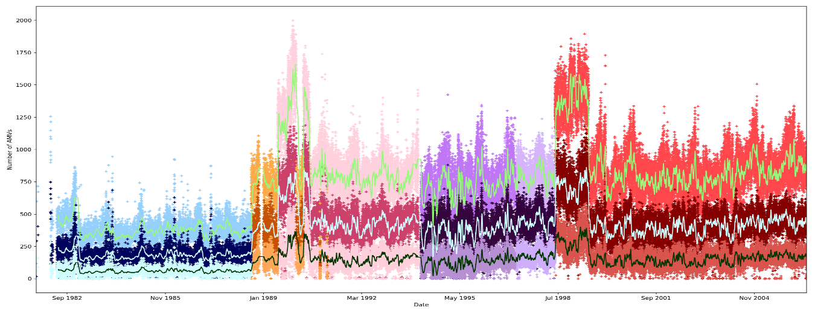
Number of WV AMVs retrieved using MVIRI and SEVIRI
all
AMVsd
1000
AMVs
(qi>30)
good
AMVs
(qi>60)
200
1982
2004
all
AMVsd
5000
good
AMVs
(qi>60)
2000
2004
2017
Notes:
Same as previous for WV6.2 channel.
Clear distinction for MVIRI between MET2/Met3 and the rest: mainly due to a different resolution of the instrument (one image every hour on Met2/3).
Issues with WV channel on MVIRI: too few vectors, will be improved in the next release.

Slide 10
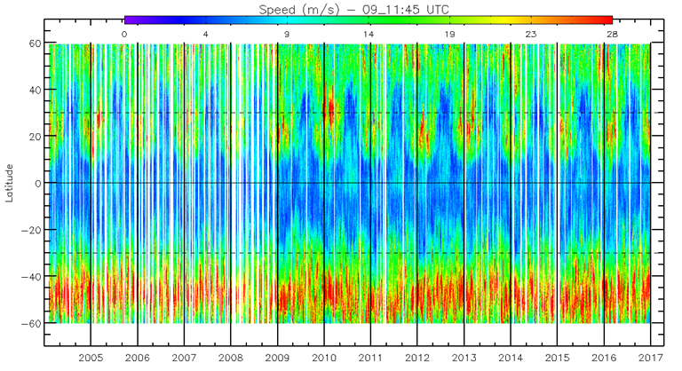
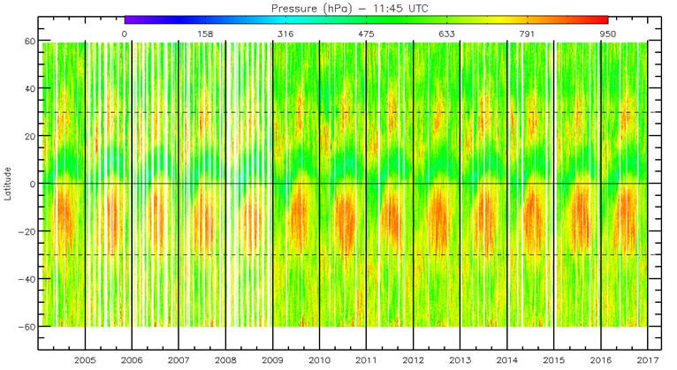
SEVIRI/MSG IR AMVs at 11:45UTC
AMV speed
AMV height in pressure units
Notes:
Zonally-averaged AMV speed and altitude (given as pressure in hPa) for the year 2004 until 2016 at 11:45UTC for SEVIRI IR channel.

Slide 11
1^{s}t EUMETSAT complete GEO wind (MVIRI+SEVIRI): conclusion
35 years of MFG (MVIRI) and MSG (SEVIRI) level 2 products have been reprocessed at EUMETSAT with an unique adapted version of the latest EUMETSAT algorithm (1982-2017).
As a first release, the dataset is rather a stable and homogeneous dataset.
Current limitation: CTP algorithm used is very crude (only uses the IR channel). That impacts the quality of the AMVs. The next release will improve it.
This reprocessing will be repeated in the future with an improved cloud top pressure and will be useful for reanalyses and climate studies.
Notes:
This is the results of the first release : next one will come (end of 2018) and will clearly improve MFG AMVs because we will use a better CTP algo…

Slide 12
AMV CDR from imager onboard low earth orbit satellite
In the framework of the ERA-CLIM2 project, polar AMVs were reprocessed using GAC data from AVHRR instrument on board all available polar satellites for the period from 1982 to 2016 using EUMETSAT algorithm (v2.4).
Polar winds AMVs dataset aims to be used in reanalysis dataset. It could also be used with regional reanalysis if AMVs are assimilated. It may be used for climate studies in conjunction with AMVs derived from geostationary satellite data, e.g., for long term statistics of the polar front position.
Notes:
The ERA-CLIM2 data record of AVHRR GAC Polar Winds data record is primarily used for the assimilation into global reanalyses.

Slide 13
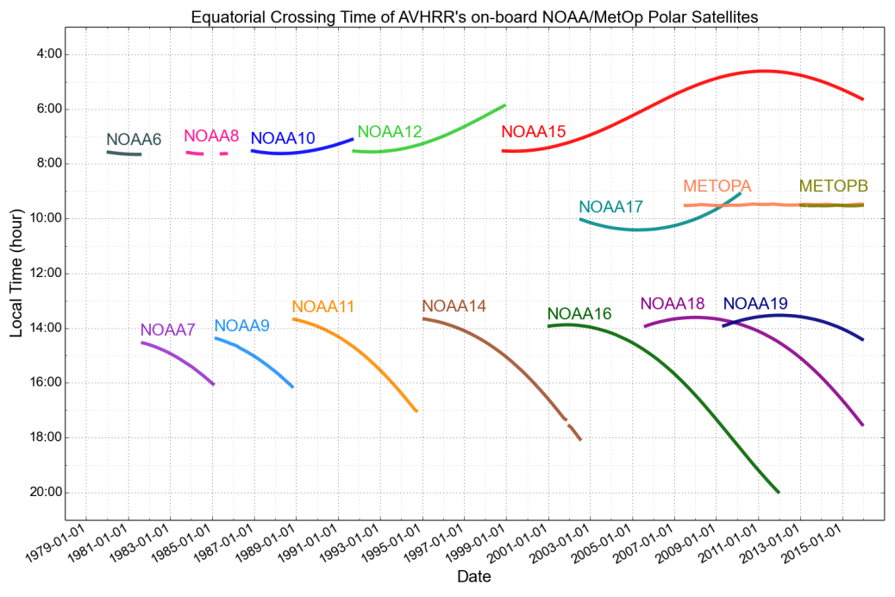
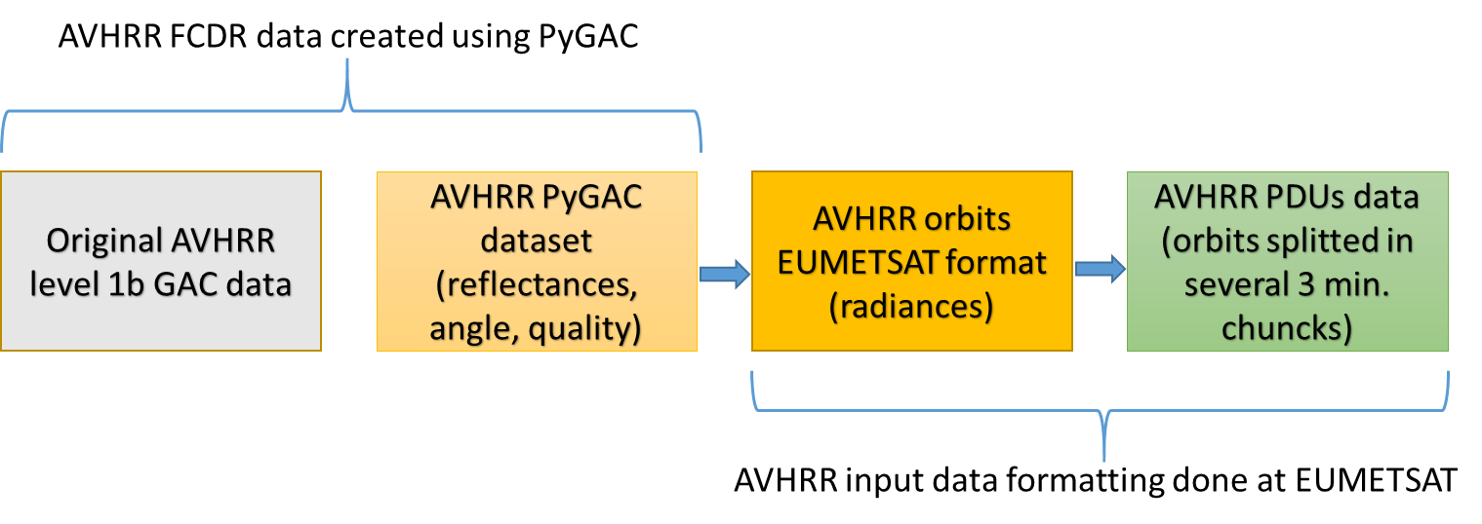
AVHRR input data also on board Metop and NOAA satellites
AVHRR FCDR PyGAC dataset [1978-2015] is used as an input data
Developed jointly by CM SAF & Cloud_cci
Reading and calibrating GAC L1b data
Notes:
The AVHRR instrument has been flown on board several polar satellites since 1978.
To help the reprocessing, we have used a preprocessed so called pyGAC dataset that includes AVHRR data from all satellites in one single format.
We have used PyGAC data (= hdf dataset) containing channel 4 information for AVHRR data onboard all satellites
Although the AVHRR instrument includes VIS, NIR, and TIR channels, the data records of polar AMVs described in this report are only retrieved using data from the level 1B Infrared channel. Data were preprocessed to fit the EUMETSAT algorithm (relevant data extracted and 3 minutes PDUs are created).
Note that no retrieval from NOAA 6, 8 and 10: just because no data in PyGAC (that were developed mainly for clouds CLARA algo)

Slide 14
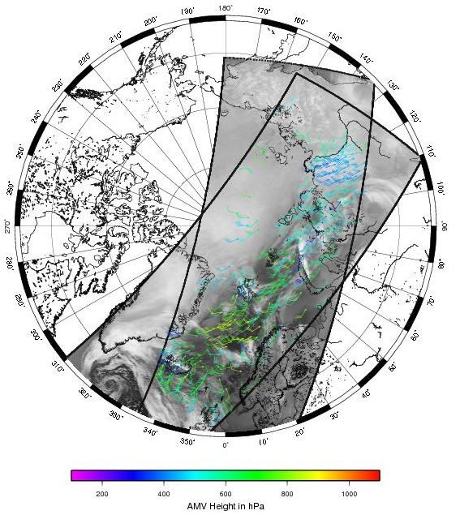
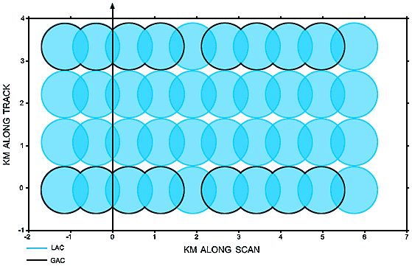
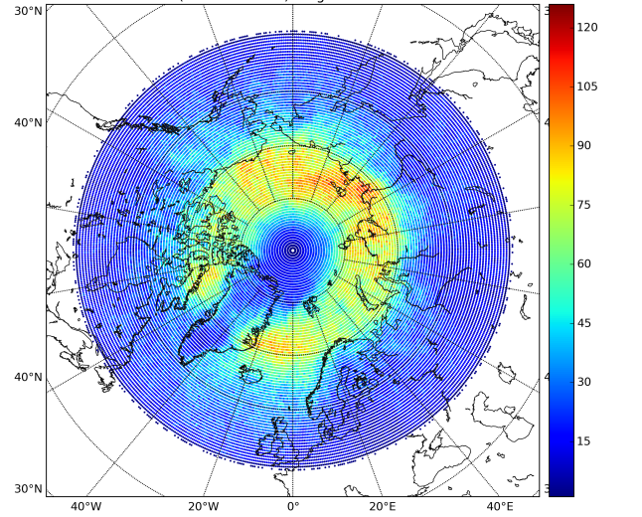
LEO AMVs reprocessing with the EUMETSAT algorithms
Entire AVHRR series
(1982-present)
GAC versus LAC format:
Sub satellite point data resolution: 1.1x4.4 km² with a 2.2 km gap between pixels across the scan line
Notes:
We reprocessed polar AMV using Global Area Coverage data (differs from Local Area Coverage

Slide 15
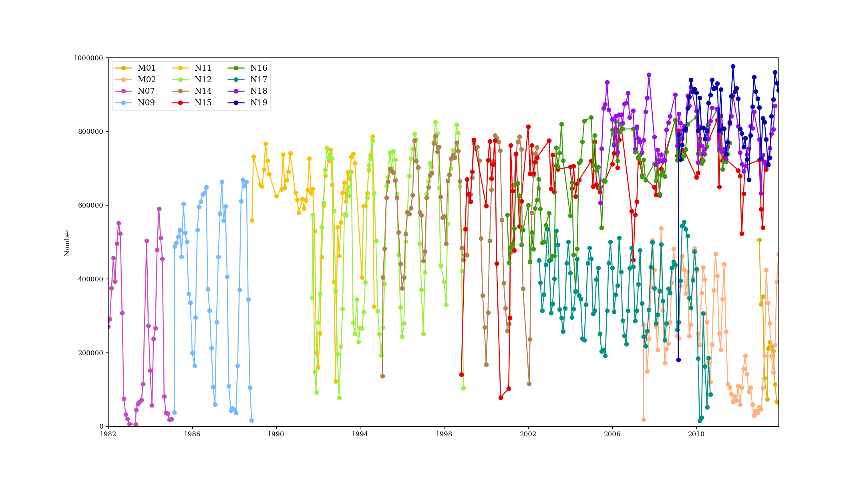
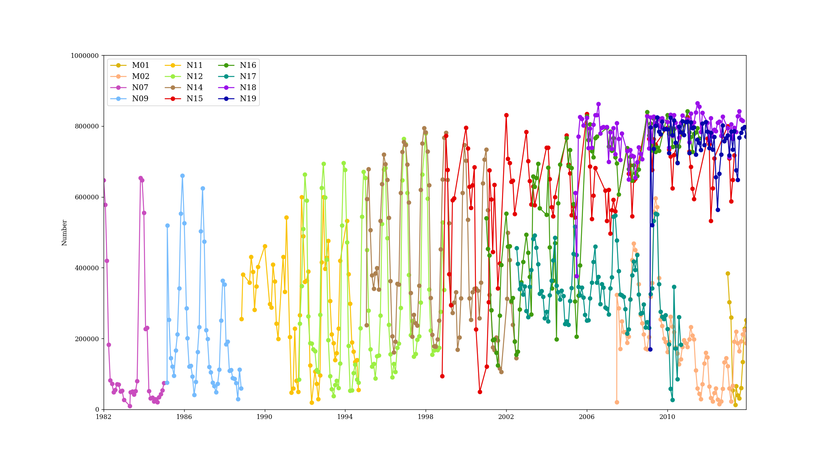
Number of AMVs over the period 1982 - 2015
100000
80000
Northern pole
60000
40000
20000
1982
2010
100000
80000
Southern pole
60000
40000
20000
1982
2010
Notes:
Time series of the number of derived AMVs for the northern and southern hemisphere, respectively. Generally, the number of polar AMVs produced varies from 200 to 600 thousands, depending of the season. More AMVs are always derived in the summer hemisphere. This is because during winter ice surfaces are much more extended and the target identification becomes much more difficult. In addition, the atmosphere in the lower levels has often and isothermal temperature profile which makes the height assignment of a derived AMV impossible. A couple of satellites (NOAA-17 and Metop satellites) show a drop in numbers after 2002 which is most likely due to a processing error. For these satellites a much higher number of PDUs was detected that prevented the data being used in the AMV operational processor. This is an issue that need to be revisited before the data should be used for reanalysis.

Slide 16
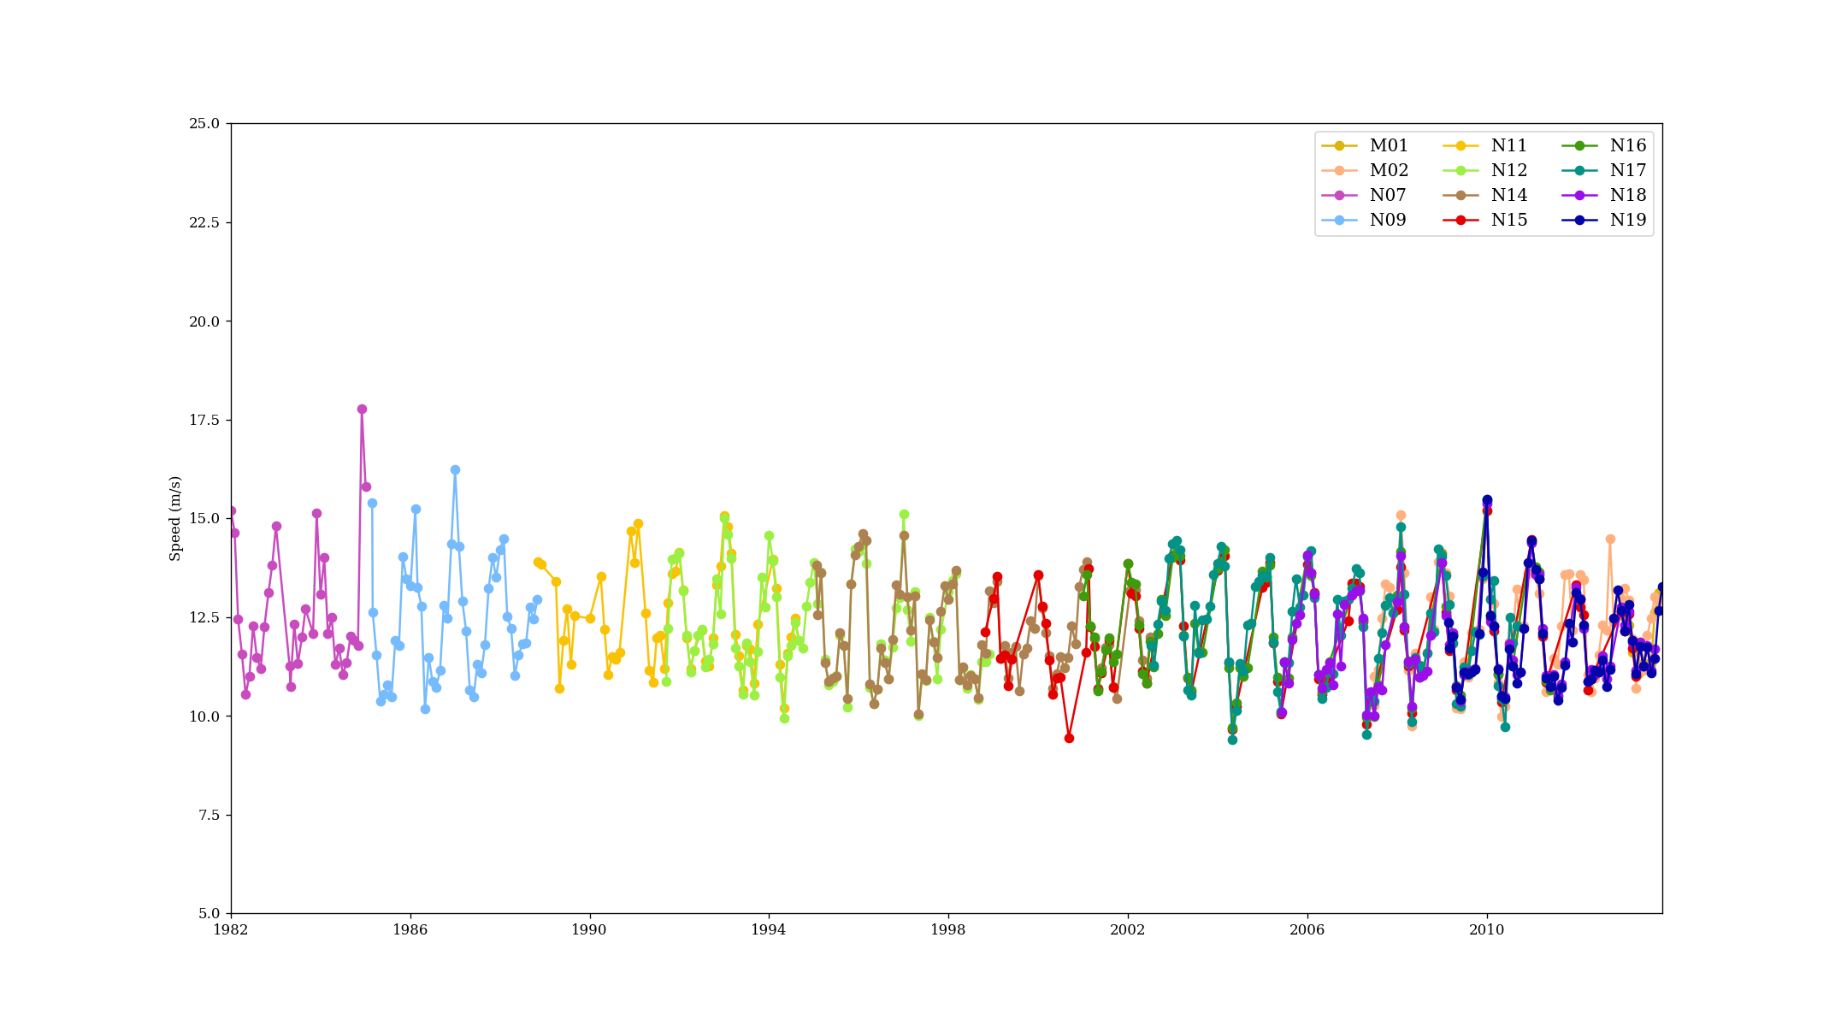
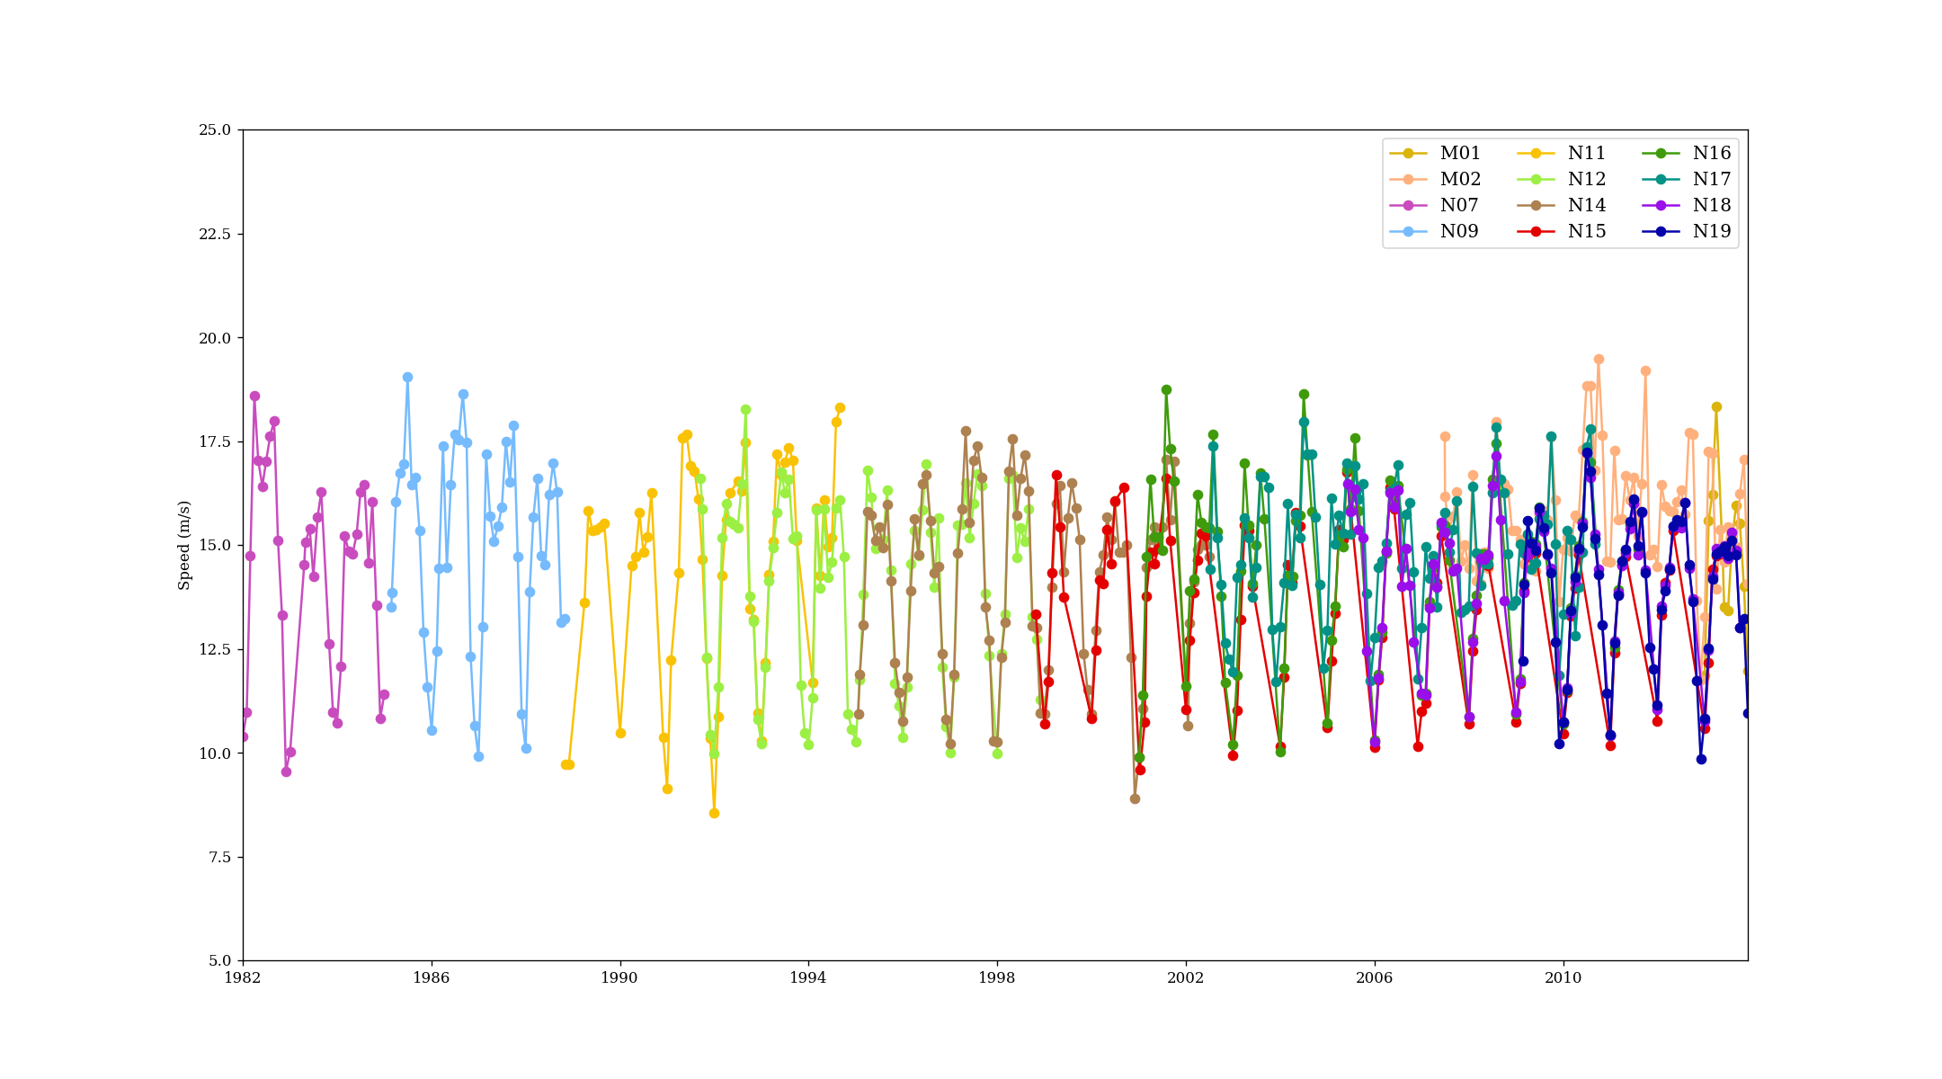
Monthly mean of speed (m/s)
Monthly mean of AMVs speed over the period 1982 - 2015
25
20
Northern pole
Speed (m/s)
15
10
5
1982
2010
(qi>50 and speed > 2m/s)
25
20
Southern pole
Speed (m/s)
15
10
5
2010
1982
Notes:
(The data are constrained by the quality index of 50 and for winds larger than 2 m/s). For both hemispheres the time series appear very stable with average wind speeds of 13 m/s over the northern hemisphere and 15 m/s over the southern hemisphere. The time series shows a distinct seasonal cycle with maximum wind speeds over the winter hemisphere and minimum wind speeds over the summer hemisphere. For most of the satellites the seasonal amplitude is very comparable with a slight tendency to smaller amplitudes for the most recent 10 years. The NOAA-17 and Metop time series show a deviation to this pattern in the most recent years which may be connected to the decreasing number of AMVs or in other words a different spatiotemporal sampling pattern, in particular over the southern hemisphere.

Slide 17
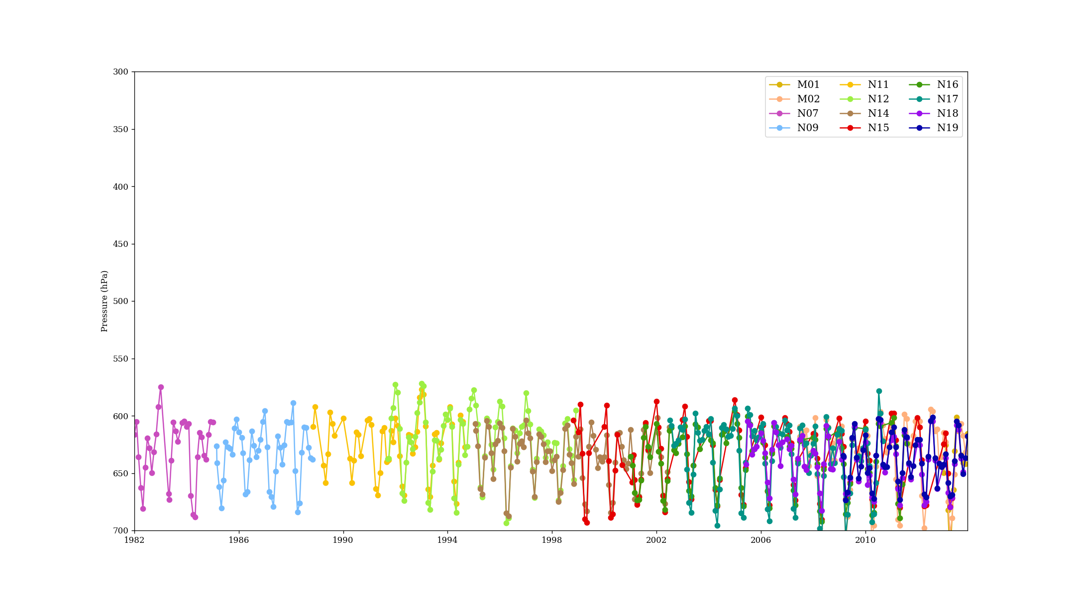
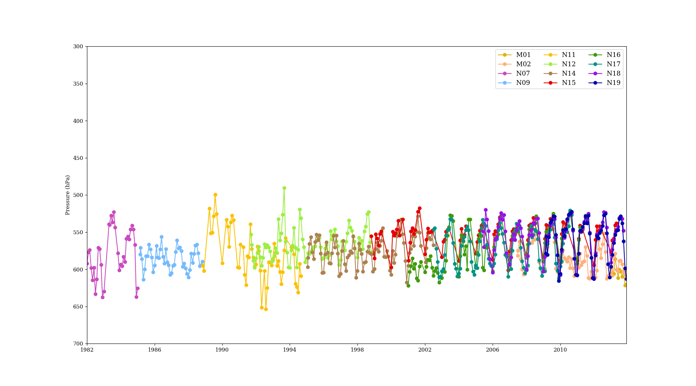
Monthly mean of speed (m/s)
Monthly mean of AMVs height over the period 1982 - 2015
300
400
Northern pole
500
Pressure (hPa)
600
700
1982
2010
(qi>50 and speed > 2m/s)
300
400
Southern pole
500
Pressure (hPa)
600
700
1982
2010
Notes:
Time series of the total area monthly averaged AMV height anomaly provided in pressure values with respect to the climatological average of all satellites for the northern and southern hemisphere, respectively. The average height of the AMVs is between 700 and 500 hPa for the northern hemisphere and 650 to 500 hPa over the southern hemisphere which is driven by the topography of Antarctica. For the northern hemisphere the AMV height time series appear homogeneous with some variation in the amplitudes of seasonal pressure changes from summer to winter. The more modern satellites show a more distinct seasonal cycle with rather constant amplitude while for some older satellites the seasonality becomes hard to detect. The distinct differences between satellites become more clearly visible in the anomaly plots. For instance over the northern hemisphere during the small temporal overlap of NOAA-9 and NOAA-11 one can see systematic different height anomalies which is most likely a mix of systematically covering a different region and systematic differences in the brightness temperature used to assign the AMV height. This may point to needs for improvement in the input data for the AMV processor. This is more pronounces in the southern hemisphere where the topography enhances the effect of differently covered regions.

Slide 18
Polar AMVs: conclusion
The first release of polar AMVs from AVHRR data from 1982 dataset is rather stable and exhibit the main expected features:
200 to 600000 AMVs per month, with more winds in the summer hemisphere
Average wind speeds of 13 m/s over the northern hemisphere and 15 m/s over the southern hemisphere.
The time series shows a distinct seasonal cycle with maximum wind speeds over the winter hemisphere and minimum wind speeds over the summer hemisphere.
The average height of the AMVs is between 700 and 500 hPa for the northern hemisphere and 650 to 500 hPa over the southern hemisphere which is driven by the topography of Antarctica
A second release is expected at the end of 2019 will improve the product:
Will include NOAA 6, 8, an 10
Include cloudy information in the retrieval
Notes:
NOAA-6, 8 and 10 data have been omitted from the processing because no source for corrected and well enough calibrated AVHRR/1 radiances were accessible. The work from the NOAA archived data to usable data for an AMV processing for those satellites was beyond the project resources;

Slide 19
Future EUMETSAT reprocessing plan
 | Time coverage | Geographical coverage | Description | Date
GEO
Meteosat-8, 9, and 10 SEVIRI AMV | 2004 - 2018 | Europe/Africa/India | Release 1 extension | Q4 2018
Meteosat-7 | 1982 - 2004 | Europe/Africa/India | Release 1 extension | Q4 2018
LEO
Metop AVHRR Polar AMV LAC | 2007 - present | Polar region (up to 50°N and S) | Release 2 | Q2 2019
Metop AVHRR Dual Wind AMV | 2011 - present | Global | Release 1 | Q2 2019
NOAA AVHRR Polar AMV GAC | 1979 - present | Polar region (up to 50°N and S) | Release 1 extension | Q4 2020

Slide 20
Thank you !

Slide 21
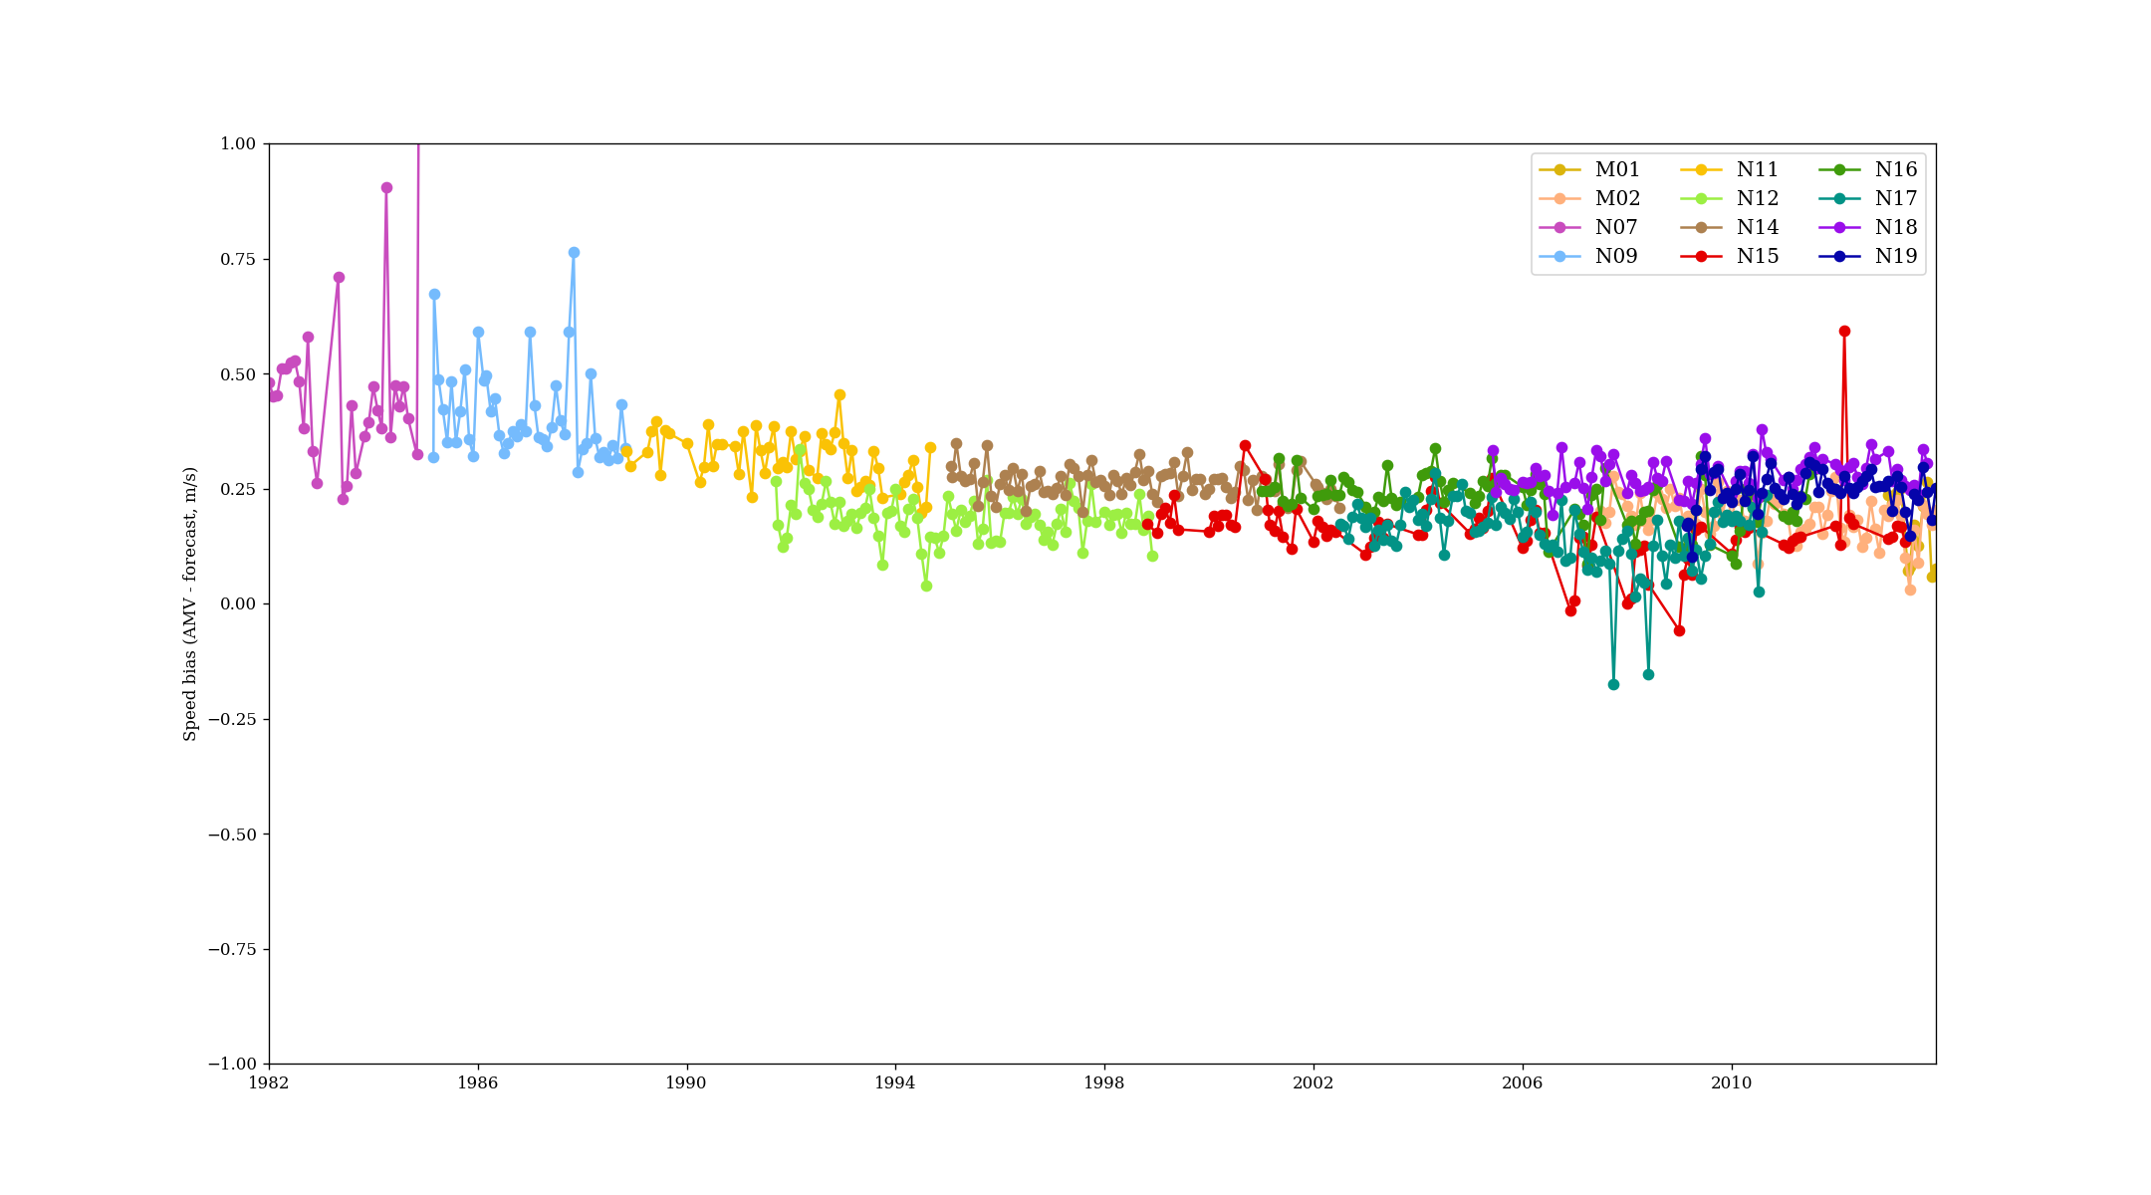
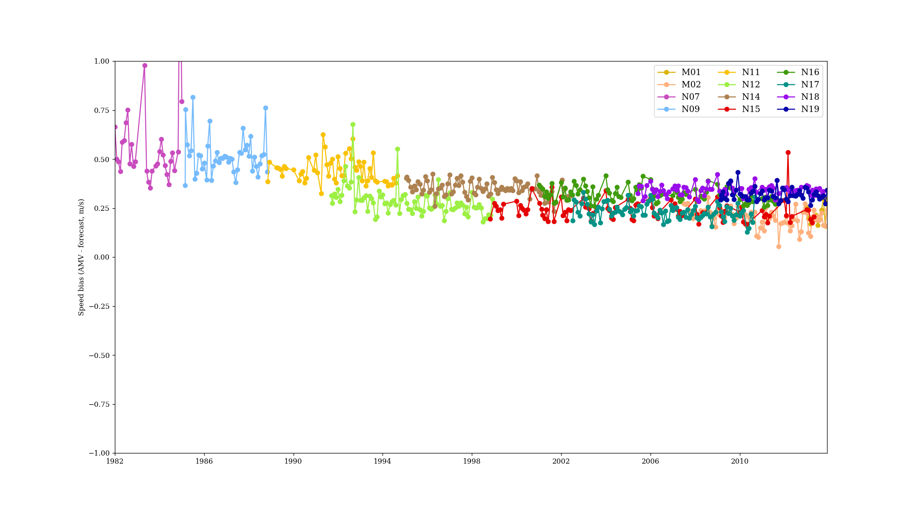
Speed bias
Northern pole
Southern pole
Notes:
The retrieved AMVs are accompanied with forecast data from the ECMWF ERA interim reanalysis that were used for the height assignment and to compute the quality index after Holmlund (1998). This also allows a comparison of the systematic and random differences for the wind speed. Figures above shows the time series of monthly averaged systematic differences between the derived AMVs and the reanalysis data for all satellite instruments used. The systematic differences for the wind speed are always positive for each instrument and in every month, i.e., the derived AMV is slightly faster than the forecast. A positive bias means that the AMV is put slightly too high in the atmosphere. The differences are also small (0.25 m/s) for most of the satellites and months with some deviations (up to 0.75 m/s) for the oldest satellites NOAA-7 and NOAA-9. The magnitude of bias is comparable to earlier reprocessing of AMVs for Metop data during the ERA-CLIM project. There are also small systematic differences among the satellites throughout their time series overlap, e.g., NOAA-12 vs. NOAA-11 and NOAA-14. Some individual months in the time series are sticking out, e.g. NOAA-15 in 2012 which could be caused by a processing artefact.

Slide 22
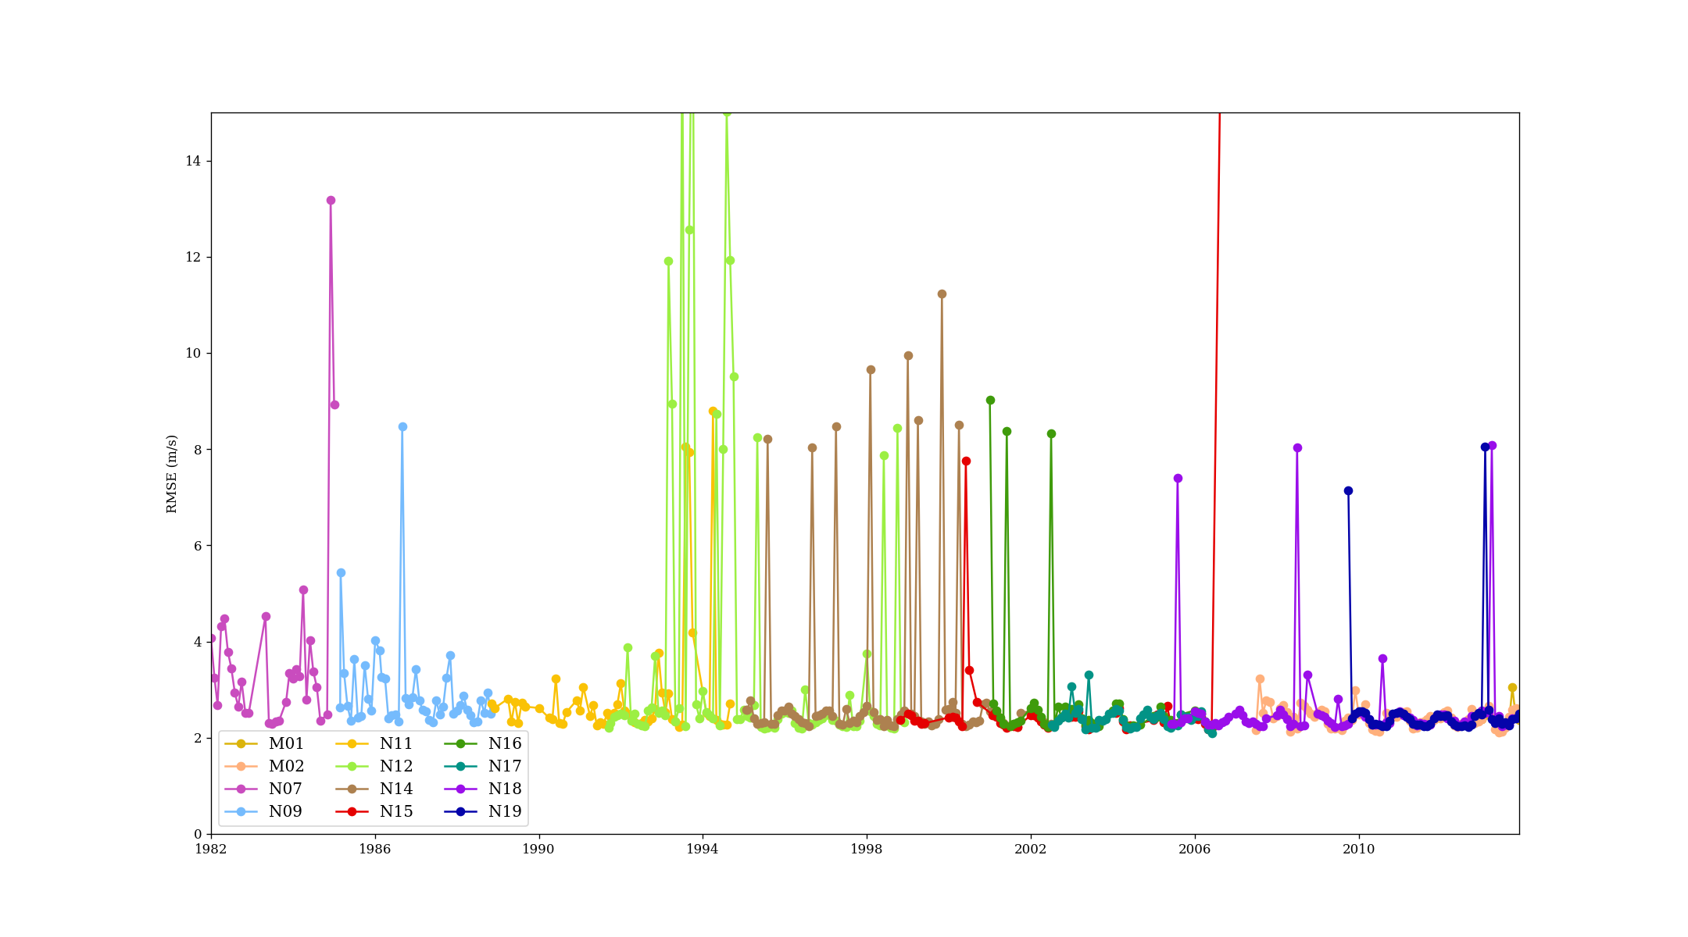
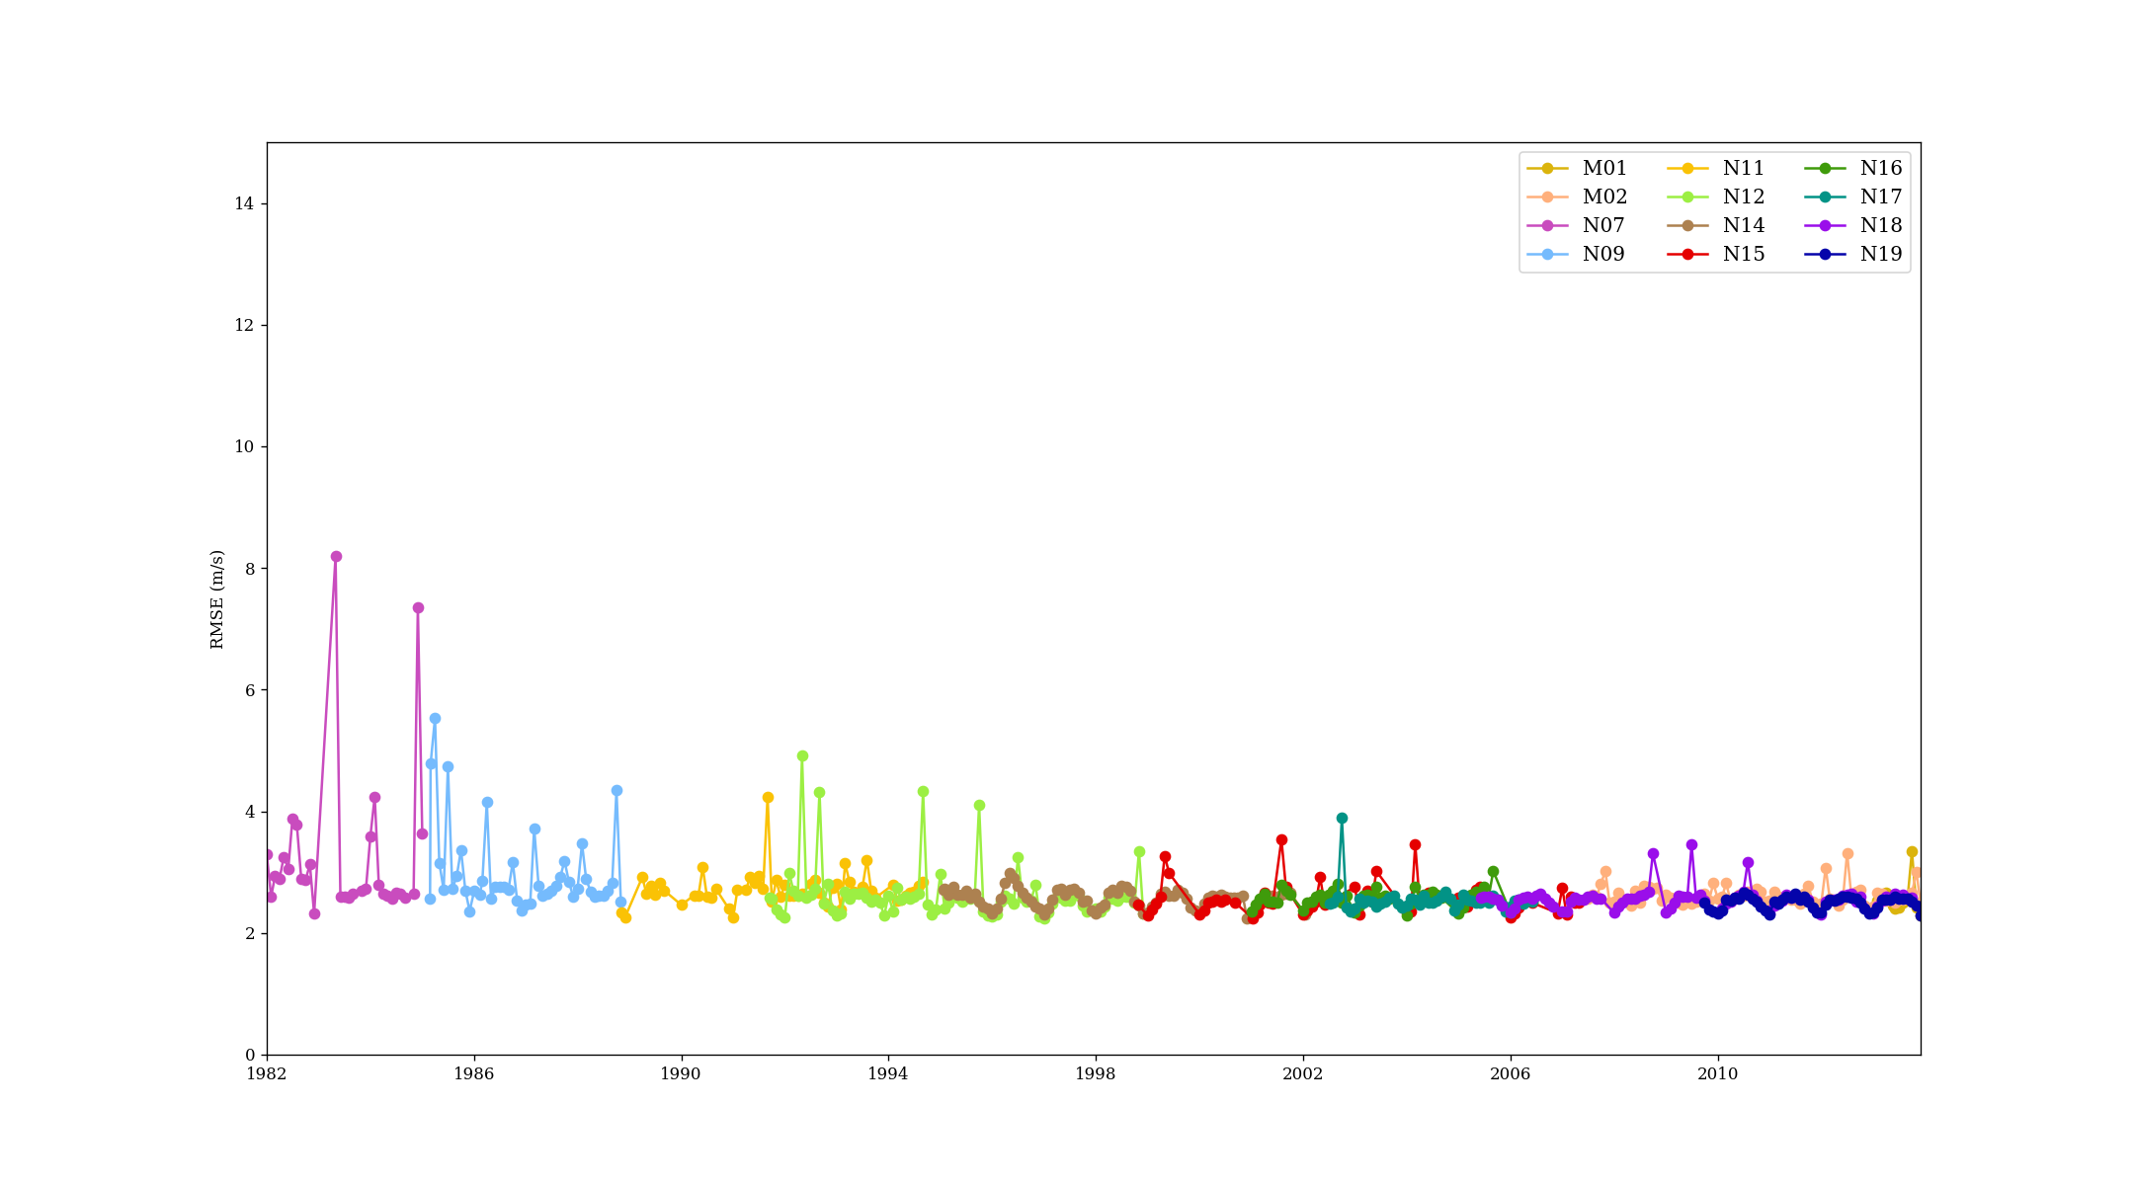
rmse
Northern pole
Southern pole
Notes:
The root mean square error (rmse) shown in Figure above may strongly vary according to the weather situation and time of the year. Despite this expectation it is generally around 4 m/s in both hemispheres with little temporal variation. Only, the old satellites NOAA-7 and NOAA-9 show higher variability in rmse. However, for some months (satellites) the rmse over the northern hemisphere is much higher than expected which is most likely caused by technical errors in the data, e.g., a wrong forecast value in the AMV data file or by specific AMV speed outliers in such a month. Some satellites experience relative high rmse values at the beginning and close to the end of the mission producing another set of outliers (not shown in Figures above).

