Slide 1
14th International Winds Workshop: 25 April 2018
Assimilation Impact of the LEOGEO AMVs on East Asia
Sihye Lee and Hyo-Jong Song
Korea Institute of Atmospheric Prediction Systems (KIAPS)
1

Slide 2
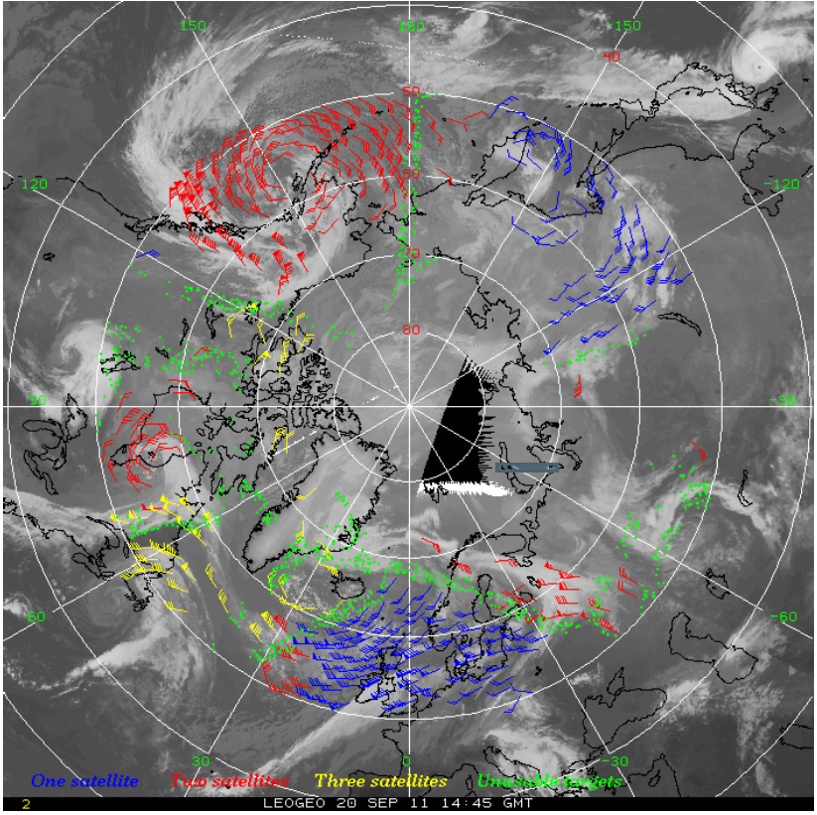
LEOGEO AMVs
LEOGEO satellite derived winds
Spatial distribution of LEOGEO AMVs
rainfall event
East Asian domain
Blue : 1 satellite
Red : 2 satellites
Yellow: 3 satellites
Green: Potential targets
Santek et al. (2016, IWW13)
(hPa)
LEOGEO AMVs have been used in the latitudinal zone from approximately 60° to 70° (300-900 hPa, QI > 50). In winter season, spatial blacklisting is applied to remove jet winds in the Northern Hemisphere (NH).
Used satellites: Meteosat-10, FY-2D, GOES-13/15, MTSAT-2, NOAA-15/18/19, MetOp-A/B
- Resulting AMVs are a mix of LEO-LEO (10%), LEO-GEO (25%), and GEO-GEO (65%) (Warrick, 2015)
2

Slide 3
Objective
To investigate the impact of the assimilation of LEOGEO AMVs
on the accuracy of global model forecast over East Asia
90˚N -
LEOGEO AMVs
winter jet
45˚N -
East Asia
The upper-level winter jet stream area, the source of the baroclinic perturbation over the NH, can be more correctly analyzed by LEOGEO AMVs with the aid of their geographical location.
0˚ -
45˚S -
The incorporation of LEOGEO AMVs into the global analysis-forecast cycle can reduce the forecasting error in weather predictions (e.g. precipitation) over East Asia.
90˚S -
180˚
120˚W
60˚W
0˚
60˚E
120˚E
180˚
3

Slide 4
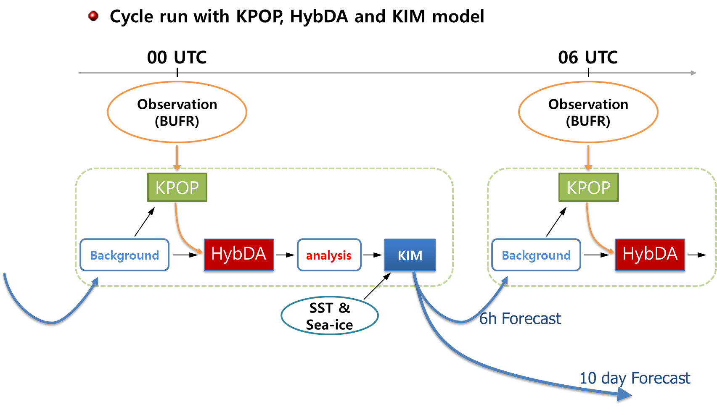
Experiment
Period: 2017010600 ~ 2017020118 UTC (27 days)
Cycle system: semi-real time KIAPS operational version 2.5
- KIM (Korean Integrated Model): 25 km, 0.3 hPa
- HybDA (3-dimensional Data Assimilation system): 100 km, 0.3 hPa
- KPOP (KIAPS Package of Observation Processing)
Observations: sonde, surface, aircraft, GPS-RO, AMSU-A, MHS, IASI, scatwind, AMV
Validation: ECMWF IFS analysis and KMA synoptic weather chart
- CTL: KIM v2.5 cycle - EXP: CTL + LEOGEO AMVs
Thinning: 100 km x 100 km x 100 hPa with ±3-hr time window
Thanks to In-Hyuk Kwon
4

Slide 5
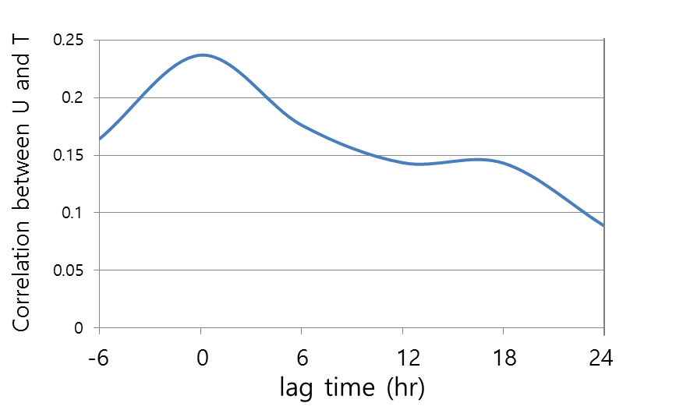
Analysis impact: time-series
Averaging region: 10-85˚N, 0-150˚E
Percent differences of
CTL RMSD and EXP RMSD
LEOGEO AMVs missing
(CTL RMSD – EXP RMSD)
CTL RMSD
x 100
positive
Correlation between U and T
negative
positive
A positive correlation between wind and temperature in RMSD time-series was observed directly; this correspondence shows the analysis improvement in temperature was derived from the thermal wind balance in the background error covariance model of 3D-Var (Song et al., 2017).
negative
5
Notes:
Throughout the data assimilation experiment, positive signals of wind and temperature on the EXP are amplified around 20 January. The positive impact of the LEOGEO AMV assimilation is not distinct at earlier times of the cycle period, but it becomes apparent in the later part of the cycle over East Asia. Unfortunately, LEOGEO AMV data were not assimilated from 0600 UTC 26 January to 0000 UTC 27 January, and the percentage differences of the RMSD between the CTL and EXP show negative values even after this missing period for about 2 days.
The background error correlation between the horizontal wind and temperature conveys the LEOGEO AMVs’ information to the mass even at the analysis time.

Slide 6
Analysis impact: zonal plot
Error reduction of zonal wind and temperature (CTL RMSD – EXP RMSD)
Earlier part
(2017010600-
2017011918)
Zonal wind in SH: positive impact
Temperature: neutral impact
Positive impacts on the zonal wind extend into the regions around 60°N and the Artic, as well as 45°-75°S,
Later part
(2017012000-
2017020118)
Temperature: neutral impact
6
Notes:
Red and blue colors mean positive and negative analysis impacts, respectively. The small black dots show the 95% significant difference, verified by a t-test, between the CTL and EXP.
For the earlier part, significant positive impacts on the zonal wind are observed around 50˚S–70˚S for all tropospheric levels (a), but the impact on the temperature is almost negligible except in the SH midlatitude upper troposphere (b).
Although the initial impact of the LEOGEO AMVs is insignificant over the NH, it is remarkable that the positive analysis-impacts on the zonal wind extend into the regions around 60°N and the Artic, as well as 45°S–75°S, for the later part of the experiment period (c). Even for the temperature, the Arctic region shows improved analyses, although the statistical significance is absent at the 95% level, in the later experiment period (d).

Slide 7
Analysis impact: 2D field
Zonal wind
Temperature
Earlier part
(2017010700)
Korea
negative
positive
Zonal wind
Temperature
Later part
(2017012000)
Although the initial impact of assimilated LEOGEO AMVs is less distinguishable, after 6-D forecast-analysis cycle has progressed, the positive impact of LEOGEO AMVs emerges in the higher latitudes over the EA domain for wind and temperature analysis.
7

Slide 8
Monte-Carlo significance test
After spin-up period, the bootstrapping test (Hesterberg et al., 2003) was used to evaluate the forecast impact of LEOGEO AMVs.
Allowing for repetitions, 100,000 bootstraps with the resultant twenty-five samples were generated randomly to create 100,000 averages for the RMSDs.
Based on these 100,000 bootstraps, the 95%, 50%, and 5% probability levels were identified.
Consequently, these reductions reach a two-tailed 90% statistical significance after a 108-hr forecast lead time for wind and temperature, except at 144-hr forecast, earlier than a 144-hr forecast lead time for surface pressure.
8
Notes:
the period of 0000 UTC 18 January–1200 UTC 1 February in 2017 was used to evaluate the forecast impact of LEOGEO AMVs assimilated in addition to the conventional AMVs.
The upper and lower gray solid lines designate the 95% and 5% probability levels in the bootstrapped samples, respectively. The black solid line is the 50% probability level (median).

Slide 9
Case study (precipitation event)
Initial: 20170120_00 UTC
Target: 20170127_00 UTC (168-hr forecast)
9

Slide 10
Precipitation event
Precipitation event over East Asia at 0000 UTC on 27 January 2017
This case was selected based on the precipitation rate (12-hr accumulation summed over the Korean Peninsula: 1126.2 mm) observed in AWS over the Korean Peninsula.
COMS IR channel (10.8 μm) shows a circulation system with a strong westerly and clouds.
10

Slide 11
Forecast impact: vertical
The positive impact of LEOGEO AMVs is presented consistently in the mid-level of 300-700 hPa.
Since 72-hr forecast, positive signal of LEOGEO AMVs in zonal wind starts from the higher level near 100 hPa and is linked up to the surface after 120-hr forecast.
The error reduction of temperature appears mainly below 500 hPa approximately after 30-hr forecast and its dramatic change also appears one day later than that of zonal wind.
11
Notes:
This slide shows the vertical difference in RMSD between the CTL and EXP (i.e. error reduction; the red colored shading shows the improvement by additional assimilation of LEOGEO AMVs) for 168-hr forecast. In Figure 8(a), the error reduction of zonal wind below 300 hPa is remarkable from initial time to 84-hr forecast.
The positive impact of LEOGEO AMVs is presented consistently in the mid-level of 300-700 hPa. Since 72-hr forecast, positive signal of LEOGEO AMVs in zonal wind starts from the higher level near 100 hPa and is linked up to the surface after 120-hr forecast.
The error reduction of temperature appears mainly below 500 hPa approximately after 30-hr forecast and its dramatic change (since approximately 144-hr forecast) also appears one day later than that of zonal wind (120-hr forecast). This delayed improvement in temperature signifies that the direct influence of LEOGEO AMVs on wind is propagated to mass in the process of dynamical forecast.

Slide 12
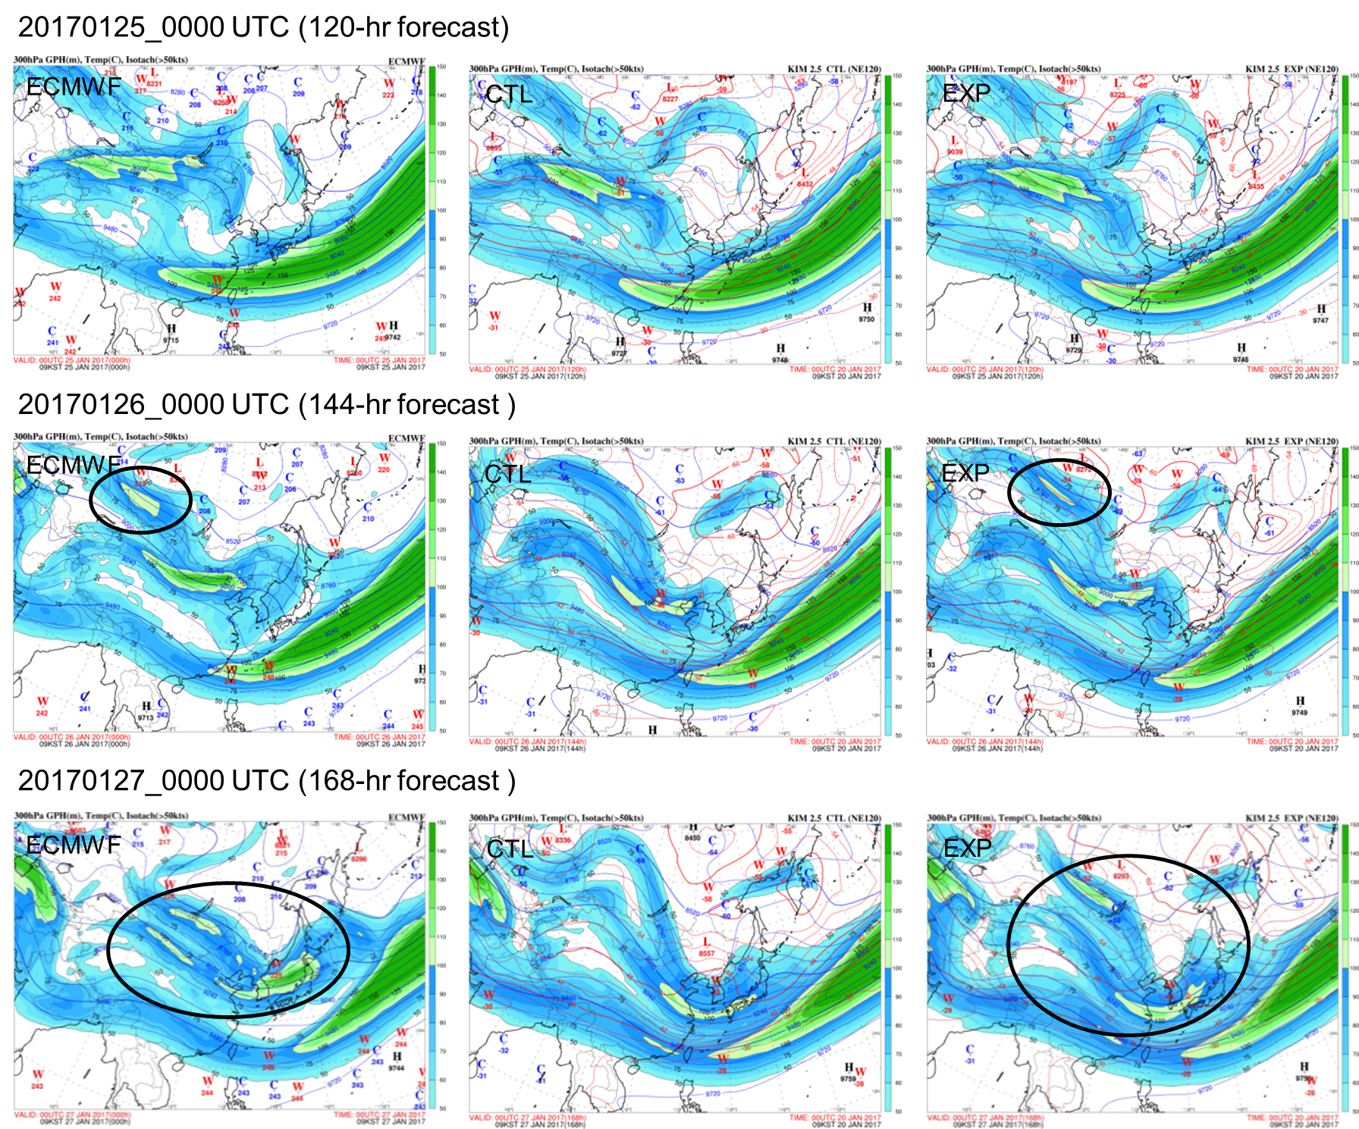
Forecast impact: GPH @ 300 hPa
Case study: initial 20170120_0000 UTC
CTL and EXP are similar
EXP is superior to CTL
EXP is superior to CTL
Solid line: GPH
Shaded: isotach
Dashed line: temperature
12
Notes:
The wintertime upper-tropospheric polar front jet stream is an important atmospheric circulation system over East Asia (Luo and Zhang, 2015).
Figure 9 shows the horizontal wind speed as well as the geopotential height and temperature of the IFS analysis and the two forecasts of the CTL and EXP in the upper atmosphere at 300 hPa.
In the 120-hr forecast, both experiments of the CTL and EXP are similar to the IFS analysis: a strong jet core west of Lake Baikal clearly appeared (Figure 9(a)-9(c)). Although the jet core propagating southeastward still exists in both forecasts at the 144-hr lead time, another north core of the split jet stream, however, is not observed in the CTL experiment (Figure 9(e)).

Slide 13
Forecast impact: GPH @ 300 hPa
Case study: initial 20170120_0000 UTC
In 120-hr forecast, both experiments of CTL and EXP are very similar to IFS analysis: inflowing jet into Korea clearly appeared at both cases.
However, the polar core of spilt jet steam disappeared in CTL at 144-hr forecast.
Especially, 168-hr forecast field contains three strong jets around Korean Peninsula. EXP is maintaining well this system relatively and the position of the jet through Korea is closer to that of the IFS analysis .
13
Notes:
In Figure 10(a), the 168-hr forecast field is described as having three strong jets around the Korean Peninsula in the IFS analysis. Compared to the CTL, this cluster of jet cores is well maintained in the EXP result, and the position of the jet stream near Korea is closer to that of the IFS than in the CTL result (Figure 10(b) and 10(c)).

Slide 14
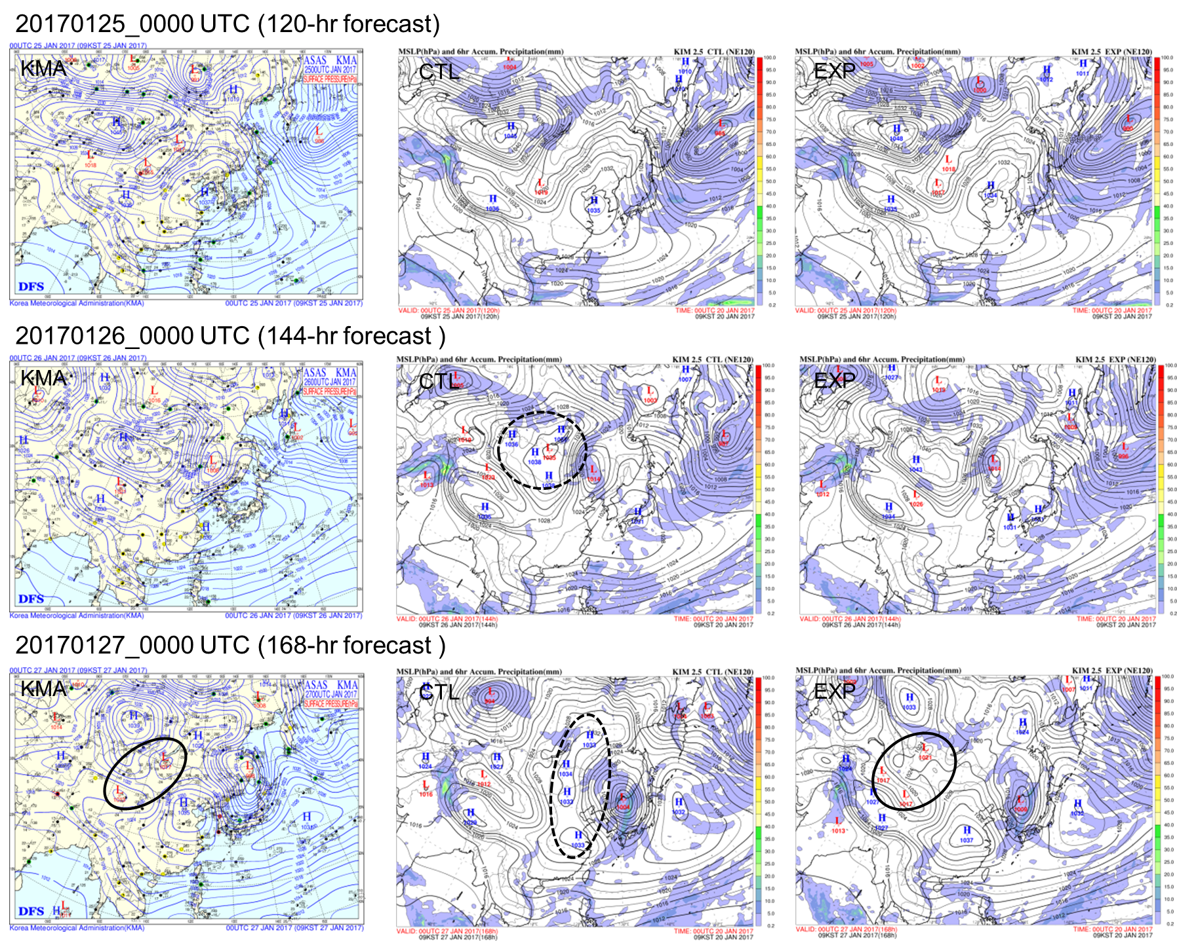
Forecast impact: surface
Case study: initial 20170120_0000 UTC
CTL and EXP are similar
EXP is superior to CTL
EXP is superior to CTL
Solid line: sea level pressure
Shaded: 6hr accumulated precipitation
14
Notes:
Both experiments of the CTL and EXP performs well in forecasting the synoptic surface pressure system until the 120-hr lead time.

Slide 15
Forecast impact: surface
Case study: initial 20170120_0000 UTC
The both experiments of CTL and EXP show a good performance until 120-hr forecast.
However, impact of CTL on 144-hr forecast decreased unexpectedly: the low pressure system is located in the middle of high pressure over northcentral China.
In 168-h forecast, KMA analysis weather chart shows the low pressure following on high pressure in the Northeast of Korea. The pressure system in the EXP is more similar to the reference than that of CTL. The high pressure of CTL is standing with elongated shape at 168-hr forecast, which is strikingly different from the KMA weather chart.
15
Notes:
As shown in the KMA analysis weather chart, the organized high-pressure system confronting the low-pressure system, at 0000 UTC on 27 January 2017 (168-hr forecast lead time), around the Korean Peninsula results in stronger cold advection to create more enhanced cold fronts accompanied by heavy rainfall. This feature is distinctively well described in the EXP forecast, in which the jet streams are well simulated with the aid of the LEOGEO AMV assimilation.

Slide 16
Summary
Assimilation of LEOGEO AMVs shows a globally significant benefit in wind analysis over the 50°–70° latitude band for all levels.
Based on a bootstrapping test, the positive forecast impact on wind, temperature, and surface pressure of the LEOGEO AMV assimilation over East Asia has been verified at a 90% statistical significance level.
Even though its spatial coverage is confined to higher latitudes and the observable variable is wind, not mass, the assimilation of LEOGEO AMVs has a positive impact on the forecast for a synoptic pattern even including wind, temperature and surface pressure over the East Asian domain.
16

Slide 17
17

Slide 18
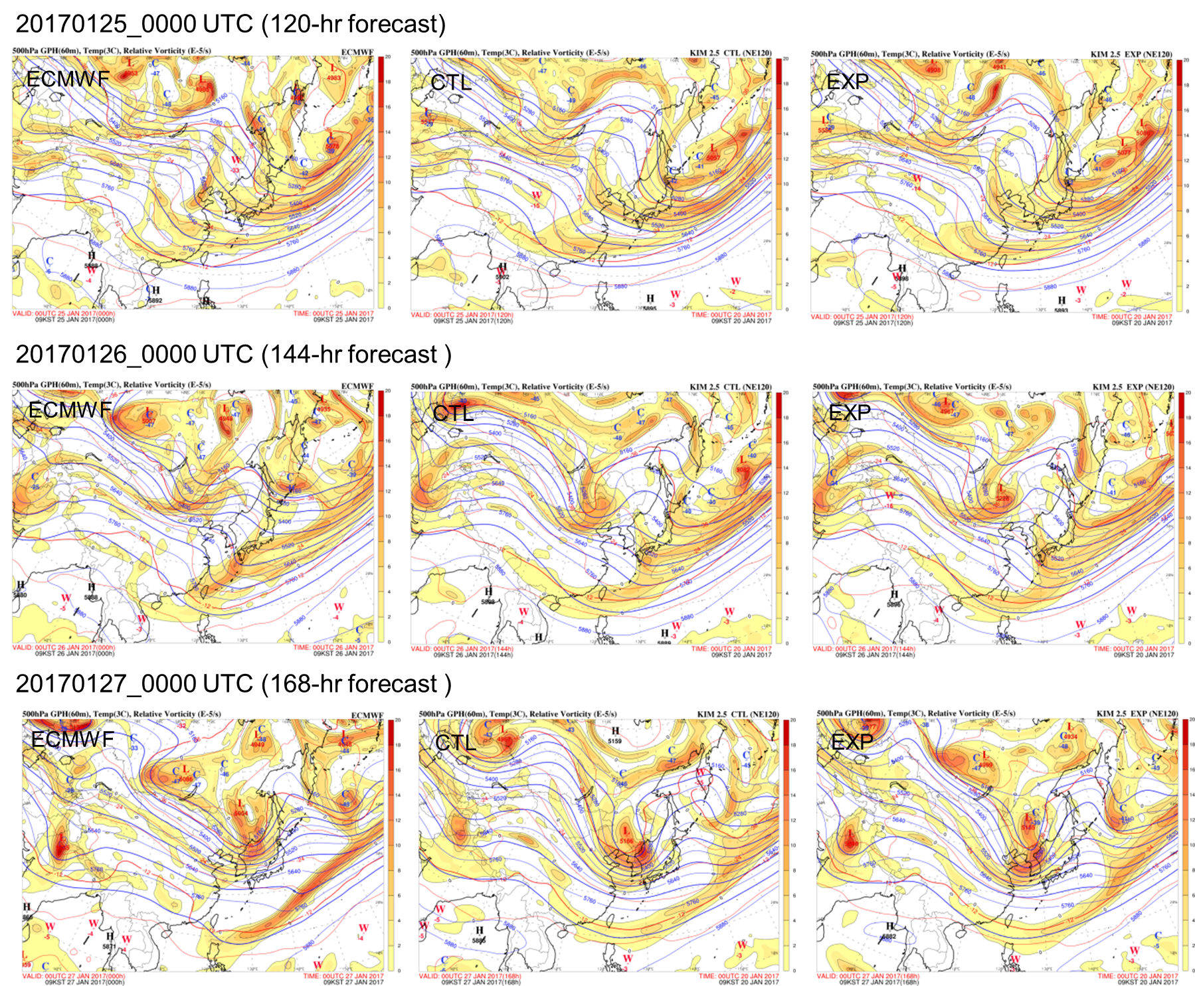
Forecast impact: GPH @ 500 hPa
Case study: initial 20170120_0000 UTC
EXP is superior to CTL
EXP is superior to CTL
EXP is superior to CTL
Solid line: GPH
Shaded: vorticity
Dashed line: temperature
18

Slide 19
Forecast impact: GPH @ 500 hPa
Case study: initial 20170120_0000 UTC
Arctic system is getting closer to the northern part of the Korean Peninsula. Inflowing pattern of winds at EXP is more similar than that of CTL, compared to IFS analysis.
Low pressure systems, which has a triangle shape, around Lake Baikal are clearly maintained until 168-hr forecast of EXP, while high pressure is located in the left side of Lake Baikal at CTL.
In EXP with LEOGEO AMVs, the intensity of low pressure at the North Pole is stronger than that of CTL initially (not shown). Propagation of the stronger low-pressure system from the Arctic to just the northwest of Lake Baikal finally abandons the intrusion of the high pressure in the case of CTL. The resultant baroclinicity is associated with the polar branch of the jets.
19

