Slide 1
A Variational Approach for Estimating AMV Reassigned Heights
Stéphane Laroche
Data Assimilation and Satellite Meteorology section
Environment and Climate Change Canada, ECCC

Slide 2
Motivation
Forsythe and Saunders (2008) proposed a situation dependent observation error estimation in which the tracking and the contribution of the height assignment errors are combined. This approach has been successfully implemented at the UK Met Office and ECMWF and will soon be operational at the Meteorological Service of Canada (see poster by Laroche et al. in this workshop).
The height assignment error is used to increase the total observation error in present of vertical wind variation (shear). Thus the impact of the AMV in the analysis is reduced when the observation is located in strong vertical wind shear without modifying the vertical position of the AMV.

Slide 3
Motivation
The impact of the systematic (bias) error of the assigned height as well as interpreting the AMV as a layer-averaged motion on NWP forecast have recently been examined using background best-fit pressure and lidar measurements (e.g. Salonen et al. 2016, Folger and Weissmann, 2016).
Salonen and Bormann (2014, IWW12) showed that taking into account the systematic height errors clearly improves forecasts where as the impact of using a layer-averaging observation operator is mixed. These results suggest that the accuracy of the assigned height plays an important role in NWP forecast skill and reassign the height is beneficial.

Slide 4
Objectives of the present study
Show how a variation of the AMV assigned height can be included in an incremental variational data assimilation scheme like 4D-EnVar.
Discuss the difficulties and limitations of this approach.
Examine a two-stage approach in which a reassigned height and observation error for each AMV are first calculated prior to assimilation.
Assess the impact of the two-stage approach on short to medium range forecasts from two data assimilation experiments (two-month winter and summer periods).

Slide 5
Incremental variational data assimilation scheme
$$X=X_{b}+∆X$$
X : analysis (u, v, T, q, p_{s})
$$J\left(∆X\right)={ J}_{b}\left(∆X\right) + J_{o}\left(∆X\right)$$
Analysis
profile
Background
profile
u
u_{b}
$$J(∆X)={0.5∆X}^{T}{B_{}^{−1}∆X+0.5{\left(H(∆X\right)−d)}^{T}R^{−1}\left(H(∆X\right)−d) }_{}$$
p_{i+1}
Δu=u-u_{b}
ΔX : analysis increments (X-X_{b})
d : innovations (y-H(X_{b}))
X_{b} : Background field
y : observations
H : observation operator
B : Background error covariances
R : Observation error covariances
p_{i}
p_{o}
u_{o}
Δu(p_{o})
u_{b}(p_{o})
p_{i-1}
Contribution of one AMV u component to J_{o}:
Δu : u increment profile
Δu(p_{o}) : u increment interpolated at p_{o}
u_{b} (p_{o}) : background u interpolated at p_{o}
u_{o} : AMV u component
σ_{o}² : observation error variance
$$J_{o}(∆u)=\frac{0.5{(∆u(p_{o})−(u_{o}−u_{b}(p_{o})))}^{2}}{{σ_{o}^{}}_{}^{2}}$$
Note that the position of the observations is assumed free of error.

Slide 6
J_{o} term with situation dependent observation error for one AMV wind component
$$J_{o}(∆u)=\frac{0.5{(∆u(p_{o})−(u_{o}−u_{b}(p_{o})))}^{2}}{{σ_{t}^{}}_{}^{2}+{σ_{h}^{}}_{}^{2}}$$
Formulation for σ_{h} proposed by Forsythe and Saunders (2008):
$${σ_{t}}^{2}=F(QI)$$
σ_{p} (hPa)
$${σ_{h}}^{2}=\frac{\sum_{i}{W_{i}{\left(u_{o}−u_{b}\left(p_{i}\right)\right)}^{2}δp_{i}}}{\sum_{i}{W_{i}δp_{i}}}$$
u_{b}(p)
$$W_{i}=exp\left(−\left[\frac{{\left(p_{i}−p_{o}\right)}^{2}}{2{σ_{p}}^{2}}\right]\right)$$
p_{i+1}
p_{i}
δp_{i}
p_{o}
u_{o}
$${{For S_{b}=cst : σ}_{h}}^{2}{{={S_{b}}_{}^{2}σ}_{p}}^{2}$$
p_{i-1}
$$S_{b}=\frac{∂u_{b}}{∂p}$$

Slide 7
Situation dependent observation error estimation for AMVs prior to the assimilation
Observations
Background field
Selected AMVs with assigned pressure (p_{o})
Calculation of observation errors (tracking and height assignment contributions)
u, v
Selected AMVs data with
σ_{o}² = σ_{t}² + σ_{h}²
All the other
satellite and conventional data
4D-EnVar
u, v, T, q, p_{s}
Analysis

Slide 8
J_{o} terms for one AMV wind component
J_{o} with adjustable AMV position (p_{o}+Δp) plus a penalty function:
$$J_{o}(∆u,∆p)=\frac{0.5{(∆u(p_{o}+∆p)−\left(u_{o}−u_{b}(p_{o}+∆p)\right))}^{2}}{{σ_{t}^{}}_{}^{2}}+\frac{0.5∆p^{2}}{{σ_{p}^{}}_{}^{2}}$$
$$=\frac{0.5{(∆u(p_{o})−\left(u_{o}−u_{b}(p_{o})\right)+∆p\left(S_{b}+∆S\right))}^{2}}{{σ_{t}^{}}_{}^{2}}+\frac{0.5∆p^{2}}{{σ_{p}^{}}_{}^{2}}$$
Linear interpolation context
Analysis
profile
Background
profile
u
u_{b}
J_{o} with situation dependent observation error:
p_{i+1}
Δu=u-u_{b}
$$J_{o}(∆u)=\frac{0.5{(∆u(p_{o})−(u_{o}−u_{b}(p_{o})))}^{2}}{{σ_{t}^{}}_{}^{2}+{σ_{h}^{}}_{}^{2}}$$
p_{i}
p_{o}
$${σ_{h}}^{2}{{={S_{b}}_{}^{2}σ}_{p}}^{2}when S_{b}=cst$$
Δp
u_{o}
p_{i-1}
$$S=\frac{∂u}{∂p}$$
$$S_{b}=\frac{∂u_{b}}{∂p}$$
$∆S=S$- $S_{b}$

Slide 9
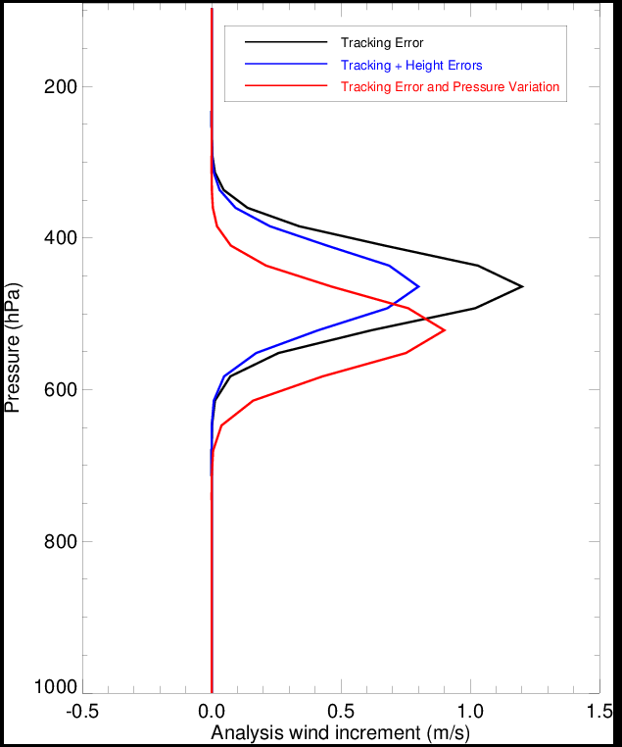
Impact of the different observation errors and pressure variation Δp on the analysis increment
Idealized assimilation of one AMV component in presence of vertical wind shear
$$J_{o}(∆u)=\frac{0.5{(∆u(p_{o})−(u_{o}−u_{b}(p_{o})))}^{2}}{{σ_{t}^{}}_{}^{2}}$$
p_{o}
Δp
$$J_{o}(∆u)=\frac{0.5{(∆u(p_{o})−(u_{o}−u_{b}(p_{o})))}^{2}}{{σ_{t}^{}}_{}^{2}+{σ_{h}^{}}_{}^{2}}$$
$$J_{o}(∆u,∆p)=\frac{0.5{(∆u(p_{o}+∆p)−\left(u_{o}−u_{b}(p_{o}+∆p)\right))}^{2}}{{σ_{t}^{}}_{}^{2}}+\frac{0.5∆p^{2}}{{σ_{p}^{}}_{}^{2}}$$

Slide 10
Limitations and Difficulties
The reassigned height is only sensitive to the vertical wind variation (shear).
As a result, the approach proposed here can be seen as an alternative way to mitigate the misrepresentation of AMVs in presence of vertical wind shear.
The approach is valid only for small Δp in a 4D incremental variational data assimilation context.
The vertical interpolation operator is performed between levels above and below the observation level and these levels remain the same during the minimization of J(ΔX). A more general vertical linear interpolation operator over multiple model levels should therefore be developed.
A nonlinear term ΔpΔS appears in J_{o}, making J(ΔX) none quadratic.
Given these difficulties and limitations, we first developed a two-stage approach in which the height variation of each AMV is estimated first using a 1D-Var scheme. AMVs are then assimilated with reassigned height in 4D-EnVar along with all the other types of observations.

Slide 11
First stage: 1D-Var scheme for estimating the reassigned height and its error
1D-Var formulation for one wind component:
J$\left(∆u,∆p\right)=\frac{0.5∆u^{2}}{{σ_{b}^{}}_{}^{2}}+\frac{0.5{\left(∆u(p_{o}+∆p)−\left(u_{o}−u_{b}\left(p_{o}+∆p\right)\right)\right)}^{2}}{{σ_{t}^{}}_{}^{2}}+\frac{0.5∆p^{2}}{{σ_{p}^{}}_{}^{2}}$
Analysis
profile
Background
profile
In a linear approximation and for one observation, it can be shown that the optimal Δp can also be found by minimizing the following cost function:
u
u_{b}
Δu=u-u_{b}
p_{o}
J$\left(∆p\right)=\frac{0.5{\left(u_{o}−u_{b}\left(p_{o}+∆p\right)\right) )}^{2}}{{σ_{t}^{}}_{}^{2}+{σ_{b}^{}}_{}^{2}}+\frac{0.5∆p^{2}}{{σ_{p}^{}}_{}^{2}}$
Δp
u_{o}
$${σ_{pr}^{}}_{}^{2}={σ_{p}^{}}_{}^{2}\left(\frac{{σ_{t}^{}}_{}^{2}+{σ_{b}^{}}_{}^{2}}{{σ_{t}^{}}_{}^{2}+{σ_{b}^{}}_{}^{2}+{{{S_{b}^{}}_{}^{2}σ}_{p}^{}}_{}^{2}}\right)$$
Error variance estimation of the reassigned height
$$S_{b}=\frac{∂u_{b}}{∂p}$$

Slide 12
‘1D-Var + 4D-EnVar’ approach
Observations
Background field
Selected AMVs with assigned pressure (p_{o})
Vertical
1D-Var
u, v
Reassigned height (p_{o}+Δp) and height error
Calculation of observation errors (tracking and height assignment contributions)
First Stage
All the other
satellite and conventional data
4D-EnVar
u, v, T, q, p_{s}
Analysis
Second Stage

Slide 13
Summer and Winter Experiments
Experiments carried out with the operational Global Deterministic Prediction System (GDPS)
Summer period : 15 June to 31 August 2016
Winter period : 15 December to 28 February 2017
Experiment | Tracking error | Height error | Height
Control | σ_{t}² | σ_{p}² | p_{o}
First | σ_{t}² | - | p_{o}+Δp
Second | σ_{t}² | σ_{pr}² | p_{o}+Δp
$${σ_{pr}^{}}_{}^{2}={σ_{p}^{}}_{}^{2}\left(\frac{{σ_{t}^{}}_{}^{2}+{σ_{b}^{}}_{}^{2}}{{σ_{t}^{}}_{}^{2}+{σ_{b}^{}}_{}^{2}+{{{S_{b}^{}}_{}^{2}σ}_{p}^{}}_{}^{2}}\right)$$
$${σ_{t}}^{2}=F(QI)$$

Slide 14
Histograms of Δp from 1D-Var and model best-fit approaches for Meteosat-10
Winter period: 15 Dec – 28 Feb 2017
1D-Var approach
Blue: 1D-Var
Red: Model best-fit
J$\left(∆p\right)=\frac{0.5{\left(u_{o}−u_{b}\right)}^{2}}{{σ_{ut}^{}}_{}^{2}+{σ_{ub}^{}}_{}^{2}}+\frac{0.5{\left(v_{o}−v_{b}\right)}^{2}}{{σ_{vt}^{}}_{}^{2}+{σ_{vb}^{}}_{}^{2}}+\frac{0.5∆p^{2}}{{σ_{p}^{}}_{}^{2}}$
In case of multiple minima, the minimum closest to the originally assigned pressure (p_{o}) is chosen.
Model best-fit pressure approach
Salonen et al. (2015)
VD = [ (u_{o} - u_{b})² + (v_{o} - v_{b})² ]^{1/2}
VD_{min} < 4 m/s
VD_{min} < (VD - 2 m/s) for |p_{o} – p_{min}| > 100 hPa
In case of multiple minima, the minimum closest to the originally assigned pressure (p_{o}) is chosen.
Δp (hPa)

Slide 15
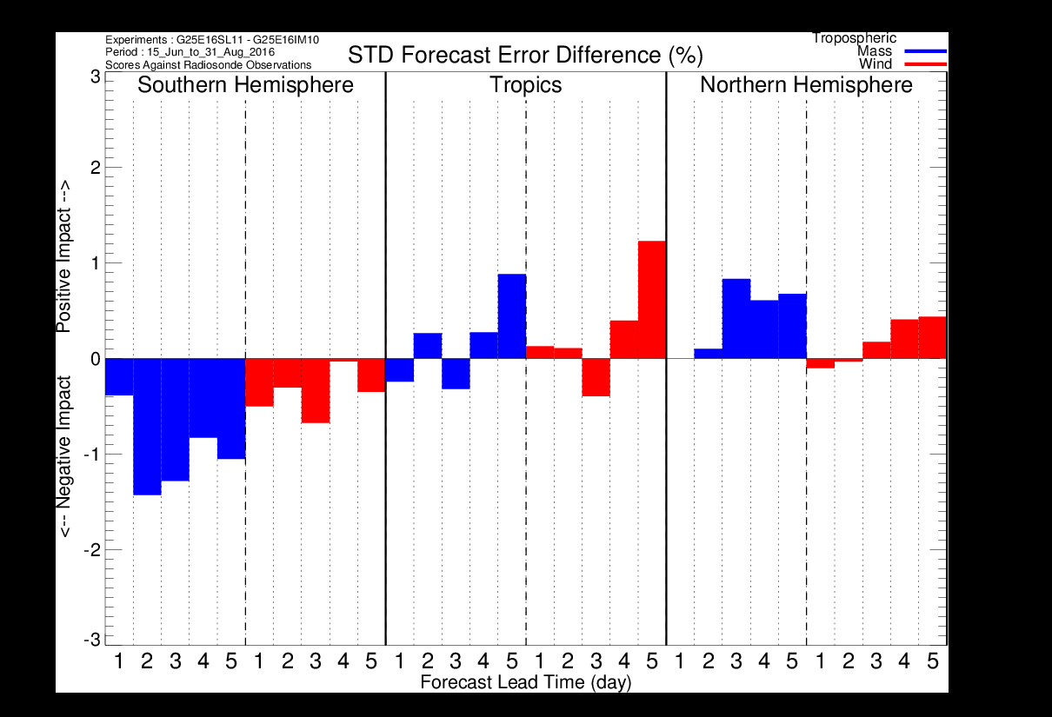
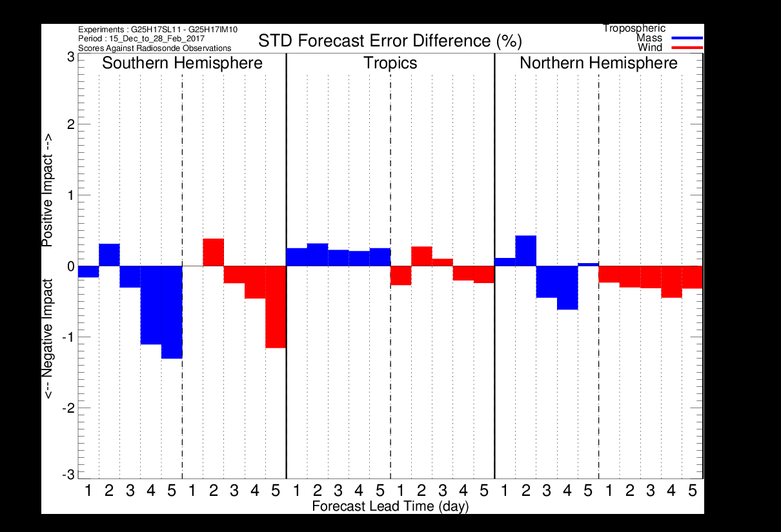
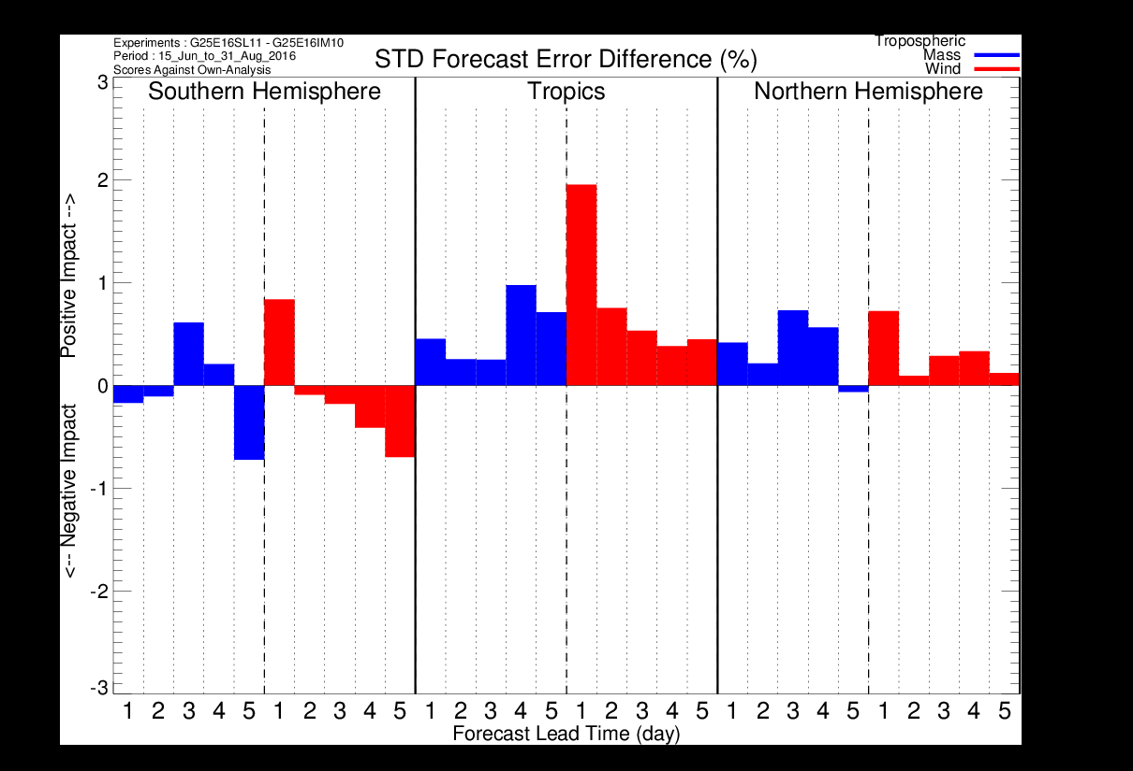
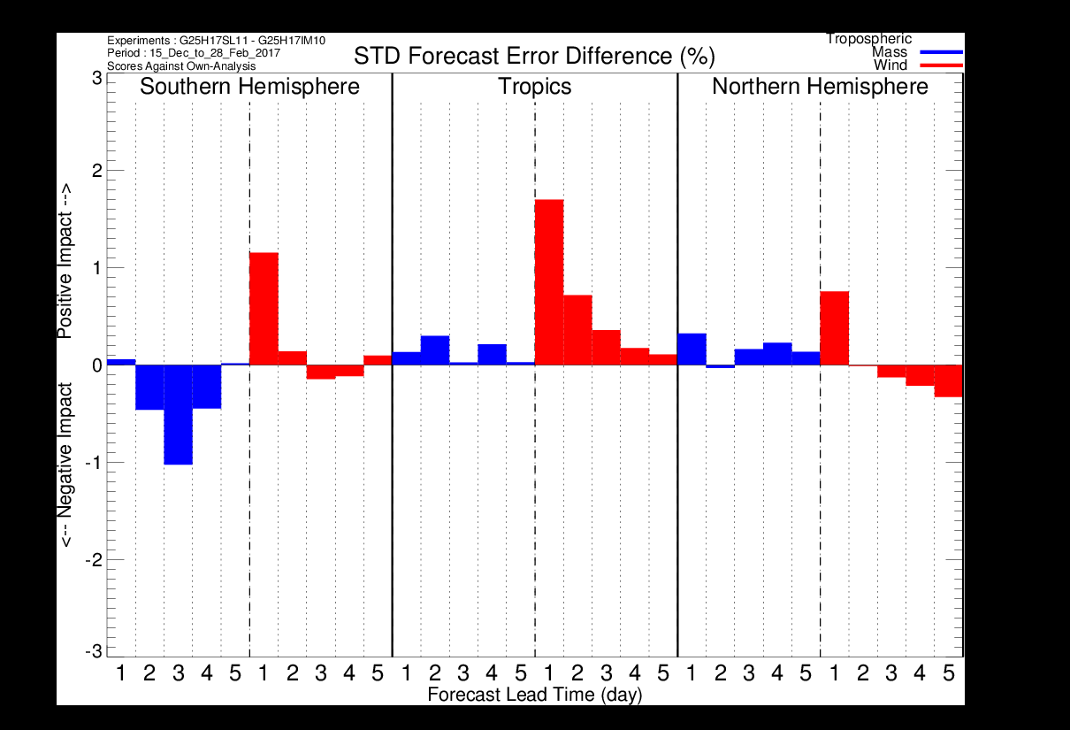
Verification scores for the first experiment (tracking error and reassigned pressure level)
Summer period: 15 Jun – 31 Aug 2016
Winter period: 15 Dec – 28 Feb 2017
Against
Radiosondes
Against
Radiosondes
Against
Own-Analysis
Against
Own-Analysis

Slide 16
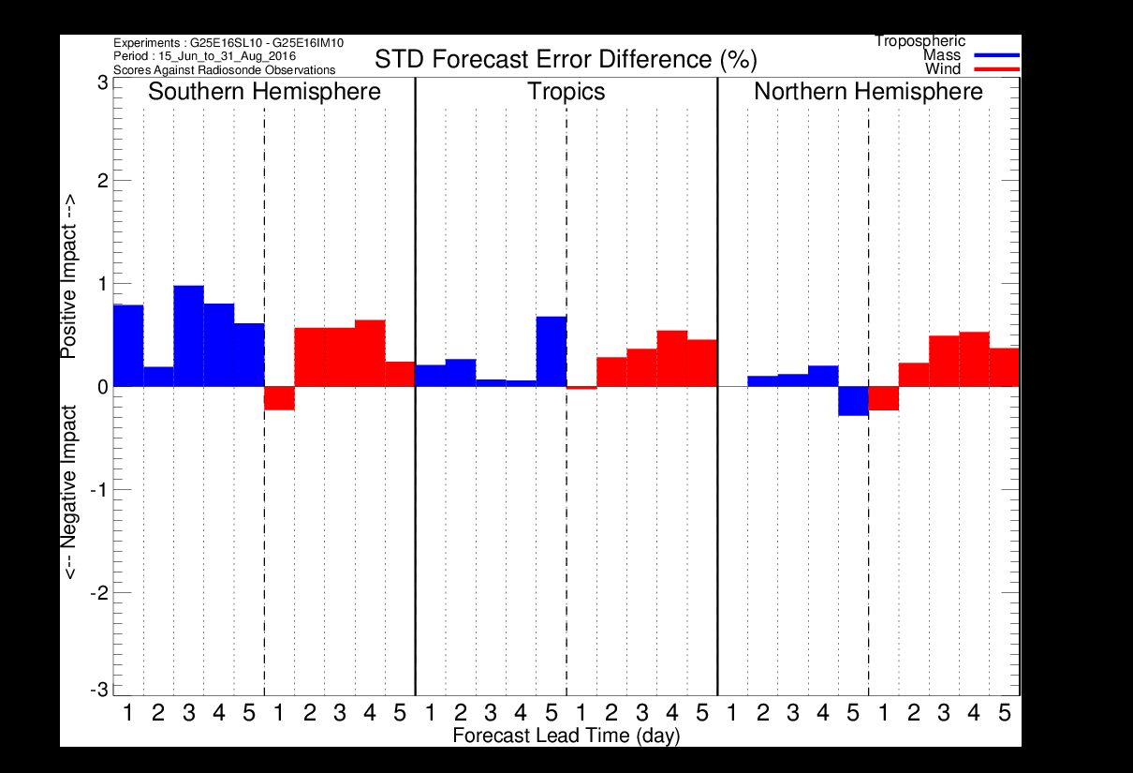
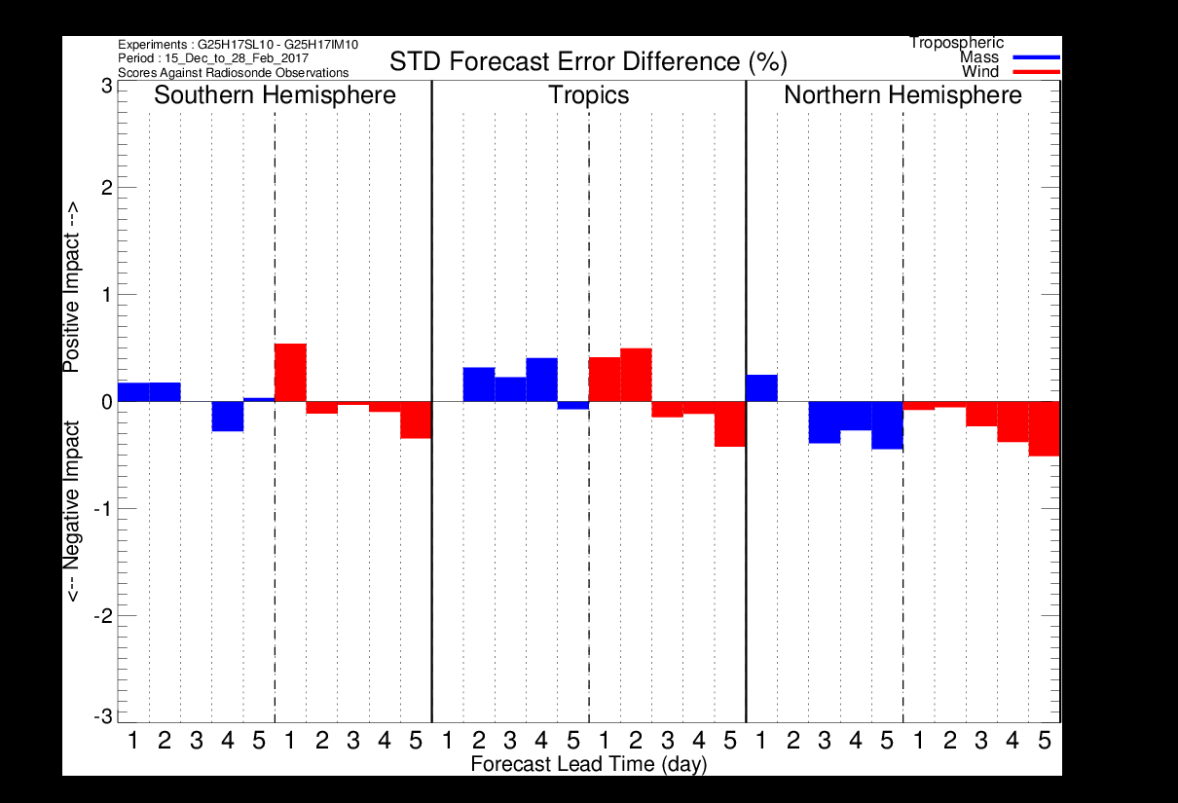
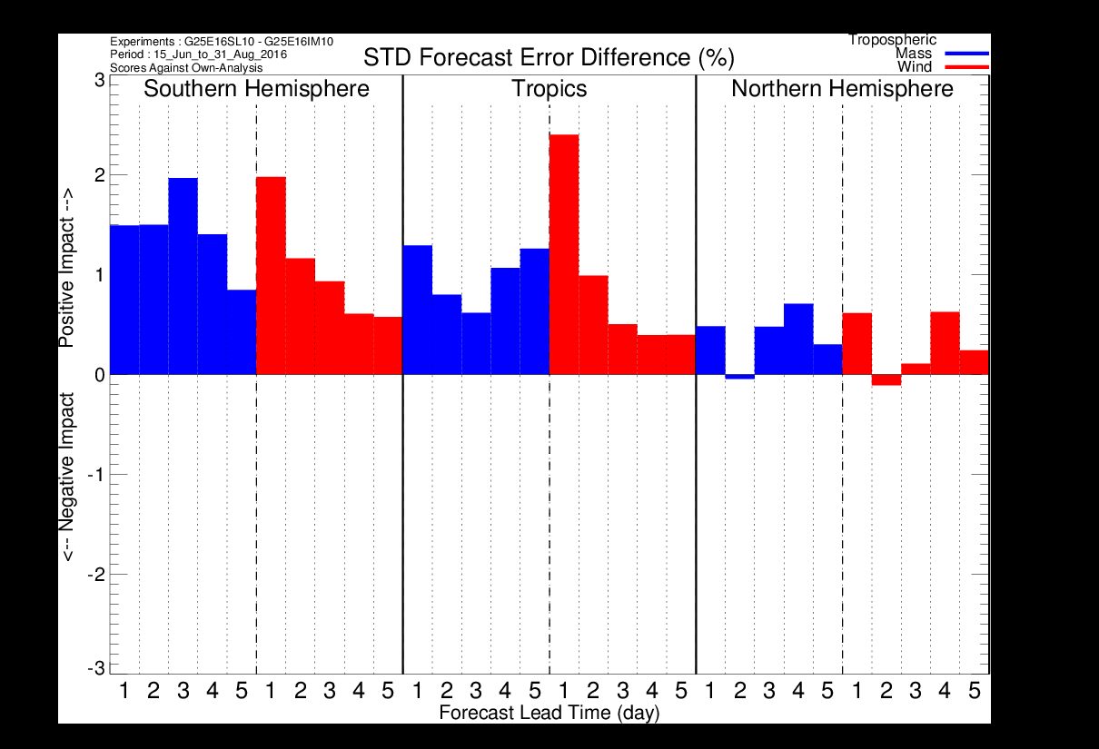
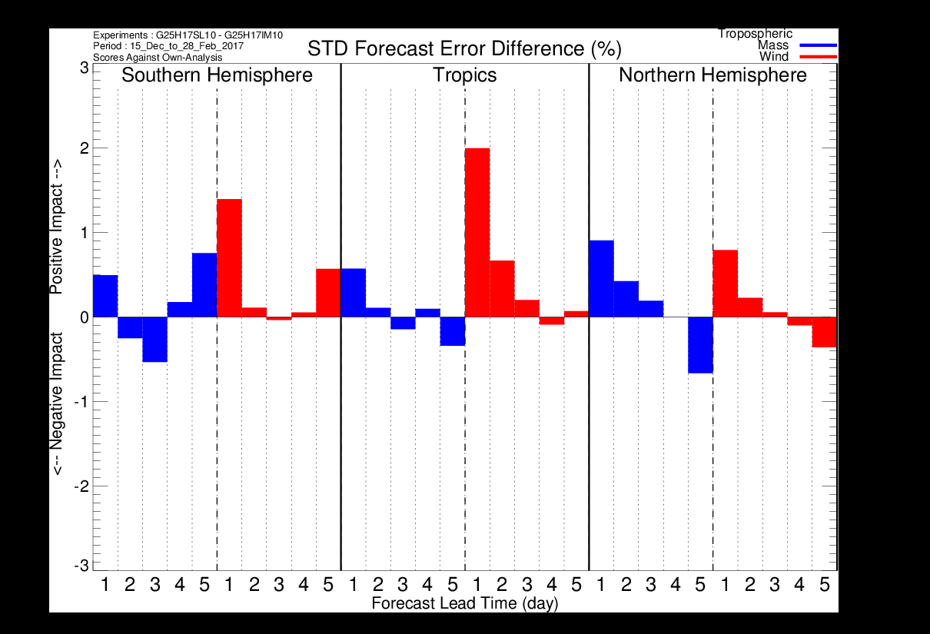
Verification scores for the second experiment (tracking + updated height errors and reassigned pressure level)
Summer period: 15 Jun – 31 Aug 2016
Winter period: 15 Dec – 28 Feb 2017
Against
Radiosondes
Against
Radiosondes
Against
Own-Analysis
Against
Own-Analysis

Slide 17
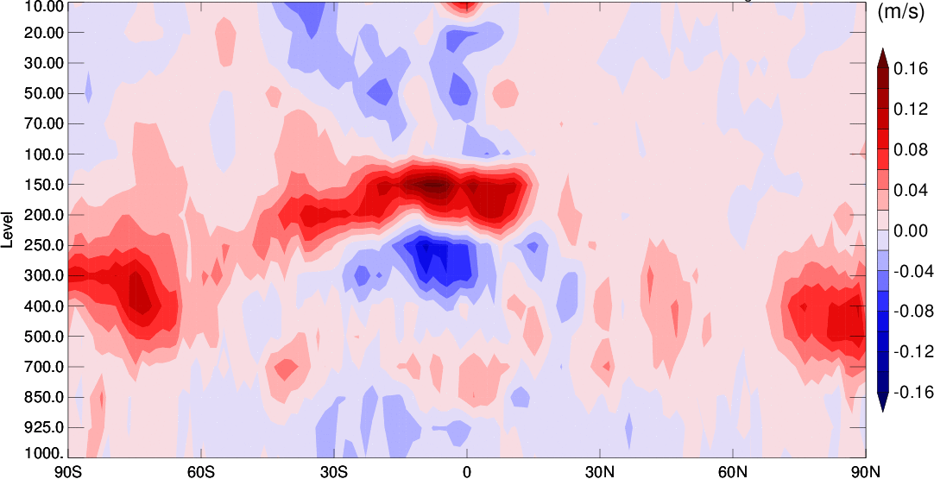
Zonal mean analysis wind speed difference
Winter period: 15 Dec – 28 Feb 2017
Second Experiment - Control

Slide 18
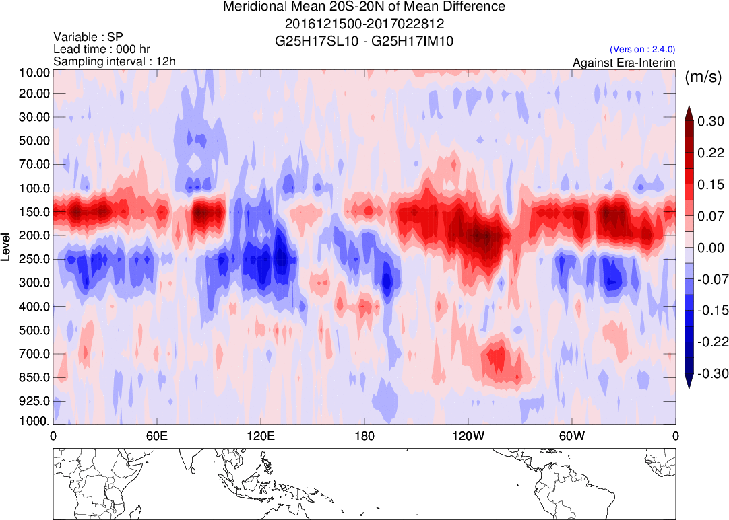
Mean analysis wind speed difference
Winter period: 15 Dec – 28 Feb 2017
Second Experiment - Control

Slide 19
Concluding Remarks
Although many difficulties remain to explicitly include a pressure variation for AMVs in a 4D incremental variational scheme, preliminary results with the ‘1D-Var + 4D-EnVar’ approach explored in this study are encouraging (neutral or slightly positive against radiosondes).
Better results are obtained when the tracking error is combined with the contribution of the reassigned height error, especially for the summer period.
The proper estimation of the tracking and height error statistics remain an important issue.
Reassigning the height of AMVs via a variational approach has been first proposed by Velden et al. (1998) and used as a post-processing step of AMV products. The main novelty of our work is to use explicitly the height error estimates in the variational data assimilation formulation.

Slide 20
References
Folger and Weissmann, 2016: Lidar-based height correction for the assimilation of
atmospheric motion vectors. Journal of Applied Meteorology and Climatology, 2211-2227.
Forsythe and Saunders, 2008 : AMV errors: a new approach in NWP. Extended abstract, IWW09.
Salonen and Bormann, 2014: Investigations of alternative interpretations of AMVs.
Extended abstract, IWW12 .
Salonen, Cotton, Bormann and Forsythe 2015: Characterizing AMV height-assignment error by
comparing best-fit pressures statistics from the Met Office and ECMWF data assimilation systems.
J. Appl. Meteor. Climatol., 225–242.
Velden, Olander, Wanzong,1998 :The Impact of Multispectral GOES-8 Wind Information
on Atlantic Tropical Cyclone Track Forecasts in 1995. Part I: Dataset Methodology,
Description, and Case Analysis. Mon. Wea. Rev., 1202-1218.

Slide 21
Extra Slides

Slide 22
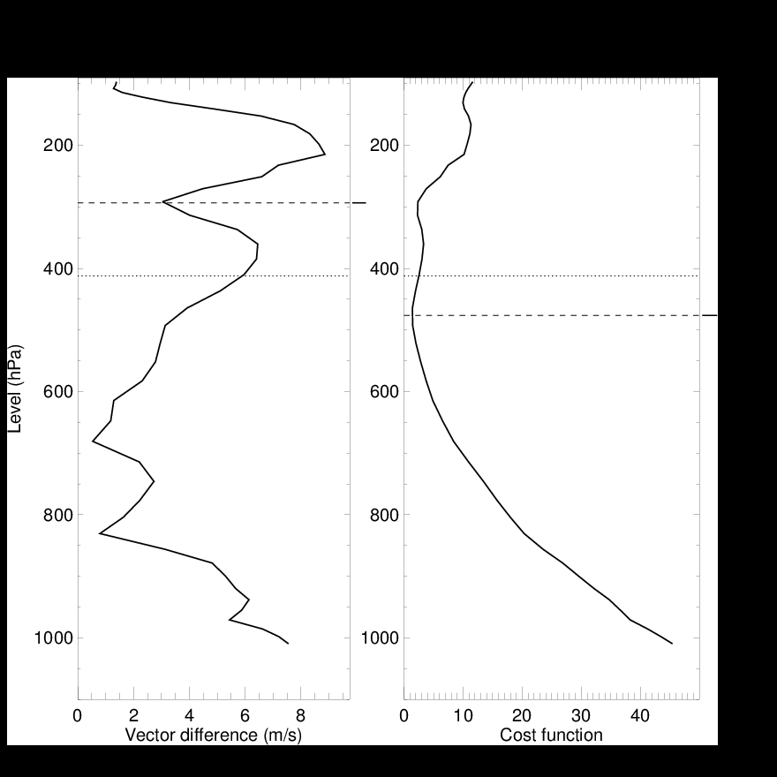
Δp from 1D-Var and model best-fit pressure approches
1D-Var approach
Model best-fit pressure
1D-Var
J$\left(∆p\right)=\frac{0.5{\left(u_{o}−u_{b}\right)}^{2}}{{σ_{ut}^{}}_{}^{2}+{σ_{ub}^{}}_{}^{2}}+\frac{0.5{\left(v_{o}−v_{b}\right)}^{2}}{{σ_{vt}^{}}_{}^{2}+{σ_{vb}^{}}_{}^{2}}+\frac{0.5∆p^{2}}{{σ_{p}^{}}_{}^{2}}$
In case of multiple minima, the minimum closest to the originally assigned pressure (p_{o}) is chosen.
p_{min}
Δp
p_{o}
p_{o}
Δp
p_{min}
Model best-fit pressure approach
Salonen et al. (2015)
VD = [ (u_{o} - u_{b})² + (v_{o} - v_{b})² ]^{1/2}
VD_{min} < 4 m/s
VD_{min} < (VD - 2 m/s) for |p_{o} – p_{min}| > 100 hPa
In case of multiple minima, the minimum closest to the originally assigned pressure (p_{o}) is chosen.
J(Δp)

Slide 23
Δp biases from the model best-fit and 1D-Var (Meteosat-10)

Slide 24
Δp standard deviations from model best-fit and 1D-Var (Meteosat-10)
Summer period: 15 Jun – 31 Aug 2016
Winter period: 15 Dec – 28 Feb 2017

Slide 25
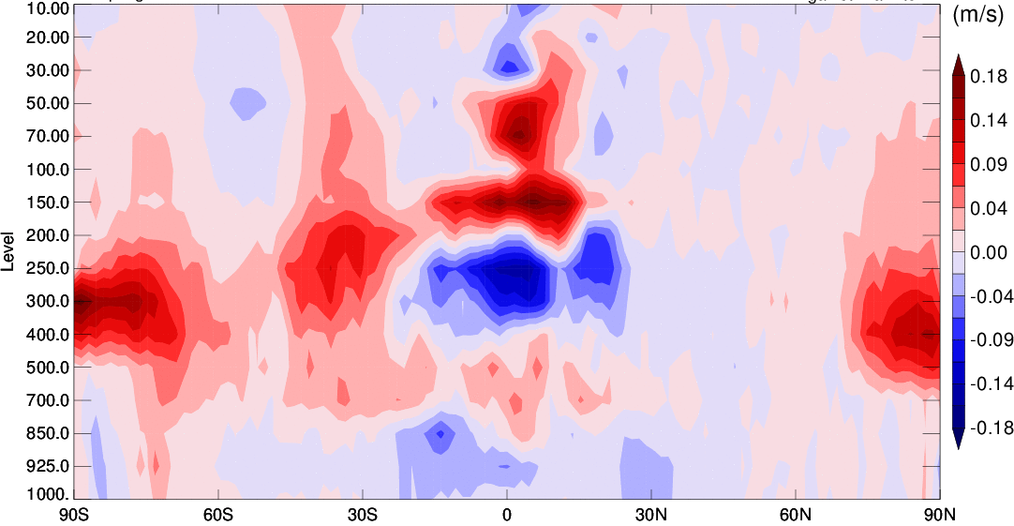
Zonal mean analysis wind speed difference
Summer period: 15 Jun – 31 Aug 2016
Second Experiment - Control

Slide 26
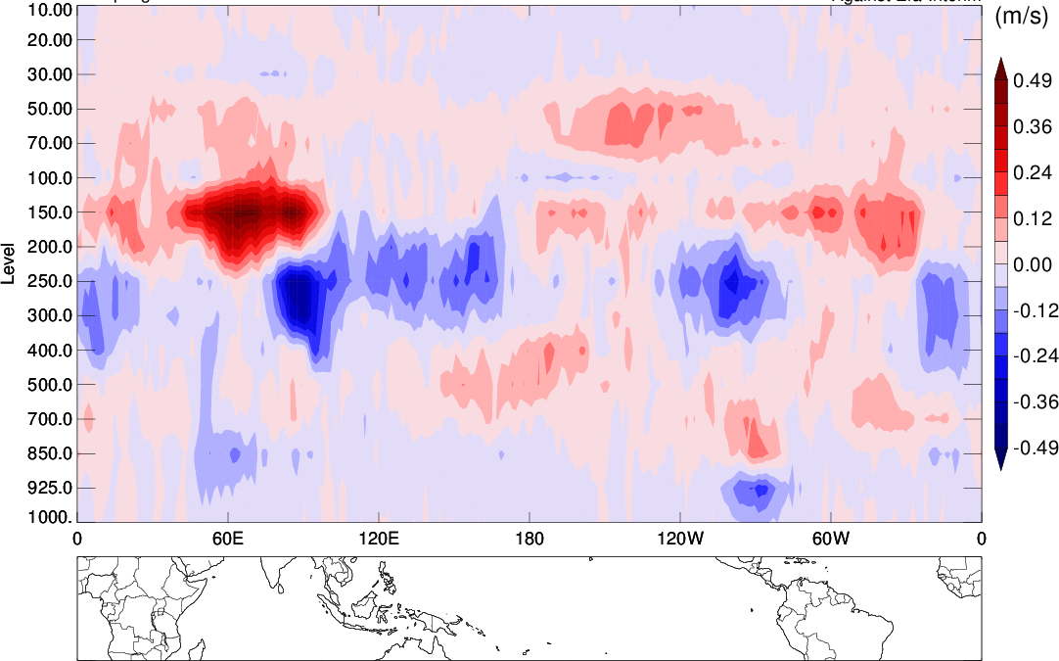
Mean analysis wind speed difference
Summer period: 15 Jun – 31 Aug 2016
Second Experiment - Control

