Slide 1
Status of Atmospheric Motion Vectors use
in NOAA NCEP weather prediction model
iliana Genkova*, Andrew Collard*, John Derber**
Sharon Nebuda***, Jim Jung***
*IMSG for NOAA/NCEP ** NOAA/NCEP
*** CIMSS/University of Wisconsin - Madison
14th International Winds Workshop
22-27 April 2018, Jeju City, South Korea

Slide 2
Outline
Meteosat transitions:
- From Meteosat 7 to Meteosat 8 winds
- From Meteosat 10 to Meteosat 11 winds
Preliminary evaluation of Himawary 9 winds
Quick peek at INSAT winds
Evaluating and Assimilating GOES-16 winds
What’s next?

Slide 3
Outline
Meteosat transitions:
- From Meteosat 7 to Meteosat 8 winds – early 2017
- From Meteosat 10 to Meteosat 11 winds
Preliminary evaluation of Himawary 9 winds
Quick peek at INSAT winds
Evaluating and Assimilating GOES-16 winds
What’s next?

Slide 4
Hourly AMVs counts & counts by spectral type
2016-12-12 0Z AMV counts per retrieval time
 | 21Z | 22Z | 23Z | 00Z | 01Z | 02Z | 03Z | All 6h
Met-7 | 3000 | 2558 | 0 | 3025 | 3251 | 0 | 4125 | 15959
Met-8 | 29331 | 29056 | 30336 | 33861 | 38530 | 44746 | 0 | 205860
Met-10 | 32005 | 32052 | 30995 | 30771 | 31032 | 33081 | 0 | 188936
2016-12-12 0Z AMV counts per spectral type
All 6h | VIS | IR | WV (cloud top) | Clear Air WV
Met-7 | 1327 | 11548 | 0 | 3084
Met-8 | 32239 | 62979 | 67113 | 43529
Met-10 | 3590 | 67237 | 74250 | 43859

Slide 5
Time series of hourly AMVs counts, 1-10 Jan 2017

Slide 6
Speed, Direction and Pressure histograms
Met-7 & Met-8
2017-01-01 (24h worth of data)
Example:
SPD, DIR and Pressure
Met-7 vs Met-8 histogram comparison

Slide 7
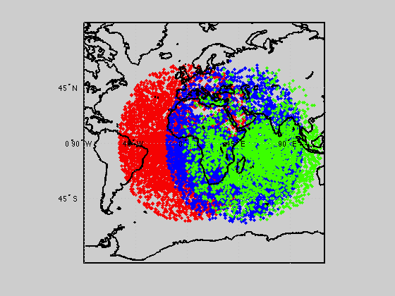
AMVs Full Disk Coverage: Met-10 (red), Met-8 (blue) and Met-7 (green)
2017-01-01 , 18Z (6h worth of data)

Slide 8
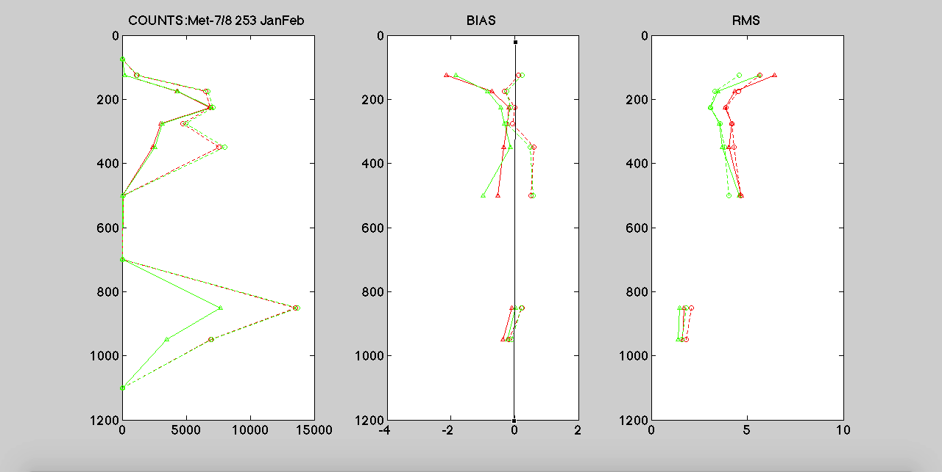
O-B and O-A profiles for Control ( Meteosat 7) and Experiment ( Meteosat 8) IR AMVs

Slide 9
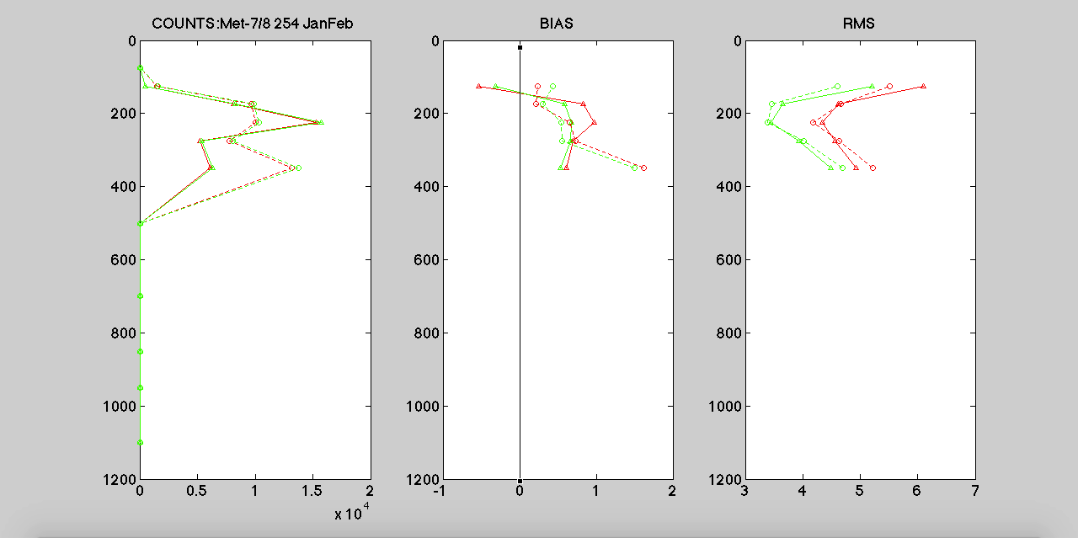
O-B and O-A profiles for Control ( Meteosat 7) and Experiment ( Meteosat 8) WV AMVs

Slide 10
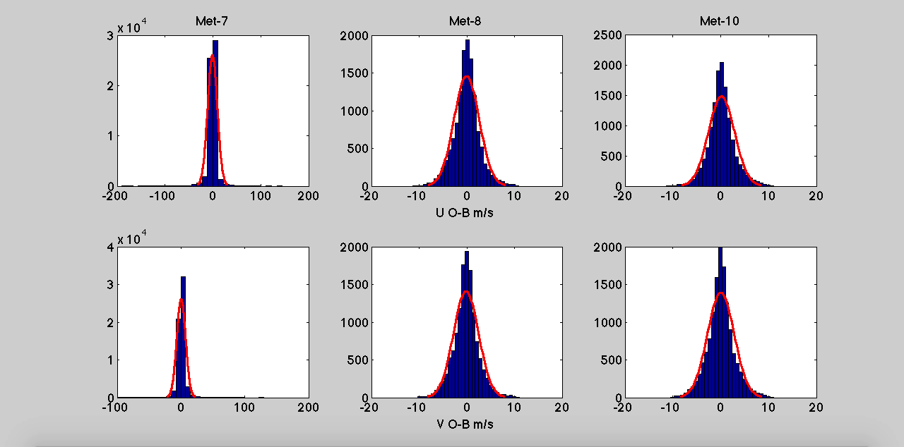
O-B fit to Normal Distribution

Slide 11
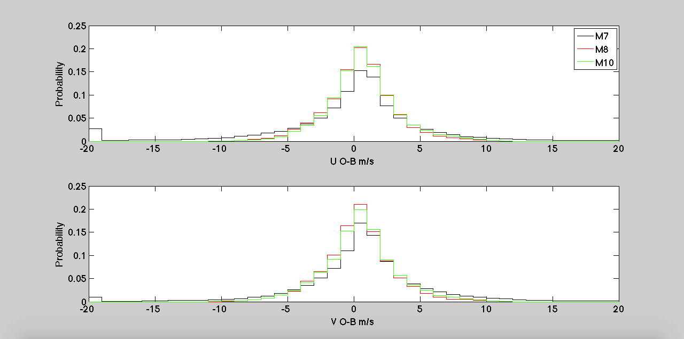
O-B PDF: shows strong similarity between M-8 and M-10

Slide 12
Final thoughts
Met-8 AMVs were thinned in the experiment, to match the current operational counts from Met-7
Met-7 and Met-8 are of comparable quality, and depending on the altitude and the counts, one or the other is slightly superior (~0.5m/s)
Both, Met-7 and Met-8’s O-B profiles are similar to Met-10, Bias <= 1.5m/s and RMS <= 6m/s

Slide 13
Outline
Meteosat transitions:
- From Meteosat 7 to Meteosat 8 winds
- From Meteosat 10 to Meteosat 11 winds – early 2018
Preliminary evaluation of Himawary 9 winds
Quick peek at INSAT winds
Evaluating and Assimilating GOES-16 winds
What’s next?

Slide 14
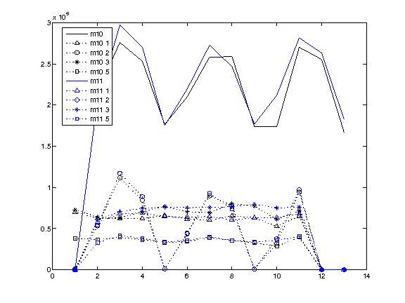
M10 and M11 AMV counts from satwnd.gdas files
1=IR
2=VIS
3=WVCT
5=WVCA
0 6 12 18 0 6 12 18 0 6 12 18
2018-02-06 2018-02-07 2018-02-08

Slide 15
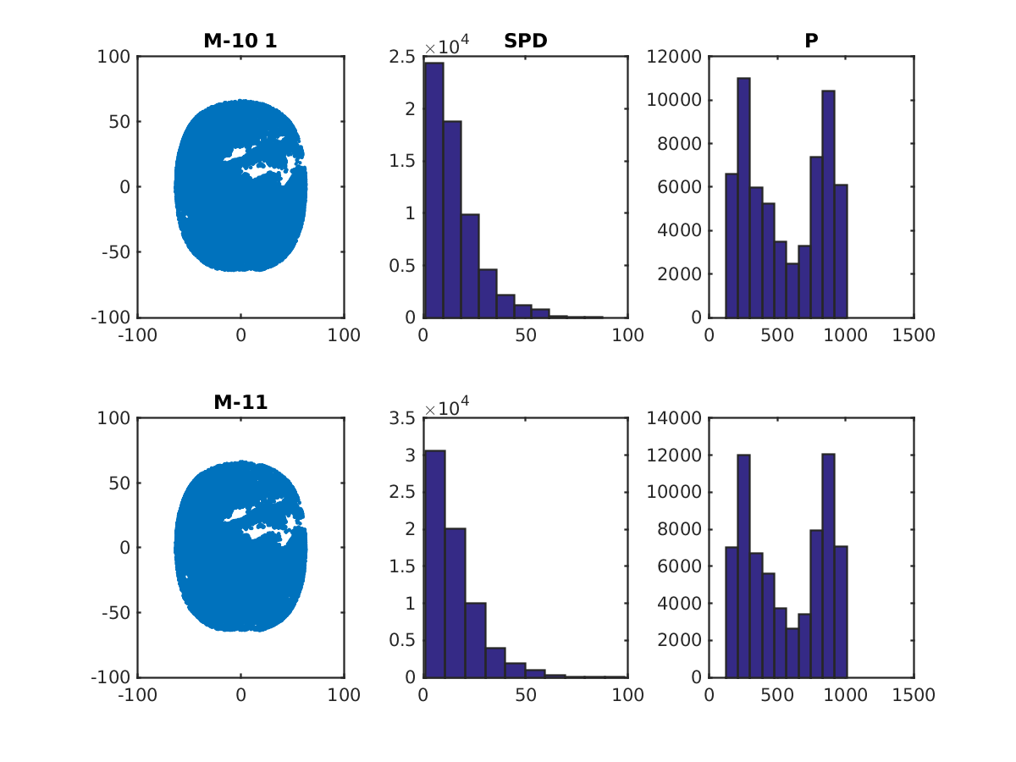
IR

Slide 16
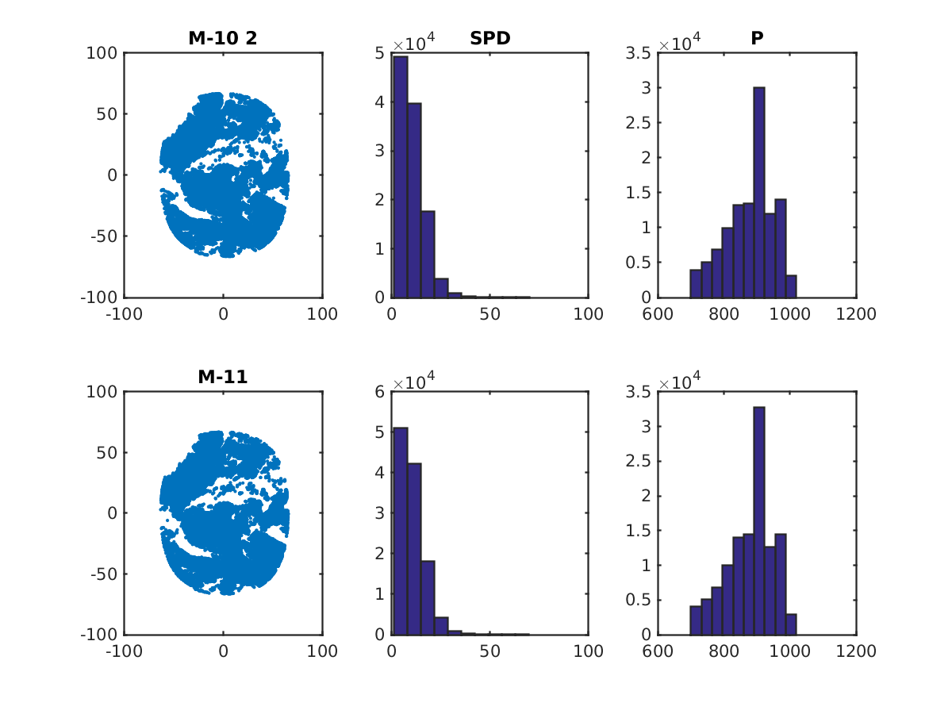
VIS

Slide 17
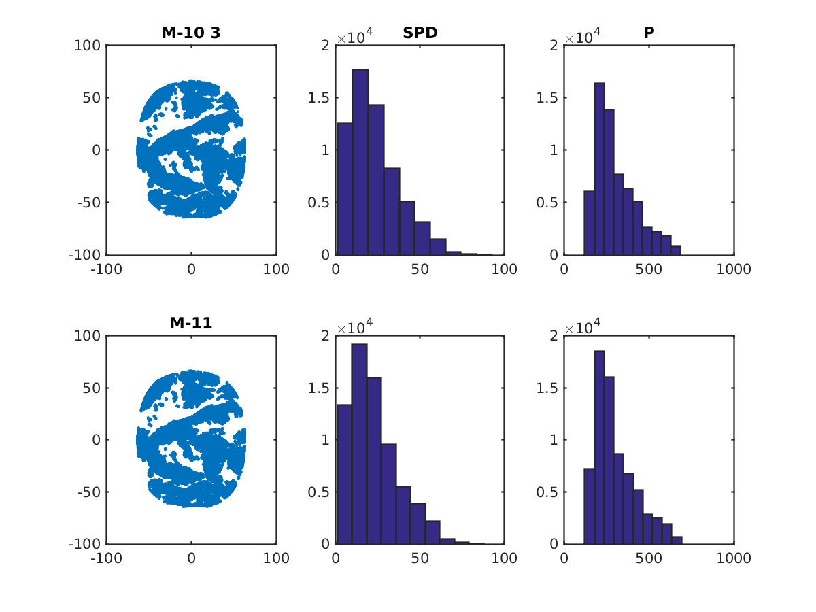
WVCT

Slide 18
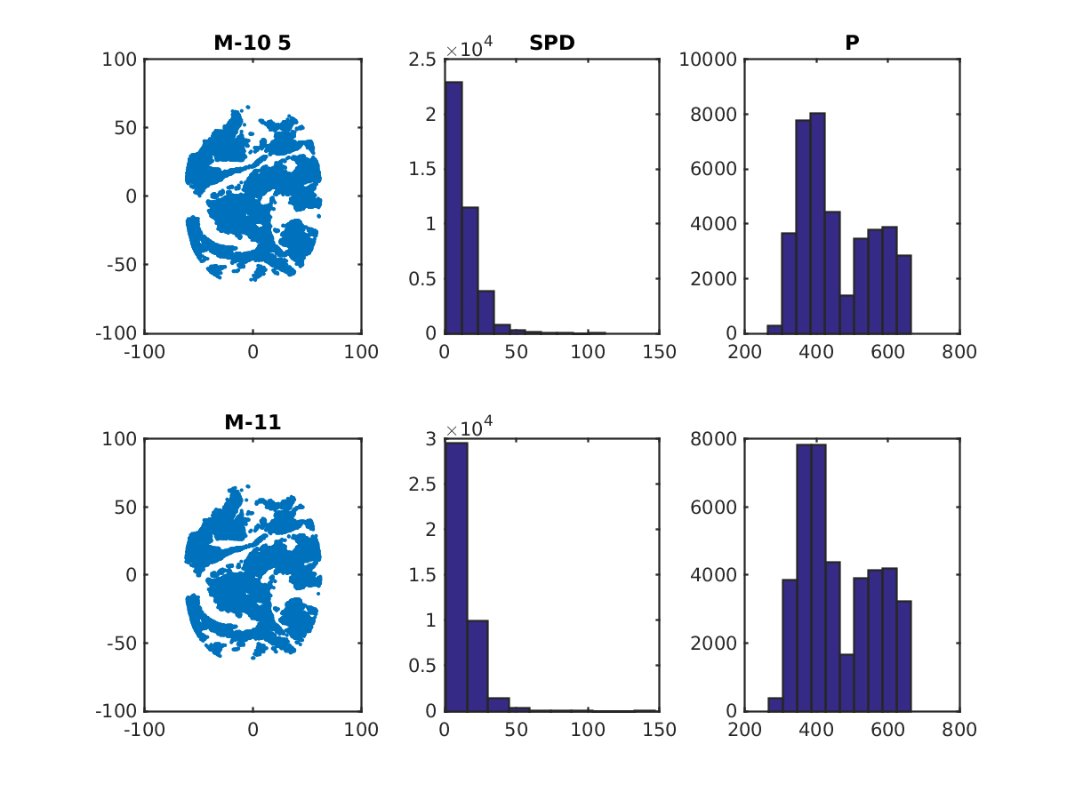
WVCA

Slide 19
GSI experiment:
Meteosat 8 – use
Meteosat 11 – use
Meteosat 10 – monitor
Parallel run @ T670
One month long, but plots only from
2018-02-06 06z – 2018-02-10-12z

Slide 20
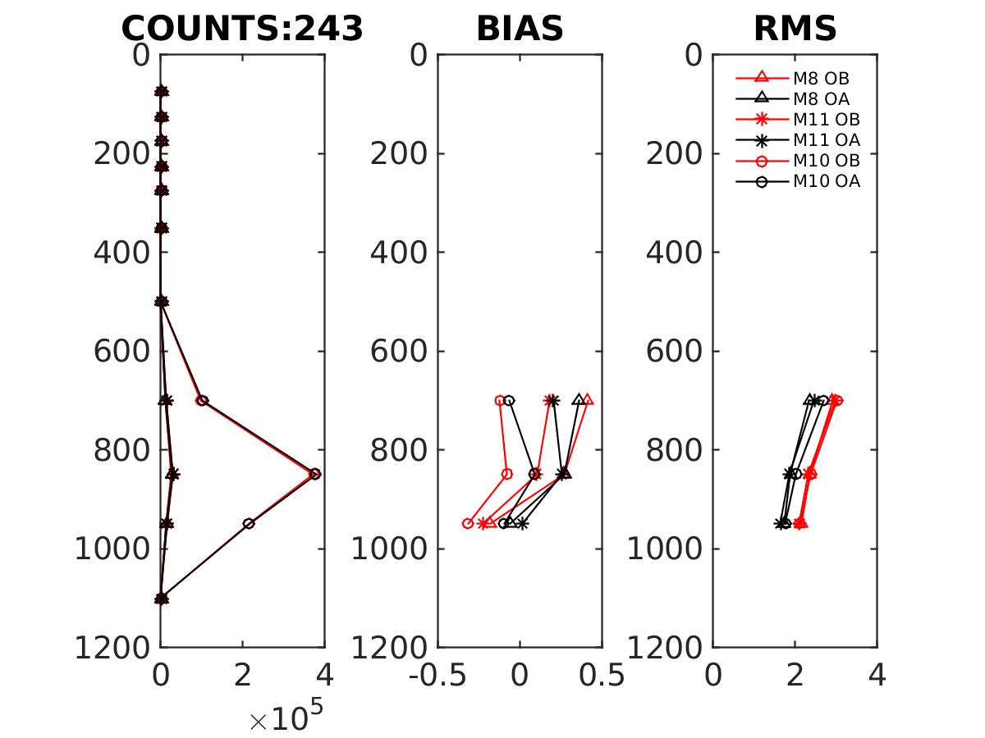
VIS

Slide 21
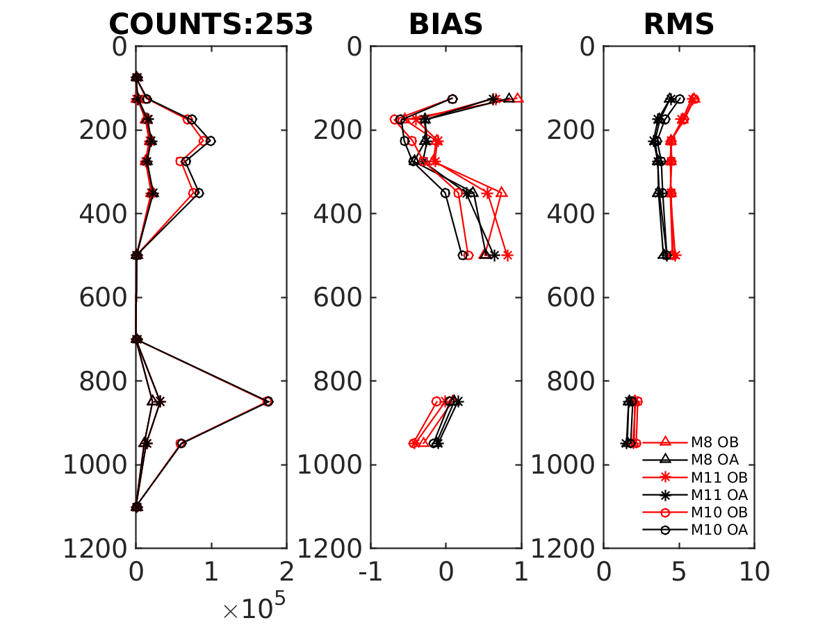
IR

Slide 22
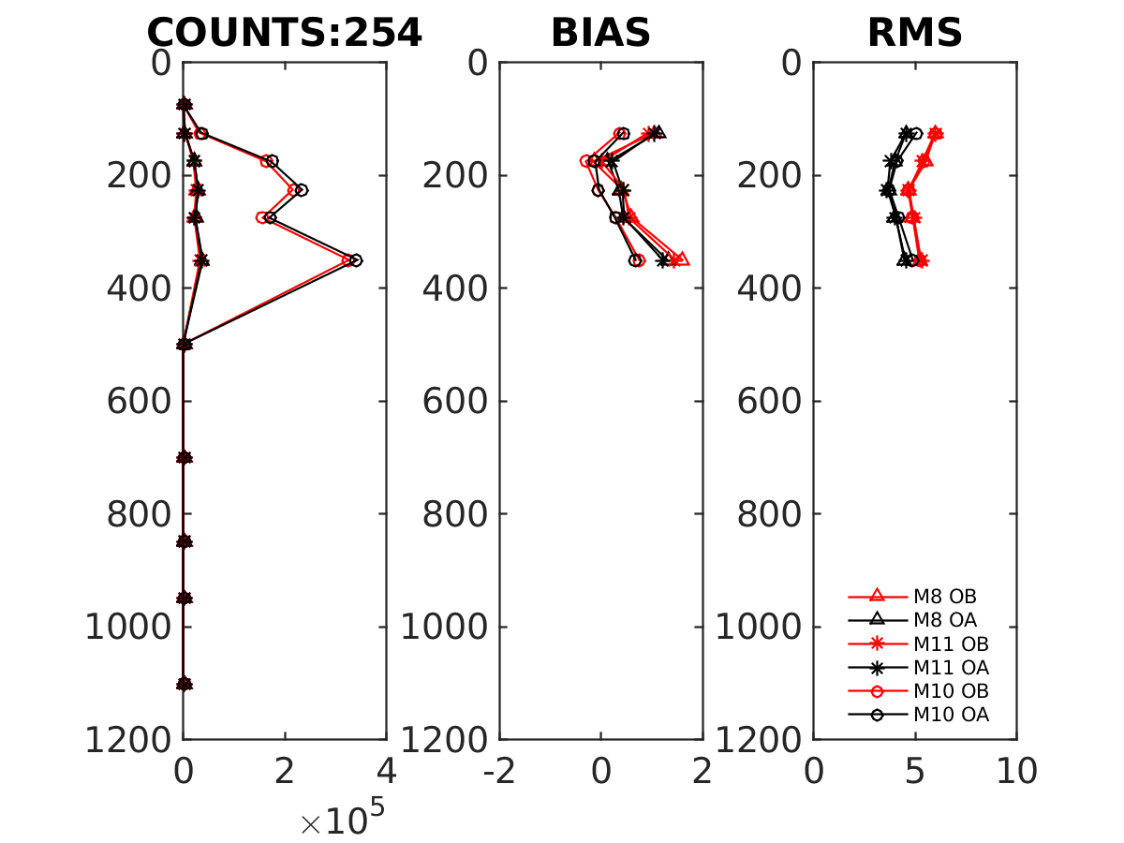
WV

Slide 23
Outline
Meteosat transitions:
- From Meteosat 7 to Meteosat 8 winds
- From Meteosat 10 to Meteosat 11 winds
Preliminary evaluation of Himawary 9 winds
Quick peek at INSAT winds
Evaluating and Assimilating GOES-16 winds
What’s next?

Slide 24
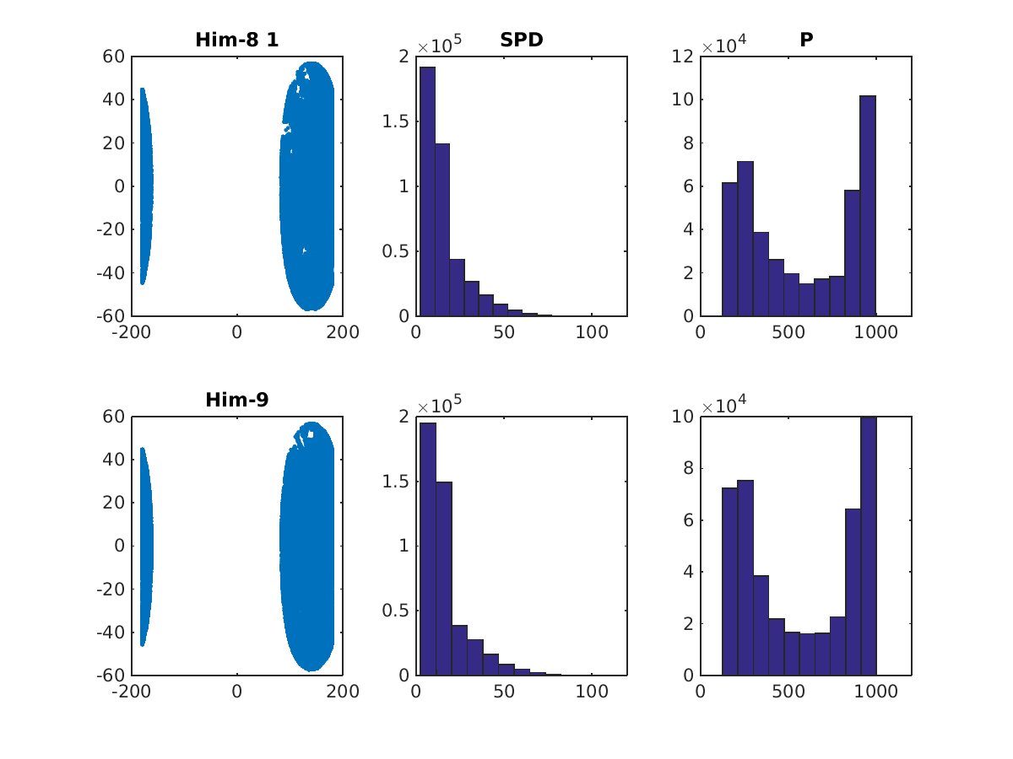
IR

Slide 25
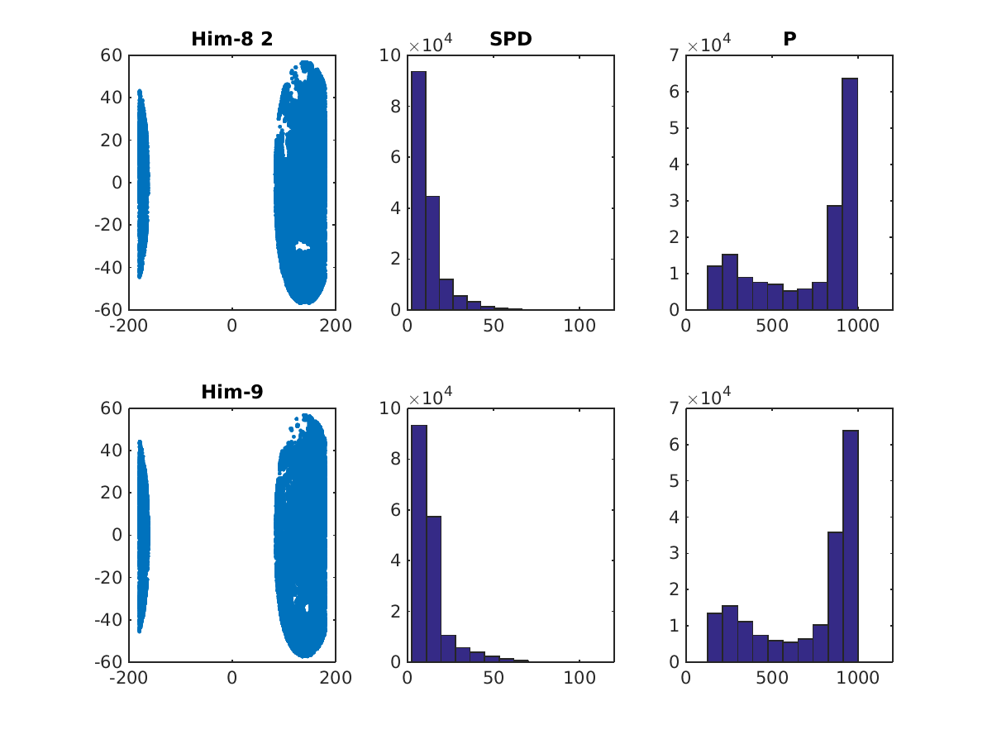
VIS

Slide 26
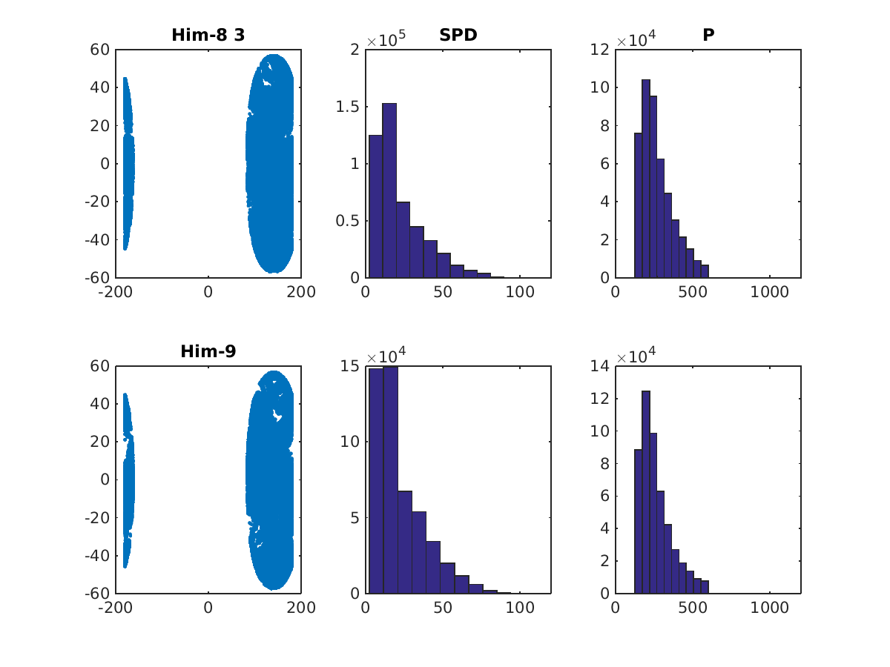
WVCT

Slide 27
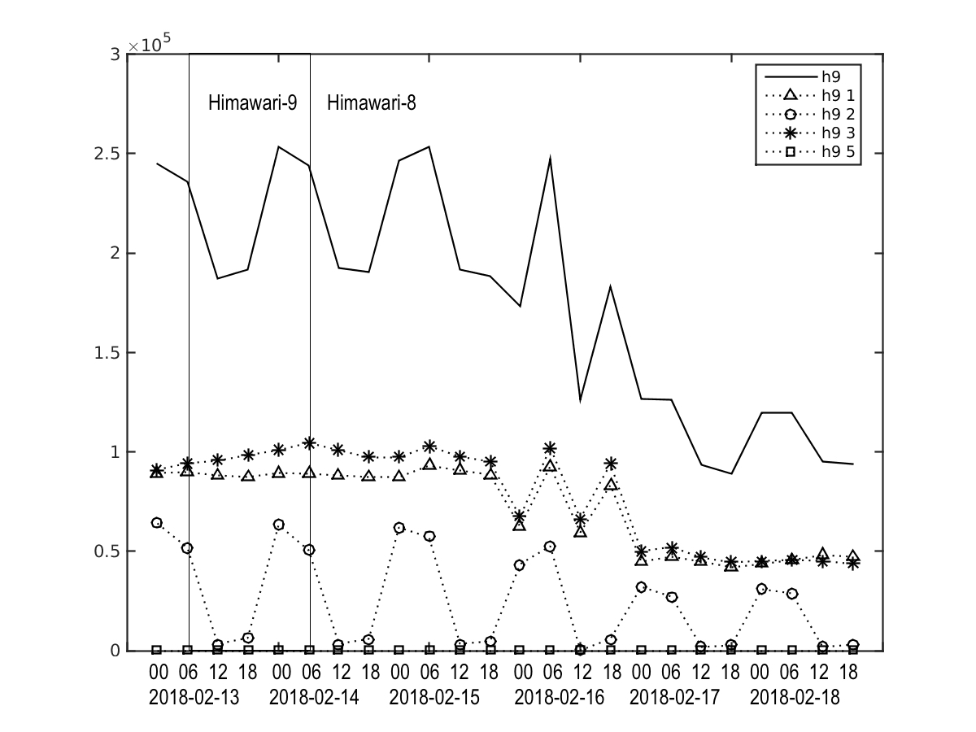
Himawari counts series

Slide 28
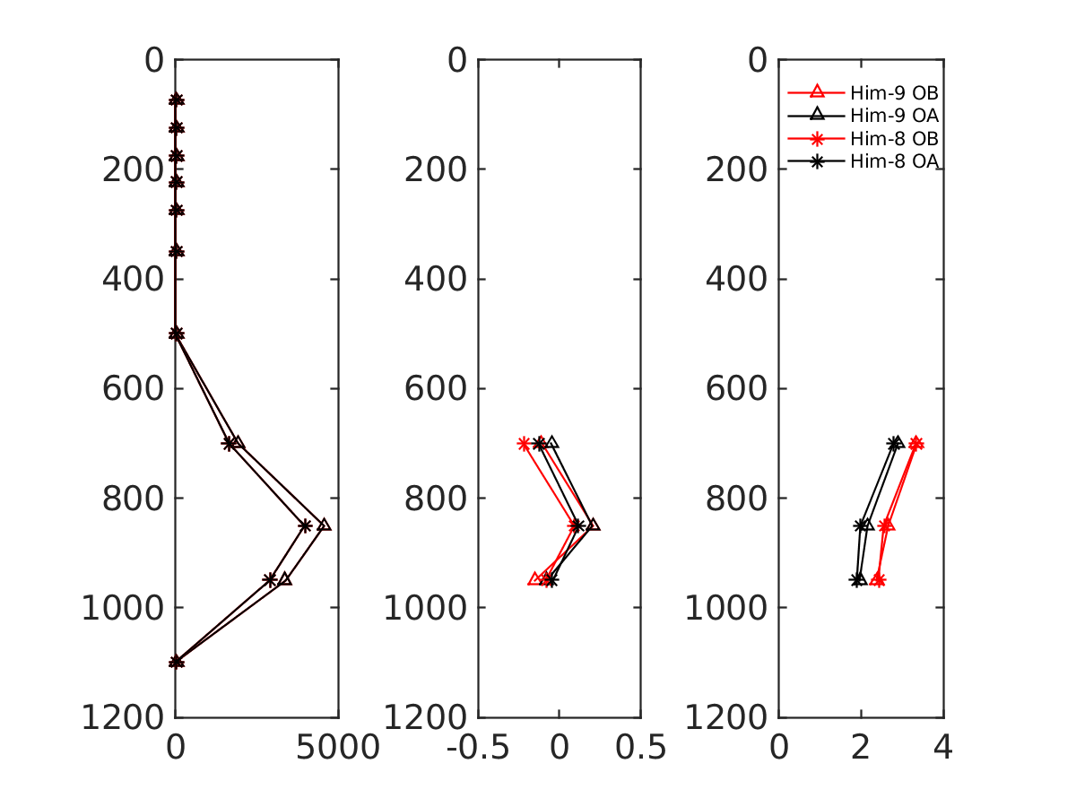
VIS
COUNTS BIAS RMS

Slide 29
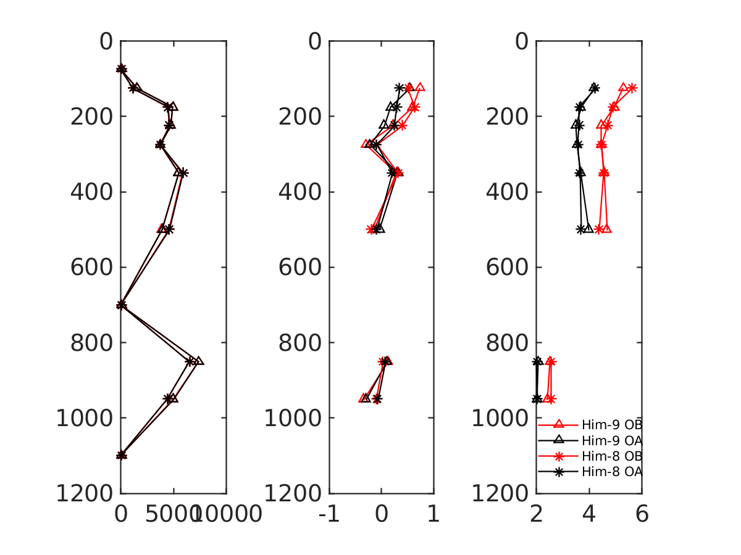
IR
COUNTS BIAS RMS

Slide 30
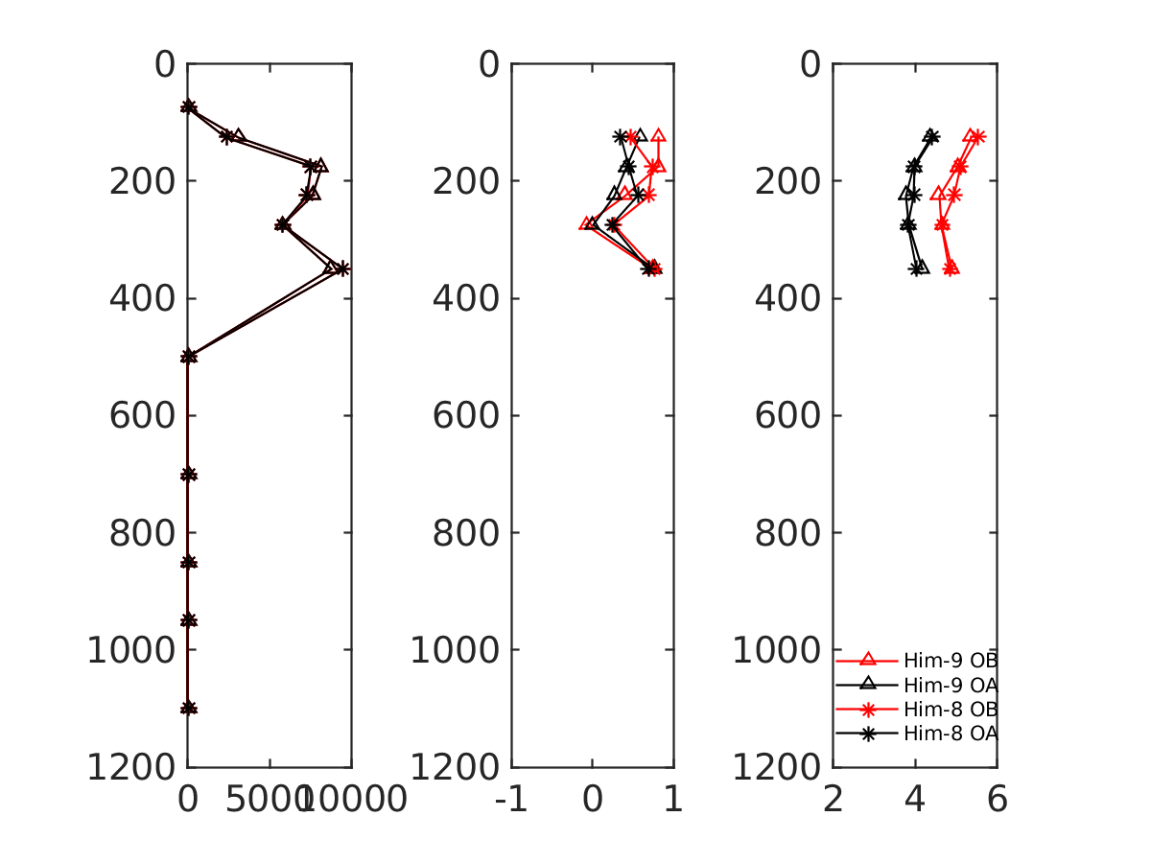
WV
COUNTS BIAS RMS

Slide 31
Outline
Meteosat transitions:
- From Meteosat 7 to Meteosat 8 winds
- From Meteosat 10 to Meteosat 11 winds
Preliminary evaluation of Himawary 9 winds
Quick peek at INSAT winds
Evaluating and Assimilating GOES-16 winds
What’s next?

Slide 32
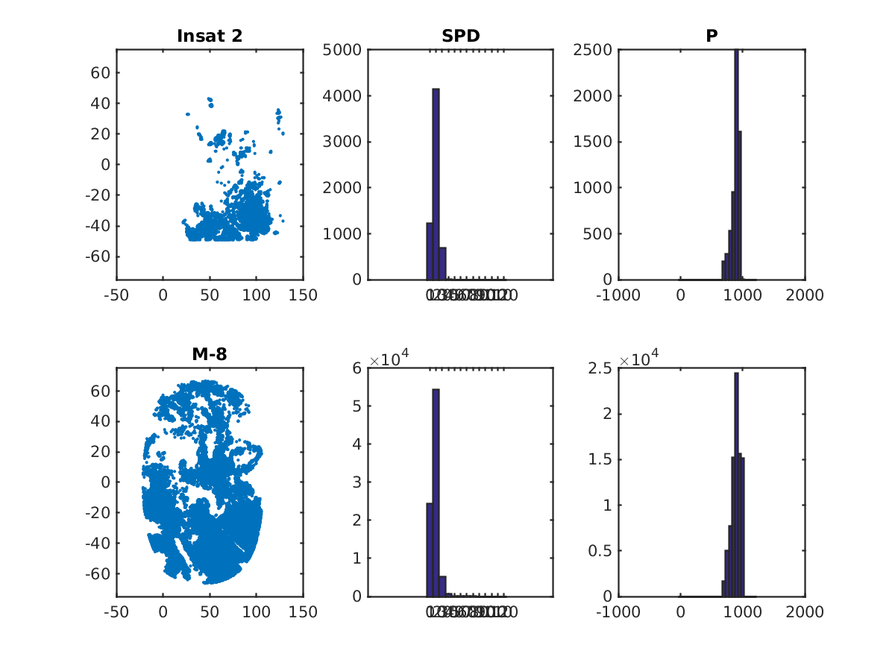
VIS

Slide 33
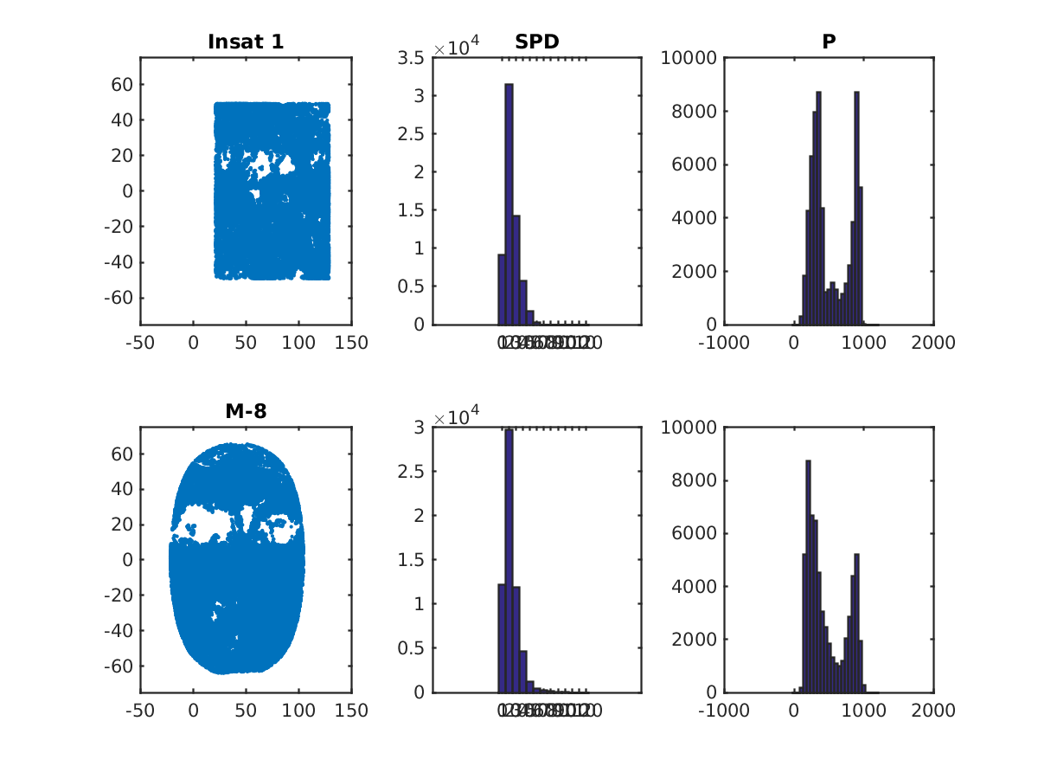
IR

Slide 34
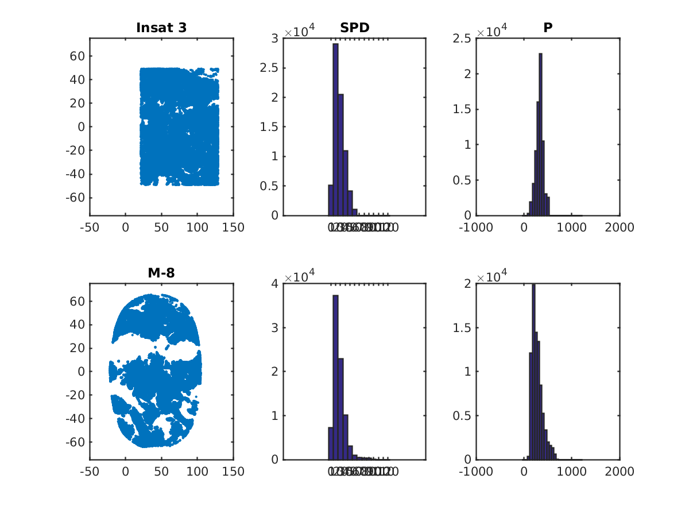
WV

Slide 35
Outline
Meteosat transitions:
- From Meteosat 7 to Meteosat 8 winds
- From Meteosat 10 to Meteosat 11 winds
Preliminary evaluation of Himawary 9 winds
Quick peek at INSAT winds
Evaluating and Assimilating GOES-16 winds
What’s next?

Slide 36
Preliminary GOES-R-like winds evaluation in GSI (from IWW13)
GOES-R-like winds – retrieved with Nested Tracking algorithm
(developed for GOES-R) from GOES-13/15 imagery
– observations from NESDIS STAR
Setup:
3D-Hybrid run, GFS at T670, GSI at T254, EnKF at T254
64 Pressure levels
20140101- 20140201
Verification against operational analysis
Used AMVs:
Meteosat, MTSAT-2 and MODIS
New:
* GOES-R-like winds replace GOES-13/15 winds for synoptic times 0, 6, 12, 18 Z
* ObsError_GOES-R = ObsError * 0.5
* PCT1 ∈ [0.04 0.5] , nested tracking parameter, a measure of the cluster standard deviation (BT) divided by the distance the cluster traveled between images
All winds subject to quality control and thinning as in operations
( read_satwnd.f90, setupw.f90, prepobs_errtable.global, global_convinfo.txt )

Slide 37
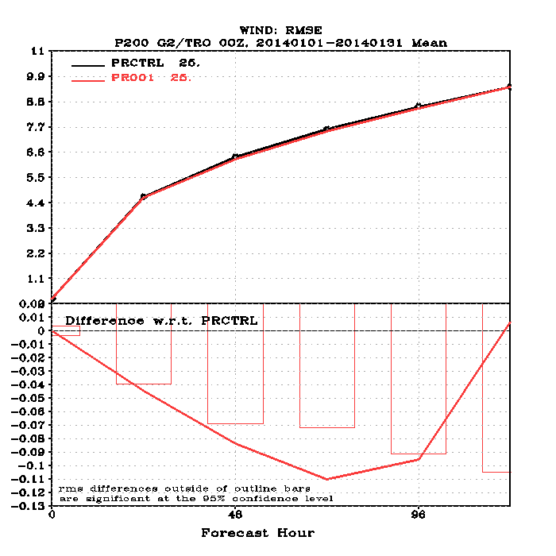

Slide 38
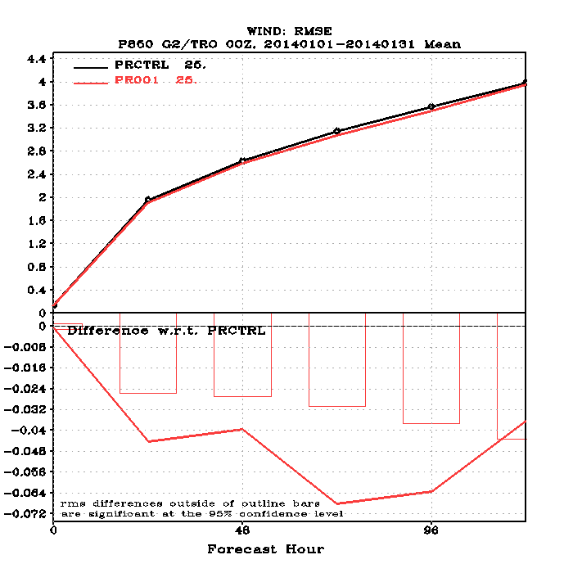

Slide 39
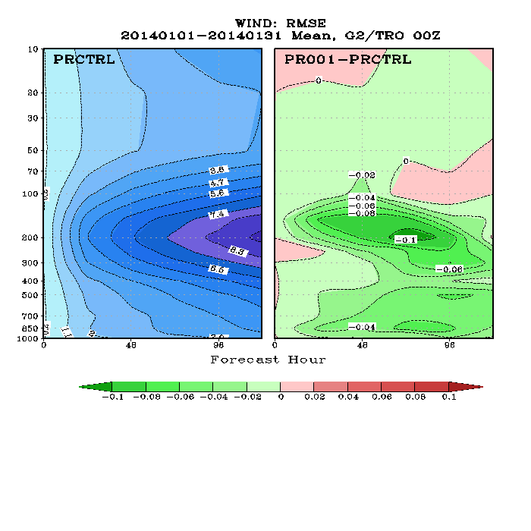

Slide 40
Operational GOES-16 (post launch GOES-R) winds status
July 2017 – WMO approved new BUFR format table
August – October 2017 – final BUFR adjustments and tests; height assignment updates implemented; operational feed finalized;
November 2017 – real data for comprehensive GOES-R AMVs evaluation
December 2017 – GOES-16 moved to permanent location; AMV product not impacted
21 Dec 2017 - monitoring GOES-16 in operation
5 Jan 2018 – started assimilating GOES-16 AMVs
An accelerated implementation schedule was necessary to ensure continuity of GOES-E winds after GOES-13 winds were switched off. At the moment IR cloud-top, WV cloud-top and WV clear-sky winds are actively assimilated.
Data quality is similar/better that seen from previous GOES satellites. Work continues to understand data better, to ensure positive FC impact and to include VIS and SWIR
Notes:
Aug-Oct: New BUFR: variables naming changes, BUFR tool showed healthy data stream; operation feed and final code changes
Nov/Dec: repositioning G-16 didn’t impact data, stats before and after confirmed

Slide 41
Thinning test
IR

Slide 42
Thinning test
WV CT

Slide 43
Thinning test
WV CA

Slide 44
IR
Monitoring experiment: 2 weeks of before / after the positioning move

Slide 45
IR
Monitoring experiment: 2 weeks of before / after the positioning move

Slide 46
WV CT
Monitoring experiment: 2 weeks of before / after the positioning move

Slide 47
WV CT
Monitoring experiment: 2 weeks of before / after the positioning move

Slide 48
WV CA
Monitoring experiment: 2 weeks of before / after the positioning move

Slide 49
WV CA
Monitoring experiment: 2 weeks of before / after the positioning move

Slide 50
GOES-16 counts , Dec 2017
800,000

Slide 51
2018-Jan-16 00z GOES-16 AMVs spectral coverage
VIS - green
IR - red
WVCT - black
WVCA - blue

Slide 52
GOES-16 experiment
Control and Experiment @T670
Conrol : Goes 13 + Goes 15
Experiment : Goes 16 + Goes 15
No thinning, OE for Goes-16 is half of that for Goes-13/15

Slide 53
IR

Slide 54
WV CT

Slide 55
WV CA

Slide 56
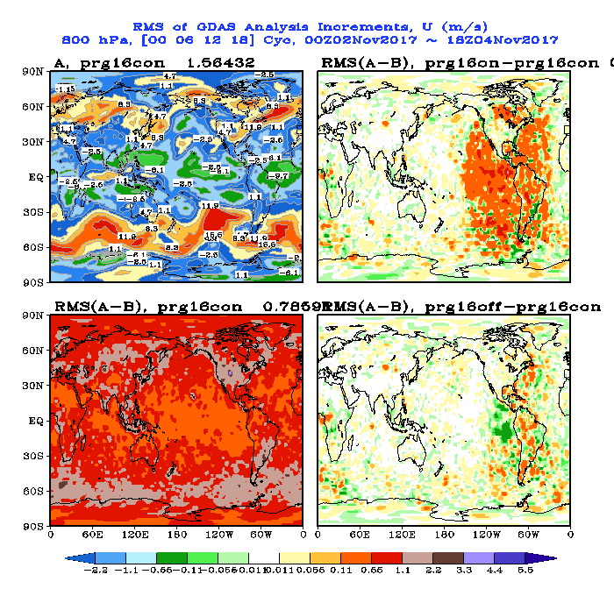

Slide 57
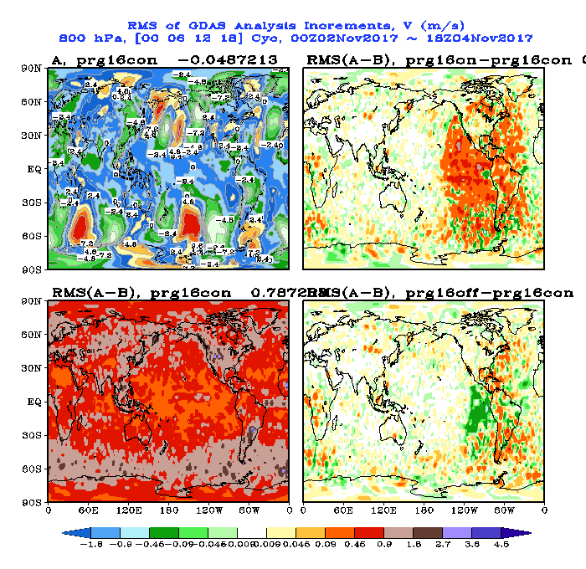

Slide 58
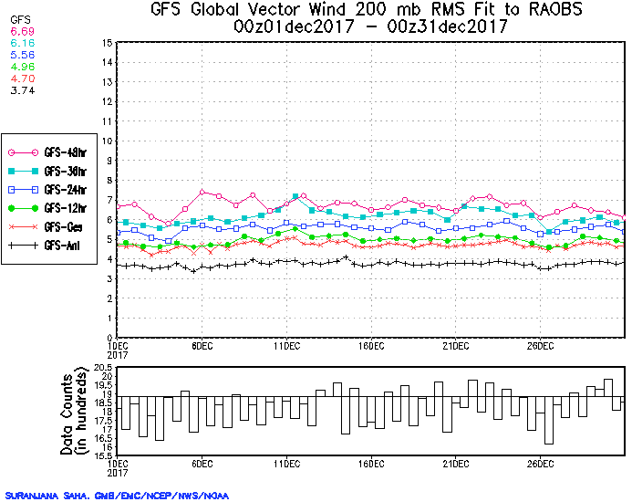
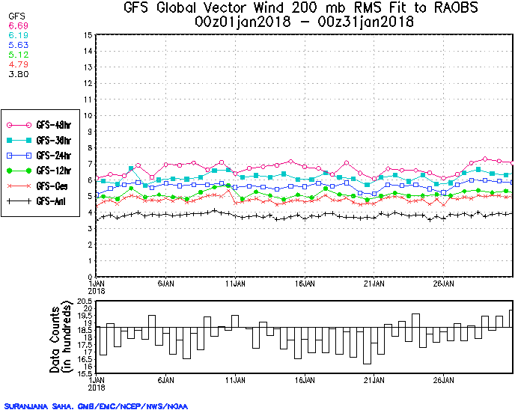
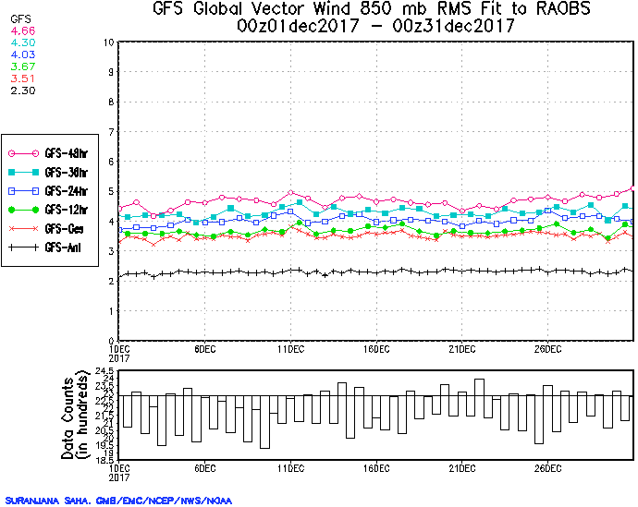
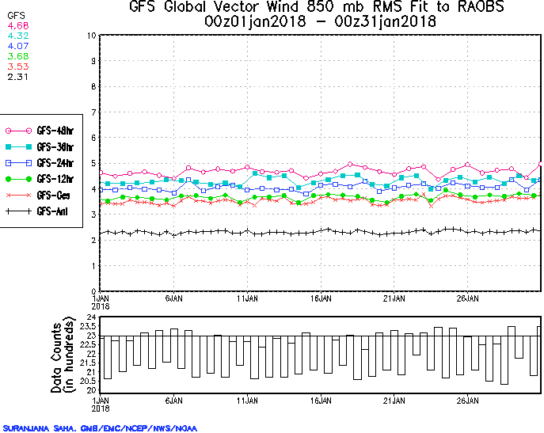
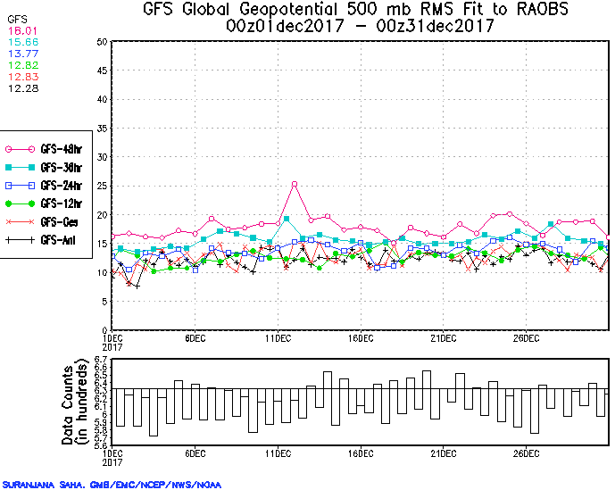
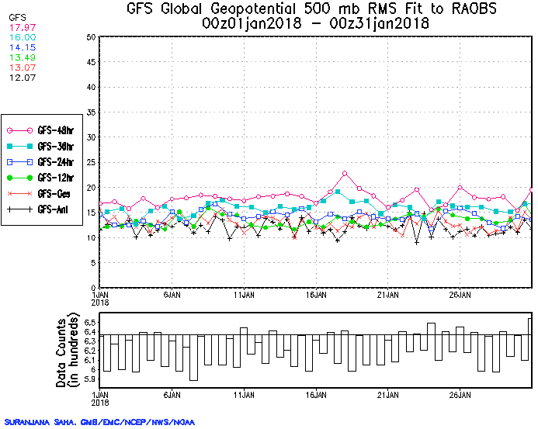
http://www.emc.ncep.noaa.gov/gmb/STATS/STATS.html
http://www.emc.ncep.noaa.gov/gmb/STATS_vsdb/

Slide 59
Still investigating:
- High AMVs altitudes
- Normality of O-B distributions
- Observation Error
- PCT1’s skill in predicting AMV departure from the GFS background
- Test new ’gross error check’ reprocessed data (J.Daniel’s talk)
- EFSOI
Lesson learned:
Longer in time overlap between satellites is needed!

Slide 60
Outline
Meteosat transitions:
- From Meteosat 7 to Meteosat 8 winds
- From Meteosat 10 to Meteosat 11 winds
Preliminary evaluation of Himawary 9 winds
Quick peek at INSAT winds
Evaluating and Assimilating GOES-16 winds
What’s next?

Slide 61
What’s next?
no thinning thinning
G-15 G-13 MSG-10 MSG-7 HIM-8
G-15 G-16 MSG-11 MSG-8 HIM-8
G-17 HIM-9
VIS/SWIR/IR/WV VIS / IR / WV
POLAR

