Slide 1
Recent work using Satellite winds at the Deutscher Wetterdienst (DWD)
Alexander Cress
Deutscher Wetterdienst, Frankfurter Strasse 135, 63067 Offenbach am Main, Germany
alexander.cress@dwd.de
Introduction
Recent changes in satellite wind usage
New projects (HR AMVs / NWPSAF – DWD cooperation)
Use of scatterometer data
Aeolus plans
Summary
14th Internat. Wind Workshop Alexander Cress

Slide 2
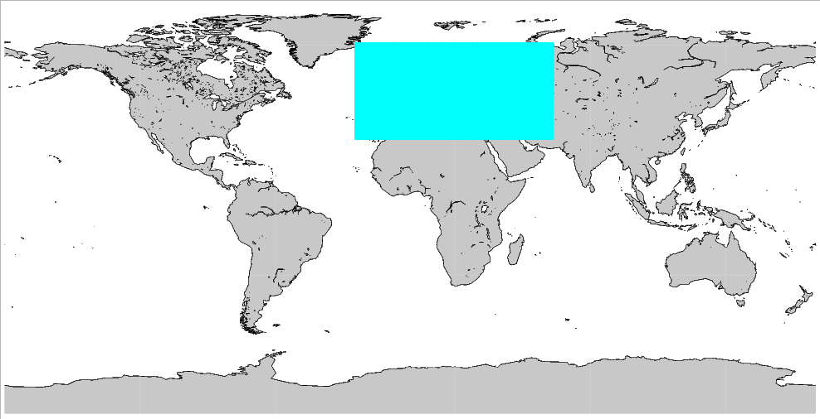
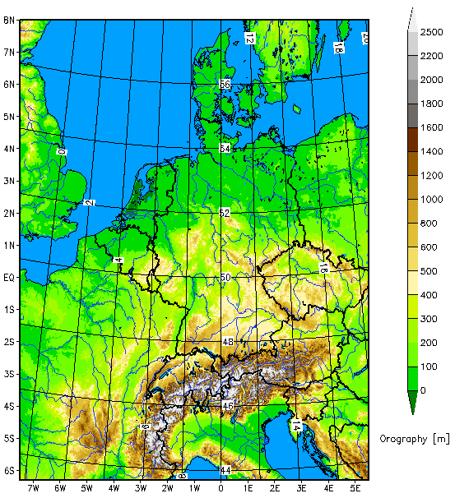
The deterministic NWP-System of DWD
Global-Modell ICON
grid size: 13 km
vertical levels: 90
Grid area: 173 km²
Hybrid DA
13km VarEnKF
Flow dependent B:
B_{VarEnKF} = αB_{LETKF} + (α-1)B_{3DVAR}
Incremental analysis update
SST, SMA and snow ana
ICON-EU Nest over Europe
grid size: 6.5 km
Vertical levels: 60
forecasts:
Grid area: 43 km²
COSMO-DE (convection resolving)
grid size: 2.8 km
vertical levels: 50
forecasts: 3-hourly
Girid area: 8 km²
Det LETKF replaced nudging
14th Intern. Wind Workshop 2018 Alexander Cress

Slide 3
The probabilistic NWP-System of DWD
ICON-EPS; M40
grid size: 40 km
vertical levels: 90
grid area: 1638 km²
Ensemble DA
40 member 40km LETKF.
Horizontal localization radius 300km.
Relaxation to prior perturbations ( 0.75).
Adaptive inflation (0.9 - 1.5).
SST perturbations Soil moisture perturbations (experimental)
COSMO-DE-EPS; M20
grid size: 2.8 km
vertical levels: 50
Forecasts: 3-hourly
grid area: 8 km²
Ensemble DA
40 member 2.8 km LETKF
SST pertubations
Soil moisture pertubations
ICON-EU Nest over Europe
grid size: 20 km
vertical levels: 60
forecasts:
grid area: 407 km²
14th Intern. Wind Workshop 2018 Alexander Cress

Slide 4
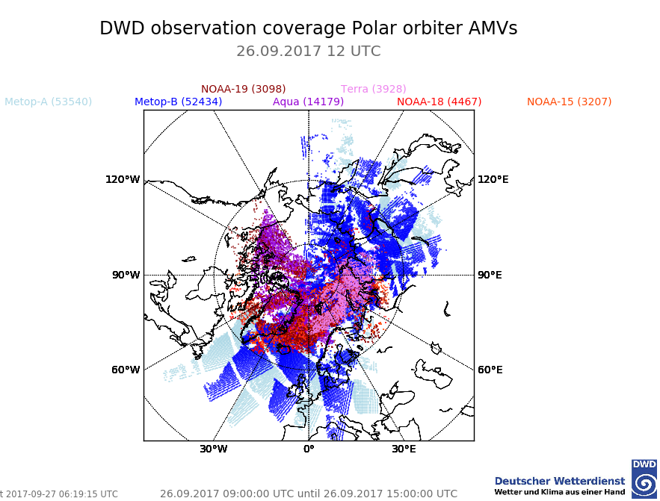
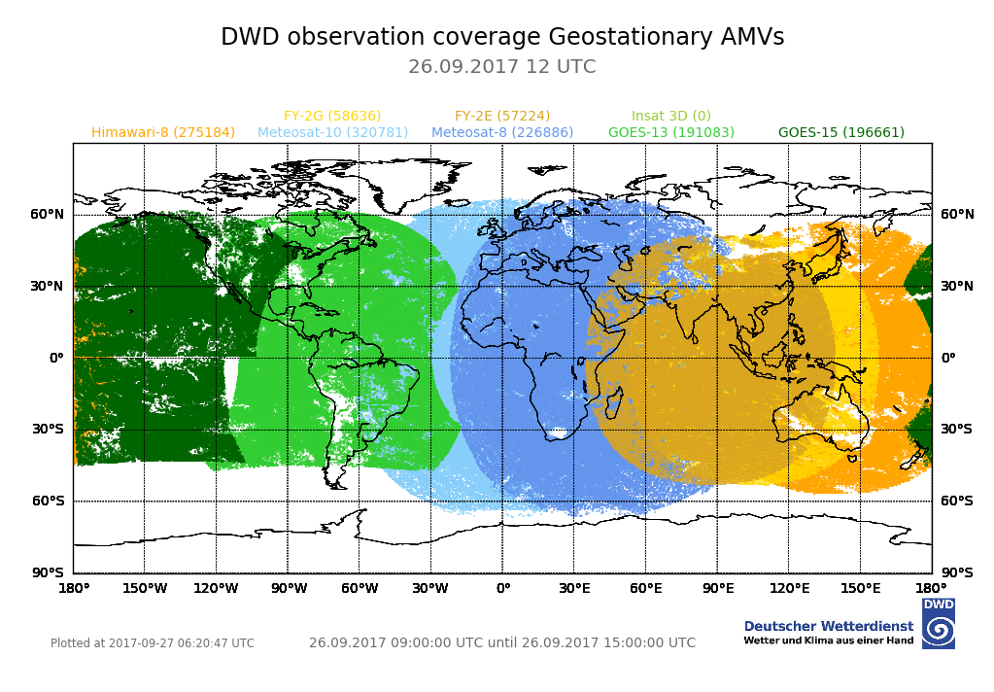
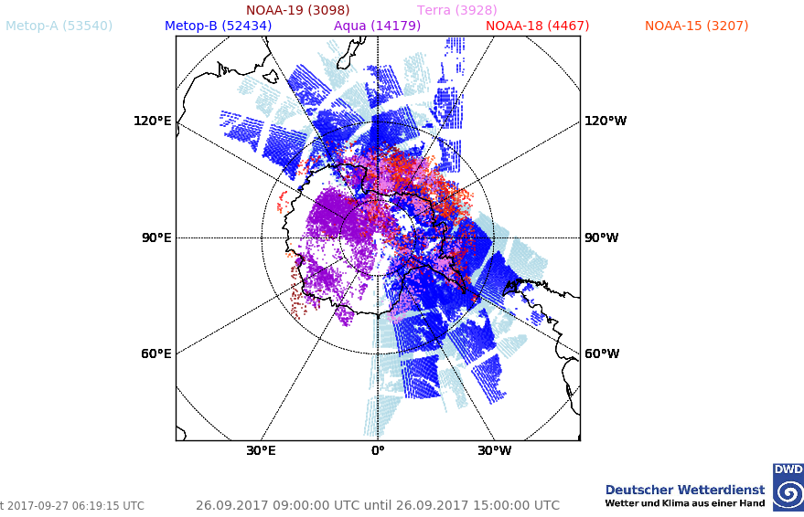
Data coverage
Operationel
Geo: GOES 15/16 Metop 8/11 Himarawi-8
Polar: AVHRR from Metop 3 / 4 single and dual the NOAA series
MODIS from Terra and Aqua

Slide 5
Changes in operationel usage of satellite winds
since the last meeting
Use of Dual Metop AMV winds
Replacing Meteosat 10 by Meteosat 11 winds
Filling the gap over eastern America by GOES 16 winds
ScatSat ocean winds in parallel routine
14th Intern. Wind Workshop 2018 Alexander Cress

Slide 6
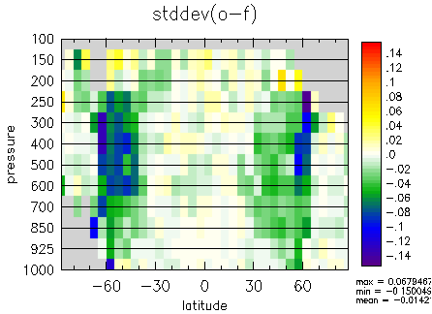
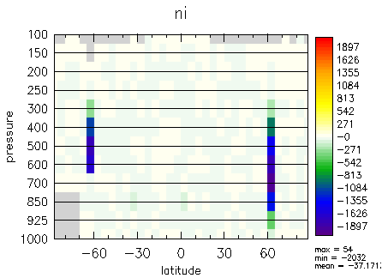
AMV Obs minus FG statistics
Crtl plus dual Metop – Crtl
all AMVs except dual Metop data
Positive impact using the other AMVs on both hemispheres
Slightly more AMV data active
14th Intern. Wind Workshop 2018 Alexander Cress

Slide 7
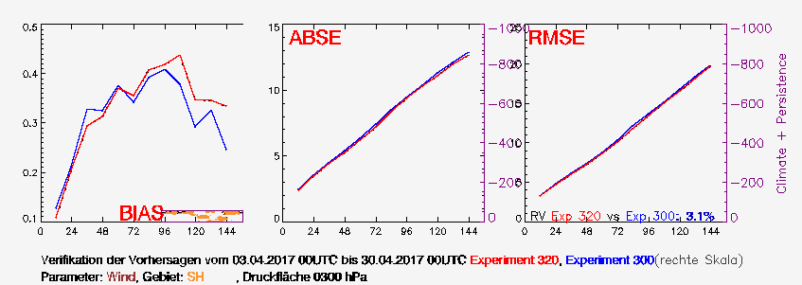
Forecast Scores
Wind 300 hPa
Crtl
Crtl + Dual Metop
Positive impact using Dual Metop on both hemispheres
Larger on the Southern Hemisphere in higher troposphere
14th Intern. Wind Workshop 2018 Alexander Cress

Slide 8
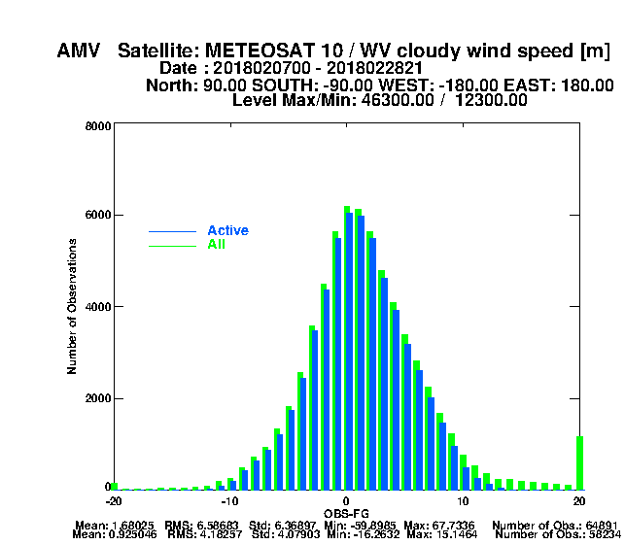
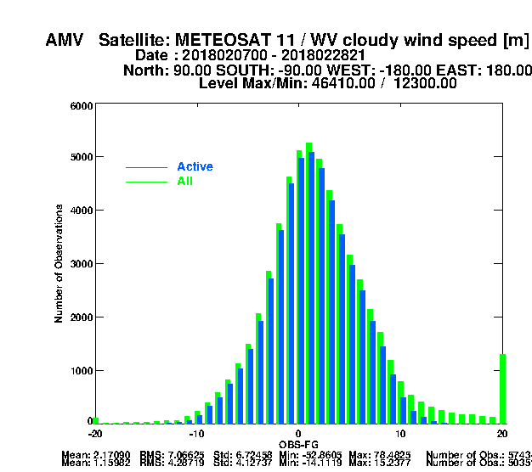
Obs –FG statistics
Comparison Meteosat 10 / Meteosat 11
 | Meteosat 10 global | Meteosat 11 global
Bias | 1.69 0.93 3,76 0.86 | 2.17 1.16 4.15 1.00
Std | 6.37 4.08 9.03 3.86 | 6.72 4.13 9.15 3.83

Slide 9
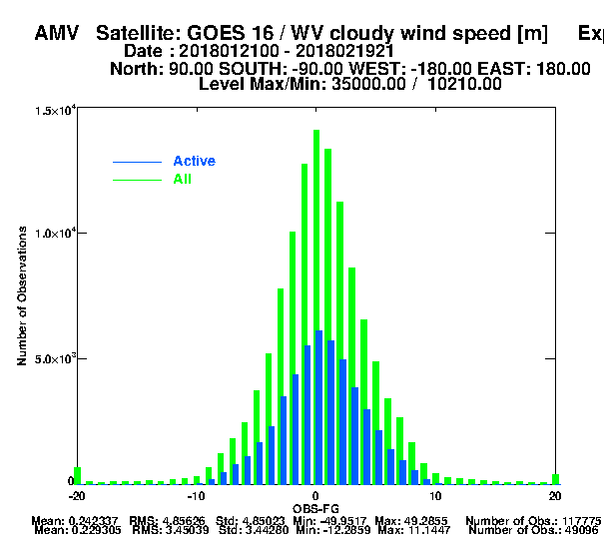
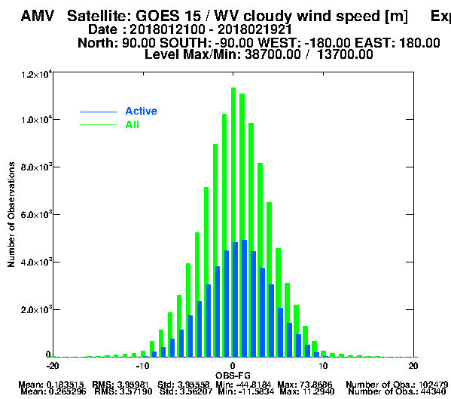
Obs –FG statistics
Comparison GOES 16 / GOES 15
 | GOES 16 global | GOES 15 global
Bias | 0.24 0.23 | 0.19 0.26
Std | 4.85 3.44 | 3.96 3.56
14th Intern. Wind Workshop 2018 Alexander Cress

Slide 10
Crtl (ohne GOES 16 und Meteosat11)
Exp: Mit Goes16 und Meteosat 11 AMVs

Slide 11
Use of high resolution AMV winds
derived by NWC SAF
Run the NWC SAF software to derive high resolution AMV Winds in house
Software: NWC SAF Software v2013. The new version (v2016) runs in test modus
The available patches are incoparated (Katja Hungersdörfer)
Area: EUROPA B (defined in house)
Output: AMVs in EUMETSAT Bufr format
# Wind guess use flag
WIND_GUESS 0 ; no use of model winds
DWD regional model system (COSMO/KENDA) is able to use HR AMVs similar to global system
First monitoring experiment started
14th Intern. Wind Workshop 2018 Alexander Cress

Slide 12
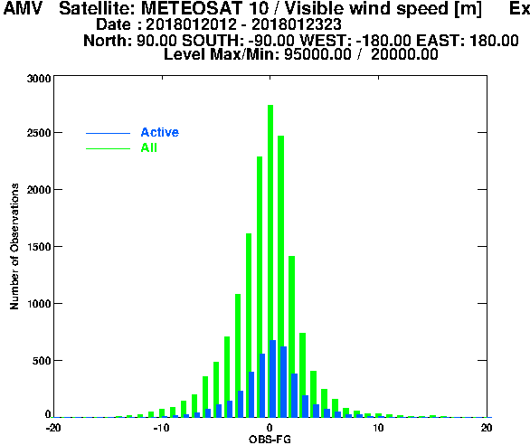
Use of high resolution AMV winds derived by NWC SAF
HR AMV monitoring started in Jan 2018
First results lock promising
A lot of wind obs. in competition with AMVs
in Kenda area (radisonde, aircraft, MODE-S,
radial winds)
Not easy to show impact
Long experiments needed => expensive
Evaluation software has to be adapted
 | IR | VIS | WV
BIAS | -2.00 -0.63 | -0.47 -0.16 | -1.21 -0.08
RMS | 4.96 3.45 | 3.28 2.98 | 5.01 3.94
STD | 4.54 3.39 | 3.25 2.97 | 4.98 3.93
14th Intern. Wind Workshop 2018 Alexander Cress

Slide 13
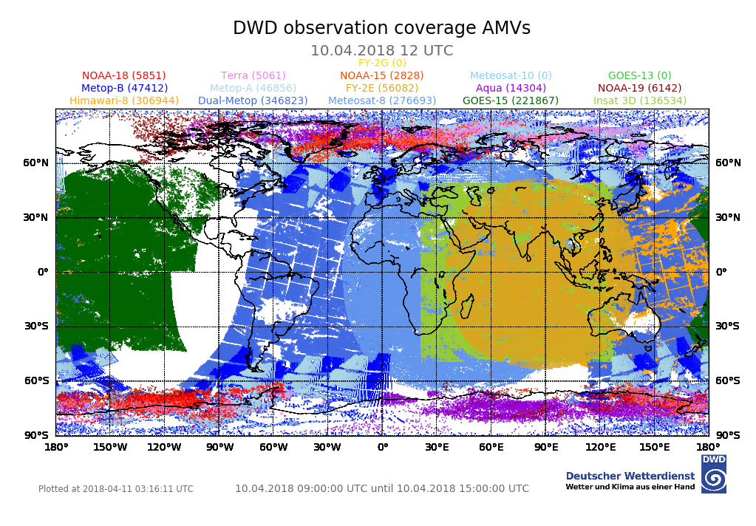
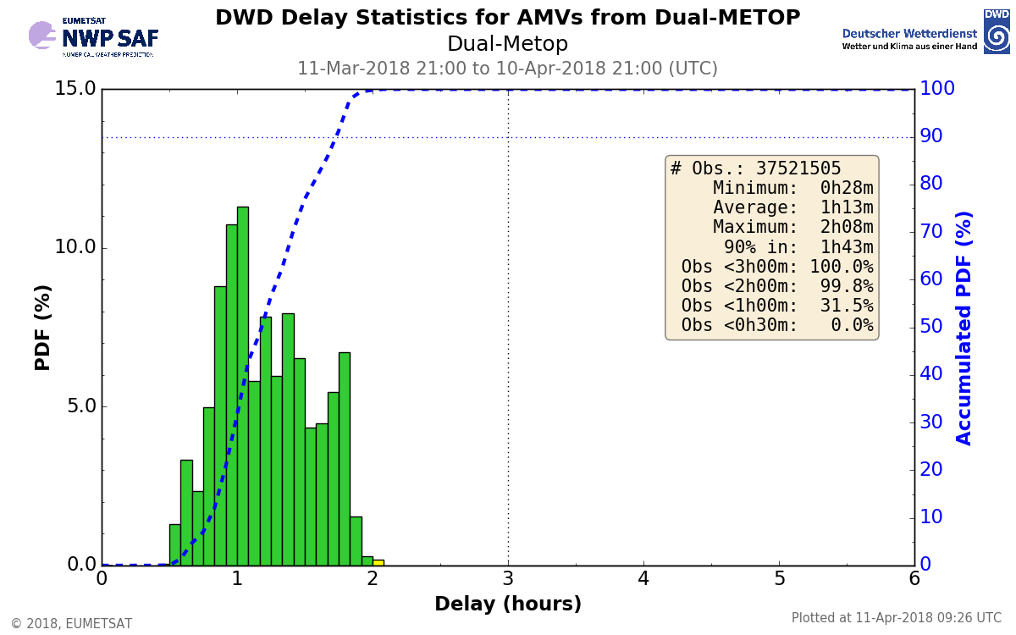
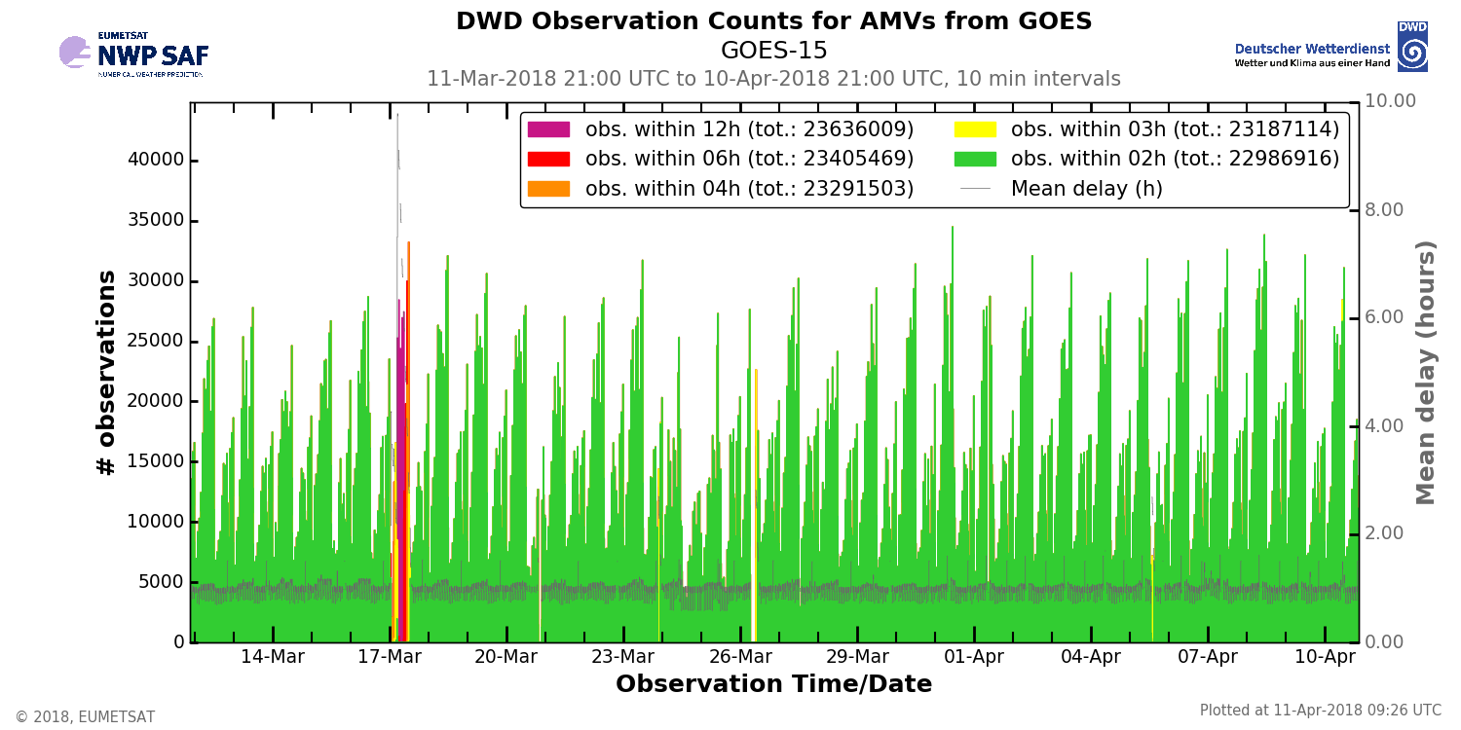
NWP SAF – DWD cooperation
AMV monitoring

Slide 14
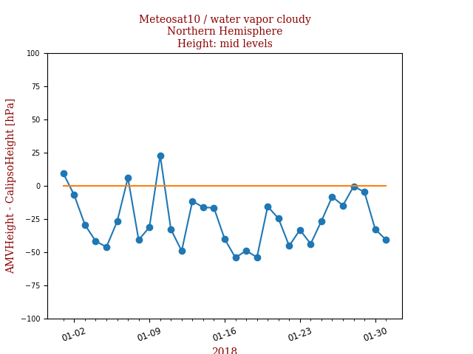
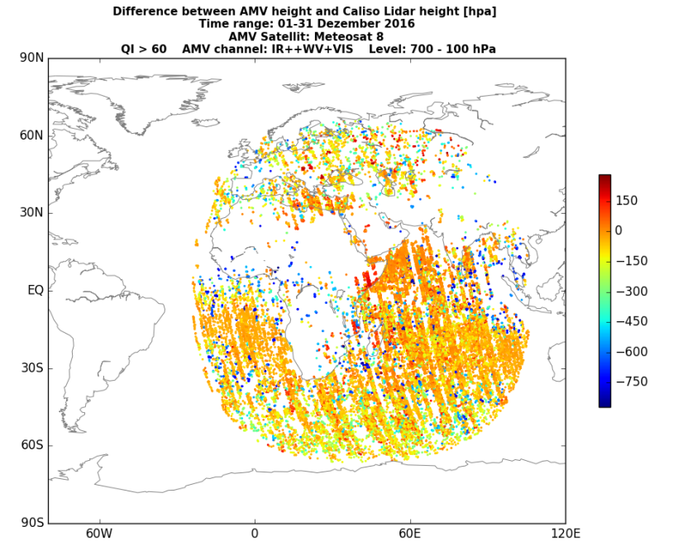
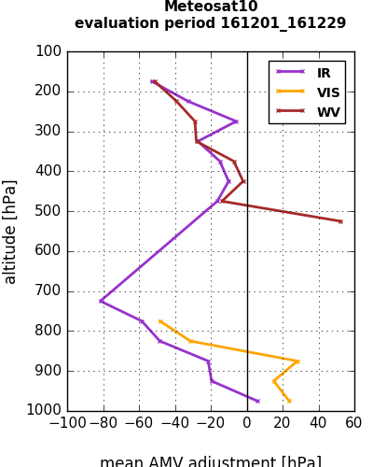
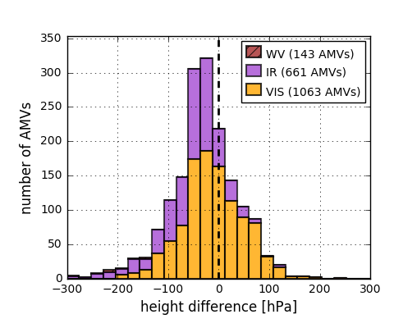
NWP SAF – DWD cooperation
AMV-Calipso lidar height monitoring

Slide 15
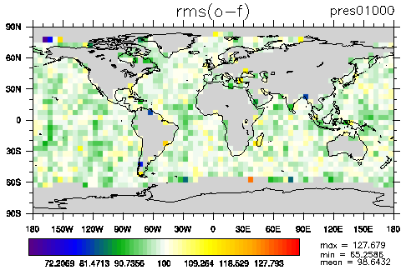
Use of scatterometer data
Operationel use of ASCAT onboard Metop 3/4
Pre-operationel use of ScatSat
Operational use of Altimeter data (Janson 2/3, SARAL)
Wind speed bias correction of Scatterometer/Altimeter data
Relative difference of obs – fg rms between exp. with and
without ScatSAT data for ASCAT observations
mean: 98.64 %

Slide 16
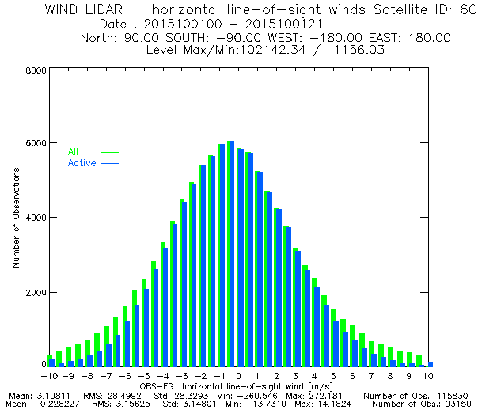
Aeolus Wind Lidar work
Aeolus will be launched in 2018
Observation will be HLOS
Level 2B Cal/Val rehearsal dataset provided
by ECMWF
The data has been regenerated (in March 2018)
with the most recent processing chain:
E2S v4.01, L1B v7.01 and L2B v3.00.
Data are provided in Bufr Format
Bufr reading is finished
Observation operator implemented
One day data assimilation with test data conducted
Looking forward on the real data
14th Intern. Wind Workshop 2018 Alexander Cress

Slide 17
Summary
Dual Metop data show postive impact for differnt seasons
AMVs operational since summer 2017
Quality of Meteosat 11 AMVs comparable to Meteosat 10
operational since March 2018
Qulaity of GOES 16 AMVs slightly better than GEOS 13, show potive impact
operational since April 2018
HR AMVs production - derived from NowCasting SAF software – successfully
implemented and first monitoring experiments started
NWPSAF-DWD cooperation started => monitoring of Lidar-AMV heights
ScatSat winds in data assimilation system tested => operational this summer
Aeolus Wind Lidar test data in DA integrated
14th Intern. Wind Workshop 2018 Alexander Cress

Slide 18
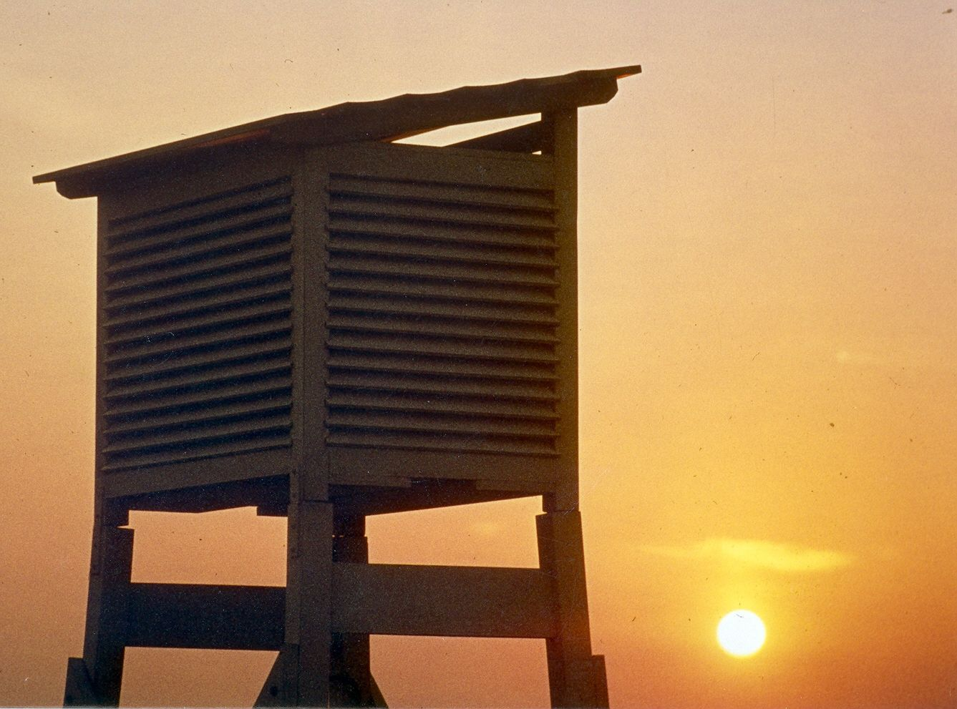
Thank you for your attention! Questions?

