Slide 1
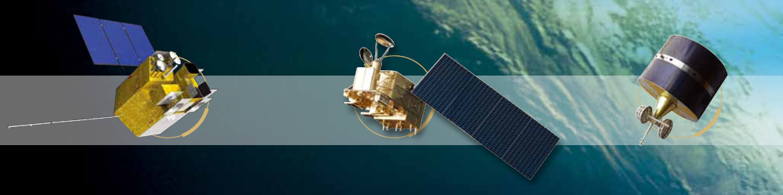



AMVs from FengYun Geo. Stereo View
-System and Bias Analysis
Feng Lu, Yixuan Shou， Peng Cui, Xiaohu Zhang
National Satellite Meteorological Center/CMA
14th International Winds Workshop (IWW14), 23-27 April 2018, Jeju, Korea
Notes:
Dual GEO

Slide 2
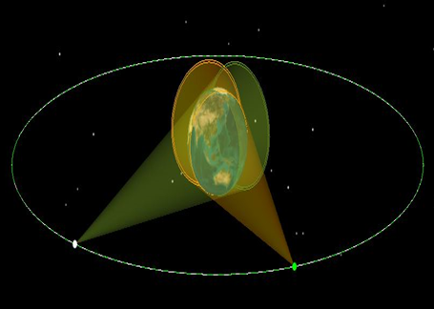
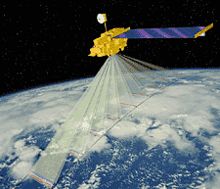
Parallax*
Apparent displacement, or difference in the apparent position, of an object, caused by actual change (or difference) of position of the point of observation; spec. the angular amount of such displacement or difference of position, being the angle contained between the two straight lines drawn to the object from the two different points of view, and constituting a measure of the distance of the object."
DUAL-GEO
LEO MISR
*Oxford English Dictionary (Second Edition ed.). 1989.
Notes:
To create stereo image pair

Slide 3
Benefits of Dual-Geo. In Visible CMV Retrieval
Not rely on NWP data for height assignment.
Good accuracy in cloud height assignment, especially for low level cloud.
Good temporal resolution.
Good spatial coverage.

Slide 4
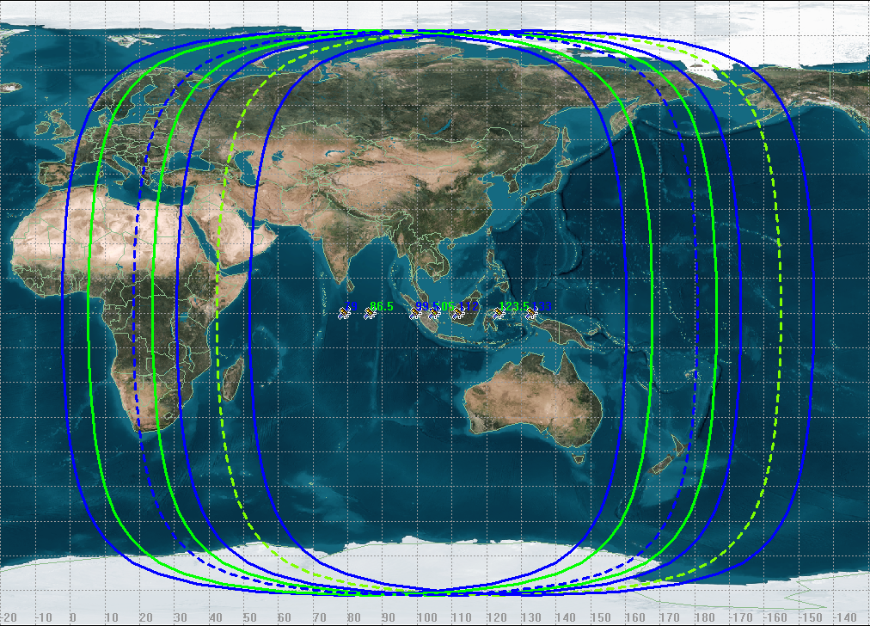
Orbital positions for FengYun Geo.
Current positions from FY-2 86.5E,105E and 112E
New positions to apply 79E,99.5E
Revised 2018

Slide 5
FengYun DUAL-Geo. CMV
Image Pair Offset = INR Bias +Parallax (T0) +Cloud motion(dT)
The two FengYun Geo. satellite make observation asynchronous
Notes:
This is schematic diagram of DUAL-GEO stereo view

Slide 6
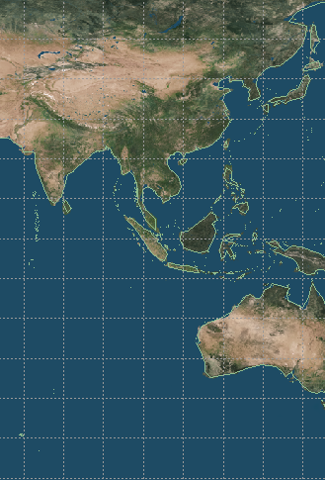
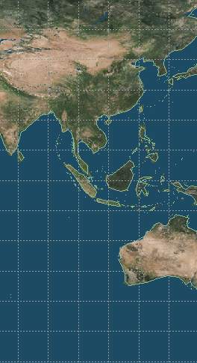
86.5E+123.5E Dual-Geo
1) FY-2 Dual-Geo CTH Capability
For FY-2 Vis channel,
86.5+112.0E dual-geo could recognize CTH >750 meters
86.5+123.5 dual-geo could recognize CTH >500 meters
79.0+133.0 dual-geo could ·recognize CTH >400 meters.
2) Coverage
86.5+123.5 dual-geo covers China and most of Asian-Pacific region
3)Operational Possibility
60N-60S
2018
63.5E-146.5E
79E+133E Dual-Geo
FY2F have been positioned over 112E for regional scan.
FY2E have been positioned over 85E for regional scan.
FY2F have been repositioned
The FY2H ,to be launched on Jun,2018, and positioned over 79E.
The FY-4A will repositioned in 105E and provide observations since May 2018
60N-60S
73E-139E
Notes:
Based on above analysis, we can get some preliminary conclusions.
For the operational setting , in Vis channel using stereo view ,we can recognize CTH above 500 Meters, for the IR channel we can recongize CTH above 1800 meters.
The potential setting have some advantage in accuracy but its not very significant.
For the spatial coverage , we can see the operational setting is much better than potential setting.
So the operational setting could satisfy for the requirement of DUAL-GEO VIS CMV applications.
25.5 37 54
0.0392 0.0270 0.01852
700 500 400

Slide 7
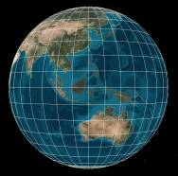

Diagram of FengYun Dual-Geo CMV
WestSat
EastSat
（time synchronous）
EastSat
Dual-Geo Image pair offset
One Geo Image Time series Offset
CTH First Guess
CMV First Guess
（Speed，Height，Direction）
*
*INR correction
*Cloud movement correction
*CTH correction
*Iteration Based On Satellite Orbit and Attitude
Dual-Geo CMV（Speed，Height，Direction）

Slide 8
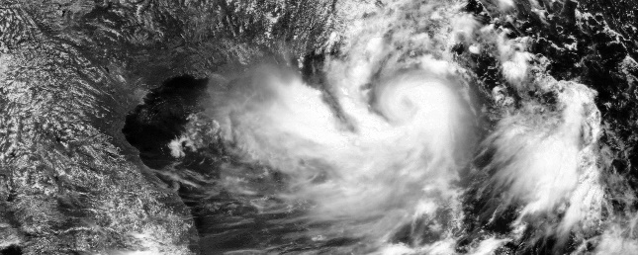
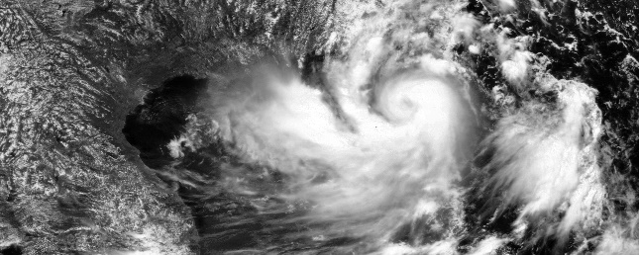

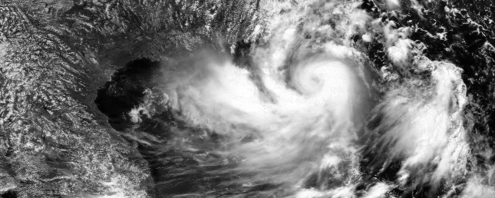
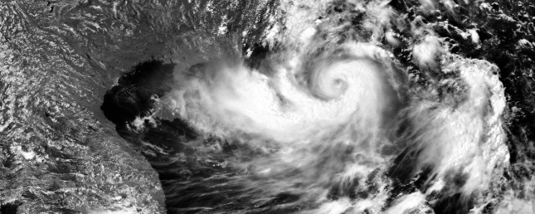

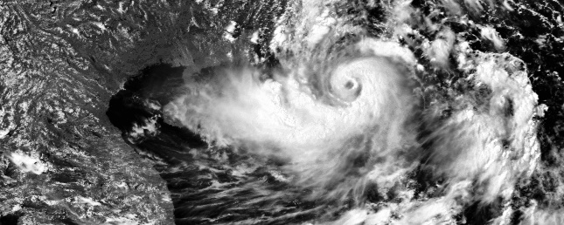

Satellite observations for this study
Typhoon Hato, Aug 22-23,2017
A maximum category 10 storm
Dt<60s
FY-2E 86E hourly FY-2F 112E 6 minute interval

Slide 9
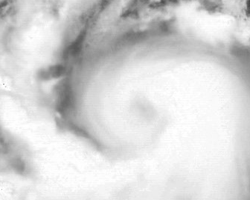
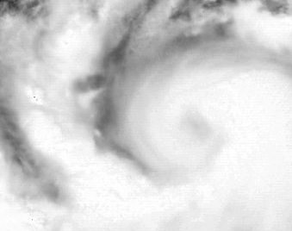
1.Image tracking:
Image at time t Image at time t+dt
several assumptions:
The target itself do not change(brightness and shape) between two frames,
The target movement is small
Pixels within the Tracking block have similar motion.

Slide 10
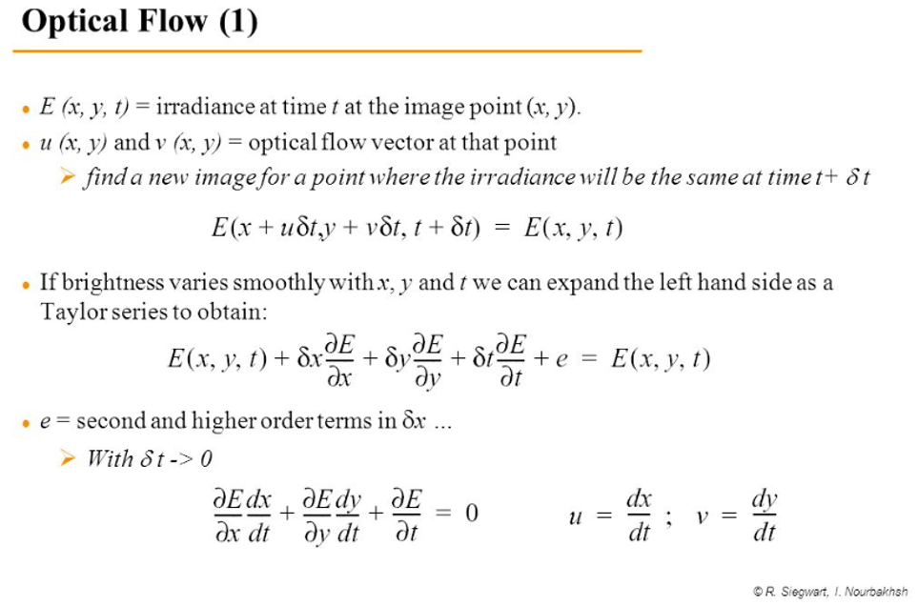

Slide 11
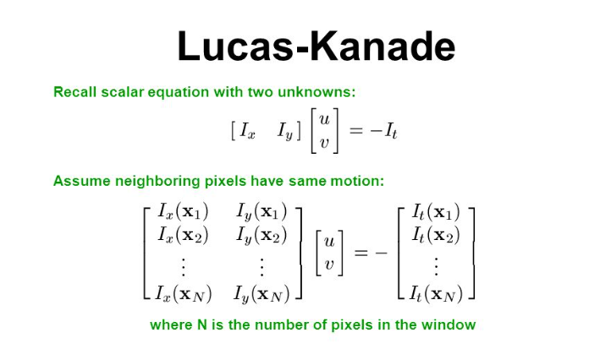
Lucas-Kanade method for optical flow

Slide 12
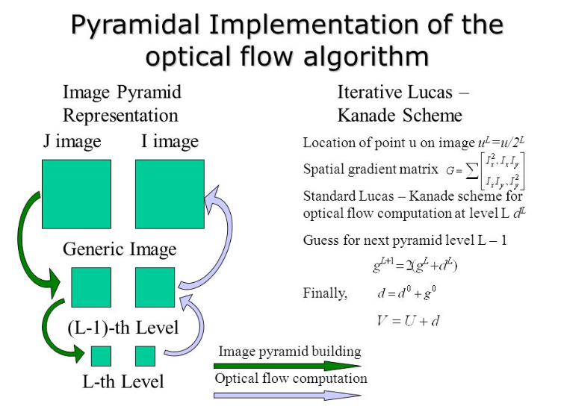
Notes:
The normal Lucas-Kanade would only adopt small motions， it fails when there is large motion. I this case，we using pyramids implementation large motions.

Slide 13


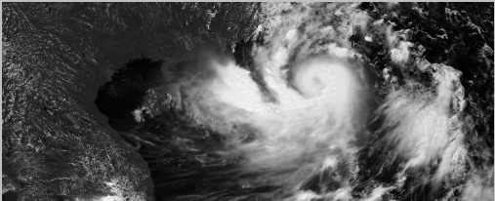

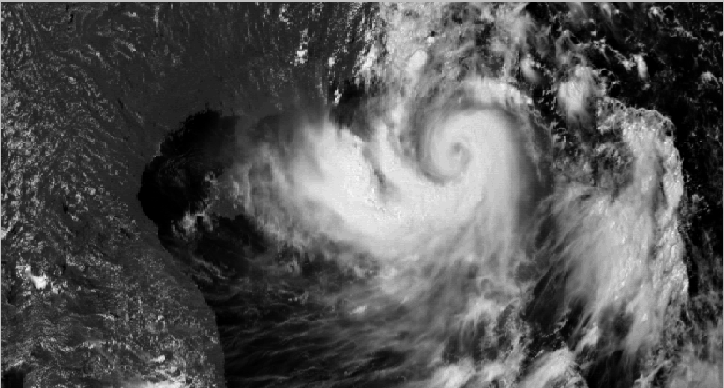

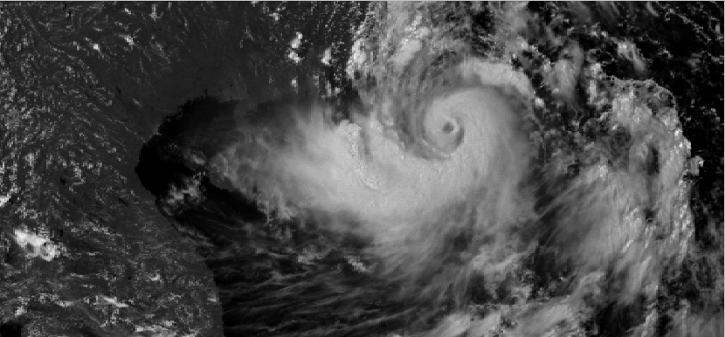
1. Image adjustment
FY2F
Solar Zenith angle correction
Histogram adjustment
FY2E
Before adjustment(FY2E)

Slide 14
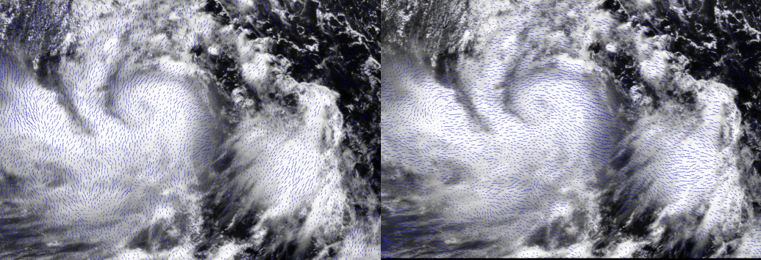
1. Image adjustment(continue)
Two satellite Stereo Image pair tracking
Before INR correction
After INR correction

Slide 15
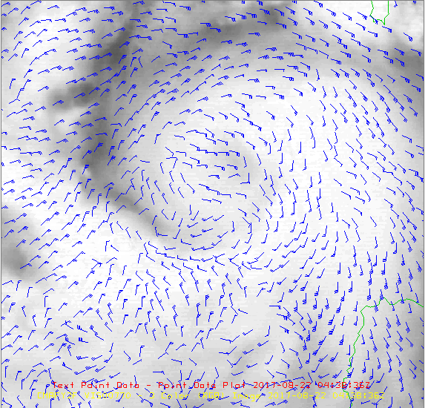
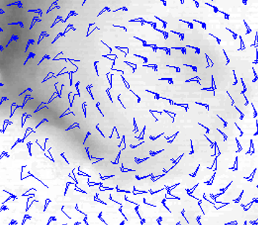
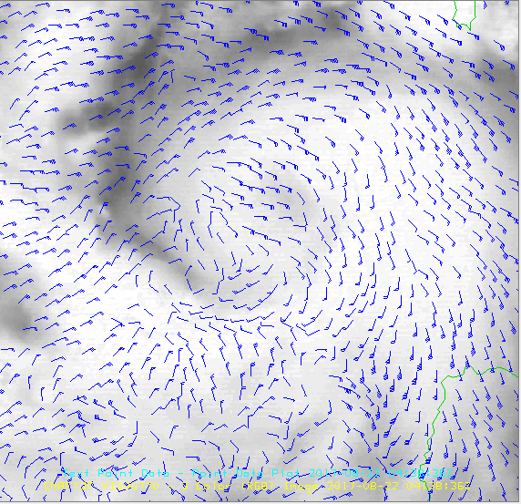
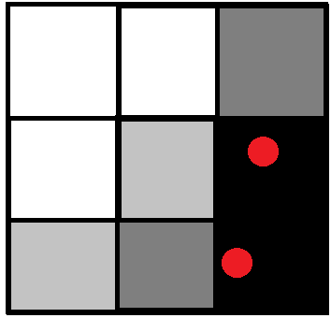
2.Subpixel accuracy target selection
pixel tracking
subpixel tracking

Slide 16

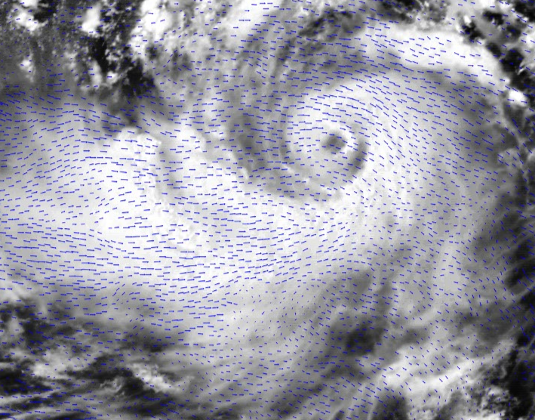
3.Parallax to altitude transformation
The common algorithm for stereo/height transform.
Fujita T.T., 1982: Principle of stereographic height computations and their and their applications to stratospheric cirrus over severe thunderstorms. J. Meteor.Soc. of Japan, 60, 355-368.
The parallax offset from FENGYUN Geo are different.

Slide 17
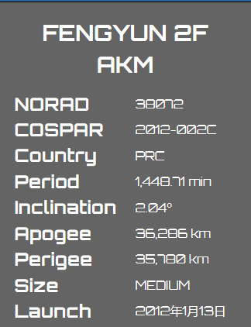
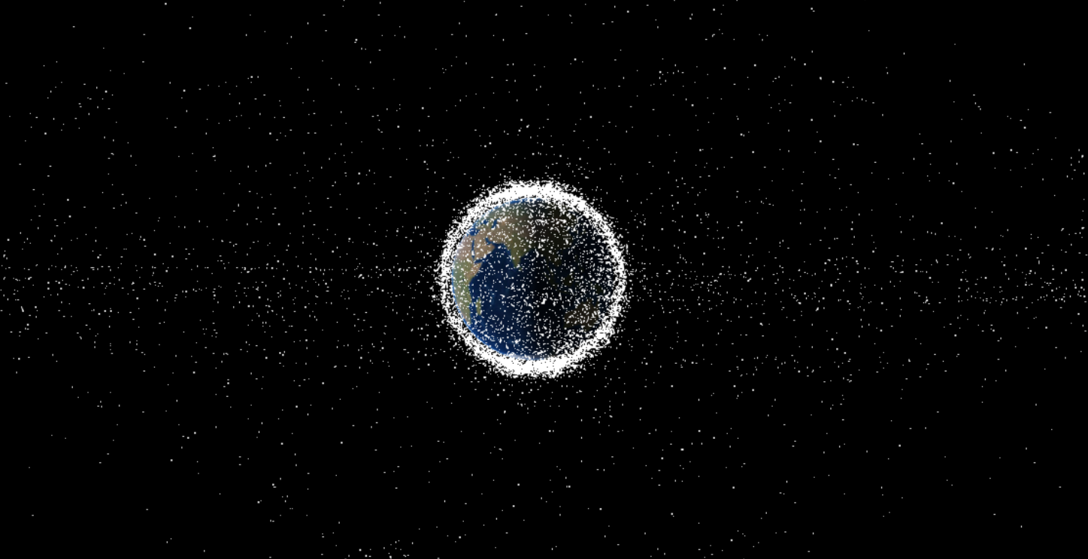
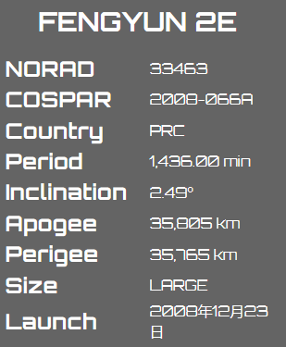
3.Parallax to altitude transformation
Geostationary orbit
Equator
Geosynchronous orbit
Equator

Slide 18
3.Parallax to altitude transformation

Slide 19
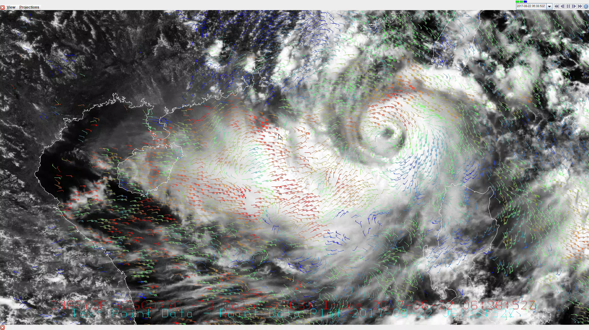
results
Tracking size=32x32

Slide 20
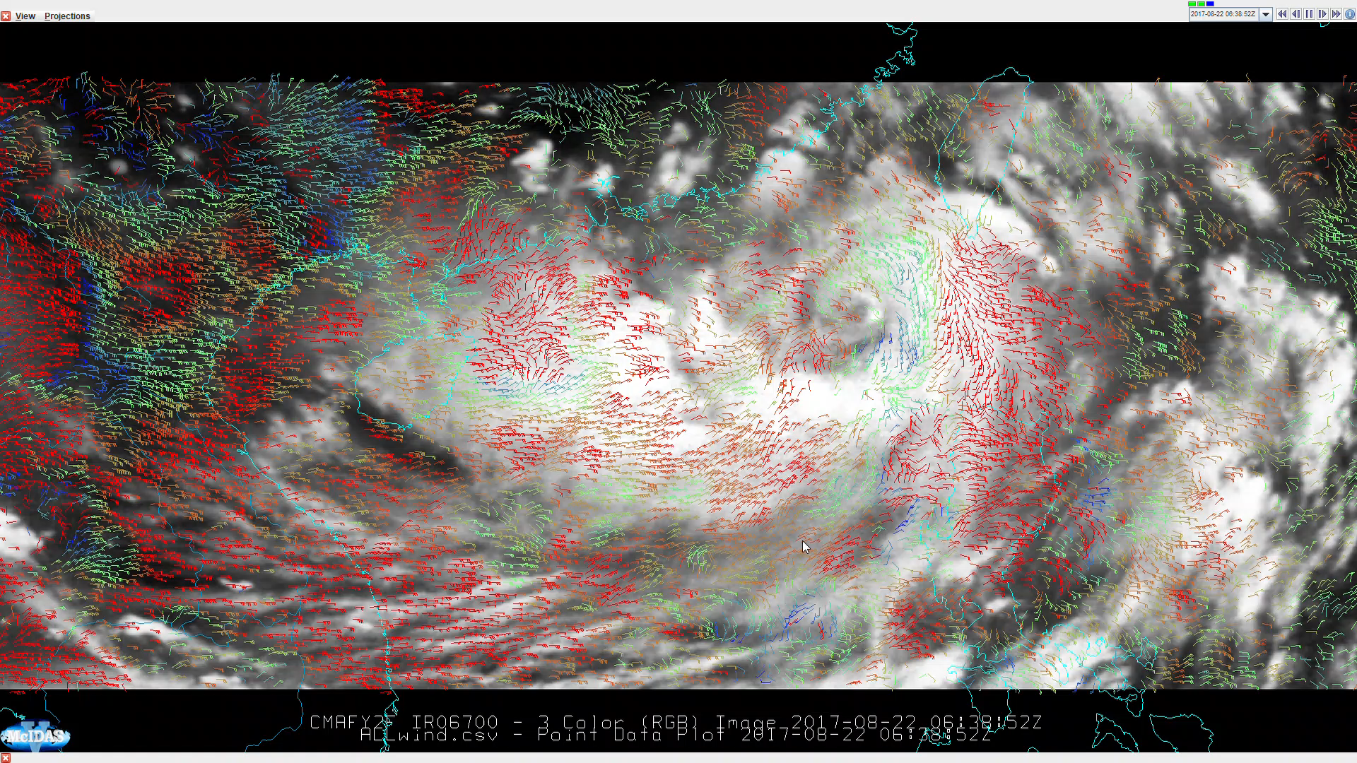
The stereo view for CMV could also be applied for Infrared channels. This is case is WV band

Slide 21
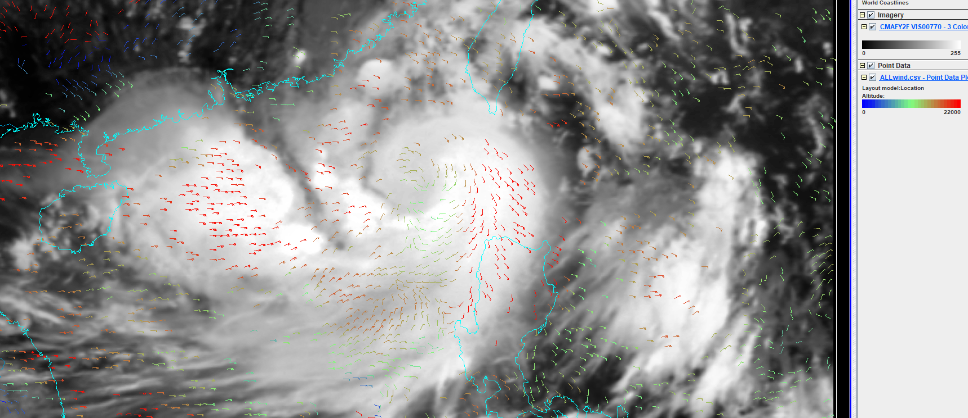
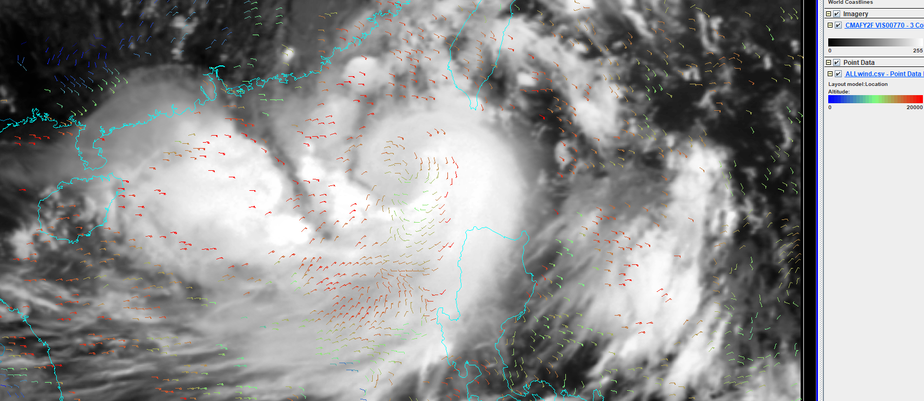
Some records higher than 20Km?
Need investigation
mistracking or INR bias?

Slide 22
Summary
AMVs from FengYun Geo. Stereo View was generated using FENGYUN 86.5E and Feng 112E asynchronous observation
The Optical flow technique was applied for image tracking
The image navigation, sun zenith angle and time asynchronous bias was eliminated.
Stereo heights from simulated IR cloud images are better represented by the height weighted by mass profiles.

Slide 23
Future Work
FY-2H launched in Jun 2018, will be located over 79.0E and the FY-2F over 112E will keep Rapid Scan service,
try stereo wind on the daily basis
2) Wind and cloud top height validation
3)Extending the Dual-GEO observations, using more imaging channels and extending geographic coverage.
4) Apply the tracking technique for FY-4 GIIRS

Slide 24

Thank you for your attention
Lufeng@cma.gov.cn

Slide 25
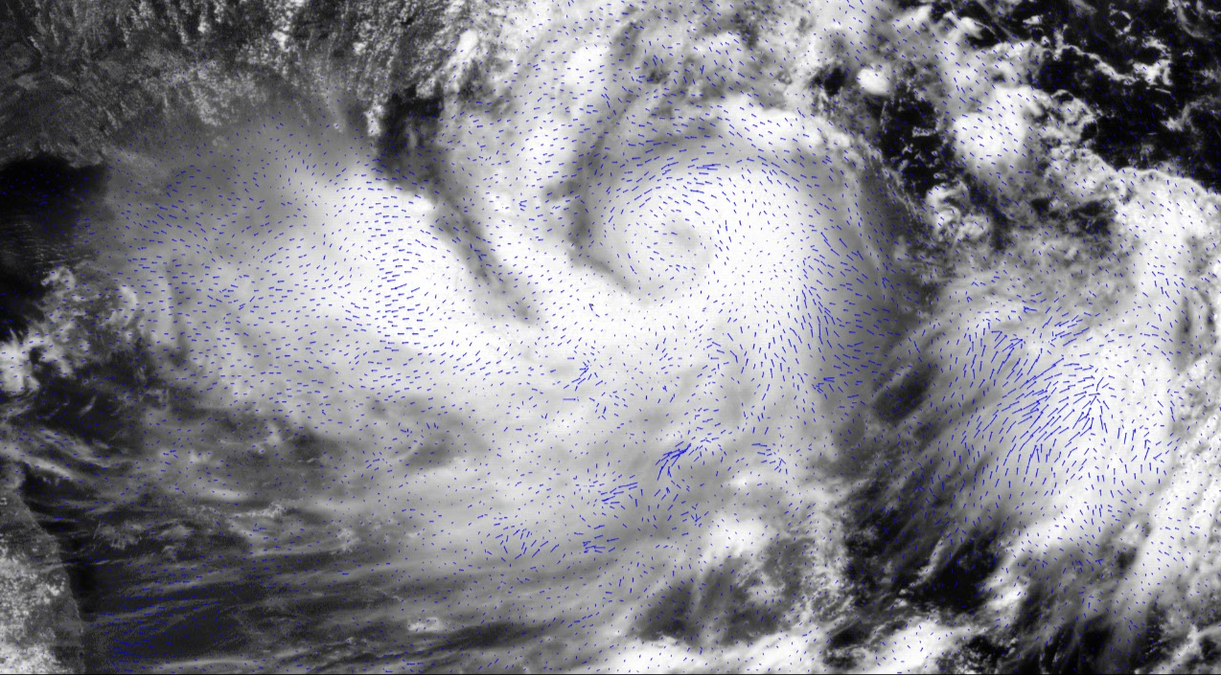
CH00770 small tracking box need more quality control try Nested tracking?

