Slide 1

WMO Oscar/Space Database Update
14th International Winds Workshop (IWW14)
23-27 April 2018, Jeju, Republic of Korea
Toshiyuki Kurino
WMO Space Programme

Slide 2
Contents
What is WMO OSCAR
OSCAR/Space maintenance Scheme
IWWG’s contributions to OSCAR/Space
Recommendations for strengthening the overall process

Slide 3
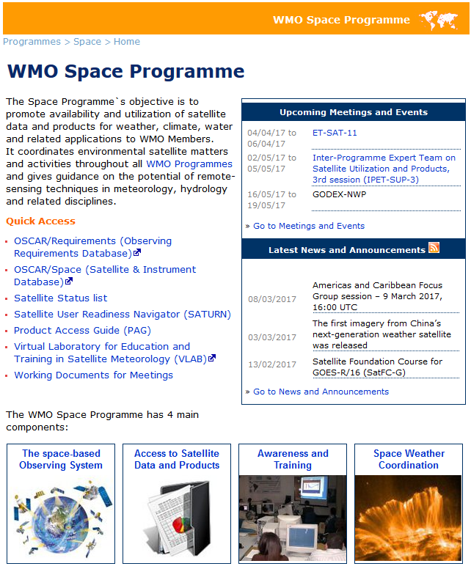

What is WMO OSCAR?
(http://www.wmo.int/pages/prog/sat/index_en.php)

Slide 4
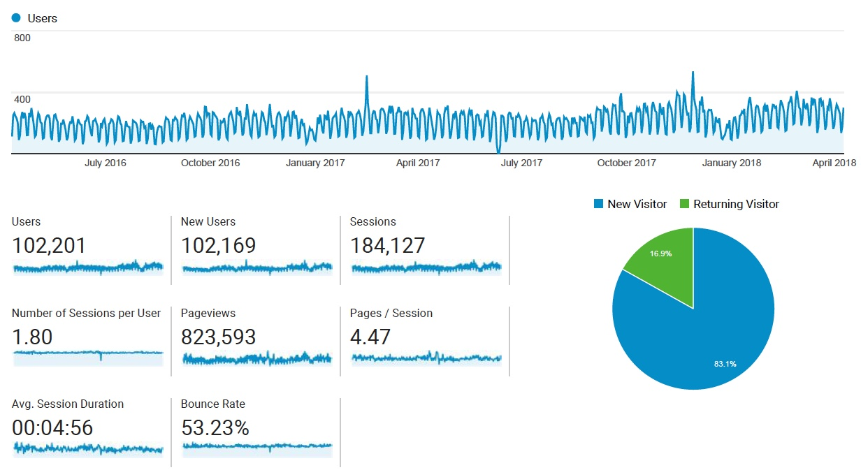
Statistics on OSCAR/Space Audience

Slide 5
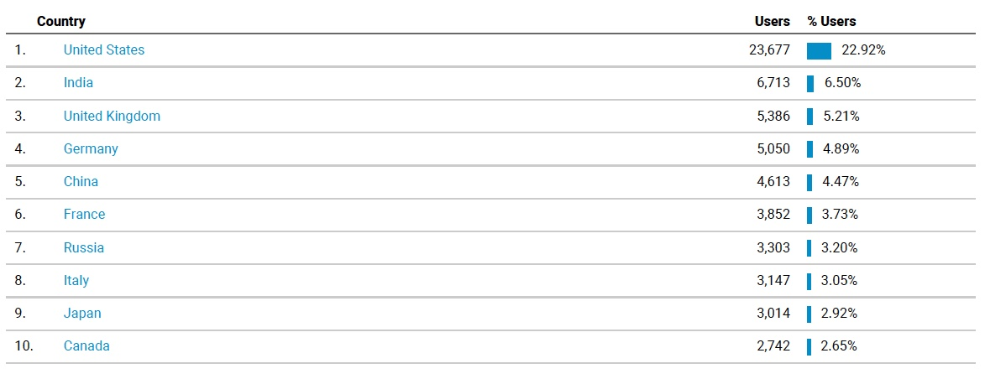
Statistics on OSCAR/Space Audience

Slide 6
WMO Observing System Capability Analysis and Review tool (OSCAR)
WMO-maintained online resource with 3 components:
  OSCAR/Space: satellite programmes, instruments, and the variables they can observe
  OSCAR/Surface: surface-based stations/platforms under WIGOS
  OSCAR/Requirements: observation requirements for 14 “application areas” and for all relevant variables
Variables
Variables
OSCAR/
Space
OSCAR/
Requirements
OSCAR/
Surface
WIGOS Information Resource
Basis for WMO Rolling Review of Requirements

Slide 7
OSCAR/ Requirements
‘OSCAR/Requirements’ provides…..
14 WMO Application Areas:
- Global Numerical Weather Prediction
- High-resolution Numerical Weather Prediction
- Nowcasting
- Sub-seasonal to Longer-range Forecasting
- Forecasting Atmospheric Composition
- Monitoring Atmospheric Composition
- Atmospheric Composition info → services in urban and populated areas
- Ocean Applications
- Aeronautical Meteorology
- Agricultural Meteorology
- Hydrology
- Climate Monitoring (GCOS) [now including GFCS requirements]
- Climate Applications
- Space Weather
https://www.wmo-sat.info/oscar/requirements

Slide 8
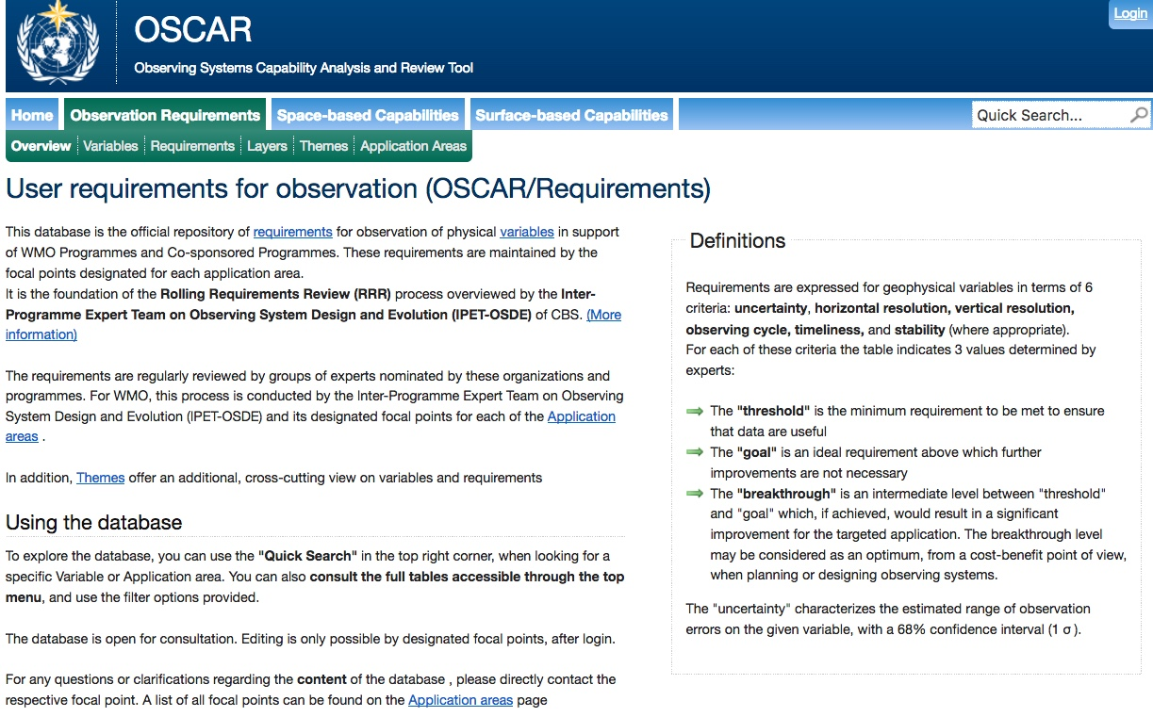
from Top Page of the OSCAR/Requirements
Wind (horizontal)

Slide 9
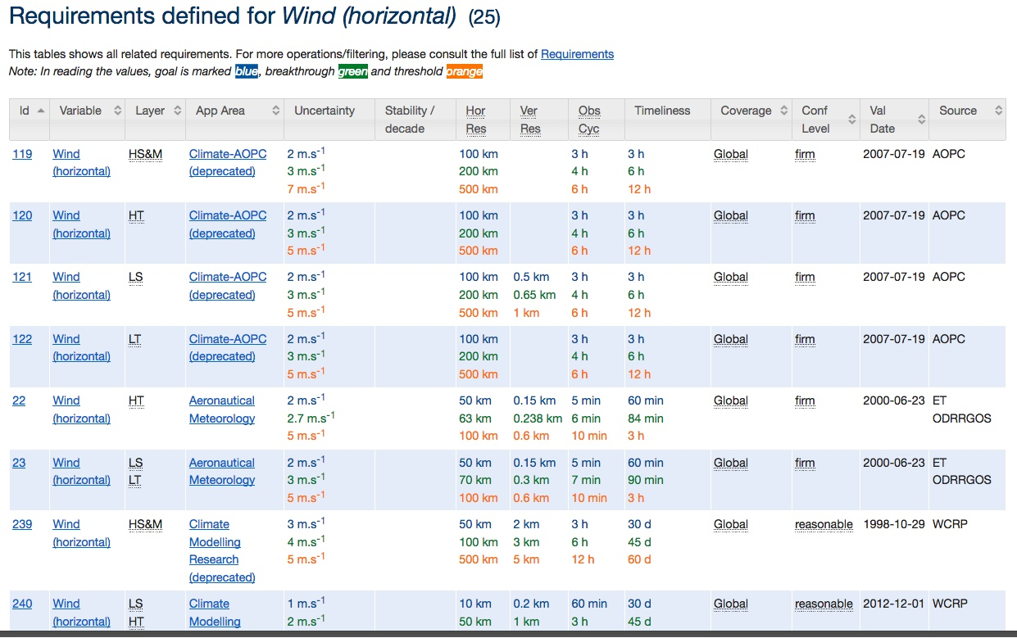
Layer
Application Area
Uncertainty
Coverage
Results of searching “Wind (horizontal)” in 761 variables
The Atmospheric Observation Panel for Climate (AOPC) was established by the GCOS Steering Committee in recognition of the need for specific scientific and technical input concerning atmospheric observations for climate.
“goal” is marked blue, “breakthrough” green and “threshold” orange

Slide 10
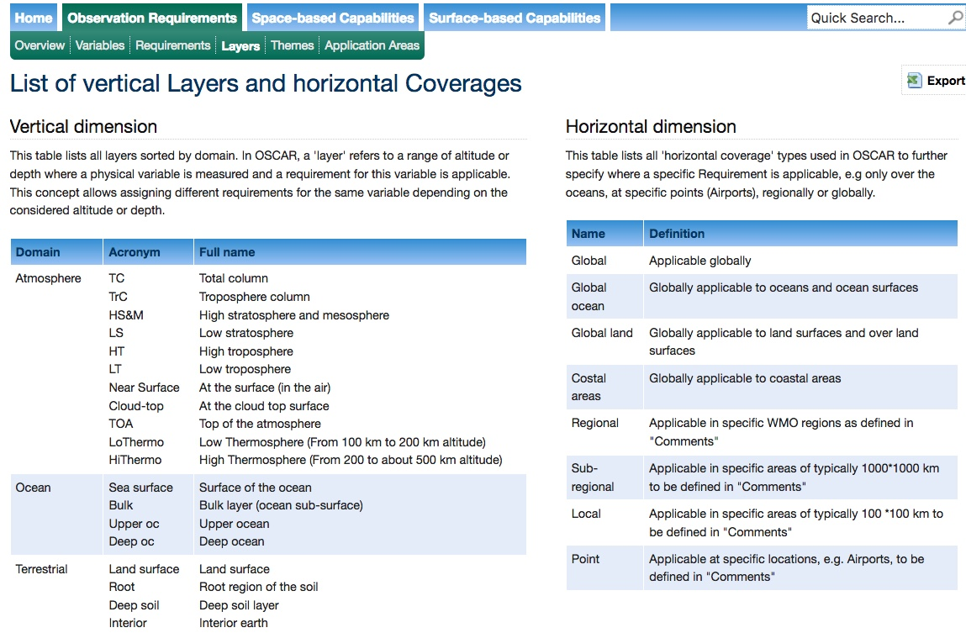

Slide 11
OSCAR/Space Database System
OSCAR/
Space
    Factual information on satellites and instruments (“capabilities”)
      81 agencies
      673 satellites
      927 instruments
Assessment of instruments, and Gap Analyses
(“analysis and review”)
  - Mapping instruments to measured variables
  “Gap Analysis” by measured variable, or by type of mission
  The built-in Expert system will infer the prioritized results?????
Notes:
Inventory of factual information ,
The responsibilty for Maintenance of this part is with the WMO Space Programme
«Expert»: Decision-tree, rule-based; to be reviewed and maintained by expert groups

Slide 12
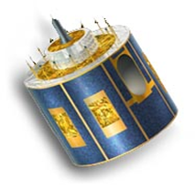
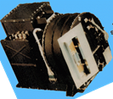
(Part 1) Looking-up information
Name, purpose
Mass, power
Orbit (type, alt, ECT, longitude)
Launch date, end date, status
Data access, telecom frequencies
Agency
Programme
Satellite
Instrument status, dates
Link to calibration events
Payload status
Instruments
Name, purpose
Mass, power
Type, description, scan mode
Resolution, FOV, coverage
Status
Spectral characteristics

Slide 13
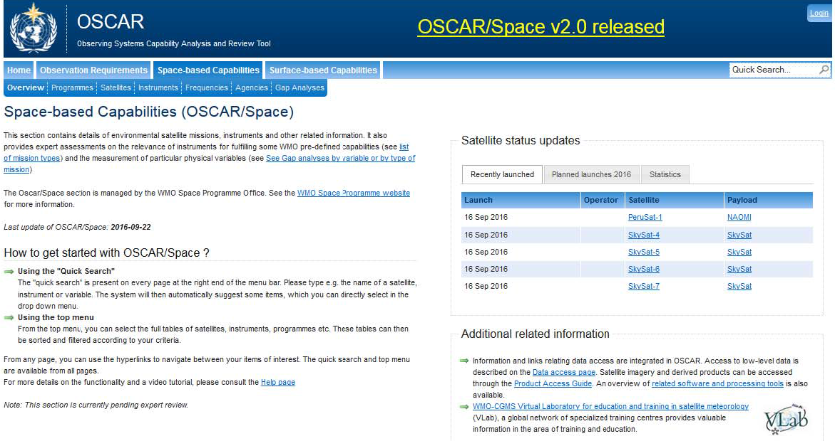
Looking-up Satellite Programme
selecting “Programmes” from Top Page of the OSCAR/Space

Slide 14
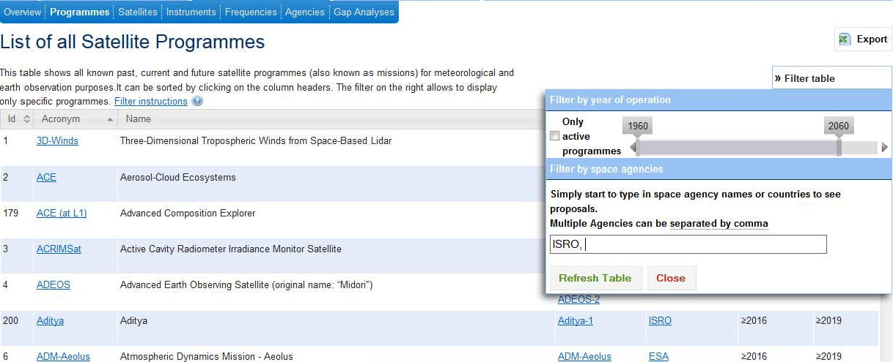
Satellite Programmes
Total: 236
Example Filter: ISRO, currently active programmes

Slide 15
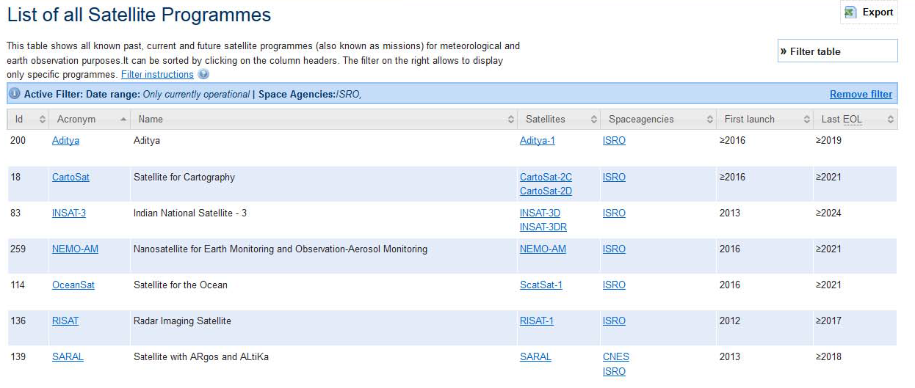
Satellite Programmes:
ISRO, active programmes
Example Satellites: INSAT-3DR

Slide 16
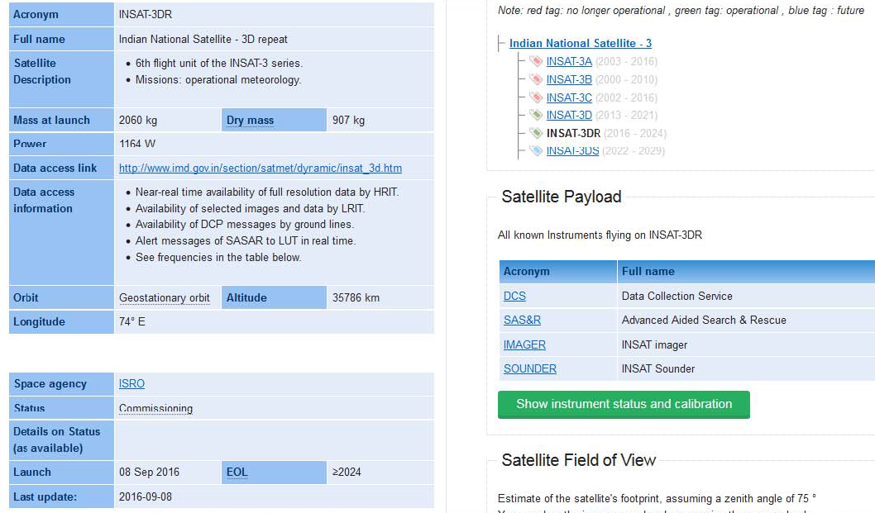
Satellite: INSAT-3DR

Slide 17
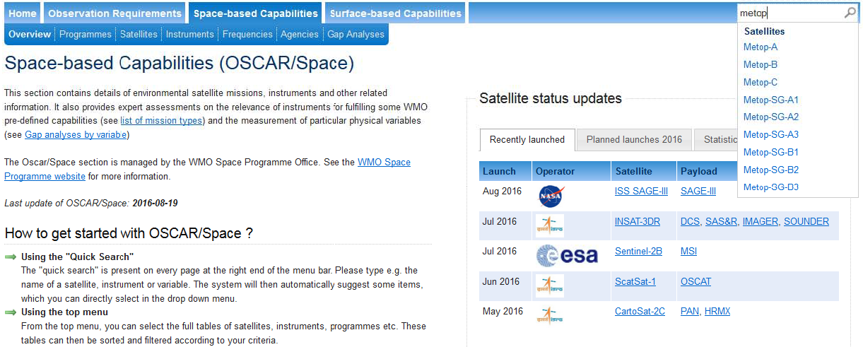
Looking-up Payload status (example: Metop-A)
selecting “Overview” from Top Page of the OSCAR/Space
Search: Metop
(automatic dropdown menu after 2 typed letters)
Notes:
The search is ajax-powered and is triggered as soon as at least 2 characters have been entered in the search field. In an attempt to implement a more intelligent search, it uses a weighing system to sort results by importance
• If the exact acronym is found => 20 points
• If the acronym is similar => 10 points
• If the name is similar => 8 points

Slide 18
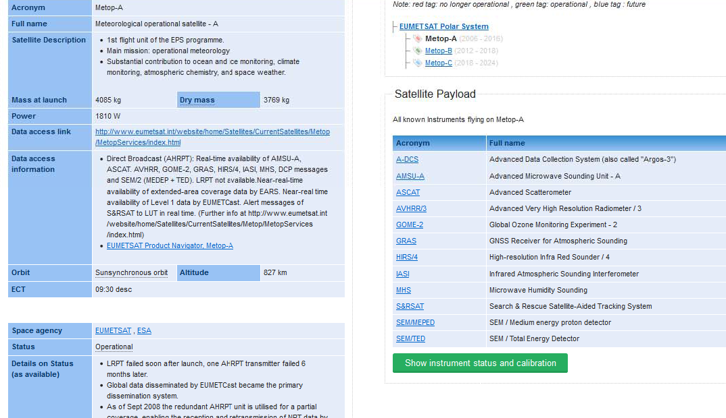
Payload status, Calibration events
Example: Metop-A

Slide 19
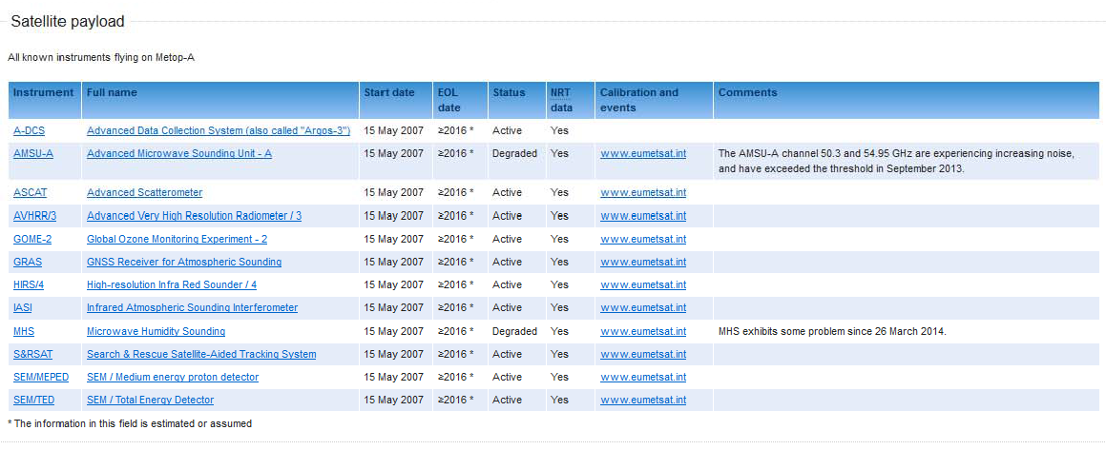
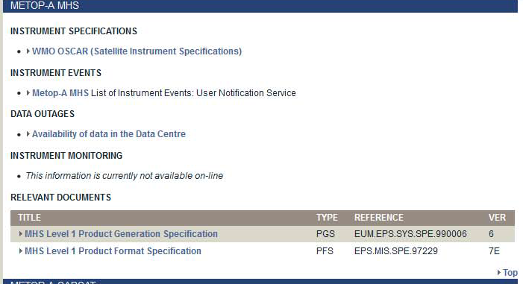
Payload status, Calibration events
Example: Metop-A
eumetsat.int
Landing page
Direct Link to GSICS (in planning)
GSICS
MHS degradation
http://www.eumetsat.int/website/home/Data/Products/Calibration/Instrumentstatusandcalibration/index.html#metopamhs

Slide 20
for Frequency management
“What is the potential impact on Jason missions of proposals for sharing 5350-5470 MHz (C band) with commercial broadband providers?”
“Give me all satellites that use C band, for sensing or for telecommunication”
Notes:
US proposals for sharing 5350-5470 MHz (C band) with commercial can impact JASON missions.

Slide 21
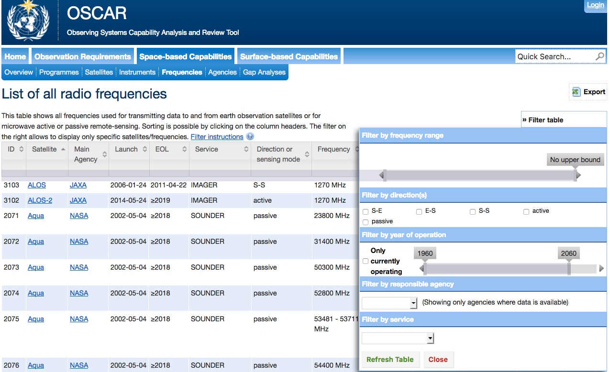
selecting “Frequencies” from Top Page of the OSCAR/Space

Slide 22
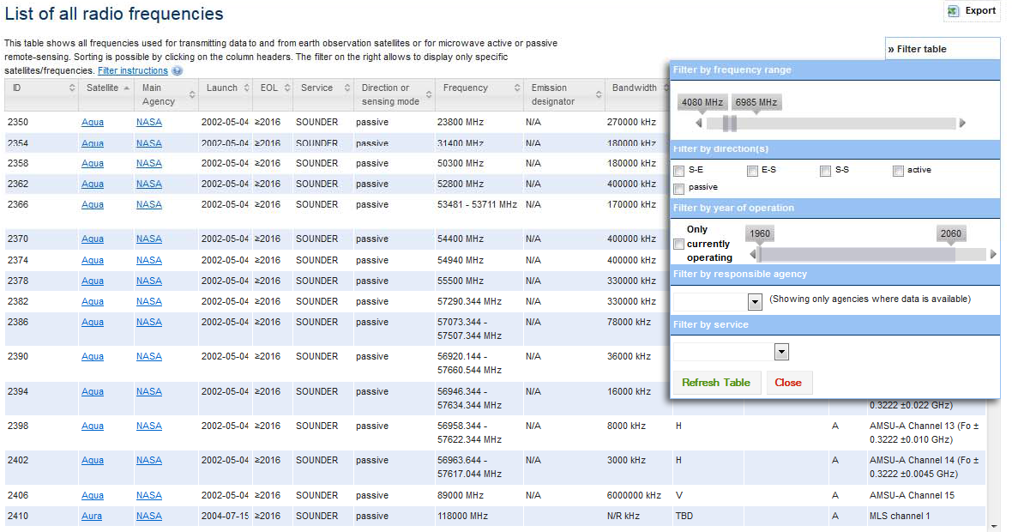
Information for frequency management
Filter C band range
Notes:
US proposals for sharing 5350-5470 MHz (C band) with commercial can impact JASON missions.

Slide 23
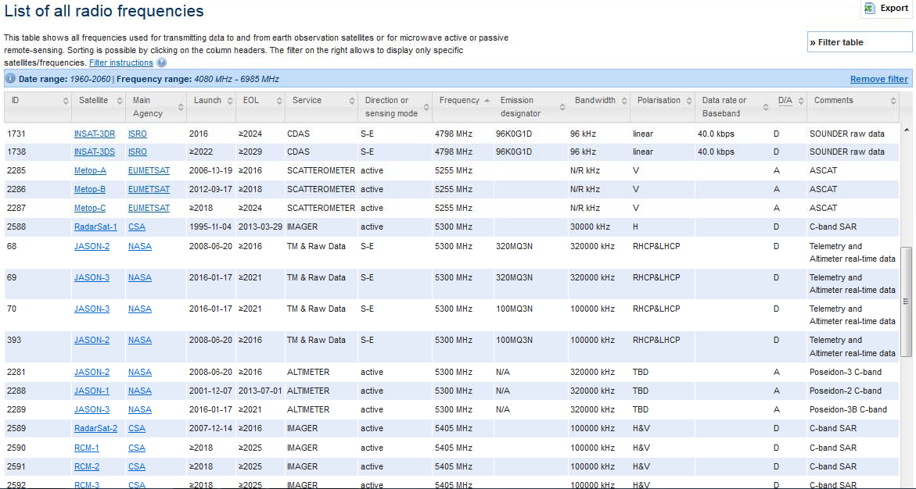
Information for frequency management:
Sensing and telecom frequencies
Total: 49

Slide 24
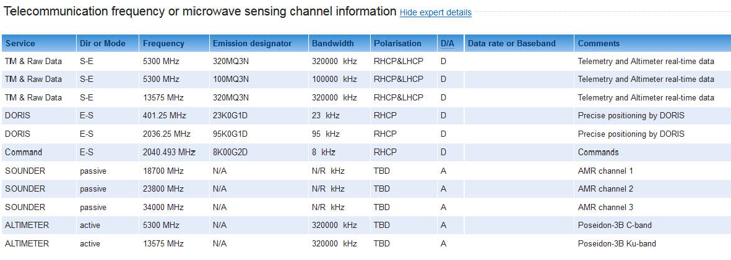
Frequency information: Jason-3
Notes:
US proposals for sharing 5350-5470 MHz (C band) with commercial can impact JASON missions.
Discussed in Space Frequency Coordination Group

Slide 25
(Part 2) Assessments: Gap Analyses
Two sides of the same relationship:
Which “variables” can be measured with a given instrument? Which capability does the instrument contribute to?
Which “instruments” can measure a given variable? Which instruments are responding to the WMO Vision?…and during which period of time ?
Notes:
Instrument types:
MW conical scanner; cross-track scanner
MW imager / XXX?

Slide 26
‘OSCAR/Space’ is a tool for ‘Gap Analysis’
Long-term WIGOS Vision
2025 / 2040
Requirements
Requirements
Requirements
“Statement of Guidance”
Implementation Plan (Actions,Recom)
Gap Analysis
Requirements
OSCAR/ Requirements
Database on the Global Observing System
OSCAR/ Surface
Members agencies and programmes
OSCAR/
Space
Notes:
26
Example GCOS IP

Slide 27
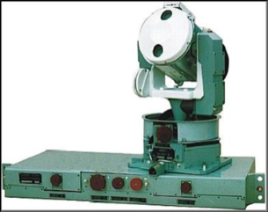
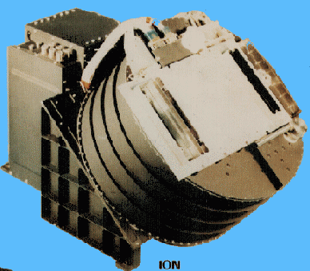
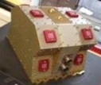


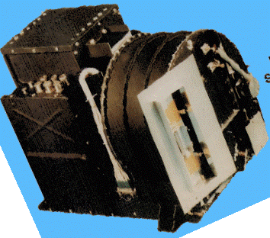
Instrument-variable mapping principle
Variable 1
Variable 2
Compliance analysis
Variable 3
Science-based rules
Variable 4
Variable x
Required instrument specifications:
Spectral bands
Bandwidth
No of channels
Polarization
Scanning mode
Etc..
Variable y
XX
X
X
X
XX
X
X
X
X
XX
X
X
X
X
XX
X
X
X
X
X
XX
X
X
X
XX
X

Slide 28
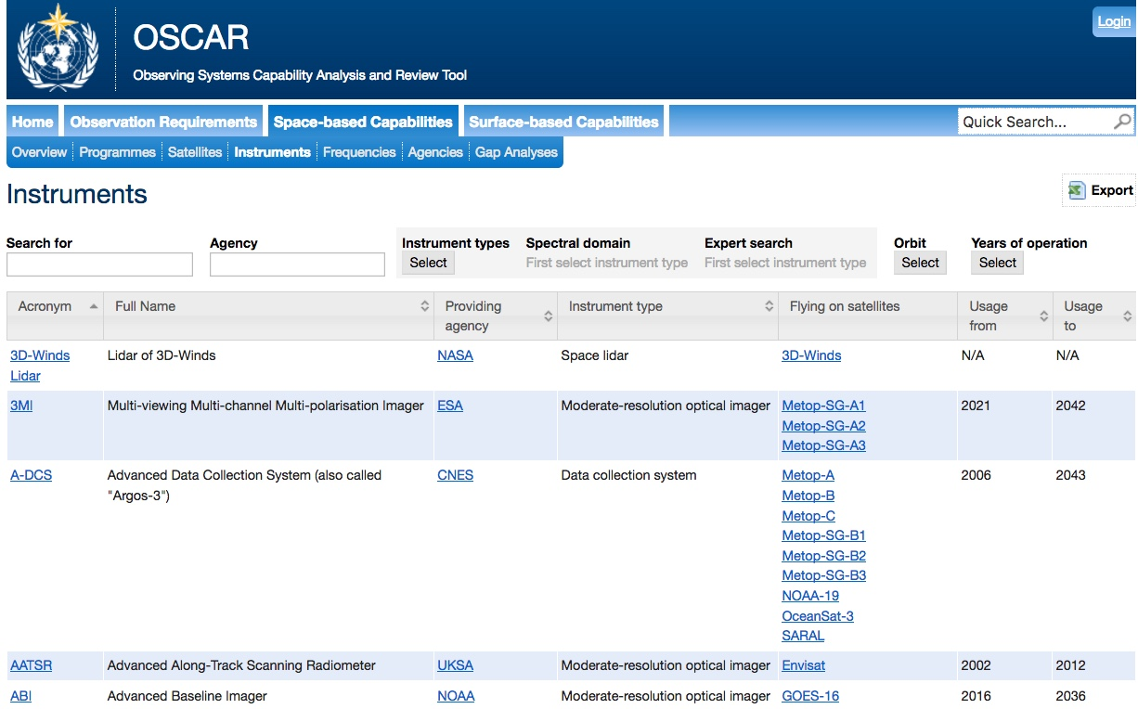
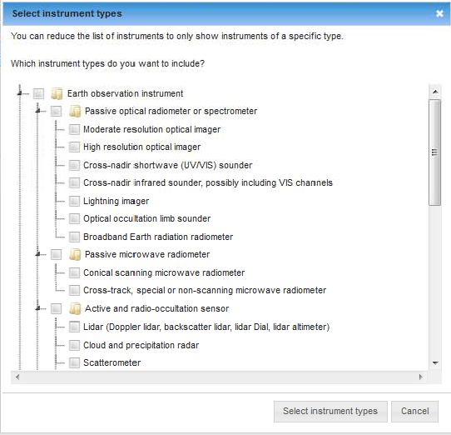
Gap Analysis from “Instruments”: Scatterometer
selecting “Instruments” from Top Page of the OSCAR/Space

Slide 29
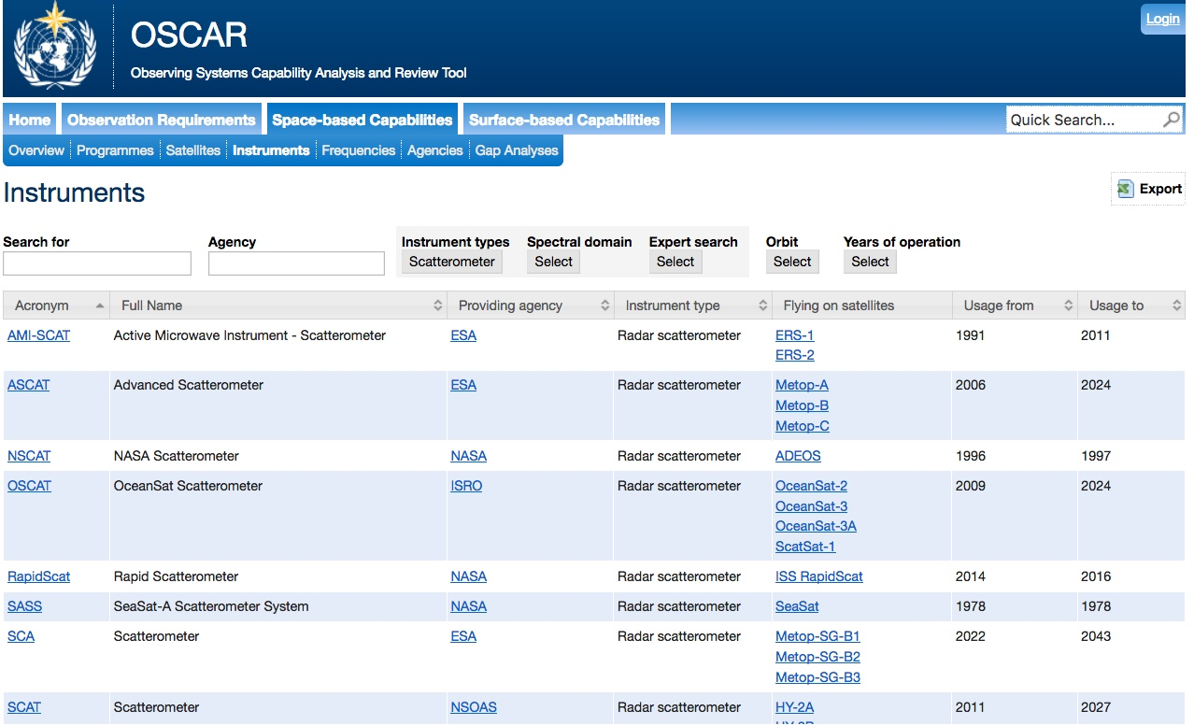

Slide 30
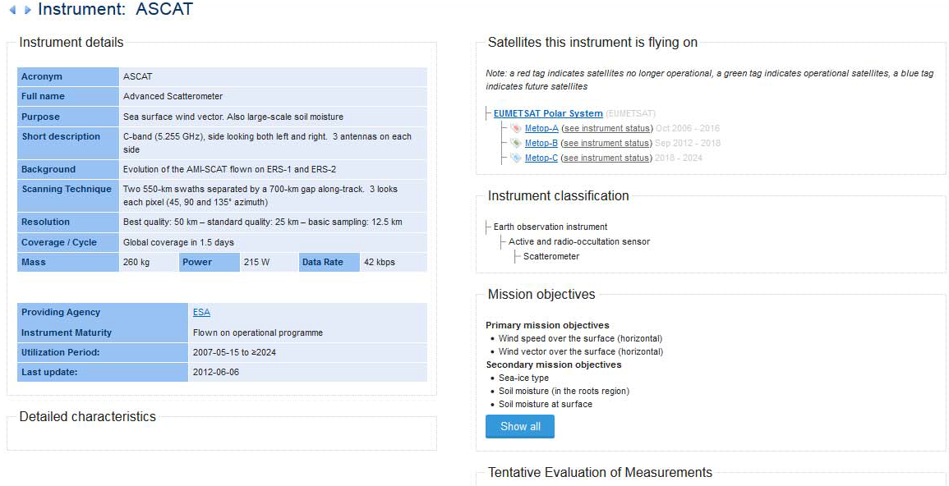
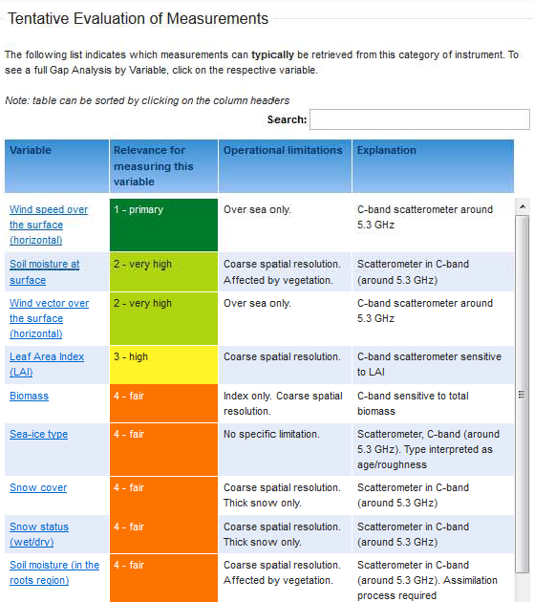
Instrument: ASCAT
Gap Analysis from “Variables”
Notes:
Check v2.0 for this content
Learn more about ASCAT

Slide 31
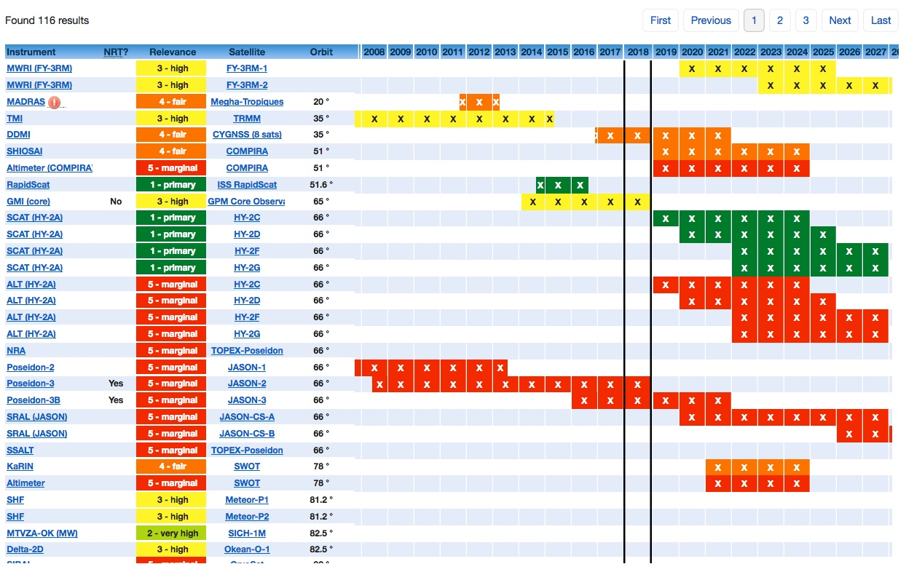
Measurement timeline for Wind speed over the surface (horizontal)
(Definition: Module of the horizontal component of the 3D wind vector)

Slide 32
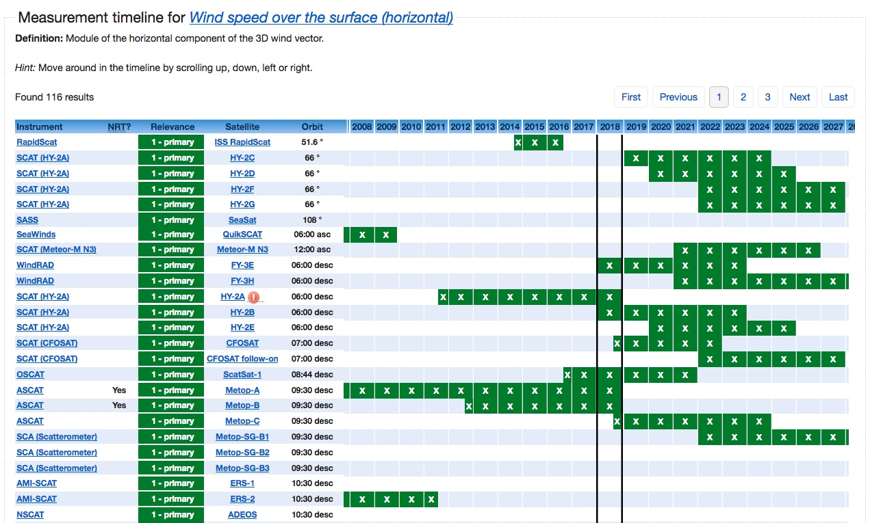
Relevance
Gap analysis

Slide 33
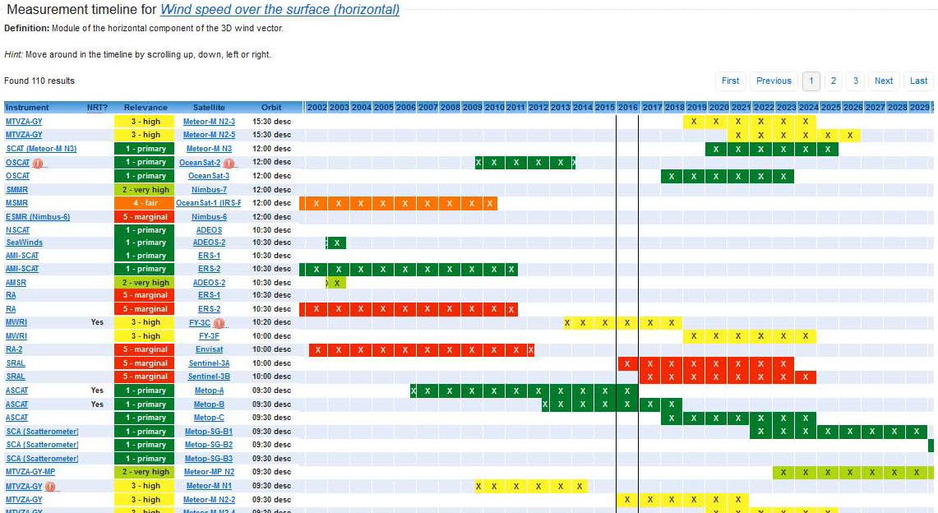
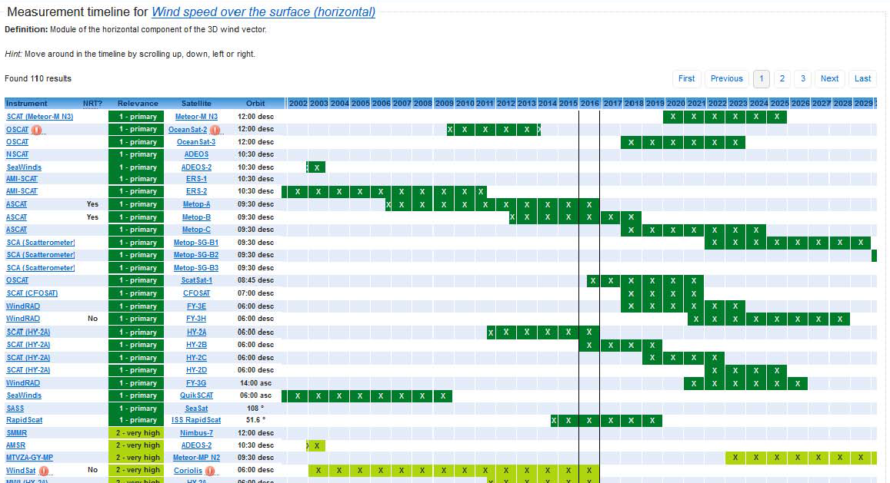
Gap analysis
Flag instrument issue
indicates “degradion”
Orbit

Slide 34
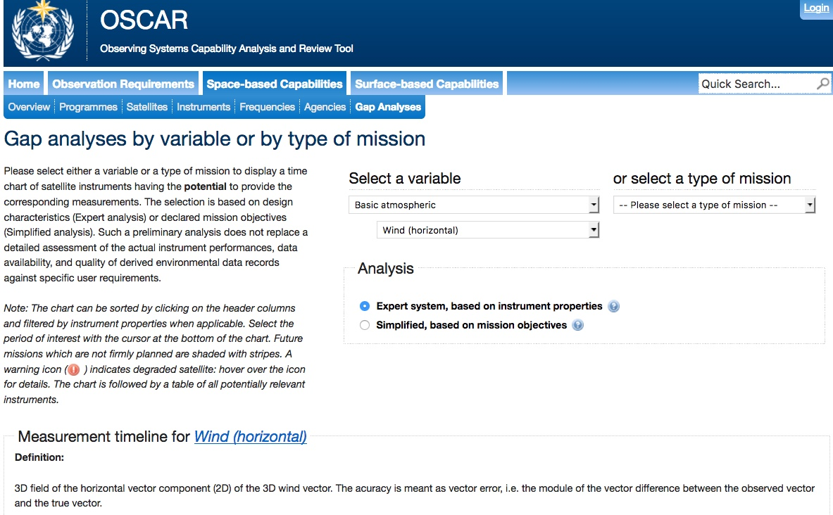
selecting “Gap Analysis” from Top Page of the OSCAR/Space

Slide 35
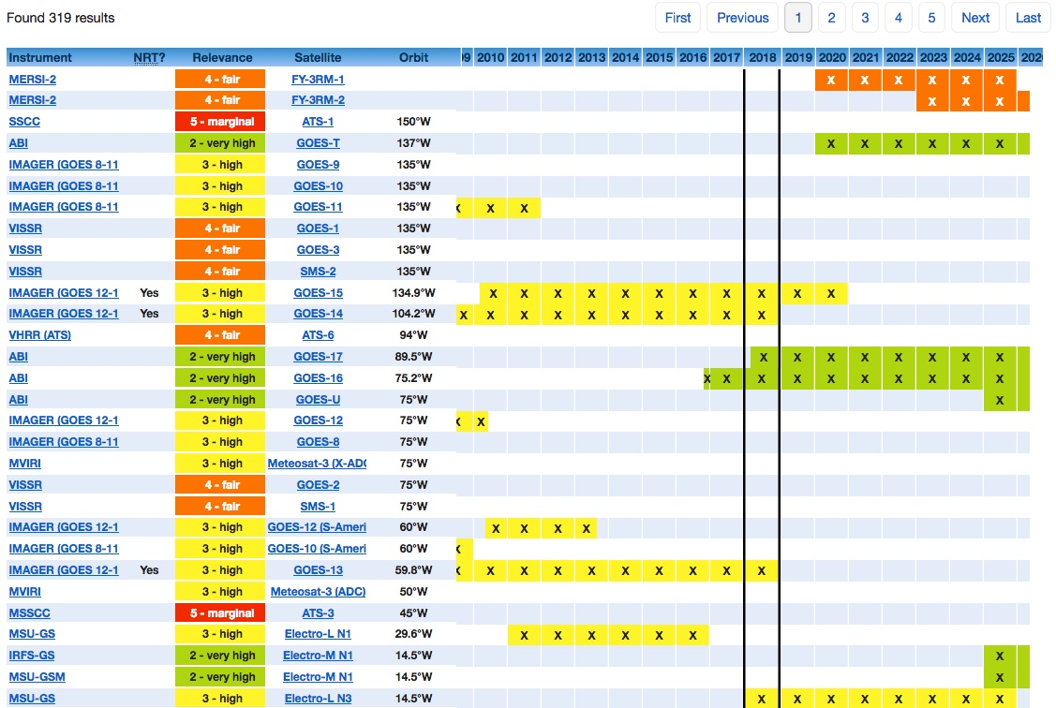

Slide 36
OSCAR/Space Maintenance Scheme

Slide 37
Maintenance and Support: Outlook
Two main tasks for OSCAR/Space:
(1) Updating facts
(2) Keep under review assessments, functions, rules, interfaces
Under supervision of WMO CBS expert teams, e.g. ET-SAT, IPET-SUP, IPT-SWeISS, and consistent with overall OSCAR development (with OSCAR/Surface and OSCAR/Requirement)
WMO Space Programme office plans to establish:
- OSCAR/Space Support Team (for task 1)
- OSCAR/Space Science and Technical Advisory Team (task 2)
Notes:
Seven functions

Slide 38
Maintenance and Support Scheme for OSCAR/Space
ET-SAT
Expert Team on
Satellite Systems
IPET-SUP
Inter-Programme Expert Team on
Satellite Utilization and Products
IPT-SWeISS
Inter-Programme Team on Space Weather Information, Systems and Services
WMO Expert Teams
OSCAR
Project
Board
WMO Space Programme Office
OSCAR/Space
Support Team (O/SST) for maintenance
- CGMS Members, Observers
- Other partners
OSCAR/Space
Science and Technical Advisory Team (O/SSAT)
- CGMS International Science Working Groups:
ITWG –Sounding
IWWG – Winds
IPWG – Precipitation
IROWG – Radio Occultation
ICWG – Clouds
- WMO GSICS, SCOPE-CM, SCOPE-NC

Slide 39
IWWG’s Contributions to OSCAR/Space

Slide 40
Questions/Advices from IWWG for “AMVs (Horizontal) Capabilities” in OSCAR/Space
Gap Analyses by Variable (0/2) http://www.wmo-sat.info/oscar/gapanalyses?view=179
Questions/Advices | Comments
What are the definitions for the various Relevance Designations (very high, high, fair, etc) and do they exist somewhere on the OSCAR site? Knowing these definitions would enable more consistent Relevance labelling of the various observation sources. | The ratings provide a qualitative idea of the relative achievable performance of the retrievals from instruments of different types and characteristics. The rating is a “blending” of several elements: the uncertainty, the vertical resolution, and the frequency and spatial resolution of the retrieved measurement in comparison with the space-time variability of the geophysical parameter. It is planned to add the “Rating criteria” to the Gap analysis by Variable” in order to make the User aware of the background for the quoted rates.

Slide 41
Questions/Advices from IWWG for “AMVs (Horizontal) Capabilities” in OSCAR/Space
Gap Analyses by Variable (1/2) http://www.wmo-sat.info/oscar/gapanalyses?view=179
Questions/Advices | Comments
- Relevance of ABI, AHI, FCI is marked as "Very high" in contrast to the previous GOES or MTSAT imagers or SEVIRI (which are "high")? The capabilities or quality of ABI, AHI and FCI might be better (although not necessarily in a major way for winds), but it is thought that the relevance for AMVs is the same for all these instruments and should be ‘very high’. - Relevance is marked as "fair" for MODIS, VIIRS and MetImage, and "marginal" for AVHRR. However, both MODIS, VIIRS and AVHRR AMVs are currently assimilated in NWP models. So it is thought that ‘high’ or ‘very high’ rating should be more appropriate, even if it is understood that VIIRS and AVHRR might be rated lower than MODIS or METImage due to the lack of availability of WV channels for example. In fact METImage is very similar to SEVIRI (VIS, IR and WV channels used for AMVs) and the relevance to extract the winds is then rather similar for the 2 instruments even if the coverage is different. In fact coverage of GEO and LEO are seen as complementary and be not rated as more or less important. | The current rating criteria are: Doppler lidar Hyperspectral sounder in GEO; OR Imager in GEO or Molniya with channels in VIS and TIR at 6-8, 10-13 and 13.3 μm Imager in GEO or Molniya with channels in VIS and TIR at 6-8 and 10-13 μm TIR imager in LEO with channels at 6-8 and 10-13 μm; OR Imager in GEO with channels in VIS and TIR at 10-13 μm; OR High-spatial-reolution multi-angle VIS radiometer in LEO; OR Very-high spectral resolution limb sounding spectrometer for oxygen lines in the VIS and NIR ranges VIS imager in GEO; OR TIR imager at 10-13 μm in LEO

Slide 42
Example of Rules (rating value is «subjective»)
Variable: Atmospheric temperature
Instrument type | Main relevant Property | Rating | Operational limitations
IR radiometer | No. of channels in the 15 μm band (in LEO) | 3.4 | Cloud sensitive, coarse vert. resolution
 | No. of channels in the 15 μm band (in GEO) | 3.3 | Cloud sensitive, coarse vert. resolution
 | No. of channels in the 4.3 and 15 μm bands (in LEO) | 3.1 | Cloud sensitive, coarse vert. resolution
 | No. of channels in the 4.3 and 15 μm bands (in GEO) | 3.0 | Cloud sensitive, coarse vert. resolution
IR spectrometer | Spectral resolution in the 15 μm band (in LEO) | 2.2 | Cloud sensitive
 | Spectral resolution in the 15 μm band (in GEO) | 2.1 | Cloud sensitive
 | Spectral resolution in the 4.3 and 15 μm bands (in LEO) | 1.3 | Cloud sensitive
 | Spectral resolution in the 4.3 and 15 μm bands (in GEO) | 1.0 | Cloud sensitive
MW radiometer | No. of channels in the 54 GHz band (conical scanning) | 2.3 | No specific limitation
 | No. of channels in the 54 and 118 GHz bands (conical scanning) | 2.0 | No specific limitation
 | No. of channels in the 54 GHz band (cross-track scanning) | 1.4 | No specific limitation
 | No. of channels in the 54 and 118 GHz bands (cross-track scanning) | 1.1 | No specific limitation
Limb sounder | Short-wave spectrometry in occultation | 5.1 | Daylight, high atmosphere only
 | Short-wave spectrometry by mechanical/electronic scanning | 5.0 | Daylight, high atmosphere only
 | IR spectrometry | 4.1 | High atmosphere only
 | Millimetre-submillimetre wave spectrometry | 4.0 | High atmosphere only
R.O. sounder | No. of soundings / day (single satellite) | 3.2 | Inaccurate in low troposphere
 | No. of soundings / day (satellite cluster) | 1.2 | Inaccurate in low troposphere

Slide 43
Requests from IWWG for “AMVs (Horizontal) Capabilities” in OSCAR/Space
Gap Analyses by Variable (2/2) http://www.wmo-sat.info/oscar/gapanalyses?view=179
Requests | Accepted Proposal
Operational limitation is marked as "Polar Regions only" for MODIS, VIIRS, MetImage, and AVHRR. AMVs using these data are extracted up to 50 deg latitude (single mode AVHRR and Leo-Geo) and have a global coverage for dual Metop AVHRR operations. It is proposed to replace the operational limitation "Polar Regions only" by "High latitudes" and to precise that the coverage is global for Dual operations for AVHRR and METImage. | “Polar regions only” is now re-worded as “Limited to high latitudes”.
3D winds are presently produced in a demonstration mode at CIMSS from AIRS instrument. It is proposed to add AIRS in the list and to set the relevance to “marginal” or “fair”. | The addition of variable “Wind (horizontal)” in the capability of hyperspectral sounders in LEO was implemented and reviewed by IWWG.

Slide 44
Questions/Advices from IWWG for “AMVs (Horizontal) Capabilities” in OSCAR/Space
Multi-purpose VIS/IR from GEO http://www.wmo-sat.info/oscar/observingmissions/view/2
Questions/Advices | Comments
AMVs are mentioned in the #1 rating, as well as the #4 rating. This is a bit confusing. AMVs are mentioned in all the ratings, which is fine if AMVs can be produced from the available observations described in each rating. | AMV is possible with different level of performances, depending on the available channels. The rating, however, is determined by the set of all the Variables retrievable from the specified set of channels, not AMV only.
The “red” colour code designation says: ”VIS/IR radiometer with >=1 channel(s) in VIS, in the TIR window ~ 11 μm and (possibly) in the TIR water vapour 6.3 μm band. Basic operational cloud and cloud motion monitoring limited to daylight.” The last sentence is only true IF only a VIS band is present, but the “red” colour designation seems to indicate the availability of 11um window observations. | This rating category refers to instruments with a minimal number of channels, but inclusive of VIS, therefore only possible in daylight. AMV are included, provided that also there is IR (for height assignment).

Slide 45
Questions/Advices from IWWG for “AMVs (Horizontal) Capabilities” in OSCAR/Space
Multi-purpose VIS/IR from LEO http://www.wmo-sat.info/oscar/observingmissions/view/1
Questions/Advices | Comments
AMVs aren’t mentioned. AMVs are now extracted from several LEO satellites (MODIS, AVHRR, VIIRS, MISR) and presently used in NWP models for high latitude areas. They will be extracted in the future from at least EPS-SG METImage and S3/SLSTR. AMVs must appear in the multi-purpose VIS/IR imagery from LEO list. | AMV is not mentioned here because not driving for the rating of the mission “Multi-purpose VIS/IR from LEO”. It appears, however, listed and rated under each instrument equipped with the appropriate channels.
Note: “Multi-purpose VIS/IR from GEO” and “Multi-purpose VIS/IR from LEO” will be merged in future updating, and the rating definition will be re-arranged. IWWG comments will be taken into account

Slide 46
Requests from IWWG for “AMVs (Horizontal) Capabilities” in OSCAR/Space
IR temperature/humidity sounding from LEO https://www.wmo-sat.info/oscar/observingmissions/view/3
Requests | Accepted Proposal
‘wind profile in clear air’ is mentioned for GEO but not for LEO. 3D winds are presently derived in a demonstration mode from AIRS at CIMSS and 3D winds are also planned to be extracted from Metop IASI. The coverage is limited to high latitudes. It is proposed to add the ‘wind profile in clear air’ mention also for LEO IR sounders. | The addition of variable “Wind (horizontal)” in the capability of hyperspectral sounders in LEO was implemented and reviewed by IWWG

Slide 47
Questions/Advices from IWWG for “AMVs (Horizontal) Capabilities” in OSCAR/Space
Observation Requirement Variable: Wind (horizontal) http://www.wmo-sat.info/oscar/variables/view/179
Questions/Advices | Comments
What are definitions of “High” “Low” Troposphere? Perhaps, Mid troposphere should be included as one of the layer designations | The terms “Lower troposhere”, “Higher troposphere”, “Lower stratoshere” and “Higher stratosphere and Mesosphere” have been agreed long ago, accounting for the variability with latitude, the vertical resolution generally achievable by remote sensing, and in order to simplify the User work of establishing requirements. According to CIMO, the conventional thresholds are: LT: surface-500 hPa; HT: 500-250 hPa; LS: 250-30 hPa; HS&M:30-0.01 hPa

Slide 48
Questions/Advices from IWWG for “AMVs (Horizontal) Capabilities” in OSCAR/Space
Instruments Section
Questions/Advices | Comments
Imager (GOES-12-15) - Coverage / Cycle: Full disk is every 3 hours. Northern and Southern Hemisphere sectors every 30 minutes. Continental US coverage every 15 minutes (nominal operations) or 7.5 minutes (rapid scan operations) - GOES-13 satellite should be tagged green since it is currently an operational satellite) | - The description “Full disk every 30 min. Limited areas in correspondingly shorter time intervals” refers to the instrument capability. The IWWG comment refers to operating modes, that are not described, - GOES-13 is now back-up, at 59.8°W.

Slide 49
Properties and Rules in OSCAR/Space
For the purpose of identifying which variable can be retrieved from an instrument, and with which quality, an appropriate set of the main instrument characteristics is extracted as ‘Properties’.
A variable is derived from the instrument Properties by means of the retrieval algorithm. In OSCAR/Space, the linkage between the variable and the appropriate Properties is expressed as ‘Rules’.
For one variable, many Rules are applicable, function of:
  the instrument type, i.e. the physical principle exploited
  the specific set of Properties having a bearing on the retrieval
  operational characterics of the satellite hosting the instrument.
The current number of Rules defined in OSCAR/Space is over 2720. The number of Properties is over 290.

Slide 50
Example of Rules (rating value is «subjective»)
Variable: Atmospheric temperature
Instrument type | Main relevant Property | Rating | Operational limitations
IR radiometer | No. of channels in the 15 μm band (in LEO) | 3.4 | Cloud sensitive, coarse vert. resolution
 | No. of channels in the 15 μm band (in GEO) | 3.3 | Cloud sensitive, coarse vert. resolution
 | No. of channels in the 4.3 and 15 μm bands (in LEO) | 3.1 | Cloud sensitive, coarse vert. resolution
 | No. of channels in the 4.3 and 15 μm bands (in GEO) | 3.0 | Cloud sensitive, coarse vert. resolution
IR spectrometer | Spectral resolution in the 15 μm band (in LEO) | 2.2 | Cloud sensitive
 | Spectral resolution in the 15 μm band (in GEO) | 2.1 | Cloud sensitive
 | Spectral resolution in the 4.3 and 15 μm bands (in LEO) | 1.3 | Cloud sensitive
 | Spectral resolution in the 4.3 and 15 μm bands (in GEO) | 1.0 | Cloud sensitive
MW radiometer | No. of channels in the 54 GHz band (conical scanning) | 2.3 | No specific limitation
 | No. of channels in the 54 and 118 GHz bands (conical scanning) | 2.0 | No specific limitation
 | No. of channels in the 54 GHz band (cross-track scanning) | 1.4 | No specific limitation
 | No. of channels in the 54 and 118 GHz bands (cross-track scanning) | 1.1 | No specific limitation
Limb sounder | Short-wave spectrometry in occultation | 5.1 | Daylight, high atmosphere only
 | Short-wave spectrometry by mechanical/electronic scanning | 5.0 | Daylight, high atmosphere only
 | IR spectrometry | 4.1 | High atmosphere only
 | Millimetre-submillimetre wave spectrometry | 4.0 | High atmosphere only
R.O. sounder | No. of soundings / day (single satellite) | 3.2 | Inaccurate in low troposphere
 | No. of soundings / day (satellite cluster) | 1.2 | Inaccurate in low troposphere

Slide 51
Retrievable variable processing in OSCAR/Space
The identification and qualification of the variables retrievable from an instrument makes use of a quasi-objective methodology.
The variables have been selected on the basis of User requirements (by official committes and expert groups) and feasibility of observing from Space.
Currently, OSCAR/Space manages 191 variables (122 for EO, 69 for SW).
A variable can be retrieved from instruments of different types. The quality of the retrieval depends on the physical principle exploited by the type of instrument, and the specific instrument characteristics.
The processing method evaluates which variables can (in principle) be retrieved from an instrument, and provides a rough rating of the achievable quality.

Slide 52
Some Critical Areas in OSCAR/Space
Maintenance:
it is very difficult to get the latest information on satellite status:
  too many satellites continue to be listed as ‘operational’, whereas they are likely to be inactive, maybe since long;
  in cases of too long absence of fresh information, the status of the satellite is quoted as ‘Unclear’;
  the problem is amplified when moving to the status of the specific instruments flown on the satellite;
the frequency plan information is often incomplete or missing.
Development and maintenance:
further development and maintenance scheme of OSCAR/Space is being pursued, within a resource-limited context.
Need for cooperation:
contacts to ensure cooperation for maintenance and, possibly, development, have been established. The outcome of these initiatives is basic for the future of OSCAR/Space.

Slide 53
Information on OSCAR/Space
Most up-to-date and relevant is the User Manual
http://www.wmo.int/pages/prog/sat/documents/OSCAR_User_Manual-2016-09-10.pdf
it is currently linked on the OSCAR homepage
https://www.wmo-sat.info/oscar/
On the same page, we also have a flyer but it needs updating:
http://www.wmo.int/pages/prog/sat/documents/oscar_brochure.pdf

Slide 54

Thank you
7L30
Questions:
tkurino@wmo.int

