Slide 1
STATUS OF AMVs FROM
FENGYUN GEO. SATELLITES
Xiaohu Zhang, Jianmin Xu, Feng Lu, Peng Cui
National Satellite Meteorological Center / China Meteorological Administrationa
14th International Winds Workshop, Jeju City, South Korea
23 April - 27 April, 2018

Slide 2
TOPIC
Status of FY-2 and FY-4 Satellites
Operational AMV System and Products
AMV System Architectures
AMV Products, and Distribution
Historical dataset reprocessing progress
Future work

Slide 3
TOPIC
Status of FY-2 and FY-4 Satellites
Operational AMV System and Products
AMV System Architectures
AMV Products, and Distribution
Historical dataset reprocessing progress
Future work

Slide 4
Launched Satellites
Before 2000: emphasizing to develop the satellite
2000 – 2010: emphasizing the transition from the R&D to the operational satellite
After 2010: emphasizing the calibration and validation for the operational satellite

Slide 5
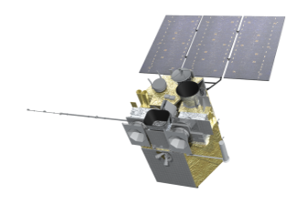
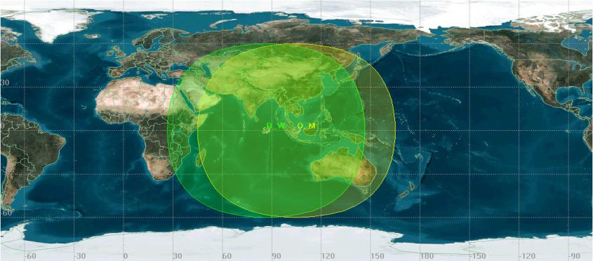
Fengyun GEO Constellation in 2018
Full Disk Scan
Rapid Regional Scan
In operation
FY-2G: Full Disk (99.5˚ E)
FY-2E: Full Disk (86.5˚E)
FY-2F: Regional (112˚E)
In trial operation
FY-4A: (105˚E)
In back-up
FY-2D: (123.5˚E)
FY-2E
FY-2G
FY-4A
FY-2F
FY-2D
Operation
Back-up
From April 16, 2018 FY-4A replaced FY-2G at 105˚E, FY-2G drifted to 99.5˚E.
FY-2E
B: 86.5ºE
FY-4A
A: 105ºE

Slide 6
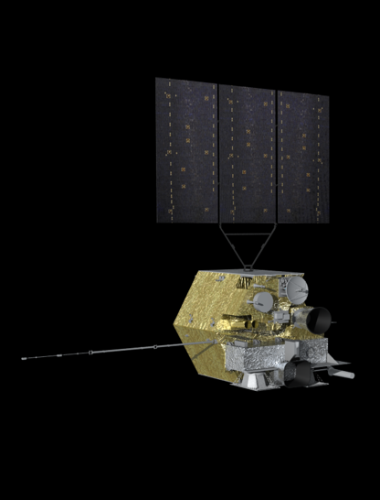
China’s new generation geostationary meteorological satellite FY-4
FY-4A
Spacecraft:
Launch Weight: approx 5300kg
Stabilization: Three-axis
Attitude accuracy: 3″
Bus: 1553B+Spacewire
Raw data transmission : X band
Output power: >= 3200W
Design life: over 7 years
GIIRS: Geo. Interferometric Infrared Sounder
AGRI: Advanced Geosynchronous Radiation Imager
LMI: Lightning Mapping Imager
SEP: Space Environment Package
Notes:
FY-4A is the first satellite of new generation meteorological geo-satellite, and expected to support various weather-related services, including weather forecasting, disaster prevention and reduction, and monitoring and warning of space weather.

Slide 7
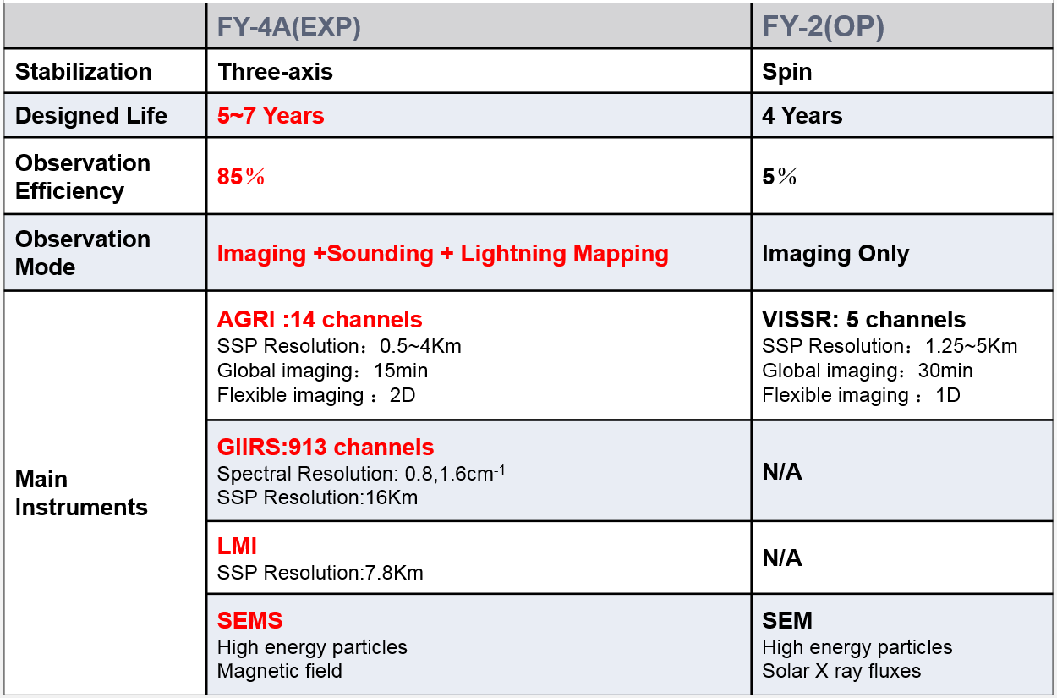
Advancement of FY-4A compared with FY-2
Notes:
FY4A is three-axis stabilization satellite. FY2 is spin stabilization satellite.
FY4A has longer design life and higher observation efficiency.
FY4A has more instruments and more channels in imager.

Slide 8
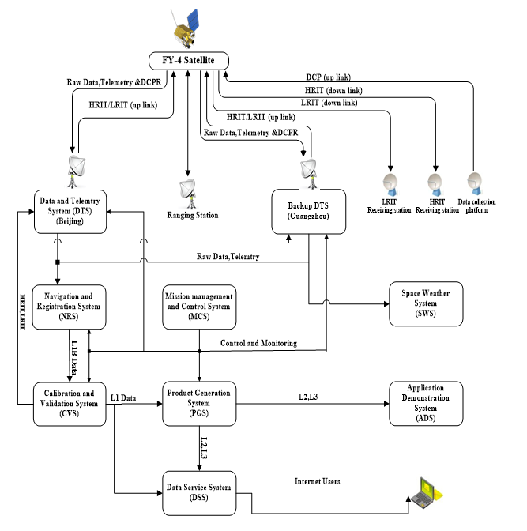
The flow chart of FY-4A ground segment

Slide 9
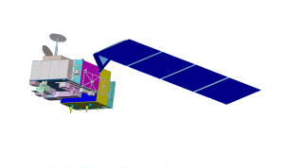
National Program for Fengyun Meteorological Satellite from 2011-2020
2013FY-3C(Op)
2014FY-2G(Op)
2016FY-4A (R&D)
2012FY-2F(Op)
2017FY-3D(Op)
2010FY-3B (R&D)
2018FY-2H(Op)
2018 FY-3E(Op)
2019FY-4B (Op)
2019FY-3F(Op)
2020FY-4C(Op)
2020FY-RM(Op)
2021 FY-3G(Op)
6 satellites will be launched within this decade

Slide 10
FY-2 to FY-4 Transition
04 | 05 | 06 | 07 | 08 | 09 | 10 | 11 | 12 | 13 | 14 | 15 | 16 | 17 | 18 | 19 | 20 | 21 | 22
FY-2D
FY-2E
FY-2F
FY-2G
Operational
FY-2H
Orbit storage or partially Operational
FY-4A
Extended service
FY-4B
Test or partially Operational
FY-4C
FY-4A was launched on December 10, 2016, FY-2H will be launched to mitigate the gap between the FY-2 and FY-4 in operation.

Slide 11
TOPIC
Status of FY-2 and FY-4 Satellites
Operational AMV System and Products
AMV System Architectures
AMV Products and Distribution
Historical dataset reprocessing progress
Future work

Slide 12
Operational AMV Systems
FY-2 AMV System
Generate FY-2E/FY2G AMV products
Run on PC Workstation
FY-4A AMV System
Generate FY-4A AMV products
Based on the cloud platform architecture

Slide 13
FY-4A AMV System
FY-4A AMV System is a subsystem of PGS
Notes:
FY-4A AMV System is a subsystem of PGS, is controlled and monitored under MCS. FY-4A AMV System is getting L1 data and auxiliary data from previous systems and generating AMV. AMV products are archiving and providing data service in DSS.

Slide 14
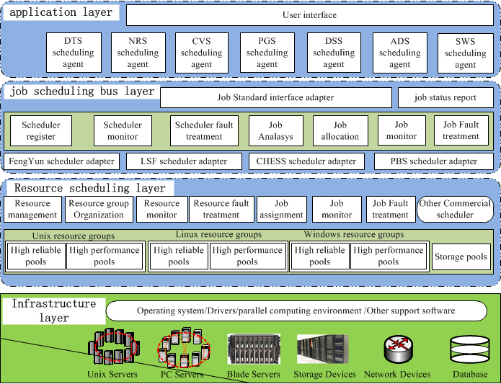
The cloud platform architecture of FY-4
Notes:
The cloud platform architecture of FY-4 consists of 4 layers: the infrastructure layer, the resource scheduling layer, the job scheduling bus layer and the application layer.

Slide 15
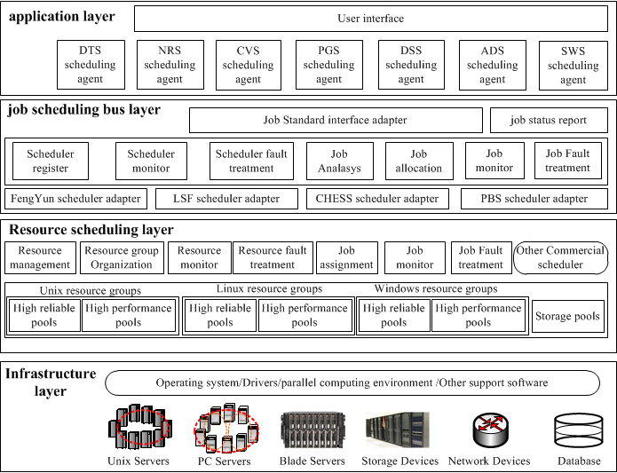
Architecture description
The infrastructure layer organizes all the medium and low level heterogeneous physical resources such as computing, networking and storage to supply high performance computing power, high-speed network and mass storage capacity.

Slide 16
Architecture description
The resource scheduling layer achieves the unified pool management of heterogeneous computing resources and designs fault-tolerant mechanisms that deal with resources and application exceptions to ensure high efficiency, flexibility and reliability of the resources.

Slide 17
Architecture description
The job scheduling bus layer is designed to provide a standard interface for job submission of application layer and is compatible with LSF, PBS, and other operation scheduler in the resource scheduling layer. Corresponding to a meta-scheduler, this layer can forward jobs to their appropriate schedulers, in which fault-tolerant strategies for fault handling are also designed.

Slide 18
Architecture description
The application layer is used to provide the user interface and operation logic management.

Slide 19
TOPIC
Status of FY-2 and FY-4 Satellites
Operational AMV System and Products
AMV System Architectures
AMV Products, and Distribution
Historical dataset reprocessing progress
Future work

Slide 20
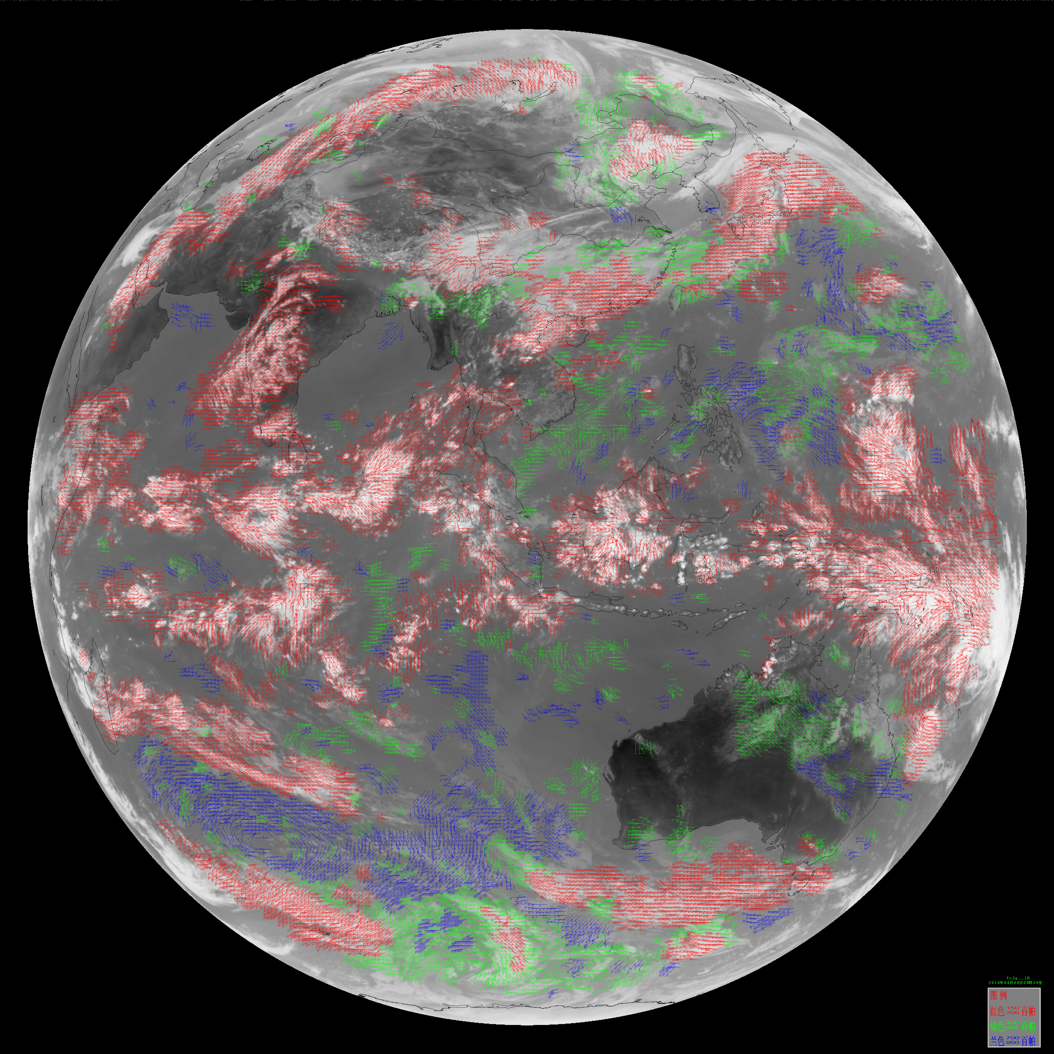
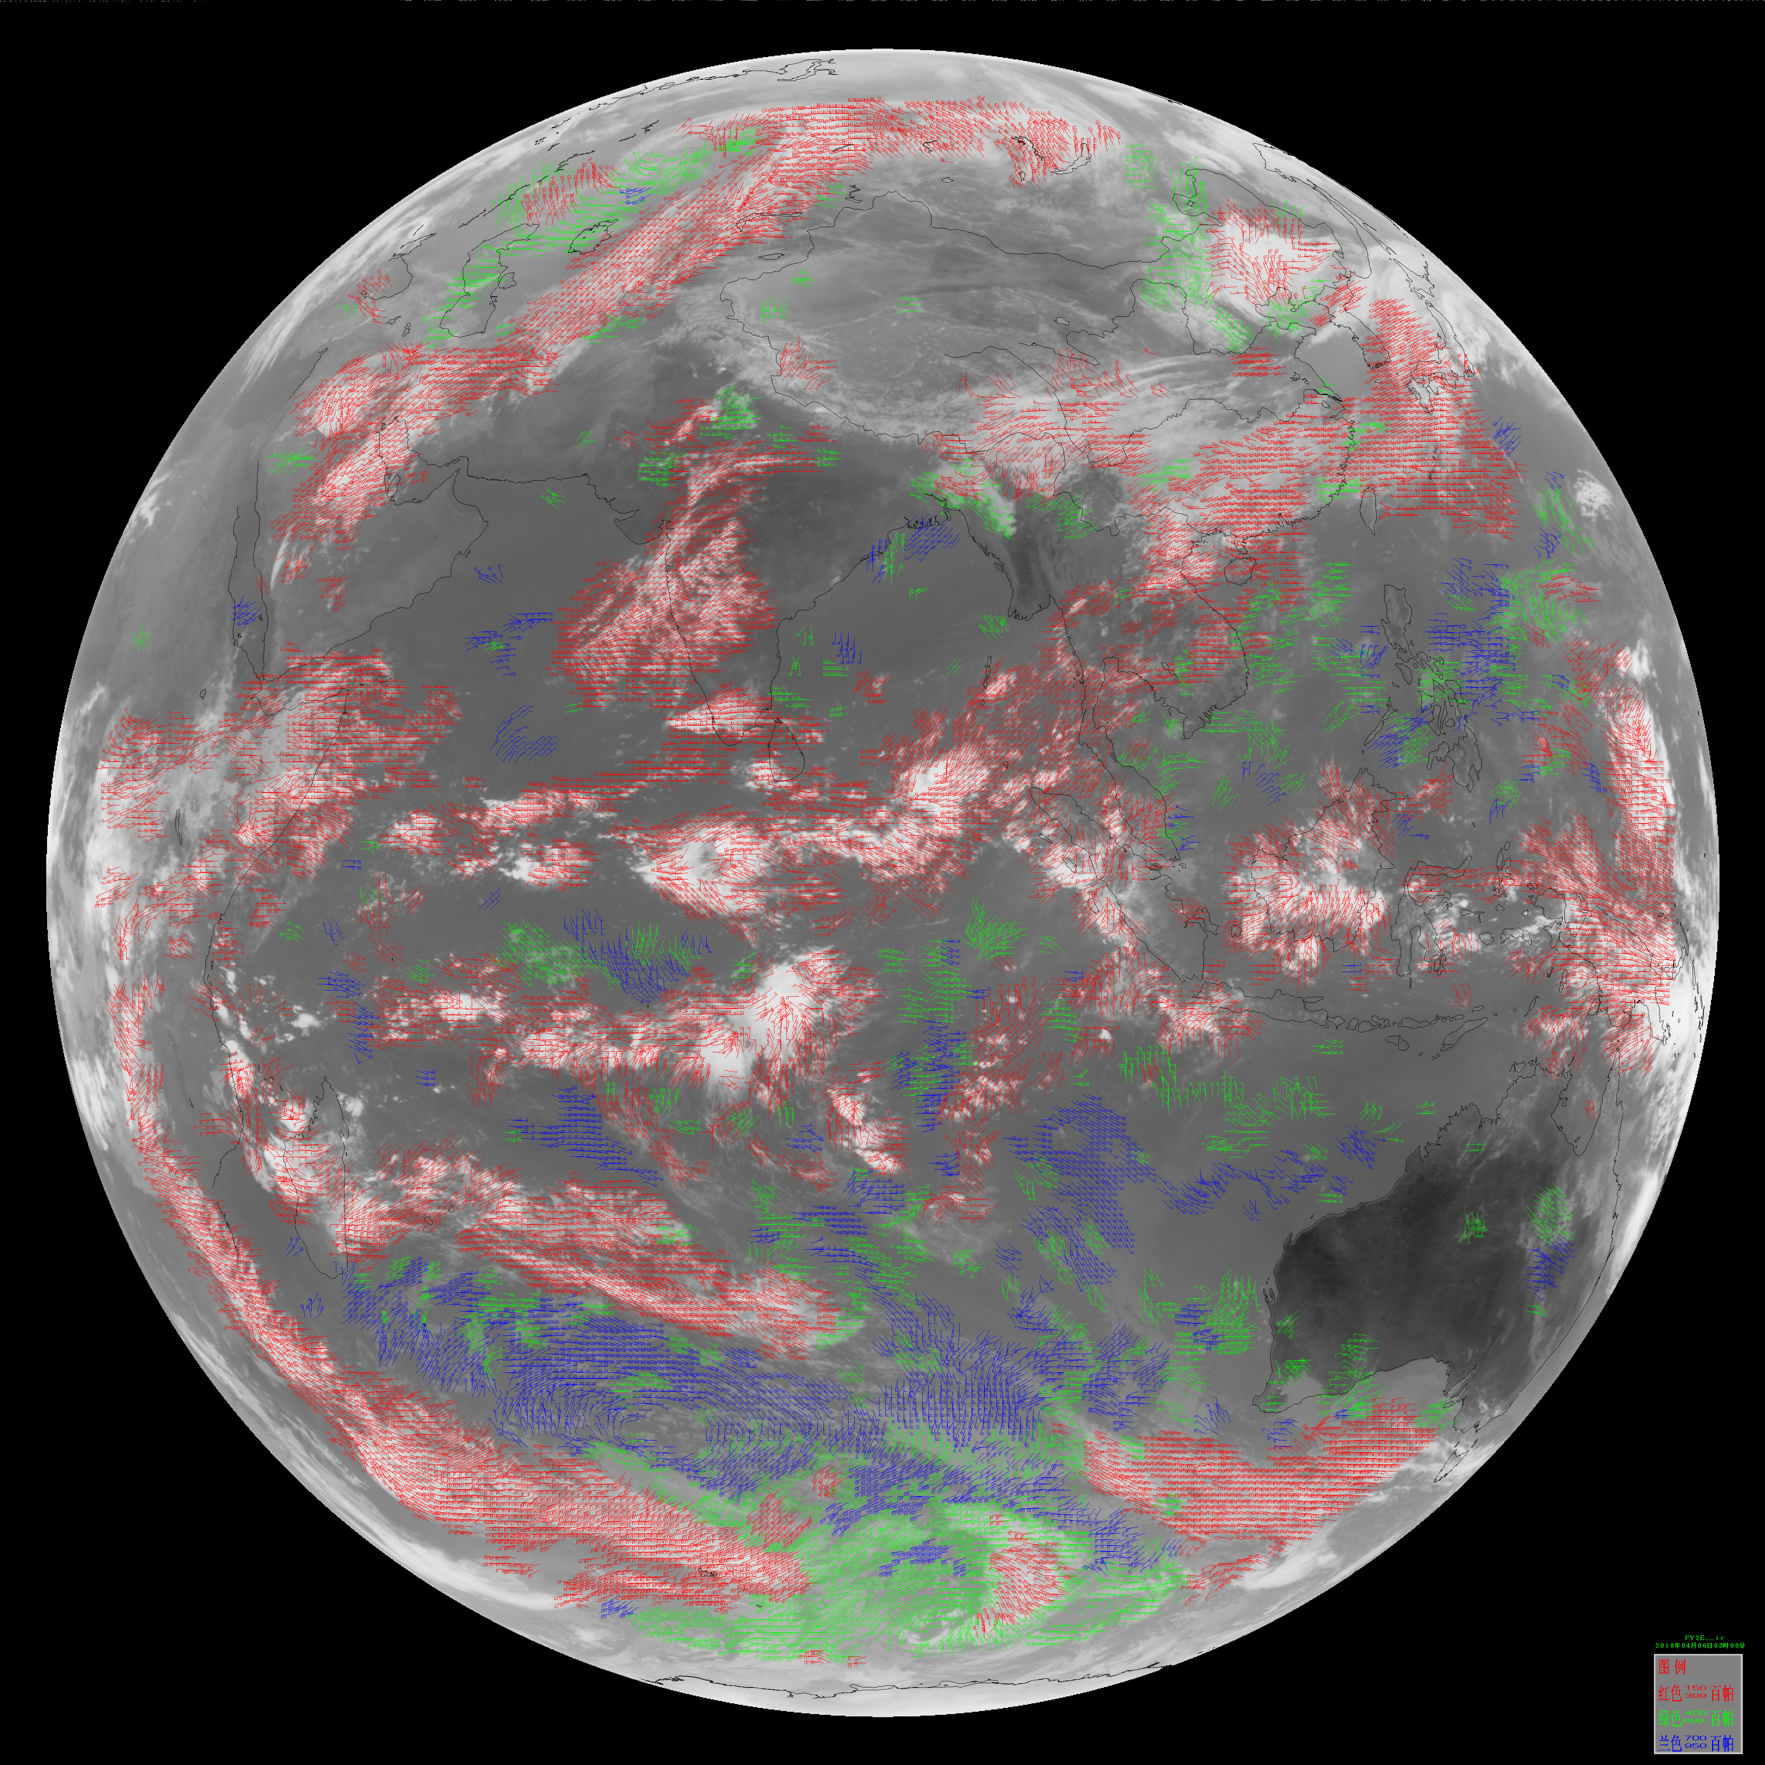
AMV products in operation
FY-2E, FY2G Winds
FY-2G
10.8um
FY-2E
10.8um

Slide 21
Current status of FY-2 winds
In FY-2 AMV operational schedule:
FY-2G generates AMV every 6 hours from 00UTC(00,06,12,18)
FY-2E generates AMV every 6 hours from 03UTC (03,09,15,21)
AMV Products | Frequency (hours) | Image Interval (min) | Format
FY-2G
LWIR (10. 8um) AMV | 6 | 30 | Native & BUFR
Water Vapor (6.7um) AMV | 6 | 30 | Native & BUFR
FY-2E
LWIR (10. 8um) AMV | 6 | 30 | Native & BUFR
Water Vapor (6.7um) AMV | 6 | 30 | Native & BUFR

Slide 22
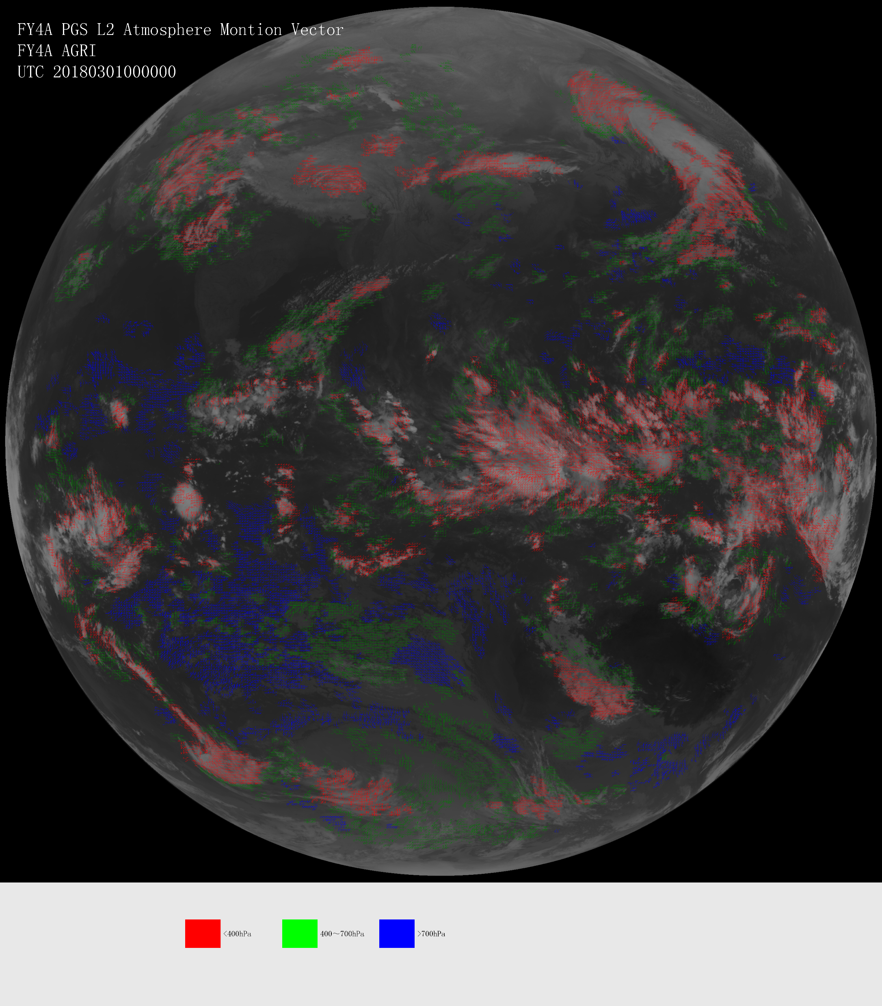
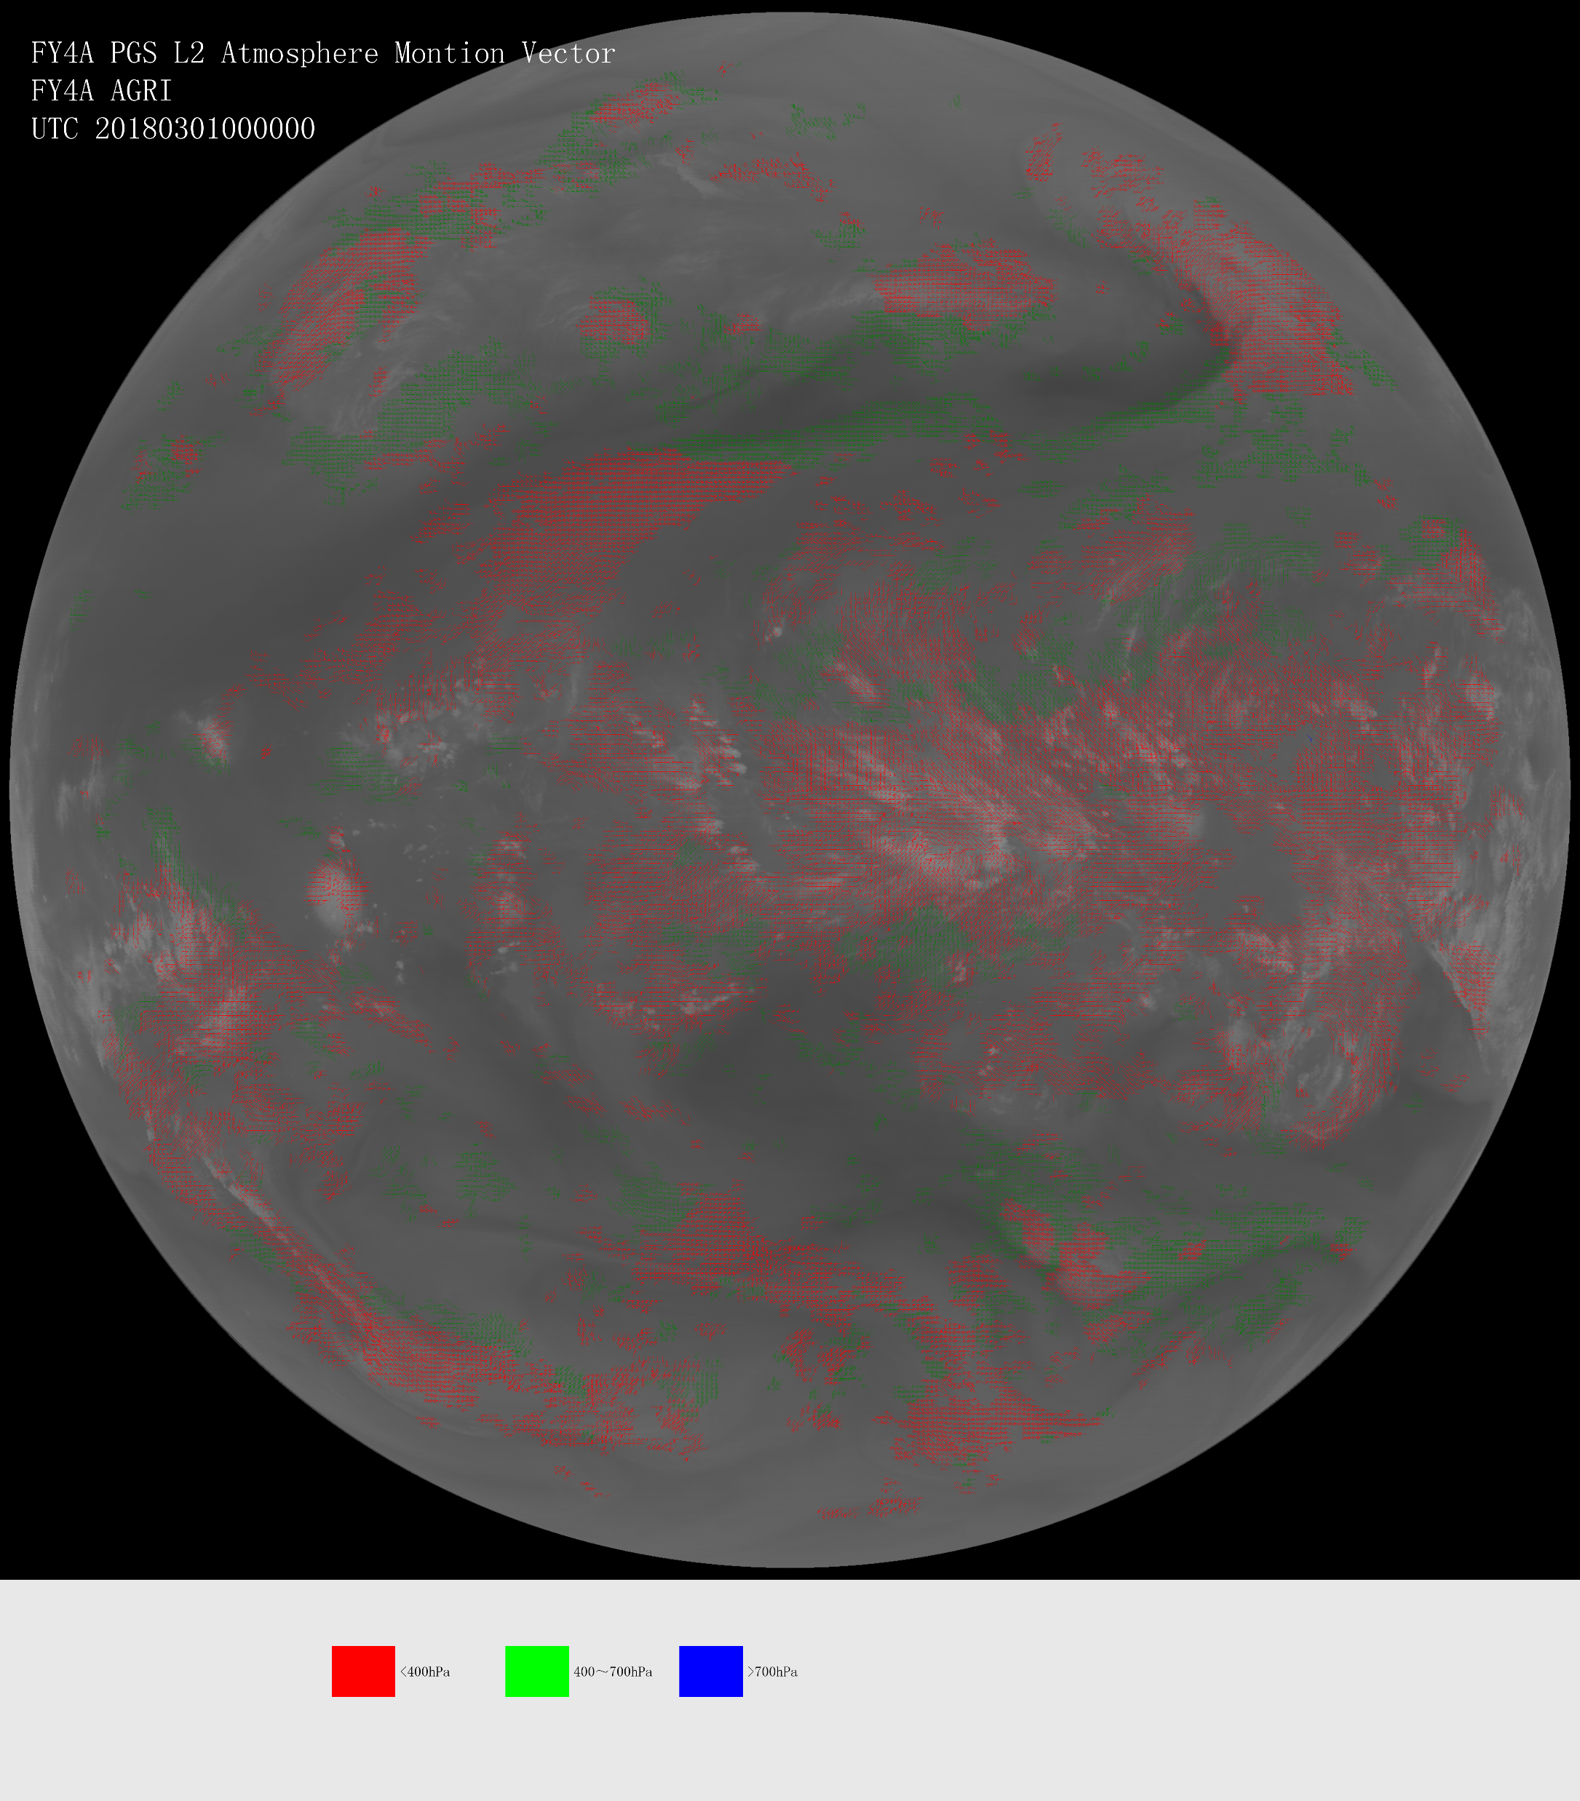
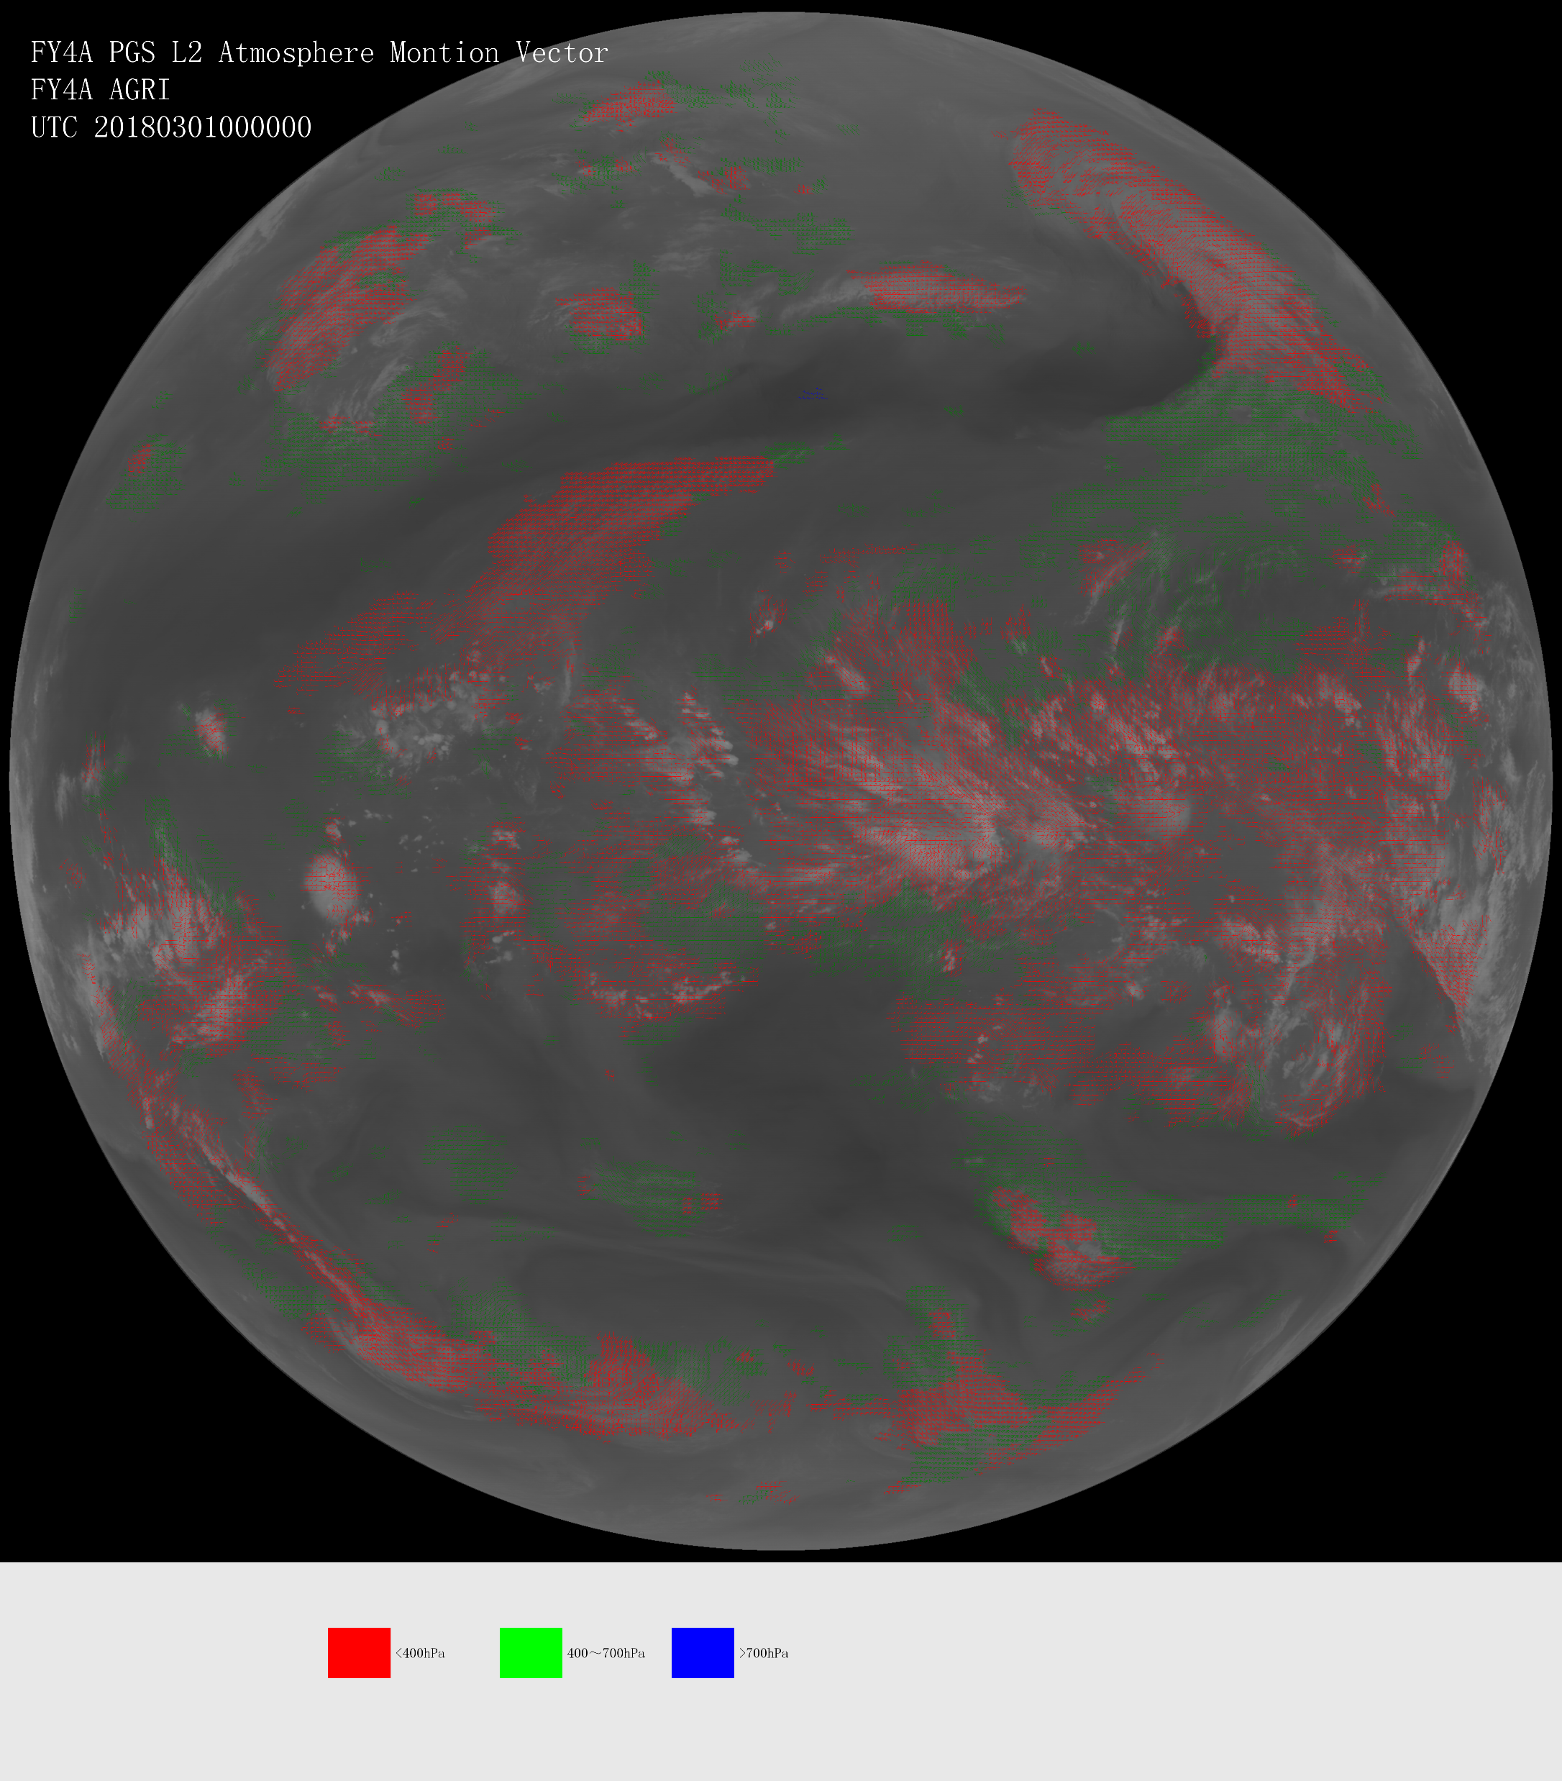
FY-4A AMV products in trial operation
10.8um
6.25um
7.10um

Slide 23
Current status of FY-4A winds
Every 3 hours from 00UTC
AMV Products | Frequency (hours) | Image Interval (min) | Format
LWIR (10. 8um) AMV | 3 | 15 | NETCDF4 & BUFR
Water Vapor (6.25um) AMV | 3 | 15 | NETCDF4 & BUFR
Water Vapor (7.10um) AMV | 3 | 15 | NETCDF4 & BUFR

Slide 24
AMV Products Distribution
FY-2E and FY-2G AMV products are in operation and distributed via FTP server or network share disk for intranet users and via GTS, CMACast or website for international users.
FY-4A AMV products are in trial operation and distributed via FTP server or network share disk for intranet users. In the near future they will be distributed via GTS, CMACast or website for international users.

Slide 25
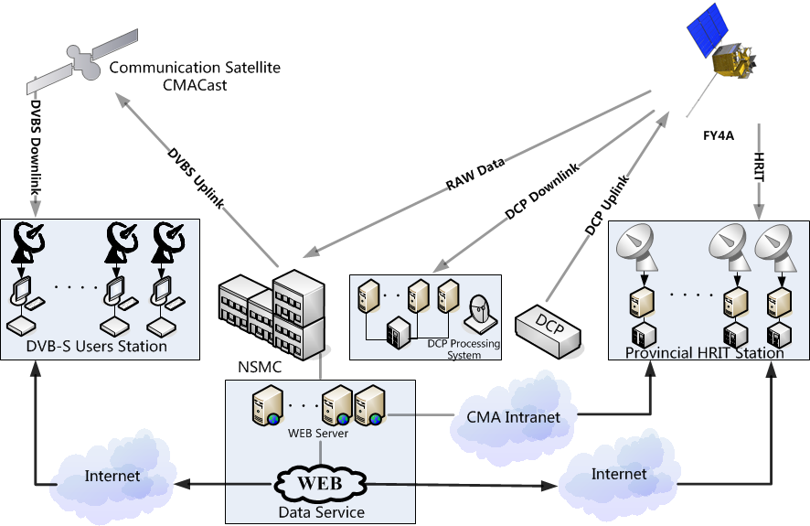
Data Service
Integrated Space/Ground Based Data Service System
Real time Data:
DB (L1)
CMACast (L2)
Non Real Time
Website
Manual Service
In addition:
Cloud Service
Notes:
For data service, there exists several ways for users to get FENGYUN data from. Users in FENGYUN satellites direct broadcast service area with appropriate receiving equipment can directly receive real time L1 data transmission of fy satellite. The CMACast users can receive L2 or L3 product with DVB-S equipment in near real time. The full NSMC dataset, both real time and historical data will be available on NSMC satellite data service website in English version (http://satellite.nsmc.org.cn). Users can search and download data after registration.

Slide 26
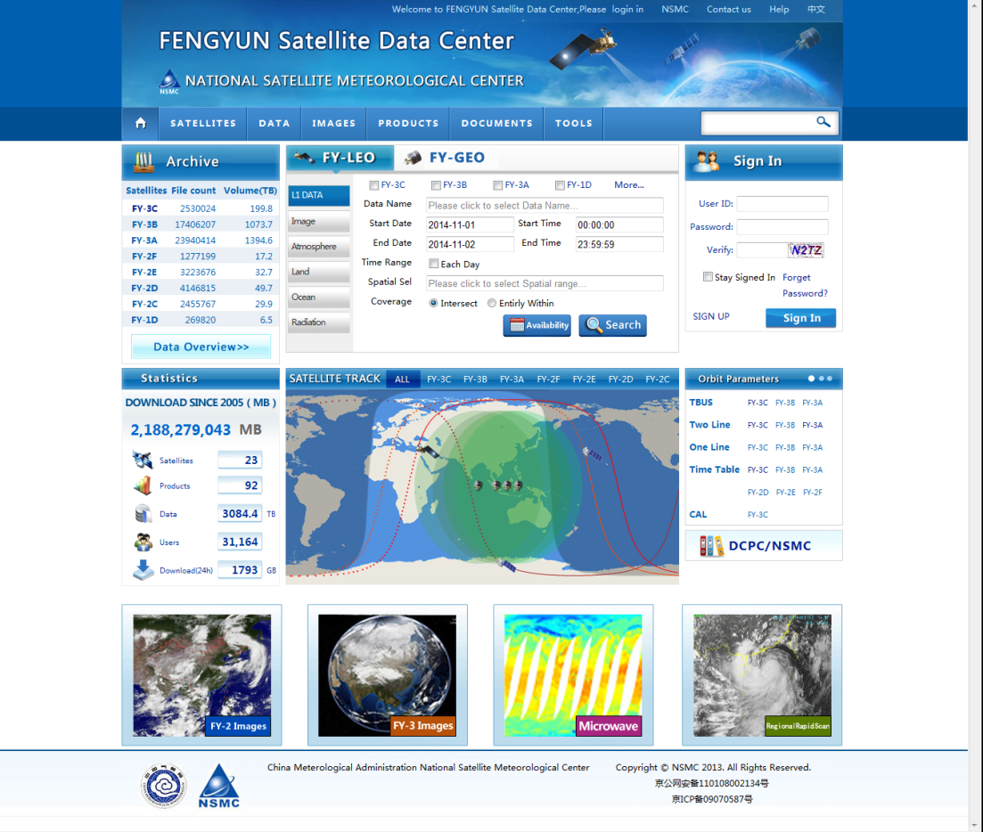
Data Service Web Portal
http://satellite.nsmc.org.cn
All 8PB archived data (real time)
Satellites’information
Satellite images browse
Documents and toolsand tools
User： freely register, update need authorize
Normal: 500MB/day
Junior: 3GB/day
Senior: 10GB/day

Slide 27
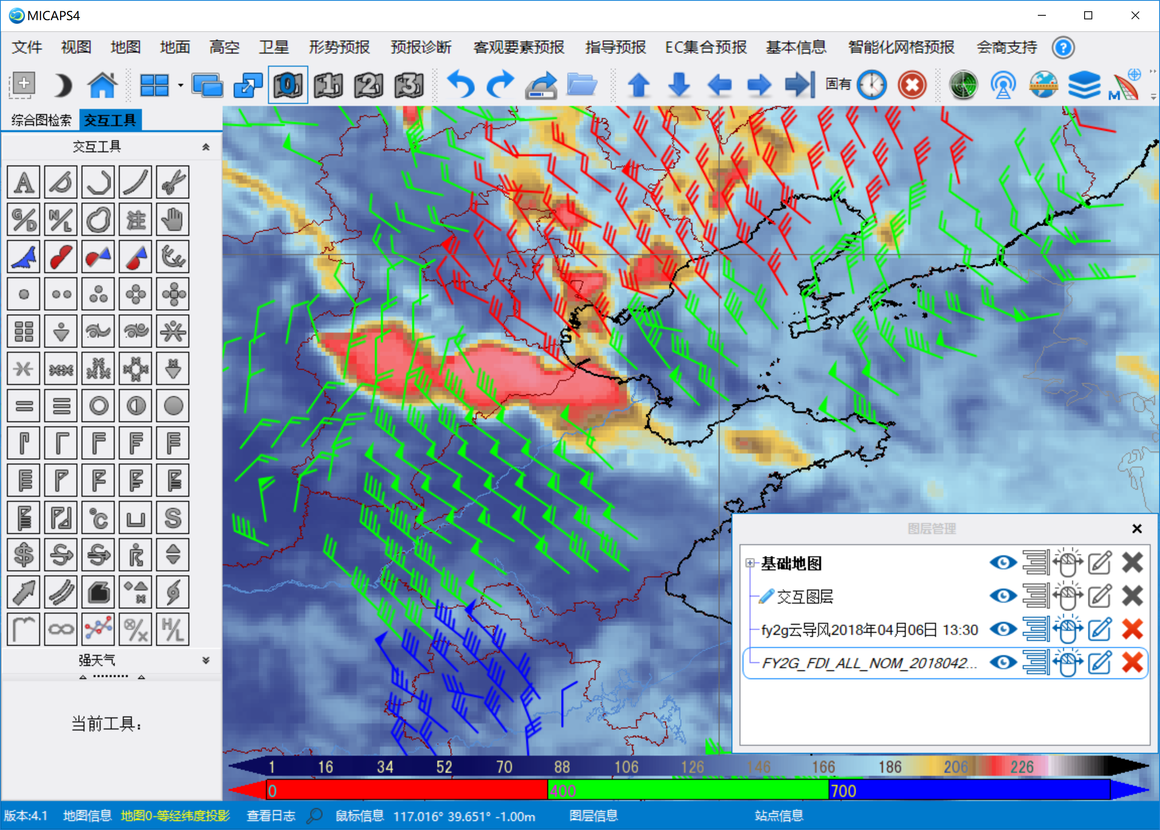
Day to Day Uses of AMV at MICAPS
MICAPS (Meteorology Information Comprehensive Analysis Process System)
MICAPS gives the field forecasters access to a multitude of digital data to help them in daily forecast preparation
MICAPS display software allows for easy integration of AMVs with a multitude of other data sources like model analyses/forecasts, observations from other observation systems

Slide 28
TOPIC
Status of FY-2 and FY-4 Satellites
Operational AMV System and Products
AMV System Architectures
AMV Products and Distribution
Historical dataset reprocessing progress
Future work

Slide 29
Historical dataset reprocessing progress
CMA started an project to reprocess the historical AMVs dataset in 2013.
Reprocess all historical AMVs data with latest AMVs algorithm(CMA Version 2014)
The project was finished by the end of 2017
Historical dataset:
SATELLITE | NADIR LONGITUDE | DATE | AMVs TIME (UTC)
FY-2C | 105º | Jan 1st, 2006 – Nov 24th, 2009 | 00/06/12/18
FY-2D | 86.5º | Feb 14th, 2007 – Dec 31st, 2013 | 03/09/15/21
FY-2E | 105º | Nov 23rd, 2009 – Dec 31st, 2013 | 00/06/12/18

Slide 30
Result of reprocessing FY-2E AMV
The comparison of quality of reprocessed AMV and operational AMV of in August 2013. (compared with ECMWF global atmospheric reanalysis data)
IR winds validation result:
The bias reduce by 1.303 m/s. (-2.855 to -1.552)
The STD reduce by 0.013 m/s. (5.031 to 5.018)
Aug.2013 FY-2E 0-400hPa (QI>80)

Slide 31
TOPIC
Status of FY-2 and FY-4 Satellites
Operational AMV System and Products
AMV System Architectures
AMV Products and Distribution
Historical dataset reprocessing progress
Future work

Slide 32
Future work
Continue to improve AMV products quality
Complete the test of FY-4A AMV products
FY-3 polar winds (in R&D status)

Slide 33
Thank you !

