Slide 2
Coffee Break
Date | 1st Time | 2nd Time
23 April (Mon) | 10:10-10:50 | 15:40-16:20
24 April (Tue) | 09:50-10:30 | 15:10-15:50
25 April (Wed) | 09:50-10:30 | -
26 April (Thu) | 10:20-11:00 | 15:20-16:00

Slide 3
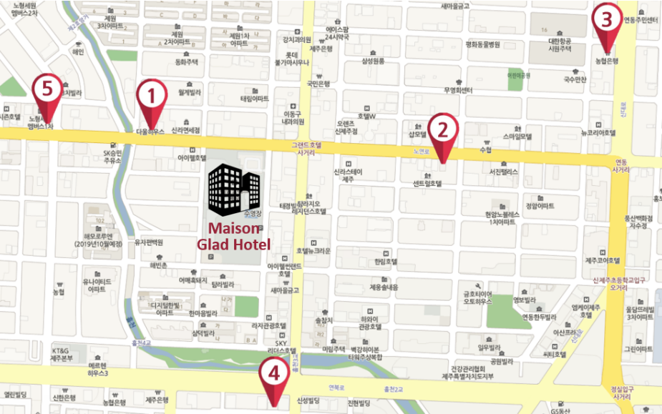
Restaurants
in walking distance
Name | Menu
① K-house | (Japanese cuisine) Curry, Noodles..
② Roost Place | Pasta, Salad, Steak..
③ ZZZ Jeju pork barbeque | Jeju Grilled Pork
④ Spoon the market | Shabu, Salad bar (meat, seafood)
⑤ GODAM 2015 | steak, rice, pasta..
* Detailed information will be provided at the registration desk.

Slide 4
Luncheon
We provide Luncheons on 25 April (Wed) and
on 26 April (Thu)
at Samdajeong (1F)

Slide 5
Ice-Breaker
17:15-18:15
Ice-Breaker will be held on 23 April (Mon) at the Jade Hall lobby.

Slide 6
Technical Visit
13:00-18:00
Please choose 1 tour program which you prefer either Plan 1 or Plan 2.
Let us know at the registration desk
before Wednesday.

Slide 7
Workshop Dinner
18:15-21:00
We will prepare Workshop Dinner on 26 April (Thursday)
at Jade Hall.

