Slide 1
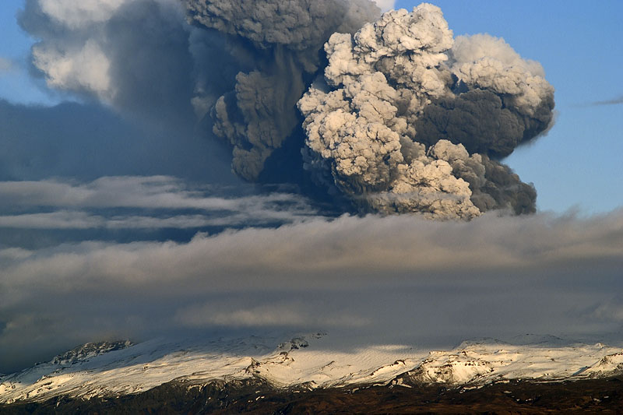
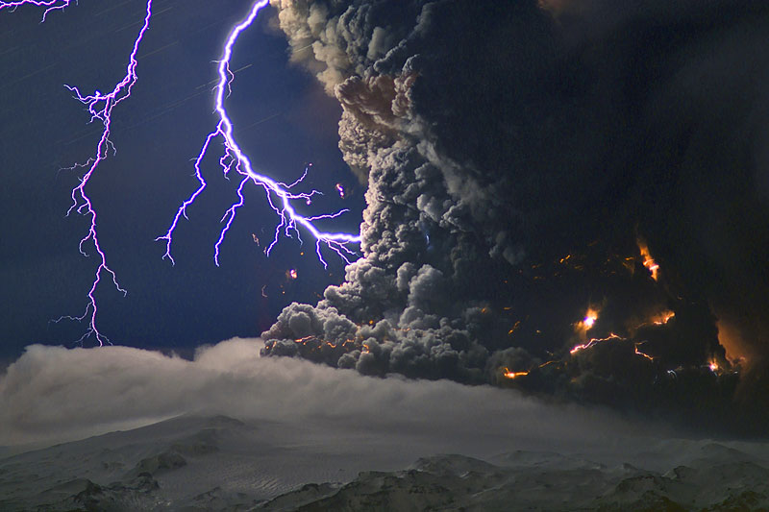
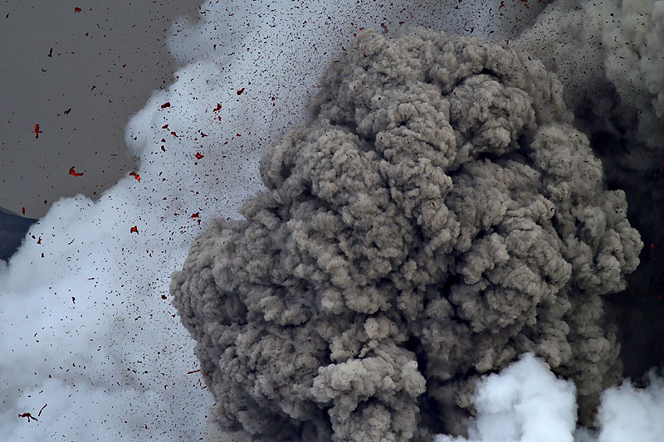
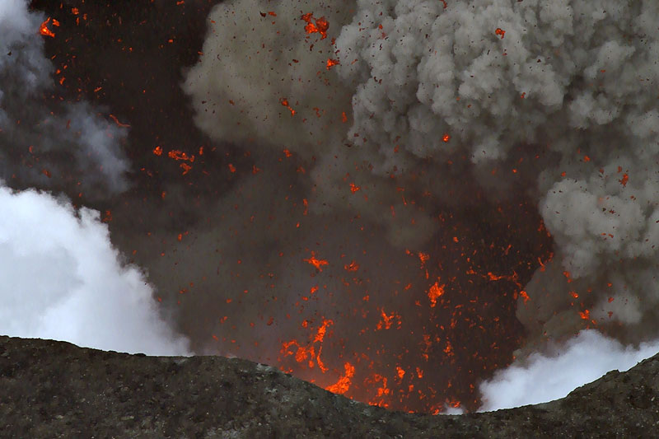
NOAA/UW-CIMSS GOES-R Volcanic Ash Product Training
Marco Fulle - www.stromboli.net
Michael Pavolonis
NOAA/NESDIS/STAR
Justin Sieglaff
UW-CIMSS

Slide 2
What You Should Know By The End of Training
What GOES-R Volcanic Ash products are available within AWIPS (physical meaning of products)
Product interpretation through examples of interest to Anchorage VAAC
Strengths and limitations of GOES-R products (including an assessment of product accuracy)
How to use GOES-R products operationally
Future improvements

Slide 3
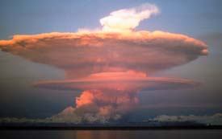
Introduction
End User Products viewable in AWIPS
Ash height (km and kilo-feet ASL)*
Ash mass loading (tons/km²)*
Ash particle effective radius (microns)*
These products are retrieved using satellite imager observations at 11, 12, and 13.3 µm
The GOES-R products are being made available by using MODIS as a proxy data source for the GOES-R ABI (similar spectral channels)
*While efforts are made to restrict the reporting of valid ash height, mass loading, and effective particle radius to satellite pixels that actually contain volcanic ash, these products will also sometimes have valid values when ash is NOT present.

Slide 4
Volcanic Ash Cloud Properties
Fully automated retrieval of ash cloud temperature, emissivity, and a cloud microphysical parameter
An atmospheric profile and an ash microphysical model are used to determine ash cloud height, mass loading, and effective particle radius
The retrieval is performed using infrared measurements and optimal estimation (e.g. Heidinger and Pavolonis, 2009; Heidinger et al., 2010)
Day/night independent
Developed in preparation for GOES-R
Notes:
-Optimal estimation framework provides error estimates
-As you might imagine, the three channel combination, which is used by the official GOES-R volcanic ash algorithm, is most desirable
-Why does the retrieval need to accommodate three different channel combinations?
-Next, introduce each panel in more detail.

Slide 5
Volcanic Ash Cloud Properties
Quantitative Ash Detection
Most important components: atmospheric correction of IR radiances and use of cloud objects (11-12 μm BTD need not be negative)
The ash detection methodology is based on the concepts described in Pavolonis et al. (2006) and Pavolonis (2010).
The GOES-R ash detection approach is currently being refined to be of “auto-alert quality”
Notes:
The ash detection algorithm was designed to mimic a human analyst as much as possible.

Slide 6
Volcanic Ash Cloud Properties
Ash Mass Loading
Ash mass loading is analogous to ash concentration
Larger values mean more ash material in atmospheric column than smaller values
Operational use: Where is the most ash within an observed ash cloud? How does this compare to dispersion model forecasts?
Approximate range of retrieval sensitivity: 0.5 – 100 ton/km²

Slide 7
Volcanic Ash Cloud Properties
Ash Cloud Height
The ash cloud height is a very important parameter for initializing dispersion models (forecasting component)
The retrieved height is generally between the top and bottom boundary of the ash cloud due to the limited vertical resolution of IR measurements

Slide 8
Volcanic Ash Cloud Properties
Ash Effective Radius
Ash effective radius is radiatively the most common ash particle size within a pixel
Particle size is well correlated with atmospheric residence time; exact relationship needs to be studied
Ash cloud away from vent will tend to have decreasing effective radius with time due to larger particles falling out (in the absence of particle aggregation)
Approximate range of retrieval sensitivity: 0.5 – 15 μm

Slide 9
Methodology - Retrievals
Space-borne lidar measurements are used to validate the GOES-R volcanic ash cloud products.
Lidar is similar to a radar that operates at visible wavelengths. Lidar provides very accurate cloud height information (ideal for validation), but is not routinely available (NOT ideal for operations)
The accuracy of the products have been assessed via independent measurements and can be trusted (if interested, the following slides illustrate the accuracy of the products); While the validation methodology is not of operational significance, the end results of the validation provide valuable insight into product accuracy.

Slide 10
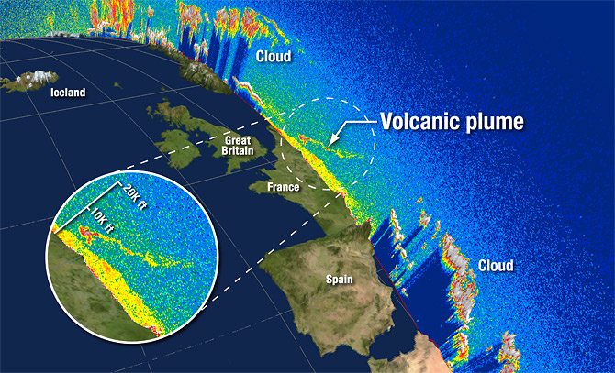
Retrieval Validation Approach
Spaceborne lidars, like CALIOP, provide accurate information on the vertical structure of clouds (60 m vertical resolution).
CALIOP ash cloud boundaries can also be used to compute mass loading (under the same assumptions used in the ash retrieval).

Slide 11
Lidar overpass
Ash cloud, south of Iceland
May 8, 2010 (04:00 UTC)

Slide 12
May 8, 2010 (04:00 UTC)
Both the GOES-R product and the lidar indicate that the height of the ash cloud varies considerably. The next slide shows a direct comparison.
Ash clouds

Slide 13
May 8, 2010 (04:00 UTC)
Single channel IR window
GOES-R product
The magenta circles indicate the height that would be inferred if the 11 μm brightness temperature were assumed to be equal to the cloud top temperature.
Ash clouds

Slide 14
May 8, 2010 (04:00 UTC)
Single channel IR window
GOES-R product
***Only the GOES-R product correctly depicts the spatial variability in ash cloud height
Ash clouds

Slide 15
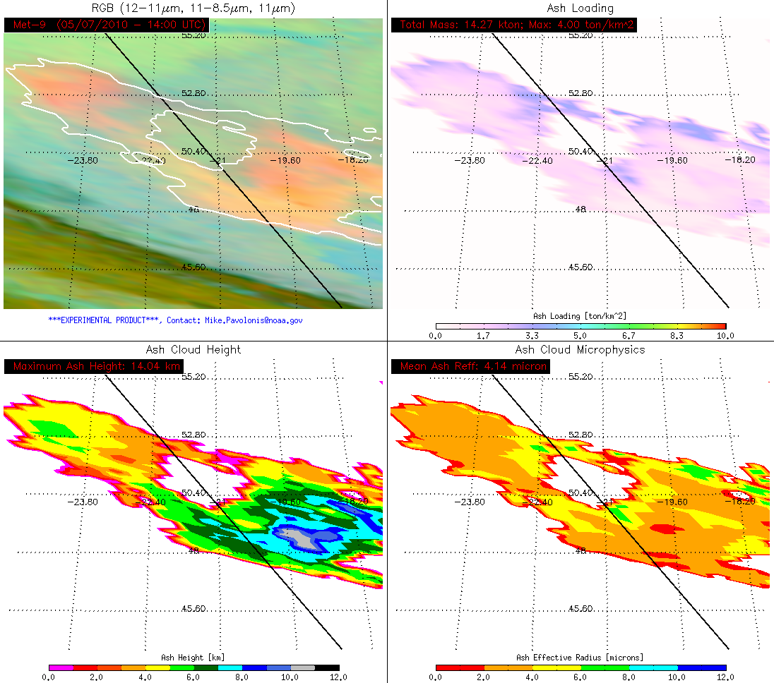
Lidar overpass
Ash cloud, south of Iceland
May 7, 2010 14:00 UTC)

Slide 16
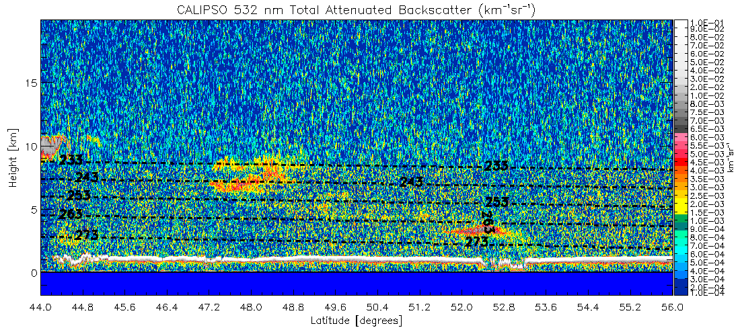
May 7, 2010 (14:00 UTC)
Once again, both the GOES-R product and the lidar indicate that the height of the ash cloud varies considerably. The next slide shows a direct comparison.
Ash clouds

Slide 17
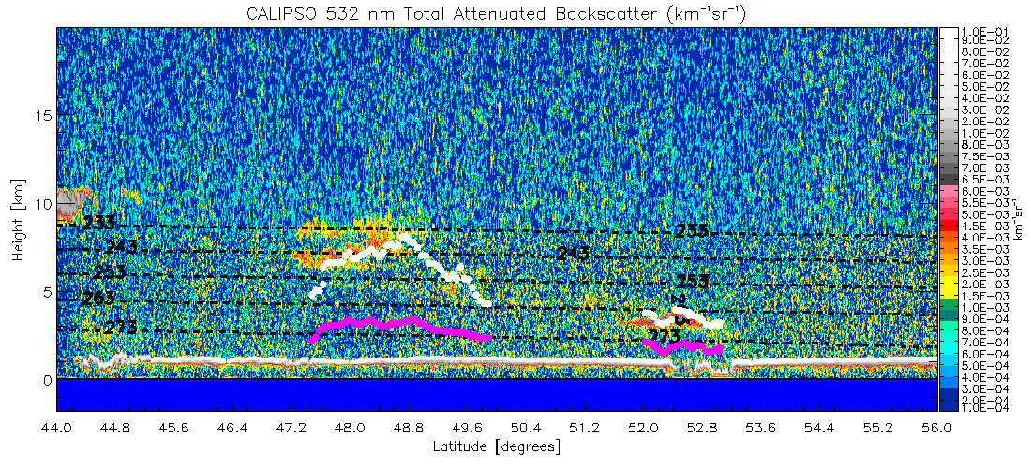
May 7, 2010 (14:00 UTC)
Single channel IR window
GOES-R product
The magenta circles indicate the height that would be inferred if the 11 μm brightness temperature were assumed to be equal to the cloud top temperature.
Ash clouds

Slide 18
May 7, 2010 (14:00 UTC)
Single channel IR window
GOES-R product
***Once again, only the GOES-R product correctly depicts the spatial variability in ash cloud height
Ash clouds

Slide 19
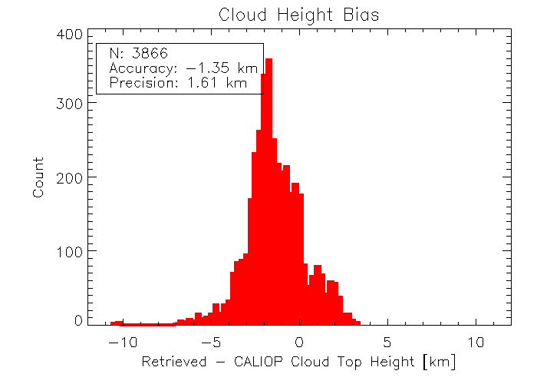
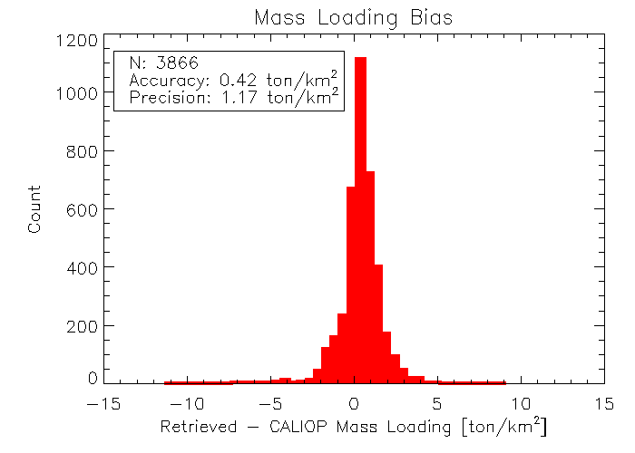
Ash Cloud Height
GOES-R Volcanic Ash Product Validation (using CALIOP - lidar) Statistics
Mass Loading
Effective Particle Radius

Slide 20
Methodology - Retrieval Validation Conclusions
The GOES-R ash cloud height product is very useful for capturing the spatial variability in ash cloud height.
The GOES-R ash cloud heights are biased low by about 1.35 km (~4500 feet). This bias is largely due to the finer vertical resolution of the LIDAR compared to the infrared-based GOES-R measurements
The GOES-R ash cloud height product is much more accurate than the height inferred if it is assumed that the 11 μm brightness temperature is equal to the cloud top temperature.
Given the 4500 ft overall low bias; a ~5000 ft (~3000 ft) buffer should be added to clouds that reside in the middle troposphere or above (lower troposphere) when using the GOES-R ash cloud height in operations, just as uncertainty buffers are applied when using other sources of ash cloud height information (e.g. PIREPS, radar, etc…)
While difficult to validate, the spatial patterns in ash mass loading and effective particle radius are physically consistent with lidar measurements

Slide 21
High Latitude Example from Eyjafjallajökull
The GOES-R products were also tested using EUMETSAT’s SEVIRI instrument, which provides coverage of Europe and the N. Atlantic from a geostationary orbit and has similar channels as GOES-R ABI and MODIS
SEVIRI is a geostationary instrument and can be used to make satellite movies. Unfortunately, such loops are not possible with the polar orbiting MODIS instrument that provides coverage of the A-VAAC’s area of responsibility
Nonetheless, the GOES-R ash cloud products were tested in real-time (and made available to the London VAAC) during the eruption of Eyjafjallajökull
The following loop demonstrates products for long-lived high latitude eruption; this type loop will be available with the GOES-R ABI

Slide 22
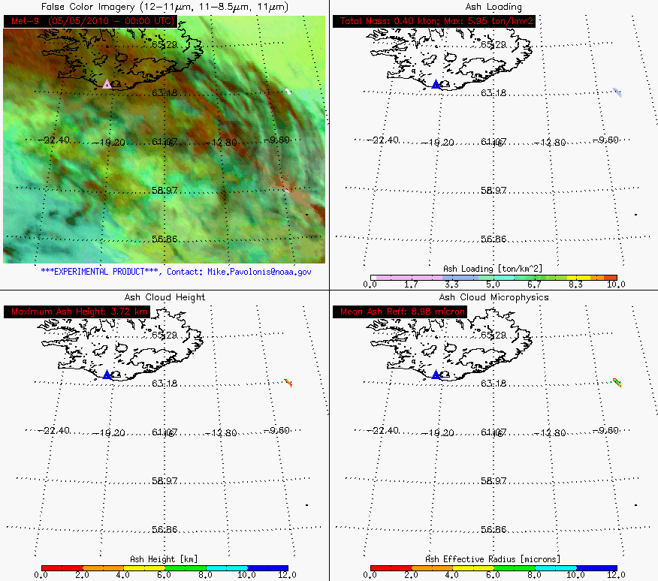

Slide 23
AWIPS Examples
We use false color RGB images to highlight the ash plume; then AWIPS four panel screen shots of GOES-R products are shown
Ash clouds in false color RGB images will generally be red/pink/magenta
Unfortunately, false color images cannot be displayed in AWIPS. They are included here for training purposes to aid in scene interpretation.
Due to the Wisconsin centric setup of our local AWIPS system, Alaska and Kamchatka will appear ‘sideways’; this will not be the case on your AWIPS

Slide 24
Examples - Redoubt
March 23, 2009 12:35 UTC
Ash cloud near and north of Anchorage

Slide 25
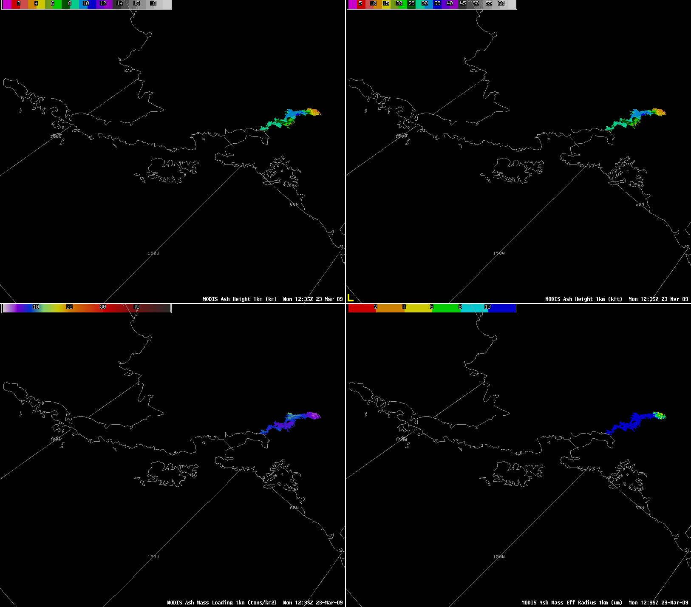
Examples - Redoubt
March 23, 2009 12:35 UTC
Height
(km)
Height
(kft)
Maximum cloud height ~ 36,000 feet ASL
Effective radius
(microns)
Mass loading
(ton / km²)

Slide 26
Zoom-in on Height (kft)
Maximum cloud height ~ 35,000 feet ASL (agrees well with NEXRAD and AVO radar estimates)

Slide 27
Zoom-in on Mass Loading (ton/km²)

Slide 28
Zoom-in on Effective Radius (μm)

Slide 29
Examples - Redoubt
March 25, 2009 22:40 UTC
Ash cloud near and south of Anchorage

Slide 30
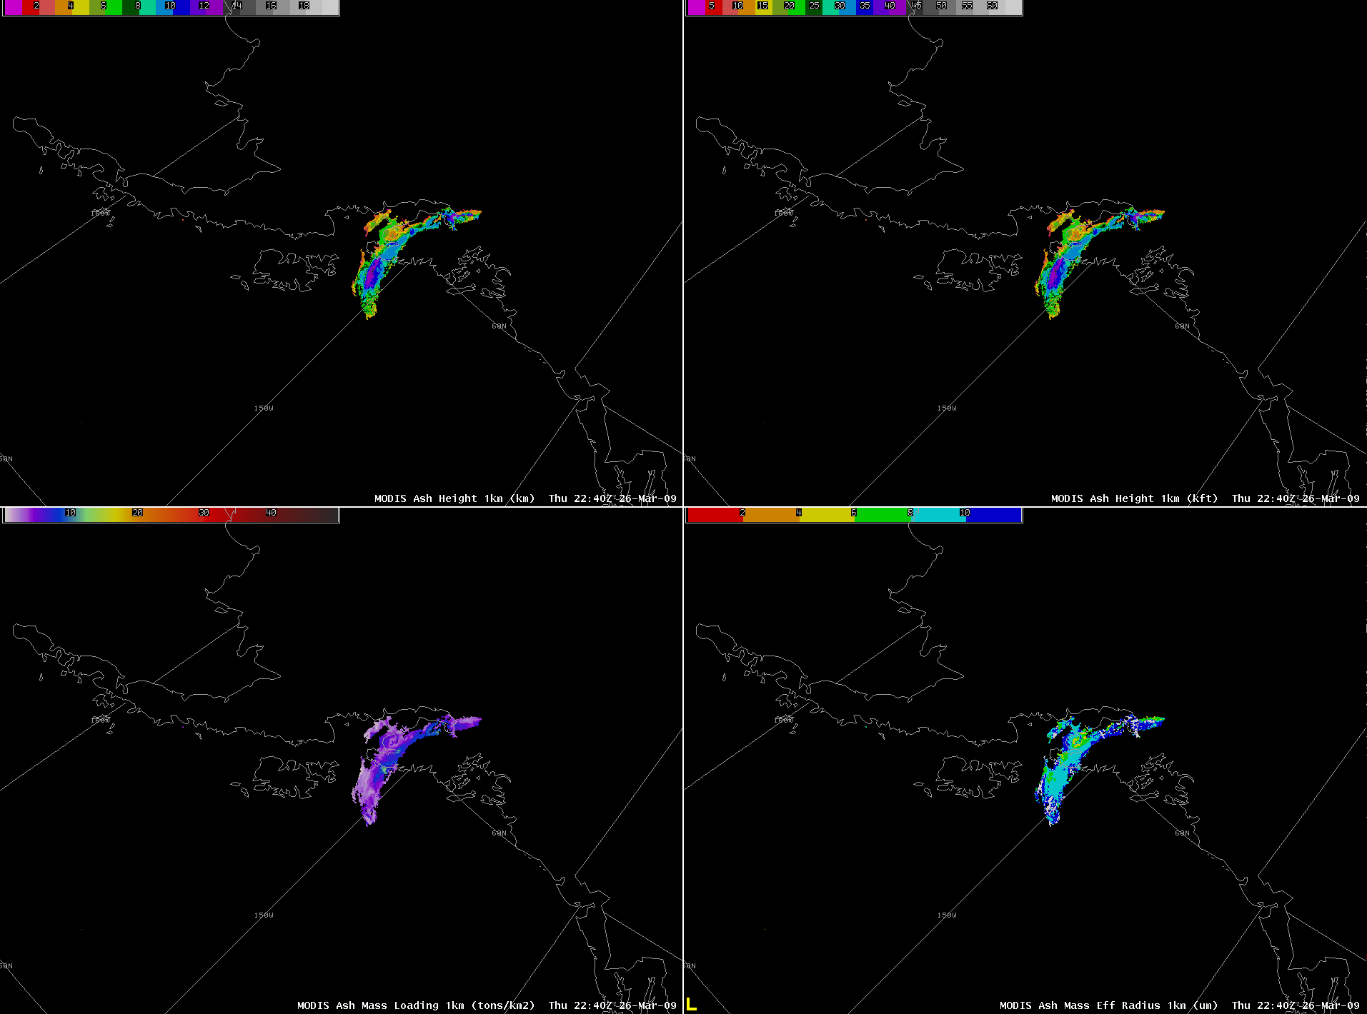
Examples - Redoubt
March 25, 2009 22:40 UTC
Height
(km)
Height
(kft)
Maximum heights ~ 13km or 40 kft
Effective radius
(microns)
Mass loading
(ton / km²)

Slide 31
Examples - Redoubt
April 1, 2009 22:05 UTC
Eruption of Redoubt

Slide 32
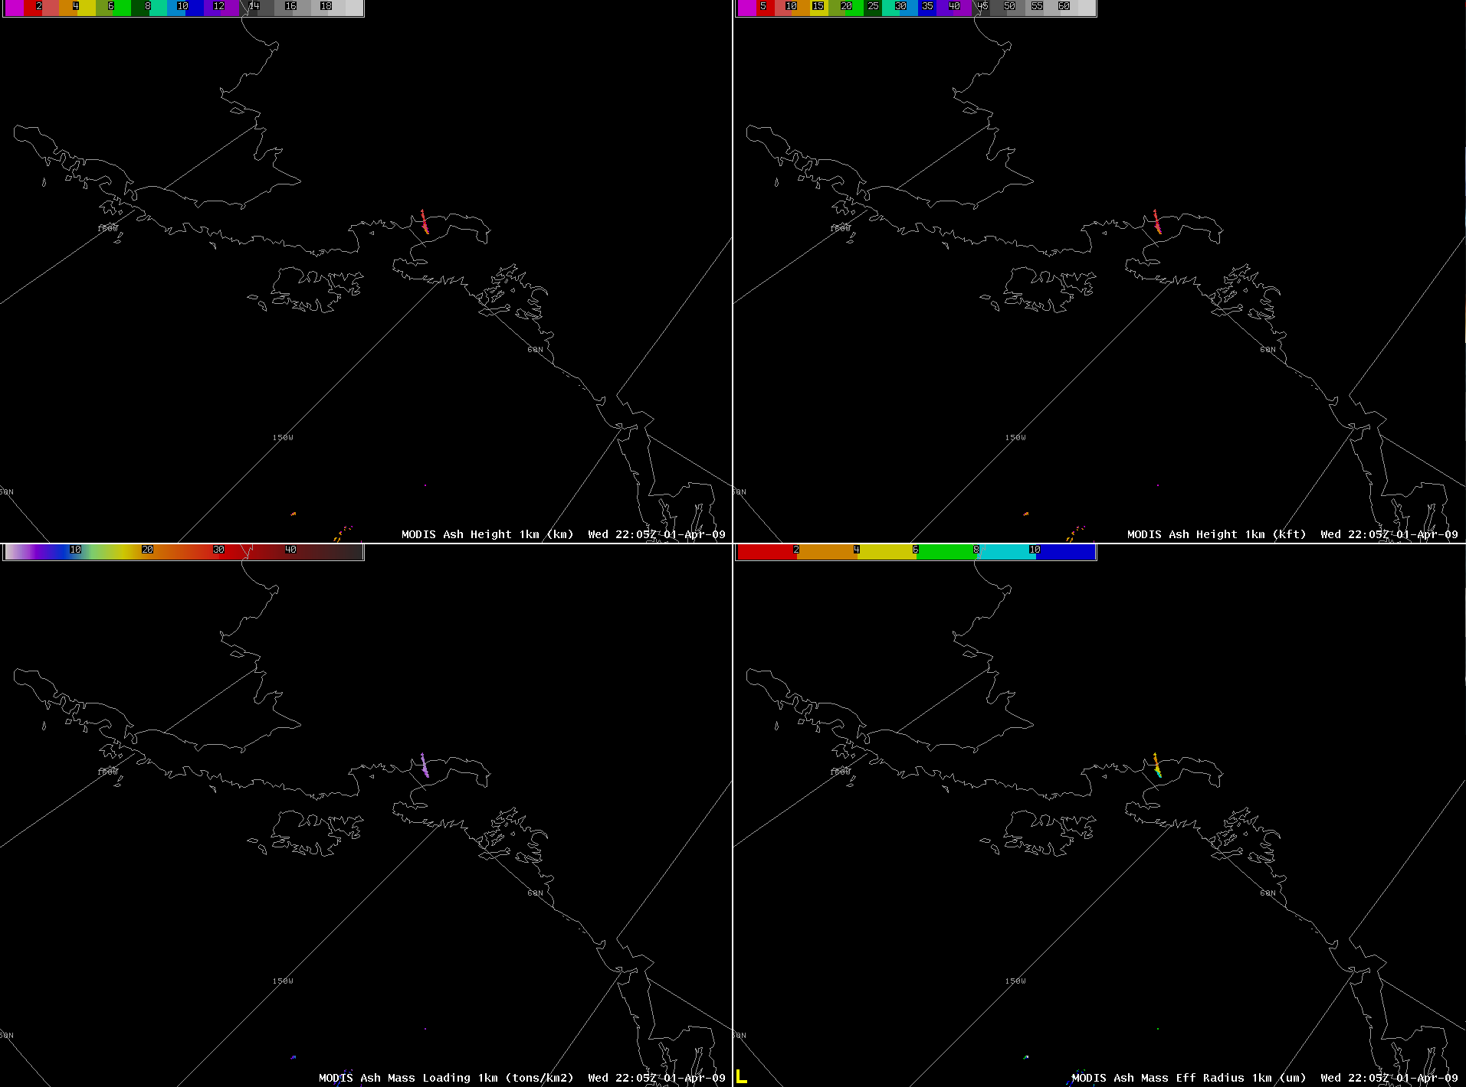
Examples - Redoubt
April 1, 2009 22:05 UTC
Height
(km)
Height
(kft)
Maximum cloud height ~ 12,000 feet ASL
Effective radius
(microns)
Mass loading
(ton / km²)

Slide 33
Examples - Redoubt
April 4, 2009 22:35 UTC
Large thin ash cloud southeast of the summit

Slide 34
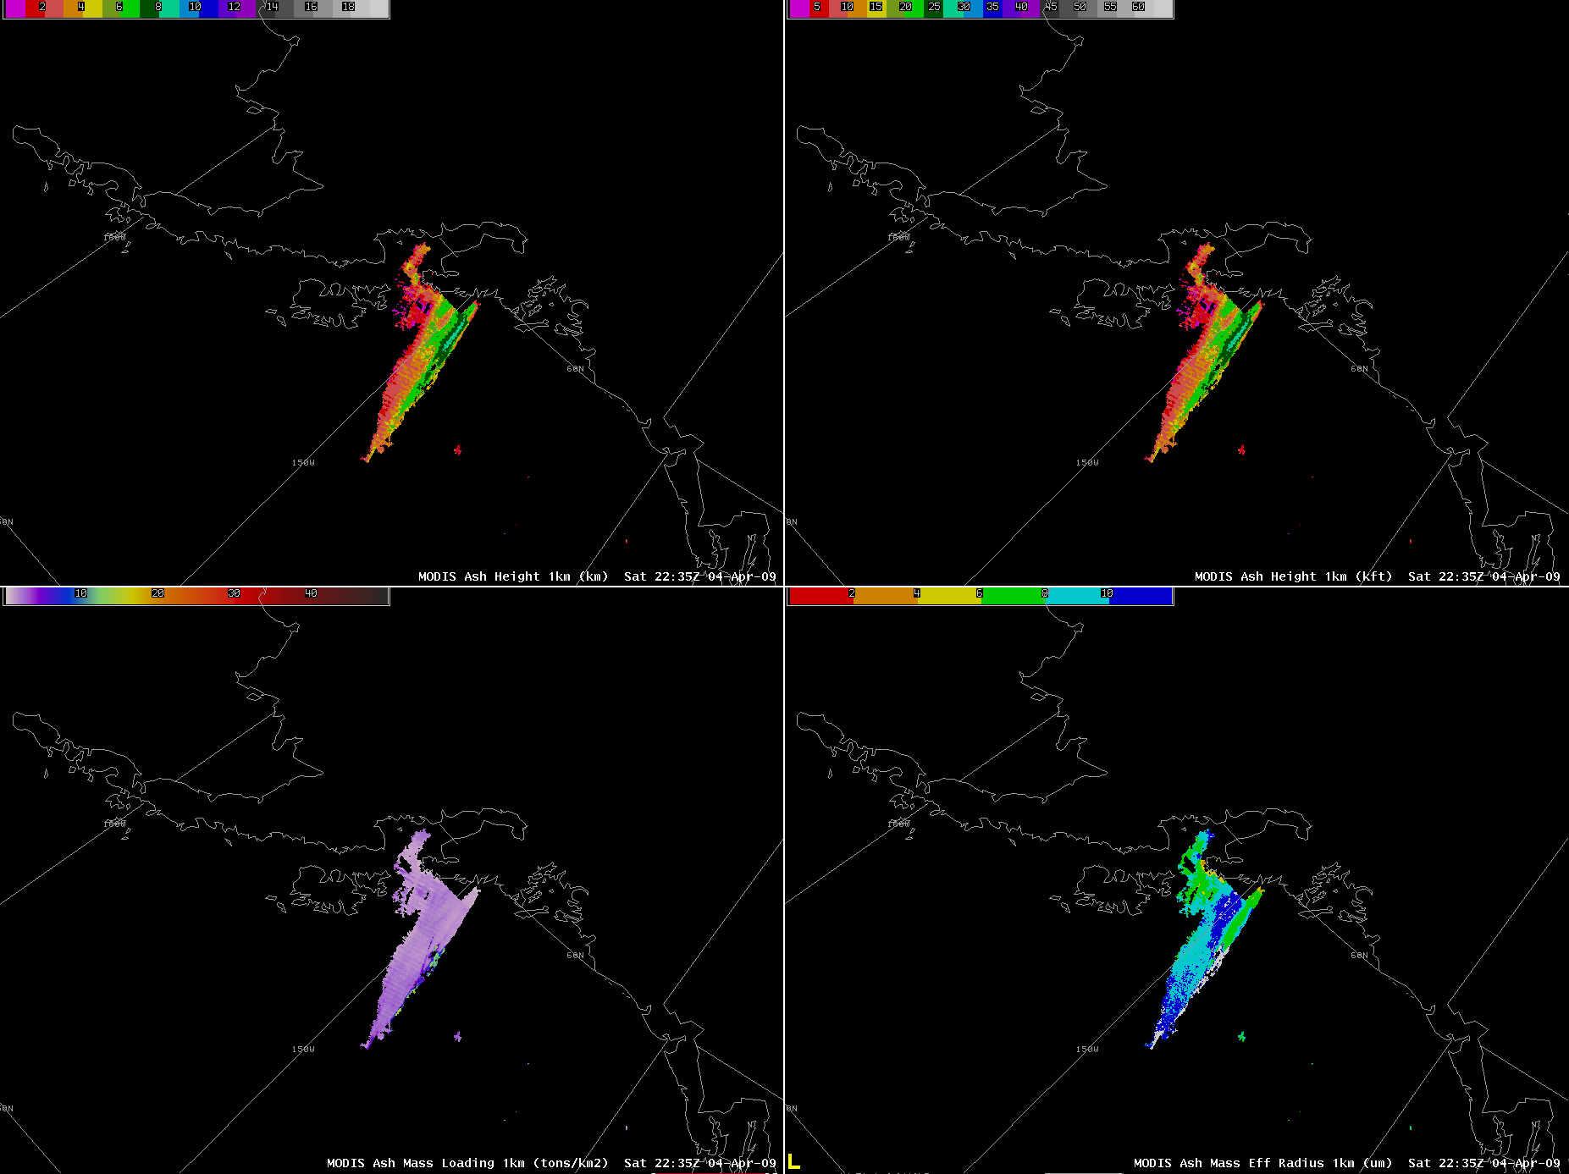
Examples - Redoubt
April 4, 2009 22:35 UTC
Maximum cloud height ~ 27,000 feet ASL
Height
(km)
Height
(kft)
Effective radius
(microns)
Mass loading
(ton / km²)

Slide 35
Examples - Kasatochi
August 8, 2008 13:40 UTC
Explosive eruption of Kasatochi

Slide 36
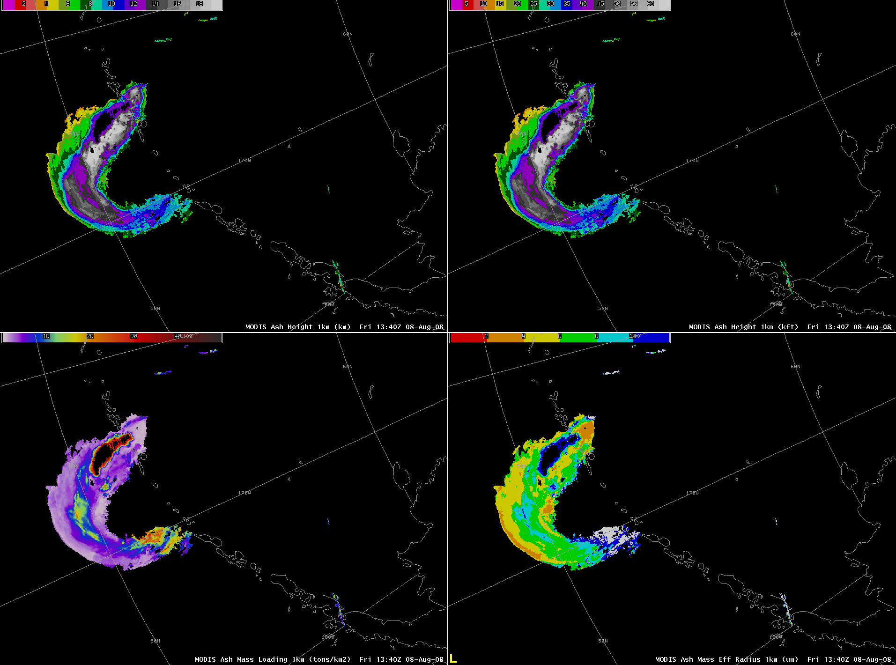
Examples - Kasatochi
August 8, 2008 13:40 UTC
Height
(km)
Height
(kft)
Explosive initial eruption with retrieved heights of up to 19 km or 60 kft! Agrees with AVO cloud shadow estimates.
Effective radius
(microns)
Mass loading
(ton / km²)
Note initial effective radius of ash particles is fairly large
Mass loading contamination due to ice particles mixed with ash

Slide 37
Examples - Kasatochi
August 9, 2008 12:45 UTC
Ash cloud wrapped up in mid-latitude low; with continued emission from volcano

Slide 38
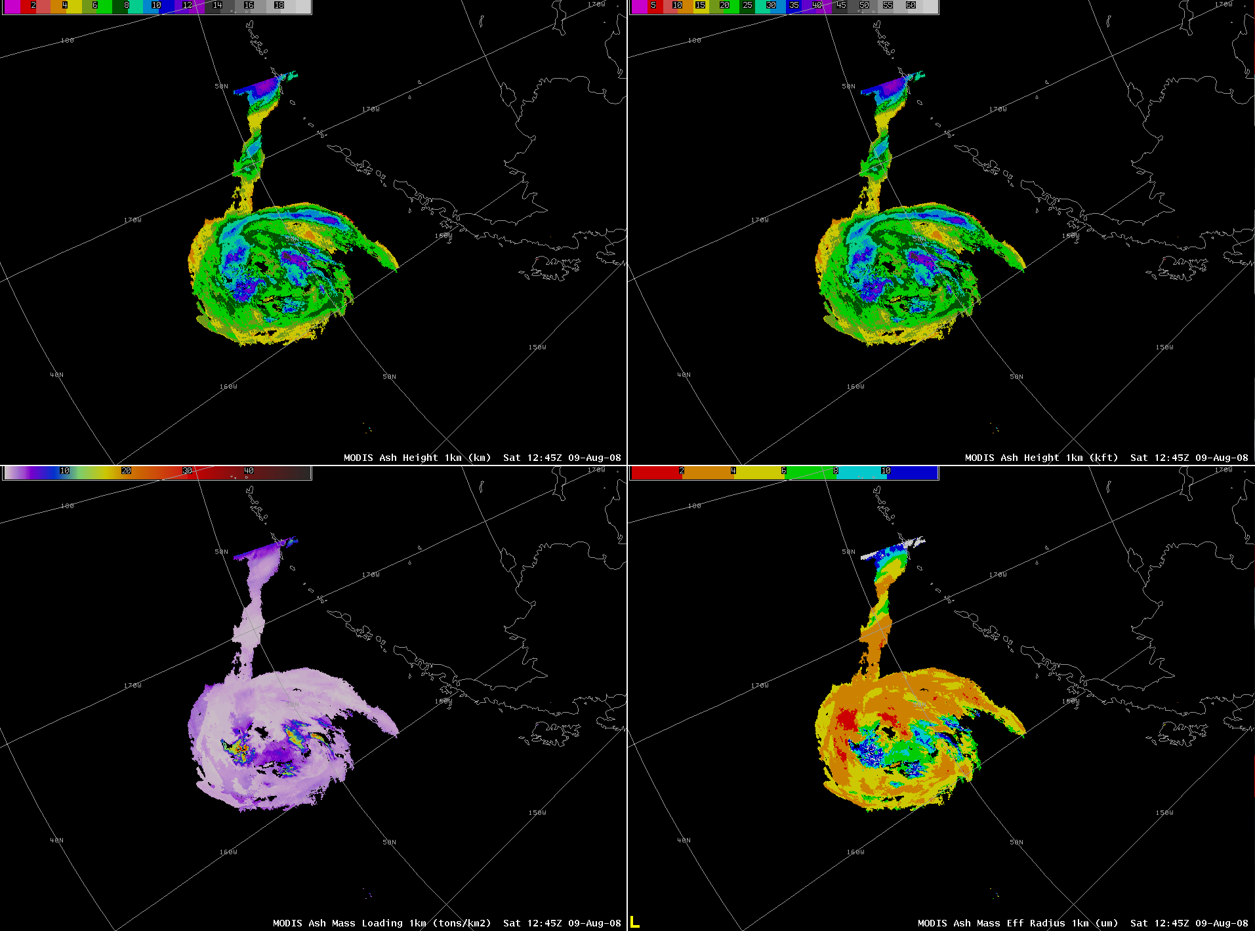
Examples - Kasatochi
August 9, 2008 12:45 UTC
Height
(km)
Height
(kft)
Maximum cloud height ~ 43,000 feet ASL
Effective radius
(microns)
Mass loading
(ton / km²)
Larger ash particles fallout, effective radius decreases

Slide 39
Examples - Kasatochi
August 9, 2008 23:55 UTC
Remnant ash cloud wrapped up in mid-latitude low

Slide 40
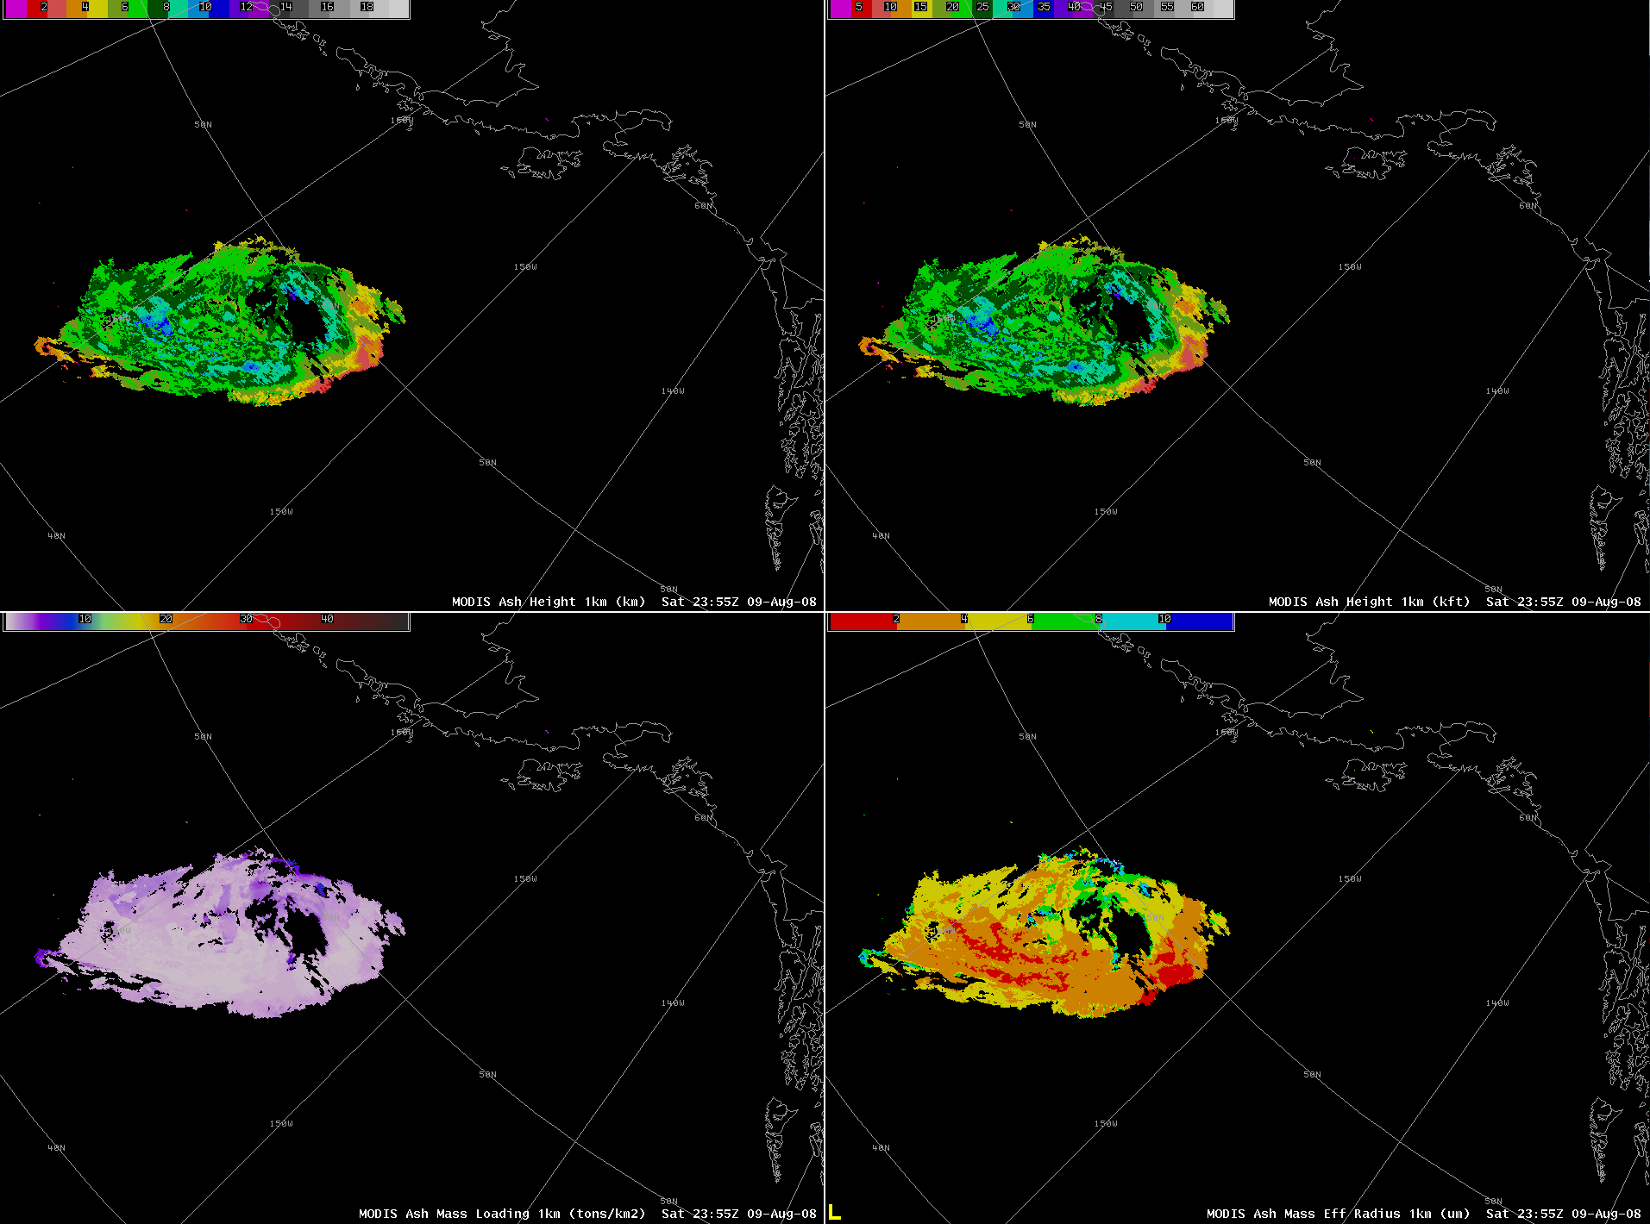
Examples - Kasatochi
August 9, 2008 23:55 UTC
Height
(km)
Height
(kft)
Maximum cloud height ~ 36,000 feet ASL
Effective radius
(microns)
Mass loading
(ton / km²)
Only very small ash particles remain ~1-4 microns

Slide 41
Examples - Kamchatka
September 13, 2010 02:00 UTC
Ash cloud from 11th drifted east over the Pacific

Slide 42
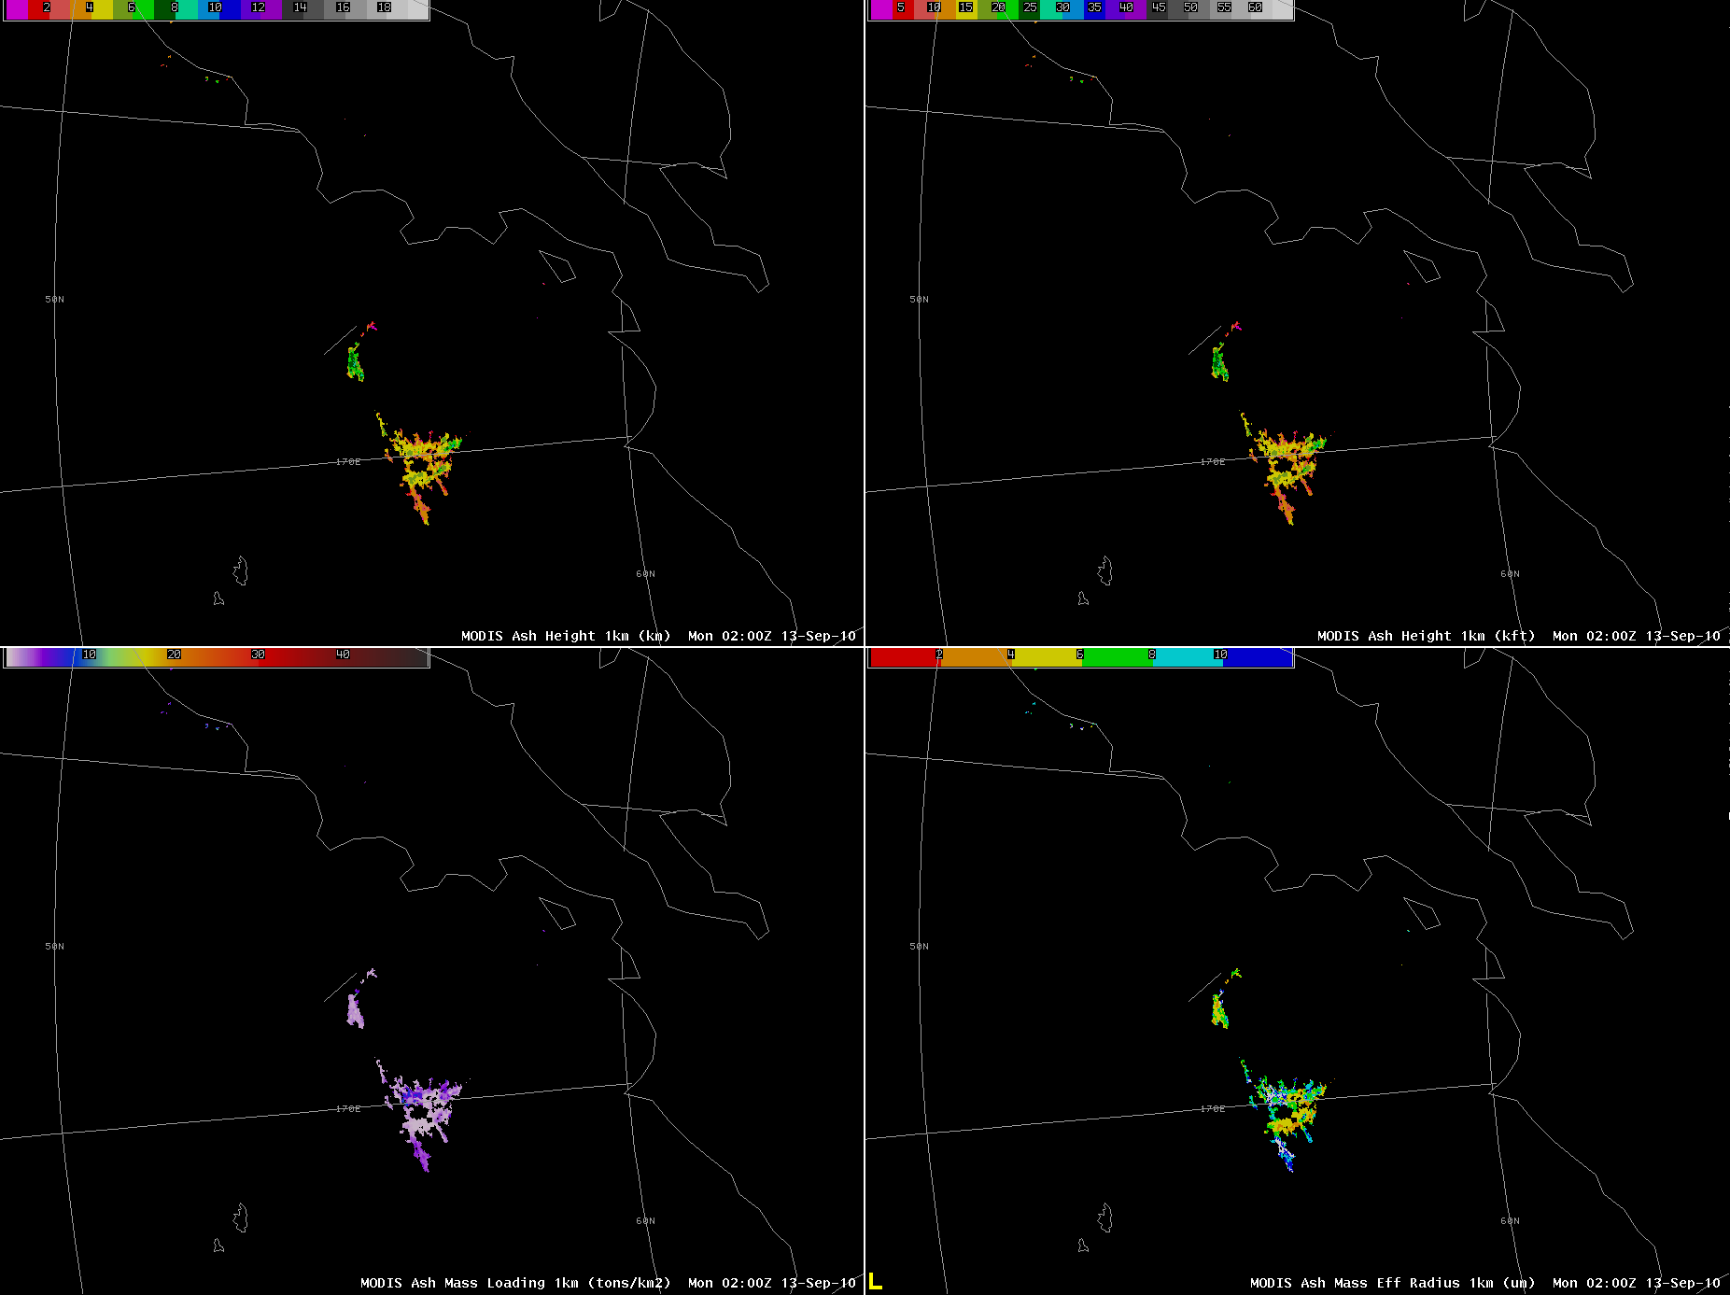
Examples - Kamchatka
September 13, 2010 02:00 UTC
Height
(km)
Height
(kft)
Maximum cloud height ~ 26,000 feet ASL
Ash cloud from 11th drifted east over the Pacific
Effective radius
(microns)
Mass loading
(ton / km²)

Slide 43
Examples - Kamchatka
September 14, 2010 16:10 UTC
Missed ash cloud
New eruption over Kamchatka

Slide 44
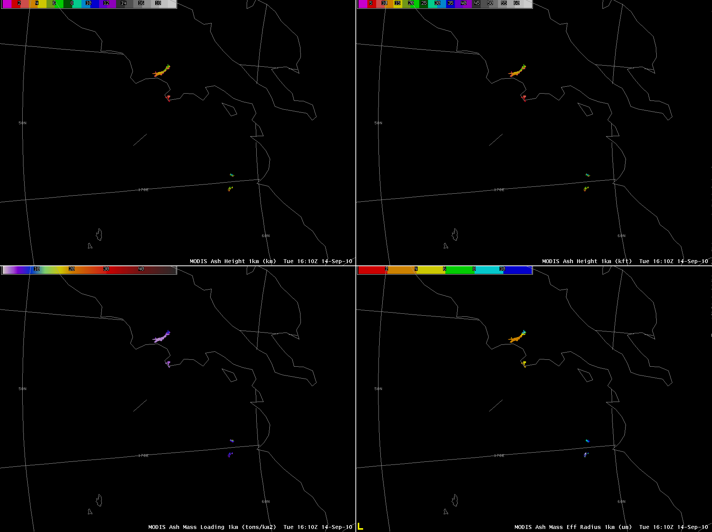
Examples - Kamchatka
September 14, 2010 16:10 UTC
Height
(km)
Height
(kft)
Maximum cloud height ~ 25,000 feet ASL
Effective radius
(microns)
Mass loading
(ton / km²)

Slide 45
Examples - Kamchatka
October 27, 2010 23:40 UTC
Ash cloud over Kamchatka and Pacific Ocean

Slide 46
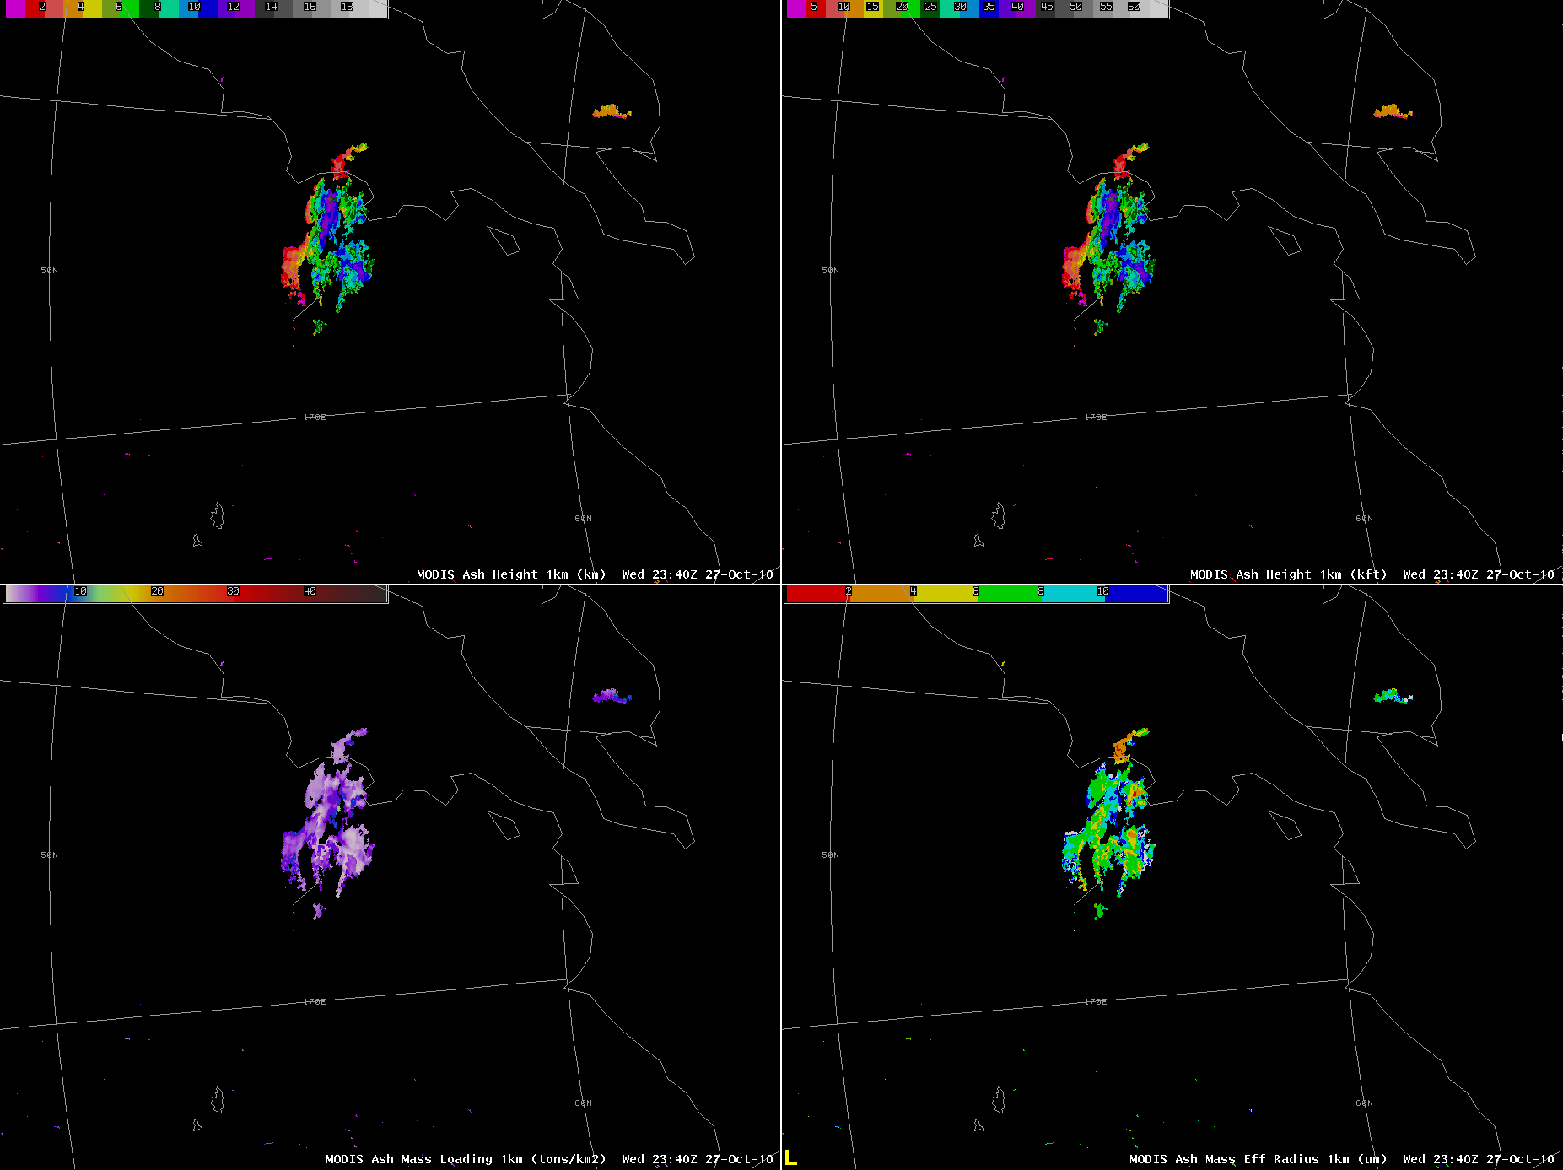
Examples - Kamchatka
October 27, 2010 23:40 UTC
Height
(km)
Height
(kft)
Ash cloud to ~13 km or 40 kft
Effective radius
(microns)
Mass loading
(ton / km²)

Slide 47
Examples - Kamchatka
October 28, 2010 15:00 UTC
Continued ash emissions

Slide 48
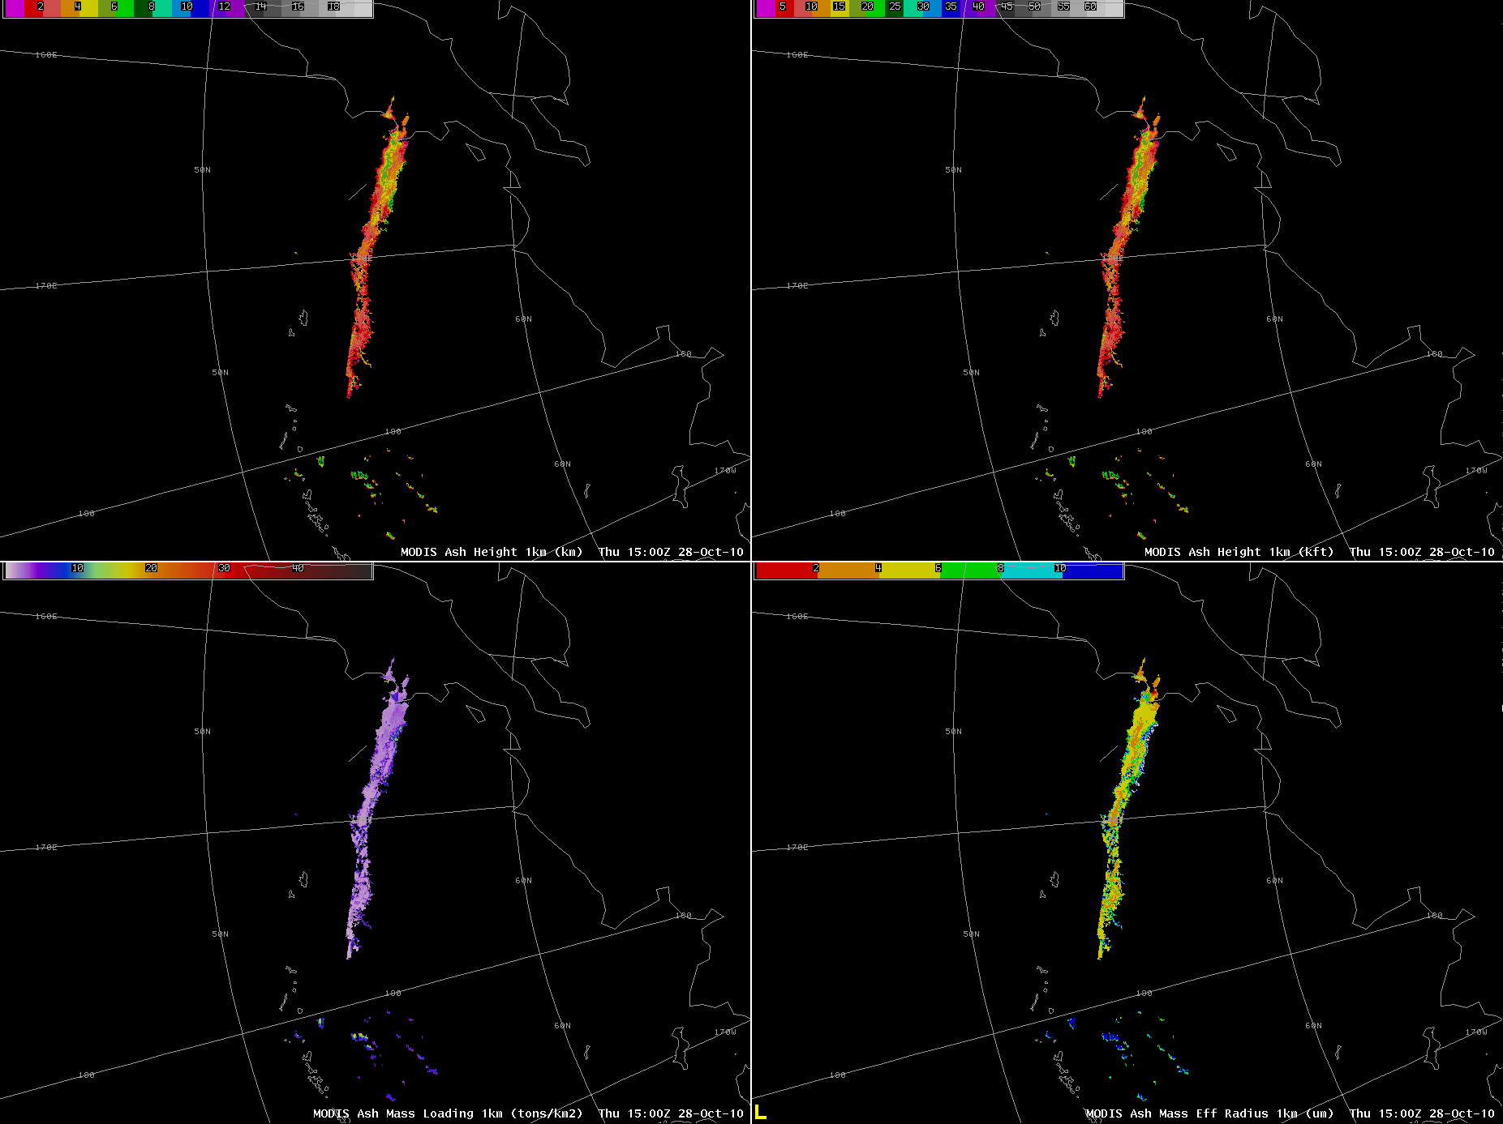
Examples - Kamchatka
October 28, 2010 15:00 UTC
Height
(km)
Height
(kft)
Ash plume
Maximum cloud height ~ 23,000 feet ASL
Remaining ash particles have smaller effective radius than on the 27th
Effective radius
(microns)
Mass loading
(ton / km²)

Slide 49
Examples - Kamchatka
January 5, 2011 01:35 UTC
Kizimen ash cloud

Slide 50
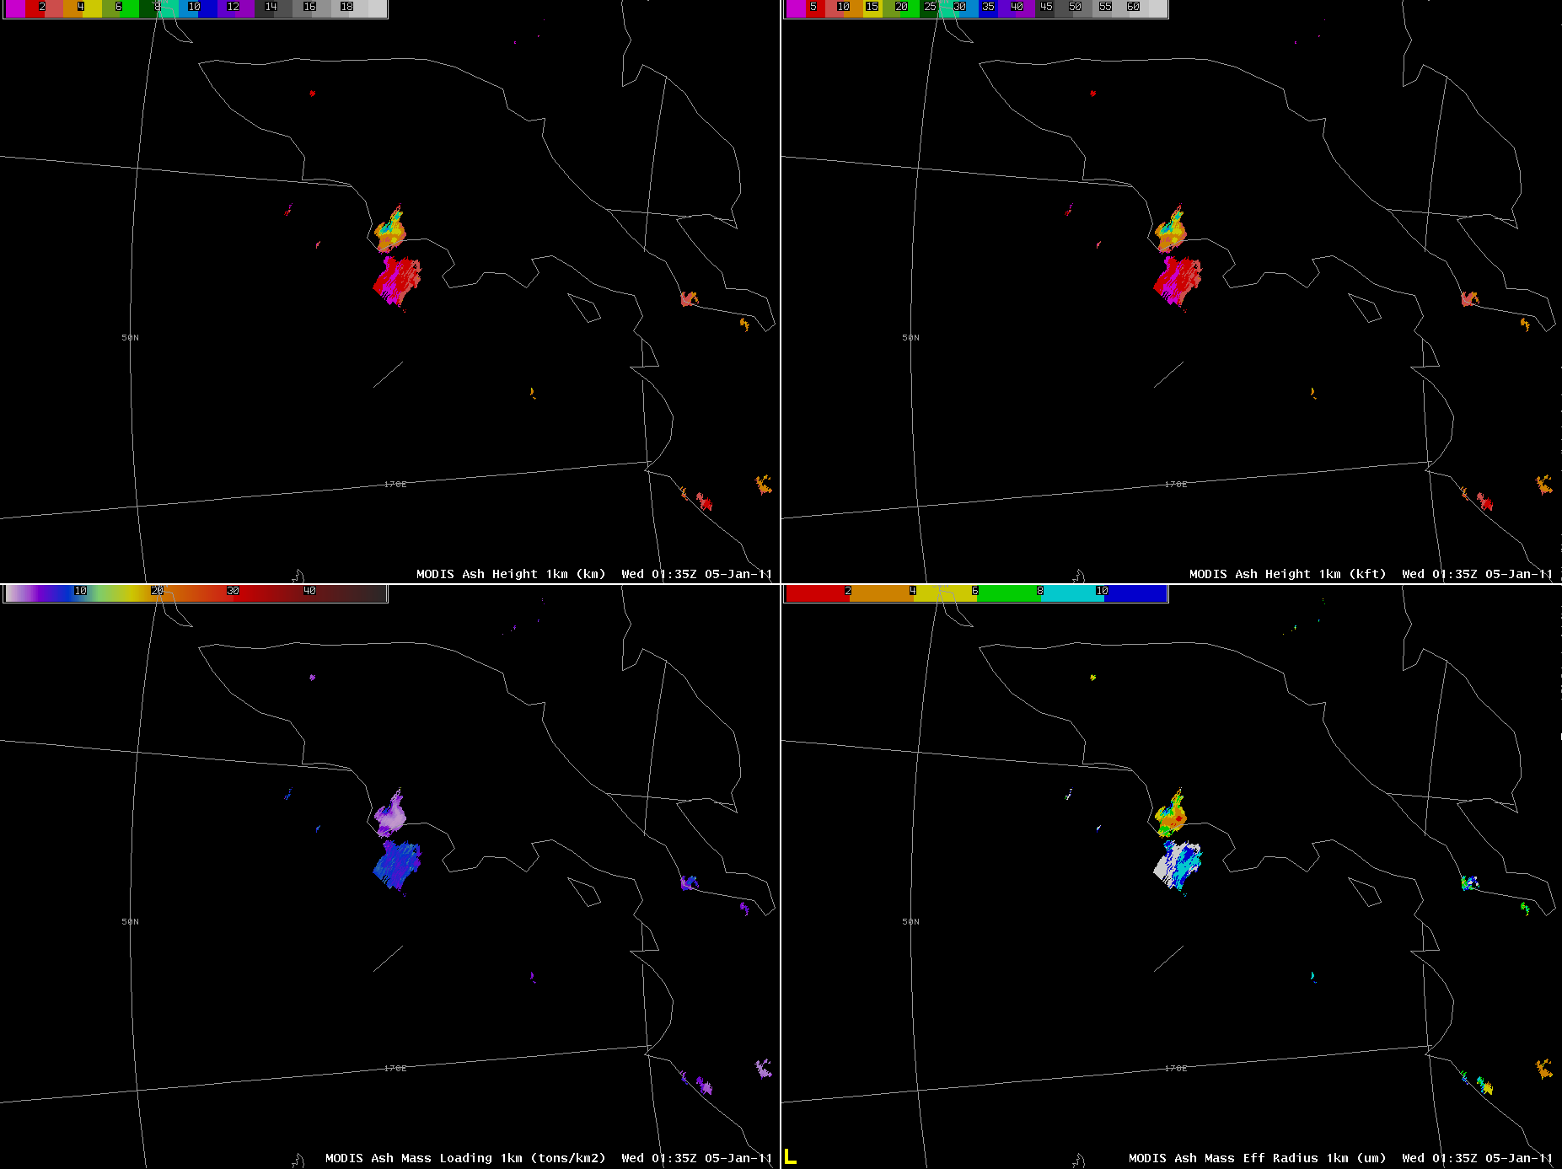
Examples - Kamchatka
January 5, 2011 01:35 UTC
Height
(km)
Height
(kft)
Kizimen initial ash cloud
False alarms
Maximum cloud height ~ 30,000 feet ASL
Effective radius
(microns)
Mass loading
(ton / km²)

Slide 51
Examples - Kamchatka
January 5, 2011 09:35 UTC
Kizimen ash cloud drifting over Pacific

Slide 52
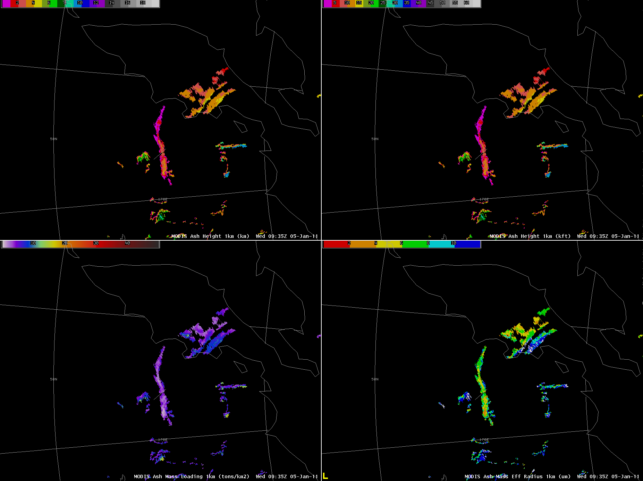
Examples - Kamchatka
January 5, 2011 09:35 UTC
Height
(km)
Height
(kft)
Ash plume
False alarms
Effective radius
(microns)
Mass loading
(ton / km²)

Slide 53
GOES-R ash cloud height
March 16, 2011 (10:37 UTC)
AVO “split-window” imagery
Any feature not in B/W exhibits an ash signature
False Alarm
The GOES-R volcanic ash products, will generally contain significantly fewer “false” alarms than the “split-window” BTD image.

Slide 54
Known Major Limitations
Currently, false alarms (FA’s) do occur on a regular basis, although the traditional “split-window” imagery contains many more false alarm
Volcanic ash must be the highest cloud layer
The GOES-R ash cloud heights are based on infrared measurements which have a limited vertical resolution. Thus, the maximum GOES-R ash cloud height can sometimes be underestimated by up to 5000 ft
The mass loading and effective particle radius can be over-estimated when ash closely overlaps a lower meteorological cloud layer
Low-level ‘warm’ ash clouds can be missed when the ash cloud is warmer than surface due to strong temperature inversion

Slide 55
Known Strengths
Very high detection rate
Ash detection does not require negative 11-12 µm brightness temperature difference
The GOES-R ash cloud products are generated using infrared measurements and therefore work the same day and night
The ash cloud height product has been directly validated and shown to accurately capture the spatial variability of ash cloud top height and determine the maximum height of ash clouds
Products are generated within minutes of receiving satellite data

Slide 56
How to use GOES-R Products Operationally
Marco Fulle - www.stromboli.net
The GOES-R Products are designed to compliment your existing methodology for issuing VAAs and SIGMETs; they should be integrated into existing procedures, not replace existing procedures (e.g. continue to use AVO products and inputs; use PIREPs, etc…).
As a first step, the GOES-R Volcanic Ash Products should be primarily used to help assign ash cloud heights and verify dispersion model output
Forecasters should use the GOES-R products in tandem with satellite imagery pattern recognition techniques

Slide 57
Operationally Available Cloud height Sources
Radar (NEXRAD or USGS) – best operationally available source of height near the vent where larger particles are present (GOES-R ash cloud heights have generally compared well with radar derived cloud heights near the vent; GOES-R cloud heights are more useful when cloud is dominated by smaller particles that cannot be sensed by radar)
Human observation (from the air or ground) (human observations are subjective and prone to error, GOES-R heights are objective)
Wind correlation (GOES-R heights are generally more accurate and objective)
Infrared brightness temperature look-up (GOES-R ash cloud heights will nearly always be more accurate than this method)

Slide 58
Expected Improvements
Bias corrected ash cloud heights
Data latency will be reduced by ~20 minutes once processing begins in Alaska (eliminate step of transferring data to UW-CIMSS) in 2011
Developing Weather Event Simulator (WES) case for hands-on training for Redoubt 2009 eruption
End user feedback is essential and will be used to guide future improvements
Currently, the GOES-R volcanic ash products contain some false alarms. The development of a version of the products that includes an extremely small number of false alarms is underway (auto-alert capability).

Slide 59
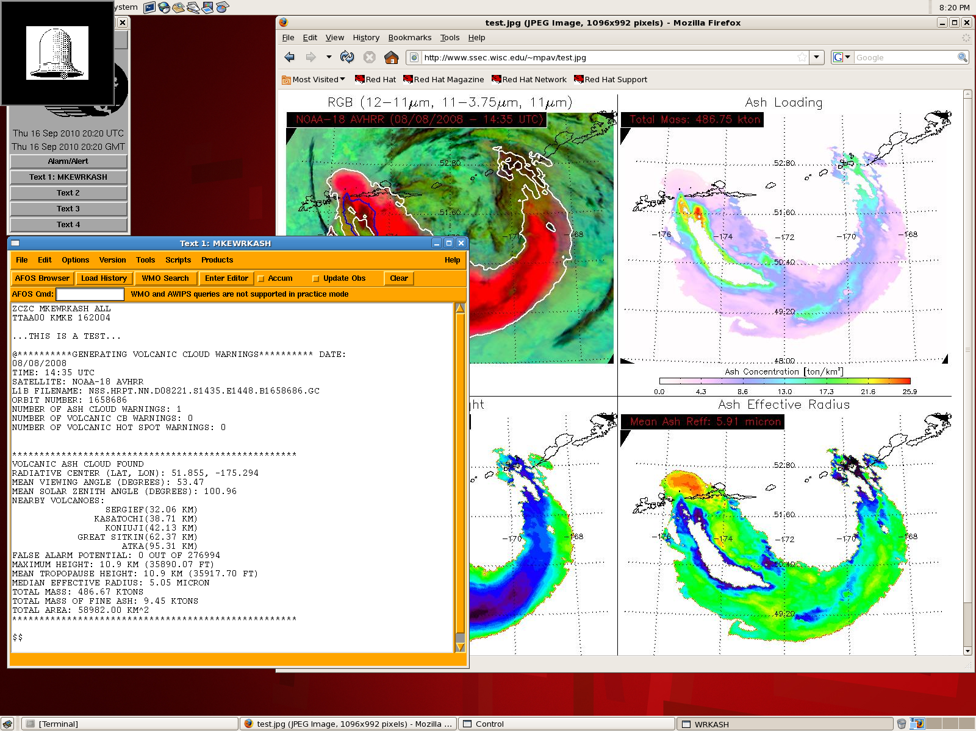

Slide 60
What You Should Know By The End of Training
What GOES-R Volcanic Ash products are available within AWIPS (physical meaning of products)
Product interpretation through examples of interest to Anchorage VAAC
Strengths and limitations of GOES-R products (including an assessment of product accuracy)
How to use GOES-R products operationally
Future improvements

Slide 61
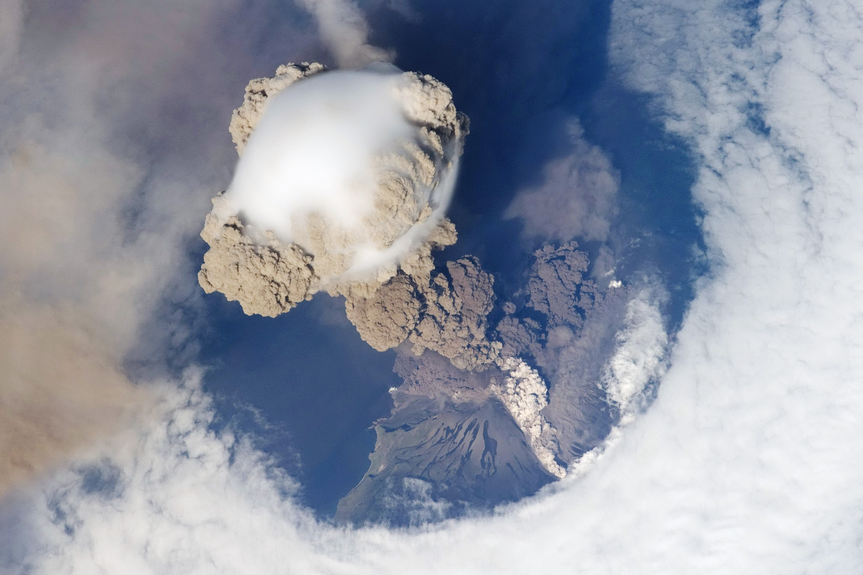
Contact
Questions? Suggestions?
Contact:
Michael Pavolonis (Mike.Pavolonis@noaa.gov)
Justin Sieglaff (justins@ssec.wisc.edu)

