Slide 1


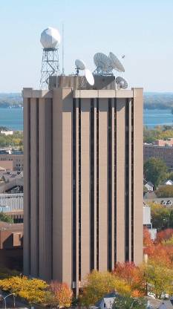
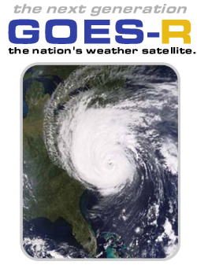

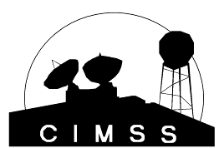
GOES-R ABI
  Timothy J. Schmit
  (tim.j.schmit@noaa.gov)
NOAA/NESDIS/Satellite Applications and Research
Advanced Satellite Products Branch (ASPB)
Kaba Bah, Mathew M. Gunshor, Jun Li, Scott Bachmeier, etc.
CIMSS, Madison, WI
Steve Goodman, James J. Gurka, etc.
GOES-R Program Office
High Impact Weather Working Group
Kick-off Workshop
Norman, OK
24 February 2011
UW-Madison

Slide 2
Also Thanks to…
Achtor, Tom; Ackerman, Steve; Antonelli, Paolo; Aune, Bob; Baggett, Kevin; Baum, Bryan; Ellrod, Gary; Feltz, Joleen; Feltz, Wayne; Frey, Rich; Griffin, Michael K.; Gumley, Liam; Heymann, Roger; Hillger, Don; Huang, Allen; Key, Jeff; Knuteson, Bob; Mecikalski, John; Menzel, Paul; Moeller, Chris; Mosher, Fred; Nelson, James; Nasiri, Shaima; Olander, Tim; Plokhenko, Youri; Prins, Elaine; Rabin, Bob; Revercomb, Hank; Schmidt, Chris; Schreiner, Tony; Seemann-Wetzel, Suzanne; Sieglaff, Justin; Strabala, Kathy; Sun, Fengying; Will Straka, Tobin, Dave; Velden, Chris; Wade, Gary; Whittaker, Tom; Woolf, Hal, Jason Otkin, etc.
Jaime Daniels, Mitch Goldberg, AWG co-chairs, AWG Leads, Walter Wolf, GPO, Jordan Gerth, Chian-Yi Liu, Thomas Greenwald, Monica Coakley, GOES-R flight/ground, Bill Smith, ASPB, PG, SSEC data center, CWG, etc.
ITT Industries, Lockheed-Martin, etc.

Slide 3
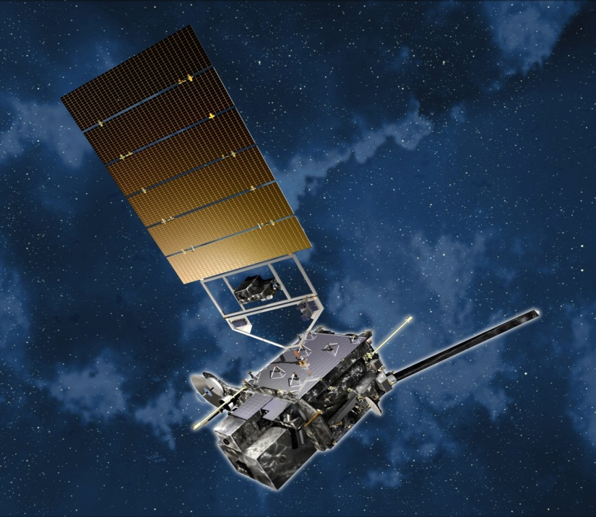
Overview
GOES-14/15
  One will become the operational GOES-West within the year. Improved water vapor band, with new 13.3 micrometer band
ABI (Advanced Baseline Imager)
  Temporal
  Spatial
  Spectral
  Imagery
Select Products
Summary
  More information
Lockheed Martin

Slide 4
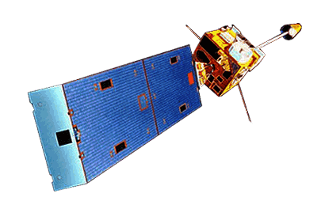
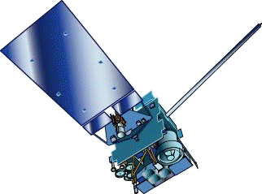
GOES-13, 14 and 15
GOES-13/14/15 have similar instruments to GOES-8-12, but on a different spacecraft bus.
Spring and fall eclipse outages will be avoided by larger onboard batteries.
Improved navigation
Improved radiometrics
GOES-8/12
GOES-13/14/15

Slide 5
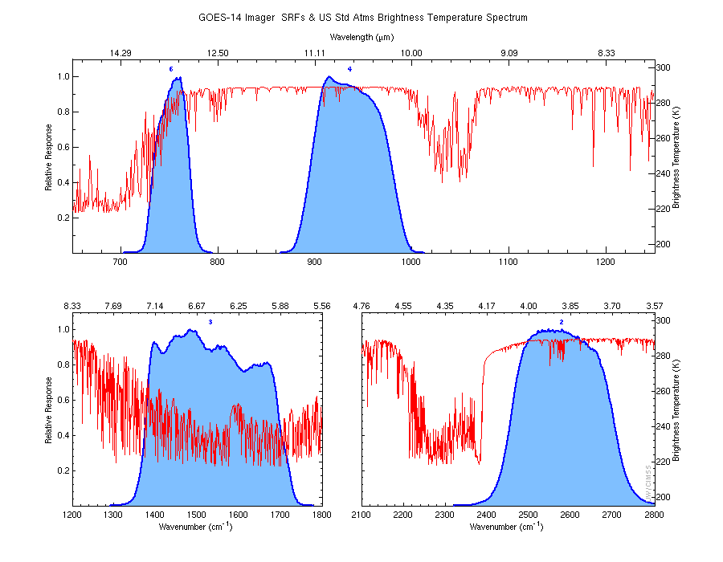
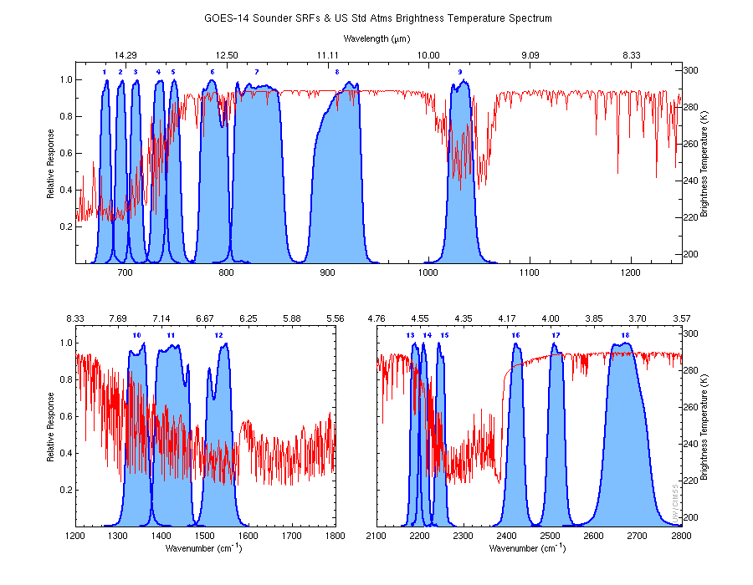
GOES Science Test
Imager and Sounder
Don Hillger and Tim Schmit co-led the NOAA Science Tests
Test’s held in 2009 and 2010 for GOES-14, 15
http://rammb.cira.colostate.edu/projects/goes-o/
Imager
Sounder
13.3
6.5

Slide 6
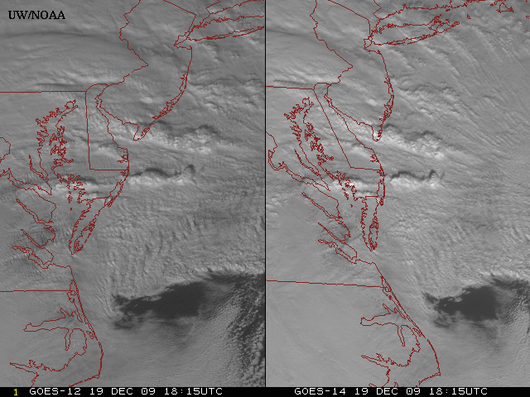
GOES-14: Sample “1-min” imagery
GOES-12
GOES-14
Visible data from the recent NOAA Science Test, lead by Hillger and Schmit
Notes:
Note the number of different levels of motion you can see (the cyclonic low level circulation over the ocean through the breaks in the higher clouds)... and you can't distinguish those on the GOES-12 loop.

Slide 7
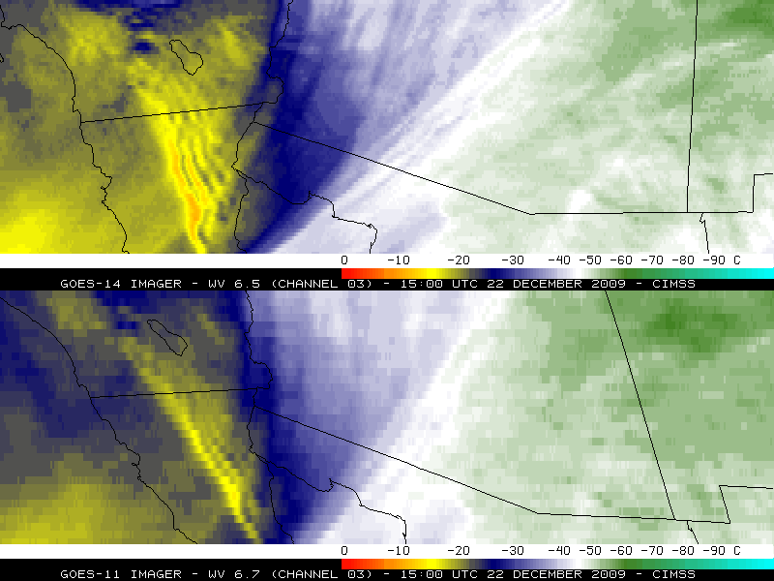
“
“4km” “water vapor” Imager

Slide 8
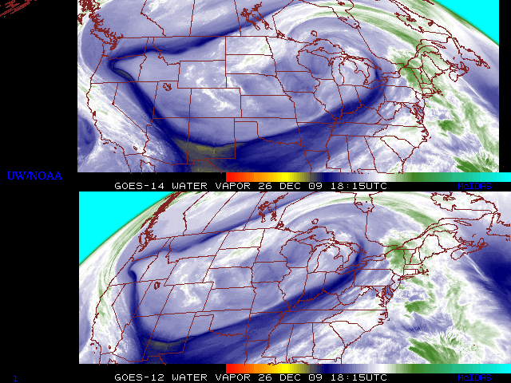
GOES-14: Sample “5-min” imagery
GOES-14
GOES-12
“Water vapor” data from the recent NOAA Science Test, lead by Hillger and Schmit
Notes:
Note the comma head is forming in the dry slot as a vort max swings around. This is not obvious from the 15 min.

Slide 9
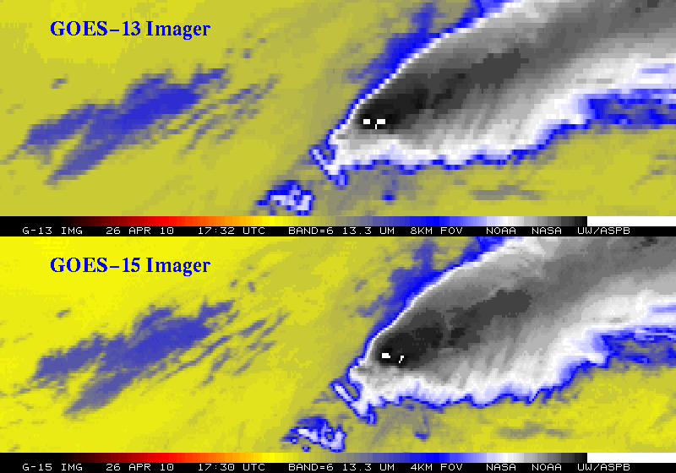
Improved spatial resolution of GOES-15 Imager band 6
The 13.3 um band 6 of the GOES-13 (top panel) has an 8 km IGFOV (Instantaneous Geometric Field of View); while the same band on the GOES-15 (lower panel) has a 4 km IGFOV. Note the finer resolution of the cloud edges and the ‘cleaner’ image.
Notes:
GOES-14 (previously GOES-0) was launched on June 27, 2009.
The issue with the band 6 of the imager, was the detector order was initially flipped in the data stream. This was fixed on August 24, 2009 (not shown).
More information can be found at:
http://rammb.cira.colostate.edu/projects/goes-o/
http://cimss.ssec.wisc.edu/goes/blog/archives/3054
Don Hillger and Tim Schmit are co-leading the GOES-14 NOAA science test.
The above images were ingested by the SSEC data center in Madison, WI. Image generated by T. Schmit of NOAA NESDIS STAR ASPB.
###

Slide 10
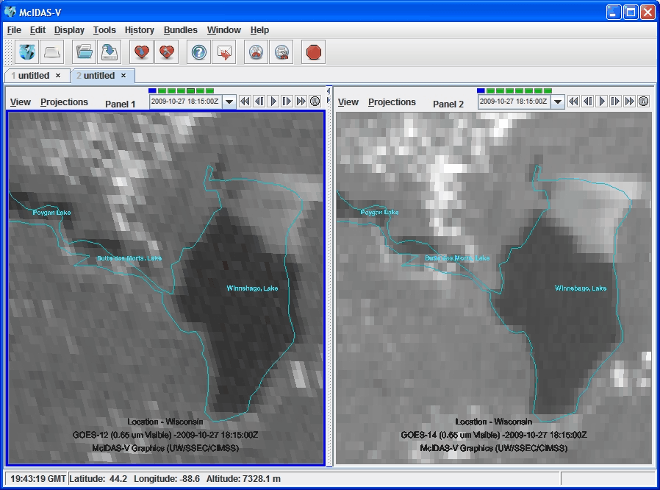
Improved INR

Slide 11
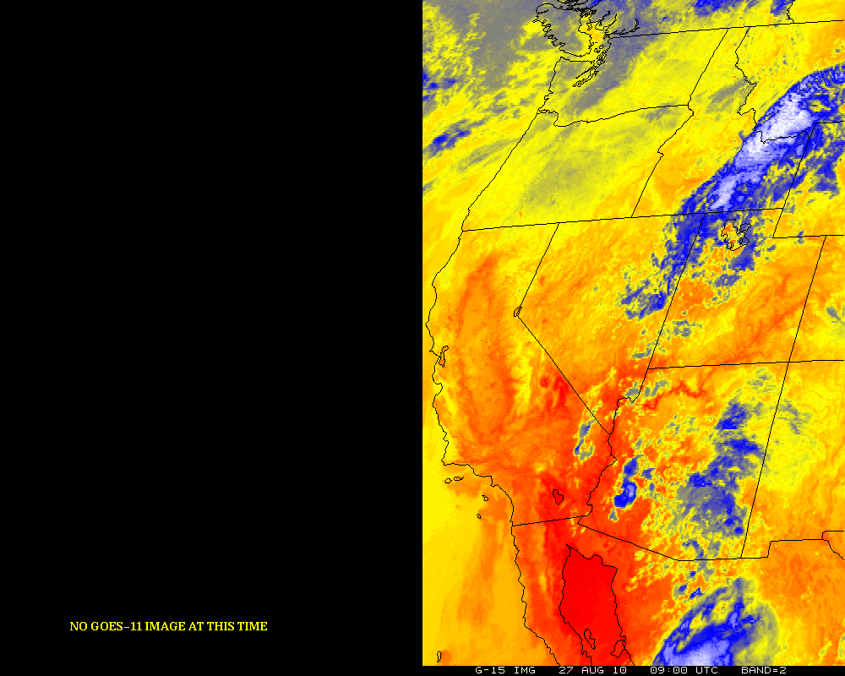
GOES-12/15 (Around eclipse period)
GOES-11 GOES-15
Notes:
http://cimss.ssec.wisc.edu/goes/blog/archives/date/2006/08

Slide 12
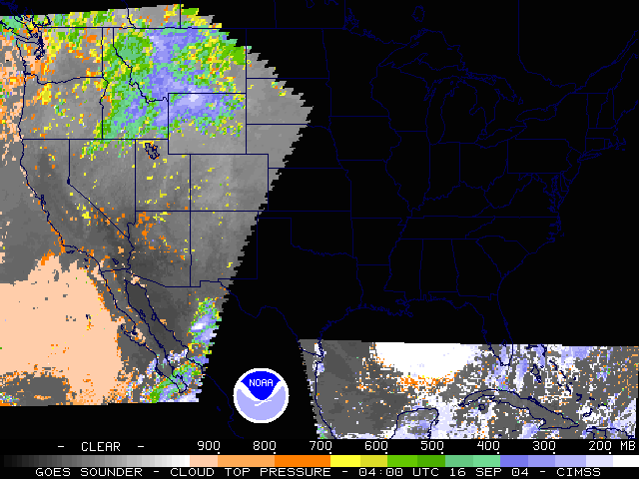
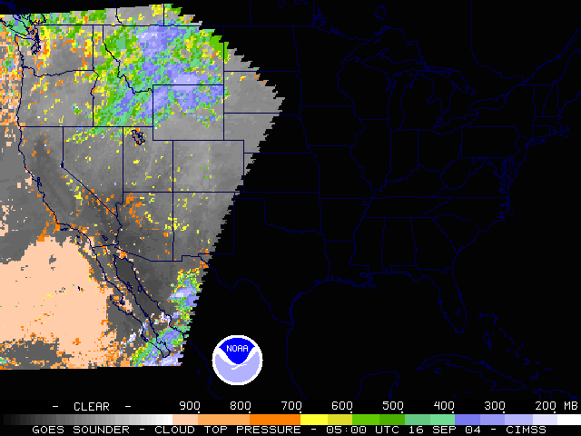
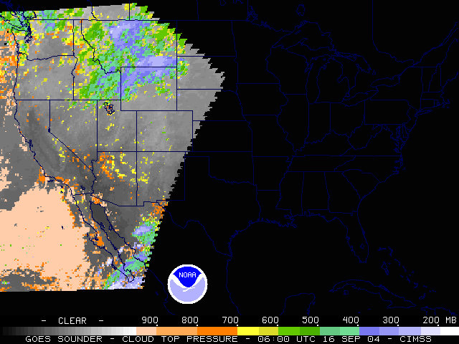
GOES Outages
-- approximate hours/year
Satellite Series | KOZ, Eclipse and Stray Light (spring and fall) | Housekeeping, SEM calibration, Maneuvers and Yaw-flip
GOES-8 thru -12 | 420 | 211
GOES-13/14/15 (may be reduced) | 220 | 107
GOES-R ABI | ~6 - 40 | ~2 - 6
Hurricane Ivan:
0400 UTC
0500 UTC
0600 UTC
Outage
during
landfall
Notes:
2004, Hurricane Ivan.

Slide 13
Overview
GOES-14/15
ABI (Advanced Baseline Imager)
  Temporal
  Spatial
  Spectral
  Imagery
Select Products
Summary
  More information
Lockheed Martin

Slide 14
GOES-R Overview
Advanced Baseline Imager (ABI)
No dedicated Sounder
Geostationary Lightning Mapper (GLM)
Space Weather
  Space Environmental In-Situ Suite (SEISS)
  Solar Ultra Violet Imager (SUVI)
  Extreme Ultra Violet/X-Ray Irradiance Sensor (EXIS)
  Magnetometer
Communications
  GOES Rebroadcast (GRB)
  Low Rate Information Transmissions (LRIT)
  Emergency Managers Weather Information Network (EMWIN)
  Search and Rescue (SAR)
  Data Collection System (DCS)
Notes:
Advanced Baseline Imager (ABI) Earth-viewing
Geostationary Lightning Mapper (GLM) Earth-viewing
Solar Ultra-Violet Imager (SUVI) Sun-viewing
EUVS and XRS Irradiance Sensors (EXIS) Sun-viewing
Space Environment In-Situ Suite (SEISS) Space-viewing
Magnetometer (MAG) Space-viewing

Slide 15
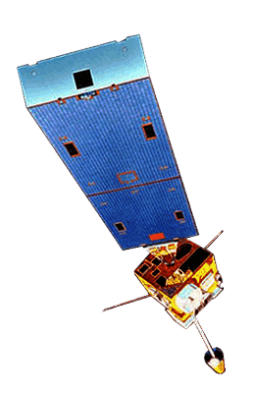
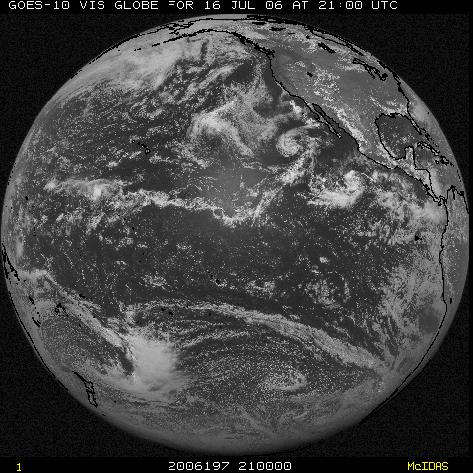
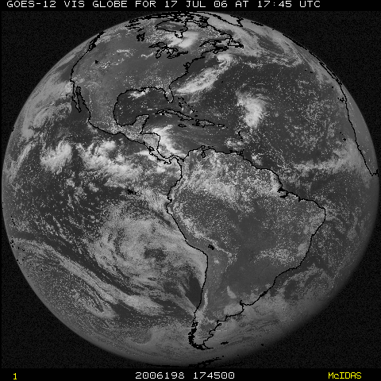
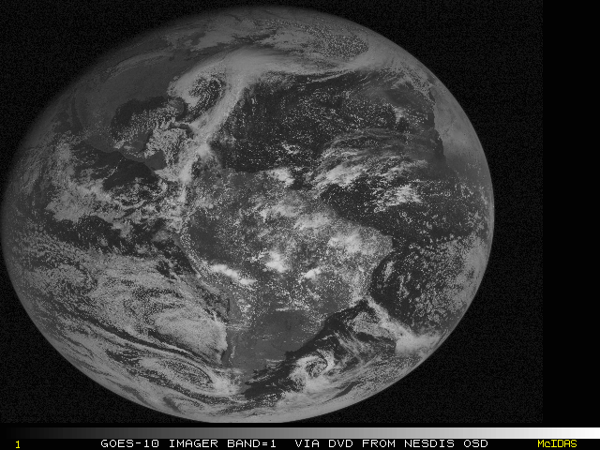
NOAA Operational: Geostationary
(early-2011)
GOES-11
(135W)
GOES-13
(75W)
Operational
Operational
GOES-14
(105W)
Storage
GOES-15
(90W)
Standby
GOES-12
(60W)
South America
Notes:
Template footer obscured. Fixed.
Estimate during mid-2010.

Slide 16
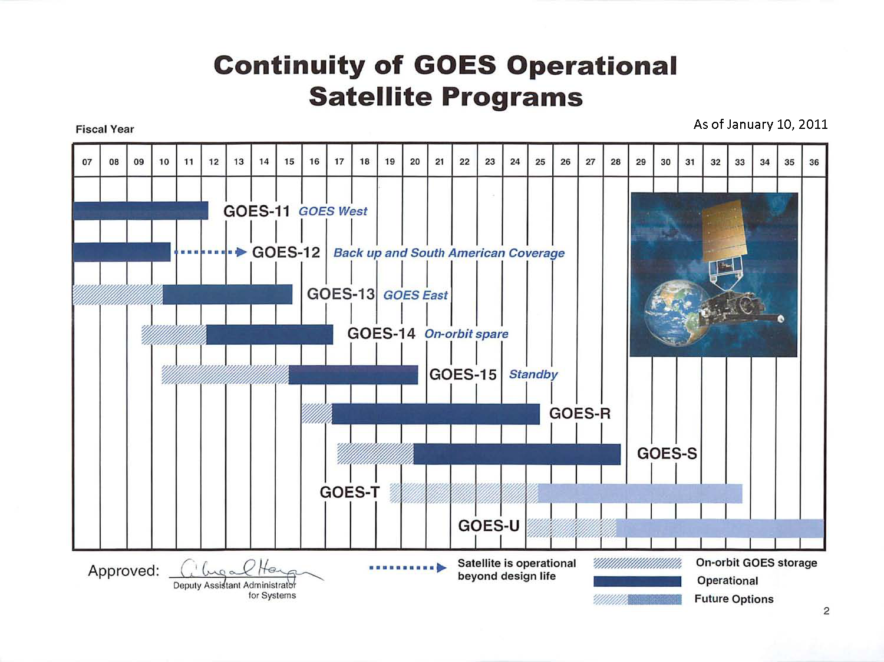
GOES Fly-out Chart

Slide 17
The Advanced Baseline Imager:
ABI Current
Spectral Coverage
16 bands 5 bands
Spatial resolution
0.64 μm Visible 0.5 km Approx. 1 km
Other Visible/near-IR 1.0 km n/a
Bands (>2 μm) 2 km Approx. 4 km
Spatial coverage
Full disk 4 per hour Scheduled (3 hrly)
CONUS 12 per hour ~4 per hour
Mesoscale Every 30 sec n/a
Visible (reflective bands)
On-orbit calibration Yes No

Slide 18
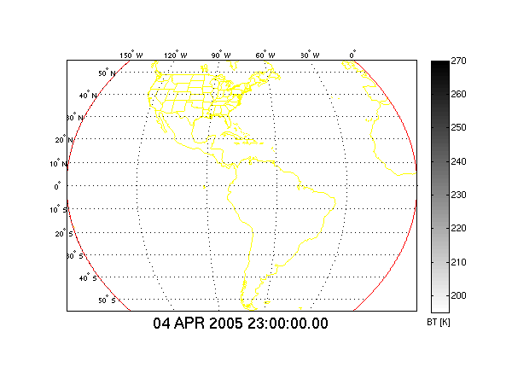
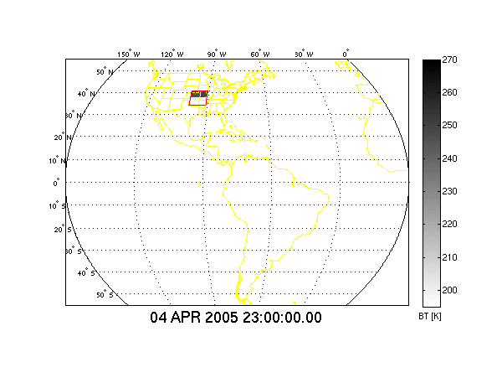
In 15 Minutes
Current GOES Imager can scan:
Most (3/5) of a Full Disk Image
Current GOES Imager scan coverage within 15 minutes
In 15 Minutes
ABI (“Flex Mode”) will scan:
30 Mesoscale Images
3 CONUS Images
1 Full Disk Image
GOES-R ABI scan coverage within 15 minutes
CIMSS
Notes:
From Jun Li and Chian-Yi Liu (CIMSS). Water vapor Image. Data from AWG Proxy Teams.

Slide 19
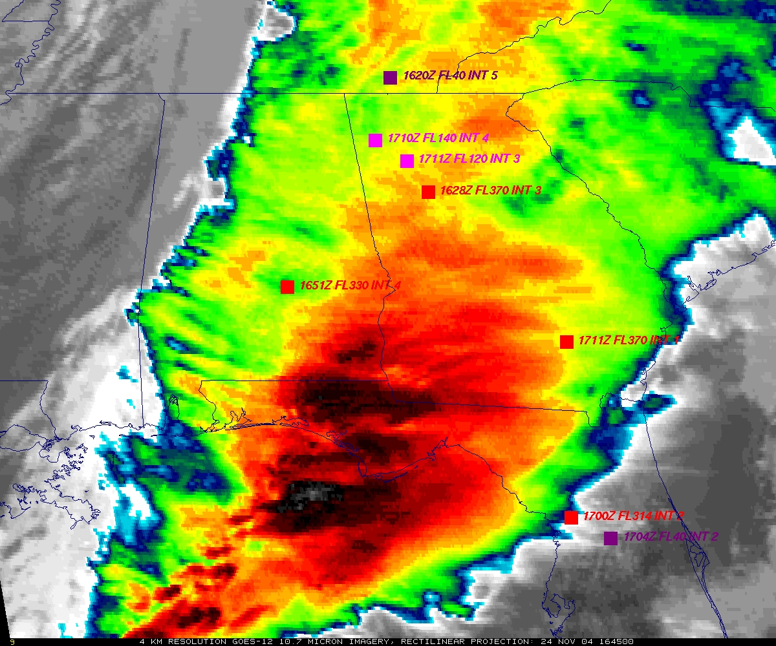
GOES
Figure courtesy of K. Bedka and W. Feltz

Slide 20
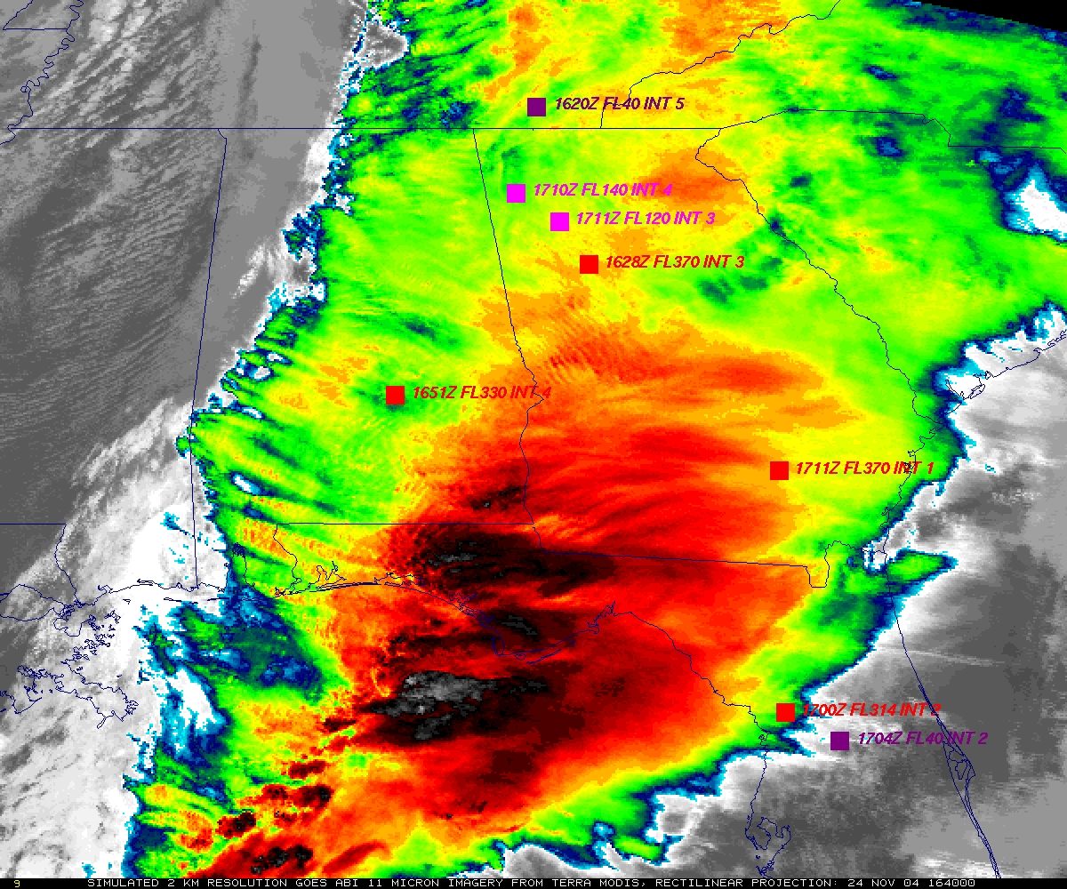
“ABI”
Figure courtesy of K. Bedka and W. Feltz

Slide 21
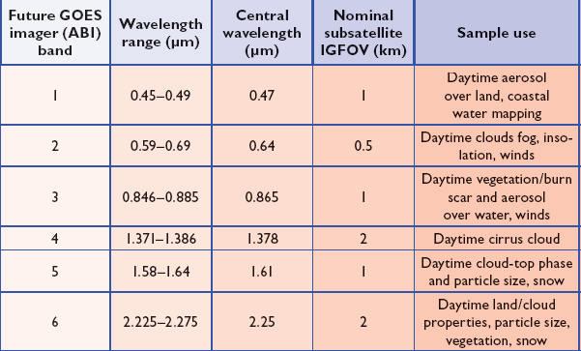
ABI Visible/Near-IR Bands
Schmit et al, 2005
Notes:
Schmit, T. J., M. M. Gunshor, W. P. Menzel, J. J. Gurka, J. Li, and A. S. Bachmeier, 2005: Introducing the next-generation Advanced Baseline Imager on GOES-R. Bull. Amer. Meteor. Soc., 86, 1079-1096.

Slide 22
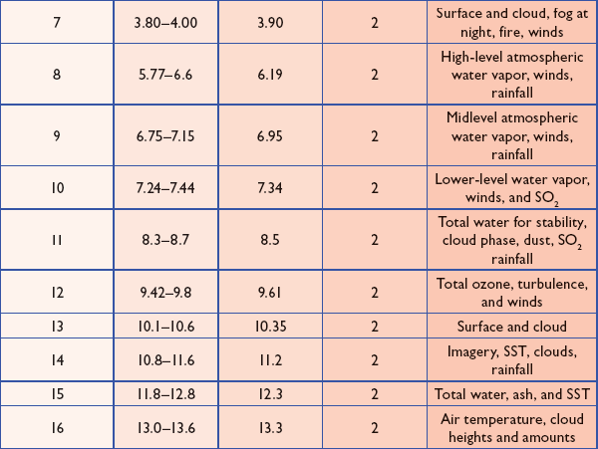
ABI IR Bands
Schmit et al, 2005
Notes:
Schmit, T. J., M. M. Gunshor, W. P. Menzel, J. J. Gurka, J. Li, and A. S. Bachmeier, 2005: Introducing the next-generation Advanced Baseline Imager on GOES-R. Bull. Amer. Meteor. Soc., 86, 1079-1096.

Slide 23
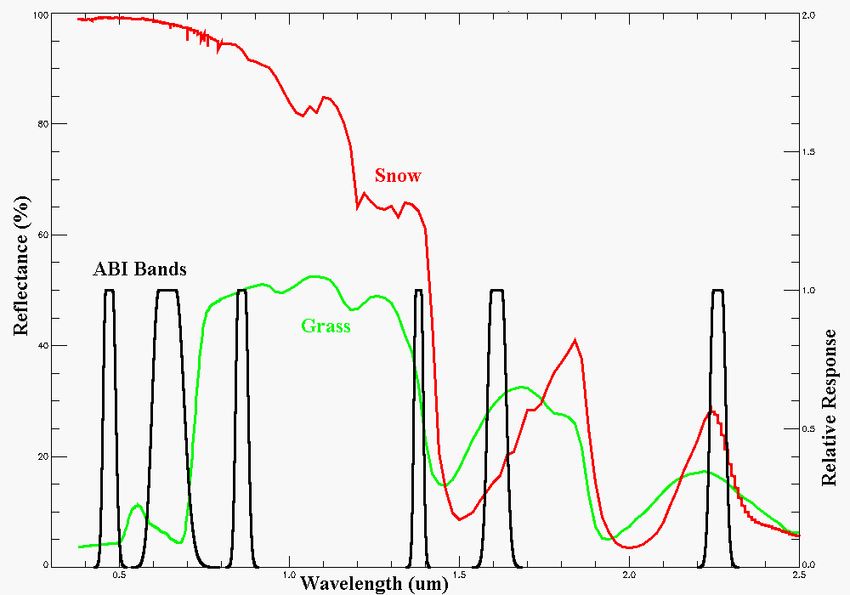
Visible and near-IR channels on the ABI
Snow, Phase
Part. size
Cirrus
Haze
Clouds
Veg.
The ABI visible and near-IR bands have many uses.
Notes:
Schmit, T. J., M. M. Gunshor, W. P. Menzel, J. J. Gurka, J. Li, and A. S. Bachmeier, 2005: Introducing the next-generation Advanced Baseline Imager on GOES-R. Bull. Amer. Meteor. Soc., 86, 1079-1096.

Slide 24
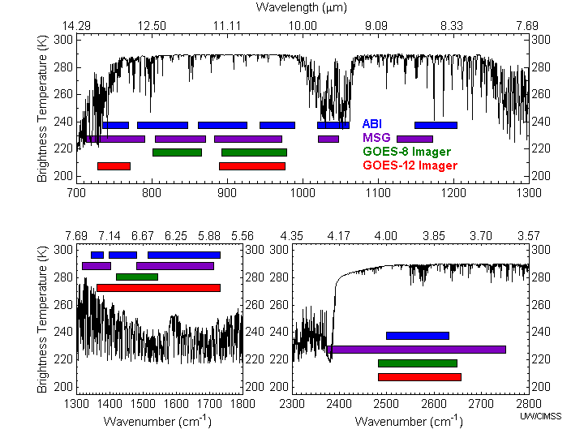
Similarities and differences for the spectral bands on Meteosat Second Generation (MSG), current GOES, and the Advanced Baseline Imager (ABI).
ABI has many more bands than the current operational GOES imagers.
Notes:
Schmit, T. J., M. M. Gunshor, W. P. Menzel, J. J. Gurka, J. Li, and A. S. Bachmeier, 2005: Introducing the next-generation Advanced Baseline Imager on GOES-R. Bull. Amer. Meteor. Soc., 86, 1079-1096.

Slide 25
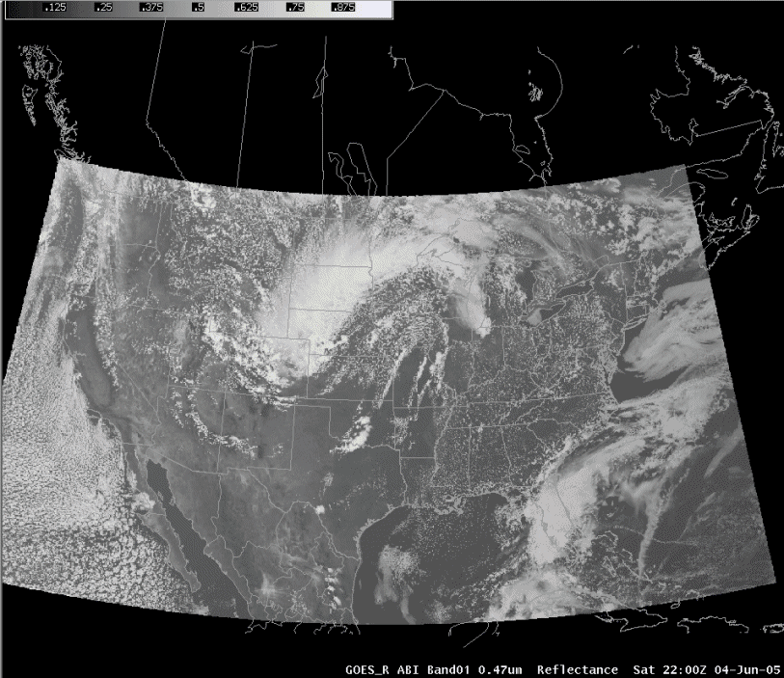
ABI in AWIPS (via netCDF)
J. Oktin et al., CIMSS
Simulated Advanced Baseline Imager (ABI) bands shown; in the legacy AWIPS.
Notes:
http://cimss.ssec.wisc.edu/goes/abi/

Slide 26
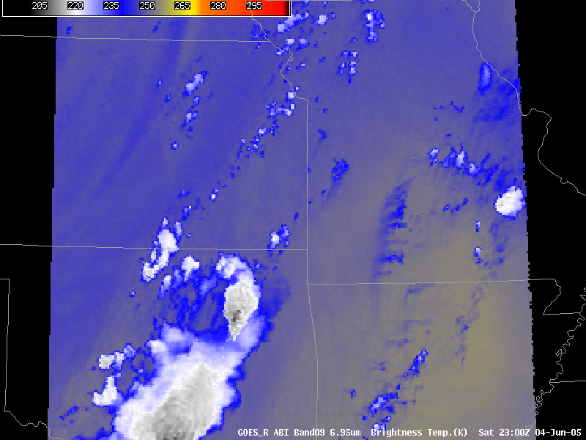
1-min Simulated ABI ‘mesoscale’ loop
6.95 micrometer band
J. Oktin et al., CIMSS
Notes:
Data from AWG Proxy Group.

Slide 27
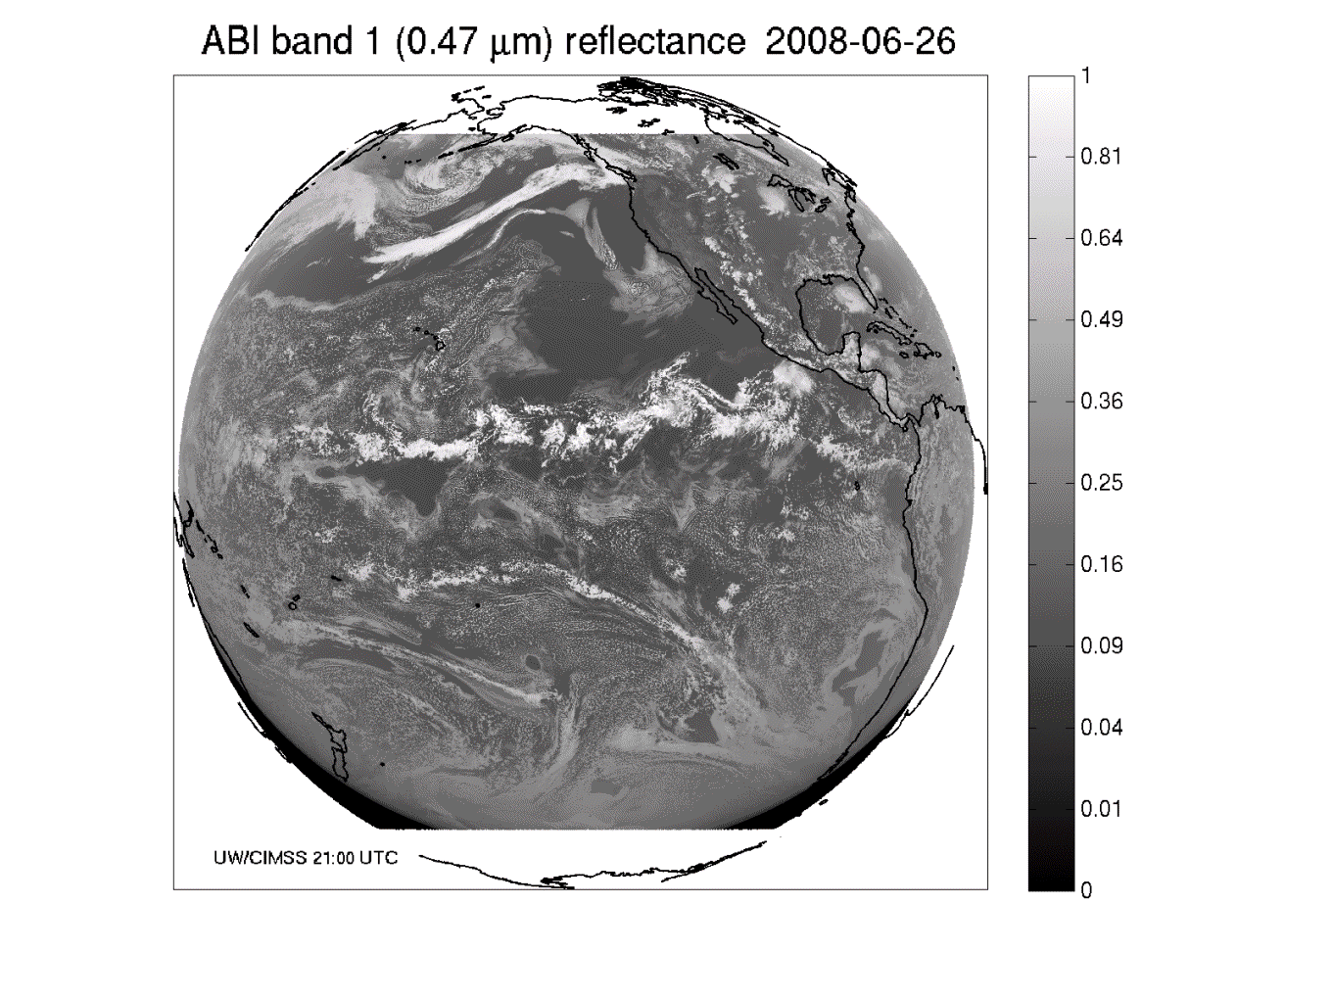
These NWP model simulations were performed on the 'cobalt' supercomputer at the National Center for Supercomputing Applications at the University of Illinois.
Band 1: Daytime “Blue” band -- aerosols

Slide 28
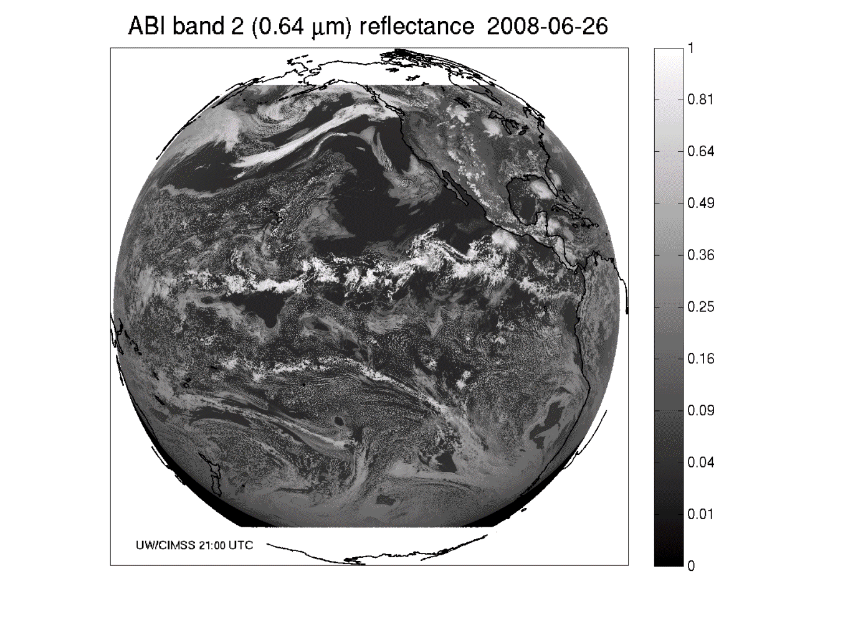
Band 2: Daytime “Red” band – clouds, etc.

Slide 29
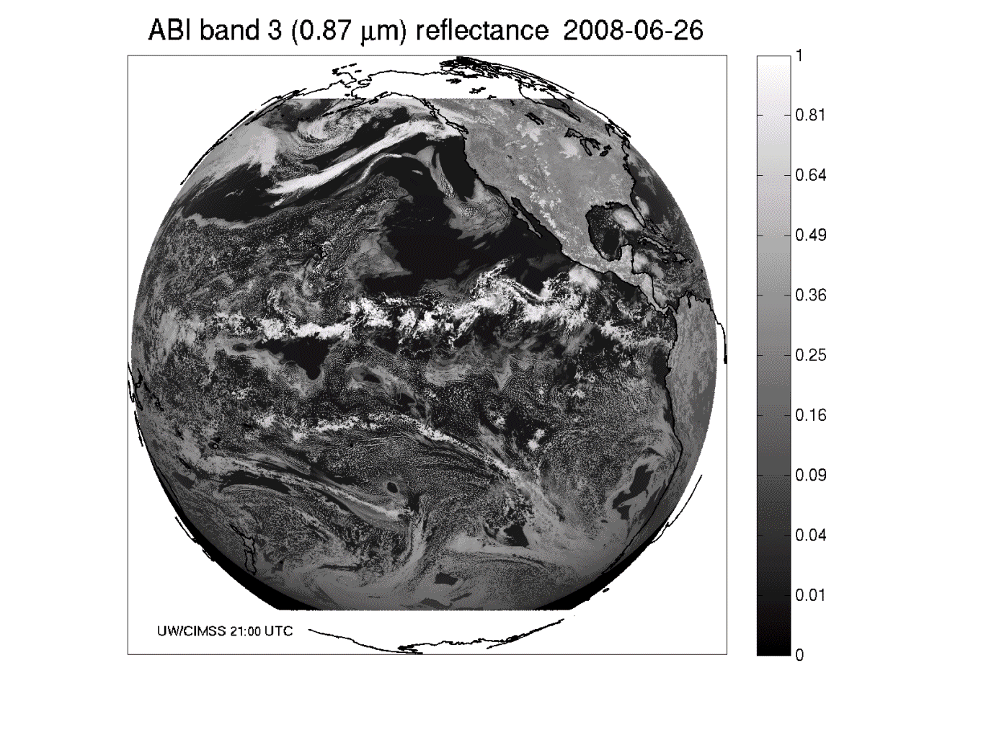
Band 3: Daytime “Veggie” band

Slide 30
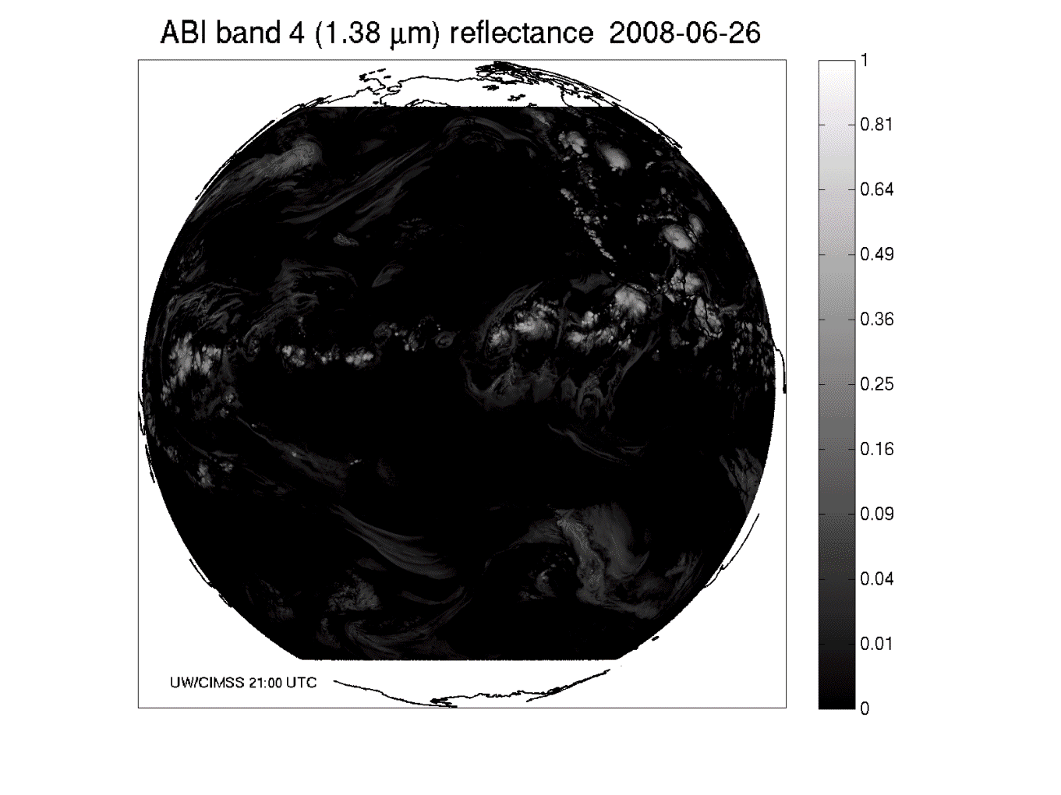
Band 4: Daytime “Cirrus” band

Slide 31
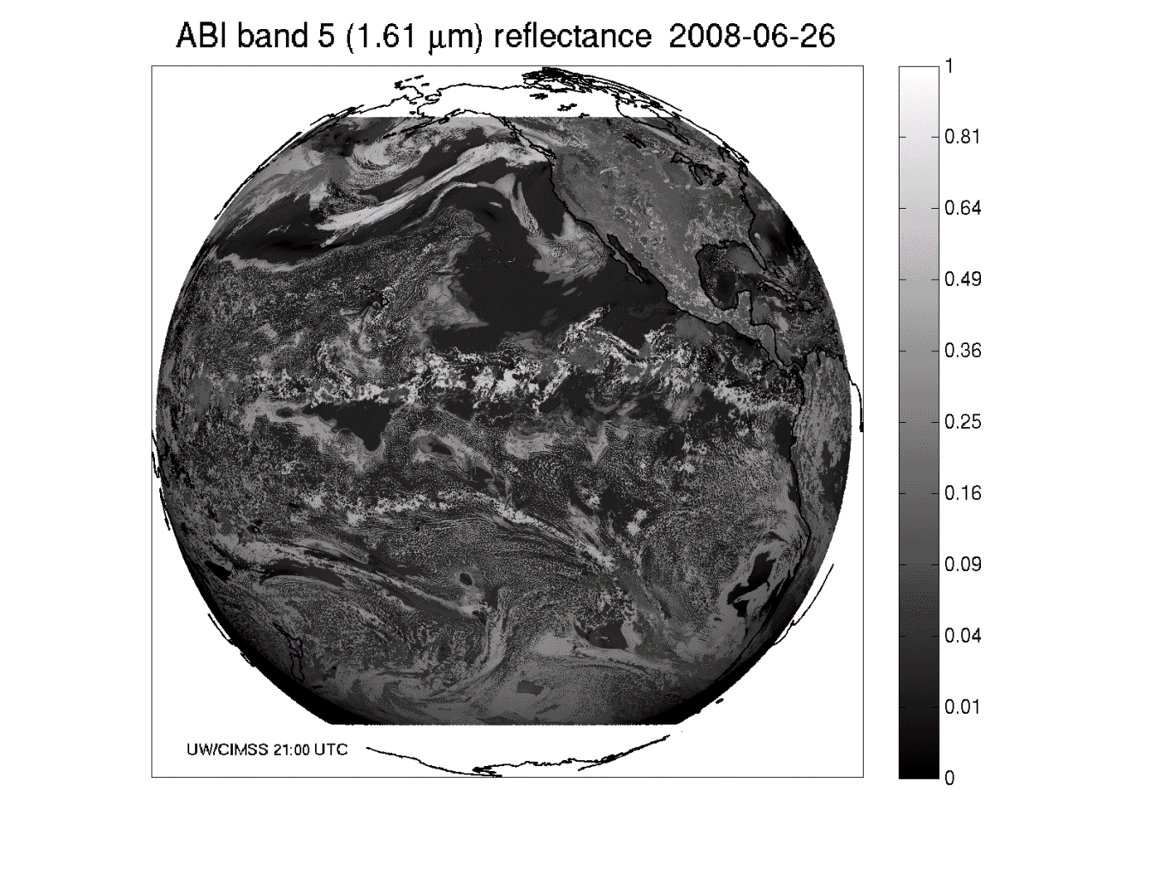
Band 5: Daytime “Snow” band

Slide 32
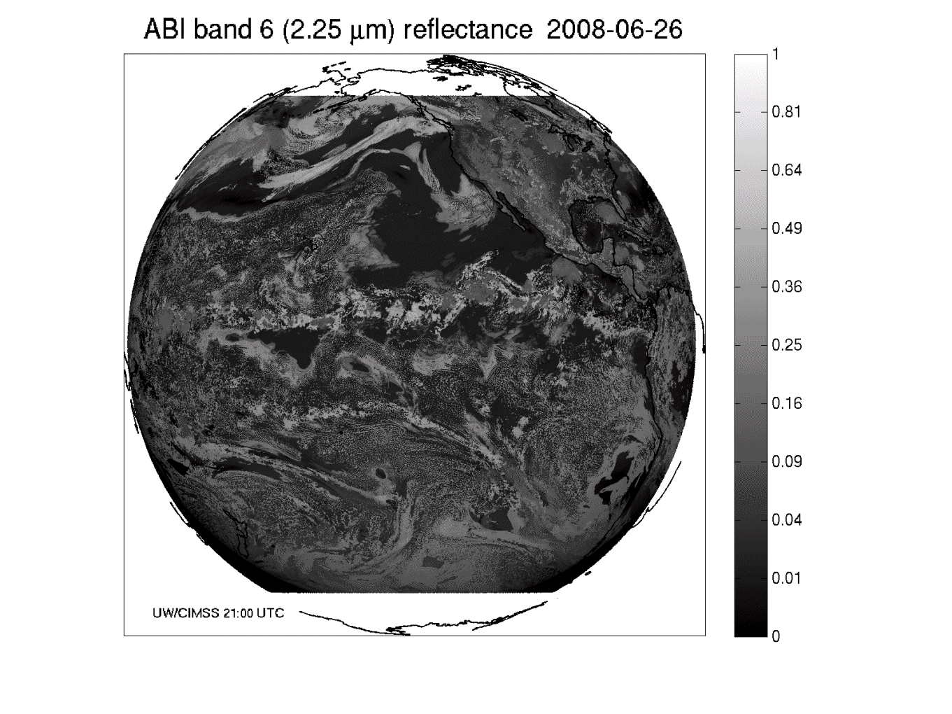
Band 6: Daytime “Cloud-top phase” band

Slide 33
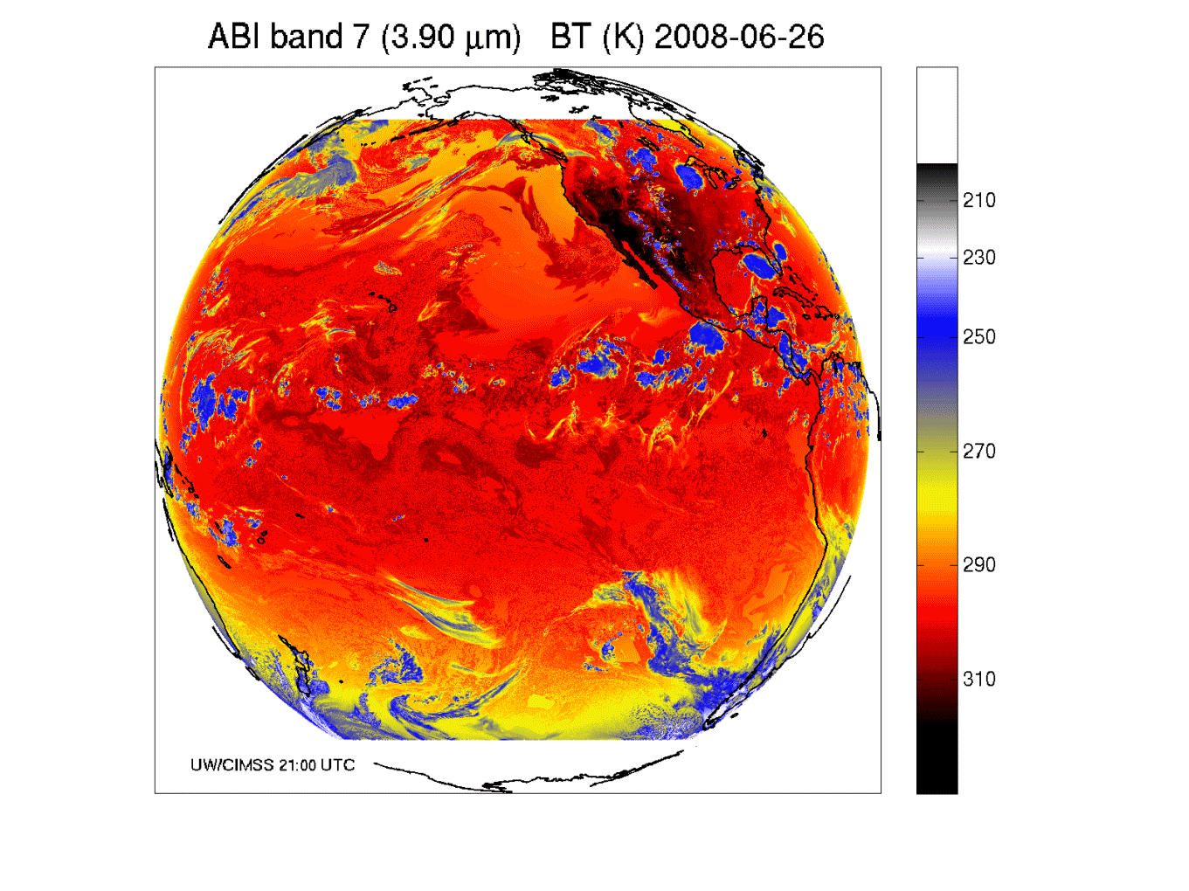
Band 7: Shortwave IR window band - fog, fires, etc.

Slide 34
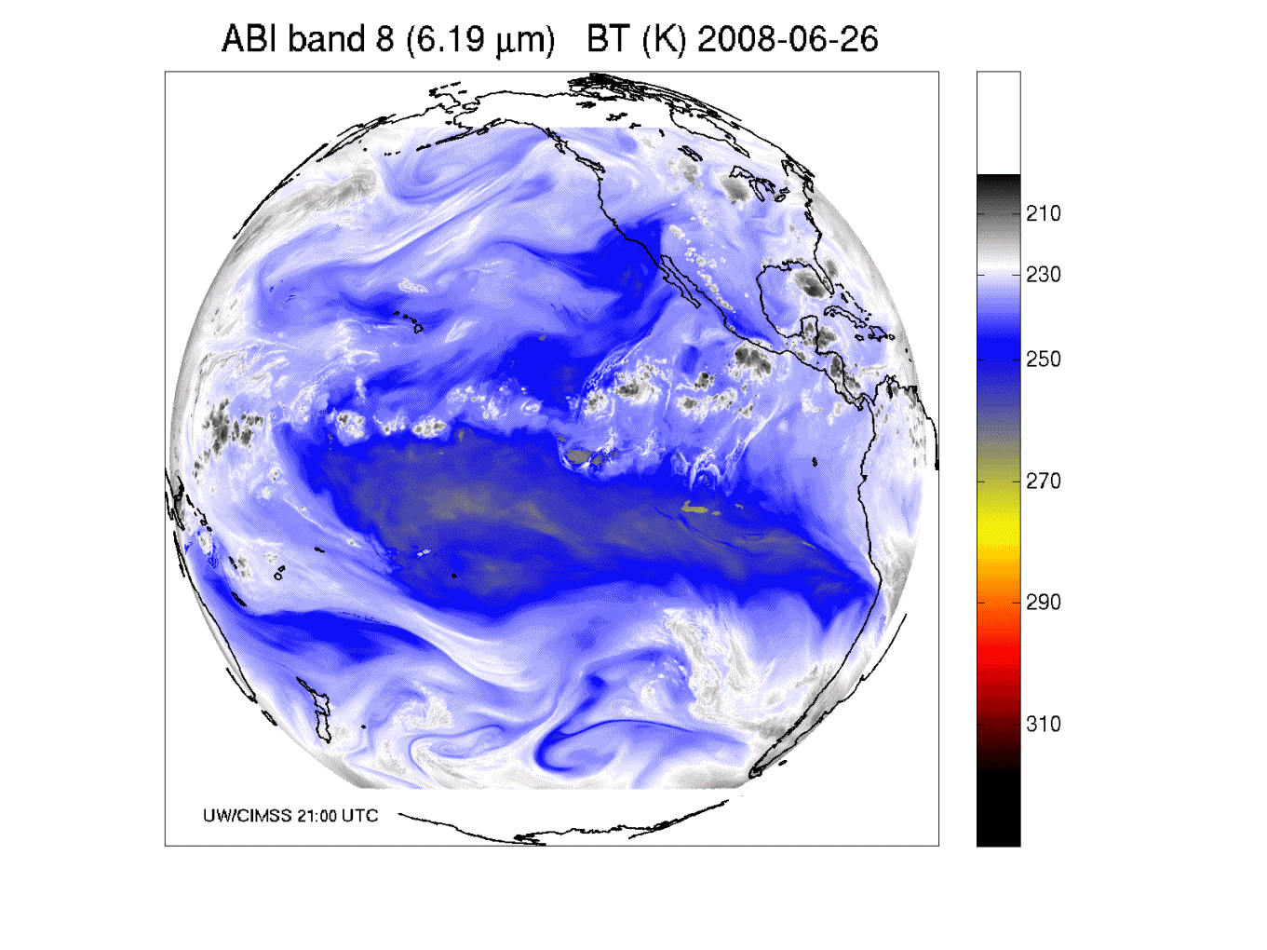
Band 8: Upper-level tropospheric water vapor band

Slide 35
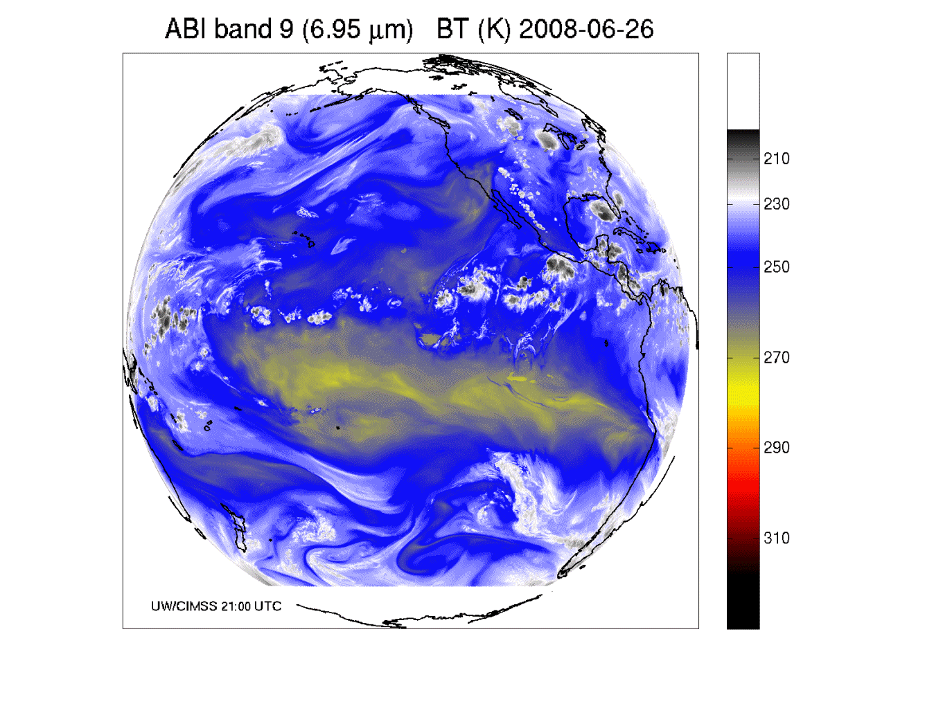
Band 9: Upper/mid-level tropospheric water vapor band

Slide 36
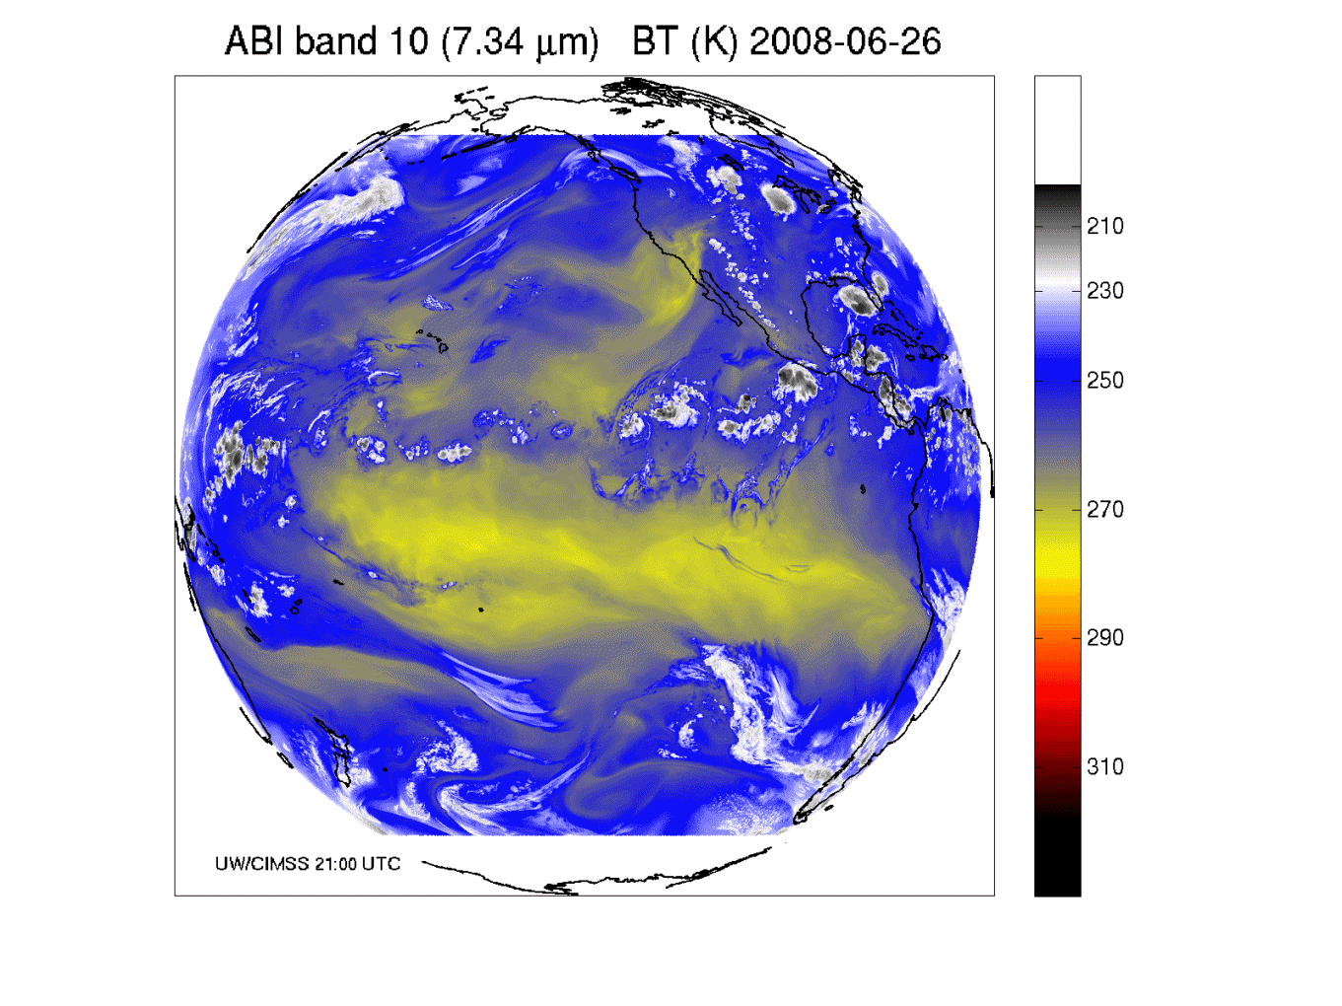
Band 10: Lower mid-level tropospheric water vapor band

Slide 37
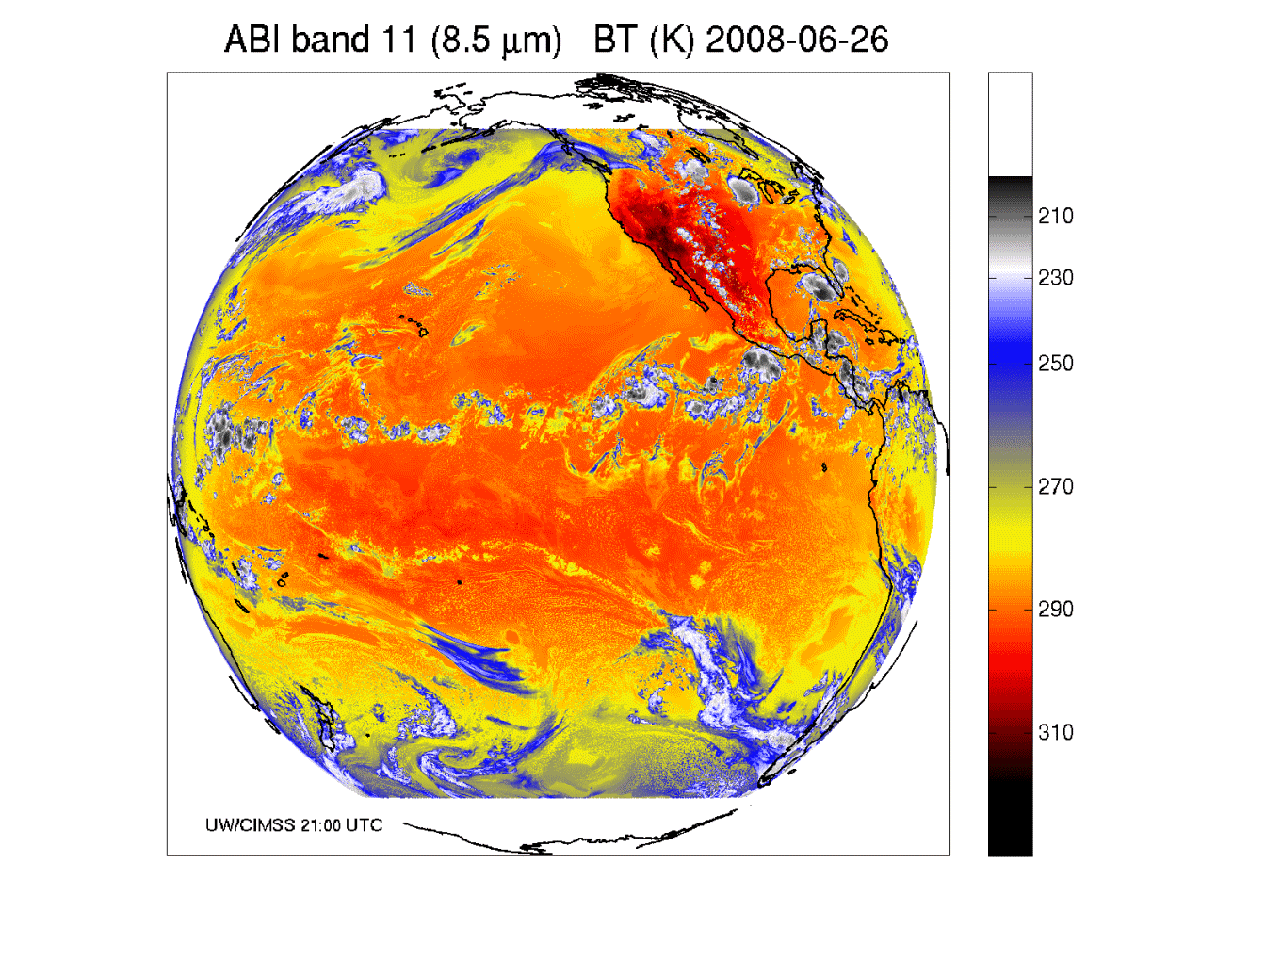
Band 11: “Cloud-top phase” band

Slide 38
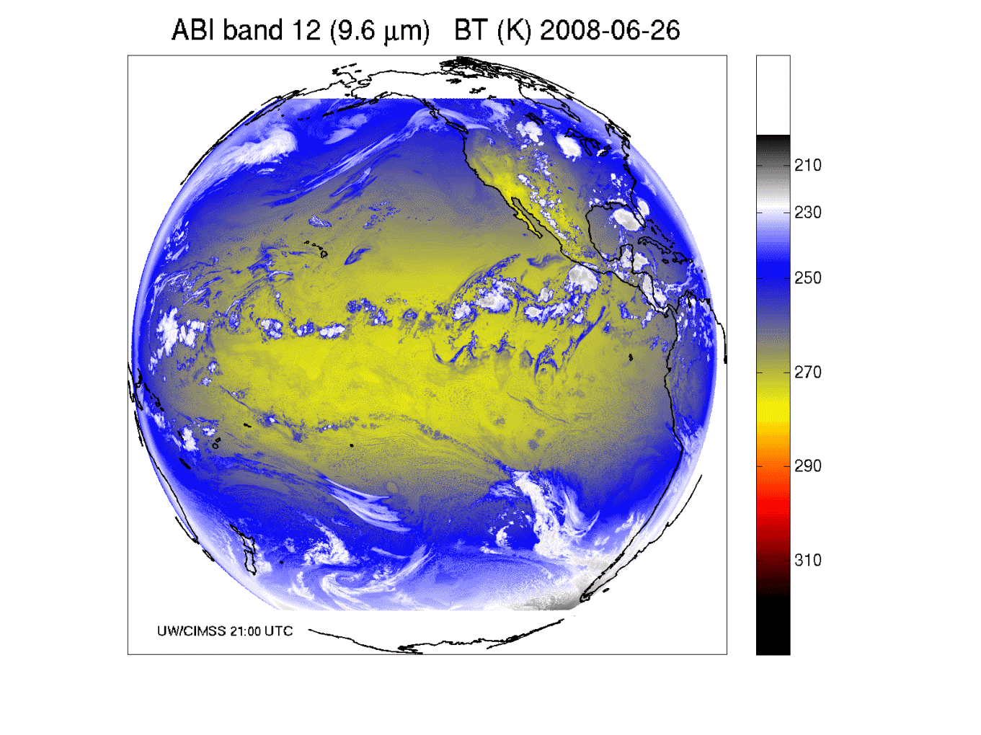
Band 12: “Ozone” band

Slide 39
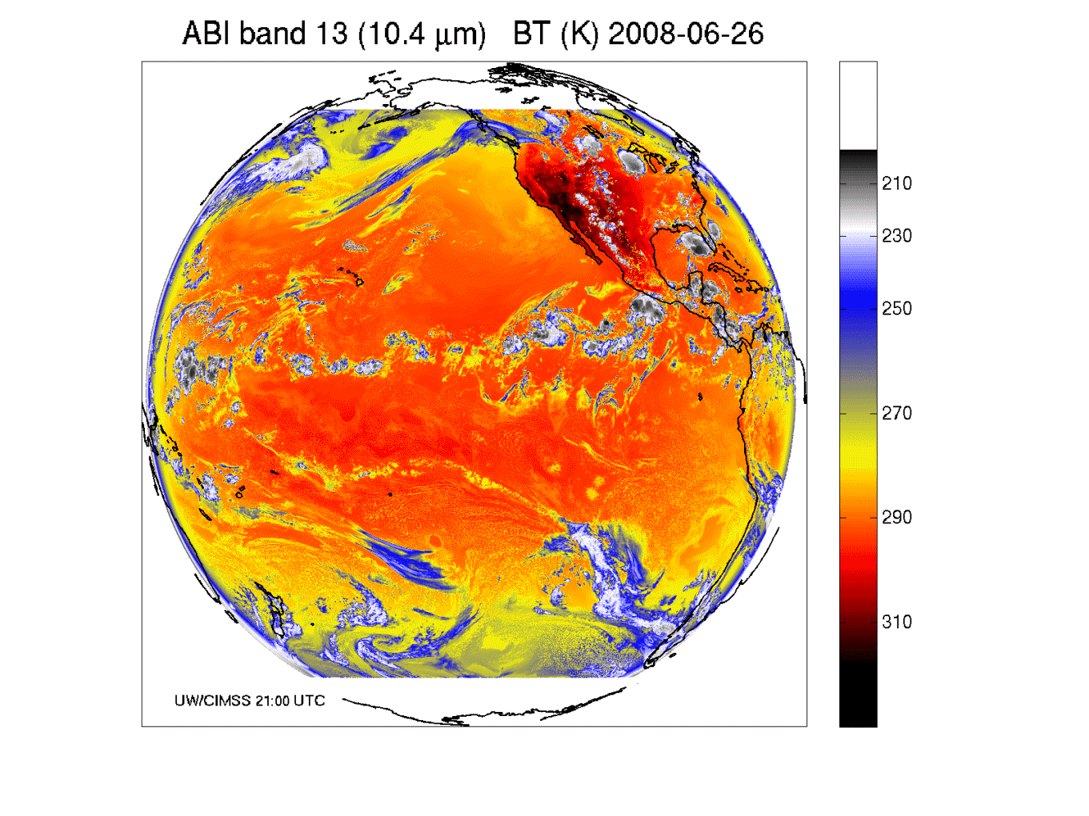
Band 13: “Clean” IR longwave window band

Slide 40
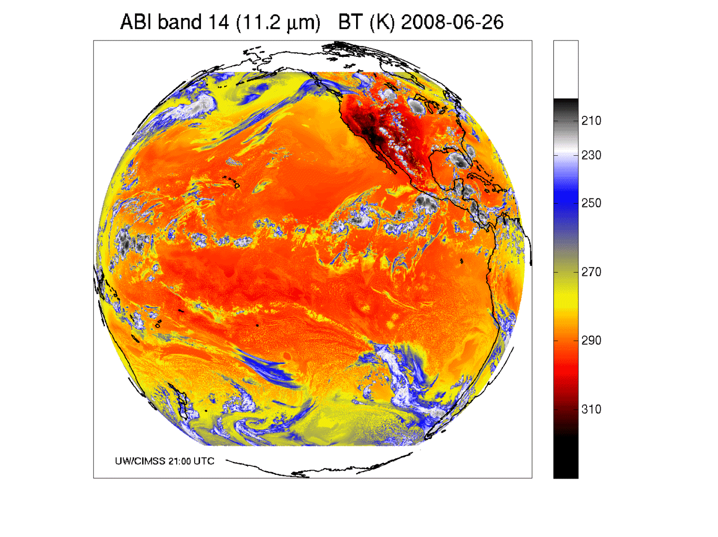
Band 14: IR longwave window band

Slide 41
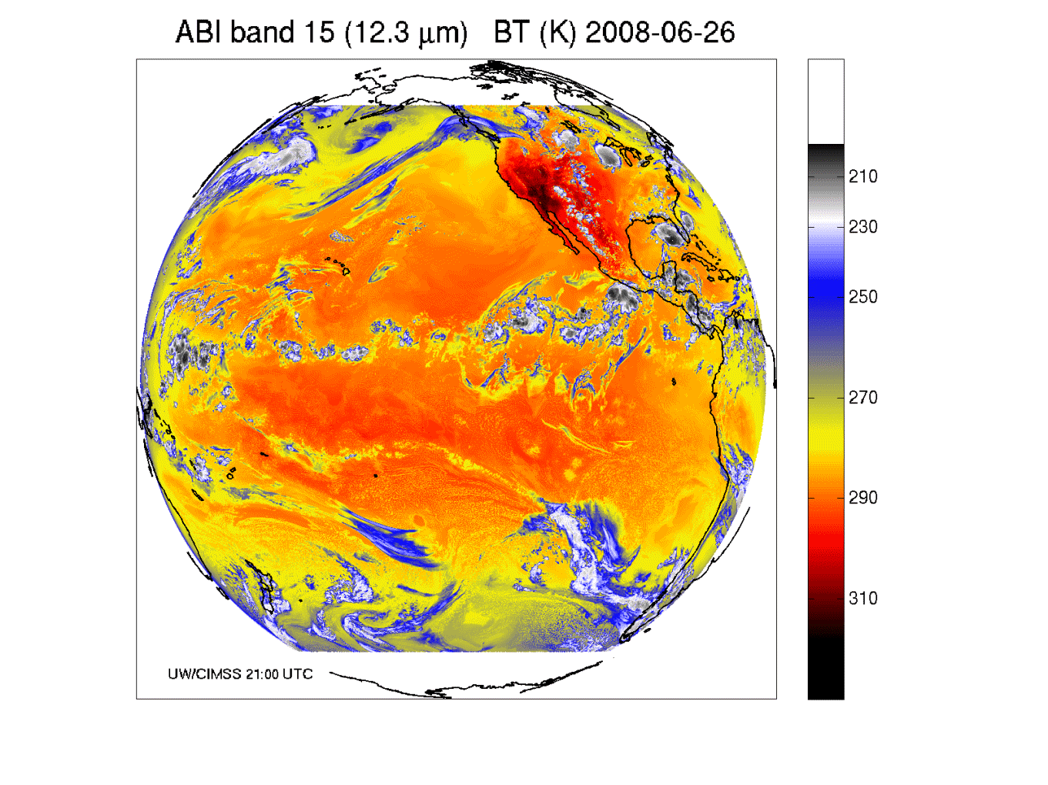
Band 15: “Dirty” IR longwave window band

Slide 42
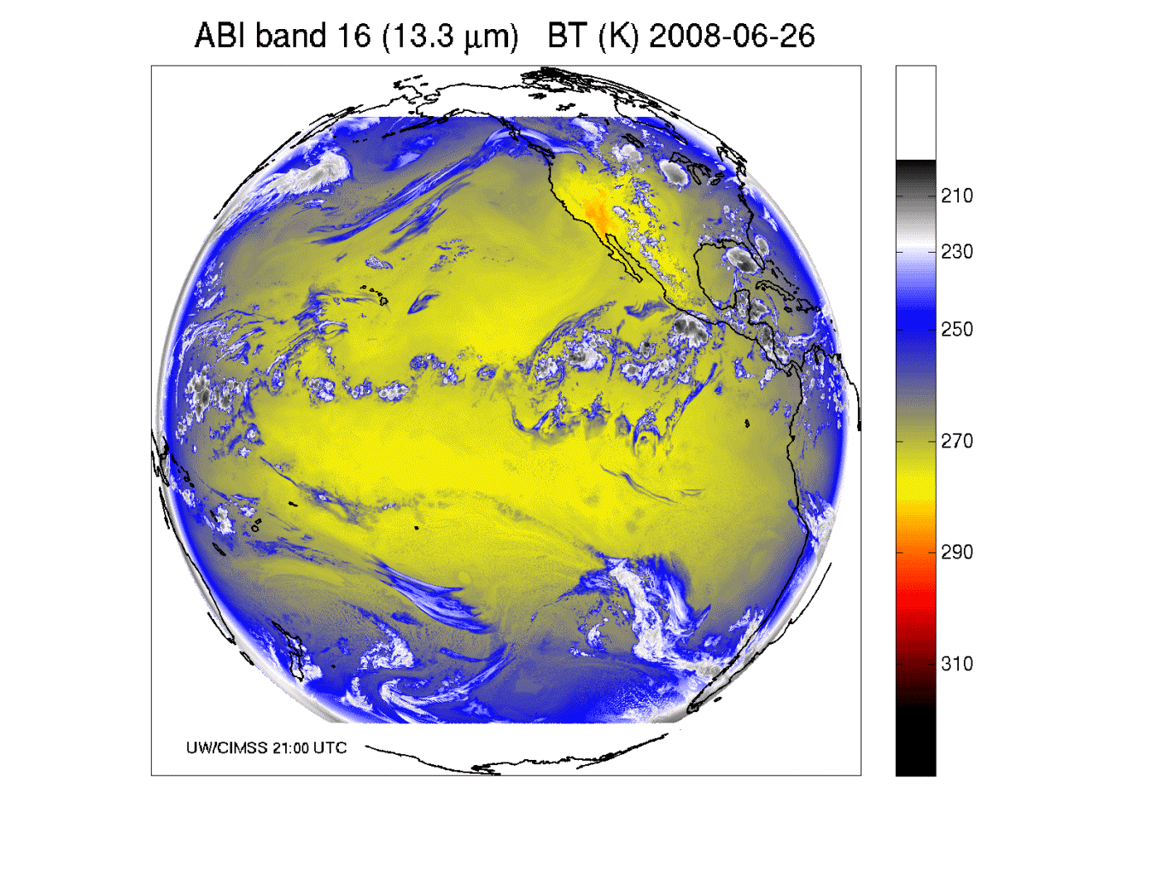
Band 16: “CO2” longwave IR band

Slide 43
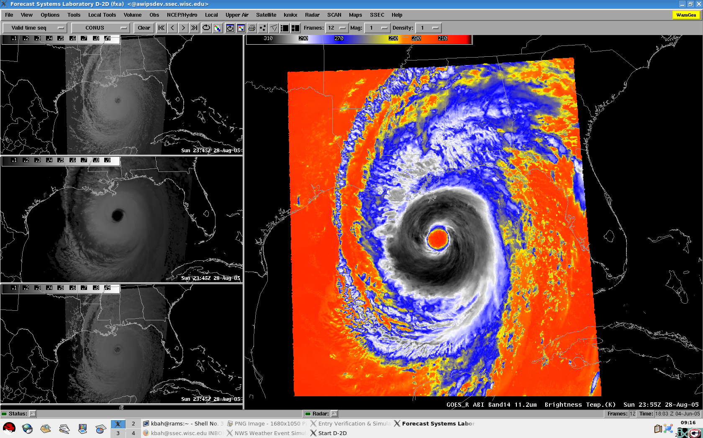
ABI Weather Event Simulation simulated all ABI bands for several cases
CONUS, Katrina, Pacific (West) case

Slide 44
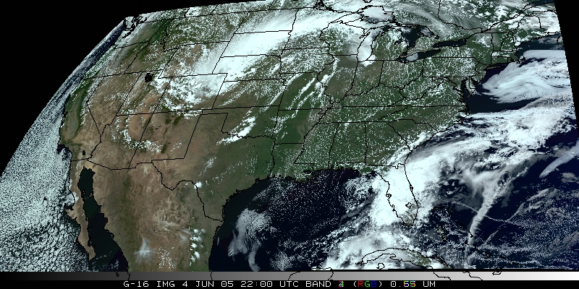
Visualization
(“decision aid”)
“True Color” with “synthetic” green from ABI simulated data (from CIMSS); image from Don Hillger, RAMMB.

Slide 45

Visualization
(“decision aid”)
“RGB Color” (VIS 0.6, VIS 0.8, and NearIR 1.6 um) with ABI simulated data (from CIMSS); image from William Straka, CIMSS and using the EUMETSAT enhancement.

Slide 46

Simulated ABI band – NSSL WRF
http://cimss.ssec.wisc.edu/goes_r/proving-ground/nssl_abi/nssl_wrf_goes.html

Slide 47
Overview
GOES-14/15
ABI (Advanced Baseline Imager)
  Temporal
  Spatial
  Spectral
  Imagery
Select Products
Summary
  More information
Lockheed Martin

Slide 48
AWG Teams
GOES-R Products Mapped to AWG Product Application Teams
Imagery (Tim Schmit)
Soundings (Tim Schmit, Chris Barnet)
Winds (Jaime Daniels)
Clouds (Andy Heidinger)
Aviation (Ken Pryor, Wayne Feltz)
Hydrology (Robert Kuligowski)
Land Surface (Bob Yu)
Cryosphere (Jeff Key)
Radiation Budget (Istvan Lazslo)
Lightning (Steve Goodman)
Space Environment (Steven Hill)
SST ______________________(Alexander Ignatov)
Ocean Dynamics ________(Eileen Maturi)
Aerosols / Air Quality / Atmospheric Chemistry (Shobha Kondragunta)
Proxy Data (Fuzhong Weng)
Cal/Val (sensor) (Changyong Cao)
Algorithm Integration (Walter Wolf)
AWG Specialty Teams

Slide 49
AWG Algorithm Development Scope
Develop algorithms for the following L2 products…
Cloud Layer/Heights
Cloud Ice Water Path
Cloud Liquid Water
Cloud Type
Convective Initiation
Turbulence
Low Cloud and Fog
Enhanced “V”/Overshooting Top
Aircraft Icing Threat
SO₂ Detections (Volcanoes)
Visibility
Upward Longwave Radiation (TOA)
Downward Longwave Radiation (SFC)
Upward Longwave Radiation (SFC)
Total Ozone
Aerosol Particle Size
Surface Emissivity
Surface Albedo
Vegetation Index
Vegetation Fraction
Flood Standing Water
Rainfall probability and potential
Snow Depth
Ice Cover
Sea & Lake Ice Concentration, Age, Extent, Motion
Ocean Currents, Currents: Offshore
Clouds and Moisture Imagery (KPP)
Clear Sky Mask
Cloud Top Pressure and Height
Cloud Top Phase
Cloud Top Temperature
Cloud Particle Size Distribution
Cloud Optical Path
Temperature and Moisture Profiles
Total Precipitable Water
Stability Parameters (Lifted Index, etc.)
Aerosol Detection
Aerosols Optical Depth
Derived Motion Winds
Hurricane Intensity
Fire/Hot Spot Characterization
Land and Sea Surface Temperature
Volcanic Ash
Rainfall Rate
Snow Cover
Downward Solar Insolation: Surface
Reflected Solar Insolation: TOA
Lightning Detection
Advanced Baseline Imager (ABI)
GLM

Slide 50




Imagery/Radiances
Imagery for nowcasting
  Clouds
  Input for products
  Channel differences
  RGB
  General Users
  Etc.
Radiances for NWP
  Clear-sky
  Cloudy-sky
  Validations
  Monitoring
  Etc.

Slide 51

ABI bands via NWP simulation (CIMSS AWG Proxy Team)
J. Oktin et al., CIMSS

Slide 52

Clear Sky Mask
(“Cloud Detection”)
Algorithm Highlights
  Designed to maximize flexibility and use
  Mask built with multiple individual tests that could be turned on and off by the downstream applications.
  Uses new ABI Bands (1.38um, 1.6um)
  Design allows for additional of new tests easily as warranted.
  Determination of test thresholds accomplished through the use and analysis of CALIPSO data.
Operational Applications
  Used extensively by downstream level-2 product algorithms
  Identifies clear pixel radiances for NWP data assimilation
Courtesy A. Heidinger: NOAA-STAR
52
52
52
Notes:
52
52
52
52
52

Slide 53



Cloud Height
Algorithm Highlights
  Algorithm uses the 11, 12 and 13.3μm channels to estimate cloud temperature, cloud emissivity and a cloud microphysics.
  Algorithm uses an optimal estimation approach that provides error estimates.
  Cloud pressure and height are computed from NWP profiles.
  For multi-layer clouds, lower cloud height estimates obtained from surrounding pixels.
  Cloud heights in the presence of low level inversions are handled using similar logic that is employed in the MODIS algorithms.
Operational Applications
  Aviation Terminal Aerodrome Forecasts (TAFs)
  Supplements Automated Surface Observing System (ASOS) with upper-level cloud information
  Cloud initialization
  Assimilation into NWP models
53
53
53
53
53
Courtesy A. Heidinger: NOAA-STAR
Notes:
53
53
53
53
53
We developed an algorithm that uses the 11, 12 and 13.3 μm observations to give us the ability to estimate cloud height and cloud microphysics.
The algorithm uses an optimal estimation approach that provides error estimates.
We use state-of-the-art scattering calculations to model the variation of cloud emissivity between 11, 12 and 13.3 μm.
For multi-layer clouds, we estimate the lower cloud height from surrounding pixels.
Cloud emissivity (11 μm) and a microphysical index (β 11&12 μm) are also generated automatically in the retrieval.
Cloud layer is retrieved using the cloud-top pressure and the assumed pressure boundaries for High, Mid and Low clouds.
Cloud heights in the presence of low level inversions are handled using the similar logic that is employed in the MODIS algorithms.

Slide 54


Cloud Phase
Algorithm Highlights
  An Infrared only algorithm that exploits the rich IR information (7.4, 8.5, 11.2, and 12.3 μm) provided by the ABI
  Algorithm determines the cloud top (layer that the radiometer senses) thermodynamic phase of the highest cloud layer
  Exploits recent improvements in fast clear-sky radiative transfer models and ancillary data (land cover, surface emissivity
  Makes advanced use of spatial information
Operational Applications
  Prerequisite for other cloud property retrievals (height, temp)
  Climate prediction
  Aviation forecasting (Aircraft icing)
M. Pavolonis
54
54
54
54
54
Water, Supercooled Water, Mixed Phase, Ice
Notes:
54
54
54
54
54
This ABI Cloud Phase Algorithm determines the cloud top (layer that the radiometer senses) thermodynamic phase of the highest cloud layer.
The cloud phase output is a subset of a more detailed cloud classification produced by the GOES-R Cloud Type Algorithm
A unique infrared cloud classification scheme is used to determine the cloud type
ABI channels used: 10, 11, 14, and 15
Effective absorption optical depth ratios (β-ratios) are used to determine cloud type (liquid water, supercooled liquid water, mixed phase, opaque ice, semi-transparent ice, and multilayered clouds).
The cloud phase (liquid water, supercooled liquid water, mixed phase, and ice) is determined from the cloud type output (ice = opaque ice, semi-transparent ice, and multilayered clouds).

Slide 55

Fog Probability Product
M. Pavolonis

Slide 56


The GOES-R Fog Product
GOES
GOES-R
M. Pavolonis
Notes:
What Is Fog and Low Stratus?
Fog is defined as a stratus cloud that has a cloud base at or close to the surface that reduces the surface visibility to less than 1 km. Even if the base of a stratus cloud is not in contact with the surface, however, it can be a hazard to aviation. The GOES-R Fog/Low Cloud Detection product is designed to quantitatively identify clouds that produce IFR or Low Instrument Flight Rules (LIFR) conditions.
The fog probability is based on textual and spectral information, as well as the difference between the cloud radiative temperature and surface temperature.
The current GOES fog products are limited to a qualitative brightness temperature difference approach (3.9μm - 11μm), available at 15 or 30-minute intervals, that can only be used at night. The GOES-R algorithm will produce a quantitative analysis of the probability that fog or low stratus is present, both day and night.
The GOES-R fog product can much more accurately capture hazardous valley fog events like this one on the east coast of the U.S., compared to current GOES

Slide 57


Convective Initiation
UWCI / Cloud-top Cooling Rate (Sieglaff et al., 2010)
  Box-averaged 0-1 hour nowcast of convective initiation and 15-minute cloud-top cooling rates
  GOES-E/W and nighttime capable
SATCAST (Mecikalski and Bedka, 2006)
  Object-based 0-1 hour nowcast of yes/no convective initiation
  Utilizes IR BT cooling rates and multi-spectral information
  GOES-E and daytime only

Slide 58



AWIPS CI/CTC Interaction with Sullivan (MKE) NWS Office
04:30 UTC
05:02 UTC
CI likely
06:30 UTC
CI occurring
Forecaster generated screen captures from AWIPS at MKE
Lightning
Courtesy W. Feltz: CIMSS
Notes:
58
Original file name: nwa2006-imprv-res-GSndrP-gsw-20060929.ppt.
Update, now including animated gifs (from Animation Ship v3) as well as most static gifs as well: nwa2006-imprv-res-GSndrP-gsw-20061009.ppt.
File submitted to NWA Mtg ftp site: nwa2006-imprv-res-GSndrP-gsw-20061010f.ppt.
File with enhanced notes added: nwa2006-imprv-res-GSndrP-gsw-20061012n.ppt.
Presentation given in the Remote Sensing Session, at 02:00 PM on Tue 17 Oct 2006.
Intro text: Well, with neither a microwave geostationary sounder nor a hyperspectral IR geostationary sounder looming in the near future, I think that the challenge remains valid to make the current geostationary soundings more relevant.
… this presentation will be an overview of the efforts, especially at CIMSS, to try to take better advantage of the GOES Sounder for forecasting purposes.
Post version, with additional notes added after the talk: nwa2006-imprv-res-GSndrP-gsw-20061018p.ppt.
Updated version for NWS FO visit on 06 Mar 2007 at ARX (La Crosse, WI), named: nwsfo-GSnsrP-gsw-20070306-arx.ppt. Version includes new animated gifs for PW, LI, CTP, and SR algorithm version comparisons for 28 Feb - 01 Mar 2007 sequence as well as Sounder band 1-4 example from 02 Mar 2007 illustrating thermal gradient reversal across tropopause.
Update with additional spectrum slide. File: nwsfo-GSndrP-gsw-20070306-arx-2.ppt.
Update again, now including recent (Jan 2008) DPI and other loops, along with some future (ABI, HES) material: nwsfo-GSndrP-gsw-20080110-grb.ppt.
Update again, with recent (May 2008) DPI and try to tighten up content and focus: nwscrh-GSndrP-cimss2kc-gsw-20080529.ppt.
Update again, with recent data (Jan 2009) and tighter focus: GOES-Sndr-ovrvw-MKXvisitCIMSS-20090127gsw.ppt.
Update again, with bit more organized focus as well as recent data (Feb 2009) and AIRS tie-in: GOES-Sndr-ovrwv-MKXvisit-20090217gsw.ppt.
Update now for SPC (GOES-R Prvng Grnd support for Spring Program) visit (May 2009): use example of 13-14 May 2009, plus “SoCenUS” retrvl version comparisons for that day as well. Incl (if needed) some GOES-R ABI and “nearcasting” slides.

Slide 59

Overshooting-top / Enhanced-V
Based on GOES-13 IR BT spatial testing (see Bedka et al., 2010)
Detects overshooting-top and thermal couplet features in mature cloud tops
  Provides detections and relative magnitudes
  Operates day/night and can operate during rapid scan

Slide 60

Courtesy K. Bedka
Overshooting tops (OTs) are the product of deep convective storm updrafts with sufficient strength to rise above the storms’ equilibrium level and penetrate into the lower stratosphere
OTs appear as small clusters of very cold pixels relative to the surrounding thunderstorm anvil
Infrared (IR) temperature gradients (i.e. texture) are combined with NWP information to accurately detect OTs during day/night using current and future satellite sensors (Bedka et al. 2010)
Detection product being evaluated within the 2010 SPC Spring Experiment via the GOES-R Proving Ground and the NCAR Global Atmospheric Turbulence Decision Support System for Aviation
OT Detection Method | OT Pixel FAR | ABI OT Detection Product Maximum Acceptable FAR Requirement | OT Top Region POD | Number of OT Detection Pixels Along CloudSat Track
IR-Texture (Applied to Synthetic ABI) | 16.1% | 25% | 74.6% | 940 (114 Global OT Events)
IR-Texture (Applied to Current GOES and SEVIRI) | 18.3% | N/A | 57.6% | 252 (59 OT Events)
WV-IR BT Diff > 0 K (Currently Operational At Aviation Weather Center) | 81.2% | 25% | 99.1% | 15079 (114 Global OT Events)

Slide 61

Derived Motion Winds
Algorithm Highlights
  Heritage in targeting, tracking, and QC algorithms lie with current NESDIS operational winds algorithms
  New nested tracking algorithm introduced that makes use of a two-dimensional clustering algorithm to capture the dominant motion in each target scene
  Utilizes clear sky mask product
  Wind height assignment will rely on utilization of pixel level cloud heights generated upstream via algorithms delivered by AWG cloud application team
  Leverages ABI’s higher spatial and temporal resolution data
Operational Applications
  Weather Forecasting
  Assimilation into mesoscale and global NWP models
  Aviation (flight routing)
Cloud-drift Winds derived from a Full Disk Meteosat-8 SEVERI 10.8 µm image triplet centered at 1200 UTC 01 February 2007
High Level 100-399 mb
Mid-Level 400–699 mb
Low-Level >700 mb
61
61
61
61
61
Courtesy J. Daniels: NOAA-STAR
Notes:
61
61
61
61
61

Slide 62


GOES-R Atmospheric Motion Vectors
Product Example: Hurricane Katrina
Low-mid level vectors- cyan Upper-level vectors - yellow
IR AMVs derived from WRF model images
using simulated future GOES-R radiances
2 km resolution; 5-minute time step
IR AMVs derived from current GOES-12
4km resolution; 15-minute time step
Courtesy C. Velden: UWisc-CIMSS/NOAA-STAR
Notes:
Will provide automated hurricane intensity estimates for tropical cyclone analysts over the GOES-R observation domain using infrared geostationary infrared window (IRW) imagery
Significant Heritage to draw from:
Based on Subjective Dvorak “Enhanced Infrared” (EIR) Technique (SDT) developed in the 1970’s and 1980’s by NOAA/NESDIS scientist Vern Dvorak.
Provides estimated hurricane intensity in oceanic regions where direct aircraft reconnaissance measurements of intensity are not available.
Satellite-based technique that employs image pattern recognition techniques and empirically based rules to derive an estimate of Tropical Cyclone (TC) intensity in “T numbers” which ultimately relate to surface wind speeds.
The increased higher density winds derived from the higher resolution GOES-R ABI allows forecasters to more accurately determine the extent of the eye and gale force winds (upper winds, not ground), and improve the model forecasts of track and intensity. Example compares the winds GOES-R ABI can produce with its 2-km IR spatial resolution and 5-min refresh rate as simulated using the Weather Research and Forecast (WRF) Model compared to the current GOES-R imager with 4-km IR resolution and 15 min or longer refresh rate.
GOES-R improves spatial and temporal resolution thereby increasing the accuracy of storm height assigment. GOES-R will also detect and more define eye helping to more accurately predict forward track.
The higher density winds derived from the GOES-R ABI allows forecasters to more accurately determine the extent of the eye and gale force winds, and will improve the model forecasts of track and intensity.

Slide 63

Fire/Hot Spot Characterization
Algorithm Highlights
  Heritage lies with the GOES operational Wildfire Automated Biomass Burning Algorithm (WF_ABBA)
  Dynamic, multi-spectral, thresholding contextual algorithm
  Utilizes the 0.64, 3.9, 11.2 and 12.3 μm channels
  Leverages ABI’s higher spatial and temporal resolution data
Operational Applications
  Fire weather forecasting
  Air quality forecasting
63
63
63
63
63
Courtesy C. Schmidt: CIMSS
Notes:
63
63
63
63
63

Slide 64




GOES-12 and GOES-R ABI
Simulation of Grand Prix Fire/Southern California
GOES-12
GOES-R ABI
GOES-12
GOES-R ABI
J. Feltz
Notes:
Here are two different fires. What we can see is a more defined peak in the higher resolution data and it is easier to pick out individual hotspots. In addition, the higher saturation tempearture of the ABI allows us to see that the fire is around 370K.

Slide 65

Volcanic Ash
Algorithm Highlights
  Detects volcanic ash and estimates its height and mass loading
  Leverages the new ABI 8.5 μm band, The 8.5 μm, 11.2 μm, and 12.3,11.2 μm channel pairs are used to detect volcanic ash
  An optimal estimation approach is used to estimate ash cloud temperature, emissivity and microphysical index.
  Ash cloud height determined from NWP profiles.
  Mass loading estimated from computed optical depth and effective particle size
  Leverages ABI’s new 8.5 μm channel, along with 11.2 μm and 12.3 μm for sensitivity to cloud microphysics (including composition)
Operational Applications
  Aviation safety
  Health safety
  Climate studies
Iceland's Eyjafjallajökull Volcano
False Color
Imagery
Mass
Loading
Ash
Height
Effective
Particle
Radius
65
65
65
65
M. Pavolonis
65
Notes:
65
65
65
65
65
Grand Comore Island, Comoros (11.75 S, 43.38 E)
summit elevation 2361 m
shield volcano
Karthala volcano is located on Grande Comore, the most westerly of four volcanic islands comprising the Comores Archipelago, between northern Madagascar and Mozambique. Karthala occupies the southern half of Grand Comore Island.

Slide 66


Temperature & Moisture Soundings, Precipitable Water, Atmospheric Stability Products
TPW
(mm)
Algorithm Highlights
  1D-variational physical retrieval algorithm that has heritage with MODIS and current operational GOES sounder physical retrieval algorithms
  Regression-based initial guess T/Q profiles
  Utilizes NWP forecast T/Q profiles
  Utilizes the 6.15, 7.0, 7.4, 8.5, 9.7, 10.35, 11.2, 12.3, and 13.3 μm bands)
  Exploits recent improvements in fast clear-sky radiative transfer models and ancillary data (surface emissivity)
Operational Applications
  Nowcasting
  Gulf of Mexico return flow
  Southwest US monsoon
  QPF (heavy rain, flash flooding)
  Convective potential and morphology
  Fog potential
  Situational awareness in pre-convective environments for potential watch/warning scenarios
  NWP
  Assimilation into regional and mesoscale NWP models (TPW)
TPW
Lifted Index
66
66
66
66
66
J. LI, CIMSS
Notes:
66
66
66
66
66

Slide 67
The relative vertical number of independent pieces of information is shown. Note that the moisture content is similar between the ABI and the current GOES Sounder. The Sounder does show more temperature information than the ABI. Caveat: Even if two systems have the same number of pieces of information, they may represent different vertical levels. This information content analysis does not account for any spatial or temporal differences.

Slide 68

GOES-R ABI Weighting Functions
ABI has only 1 CO₂ band, so upper-level temperature will be degraded compared to the current sounder

Slide 69

GOES-13 Sounder WFs
The GOES-N sounder has 5 CO₂ bands, and more SW bands than ABI

Slide 70
Overview
GOES-14/15
ABI (Advanced Baseline Imager)
  Temporal
  Spatial
  Spectral
  Imagery
Select Products
Summary
  More information
Lockheed Martin

Slide 71

Improved attributes with the Future GOES Imagers

Slide 72
Approximate spectral and spatial resolutions of US GOES Imagers
~ Band Center (um) | GOES-6/7 | GOES-8/11 | GOES-12/N | GOES-O/P | GOES-R+
0.47
0.64
0.86
1.6
1.38
2.2
3.9
6.2
6.5/6.7/7 | 14km
7.3
8.5
9.7
10.35
11.2
12.3
13.3
Visible
Near-IR
Box size represents pixel size
8
4
2
“MSI mode”
Infrared
Notes:
0.40 inches = 4km; 0.80 inches = 8km
MSI is Multi-Spectral Imaging Mode (dashed boxes)
This does not show other improvements: SNR, MTF, bit-depth, navigation, coverage rates, etc.

Slide 73

More information
GOES-R:
  http://www.goes-r.gov
  http://www.meted.ucar.edu/index.htm
  http://cimss.ssec.wisc.edu/goes_r/proving-ground.html
GOES and NASA:
  http://goespoes.gsfc.nasa.gov/goes/index.html
  http://goes.gsfc.nasa.gov/text/goes.databookn.html
UW/SSEC/CIMSS/ASPB:
  http://cimss.ssec.wisc.edu/goes_r/proving-ground/nssl_abi/nssl_abi_rt.html
  http://cimss.ssec.wisc.edu/goes_r/awg/proxy/nwp/
  http://cimss.ssec.wisc.edu/goes/abi/
  http://cimss.ssec.wisc.edu/goes/abi/wf
  http://cimss.ssec.wisc.edu/goes/blog/
  http://www.ssec.wisc.edu/data/geo/
AMS BAMS Article on the ABI (Aug. 2005)

Slide 74


Google Earth
Sample ABI simulated data are available in google earth format:
  http://cimss.ssec.wisc.edu/goes/abi/loops/links.html

Slide 75

Summary
The ABI on GOES-R will improve over the current instrument in many aspects (spectral, spatial, and temporal on orders of 3, 4 and 5, respectively), plus improved image navigation and registration and radiometer performance.
These improvements will
greatly assist a host of
applications, especially on
the regional and
meso-scales.

Slide 76


Acknowledgements
The authors would like to thank the entire GOES-R team; both within the government, industry and academia.
The views, opinions, and findings contained in this presentation are those of the authors and should not be construed as an official National Oceanic and Atmospheric Administration or U.S. Government position, policy, or decision.

Slide 77
Back-up
No dedicated Sounder on GOES-R/S/T/U
Legacy products can be produced from the ABI.
ABI+forecast and GOES Sounder+forecast have similar precisions on temperature, moisture profiles, TPW, LI
Both GOES Sounder and ABI has significantly less temperature and moisture information than a hyperspectral resolution IR sounder

Slide 78
Regional simulation using GOES-12 measurements
(update on 07 March 2007)
Using time/space collocated GOES-12 Sounder/RAOB/Forecast over CONUS
GOES-12 Sounder real retrieval
ABI-like from GOES-12 Sounder real retrieval (via channel selection)
HES retrieval is from simulated data
Retrievals are compared with RAOB
Soundings, Total precipitable water (TPW) and Lifted Index (LI) are used for performance analysis

Slide 79

RMS is based on the absolute difference between the retrieval and radiosondes

Slide 80

RMS is based on the absolute difference between the retrieval and radiosondes

Slide 81

Benefits of high-spectral resolution over narrowband measurements!
Root Mean Square Error
Forecast: 2.27
ABI like + fcst: 2.20
GOES 12 + fcst: 2.18
HES + fcst: 1.79
Experiments show that retrievals of atmospheric instability from high-spectral (HES) data are much improved over current broadband (GOES-12+forecast).
Notes:
For LI, the error much less from high-spectral data, compared to broad-band measurements.
Raob data are used for truth.
The ABI-like data are select sounder bands.
The GOES-12 case is GOES-12 sounder bands.
The HES (high-spectral) data are simulated.
The region is over CONUS.

Slide 82

Benefits of high-spectral over broad-band measurements!
Root Mean Square Error
Forecast: 0.40
ABI like + fcst: 0.35
GOES 12 + fcst: 0.34
HES + fcst: 0.16
Experiments show that retrievals of Total Precipitable Water (TPW) from high-spectral (HES) data are much improved over current broadband (GOES-12+forecast).
Notes:
For TPW, the error is half from high-spectral data, compared to broad-band measurements.
Raob data are used for truth.
The ABI-like data are select sounder bands.
The GOES-12 case is GOES-12 sounder bands.
The HES (high-spectral) data are simulated.
The region is over CONUS.

Slide 83
Summary of Simulations
ABI alone temperature is degraded significantly from GOES Sounder alone, ABI alone moisture has comparable information of GOES Sounder alone
ABI+forecast and GOES Sounder+forecast have similar precisions on temperature, moisture profiles, TPW, LI
Both GOES Sounder and ABI has significant less temperature and moisture information than HES like hyperspectral IR sounder

Slide 84






New Nearcasting Approach Demonstrates Power of Sounder
5-hour Nearcast for 2000 UTC using Equivalent Potential Temperature (Theta-E)
Simulated ABI
Simulated HES
Same
12 June 2002
IHOP OSSE
CIMSS
Nearcasting
multi-layered
observations projected forward in time along Lagrangian trajectories
(using winds from RUC)
Strong, localized low-level Theta-E gradients seen by HES, not ABI
(enhanced vertical resolution gives HES much higher sensitivity to low level moisture)
Robert Aune
(NESDIS)
Ralph Petersen
(UW-SSEC/CIMSS)
Vertical Theta-E Differences (500-800 mb) indicate where instability (large negative) supports severe deep convection

Slide 85

Current Sounder Data Volume
Current GOES Sounder
Horizontal
Notes:
Define current GOES sounder information volume to be 1 x 1 x 1 for the attributes.

Slide 86

Advanced High-Spectral IR Sounder
(GIFTS example)
Horizontal

