Slide 1
GOES-R Proving Ground NASA/SPoRT Update
2009 Planning Meeting, Boulder, CO

Slide 2
SPoRT Plan Outline – 2009/10
Overview of planned contributions
Transition and Evaluate GOES-R ABI proxy data/products produced by other members of Proving Ground Team to SR WFOs
Improve the display of LMA data in AWIPS
Risk Reduction via GLM proxy data
Development of multi-channel and composite products and displays to meet forecast needs
Apply lightning algorithm to WRF-ABI simulation
Assimilation of real and proxy data in modeling

Slide 3
Transition Efforts
This is the SPoRT paradigm. Recent examples of transitioned products include MODIS SST and Fog products, GOES aviation products, and CIRA TPW.
Match products to problems
Make PG products available to forecasters in their DSS
Developing and implementing product training
Conduct assessment on utility of product in operations
Document usefulness of product to address specific forecast need

Slide 4
SPoRT South/Southeast Focus for GOES-R Products
Forecast Problem | Proxy Data / Source | Product(s)
Diagnosing changing weather | ABI / TBD | High resolution imagery and derived products
Diagnosing low clouds and fog | ABI / SPoRT | Enhanced channel difference imagery
Local temperature forecasts | ABI / SPoRT | Land surface temperature
Visibility reductions due to smoke and fire weather support | ABI / CIMSS-SPoRT | Color composites, active fires and burn areas
Lead time for severe weather | GLM, WRF / AWG | Total lightning products, WRF lightning threat
Sea breeze impact | ABI / SPoRT | Local model forecasts initialized with surface parameters and SSTs
Diagnosing severe weather and heavy precipitation | ABI / CIRA-SPoRT | Blended total precipitable water
Convective weather forecasts | ABI / CIMSS-SPoRT | Local modeling initialized with vegetation parameters and SSTs, and assimilated cloud-tracked wind fields
Regional precipitation forecasts and off shore weather | ABI / CIMSS-SPoRT | T(p), q(p), 3D fields of met. variables from model forecasts improved with radiances or profile information

Slide 5
SPoRT South/Southeast Focus for GOES-R Products
Forecast Issues
Relevant GOES-R product/data
Diagnosing changing weather
Diagnosing low clouds and fog
Local temperature forecasts
Visibility reductions from smoke and fire weather
Lead time for severe weather
Sea Breeze Impact
Diagnosing severe weather and heavy precipitation
Convective weather forecasts
Regional precipation forecasts and off shore weather
ABI – high res. Imagery and derived products
ABI – enhanced channel difference imagery
ABI – Land Surface Temperature
ABI – Color Composites, active fires and burn areas
GLM – Total lightning, and lightning threat
ABI – Local models initialized with sfc parameters and SST
ABI – Blended TPW
ABI – Local modeling initialized with veg. parameters, and SSTs, and assimilated cloud track winds
T(p), q(p), 3D fields of met. Variables from model forecasts improved with radiances or profile information
Notes:
This is the same as the table in the previous slide. I typed this in and then realized that I might be able to cut and paste the table with this same data. So I’m leaving this here just in hidden mode.

Slide 6
Contributed Expertise
From proxy data sets by PG and AWG teams that mimic GOES-R instruments…….
Multi-channel
True Color, False Color, Fog
Composites
SST from simulated ABI – Impact difference from MODIS?
Lightning Threat
Facilitate GLM proxy data usage in severe weather
Apply McCaul algorithm to ABI-WRF 2km domain
Assimilation of Real and Proxy Data in Models
ABI simulated T and q profile assimilation (compare to AIRS/CrIS)
ABI proxy data (MODIS LST, veg.) in coupled WRF-LIS
Partnerships
HUN, ESSC, GLM AWG members
NASA Goddard GMAO, JCSDA

Slide 7
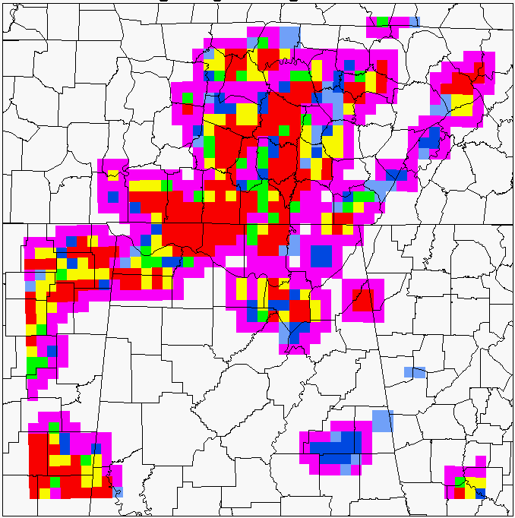
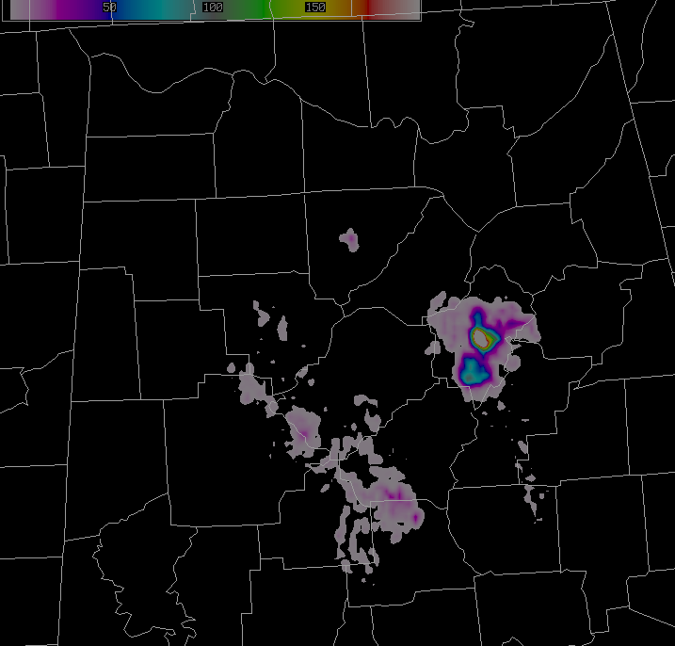
GLM Proxy Product from LMA data
Can applications from LMA still be used with reduced resolution of GLM?

Slide 8
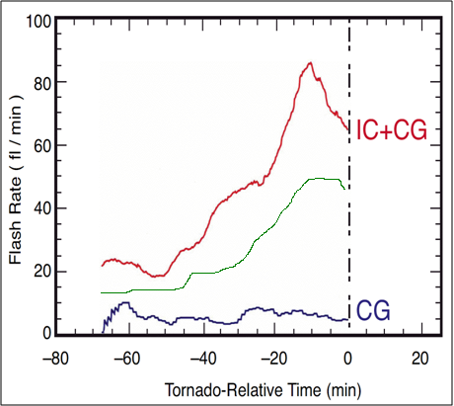
What is the Practical Benefit?
Notice intra-cloud and CG trends before the tornado touchdown
Intra-cloud shows clear trend
Cloud-to-ground is steady
Correlates with:
Storm updraft strength
Incipient severity
Source density “jump” noted in advance of many severe weather occurrences
Updraft Intensifies
GLM?
Vortex
Spin-up
Notes:
8
It has been stated several times that the source densities can be used to infer storm strength and severity. This and the following slide will give an example of how. Notice the trends of intra-cloud lightning, in red, and cloud-to-ground lightning, in blue, leading up to a tornado touchdown in the graphic provided. The additional intra-cloud observations show a clear trend. The source densities are increasing as the vortex “spins-up” and the updraft intensifies. Conversely, the cloud-to-ground observations show no clear change leading up to the touchdown. This shows that the intra-cloud flashes correlate with the storm updraft strength as well as the incipient storm severity. This source density “jump” is noted in advance of many severe weather occurrences. Let’s return to the original animation example.

Slide 9
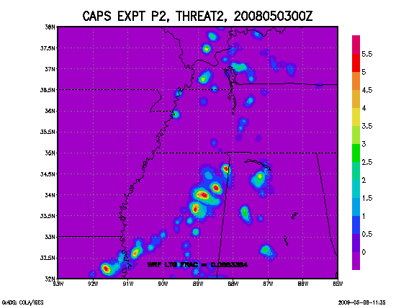
WRF-based Forecasts of Lightning Threat
E. McCaul, USRA, and S. Goodman, NOAA
GOALS
To apply the McCaul et al lightning forecast algorithm to CAPS WRF ensembles to examine robustness
APPROACH
apply lightning algor. to some prototypical event
modify calibrations using NALMA data, if needed
examine scale sensitivity of the two threat fields
examine statistical envelope of inferred lightning
Sample 24 hr LTG forecast
RECENT RESULTS - Completed first-pass analysis of CAPS WRF ensemble fields for 2 May 2008
Threat1 (based on graupel flux) more scale sensitive than VII; LMA data uncertain (range)
FUTURE WORK - Apply technique to additional dates to confirm preliminary findings for storms closer to LMA
- Extend technique to analysis of CIMSS ABI WRF hemispheric simulation of 4 June 2005 event

Slide 10
Evaluation of Products
Key to success
Sustained interaction between developers and end users facilitated by PG teams for the purpose of training, product assessment, and obtaining feedback
Type of methods to engage users
Site visits and presentations
(8 last year outside of HUN)
Distance-learning modules with GOES-R proxy product impacts to specific forecast problems
WES Cases
Regular coord. telecons (Q&A and feedback opportunity)
Online surveys (comparable, metric oriented)
Blog posts (peer influence, visual, relevant)

Slide 11
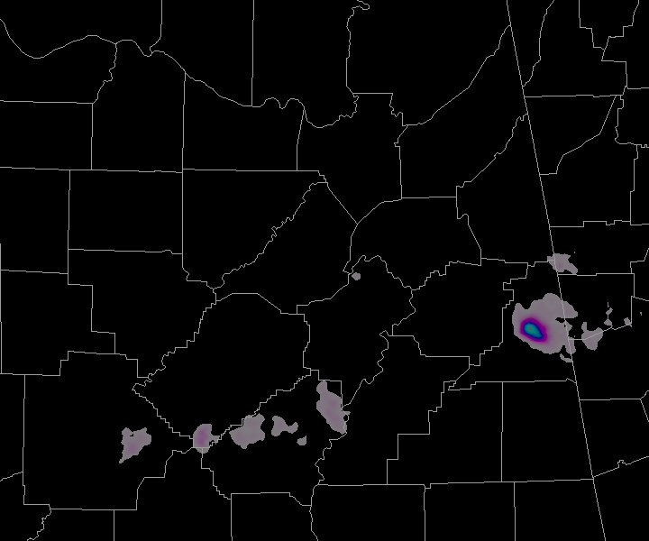
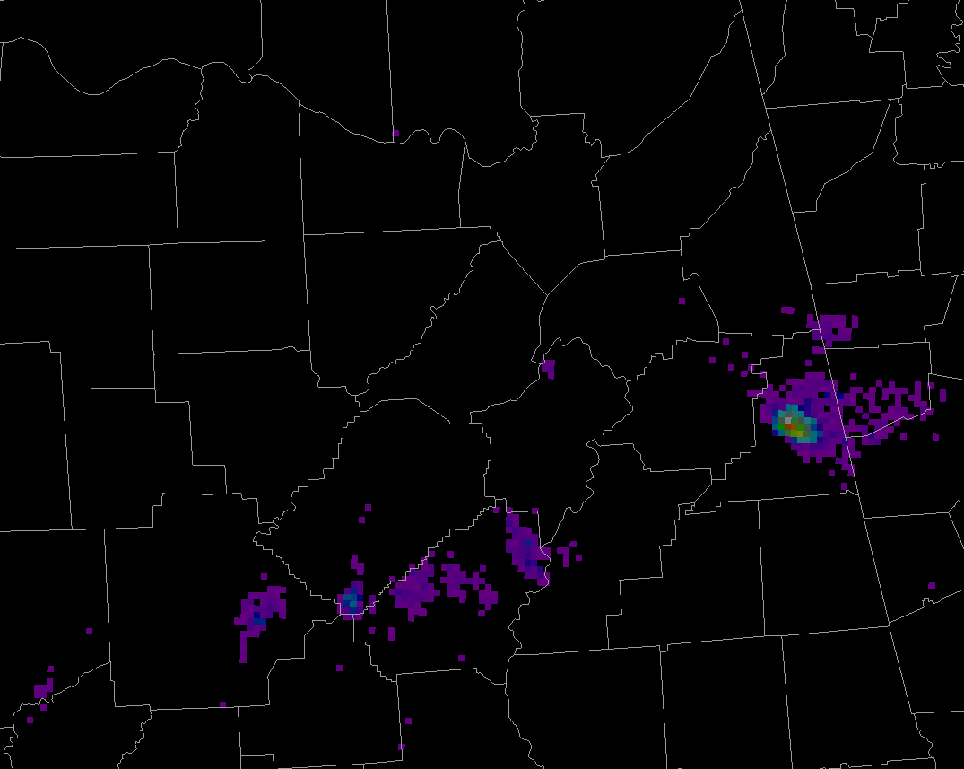
Data in AWIPS II
Lightning Mapping Array Observations
18 February 2009 – 2306 UTC
AWIPS
Displaying source densities
Using GRIB format
Combined with radar
Have physical side-by-side comparison of AWIPS versus AWIPS II
Lessons learned to be applied to other SPoRT products
AWIPS II

Slide 12
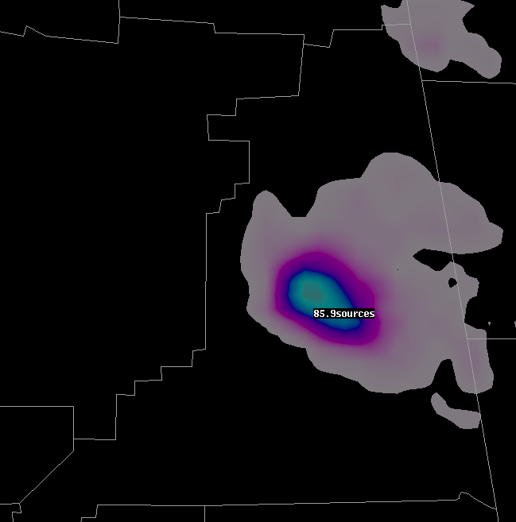
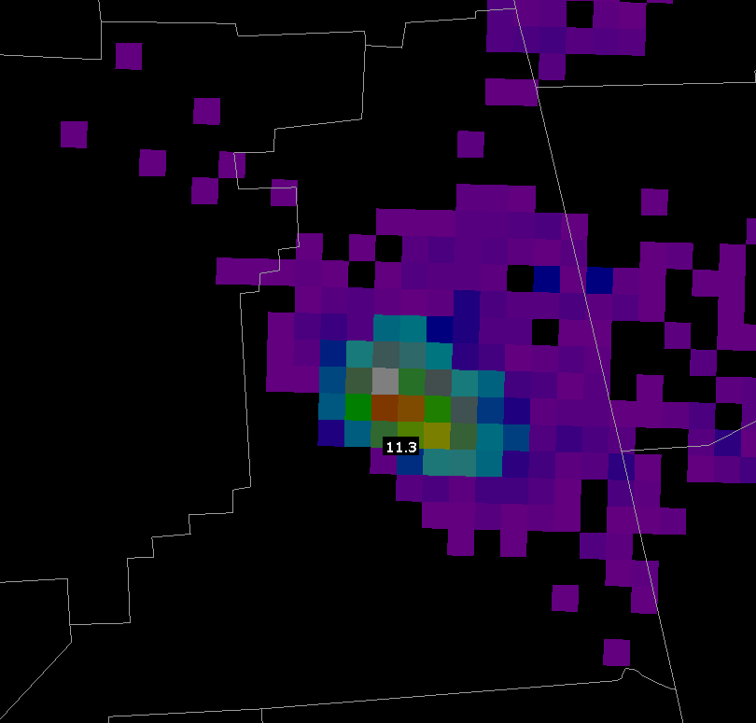
Magnitude Comparison
AWIPS
~86 sources
AWIPS II
~113 sources

Slide 13
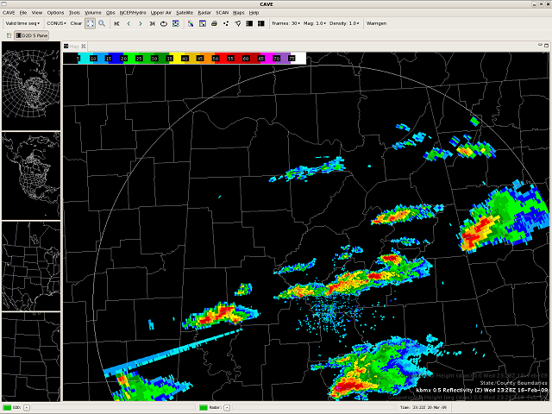
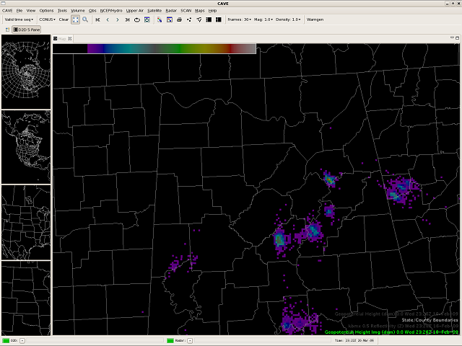
Benefits to the Proving Ground
SPoRT’s efforts to ingest products into AWIPS II are preparing for the future of visualization by NWS
Lessons learned can be applied directly to GOES-R Lightning Mapper
SPoRT is developing expertise with AWIPS II (future McIDAS plug-in)
Radar
NALMA

Slide 14
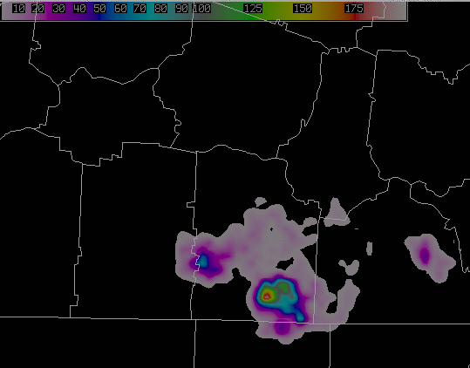
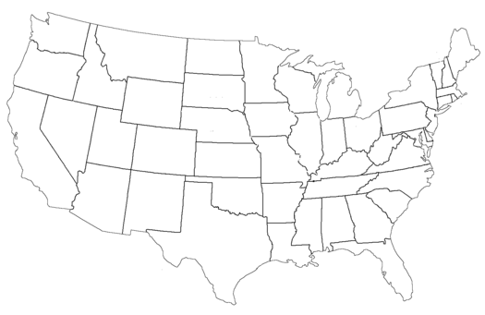
SPC Spring Program Activities with GOES-R PG
Training for source density product
SPoRT and the Lightning Group are providing expertise in total lightning
Provide training to personnel
Visits by SPoRT staff to SPC and Experimental Warning Program
Real-time total lightning data from three networks will be provided
North Alabama Lightning Mapping Array
Washington DC Lightning Mapping Array
Kennedy Space Center Lightning Detection and Ranging II Network
Updrafts
Data Flow to SPC

Slide 15
Summary
Transition and evaluation of proxy products from PG members to forecast issues of S/SE WFOs
Contribute expertise on total lightning in operations based on partnerships with AWG and RR and past work over several years with WFOs within the NALMA
Use of proxy data for multi-channel or composite product development, as needed for S/SE fcst issues
Lightning threat forecast product from WRF-ABI run
Use both real and proxy data to understand impacts of data assimilation / model initialization

