Slide 1

The GOES-R Proving Ground:
Goals, Objectives, Purpose and Scope
Greg Mandt, Steve Goodman, Jim Gurka
GOES-R Program Office
(with contributions from NESDIS/STaR, CIMSS, CIRA, SPoRT, NWS)
High Latitude and Arctic Proving Ground Meeting
University of Alaska-Fairbanks
August 18, 2009

Slide 2
GOES-R Program: Overview and Status

Slide 3



Continuity of GOES Operational
Satellite Program
Notes:
3

Slide 4
GOES-R Instruments
Instrument | Function | Contractor | Status
Advanced Baseline Imager (ABI) | Primary Instrument: Provides imagery of the Earth’s surface, atmosphere and ground cover | ITT | Engineering unit being fabricated
Geostationary Lightning Mapper (GLM) | Detects the frequency and location of lightning activity | Lockheed Martin Space Systems Company | Preliminary design started
Space Environmental In-Situ Suite (SEISS) | Monitors the space environment | Assurance Technology Corporation | Preliminary design started
Extreme Ultra Violet / X-Ray Irradiance Sensor (EXIS) | Provides real time measurement of solar activity. Observes the sun’s emissions and provides early detection and location of flares | Laboratory for Atmospheric and Space Physics | Preliminary design started
Solar Ultra Violet Imager (SUVI) |  | Lockheed Martin Space Systems Company | Preliminary design started
Magnetometer | Measures the magnitude and direction of the Earth’s magnetic field | TBD | To be procured as part of spacecraft contract
Notes:
4

Slide 5
GOES-R Program Master Schedule

Slide 6
GOES-R Imager Coverage

Slide 7
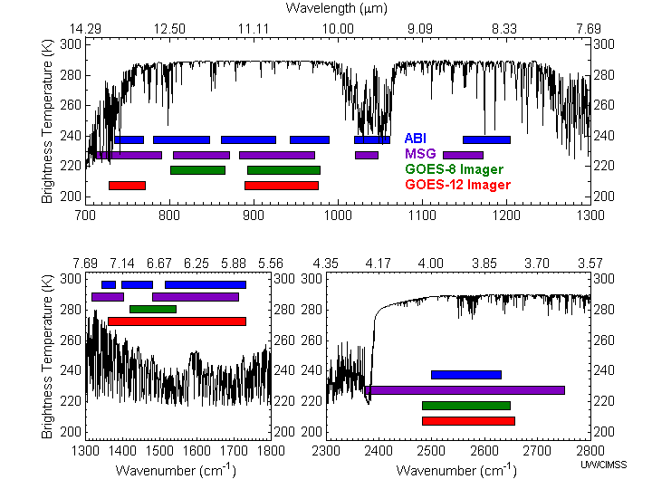
GOES-R Imager Spectral Coverage
While there are differences, there are also many similarities for the spectral bands on MSG SEVERI and the Advanced Baseline Imager (ABI). MODIS and SEVERI provide the bulk of proxy data sets for evaluating the ABI algorithms.
Notes:
Schmit, T. J., M. M. Gunshor, W. P. Menzel, J. J. Gurka, J. Li, and A. S. Bachmeier, 2005: Introducing the next-generation Advanced Baseline Imager on GOES-R. Bull. Amer. Meteor. Soc., 86, 1079-1096.

Slide 8
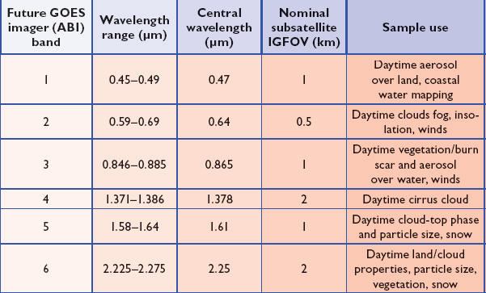
ABI Visible/Near-IR Bands
Schmit et al, 2005
Notes:
Schmit, T. J., M. M. Gunshor, W. P. Menzel, J. J. Gurka, J. Li, and A. S. Bachmeier, 2005: Introducing the next-generation Advanced Baseline Imager on GOES-R. Bull. Amer. Meteor. Soc., 86, 1079-1096.

Slide 9
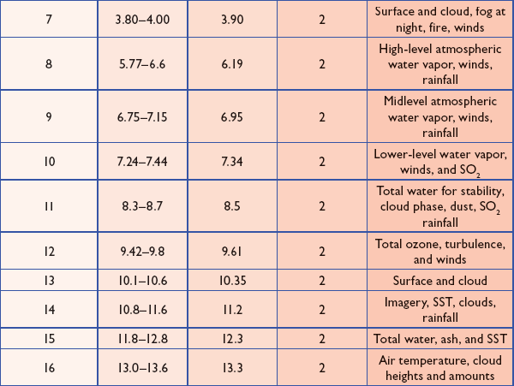
ABI IR Bands
Schmit et al, 2005
Notes:
Schmit, T. J., M. M. Gunshor, W. P. Menzel, J. J. Gurka, J. Li, and A. S. Bachmeier, 2005: Introducing the next-generation Advanced Baseline Imager on GOES-R. Bull. Amer. Meteor. Soc., 86, 1079-1096.

Slide 10
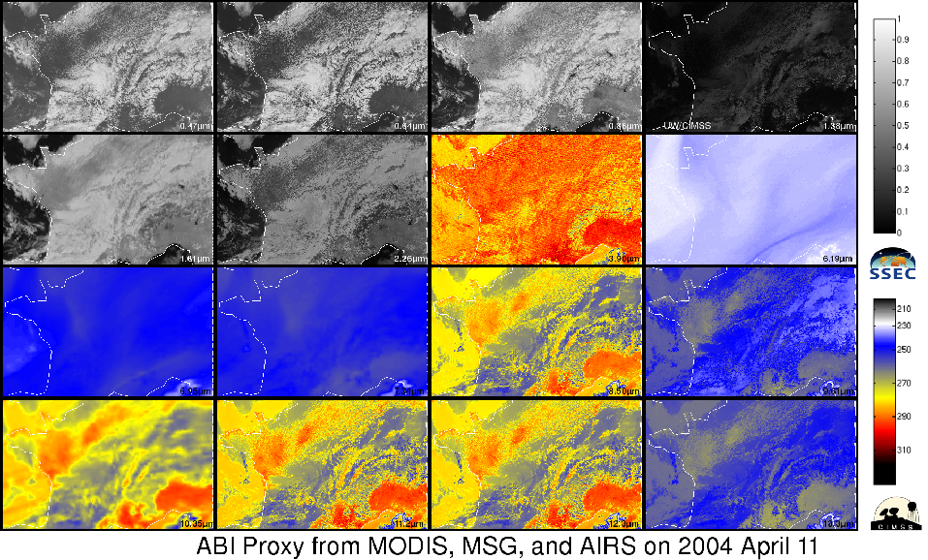
“ABI” Proxy Data from Current Satellites
Heritage,
clouds, etc
Cirrus
Clouds
Aerosols
Vegetation
Snow, Cloud phase
Fog, Fires,
clouds, etc
Water Vapor
Particle size
WV, Upper-level SO2
Vol. Ash,
Cloud phase
Water Vapor
Total Ozone
Surface
features, clouds
Heritage,
clouds, etc
Low-level
Moisture
Clouds

Slide 11
The Advanced Baseline Imager
ABI Current
Spectral Coverage
16 bands 5 bands
Spatial resolution
0.64 μm Visible 0.5 km Approx. 1 km
Other Visible/near-IR 1.0 km n/a
Bands (>2 μm) 2 km Approx. 4 km
Spatial coverage
Full disk 4 per hour Scheduled (3 hrly)
CONUS 12 per hour ~4 per hour
Mesoscale Every 30 sec n/a
Visible (reflective bands)
On-orbit calibration Yes No

Slide 12
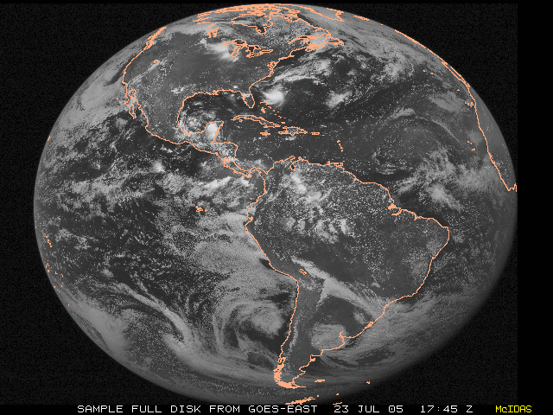
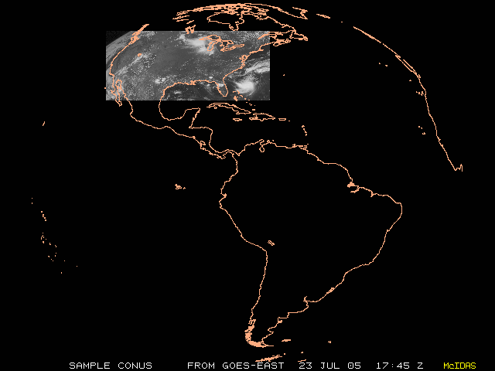
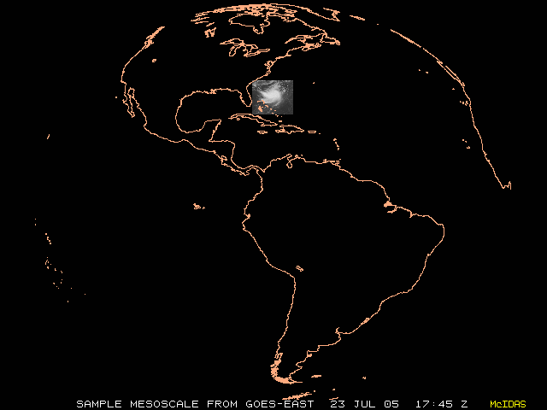
Imager Coverage in ~30 minutes
 | Current Imager (Rapid Scan mode) | Future Imager (“Flex” mode)
Full Disk | 0 | 2
Northern Hemi | 1 | -
CONUS | 3 | 6
Mesoscale | 0 | 60
Full Disk
N. Hemisphere
CONUS
Mesoscale

Slide 13
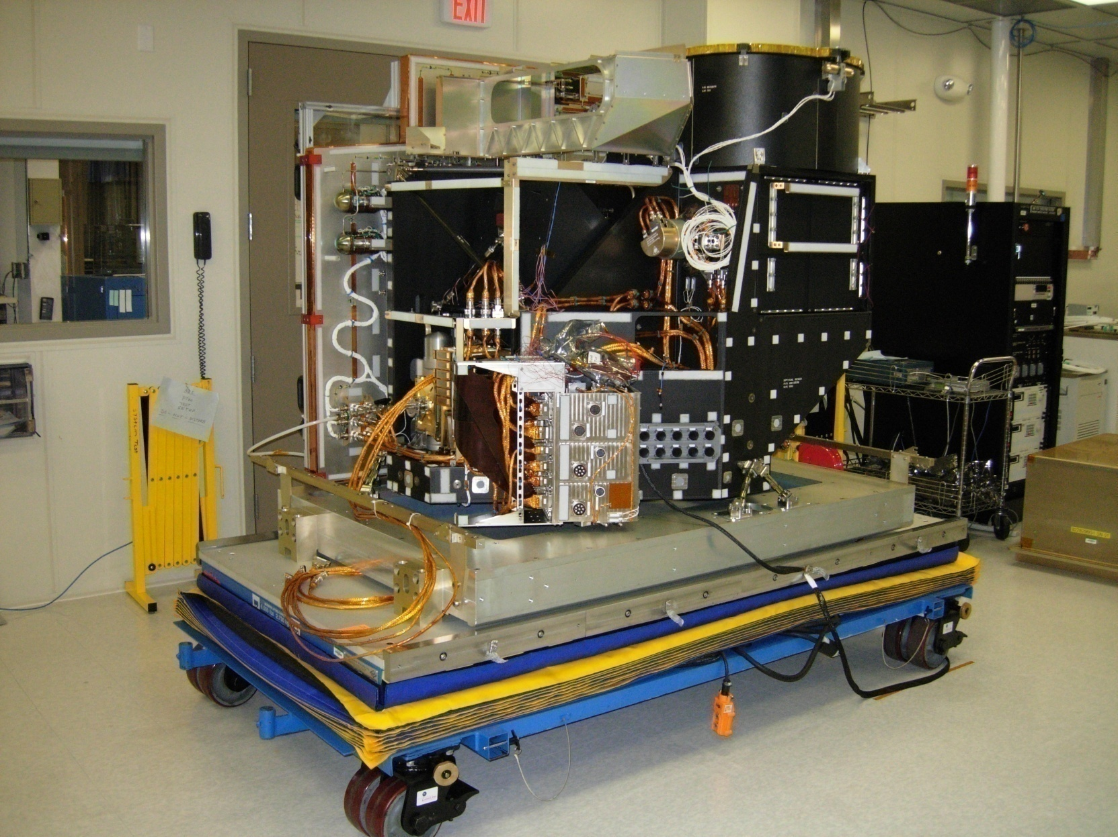
ABI PTM Integration and Test

Slide 14
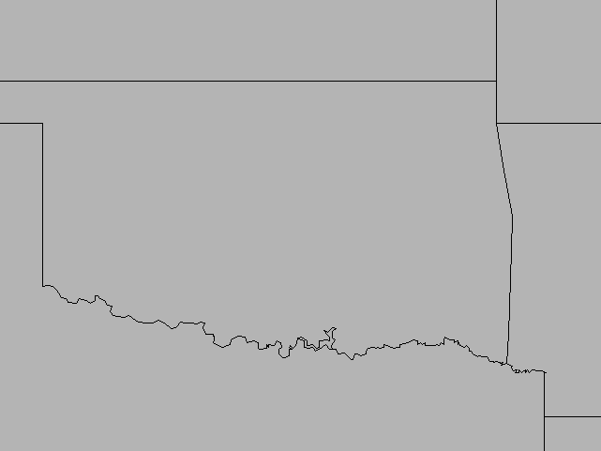
Geostationary
Lightning Mapper (GLM)
GLM is a new capability for the GOES Program
In process of developing Engineering Unit (EU)
  Completed reviews of electronics boards and released schematics
  Brassboard and EU procurements underway
Critical Design Review 03/2010
TRMM LIS

Slide 15
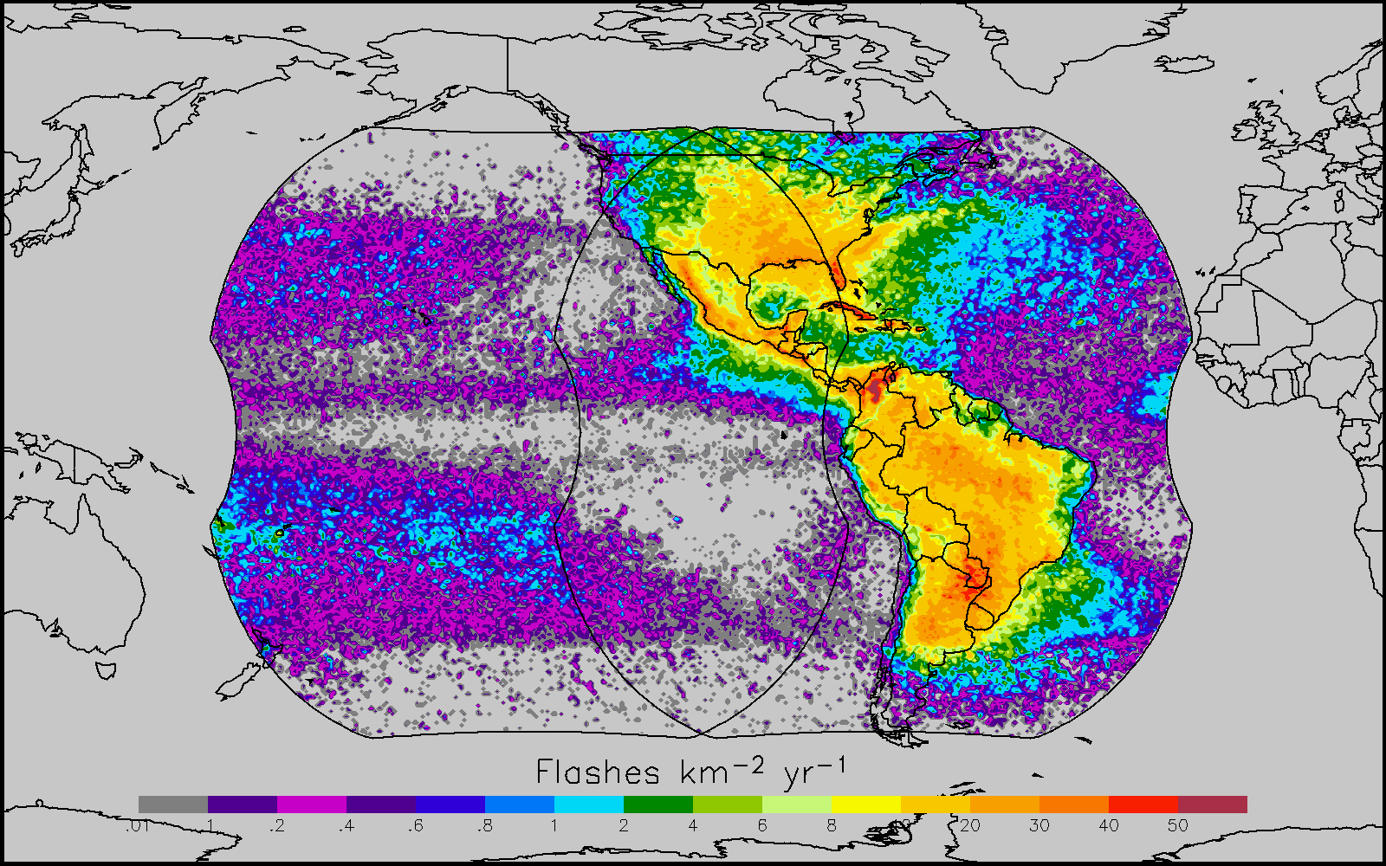
GOES-R+S Combined FOV
GLM Characteristics
Staring CCD imager (1372x1300 pixels)
Near uniform spatial resolution
  - 8 km nadir
  - 12 km edge fov
Single band 777.4 nm
Simple commanding
Adaptive thresholding
2 ms frame rate
7.7 Mbps downlink data rate
< 20 sec product latency
LIS/OTD Combined Lightning 1997-2005

Slide 16
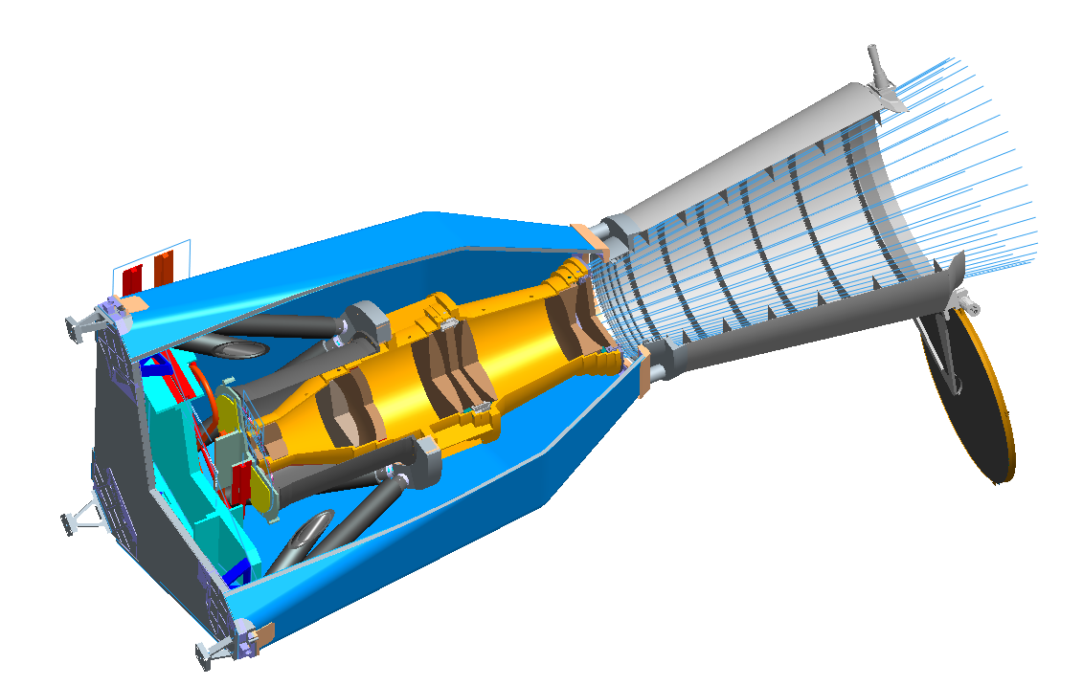
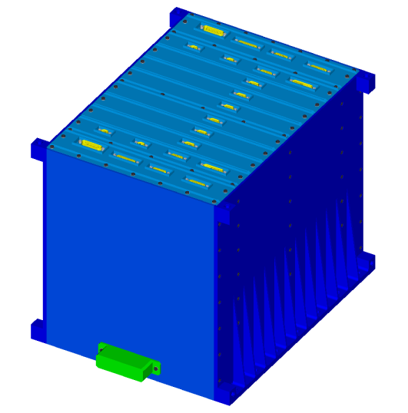
Geostationary Lightning Mapper (GLM)
Sensor Unit
Baffle
Solar Rejection filter (not depicted)
Narrow Band filter
Thermal Shroud
Heat Pipes +Y interface
Metering Tube
Lens Assembly
Debris Cover (one time use)
SU Electronics
Solar Blocking Filter
Hexapod struts (composite)
Focal Plane
ElectronicsUnit
16

Slide 17
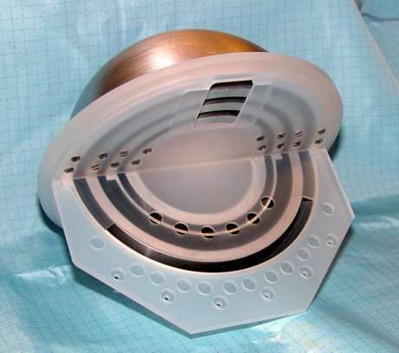
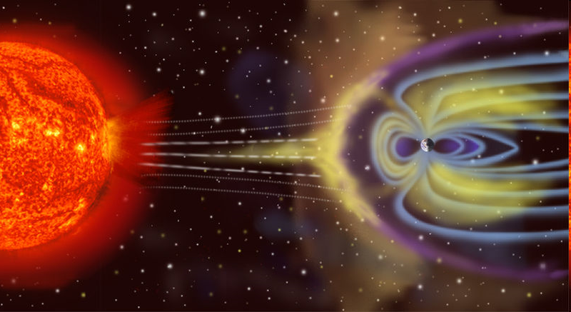
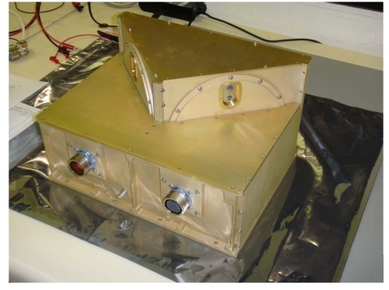
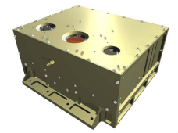
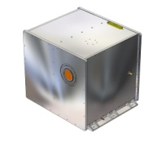
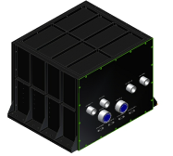
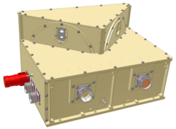
Space Environment In-Situ Suite (SEISS)
  SEISS
    Monitors solar, galactic and in situ electrons, proton and alpha particle fluxes
    Brassboard builds progressing well
    Critical Design Review planned for Spring 2010
Hi energy Magnetospheric particles
Low energy Magnetospheric particles
Solar and Galactic protons
Extreme Heavy Ions
MPS-Lo
MPS-Hi
SGPS-1
SGPS-2
EHIS
DPU

Slide 18
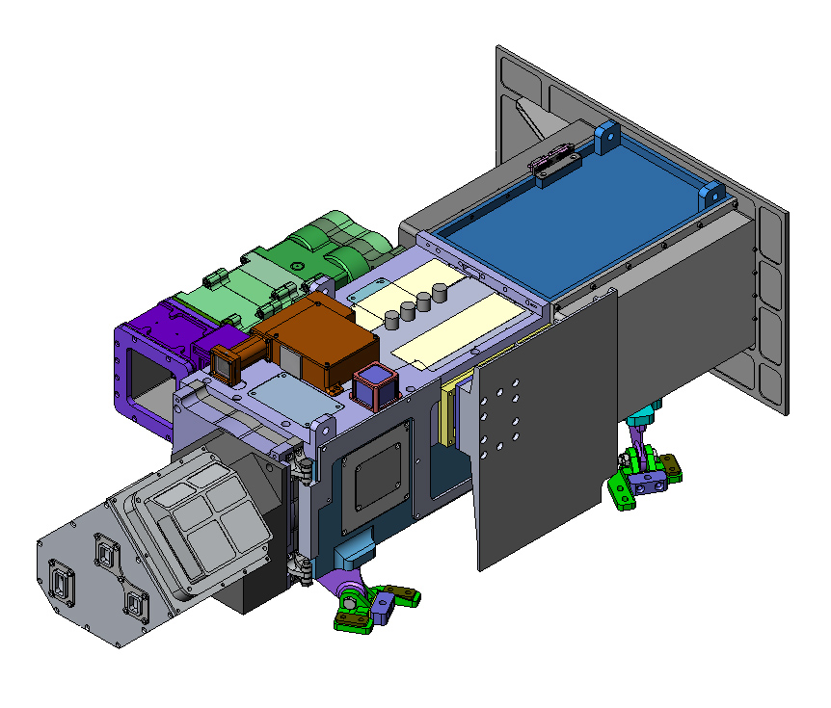
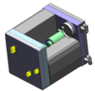
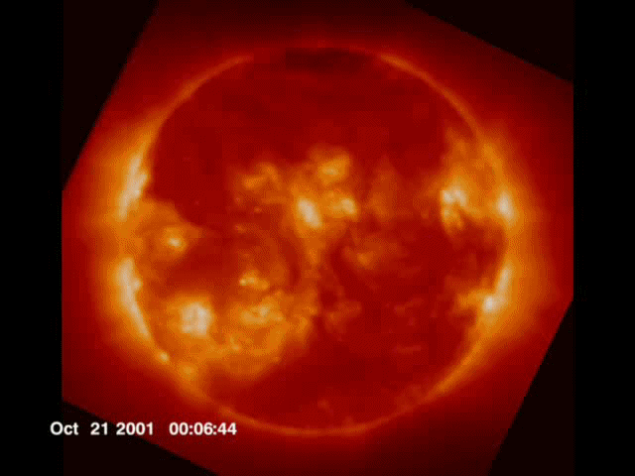
Extreme Ultraviolet and
X-ray Irradiance Suite (EXIS)
+Y
Thermal Radiator
Spacecraft Electrical
Interface (+Z axis)
+Z
  X-Ray Sensor (XRS)
  -monitors whole-Sun X-ray irradiance in
  two bands
Purge Inlet
(near base)
+X
Filter Mechanism
  EUV Sensor (EUVS)
  -monitors whole-Sun EUV irradiance in
  five bands
Instrument
Apertures
Channel C Thermal Radiator
Alignment Cube
Kinematic Mounts
S/C attachments
Door Mechanism
(Opens Inside)
  Status
  -Engineering Test Unit build well underway
  -Critical Design Review 11/09
GOES SXI

Slide 19
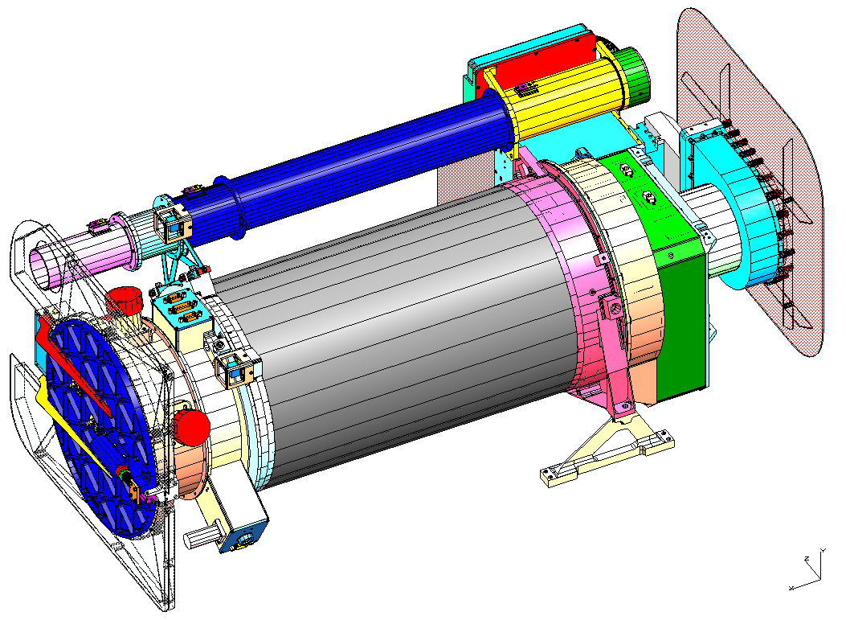
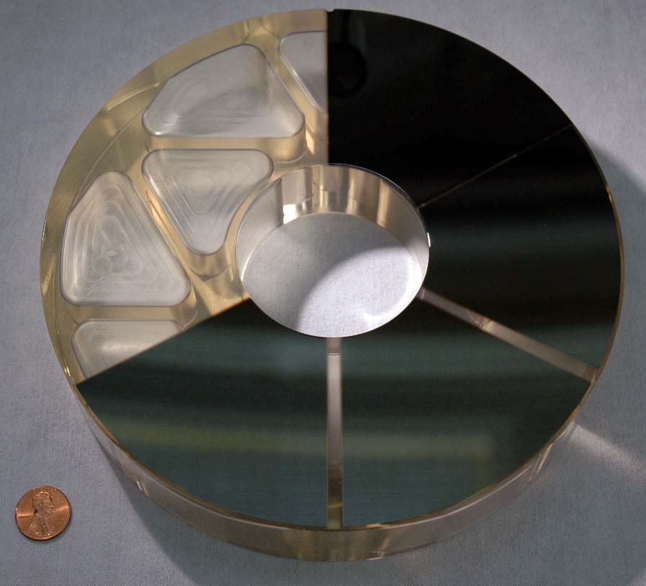
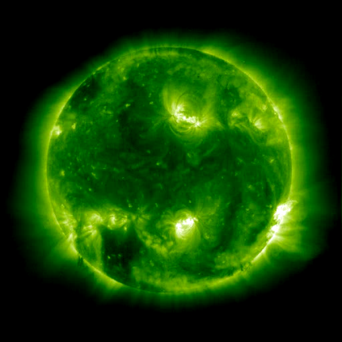
Solar Ultraviolet Imager (SUVI)
Solar Ultraviolet Imager (SUVI)
  9.4 to 30.4 nm (6 bands)
  Structural Model build underway
  Critical Design Review 12/09
GOES-R/SUVI Primary Mirror
The 94Å coating
The 304Å coating
The 284Å coating
The 195Å coating

Slide 20
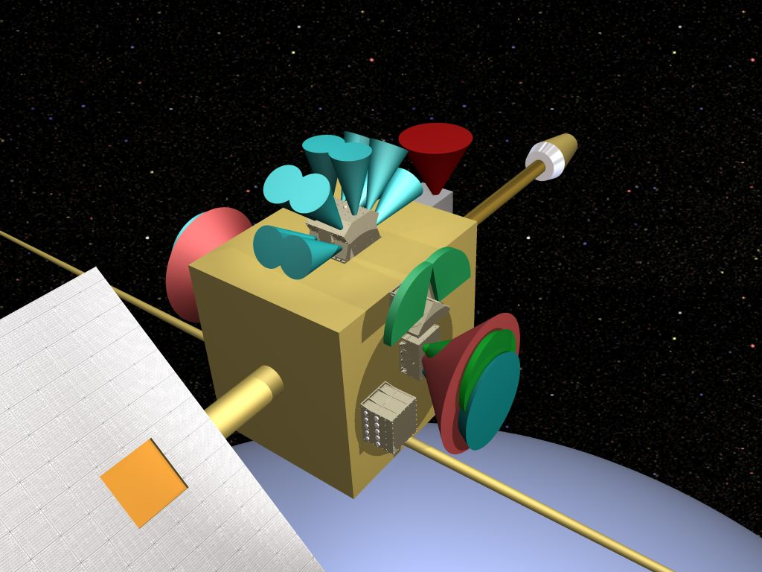
Satellite Configuration FOVs
-Z (Anti-Earthward)
North
MPS-HI
EHIS
West
SGPS 2
MPS-LO
SGPS 1
DPU
East

Slide 21
GOES-R System Description
Blue – Primary
Red – Back-up

Slide 22
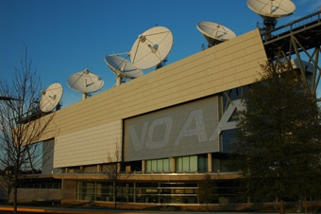
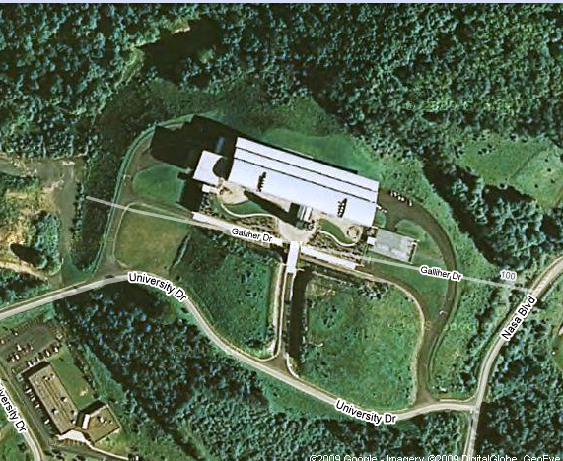
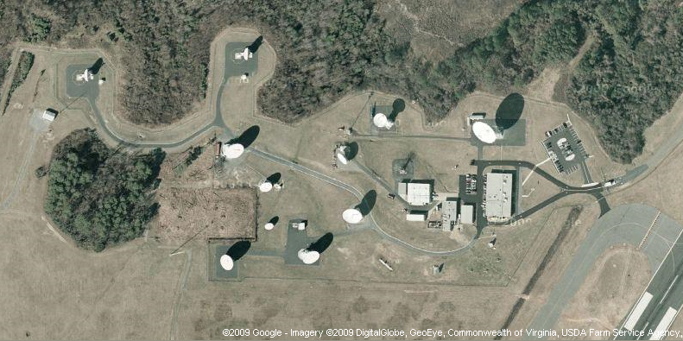
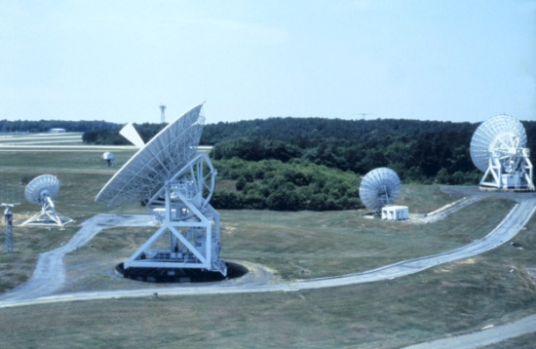
Antenna System Sites
NOAA Satellite Operations Facility
Remote Backup Facility – possible site
Wallops Command & Data Acquisition Station

Slide 23

GOES-R Program: Proving Ground
Proving Ground Framework

Slide 24
GOES-R Proving Ground
  Place where technologies and ideas are tested and proven before being fielded in operations
  Evaluates how infusion of technology or process in forecast environment impacts operations
  Integrates technology or process with other available tools
  User readiness risk mitigation
  Key component: operational testing by those independent of the development process
  Key Benefit: users more accepting of fielded technology
    They have had a say in the design
    Design better fits an identified need

Slide 25
GOES-R Program Risks: User Readiness
Mitigation
Rank | Risk ID | Risk Statement (Condition; Consequence) | Approach/Plan | Status
3 | GP0-33 | GOES-R User Readiness If user or NOAA infrastructure upgrades necessary to ensure compatibility with GOES-R are not adequately identified, prioritized, developed, and funded to coincide with planned deployment schedules; Then, there is a possibility that specific users will be unable to use the data products from lack of available infrastructure or from incompatibility with data distribution to meet increased performance needs resulting in schedule delays and cost impacts; Risk Owner: Steve Goodman | Mitigation 1. Interface Requirements Definition & Coordination a. Interface Requirements Docs (IRDs) (Aug. 2008) b. GOES-R User Readiness Plan Development & Approval (Sep. 2009) 2. External (to GOES-R) Orgs. (OSO, AWG, OSD) Communication & Collaboration from Design thru. Deployment 3. GOES-R Proving Grounds & User Community Training 4. User Community Outreach & Conferences 5. NOAA/User Orgs. Resources and Schedule Commitments | GOES-R User Readiness Plan to consolidate and document all user interface & readiness activities and coordination. Conferences, Workshops, and other forums will continue to be used to provide user community with information and transition planning Major event being planned includes the GOES Users Conference (November, 2009) GOES-R Proving Ground concept is being initiated to allow for the research-to-operations. Focus is on forecaster/AWIPS-2 to prepare for the GOES-R information, to get real-world experience by leveraging existing resources, and to evaluate product tailoring. Participated in NOAA Hazardous Weather Test Bed (HWT) PG Spring Experiment Demonstration. (SPC/NSSL/VORTEX-2)
Criticality | Planned Closure
2x4 | Long-Term
M
25
Notes:
25

Slide 26
Proving Ground Mission Statement
The GOES-R Proving Ground engages NWS in pre-operational demonstrations of selected capabilities of next generation GOES
Objective is to bridge the gap between research and operations by:
  Utilizing current systems (satellite, terrestrial, or model/synthetic) to emulate future GOES-R capabilities
  Infusing GOES-R products and techniques into NWS operations with emphasis on AWIPS and transitioning to AWIPS-II.
  Engaging in a dialogue to provide feedback to developers from users
The Proving Ground accomplishes its mission through:
  Sustained interaction between developers and end users for training, product evaluation, and solicitation of user feedback.
  Close coordination with GOES-R Algorithm Working Group (AWG) and Risk Reduction programs as sources of demonstration products, promoting a smooth transition to operations
Intended outcomes are Day-1 readiness and maximum utilization for both the developers and users of GOES-R products, and an effective transition to operations

Slide 27
Proving Ground Program Plan
Purpose
Document the vision and objectives of the Proving Ground program and concept.
Provide the top-level plan for describing the overall scope and management approach for the program.
Identify key decision points and checkpoints for effective management control.
Scope
Identify those functions necessary to pre-operationally demonstrate selected capabilities of the next generation GOES satellites.
Prioritize products- who, what, where and when demonstrated.
The demonstration proving ground will be the agency test bed that will feed other activity planning.
The plan will document the linkages with the GOES-R AWG Baseline/Option-2 Products and Risk Reduction (Decision Aids, Product Tailoring, Product Enhancements)

Slide 28
Proving Ground Organization
Executive Board:
Steve Goodman (Chair)- NESDIS/GOES-R Senior Program Scientist
Jim Gurka- NESDIS/GOES-R Ground Segment Project Scientist
Jaime Daniels-NESDIS/STAR/GOES-R AWG
Mark DeMaria-NESDIS/STAR/ GOES-R Risk Reduction
Tim Schmit-NESDIS/STAR/ASPB
Mike Johnson (Kevin Schrab)- NWS
Advisory Team:
Tony Mostek-NWS/COMET
Russ Schneider- NWS/NCEP/SPC
Gary Hufford- NWS Alaska Region
Shanna Pitter- PPI, NWS WW Goal Team
Cecilia Miner- NWS, C&T Goal Team
Steve Miller- CIRA
Wayne Feltz-CIMSS
Shobha Kondragunta-NESDIS/STAR AQ IPT
Gary Jedlovec-NASA SPoRT

Slide 29
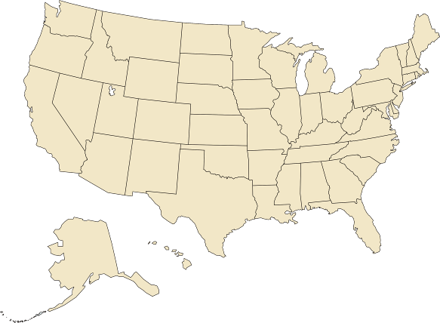
GOES-R Proving Ground Partners
Green Bay, WI WFO
Sullivan, WI WFO
Cooperative Institute for Meteorological Satellite Studies
Madison, Wisconsin
Sterling, VA WFO
Cheyenne, WY WFO
Cooperative Remote Sensing Science and Technology Center
New York, NY
Cooperative Institute for
Research in the Atmosphere
Fort Collins, Colorado
La Crosse, WI WFO
NWS Headquarters;
Cooperative Institute for
Satellite Climate Studies;
Center for Satellite
Applications and Research;
Office of Satellite Data
Processing and Distribution;
GOES-R Program Office;
University of Maryland
Baltimore County
Maryland
Boulder, CO WFO
Eureka, CA WFO
NWS Central Region
Kansas City, MO
EPA
Research Triangle Park, NC
NWS Alaska Region
Anchorage, Alaska
Melbourne, FL WFO
NASA Kennedy Space Center
NWS Pacific Region
Honolulu, Hawaii
NCEP Tropical Prediction Center Joint Hurricane Testbed
Miami, Florida (Planned for FY2010)
NCEP: National Centers for Environmental Prediction
NWS: National Weather Service
WFO: Weather Forecast Office
NCEP Storm Prediction Center;
Norman, OK WFO;
National Severe Storms Laboratory;
University of Oklahoma;
Cooperative Institute for Mesoscale Meteorological Studies
Norman, Oklahoma
Hazardous Weather Testbed- Experimental Forecast and Warning Programs
Huntsville, AL WFO
University of Alabama Huntsville
NASA Short-term Prediction Research and Transition Center
Huntsville, AL

Slide 30
GOES-R- Level-2 Baseline Products
Aerosol Detection (Including Smoke and Dust) | Cloud Top Height | Legacy Vertical Temperature Profile | Snow Cover
Aerosol Optical Depth: AOD & Suspended Matter | Cloud Top Pressure | Derived Stability Indices | Fire/Hot Spot Characterization
Volcanic Ash: Detection and Height | Cloud Top Temperature | Total Precipitable Water | Land Surface (Skin) Temperature
Cloud and Moisture Imagery | Hurricane Intensity | Clear Sky Masks | Land Surface (Skin) Temperature
Cloud Optical Depth | *Lightning Detection: Events, Groups & Flashes | Downward Shortwave Radiation: Surface | Seas Surface Temperature (Skin)
Cloud Particle Size Distribution | Rainfall Rate / QPE | Reflected Shortwave Radiation: TOA | Radiances
Cloud Top Phase | Legacy Vertical Moisture Profile | Derived Motion Winds
*Lightning Detection-GLM provided, events is L1B Product: GRB provides all 3 Lightning Detection elements

Slide 31
GOES-R- Level-2 Option 2 Products
Aerosol Particle Size | Cloud Type | Rainfall Potential | Flood/Standing Water | Currents
Aircraft Icing Threat | Convective Initiation | Absorbed Shortwave Radiation: Surface | Ice Cover | Currents: Offshore
Cloud Ice Water Path | Enhanced “V” / Overshooting Top Detection | Downward Longwave Radiation: Surface | Snow Depth (over Plains) | Sea and Lake Ice: Age
Cloud Layers/Heights | Low Cloud and Fog | Upward Longwave Radiation: Surface | Surface Albedo | Sea and Lake Ice: Concentration
Cloud Liquid Water | Tropopause Folding Turbulence Prediction | Upward Longwave Radiation : TOA | Surface Emissivity | Sea and Lake Ice: Motion
Cloud Layers/Heights | Visibility | Ozone Total | Vegetation Fraction: Green
Cloud Liquid Water | Probability of Rainfall | SO₂ Detection | Vegetation Index

Slide 32
Space Weather Products

Slide 33
GOES-R Program: Proving Ground
Proving Ground Examples

Slide 34
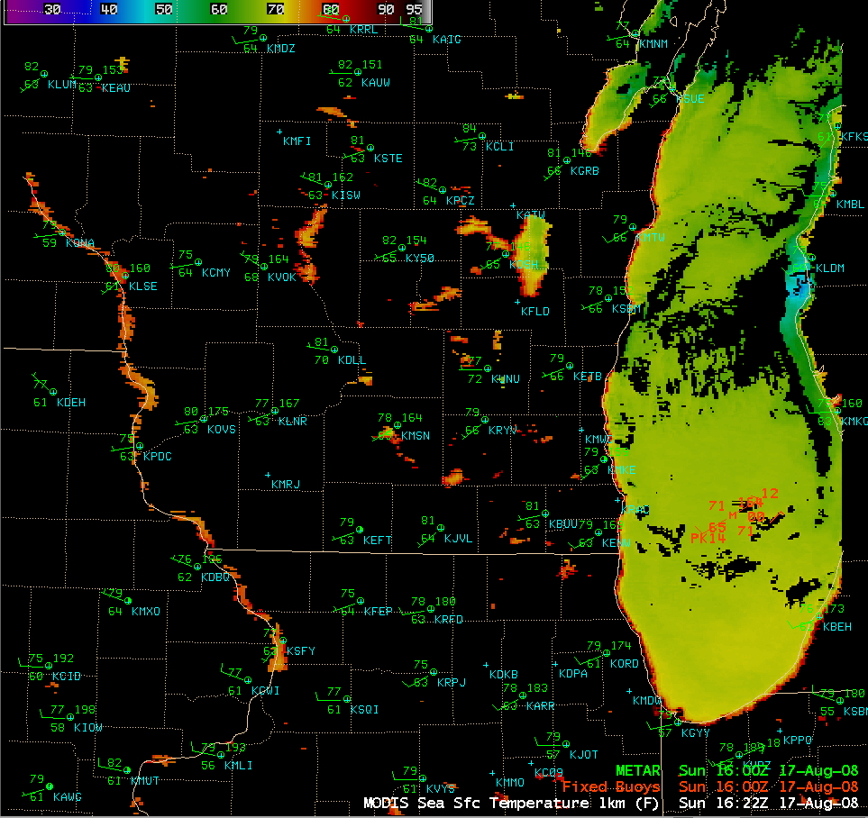
AREA FORECAST DISCUSSION
NATIONAL WEATHER SERVICE MILWAUKEE/SULLIVAN WI
159 PM CDT SUN AUG 17 2008
EVEN WITH THE WEST SURFACE WINDS 1622Z MODIS SHOWS WARM UPPER 60 DEGREE LAKE MICHIGAN TEMPS NEAR SHORE...WITH NO COOLER UPWELLING SEEN. WOULD HAVE THOUGHT TEMPS WOULD HAVE BEEN COOLER...BUT WINDS ARE WEAK.

Slide 35
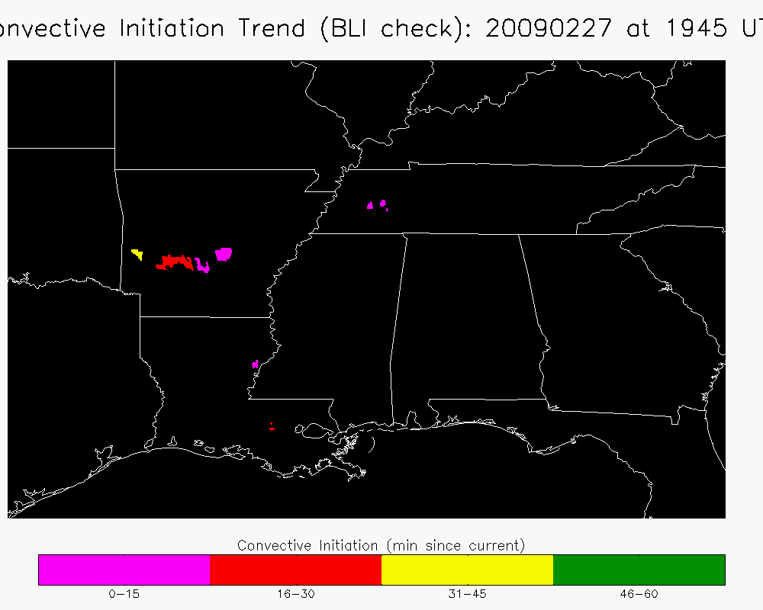
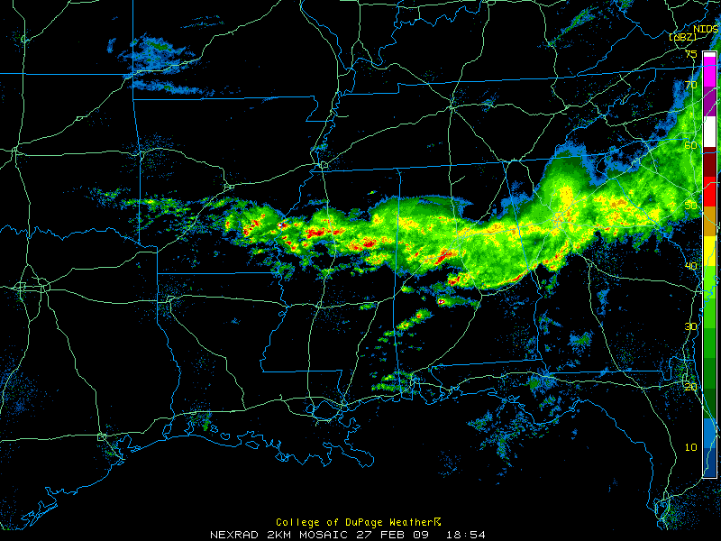
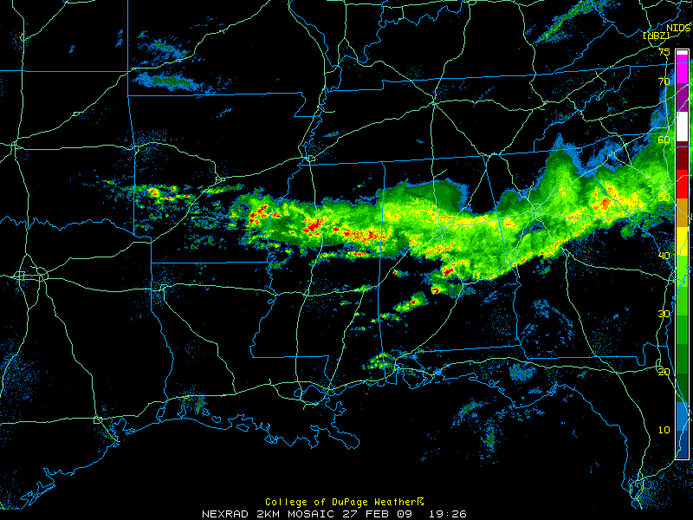
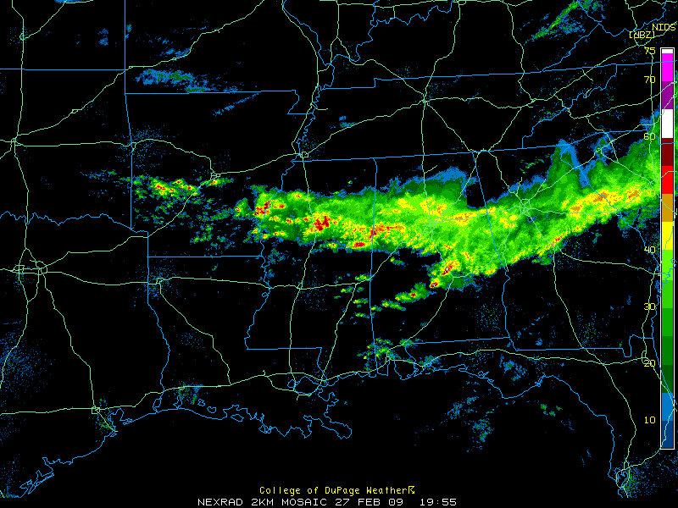
Convective Initiation (CI) Trend
CI TREND: 20090227 at 1945 UTC
1854 UTC
1926 UTC
1955 UTC
No echo around time of first CI indication
Notes:
35

Slide 36
Lessons Learned at SPC
CI/CTC
  CTC is valuable product in itself- forecaster wants to see intermediate products- no black box
  Poor over SE warm sector environments
  Masked where thick cirrus present
  Thin cirrus over land/water/water clouds and expanding edge false alarms
  Avg. lead time ~15 minutes over radar (for successful nowcasts)
  Full disk 30 min. scan limitations (false alarms/missed nowcasts)
  Cloud detection limitations due to poor spatial/spectral resolution
  Instantaneous fields more useful to forecasters than accumulated fields
  Overlay on visible/IR essential to forecasters
  Continue CTC after CI occurs (storm severity) interest from forecasters
  Effective for terrain/dryline convection
  CI misses some CTC signals
  Works well in rapid scan operations

Slide 37
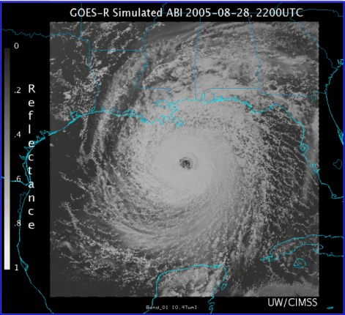
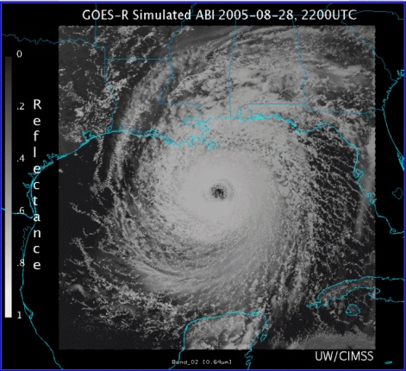
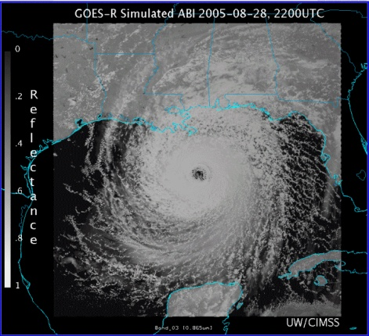
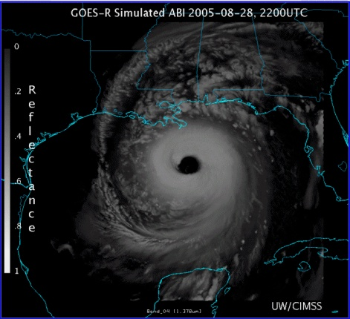
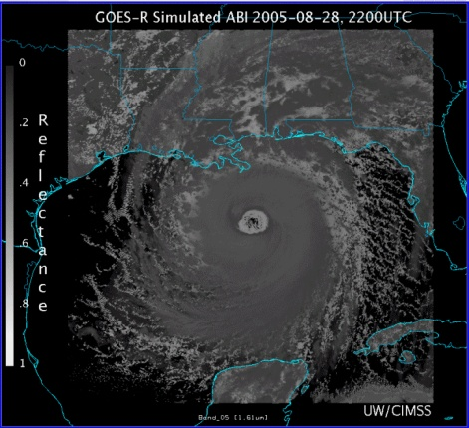
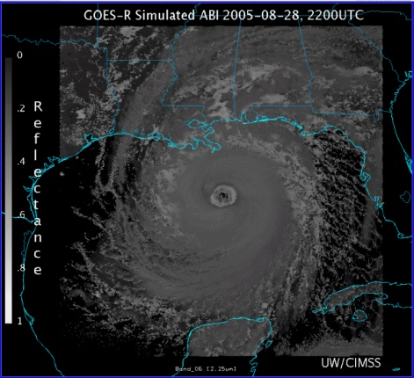
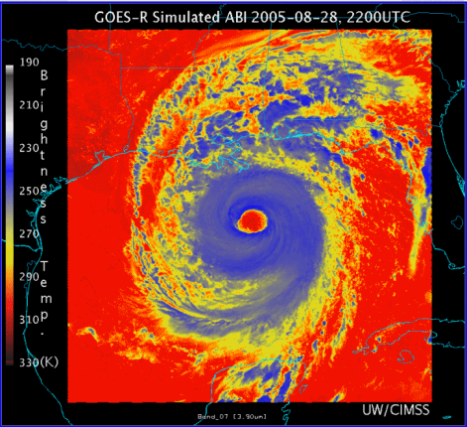
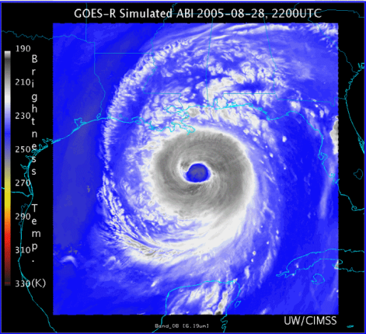
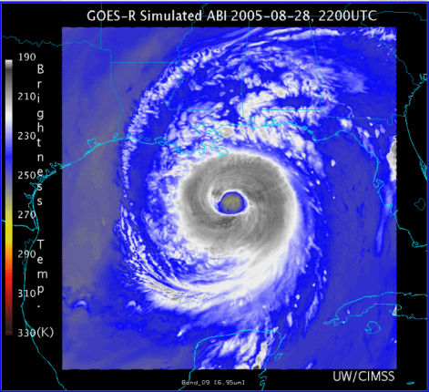
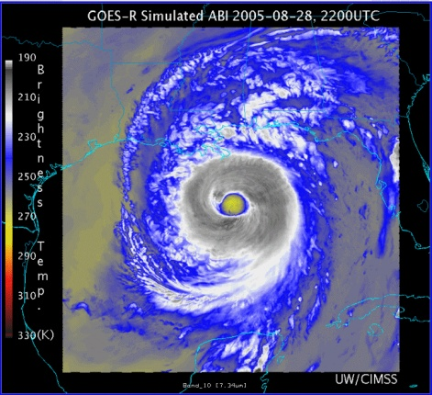
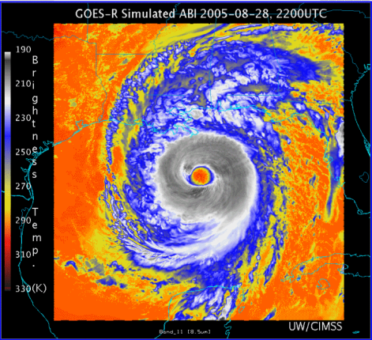
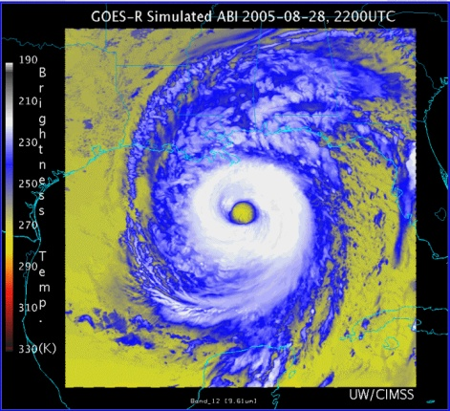
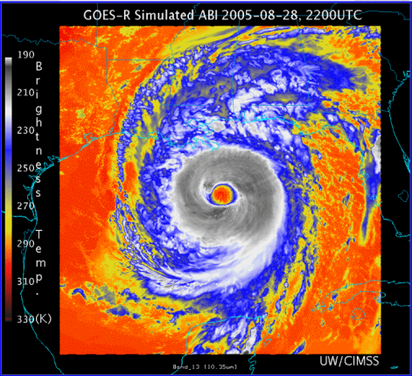
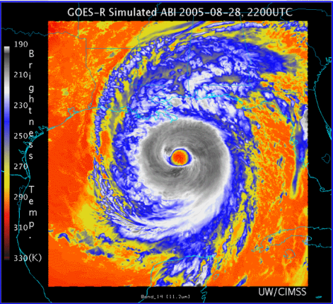


0.47 μm
0.64 μm
0.86 μm
1.38 μm
AWG Proxy ABI Simulations of Hurricane Katrina
1.61 μm
2.26 μm
3.9 μm
6.19 μm
NOAA/NESDIS STAR and GOES-R Imagery Team
6.95 μm
7.34 μm
8.5 μm
9.61 μm
10.35 μm
11.2 μm
12.3 μm
13.3 μm

Slide 38

DCLMA Area Lightning Discharge Animation
2.2 sec hybrid flash
50 km horiz extent
Initiation at 5.2 km
VHF Sources 2187
CG strike at 2 s
Saba Hyperlink
Animated gif

Slide 39

GLM Proxy Data from OKLMA

Slide 40


GLM Proxy Data
DC Regional Storms November 16, 2006
Resampled 5-min source density at 1 km and 10 km
LMA 1 km resolution
LMA @ GLM 10 km resolution

Slide 41





GLM Lightning Jump Algorithm:
Experimental Trending Implementation in AWIPS/SCAN
Red > 60
Red > 6
Yellow: 2-6
White : 1-2
Gray < 1
SCAN Cell Table
Cell S1
DC LMA total lightning
Red > 6
Yellow: 2-6
(July 04, 2007 at 21:36Z)
Courtesy Momoudou Ba

Slide 42



Volcanic Ash
Mt. Redoubt has had more than 20 major eruptions since Sunday morning March 22, 2009. The eruptions have created a continuous major ash plume that has disrupted aviation across the State of Alaska. Rapid scan products of GOES imagery provided new insight on the eruptive activity of the mountain. NWS forecasters were able to use this insight to provide better information for warnings and advisories issued to the public and aviation communities.
False-color RGB image along with 3 other volcanic retrieval products: Ash loading, Ash height, and Ash effective radius. (produced by Mike Pavolonis, CIMSS/ASPB)
http://cimss.ssec.wisc.edu/goes/blog/archives/2228

Slide 43
Summary
    Program Plan under development
    Phase I spin-up at CIMSS, CIRA (2008)
    Phase II added SPoRT, AQ, Alaska, Pacific
      HWT IOP with VORTEX-2 (2009, 2010)
      JHT IOP with GRIP (NASA), PREDICT (NSF) 2010
    Need real time and archived events (AWIPS2, WES)
    PG is the ultimate tool for user interaction
    Must maintain focus on clear path to operations
    Ensuring pathway into operations by developing GOES-R proxy products for the AWIPS2 environment
    Existing and Planned collaborations with NOAA Testbeds- HWT, JHT, DTC, HMT, others (Aviation Testbed)

Slide 44








6th GOES Users’ Conference
http://cimss.ssec.wisc.edu/goes_r/meetings/guc2009/
3-5 November 2009
Monona Terrace Convention Center
Madison, Wisconsin
Geostationary Operational Environmental Satellites: http://www.goes-r.gov
Special Event on 2 November: 50th Anniversary of the 1st Meteorological Satellite Experiment

Slide 45
A new one-stop source for all GOES-R information.
http://www.GOES-R.gov
A joint web site of NOAA and NASA
Notes:
GOES-R is well Poised to Succeed
GOES-R Program Office combines NASA satellite acquisition experience with NOAA ground acquisition experience at a single site at Goddard Space Flight Center under integrated Program Management authority
Cost estimation at 80% confidence
Reconciled with Independent Cost Estimate
Validated by Independent Review Team
Sufficient resources to execute requirements
Risk reduction commenced early with longest lead time instruments
Prioritized operational requirements, lower priority instrument development cancelled to match available resources
Realistic schedule in place to satisfy performance and cost requirements
Critical technology developments have good cost and schedule margin
Prototype being developed early allowing for assurance of technology readiness

