Slide 1
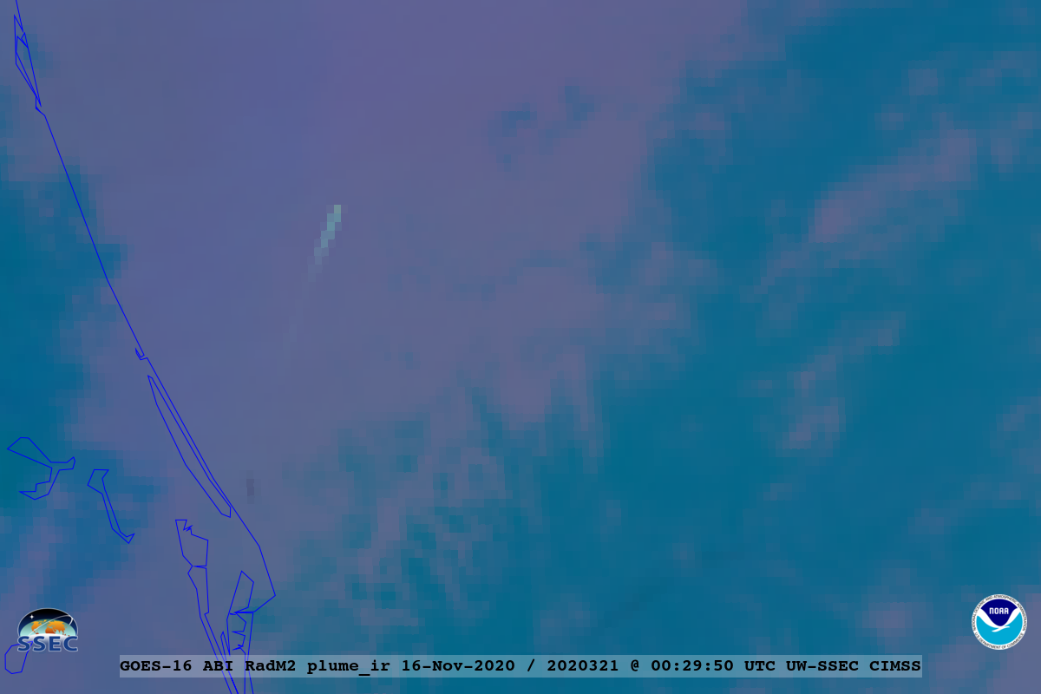
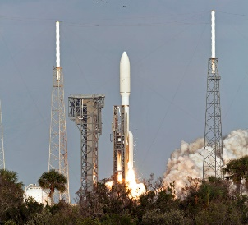
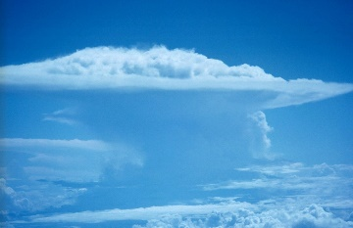
Rocket Plume RGB
Quick Guide (nighttime)
Why is the Plume RGB Important?
The improved spatial, temporal and spectral attributes of the ABI allow for monitors plumes associated with rockets and other hotspots.
Instead of needing to show 3 or 4-panels with separate spectral bands, these RGBs combine information on the plumes from several key spectral bands: 3.9 micrometer or the “fire band”, the upper-level water vapor band (8), and the 7.3 micrometer (water vapor) band.
Warmer in water vapor bands
Plume cloud
Plume RGB from GOES-16 ABI at 0029 UTC, 16 November 2020.
How is the Plume RGB Created?
Color | Band / Band (µm) | Range (Min –> Max) | Physically Relates to… | Gamma | Large Contribution to pixel indicates…
Red | 7 / 3.9 | 273 to 338 K | Plume temperature | 1.0 | Warm plume
Green | 8 / 6.2 | 220 to 280 K | Plume warming | 1.0 | Plume cloud
Blue (night) | 10 / 7.3 | 230 to 290 K | Plume warming | 1.0 | Plume cloud
Impact on Operations
Limitations
Thick clouds: Thick clouds or low-level moisture may hinder viewing the plume hotspot when it’s lower in the atmosphere.
Primary Application Application: Viewing the spectral signatures associated with rocket launches.
Limitations:
- Care should be taken as the region of interest approaches the edge of the full disk.
- The water vapor plume may be harder to detect, depending on the background.
- The “blue” component can be overwhelmed by the 3.9 micrometer band.
- May need to address limits for improved presentation.
Application: This RGB can allow for a quick-look for signal associated with rocket plumes or other hot spots. The solar illumination determines if one wants to use the day or night version of this plume RGB. The IR-only “nighttime” version can be used both day and night.
Contributor: Tim Schmit NOAA NESDIS STAR CORP ASPB http://cimss.ssec.wisc.edu/aspb/

Slide 2
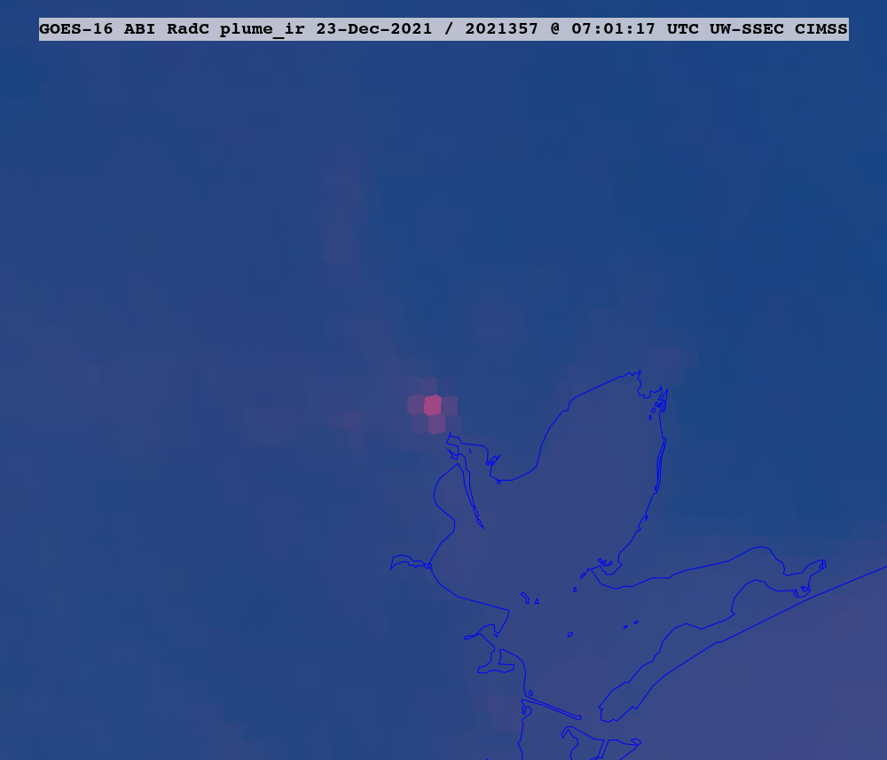
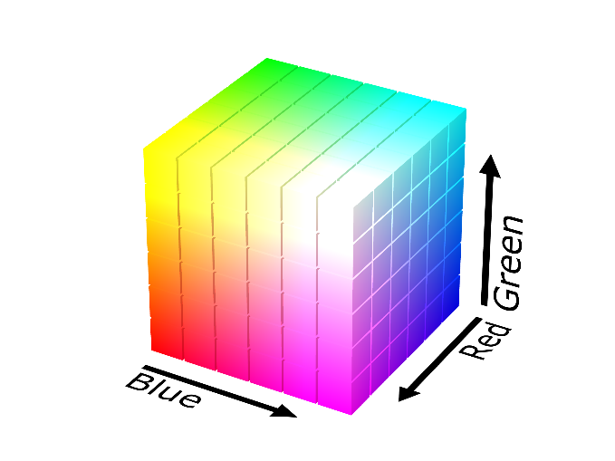
Rocket Plume RGB
Quick Guide (nighttime)
RGB Interpretation
Hot-spot (reddish)
1
coastline
1
Plume from GOES-16 ABI at 0701 UTC, 23 December 2021.
Note:, colors may vary diurnally, seasonally, and latitudinally; plus with hotspots, plumes, moisture amount, etc.
Comparison to other products: Similar to the Fire RGB with hotspots appearing red, similar to the airmass RGB, in that it leverages a mid-level water vapor band. The images shown on this page are of the GOES-S rocket launch from Cape Canaveral, Florida.
Resources
Source Name Title as a hyperlink
Source Name Title as a hyperlink
Source Name Title as a hyperlink
Size of this box can vary
Hyperlinks not available when viewing material in AIR Tool
RGB Color Guide
Plume
Hot spot
ABI 0.64 µm
ABI 3.9 µm

