Slide 1
Looking Ahead to GeoXO
Andrew Heidinger, Dan Lindsey, Pam Sullivan, Andy Latto
NOAA/NESDIS GEO

Slide 2
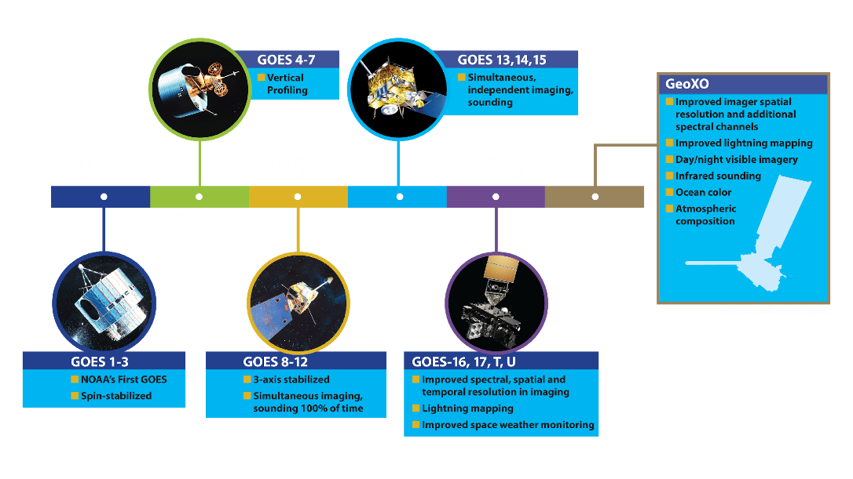
History of GOES Satellites
Coming next: Geostationary Extended Observations (GeoXO)

Slide 3
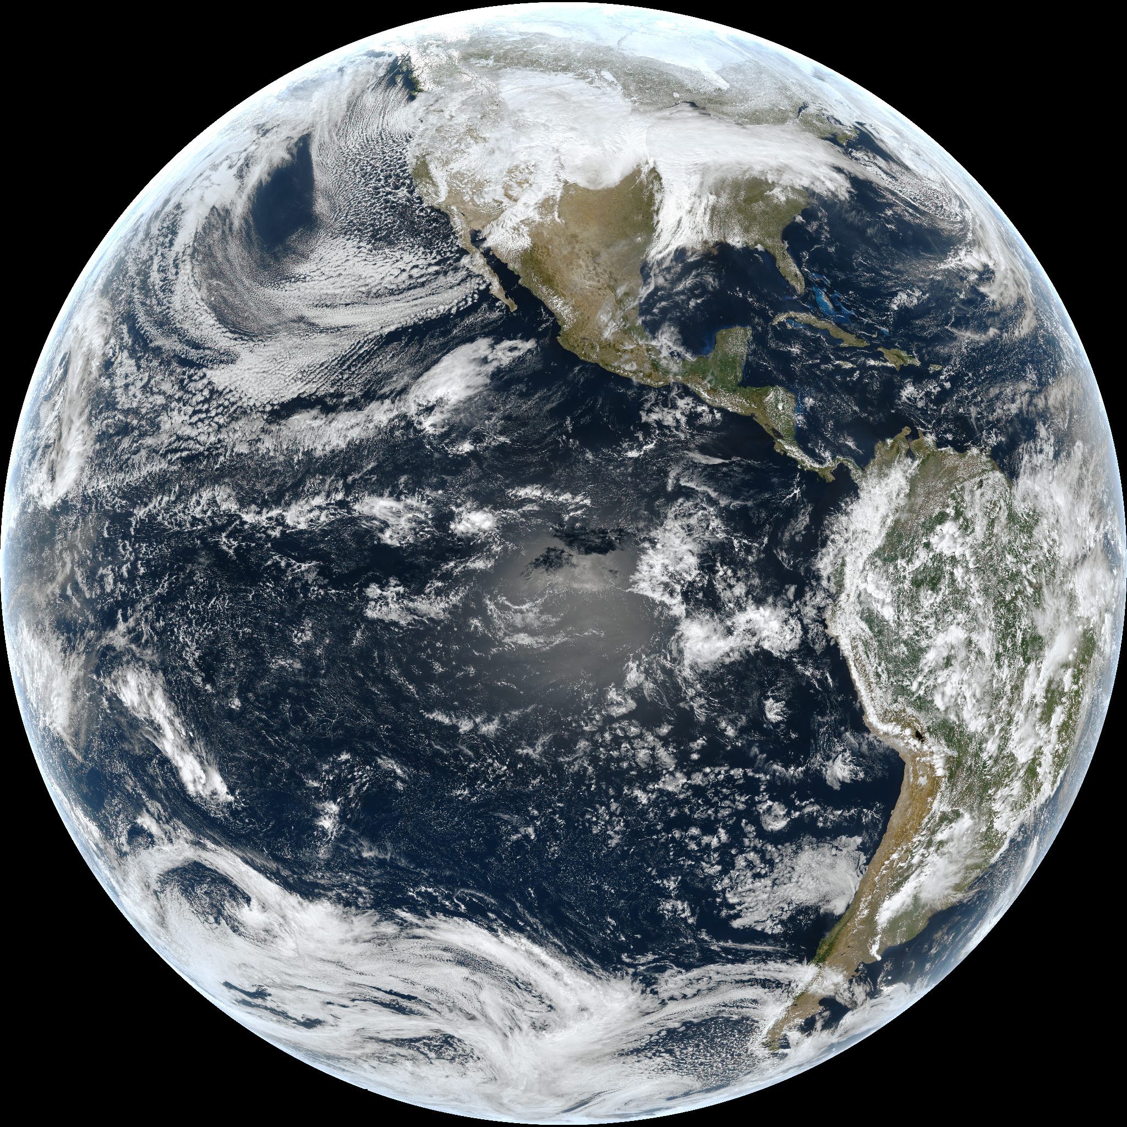
GeoXO Constellation

Slide 5
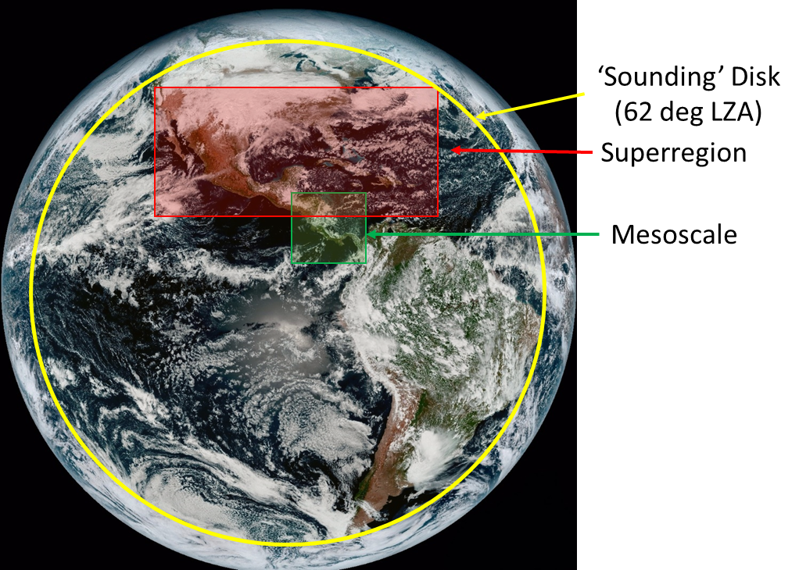
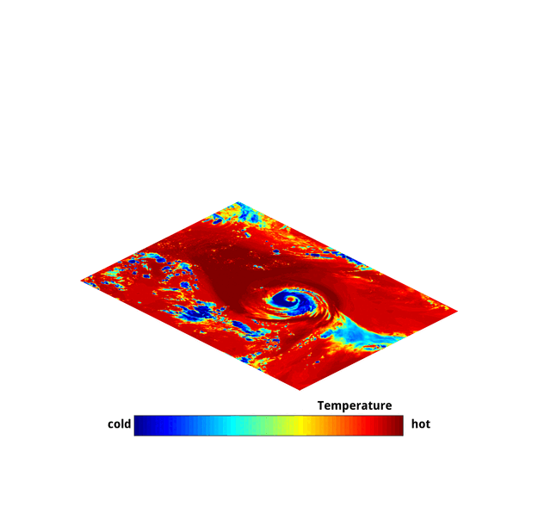
Sounder Provides Detailed 3D Measurement of Atmospheric Temperature and Humidity
Sounding Disk
(1X per hour)
Super-region
Mesoscale
Spatial resolution 4km at nadir
GXS provides atmospheric soundings for forecasting, numerical weather prediction, and environmental observation
Data products: Temperature and Water Vapor Profiles, Atmospheric Composition including Carbon Dioxide, Carbon Monoxide, Ammonia, Nitric Acid, Nitrous oxide, Isoprene

Slide 6
GeoXO Ocean Color Sensor (OCX)
MODIS – 1 km resolution
OCX – 0.3 km GSD
Dynamic coastal management requires a satellite designed with the coast in mind.
OCX will provide hyperspectral observations over USA’s coastal regions (EEZs) multiple times per day.
Notes:
Another important feature of OCX is that relative to a 1-km footprint provided by most LEO instruments, OCX will be able to resolve over 2 times as many estuaries along the U.S. coasts. They will also be collecting data 10-15x more frequently than LEO sensors at the same resolution. We need to shed light on the details, because they really make a difference in the context of management and decision making.

Slide 7
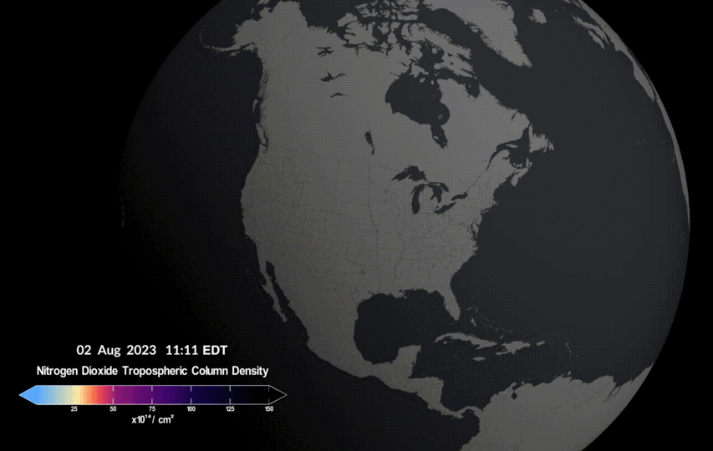
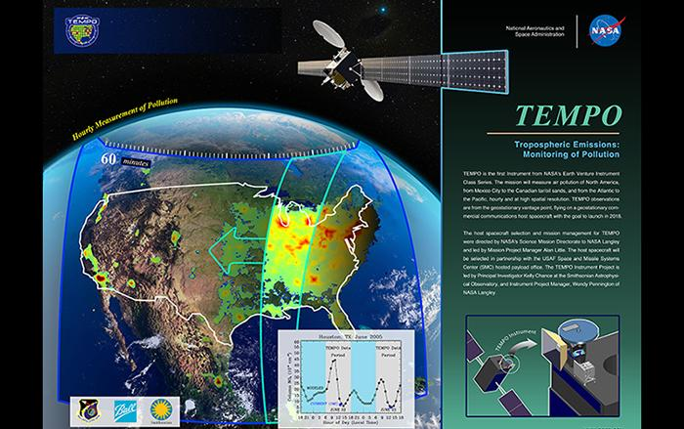
ACX: NASA TEMPO First Light (NO₂)

Slide 9
Thank You
For more information visit www.nesdis.gov/geoxo
www.facebook.com/GOESRsatellite www.youtube.com/user/NOAASatellites twitter.com/NOAASatellites www.flickr.com/photos/noaasatellites

