Slide 1
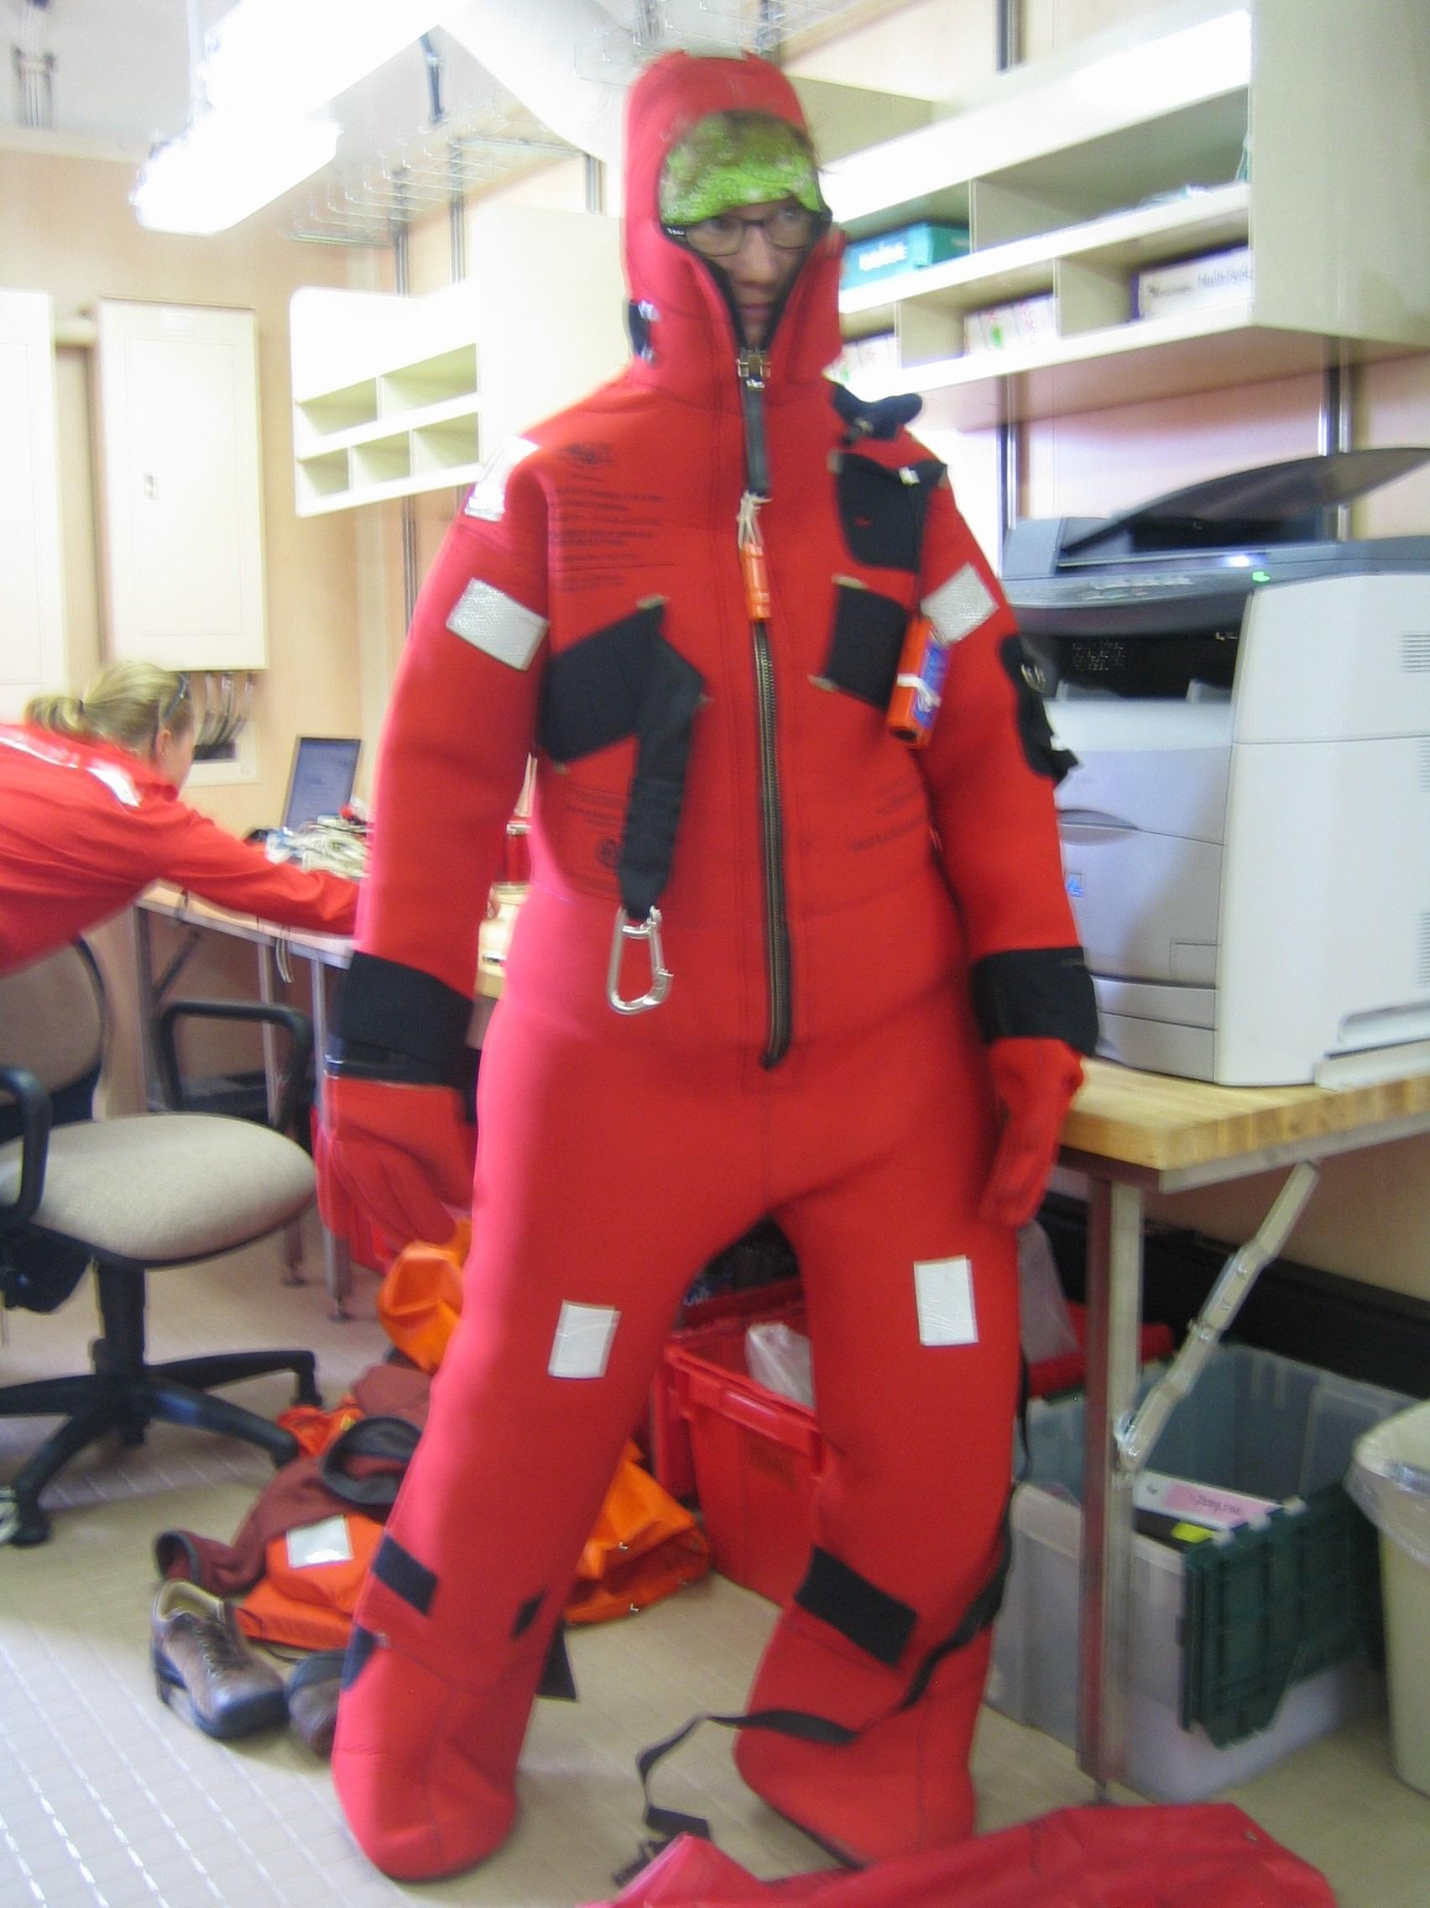
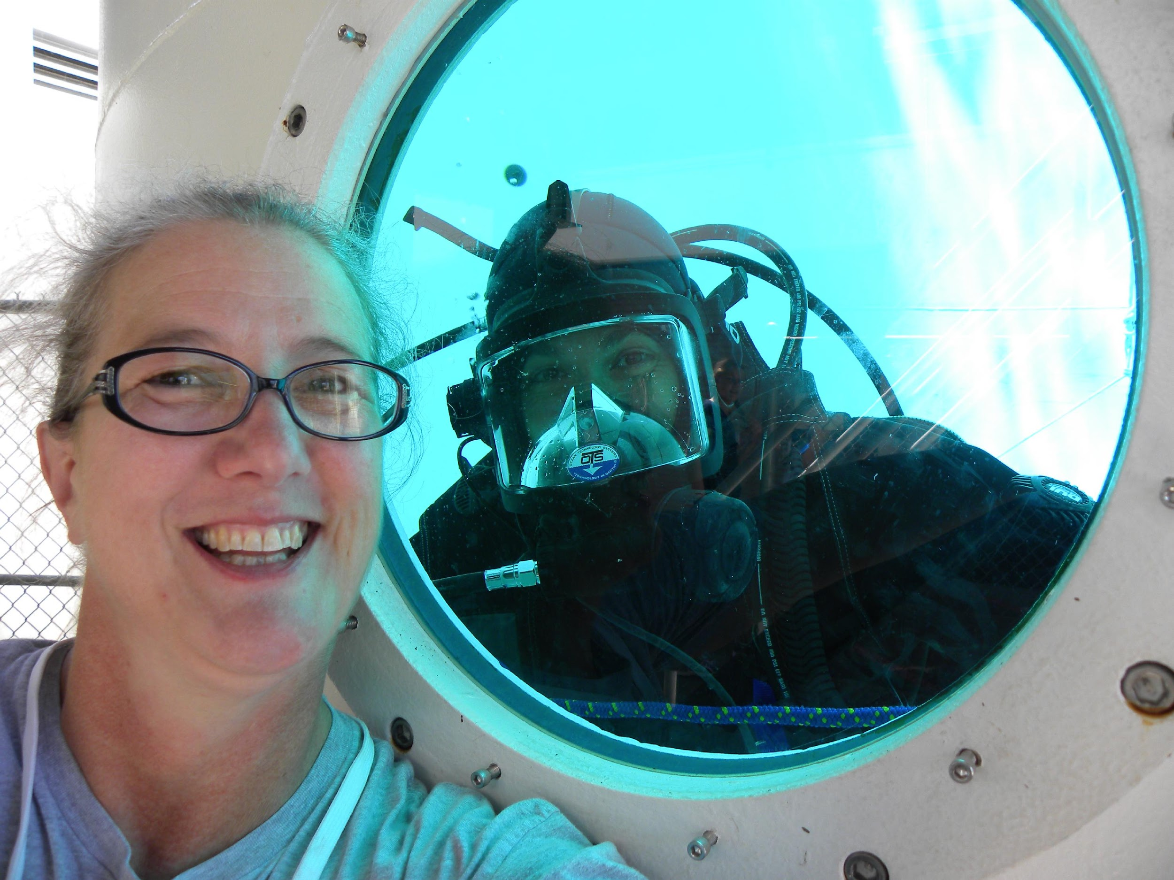
Classroom Connections
to Satellite Data
Turtle Haste
Albuquerque Public Schools
New Mexico

Slide 2
“The Plan”
Who am I? Who and where I teach
(aka What to know about 6th-grader brains post COVID)
When using GOES and VIIRS comes into our year
Getting students comfortable with the imagery and interfaces
Connecting it to kids’ experience
False color, camera footprints, learning to read the landscape, and annotating images
Developing projects and student samples

Slide 3
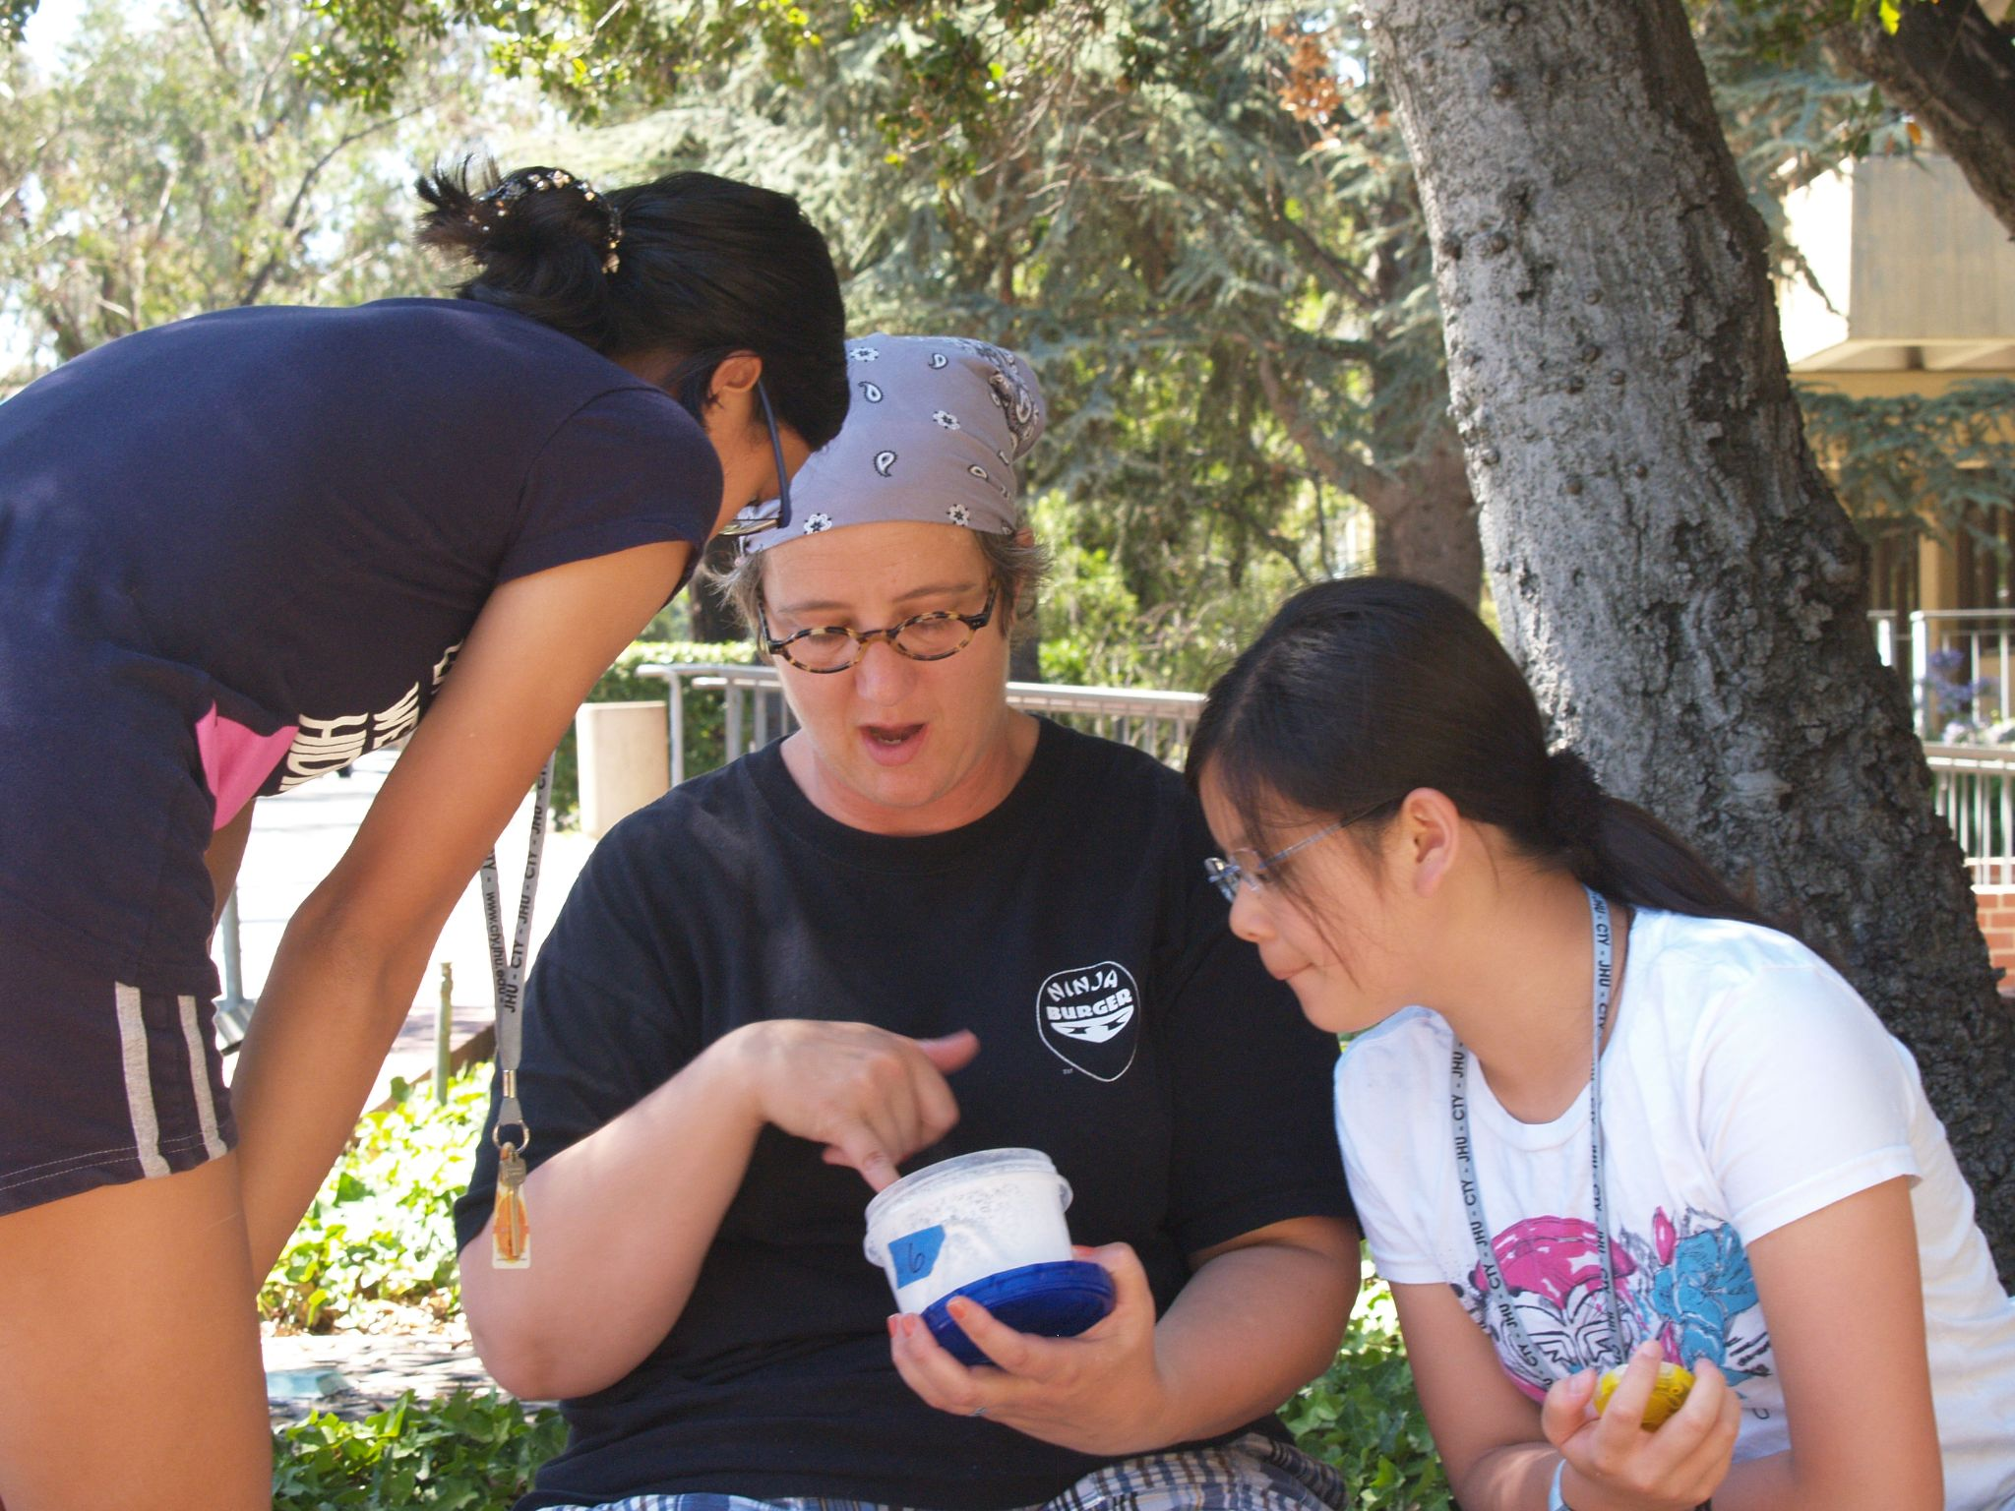
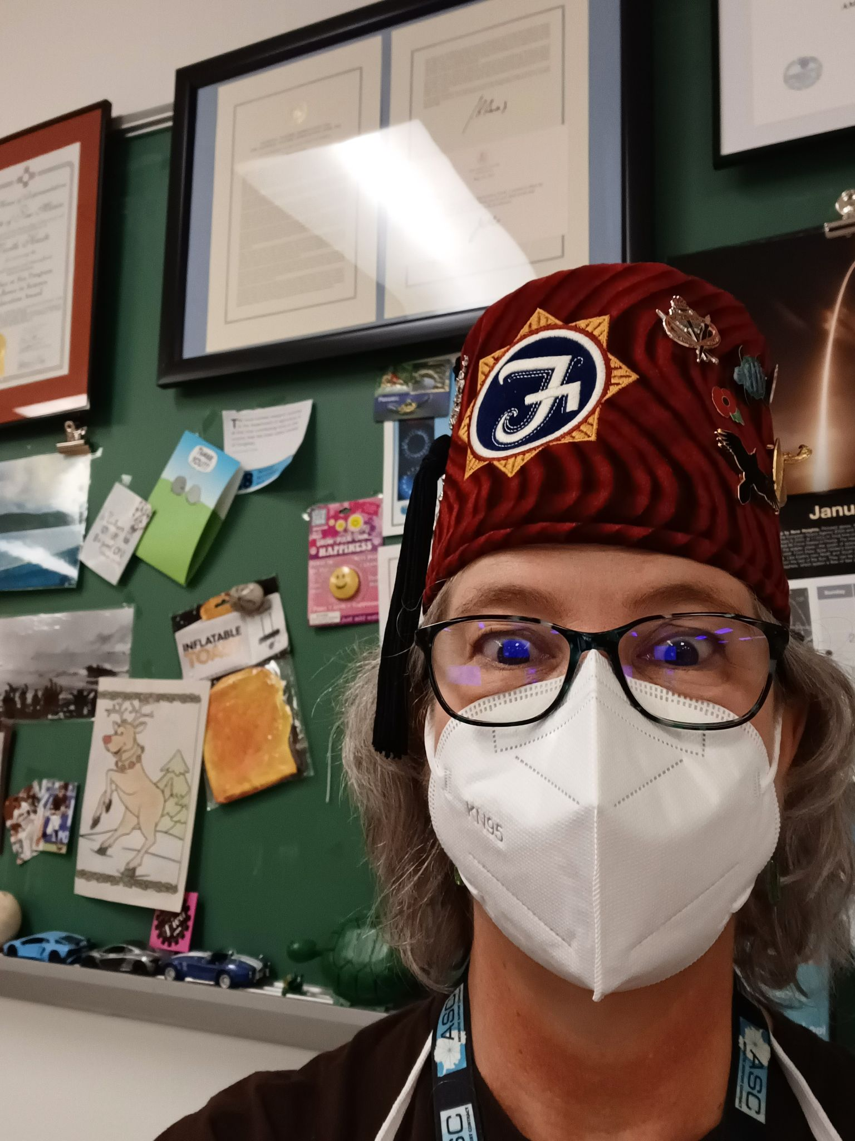
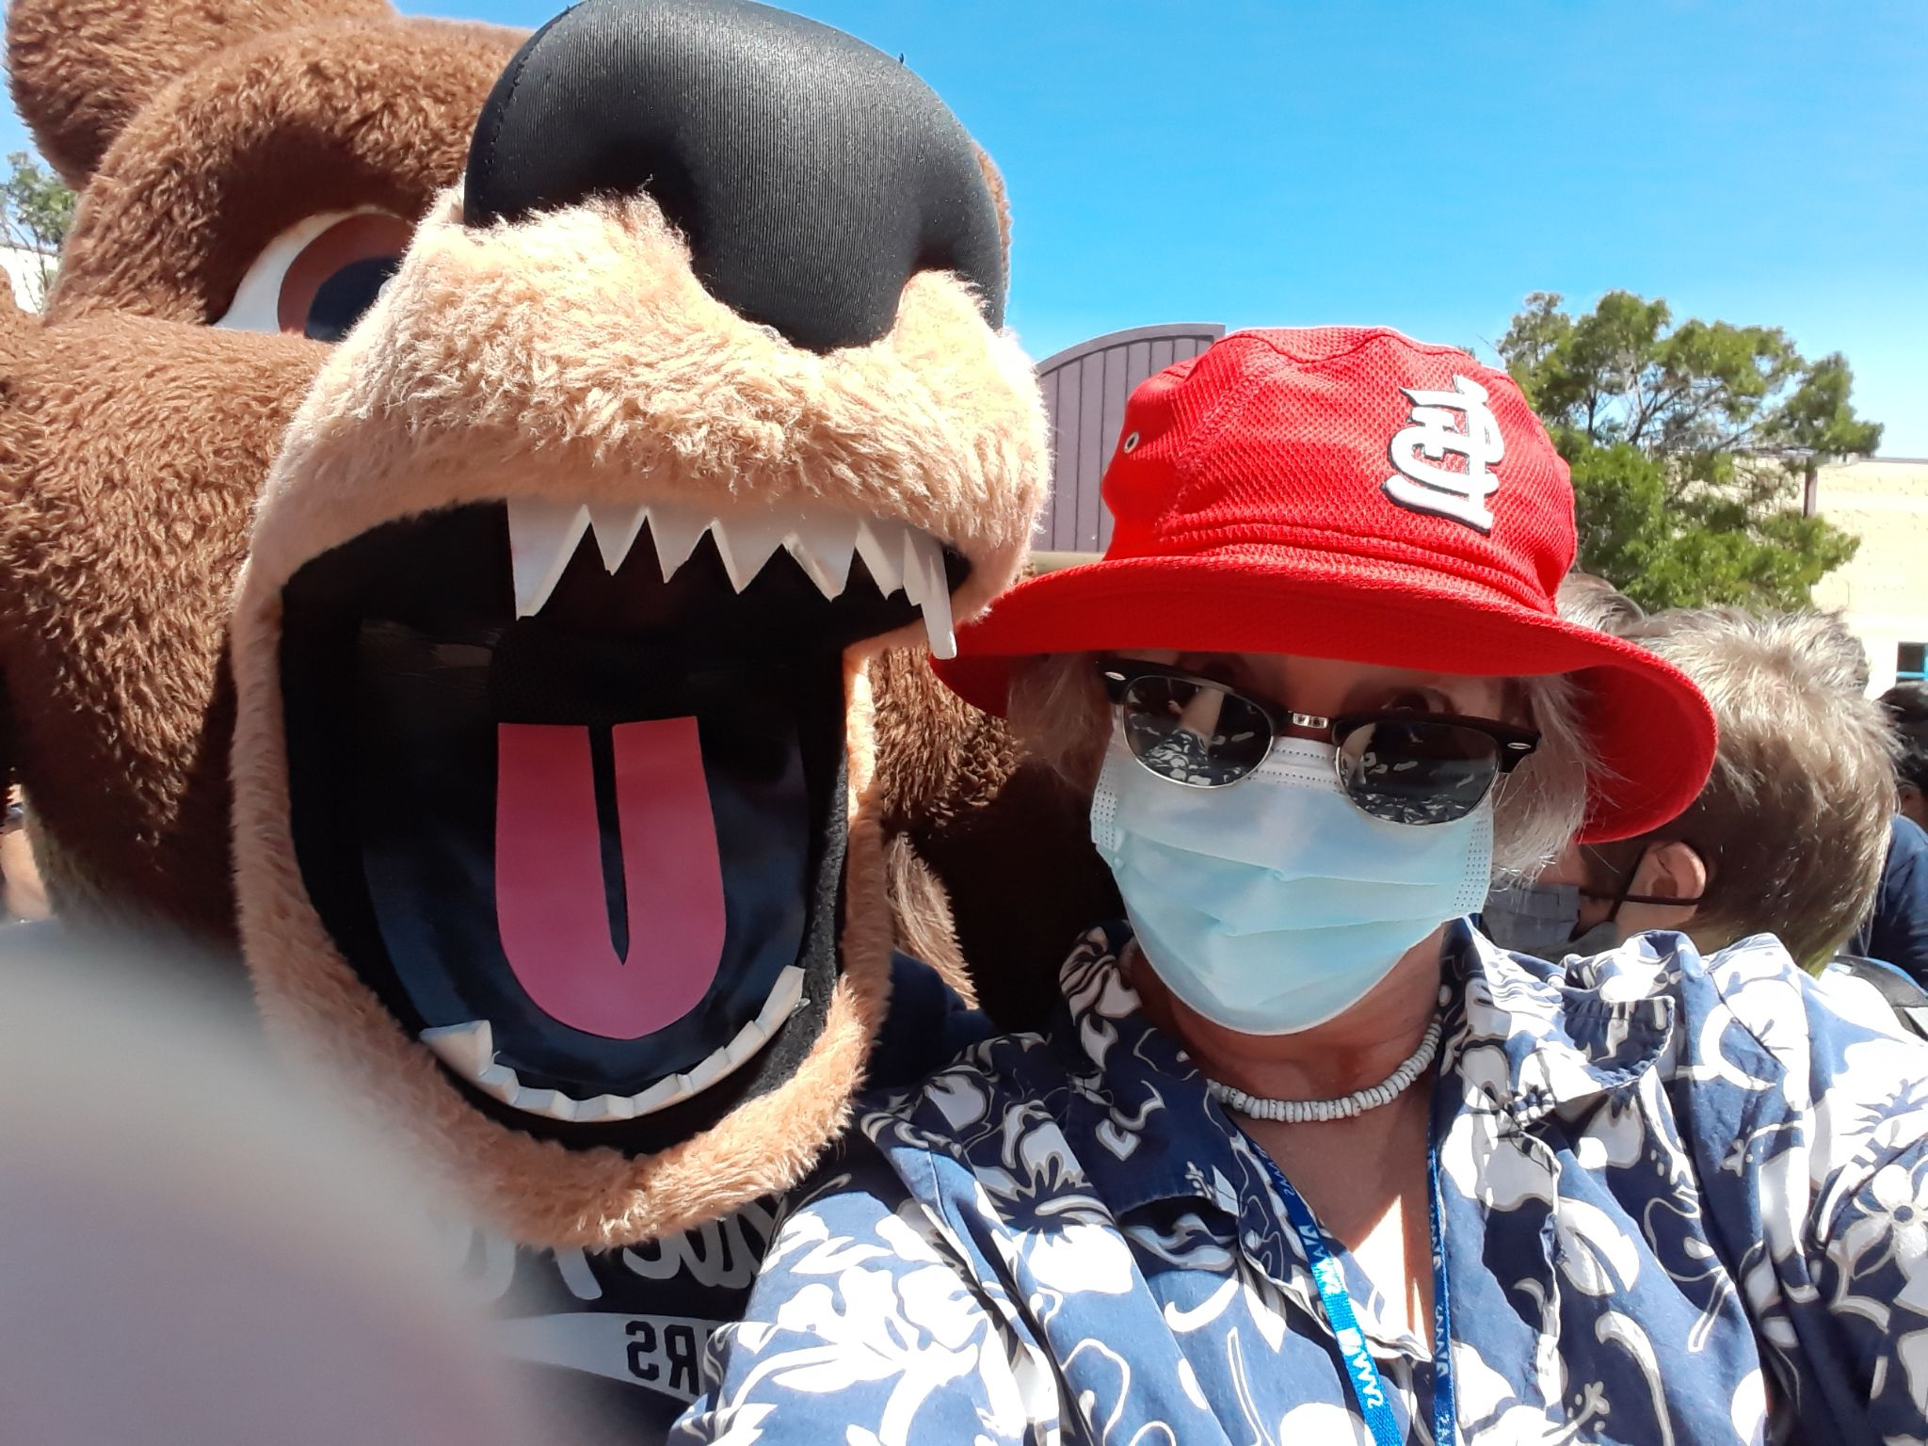
Who am I?
National Board Certified Teacher- Early Adolescent Science
U.S. Institute of Peace - Peace Teachers alumni
NOAA Teacher at Sea alumni
Science Friday: Educate Teacher Collaborative
IODP School of Rock alumni
Fulbright Teachers for Global Classrooms Georgia alumnae
Contributor to Polar Science and Global Climate: An International Resource for Education and Outreach
Japan Fulbright Memorial Fund alumni
Fulbright-Hays Ghana alumni
In the classroom for 32 years!

Slide 4
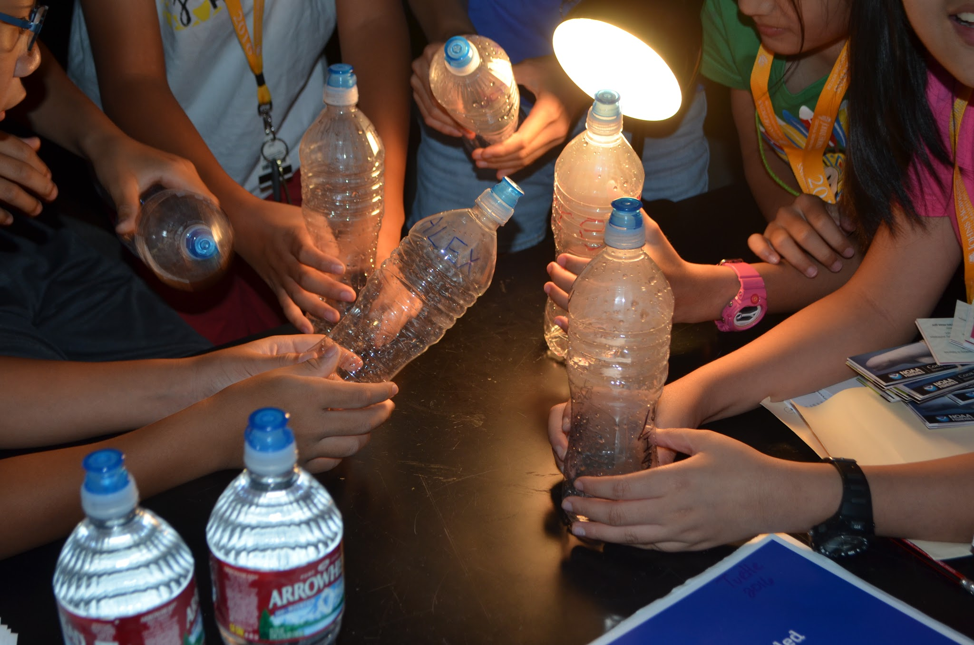
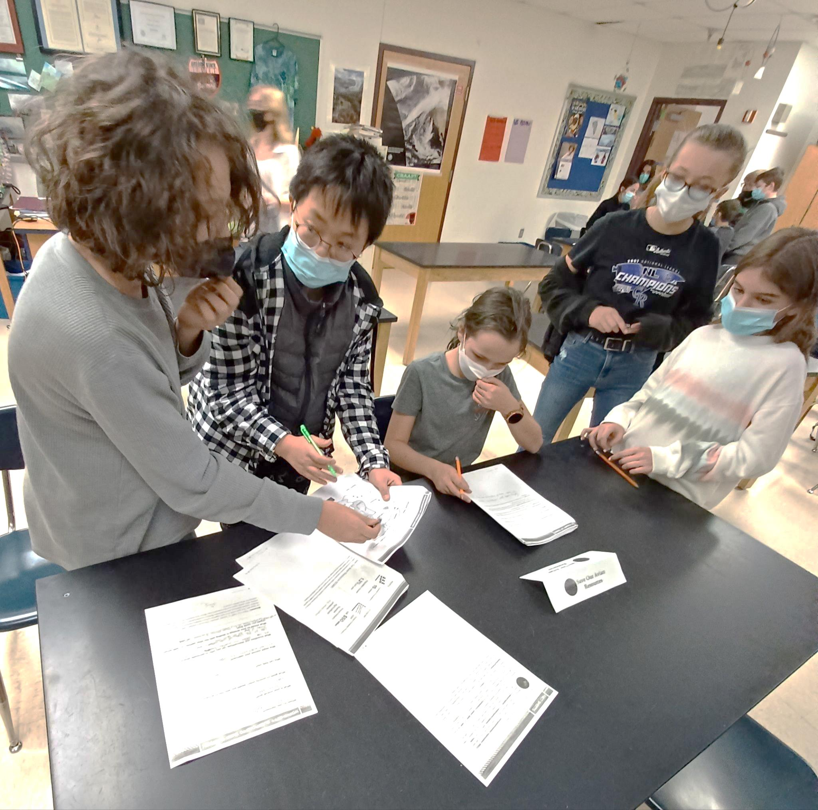
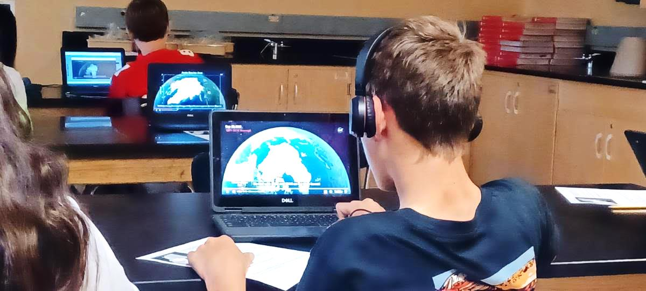
About the students I work with-
11-12 year olds
Their first regular science class - ever
Full inclusion: providing for all the needs of a wide variety of learners
Hands on-minds on inquiry and project based Earth-systems content
Technology ratio 1:1
Learning and maturity gaps from COVID learning very much apparent
Notes:
SPED: LD to GIFTED, including high functioning members of the autistic program
Maturity levels- little to know experience in collaborative groups

Slide 5
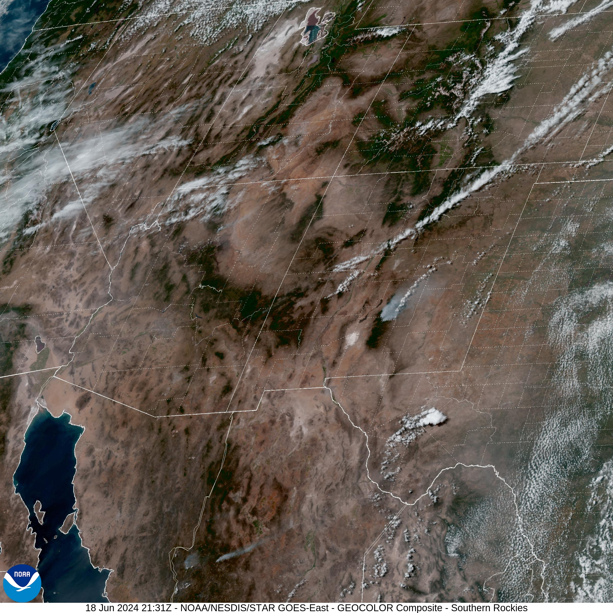
When using GOES and VIIRS comes into our year
Introduce satellites during first quarter with weather and climate as tools to help scientists monitor
(aka Justifying Claim Evidence Reason argumentation within our school 90-day plan)

Slide 6
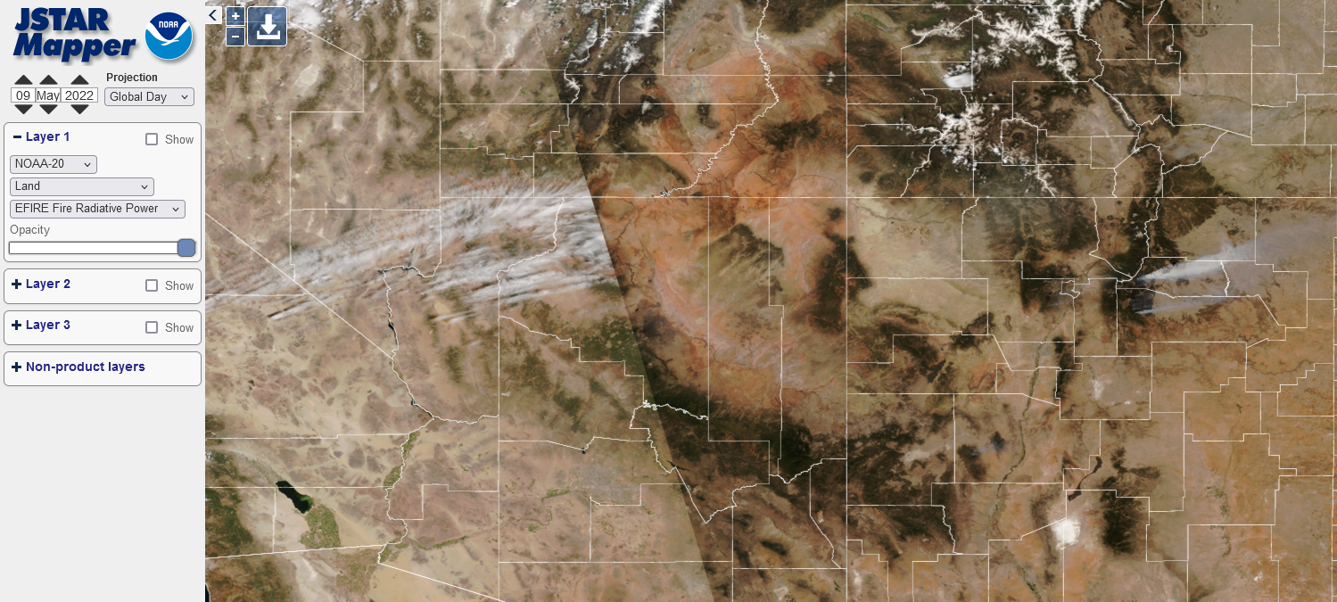
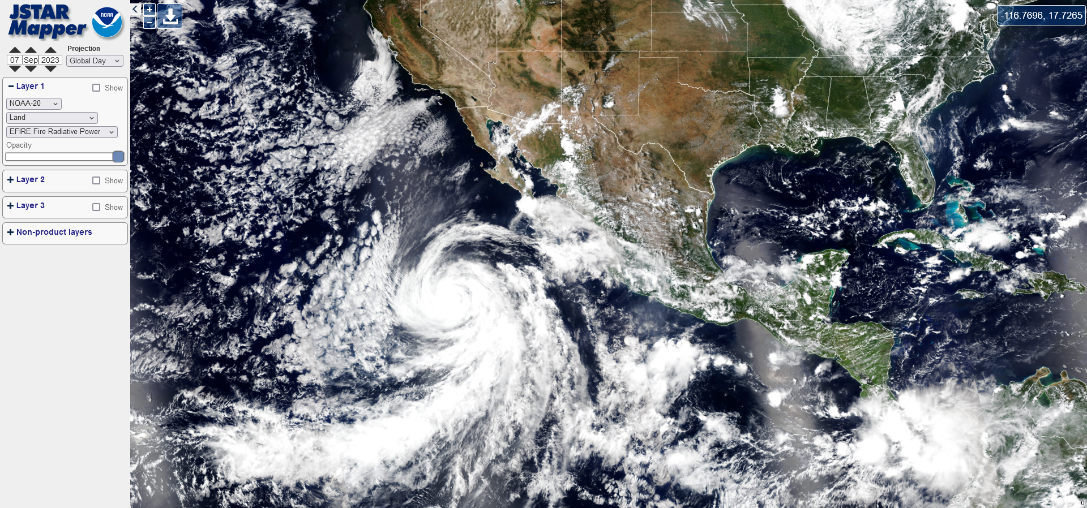
Why during weather?
Follow wildfires and hurricanes with GOES and VIIRS imagery
“Weather affects us directly” – students can experience the effects
Notes:
Follow wildfires and hurricanes with GOES and VIIRS imagery – at first as these can relate directly to NM weather and air quality
Hurricane interactives from UCAR, NOAA SciJinks

Slide 7
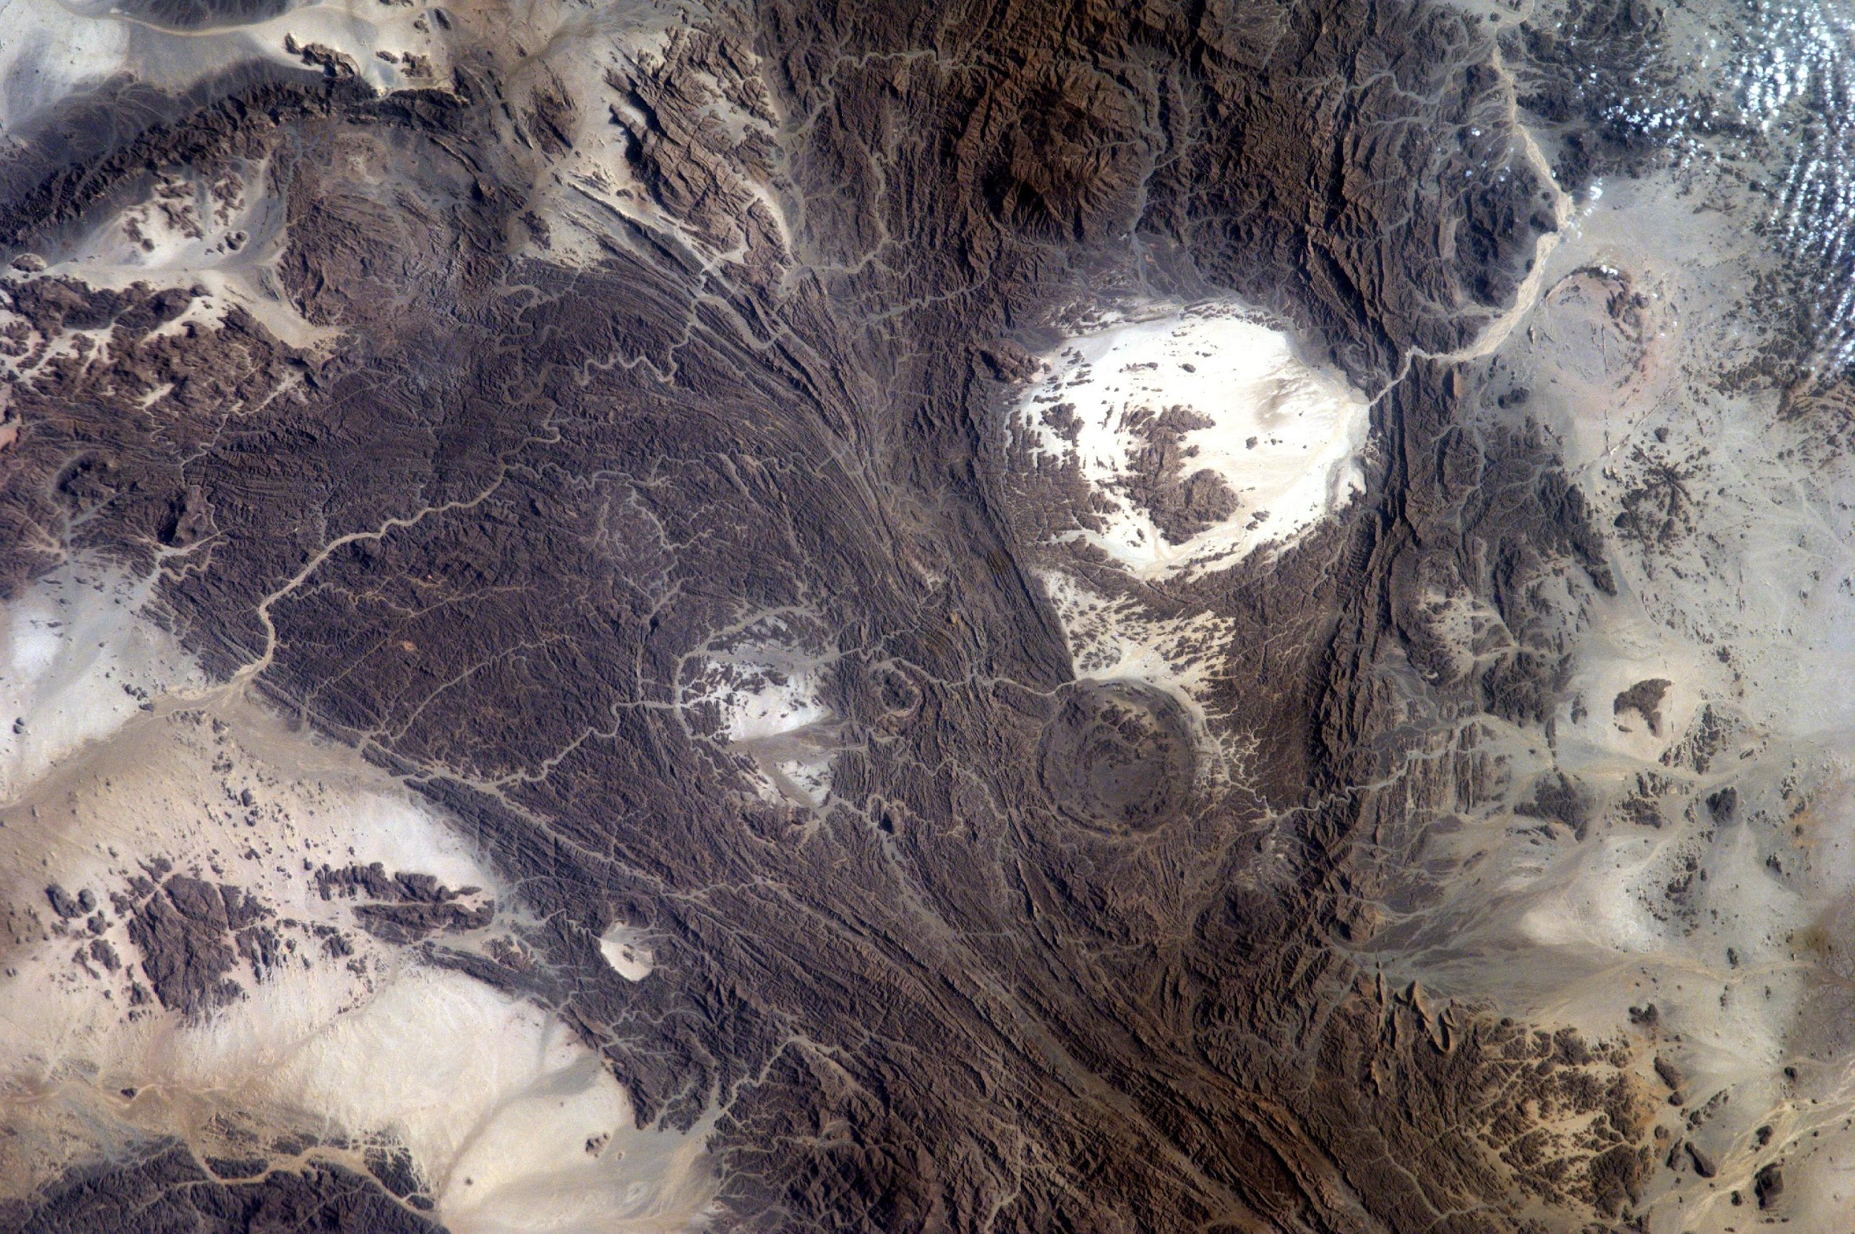
When do you incorporate satellites in your curriculum?
Student image Using the Sally Ride EarthKAM - 21.69N_35.30E Sudan
Notes:
Turn and talk
Anyone willing to share?
EarthKAM Educator tools - https://www.earthkam.org/activities

Slide 8
Getting younger students comfortable with imagery and interfaces
Connecting the work to kids’ experience
6th graders are very concrete and literal thinkers
Learning how to practically use latitude and longitude – not just on a flat map
Understanding different types of satellites and orbits
Understanding camera footprints and resolution
EarthKAM vs GOES vs VIIRS
Did you know?
EarthKAM uses a camera that many families have:
Notes:
Because students are concrete and literal thinkers, I need to connect what they are doing not only with science, but with other content areas so they can process what they are doing more fully
What images they see on the news, where are those from?

Slide 9
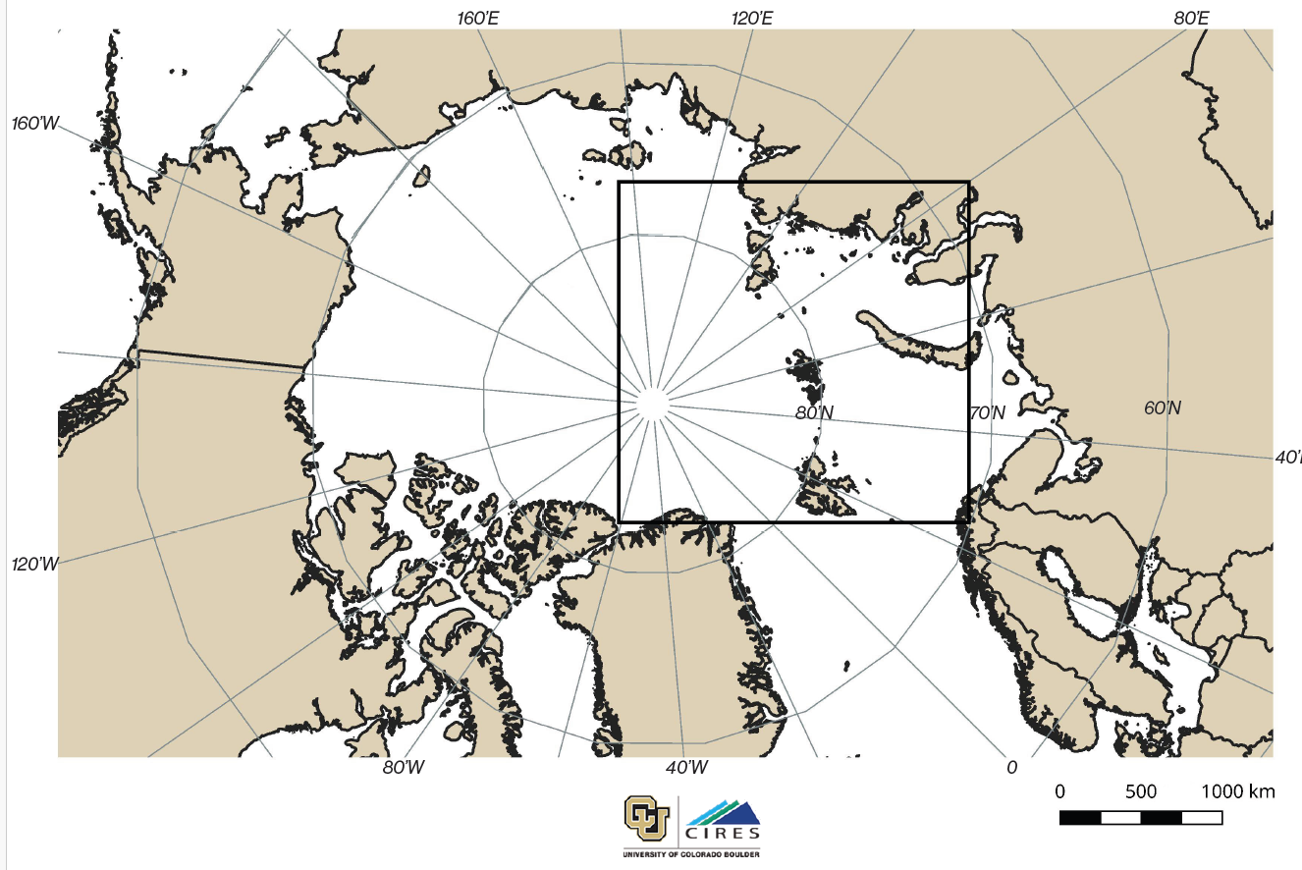
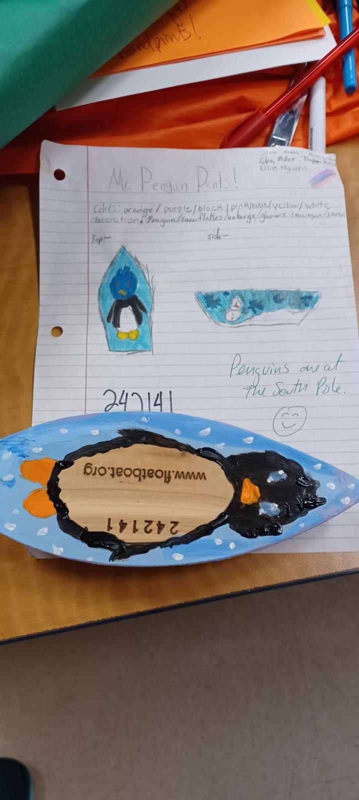
For example … …
Deployed April 4, 2024
Notes:
Float Your Boat – one of the reasons we were so interested in the VIIRS imagery is to see if we can track our recently placed floats that are helping to track the Arctic Ocean and sea ice movement. https://www.floatboat.org/post/utqiagvik-april-2024-deployment
MOSAiC Resources- (maps, Arctic Ice floe maps) https://mosaic.colorado.edu/activities and https://serc.carleton.edu/teachearth/activities/180222.html
My NASA Data Arctic Sea Ice activity – https://mynasadata.larc.nasa.gov/mini-lessonactivity/exploring-sea-ice-changes-over-time and https://mynasadata.larc.nasa.gov/lesson-plans/investigating-sea-ice-extent-arctic-and-antarctic
UCAR - https://scied.ucar.edu/teaching-box/climate-water/dwindling-sea-ice

Slide 10
Challenge - Landforms
Students collected images from several satellite systems to learn how to and practice identifying land features.
After using the samples from EarthKAM - they made and gave bingo cards to each other to see who “got it correct”.
Students then used NASA Earth Observatory and JStar Mapper to practice identifying land features and be introduced to false color images.
Model from EarthKAM teacher materials
Notes:
At this developmental level – concrete learners can struggle with landforms – especially if the feature is beyond their experience.
EarthKam Earth Images Bingo- https://www.google.com/url?sa=t&source=web&rct=j&opi=89978449&url=https://www.earthkam.org/dls/9_EarthKAM%2520activities/EK_EarthImagesBingo_Teacher.pdf&ved=2ahUKEwiR_7-lluaGAxUrATQIHUoPD2cQFnoECBkQAQ&usg=AOvVaw3-pg5Oq7PFm9n0JmKjCqtN
NASA Earth Observatory - https://earthobservatory.nasa.gov/

Slide 11
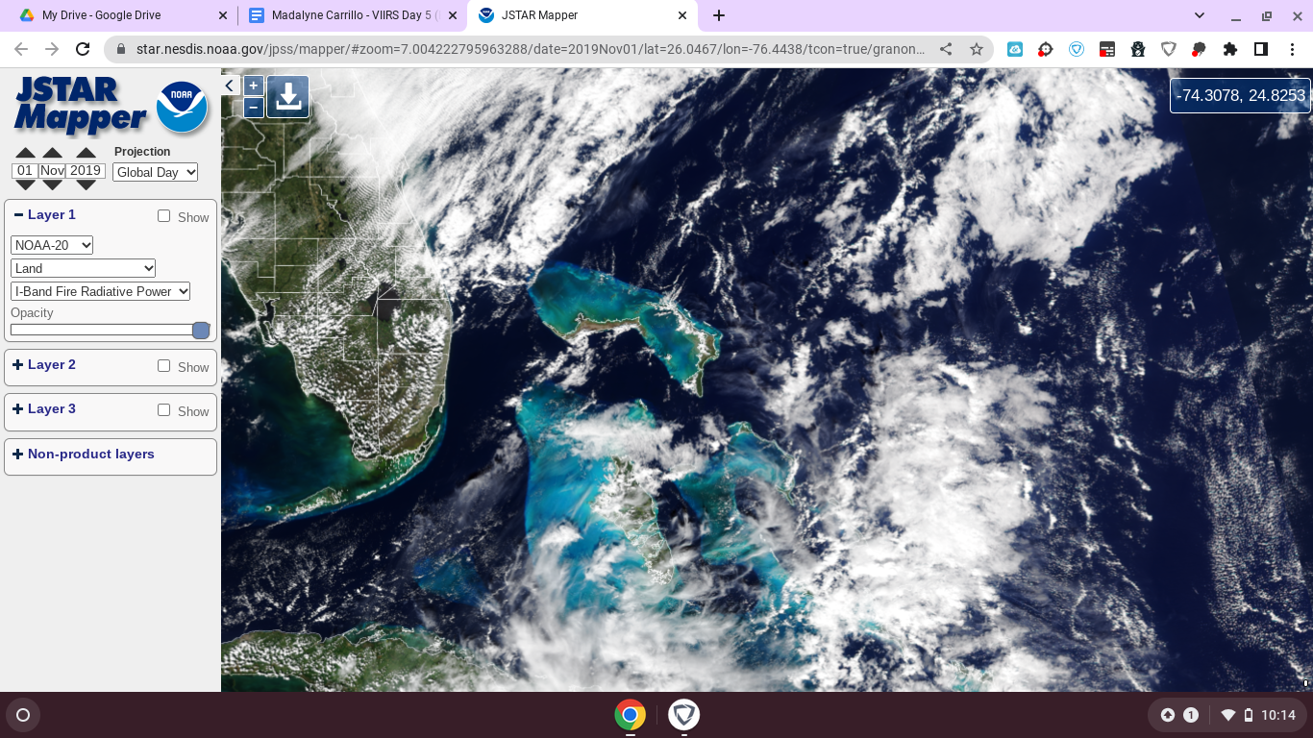
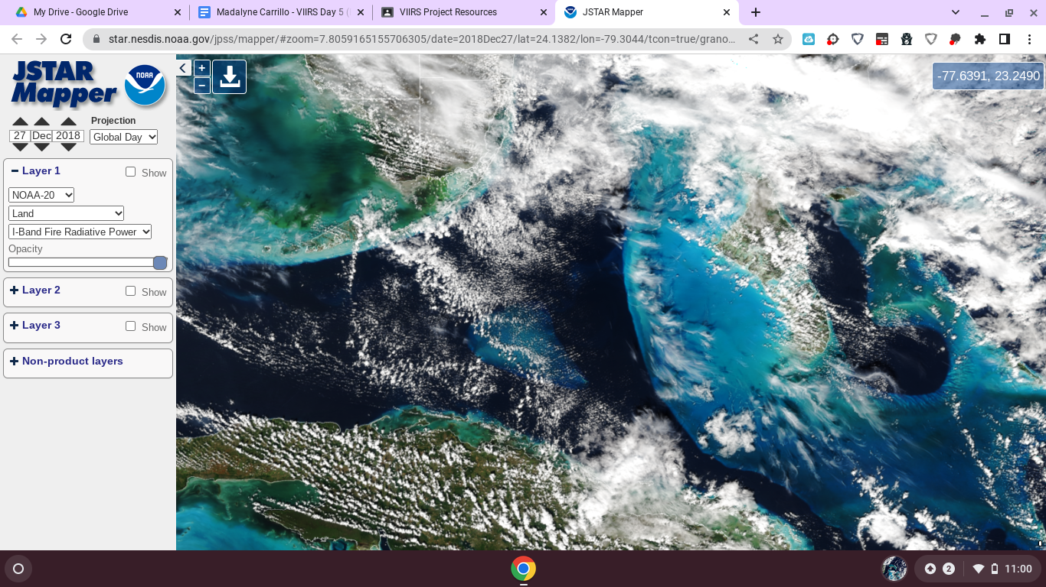
Student Work-
“We are using the Jstar Mapper to see the coral reefs and how they get affected by Climate Change. The latitude and longitude for the first picture is (74.3078, 24.8253). For the second picture the latitude and longitude is (77.6391, 23.2490). For the third picture the latitude and longitude is (91.3533, 19.2338). The images are showing the coral reefs. The coral reefs appear blue, and the land appears greenish brown. The Jstar Mapper is helping us locate the coral reefs. Jstar Mapper has different times of where the coral reefs are and only have color in 2018-2022.”

Slide 12
Challenge - False Color Imagery
Students struggled understanding how to use false color to depict phenomenon
We spent a lot of time viewing true color and comparing what we observed when we changed the wavelengths.
What was different? What did it show? What were we looking for? How did the wavelength change help us understand the data?
Your turn –what students were trying to show?
Notes:
My NASA Data satellite resources - https://mynasadata.larc.nasa.gov/search?keys=satellites
Do you understand the limitations of their literal thinking?
Can you understand why younger students struggle with color value representation? Consider the limited abstract ability and their experience with video games.

Slide 13
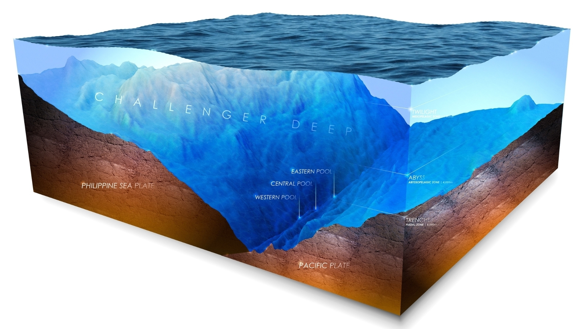
1 kiddo of 150
“The source is https://www.npr.org/2023/11/06/1198908501/mariana-trench-challenger-deep-ocean-map-tsunami. I used the mountain as the blue since it is closest to the top. ”
- Mikey

Slide 14
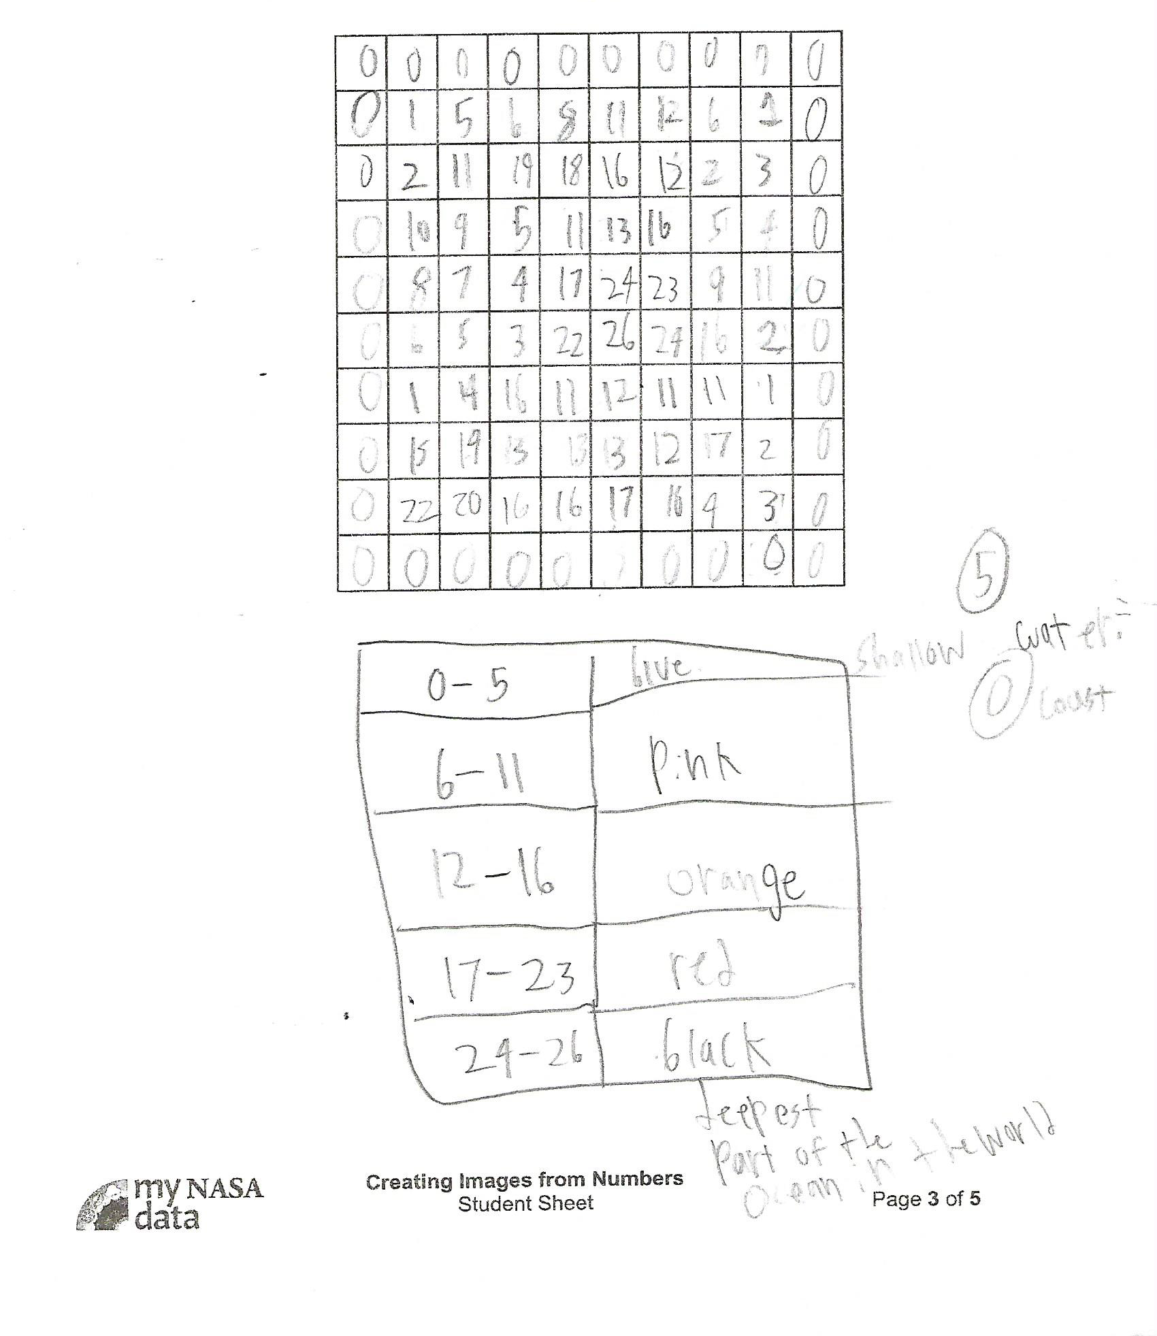
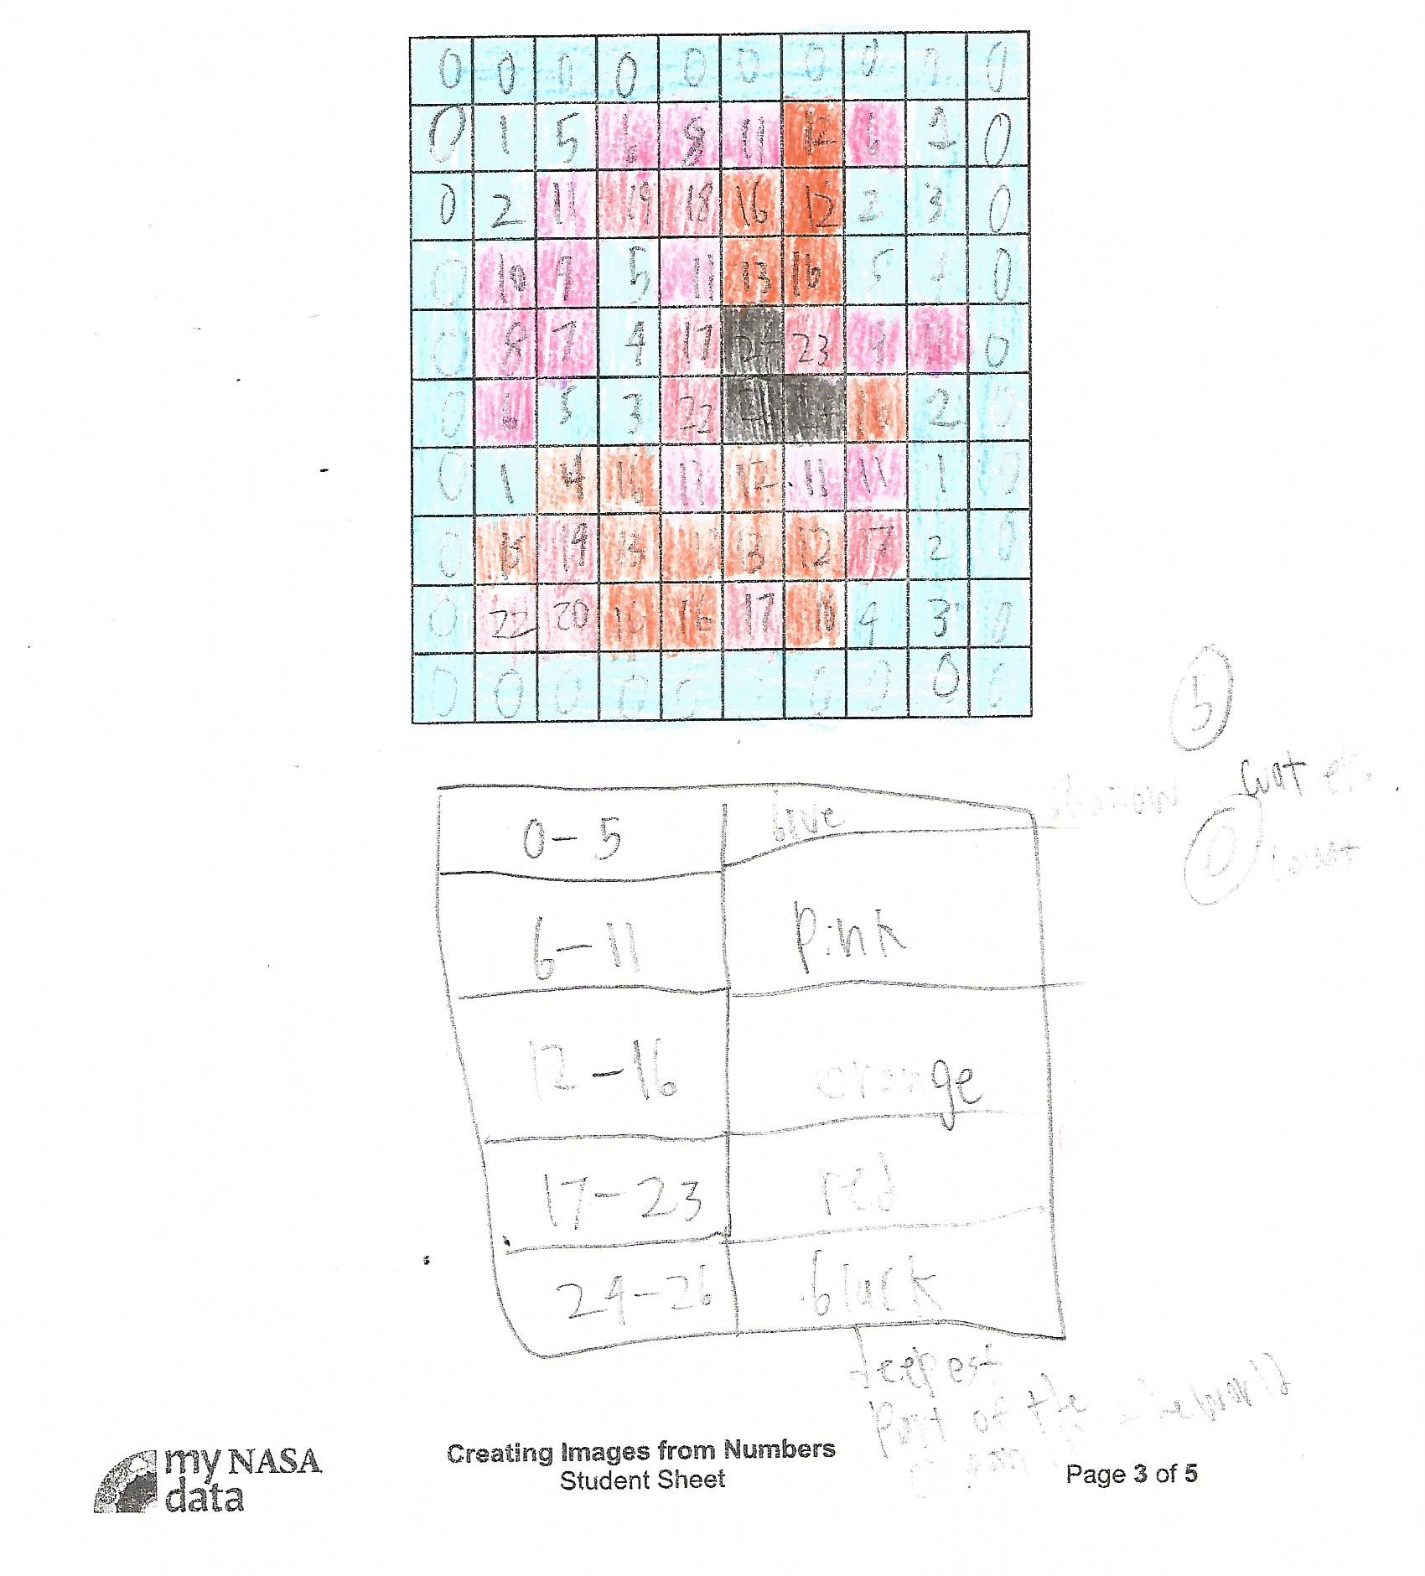
Master
Filled in

Slide 15
Student Projects-
It takes about 25 days of class time to get students familiar enough with the interfaces, settle on a project, and work through any group dynamic issues in order to produce a group product.
Notes:
It takes about 20 days of class time to get students familiar enough with the interfaces, settle on a project and work through any group dynamic issues in order to produce a group product.
First step – a solo assignment to become familiar with the interfaces, type of satellite and orbits, imagery, and calendar aspects.
Step 2 – Introduce the topics, group selection and role assignments.
Step 3 – Developing problem statements, searching for initial images and refining statements
Step 4 revisions of statements, researching phenomenon, developing drafts of what will be placed in poster
Step 5 – selecting “Before & After” images, revisions and finalizing writing
Step 6 – putting everything into the poster, teacher review

Slide 16
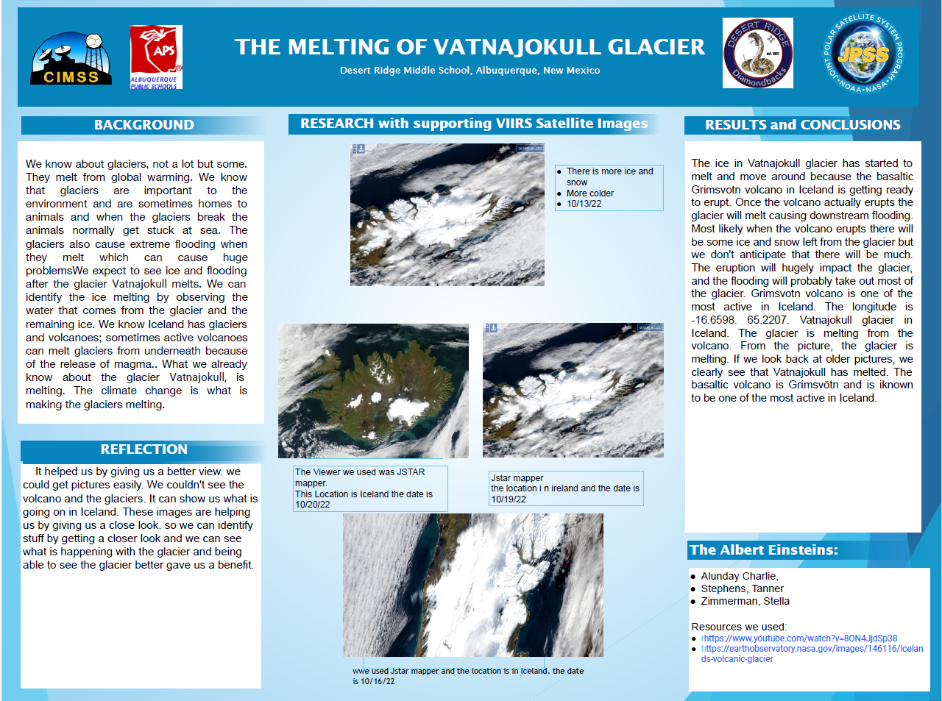
Notes:
Students were curious about how a glacier might melt as a result of a volcano underneath. I know of a YouTuber from Iceland who had talked about this geology and off we went!
A Landstat image would have been more clear. https://earthobservatory.nasa.gov/images/152890/iceland-eruption-goes-another-round

Slide 17
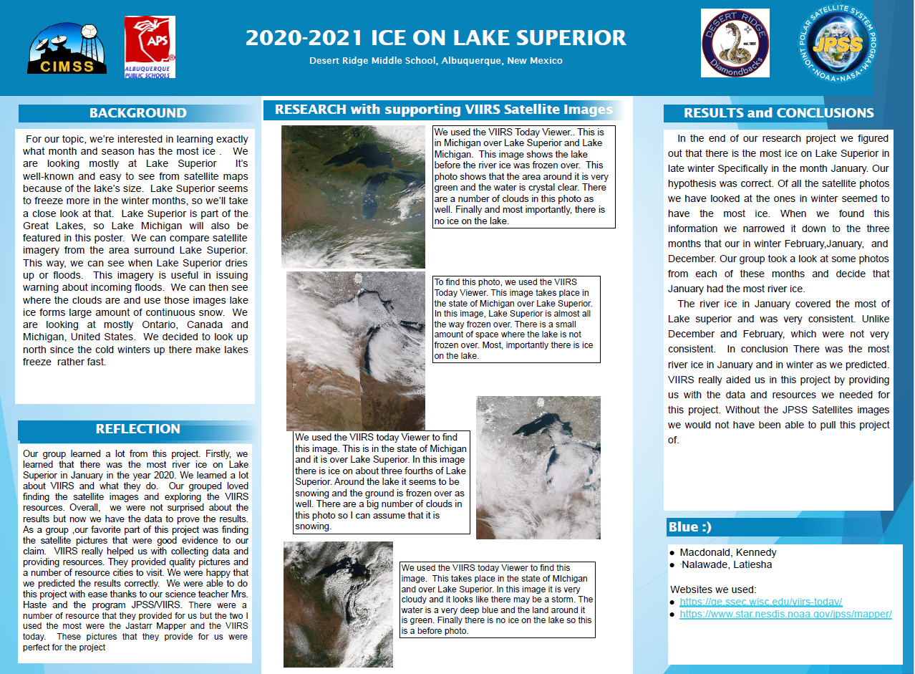

Slide 18
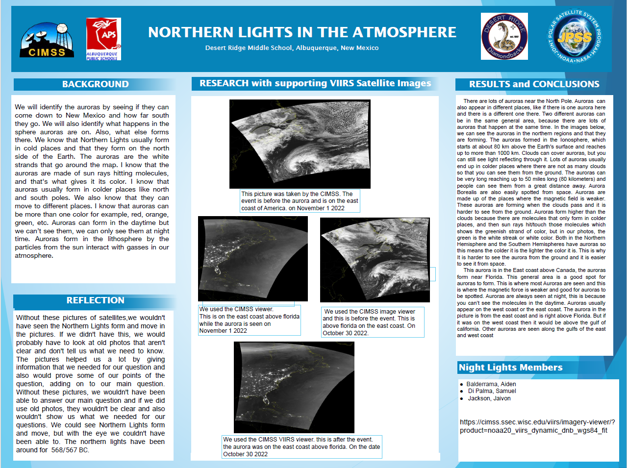
Notes:
Students are very interested in auroras.
We used NASA Space Weather and SpaceWeather.com to forecast when auroras are expected and then checked VIIRS Imagery Viewer(https://cimss.ssec.wisc.edu/viirs/imagery-viewer/) for appearance.
Students struggled to understand why the colors didn’t appear.
They seem to be more interested in why the auroras happen and forgot that we learned about the process when we were investigating the sun’s affect on our planet and the atmosphere.

Slide 19
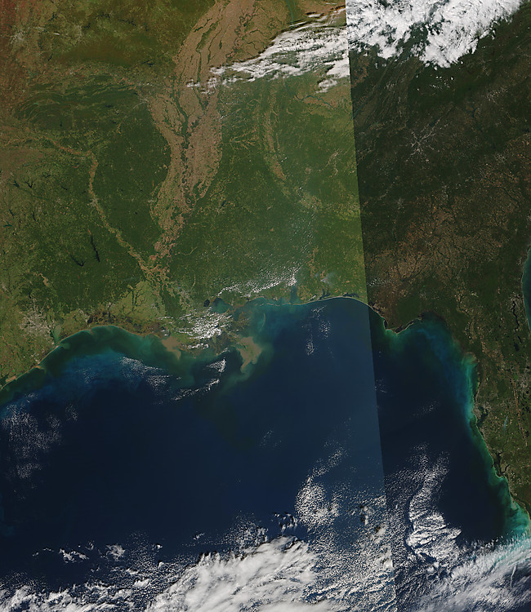
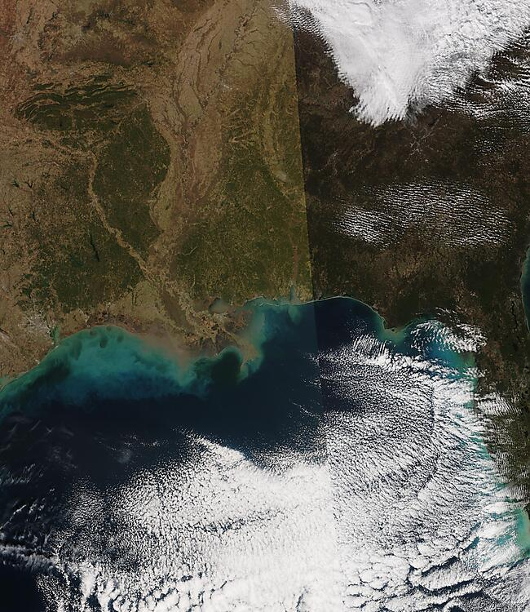
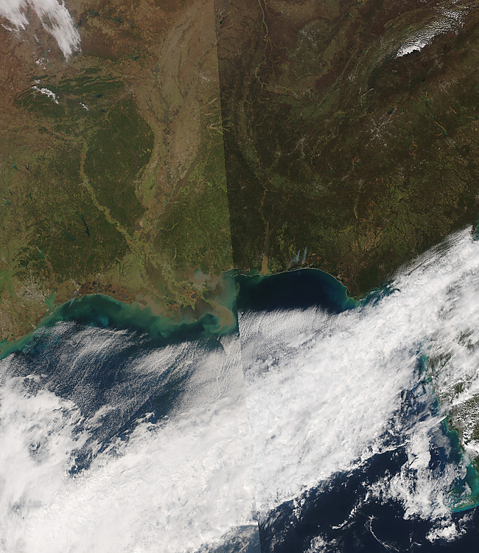
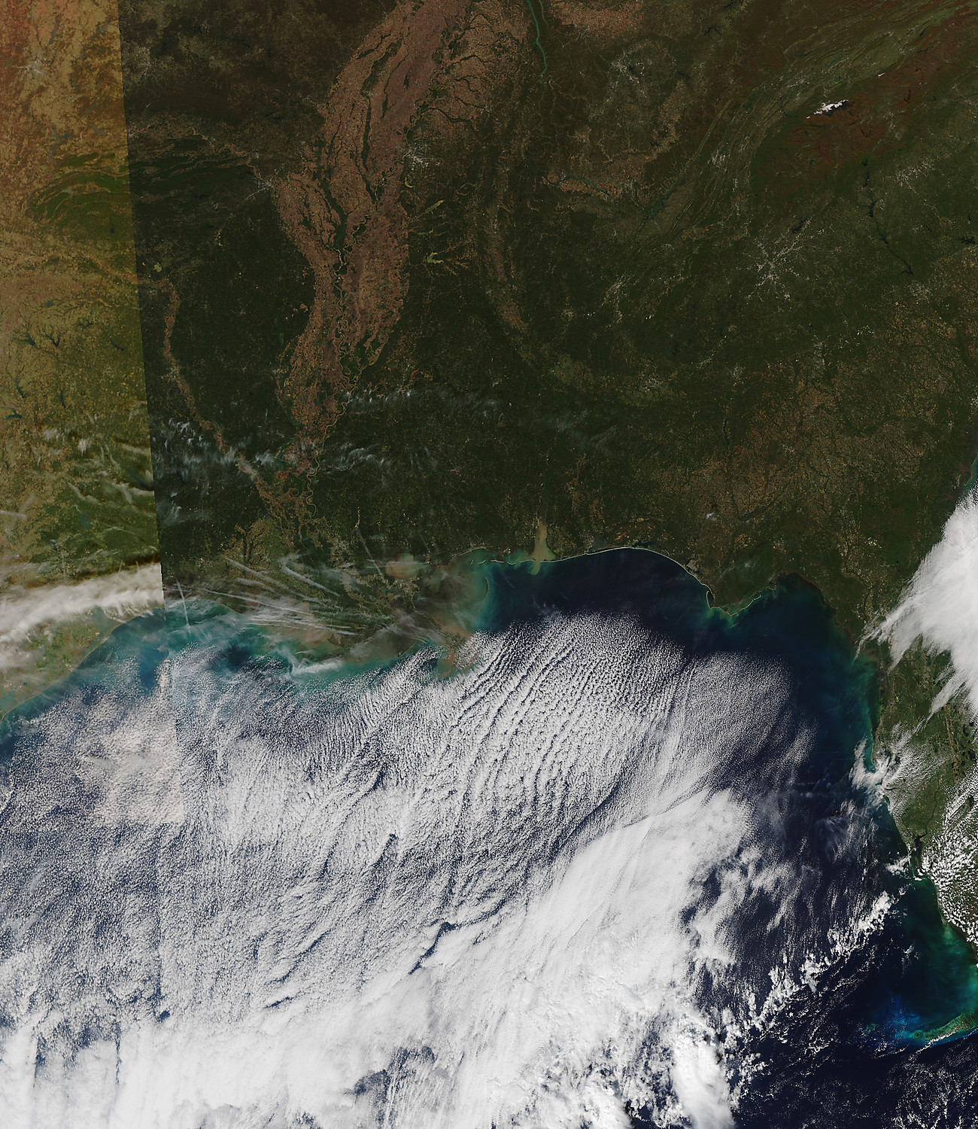
SPRING 2019 LOUISIANA FLOODS ALONG THE MISSISSIPPI RIVER
Desert Ridge Middle School, Albuquerque New Mexico
REFLECTION
RESEARCH with supporting VIIRS Satellite Images
RESULTS and CONCLUSIONS
We learned many things about this topic. One of those things is we learned how to tell if a place if flooded or not. We do this by, seeing a satellite photo of that area not flooded, then, we see if the river/body of water is larger. We also discovered how we can find days on the VIIRS satellite that were wet and condensed. We did this so that we could tell if there was enough water and natural materials to create clouds. There were many things we learned about in this project, but these are the main things that we learned about that helped us.
The VIIRS instrument helped us decide what pictures to take because it helped us see Louisiana (the state we are studying) and if it was cloudy or sunny or maybe rainy that day. It did kind of help us see things we couldn’t before but not too much. We were able to see if the tide was low or high that day. That is how the VIIRS instrument helped us decide what pictures to get.
Image 1
We want to learn more about how the flooding in Spring 2019 affected Baton Rouge, Louisiana. We are also mainly focusing on the area nearest to the Mississippi River. We will also find out what areas flood more and flood more often. We will also try to find out the areas of the Mississippi River that flood in Baton Rouge the most. We will be using the satellite mostly to inform us of the floods in Spring 2019 in Baton Rouge, Louisiana. This resource will also help us determine when the flooding occurred. In conclusion, we will be using the satellite to get our information on the flooding in Spring 2019 in Baton Rouge, Louisiana.
We picked three images that took place before our selected time period. The general conditions in the photo titled “Aragon 10/11/2018” is that it was sunny with no clouds in Louisiana. There are clouds in other parts of the picture though. It is also very green with a lot of vegetation in most parts of the picture. There is one line of brown area. Our second picture was titled “Frish December 24 2018”. In this picture, there are clouds along the south edge of louisiana. It is also cloudy along the coast of the United States. There are a few areas of brown but it is mostly very green in this photo. Lastly, there are lots of clouds over the gulf of Mexico ocean. Our last photo was titled “Campos March 02, 2018. In this photo there is mostly a brown area and a slight green area. There were light clouds over southern Louisiana and lots of clouds over the gulf of Mexico. These are the conditions of our three “before pictures”.
We also picked three images from after our selected time period. The general conditions in the photo titled, “Aragon 11/01/2019” is that it was a little bit more dry along the Mississippi river and was really cloudy over the Gulf of Mexico. Our second picture was titled, “Frish December 24 2020”. In this picture, Louisiana had no clouds but was shady and the grass looked kind of dead. Our last picture was titled, “CamposSep.25.2019”. This picture had almost all land without clouds or just a bit. I could also tell the water wasn’t very high that day.
This image was taken on October 28 2018 and it looks sunny and has lots of vegetation.
Image 2
Image 3
This photo was taken on September 25th 2019 and as you can see, there is some clouds but they are towards the water more than land.
This image was taken on December 25 2020 and there was not very much vegetation but the tides were very low along the coast of louisiana.
RESEARCH QUESTION/BACKGROUND
We wanted to know how much it floods in Baton Rouge, Louisiana. We will find that by looking at our selected area on the VIIRS satellite. We expect to discover how often it flooded in spring 2019.We also want to measure how much it flooded in this time period. We know that Baton Rouge, Louisiana had a huge flood in may 2019. We also recall knowing that flooding happens when there is a lot of precipitation, an overflowing amount of water or the soaked soil mixed with the elevated water of the Mississippi River. That was what we knew from our research about the floods in Louisiana in spring 2019
Our topic was how much floods there were along the Mississippi river in Louisiana in spring 2019. In particular, we wanted to find how much Baton Rouge,Louisiana flooded in spring of 2019. We also wanted to find how often this city flooded in this time period. We wanted to find specific spots where there is more water than the rest of the river. This is our more particular and specific answer.
Image 4
This image was taken on November 1 2019 and it looks like the tide was short that day. It also looks like there light clouds over the Guld of Mexico.
GROUP MEMBERS
Lauryn Aragon
Teya Campos
Hadas Frish
Notes:
‹#›

Slide 20
Notes:
http://cimss.ssec.wisc.edu/education/jpss/TopProjects2021.html
2021 Top Projects

