Slide 1
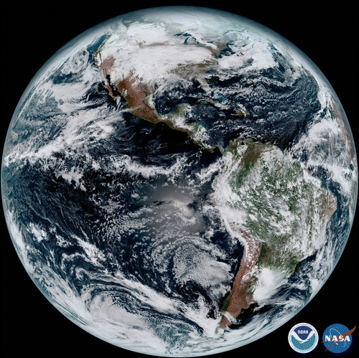
Projects underway
to slow or halt
Climate Change

Slide 2
Goal: to limit global warming to below 2 degrees Celsius (1.8 °F), compared to pre-industrial levels, preferably to 1.5 °C (3.6 °F).

Slide 3
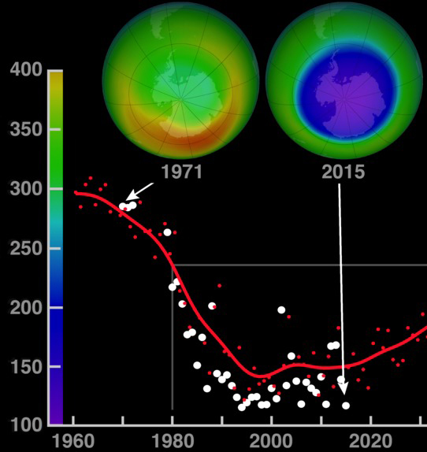
We’ve succeeded before ….
Montreal Protocol
1987 United Nations agreement to limit the production of ozone-depleting chemicals.
Since then, 197 countries and the European Union have ratified the binding treaty, and CFC levels have steadily declined in the atmosphere.
Notes:
While the Montreal Protocol resulted in a rapid phase out of CFCs worldwide, the ozone hole was a bit slower to recover because CFCs are chemically stable and remain in the atmosphere for nearly a century.

Slide 4
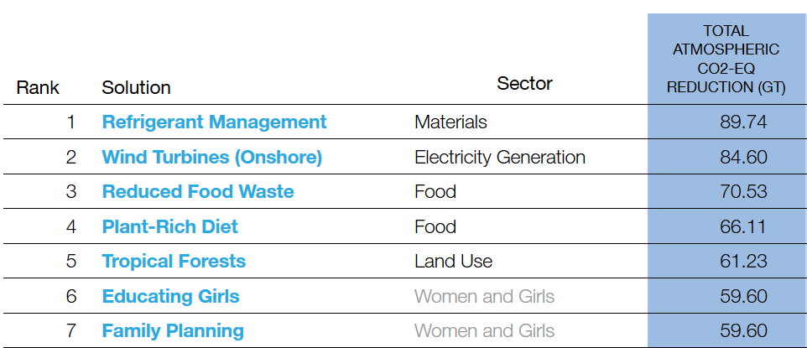
Project Drawdown
Project Drawdown is a research and communication organization that ranked the 100 most substantive, existing solutions to address climate change.
Drawdown is the point at which levels of greenhouse gases in the atmosphere stop climbing and then steadily decline, ultimately reversing global warming.
TOP SEVEN
NOTE!
Actions 3 and 4 are
easy for everyone
to undertake
https://www.drawdown.org/

Slide 5
#1 Refrigerant Management
Every refrigerator and air conditioner contains chemical refrigerants that absorb and release heat to enable chilling. Refrigerants, specifically CFCs and HCFCs, were once culprits in depleting the ozone layer. Thanks to the 1987 Montreal Protocol, they have been phased out.
BUT –
HFCs, the primary replacement, spare the ozone layer, but have 1,000 to 9,000 times greater capacity to warm the atmosphere than carbon dioxide.
Through an amendment to the Montreal Protocol, the world is phasing out HFCs—starting with high-income countries.
This is an expensive but key strategy for curbing climate change.

Slide 6
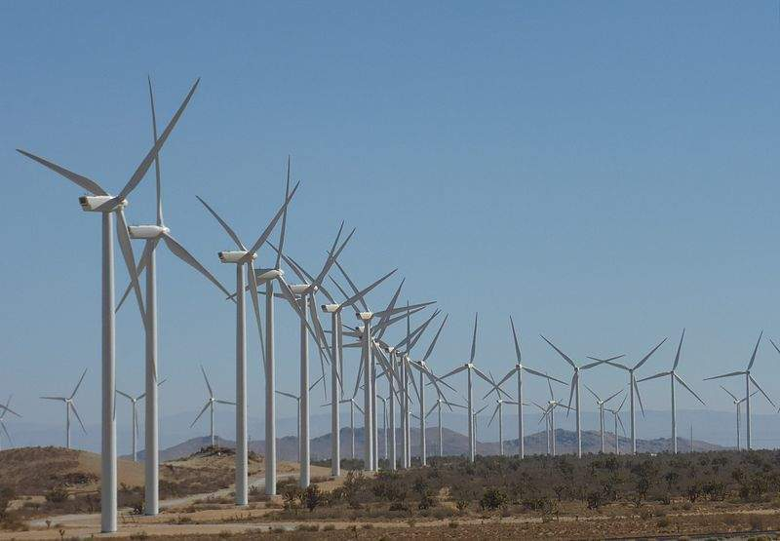
#2 Onshore Wind Farms
Onshore wind turbines generate electricity
at a utility scale, comparable to power plants.
They replace fossil fuels with
emissions-free electricity.
The Alta Wind Energy Centre in California
is the largest wind farm in the United States
and produces 1,550MW.
Gansu Wind Farm – China – worlds largest wind farm largest - 20,000 megawatts

Slide 7
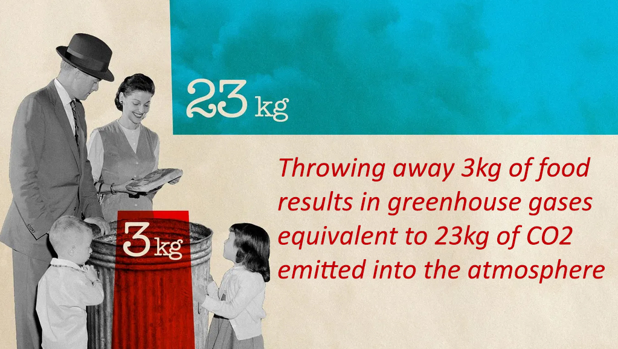
#3 Eliminate Food Waste
If food wastage were a country, it would be the third largest emitting country in the world!
Roughly a third of the world’s food is never eaten, which means land and resources used and greenhouse gases emitted were unnecessary.

Slide 8
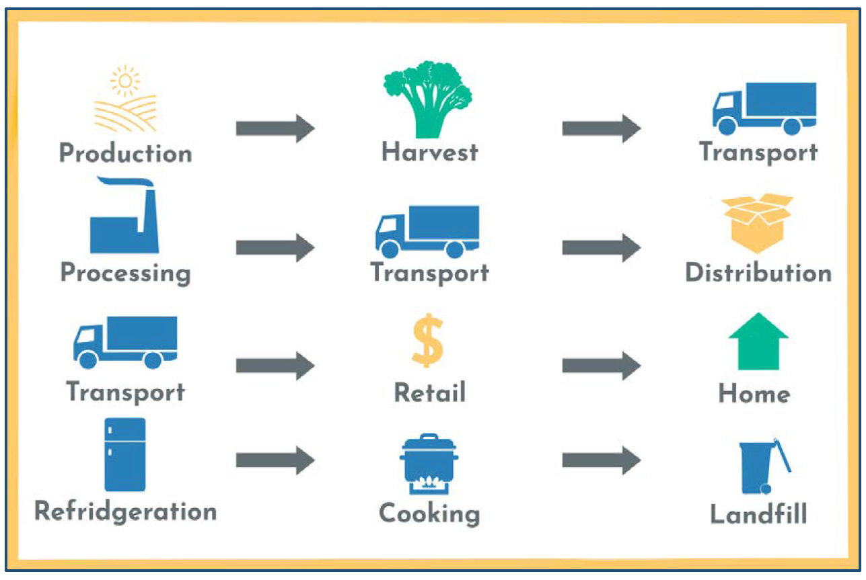
A Typical Food Supply Chain has Multiple Steps
Greenhouse gases, (carbon dioxide, methane, and nitrous oxide) are produced at each step

Slide 9
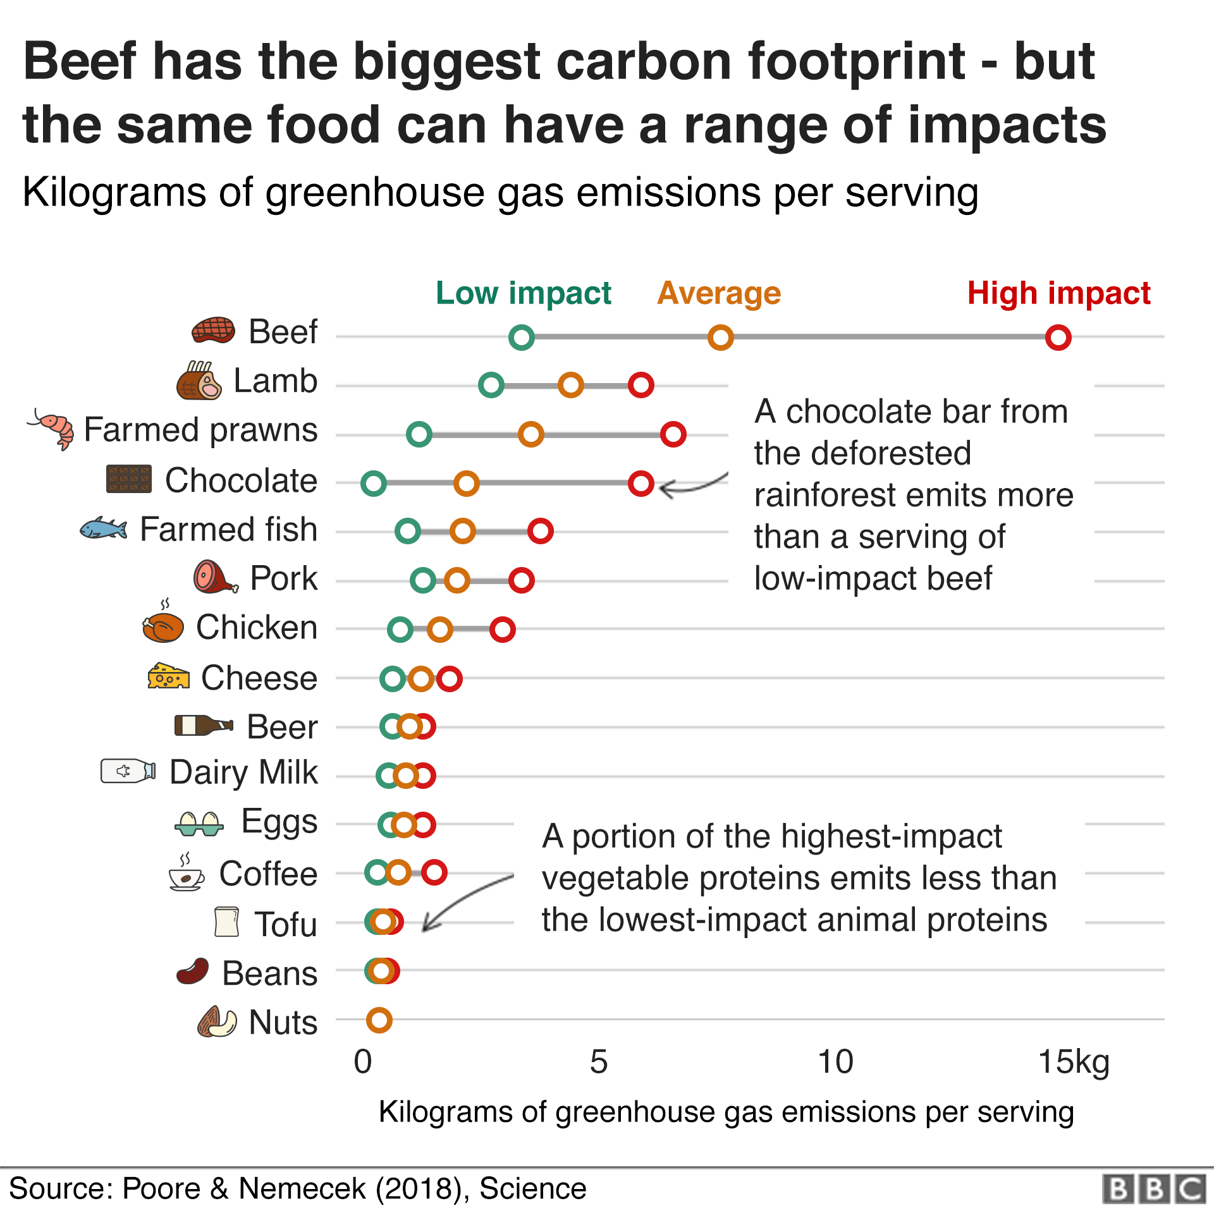
#4 Plant Rich Diet
If cattle were their own nation, they would be the world’s third-largest emitter of greenhouse gases.

Slide 10
Since solar and wind energies are already cheaper than fossil fuels and they work at the scales necessary to power the world, there is no reasonable excuse for not moving aggressively to a more sustainable energy future.

Slide 11
Solar Farms are getting bigger & more common
20-megawatt solar project in Dane County WI is providing clean energy
to the UW-Madison, local businesses and governments.

Slide 12
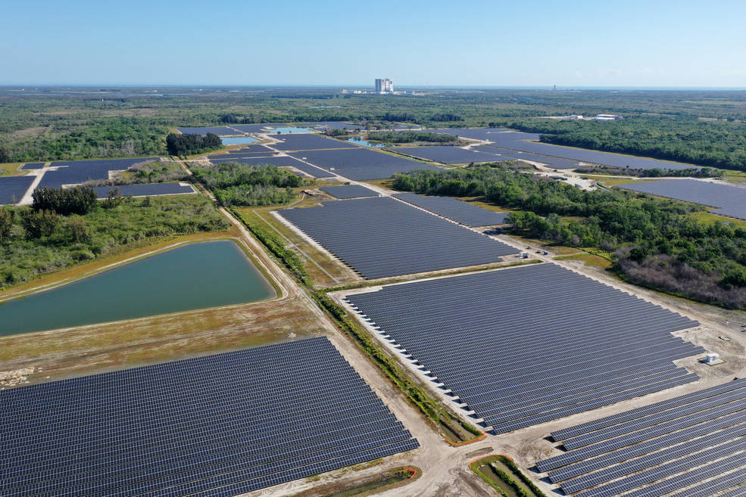
74.5 megawatts
(491 acres)
at KSC !
Florida Power and Light's (FPL) 74.5 megawatt solar site, spanning 491 acres at NASA's Kennedy Space Center in Florida.

Slide 13
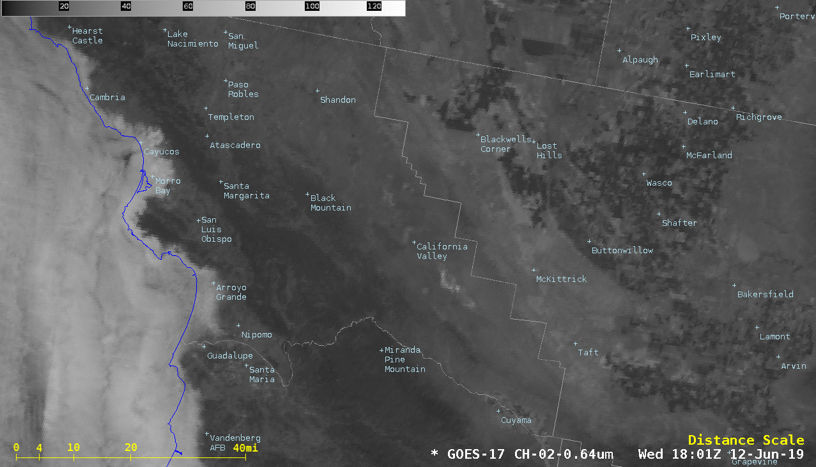
Topaz Solar Farm (550 megawatts) as seen from space!
4700 acres (7.3 sq mi) in southern California

Slide 14
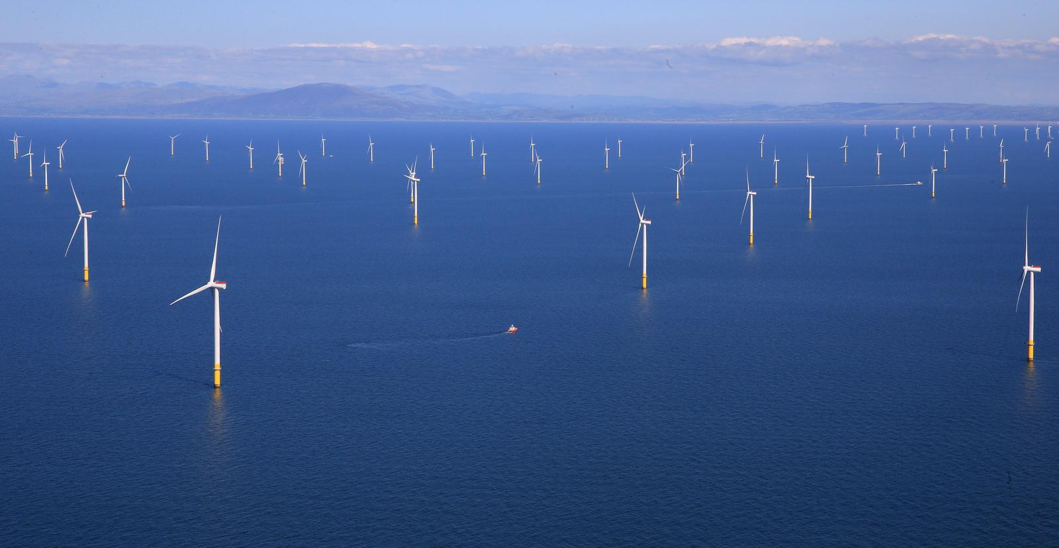
Walney Extension Offshore Wind Farm is located in the Irish Sea and has a total capacity of 659MW

Slide 15
IPCC 6th Report (2022 & 2023)
The Intergovernmental Panel on Climate Change (IPCC) urges countries and individuals enact the following to avoid the worst of Climate Crisis …
Stop methane emissions
Stop deforestation
Restore degraded land
Change what we eat
Adapt Renewable Energy
Use energy more efficiently
Stop burning Fossil Fuels
ACT NOW

Slide 16
The U.S. Inflation Reduction Act – 2022
The Inflation Reduction Act was passed in August 2022 and includes
$369 billion in funding to tackle climate change and cut climate pollution by 40 percent (from 2005 levels) by 2030.
The Inflation Reduction Act includes: • Deficit reduction (to fight inflation) • Lower energy costs, cleaner energy production, and
reduced carbon emissions by roughly 40 percent by 2030 • Allows Medicare to negotiate drug prices and caps out-of-pocket costs • Lowers health care premiums for millions of Americans • Increases the cooperate tax to 15%

Slide 17
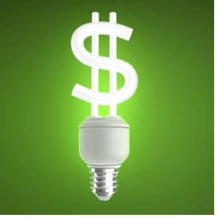
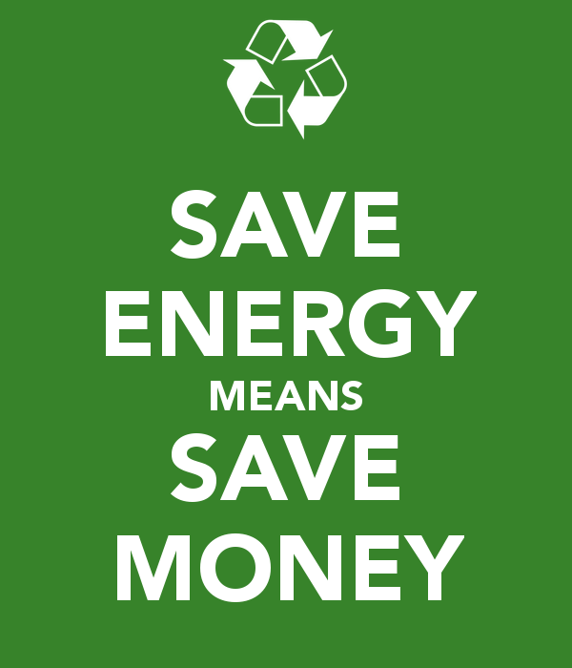
There are LOTS of co-benefits from reducing carbon footprint …
Active transport saves $$ & improves health
Plant-based
Diets are
Healthier!

Slide 18
Climate Change – summary points
1. It’s real
2. It’s us (human caused)
3. Experts agree
4. It’s bad (harmful to humans)
5. We have solutions that are:
Technically feasible.
Economically affordable.
Politically viable.
This succinct highlight presentation compiled by Margaret Mooney

