Slide 1
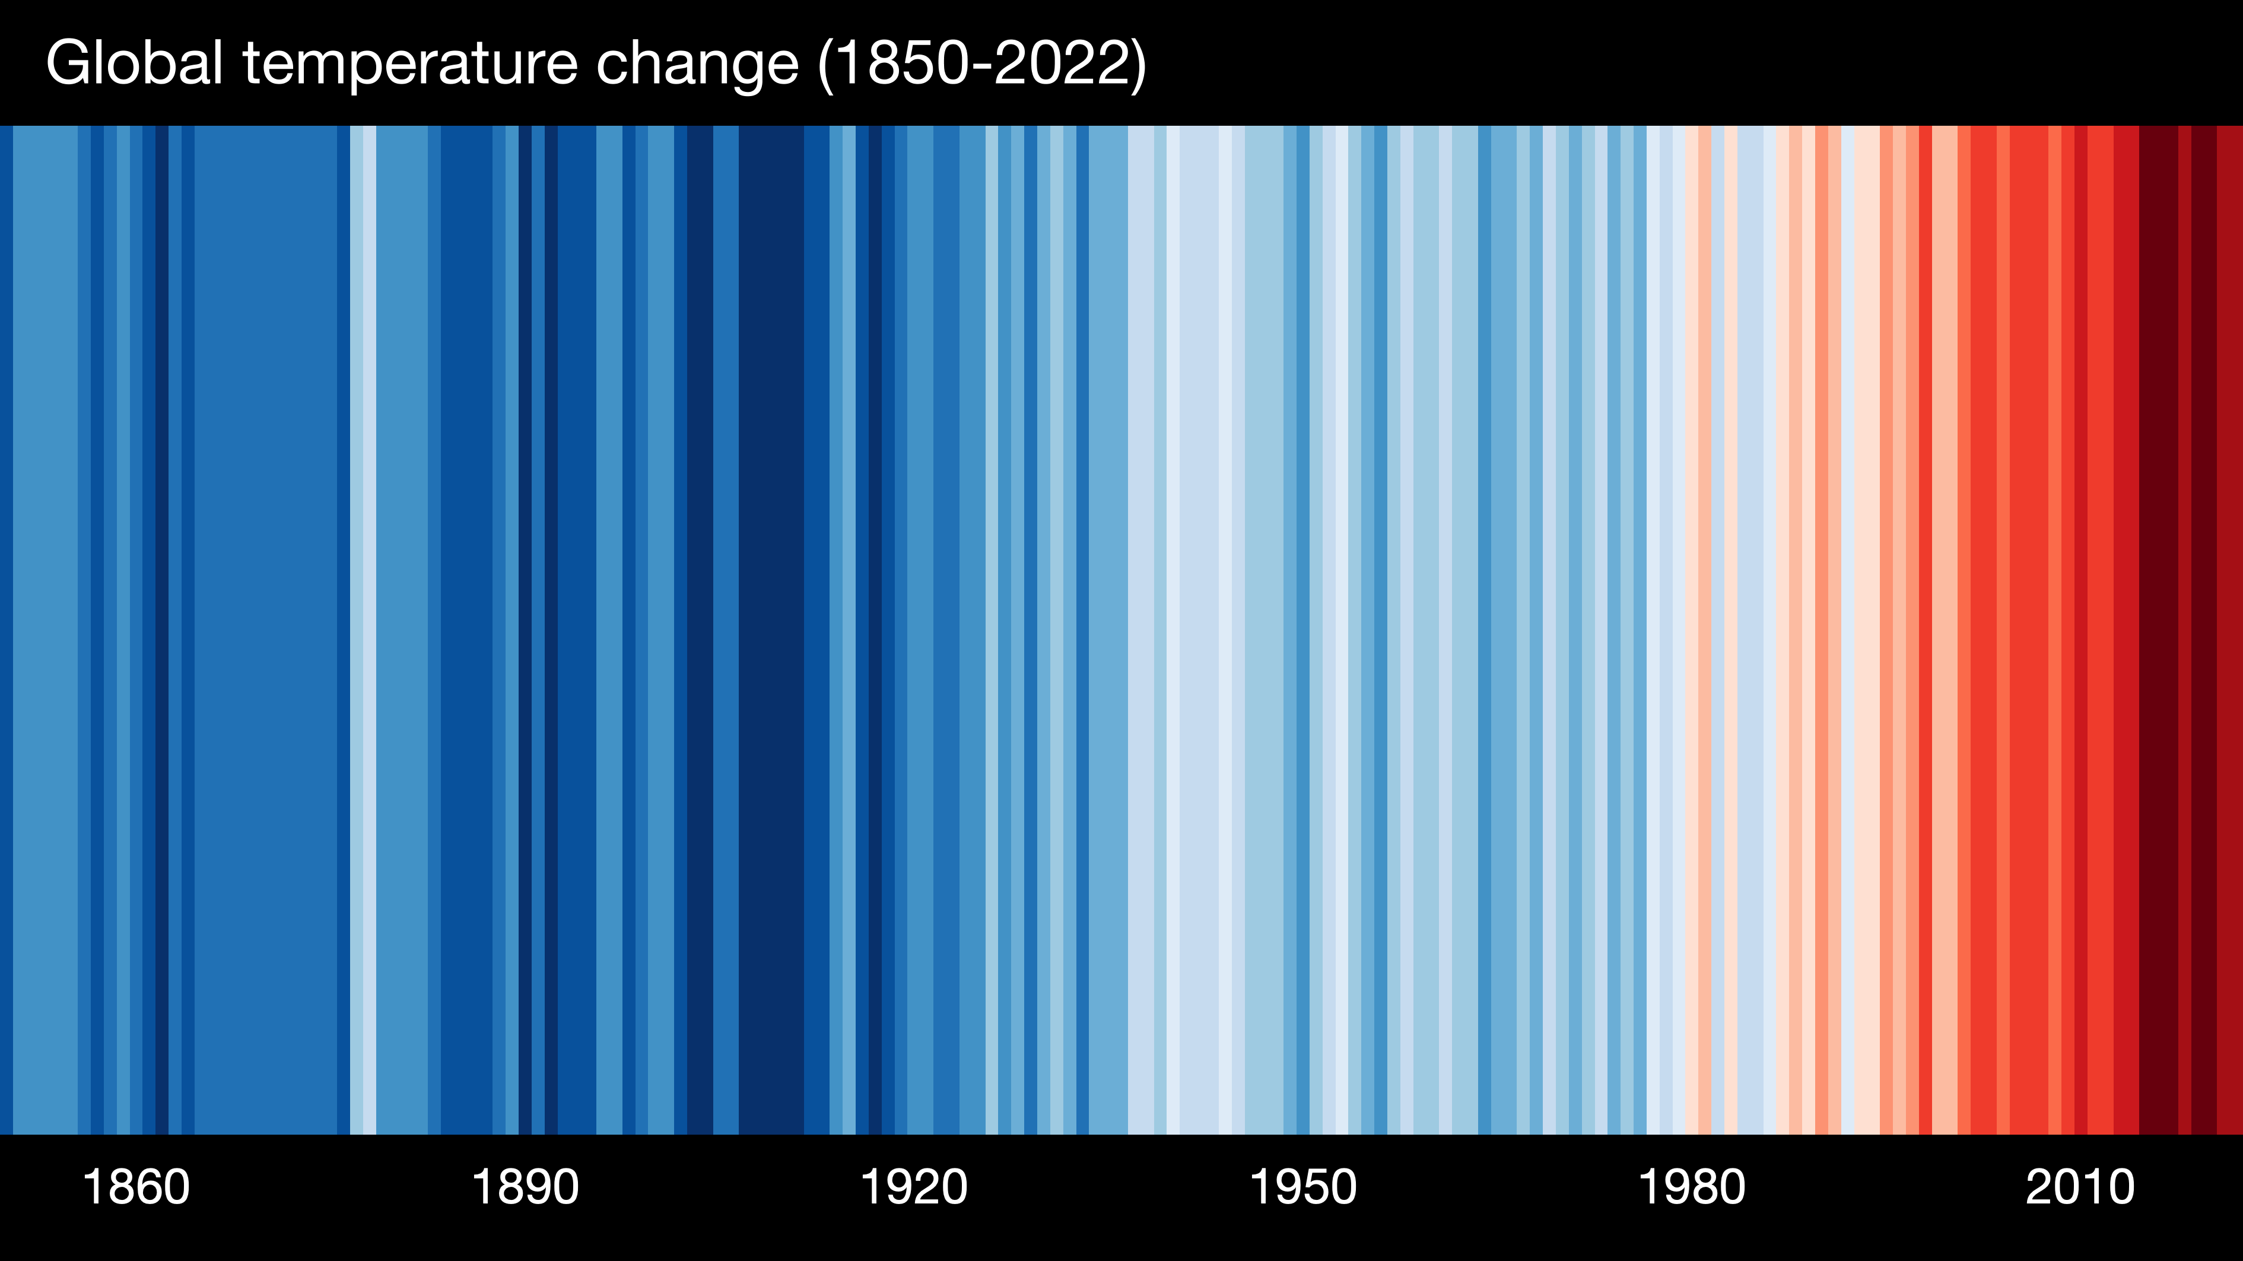
Climate Change in the United States
and Beyond
Notes:
Climate Stripes – Global temperatures from 1850-2022
Ed Hawkins, National Centre for Atmospheric Science, University of Reading., National Centre for Atmospheric Science, UoR.
Data: Berkeley Earth, NOAA, UK Met Office, MeteoSwiss, DWD, SMHI, UoR & ZAMG

Slide 2
Climate Change: What We Know
Ten Signs of a Warming World
Humidity
Temperature of the Lower Atmosphere
Air Temperature over Ocean
Spring Snow Cover
Arctic Sea Ice
Air Temperature over Land
Global Sea Level
Glaciers
Sea Surface Temperature
Ocean Heat Content
Notes:
Earth system landscape by Hunter Allen, NOAA. See http://cpo.noaa.gov/warmingworld/

Slide 3
How long have we known?
In 1856 Eunice Newton Foote, an American scientist, and inventor from Seneca Falls, New York became the first scientist known to experiment on the warming effect of sunlight on different gases. She theorized that changing the proportion of carbon dioxide in the atmosphere would raise its temperature.
Eunice – 8 minute film on YouTube:
https://youtu.be/WxgAOKzOcBU

Slide 4
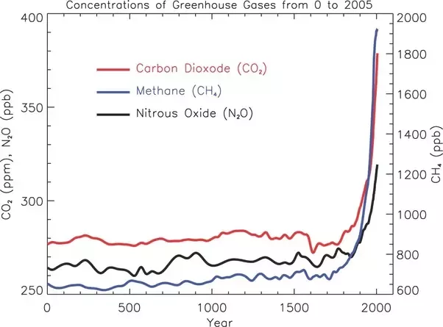
“Hockey Stick” graph of Heat-trapping Gases

Slide 5
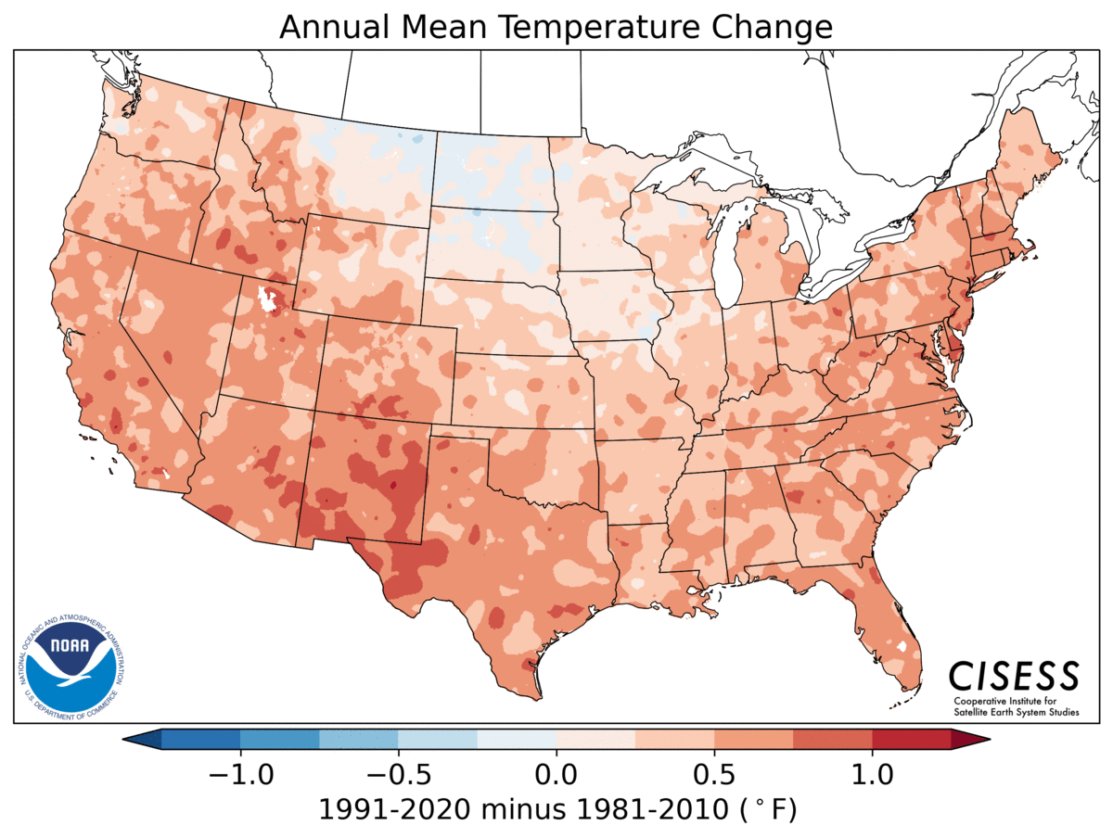
New Climate Normals updated very 30 years
These graphs show differences between successive climate normals
Note – there is a 10-year overlap in datasets

Slide 6
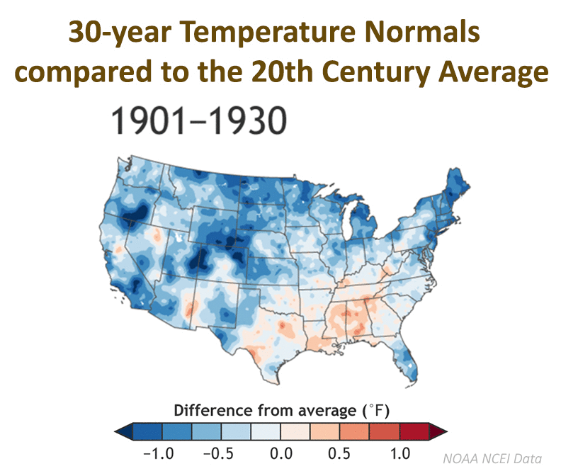
Comparing Normals to 20th Century Average Temperatures

Slide 7
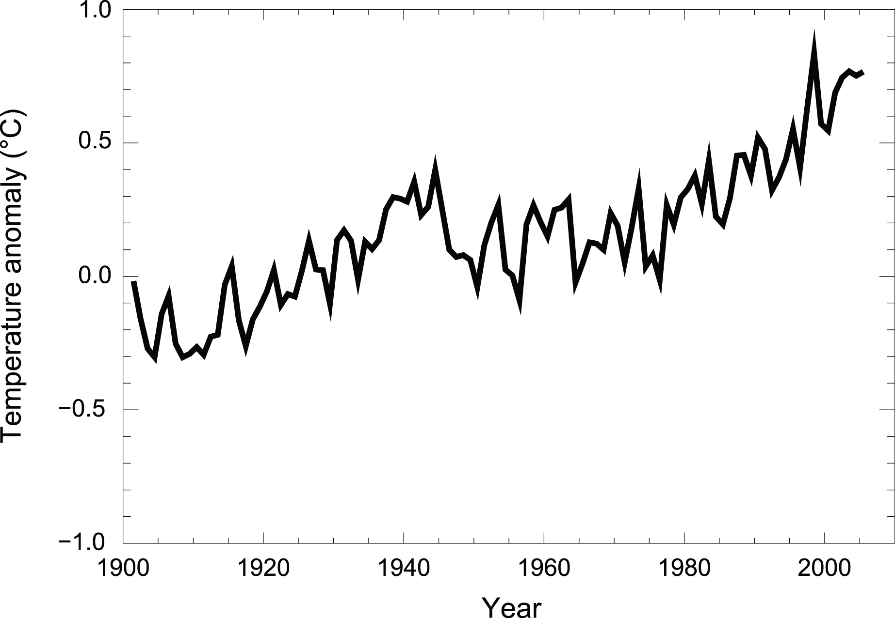
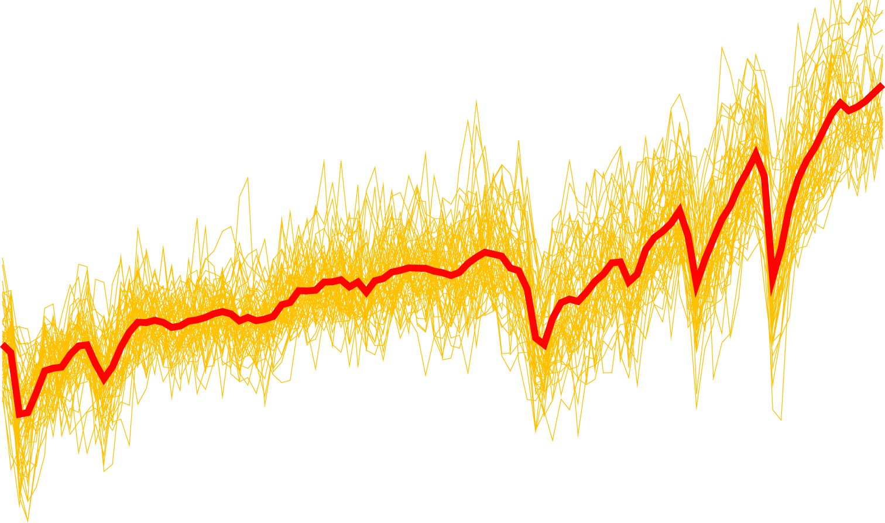
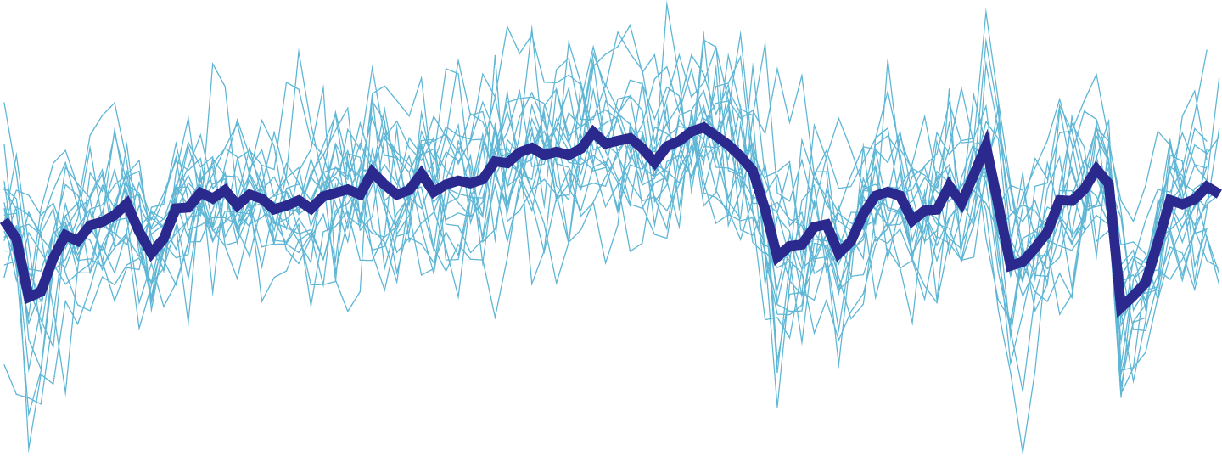
Are Humans Responsible?
Natural and human effects
IPCC (1995):
“Balance of evidence suggests discernible human influence”
IPCC (2001):
“Most of global warming of past 50 years likely (odds 2 out of 3) due to human activities”
IPCC (2007):
“Most of global warming of past 50 years very likely (odds 9 out of 10) due to greenhouse gases”
Observations
Natural forcings only
Pinatubo
Agung
Chichon
IPCC WG1 (2007)

Slide 8
IPCC 5th Assessment (2013 & 2014)
Snow cover is decreasing
Warming of the climate system is unequivocal, and since the 1950s, many of the observed changes are unprecedented over decades to millennia.
Arctic sea ice is shrinking
Oceans are warming
All time series show annual values
(colored lines indicating different data sets) uncertainties are indicated by colored shading.
Sea Level is rising
https://www.ipcc.ch/pdf/assessment-report/ar5/wg1/WG1AR5_SPM_FINAL.pdf

Slide 9
IPCC 6th Assessment (2022 & 2023)
Key Messages
1. Fossil fuel emissions from human activities have already raised global temperature by 1.1C (2 degrees F) above 1850-1900
2. Current policy action will lead to further temperature rise, and the impacts on human and other forms of life will become more severe
3. At current emissions levels, we will deplete the remaining carbon budget
4. We need to cut GHG emissions across all sectors urgently, within this decade and no later
5. We have the solutions we need to shift to low-carbon economic systems
“Several mitigation options, notably solar energy, wind energy, electrification of urban systems, urban green infrastructure, energy efficiency, demand-side management, improved forest- and crop/grassland management, and reduced food waste and loss, are technically viable, are becoming increasingly cost effective and are generally supported by the public”
6. Political commitment and equity are key to enabling this shift – there is enough finance, it needs to be directed to climate action

Slide 10
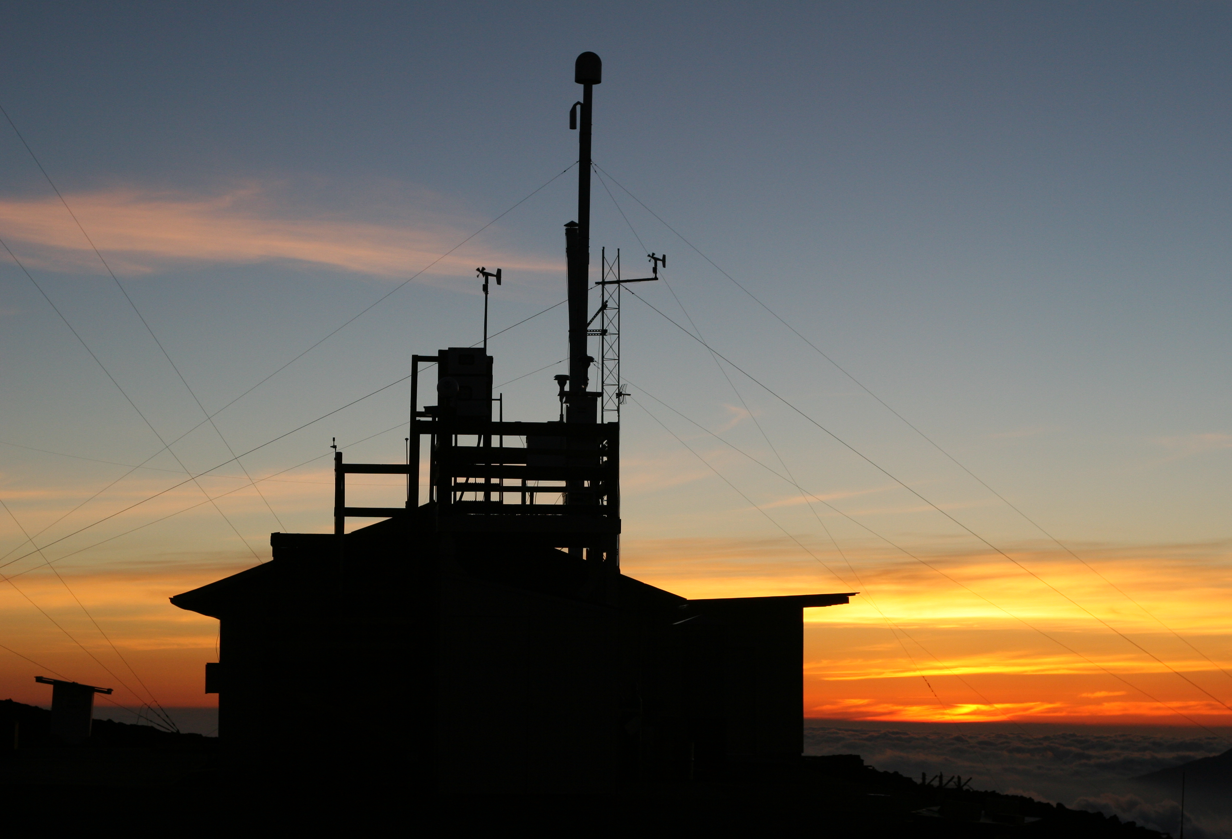
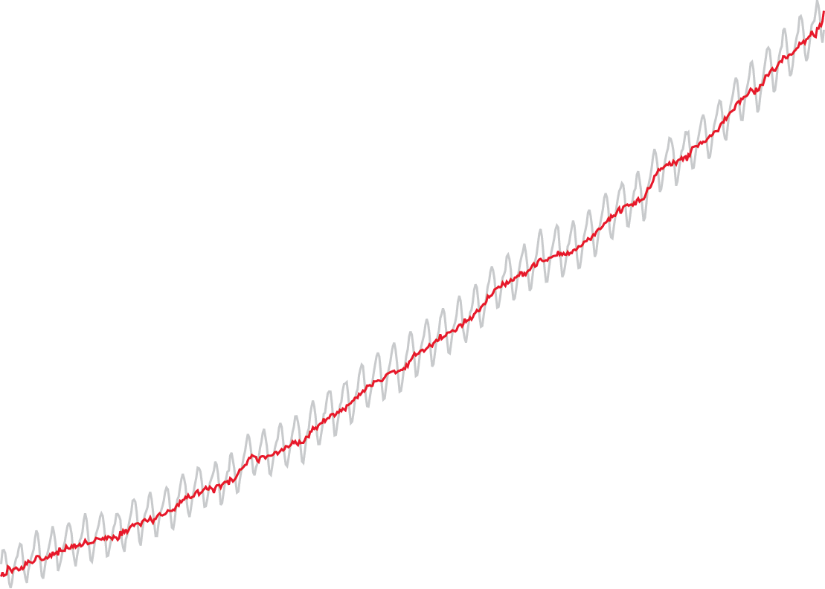
Carbon dioxide has risen by 20% since 1958 and 50% since the Industrial Revolution
396 ppm (2013)
June 2024: CO2 = 427 ppm
318 ppm (1958)
Mauna Loa Observatory on Hawai’i
Notes:
The photo in the background shows the Mauna Loa Observatory at dusk. This is where, in 1958, Charles David Keeling began his now-famous atmospheric carbon dioxide data set – sometimes called “the Keeling Curve.” The data trend shows carbon dioxide has risen from about 318 parts per million in 1958 to about 388 ppm in 2008. The gray “saw-toothed” line shows actual measurements and the red line shows the running mean value.

Slide 11
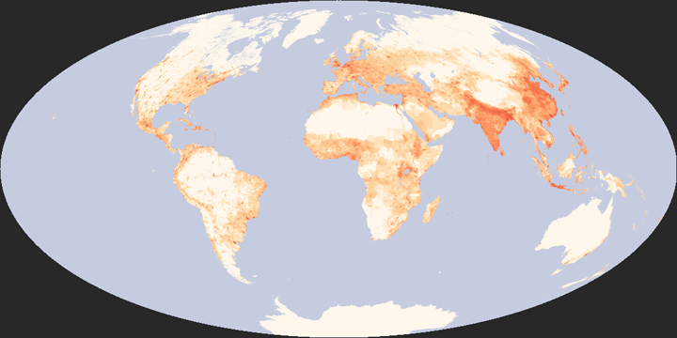
What We Know
We share this planet with more than 7 billion other humans
Notes:
The top global map shows a composite image of Earth’s city lights at night. This map has become an icon of humanity’s population increase and increasing demands for energy worldwide. The bottom map shows a recent measure of global population density — dark red areas show greater numbers of humans in the region, lighter red shades show decreasing numbers of people per unit area, and white shows areas with very little or no human presence. (Top map produced using DMSP OLS data courtesy Chris Elvidge, NOAA; bottom map produced using population density data courtesy the SEDAC.)

Slide 12
7 billion energy-using humans -
some of us use more energy than others…
Notes:
This new global view and animation of Earth's city lights is a composite assembled from data acquired by the Suomi NPP satellite. The data was acquired over nine days in April 2012 and 13 days in October 2012. It took 312 orbits to get a clear shot of every parcel of Earth's land surface and islands. This new data was then mapped over existing Blue Marble imagery of Earth to provide a realistic view of the planet. Credit: NASA Earth Observatory/NOAA

Slide 13
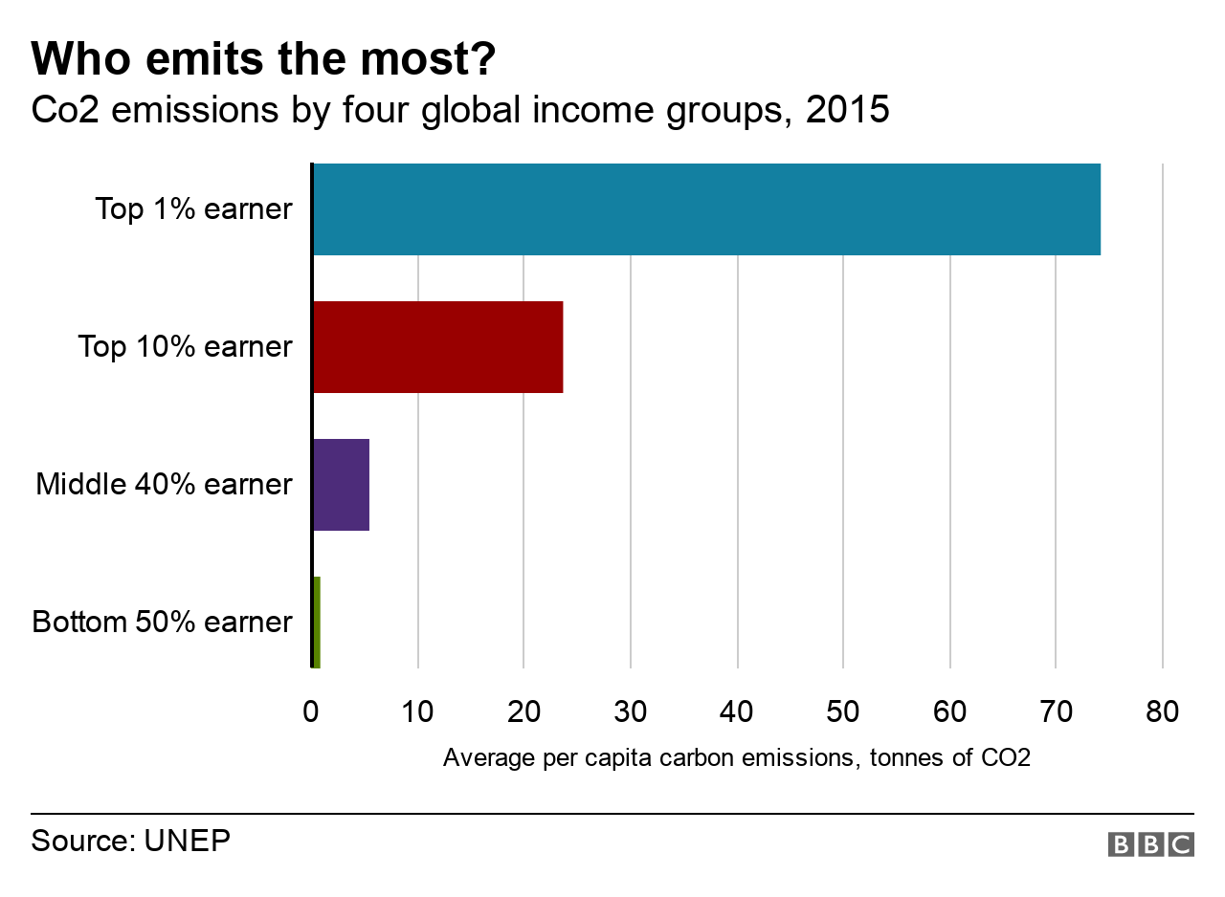

Slide 14
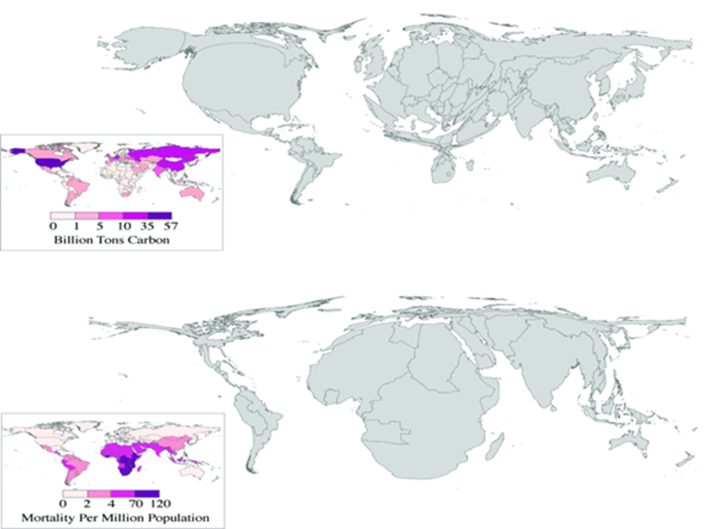
Climate Justice
The World Health Organization claims that climate change is the greatest threat to global health in the 21st century, making climate change a moral problem.
The top map shows the cumulative tons of carbon dioxide emissions from 1950-2000. Note that the United States is bulging.
Meanwhile, the bottom map depicts mortality per million population from climate-sensitive health effects of malaria, malnutrition, diarrhea, and inland flood-related fatalities.
This reveals which countries are the most vulnerable to our changing climate.
It is clear that those most vulnerable are the least responsible

Slide 15
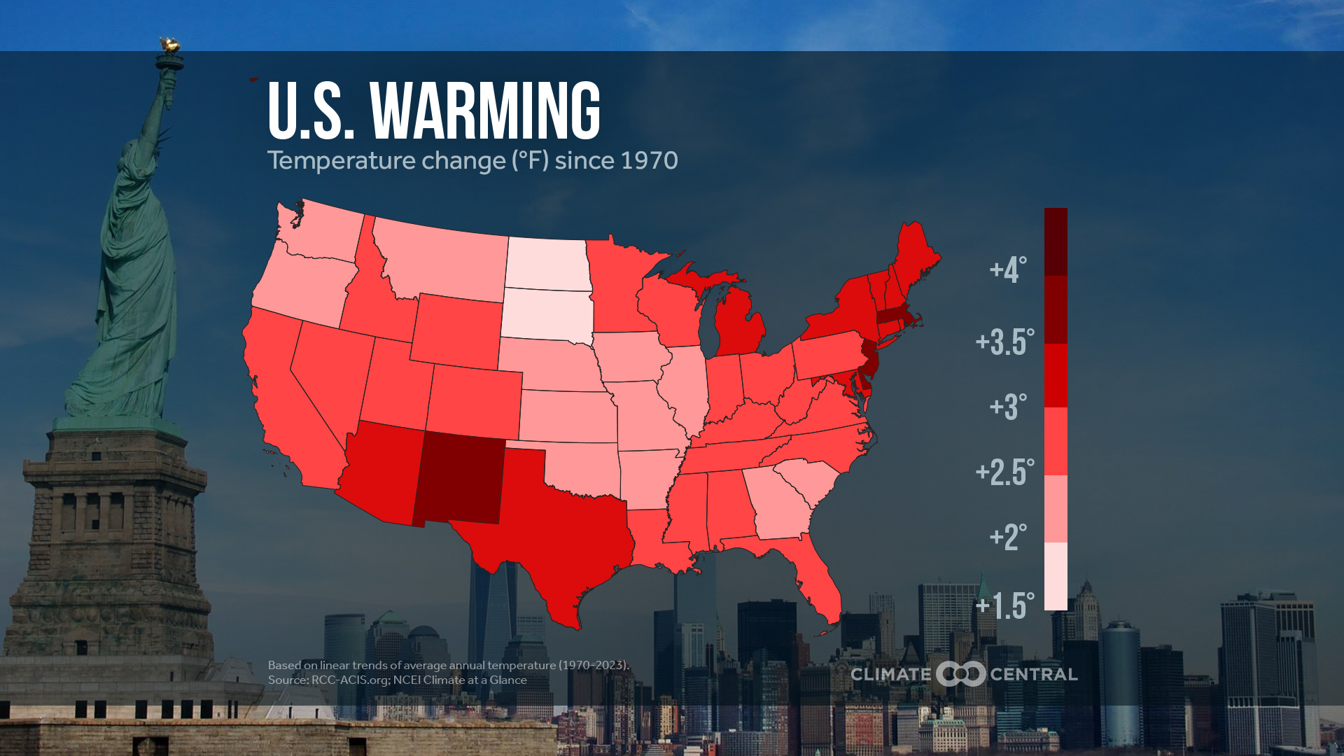
Warming since the 1st Earth Day

Slide 16
National Climate Assessment (NCA) 2014
TOP 3 FINDINGS
1. Global climate is changing and this is apparent across the United States in a wide range of observations. The global warming of the past 50 years is primarily due to human activities, predominantly the burning of fossil fuels.
2. Some extreme weather and climate events have increased in recent decades, and new and stronger evidence confirms that some of these increases are related to human activities.
3. Human-induced climate change is projected to continue, and it will accelerate significantly if global emissions of heat-trapping gases continue to increase.
http://nca2014.globalchange.gov/

Slide 17
COMMIT SCENARIO
As a result of past emissions, some changes
in climate over the next few decades are now unavoidable.
Beyond the next several decades, the amount of climate change we experience will be determined by choices society makes about fossil fuel emissions.

Slide 18
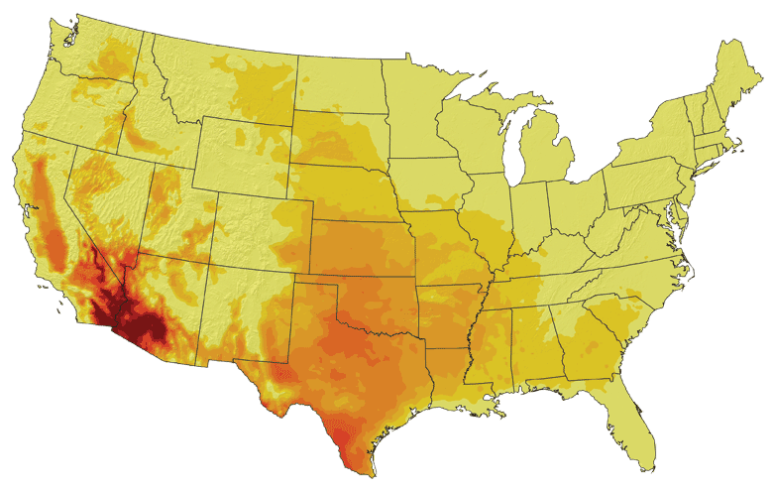
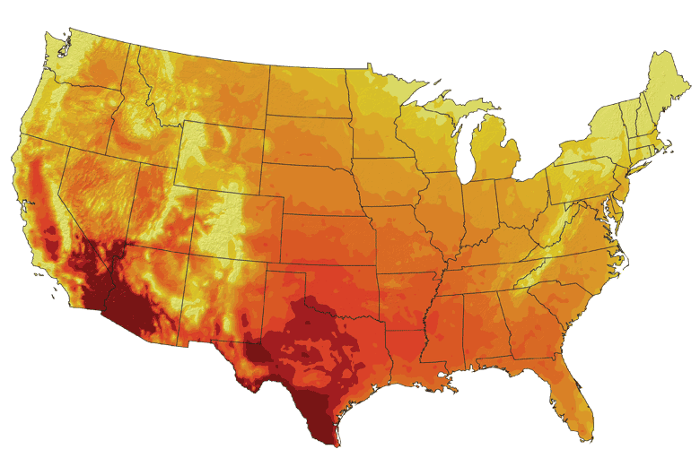
Projections for number of days/year over 100°F
Lower Emissions Scenario, 2080-2099
Higher Emissions Scenario, 2080-2099
Notes:
NOAA's Observations, Modeling, and Research on Climate Variability and Change
18

Slide 19
What We Might Do About It
Mitigate
Get off fossil fuels or figure out how to remove carbon dioxide from the atmosphere

Slide 20
What We Might Do About It
Mitigate
Adapt
Get off fossil fuels or figure out how to remove carbon dioxide from the atmosphere
Spend money to get ready for things to be different than they have been

Slide 21
What We Might Do About It
Mitigate
Adapt
Get off fossil fuels or figure out how to remove carbon dioxide from the atmosphere
Spend money to get ready for things to be different than they have been
Suffer
Deal with changes, including increased numbers and severity of extreme events

Slide 22
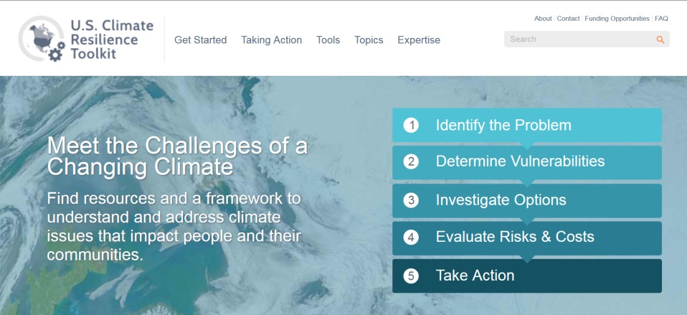
Adaptation
Adaptation planning takes place on national and regional levels but
actions take place locally.
More examples from around the U.S. are available via the
U.S. Climate Resilience toolkit
https://toolkit.climate.gov/

Slide 23
Mitigation – actions to slow future warming
Mitigation starts with every individual
According to the IPCC:
“Efficiency enhancements and behavioral changes, in order to reduce energy demand compared to base-line scenarios without compromising development, are a key mitigation strategy. “
“Behavior, lifestyle and culture have a considerable influence on energy use and associated emissions, with high mitigation potential in some sectors, in particular when complementing technological and structural change.” ( mobility demand and mode, energy use in households, choice of longer-lasting products and dietary change and reduction in food wastes)
Mitigation requires regional, national & global policies
Examples:
Clean Power Plan - cut carbon pollution from the U.S. power sector by 32% by 2030 (dead right now)
Paris Accord - Hold global average temperature to below 2 degrees C above pre-industrial levels
California’s 2015 Under 2 MOU
RGGI - Regional Greenhouse Gas Initiative in the northeast U.S. – cap and trade
The Western Climate Initiative (WCI) – multi state tracking process
Citizens Climate Lobby – carbon tax where monies collected go back to citizens
Green New Deal – Aggressive Targets, no actuall specifics

Slide 24
IPCC 6th Report (2022 & 2023)
The Intergovernmental Panel on Climate Change (IPCC) urges countries and individuals enact the following to avoid the worst of Climate Crisis …
Stop methane emissions
Stop deforestation
Restore degraded land
Change what we eat
Adapt Renewable Energy
Use energy more efficiently
Stop burning Fossil Fuels
ACT NOW

Slide 25
Climate change – summary points
1. It’s real
2. It’s us (human caused)
3. Experts agree
4. It’s bad (harmful to humans)
5. We have solutions that are:
Technically feasible.
Economically affordable.
Politically viable.

