Slide 1
Chlorophyll algorithms comparison and observations in the coast of Puerto Rico
William J Hernandez
David Gonzalez
April 29, 2016
UPRM Direct Broadcast Workshop

Slide 2
Outline
Compare chlorophyll standard algorithms with band combinations in a VIIRS ocean color images. Verify the accuracy of the algorithms
We used VIIRS ocean images for selected dates with no clouds (December 8, 2014).

Slide 3
Data and Methods
Dataset:
VIIRS Ocean Color dataset (Netcdf) for December 8, 2014.
Use Hydra 3.70 software for image analysis.
Use VIIRS chlorophyll L2 products.
Compare L2 products with band combinations in the blue/green region.
Rrs443/Rrs551

Slide 4
Data Analysis
Modis and VIIRS provide similar chlorophyll L2 products.
VIIRS chlorophyll L2 products seems to be more detailed.
High concentrations of chlorophyll are located in the coast of Puerto Rico specially in the north-east and south-west.
For Rrs671 high values are only observed in the north-east of Puerto Rico
For Rrs551 high values are observed in the whole coast of Puerto Rico specially in the north-east and south-west.
For Rrs443 high values are observed in the north-east of Puerto Rico but low values are obtained in the other parts of the coast.
If the Rrs443/Rrs551 ratio would have been calculated low values were going to be obtained for the whole coast of Puerto Rico except for the north-east.

Slide 5
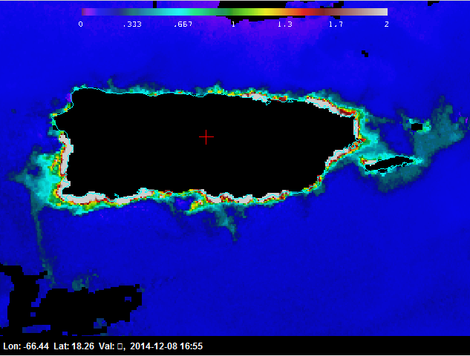
MODIS Aqua Chl
VIIRS Chl

Slide 6
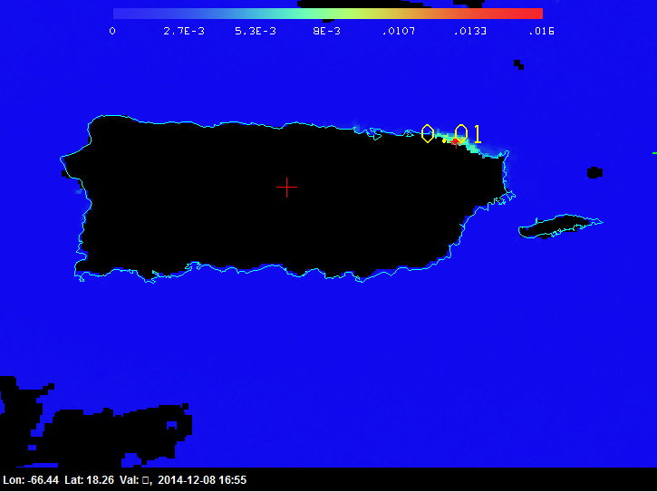
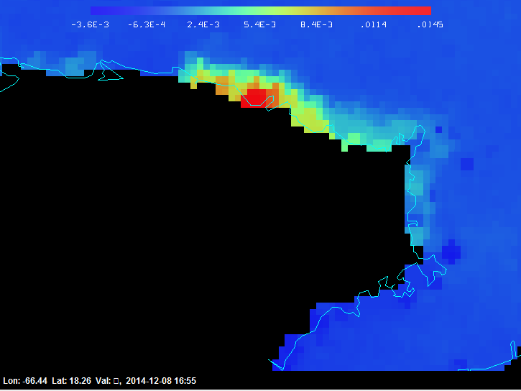
Rrs671

Slide 7
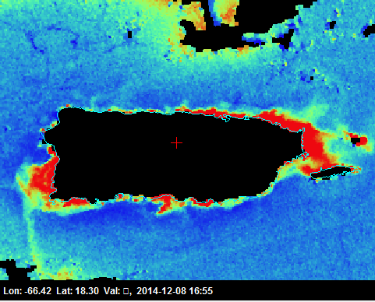
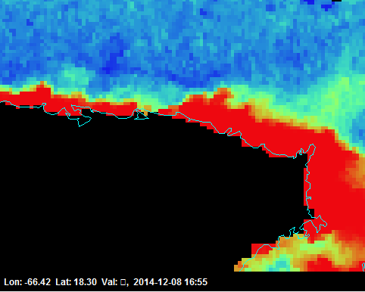
Rrs551

Slide 8
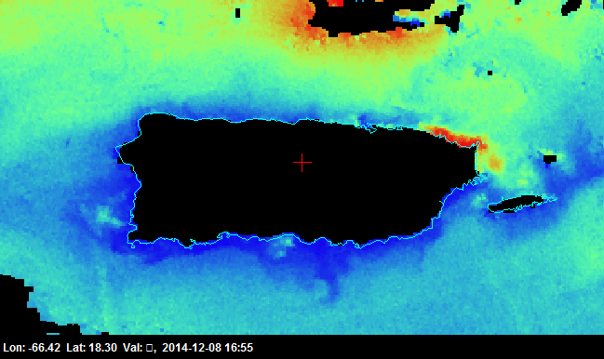
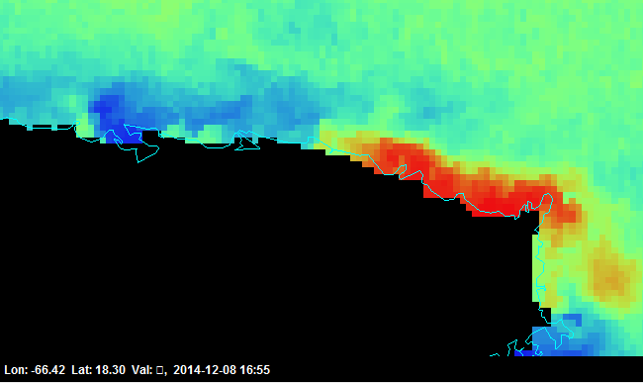
Rrs443

Slide 9
Conclusions
Modis and VIIRS provide similar chlorophyll products
VIIRS chlorophyll product seems to be more detailed.
Sediments are observed more in the red band
Chlorophyll are observed more in the green band
Hydra was unable to calculate Rrs443/Rrs551 ratio for the Puerto Rico region
If the Rrs443/Rrs551 ratio would have been calculated low values were going to be obtained for the whole coast of Puerto Rico except for the north-east.

