Slide 1
Dust detection methods applied to MODIS and VIIRS
Abel morales, Graduate student, ece
Vidya manian, professor, ece
April 29, 2016

Slide 2
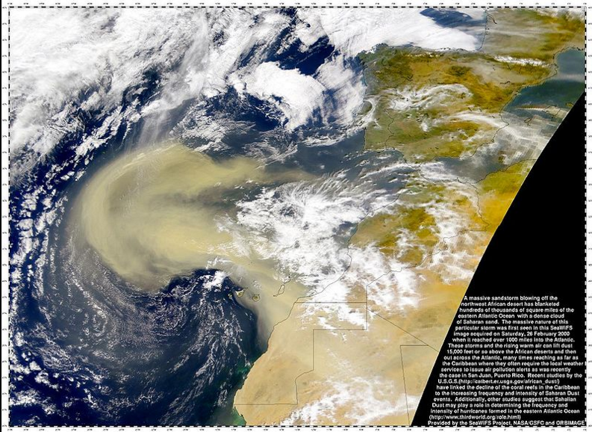
Overview
Sahara Desert Dust- is an extremely hot, dry and sometimes dust-laden layer of the atmosphere that often overlies the cooler, more-humid surface air of the Atlantic Ocean.
Sahara Dust is the major source on Earth of mineral dust.
Has significant effects on tropical weather, specially as it interferes with the development of hurricanes.
Some people must be careful when going outdoors in Sahara Dust conditions if they have respiratory conditions.

Slide 3
Dust detection
Mineral dust and smoke particles can directly alter solar and Earth radiation in both visible and infrared (IR) spectral regions through scattering and absorption processes.
Due to specific optical properties of dust and smoke particles, satellite observed radiances carry the spectral signatures of dust and smoke particles that are different from molecular, cloud, and underlying surface.
Various detection algorithms have been developed to detect dust and smoke.

Slide 4
Dust detection algorithms
Daytime dust detection techniques take advantage of the increase in the reflectance of dust (sand and soil) with the increase in wavelength between .4 and 2.5 microns
Band 3 (.47 micron) / Band 1 (.65 micron)
Band 32 (12.0 micron) – Band 31 (11.0 micron)
Band 31 (11.0 micron) - Band 29 (8.5 micron)
RGB composite: Red: Band 32-Band 31, Green: Band 31-Band 29, and Blue: Band 31
VIIRS dust detection applies the same procedure as follows:
RGB composite: Red: M16-M15, Green: M15-M14, Blue: M15 (M16 corresponds to 12 micron, M15 to 10.76, M14 to 8)

Slide 5
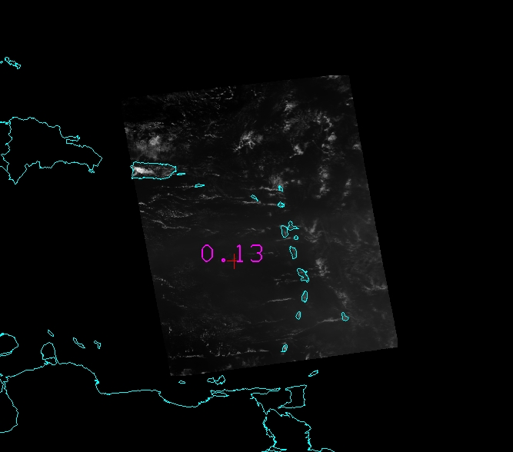
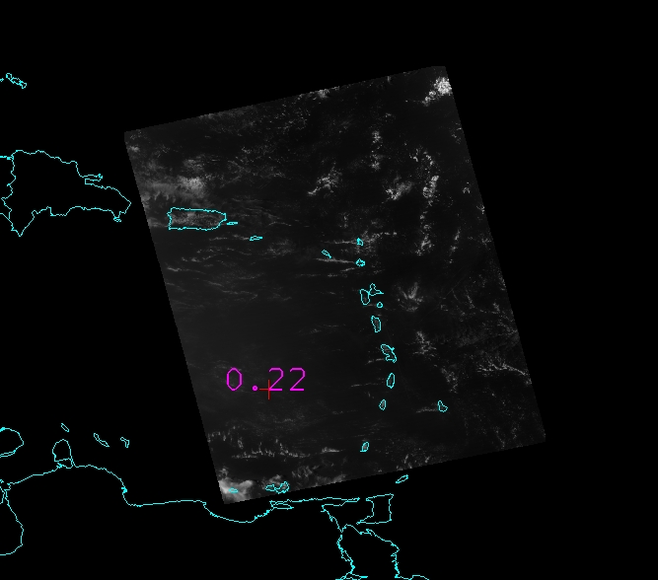
Data and Method
Datasets: (1) Aqua MODIS from18 June 2015 at 1800 UTC
(2) VIIRS data from18 June 2015 at 1649 UTC

Slide 6
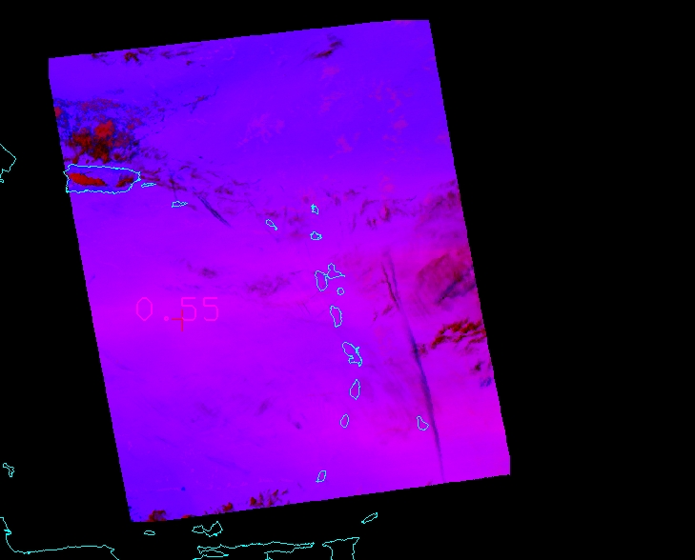
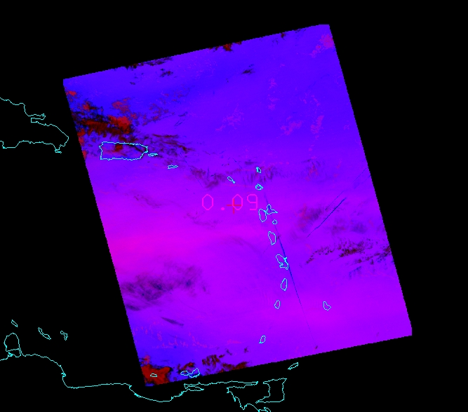
Processed Output Images
MODIS AQUA at 18:00 UTC
VIIRS at 16:49 UTC

Slide 7
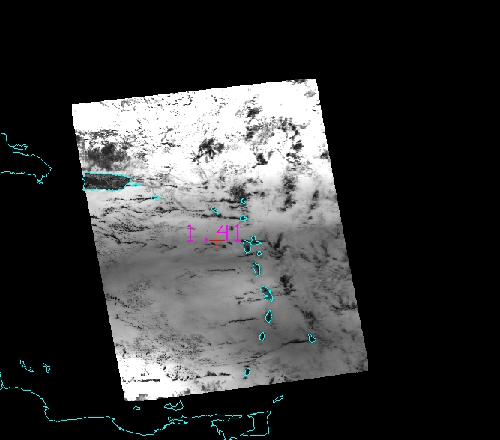
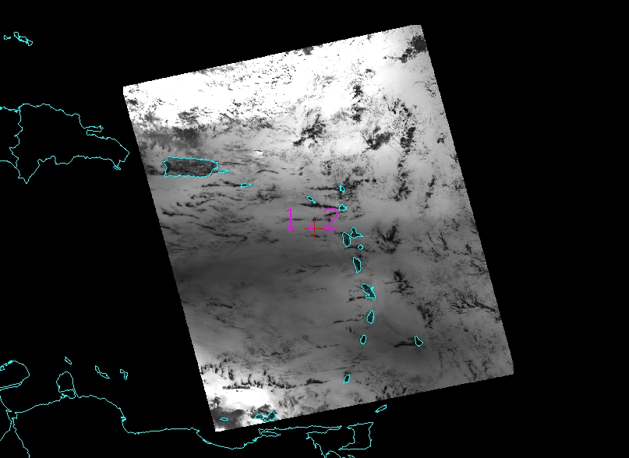
Band 3 / Band 1 for MODIS and Band M3 / Band M5 from VIIRS

Slide 8
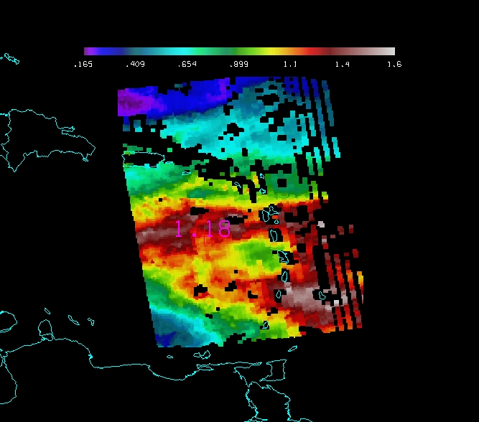
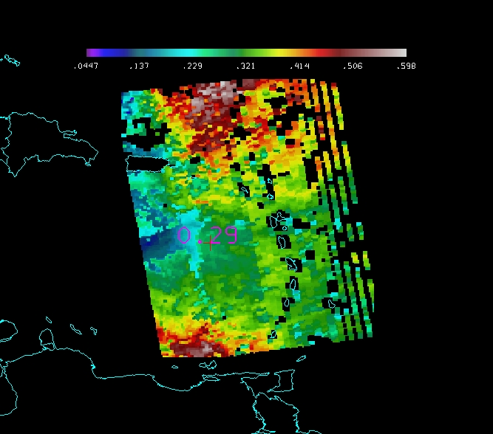
OD and OD small for MODIS and from DBproducts

Slide 9
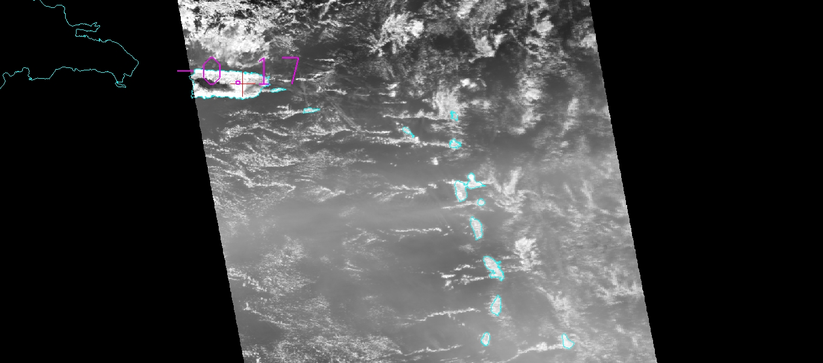
Dust detection over land
The presented results seemed to work only over the ocean.
We applied the NDDI method [(R2.3micron -R0.4micron)/(R2.3micron -R0.4micron)] for detecting dust over the land in Puerto Rico from MODIS image

Slide 10
Conclusion and future work
Dust detection algorithm applied on VIIRS provides visually similar results to MODIS outputs.
Dust detection results obtained from MODIS visible bands agrees with results obtained from Infrared based method (EUMETSAT)
The band ratio algorithm does not detect dust on land
Other dust detection methods:
NDDI (normalized dust detection index)
EDI (Enhanced dust index)
BTD (Brightness temperature difference)
The NDDI algorithm gives some results over land. Not sure if it is correct, further research with different data sets is necessary.
Observation: The methods have to be applied after using the cloud mask.

Slide 11
References
J. J. Qu, X. Hao, M. Kafatos and L. Wang, "Asian Dust Storm Monitoring Combining Terra and Aqua MODIS SRB Measurements," in IEEE Geoscience and Remote Sensing Letters, vol. 3, no. 4, pp. 484-486, Oct. 2006.
http://oiswww.eumetsat.int/~idds/html/doc/dust_interpretation.pdfZ
Zhao et al., Dust and smoke detection for multi-channel imagers, Remote Sensing, 2010, 2, 2347-2368.
L. Han et al., An enhanced dust index for Asian dust detection with MODIS images, Intl. Journal of Remote Sensing, Oct. 2013.
X. Zhao, Asian dust detection from the satellite observations of moderate resolution imaging spectroradiometer (MODIS), 2012.
S. S. Park et al., Combined dust detection algorithms by using MODIS Infrared channels over East Asia, Remote Sensing of Environment, 2014.

Slide 12
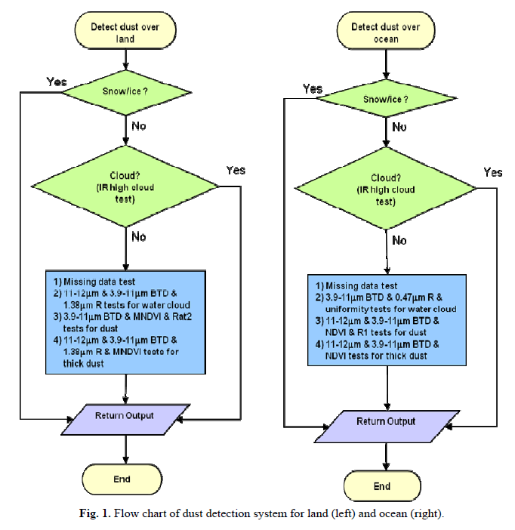
[Zhao,2012]

Slide 13
Acknowledgment
UPRM Direct Broadcast Remote Sensing Workshop
Liam Gumley, Kathy Strabala and Jessia Braun
Rafael Rodriguez, ECE, UPRM

