Slide 1
Hurricane Edouard Intensity and Structure Estimate
Xuejin Zhang
AOML/HRD & UM

Slide 2
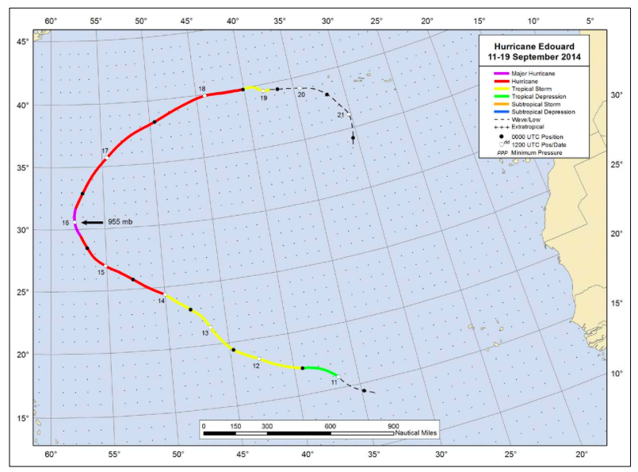
SNPP imagery
Best track position for Hurricane Edouard, 11-19 August 2014.

Slide 3
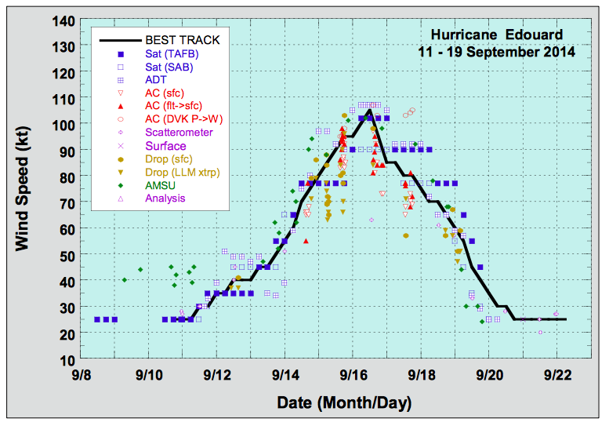
Selected wind observations and best track maximum sustained surface wind speed curve for Hurricane Edouard, 11-19 September 2014. Advanced Dvorak Technique estimates represent the Current Intensity at the nominal observation time. AMSU intensity estimates are from the Cooperative Institute for Meteorological Satellite Studies technique. Dashed vertical lines correspond to 0000 UTC.

Slide 4
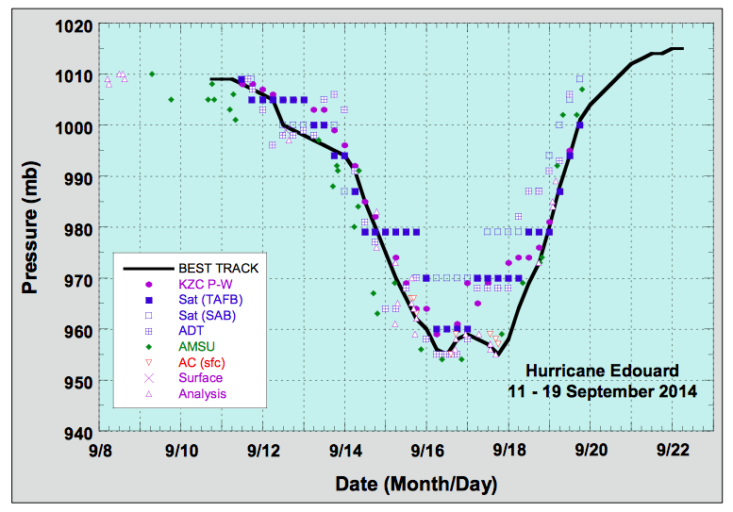
Selected pressure observations and best track minimum central pressure curve for Hurricane Edouard, 11-19 September 2014. Advanced Dvorak Technique estimates represent the Current Intensity at the nominal observation time. AMSU intensity estimates are from the Cooperative Institute for Meteorological Satellite Studies technique. KZC P-W refers to pressure estimates derived using the Knaff-Zehr-Courtney pressure-wind relationship. Dashed vertical lines correspond to 0000 UTC.

Slide 5
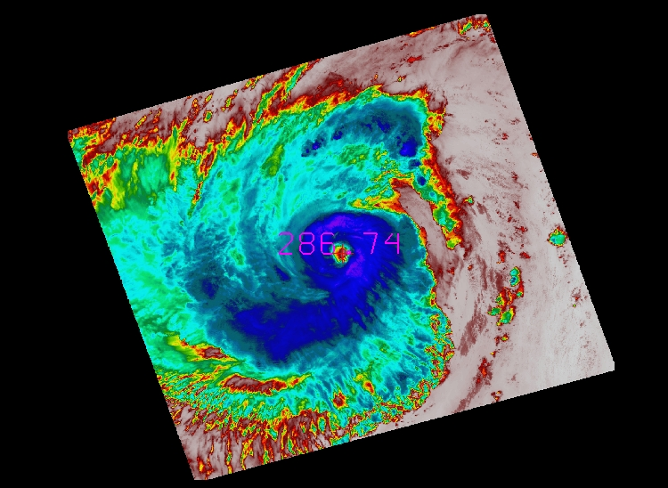
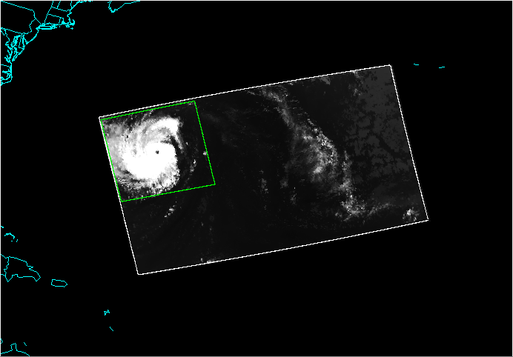
Hurricane Edouard SNPP imagery of VIIRS Channel 15 at 1617Z 16 Spetember 2015. Eye temperature: 287K, Coldest temperature of the eyewall: 201K; Dvorak Technique estimate intensity: storm evolution type A, 90 kts.

Slide 6
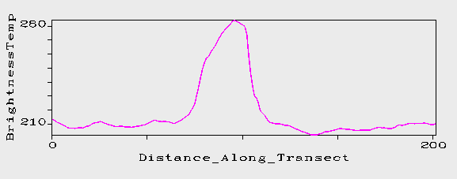
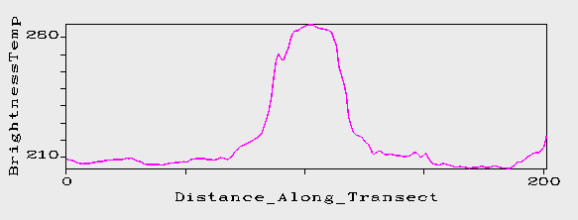
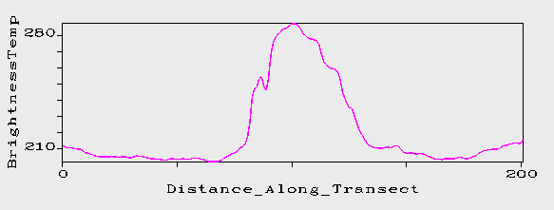
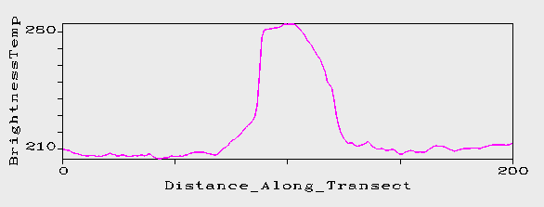
N-S
Brightness temperature (K)
W-E
NW-SE
NE-SW
0
50
100
150
200
Distance (km)
Hurricane Edouard has a closed circular eye. The eye diameter: N-S, 40km; W-E, 40km; NW-SE, 55km; NE-SW, 40km. The average Radius Maximum Wind: 22km. The maximum wind will be in NNW and SSE.

Slide 7
Estimated Intensity by ATMS Channels
Channel 7: 969hPa
Channel 8: 952hPa
Channel 9: 955hPa
Estimate MSLP and ATMS
ATMS
MSLP=CH9*60%+CH8*30%+CH7*10%=955hPa
MW, 107 kts
Eyewall diameter estimated by VIIRS: 44 km
Dvorak
MSLP 970 hPa
MW, 90 kts
Real time at 15UTC:
MSLP 955 hPa
Diameter, 37 km
MW, 100 kts
Best track:
MSLP, 955 hPa
MW, 105 kts;

Slide 8
A few comments
Intensity of mature hurricanes can be estimated by ATMS accurately
Hurricane size can be estimated by VIIRS
Estimated MSLP by polar-orbiting satellite may be more representative than estimated wind.
Accurately estimate MSLP and size of hurricane is critical to initialize forecast model
Further test with (Knaff & Zehr 2011, WAF, 71-88)
Validate the intensity and structure by flight observations

