Slide 1
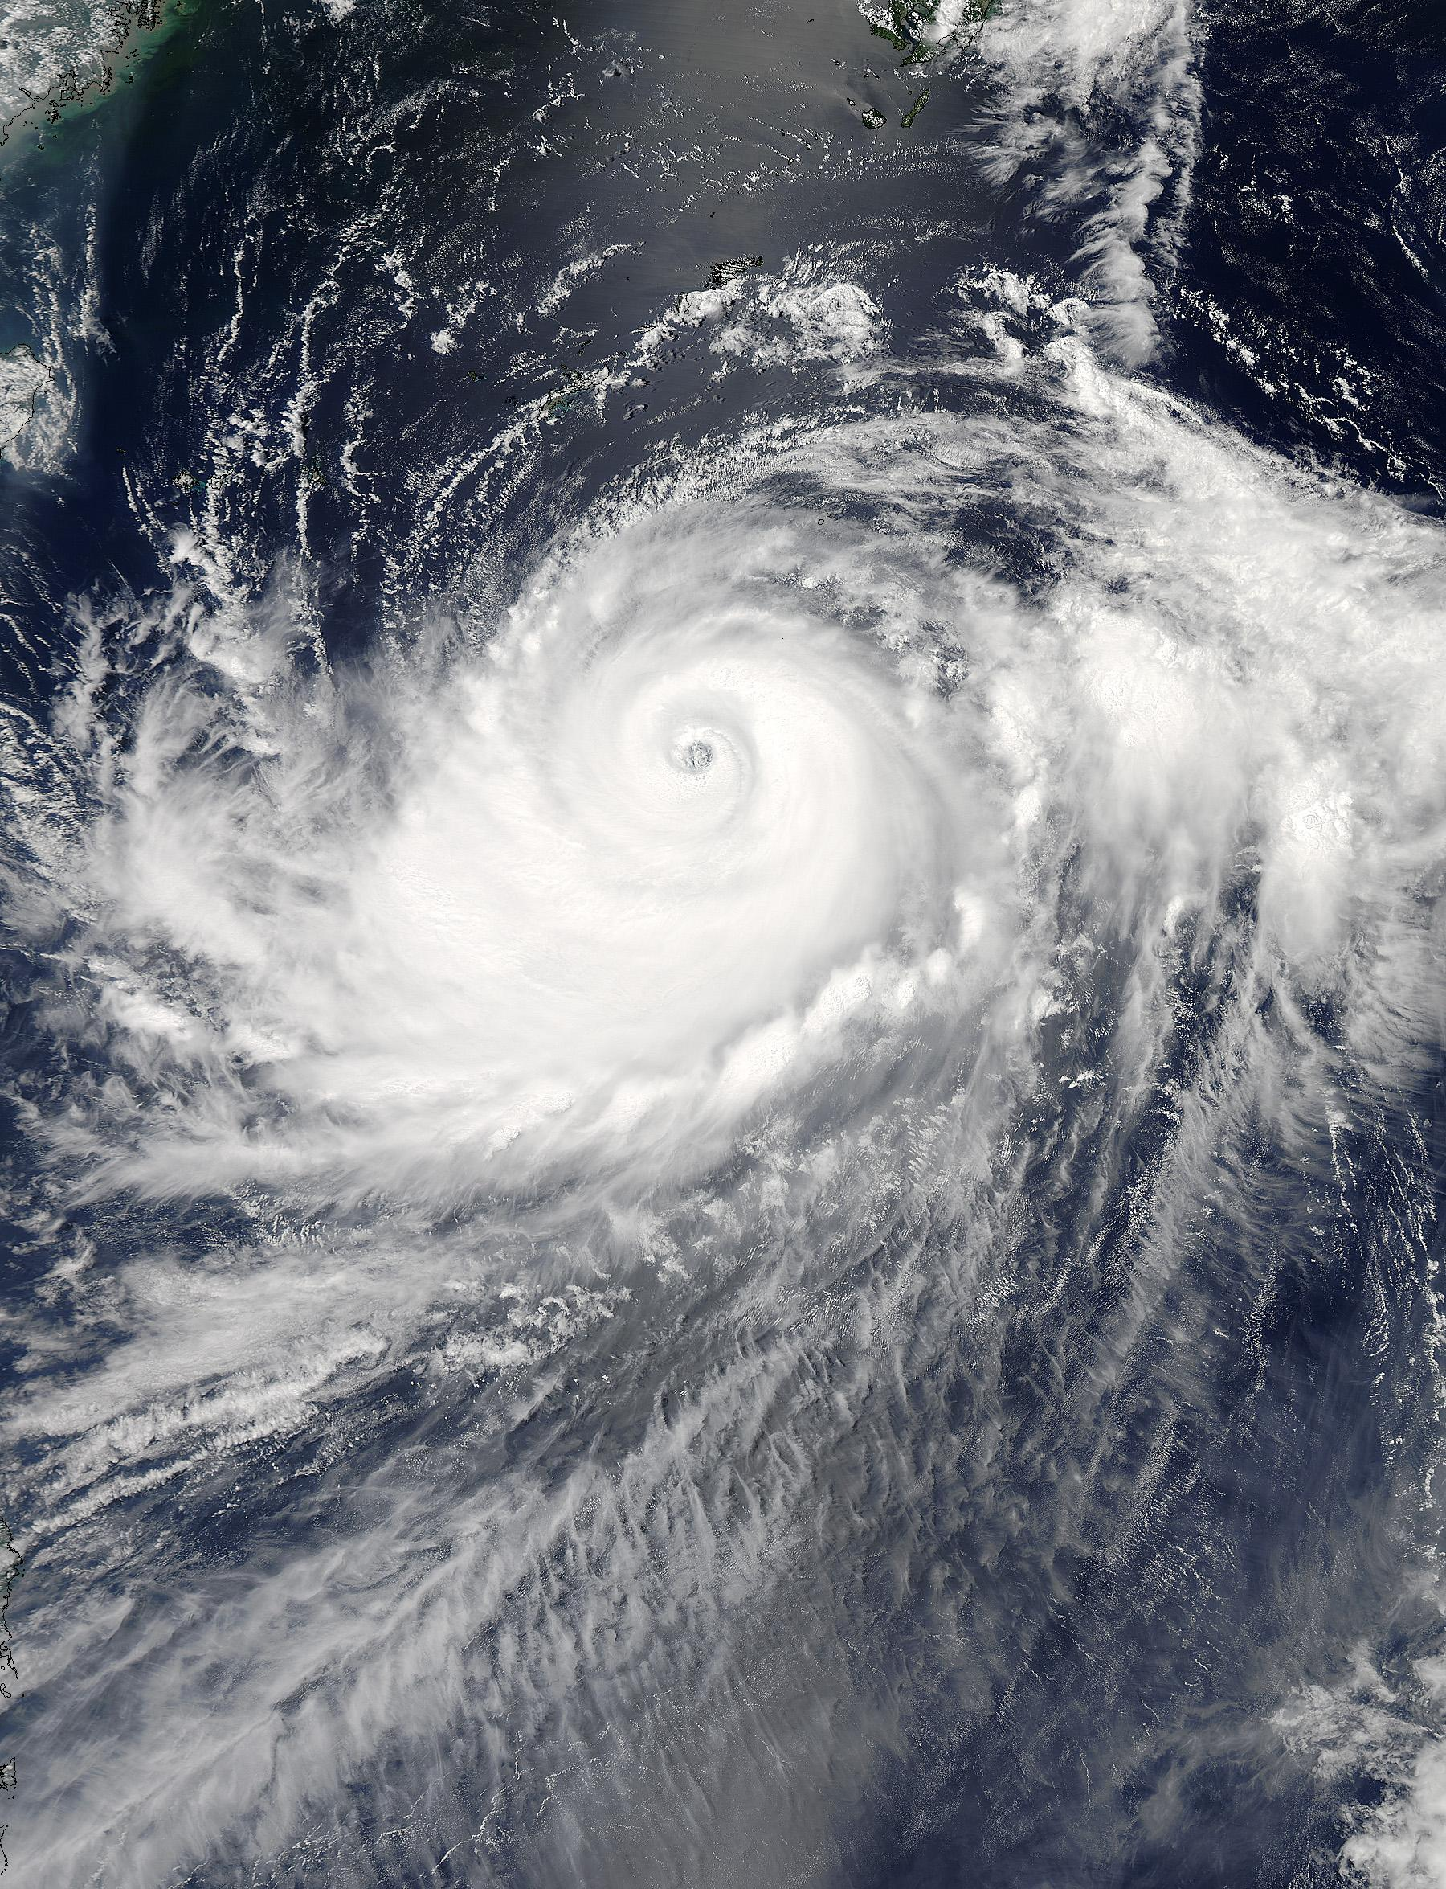
Typhoon Halong
Russell StFleur
Jodi
Brewster

Slide 2
Halong Characteristics
formed: Jul 27, 2014
dissipated: Aug 15, 2014
Rapid Intensification:
Aug 2, 2014 in 12 hours
From Cat 1 to Cat 3

Slide 3
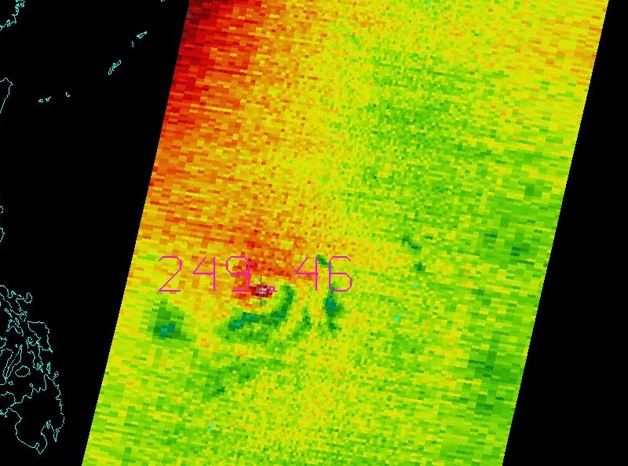
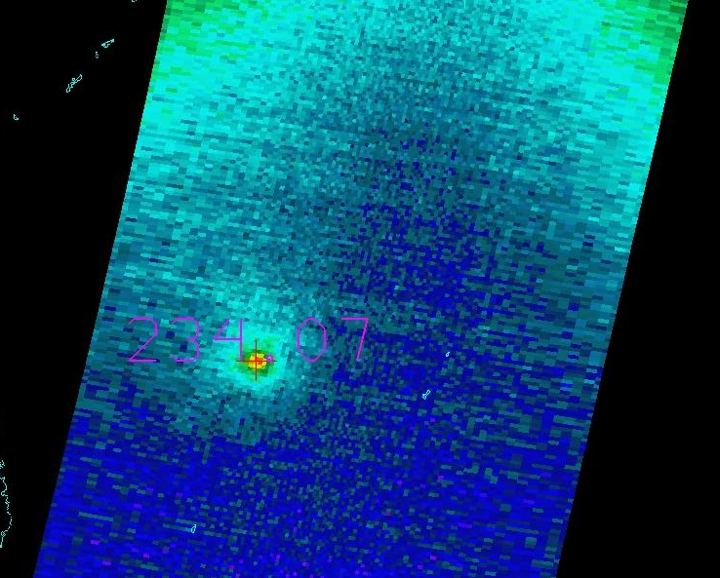
Channel 7 vs Channel 8

Slide 4
Channel 1 and Channel 2
Weighting at Surface
Halong
Land
limb effects?

Slide 5
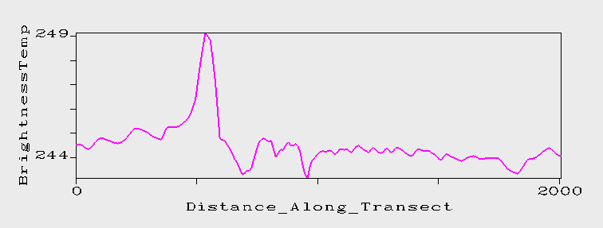
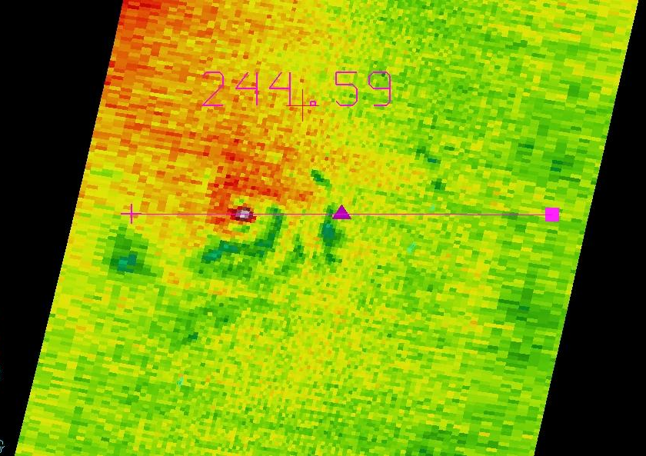

Slide 6
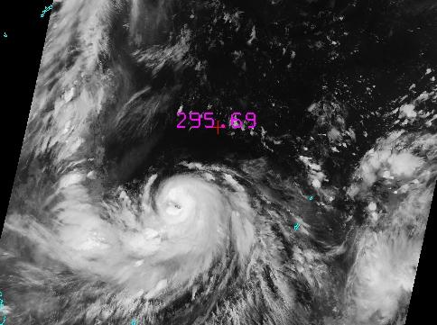
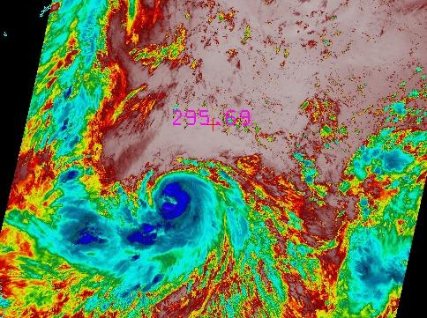
Why Did It RI?

Slide 7
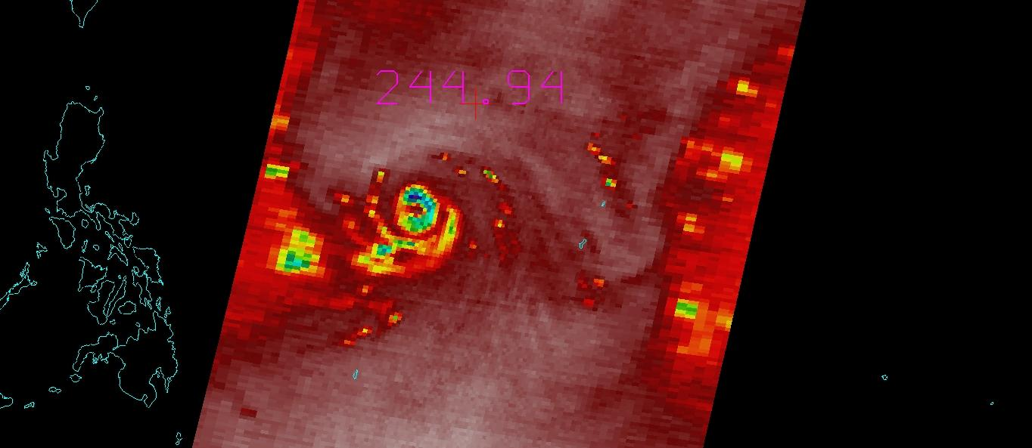
Channel 22

Slide 8
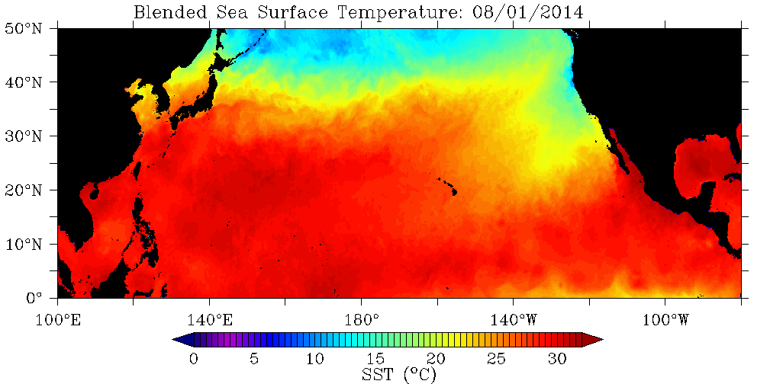
GeoPolar Blended SST: NESDIS

Slide 9
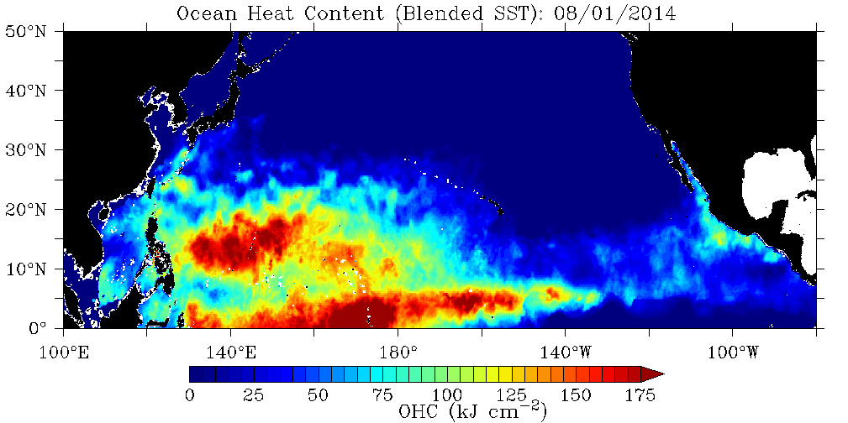
Ocean Heat Content: RSMAS/UOD
isotherm.rsmas.miami.edu/heat/webp/pacific.php

